Slide 1
Forecasting Fire hazard and Drought in Cyprus, Eastern Mediterranean and Balkan
6th SALGEE/EUMETSAT Workshop 14-17 October, 2019
Darmstdadt, DE
Yiannis Proestos, Ph.D.
Environmental Predictions Department
Notes:
1

Slide 2
Outline
Motivation - Climate Change and Wildfire hazard… The importance of Satellite information and monitoring
Numerical forecasting of short range meteorological fire hazard indices at high horizontal resolution over Cyprus
Pre-evaluation of the short term forecasts: The case of Solea forest fire, summer 2016
Extended term meteorological fire risk forecasts and scenario projections for Cyprus, the Balkan and East Med
Future outlook
Notes:
2

Slide 3
Motivation
Climate change: global temperatures are on the rise, mainly due to the continued unabated GHG emissions.
source: NASA/GISS
Notes:
3

Slide 4
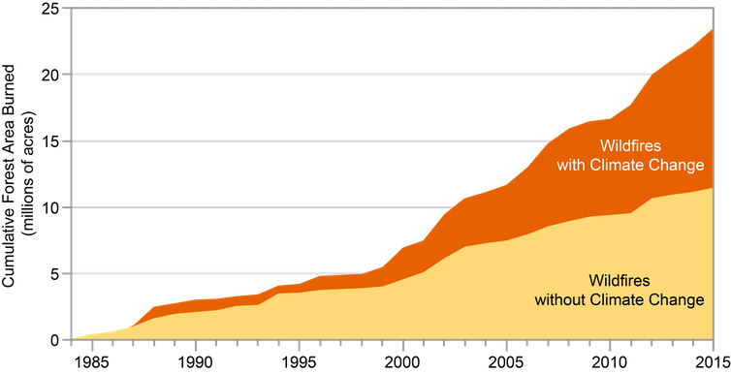
Motivation
Global warming is already altering precipitation patterns, affects soil moisture content leading to excess drought in parts of the planet, which is a contributing factor to the increased wildfire risk.
Analysis reveals that the doubling of forest area burned by wildfires in the Western US between 1985-2015, is associated with drought induced by climate change.
source: USGCRP, NCA4, Vol. 2
Notes:
4

Slide 5
Motivation
NASA has compiled satellite data on a monthly basis to map fires, burning from 2000 to 2019. A seasonal trend in fire activity is evident. In Africa, South America and Asia fires are often deliberately set during the dry season August-October to clear land for agriculture.
source: NASA/Earth Observatory
Notes:
5

Slide 6
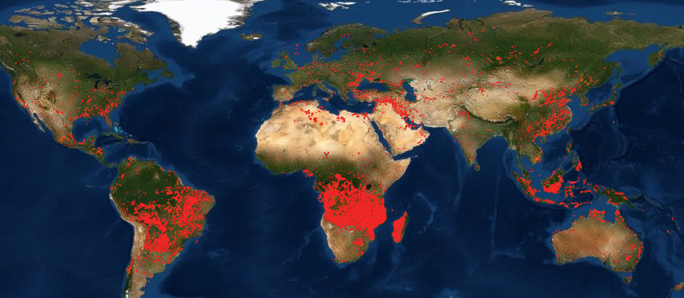
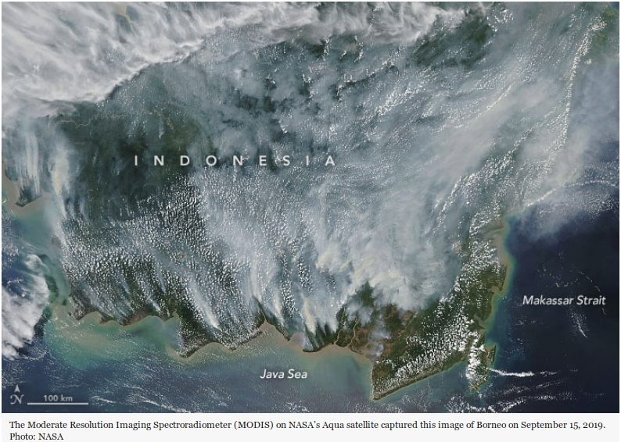
Use of satellite technology is crucial!
Satellite observations reveal the extend of fire outbreaks and help dramatically
to the fire management, and inform, after appropriate data assimilation, wildfire prediction systems.
source: NASA/FIRMS active fires 24 Sep. 2019 (VIIRS, MODIS)
source: Copernicus/CAMS: Biomass burning aerosol optical depth at 550 nm
Biomass burning is estimated using satellite observations. CAMS reports that the amount of CO2 released in the atmosphere during August 2019, from Amazonia, is almost 30Mtons!
source: NASA/Earth Observatory
Notes:
6

Slide 7
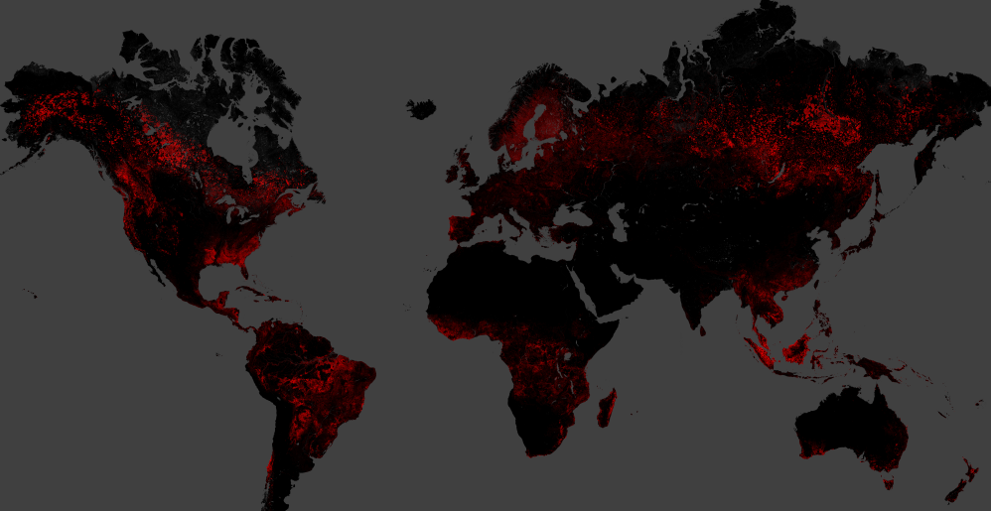
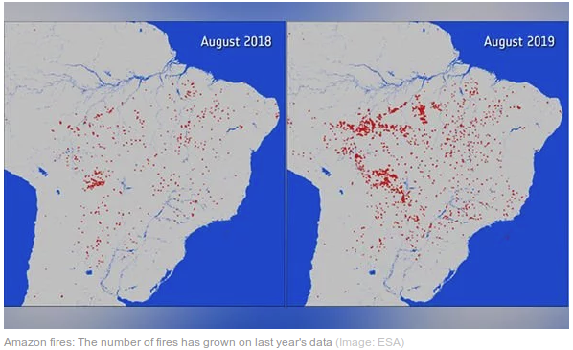
Use of satellite technology is crucial!
Satellite observations reveal the extend of fire outbreaks and help dramatically to the fire management, and inform, after appropriate data assimilation, wildfire warning and prediction systems, atmospheric models.
Forest cover loss 2000-2018
Aug. 2018
Aug. 2019
source: NASA/Landsat7, M. Hansen et al. (2013)
source: ESA
Notes:
7

Slide 8
Numerical prediction of fire risk and drought conditions at high spatial and temporal resolution
Cyprus-The case of Solea forest fire June 20, 2016

Slide 9
Cyprus wildfires
More than 1000 wildfire outbreaks have been reported in the areas administered by the government of Cyprus over the years 2007-2016.
source: Data provided by
Cyprus Dept. of Meteorology

Slide 10
Cyprus high resolution, short range forecasts
The short term fire risk assessment utilizes operational meteorological forecasts provided by the Cyprus Department of Meteorology (DoM).
DoM employs the WRF-ARW regional climate model using a telescoping nested configuration with the finest domain centered over Cyprus at a spatial/horizontal resolution of about 2km.
The operational forecasts utilize computational resources from the Cy-TERA HPC facility, hosted by the Cyprus Institute (CyI). The model is initialized twice a day and provides numerical weather forecasts up to five days ahead.
DoM operational forecast is forced by meteorological initial and lateral boundary conditions from the Global Forecast System (GFS) available at NOAA/NCEP (0.25º grid resolution). GFS forecasts make systematic use of satellite observations (via data assimilation).

Slide 11
Short term forecasts: Meteorological fire risk indices
1. Haines index (or Lower Atmosphere Stability Index-LASI) consists of two terms: the stability and moisture content. For its calculation air pressure, temperature and relative humidity are used as inputs. LASI is based on an integer rating scale (between 2-Low and 6-High). For example, when the lower atmosphere is more unstable and drier the index is higher and the potential risk of fire growth is high.
2. Angstrom index (SAI) is a non-linear combination of near surface temperature and relative humidity, which models the ambient air dryness. Values <2 indicate a high risk (Very likely) for fire development and >4 a minimal risk (Unlikely).
Our preliminary assessment of the short term fire risk indices utilizes three years (2015-2017) of operational numerical weather prediction forecasts provided by the DoM.

Slide 12
Short term forecasts: Meteorological fire risk indices
3. Canadian fire weather index (index-CFWI) is the most widely used by the forest fire management services fire risk index. The CFWI system uses meteorological input such as near surface temperature, relative humidity, wind speed, and 24hr rainfall. CFWI is a numerical rating system of fire intensity and indicates the probable fire intensity, typically divided into six fire danger classes.
4. Sharples index (or “simple” Sharples fire danger index-SFDI) is a composite of near surface temperature, relative humidity -to account for fuel moisture content- and wind speed.
Our preliminary assessment of the short term fire risk indices utilizes three years (2015-2017) of operational numerical weather prediction forecasts provided by the DoM.

Slide 13
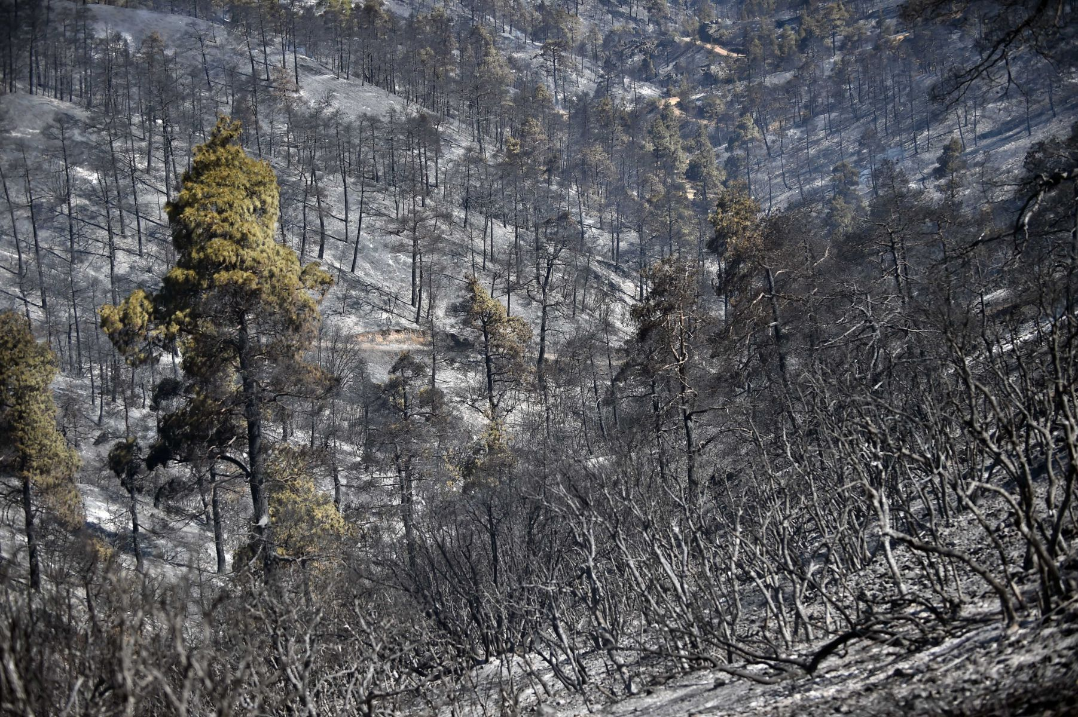
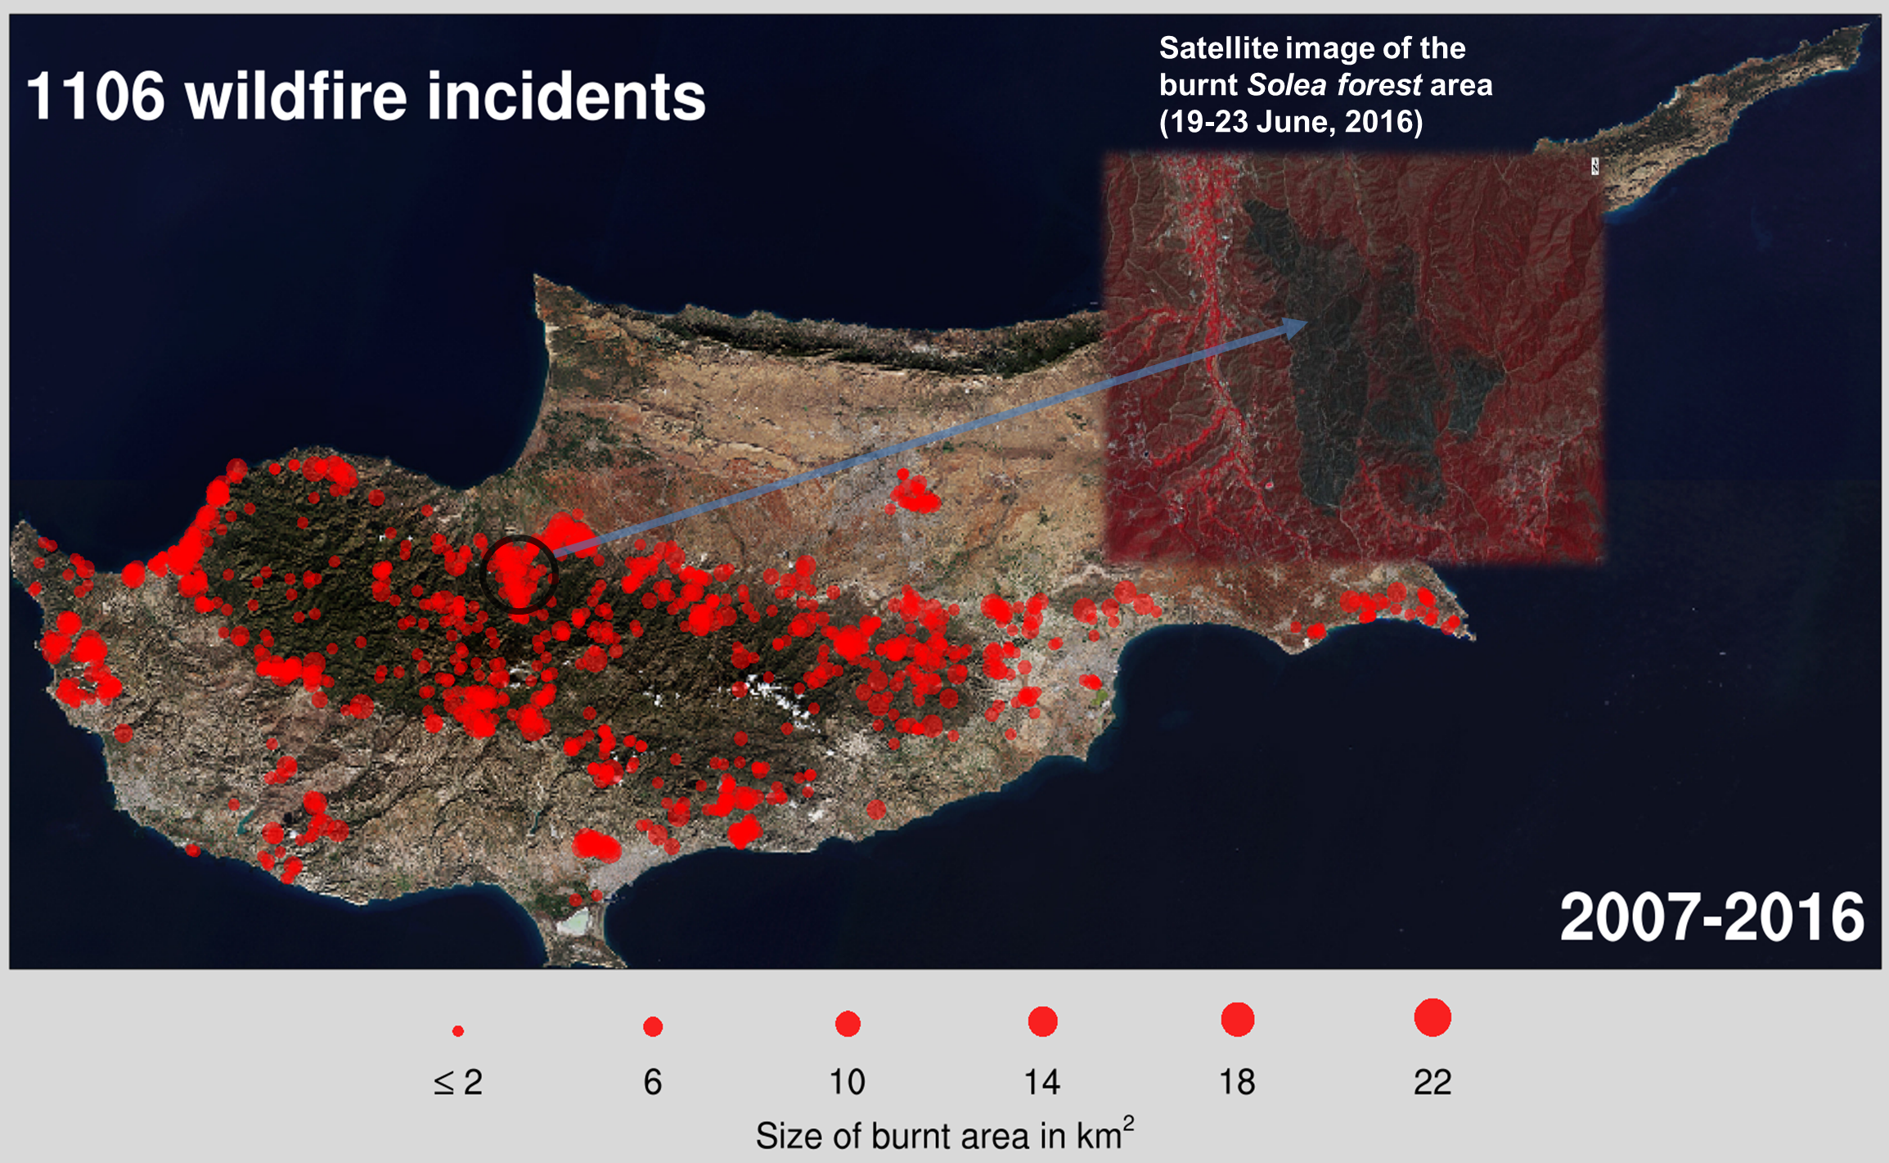
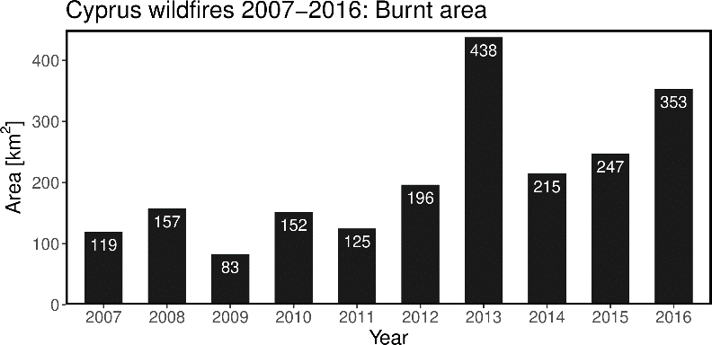
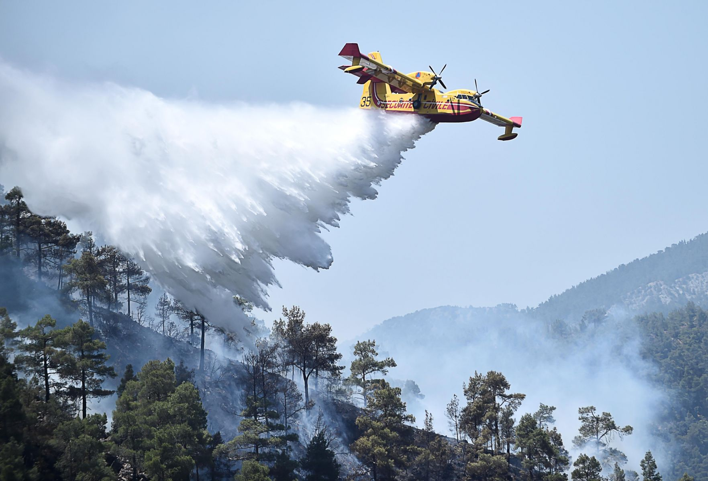
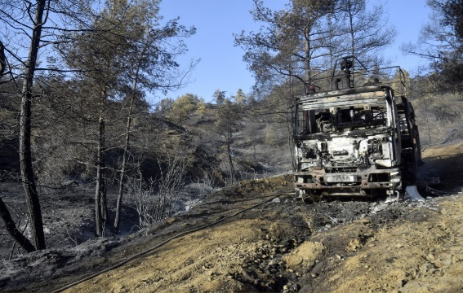
Solea forest fire: 19-23 June 2016
The ever increasing hotter and drier summers in Cyprus and irresponsible human activities near woodland areas caused two major wildfires in the summer of 2016, burning a total forested area of ≈25km².
From 2000 to 2018 the tree cover has decreased by about 3%.
source: Data provided by
Cyprus Dept. of Meteorology
We demonstrate the performance of four meteorological fire hazard indices, near Evrichou village (35.02ºN, 32.93ºE; alt.≈600m) within the vulnerable Solea forest.
Notes:
13

Slide 14
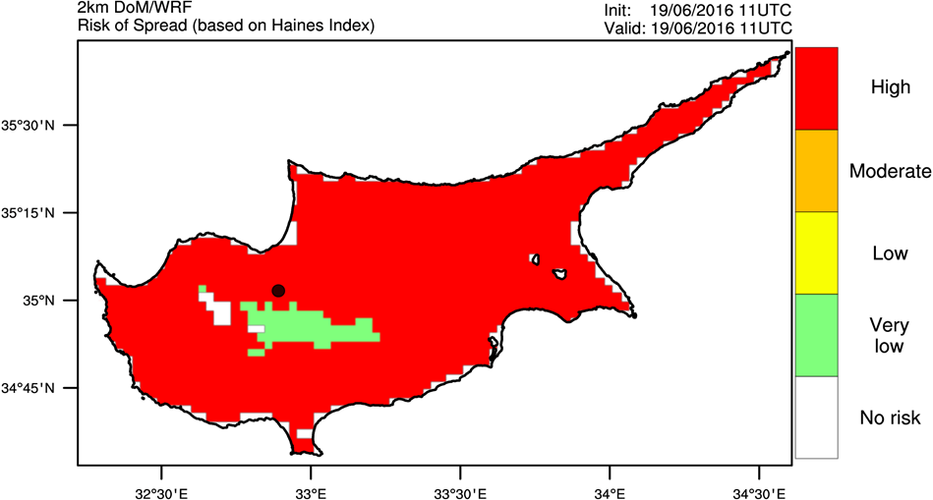
1. Haines index (LASI)
19/06/2016 (11UTC)
Snapshots of LASI instantaneous horizontal distribution. The potential of fire spread was rated as High, the highest possible value of its severity rating scale, during the disastrous Solea forest fire event (black dot).
20/06/2016 (11UTC)
Notes:
14

Slide 15
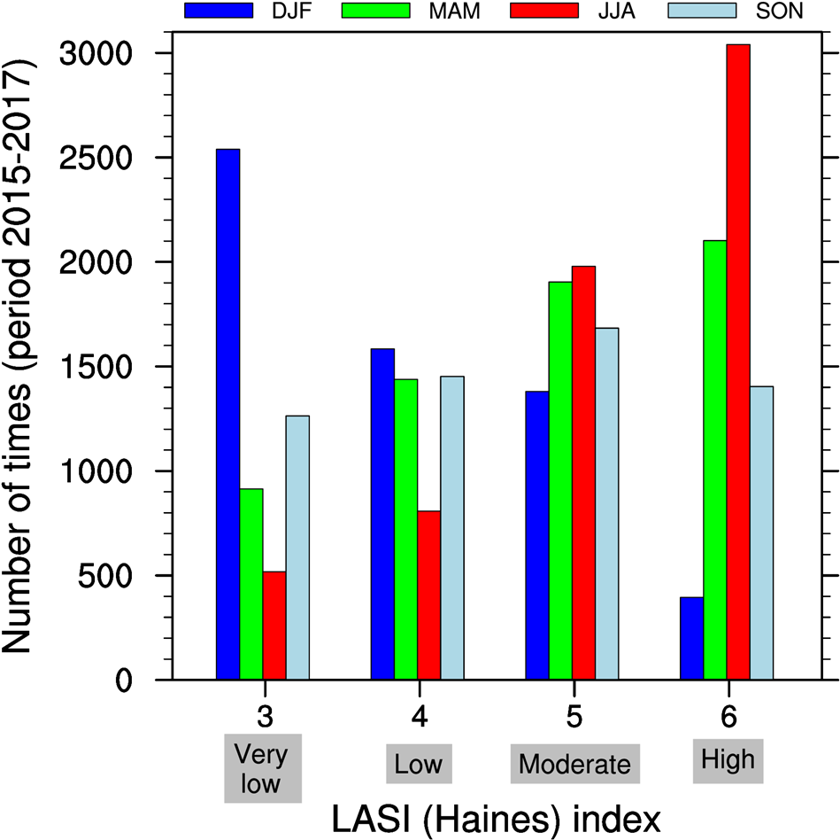
1. Haines index (LASI)
From the seasonal frequency distribution plot, the fact that the fire spread risk is highly enhanced over Cyprus during the summer season, is well captured by the LASI index over the three year period between 2015-2017 (DoM data).
The LASI frequency distribution indicates that the fire season spans Spring, Summer and Autumn.
Notes:
15

Slide 16
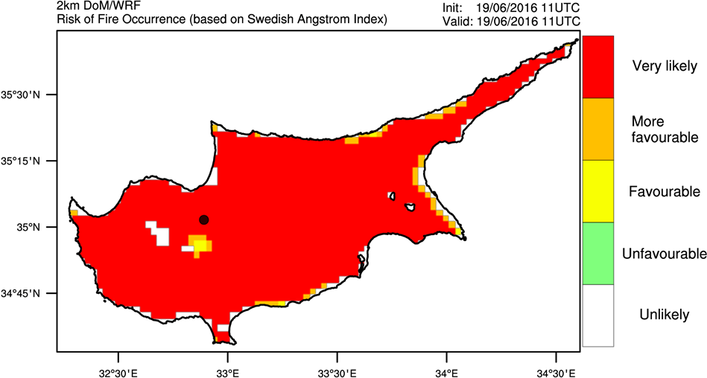
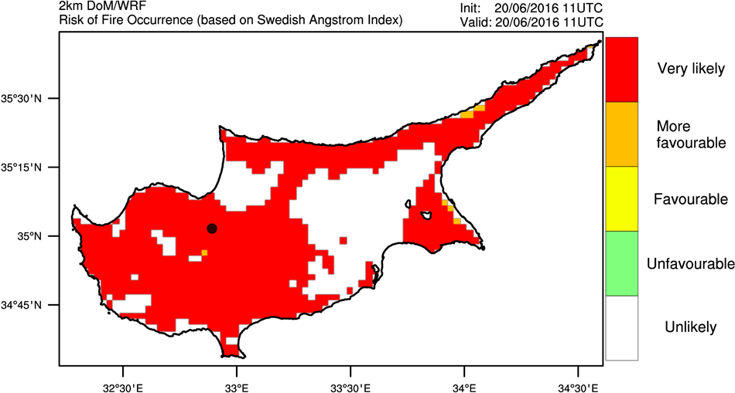
2. The Swedish Angstrom index (SAI)
Snapshots of SAI instantaneous spatial distribution. The maps show the SAI index predictions for 19-20/June, 2016.
During 19/06 both LASI and SAI have almost identical spatial distribution, but this is not the case for 20/06.
LASI and SAI show agreement in terms of the severity rating, which is at maximum around the Solea forest area.
19/06/2016 (11UTC)
20/06/2016 (11UTC)

Slide 17
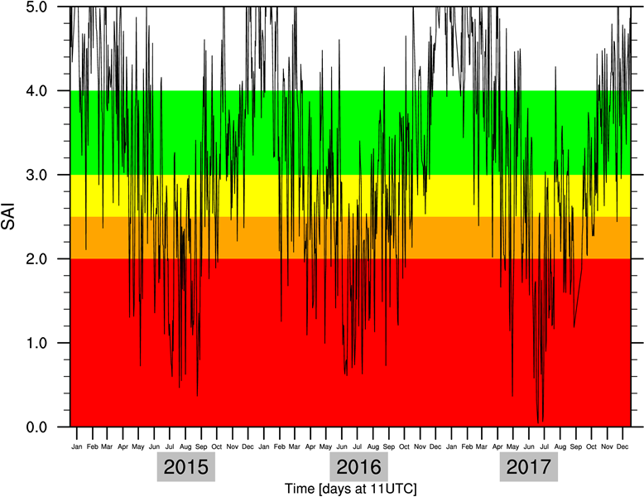
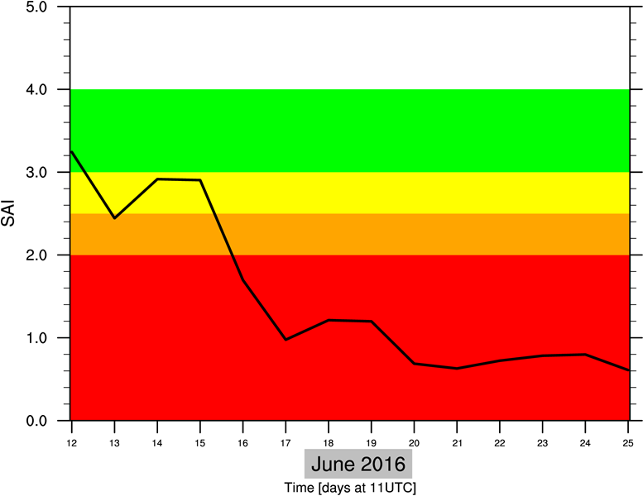
2. The Swedish Angstrom index (SAI)
Modelled (daily) time series plot (top right) for the period 2015-2017, for the Solea forest location (35.02ºN, 32.93ºE). The seasonal variation of the SAI index is evident. The typical forest fire season -May through October- over the specific area and Cyprus, is identified.
We note the off fire season peaks, which may be used as a remainder that we might still have the potential risk for wildfires outside of the regular fire season.
The bottom-right time series plot shows that the potential of fire risk was rated Very likely (i.e., the highest) during the Solea forest fire incident in June 2016.
Notes:
17

Slide 18
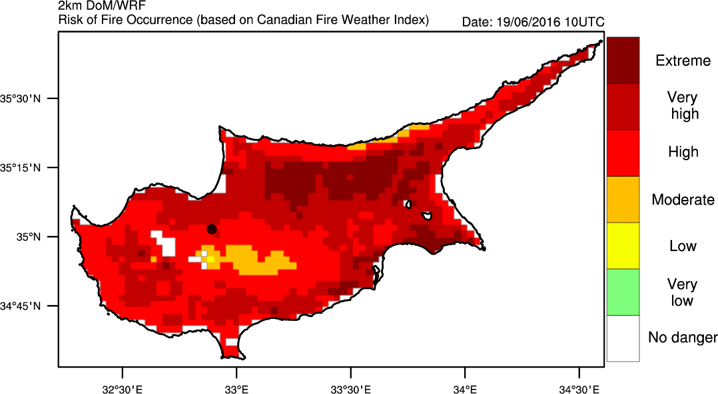
3. Canadian fire weather index (CFWI)
19/06/2016 (11UTC)
Snapshots of CFWI instantaneous horizontal distribution. The maps show the CFWI index predictions for 19-20/June, 2016.
CFWI predicted a High risk for fire development, which is not the highest in its severity scale, but it is close to Very High rating.
20/06/2016 (11UTC)

Slide 19
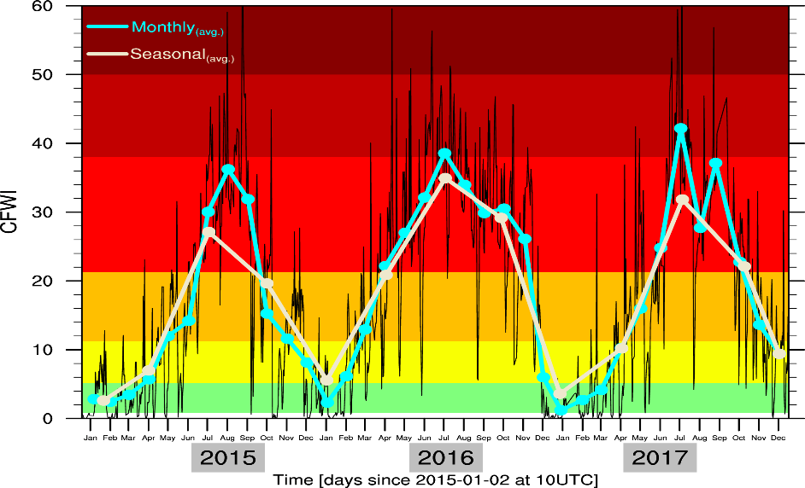
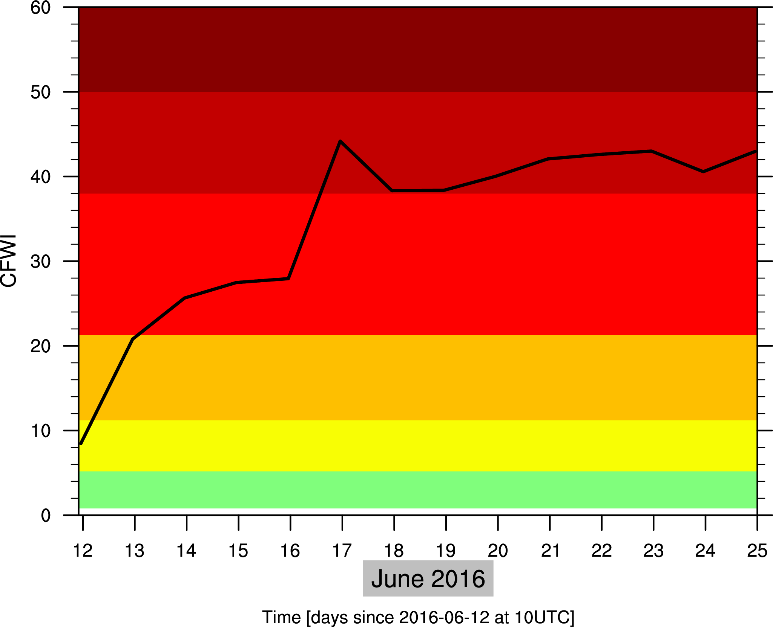
3. Canadian Fire weather index (CFWI)
Modelled CFWI (daily) time series (2015-2017), at a location within the Solea forest. The seasonal variation is highlighted.
The simulated rating of CFWI, is high to very-high during the Solea wildfire.

Slide 20
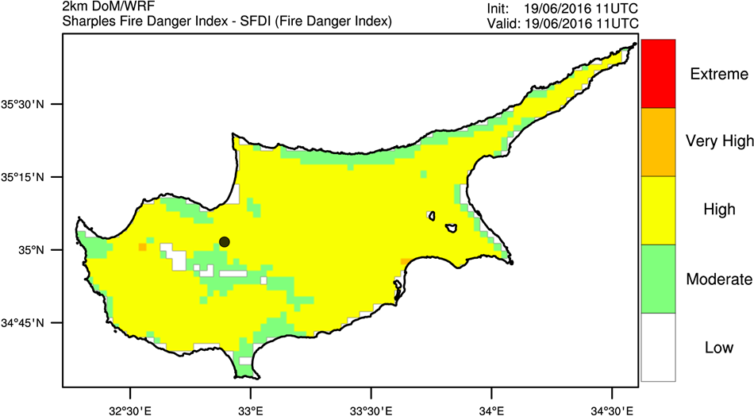
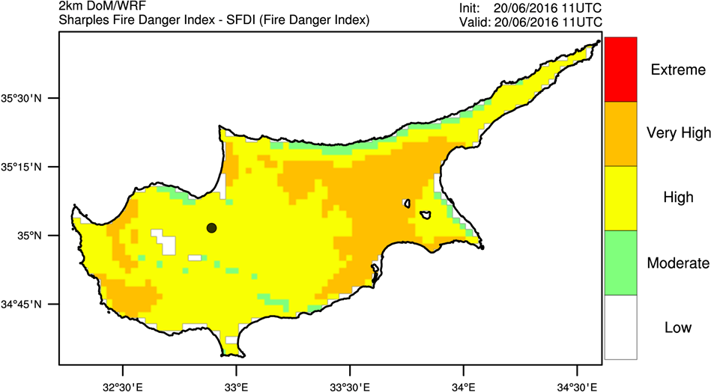
4. Sharples index (SFDI)
19/06/2016 (11UTC)
Snapshots of SFDI instantaneous spatial distribution. The maps show the SFDI index predictions for 19-20/June, 2016.
SFDI predicted a High risk for fire development, not the highest in its severity rating scale. Near the Solea forest area (black dot), it is close to Moderate (19/06).
20/06/2016 (11UTC)

Slide 21
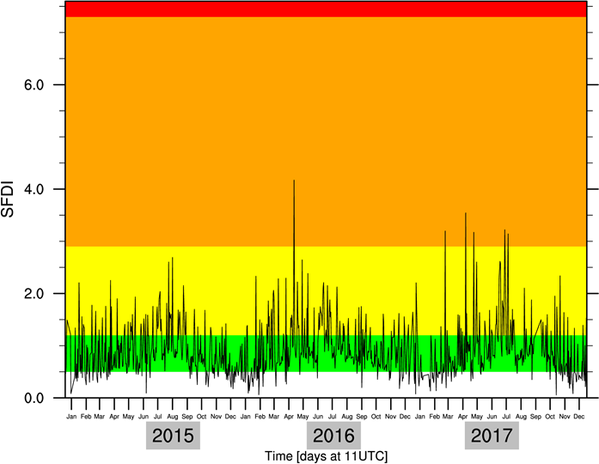
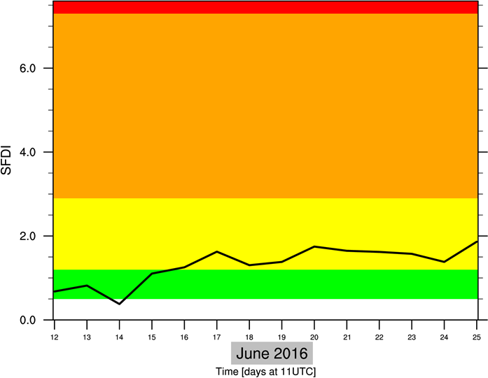
5. Sharples index (SFDI)
Modelled SFDI (daily) time series (2015-2017), at a point within the Solea forest. A seasonal variation is shown as expected, due to its temperature and relative humidity dependence.
The simulated values of SFDI, are relatively low during the Solea forest fire event. Need to appropriately calibrate the SFDI model regarding its fire risk severity scale, for Cyprus.

Slide 22
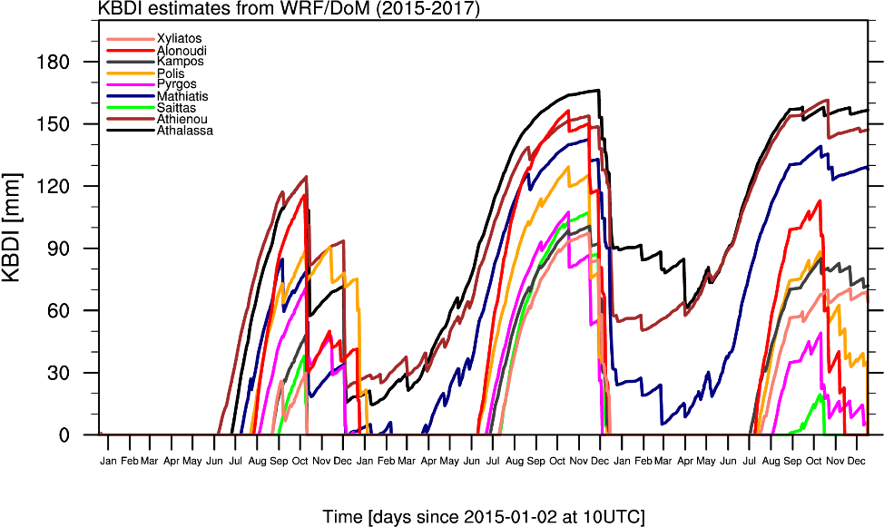
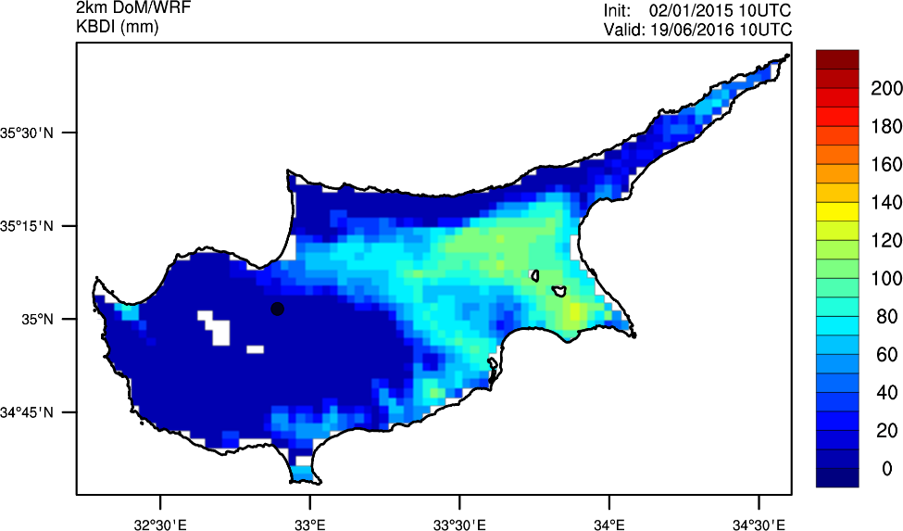
Short term forecasts: Meteorological drought - KBDI
Severe drought and potentially extreme fire behavior.
Implemented Keetch-Byram (1968) drought index. KBDI is estimated for several DoM weather station locations, using daily numerical forecasts 2015-2017.
KBDI estimated relatively saturated soil conditions (0-50mm) during the outbreak of the Solea forest fire event. Needs further investigation.
2015
2016
2017

Slide 23
Meteorological drought in the Balkan and East Med - SPI
Extended term CFWI forecasts based on the NCEP/CFSv2 long-term climatological forecasts
Climate projection example of CFWI based on dynamically downscaled CMIP5 data –DISARM project

Slide 24
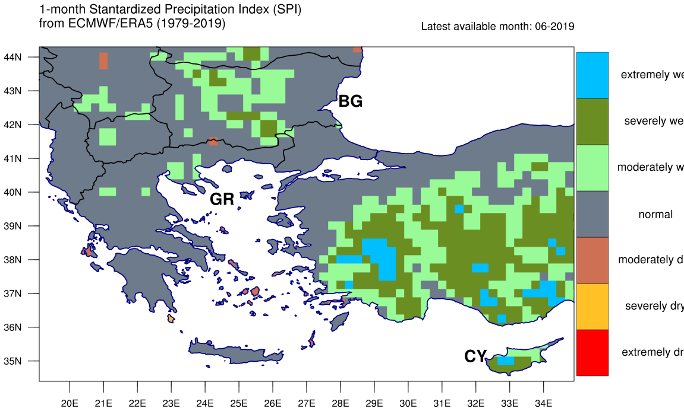
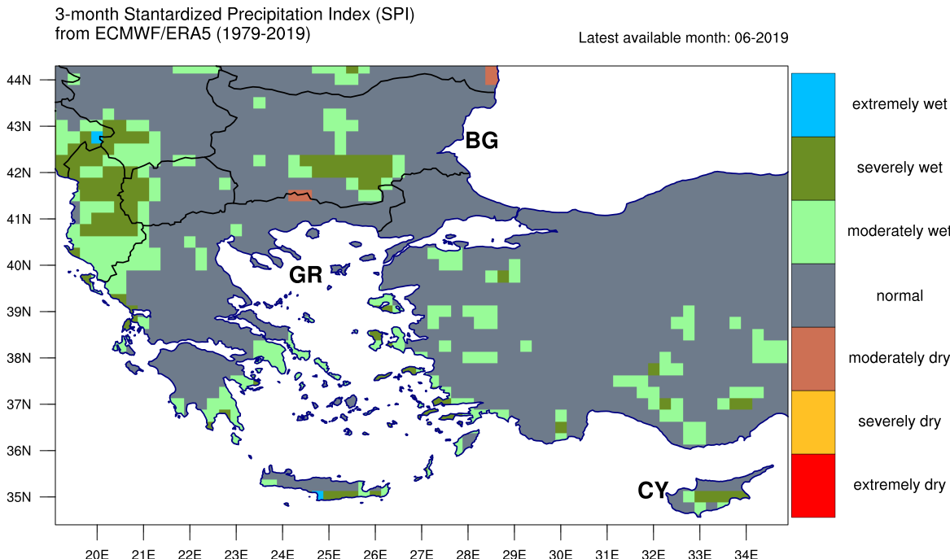
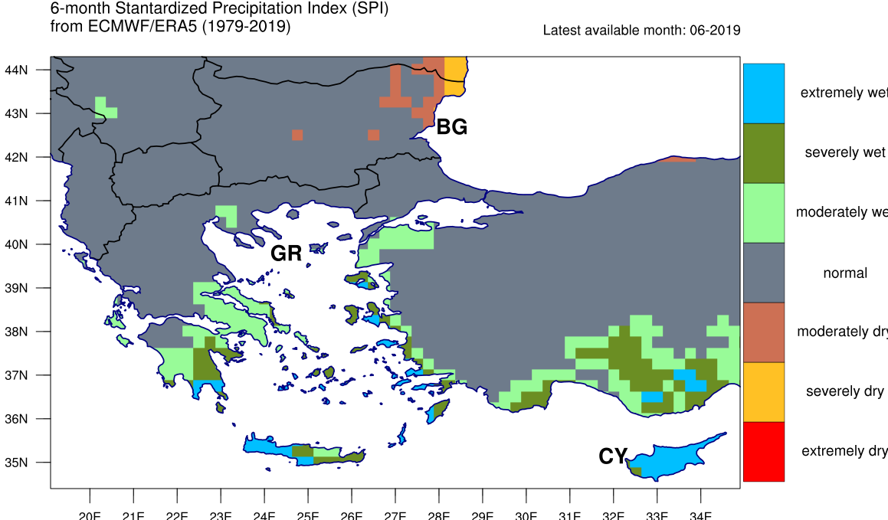
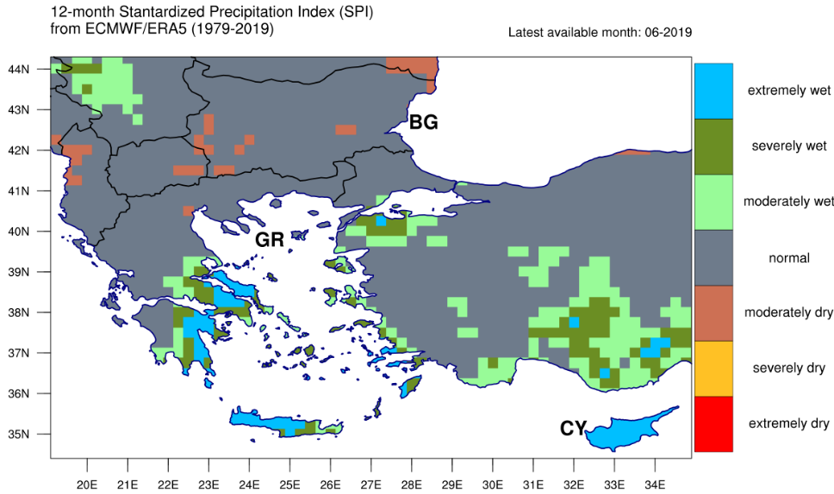
SPI over Balkan and East Med
SPI is calculated based on ECMWF ERA5 (0.25º) re-analysis 1979-2019.

Slide 25
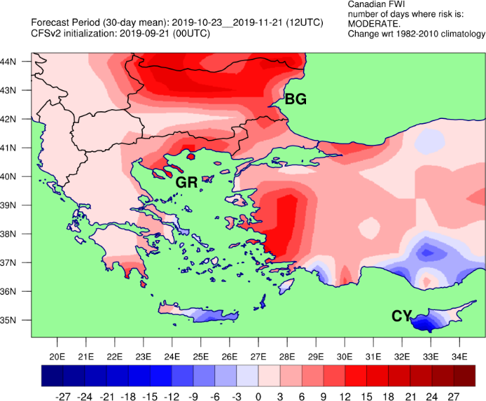
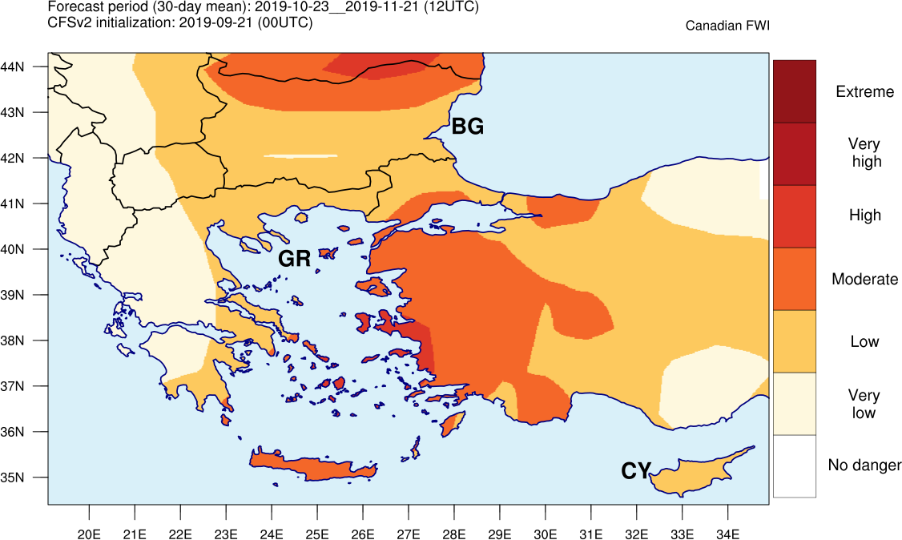
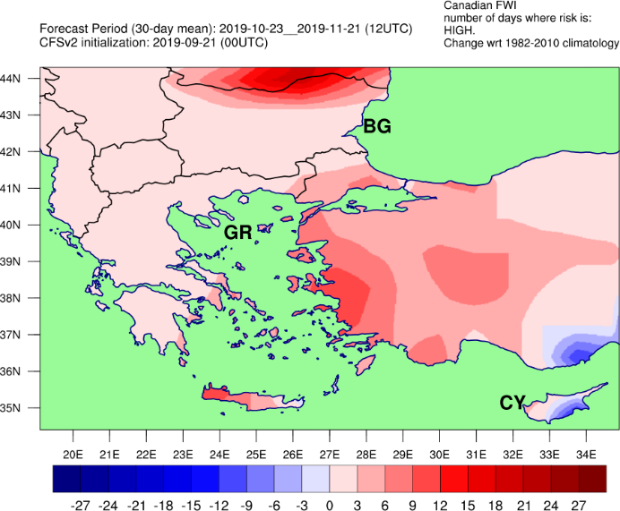
Long-term predictions for CFWI
Based on the daily global NCEP/CFSv2 long-term forecasts (9-month outlook) provided at 0.9º resolution (not ideal for small scales…).

Slide 26
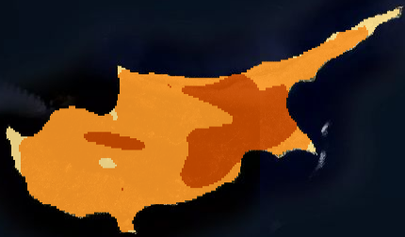
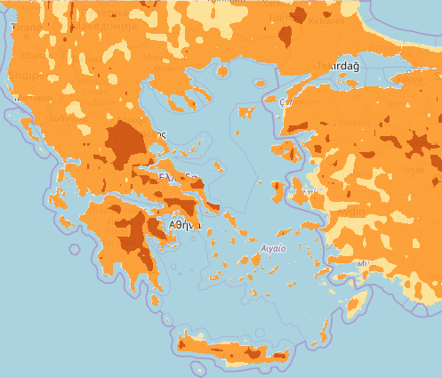
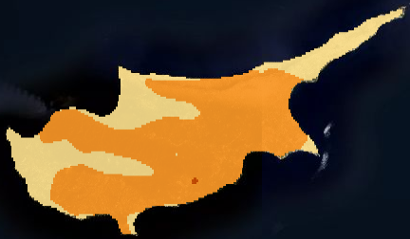
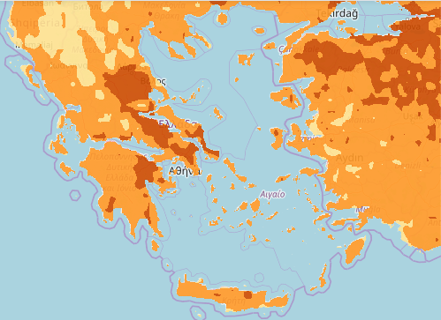
CFWI projections over Balkan and East Med
Number of days with Very High CFWI rating – Future minus Base period.
RCP4.5: Fut. – Ref.
RCP4.5
RCP8.5: Fut. – Ref.
RCP8.5
Ref.: 1960-1990
Fut.: 2030-2060
Model: RC4/MPI-M-MPI-ESM-LR
Data: EURO-CORDEX11
http://map.disarmfire.eu

Slide 27
Future goals
The skill of the high resolution fire/drought danger indices is going to be evaluated against weather station measurements (DoM) and selected wildfire occurrences over Cyprus
Improve the fire risk forecast for the short term predictions, utilizing local weather station, radar data (DoM) and satellite information (e.g., high res. vegetation map, land-cover, …) from EUMETSAT
Compute KBDI drought index using the NCEP/CFSv2 long-term/seasonal climatological forecasts
Compute climate projections of several fire risk and drought indices using dynamically downscaled CMIP5 data (EURO-CORDEX11) based on RCP2.6, RCP4.5 and RCP8.5

Slide 28
THANK YOU!
Yiannis Proestos
y.proestos@cyi.ac.cy

