Slide 1
Drought and fire observatory and early warning system: The DISARM project Kotroniª V., Branzov^{b} H., Cartalis^{c} C., Michaelides^{d} S. Tymvios^{e} F., Christoudias^{d} T., Georgiev^{b} Ch., Giannakopoulosª Ch., Giannarosª Th., Gospodinov^{b} I., Hadjinicolaou^{d} P., Karaliª A., Karagiannidisª A., Lagouvardosª K., Mavrakou^{c} Th., Ninov^{b} P., Papagiannakiª K., Proestos^{d} Y., Polydoros^{c} A., Stoyanovª b J. a National Observatory of Athens, Lofos Nymfon, Thission, 11810, Athens, Greece; Tel: 30-210-8109126; E-mail: kotroni@noa.gr b National Institute of Meteorology and Hydrology – Bulgarian Academy of Sciences, Sofia 1784, Tzarigradsko shosse 66 blv., Bulgaria; Tel: +359 885440495; E-mail: plamen.ninov@meteo.bg c National and Kapodistrian University of Athens,: Panepistimiopolis, Build Phys -V, Athens 15784, Greece; Tel: 30 210 7276774; E-mail: ckartali@phys.uoa.gr d The Cyprus Institute, 20, Kavafi Str., Aglantzia, Nicosia, Cyprus; Tel: +35722208789 ; E-mail: s.michaelides@cyi.ac.cy e Department of Meteorology, L. Nikis 28, 1086, Nicosia, Cyprus; Tel: +35722802934; E-mail: ftymvios@dom.moa.gov.cy
6th SALGEE workshop. 14-17 October 2019. EUMETSAT HQ, Darmstadt, Germany.

Slide 2
What is the DISARM project:
The DISARM Interreg Balkan-Med project, co-funded by the European Union and national funds of the participating countries, aims at developing, validating and demonstrating a set of services that employ state-of-the-art observational and modeling techniques to assist interested authorities in better preventing, addressing and finally mitigating the adverse impacts of droughts and wildland fires, with the latter being intensified due to climate change.
Partnership:
Leading Partner: National Observatory of Athens, Greece.
Project partners: National Institute of Meteorology and Hydrology, Bulgaria
Department of Meteorology, Cyprus
National and Kapodistrian University of Athens, Greece
The Cyprus Institute, Cyprus
Observer Partner: 7th Hunting Federation of Thessaly & Sporades Islands, Greece
Cyprus Civil Defence, Cyprus

Slide 3
End Users:
Regional public authorities
Civil protection agencies and fire services
Private sector investors and stakeholders
Public
Framework:
In the framework of the DISARM project, an integrated early warning system for detection, monitoring and spread simulation of wildfires was developed. The system encompasses:
Fire risk forecasts based on a series of related indices, including a new one developed just for the Greek area, called DISARM index.
A platform for satellite detection and monitoring of wildfires.
A fire spread simulation system named IRIS, which is based on the WRF-SFIRE model.
A platform for the estimation of fire risk in the future, based on regional climate simulations, provided by EURO-CORDEX
Project Web Page: http://disarmfire.eu/
6th SALGEE workshop. 14-17 October 2019.
EUMETSAT HQ, Darmstadt, Germany.

Slide 4
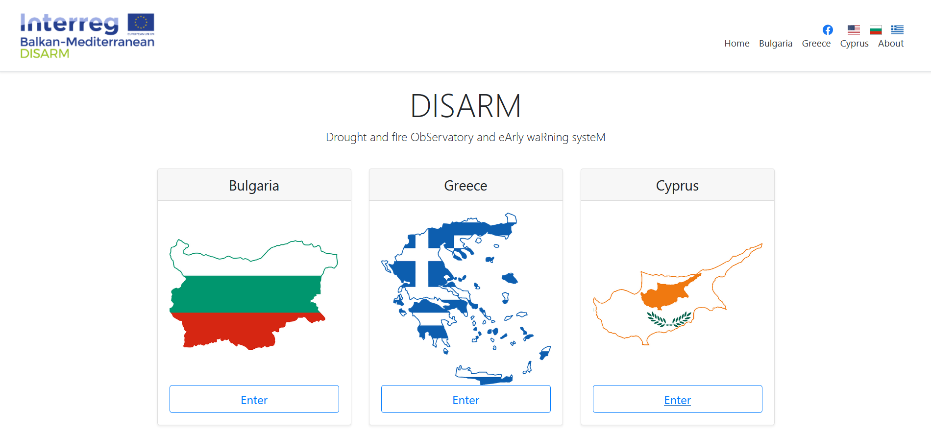
Fire Web Portal: http://map.disarmfire.eu/
6th SALGEE workshop. 14-17 October 2019.
EUMETSAT HQ, Darmstadt, Germany.

Slide 5
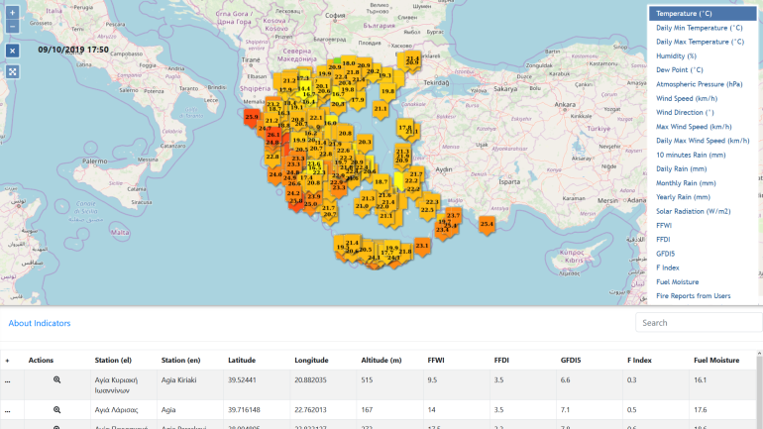
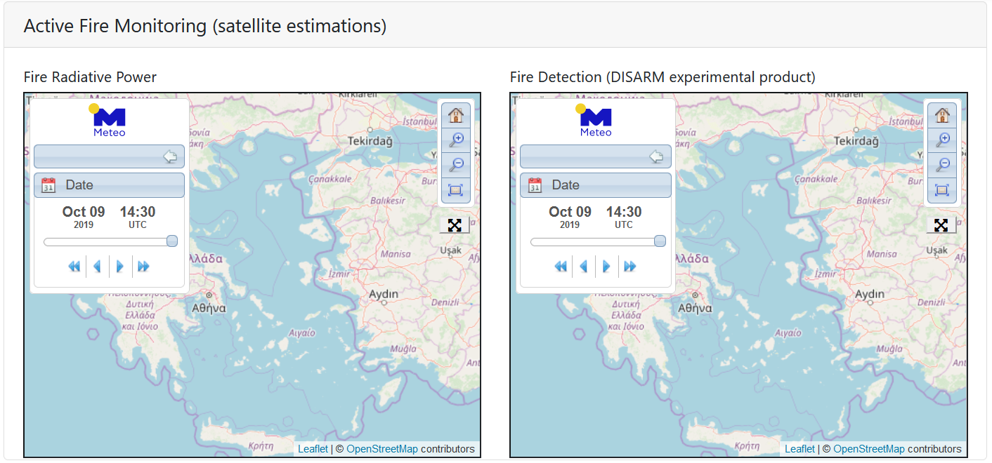
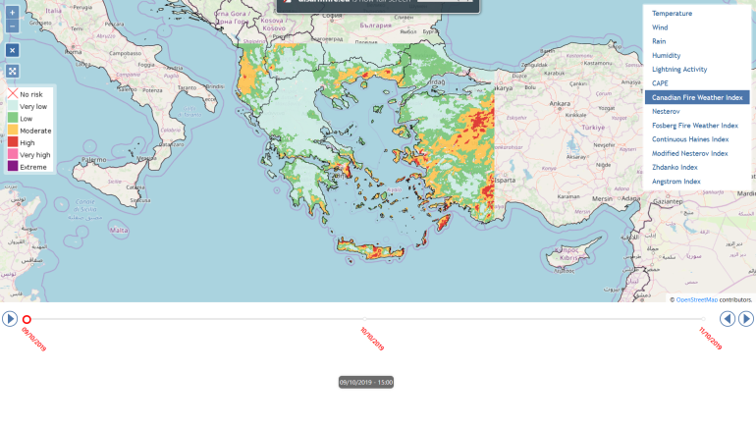
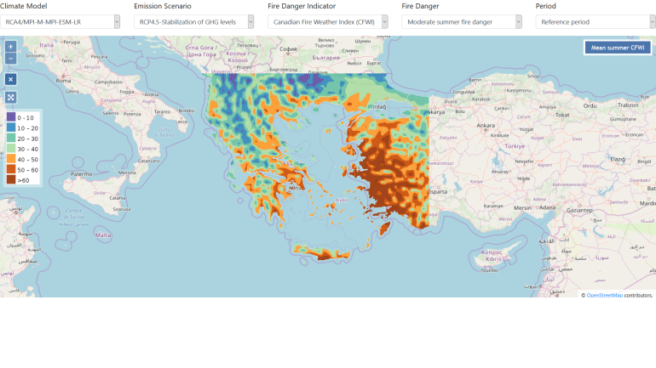
Fire Web Portal: http://map.disarmfire.eu/
The user can find information about (example for Greece)
Real time Station data & Fire Indices Active Fire Monitoring (satellite estimations)
Weather and fire risk Forecasts Climate Projections of fire risk
6th SALGEE workshop. 14-17 October 2019.
EUMETSAT HQ, Darmstadt, Germany.

Slide 6
IRIS: RapId-Response FIre Spread Forecast System
Named under a messenger goddess in Greek mythology, IRIS was developed with the aim to support the operational fire suppression activities of the Greek Fire Service.
Coupled fire-atmosphere modelling system (based on WRF-SFIRE)
Prototype fuel models geospatial database
Calibrated for Greece
Transferable and replicable
Fully automated implementation
Rapid response (6h forecast in ~ 15 mins)
6th SALGEE workshop. 14-17 October 2019.
EUMETSAT HQ, Darmstadt, Germany.

Slide 7
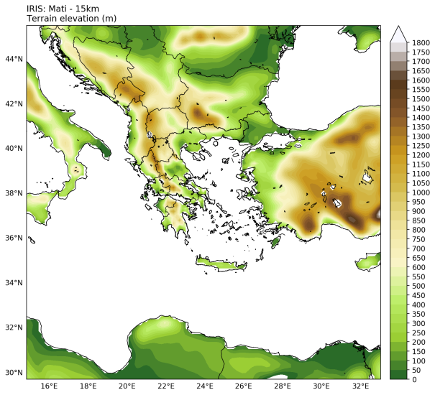
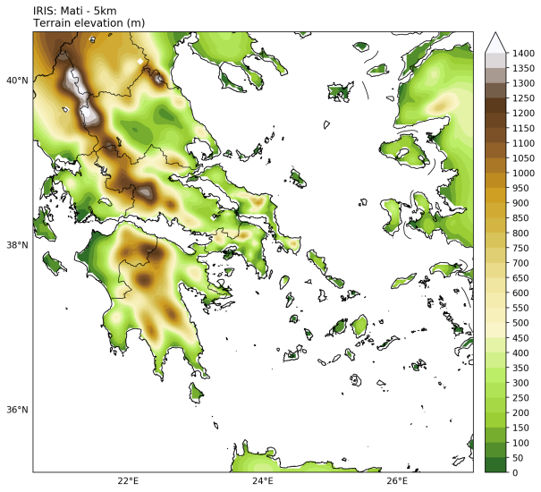
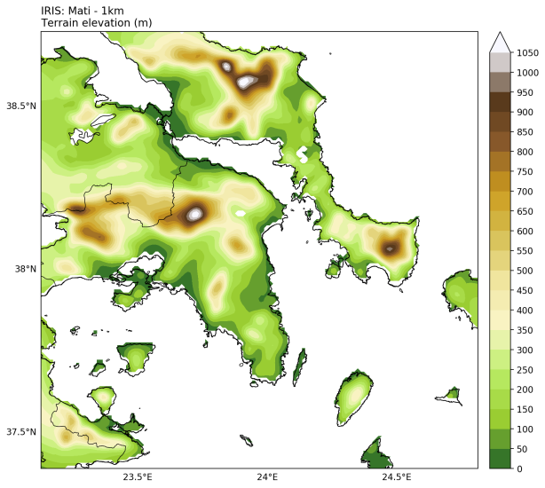
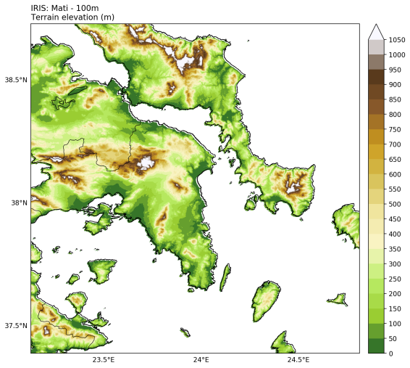
IRIS: RapId-Response FIre Spread Forecast System
Three 2-way nested modelling domains, centred around fire ignition: 15 - 5 - 1 km.
Initialisation: Latest available (based on ignition time) GFS forecast, ~25km resolution
Forecast: 24h forecast
D01 - 15km
D02 - 5km
D03 - 1km
Ultra-high-resolution domain (100m) embedded as sub-grid within the 1km atmospheric domain:
90m SRTM topography.
100m fuel models (based on Copernicus Land Monitoring Service products).
6th SALGEE workshop. 14-17 October 2019.
EUMETSAT HQ, Darmstadt, Germany.

Slide 8
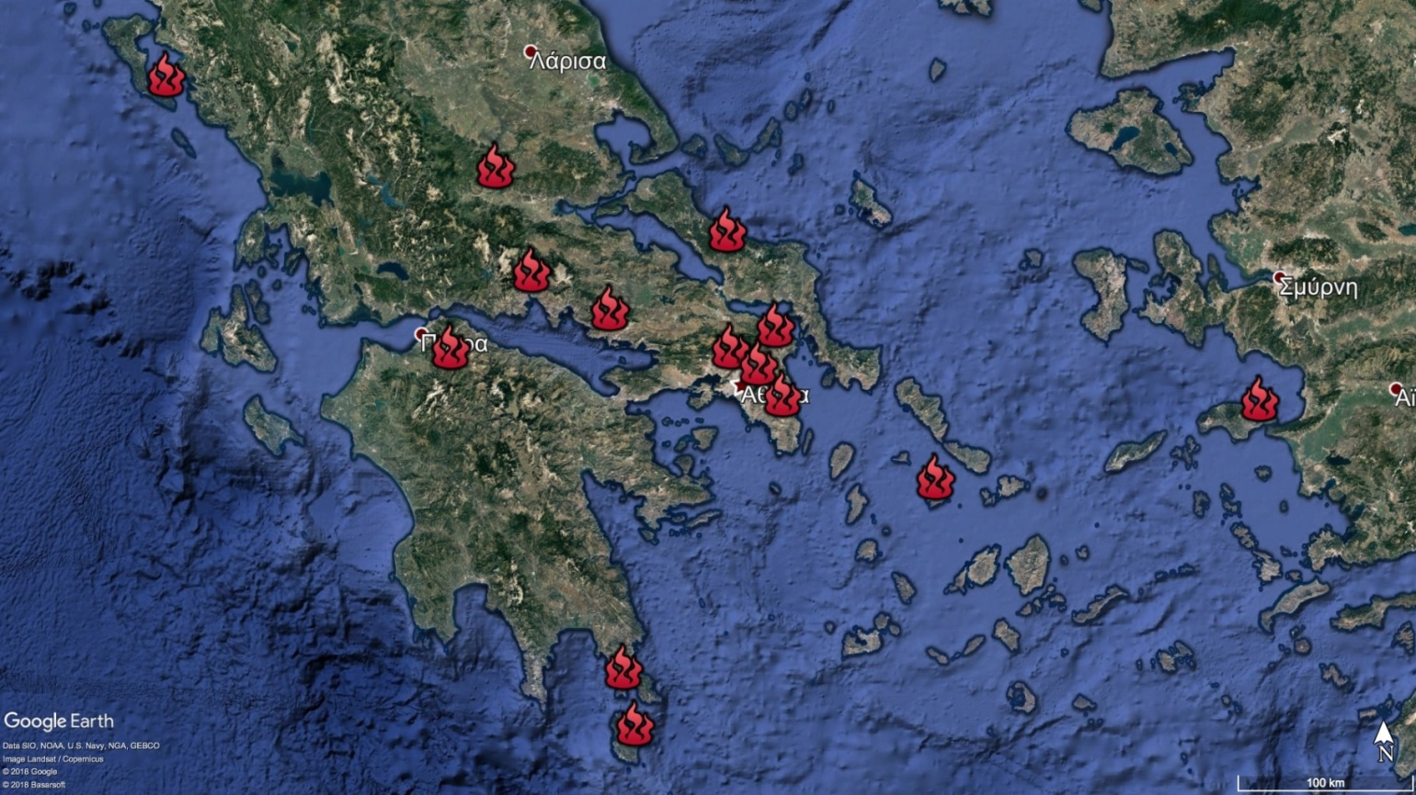
IRIS: RapId-Response FIre Spread Forecast System
14 activations of IRIS as of September 04 2019
6th SALGEE workshop. 14-17 October 2019.
EUMETSAT HQ, Darmstadt, Germany.

Slide 9
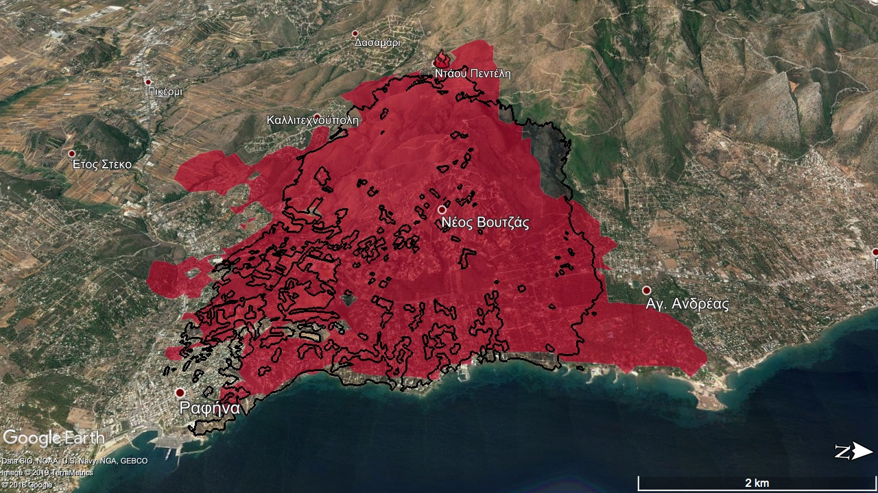
IRIS: RapId-Response FIre Spread Forecast System
WF10: Mati
6th SALGEE workshop. 14-17 October 2019.
EUMETSAT HQ, Darmstadt, Germany.

Slide 10
IRIS: RapId-Response FIre Spread Forecast System
6th SALGEE workshop. 14-17 October 2019.
EUMETSAT HQ, Darmstadt, Germany.

Slide 11
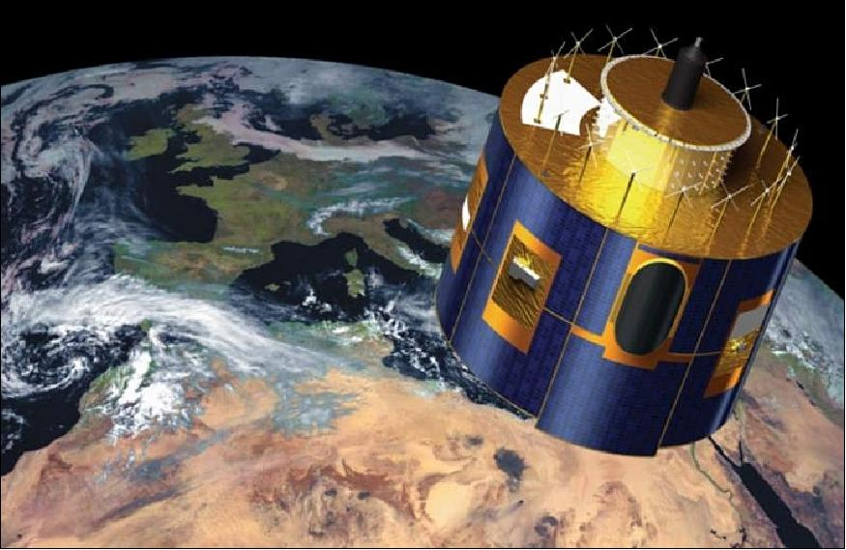
Satellite detection of forest fires
6th SALGEE workshop. 14-17 October 2019.
EUMETSAT HQ, Darmstadt, Germany.

Slide 12
Satellite detection of forest fires
Active fire monitoring (EUMETSAT) misses a lot of fires over Greece. Why? Let’s take a look at the product algorithm…
The FIR algorithm is applied if following conditions are met:
Pixel is land
Pixel is not bare soil (information from the land-sea-mask and in addition the brightness temperature difference (IR8.7 – IR10.) needs to be smaller than 4 K)
Pixel is at least 1 pixel length away from the nearest coastline / lake
During day the reflectance in channel VIS0.6 is smaller than 15%
The sunglint angle is larger than 3º
For the processed pixels, the FIR algorithm uses the following four criteria to check for potential fire and fire pixels:
Brightness temperature of channel IR3.9
Brightness temperature difference of channels IR3.9 and IR10.8
Difference of the standard deviations of channel IR3.9 and IR10.8
Standard deviation of channel IR3.9
Standard deviation of channel IR10.8 (all StDevs are computed over a 3x3 pixel group)
6th SALGEE workshop. 14-17 October 2019.
EUMETSAT HQ, Darmstadt, Germany.

Slide 13
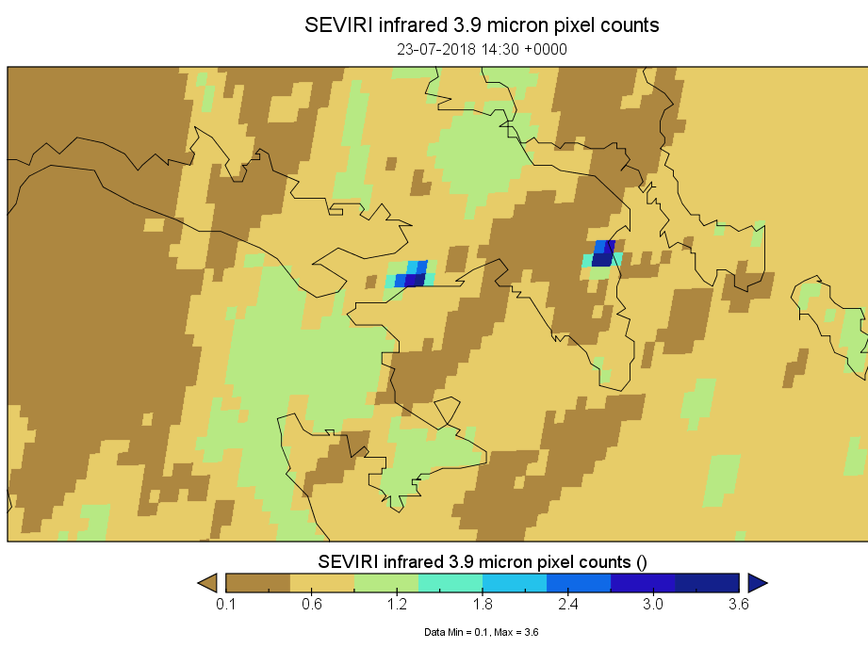
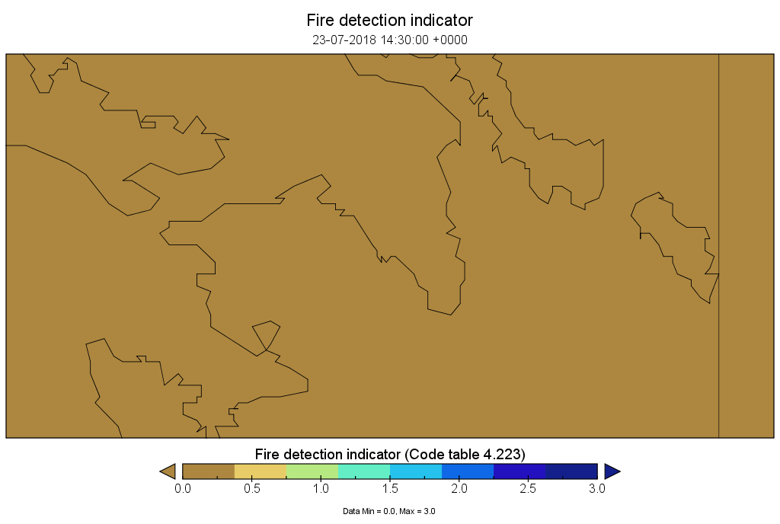
Satellite detection of forest fires
The cases of Mati and Kineta Fire Events (23/07/2018)
Mati
Kineta
Although the thermal anomalies are clearly detected in IR3.9, the Active Fire Monitoring product indicates no fires. The pixels are next to sea pixels and are excluded from the application of the algorithm. The used thresholds may also be responsible for the fail of the algorithm.
An anomaly was raised with STG on October 2018. The issue was investigated and improvements were planned.
6th SALGEE workshop. 14-17 October 2019.
EUMETSAT HQ, Darmstadt, Germany.

Slide 14
Satellite detection of forest fires
Active Fire Monitoring excludes coastal pixels. All included pixels must be at least 1 pixel length away from the nearest coastline / lake. Greece, presents extensive and complex coastlines, with forest in close proximity.
FDM FidAlgo does not exclude next-to-water pixels
FRP algorithm excludes WATEREDGE pixels
We attempted to overcome the problem by applying a modified / simplified version of the algorithm (FIREX – FIRes EXperimental)
The main modifications from the original FIR algorithm concern the removal of the StDev tests and the application of the algorithm in coastal pixels. Also the VIS0.6 and the sunglint angle tests are omitted. These modifications were chosen at the expense of false alarms, as they make the algorithm capable of successfully identifying fire pixels during fire events near the coastline. FIREX is highly sensitive but not so selective.
The current pilot version is under evaluation.
6th SALGEE workshop. 14-17 October 2019.
EUMETSAT HQ, Darmstadt, Germany.

Slide 15
Satellite detection of forest fires
FIREX algorithm description
Land – Sea mask
Used LSA SAF mask (https://landsaf.ipma.pt/en/getdata/msg-toolbox/ --> Reference grid and land sea mask). We added one more pixel to coastline!
Cloud mask
We use the NWC SAF cloud mask
Test for bare soil surfaces
IR10.8–IR8.7 < 5 K
For the selected pixels the following test were initially applied. Some fine tuning made our algorithm more selective.
TEST | FIRE
 | Day SZA < 70 | 70 ≤ SZA≤90 | Night SZA > 90
IR3.9 | >310 | >380 - SZA | >290
IR3.9-IR10.8 | >5 | >26 – 0.3 * SZA | >-1
6th SALGEE workshop. 14-17 October 2019.
EUMETSAT HQ, Darmstadt, Germany.

Slide 16
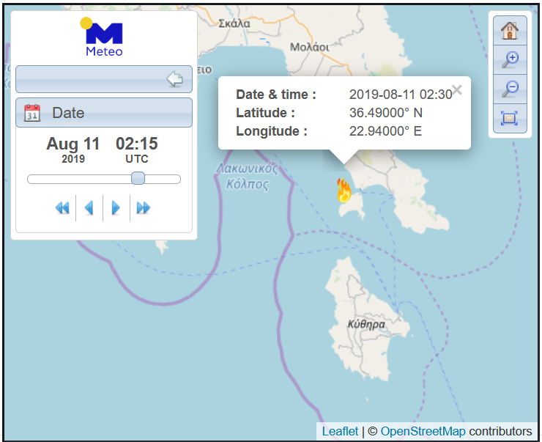
Satellite detection of forest fires
The case of Elafonissos Fire Event (10/8/2019 5:00 UTC-11/8/2019 5:00 UTC)
A tourist camp on the island of Elafonissos, in southern Greece, was evacuated for two days in a row, as a wildfire broke out on 10/8/2019 morning (around 8:00 local time) at a nearby landfill. The island’s mayor also ordered the evacuation of nearby houses.
Authorities had pronounced the fire as “under control” on 10/8/2019 night, but winds picked up and the fire intensified again during the night.
6th SALGEE workshop. 14-17 October 2019.
EUMETSAT HQ, Darmstadt, Germany.

Slide 17
Satellite detection of forest fires
The event was not detected by the Active Fire Monitoring product.
The event was not detected by the FD&M (LSA SAF) product
The event was not detected by the FRP (LSA SAF) product
The event was detected by FIREX experimental algorithm in 69 out of 97 15-minute scans.
 | Fire Ignition (Fire service) | FIREX 1st detection | # FIREX Detected scans (UTC) | # FIR scans | # FRP scans | # FD&M scans
Elafonissos | 10/8 5:00UTC | 10/8 6:30UTC | 69/97 (10/8 5:00-11/8 5:00) | Non-processed pixel | Non-processed pixel | Non-processed pixel
6th SALGEE workshop. 14-17 October 2019.
EUMETSAT HQ, Darmstadt, Germany.

Slide 18
Satellite detection of forest fires
Fire broke out near Behramlı village on the Çanakkale peninsula (Turkey) during 10/8 night
 | Fire Ignition (Fire service) | FIREX 1st detection | # FIREX Detected scans (time range UTC) | # FIR scans | # FRP scans | # FD&M scans
Elafonissos | 10/8 5:00 UTC | 10/8 6:30 UTC | 69/97 (10/8 5:00-11/8 5:00) | No detection | Non-processed pixel | Non-processed pixel
Marathonas (Small fire) | 10/8 12:00UTC | 10/8 12:30UTC | 2/17 (10/8 12:30-10/8 16:30) | No detection | Non-processed pixel | 2/17
6th SALGEE workshop. 14-17 October 2019.
EUMETSAT HQ, Darmstadt, Germany.

Slide 19
Satellite detection of forest fires
Fire Radiative Power - PIXEL [15min]
10/08/2019 13:30 UTC
Elafonissos and Marathonas pixels are non-processed pixels (close to water body/light blue)
6th SALGEE workshop. 14-17 October 2019.
EUMETSAT HQ, Darmstadt, Germany.

Slide 20
Satellite detection of forest fires
Fire Detection and Monitoring [15min]
10/08/2019 13:00 UTC
Elafonissos pixels are non-processed pixels (water)
Marathonas fire detected in 2 scans 13:00UTC and 13:15UTC
6th SALGEE workshop. 14-17 October 2019.
EUMETSAT HQ, Darmstadt, Germany.

Slide 21
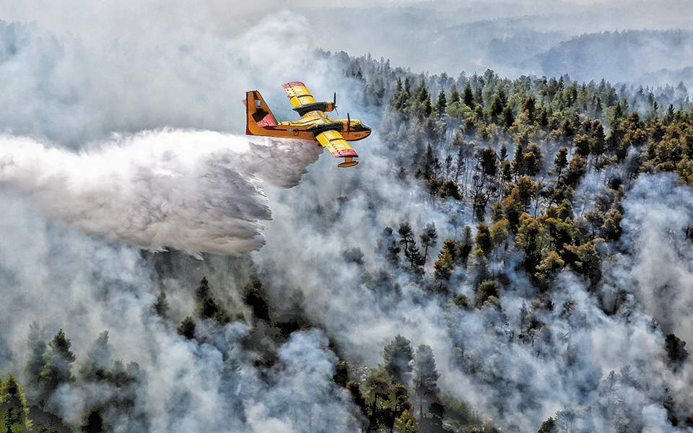
Satellite detection of forest fires
3days assessment
13/8/2019 00:00 UTC -
15/8/2019 23:59 UTC
A wildfire fanned by strong winds razed tracts of pine forest on the Greek island of Evia on Tuesday 13/8, leading to villages being evacuated and to an appeal from the authorities for assistance from its European partners. The blaze burned for three days, ravaging a total of 2,260 hectares of forestland.
 | Fire Ignition (Fire service) | FIREX 1st detection | FRP 1st detection | FD&M 1st detection | # FIR
Evia | 13/8 around 00:00UTC | 00:15UTC | 02:00UTC | 07:15UTC | No detection
6th SALGEE workshop. 14-17 October 2019.
EUMETSAT HQ, Darmstadt, Germany.

Slide 22
Satellite detection of forest fires
In conclusion…
FIREX detects islands fires and fires near the coastline that FIR, FD&M and FRP miss.
FIR, FD&M and FRP detect some fires with significant delay, compares to FIREX.
FIREX detects fires 30min to 90min after the fire ignition, as reported by the fire service.
FIREX is sensitive but not so selective.
EUMETSAT and LAND SAF could examine to possibility that FIR and FRP do not discard next-to-water pixels.
We may be able to improve by…
Adding one criterion related to the land cover classes based on the land cover map.
Fine tuning threshold values.
Adapting time-of-day dependent thresholds.
6th SALGEE workshop. 14-17 October 2019.
EUMETSAT HQ, Darmstadt, Germany.

Slide 23
Acknowledgements
DISARM project is funded by European Union and national funds of the participating countries in the framework of “INTERREG Balkan-Mediterranean 2014-2020” cooperation Programme.
6th SALGEE workshop. 14-17 October 2019.
EUMETSAT HQ, Darmstadt, Germany.

Slide 24
Thank you for
your attention!
Any questions?
6th SALGEE workshop. 14-17 October 2019.
EUMETSAT HQ, Darmstadt, Germany.

Slide 25
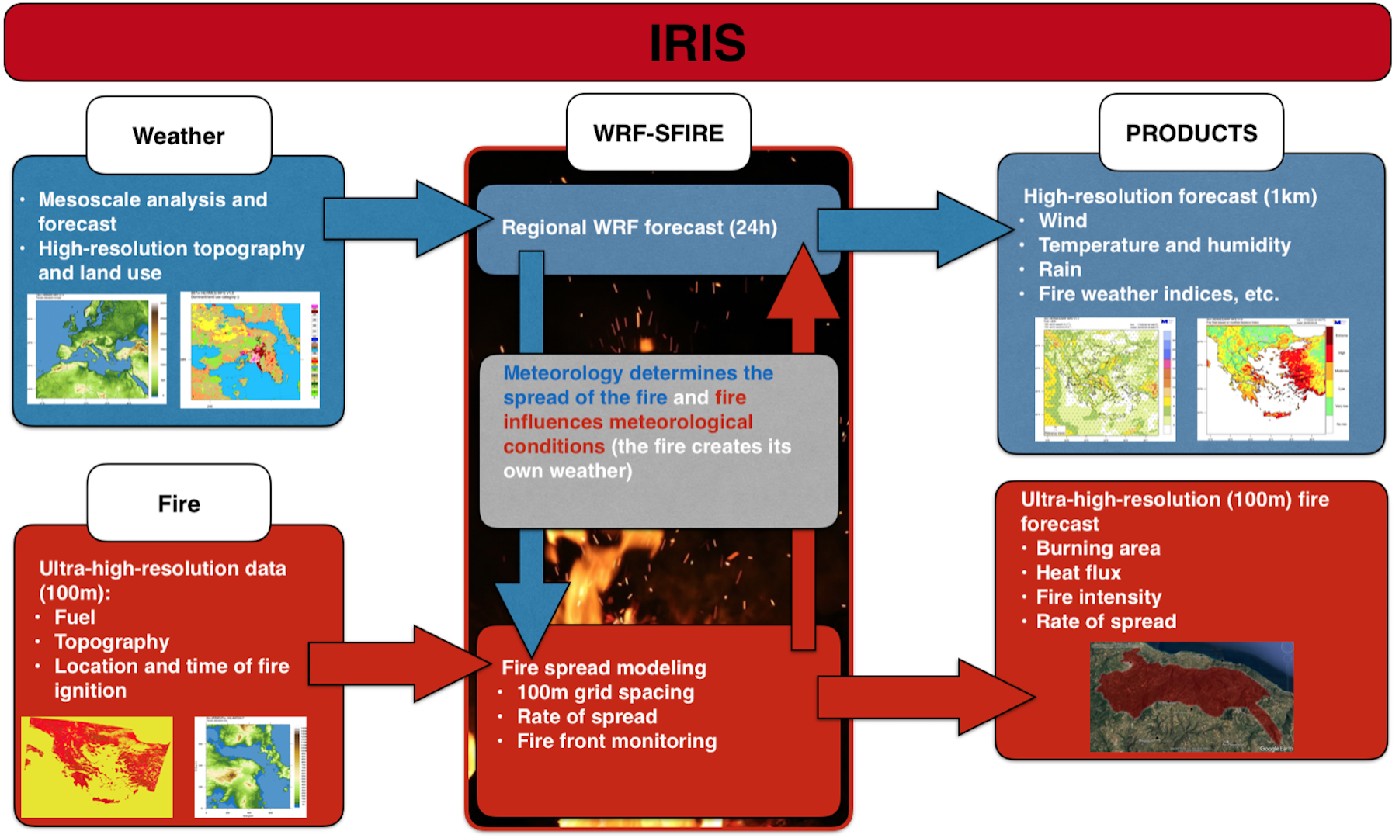
IRIS: RapId-Response FIre Spread Forecast System
6th SALGEE workshop. 14-17 October 2019.
EUMETSAT HQ, Darmstadt, Germany.

Slide 26
IRIS: RapId-Response FIre Spread Forecast System
Coupled fire-atmosphere modelling system
Quasi-physical model (does not consider chemistry of fire spread)
Semi-empirical fire spread algorithm (Rothermel, 1972)
Two-way coupling between the fire and the atmosphere (heat/vapour fluxes)
Fires can create their own weather
Weather
Topography
6th SALGEE workshop. 14-17 October 2019.
EUMETSAT HQ, Darmstadt, Germany.

Slide 27
Satellite detection of forest fires
6th SALGEE workshop. 14-17 October 2019.
EUMETSAT HQ, Darmstadt, Germany.

