Slide 1
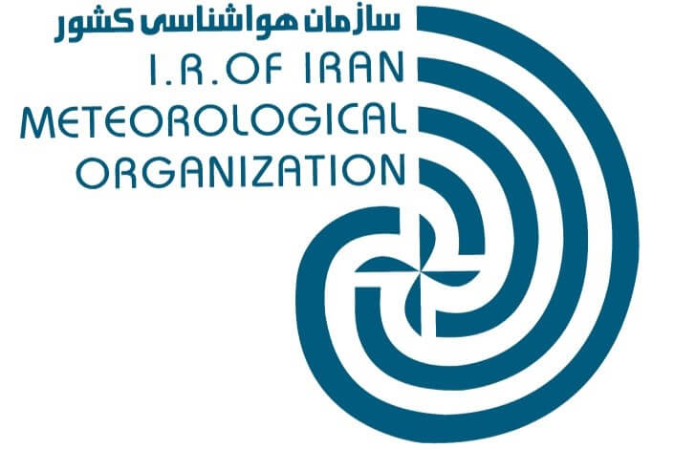
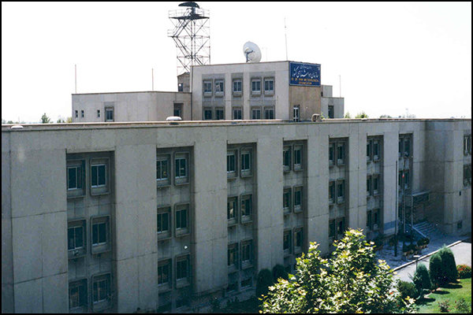
National report: application of satellite images in IRIMO
Mahnaz Khazaei (mkhazaee402@gmail.com)
- I.R. of Iran meteorological organization

Slide 2
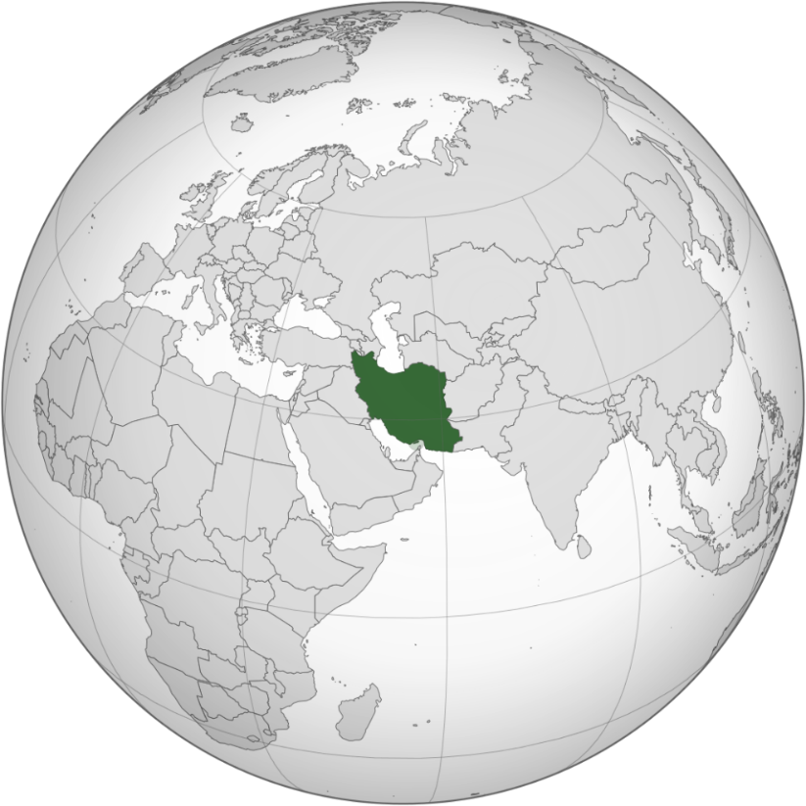
IRAN
Iran is located between 25° to 40°N latitude and 44° to 63°E longitude and has a total area of 1,648,000 km²

Slide 3
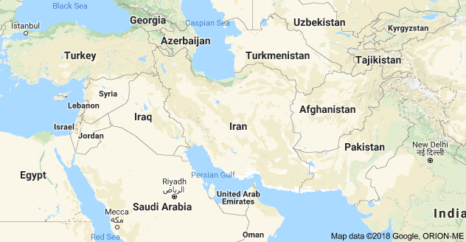
Islamic Republic of Iran
A country in western Asia
With over 81 million inhabitants
Religion: Islam
Official language: Persian

Slide 4
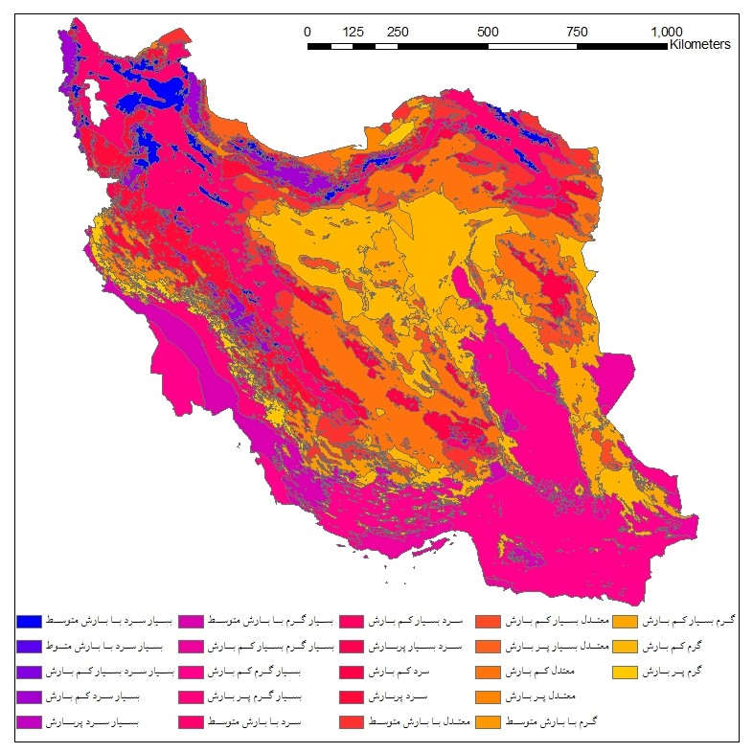
climate zoning
This country coverages of different types of climate.
about 85% of Iran’s territory is dry with significant water shortage, frequent droughts and a large reliance on ground-water resources.

Slide 5
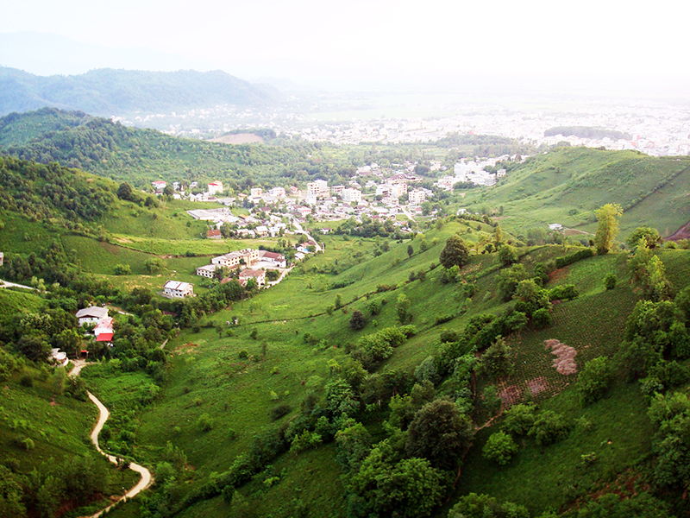

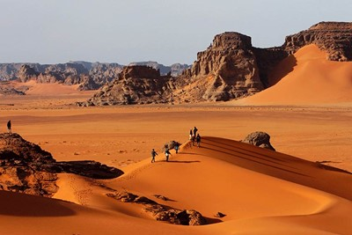
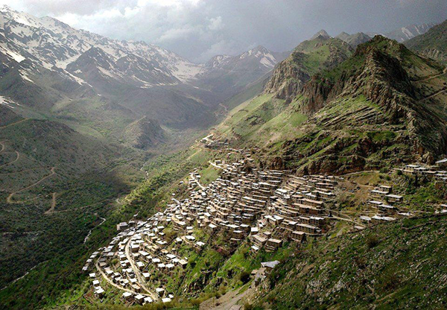
Different type of climates over Iran

Slide 6
Climatological information

Slide 7
Climatological information
Mean annual Temperature : –36°C and +54°C
Mean annual rainfall : 232 mm
The major crops cultivated in Iran are wheat, barley, corn and rice.
Wheat as the core commodity of Iranian food is grown on nearly 60% of the arable land.

Slide 8
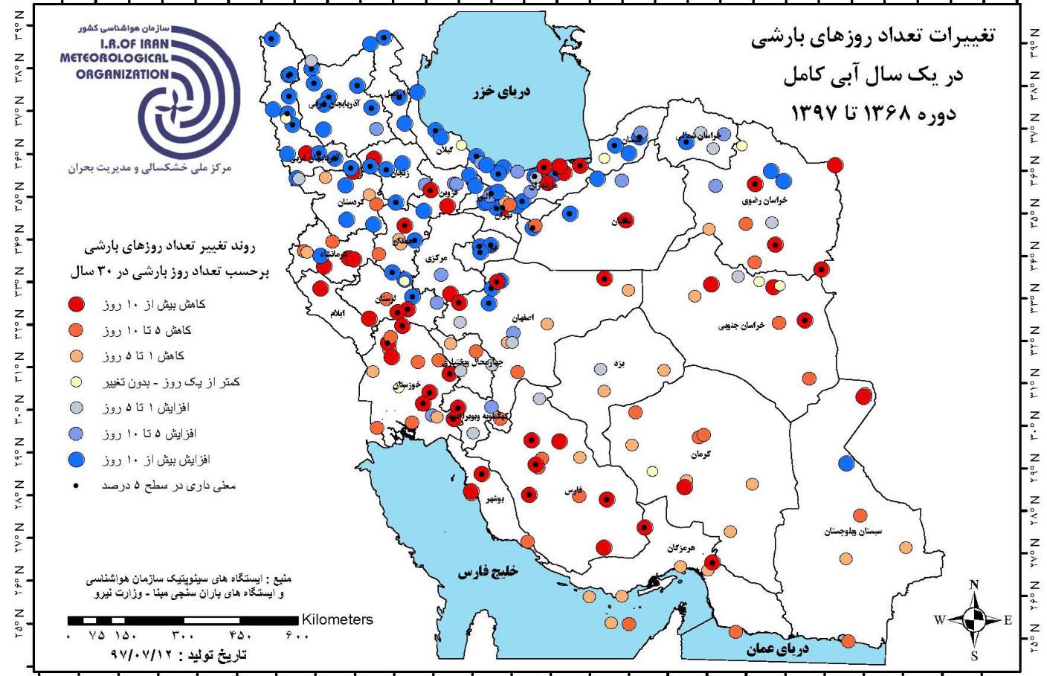
Trend of annual number of rainy days in last 30 years
Changes in Number of rainy days per year in last 30 years
d>10
d: 5-10
d: 1-5
d=0
i: 1-5
i:5-10
I >10

Slide 9
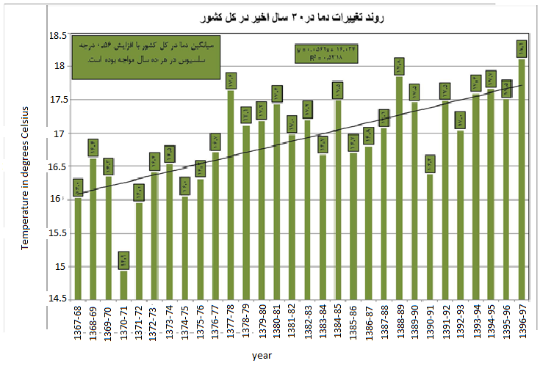
Trend of annual mean temperature in last 30 years
Increase 0.56 degrees Celsius per decade

Slide 10
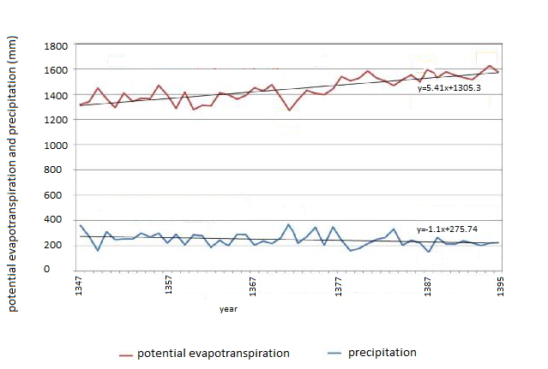
Trend of potential evapotranspiration and precipitation in last 50 years over Iran

Slide 11
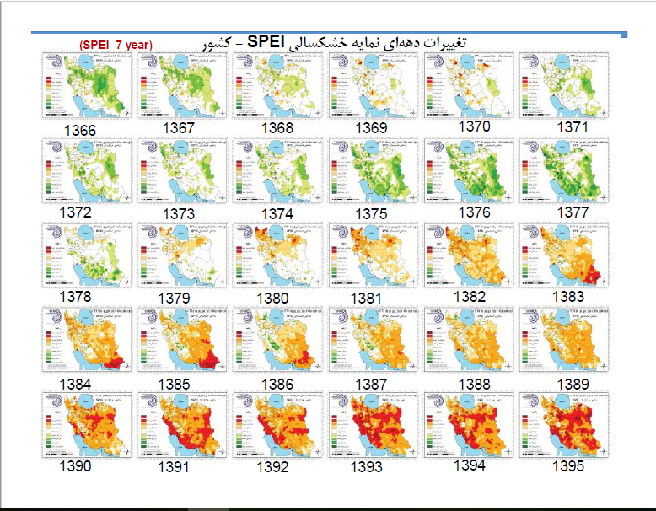
Distribution of drought- last 30 years

Slide 12
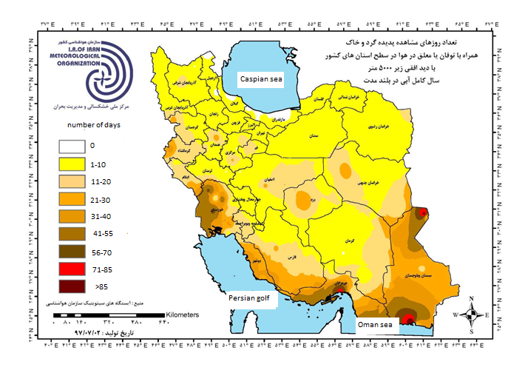
Average long –term annual number of days with dust )Horizontal view< 5000m(

Slide 13
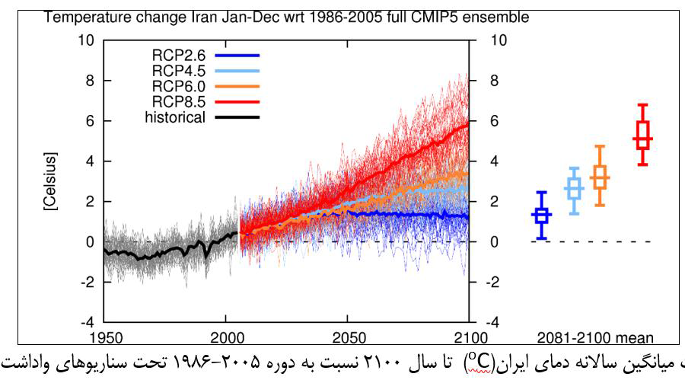
Temperature changes in Iran

Slide 14
Centers use satellite images
National Drought Warning and Monitoring Center (NDWMC)
IRIMO Dust National Center
IRIMO Forecasting Center

Slide 15
National Drought Warning and Monitoring Center (NDWMC)
1. NOAA – AVHRR (resolution 4 km)
NDVI (Normalized Difference Vegetation Index)
VHI (Vegetation Health Index)
VCI (Vegetation Condition Index)
2. MODIS – Aqua & Terra (resolution 500m)
Snow cover

Slide 16
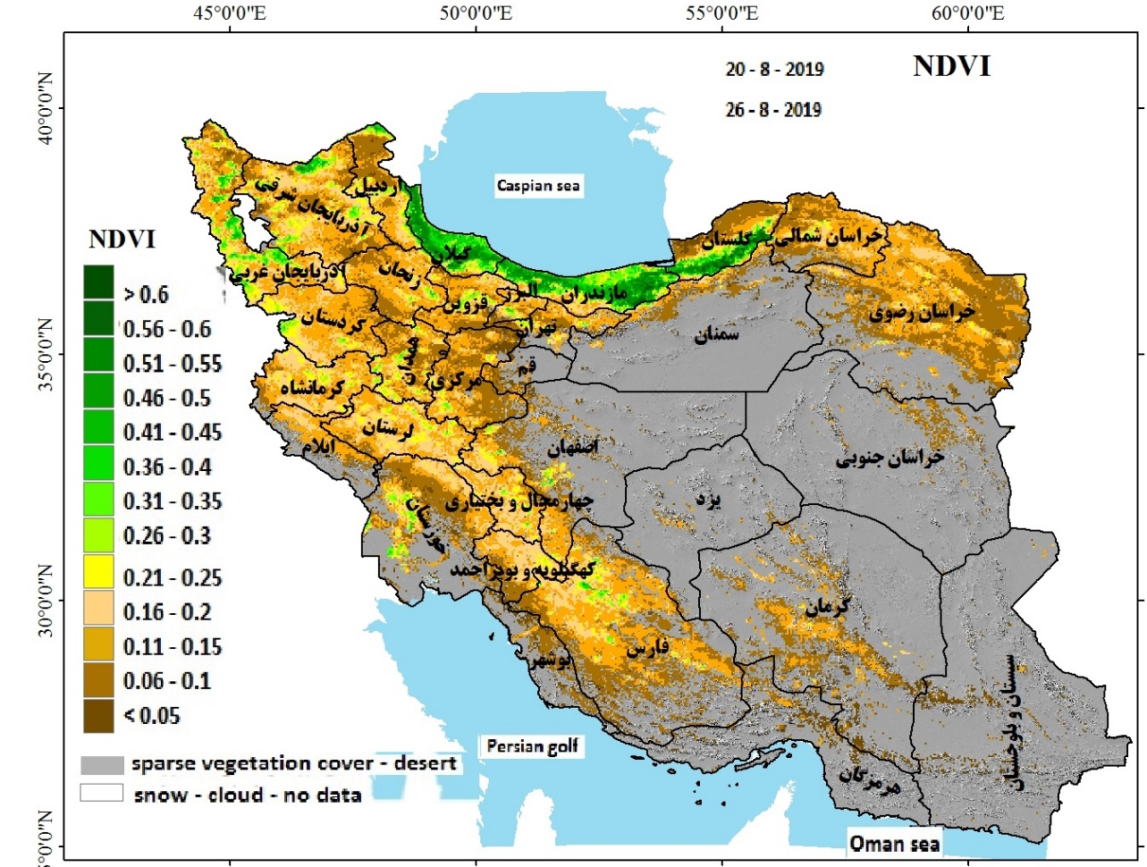
NDVI (Normalized Difference Vegetation Index)
NDVI quantifies vegetation by measuring the difference between near-infrared (which vegetation strongly reflects) and red light (which vegetation absorbs).
To determine the density of green on a patch of land

Slide 17
VHI (Vegetation Health Index)
The Vegetation Health index (VHI) is based on a combination of products extracted from vegetation signals, namely the Normalized Difference Vegetation Index (NDVI) and from the brightness temperatures, both derived from the NOAA Advanced Very High Resolution Radiometer (AVHRR) sensor.
july

Slide 18
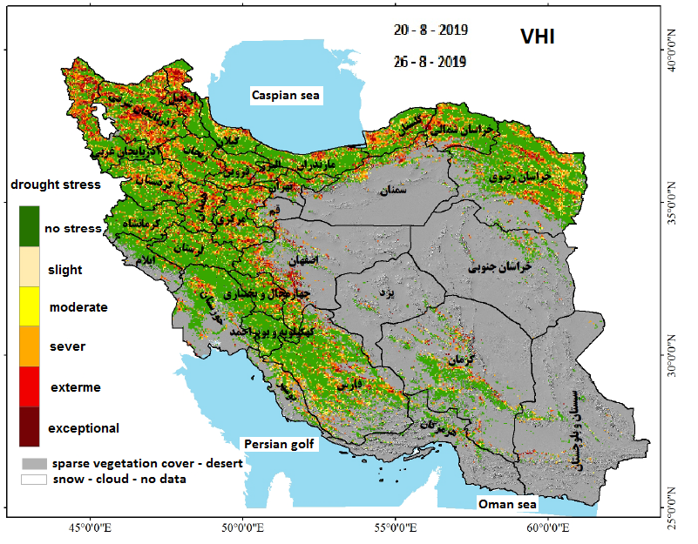
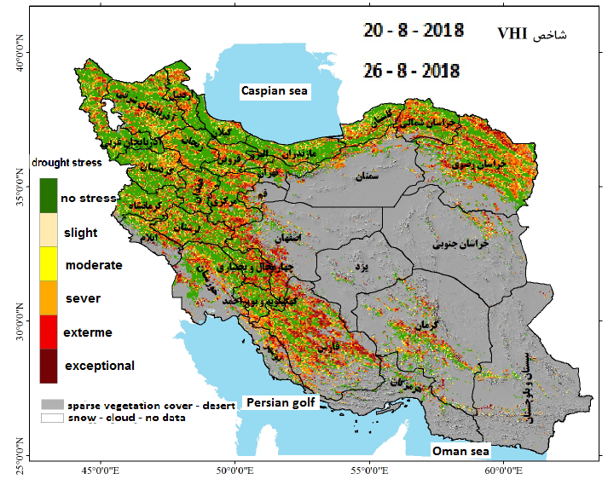
VHI (Vegetation Health Index)

Slide 19
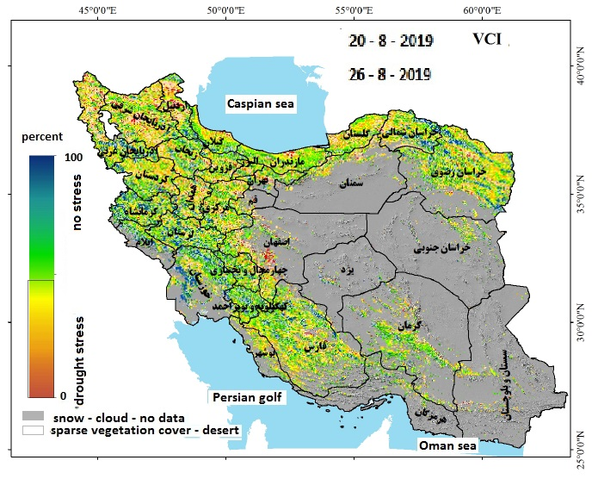
VCI (Vegetation Condition Index)
The Vegetation Condition Index (VCI) compares the current NDVI to the range of values observed in the same period in previous years. The VCI is expressed in % and gives an idea where the observed value is situated between the extreme values (minimum and maximum) in the previous years.

Slide 20
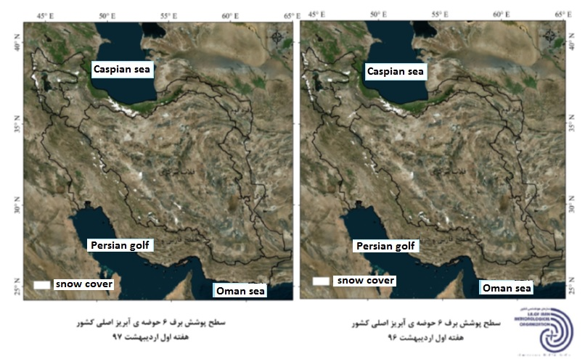
Snow cover
april

Slide 21
IRIMO Dust National Center

Slide 22
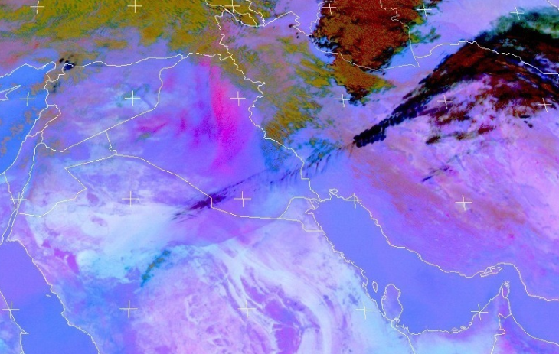

IRIMO Dust National Center
30 OCT 2017

Slide 23
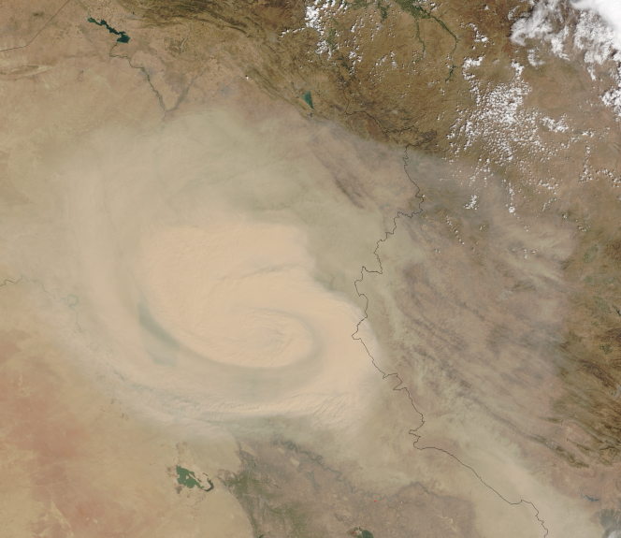
Dust storm on Iraq – 27 September 2015
Modis satellite image
resolution

Slide 24
IRIMO Forecasting Center
IR
VW
VIS

Slide 25
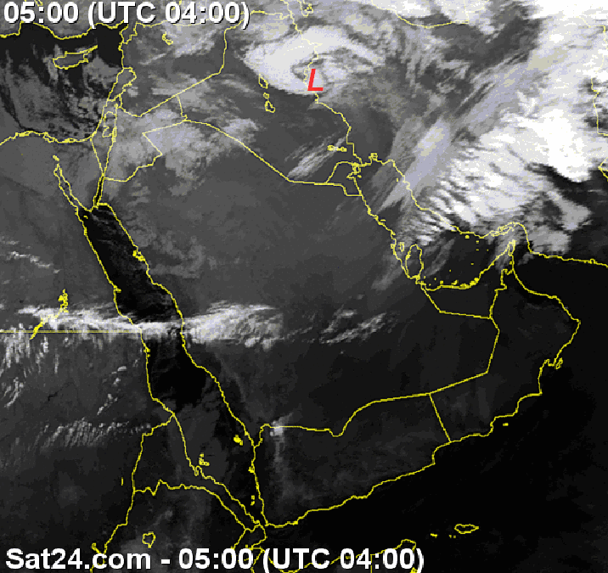
IRIMO Forecasting Center
Mediterranean cyclone and occluded front
IR band

Slide 26
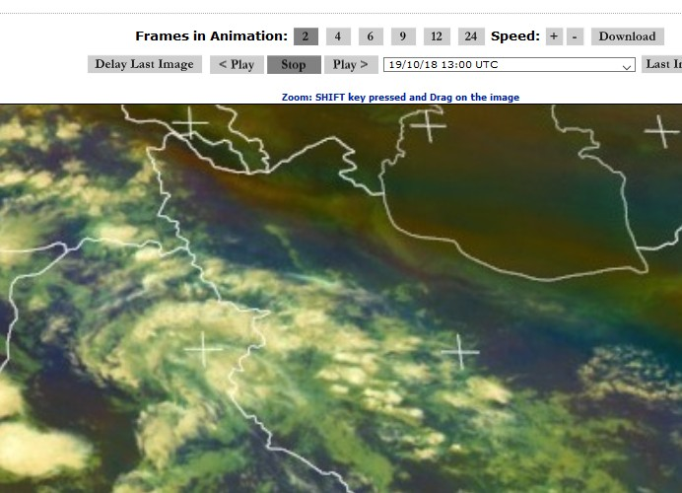
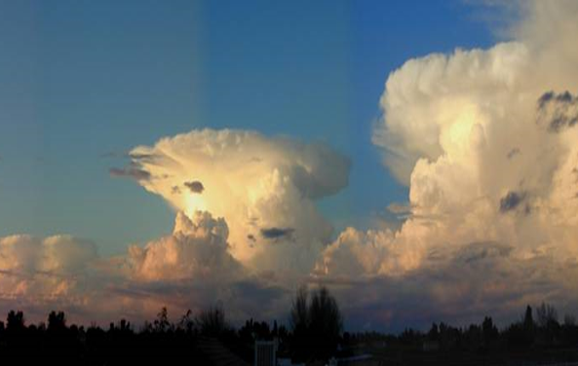
IRIMO Forecasting Center
Convective Clouds
With lightning

Slide 27
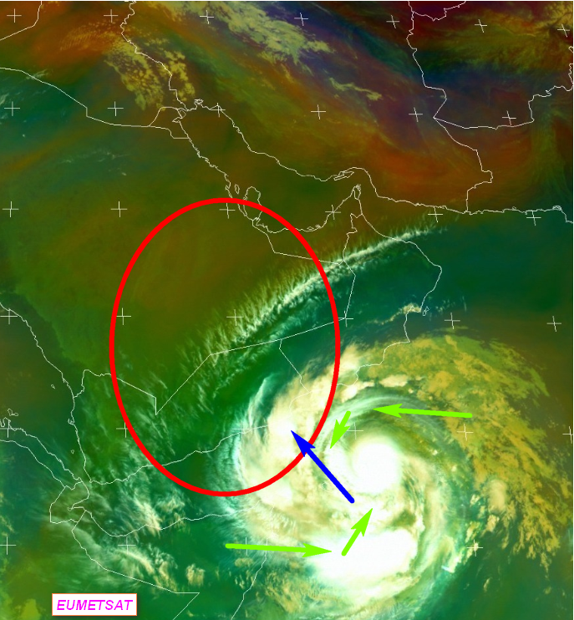
IRIMO Forecasting Center
Detection of air mass
24 may 2018
Mekunu cyclone
Green color indicates tropical warm and humid air

Slide 28
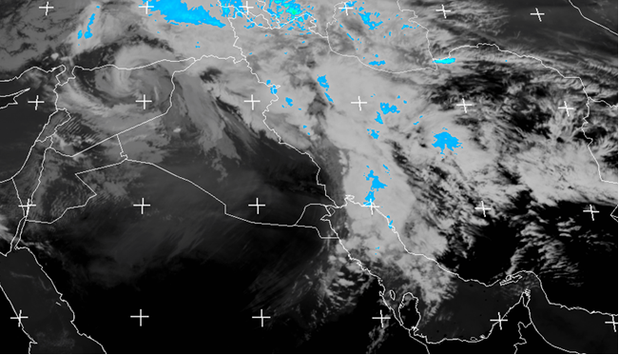
IRIMO Forecasting Center
Strong Mediterranean cyclone With convective clouds ( in blue color)
18 feb 2018
Detection of ranfall intensity
Eumetsat

Slide 29
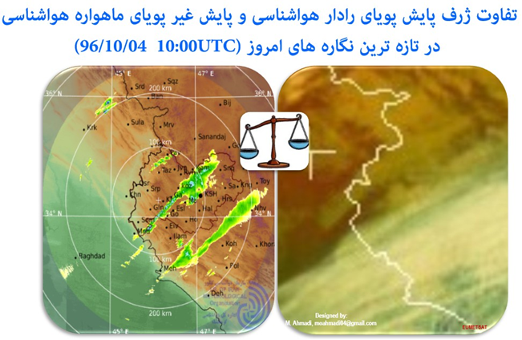
IRIMO Forecasting Center
Difference between IR satellite image and RADAR image for detecting nimbostratus clouds
West of Iran-Kermanshah province

Slide 30
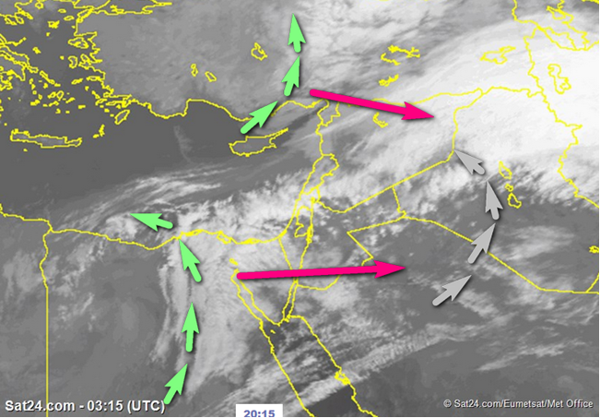
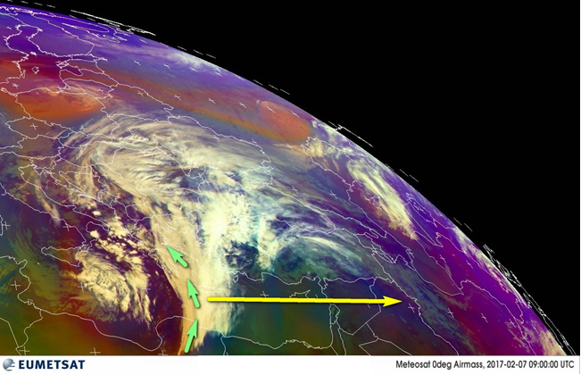
IRIMO Forecasting Center
Frontal cyclone – 18 Mar 2018

Slide 31
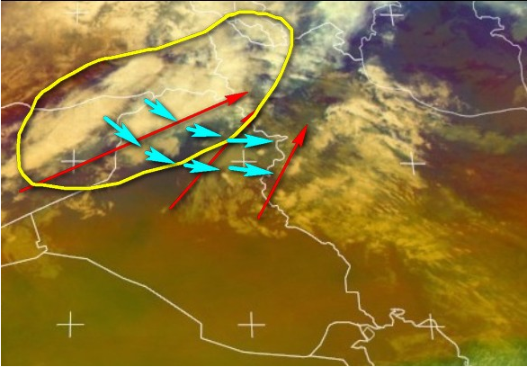
IRIMO Forecasting Center
Infiltration of cold air with cold front
28 feb 2019
Eumetsat

Slide 32
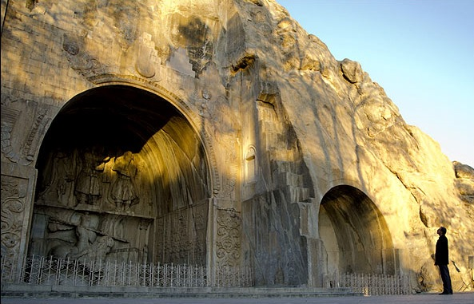
Thanks for your attention
Danke für Ihre Aufmerksamkeit

