Slide 1













Land Surface Temperature CCI: project status
Darren Ghent and the LST CCI Project Team

Slide 2
What is Land Surface Temperature
Land Surface Temperature (LST) is a measure of how hot or cold the surface of the Earth would feel to the touch
For ground-based, airborne, and spaceborne remote sensing instruments it is the aggregated radiometric surface temperature of the ensemble of components within the sensor field of view
Provides a crucial constraint on surface energy budgets, particularly in moisture-limited states - the LST record contains the imprint of climate events related to water stress and availability
Provides a metric of surface state when combined with vegetation parameters and soil moisture, and is related to the driving of vegetation phenology
LST can be determined from thermal emission at wavelengths in either infrared (IR) or microwave (MW) atmospheric windows
Notes:
LST is the quantity desired by climate modellers
We can also provide land surface radiometric temperature, but this is a wavelength dependent quantity and so intercomparisons between instruments become very challenging due to different wavelengths of channels

Slide 3
Applications for LST Data
Climate change
  Urban heat islands, land/atmosphere coupling, surface energy balance
Modelling studies
  Model validation, data assimilation
Land cover change
  Desertification, change detection
Crop management
  Irrigation, drought stress
Water management
  Evapotranspiration, soil moisture retrievals
Fire monitoring
  Burned area mapping, fuel moisture content
Geological applications
  Geothermal anomalies, volcanic activity
Darren Ghent | djg20@le.ac.uk | University of Leicester

Slide 4
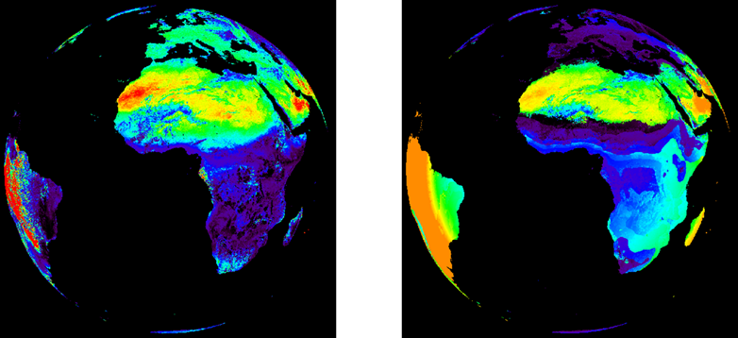
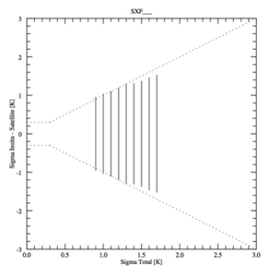
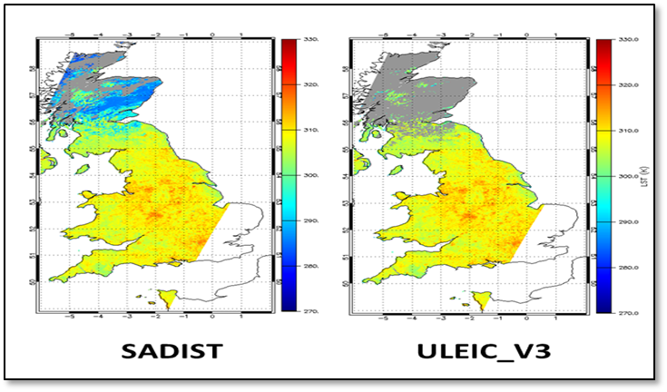
Key developments
Algorithm development:
Bias and time difference corrections of level-1 data for CDRs
Retrieval algorithm consistency across LST ECV products and CDRs
Ensure consistency of uncertainty approach:
Components that are separated according to their differing correlation properties
Validation of uncertainties
Optimisation of best cloud clearing detection:
Best cloud clearing approaches for long-term CDR and for Merged CDR
Website: cci.esa.int/lst

Slide 5
User requirements
 | Threshold | Breakthrough | Objective
Dataset length | 10 years | 30 years | > 30 years
Spatial resolution | 1 km | < 1 km | < 1 km
Temporal resolution | 6 hours | 1 hour | < 1 hour
Accuracy | 1 K | 0.5 K | 0.3 K
Precision | 1 K | 0.5 K | 0.3 K
Stability | 0.3 K / decade | 0.2 K / decade | 0.1 K / decade
LST CCI User Requirements
GCOS LST Requirements
Item | Type | Value
Horizontal resolution | Threshold | 0.05°
Temporal resolution | Threshold | Day-night
 | Target | ≤ 3-hourly
Accuracy | Threshold | <1 K
Precision | Threshold | <1 K
Stability | Threshold | <0.3 K per decade
 | Target | <0.1 K per decade
Length of record | Threshold | 20 years
 | Target | >30 years
High quality data more important than spatially complete fields
High temporal resolution more important for global studies
High spatial resolution more important for local studies
Dataset length is more important for global studies, whilst high data resolution is more important for local studies

Slide 6
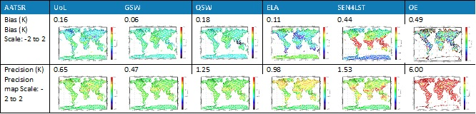
Algorithm consistency
For highest quality LST products for climate studies it is critical to implement the optimum retrieval algorithm
Achieved through an algorithm intercomparison (“round robin”):
6 infrared algorithms were tested for 3 infrared sensors
7 microwave algorithms were tested for 1 microwave sensor
Assessment through a set of metrics
Designed and developed a Benchmark Database (BDB) for training, testing and selection of algorithms
Paper in preparation
Dataset | First Choice Algorithm | Second Choice Algorithm
AATSR | UOL Overall Rank for AATSR: 4 | GSW Overall Rank for AATSR: 6
MODIS | GSW Overall Rank for MODIS: 3 | QSW Overall Rank for MODIS: 8
SEVIRI | GSW Overall Rank for SEVIRI: 3 | UOL Overall Rank for SEVIRI: 8
AATSR / SLSTR / MODIS CDR | UOL | GSW
Merged Dataset (AATSR / MODIS / SEVIRI) | GSW | UOL
SSM/I | NNE_A | NN_A

Slide 7
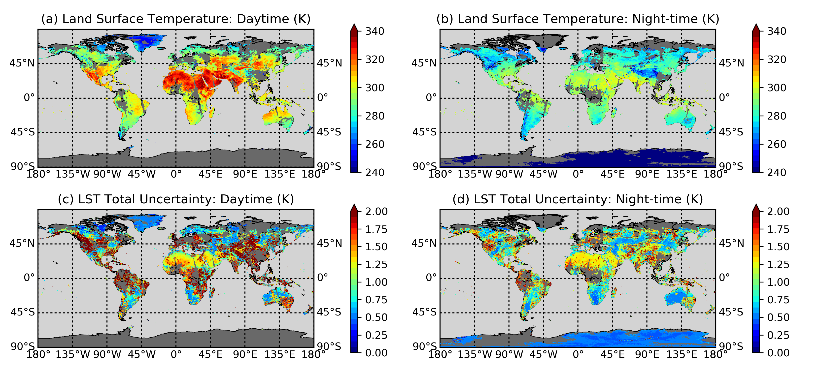
MODIS LST ECV product
Implemented the Generalised Split Window (GSW) algorithm as recommended by the Algorithm Intercomparison:
Collection 6.0 radiances and geolocation data available on CEDA Archive NLA
Emissivity from CIMSS spatially and temporally interpolated
First breakdown of uncertainty components by correlation properties
CCI Data Standards
Evolutions identified for next Cycle:
Improved emissivity inputs
Coefficients to be determined using new Calibration Database:
  CAMEL emissivity
  ERA5 profiles
Probabilistic cloud masking expected to be improvement on operational cloud mask
Implementation of further recommendations from E3UB

Slide 8
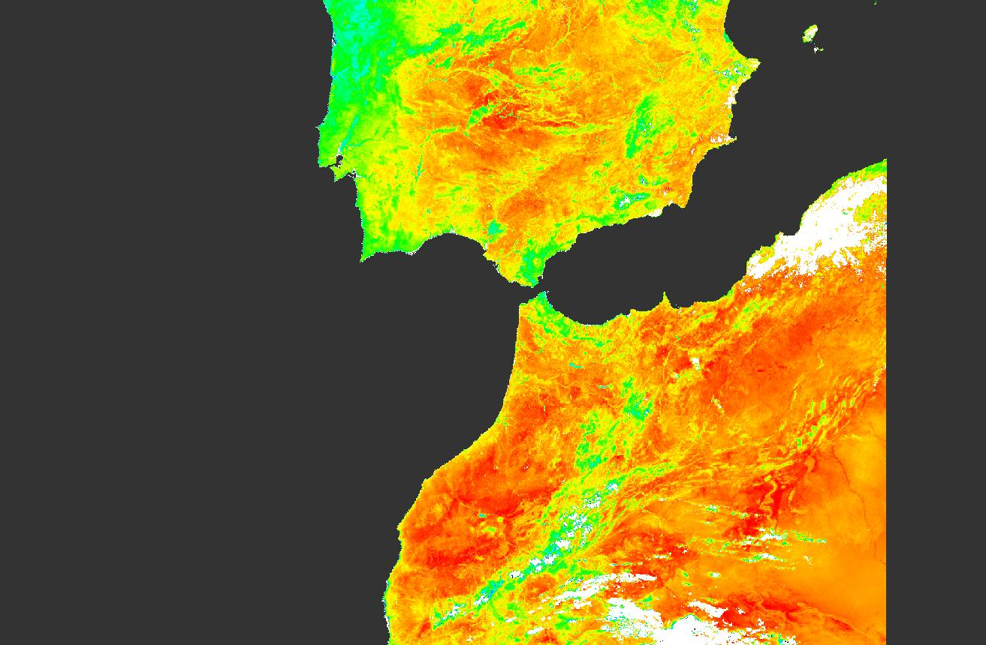
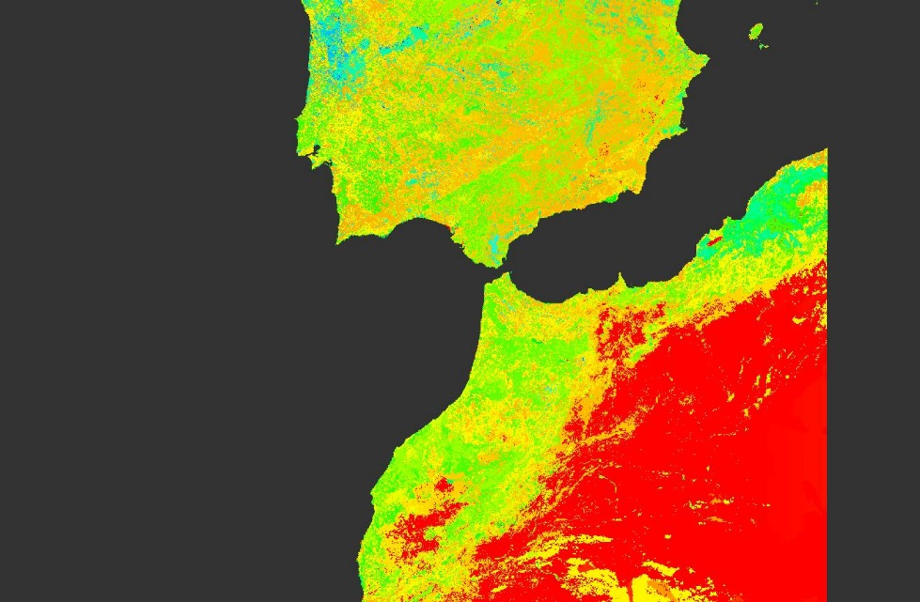
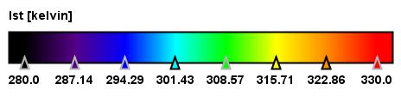
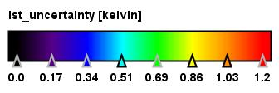
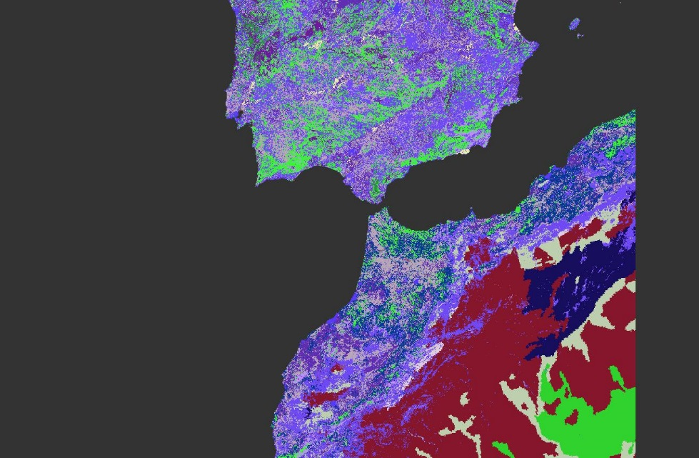
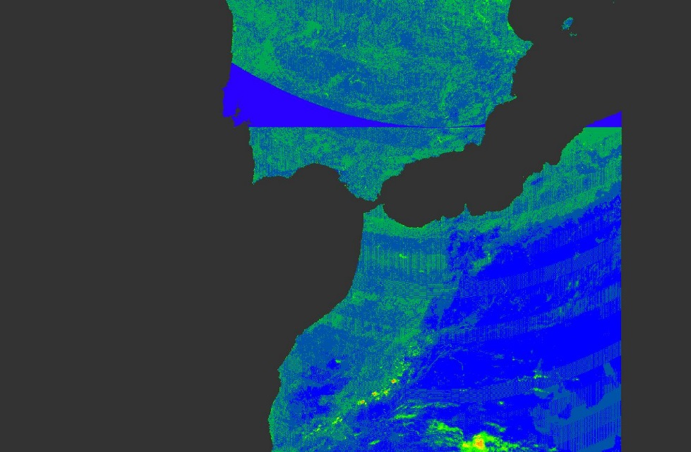
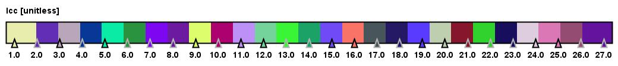
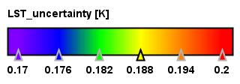
SLSTR-A LST ECV product
Implemented the U. Leicester (UOL) algorithm as recommended by the Algorithm Intercomparison:
SLSTR-A L1 data from November 2016 through to end-2018
First breakdown of uncertainty components by correlation properties
CCI Data Standards
Evolutions identified for next Cycle:
Availability of re-processed Level-1 data
Integration of Land Cover CCI biome data with bare soil sub-classification
Investigation into temperature dependent coefficients
Coefficients to be determined using new Calibration Database
  CAMEL emissivity
  ERA5 profiles
Probabilistic cloud masking expected to be improvement on operational cloud mask
Implementation of further recommendations from E3UB
Replicate for SLSTR-B
LST
LST uncertainty
Biome
Operational uncertainty

Slide 9
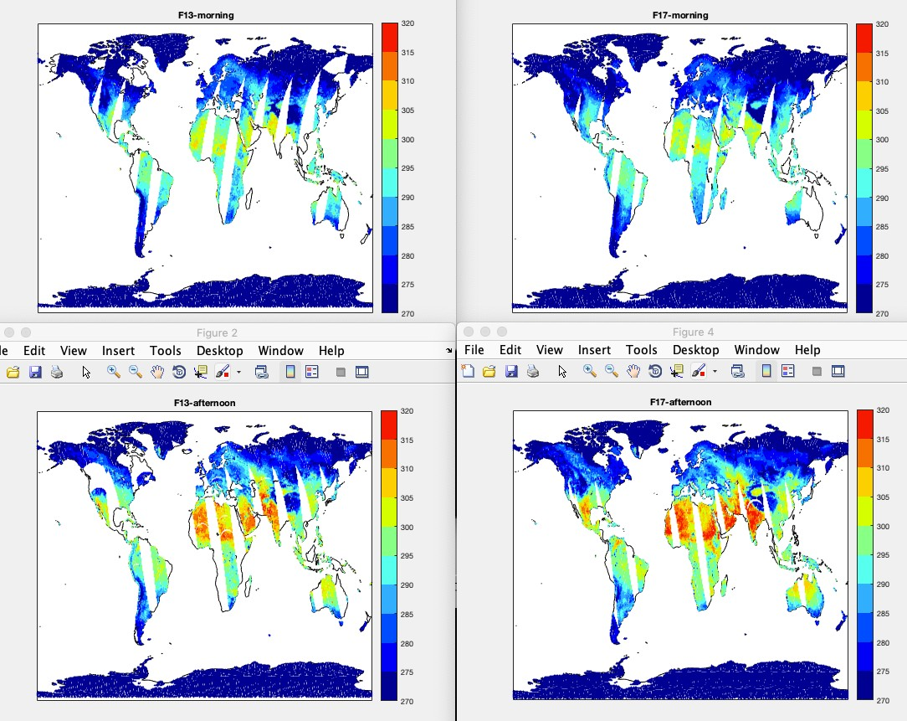
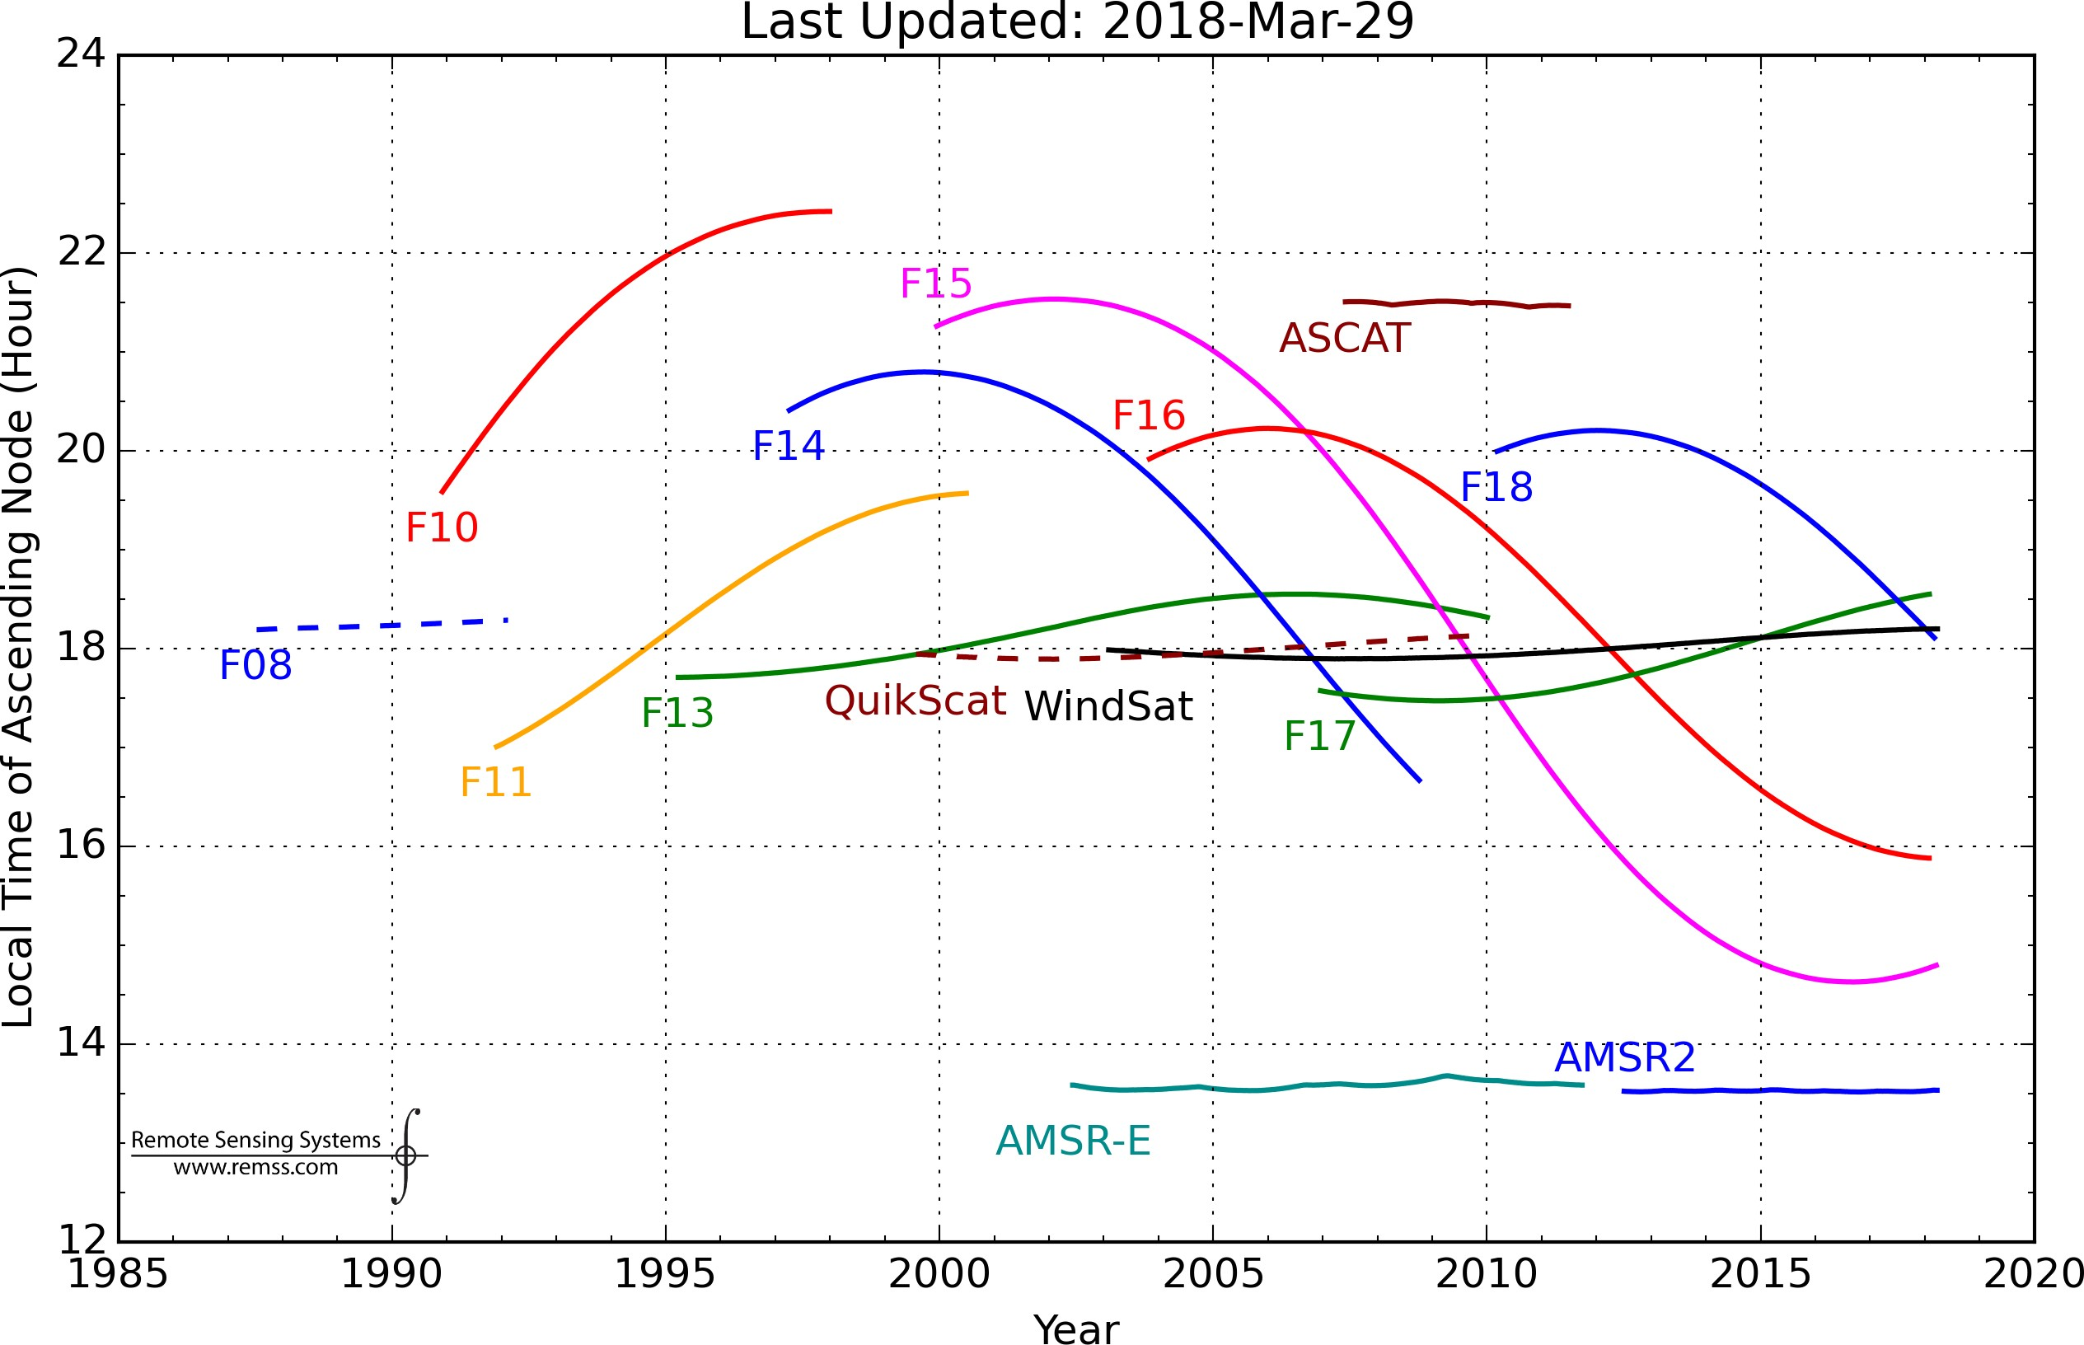
Microwave algorithm development
Single-sensor SSM/I on DMSP F-13, SSMIS on F-17 (1998-2016)

Slide 10
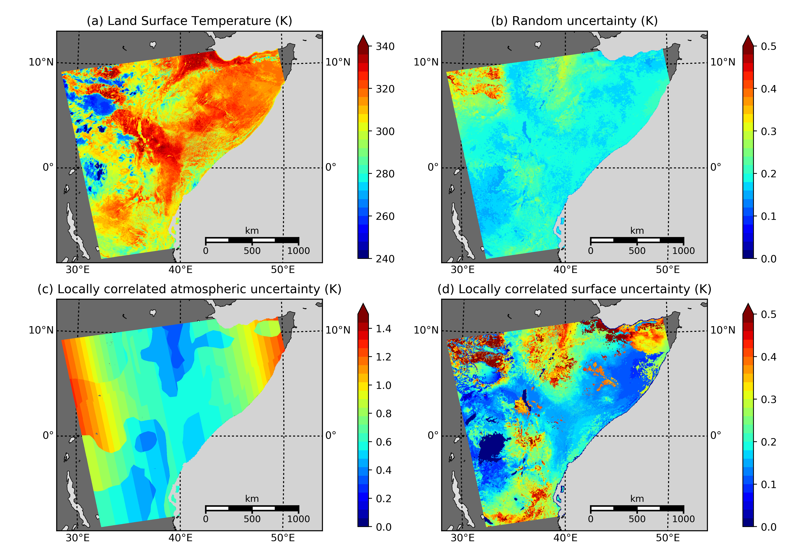
Quantifying uncertainties in LST CCI
Our objective for uncertainty information provision in LST CCI is:
To provide uncertainties in LST for every LST retrieval made
To provide uncertainties in LST in products at different levels (L2, L3)
To provide uncertainties in LST data given at different resolutions
To derive LST uncertainties independently of in-situ data
One key benefit of providing LST uncertainties independently of in-situ data is that we can use these data to validate not only the LST, but also the associated uncertainty
We use an approach that is common to surface temperature retrieval across all surface types. It was originally proposed for sea surface temperature and has since been developed for use with land, lake and ice surface temperatures
In LST CCI we build on the work from ESA DUE GlobTemperature

Slide 11
LST ECV products
Instrument | Satellite(s) | Year 1 | Year 3 | Products | Comments
ATSR-2 | ERS-2 | 1995-2003 | 1995-2003 | 1 km L2P 0.05° [0.01°] Daily L3C 0.05° [0.01°] Monthly L3C
AATSR | Envisat | 2002-2012 | 2002-2012
AVHRR/3 | NOAA-15-19 |  | 1998-2016 |  | GAC (4km)
 | Metop-A-C |  | 2007-2020 |  | FRAC (1km)
MODIS | Terra | 1999-2018 | 1999-2020
 | Aqua | 2002-2018 | 2002-2020
SLSTR | Sentinel-3A | 2016-2018 | 2016-2020
 | Sentinel-3B |  | 2018-2020
SEVIRI | MSG-1-4 | 2008-2010 | 2004-2020 | 0.05° Hourly L3U | MVIRI being done by CM SAF
Imager | GOES 12-16 |  | 2004-2020
JAMI | MTSAT-2 |  | 2009-2015
SSM/I | DMSP F-13,17 | 1998-2018 | 1995-2018 | 0.25° Daily L3C
ATSR-MODIS-SLSTR CDR | ATSR, MODIS, SLSTR | 1995-2012 | 1995-2020 | 0.05° [0.01°] Daily + Monthly L3S | ATSR-2 through to SLSTR
Merged IR CDR | LEO+GEO IR above |  | 2009-2020 | 0.05° 3-hourly L3S | 3-hourly Merged GEO+LEO
Experimental IR+MW | Select IR + MW |  | [1 year 2008] | 0.05° 3-hourly L3S | Global diurnal cycle (clear+cloudy)

Slide 12
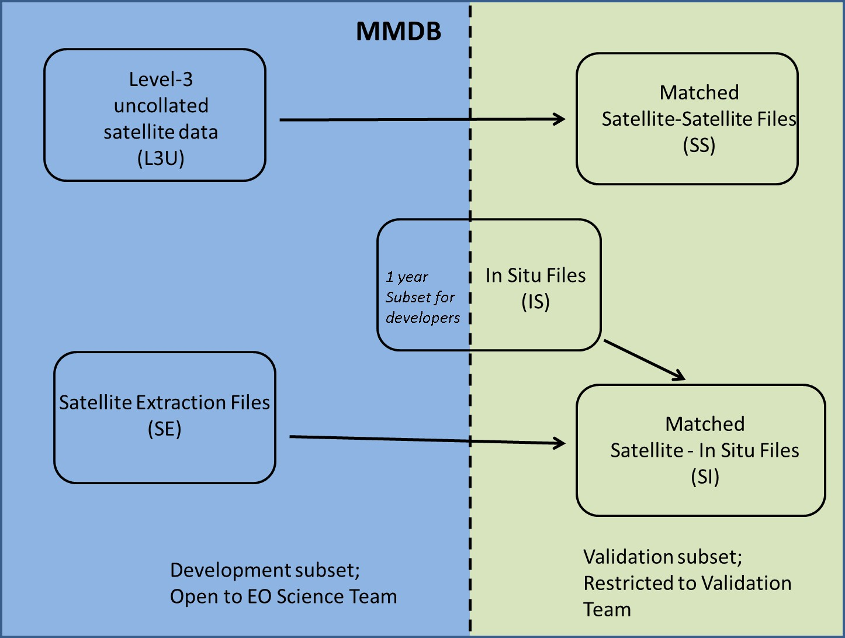
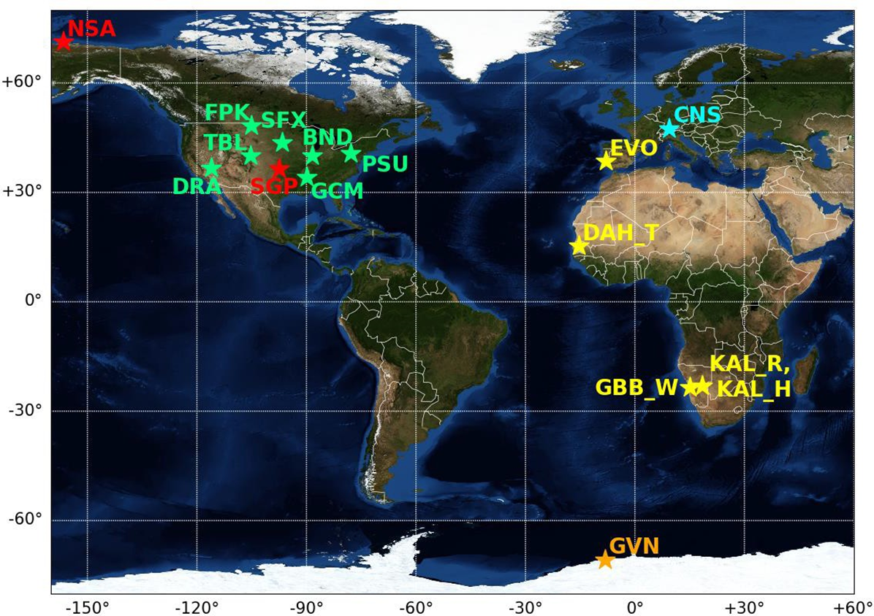
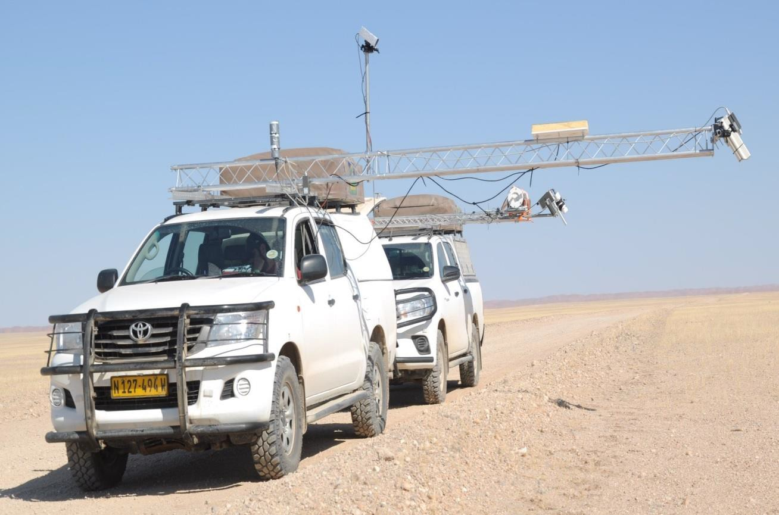
LST ECV product validation
Need for reliable information on product quality
Validation provides insights into the quality of LST data sets
Two common validation approaches:
Direct validation: satellite LST against in situ LST
Inter-comparisons: LST_CCI data products against external LST products
Compliance to LST validation protocols
CEOS-WGCV LST Validation Protocol
MMDB split into two parts:
Smaller part accessible to producers for algorithm development & testing
Larger part accessible only to validation team, ensuring independence of results

Slide 13
Highlights
Strong interaction with the community:
Input into cross-ECV activities
Good visibility of LST CCI within the science community, government, and awareness by industry
Building into the ESA CCI portfolio
High quality products:
Driven by the User Requirements
Consistent algorithms applied to both IR and MW datasets
First datasets being made available on UK JASMIN project workspace to CRG and CMUG users
Improvements on pre-cursor datasets and current operational products
First papers in preparation

Slide 14
Next steps
Further consistency in algorithms, cloud masking, uncertainties
Building the first 25-year dataset for LST from ATSR-2 through to SLSTR
Resolving the global diurnal cycle for LST by merging multiple polar orbiting and geostationary data
An objective to be the best source of LST data for the user community

Slide 15
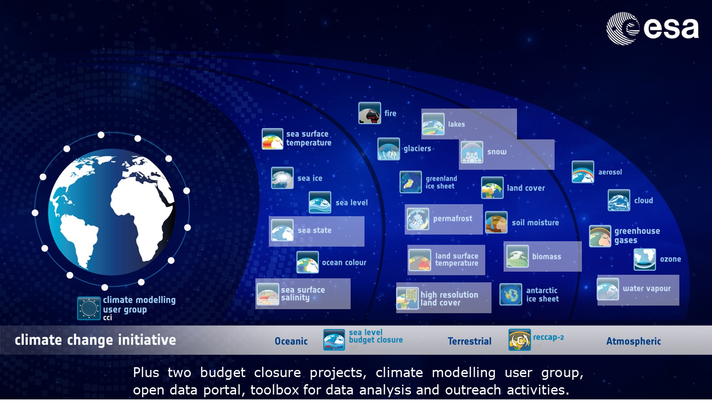
Potential CCI links to SALGEE
Multiple CCIs of relevance:
  LST, Fire, Land cover, Soil moisture, Biomass
Existing links with CM SAF
Consistency assessments between CCI and CM SAF datasets
Additional long-term CDRs in addition to CM SAF and LSA SAF from ESA, NASA, NOAA satellites

Slide 16
LST CCI: The energy balance equation
S = solar radiation
α = albedo: water 0.06; conifer forest 0.09; Amazon broadleaf forest 0.12; grassland 0.2–0.4
F= downward infrared radiation, depends on temperature, water vapor, and clouds
T_{s} = surface temperature
H = sensible heat transfer (+ is surface to atmosphere)
L = latent heat transfer in water evaporating or condensing (+ is evapotranspiration, – is condensation)
G = heat conducted into soil

Slide 17

LST CCI: Example - Deriving Crop Water Stress
LST Important parameter for crop monitoring: stress detection, crop growth, forecasting yield, irrigation scheduling
If LST represents the plant canopy temperature, we can measure the canopy and air temperature difference to indicate how “stressed” a crop may be
Larger differences between crop canopy and air temperature can indicate if crops are under stress due to decreased transpiration
  information about stress due to lack of water availability
Spatial mapping of crop stress can be useful in agriculture water management
Solar Radiation
Transpiration
Conduction & Convection
Ground Radiation
Water Absorption
Darren Ghent | djg20@le.ac.uk | University of Leicester
Notes:
Plant transpires -> leaves cool
surface temperature of the canopy is < air temperature.
If water is limited -> transpiration* is decreased…
As leaves absorb more radiation, the surface temperature of the canopy > air temperature.

Slide 18
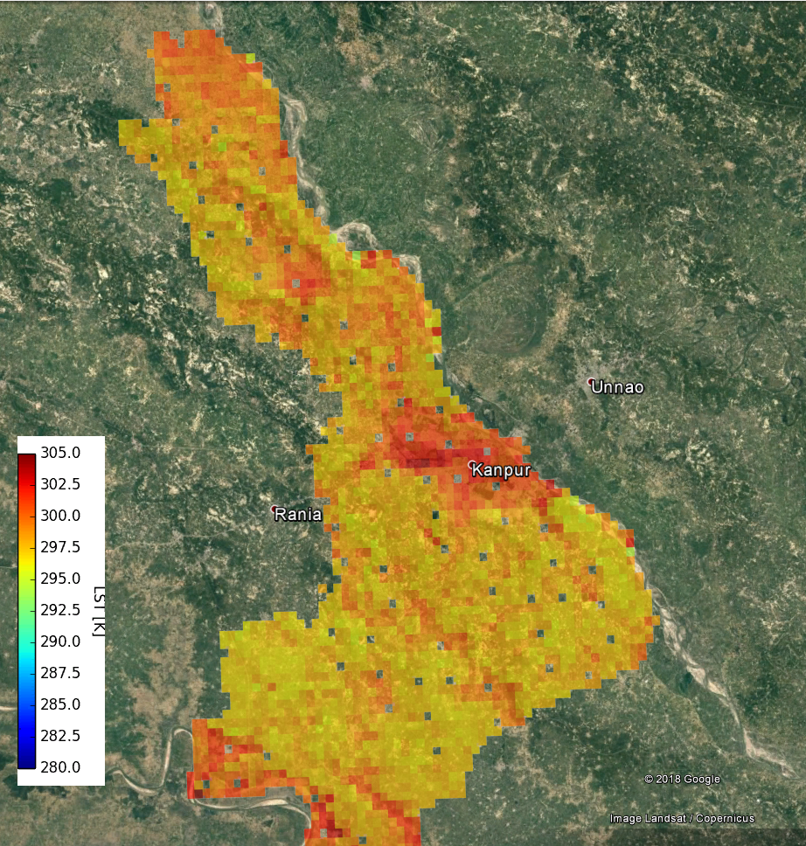
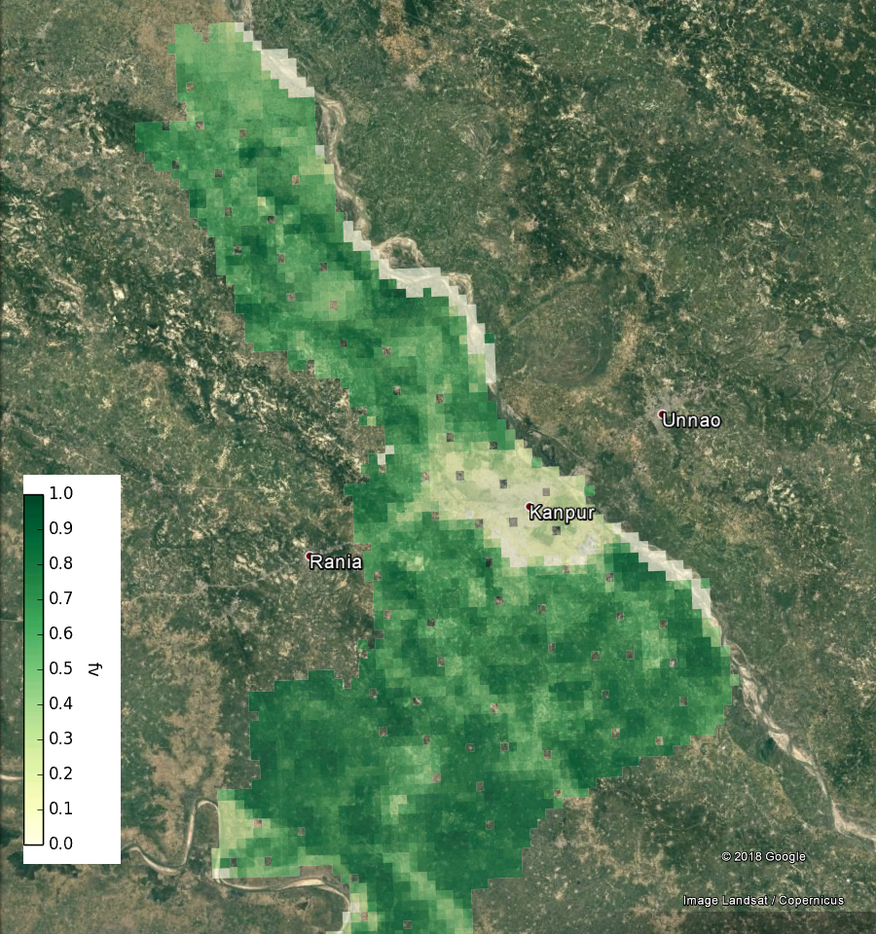
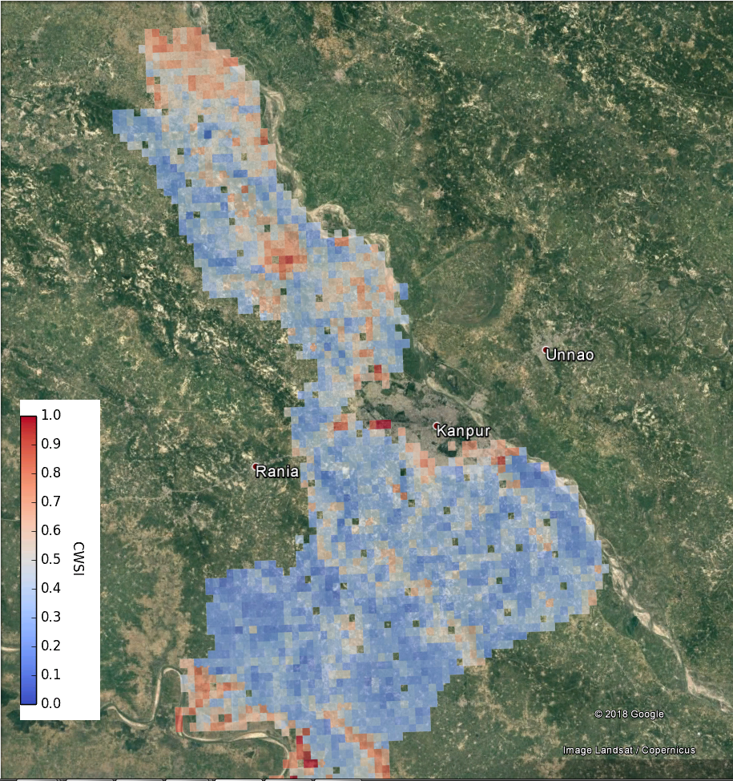
LST CCI: Example – crop stress from LST CCI AATSR dataset
Land surface temperature
Fractional vegetation
Crop water stress

Slide 19
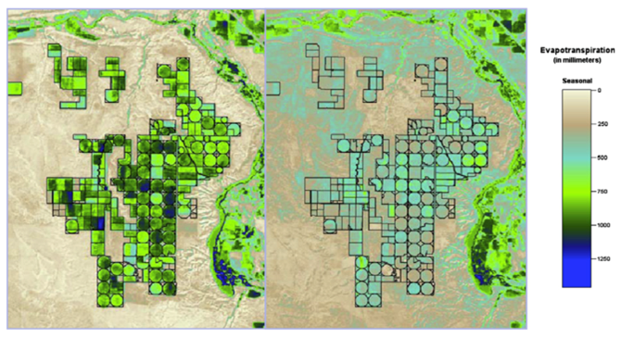
Copernicus Expansion
High-Resolution Thermal observations is one of six priority candidate missions
LST Monitoring (LSTM) Mission Objective:
To complement Sentinel observation capabilities with high spatio-temporal resolution Thermal Infra-Red observations over land and coastal regions
To support agriculture management services, and a range of additional applications and services (urban heat islands, …)
30-50m spatial resolution
Mid-2020s projected launch
Anderson et al. (USDA)

