Slide 1
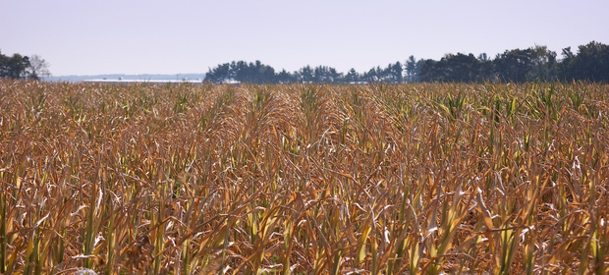
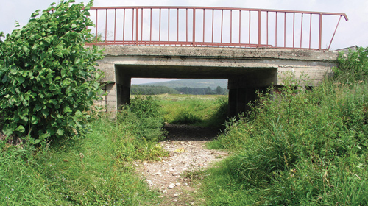
Deficiency of rain and high temperaturesin 2015 caused the development of:
meteorological drought
agricultural drought
hydrological drought
H-SAF H-14 SWI
Effective monitoring of all phases of drought

Slide 2
ECONOMIC IMPACTS
OF AGRICULTURAL DROUGHT ‘2015
July 1st – August 31st – high risk for 14 kinds of crops: potato, maize, sugar beats, vegetables, legume, tobacco, hop, fruit trees etc.
Losses in 2.000 farms, i.e. 1,8 mln ha
Financial losses = > EUR 240 million (1 billion zl)
Delay in field-works
Delay in winter-crop and rape sawing
2015 drought can cause losses also in 2016

Slide 3
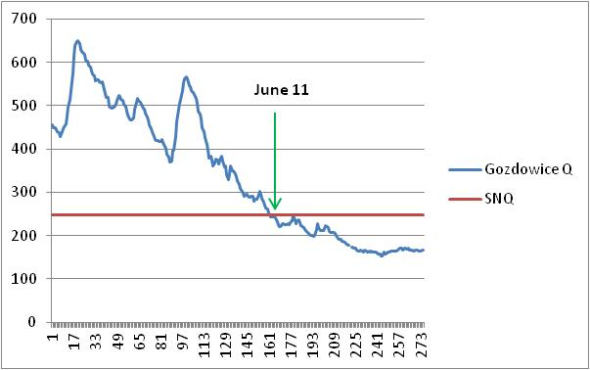
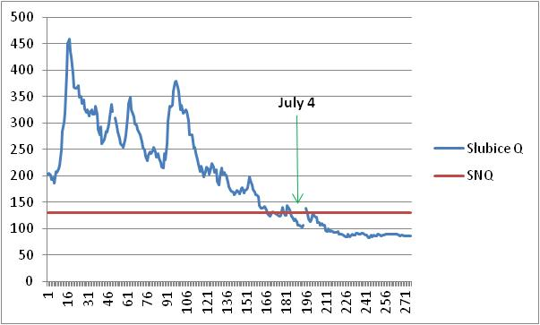
LOW-FLOWS
IN POLAND IN 2015
Odra river

Slide 4
