Slide 1
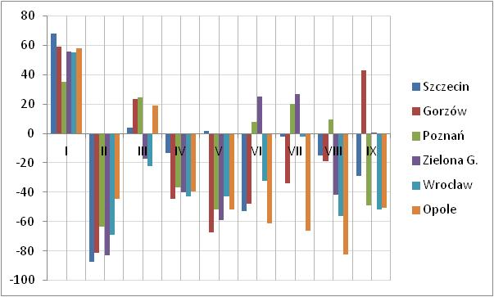
Deviation of the monthly precipitations
from the multiannual period (%)
western Poland

Slide 2
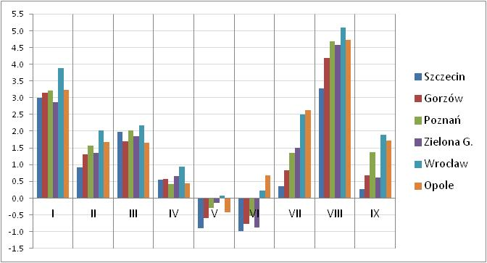
Deviation of the monthly average temperature
from the multiannual period (ºC)

Slide 3
H-SAF Soil Wetness Index [%] for the period 1.03-31.10.2015 – area of Poland,
layer 7-28 cm

Slide 4
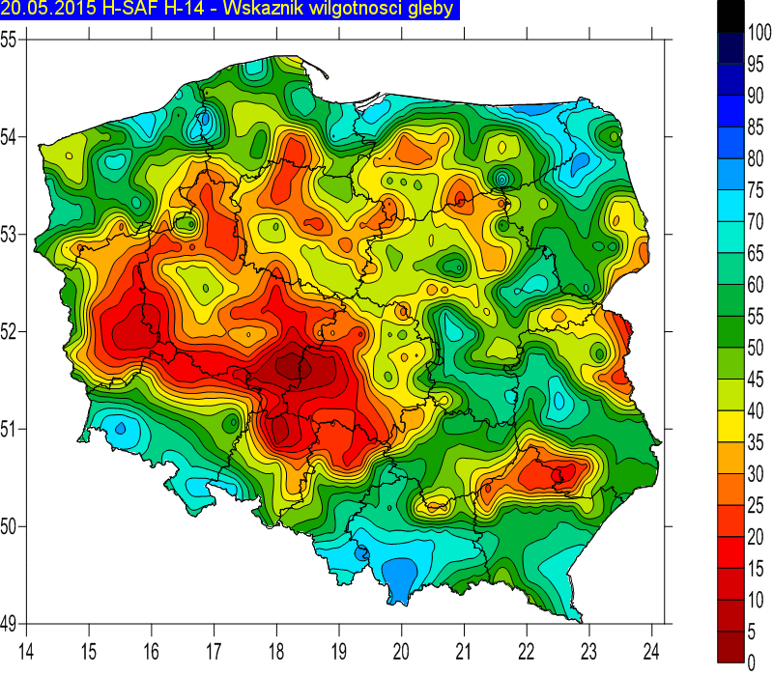
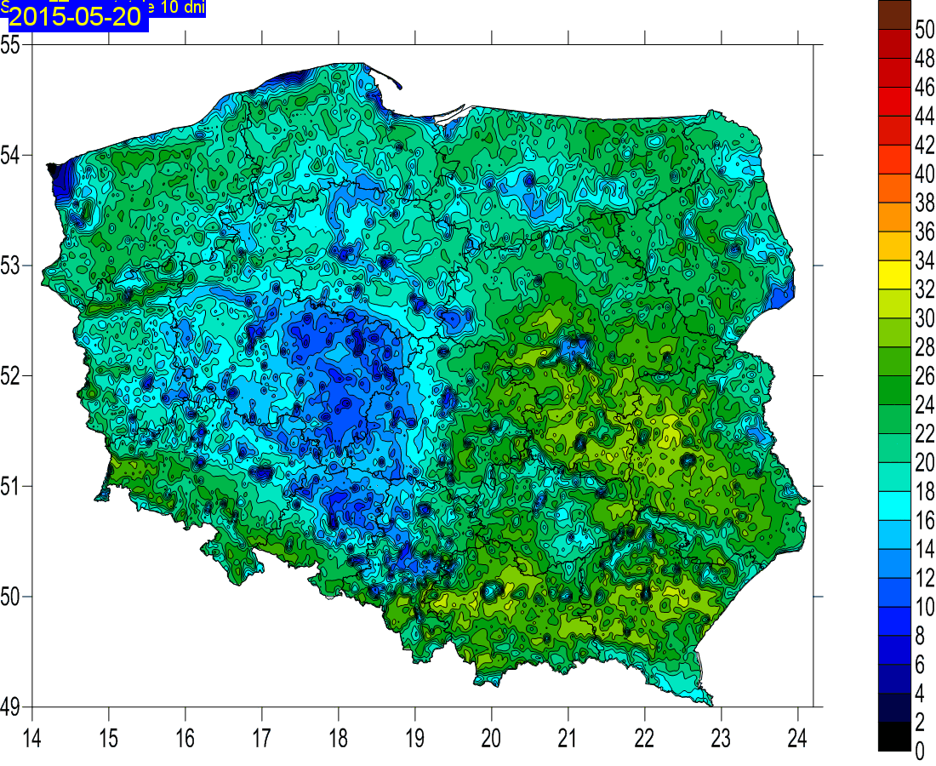
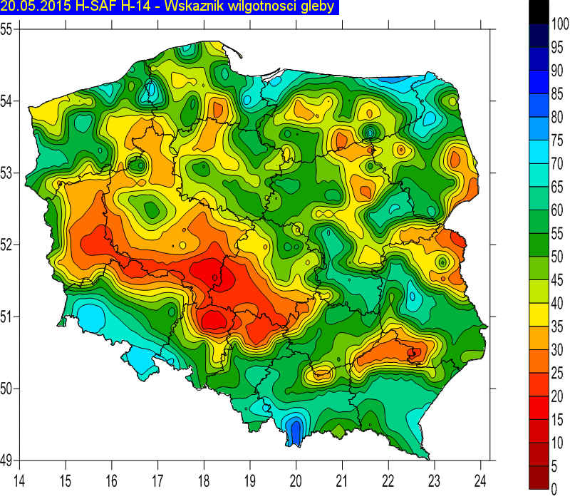
Actual evapotranspiration amount for 2nd decade of May 2015 (based on LSA-SAF ET product)
7-28 cm
Soil Wetness Index (H-Saf product)
Layer 7-28 cm
Layer 28-100 cm
28-100 cm

Slide 5
Tytuł prezentacji z tutaj
Conclusions
H-SAF h14 Soil Moisture product offers interesting solution for agriculture practices.
Despite the coarse resolution (25 km), regional monitoring is possible.
Problematic soil properties lead to artificial effects on soil moisture map.
Interesting applications of H-SAF H-14 Soil Wetness Index at:
www.agrometeo.pogodynka.pl

Slide 6
Calculations, which can improve agricultural practices, require further analysis of those components of models, which are not measured but calculated.
Remote sensing information could be substitute of lacking measurements, being better solution than empirical formulas.

Slide 7
Thank you
Piotr Struzik

