Slide 1

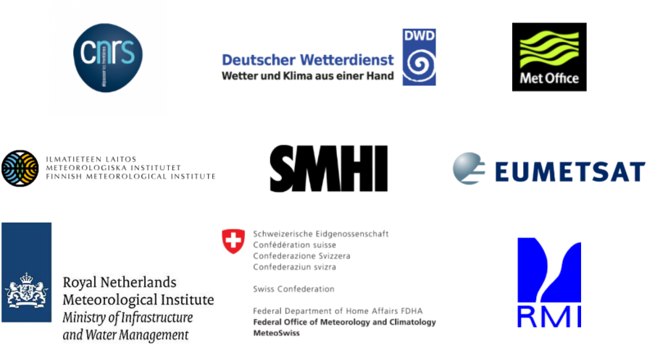
CM SAF Products for Land Surface Analysis
Anke Duguay-Tetzlaff & the CM SAF Team

Slide 2

EUMETSAT Climate Monitoring Satellite Application Facility (CM SAF)
Created by wordclouds.com with cmsaf.eu
HSAF, 2019

Slide 3
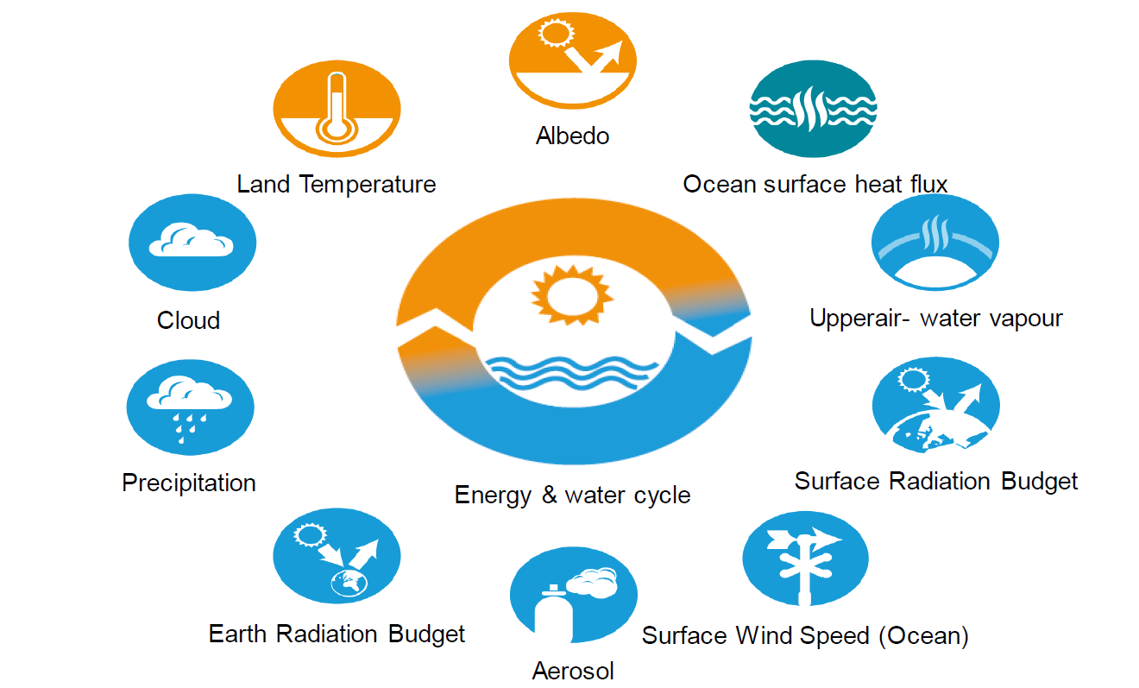
EUMETSAT Climate Monitoring
Satellite Application Facility (CM SAF)
R. Hollmann, 2019
High quality, long-term satellite data for specific climate applications.

Slide 4
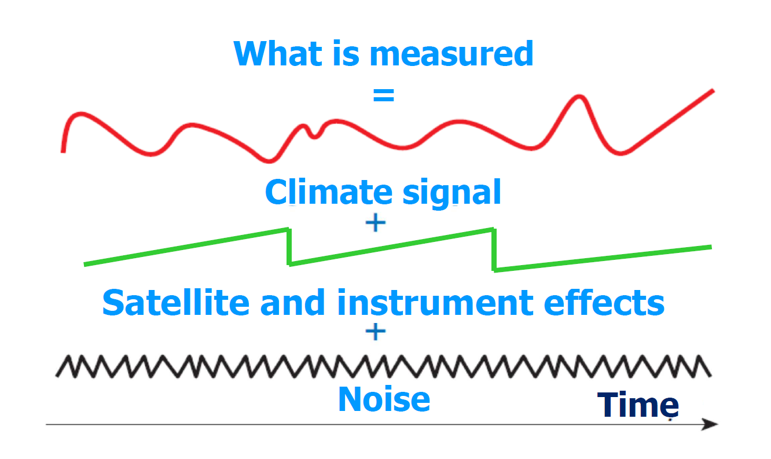
Issues with long series
1980
2019
L. Schüller 2019

Slide 5
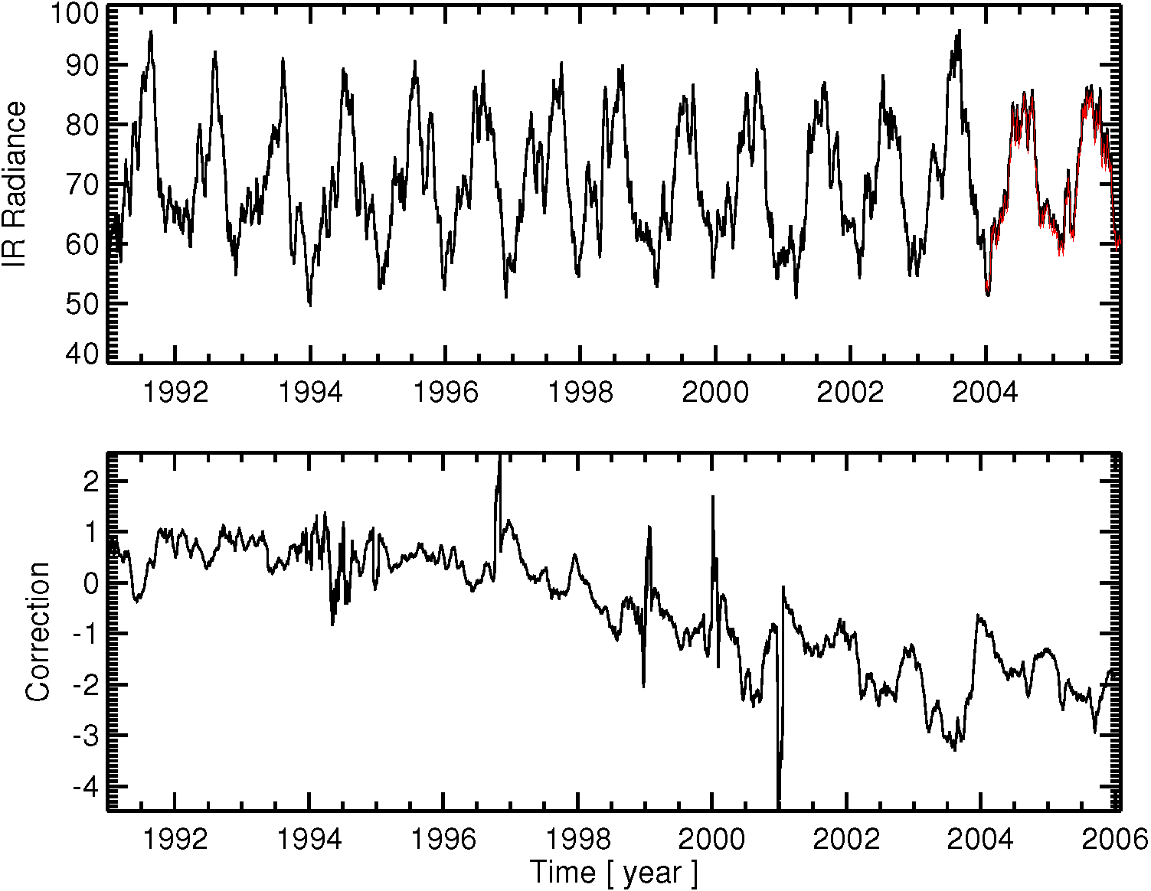

Close collaboration with EUMETSAT
Daily recalibration of the Meteosat First Generation thermal channel (Viju John, EUMETSAT).

Slide 6
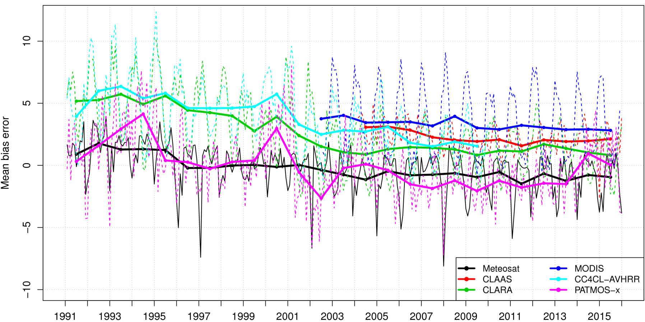
CM SAF Meteosat Cloud Cover
Climate quality (!): Stability < 1%, Bias Error < 1%
Comparison with SYNOP ground observations.

Slide 7
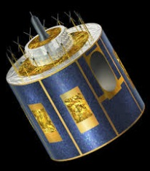
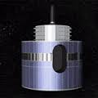
Forget about modern
multi-channel satellite schemes!
1979
2005
2019
MVIRI Sensor
Spectral bands:
Visible (VIS), Thermal (TIR), Water vapour (WV)
SEVIRI Sensor
Spectral bands:
VIS 0.6, VIS 0.8, IR 1.6, IR 3.9, IR 8.7, IR 10.8, IR 12.0, WV 6.2, WV 7.3, IR 9,7, IR 13.4

Slide 8
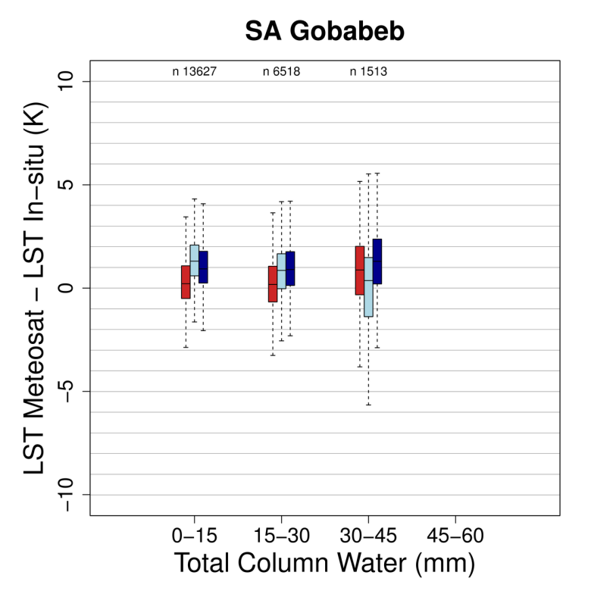

Single Channel Land Surface Temperature (LST) Algorithm
Radiative transfer-based approach:
$$L_{ToA,x}=L_{SFC,x}{ τ}_{ATM,x}+L_{ATM,x}^{↑}+L_{ATM,x}^{↓}\left(1−ε_{SFC}\right){ τ}_{ATM,x}$$
$$L_{SFC,x}= B (LST)$$
Limitations:
Dependency on ERA Interim model data for the atmospheric correction
Static surface emissivity
LSA SAF Split-Window LST
CM SAF Mono-Window LST

Slide 9
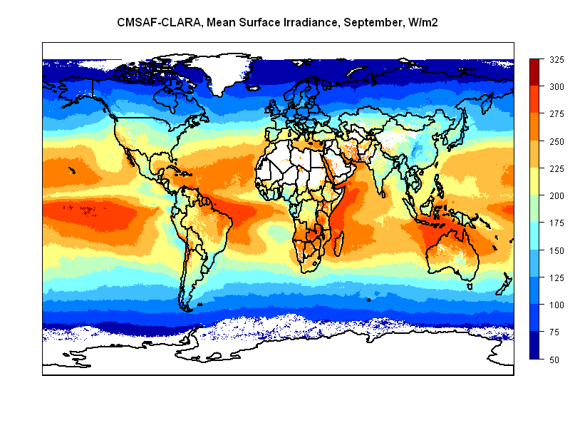
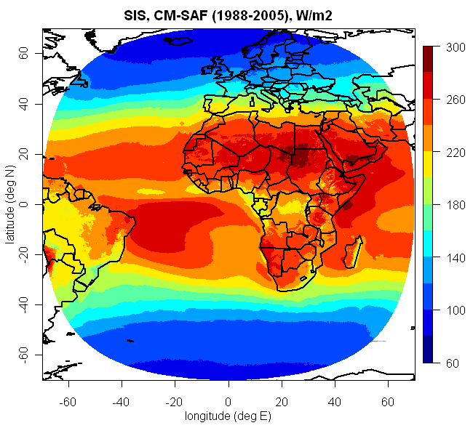
Climate Data back to the 1980s
Global (AVHRR) 0.25°
Local (Meteosat) 0.05°
Web User Interface: www.cmsaf.eu/wui
Data format: netcdf
Regular lon-lat grid (mainly 0.05° / 0.25°)
Temporally aggregated (daily, monthly, monthly diurnal cycle)

Slide 10

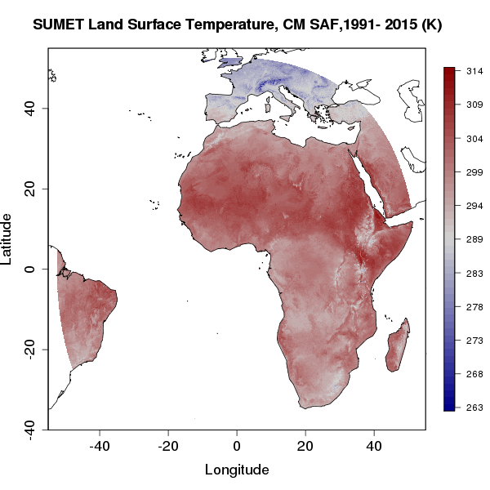
CM SAF Products
Land Temperature
Land Surface Temperature
Resolution
  Spatial: 0.05° × 0.05°
  Temporal: 60-min, monthly diurnal cycle
Coverage
  Spatial: Meteosat full disk (< 60° scanning angle)
  Temporal: 1991 to 2015
Version 2.0 in prep. (release 2020): 1983-2020, (< 70° scanning angle)

Slide 11
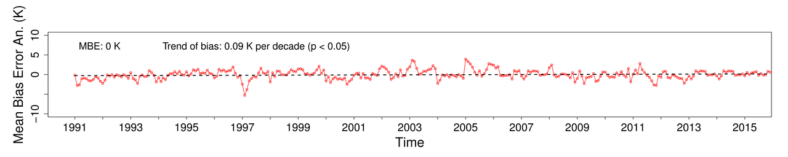
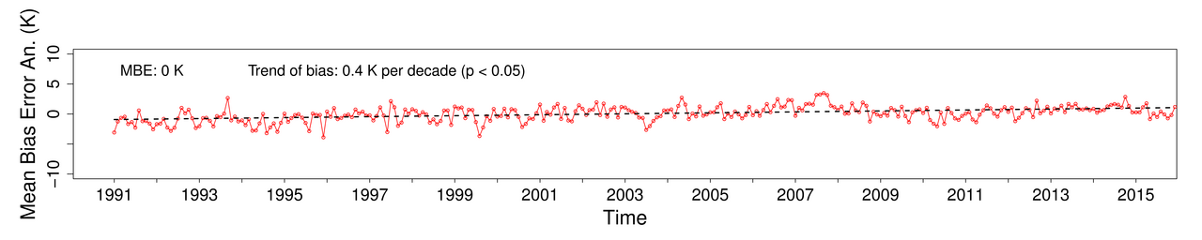
CM SAF Land Surface Temperature
Land Temperature
Europe
Tropics
Mean bias error Meteosat CM SAF Land Surface Temperature - ECMWF ERA-Interim Skin Temperature (anomaly space).

Slide 12


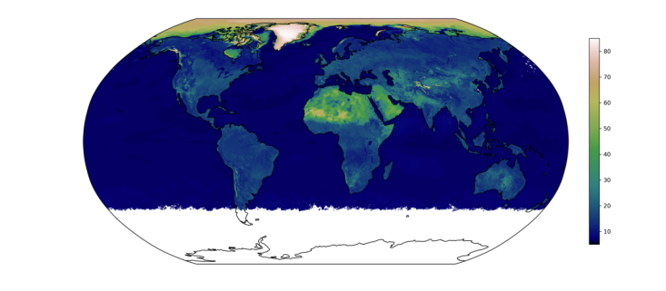
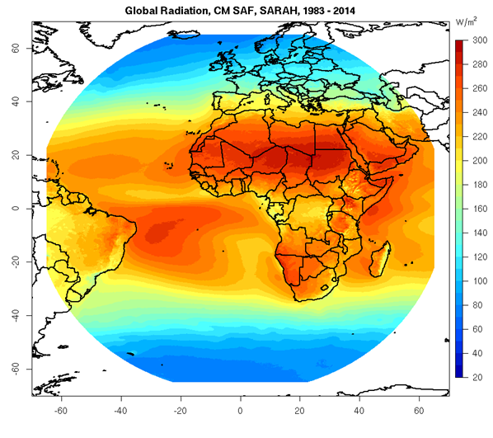
CM SAF Products
Surface Radiation
Global (SIS), Albedo (SA), Downwelling Longwave (SDL), Upwelling Longwave (SOL) Surface Radiation
AVHRR
Meteosat
Resolution
  Spatial: 0.25° × 0.25°
  Temporal: daily, monthly means
Coverage
  Spatial: global
  Temporal: since 1982
  Solar and longwave radiation, Albedo
Resolution
  Spatial: 0.05° × 0.05°
  Temporal: 30-min, daily, monthly
Coverage
  Spatial: Meteosat full disk
  Temporal: since 80s/90s
Solar Radiation, incl. direct and sunshine duration

Slide 13
Surface Radiation
Surface Downward Longwave
Radiation (SDL)
MSG Cloud Fraction
SDL = SDL_{ECMWFclear} + CFC_{METEOSAT} * CCF
Monthly ECMWF SDL (clear-sky)
Cloud Correction Factor determined on a monthly bases by linear regression using ERA-Interim

Slide 14

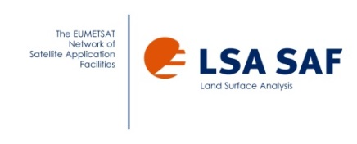
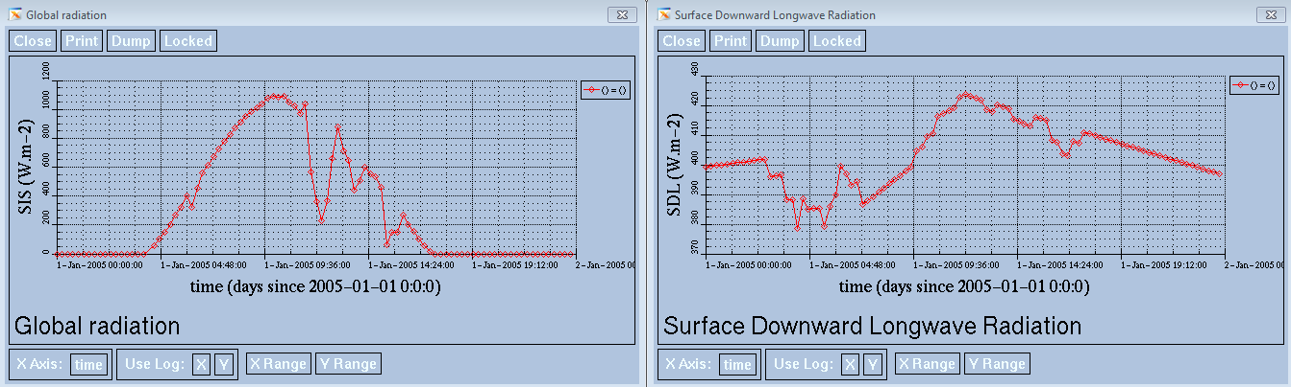
CM SAF Products
Surface Radiation
NEW
In preparation (release 2021):
Consistent (joint) Meteosat Land Surface Fluxes 1983 to 2020
Surface Incoming, Albedo, Surface Downward Longwave, Surface Outgoing Longwave, Latent and Sensible Heat
Namibia 01/01/2005 Diurnal Cycle

Slide 15
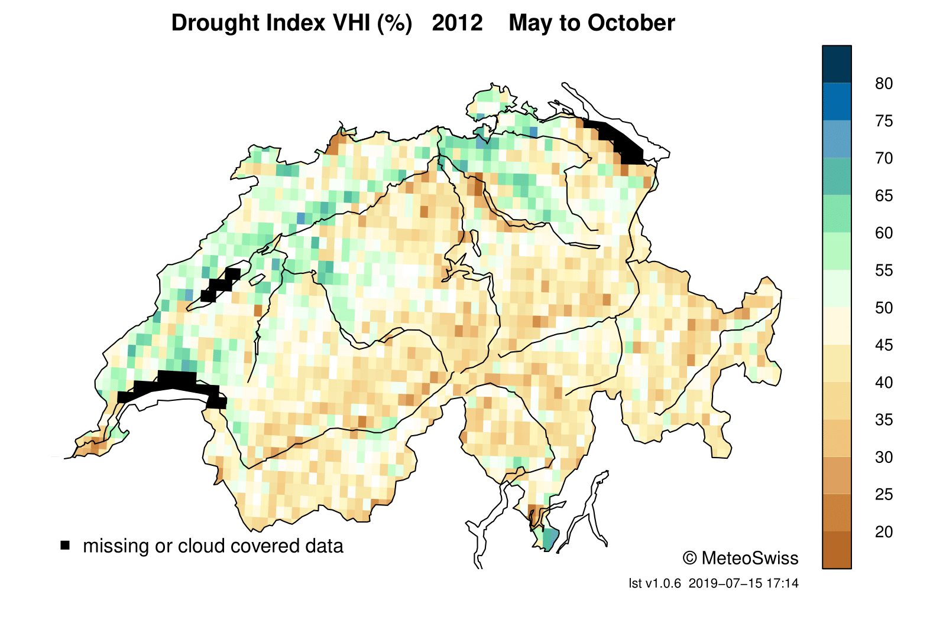
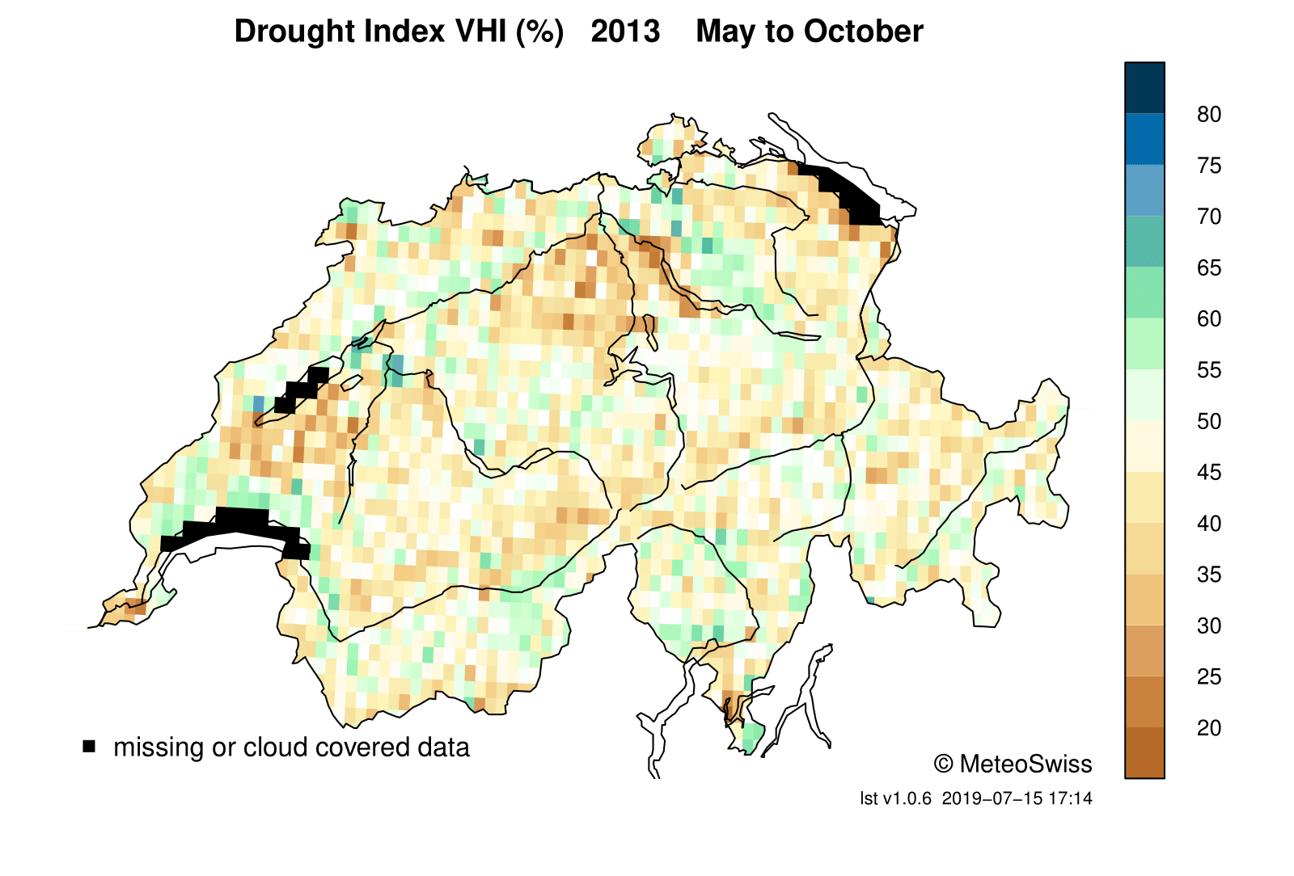
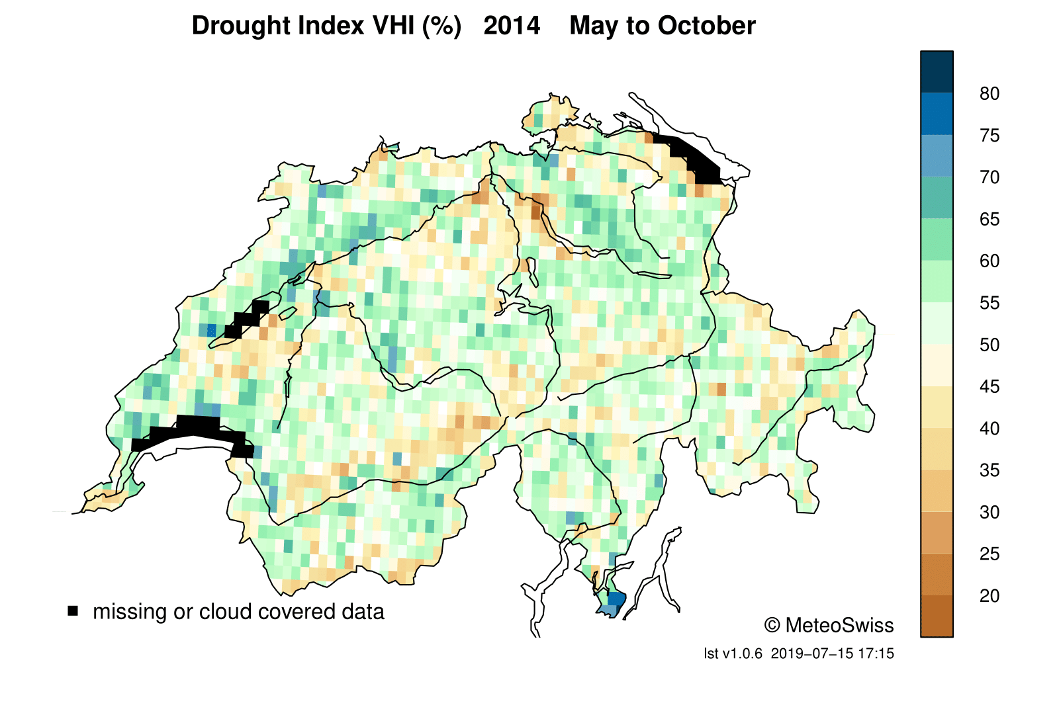
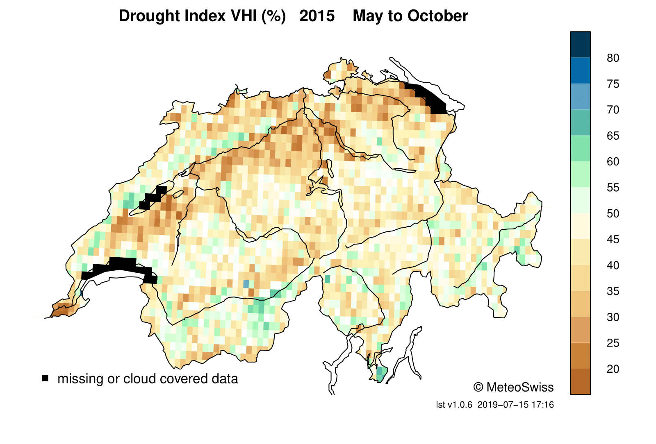
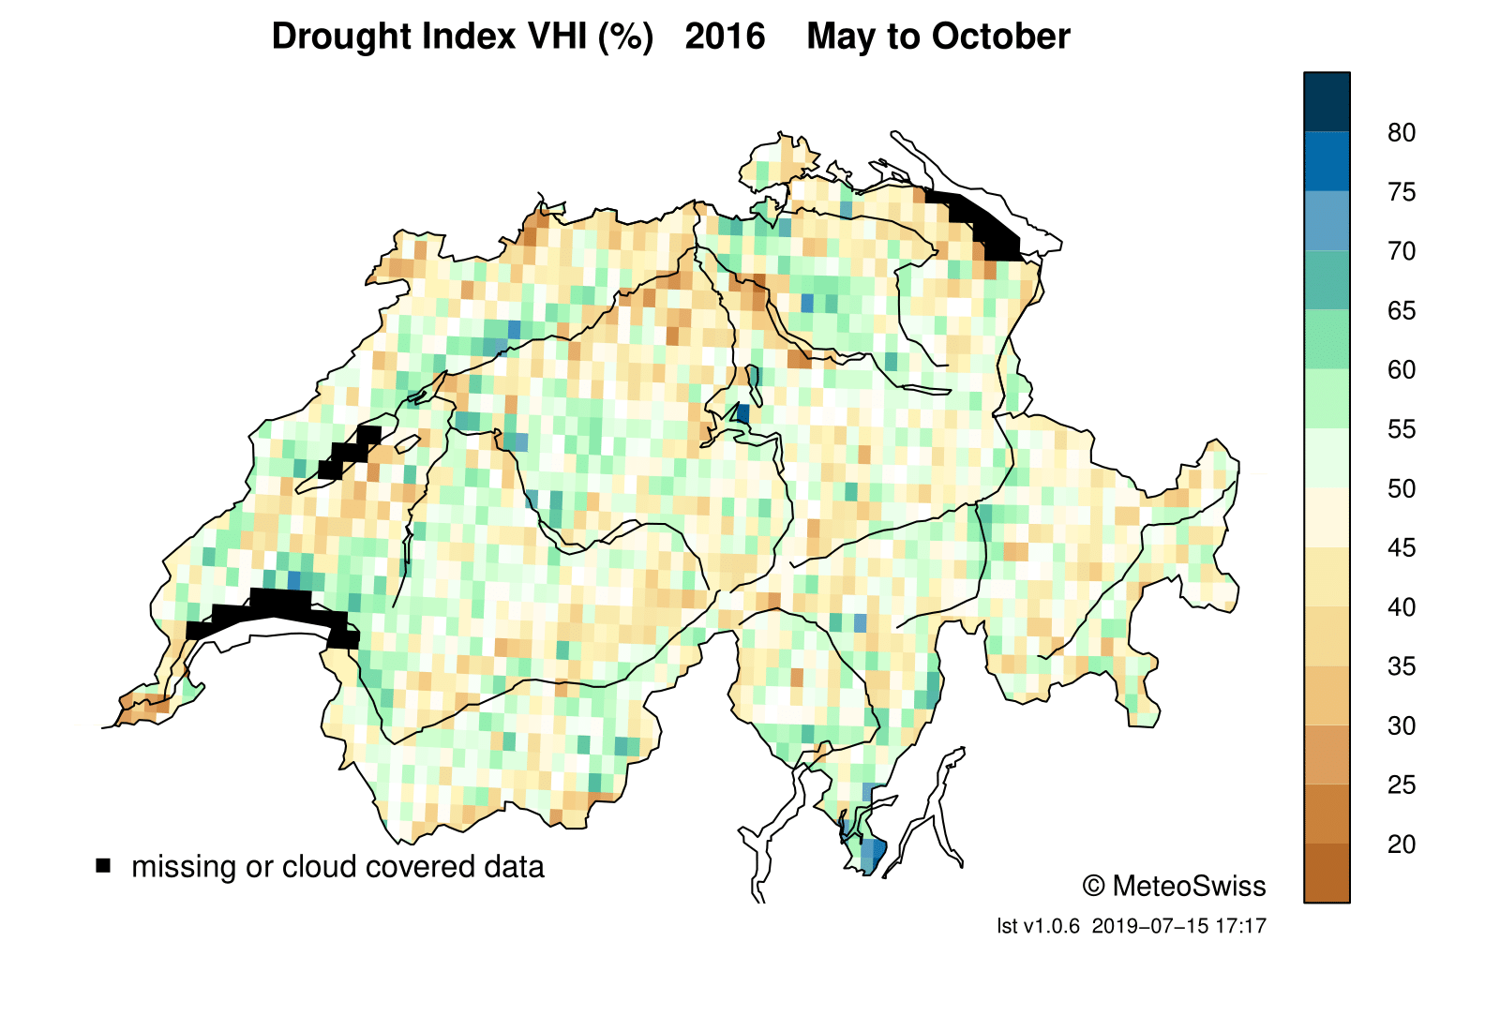
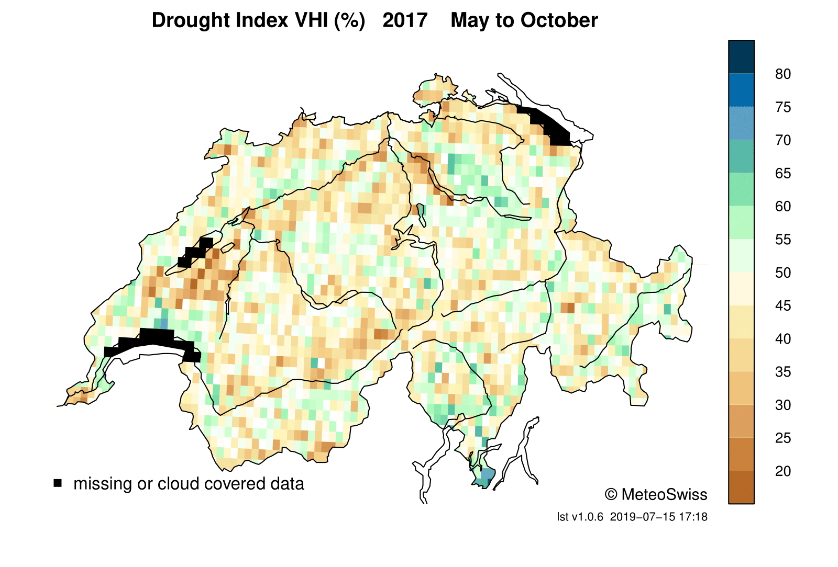
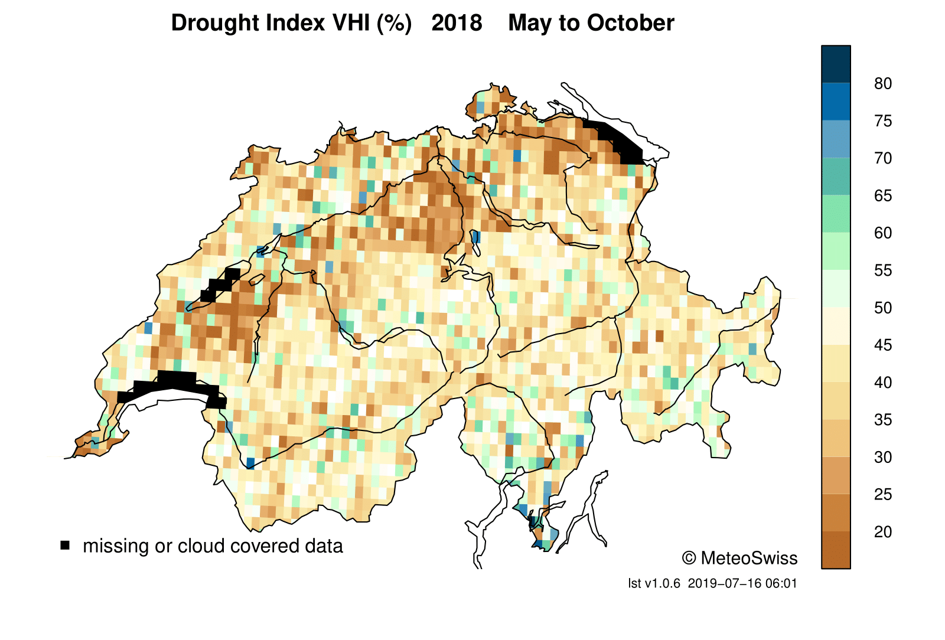
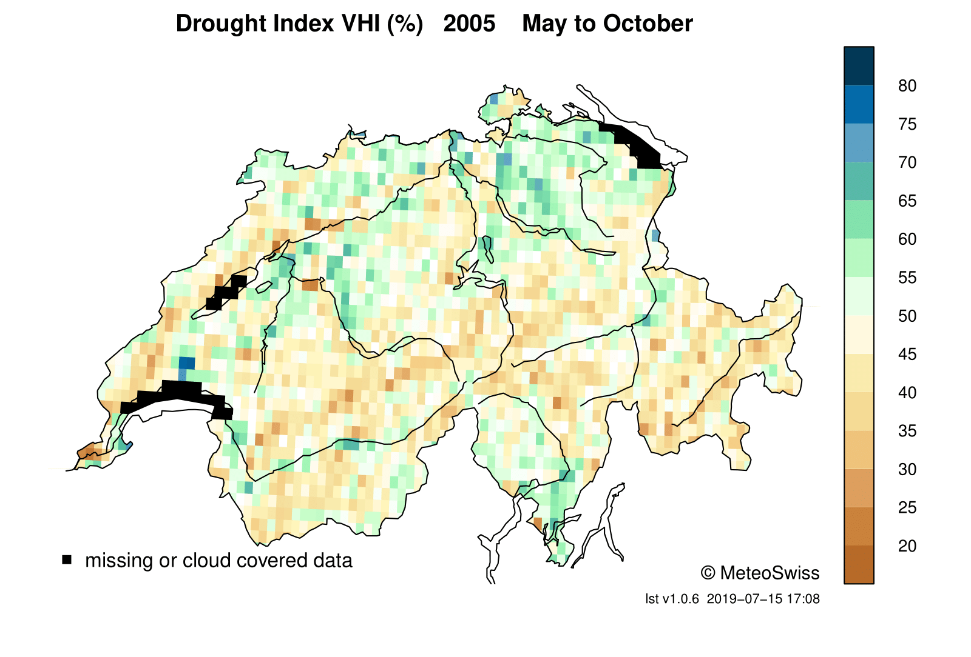
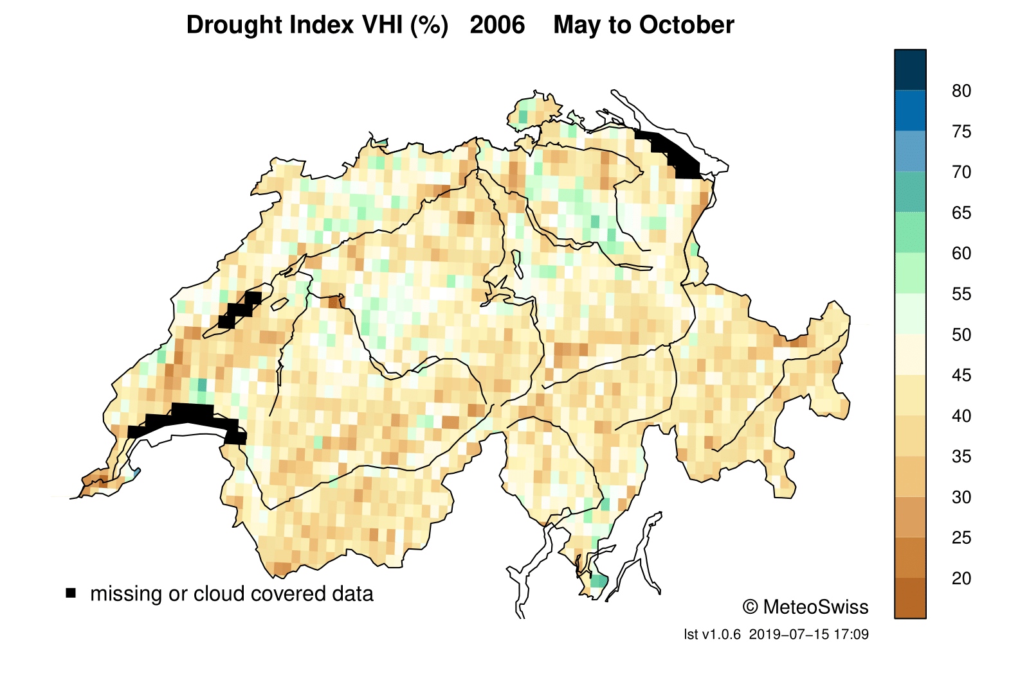
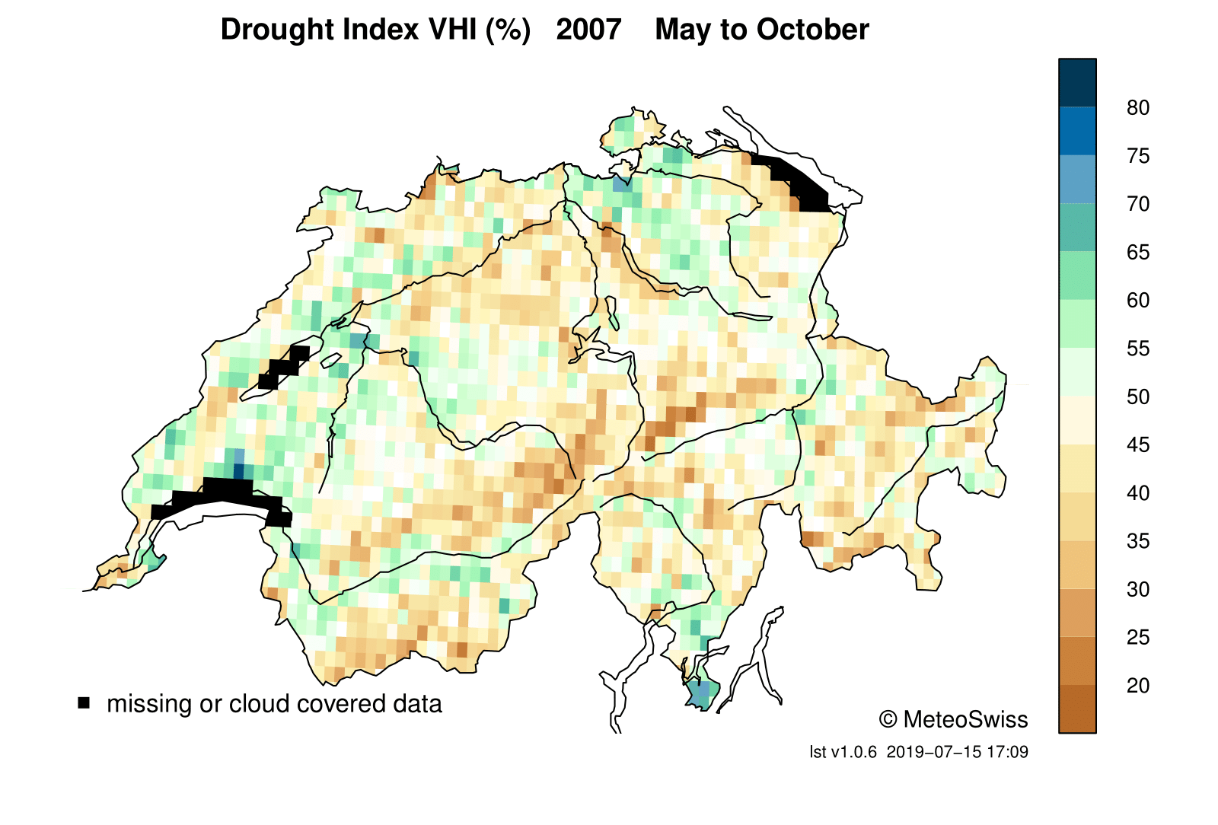
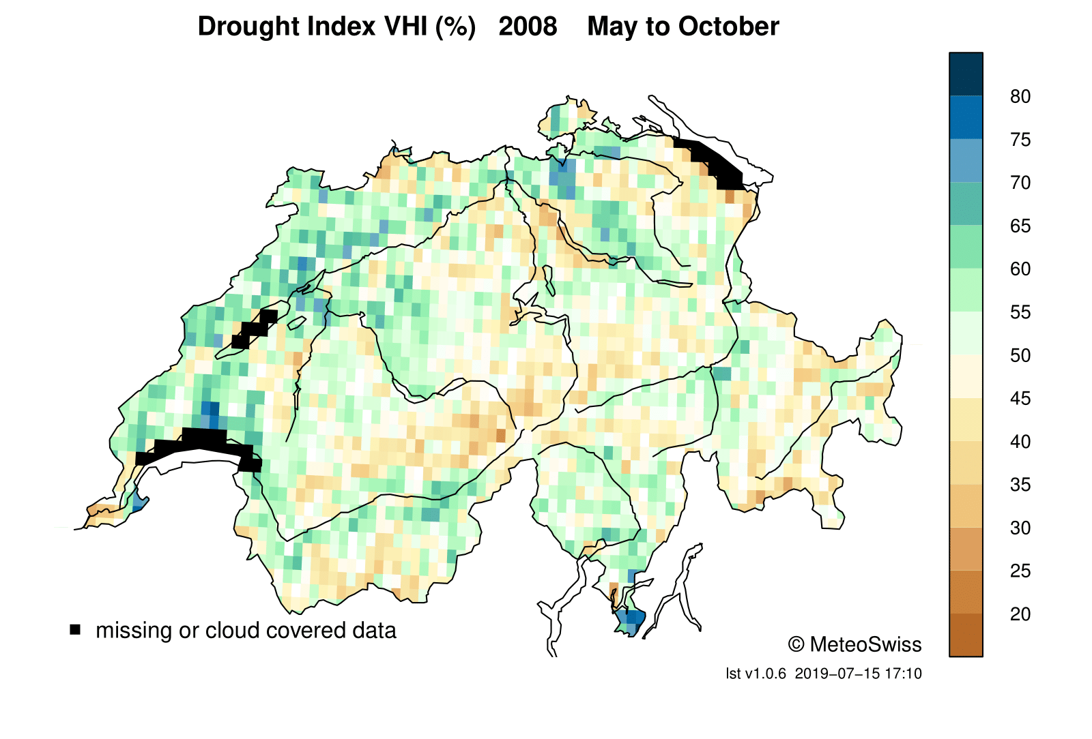
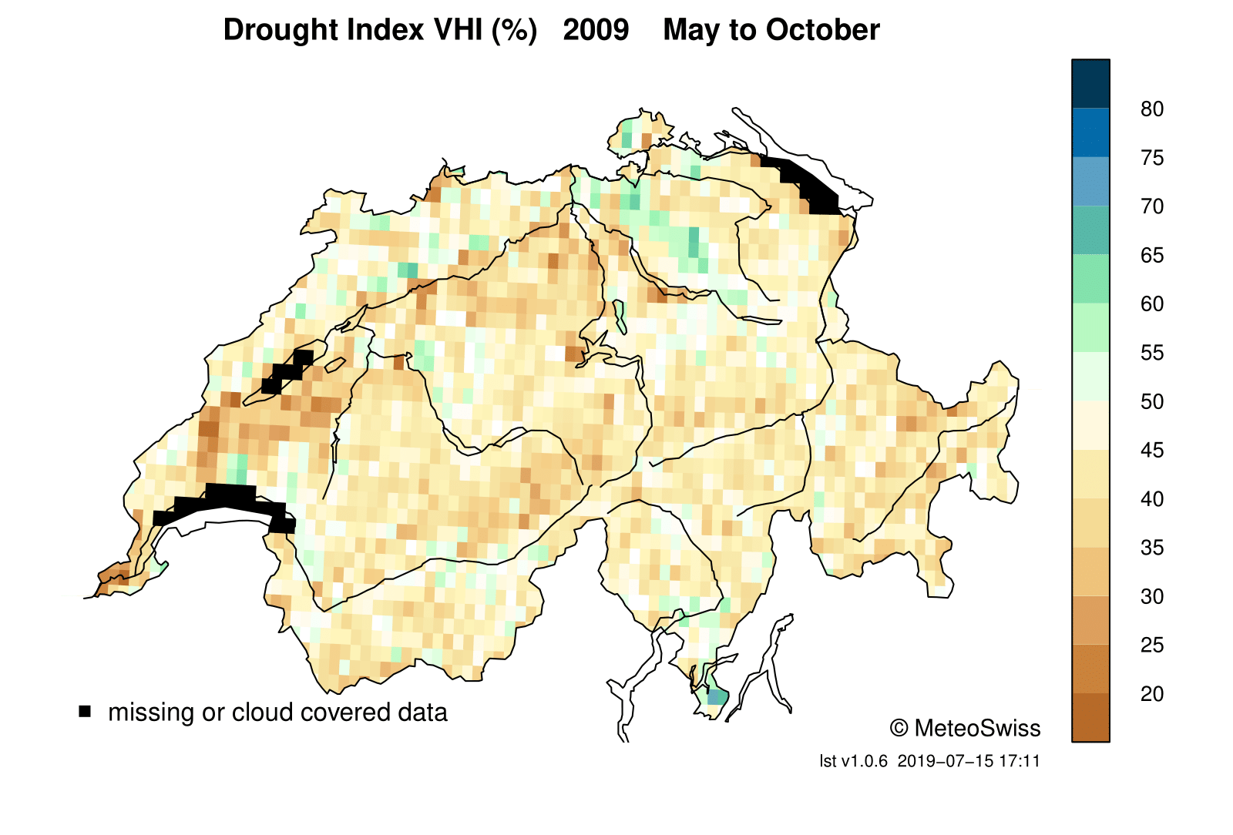
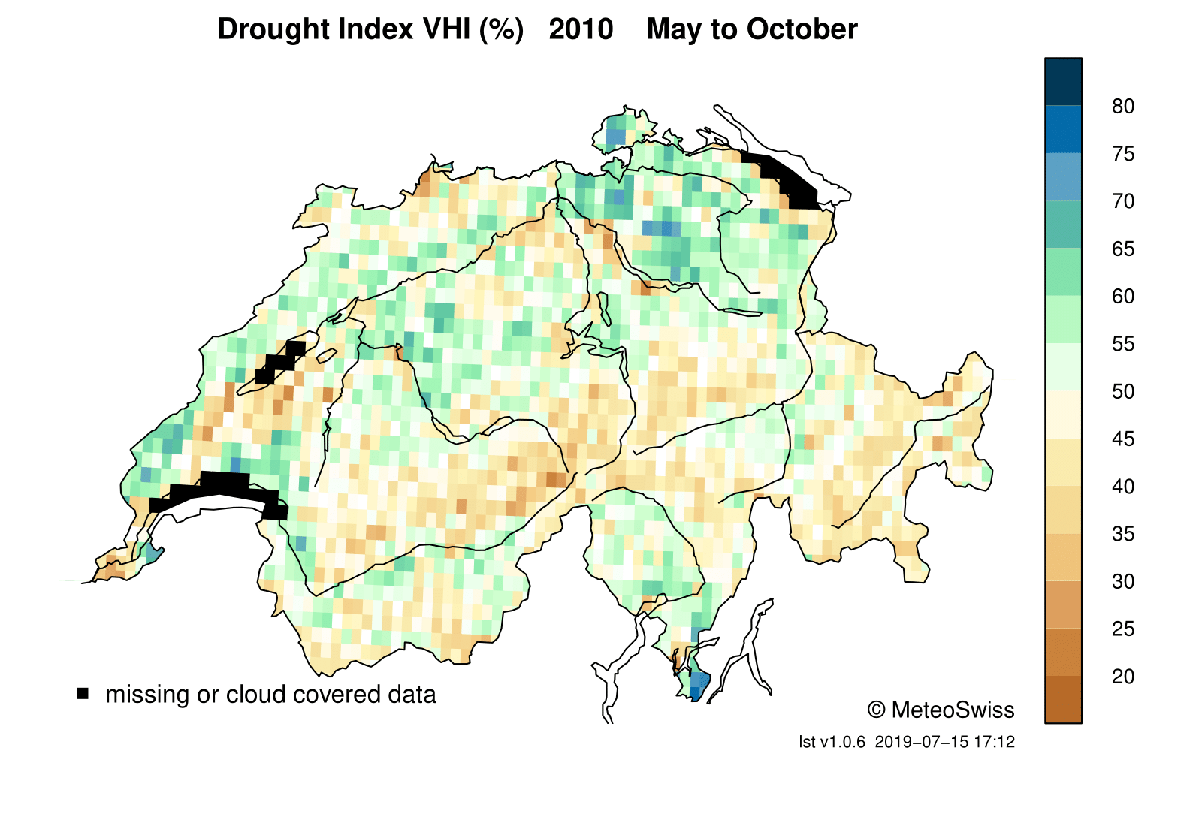
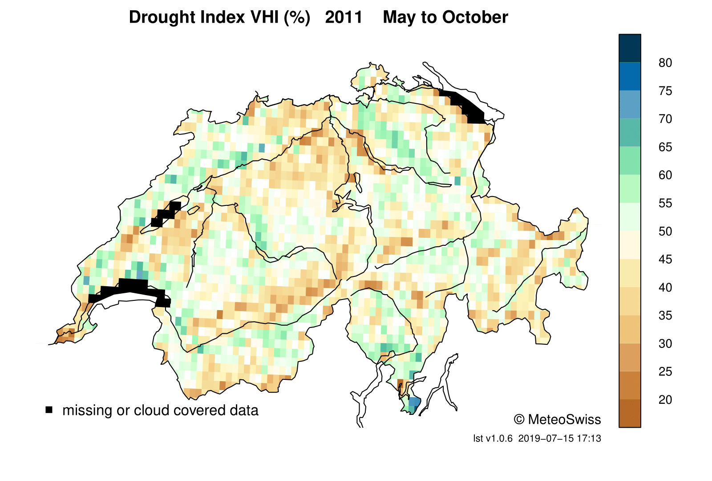
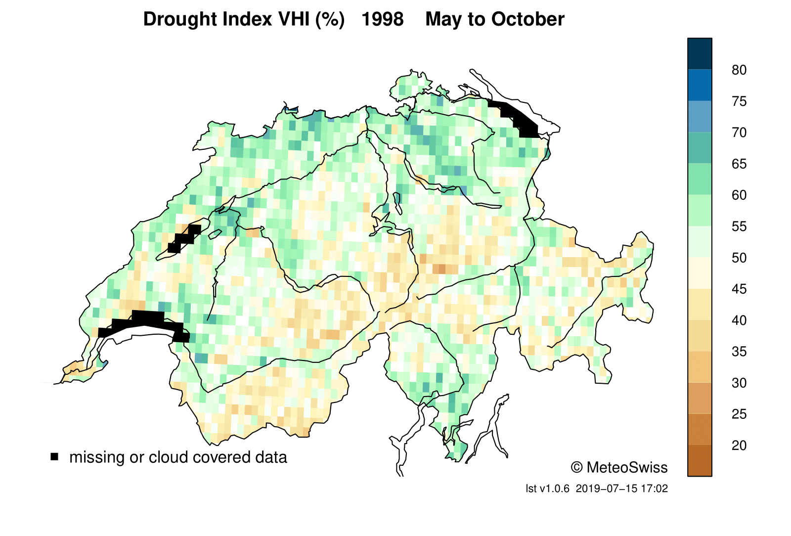
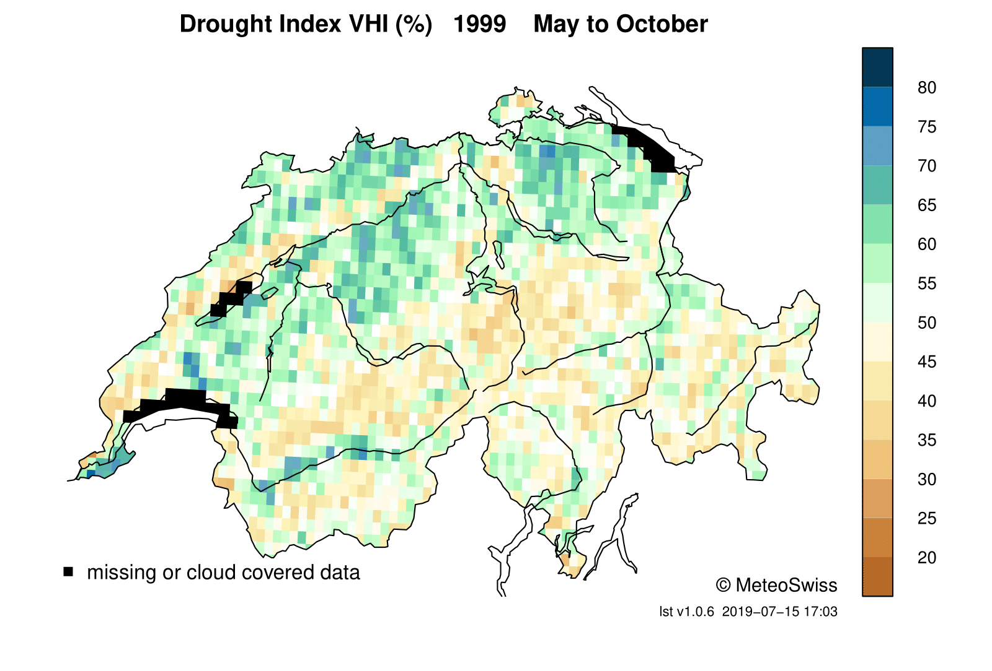
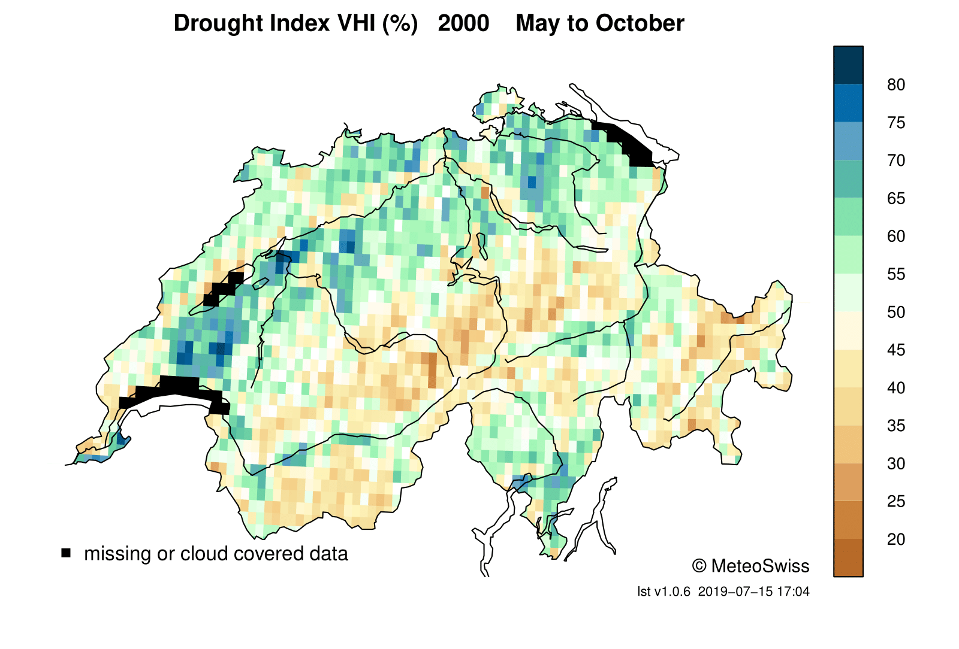
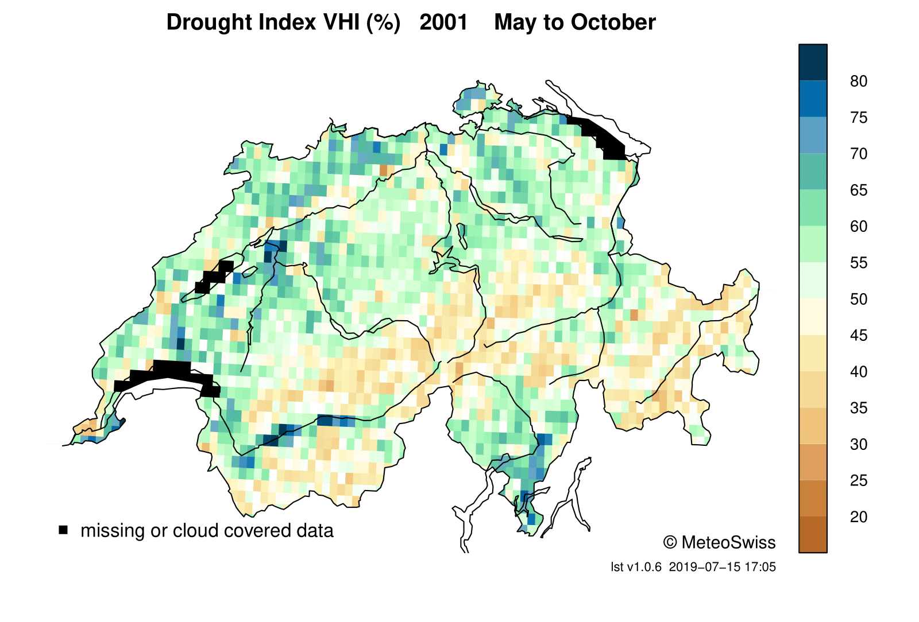
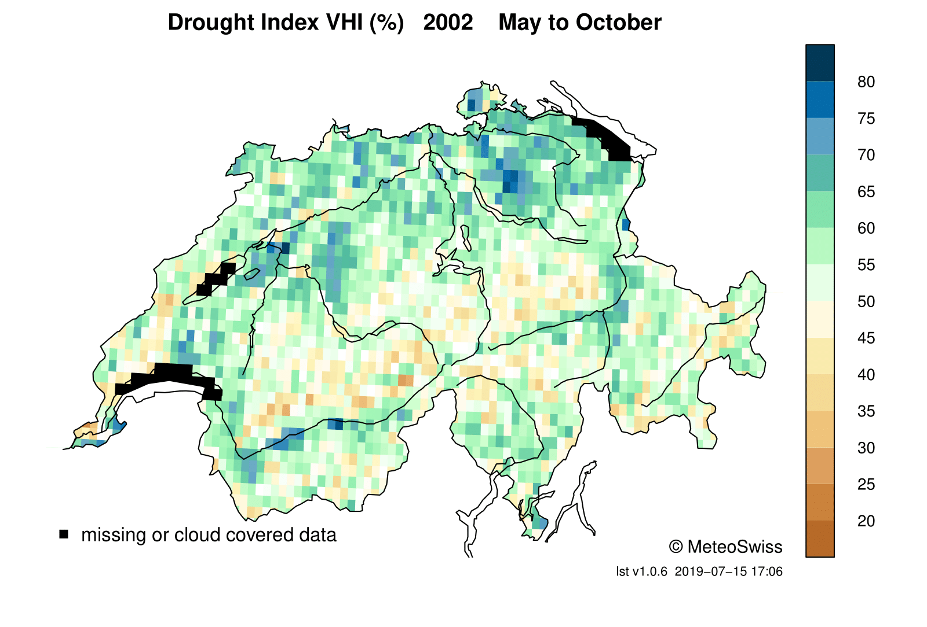
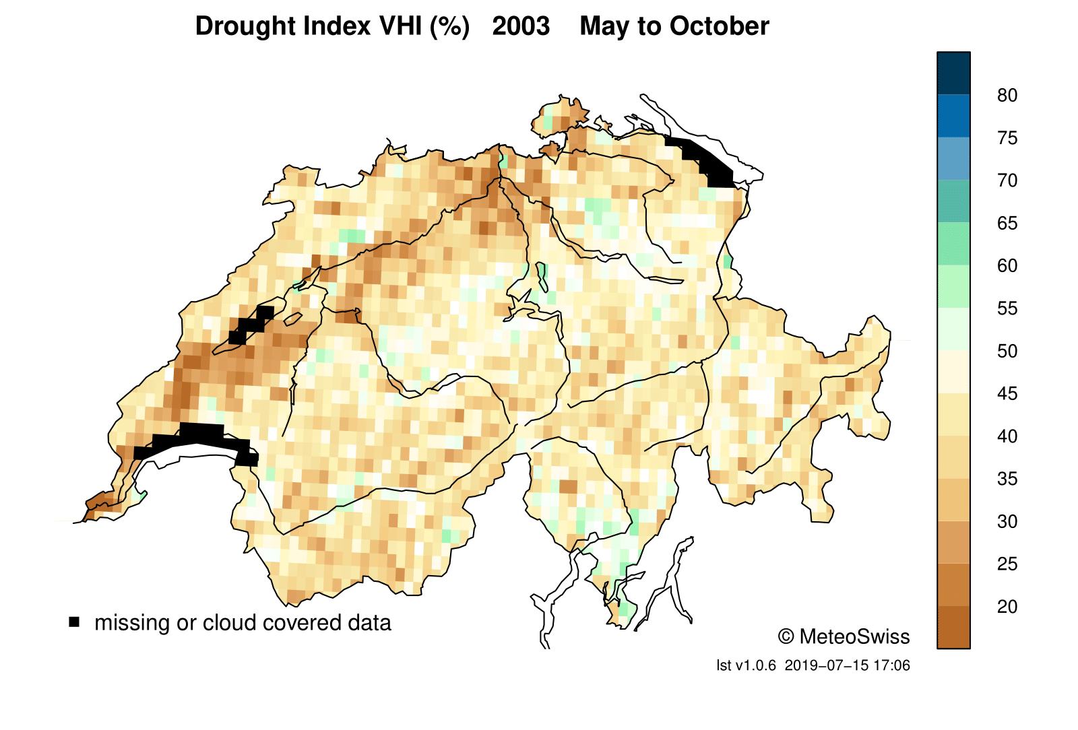
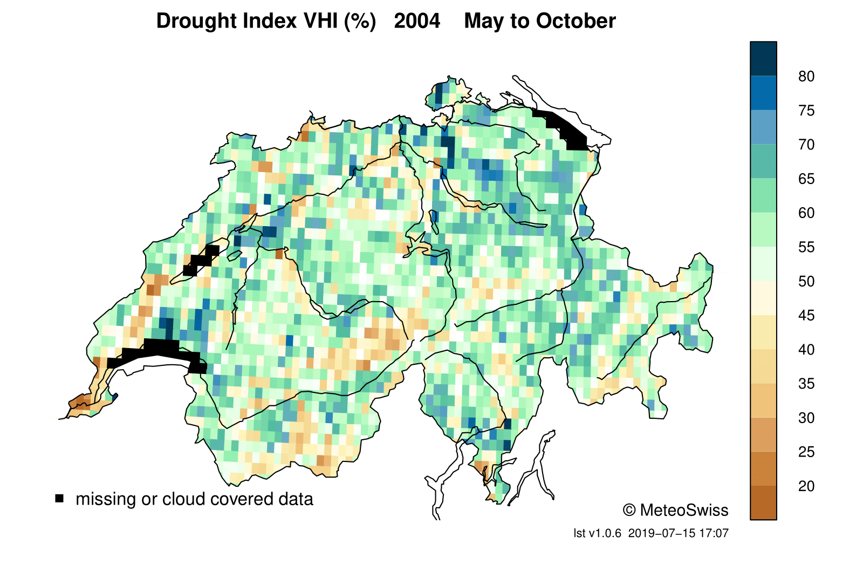
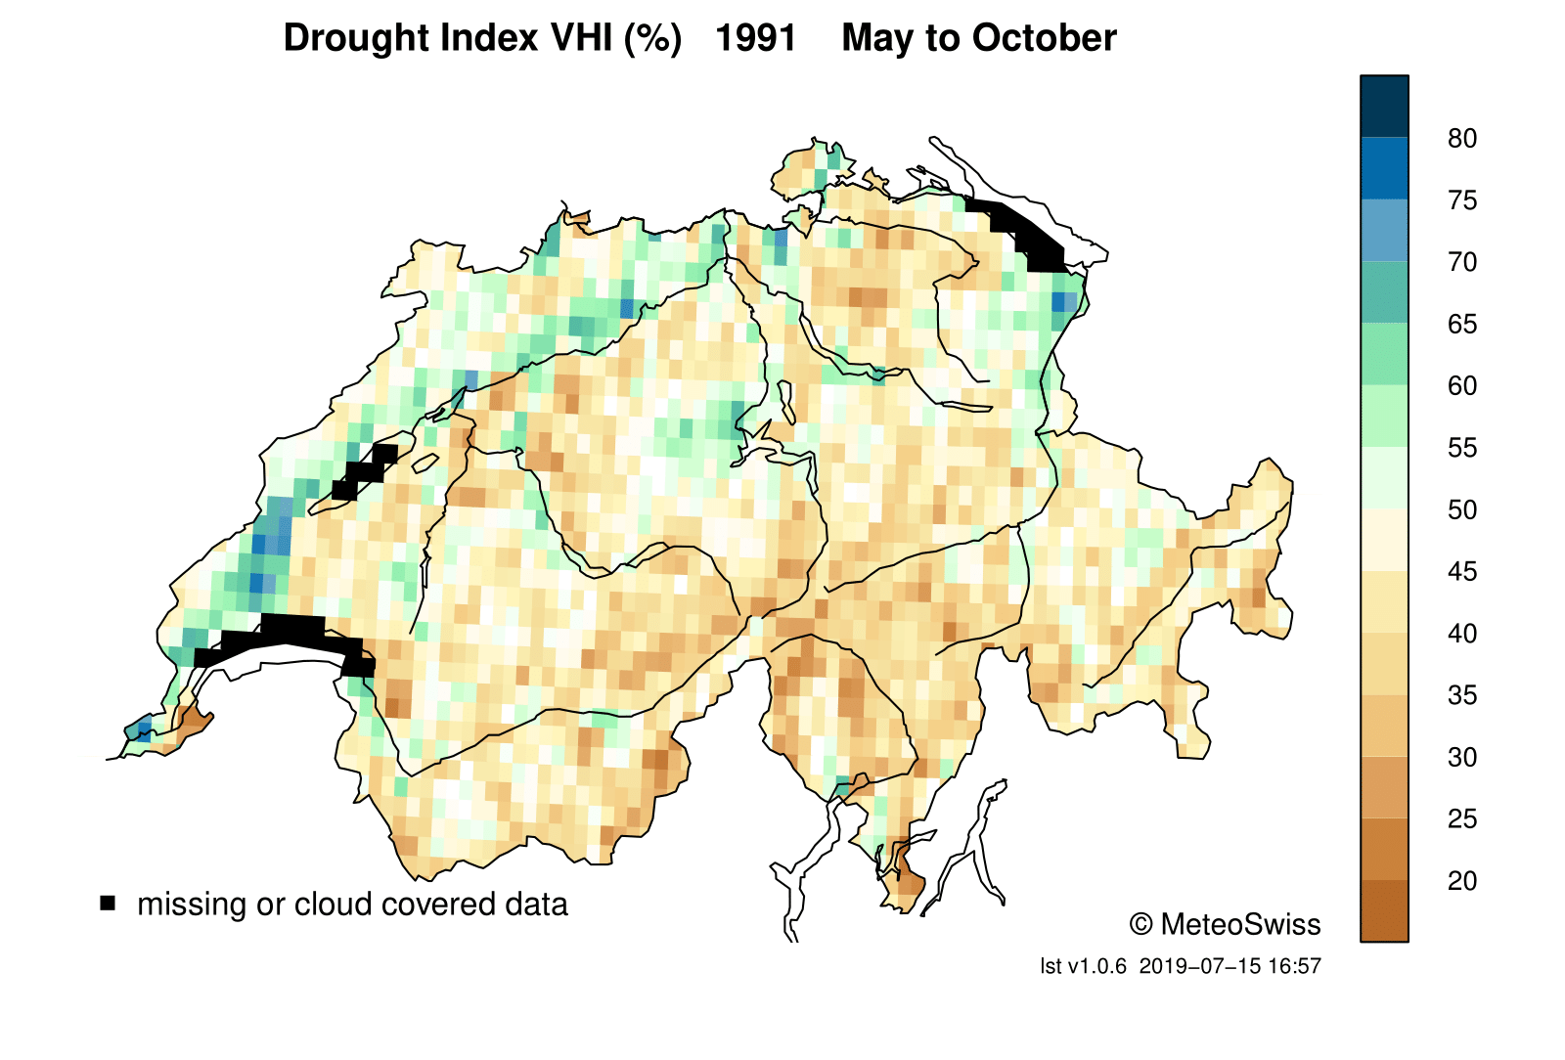
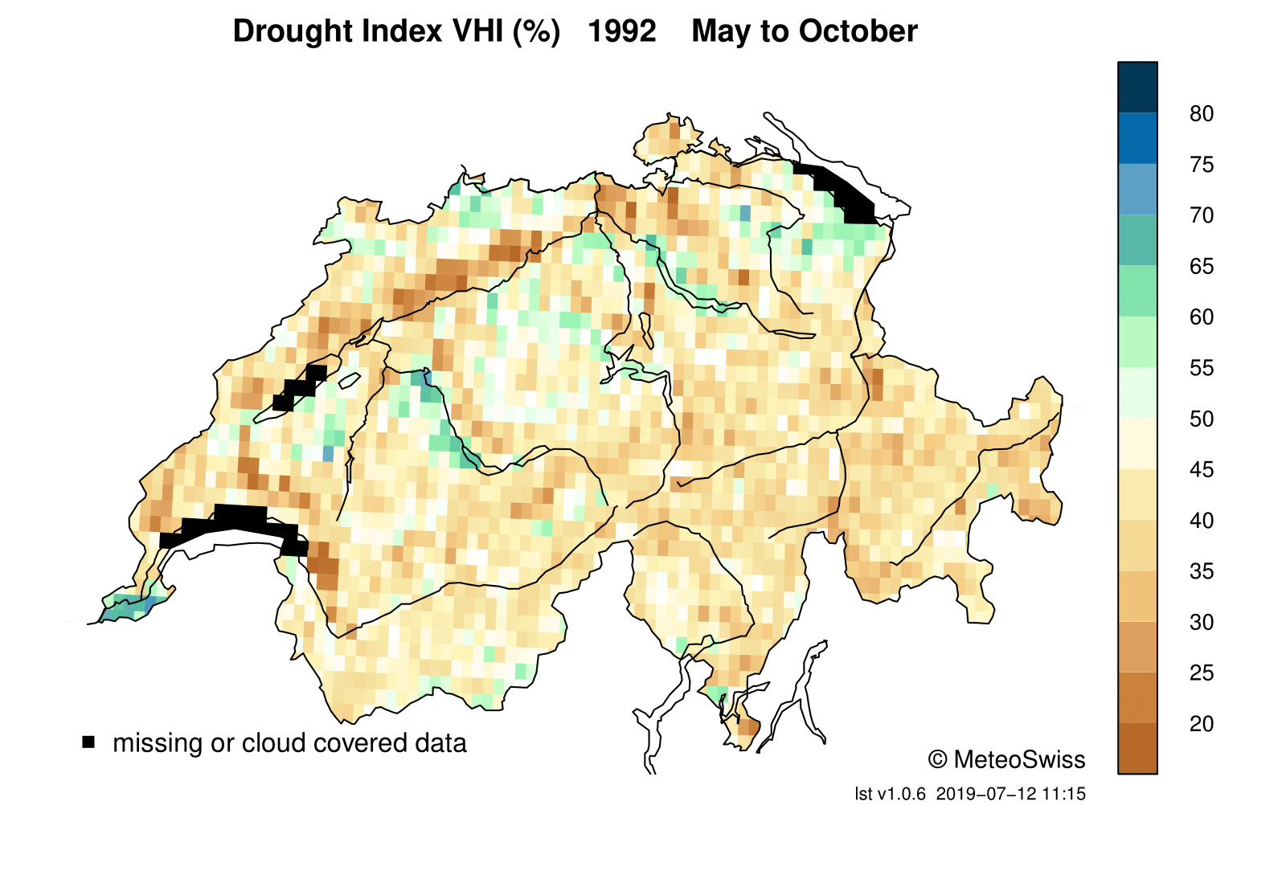
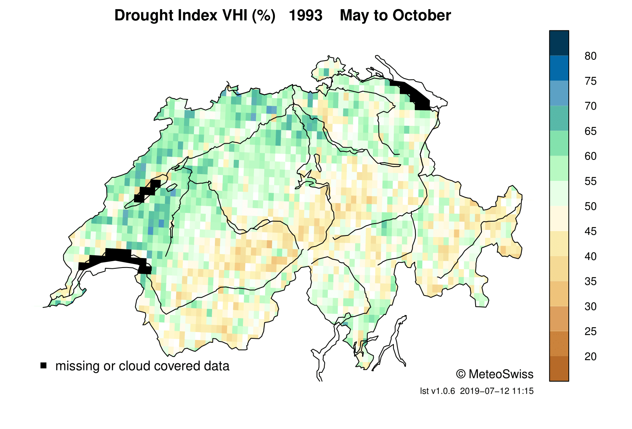
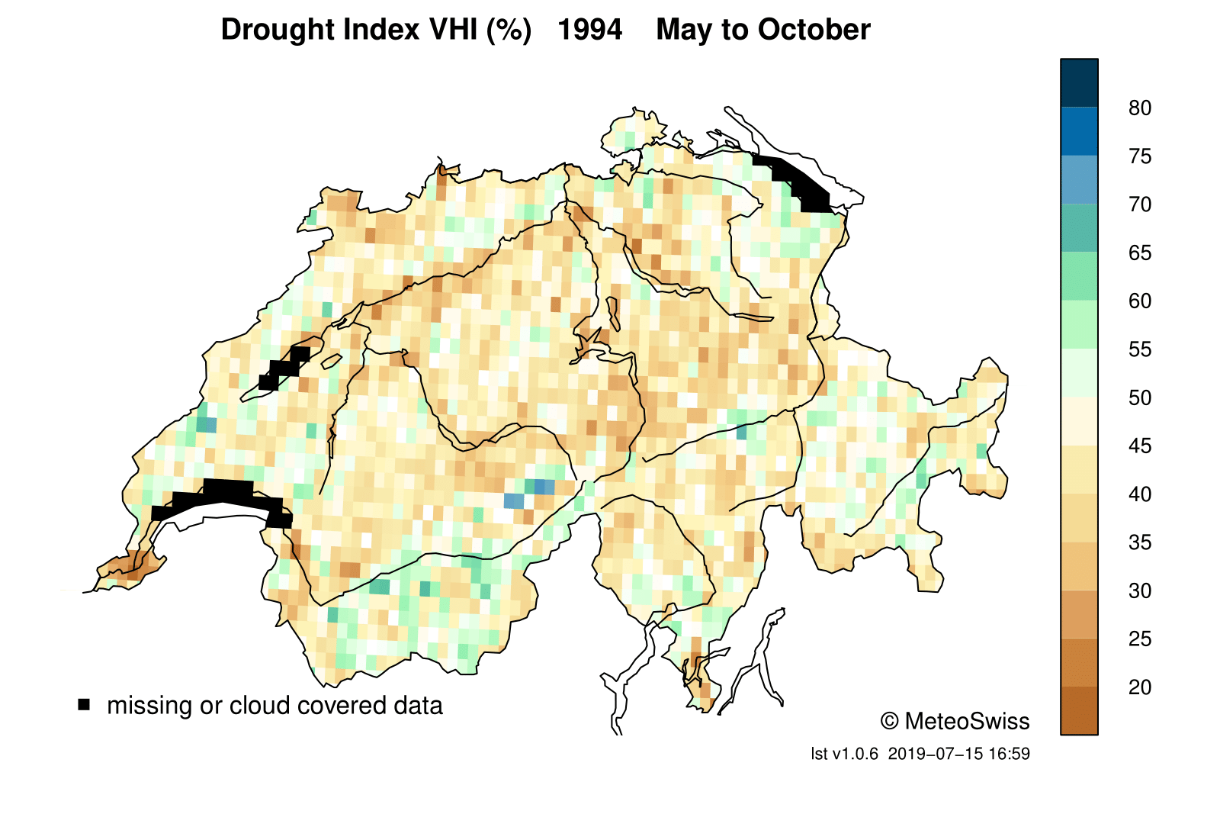
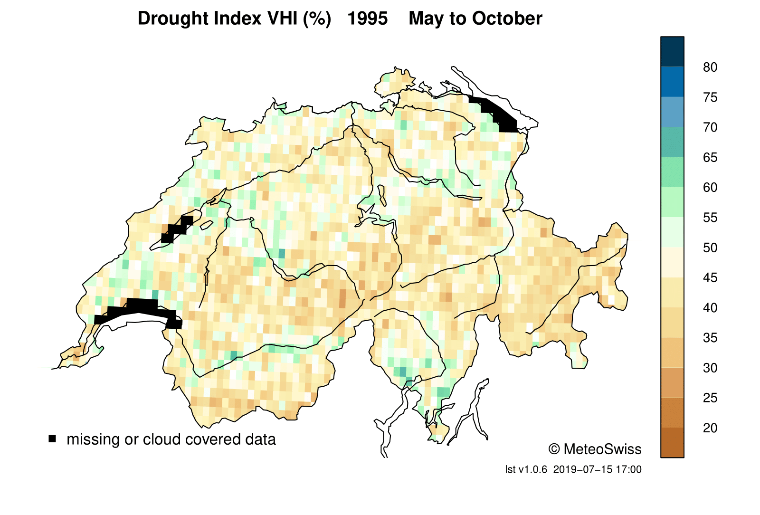
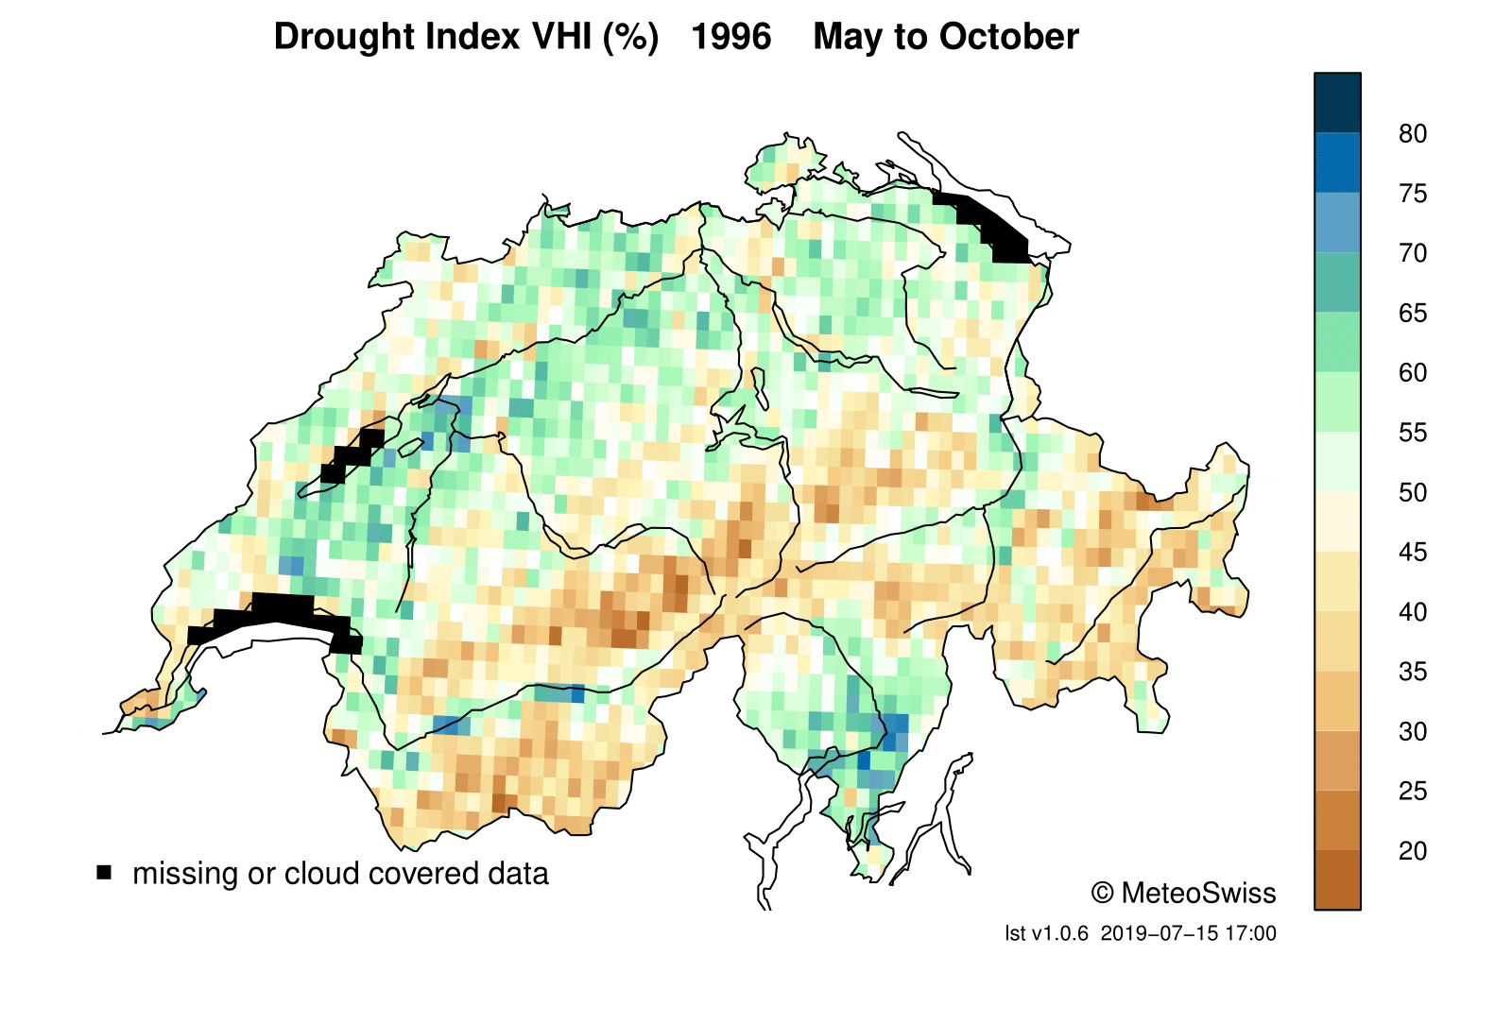
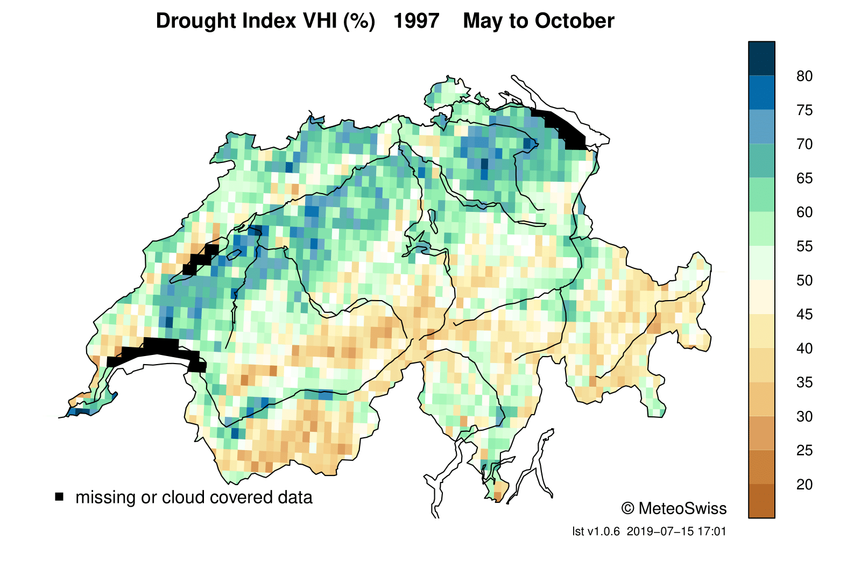
Drought Index VHI for Switzerland
(CM SAF LST + NOAA NDVI)
2012
2013
2014
2015
2016
2017
2018
2005
2006
2007
2008
2009
2010
2011
1998
1999
2000
2001
2002
2003
2004
1991
1992
1993
1994
1995
1996
1997

Slide 16

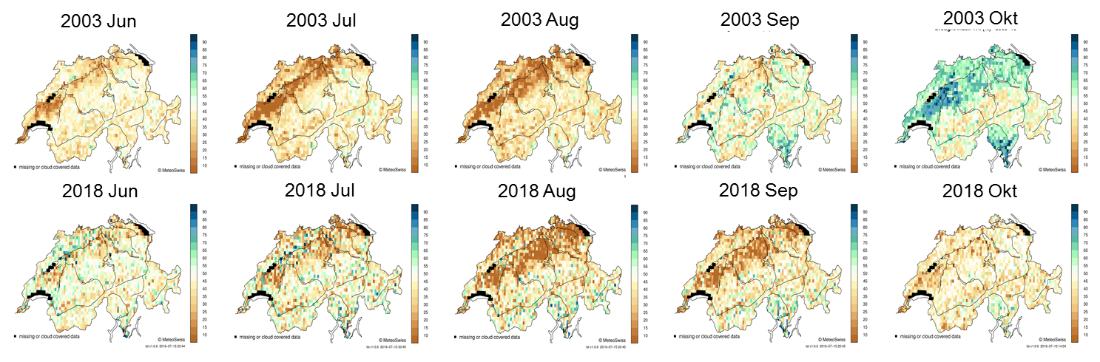

Slide 17
Summary
CM SAF provides long-term climate data back to the 80s for longwave and shortwave radiation, land surface temperature and surface albedo
Serious efforts on data calibration and stability (→ climate stability)
New joint retrieval off all components of the surface radiation budget including latent and sensible heat to be released in 2021
www.cmsaf.eu/wui

