Slide 1
LSA-SAF
Operational products characteristics and expected evolution
Luís Pessanha (luis.pessanha@ipma.pt)

Slide 2
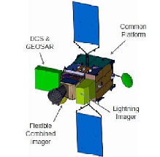
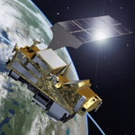


Land-SAF Chronogram
MTG-I
EPS-SG
MetOp-B
MetOp-C
MetOp-A
2021
2022
Meteosat-11 (MSG-4)
Meteosat-9 (MSG-2)
Meteosat-10 (MSG-3)
Meteosat-8 (MSG-1)
CDOP-4
CDOP-2
CDOP-3
IOP
CDOP-1
99
00
01
02
03
04
05
06
07
08
09
10
11
12
13
14
15
16
17
18
19
20
21
22
Development Phase:
Sep 1999 – Jan 2005
Continuous Development & Operations Phase 4:
Mar 2022-Feb 2027
Initial Operations Phase:
Feb 2005 – Feb 2007
Continuous Development & Operations Phase 3:
Mar 2017-Feb 2022
Continuous Development & Operations Phase 1 & 2:
Mar 2007-Feb 2012 & Mar 2012 – Feb 2017

Slide 3
Steering Group
Main body controlling the Land-SAF activities:
Project Activities versus Master Schedule
  Changes in the Master Schedule (and therefore in the PP) must be approved by the SG
Follows Project Reviews
  Endorses Recommendations of Review Boards
  Approves new versions of PRD and SeSp
New Activities (e.g., new WP, FA, VS)
  Presented to the SG by the Project Manager/ Scientific Coordinator
  To be approved by the SG, together with changes in the PP, Master Schedule and Funding Release Plan (when applicable!)

Slide 4
Steering Group
SG members are independent from the LSA-SAF team, chaired by the leading entity member, IPMA, and co-chaired by the Coordinator of the EUMETSAT SAF Network
SG Members
Consortium Members represented by IPMA
EUMETSAT – Co-Chair (Coordinator EUM SAF Net)
IPMA (Portugal) – Co-Chair
MF (France)
RMI (Belgium)
VITO (Flemish Inst Technological Res)
ARSO (Slovenian Env Agency)
EUMETSAT STG and AFG
IDL (Univ Lisbon)
KCL (King’s College London)
KIT (Karlsruhe Inst Technology)
UV (Univ Valencia)
NIMH (Bulgarian Inst Met and Hyd)

Slide 5








Land SAF Consortium CDOP- 3
IPMA (Portugal) – Leading Institution | DATA PRODUCTION. LST, Emissivity, Long-wave Radiation, Reference Evapotranspiration
MF (France) | Albedo, Short-wave Radiation
RMI (Belgium) | Evapotranspiration, Energy Turbulent Fluxes
IDL (University of Lisbon) | Fire Risk, Burnt Area
KCL (King’s College London) | Fire Radiative Power, Fire emissions
KIT (Karlsruhe Inst. Technology) | LST, LST Validation
UV (University Valencia) | FVC, LAI, FAPAR, GPP, Canopy water
VITO (Flemish Institute Technological Res) | NDVI, DATA PRODUCTION
ARSO (Slovenian Environment Agency) NIMH (Bulgarian Inst. Met and Hyd.) | PRODUCT VALIDATION & Consistency Assessment Training & Promotion
  10 Institutes / 8 Countries

Slide 6
CDOP-3 Objectives
LSA SAF
  Service continuation: NRT & Off-line production of Land Surface variables
    retrieved primarily from EUMETSAT satellites
  Maintain User Support:
    Helpdesk & Product Distribution
    Promotion: training; workshops;
  Ensure transition to MTG & EPS-SG

Slide 7
CDOP-3 Objectives
Energy Fluxes at the Sfc and Ground Primary Production
All products can be navigated. It is always possible to associate a pixel localization (line, col) to latitude/longitude.

Slide 8
LSA SAF – Product Validation
Validation of products is mandatory. A product to be distributed shall have a validation report prepared, including how had been conducted, products compliance with user requirements and quality results.
Validation is always a comparison:
  • Intercomparison with other satellite deriving similar products
  MODIS
  AATSR
  CERES
  ...
  • Comparison with Ground Observations
  LSA SAF/ KIT sites (Southern Portugal; Namibia; Senegal)
  Established Networks (e.g., BSRN, Fluxnet)
  Field Campaigns (e.g., AMMA)
  • Comparison with Model fields

Slide 9
Information to the user
Standardized set of documentation
  Product Requirements Document
  Per product
    Algorithm Theoretical Basis Document
    Product User Manual
    Product Output Format
    Validation Report
  Service documents
    Service Specification
    Operations report (biannually)

Slide 10
Relation with projects
Programmes such as GCOS (WMO), GEOSS, and Copernicus (EC and ESA) have established important guidelines for monitoring of climate and environment, stressing the need for global, long-term, high quality and reliable products.
The life-cycle of EUMETSAT satellites, and the contributions of LSA SAF consortium members to Copernicus services (land and atmosphere) put the LSA SAF in a privilege position as a product/service provider for those programmes.
The Global Climate Observing System (GCOS) is a co-sponsored programme which regularly assesses the status of global climate observations and produces guidance for its improvement.
A central part of GEO’s Mission is to build the Global Earth Observation System of Systems (GEOSS). It is a set of coordinated, independent Earth observation, information and processing systems interacting and providing access to diverse information for a broad range of users in both public and private sectors

Slide 11
CDOP-3 Objectives
Land-SAF CDOP-3 main objectives:
1) Ensure the continuity of a reliable near real time and offline service, where emphasis will be put on
  A smooth transition to MTG-based operations
  The improvement of system and product quality monitoring
  Maintaining an efficient user support service
2) Provide homogeneous datasets for products developed in CDOP-1 and CDOP-2
  Maintain re-processing capabilities for MSG and AVHRR/Metop for a subset of products (identified by 240 user requirements)
  Provide careful characterization of product uncertainty
3) Explore the capabilities of forthcoming EUMETSAT satellites
  Developing and/or adapting existing algorithms to MTG-FCI. Except when explicitly indicated, all MTG-FCI products will be generated using the Full Disk Scan Service (FDS).
  Designing new products for sensors on-board EPS-SG, which will be more suitable for land surface monitoring, VII and 3MI

Slide 12
Project Reviews
Evolution of product chains to new programs – MTG and EPS-SG
  Requirements Review (RR): assess requirements & feasibility in order to release the requirements baseline for products (setting the PRD) and system
  Preliminary and Design Component Consolidation Review (PDCR): Detailed Design Definition and Component requirements; Test plan; ATBD to release the Scientific Baseline
  System/Components Integration Review (SIRR) Internal Review to start integration
  System/Components Verification Test Result Review (STRR)
  Operations Readiness Review (ORR): to assess validation against the PRD, and the readiness to start Operations (PUM, VR).

Slide 13
MTG & ESP-SG

Slide 14
MTG

Slide 15
Instruments on MTG
The imaging satellites, MTG-I, carries:
  Flexible Combined Imager (FCI)
  Lightning Imager (LI)
MTG-S, The sounding satellites
  Infrared Sounder (IRS)
  Copernicus Sentinel-4 instrument: High resolution Ultraviolet Visible Near-infrared (UVN) spectrometer.
For further details on the instruments on board the MTG satellites, including their scanning modes, follow the respective links:
Flexible Combined Imager (FCI) https://www.eumetsat.int/website/home/Satellites/FutureSatellites/MeteosatThirdGeneration/MTGDesign/index.html#fci
Lightning Imager (LI) https://www.eumetsat.int/website/home/Satellites/FutureSatellites/MeteosatThirdGeneration/MTGDesign/index.html#li
Infrared Sounder (IRS) https://www.eumetsat.int/website/home/Satellites/FutureSatellites/MeteosatThirdGeneration/MTGDesign/index.html#irs
Ultraviolet Sounder (UVN) ttps://www.eumetsat.int/website/home/Satellites/FutureSatellites/MeteosatThirdGeneration/MTGDesign/index.html#uvn

Slide 16
Instruments on MTG
Channel | Centre Wavelength | Spectral Width | Spatial Sampling Distance (SSD)
VIS 0.4 | 0.444 µm | 0.060 µm | 1.0 km
VIS 0.5 | 0.510 µm | 0.040 µm | 1.0 km
VIS 0.6 | 0.640 µm | 0.050 µm | 1.0 km; 0.5 km*
VIS 0.8 | 0.865 µm | 0.050 µm | 1.0 km
VIS 0.9 | 0.914 µm | 0.020 µm | 1.0 km
NIR 1.3 | 1.380 µm | 0.030 µm | 1.0 km
NIR 1.6 | 1.610 µm | 0.050 µm | 1.0 km
NIR 2.2 | 2.250 µm | 0.050 µm | 1.0 km; 0.5 km*
IR 3.8 (TIR) | 3.800 µm | 0.400 µm | 2.0 km; 1.0 km*
WV 6.3 | 6.300 µm | 1.000 µm | 2.0 km
WV 7.3 | 7.350 µm | 0.500 µm | 2.0 km
IR 8.7 (TIR) | 8.700 µm | 0.400 µm | 2.0 km
IR 9.7 (O₃ ) | 9.660 µm | 0.300 µm | 2.0 km
IR 10.5 (TIR) | 10.500 µm | 0.700 µm | 2.0 km; 1.0 km*
IR 12.3 (TIR) | 12.300 µm | 0.500 µm | 2.0 km
IR 13.3 (CO₂ ) | 13.300 µm | 0.600 µm | 2.0 km

Slide 17
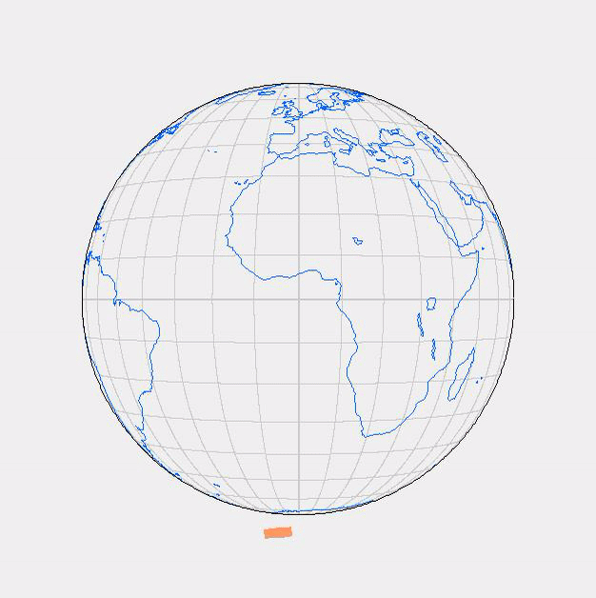

Instruments on MTG
Animation of the FCI scanning pattern in support of the Full Disc Scanning Service (FDSS)
Animation of the FCI scanning pattern in support of the Rapid Scanning Service (RSS)

Slide 18
EPS-SG

Slide 19
Instruments on EPS-SG (Metop-SG A)
Metop-SG A is an atmospheric sounding and imaging mission. It has a suite of infrared, microwave, and imaging instruments for sounding temperature, moisture and trace gases in the atmosphere:
Infrared Atmospheric Sounding Interferometer (IASI-NG)
https://www.eumetsat.int/website/home/Satellites/FutureSatellites/EUMETSATPolarSystemSecondGeneration/IASING/
Microwave Sounder (MWS)
https://www.eumetsat.int/website/home/Satellites/FutureSatellites/EUMETSATPolarSystemSecondGeneration/MWS/
METimage
https://www.eumetsat.int/website/home/Satellites/FutureSatellites/EUMETSATPolarSystemSecondGeneration/METImage/
Multi-viewing, Multi-channel, Multi-polarisation Imager (3MI)
https://www.eumetsat.int/website/home/Satellites/FutureSatellites/EUMETSATPolarSystemSecondGeneration/3MI/
Sentinel-5 /instrument
https://www.eumetsat.int/website/home/Satellites/FutureSatellites/EUMETSATPolarSystemSecondGeneration/Sentinel5

Slide 20
Instruments on EPS-SG (Metop-SG B)
Metop-SG B is a microwave imaging mission, focused on radar observations of ocean-surface wind and soil moisture and all-weather microwave imagery of precipitation and ice clouds:
Scatterometer (SCA)
https://www.eumetsat.int/website/home/Satellites/FutureSatellites/EUMETSATPolarSystemSecondGeneration/SCA/
Microwave Imager (MWI)
https://www.eumetsat.int/website/home/Satellites/FutureSatellites/EUMETSATPolarSystemSecondGeneration/MWI/
Ice Cloud Imager (ICI)
https://www.eumetsat.int/website/home/Satellites/FutureSatellites/EUMETSATPolarSystemSecondGeneration/ICI/
Both satellites are equipped with a Global Navigation Satellite System (GNSS) a Radio-Occultation (RO) instrument for limb sounding of temperature and humidity at high vertical resolution.
https://www.eumetsat.int/website/home/Satellites/FutureSatellites/EUMETSATPolarSystemSecondGeneration/RO/

Slide 21
Planned launch dates of MTG and EPS-SG
Satellite | Planned Launch | Details
MTG I1 | Q4 2021 | Imaging (FCI, LI, DCS, GEOSAR)
MTG S1 | Q1 2023 | Sounding (IRS, UVN)
MTG I2 | Q3 2025 | Imaging (FCI, LI)
MTG I3 | Q2 2028 | Imaging (FCI, LI)
MTG S2 | Q4 2030 | Sounding (IRS, UVN)
MTG I4 | Q4 2032 | Imaging (FCI, LI)
Satellite | Planned Launch | Start of Routine Operations | Details
Metop-SG A1 | Q4 2022 | Q2 2023 | 823–848 km, METimage, IASI-NG, MWS, Sentinel-5, 3MI, RO
Metop-SG B1 | Q4 2023 | Q2 2024 | 823–848 km, SCA, MWI, ICI, RO, ADCS-4
Metop-SG A2 | Q4 2029 |  | 823–848 km, METimage, IASI-NG, MWS, Sentinel-5, 3MI, RO
Metop-SG B2 | Q4 2030 |  | 823–848 km, SCA, MWI, ICI, RO, ADCS-4
Metop-SG A3 | Q4 2036 |  | 823–848 km, METimage, IASI-NG, MWS, Sentinel-5, 3MI, RO
Metop-SG B3 | Q4 2037 |  | 817 km, SCA, MWI, ICI, RO, ADCS-4

Slide 22
SYSTEM FOR
LSASAF PRODUCTS

Slide 23
Finalized Reviews – MTG PDCR
The Preliminary Review of the SAF System Architecture Design and Component Consolidation (PDCR) of the SAF MTG system took place in Darmstadt in February 2017 and was completed in March 2017, shortly after the start of CDOP-3.
The proposed project takes into consideration all product families (radiation, vegetation, energy flows and fires).
A new system requirements is being prepared to be ready till the end of 2019, to open a call for tender in 2020. It will be sized to guarantee the full set of all envisaged MTG products

Slide 24
LSASAF PRODUCTS AND EVOLUTION

Slide 25
LSA-SAF Products
Product Family Product Group Sensors/Platforms | Product Group | Sensors/Platforms
Radiation | Land Surface Temperature (LST) | SEVIRI/MSG, AVHRR/Metop, FCI/MTG, VII/EPS-SG
 | Land Surface Emissivity (EM) | SEVIRI/MSG, FCI/MTG (internal product for other sensors)
 | Land Surface Albedo (AL) | SEVIRI/MSG, AVHRR/Metop, FCI/MTG, VII/EPS-SG, 3MI/EPS-SG
 | Down-welling Short-wave Fluxes (DSSF) | SEVIRI/MSG, FCI/MTG
 | Down-welling Long-wave Fluxes (DSLF) | SEVIRI/MSG, FCI/MTG

Slide 26
LSA-SAF Products
Product Family Product Group Sensors/Platforms | Product Group | Sensors/Platforms
Vegetation | Normalized Difference Vegetation Index (NDVI) | AVHRR/Metop, VII/EPS-SG
 | Fraction of Vegetation Cover (FVC) | SEVIRI/MSG, AVHRR/Metop, FCI/MTG, VII/EPS-SG, 3MI/EPSSG
 | Leaf Area Index (LAI) | SEVIRI/MSG, AVHRR/Metop, FCI/MTG, VII/EPS-SG, 3MI/EPSSG
 | Fraction of Absorbed Photosynthetically Active Radiation (FAPAR) | SEVIRI/MSG, AVHRR/Metop, FCI/MTG, VII/EPS-SG, 3MI/EPS-SG
 | Gross Primary Production (GPP) | SEVIRI/MSG, FCI/MTG
 | Canopy Water Content (CWC) | AVHRR/Metop, VII/EPS-SG

Slide 27
LSA-SAF Products
Product Family Product Group Sensors/Platforms | Product Group | Sensors/Platforms
Energy Fluxes | Evapotranspiration (ET) | SEVIRI/MSG, FCI/MTG
 | Reference Evapotranspiration (ET0) | SEVIRI/MSG, FCI/MTG
 | Surface Energy Fluxes: Latent and Sensible (LE&H) | SEVIRI/MSG, FCI/MTG
Wild Fires | Fire Detection and Monitoring (FD&M) | SEVIRI/MSG
 | Fire Radiative Power | SEVIRI/MSG, FCI/MTG, VII/EPSSG
 | Fire Radiative Energy and Emissions (FRE) | SEVIRI/MSG, FCI/MTG, VII/EPSSG
 | Fire Risk Map (FRM) | SEVIRI/MSG, FCI/MTG
 | Burnt Area (BA) | AVHRR/Metop, VII/EPS-SG

Slide 28
Day 1 MTG Products
The MTG system requirements and system design takes into account a set of MTG Day-1 (LST and AL). ATBDs (Algorithm Theoretical Base Documents) for this products have already been subject to a review.
Product ID | Description | Name | Satellite
LSA-007 | MTG Land Surface Temperature | MTLST | MTG
LSA-105 | MTG Daily Surface Albedo | MTDAL | MTG
Emissivity is a product needed to calculate LST. Emissivity is dependent of vegetation products. During some time (till vegetation be available, estimated by MTG), MSG vegetation rescaled to MTG, will be used.

Slide 29
Day 2 MTG Products
Day-2 products are being developed to be released to users shortly after the operational distribution of MTG/FCI. These products correspond to current MSG operational products, as an adaptation of existing algorithms to FCI channels.
Note that The LSA SAF team is treating Day-2 products as "quasi day-1", which means that the respective development schedule is very close to that of day-1 delivery plan.
Therefore the SG recommends that the LSA SAF proceeds with the inclusion of these additional products into the current day-1 baseline with urgency, in order to ensure that the MTG system will be sized, verified and validated against this new baseline guaranteeing the CDOP 1 products continuity with MTG as day-1.
The team is now seeking an agreeable date with EUM to proceed with the corresponding RRs and PCRs for all MTG day-2

Slide 30
EPS-SG Products
The LSA-SAF team has begun the preparation of EPS-SG chains to process MetImage and 3MI products. The RR has already taken place and all actions have been closed by the project team.
A preparatory meeting to prepare the EPS-SG System PDCR was held in Tallin with the participation of members of all SAFs that will process EPS-SG products.
The EPS-SG PDCR (Preliminary Design and Component Reviews) is now scheduled to end of 2019.

Slide 31
Day 2 MTG Products
Product ID | Description | Name | Satellite
LSA-008 | MTG Derived Land Surface Temperature | MTDLST | MTG
LSA-209 | MTG DSSF (Downwelling Surface Short-wave Radiation) | MTDSSFTD | MTG
LSA-211 | MTG Daily Downward Surface Shortwave Flux | MTDIDSSF | MTG
LSA-210 | MTG Downward Surface Longwave Flux | MTDSLF | MTG
LSA-212 | MTG Daily Downward Surface Shortwave Flux version 2 | MTDIDSSF v2 | MTG
LSA-306 | MTG Evapotranspiration | MTET | MTG
LSA-307 | Daily MTG Evapotranspiration | MTDET | MTG
LSA-308 | MTG Reference Evapotranspiration | METREF | MTG
LSA-309 | MTG Sensible heat flux | MTH | MTG
LSA-310 | MTG Latent heat flux | MTLE | MTG
LSA-414 | MTG Daily Fraction of Vegetation Cover | MTDFVC | MTG
LSA-415 | MTG 10-day Fraction of Vegetation Cover | MTTFVC | MTG
LSA-416 | MTG Daily Leaf Area Index | MTDLAI | MTG
LSA-417 | MTG 10-day Leaf Area Index | MTTLAI | MTG
LSA-418 | MTG Daily Fraction of Absorbed Photosynthetically Active Radiation | MTDfAPAR | MTG
LSA-419 | MTG 10-day Fraction of Absorbed Photosynthetically Active Radiation | MTTfAPAR | MTG
LSA-509 | MTG Fire Radiative Power - Pixel | MTFRPPixel | MTG

Slide 32
LSASAF PRODUCTS

Slide 33
Land SAF Radiation Products
Land Surface Temperature 1st Day product
LSA-001 | MSG Land Surface Temperature | MLST | EUMET | 15 Min
LSA-002 | EPS Land Surface Temperature | ELST | EUMET | 2 Day (Day/Night)
LSA-003 | Derived Products Land Surface Temperature | DLST | FTP | 10 Day
LSA-003A | Thermal surface parameters | LSA-003B | FTP | 1 Day
LSA-004 | Land Surface Temperature – Directional Effects | MLST_Dir | EUMET | 15 Min
LSA- 005 | All weather Land Surface Temperature | MLSTS | EUMET | 30 Min
LSA-006 | Infrared emissivity – Direct retrieval | MEMD | FTP | 1 Day
LSA-007 | MTG Land Surface Temperature | MTLST |  | MTG
LSA-008 | MTG Derived Land Surface Temperature | MTDLST |  | MTG
LSA-009 | MTG Infrared emissivity - Direct | MTEMD |  | MTG
LSA-010 | EPS-SG/VII Land Surface Temperature | ESG_DLST |  | EPS-SG
LSA-050 | MSG Land Surface Temperature - Reprocessed since 2004 | MLST-R | FTP | DR (2004/2012)

Slide 34
Land SAF Radiation Products
Land Surface Albedo 1st Day product
LSA-101 | MSG Daily Surface Albedo | MDAL | EUMET | 1 Day
LSA-102 | MSG 10-day Surface Albedo | MTAL | FTP | 10 Day
LSA-103 | EPS Surface Albedo | ETAL | FTP | 10 Day
LSA-104 | MSG Land Surface Albedos For Snow-Free Bare Soil, Snow-Free Vegetation And Snow | MDAL-SVS | EUMET | 1 Day
LSA-105 | MTG Daily Surface Albedo | MTDAL |  | MTG
LSA-106 | MTG 10-day Surface Albedo | MTTAL |  | MTG
LSA-105.2 | MTG Daily Surface Albedo version 2 | MTDAL v2 |  | MTG
LSA-106.2 | MTG 10-day Surface Albedo version 2 | MTTAL v2 |  | MTG
LSA-108 | MSG Daily Surface Albedo – v2 | MDAL | EUMET | 1 Day
LSA-109 | MSG 10-day Surface Albedo – v2 | MTAL | FTP | 10 Day
LSA-110 | EPS-SG/VII Land Surface Albedo | ESG_TAL |  | EPS-SG
LSA-111 | EPS-SG/3MI Land Surface Albedo | ESG3MI_TAL |  | EPS-SG
LSA-112 | EPS-SG/3MI Land Surface BRDF | ESG3MI_TBRDF |  | EPS-SG
LSA-150 | MSG 10-day Surface Albedo - Reprocessed since 2004 | MTAL-R | FTP | DR
LSA-151 | MSG 10-day Surface Albedo - Reprocessed since 2004 v2 | MTAL-R v2 | FTP | DR
LSA-152 | EPS 10-daily Surface Albedo - Reprocessed since 2007 | ETAL-R | FTP | DR

Slide 35
Land SAF Radiation Products
Downward Surface Flux product
LSA-201 | MSG Downward Surface Shortwave Flux | MDSSF | EUMET | 30 Min
LSA-203 | Daily Downward Surface Shortwave Flux | DIDSSF | FTP | 1 Day
LSA-204 | MSG Downward Surface Longwave Flux | MDSLF | EUMET | 30 Min
LSA-206 | Daily Downward Surface Longwave Flux | DIDSLF | FTP | 1 Day
LSA-207 | Total and Diffuse DSSF | MDSSFTD | EUMET | 15 Min
LSA-208 | Net surface LW | MNSLF | EUMET | 1 Day
LSA-209 | MTG DSSF (Downwelling Surface Short-wave Radiation) | MTDSSFTD |  | MTG
LSA-209.2 | MTG DSSF (Downwelling Surface Short-wave Radiation) version 2 | MTDSSFTD v2 |  | MTG
LSA-210 | MTG Downward Surface Longwave Flux | MTDSLF |  | MTG
LSA-211 | MTG Daily Downward Surface Shortwave Flux | MTDIDSSF |  | MTG
LSA-211.2 | MTG Daily Downward Surface Shortwave Flux version 2 | MTDIDSSF v2 |  | MTG
LSA-212 | MTG Daily Downward Surface Longwave Flux | MTDIDSLF |  | MTG
LSA-213 | MTG Net surface LW | MTMNSLF |  | MTG

Slide 36
Land SAF Energy Fluxes Products
LSA-301 | MSG Evapotranspiration | MET | EUMET | 30 Min
LSA-302 | Daily MSG Evapotranspiration | DMET | FTP | 1 Day
LSA-303 | Reference Evapotranspiration | METREF | EUMET | 1 Day
LSA-304 | Sensible heat flux | MH | FTP | 30 Min
LSA-305 | Latentheat flux | MLE | FTP | 31 Min
LSA-306 | MTG Evapotranspiration | MTET |  | MTG
LSA-307 | Daily MTG Evapotranspiration | MTDET |  | MTG
LSA-308 | MTG Reference Evapotranspiration | METREF |  | MTG
LSA-309 | MTG Sensible heat flux | MTH |  | MTG
LSA-310 | MTG Latent heat flux | MTLE |  | MTG
LSA-311 | MSG Evapotranspiration – v2 | MET v2 | EUMET | 30 Min
LSA-312 | Daily MSG Evapotranspiration – V2 | DMET v2 | FTP | 1 Day
LSA-350 | MSG Evapotranspiration CDR | MET-R | EUMET | 30 Min
LSA-351 | Sensible Heat Flux CDR | MH-R | FTP | 1 Day
LSA-352 | Latentheat flux CDR | MLE -R | FTP | 1 Day

Slide 37
Land SAF Vegetation Products 1/3
LSA-401 | MSG Daily Fraction of Vegetation Cover | MDFVC | EUMET | 1 Day
LSA-402 | MSG 10-days Fraction of Vegetation Cover | MTFVC | FTP | 10 Day
LSA-403 | EPS Fraction of Vegetation Cover | ETFVC | FTP | 10 Day
LSA-404 | MSG Daily Leaf Area Index | MDLAI | EUMET | 1 Day
LSA-405 | MSG 10-days Leaf Area Index | MTLAI | FTP | 10 Day
LSA-406 | EPS Leaf Area Index | ETLAI | FTP | 10 Day
LSA-407 | MSG Daily Fraction of Absorbed Photosynthetically Active Radiation | MDfAPAR | EUMET | 1 Day
LSA-408 | MSG 10-days Fraction of Absorbed Photosynthetically Active Radiation | MTfAPAR | FTP | 10 Day
LSA-409 | EPS Fraction of Absorbed Photosynthetically Active Radiation | ETfAPAR | FTP | 10 Day
LSA-410 | Vegetation index | ENDVI10 | FTP | 10 Day
LSA-411 | Gross Primary Productions | MGPP | FTP | 10 Day
LSA-412 | Canopy water content /Fuel moisture content | ETCWC | FTP | 10 Day
LSA-414 | MTG Daily Fraction of Vegetation Cover | MTDFVC |  | MTG
LSA-415 | MTG 10-day Fraction of Vegetation Cover | MTTFVC |  | MTG
LSA-416 | MTG Daily Leaf Area Index | MTDLAI |  | MTG
LSA-417 | MTG 10-day Leaf Area Index | MTTLAI |  | MTG
LSA-418 | MTG Daily Fraction of Absorbed Photosynthetically Active Radiation | MTDfAPAR |  | MTG
LSA-419 | MTG 10-day Fraction of Absorbed Photosynthetically Active Radiation | MTTfAPAR |  | MTG

Slide 38
Land SAF Vegetation Products 2/3
LSA-420 | Vegetation index – v2 | ENDVI10 | FTP | 10 Day
LSA-421 | MSG Daily Fraction of Vegetation Cover – version 2 | MDFVC – v2 | EUMET | 1 Day
LSA-422 | MSG 10-days Fraction of Vegetation Cover – version 2 | MTFVC – v2 | FTP | 10 Day
LSA-423 | MSG Daily Leaf Area Index – version 2 | MDLAI – V2 | EUMET | 1 Day
LSA-424 | MSG 10-days Leaf Area Index – Version 2 | MTLAI –v2 | FTP | 10 Day
LSA-425 | MSG Daily Fraction of Absorbed Photosynthetically Active Radiation | MDfAPAR – v2 | EUMET | 1 Day
LSA-426 | MSG 10-days Fraction of Absorbed Photosynthetically Active Radiation – V2 | MTfAPAR– V2 | FTP | 10 Day
LSA-427 | MTG Gross Primary Productions | MTGPP |  | MTG
LSA-428 | EPS-SG Fraction of Vegetation Cover | ESG_TFVC |  | EPS-SG
LSA-429 | EPS-SG Leaf Area Index | ESG_TLAI |  | EPS-SG
LSA-430 | EPS-SG Fraction of Absorbed Photosynthetically Active Radiation | ESG_TfAPAR |  | EPS-SG
LSA-431 | EPS-SG Vegetation index | ESG_NDVI10 |  | EPS-SG
LSA-432 | EPS-SG Canopy water content /Fuel moisture content | ESG_TCWC |  | EPS-SG
LSA-433 | EPS-SG 3MI Fraction of Vegetation Cover | ESG3MI_TFVC |  | EPS-SG
LSA-434 | EPS-SG 3MI Leaf Area Index | ESG3MI_TLAI |  | EPS-SG
LSA-435 | EPS-SG 3MI Fraction of Absorbed Photosynthetically Active Radiation | ESG3MI_TfAPAR |  | EPS-SG

Slide 39
Land SAF Vegetation Products 3/3
LSA-450 | MSG 10-day Fraction of Vegetation Cover - Reprocessed since 2004 | MTFVC-R | FTP | 10 Days
LSA-451 | MSG 10-days Leaf Area Index - Reprocessed since 2004 | MTLAI-R | FTP | 10 Days
LSA-452 | MSG 10-days Fraction of Absorbed Photosynthetically Active Radiation - Reprocessed since 2004 | MTfAPAR-R | FTP | 10 Days
LSA-450.2 | MSG 10-day Fraction of Vegetation Cover - Reprocessed since 2004 version 2 | MTFVC-R v2 | FTP | 10 Days
LSA-451.2 | MSG 10-days Leaf Area Index - Reprocessed since 2004 version 2 | MTLAI-R v2 | FTP | 10 Days
LSA-452.2 | MSG 10-days Fraction of Absorbed Photosynthetically Active Radiation - Reprocessed since 2004 version 2 | MTfAPAR-R v2 | FTP | DR (2004/2012)
LSA-453 | Vegetation index CDR | ENDVI10 - CDR | FTP | CDR
LSA-454 | Vegetation index CDR – v2 | ENDVI10 - CDR | FTP | CDR
LSA-455 | EPS Fraction of Vegetation Cover CDR | ETFVC - R | FTP | CDR
LSA-456 | EPS Leaf Area Index CDR | ETLAI - R | FTP | CDR
LSA-457 | EPS Fraction of Absorbed Photosynthetically Active Radiation CDR | ETfAPAR - R | FTP | CDR

Slide 40
Land SAF Wild Fires Products
LSA-501 | Fire Detection and Monitoring | FD&M | EUMET | 15 Min
LSA-502 | Fire Radiative Power | FRPPixel | EUMET | 15 Min
LSA-503 | Fire Radiative Power - Gridded | FRPGrid | EUMET | 1 Hora
LSA-504 | Fire Risk Map | FRM | EUMET | 1 Day
LSA-505 | FRP Pixel - bias corrected | FRPPixel_LEO | EUMET | 1 Hora
LSA-506 | Burnt Area / vegetation recovery | FBA | EUMET | 10 Day
LSA-507 | Daily FRE/ Carbon Emissions | DFRE | EUMET | 1 Day
LSA-509 | MTG Fire Radiative Power - Pixel | MTFRPPixel |  | MTG
LSA-510 | MTG Fire Risk Map | MTFRM |  | MTG
LSA-511 | MTG Daily FRE/ Carbon Emissions | MTDFRE |  | MTG
LSA-512 | MTG Fire Radiative Power | MTDFRE |  | MTG
LSA-513 | EPS-SG Burnt Area / vegetation recovery | ESG_FBA |  | EPS-SG
LSA-514 | EPS-SG Fire Radiative Power | ESG_FRP |  | EPS-SG
LSA-550 | Fire Radiative Power/Pixel - Reprocessed since 2004 | FRPPixel-R | FTP | DR (2004/2012)
LSA-551 | Fire Radiative Power/Gridded - Reprocessed since 2004 | FRPGrid-R | FTP | DR (2004/2012)
LSA-550.2 | Fire Radiative Power/Pixel - Reprocessed since 2004 version 2 | FRPPixel-R v2 | FTP | DR (2004/2020)
LSA-551.2 | Fire Radiative Power/Gridded - Reprocessed since 2004 version 2 | FRPGrid-R v2 | FTP | DR (2004/2020)

Slide 41
Evolution of some products

Slide 42
Evolution of some products
30/10/2017 New LSA SAF products available
Derived Land Surface Temperature (DLST) products provide 10-day syntheses of MSG/SEVIRI LST in the form of temporal composites (LSA-003A) and thermal surface parameters (TSP; LSA-003B), both with an improved spatial continuity.
In contrast to individual LST observations, TSP summarise the thermal behaviour of the land surface: therefore, they are readily combined and analysed with other space-derived parameters, e.g. vegetation indices, land cover maps and burn scar maps, to additionally provide applications with thermal information.

Slide 43
Evolution of some products
11 May 2018 Vegetation Data Records derived from MSG
The MSG vegetation products (FVC, LAI and fAPAR) were reprocessed for the period 2004-2015 to provide users with an homogeneous time-series. The validation of these data records are detailed in the Validation Report for the 2004-2012 period.
The following LSA SAF Data Records have been released:
MSG 10-days Fraction of Vegetation Cover, product LSA-450 (MTFVC-R)
MSG 10-days Leaf Area Index, product LSA-451 (MTLAI-R)
MSG 10-day Fraction of Absorbed Photosynthetic Active Radiation, product LSA-452 (MTfAPAR-R)
These data records correspond to 10-daily updates of the 3 vegetation parameters: FVC, LAI and fAPAR and are available for the earth disk covered by the prime MSG satellite.

Slide 44
Some products evolution
11 May 2018 Vegetation Products derived from Metop/AVHRR
Released set of pre-operational products derived from Metop/AVHRR measurements:
EPS Fraction of Vegetation Cover, product LSA-403 (ETFVC)
EPS Leaf Area Index, product LSA-406 (ETLAI)
EPS Fraction of photosynthetically active Radiation, product LSA-409 (ETfAPAR)
These products correspond to 10-daily updates of the 3 vegetation parameters: FVC, LAI and fAPAR and are available in a global 1km sinusoidal grid.

Slide 45
Some products evolution
28 Sep 2018 Gross Primary Production derived from MSG/SEVIRI
Release of a new operational vegetation product derived from MSG/SEVIRI measurements:
Gross Primary Production (MGPP). MSG 10-days Gross Primary ProducRtion (MGPP), product LSA-411 (MGPP).
This product is generated at 10-day temporal resolution for the full spatial resolution of the MSG/SEVIRI instrument.
The Gross Primary Production corresponds to the rate at which vegetation converts light into chemical energy by photosynthesis. It is an essential parameter to characterize the ecosystem processes.

Slide 46
Some products evolution
13 Mar 2019 Release of LSA SAF Climate Data Records
MSG Land Surface Temperature, product LSA-050 (MLST-R) available with a temporal frequency up to 15-minute;
MSG 10-days Albedo, product LSA-150 (MTAL-R) available as 10-daily fields
These CDRs were generated for the 2004-2015 period, covering the full MSG disk (only prime satellite) on a pixel-by-pixel basis, and using the algorithm of the corresponding near real-time operational products (i.e., MLST/LSA-001 and MTAL/LSA-102, respectively).
The LSA SAF also makes available MSG daily Albedo reprocessed for the same 2004-2015 period, which constituted the main input to MTAL-R.
All datasets are available through the LSA SAF website: lsa-saf.eumetsat.int

Slide 47
Some products evolution
20 Mar 2019 Release of enhanced MSG Evapotranspiration (ET)
Release of enhanced MSG Evapotranspiration (ET) products:
  MET [LSA-311] : instantaneous evapotranspiration (every 30-minutes)
  DMET [LSA-312] : daily evapotranspiration composites.
In the new products, the main improvements to the Evapotranspiration algorithm concern mostly the input data, with a reinforced use of satellite data.
Vegetation information is provided by LSA SAF MSG LAI (Leaf Area Index) and FVC (Fraction of Vegetation Cover), updated on a daily basis.
Soil moisture information is derived from two complementary sources: H SAF SM-DAS-2 (Soil Moisture Profile Index in the roots region retrieved by surface wetness scatterometer assimilation method) and LSA SAF MSG LST (Land Surface Temperature).
The distribution of the new MET product [LSA-311] via EUMETCast has started on the 20th February 2019.
From now the new versions of both products (MET and DMET) are also available for download at our website

Slide 48
Some products evolution
6 May 2019 EPS Albedo product promoted to operational
10-daily EPS Albedo (ETAL) [LSA-103] has been promoted to operational status.
The product was initially released as pre-operational (by Feb 2017) and since then a few corrections were implemented and the documentation updated.
A new versions of the Validation Report is available
8 May 2019 Vegetation Products derived from Metop/AVHRR promoted to operational
[LSA-403] - EPS Fraction of Vegetation Cover (ETFVC)
[LSA-406] - EPS Leaf Area Index (ETLAI)
[LSA-409] - EPS Fraction of photosynthetically active Radiation (ETfAPAR)
The products were initially released as pre-operational (by May 2018) and since then a few corrections were implemented and the Validation Report was updated.

Slide 49
Some products evolution
Wed, 9 Oct 2019 Release of new products: Sensible Heat Flux (MH) & Latent Heat Flux (MLE)
Release of two new products that contribute to characterize the land-atmosphere interactions:
[LSA-304] - Sensible Heat Flux (MH): accounts for the flux of energy associated to the exchange of heat by convection at the Earth-atmosphere interface (soil + vegetation + water bodies).
[LSA-305] - Latent Heat Flux (MLE): accounts for the flux of energy associated to the exchange of water vapour at the Earth-atmosphere interface (soil + vegetation + water bodies). Latent heat flux is the heat flux associated to evapotranspiration.

Slide 50
Some products evolution
10 Oct 2019 Release of NEW LSA SAF Climate Data Records
Release of NEW Climate Data Records (CDR). Please note this set of new CDRs corresponds to Demonstration Products. These new CDR products are:
MSG Downward Surface Shortwave Flux (MDSSF-R)available with a temporal frequency of 30-minute;
Daily Downward Surface Shortwave Flux (DIDSSF-R) - available as daily fields;
MSG Downward Surface Longwave Flux (MDSLF-R) - available with a temporal frequency of 30-minute;
Daily Downward Surface Longwave Flux (DIDSLF-R) - available as daily fields.
Reference Evapotranspiration (METREF-R) - available as daily fields.
These CDRs were generated for the 2004-2015 period, covering the full MSG disk (only prime satellite) on a pixel-by-pixel basis, and using the algorithm of the corresponding near real-time operational products (i.e., MDSSF/LSA-201, DIDSSF/LSA-203, MDSLF/LSA-204, DIDSLF/LSA-206 and METREF/LSA-303, respectively).

Slide 51
MSG Toolbox v2.0 available
MSG Toolbox is a software intended to prepare operational LSA-SAF products for further analysis and use in GIS and Remote Sensing software, in particular by preparing temporal composites and/or by remapping to geographic lat/lon coordinate system and reformatting. The main change in this second release is the support for LSA-SAF products with coverage of the full MSG Disk.
Description
MSG Toolbox is a free software intended to prepare operational LSA-SAF products for further analysis and use in GIS and Remote Sensing software.
Purpose and limitations
A variety of operational products, derived from MSG, are produced by the LSA-SAF partners and distributed via the web and FTP sites as well as by the EUMETCast satellite broadcast. The distributed products are usually in the form of bz2 compressed archives, that consist of one or more data files in HDF5 format.
MSG Toolbox is a software intended to prepare operational LSA-SAF products for further analysis and use in GIS and Remote Sensing software, in particular by preparing temporal composites (e.g. deriving daily values from 15min/30min/hourly products) and/or by remapping to geographic lat/lon coordinate system and also by reformatting to more widely used file formats such as IDL-ENVI, GeoTIFF or ILWIS.
After LSA SAF-MSG system upgrade (November 2015) LSA SAF products can be found both in 4 geographical regions (Euro, NAfr, SAfr, SAme) and/or on one single area covering the 4 regions (MSG-Disk).
MSG Toolbox v2.0 is able to process any of these files.
Notes:
Envisaged users
The utility is intended for all users of operational LSA-SAF products derived from Meteosat Second Generation (MSG), in particular those facing issues with reading or preparing the products for further processing, analysis or visualization. As it facilitates the integration into other GIS and Remote Sensing (RS) software, it is recommended that users have at least a basic understanding of GIS or Remote Sensing technique

Slide 52
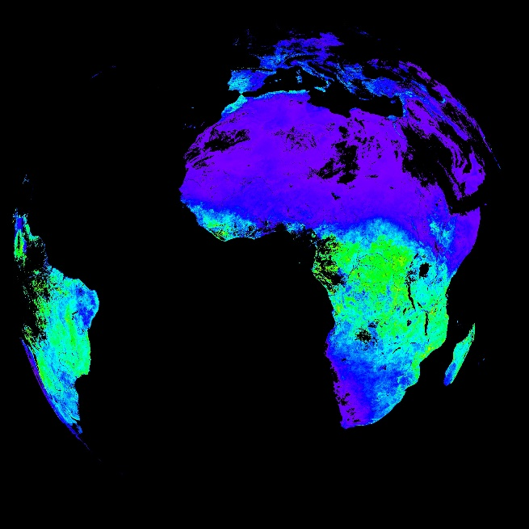
Examples of some products evolution
MSG 10-days Gross Primary Production (MGPP) (Operational)
The LSA SAF has been released a new product that helps to characterize ecosystem processes.
The gross primary production (GPP), i.e. the rate at which vegetation converts light into chemical energy by photosynthesis, is an essential parameter to characterize the ecosystem processes. The assessment of GPP on wide areas, which is necessary to study the global carbon cycle and for planning and managing resources in response to changing environmental conditions, can be performed using procedures driven by remote sensing data.
201803210000

Slide 53
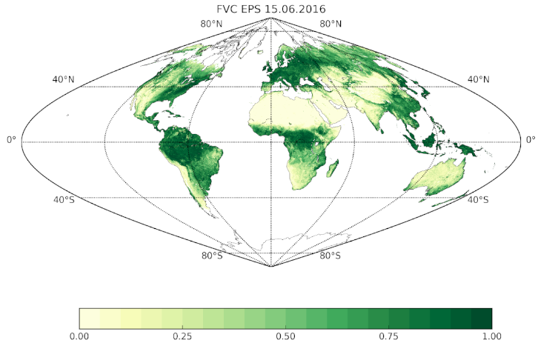
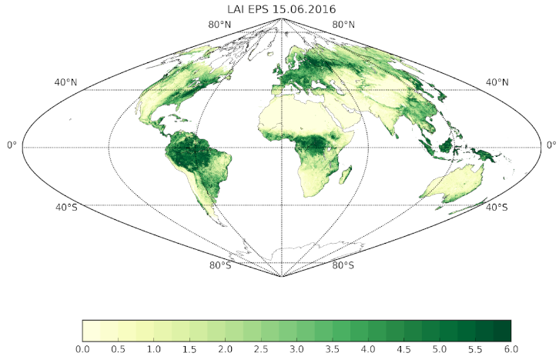
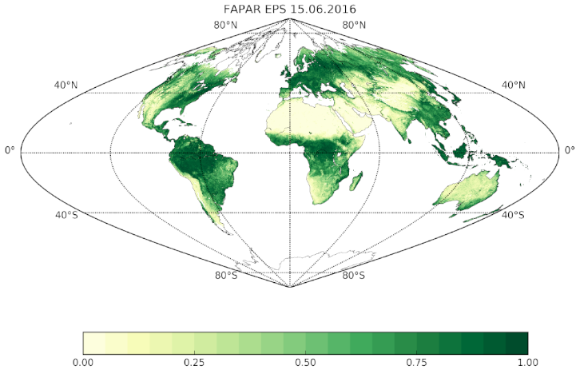
Examples of some products evolution
EPS vegetation products released declared as operacional
Discover the suite of ten-day vegetation products derived from Metop/AVHRR measurements.
The preoperational LAI, FAPAR and FVC biophysical products are level 3 full globe rectified images in sinusoidal projection, centred at (0ºN, 0ºW) with a resolution of 0.01º×0.01º. The products are available since January 2015 on a 10-day basis.
A novel multi-output algorithm is used for the joint retrieval of LAI, FAPAR and FVC, which combines physically-based radiative transfer models with advanced machine learning methods (García-Haro et al. 2018). The products include an uncertainty estimate which is especially useful for data assimilation applications. The quality assessment is performed in agreement with best practices for validations of global satellite products.
ETFVC
ETLAI
ETfAPAR
20160615

Slide 54
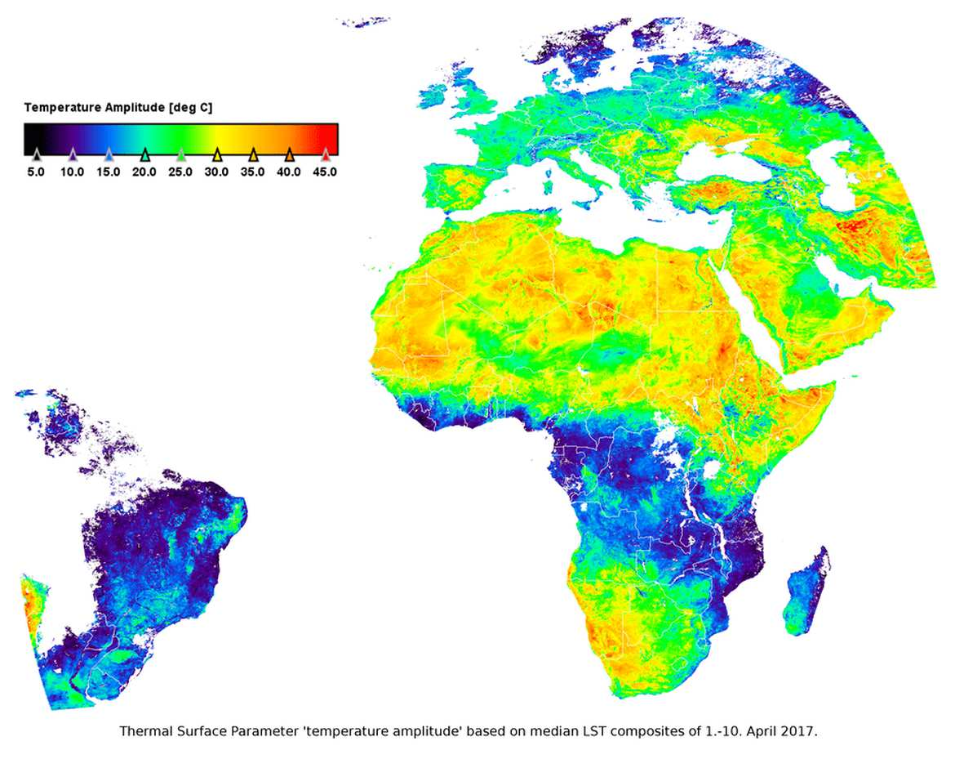
Examples of some products evolution
Included Product: Derived Land Surface Temperature. Operational
10-day synthesis of MSG/SEVIRI LST in the form of temporal composites and thermal surface parameters is now available.
This product provides a synthesis of the Meteosat Land Surface Temperature products within a 10 day interval. It consists of two sub-products: LSA-003A, the maximum and median MLST composites over the 10-day interval, and LSA-003B, a set of so-called Thermal Surface Parameters (TSP; LSA-003B), which are obtained by fitting a diurnal temperature cycle model (Göttsche and Olesen, 2009) to the corresponding MLST composites.

Slide 55
Data Records

Slide 56
Data Records
LSA-050 | MSG Land Surface Temperature - Reprocessed since 2004 | MLST-R | FTP | DR
LSA-150 | MSG 10-day Surface Albedo - Reprocessed since 2004 | MTAL-R | FTP | DR
LSA-151 | MSG 10-day Surface Albedo - Reprocessed since 2004 v2 | MTAL-R v2 | FTP | DR
LSA-152 | EPS 10-daily Surface Albedo - Reprocessed since 2007 | ETAL-R | FTP | DR
LSA-350 | MSG Evapotranspiration CDR | MET-R | FTP | DR
LSA-351 | Sensible Heat Flux CDR | MH-R | FTP | DR
LSA-352 | Latent heat flux CDR | MLE -R | FTP | DR
LSA-450 | MSG 10-day Fraction of Vegetation Cover - Reprocessed since 2004 | MTFVC-R | FTP | DR
LSA-451 | MSG 10-days Leaf Area Index - Reprocessed since 2004 | MTLAI-R | FTP | DR
LSA-452 | MSG 10-days Fraction of Absorbed Photosynthetically Active Radiation - Since 2004 | MTfAPAR-R | FTP | DR
LSA-450.2 | MSG 10-day Fraction of Vegetation Cover - Since 2004 version 2 | MTFVC-R v2 | FTP | DR
LSA-451.2 | MSG 10-days Leaf Area Index - Reprocessed since 2004 version 2 | MTLAI-R v2 | FTP | DR
LSA-452.2 | MSG 10-days Fraction of Absorbed Photosynthetically Active Radiation - Since 2004 V2 | MTfAPAR-R v2 | FTP | DR
LSA-453 | Vegetation index CDR | ENDVI10 - CDR | FTP | DR
LSA-454 | Vegetation index CDR – v2 | ENDVI10 - CDR | FTP | DR
LSA-455 | EPS Fraction of Vegetation Cover CDR | ETFVC - R | FTP | DR
LSA-456 | EPS Leaf Area Index CDR | ETLAI - R | FTP | DR
LSA-457 | EPS Fraction of Absorbed Photosynthetically Active Radiation CDR | ETfAPAR - R | FTP | DR
LSA-550 | Fire Radiative Power/Pixel - Reprocessed since 2004 | FRPPixel-R | FTP | DR
LSA-551 | Fire Radiative Power/Gridded - Reprocessed since 2004 | FRPGrid-R | FTP | DR
LSA-550.2 | Fire Radiative Power/Pixel - Reprocessed since 2004 version 2 | FRPPixel-R v2 | FTP | DR
LSA-551.2 | Fire Radiative Power/Gridded - Reprocessed since 2004 version 2 | FRPGrid-R v2 | FTP | DR

Slide 57
Data Records
LSA-201 | MSG Downward Surface Shortwave Flux, with a temporal frequency of 30-minute | MDSSF-R | FTP | DR
LSA-203 | Daily Downward Surface Shortwave Flux | DIDSSF | FTP | DR
LSA-204 | MSG Downward Surface Longwave Flux, with a temporal frequency of 30-minute | MDSLF-R | FTP | DR
LSA-206 | Daily Downward Surface Longwave Flux | DIDSLF | FTP | DR
LSA-303 | Reference Evapotranspiration | METREF-R | FTP | DR
Please note this set of new CDRs corresponds to Demonstration Products.
These CDRs were generated for the 2004-2015 period, covering the full MSG disk (only prime satellite) on a pixel-by-pixel basis, and using the algorithm of the corresponding near real-time operational products

Slide 58
Conclusions
LSA SAF products have a large potential to be included in different applications and not just the traditional meteorological community (Agriculture, Hydrology, Wild Fires, etc.);
Contacts with different user communities and getting feedback is an important mechanism to improve products;
LSA SAF products has grown significantly both, in quality and quantity. This development shall have impact in new applications to be developed by users;
The use of reprocessed series already available is important. The same algorithm running for several years can help climatological proposes;
Preparation for MTG and EPS-SG is ongoing as scheduled, challenging EUMETSAT, SAFs and, later, user communities;
LSA SAF products are free distributed for all users, including for commercial activities.

Slide 59
https:/landsaf.ipma.pt/
Thank You

