Slide 1
EPS-SG Overview
Peter Schlüssel

Slide 2
EPS-SG
  Continuity of the EUMETSAT Polar System Services
    Provision of continuous long-term datasets in support of operational meteorological and environmental forecasting and global climate monitoring
  EPS-SG will be part of the NOAA / EUMETSAT Joint Polar System
    Service in the mid-morning orbit covered by EUMETSAT
    Service in the afternoon orbit covered by NOAA
  EPS-SG will fulfil the European contribution to the WMO Global Observing System (GOS) as concerns the space-based observations from polar orbits
  EPS-SG will rely on international cooperation for the development and on national contributions for key instruments
    ESA: development of the space segment
    CNES: development of IASI-NG and Argos-4
    DLR: development of METimage

Slide 3
EUMETSAT Polar System – Second Generation
Programme Objectives
  Primary mission: further improve observational inputs to Numerical Weather Prediction models.
  Continuation and enhancement of service from mid morning polar orbit in 2022 – 2042.
  Significant contributions to other real time applications:
    Nowcasting at high latitudes
    Marine meteorology and operational oceanography
    Operational hydrology
    Air quality monitoring
  Climate monitoring: expand by 20+ years the climate data records initiated in 2006 with EPS (first generation).

Slide 4
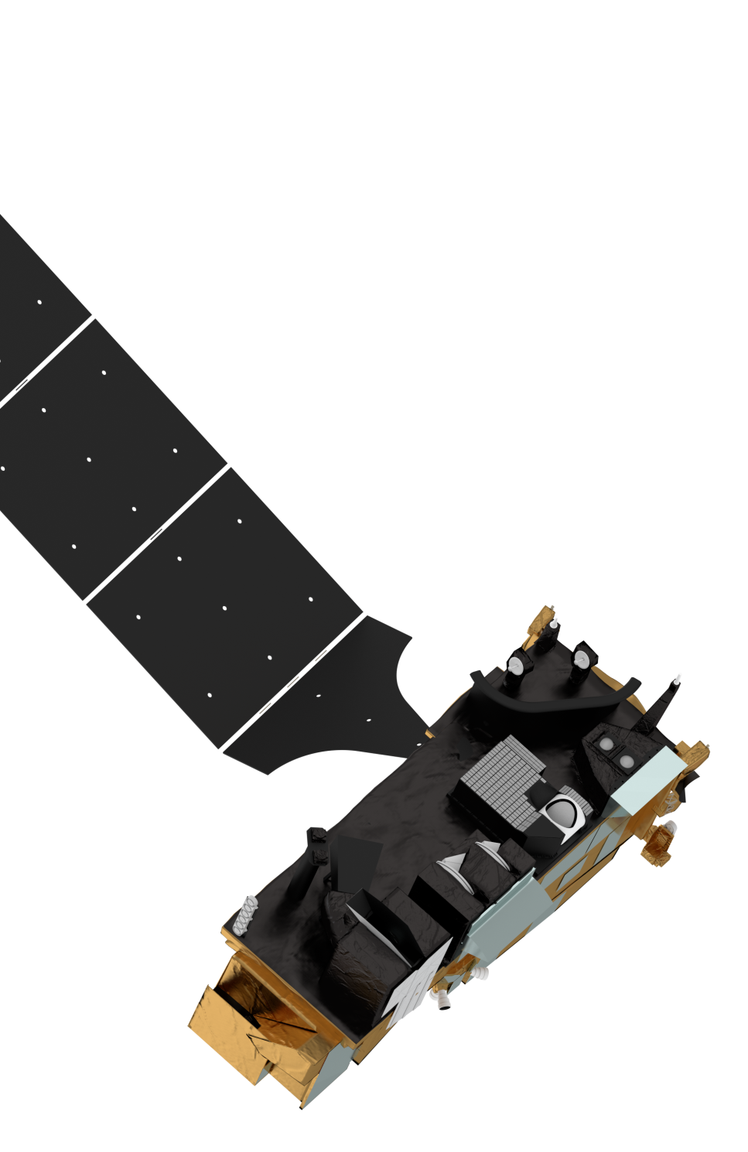
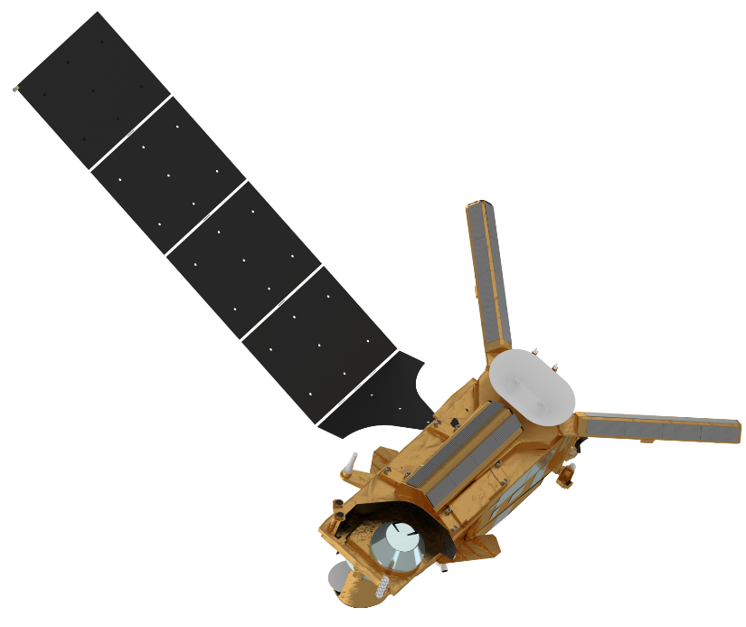

EPS-SG: Metop-SG satellites
Metop-SG B
SCA
Scatterometer
Metop-SG A
Radio Occultation
RO
MWI
Micro-Wave Imager
Radio Occultation
RO
3MI
Multi-viewing,
-channel,
-polarisation Imager
ICI
sub-mm wave Ice Cloud Imager
MWS
Micro-Wave Sounder
Sentinel-5
UV-VIS-NIR-SWIR Sounder
Two-satellite configuration Metop-SG-A and –B
on the same orbit, separated by 90°
Metop-like orbit:
→ Sun synchronous
→ low earth orbit at 835 km mean altitude
→ 09:30 local time of the descending node
  First launches:
    11/2022 Metop-SG A1 11/2023 Metop-SG B1
METimage
Visible-Infrared Imager
IASI-NG
Infrared Atmospheric Sounding Interferometer
– New Generation

Slide 5
EPS-SG benefits to activities of NMSs
Main Payload | Enhanced Capabilities | Innovative Capabilities | Applications Benefiting
High-Resolution Infrared Sounding (IASI-NG) | +75% information in temperature profiles +30% in humidity-profiles | More trace gases and their vertical profiles | NWP, NWC, AC, CM, Oceanography
Microwave Sounding (MWS) | Enhanced spatial over-sampling | Ice-cloud info in support of water-vapour profiling | NWP, NWC, CM, Hydrology
Radio Occultation Sounding (RO) | Large increase of number of radio-occultations | Tracking of Galileo, Beidou and QZSS signals | NWP, CM
Nadir viewing UV/VIS/NIR/SWIR Sounding (Sentinel-5) | Drastic increase of spatial resolution | Additional trace gas measurements; CO₂ being studied | Air Quality, CM, AC
VIS/IR Imaging (METimage) | Better radiometric and spatial resolution | Far more variables measured with higher accuracy | NWC, NWP, CM, Land-surface analysis, Oceanography, Hydrology
Scatterometry (SCA) | Higher spatial resolution and coverage | Cross polarisation for higher wind speeds | NWP, NWC, CM, Hydrology, Oceanography
Multi-viewing, -channel, -polarisation Imaging (3MI) | New mission | Aerosol parameters | Air quality, CM, NWC, Land surface analysis
Microwave Imaging (MWI) | New mission | Precipitation observations | NWP, NWC, Hydrology, CM, Oceanography
Ice Cloud Imaging (ICI) | New mission | Cloud microphysics parameters | NWP, NWC, Hydrology, CM
NWP: Numerical Weather Prediction; NWC: Nowcasting; CM: Climate Monitoring; AC: Atm. Composition

Slide 6
EPS-SG Sounding Missions
EPS-SG Sounding Missions
Main Payload | Heritage | Applications Benefiting
High-Resolution Infrared Sounding (IASI-NG) | IASI | NWP, NWC, AC, CM, Oceanography
Microwave Sounding (MWS) | AMSU-A and MHS | NWP, NWC, CM, Hydrology
Radio Occultation Sounding (RO) | GRAS | NWP, CM
Nadir viewing UV/VIS/NIR/SWIR Sounding (UVNS - Sentinel-5) | GOME-2 | Air Quality, CM, AC
All missions on SAT-A, RO on both satellites
NWP: Numerical Weather Prediction; NWC: Nowcasting; CM: Climate Monitoring; AC: Atm. Composition

Slide 7
EPS-SG Imaging Missions
EPS-SG Imaging Missions
Main Payload | Heritage | Applications Benefiting
VIS/IR Imaging (METimage) | AVHRR | NWC, NWP, CM, Land-surface analysis, oceanography, hydrology
Scatterometry (SCA) | ASCAT | NWP, NWC, CM, hydrology, oceanography
Multi-viewing, -channel, -polarisation Imaging (3MI) | New mission | Air quality, CM, NWC, Land surface analysis
Microwave Imaging (MWI) | New mission | NWP, NWC, Hydrology, CM, Oceanography
Ice Cloud Imaging (ICI) | New mission | NWP, NWC, Hydrology, CM
MetImage and 3MI on board Sat-A
SCA, MWI, ICI on board Sat-B
NWP: Numerical Weather Prediction; NWC: Nowcasting; CM: Climate Monitoring; AC: Atm. Composition

Slide 8
Sounding missions
Measure the vertical distribution of the atmospheric state
Infrared Atmospheric Sounding Interferometer – New Generation (IASI-NG)
Micro-Wave Sounding (MWS)
Radio Occultation Sounding (RO)
Nadir viewing UV/VIS/NIR/SWIR Sounding (Sentinel-5)

Slide 9
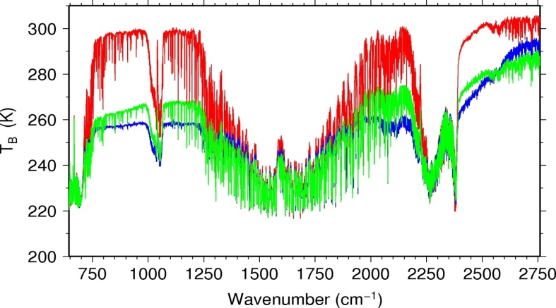
Hyper-spectral infrared sounding
(IASI – NG)
Objectives / products
Temperature/humidity profile at high vertical resolution in clear air
Clouds, trace gases (O₃, CO, CH₄, CO₂,...)
Sea/land/ice surface temperature
Aerosols, Volcanic Ash
Key performances
Spectral range: 645 – 2760 cm⁻¹
Spectral resolution: 0.25 cm⁻¹
Radiometric calibration: 0.25 K
Stability: 0.1 K
Radiometric noise: 0.045 – 1.1 K
Pixel size: 12 km
Spatial sampling: 25 km
Cross-track scan
Applications benefitting
Numerical weather prediction
Nowcasting
Climate monitoring
Oceanography
Atmospheric composition
Breakthrough
Doubling of spectral and increase of radiometric resolution of IASI for the benefit of weather forecast and atmospheric composition
    75% more information in temperature profiling, particularly PBL
    30 % more information in water vapour profiling
    Quantification of trace gases which are currently only detected
    Vertical resolution of trace gases instead of columnar amounts only

Slide 10
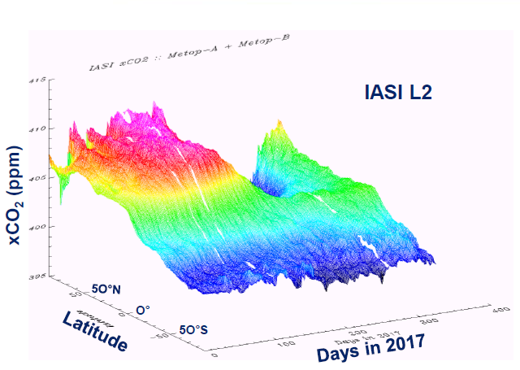
Hyper-spectral infrared sounding
(IASI – NG)
Level 1C product
16921 spectral radiance samples
    Apodised, calibrated, geolocated
Level 1D product
Principal component scores of Level 1C spectra
    No new development needed, adaptation of methodology from IASI
Level 2 products
Continuation of IASI Level 2
    Re-use of methods developed for IASI at Day-1
    Lower errors in products
    Day-2 developments of new products together with SAF on Atmospheric Composition
    Activities ongoing for new or improved trace gas and cloud products
    Combined IASI-NG/MWS products being developed

Slide 11
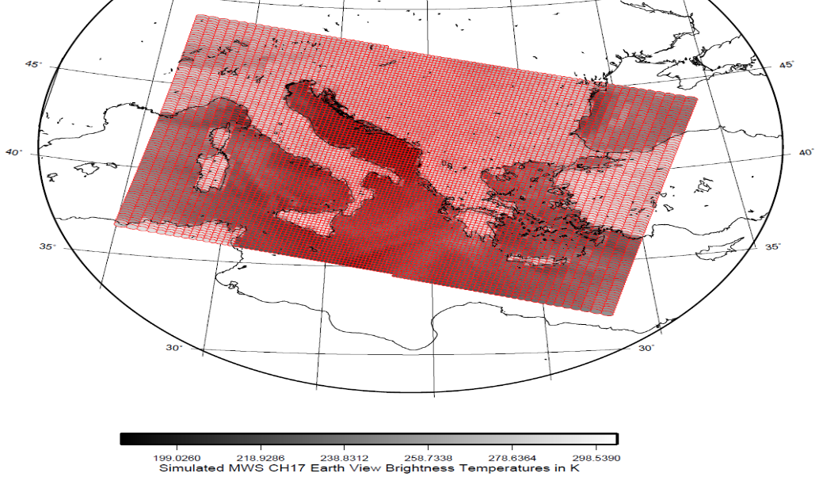
Micro-wave sounding (MWS)
Objectives / products
Temperature/humidity profiles in clear and cloudy air
Cloud liquid water total column
Imagery: precipitation
Key performances
24 channels: 23.8 – 229 GHz
Absolute calibration: 0.5 K
Radiometric noise: 0.2 – 1.6 K
Footprint size: 17 – 40 km
Cross-track scan
Applications benefitting
Numerical weather prediction
Nowcasting
Climate monitoring
Hydrology
Breakthrough
Addition of a quasi-window channel at 229 GHz (recommended by ITSC-11)
  Cirrus cloud information giving a better humidity retrieval performance
Addition of sounding channels
  + 2 channels at 53-54 GHz
  + 2 channels at 183.31 GHz
  More information on temperature and water vapour profiles

Slide 12
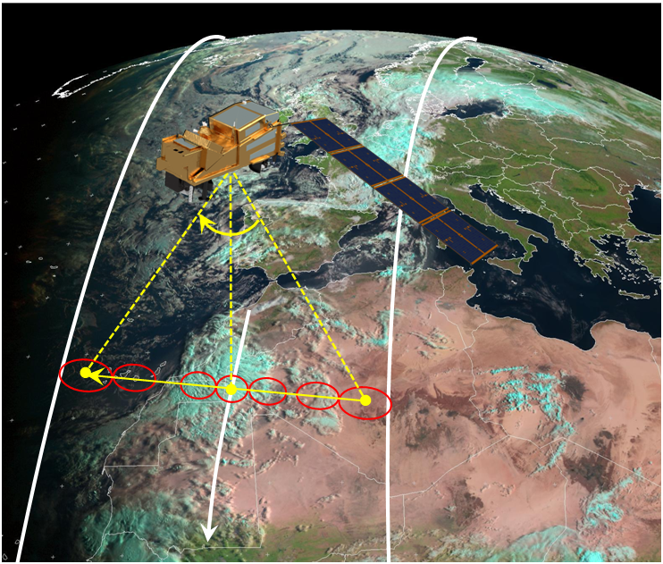
Micro-wave sounding (MWS)
Level 1B
Calibrated and geolocated radiances in 24 spectral channels
  + 2 temperature sounding channels at 53-54 GHz
  + 2 humidity sounding channels at 183.31 GHz
  + quasi-window channel at 229 GHz providing cirrus cloud information for better humidity retrieval
Level 2
Total precipitable water
  Continuity of AMSU-A / MHS product

Slide 13
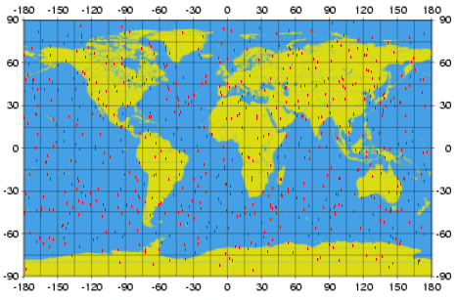
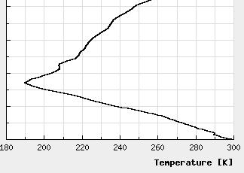
Radio occultation sounding (RO)
Objectives / products
Refractivity profiles at high vert. resolution
Temperature / humidity profiles
PBL top and tropopause height
Ionospheric electron content
Key performances
Tracking of GPS and Galileo satellites
Optional: Beidou and QZSS
RO on two satellites: > 2600 occultations per day (GPS and Galileo only)
Bending angle accuracy: 0.5 µrad or 0.2%
Applications benefitting
Numerical weather prediction
Climate monitoring
Space weather
Breakthrough
Tracking of GPS and Galileo satellites to double the number of occultation measurements, addition of Beidou and QZSS
Equipment of both Metop-SG satellites with RO in case of a dual satellite configuration

Slide 14
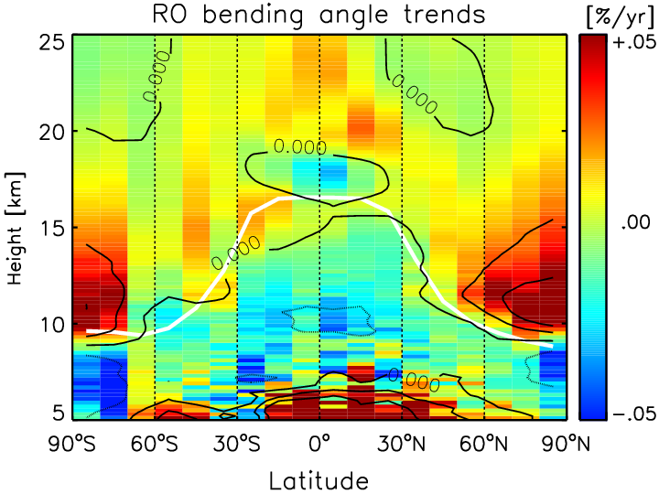
Radio occultation sounding (RO)
Level 1B
Geolocated bending angles
Addition of new GNSS constellations
  Galileo
  Beidou
  Quasi Zenith Satellite System (QZSS)
Inclusion of new Precise Orbit Determination (POD)
Level 2
ROM SAF: 8 level 2 products
Space weather products under development
GFZ Potsdam, 2011

Slide 15
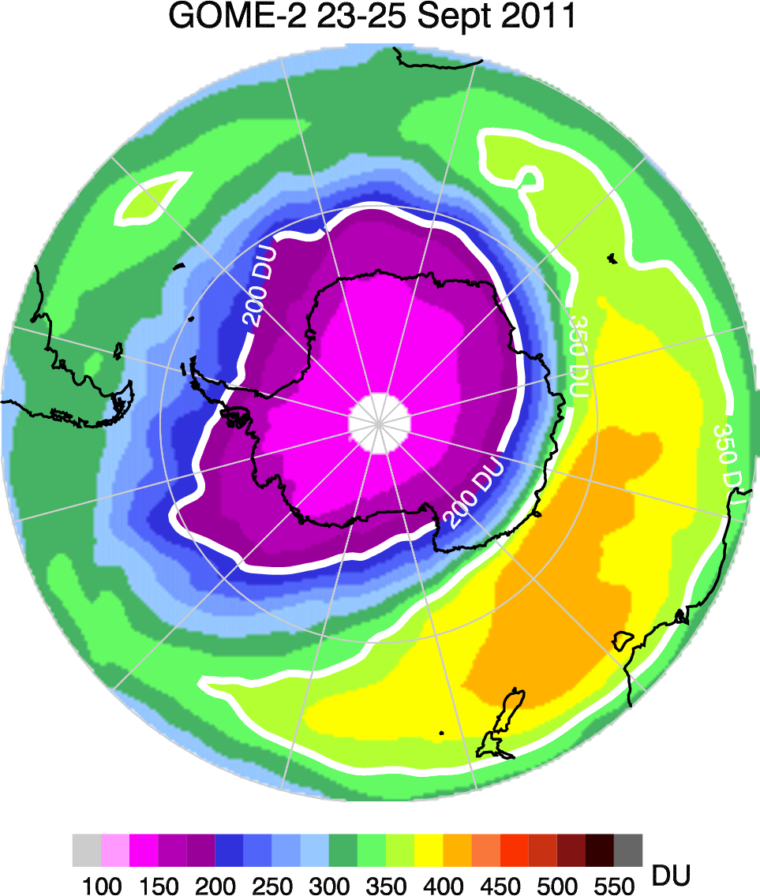
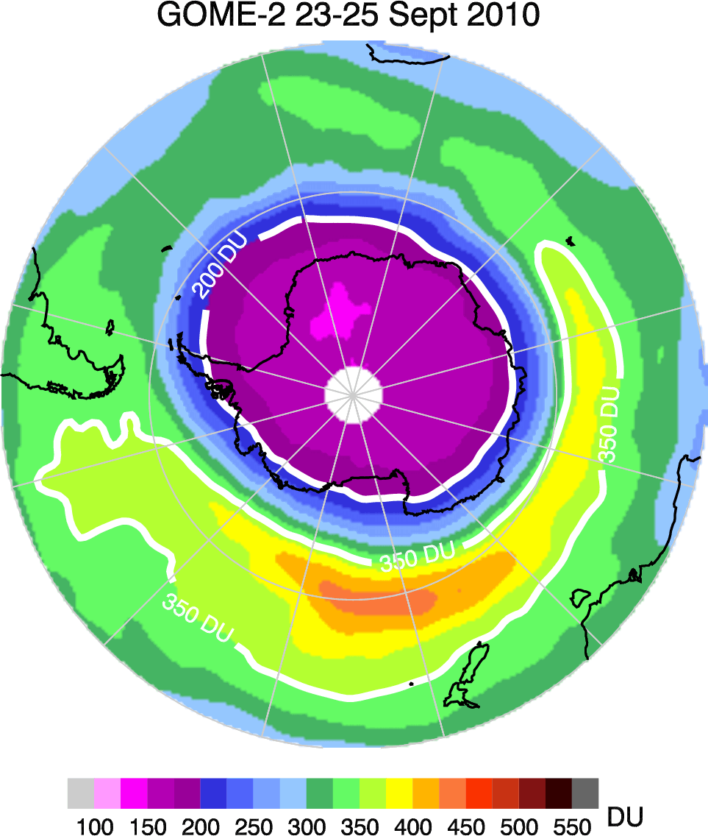
Nadir viewing UV/VIS/NIR/SWIR sounding
(Sentinel-5)
Objectives / products
Ozone profile and column
Columns of CO₂,SO₂, NO₂, H₂O, CO, CH₄,
Aerosol optical depth
Columns of BrO, HCHO, OCHCHO
Volcanic Plumes
Key performances
Spectral range: 0.27 – 2.385 µm
Spectral resolution: 0.25 – 1 nm
Radiometric calibration: 1 – 2%
SNR: 120 - 1500
Spatial sampling: 7.5 km
Cross-track scan
Applications benefitting
Air quality forecasting
Ozone-UV
Atmospheric Composition
Climate monitoring
XXXX
X
Breakthrough
Drastically increased spatial sampling (7.5 km)
    for the benefit of air quality monitoring
Extended spectral range into the near and shortwave infrared regions
    to measure aerosols as well as methane and carbon monoxide in the PBL

Slide 16
Nadir viewing UV/VIS/NIR/SWIR sounding (Sentinel-5)
Level 1B
Calibrated and navigated spectral radiances
    Spectral resolution of 0.25 – 1 nm
    Spatial sampling at 7.5 km
Level 2
Development by ESA on behalf of Copernicus
    18 trace gas, aerosol, and surface products
    Processing will be implemented at EUMETSAT HQ for NRT dissemination
Further products being developed by the SAF on Atmospheric Composition
    4 trace gas products
XXXX
X

Slide 17
Imaging missions
Measure the horizontal distribution of clouds, aerosols, and surface variables
Visible/Infra-red Imaging (METimage)
Multi-viewing, -channel, -polarisation Imaging (3MI)
Micro-wave Imaging (MWI)
Ice Cloud Imaging (ICI)
Scatterometry (SCA)

Slide 18
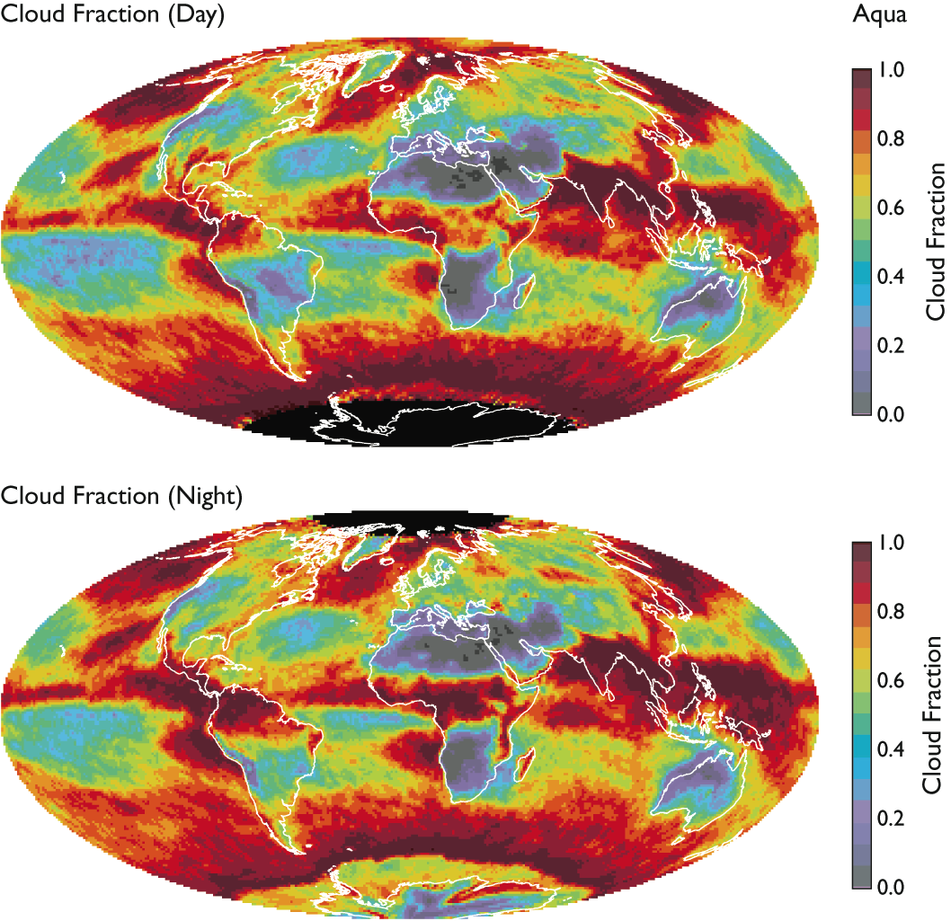
Optical imaging (METimage)
Objectives / products
Hi-res cloud products, incl. microphysics
Aerosols
Polar AMVs
Vegetation, snow, fire
Sea/ice/land surface temperature
Support to sounding missions
Key performances
20 channels: 0.443 – 13.345 µm
Absolute calibration: 5% (short-wave)
0.5 K (long-wave)
Radiometric sensitivity:
SNR 60 – 500 (short-wave)
0.05 – 0.3 K (long-wave)
Spatial sampling: 500 m
Cross-track scan
Applications benefitting
Nowcasting
Numerical weather prediction
Oceanography
Hydrology
Climate monitoring
Land surface analysis
Breakthrough
Far more spectral channels than AVHRR for the benefit of measuring more variables
Higher spatial sampling (500 m):
    more complete coverage through greater likelihood to measure surface variables in partly cloud conditions
Better radiometric resolution for more accurate quantification of many variables

Slide 19
Optical imaging (METimage)
Level 1B
Calibrated and navigated radiances in 20 spectral channels at 500 m sampling
Level 2 Cloud Mask
Product in support of IASI-NG, S-5, 3MI
  Fast algorithms to allow usage of product in other product processing
  Will be part of Level 2 product
Level 2 products
Centrally generated
    7 cloud variables, total precipitable water, polar atmospheric motion vectors, volcanic ash
Products by SAFs on Hydrology, Land Surface Analysis, Ocean and Sea Ice
    Snow cover, surface temperature (sea/ice/land), albedo, vegetation cover / index, leaf area index, FAPAR, burnt area, BRDF, fire radiative power

Slide 20
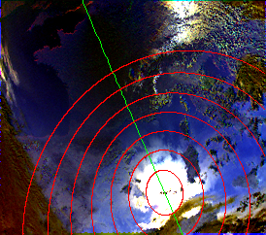
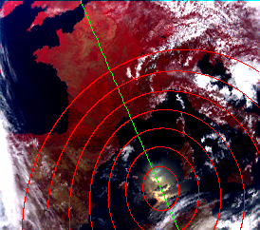
Multi-viewing Multi-channel
Multi-polarisation Imaging (3MI)
Objectives / products
Aerosol – optical thickness, particle size,
type, height, absorption
Volcanic Ash
Cloud phase, height, optical depth
Surface albedo
Key performances
12 channels: 0.41 – 2.13 µm
3 polarisations: 0°, 60°, -60°
14 views
Radiometric bias: 3%
SNR: 200
Spatial sampling: 4 km
Push-broom scan (2200 km swath)
Applications benefitting
Climate monitoring
Nowcasting
Air quality
Land surface analysis
Breakthrough:
Enhanced spatial sampling (4 km)
  Improves separation of cloudy areas
12 spectral channels (9 polarised), extending into the SWIR
  Better aerosol characterisation
High angular resolution (14 views)
  Phase function characterisation

Slide 21
Multi-viewing Multi-channel
Multi-polarisation Imaging (3MI)
Level 1B
Radiances in 12 spectral channels at three polarisations 0°, 60°, -60°, calibrated and geolocated
  4 km sampling
  2200 km swath
Level 1C
Stokes vectors
  Geoprojected, regridded
Level 2
Aerosol product
  GRASP (Generalized Retrieval of Aerosol and Surface Properties)
Cloud product
  Optical thickness, top pressure, phase, albedo, droplet size
LSA SAF
  Surface albedo, BRDF, vegetation cover, FAPAR, leaf area index

Slide 22
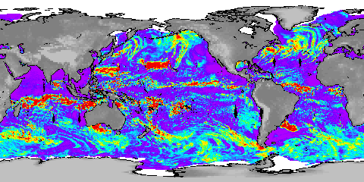
Micro-wave imaging (MWI)
Objectives / products
Precipitation and cloud products
Water vapour imagery
Sea-ice, snow, sea surface wind
Key performances
18 channels: 18.7 – 183 GHz
Dual polarisation (V, H) up to 89 GHz
V polarisation at higher frequencies
Radiometric accuracy: 1 K
Radiometric sensitivity: 0.6 – 1.2 K
Footprint size: 10 – 50 km
Spatial sampling: 7 km
Conical scan
Applications benefitting
Numerical weather prediction
Nowcasting
Oceanography
Hydrology
Climate monitoring
Cloud Liquid Column
mm
Breakthrough: 18 channels
Continuity of key microwave imager channels for weather forecast
Inclusion of dedicated sounding channels (118.75 GHz)
  Enhanced precipitation measurements through inclusion of dedicated sounding channels
Extended suite of 183.31 GHz channels
  water-vapour and cloud profiling

Slide 23
Micro-wave imaging (MWI)
Level 1B
Radiances in 18 spectral channels, dual polarisation up to 89 GHz, calibrated and geolocated
  Continuation of key micro-wave imager channels
  Inclusion of dedicated sounding channels (118.75 GHz) for enhanced precipitation measurement
  Extended suite of 183.31 GHz channels for water vapour and cloud profiling
Level 2
Centrally generated: cloud liquid water path
SAFs: rain products, sea ice products, wind speed over ocean

Slide 24
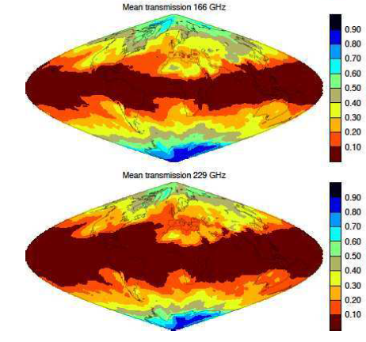
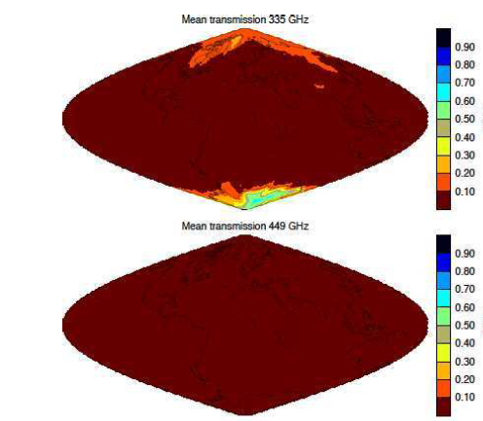
Ice cloud imaging (ICI)
Objectives / products
Cloud products, in particular ice clouds
Snowfall detection and quantification
Water-vapour profiles and imagery
Key performances
11 channels: 183 – 664 GHz
Single polarisation (V) for all channels
Dual polarisation (V, H) at 243 and 664 GHz
Radiometric accuracy: 1 – 1.5 K
Radiometric sensitivity: 0.6 – 1.9 K
Footprint size: 15 km
Spatial sampling: 7.5 km
Conical scan
Applications benefitting
Numerical weather prediction
Nowcasting
Hydrology
Climate monitoring
Breakthrough: 11 channels
Establishes operational ice-cloud imaging mission
Support of weather forecast, hydrology, and climate monitoring

Slide 25
Ice cloud imaging (ICI)
Level 1B
Radiances in 11 spectral channels
  Two channels with dual polarisation
Level 2
Centrally generated: cloud ice water path
H SAF: snowfall products

Slide 26
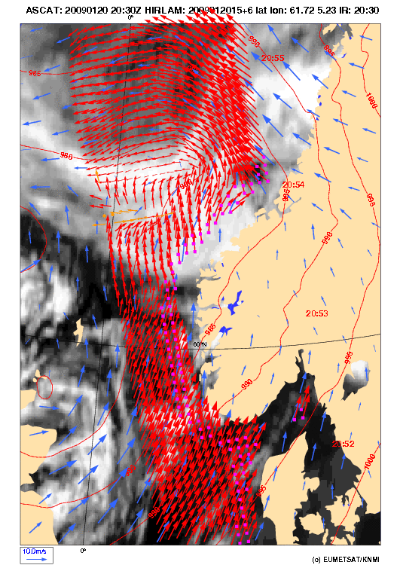
Scatterometry (SCA)
Objectives / products
Ocean surface wind vectors
Soil moisture
Snow equivalent water
Sea-ice type
Key performances
C-band carrier frequency
VV, HH, VH, HV polarisation
Measurement range: 4 – 40 m/s
Radiometric resolution: 3%
Spatial resolution: 25 km
Dual swath: 600 km each
Applications benefitting
Numerical weather prediction
Nowcasting
Oceanography
Hydrology
Climate monitoring
Breakthrough
Increase of spatial resolution to 25 km
  Better approach of coast lines
Increase of swath width to ~1200 km
  Enhanced coverage
Addition of cross polarisation
  Covers higher wind speeds without saturation, will benefit observation of tropical and extra-tropical storms

Slide 27
Scatterometry (SCA)
Level 1B
Backscatter cross sections at a spatial resolution of 25 km in two swaths of 600 km width
Cross-polarisation signals are subject to errors due to the Faraday rotation in the Earth atmosphere, correction will be added to the product
  Dependent on total electron content (TEC)
  Dependent on Earth magnetic field
Level 2
OSI SAF: Surface wind vectors
  Cross-polarisation measurements will allow measurements of surface wind speeds up to ~70 m/s
  H SAF: Surface soil moisture products

Slide 28
Global and Regional Data Services
Timeliness requirements
Global Data Service:
To send L1b global (worldwide) products to end users within end-to-end breakthrough timeliness
 | Threshold |  | Breakthrough
Data received | 50% | 90% | 50% | 95%
Global | 110 min | 120 min | 60 min | 70 min
Regional Data Service:
To send L1b regional (sensed over Europe and North Atlantic) products to end users within end-to-end breakthrough timeliness
 | Threshold |  | Breakthrough
Data received | 50% | 90% | 50% | 95%
Regional | 30 min | 110 min | 20 min | 30 min
*

Slide 29
Key Meteorological Information from EPS-SG Mission
Key Meteorological Information from EPS-SG Mission
Vertical profiles of temperature and humidity, even in cloudy cases
Wind vectors of the troposphere in polar regions
Optical and physical properties of clouds and aerosols including volcanic ash
Vertical profiles of many atmospheric gases
Sea surface temperature, ocean surface wind vectors and sea-ice
Precipitation, soil moisture and snow cover
Land surface parameters, fire
Ionospheric electron content

Slide 30
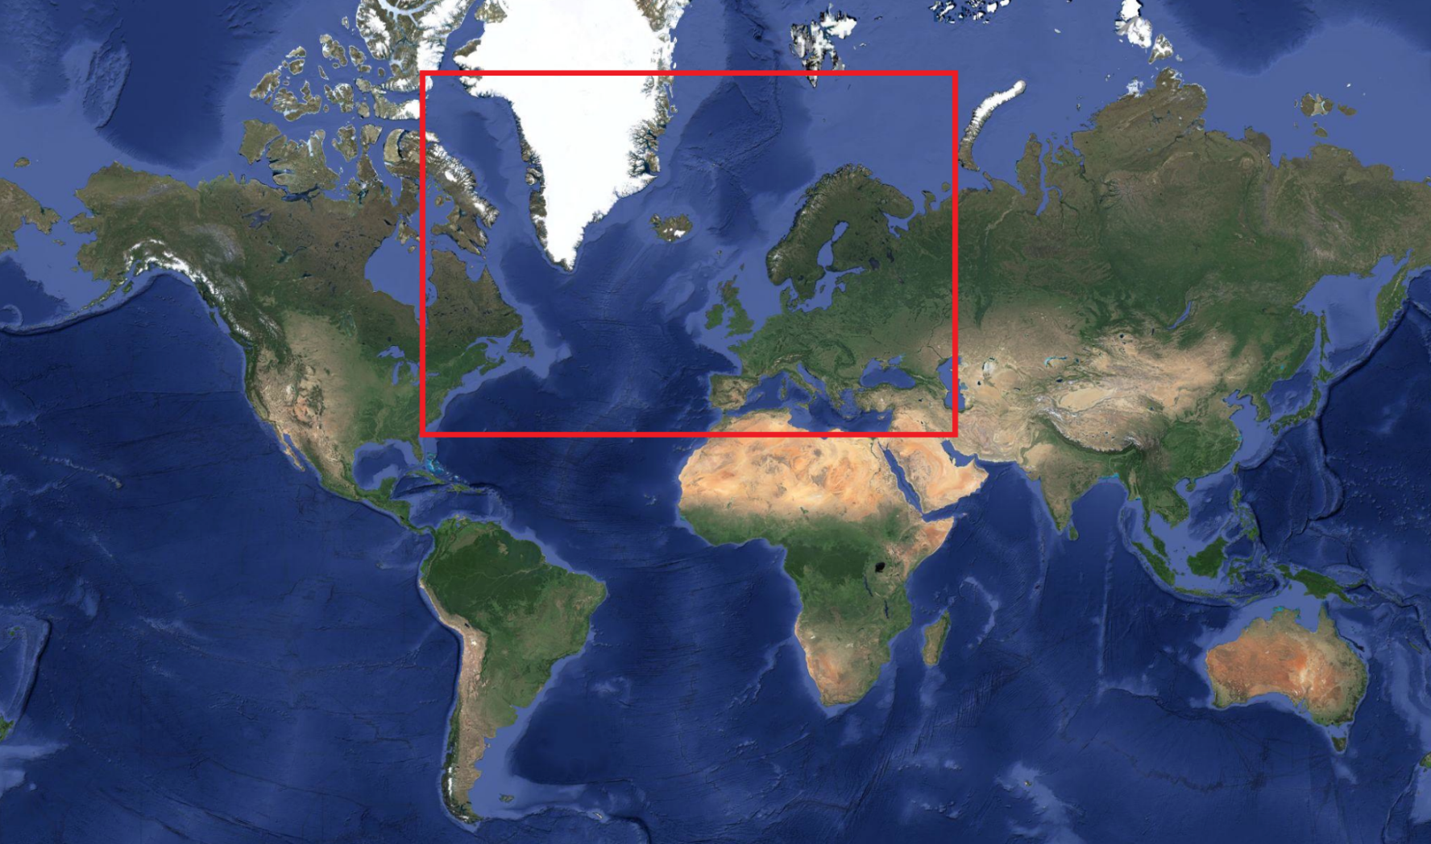
EPS-SG Regional Service

Slide 31
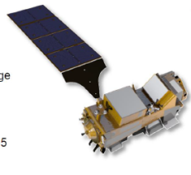
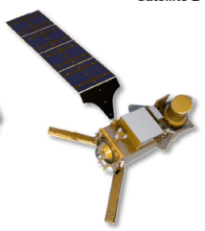
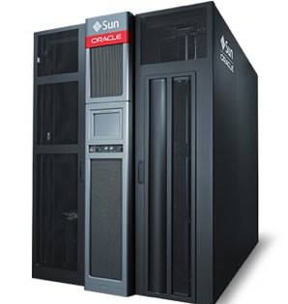
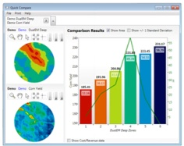
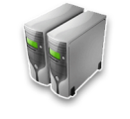
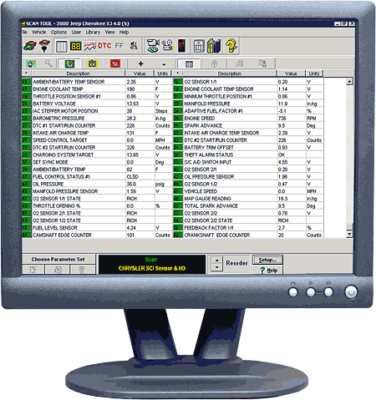

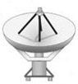


Payload Data Acquisition and Processing (PDAP)
Metop-SG/A
Metop-SG/B
EUMETSAT HQ - Mission Control Centre
Data Centre
(MME DAC)
Analysis & Reporting
and Cal/Val
Maintenance
SW development
Ka-band
SMD
Ops Prep
X-band
DDB
Configuration Mng
2 SDA
polar
stations
Global data
Global L1/L2 products
Dissemination
(MME DIS)
Regional L1/L2 products
Aux data for local users
Regional data
Payload Data
Processing
6 DBA
regional stations
Auxiliary
data
Ka-band HKTM
Auxiliary
data
DDB: Direct Data Broadcast
SMD: Stored Mission Data
SDA: Stored Data Acquisition
DBA: Direct Broadcast Acquisition
MME: Multi Mission Element
Aux data providers
External Data Ingestion
(MME DIS)
Aux data providers
Aux data providers
Mission
Operations (MO)
GS Centralised
Monitoring (MME MON)

Slide 32

Payload Data Processing: Functional Breakdown
Global
raw data
Regional
raw data
Inner functional breakdown of the
Payload Data Processing function
with main NRT data flows
Native product format:
NetCDF-4 (enhanced data model) for all products
Some products will be reformatted in BUFR before dissemination
Aux data
Data Ingestion
Production Monitoring
Payload Data Extraction and Consolidation
L0 Mission Products Generation
Processing Management
L1 and L2 Mission Products Generation
Data Aggregation, Reformatting
L1/L2 Product Generation Functions (PGFs) for all Metop-SG instruments and L1/L2 products
Data Distribution
L1 PGFs
L2 PGFs
L1 PGFs
L2 PGFs
L1 PGFs
L2 PGFs
L1 PGFs
L1 PGFs
Global L0/L1/L2 products
(archiving /
dissemination)
Regional L1/L2 products
(dissemination)
Aux data
(archiving/
dissemination

Slide 33
Summary
Products have been defined and the implementation of their operational processing is progressing
  Centrally generated L1 and L2 products
  L2 and L3 products generated by the SAF Network
Product formats have been defined, using NetCDF-4 as native format, as described in so-called Product Format Specifications (PFS)
  Global and regional products follow the same processing
  Formats for global and regional products are identical

