Slide 1
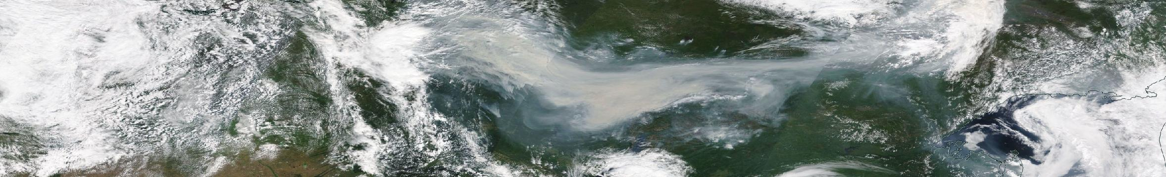
Tracking Smoke
Introduction to Satellite-Based Atmospheric Observations
of Fire Emissions
User Workshop and Training on Fire Monitoring 11.-15.5.2020
Jointly organized by EUMETSAT, CAMS-ECMWF, AC SAF, LSA SAF

Slide 2
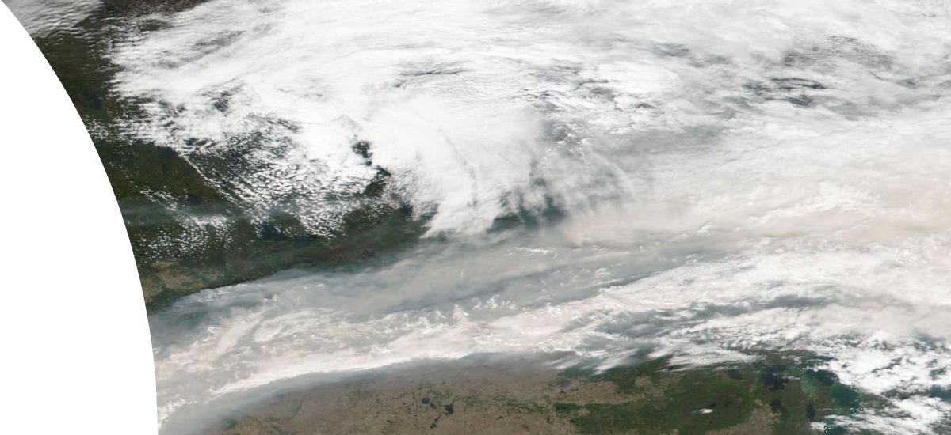
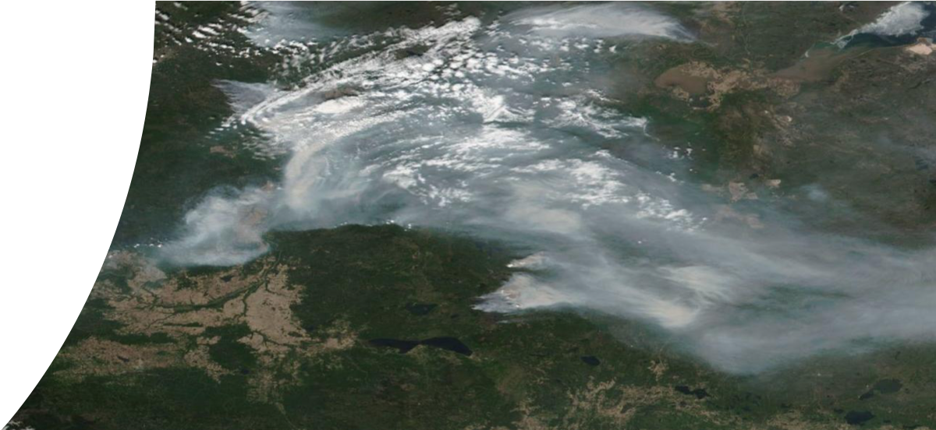


Learning objectives
Tracking smoke using relevant satellite observations
  Absorbing Aerosol Index and how to interpret the data
  Satellite-based CO and data interpretation
Learn to know sources where find quicklooks of the data
This will give you the basis also for handling the data by yourself

Slide 3
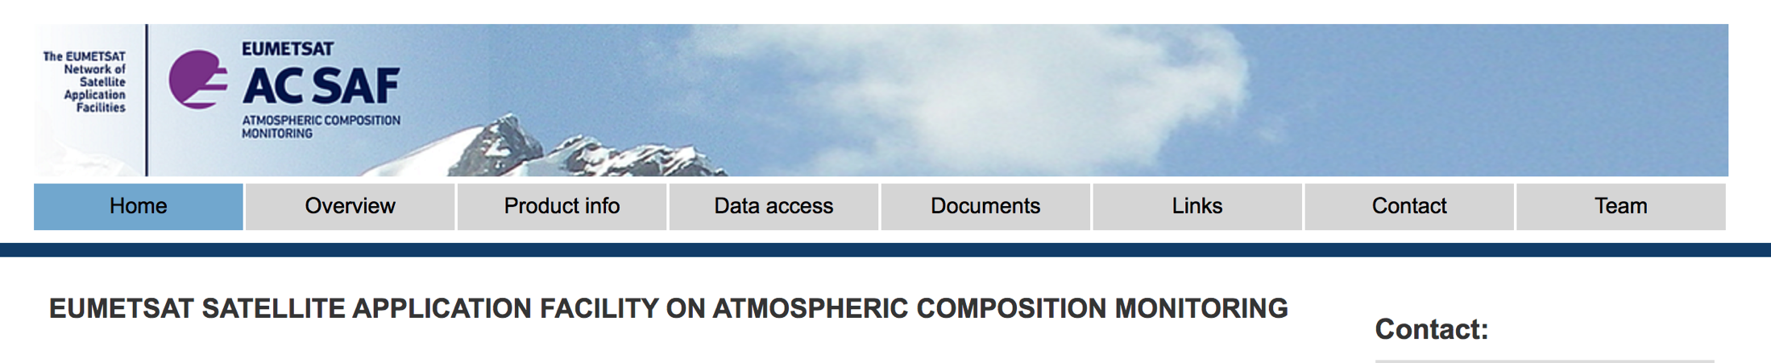












www.acsaf.org
EUMETSAT Satellite Application Facility on Atmospheric Composition Monitoring – AC SAF
Develop algorithms and methods to retrieve atmospheric composition data from polar orbiting Metop- A, -B, and –C satellites.
Carry out the validation for the AC SAF products.
Disseminate the data
Training on atmospheric composition and air quality
Leading entity
Co-operating entities
Sub-entities
@Atmospheric_SAF

Slide 4
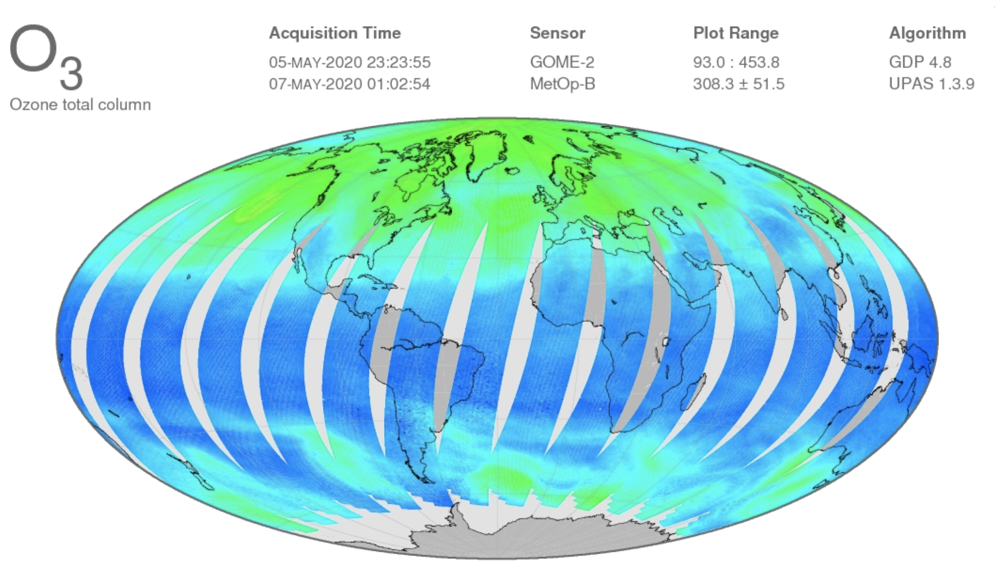
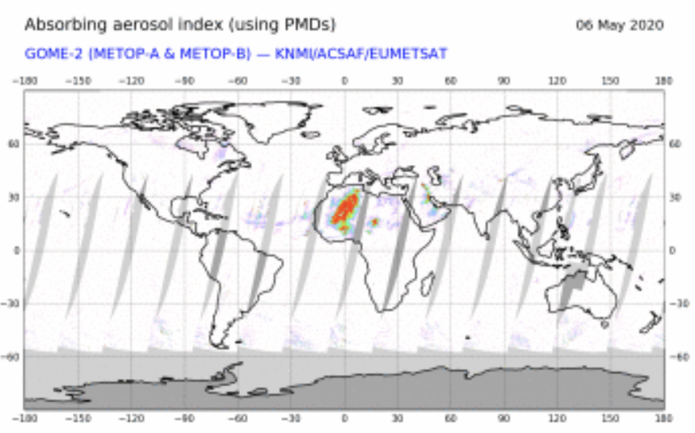
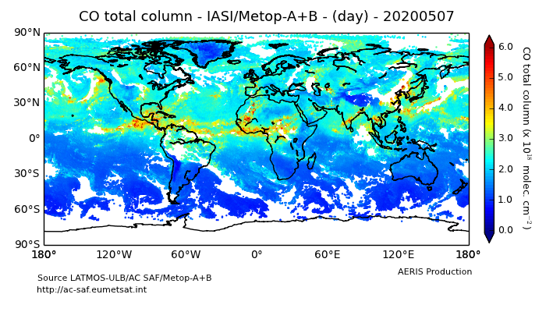
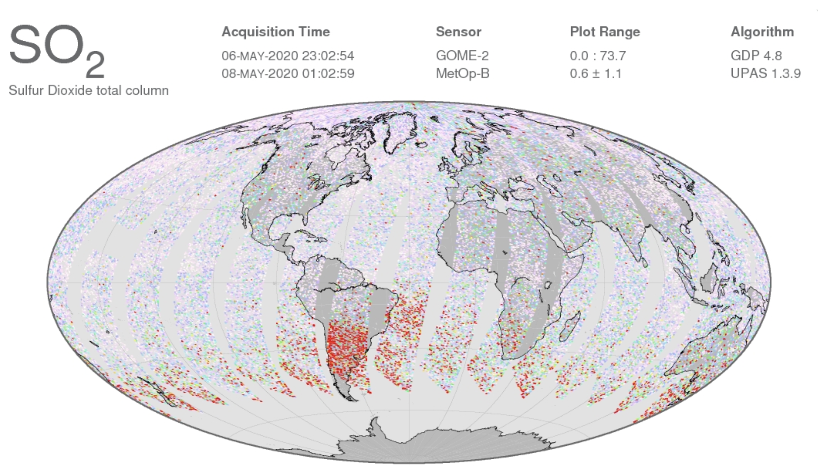
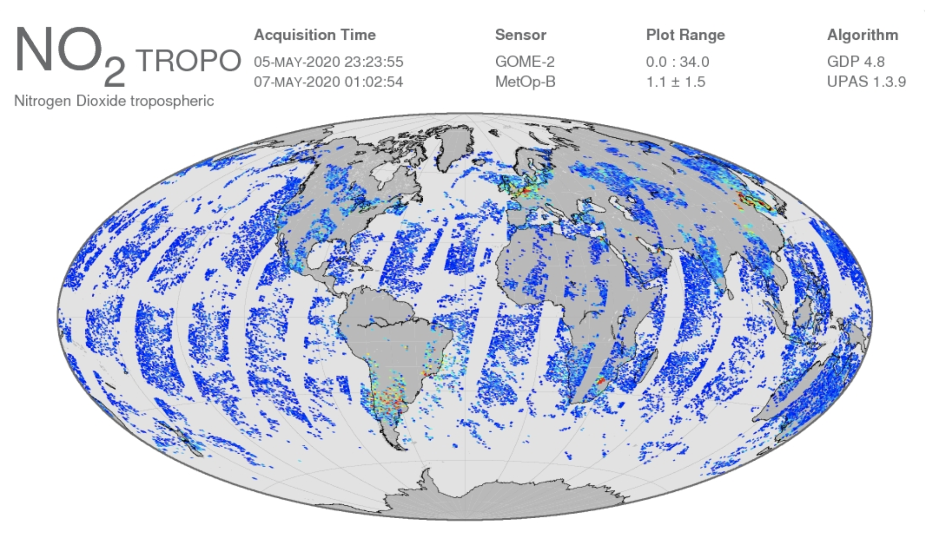
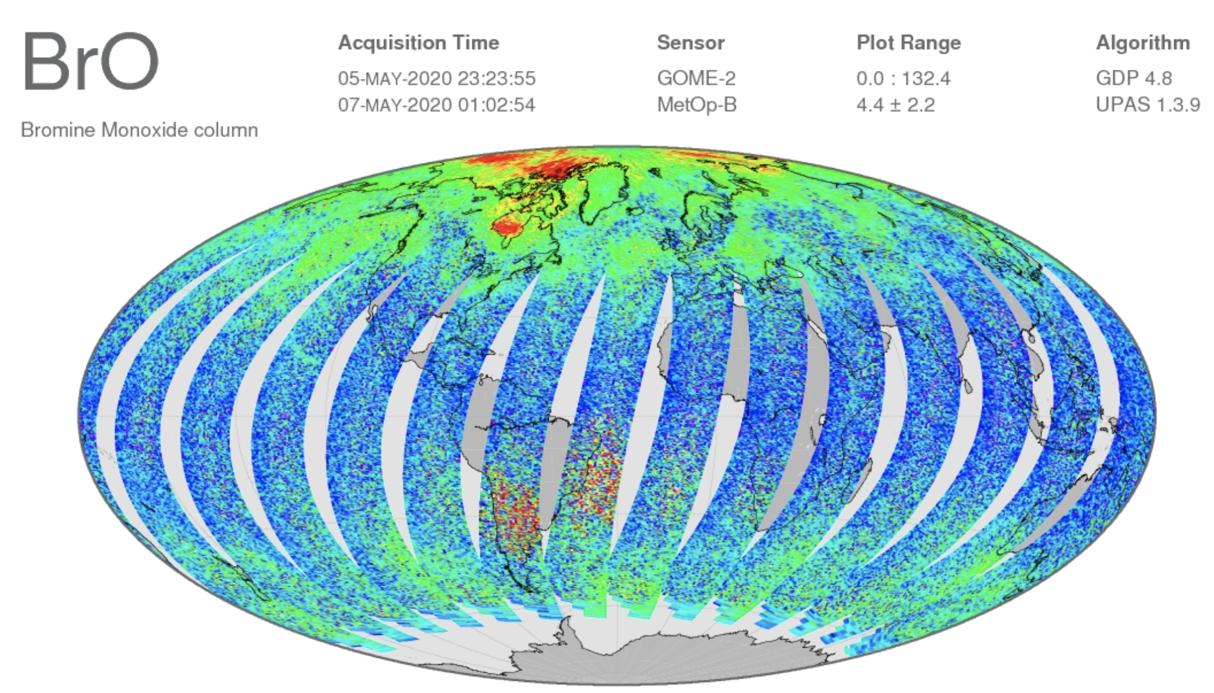
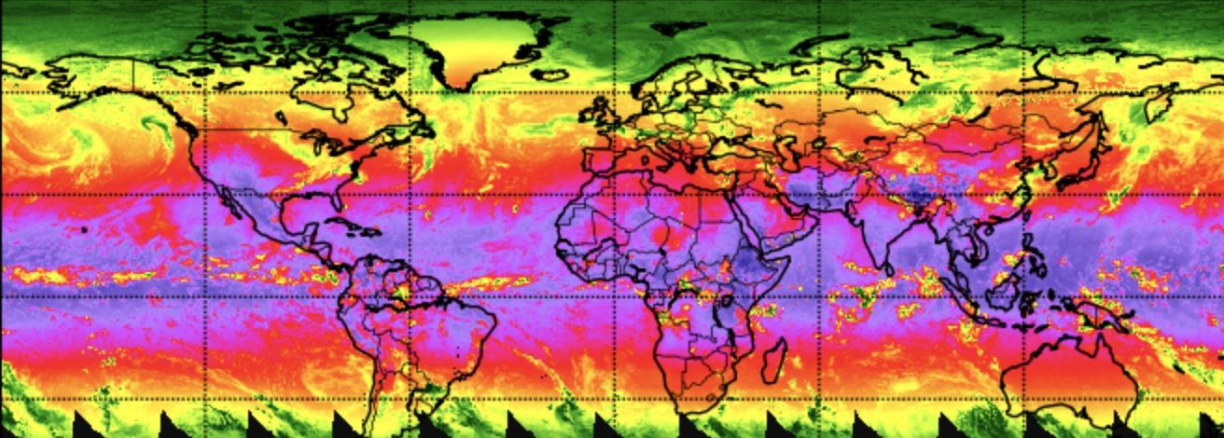
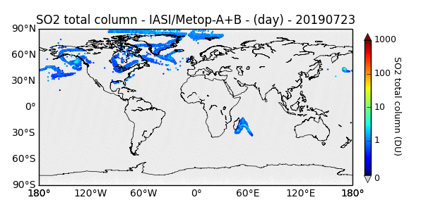
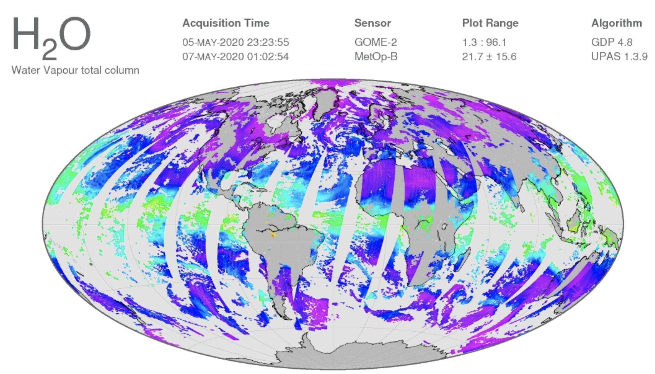
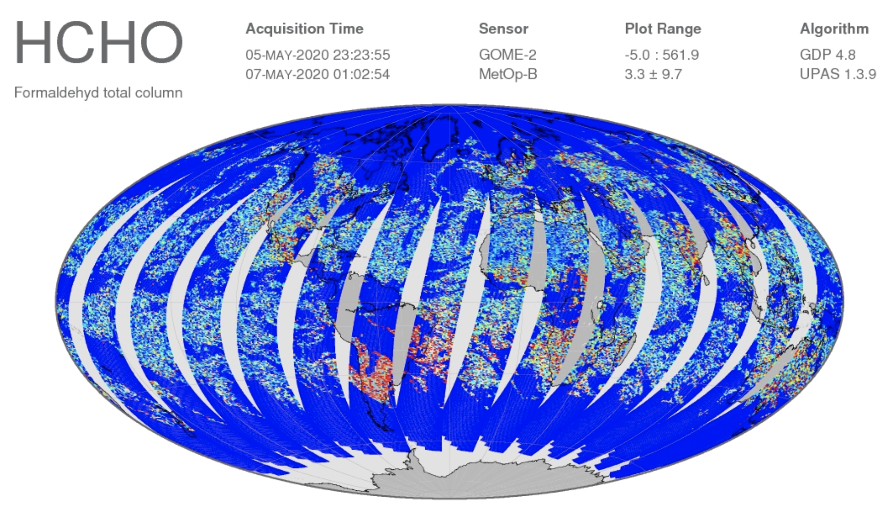
An overview of the AC SAF products
GOME-2
AAI
IASI
Surface UV

Slide 5
Satellites observing atmospheric composition
EUMETSAT METOP A (2006->), B (2012->) and C (2018->)
  Instruments:
    GOME-2 (UV-VIS)
    IASI (Thermal IR)
Copernicus Sentinel 5p (2017->)
  Instrument:
    TROPOMI (UV-VIS + Shortwave IR)
IASI
TROPOMI
GOME-2, IASI
Noon

Slide 6
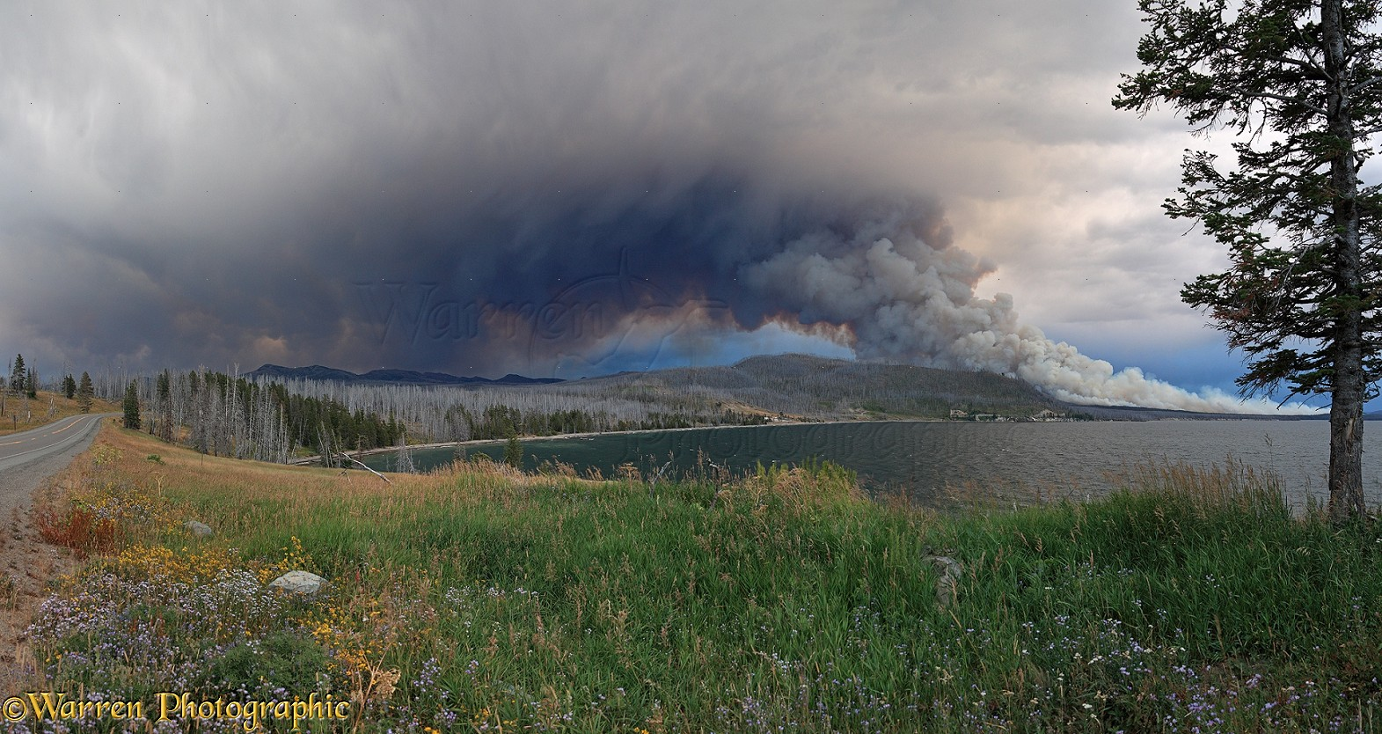
Fire emissions in the atmosphere
Potential risk to aviation
Transport
Determined by weather conditions
Emissions
Gases
Aerosols
Decreased air quality and health hazard
Low visibility
https://www.warrenphotographic.co.uk/

Slide 7
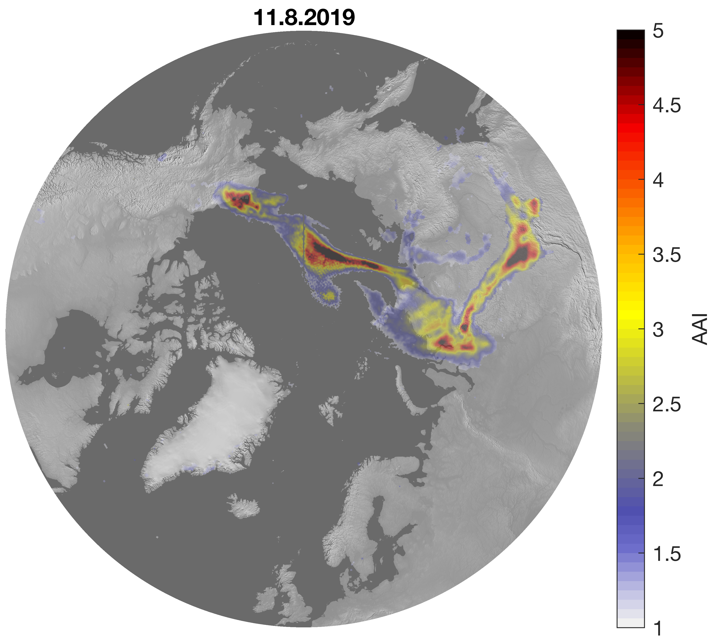
Absorbing Aerosol Index (AAI)
  Also known as UV Aerosol Index (UVAI)
  Defined using UV-wavelengths (GOME-2, TROPOMI, OMI, OMPS)
  Sensitive to absorbing aerosols: smoke, volcanic ash, desert dust
  AAI separates the spectral contrast at two UV wavelengths caused by aerosol extinction from that of other effects (e.g. molec. scattering)
  Clouds do not “prevent” the observation
AAI is a good tracer for smoke plumes

Slide 8
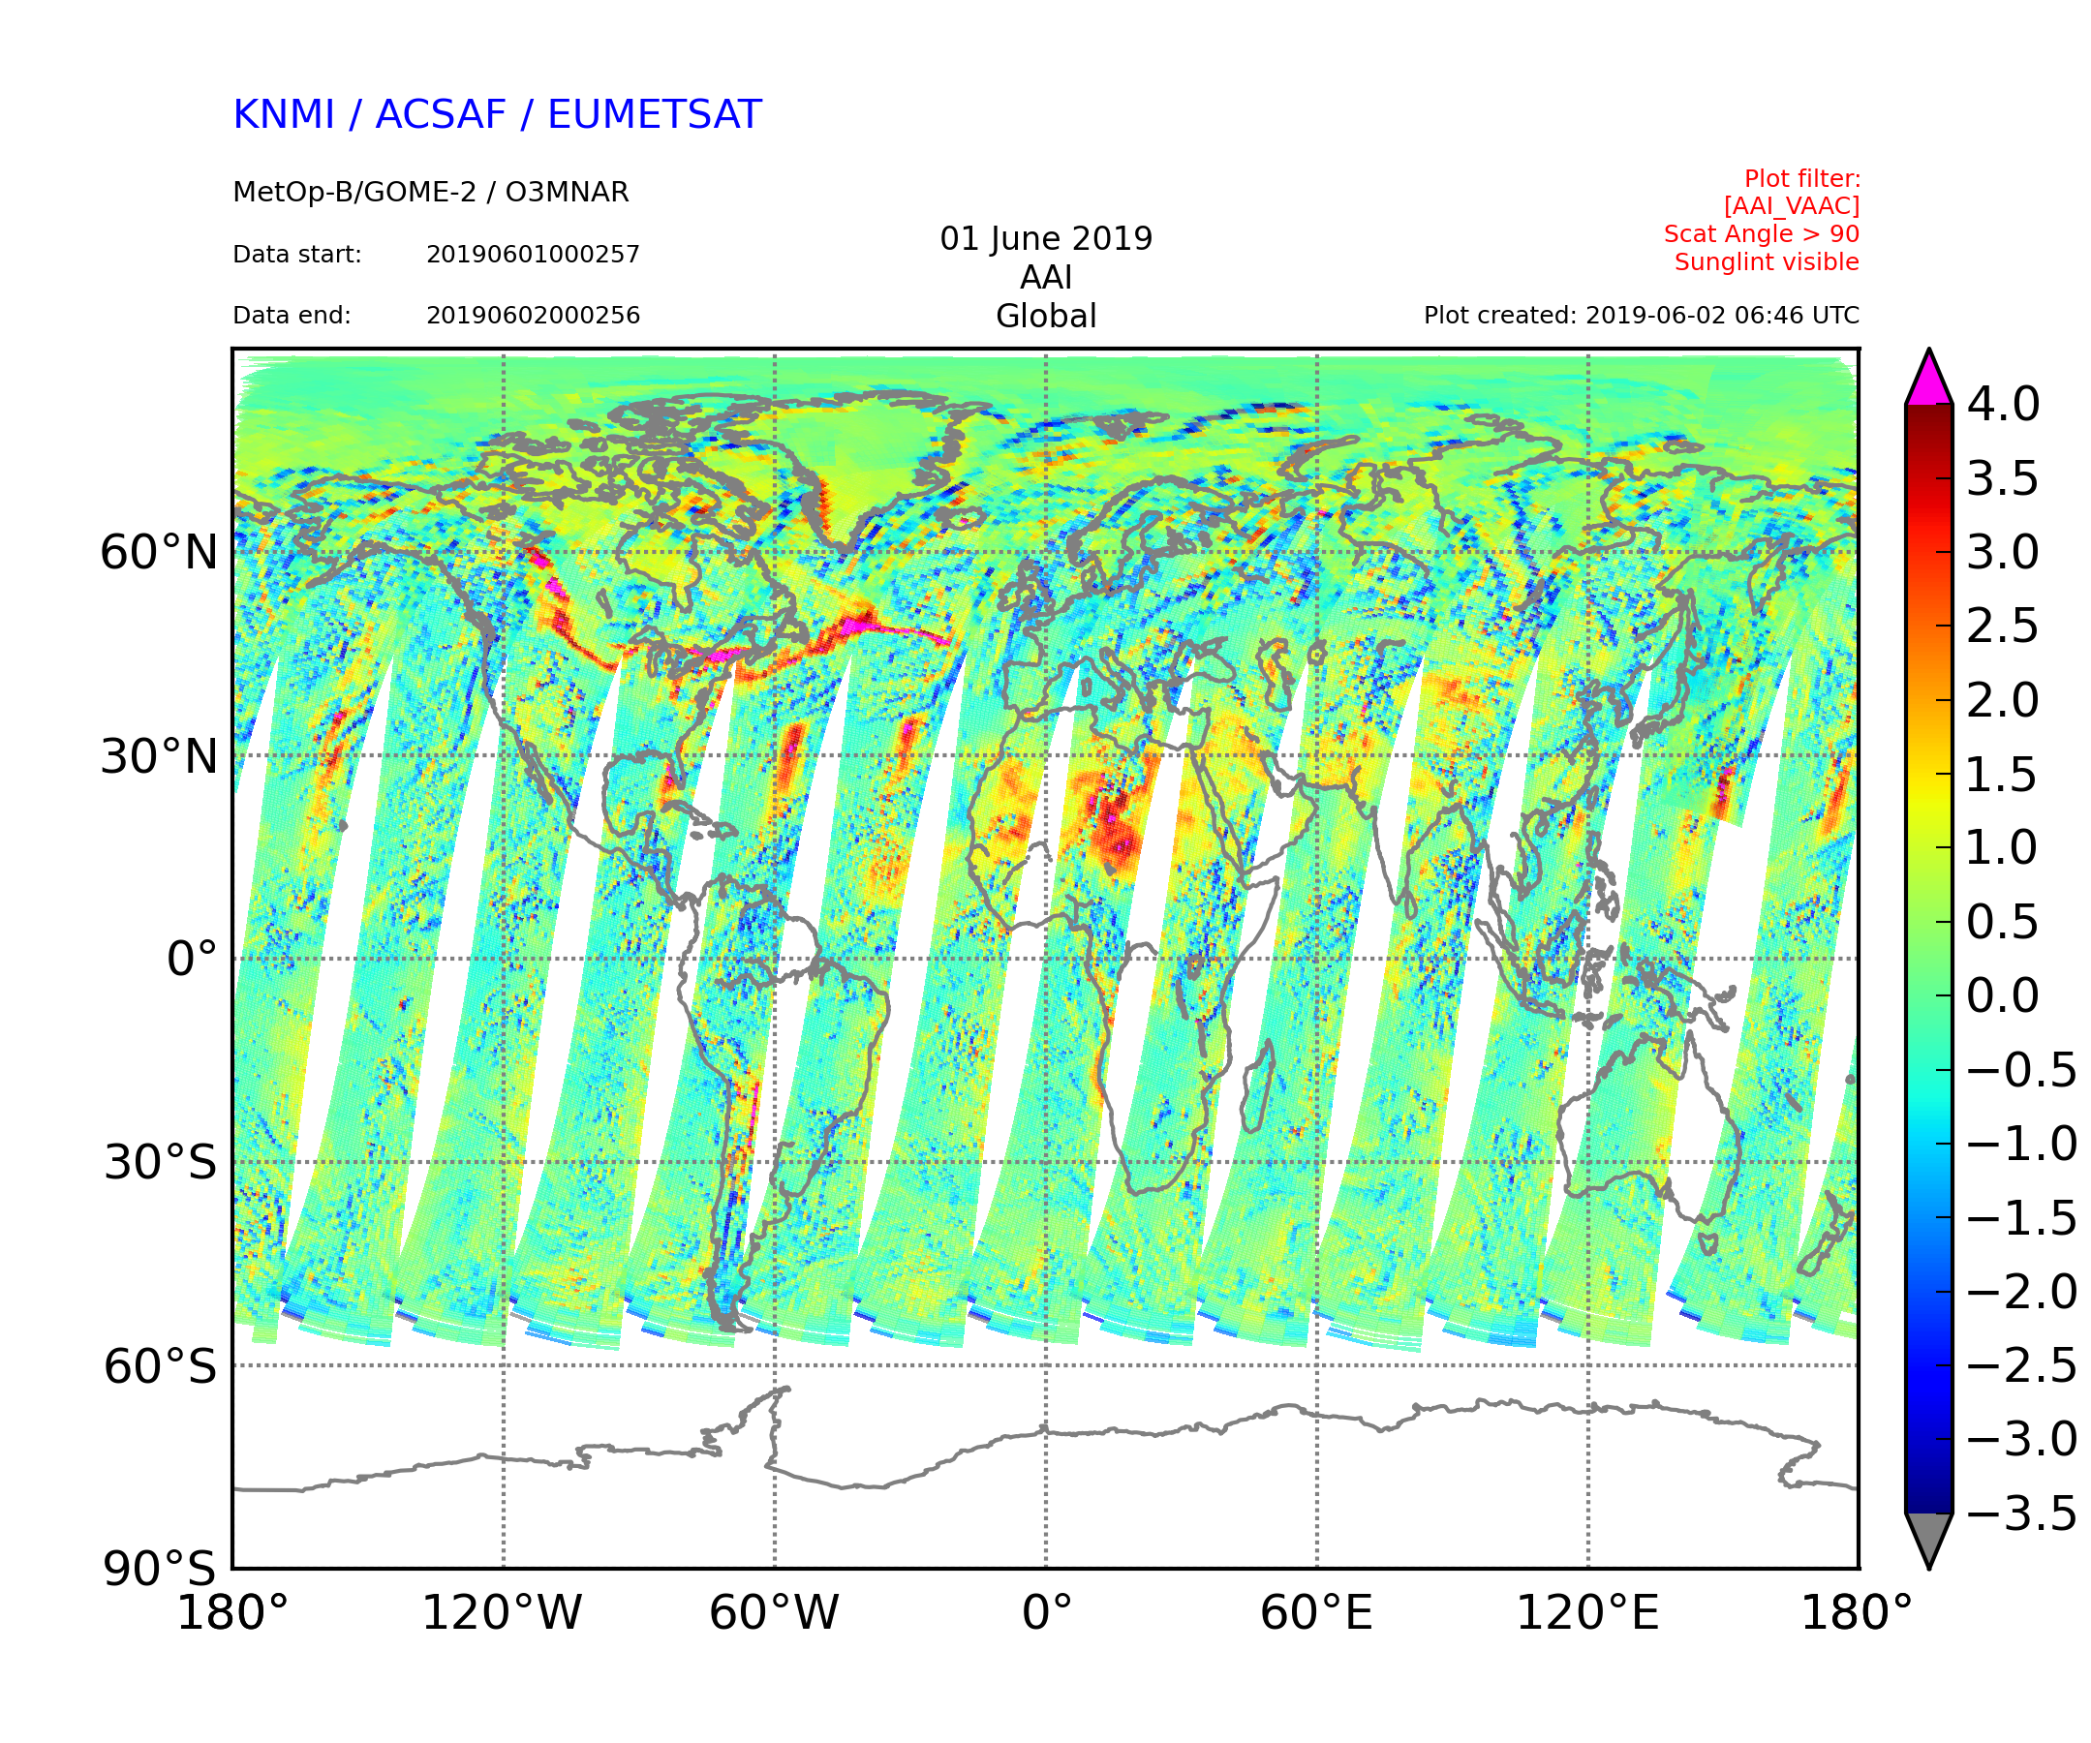
Interpreting AAI (1)
Smoke plume from Canadian forest fires
Positive values indicate presence of absorbing aerosols
  For clouds (or scattering aerosols) AAI is close to zero or negative
  Positive values can also be other aerosols than smoke!
  Also sunglint over ocean causes positive values but that is often filtered out from the data.
For (smoke) plumes typically AAI > 1.0
  Typical background slightly positive
Desert dust
Sun glint

Slide 9
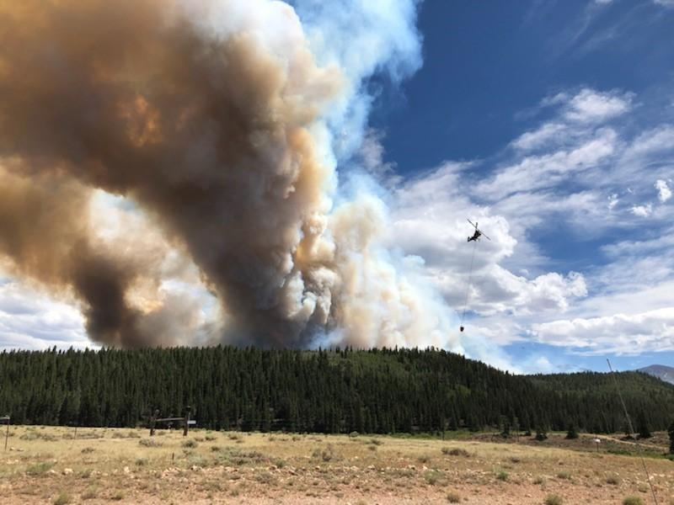
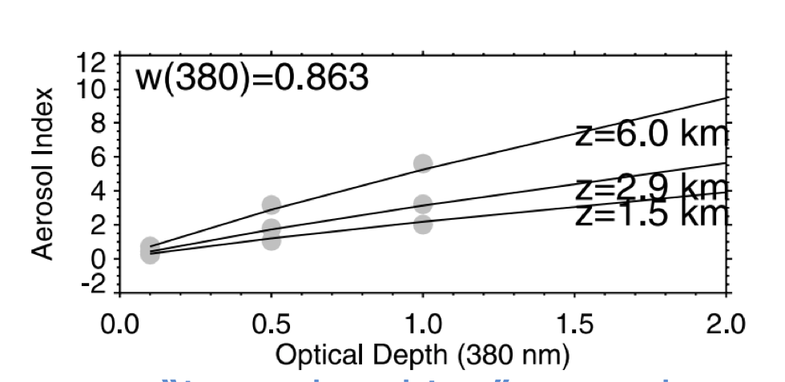
AAI values depend on various factors
  Comparing cases is not straightforward!
Not a ”direct” measure of aerosol loading
With AAI you typically see an elevated plume
  For assessing air quality at the surface, additional information (model, in situ) is recommended.
Interpreting AAI (2)
AAI values increase with aerosol loading
AAI values depend also on aerosol absorption properties
AAI values increase with plume height
->”Aerosol amount”
Ginoux & Torres, JGR, 2003
https://en.wikipedia.org/wiki/File:Weston_Pass_Fire_smoke_plume.jpg

Slide 10
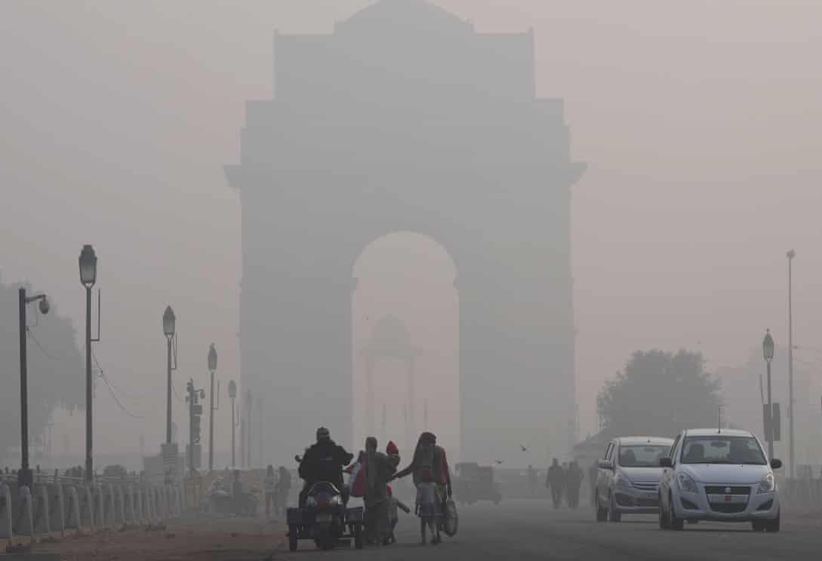
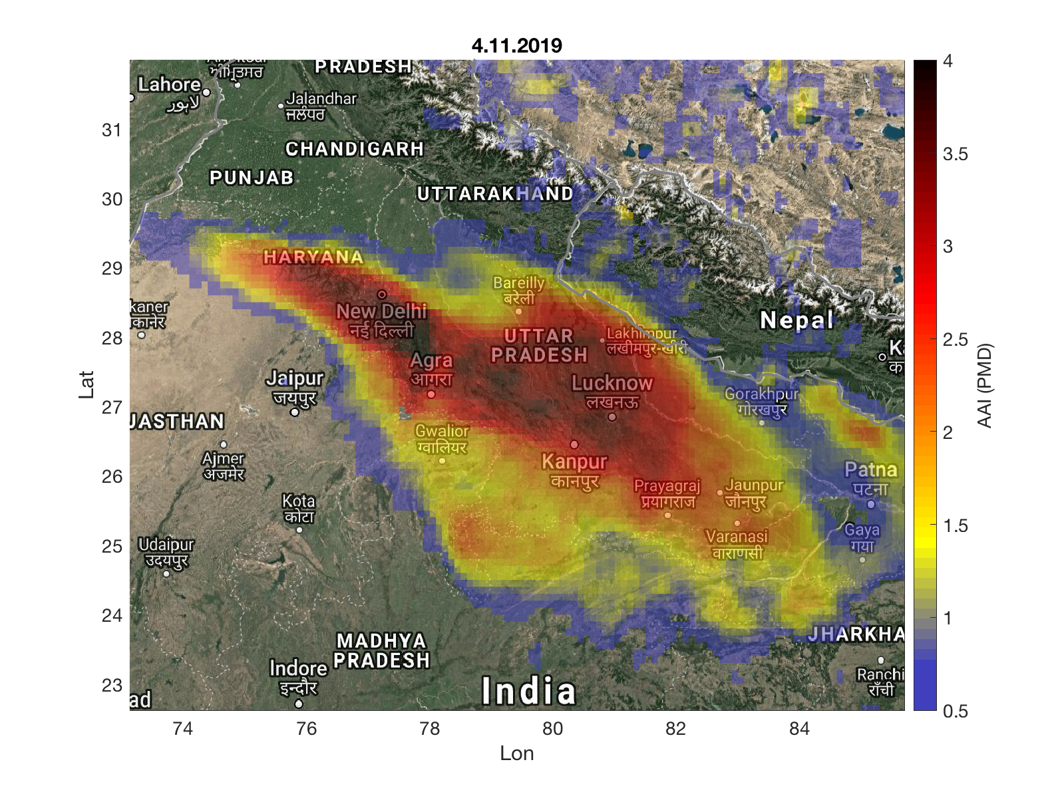

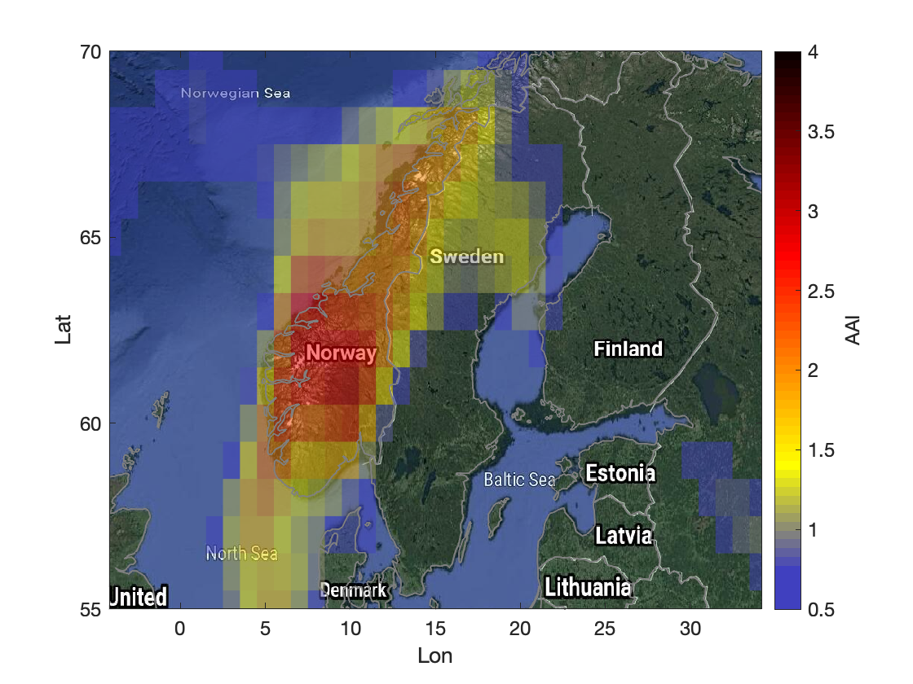
Interpreting AAI (3): Example of two cases
AAI values about the same level, at surface situation very different
In India extremely large amount of biomass burning aerosols at 0-3 km layer.
Over Norway smaller amounts of smoke from Canadian fires at about 7-10 km height

Slide 11
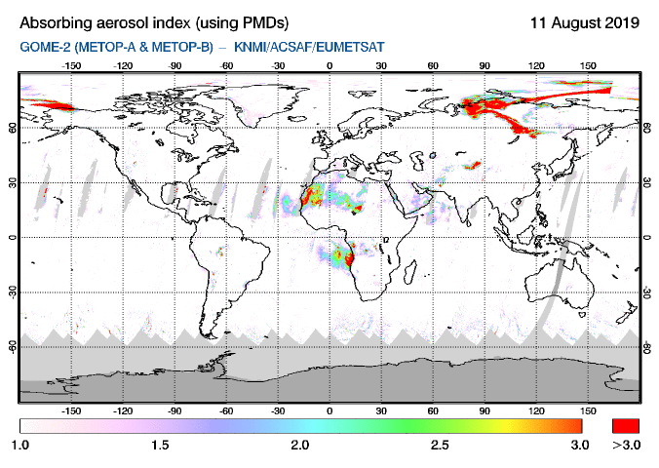
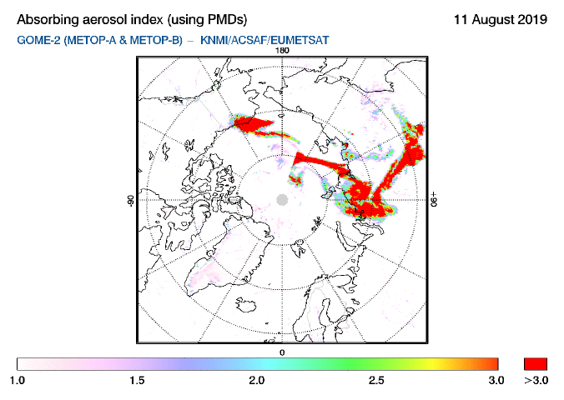
GOME-2 AAI quicklook at SACS
https://sacs.aeronomie.be/nrt/
GOME-2
TROPOMI
Metop A&B observations combined
Noon
You can change ”worldview” to ”North Pole”
Sun glint filtered out
AAI color scale starts from 1

Slide 12
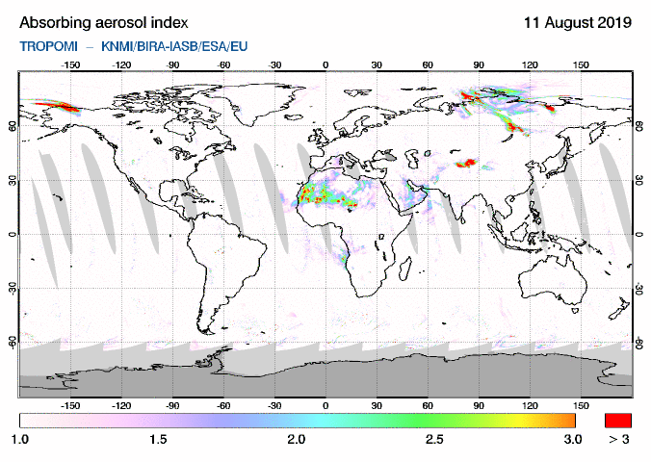
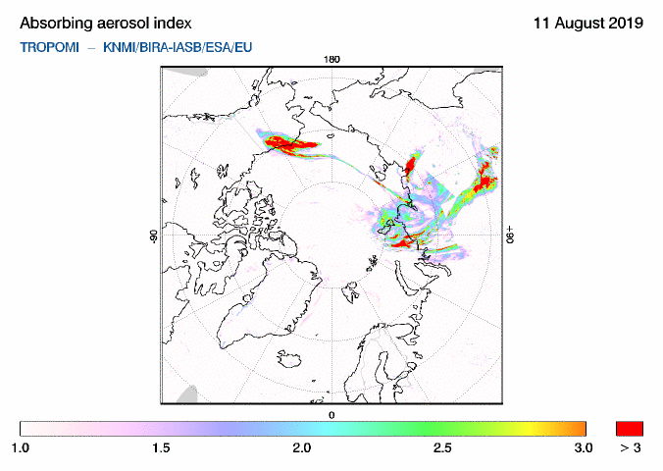
TROPOMI AAI (UVAI) quicklook at SACS
GOME-2
TROPOMI
https://sacs.aeronomie.be/nrt/
Noon
AAI values somewhat lower than GOME-2; this can be explained with different observation time, also possible differences in the AAI algorithm, however, ”message” is the same!

Slide 13

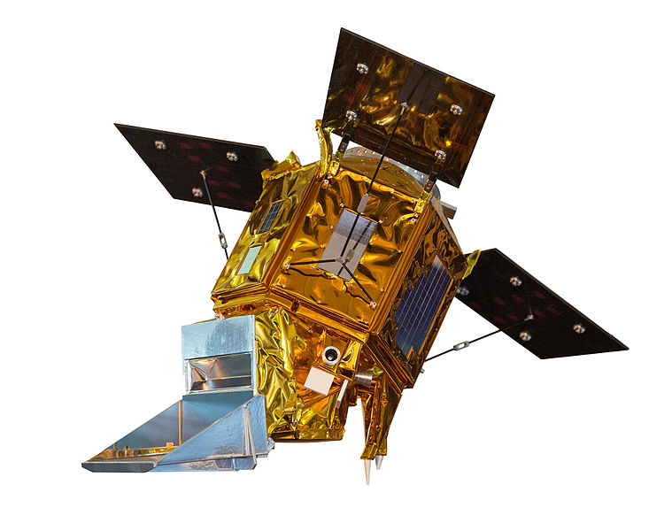
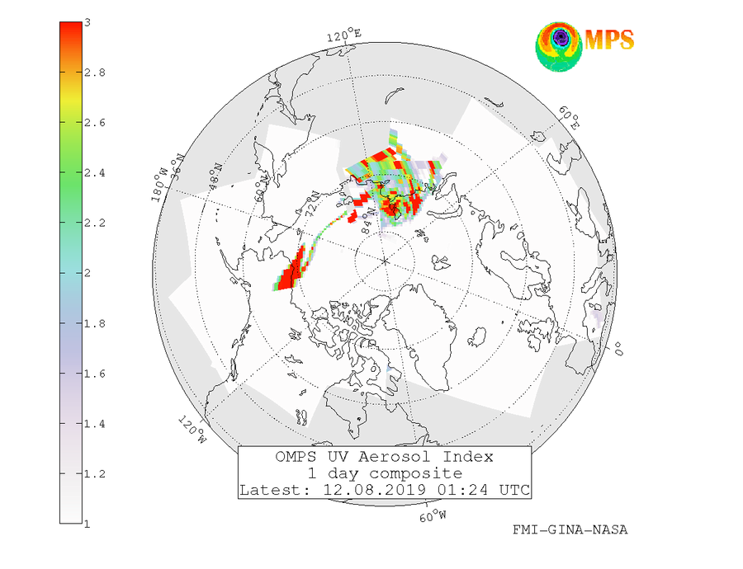
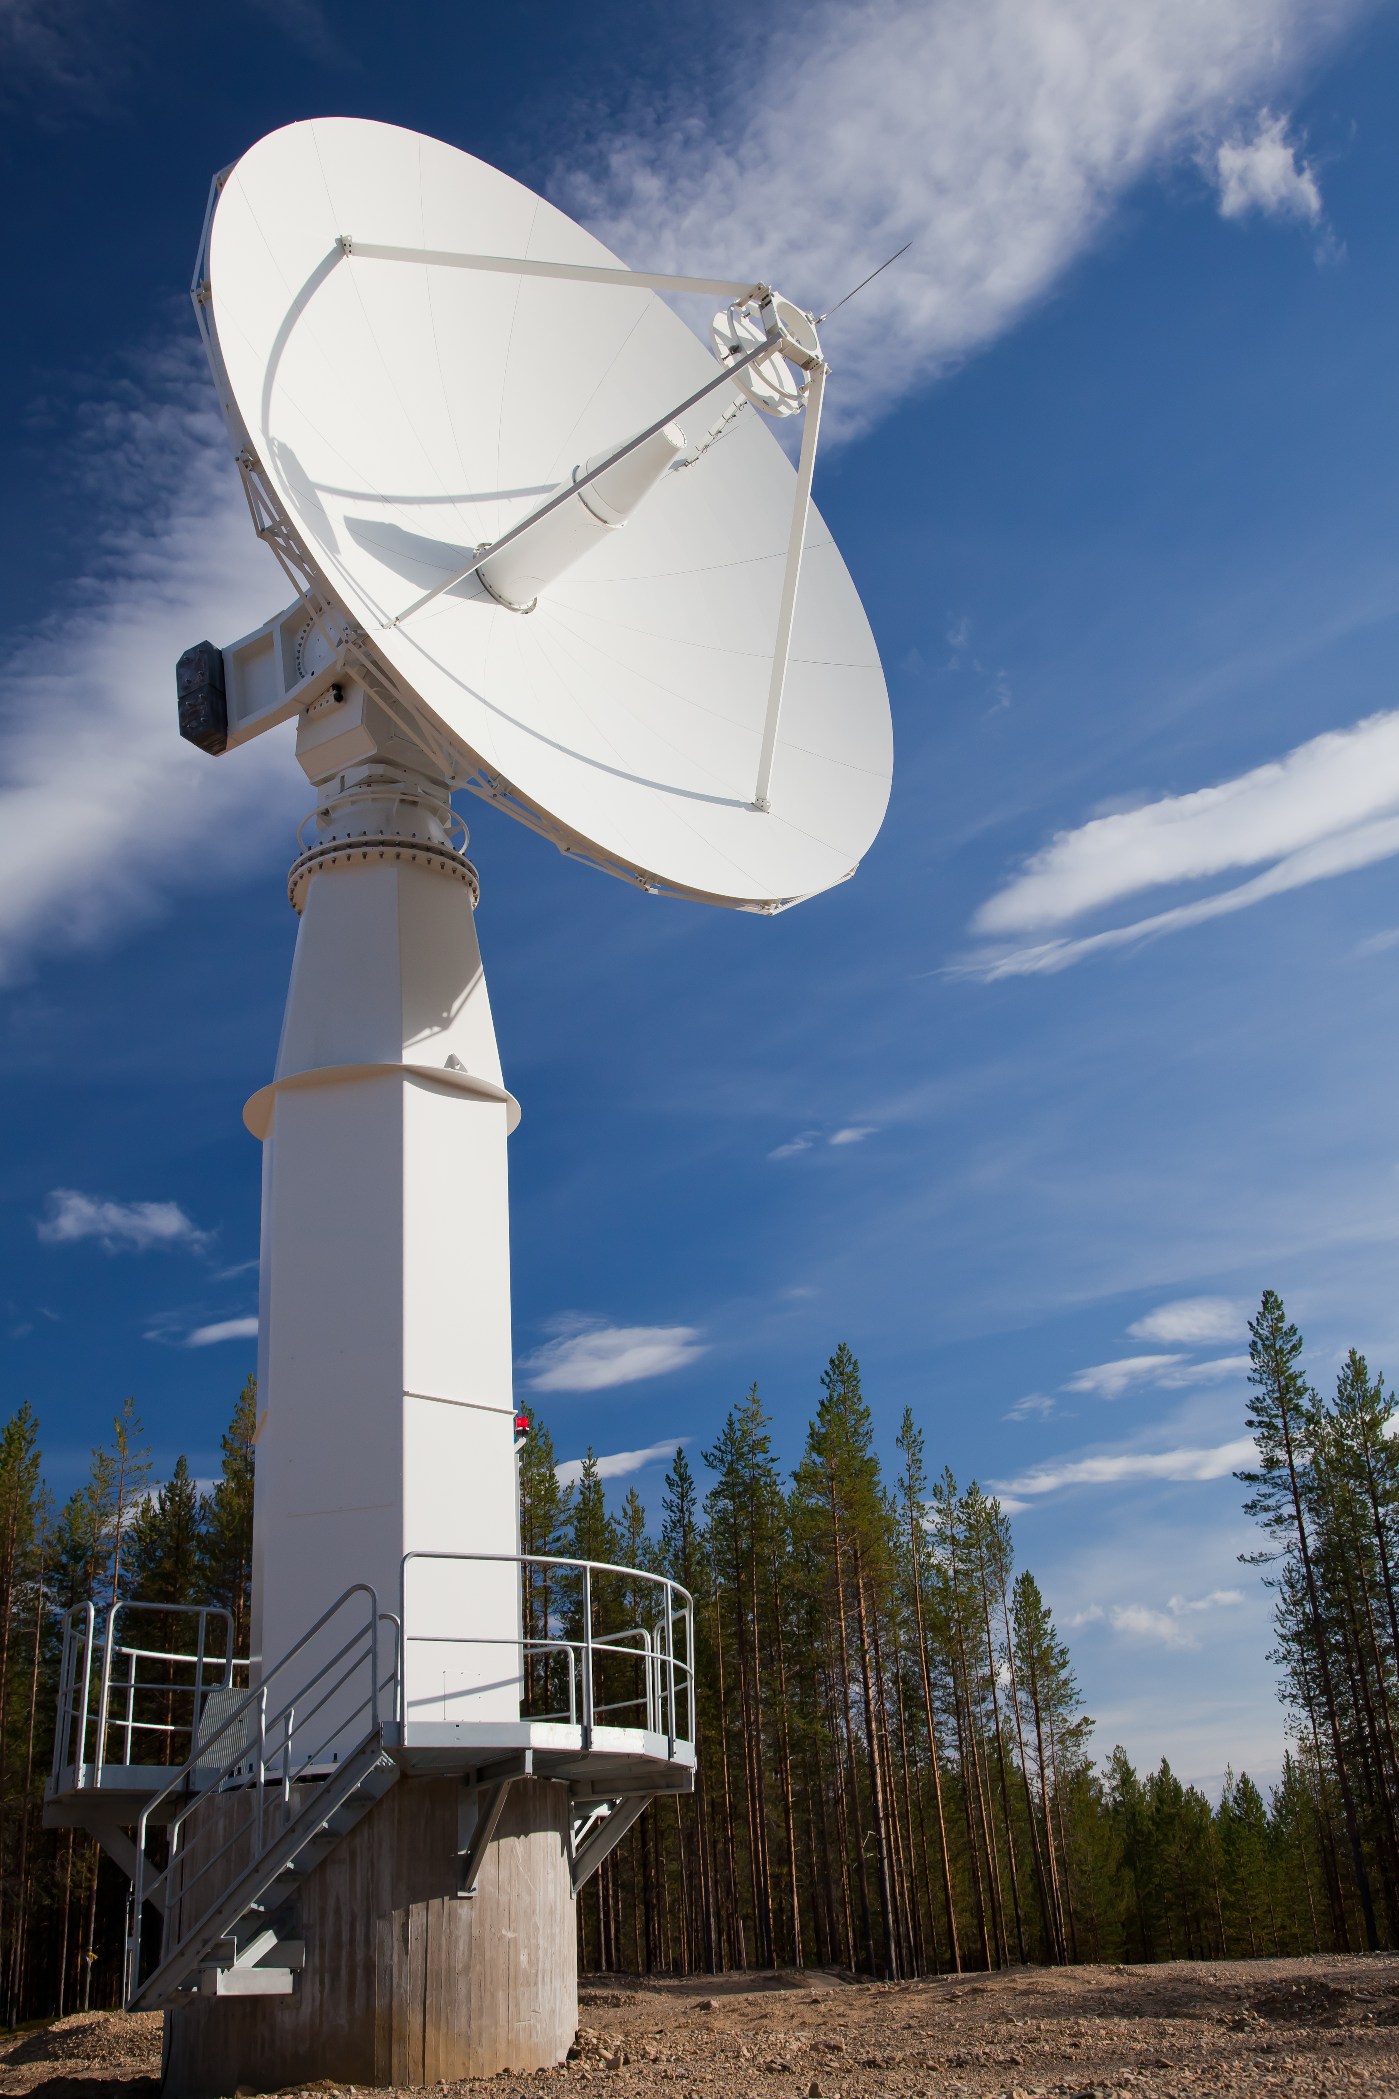
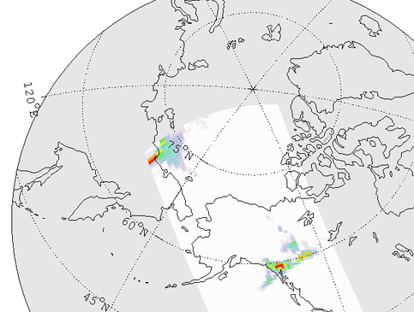
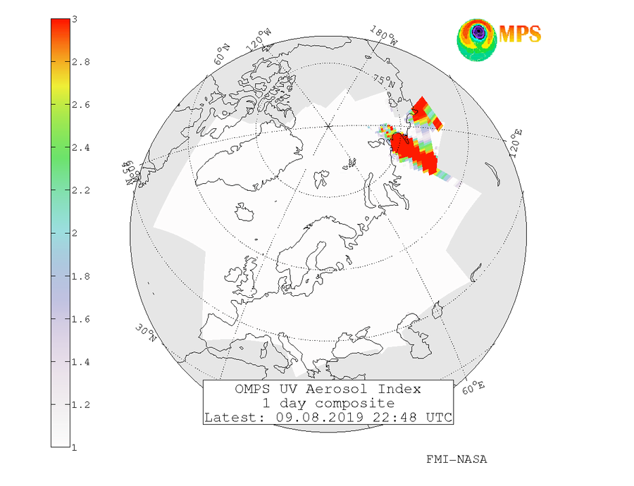
The SAMPO service (www.sampo.fmi.fi) by Finnish Meteorological Institute
NRT satellite service maintained by FMI for monitoring atmospheric composition in the Northern Hemisphere/ Arctic
Receiving stations in Sodankylä and Alaska
  Satellite-instruments: OMI, OMPS
10 – 20 min.
SAMPO provides observations also on AAI

Slide 14
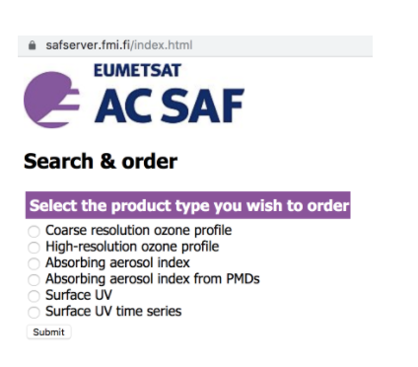
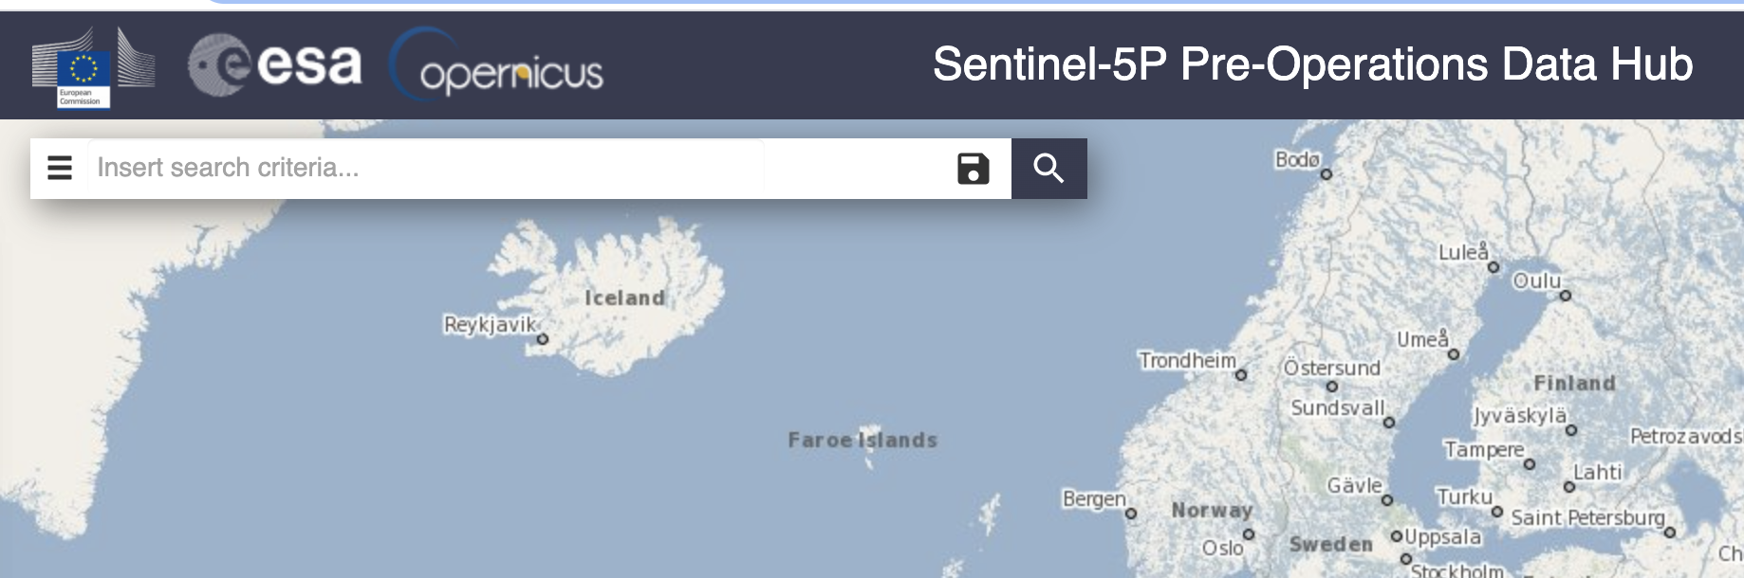
Accessing the AAI data
GOME-2 AAI: FMI AC SAF data service
  Register: https://acsaf.org/registration_form.html
  Download: https://acsaf.org/offline_access.html
TROPOMI UVAI: Sentinel 5p pre-operations data hub
  No registration needed, username and password: s5pguest
  Download: https://s5phub.copernicus.eu/dhus/#/home
For more detailed info see the course Moodle page!

Slide 15
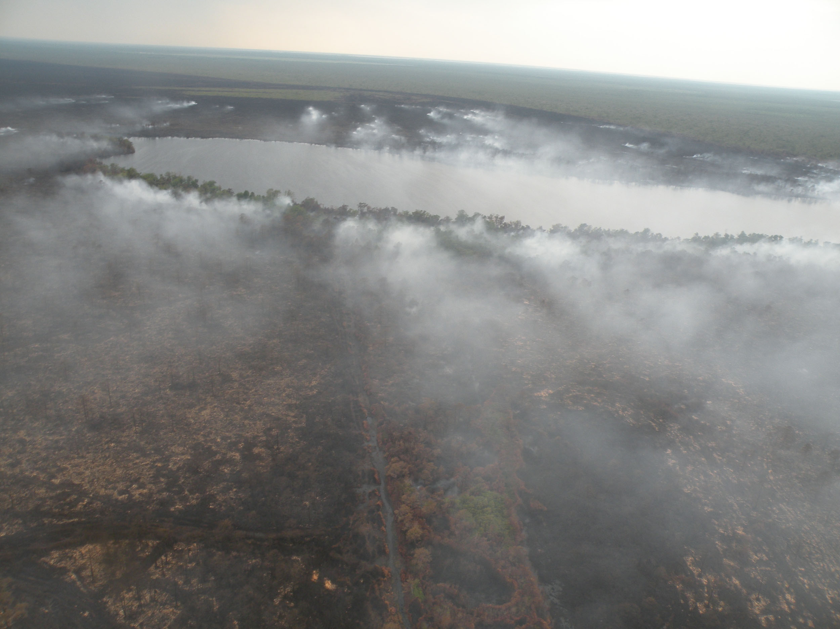
Carbon monoxide (CO)
Emitted from incomplete combustion processes (industry, biomass burning, traffic, heating)
Lifetime in the atmosphere from few weeks to months
  Major part of CO removal via reaction with OH radical
  Good tracer for plume transport
Satellite instruments monitoring CO:
  IASI onboard Metop A, B and C
  TROPOMI onboard Copernicus Sentinel 5p
IASI
IASI
TROPOMI
Noon

Slide 16
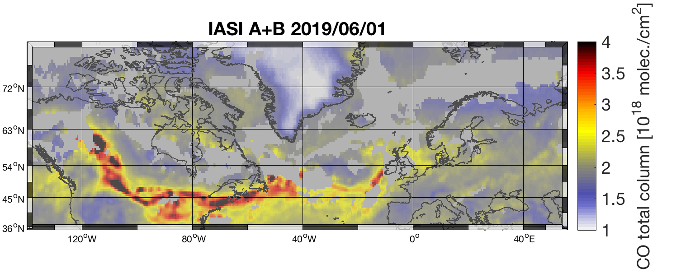
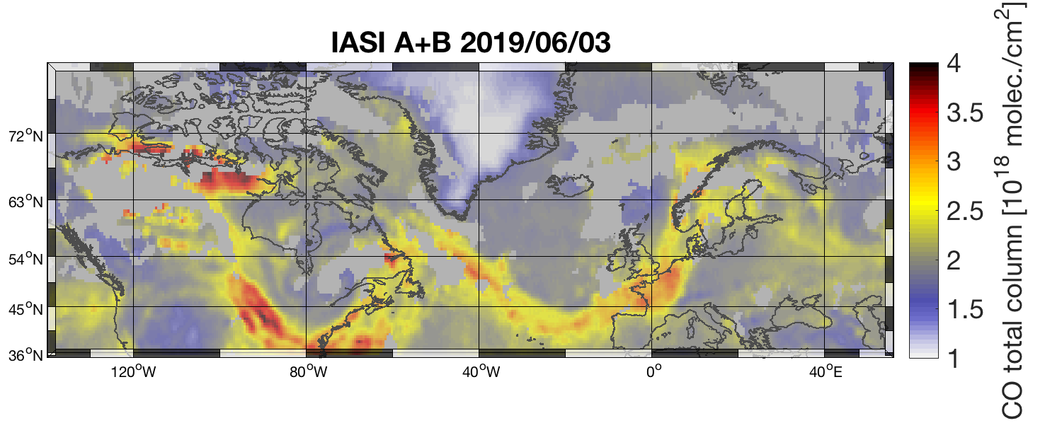
The IASI instrument observes CO using the Thermal InfraRed (TIR) spectral band
  Observations are made twice a day: ”day”, ”night”
  IASI is most sensitive to CO at 5-7 km layer
CO is given as ”total column” values
  Units are e.g. molec./cm²
Co-analysis with (daytime) IASI and GOME-2 can help to identify smoke plumes.

Slide 17
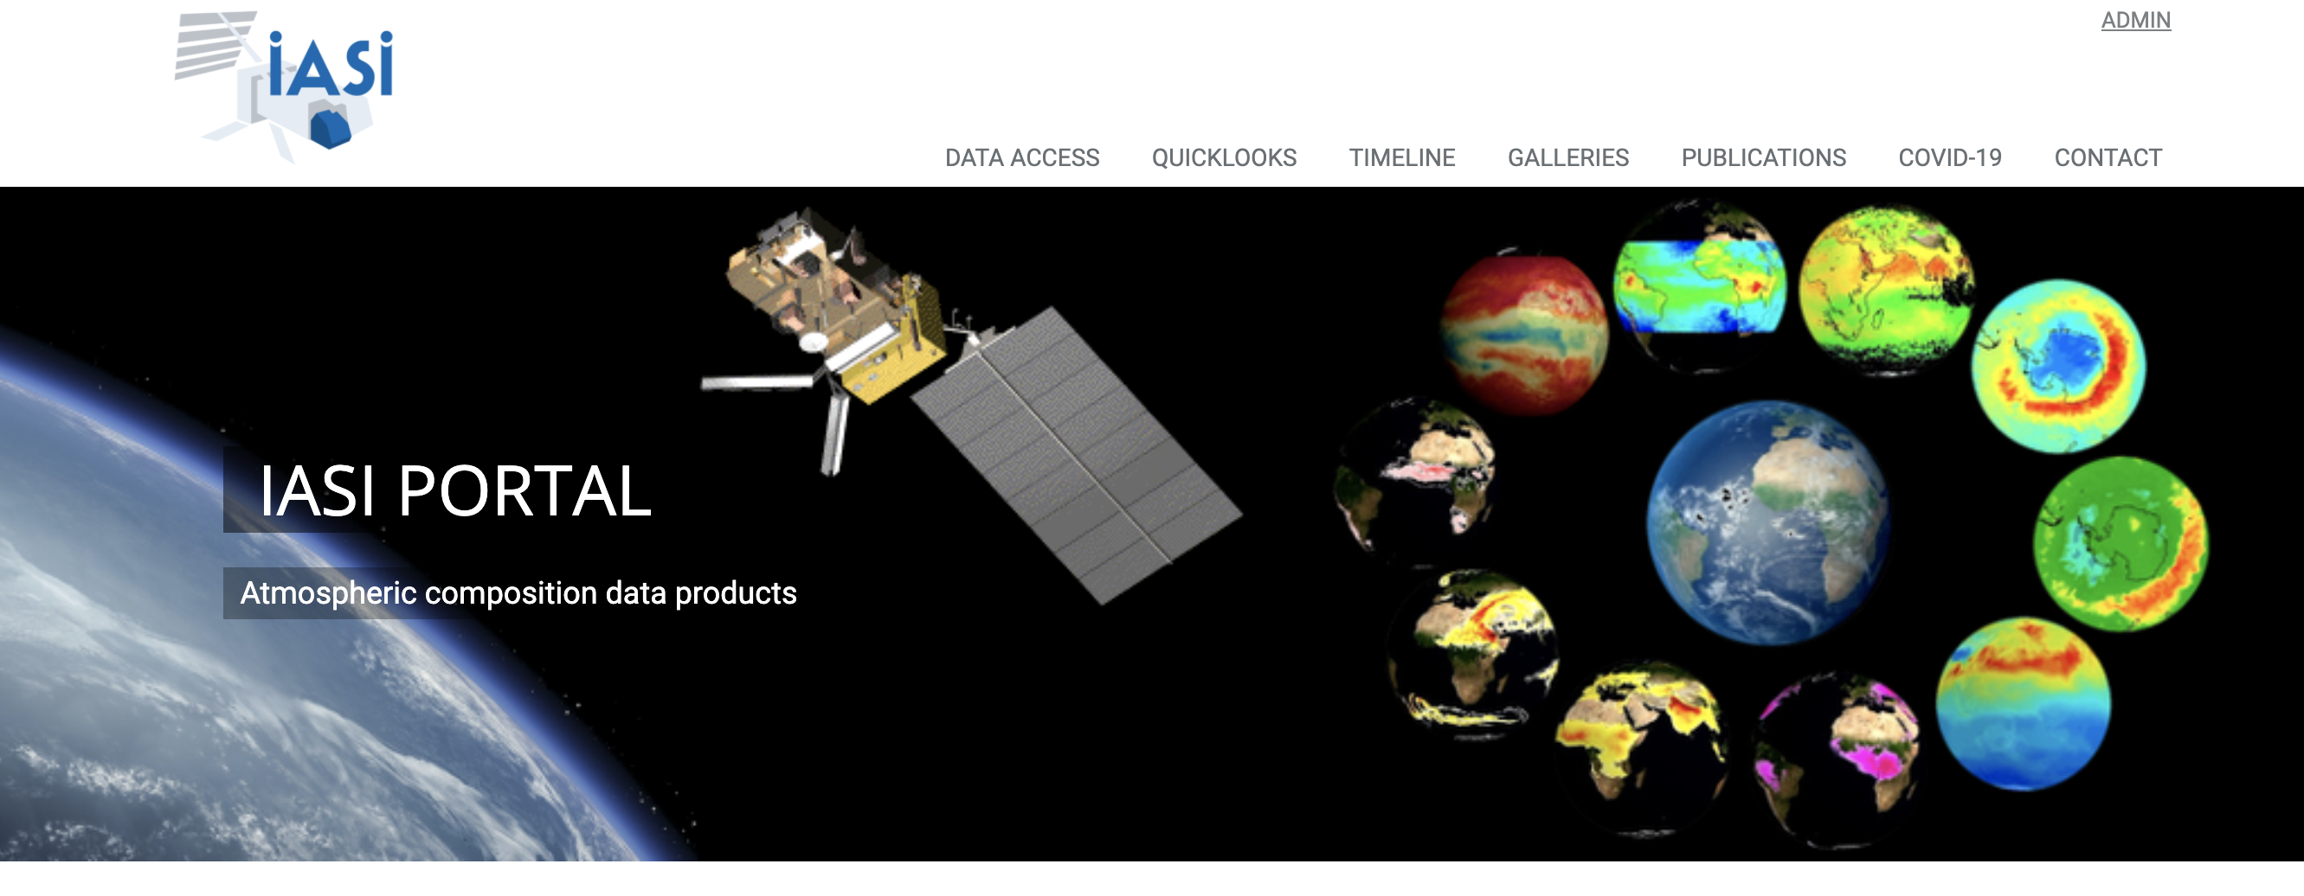
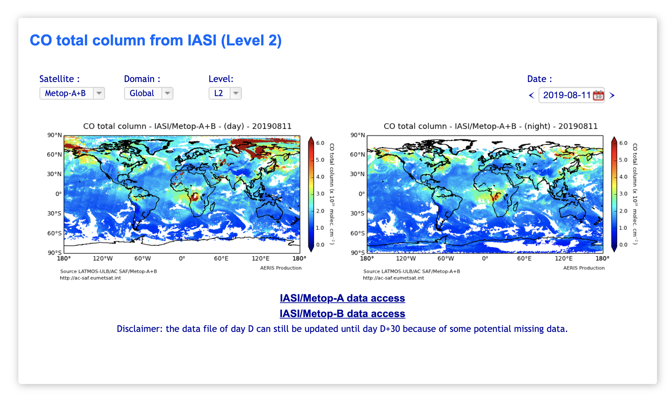
IASI CO quicklook:
https://iasi.aeris-data.fr/

Slide 18
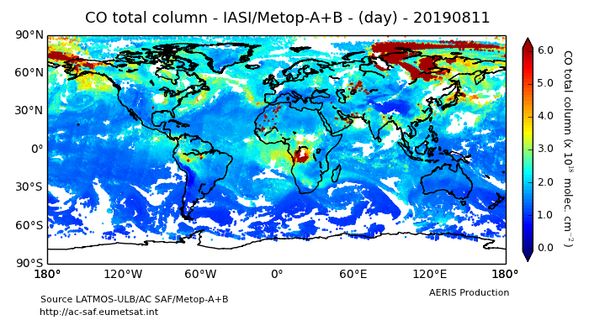
Example: IASI CO and GOME-2 AAI combined from Metop-A and B observations
Fire plume Where both AAI and CO enhancements are observed

Slide 19
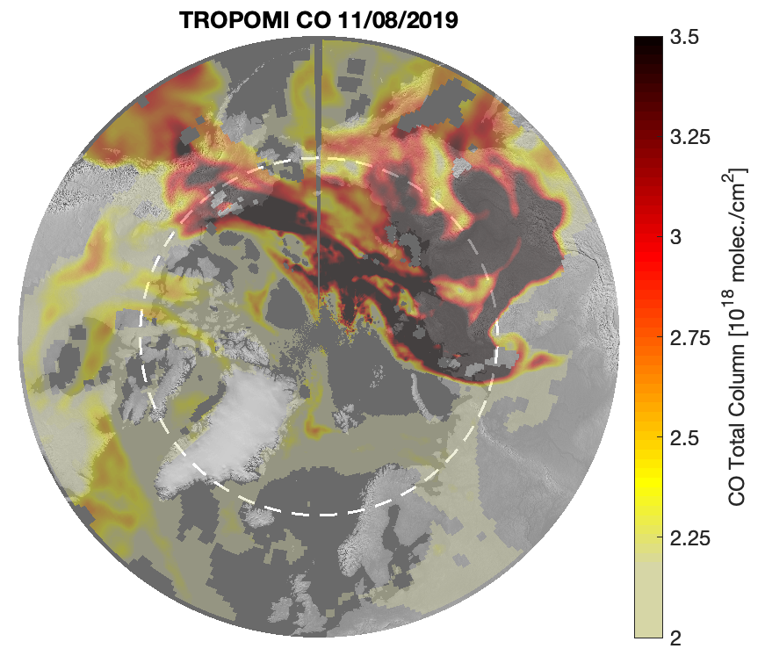
TROPOMI observes CO from the from sunlight reflected by the Earth atmosphere (clear- and cloudy sky) in the 2.3 μm spectral range of the shortwave infrared (SWIR)
TROPOMI has also sensitivity to boundary layer (in clear sky situations)
  For cloudy scenes partial column is obtained.
Units and interpretation is the same as for IASI
IASI
IASI
TROPOMI
Noon

Slide 20
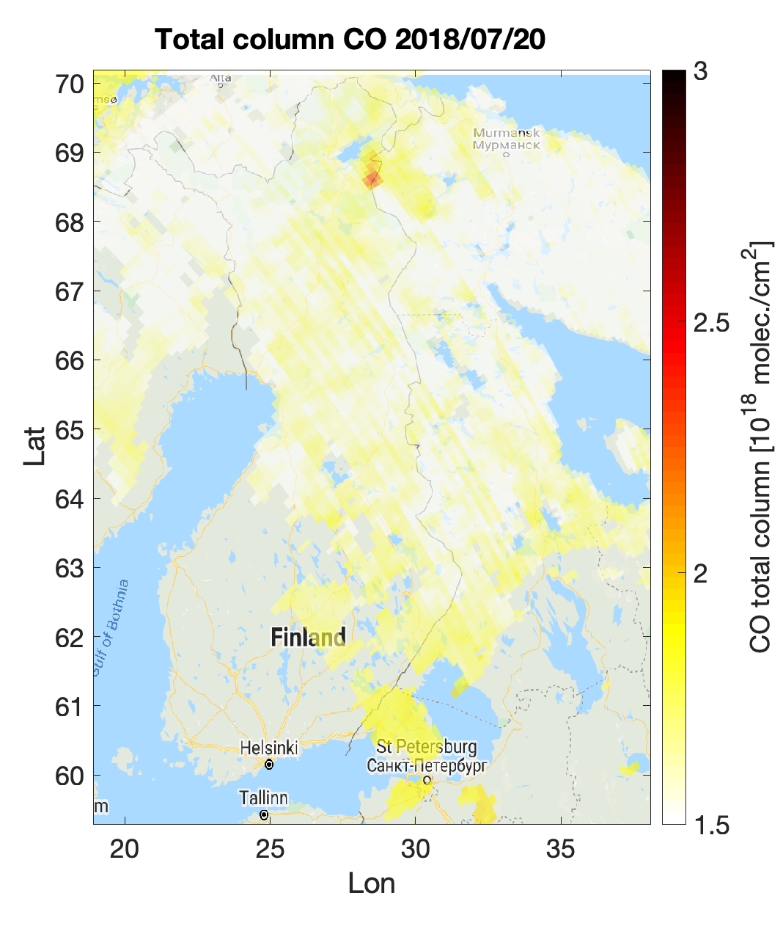
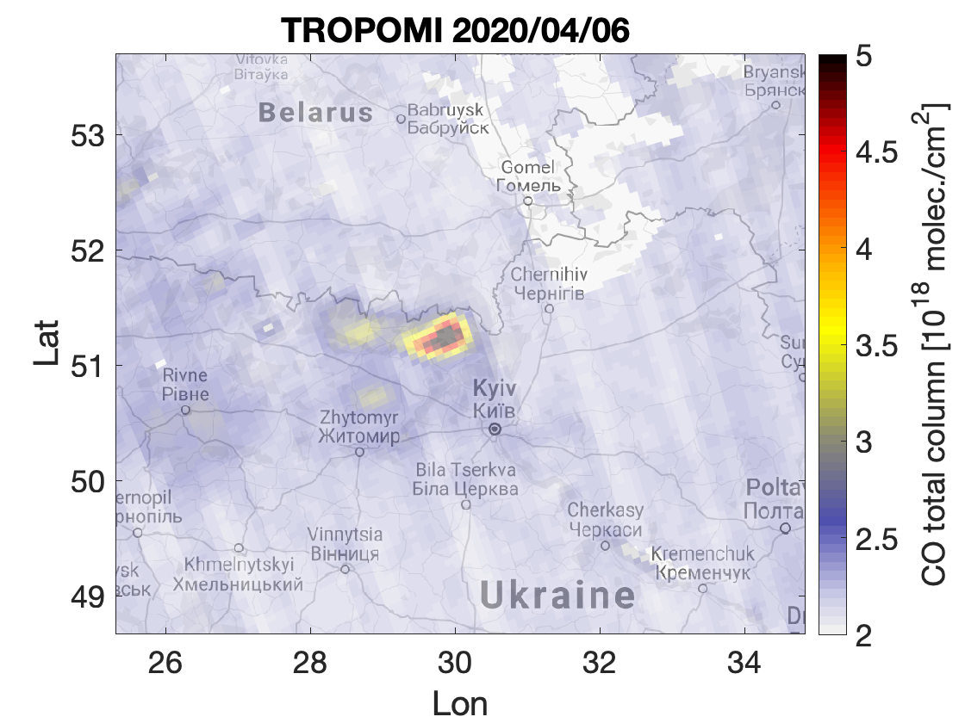
Raja-Jooseppi, Finland
CO enhancement due to forest fire
TROPOMI has very high spatial resolution (5.6 x 7 km²), and therefore relatively small-scale fires can also be observed.
Currently TROPOMI is the only instrument that provides both AAI and CO!
Recent fires near Chernobyl, Ukraine

Slide 21
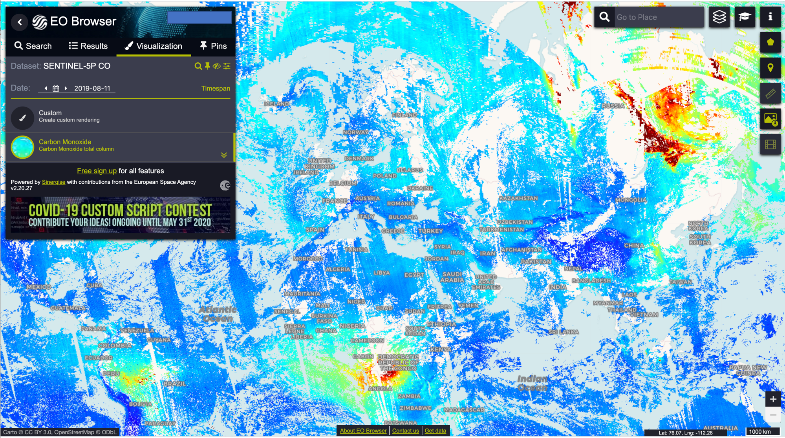
TROPOMI CO Quicklook: Sentinel EO browser
(https://apps.sentinel-hub.com/eo-browser)

Slide 22
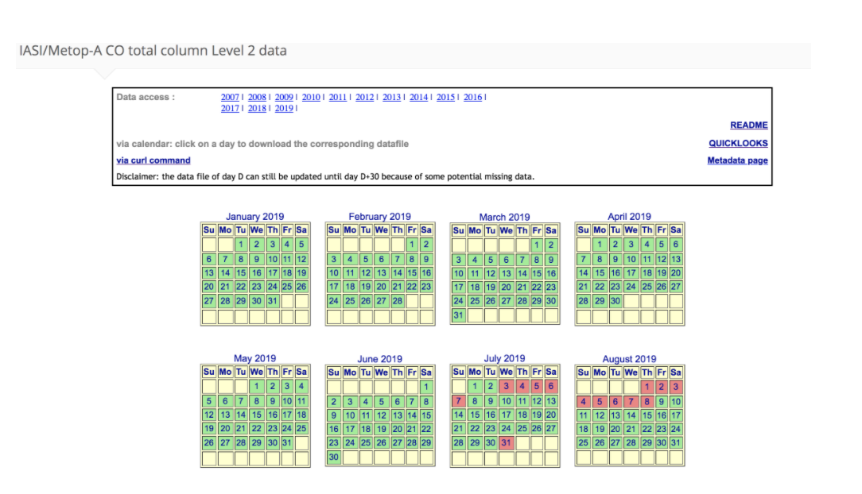
Accessing the CO data
IASI CO: AERIS data hub
  Register and download: https://iasi.aeris-data.fr/CO_IASI,_A_data/, https://iasi.aeris-data.fr/co_iasi_b_arch/
TROPOMI CO: Sentinel 5p pre-operations data hub
  No registration needed, username and password: s5pguest
  Download: https://s5phub.copernicus.eu/dhus/#/home
For more detailed info see the course Moodle page!

Slide 23

Customized Jupyter notebooks for handling the data
…stay tuned for the next lecture given by Julia Wagemann!
Examples on how to handle the data (both CO and AAI), introduced in this webinar
Allows you to practice at your own pace
  Example datafiles are already downloaded to the hub
  Create your own customized maps
Introduces good practices for data handling
  E.g. quality flagging

Slide 24
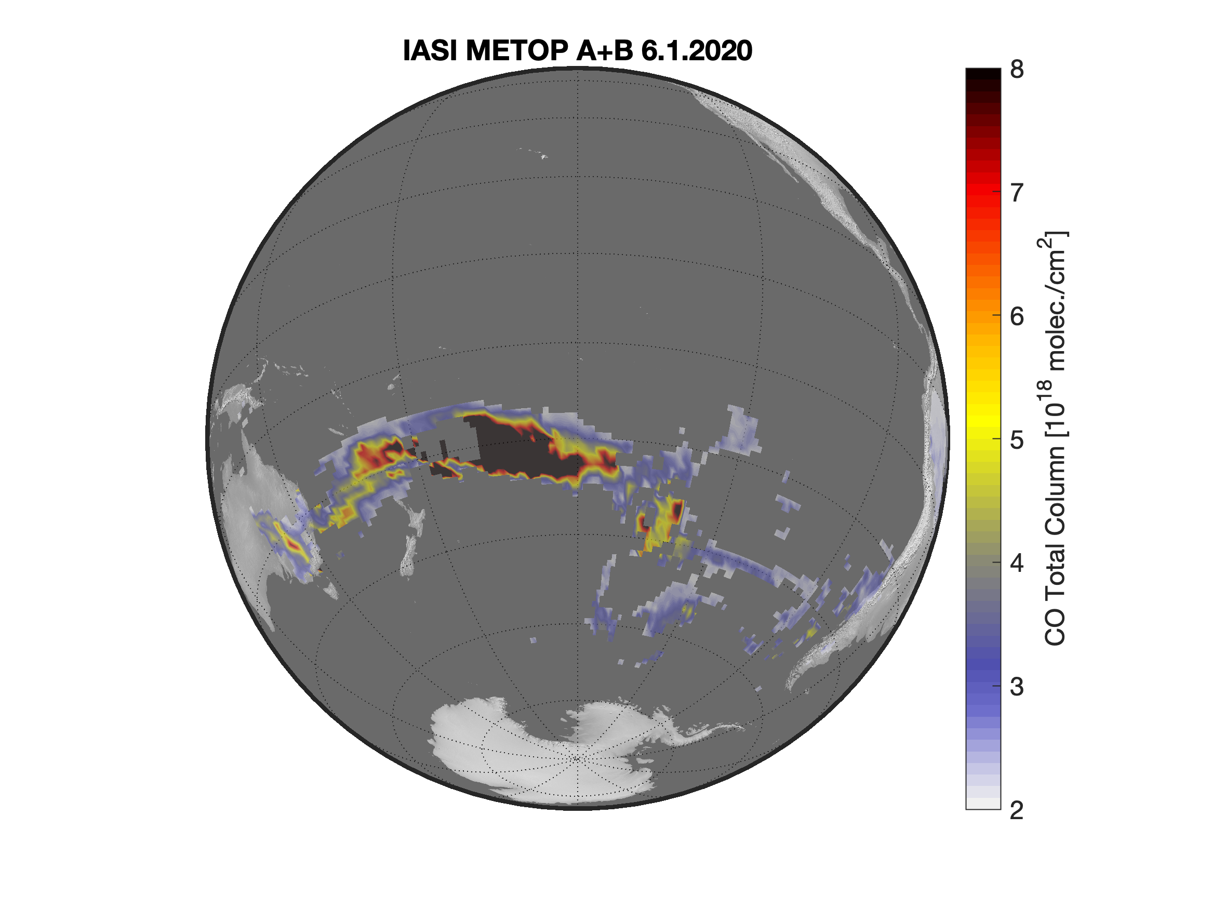
Take home messages
Smoke plume transport can be analyzed using AAI and CO satellite observations
  Different web-based services offer quicklooks of both parameters
To assess air quality, it is recommended to use additional information e.g. model data that you will learn later this week

