Slide 1
Agenda - Day 2 12 May, 10:00 CET: Copernicus Atmosphere Monitoring Service products for monitoring fire emissions and smoke (Mark Parrington, Copernicus Atmosphere Monitoring Service - CAMS, European Centre for Medium-Range Weather Forecasts - ECMWF).
Welcome to the User Workshop and Training on Fire Monitoring – Data Discovery Week webinars
Please mute your microphone.
Be mindful of background noise.
Better have your video off to avoid connection issues.
Raise your hand in case you need to ask a question or make a comment. You can also drop a message in the chat if you are experiencing technical problems or if you need to communicate with the host and the other attendees.
Enjoy the webinar!
Join the Q&A session from 15:00 to 16:00 CET at slido.com #fireworkshop.

Slide 2
Discover the Data, Day 2:
Copernicus Atmosphere Monitoring Service products for monitoring fire emissions and smoke
Mark Parrington (mark.parrington@ecmwf.int)
@m_parrington
User Workshop and Training on Fire Monitoring, 12 May 2020
Acknowledgements: Sebastien Garrigues, Miha Razinger, Vincent-Henri Peuch, Melanie Ades, Anna Agusti-Panareda, Jerome Barre, Richard Engelen, Johannes Flemming, Antje Innes, Zak Kipling, Martin Suttie, Juan Dominguez, Roberto Ribas, Luke Jones & CAMS development teams
Notes:
while ECMWF has a lot of expertise in the field of data assimilation and NWP, we are fairly new to atmospheric composition modelling
give credit to ECMWF core staff and CAMS partners, focus on collaborations

Slide 3
Topics addressed in this presentation
The Copernicus programme and services.
The role of observations in the Copernicus Atmosphere Monitoring Service (CAMS).
CAMS products for monitoring global fire emissions and atmospheric impacts.
Other products, and tools, in the CAMS portfolio for understanding air pollution.
Data access.

Slide 4
WHAT IS COPERNICUS?
Copernicus is a flagship Space programme of the European Union
to monitor the Earth, its environment and ecosystems
to ensure its citizens are prepared and protected for security risks and natural or man-made environmental risks and disasters
Copernicus as user-driven Programme
It has full, free and open to all data policy
Is a tool for economic development and a driver for the digital economy
Initiated in 1998, Copernicus became operational in 2014. Budget for 2014-2020 was 4.3 B€. Foreseen budget for 2021-2027 is 5.8 B€.
Notes:
obligatory mention of the ambitious and expensive Copernicus programme
something about motivation for services and improving the data access for wider audience
feel that I need to justify

Slide 5
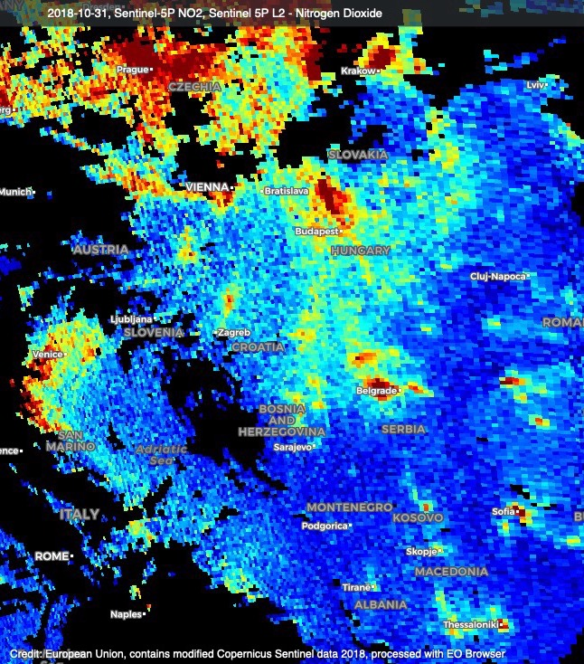
Why are Copernicus services needed?
Observations are essential, but direct use is generally limited:
gaps in space and time
observed quantities may not be directly relevant (vertical column vs surface concentration)
can be complex and numerous
What services do:
blend observations (satellite and non satellite) with model to provide a consistent 3D state
forecasts, a few days ahead
reanalyses over past years or decades
Example: NO₂ tropospheric column from Copernicus Sentinel-5P (31/10/2018)
Notes:
it’s the users like you who are really able to answer these vital questions, but based on our user uptake and feedback we feel that our existence is fully justified

Slide 6
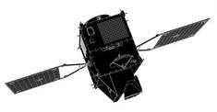
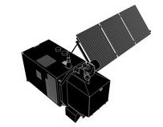
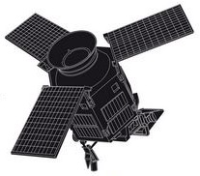
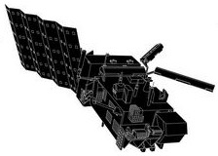
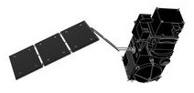
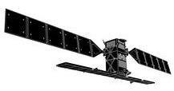
COPERNICUS AND ECMWF
Atmosphere
Observations feeding into value-added Services
Climate
Land
Marine
Sentinels
Copernicus is the European Union’s operational Earth Observation and Monitoring programme, looking at our planet and its environment for the ultimate benefit of all citizens.
User-driven with free and unrestricted data access
Emergency
Security
Service is implemented by ECMWF
ECWMF is contributing to the Service

Slide 7
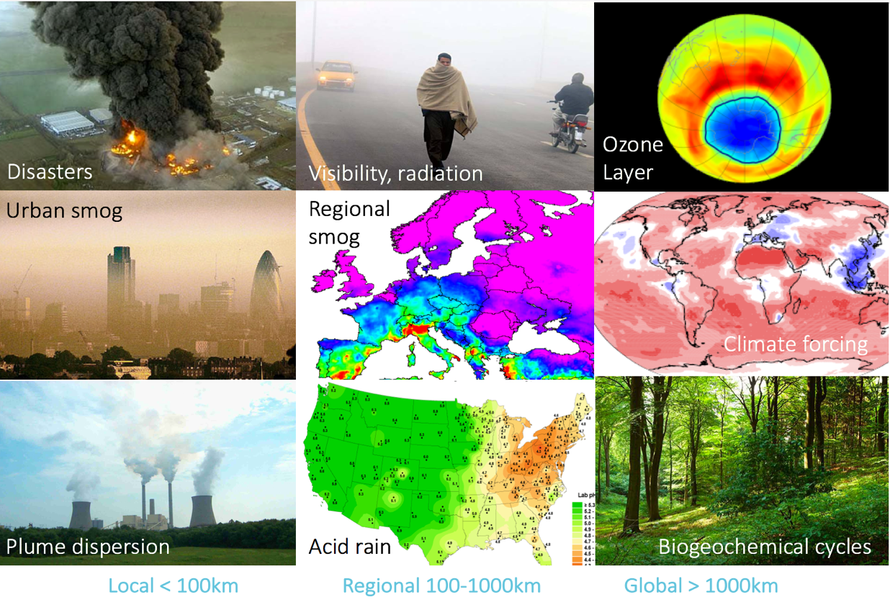
Reasons to care about atmospheric composition
…but also benefiting NWP
direct effect of aerosols, ozone and greenhouse gases on radiation
effect on cloud formation and precipitation
use in observation operators for satellite radiance assimilation
from D. Jacob
Notes:
Atmospheric composition matters from local to global scales.
some of the ECMWF motivations: effect on radiation budget, interaction between aerosols and cloud formation, cleaning-up/interpreting information from satellite instruments

Slide 8
Atmospheric science in the ECMWF Integrated Forecast System (IFS)
IFS
Observation operators
The CAMS global production system is the ECMWF Integrated Forecast System (IFS).
IFS is the full NWP forecasting and data assimilation system of ECMWF
4D-Var
TM5-CB05
Bin scheme
Chemical module
Aerosol module
Meteorology
CHTESSEL
GHG module

Slide 9
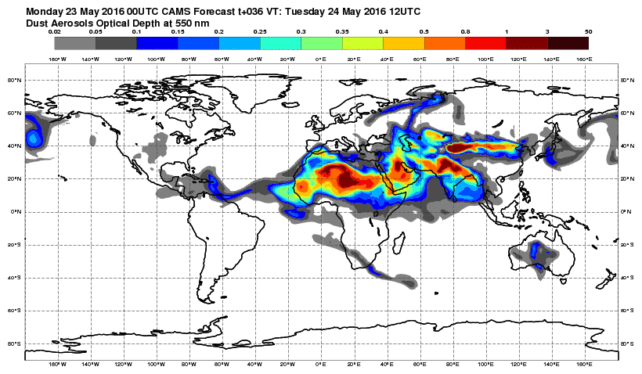
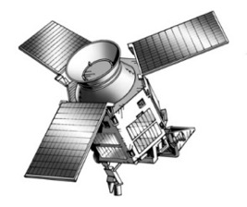
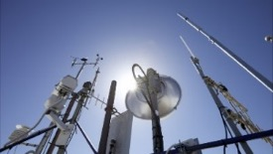
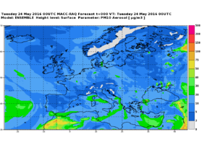
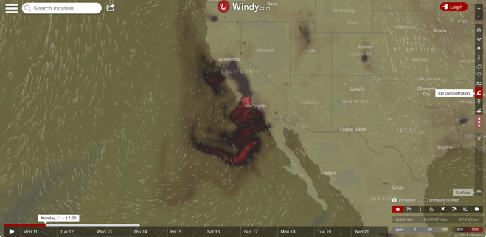
CAMS SERVICE CHAIN
CAMS SERVICE CHAIN
Space Agencies
In-situ observations
ECMWF Integrated Forecasting System (IFS)
Regional multi-model ensemble (lead: Météo-France)
Users
15

Slide 10
Near-real-time satellite data usage
Species | Instruments
Global system
O₃ | OMI, SBUV-2, GOME-2, MLS, TROPOMI, OMPS, IASI
CO | IASI, MOPITT, TROPOMI
NO₂ | OMI, GOME-2, TROPOMI
SO₂ | OMI, GOME-2, TROPOMI, IASI
Aerosol | MODIS, PMAp, VIIRS, SLSTR, SEVIRI
CO₂ | GOSAT, OCO-2
CH₄ | GOSAT, IASI, TROPOMI
GFAS fire emissions | MODIS, GOES-E/W*, SEVIRI*, SLSTR, VIIRS, HIMAWARI-8*
A wide-range of atmospheric composition satellite observations are assimilated in the IFS to produce daily analyses.
Control runs (with no data assimilated) and forecasts (initialised from analyses) are also produced in CAMS.
CAMS data used for field campaign planning and evaluating special events.
Composition data additional to thousands of assimilated meteorological data.
Assimilated Monitored Future
*Geostationary platform

Slide 11
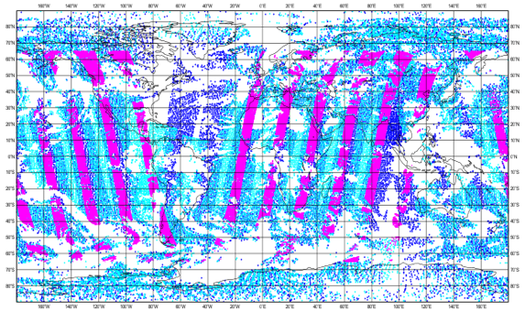
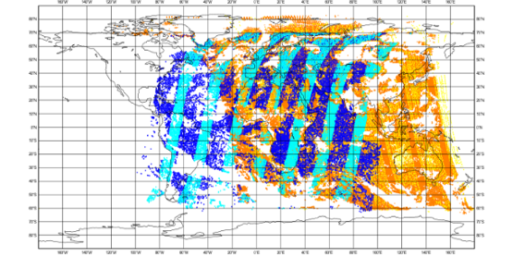
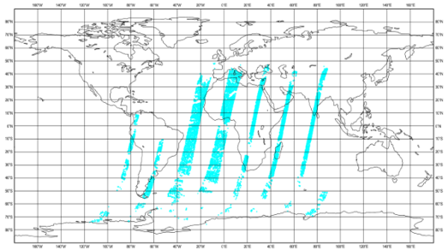
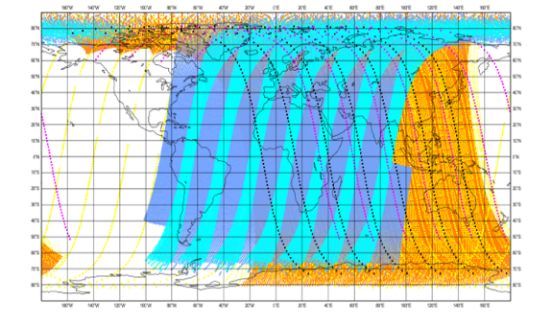
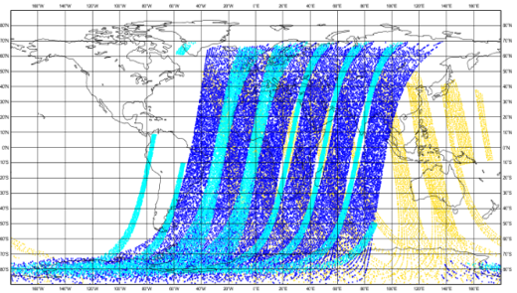
Assimilated reactive gases in CAMS real-time system
CO
Tropospheric NO2
IASI Metop-A
OMI
AURA
TROPOMI
S5P
IASI Metop-B
GOME-2 Metop-A
GOME-2 Metop-B
MOPITT TERRA
HCHO
O3
GOME-2 Metop-A
GOME-2 Metop-A
GOME-2 Metop-B
OMI
AURA
OMI, MLS
AURA
SO2
GOME-2 Metop-A
GOME-2 Metop-B
SBUV/2
NOAA-19
assimilated
TROPOMI
S5P
OMPS
SNPP
monitored
Notes:
better coverage, reducing errors, redundancy, satellite monitoring

Slide 12
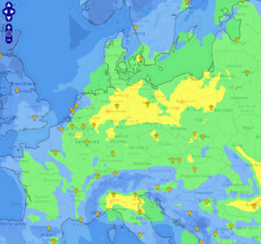
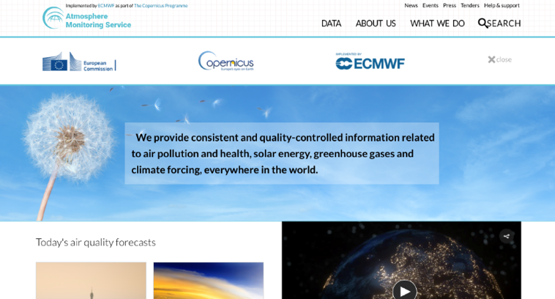
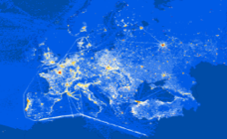
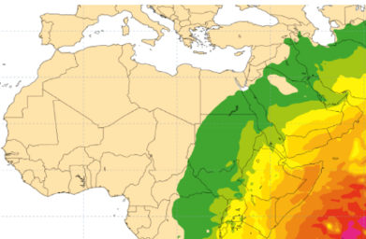
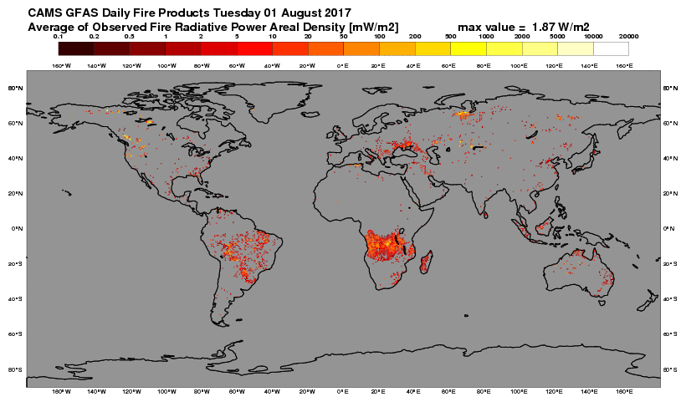
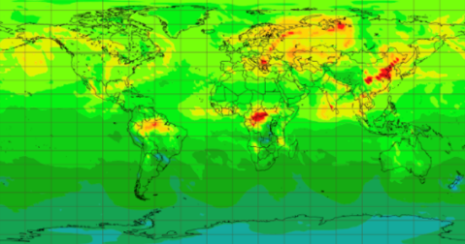
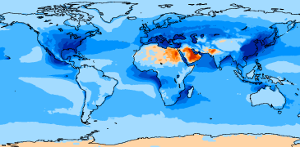
CAMS products families
atmosphere.copernicus.eu
https://atmosphere.copernicus.eu/
European Air Quality and products in support of policy users
NO₂
Ozone layer
Bottom-up emissions and surface fluxes of greenhouse gases
Climate forcing estimates
Solar radiation and UV index
Global emissions based on satellite observations
Global analyses, forecasts and reanalyses (2003-...)

Slide 13
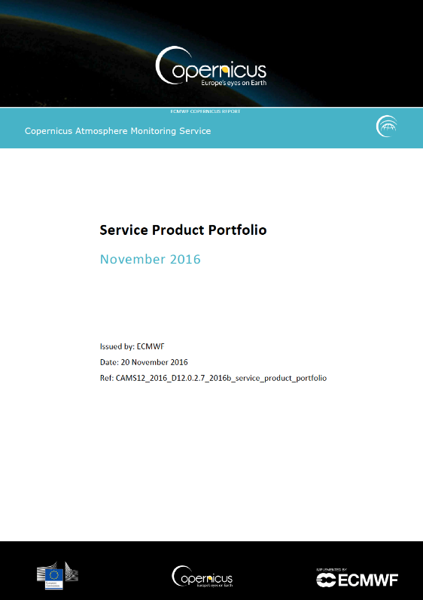
CAMS Service Product Portfolio
Portfolio | Product groups
A. Regional products | Real-time analyses
 | Real-time forecasts
 | Interim annual reanalyses
 | Annual reanalyses
B. Global products | Real-time analyses
 | Real-time forecasts
 | Reanalyses
C. Supplementary products | Policy support products
 | Solar radiation
 | Greenhouse gas flux inversions
 | Climate forcings
D. Emissions products | Anthropogenic emissions
 | Fire emissions
 | Natural emissions

Slide 14
ESTIMATING GLOBAL WILDFIRE EMISSIONS IN CAMS
Global Fire Assimilation System (GFAS); see http://apps.ecmwf.int/datasets/data/cams-gfas/
Uses satellite observations of Fire Radiative Power (FRP)
Currently Aqua and Terra MODIS FRP observations
FRP from VIIRS, Sentinel-3 and geostationary satellites will be added in 2020
Daily global coverage at ~10km resolution
1-day behind NRT (pre-operational diurnal cycle/hourly output since 2018)
Emissions of aerosols and gases are estimated using factors dependent on vegetation type.
Injection heights calculated with Plume Rise Model and IS4FIRES.
Upcoming hourly GFAS
c/o I. Hüser,
J. Kaiser (MPIC) et al.

Slide 15
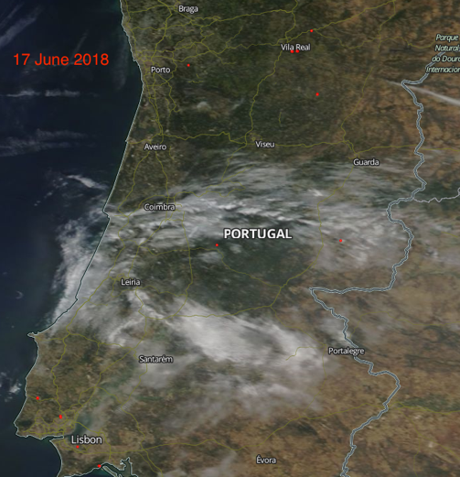
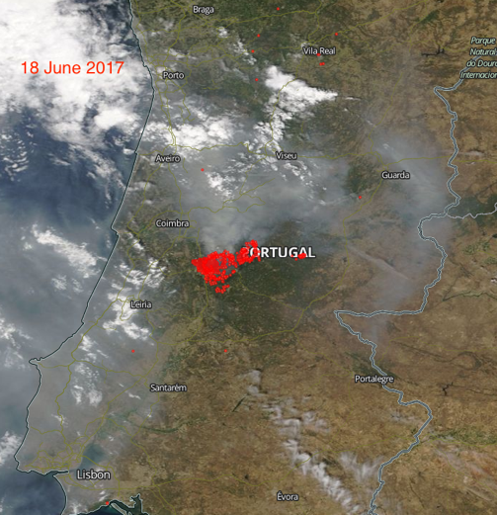
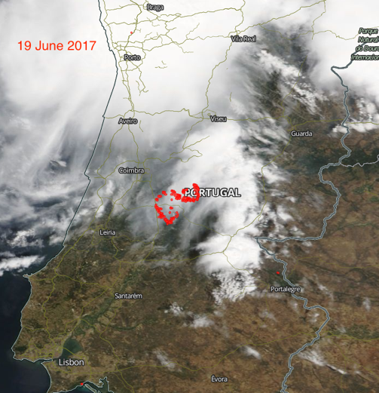
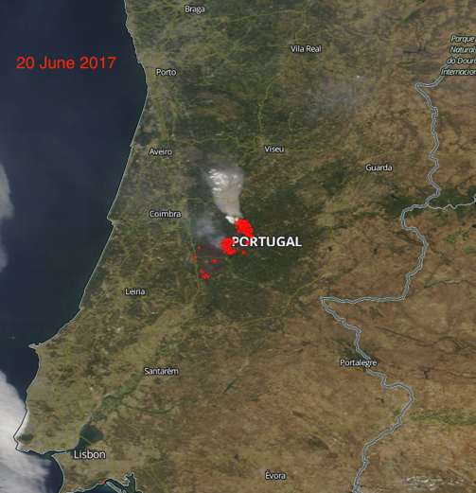
GFAS hourly fire emissions
17 June
18 June
Portugal fires 17-22 June 2017: diurnal cycle (including LEO+GEO obs) improves temporal profile of fire emissions
19 June
20 June

Slide 16
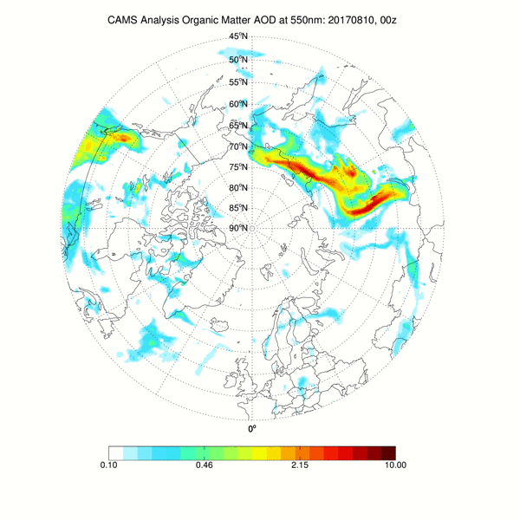
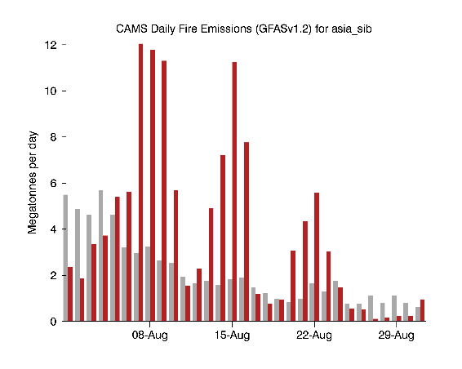
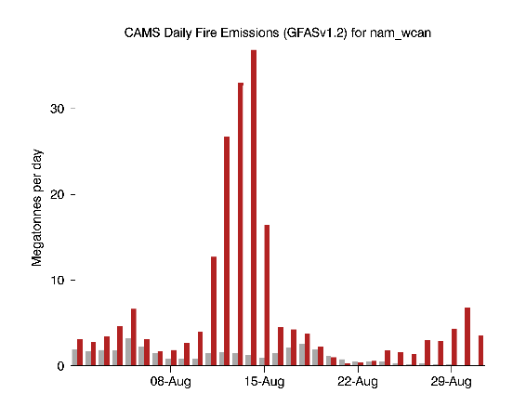
Long-range transport of boreal fire emissions, August 2017
CAMS daily fire CO₂ emissions (GFASv1.2)
Mean daily emission 2003-2016
Daily emission 2017
Fires in Siberia
Fires in Canada
Mean daily emission 2003-2016
Daily emission 2017

Slide 17
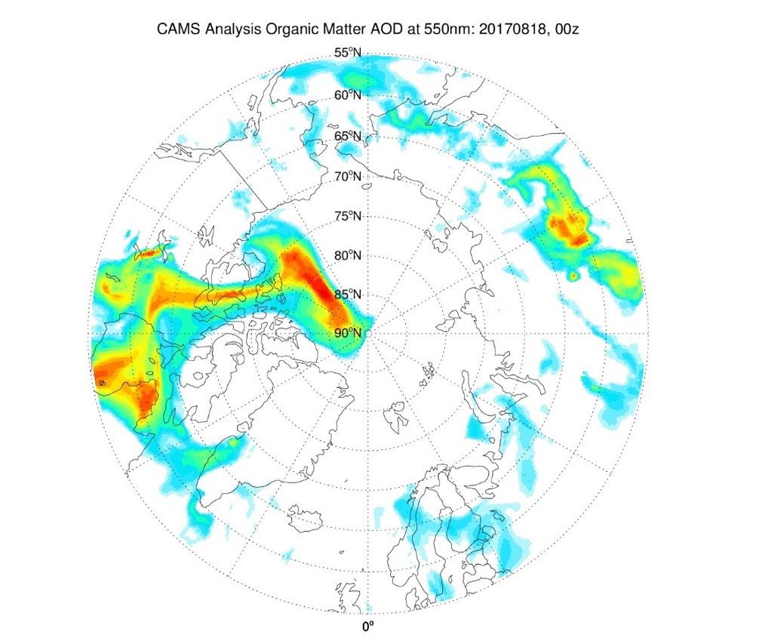
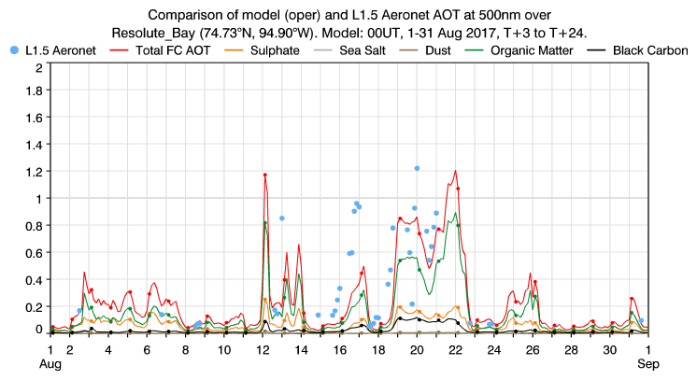
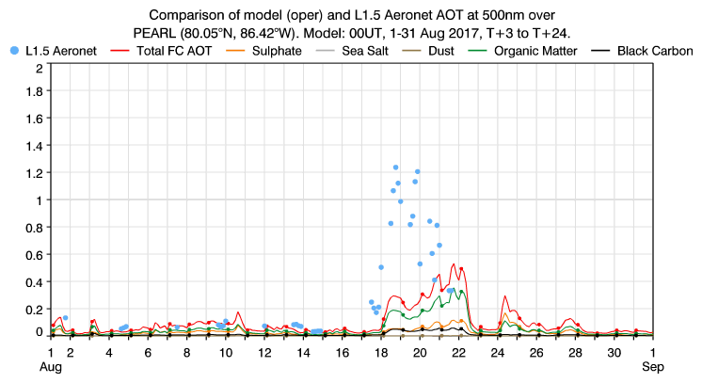
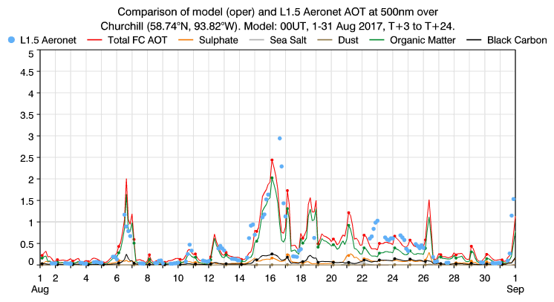
Long-range transport of boreal fire emissions, August 2017
Smoke from fires in NWT crossed the Arctic Circle in mid-August.
Generally good comparison of CAMS AOD with Aeronet observations.

Slide 18
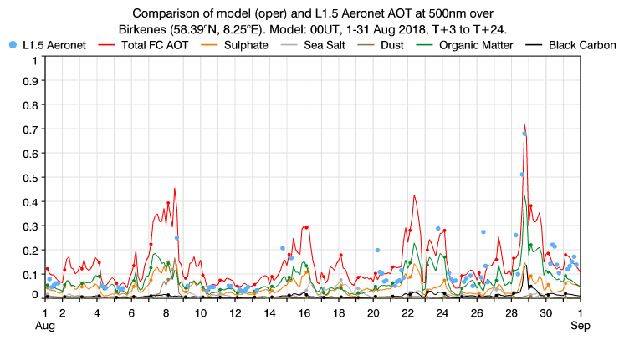
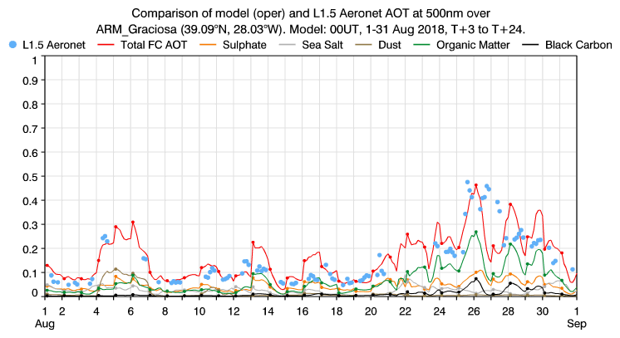
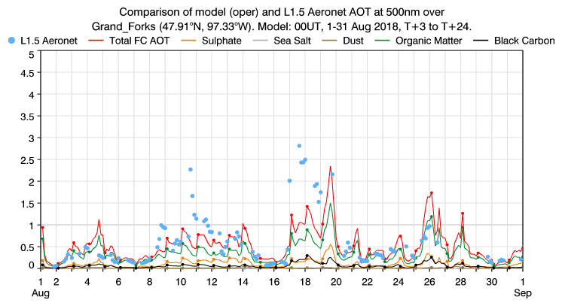
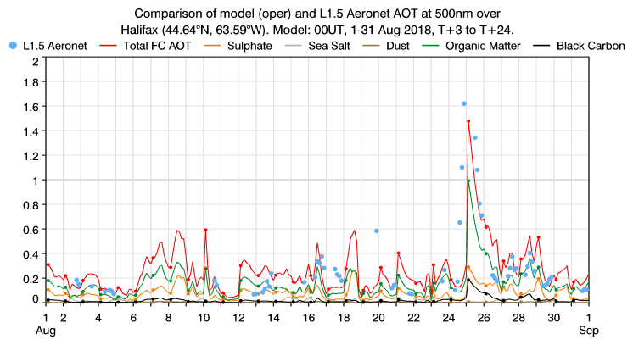
Long-range transport of boreal fire emissions, August 2018
Thick smoke blanketed much of North America for several weeks leading to significant deterioration in air quality.
Several events of smoke transport across North Atlantic to Europe monitored by CAMS and observed at AERONET sites.
Birkenes, Norway
Graciosa, Azores
Grand Forks, ND, USA
Halifax, NS, Canada

Slide 19
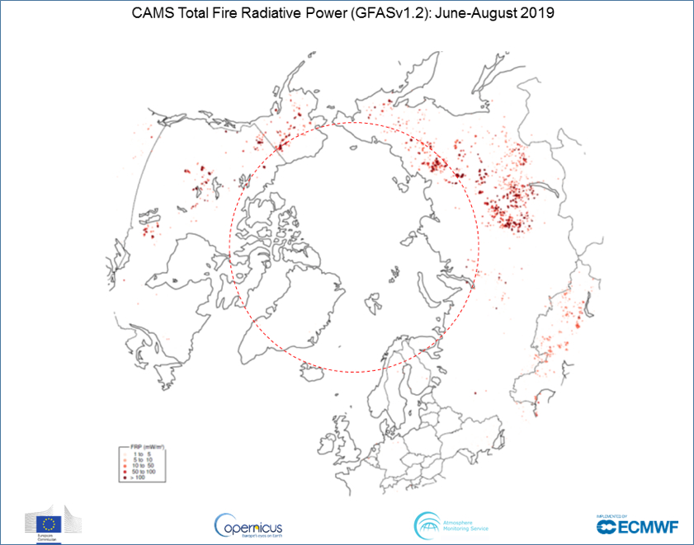
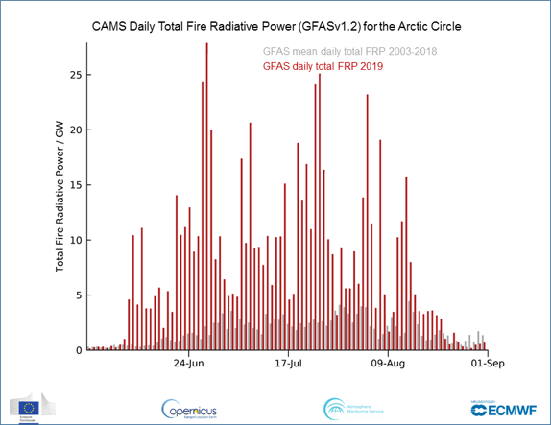
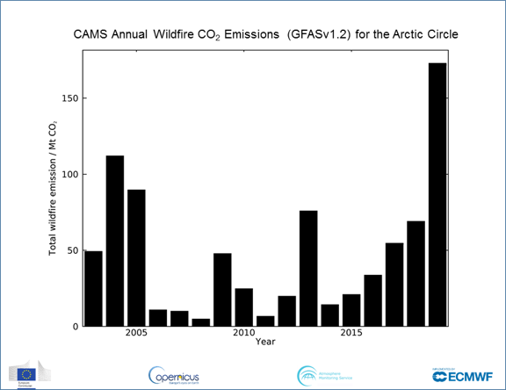
Monitoring Arctic wildfires during summer 2019
Daily total wildfire emissions were well above the 2003-2018 average throughout the summer north of the Arctic Circle
Many wildfires concentrated in the Sakha Republic, Russia with other fire activity in Alaska, Yukon Territory and Greenland
Total estimated equivalent CO2 of ~170 megatonnes

Slide 20
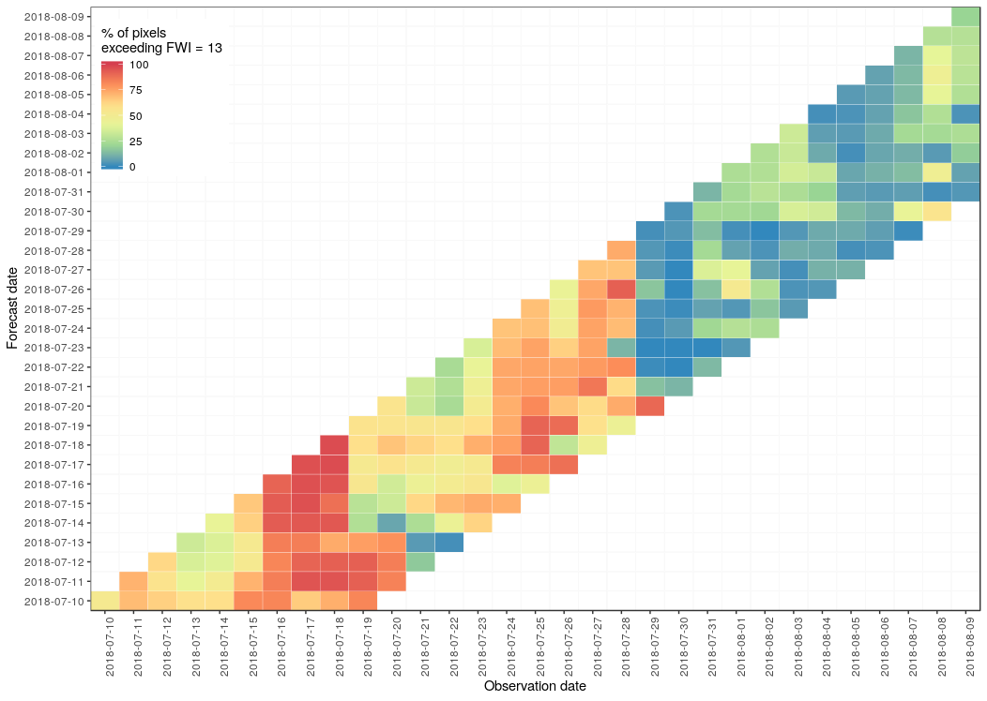
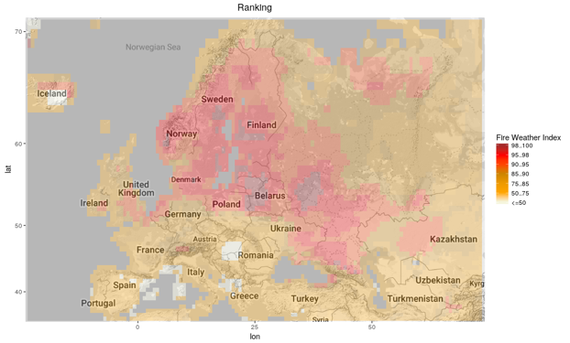
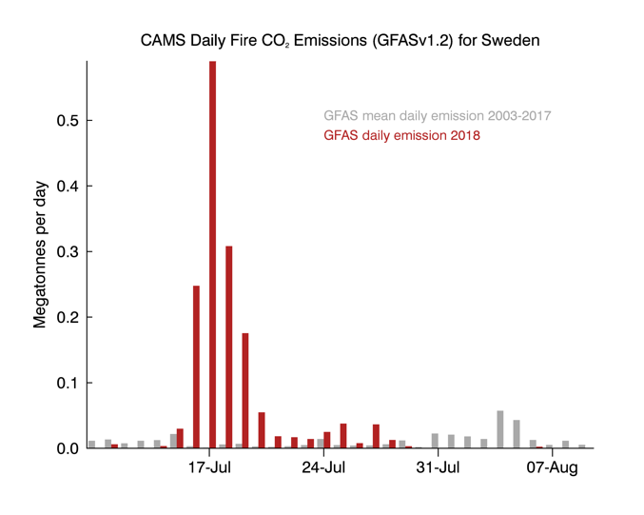
Links between CAMS and CEMS: from fire forecasts to emissions
09-Aug
CEMS Daily Fire Danger Forecasts for Central Sweden
10-day forecasts of fire danger, calibrated for central Sweden between 10 July and 9 August 2018.
Forecast date
10-Jul
c/o C. Vitolo, F. di Giuseppe (ECMWF)
Fire danger classes calculated with the Global ECMWF Fire Forecast (GEFF) System.
Daily forecasts available via CEMS EFFIS (for Europe) and GWIS (globally).
Discover the Data - Day 3: ECMWF and Copernicus data offering for assessing and forecasting forest fire danger
CAMS GFAS daily CO₂ emissions from wildfires ibn Sweden.

Slide 21
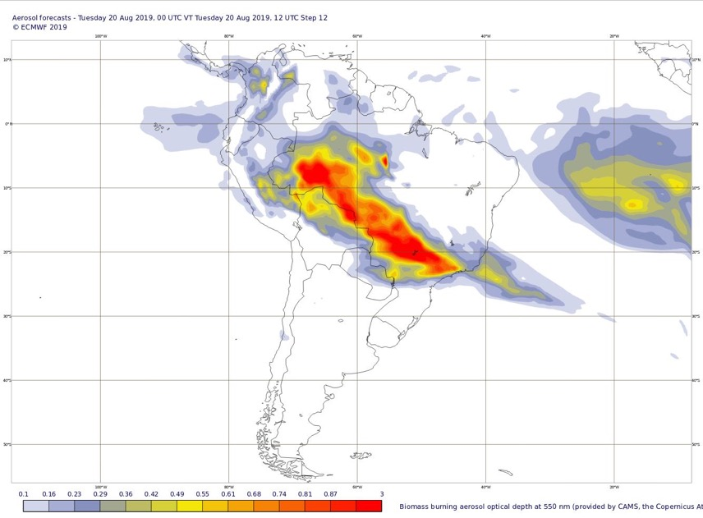
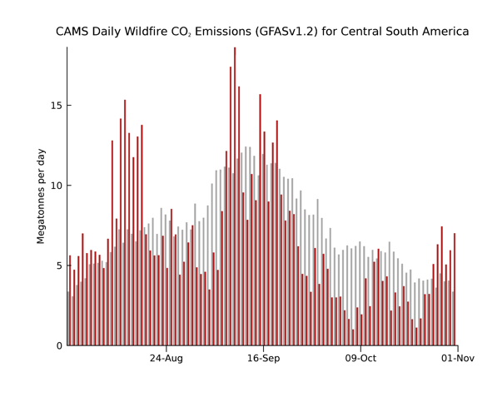
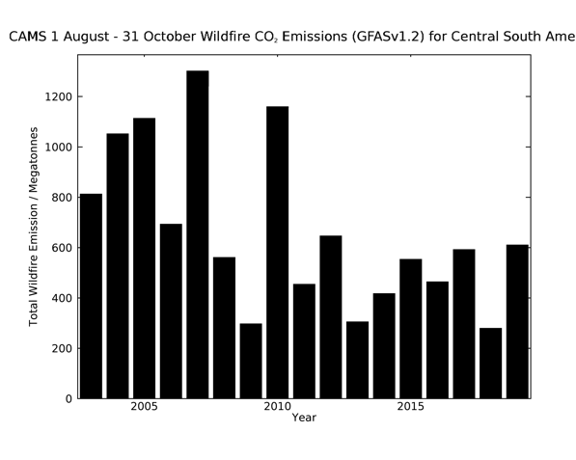
Monitoring Amazon fires in August 2019
Above average daily fire activity during first 2 weeks of August across the main states of the Brazilian Amazon (also in Bolivia and Paraguay) with smoke predicted by CAMS across much of southern Brazil
Below average (2003-2018) daily activity through September and October shows annual total is not particularly high compared to previous years in GFAS dataset.

Slide 22
Global analyses and forecasts
AOD
CO
CO₂
CH₄
40 km horizontal resolution at 137 model levels, pressure levels and single levels
two 5-day forecasts at 00z and 12z UTC each day
aerosols (AOD and concentration): biomass burning, dust, sea salt, sulphate
reactive gases: CO, HCHO, NO₂, O₃, SO₂ + 40 other species
9 km horizontal resolution at 137 model levels; one 5-day forecast per day (CO₂, CH₄, linear CO)

Slide 23
Visualizing CAMS forecasts on Windy.com
NO2
PM2.5
Latest CAMS 5-day global forecasts visualized via website and mobile app of windy.com
AOD

Slide 24
CAMS aerosol case study, Storm Ophelia, October 2017
CAMS aerosol forecasts initialized on 13 October 2017. Storm Ophelia transported a mixture of smoke, dust and sea salt aerosol across Europe leading to the sun appearing red and to yellow skies.

Slide 25
CAMS global reanalysis 2003 – 2018 (updated yearly)
Global scale
O3 score at Neumayer station
good
Reanalysis
Real-time
CAMS global reanalysis
2003 – 2018, with new years being added
Aerosols, 13 chemical pollutants, CO₂ & CH₄
80 km spatial resolution
Inness et al. 2019, https://doi.org/10.5194/acp-19-3515-2019
bad

Slide 26
Assimilated satellite products in CAMS Reanalysis

Slide 27
CAMS European air quality multi-model ensemble
Based on a multi-model approach (same boundary conditions, same emissions, same meteo, assimilation of 1000+ surface observations for key species)
Individual operational AQ models
Operational AQ ensemble
(incl. spread/uncertainty)
DEHM (AARHUS University)
GEM-AQ (IEP)
Once daily D+4 forecasts
Regulatory pollutants and pollens
Annual reanalyses
~ 10km resolution
MINNI (ENEA)
MONARCH (BSC)
http://www.regional.atmosphere.copernicus.eu
Notes:
27

Slide 28
High quality products at European scale
NO₂
Ozone

Slide 29
Access the regional air quality forecast data
Data available in GRIB and NetCDF format
You can download it using the CAMS regional data API service:
https://confluence.ecmwf.int/pages/viewpage.action?pageId=74753748
http://www.regional.atmosphere.copernicus.eu/index.php?category=data_access&subensemble=api_catalogue

Slide 30
Regional air quality reanalysis (2010) 2014 - 2018
Data available in NetCDF format
Interim and validated dataset versions
You can download it using the CAMS interactive web interface:
http://www.regional.atmosphere.copernicus.eu/index.php?category=data_access&subensemble=reanalysis_products

Slide 31
Products in support of policy users
Experimental: local vs imported, geographical origin, chemical speciation
http://policy.atmosphere.copernicus.eu/DailySourceAllocation.html
Notes:
A national environmental institute wants to know what caused the greatly increased pm10 concetrations. Was it local, so that measures could have been taken or was the contamination this time coming from neighboring countries? The CAMS policy instruments provide an initial indication with the sorce receptor tools.

Slide 32
Products in support of policy users
Assess the effect of emission reductions on daily forecasts
CAMS_ACT : O3, PM10 (PM2.5 coming)
http://policy.atmosphere.copernicus.eu/CAMS_ACT.html
Notes:
CAMS also provides emission scenario calculations: what is the effect of a reduction in emissions?

Slide 33
Access the global analyses and forecasts dataset
Interactive data server:
https://apps.ecmwf.int/datasets/data/cams-nrealtime
ECMWF Python Web API access
https://confluence.ecmwf.int/display/WEBAPI
https://confluence.ecmwf.int/display/WEBAPI/Python+CAMS+real-time+examples
FTP access to real-time data:
https://confluence.ecmwf.int/display/CKB/FTP+access+to+CAMS+global+data
Latest analyses and forecasts maps:
https://atmosphere.copernicus.eu/charts/cams/
WMS catalogue:
https://confluence.ecmwf.int/pages/viewpage.action?pageId=69180318
https://confluence.ecmwf.int/display/COPSRV/CAMS+WMS+gallery
Requirements:
ECMWF web account
self-registrations
CAMS licence accepted
Requirements:
ECMWF FTP account
registration on request
CAMS licence accepted
Public services

Slide 34
Accessing CAMS data: Online catalogue
https://atmosphere.copernicus.eu/data

Slide 35
Accessing CAMS data: Online catalogue
http://atmosphere.copernicus.eu/catalogue
Search criteria based on:
Product family – analysis, forecast (global/regional, emissions/fluxes.
Parameter family – aerosol, greenhouse gas, reactive gas, radiation
Parameter – e.g. organic matter aerosol concentration/AOD for smoke
Products found

Slide 36
Accessing CAMS data
Surface or 3-D fields
Time period
Analysis time
Forecast time
Parameter
https://apps.ecmwf.int/datasets/data/cams-nrealtime/

Slide 37
Accessing CAMS data
Time period
Parameter
Download
https://apps.ecmwf.int/datasets/data/cams-nrealtime/

Slide 38
Atmosphere Data Store (ADS)
Search or browse available datasets
https://ads.atmosphere.copernicus.eu/cdsapp#!/home

Slide 39
Atmosphere Data Store (ADS)
https://ads.atmosphere.copernicus.eu/cdsapp#!/home

Slide 40
Atmosphere Data Store (ADS)
Product overview gives data description and list of available variables
https://ads.atmosphere.copernicus.eu/cdsapp#!/home

Slide 41
Atmosphere Data Store (ADS)
Choose variables, model, level, date, time, area for API request of download as netcdf file
https://ads.atmosphere.copernicus.eu/cdsapp#!/home

Slide 42
Further information and user support for CAMS
Further information: http://atmosphere.copernicus.eu/ | @CopernicusECMWF @ECMWF
User support: https://atmosphere.copernicus.eu/cams-user-service-desk/

Slide 43
THE ATMOSPHERE MOOC
https://www.atmospheremooc.org/course-overview
#AtmosphereMOOC

Slide 44
User Workshop and Training on Fire Monitoring
1
Create an account: https://wekeo-login.services.meeo.it
Access to the practical course material via Jupyterhub
2
Go to:
https://ltpy.adamplatform.eu

