Slide 1
Forest fire danger
Copernicus and ECMWF data offering
Claudia Vitolo and Francesca Di Giuseppe
European Centre for Medium-range Weather Forecasts

Slide 2
About me
Scientist @ECMWF
Background in geospatial analytics and software/web service development
15+ years experience in environmental applications:
Multi-Hazard Early Warning Systems
Wildfires
Floods
Droughts, Heatwaves
AI solutions for air pollution modelling
Virtual Observatories for ecosystem services

Slide 3
Learning objectives
What are ECMWF and CEMS?
What is wildfire danger?
How is wildfire danger measured?
Where do you find relevant data?
How do I interpret (and process) the raw data for effective decision making?

Slide 4
OUTLINE
Introduction
ECMWF and Copernicus services
Fire activities at ECMWF
Wildfire danger, what/how?
Resources (web apps, data, software)
Practicals

Slide 5
Introduction

Slide 6
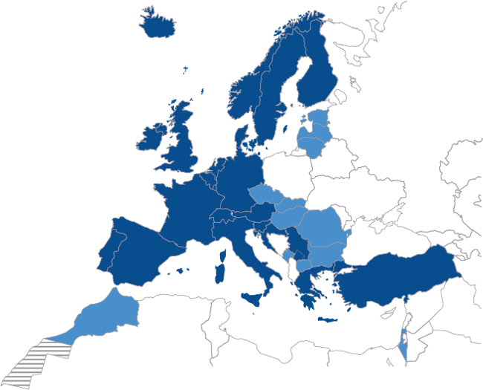
ECMWF
ECMWF is the European Centre for Medium-Range Weather Forecasts.
We are an independent inter-governmental organisation established in 1975 both a research institute and a 24/7 operational service, producing global numerical weather predictions and other data for our Member (22) and Co-operating (12) States and the broader community.
The Centre has one of the largest supercomputer facilities and meteorological data archives in the world. Other strategic activities include delivering advanced training and assisting the WMO in implementing its programmes.
ECMWF operates two services from the EU’s Copernicus Earth observation programme, the Copernicus Atmosphere Monitoring Service (CAMS) and the Copernicus Climate Change Service (C3S). We also contribute to the Copernicus Emergency Management Service (CEMS).

Slide 7
Fire activities at ECMWF
ECMWF provides monitoring and forecasting of global wildfire emissions and danger conditions through the Copernicus Atmosphere Monitoring and Emergency Management Services (CAMS and CEMS).
CAMS monitors global wildfire emissions based on satellite observations of Fire Radiative Power from MODIS in the Global Fire Assimilation System (GFAS) atmosphere.copernicus.eu
CEMS forecasts global fire danger with the Global ECMWF Fire Forecasting (GEFF) model. emergency.copernicus.eu
Global Fire monitoring
Global fire evolution forecasting (d+5)
Global fire danger forecasting (d+10)

Slide 8
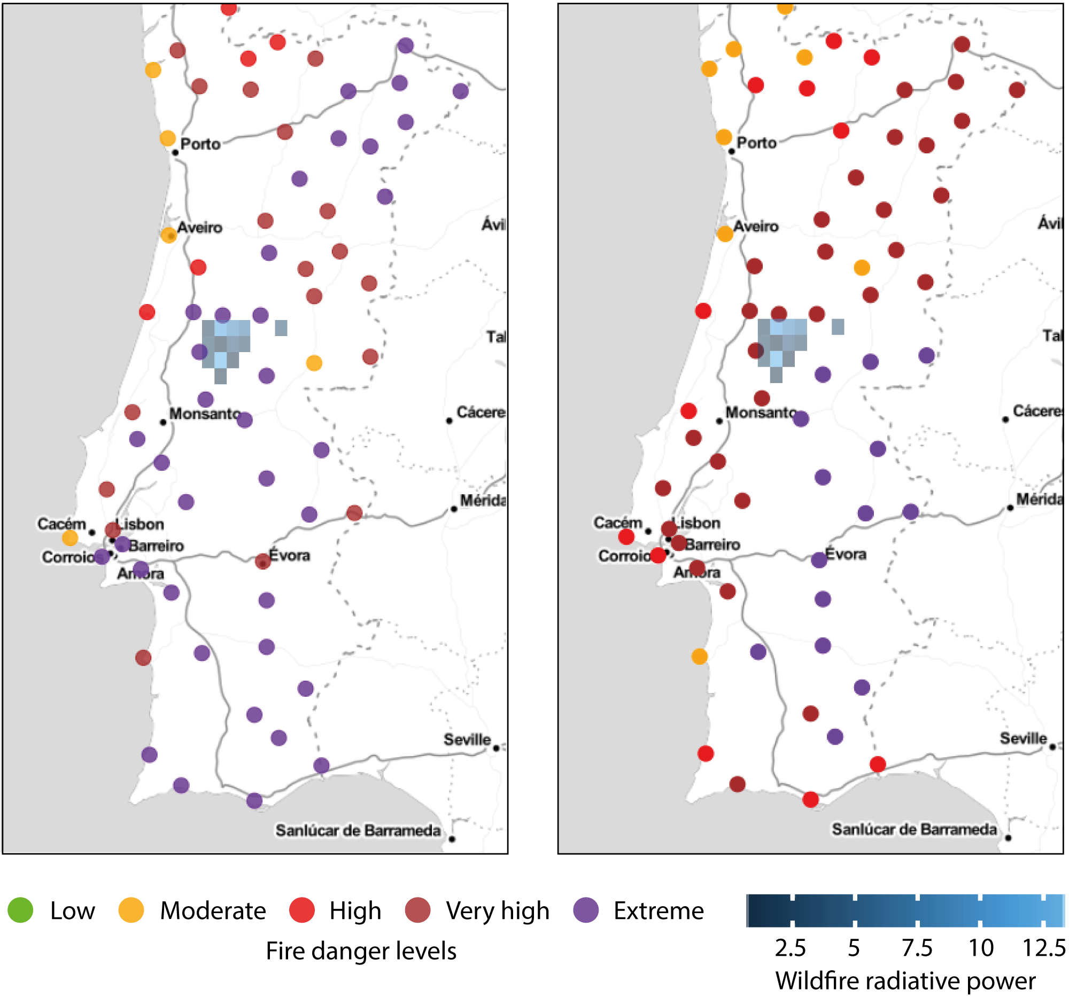
CEMS-Fire activities for proactive fire management practices
Need for monitoring fire weather (weather conditions conducive of a dangerous fire, typically this includes high temperature, low humidity and strong winds, but other variables can play a role) for improved hazard management and control (effective reactive approach).
But monitoring is not enough, we also need prevention (pro-active approach, adopt suitable control measures e.g. burn ban).
ECMWF’s IFS can be used to predict fire weather (using GEFF) many days in advance.
FWI using station data
FWI using ECMWF FC 10 days
Drawbacks of using station data to monitor fire weather
Fire weather info only available at discrete locations
Little time to act

Slide 9
CEMS-Fire activities for proactive fire management practices
Need for monitoring fire weather (weather conditions conducive of a dangerous fire, typically this includes high temperature, low humidity and strong winds, but other variables can play a role) for improved hazard management and control (effective reactive approach).
But monitoring is not enough, we also need prevention (pro-active approach, adopt suitable control measures e.g. burn ban).
ECMWF’s IFS can be used to predict fire weather (using GEFF) many days in advance.
FWI using station data
FWI using ECMWF FC 10 days
Drawbacks of using station data to monitor fire weather
Fire weather info only available at discrete locations
Little time to act

Slide 10
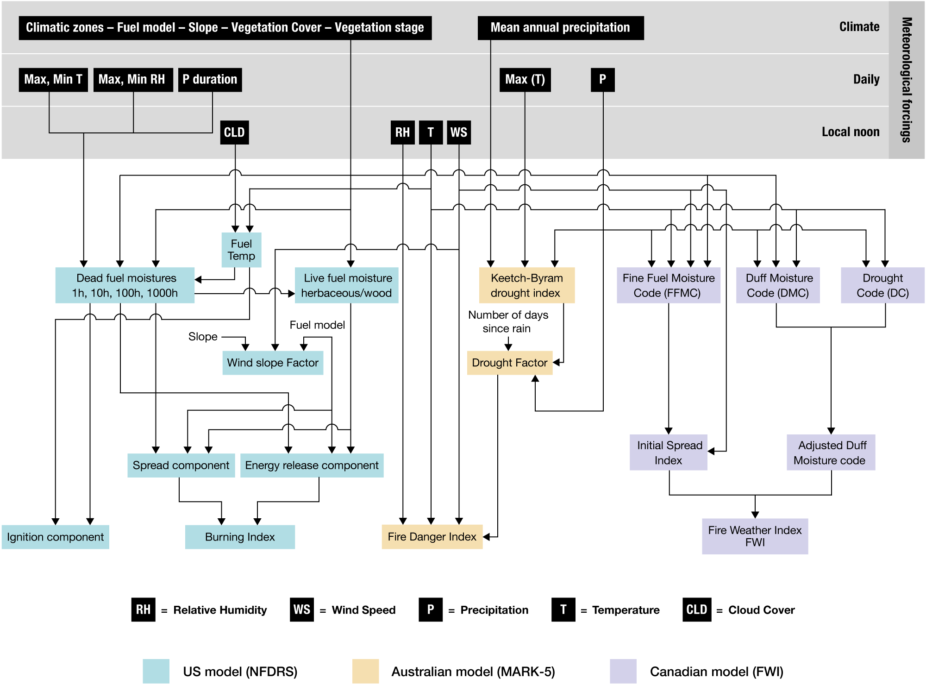
Fire danger, what is it and how do we measure it?
Fire (potential) danger => weather conditions conducive of a dangerous fire but conditional to an ignition to occur.
Three main systems:
Canadian Forest Fire Weather Index (most widely used around the world)
The U.S. Forest Service National Fire-Danger Rating System
The Australian McArthur’s Forest Fire Danger Meter
The Global ECMWF Fire Forecasting (GEFF) system implements the three systems, today we will focus on the FWI.
Di Giuseppe, Francesca, et al. "The potential predictability of fire danger provided by numerical weather prediction." Journal of Applied Meteorology and Climatology 55.11 (2016): 2469-2491.

Slide 11
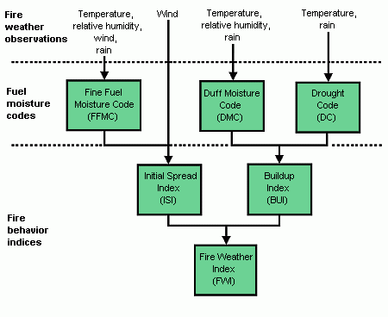
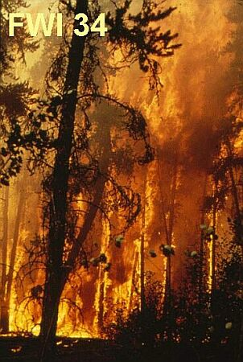
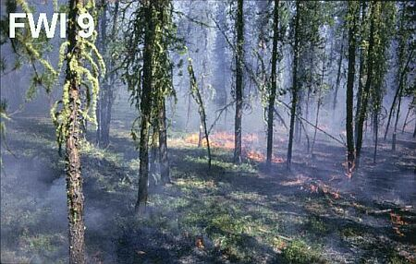
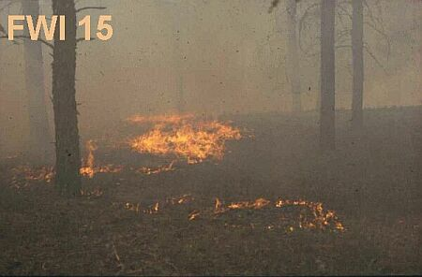
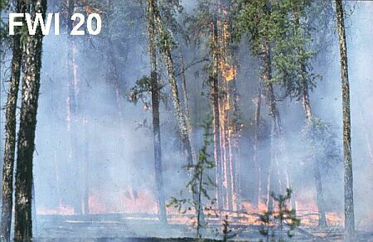
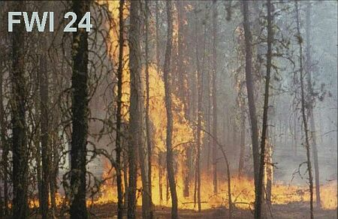
The Canadian Forest Fire Weather Index System
Three non interactive fuel layers
Drying depends on long and short term temperature, humidity and precipitation conditions
Wind mostly controls flammability
Combinations of dryness and flammability produces a general index of fire danger called Fire Weather Index (FWI):
FWI is a numeric rating in the range [0, Inf[
FWI gives an indication of the consequences of a fire, if one was to start. The higher the FWI, the more dangerous the conditions.
https://cwfis.cfs.nrcan.gc.ca/background/examples/fwi
Alexander, M.E.; De Groot, W.J. 1988. Fire behavior in jack pine stands as related to the Canadian Forest Fire Weather Index System. Canadian Forest Service, Northern Forestry Centre, Edmonton, AB. Poster with text. Quintilio, D.; Fahnestock, G.R.; Dubé, D.E. 1977. Fire behavior in upland jack pine: the Darwin Lake Project. Canadian Forest Service, Northern Forestry Centre, Edmonton, AB. Information Report NOR-X-174.
Notes:
Fine Fuel Moisture Code (FFMC), refers to the moisture content of litter and other cured fine fuels occupying the first fuel bed layers (surface layer, 1-2 cm deep). This code is an indicator of the relative ease of ignition and the flammability of fine fuel and it is characterised by a fast response to weather variations, with a timelag of 16 hours under standard conditions. FFMC is a unit-less number defined in the range [2, 101], with a conventional starting value of 85.
Duff Moisture Code (DMC), refers to the moisture content of loosely compacted organic layers of moderate depth (duff layer, 5-10 cm) and gives an indication of fuel consumption in moderate duff layers and medium-size woody material. DMC is characterised by a medium-term response (about 10-12 days) to weather variations. This is also a numeric rating defined in the range [0, $+\infty$[, with a default startup value of 6.
Drought Code (DC), refers to the moisture content of deep, compact organic layers (deep duff layer, 1-20 cm). This code is a useful indicator of seasonal drought effects on forest fuels and the amount of smoldering in deep duff layers and large logs. DC has a long-term response (about 50 days) to weather variations. The rating is defined in the range [0, $+\infty$[, with a default startup value of 15.
Initial Spread Index (ISI), a measure of the rate at which a fire would spread in its early stages shortly after ignition. It combines the effects of wind and the FFMC on rate of spread without the influence of variable quantities of fuel. ISI is a numeric rating defined in the range [0, $+\infty$[.
Build Up Index (BUI), the total amount of fuel available for combustion. It is a weighted combination of the DMC and DC and defined in the range [0, $+\infty$[.
Fire Weather Index (FWI), a unit-less index of general fire intensity which results from the integration of ISI and BUI. It is defined in the range [0, $+\infty$[ and widely considered a general index of fire danger.
Daily Severity Rating (DSR), a non-linear transformation of the Fire Weather Index which is intended to be directly proportional to the expected effort required for fire suppression and therefore widely used to predict the difficulty to control a fire. It is suitable to be averaged over space (i.e. region) and time (i.e. season).

Slide 12
Resources

Slide 13
URL: https://emergency.copernicus.eu/
Notes:
Here is how the website looks like, there are 2 relevant tools to explore:
Rapid mapping where there are reports of events occurring in real time and users can get information on the cause of the event (whether fires where natural in original or due to arson) but you can also get information on the extent of the area affected.
EFFIS - the European Fire Information system which we will explore in more detail in a bit

Slide 14
Notes:
Here is how the website looks like, there are 2 relevant tools to explore:
Rapid mapping where there are reports of events occurring in real time and users can get information on the cause of the event (whether fires where natural in original or due to arson) but you can also get information on the extent of the area affected.
EFFIS - the European Fire Information system which we will explore in more detail in a bit

Slide 15
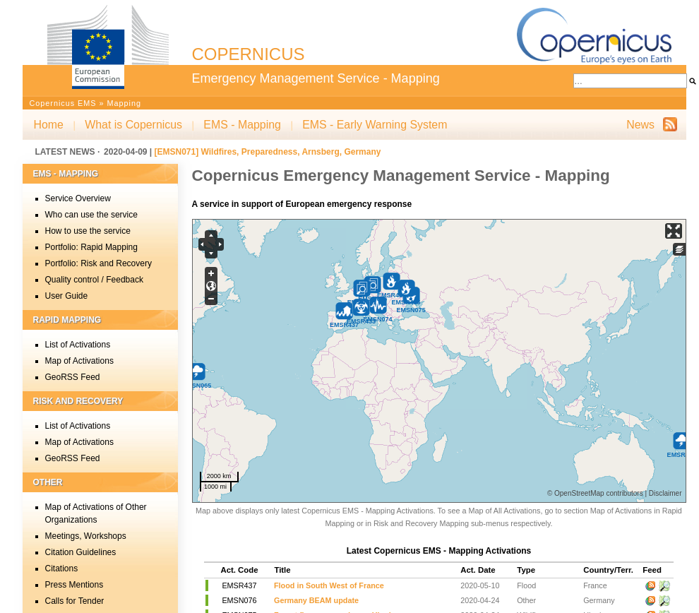
CEMS mapping tool

Slide 16
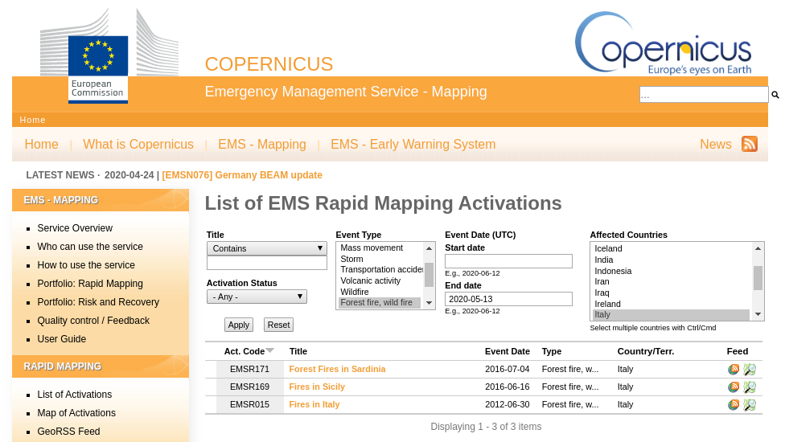
CEMS mapping tool

Slide 17
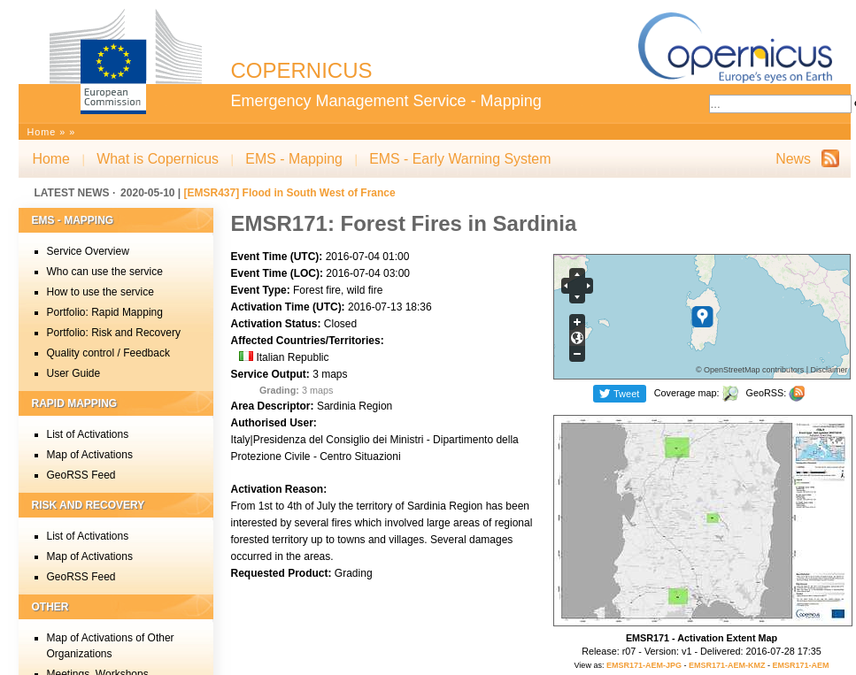
CEMS mapping tool

Slide 18
Notes:
Here is how the website looks like, there are 2 relevant tools to explore:
Rapid mapping where there are reports of events occurring in real time and users can get information on the cause of the event (whether fires where natural in original or due to arson) but you can also get information on the extent of the area affected.
EFFIS - the European Fire Information system which we will explore in more detail in a bit

Slide 19
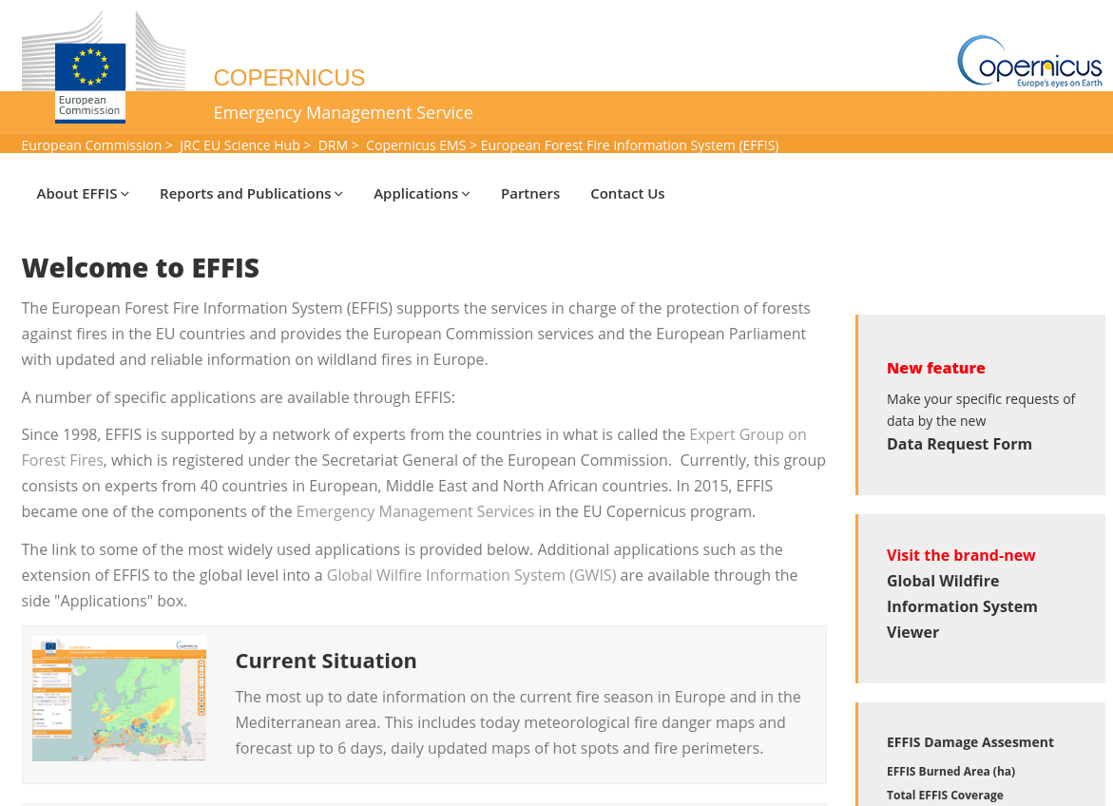
EFFIS

Slide 20
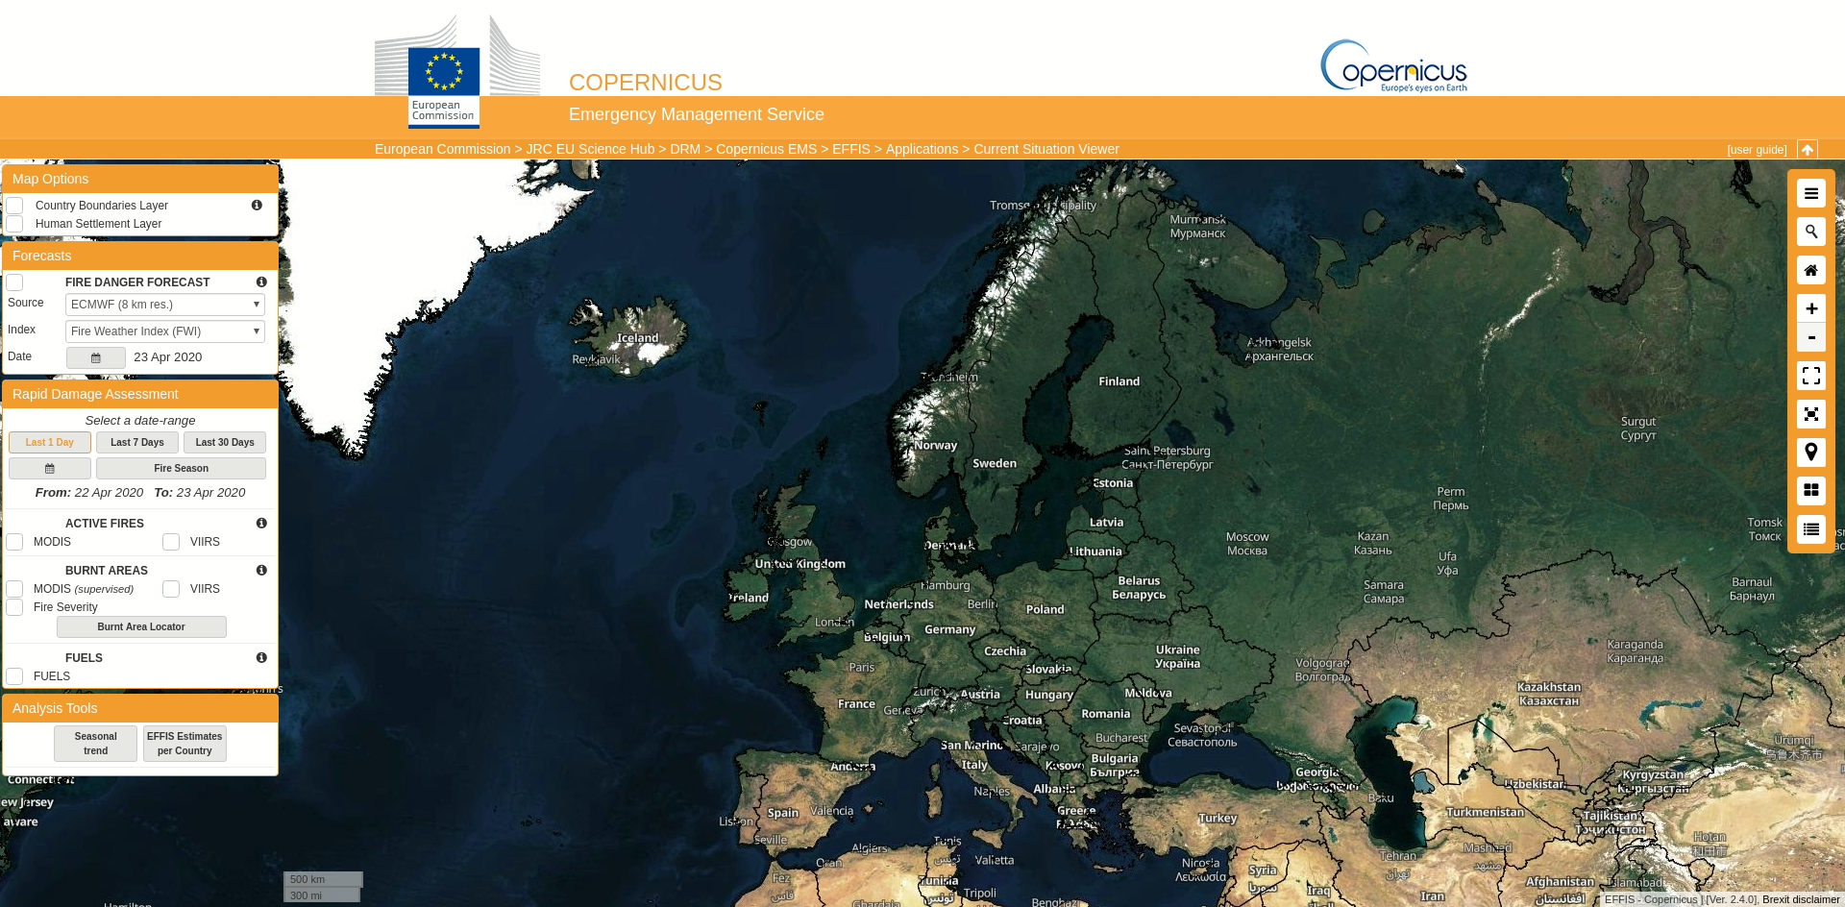
Data resources (1)
Medium-range fire danger forecasts (real-time) available from the JRC:
The European Forest Fire Information System (EFFIS) https://effis.jrc.ec.europa.eu/
The Global Wildfire Information System (GWIS) https://gwis.jrc.ec.europa.eu/
Data can be requested here: https://effis.jrc.ec.europa.eu/applications/data-request-form/

Slide 21
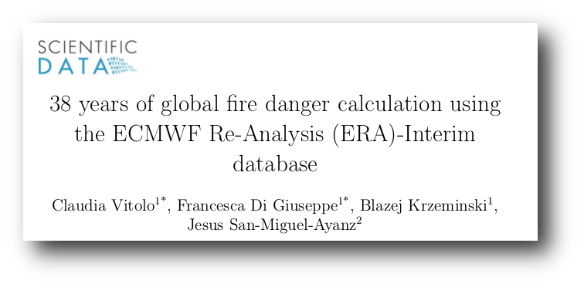
Global ECMWF Fire Forecasting system - data offering
Climatological data sets - issued daily (2 months behind real-time)
~40 years of Re-analysis
ERA5 (~28 Km resolution, using IFS cycle 41r2 operational at ECMWF in 2016)
ERA-Interim (~80 Km resolution, using IFS cycle 31r2 operational at ECMWF in 2006)
Medium-range forecasts - issued daily - up to 15 days ahead
Daily outputs using latest version of IFS model cycle (46r1, operational since March 2019)
High resolution ~9 Km globally
ENS prediction (51 ensemble members at ~18 Km).
Seasonal forecast - monthly - 7 months ahead (coming soon)
Test development using ECMWF seasonal forecast S5

Slide 22
Typical data volumes
Dataset | 1 Year | 1 Day
HRES fire forecast | ~1.3 TB | ~3.6 GB
ENS fire forecast | ~7.3 TB | ~20 GB
Dataset | 40 Years | 1 day
Fire reanalysis (ERA5 HRES) | ~50 GB (1 index) | ~29 MB (all indices + forcing)
Fire reanalysis (ERA5 ENS - 10 members) |  | ~33 MB (all indices + forcing)

Slide 23
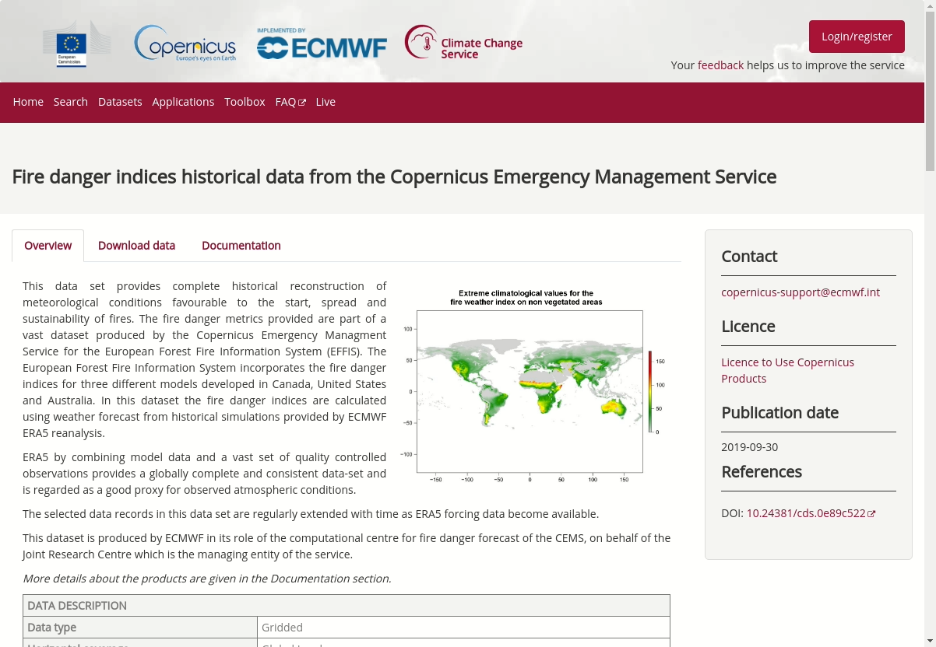
Data resources (2)
Open data under Copernicus license:
Seasonal fire danger forecasts Coming soon … on the Copernicus Climate Data Store! https://cds.climate.copernicus.eu/
Reanalyses: ERA5 - FWI/NFDRS/MARK-5 systems Copernicus Climate Data Store https://cds.climate.copernicus.eu/cdsapp#!/dataset/cems-fire-historical
Instructions:
Go to Copernicus Climate Data Store: https://cds.climate.copernicus.eu/cdsapp#!/dataset/cems-fire-historical?tab=overview
Register an account
Click on the ‘Download data’ tab and select data of Interest. Click on ‘Submit form’ to download the data.
Sample datasets, for education purposes only, available on the Zenodo wildfire community https://zenodo.org/communities/wildfire

Slide 24
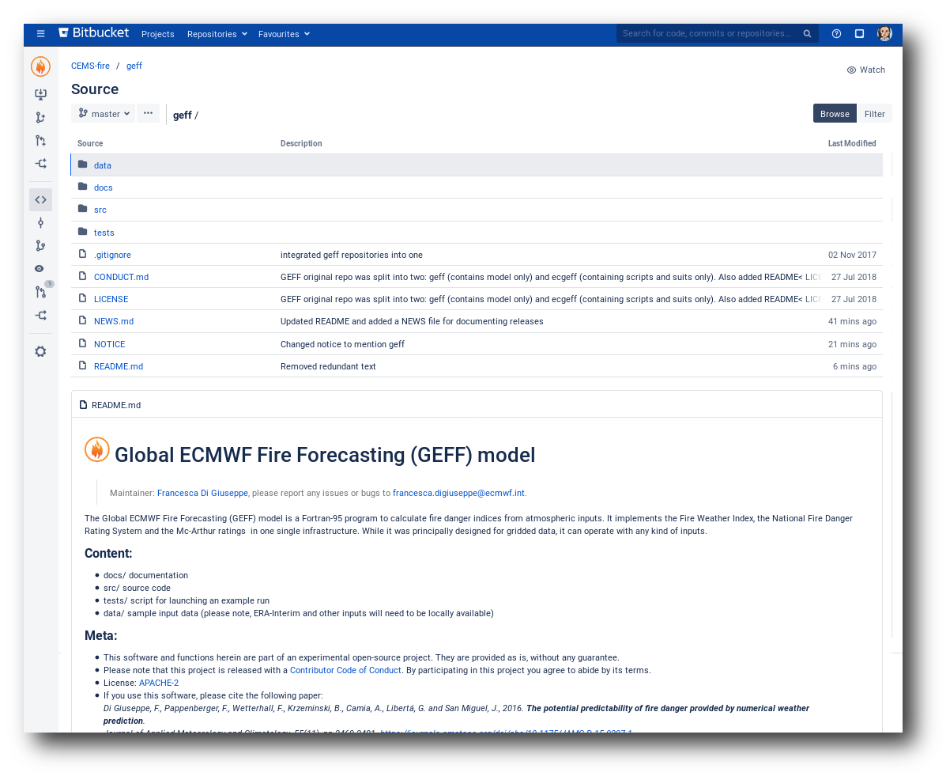
Software resources
GEFF MODEL SOURCE CODE
https://git.ecmwf.int/projects/CEMSF/repos/geff/browse
DATA PROCESSING
For Python3 users:
Collection of Jupyter notebooks: https://github.com/cvitolo/geff_notebooks
For R users:
The R package “caliver” (open source under APACHE-2 license).
Vitolo C., Di Giuseppe F. and D’Andrea M. (2018) “Caliver: An R Package for Calibration and Verification of Forest Fire Gridded Model Outputs”. PLOS ONE 13 (1). Public Library of Science: 1–18. doi:10.1371/journal.pone.0189419

Slide 25
Practicals

Slide 26
GEFF Jupyter notebooks and data
Global data, July 2018: RT HR, RT EN, E5 HR, E5 EN
Local data:
Greece, 23-26 July 2018
GUIDED and SOLVED exercises
Data: RT HR, RT EN, E5 HR, E5 EN
Sweden, 15-20 July 2018
GUIDED exercises
Data: RT HR, RT EN, E5 HR, E5 EN
Siberia, 23-25 July 2019
Section GEFF Fire Weather Index in 61_case_study_siberian_fires_summer_2019.ipynb
Data: RT HR, RT EN, E5 HR, E5 EN

Slide 27
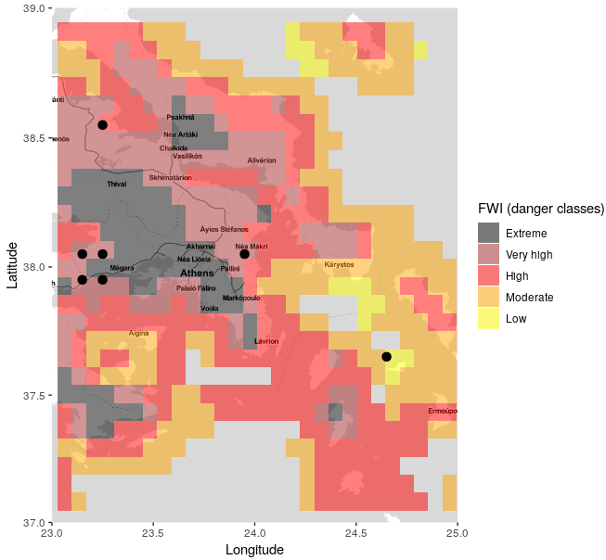
Event: Attica (Greece) fires, 23-26 July 2018
A series of wildfires in Greece, during the 2018 European heat wave, began in the coastal areas of Attica in July 2018. 102 people lost their lives. (Source: https://en.wikipedia.org/wiki/2018_Attica_wildfires).
The first fire was ignited on 23rd July.
Arson may have been a possible cause of the fires
ECMWF forecast showed a clear signal for very high to extreme fire danger conditions 10 days before the event

Slide 28
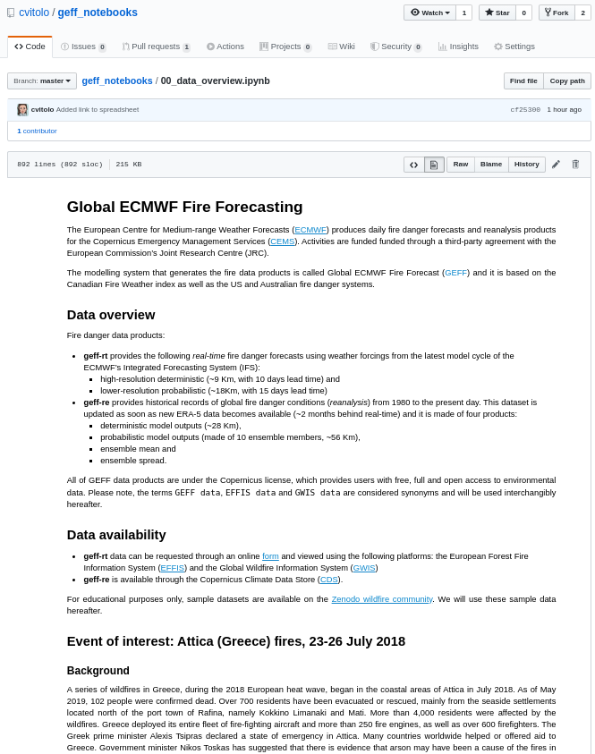
Data overview
Jupyter notebook: https://github.com/cvitolo/geff_notebooks/blob/master/00_data_overview.ipynb

Slide 29
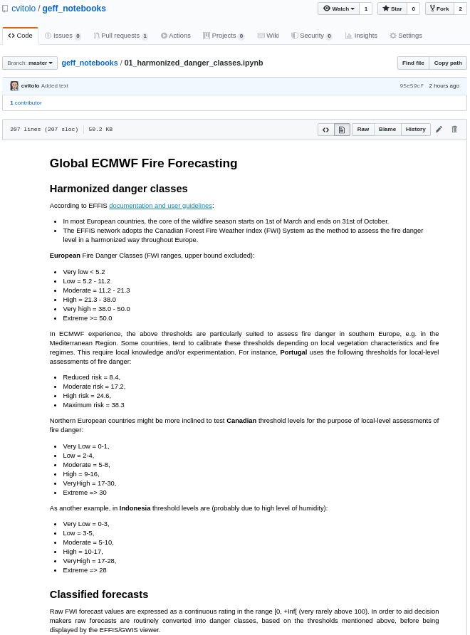
Harmonised danger classes
Jupyter notebook: https://github.com/cvitolo/geff_notebooks/blob/master/01_harmonized_danger_classes.ipynb

Slide 30
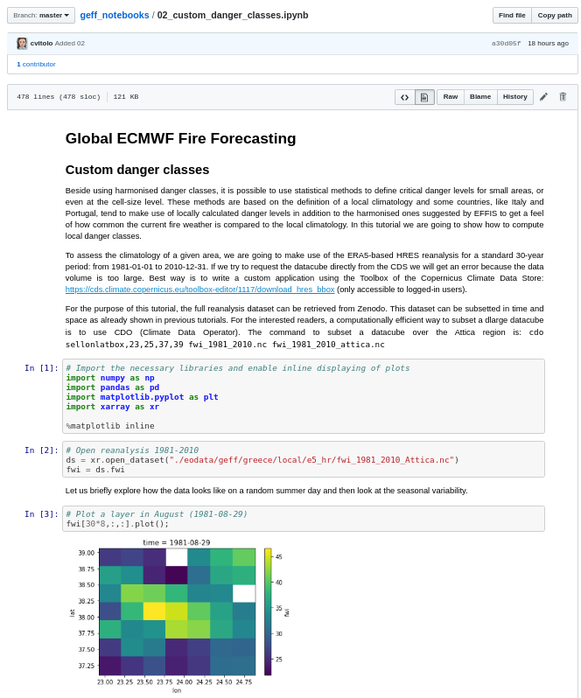
Extras: Custom danger classes
Jupyter notebook: https://github.com/cvitolo/geff_notebooks/blob/master/02_custom_danger_classes.ipynb

Slide 31
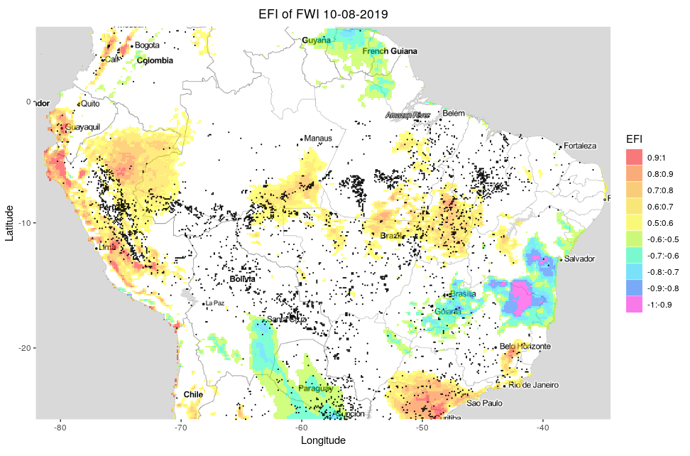
Extras: other danger indicators (anomaly, ranking, EFI, SOT)

Slide 32
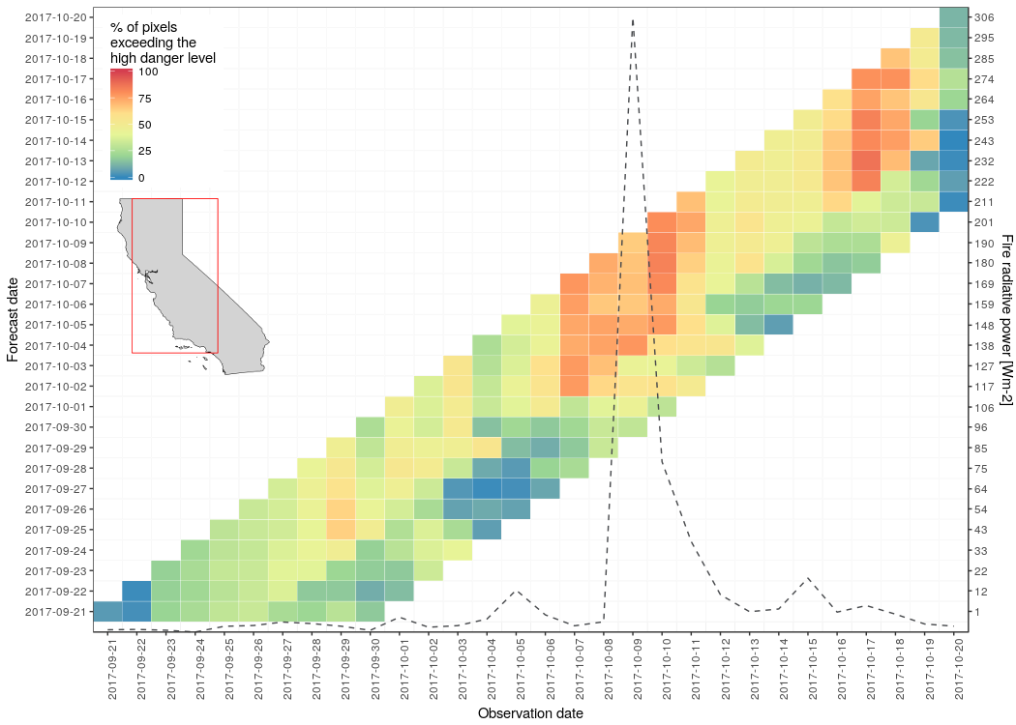
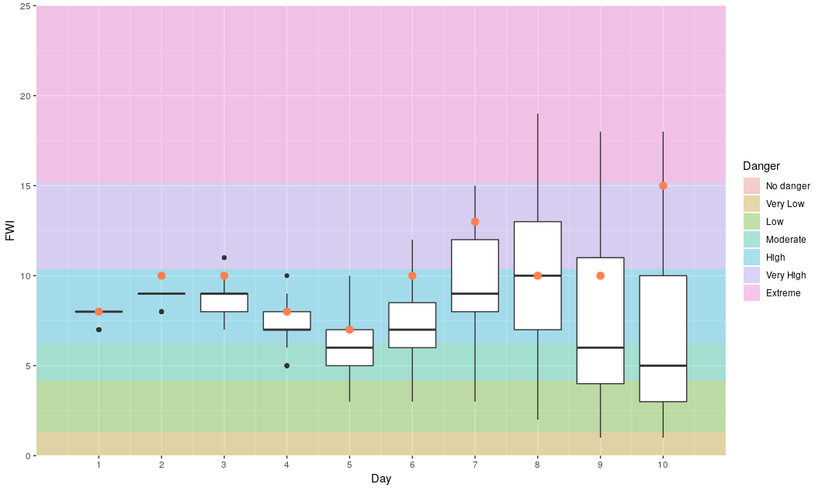
Extras: more advanced statistical processing and custom visualisations

Slide 33
Take home messages
Fire danger forecasting plays a crucial role in developing proactive fire management practices (e.g. adopt suitable control measures)
ECMWF and CEMS make available a large volume of information (forecasts and reanalysis products)
All data is under a Copernicus license, therefore free for everyone to use.

Slide 34
References
Journal papers
Vitolo, C., Di Giuseppe, F., Krzeminski, B. and San-Miguel-Ayanz, J., 2019. A 1980–2018 global fire danger re-analysis dataset for the Canadian Fire Weather Indices. Scientific data, 6, p.190032.
Vitolo, Claudia, Francesca Di Giuseppe, and Mirko D’Andrea. Caliver: An r package for calibration and verification of forest fire gridded model outputs. PLOS ONE, 13(1):1–18, 01 2018
Di Giuseppe, F., Pappenberger, F., Wetterhall, F., Krzeminski, B., Camia, A., Libertá, G. and San Miguel, J., 2016. The potential predictability of fire danger provided by numerical weather prediction. Journal of Applied Meteorology and Climatology, 55(11), pp.2469-2491.
Newsletter articles
ECMWF forecasts support Portugal wildfire response (Number 153 - Autumn - October 2017) https://www.ecmwf.int/en/newsletter/153/news/ecmwf-forecasts-support-portugal-wildfire-response
Devastating wildfires in Chile in January 2017 (Number 151 - Spring - April 2017) https://www.ecmwf.int/en/newsletter/151/news/devastating-wildfires-chile-january-2017
Copernicus fire danger forecast goes online (Number 151 - Spring - April 2017) https://www.ecmwf.int/en/newsletter/151/news/copernicus-fire-danger-forecast-goes-online
E-Learning
https://www.ecmwf.int/en/learning/education-material/elearning-online-resources

Slide 35
Thank you!

Slide 36
User Workshop and Training on Fire Monitoring
1
Create an account: https://wekeo-login.services.meeo.it
Access to the practical course material via Jupyterhub
2
Go to:
https://ltpy.adamplatform.eu

