Slide 1
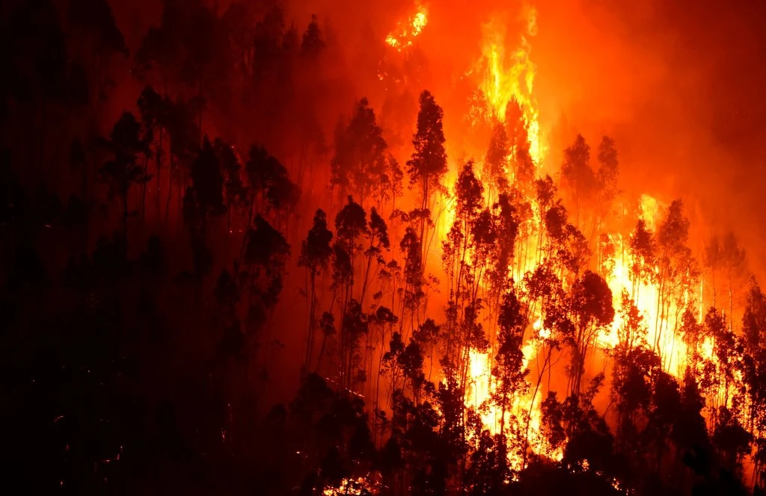
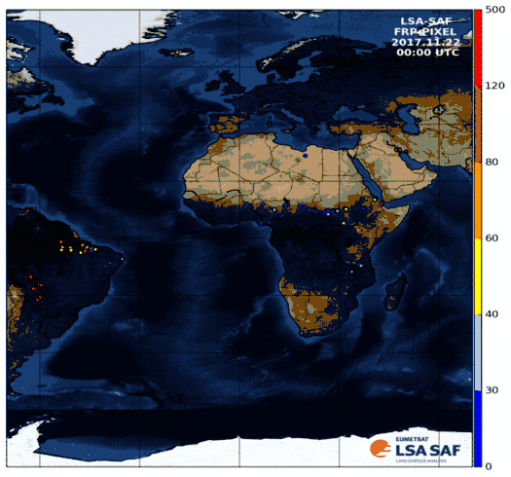
Fire related applications using satellite data records from LSA-SAF
User Workshop and Training on Fire Monitoring
14th May 2020
Welcome to Day 4!

Slide 2
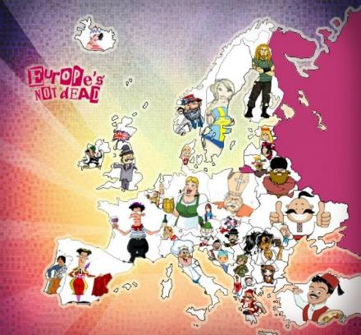



Dr. Célia M. Gouveia
celia.gouveia@ipma.pt
Senior Researcher at LSA-SAF
Instituto Português do Mar e Atmosfera
&
Assistant Professor (Remote Sensing and Environment)
Science Faculty University of Lisbon
Research Topics
Climate extremes: droughts, heatwaves
Vegetation dynamics, carbon balance
Fire behaviour, risk and recovery

Slide 3
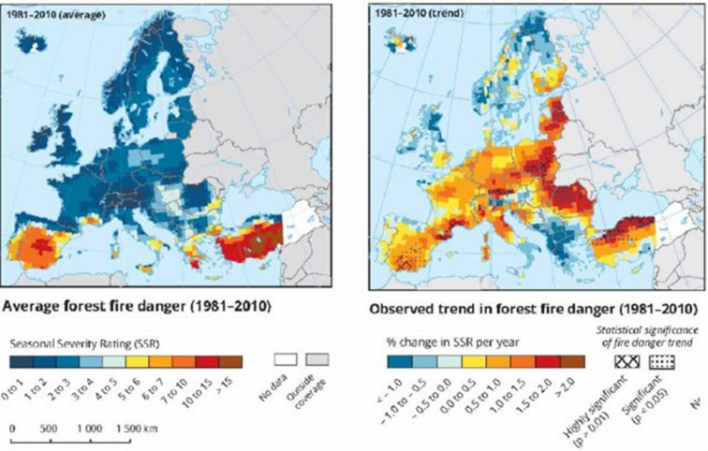
Wildfires - European Context
https://www.eea.europa.eu/data-and-maps/indicators/forest-fire-danger-2/assessment

Slide 4
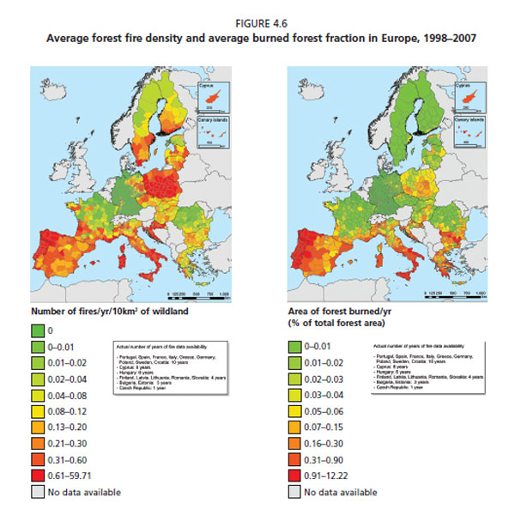
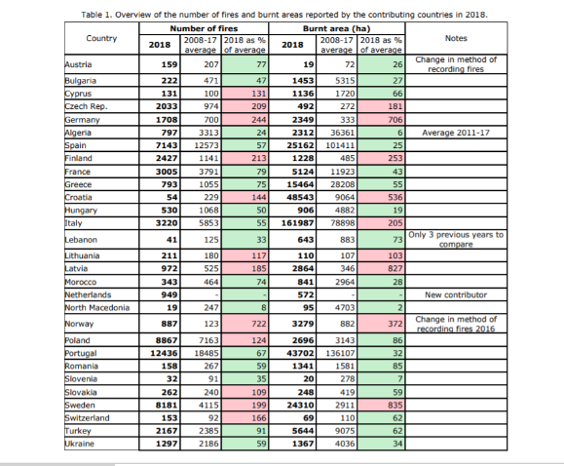
EFFIS Annual Report 2018
http://www.fao.org/forestry/fra/69109/en/

Slide 5
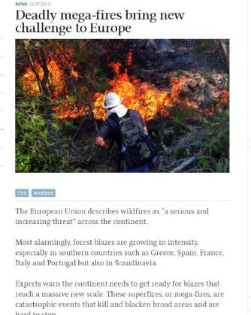

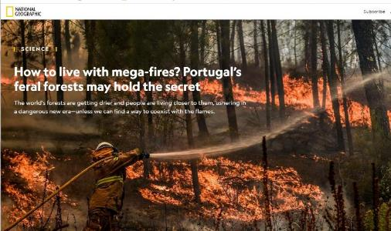
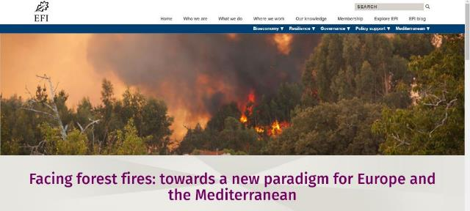
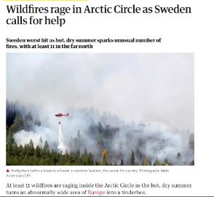

Slide 6
LSA SAF Consortium
LSA-SAF Objective
Satellite Products related to Land Surfaces & Land-Atmosphere interactions
Focusing primarily EUMETSAT satellites
Maintain (& improve!) the service for current missions
Ensure transition to Next Generation of EUM satellites: MTG & EPS-SG
IPMA-Lead
IPMA (Portugal) – Leading Institution
MF (France)
RMI (Belgium)
IDL (Univ Lisbon)
KCL (King’s College London)
KIT (Karlsruhe Inst Technology)
UV (Univ Valencia)
VITO (Flemish Inst Technological Res)
ARSO (Slovenian Env Agency)
NIMH (Bulgarian Inst Met and Hyd)
  NRT & Off-line production of Land surface variables (EUMETCast, ftp & Website)
  Helpdesk User Support Service (helpdesk.landsaf@ipma.pt)

Slide 7
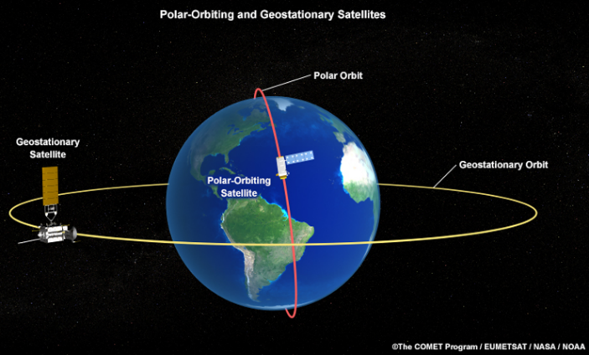
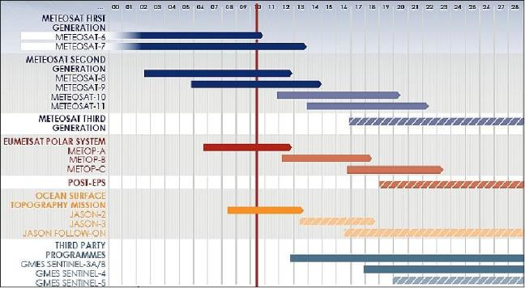

EUMETSAT Missions
{
{

Slide 8
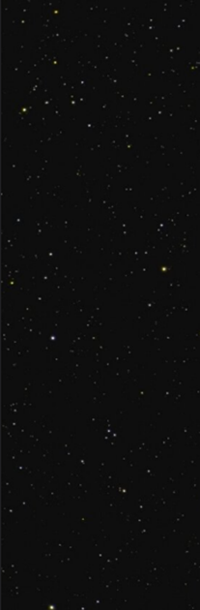
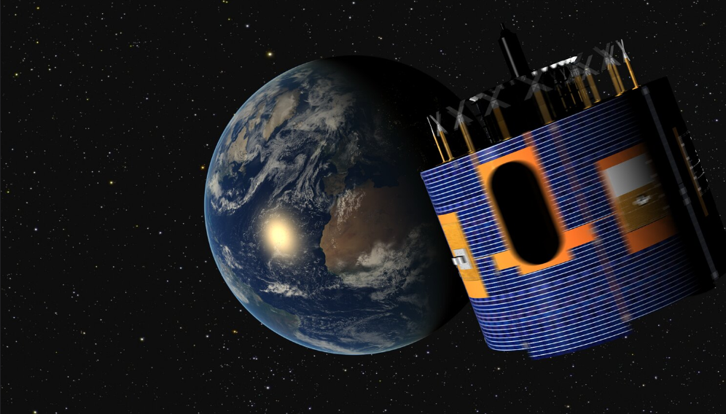
Meteosat Second Generation MSG
Geostationary orbit
Nominal sub-satellite point at 0º long
Spinning Enhanced Visible and Infrared Imager - SEVIRI
        15 min (96 observations /day)
  12 channels ...
  3 km at nadir

Slide 9
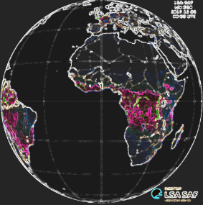
SURFACE RADIATION BUDGET
DSSF: ↓Surface Short-wave Flux
DSLF: ↓Surface Long-wave Flux
LST: Land Surface Temperature
AL: Albedo
WILDFIRES
FRP: Fire Radiative Power
FRM: Fire Risk Map
VEGETTAION STATE
FVC: Fraction Vegetation Cover
fAPAR
LAI
SURFACE ENERGY FLUXES
ET: Evapotranspiration
ETREF: Reference Evapotranspiration

Slide 10

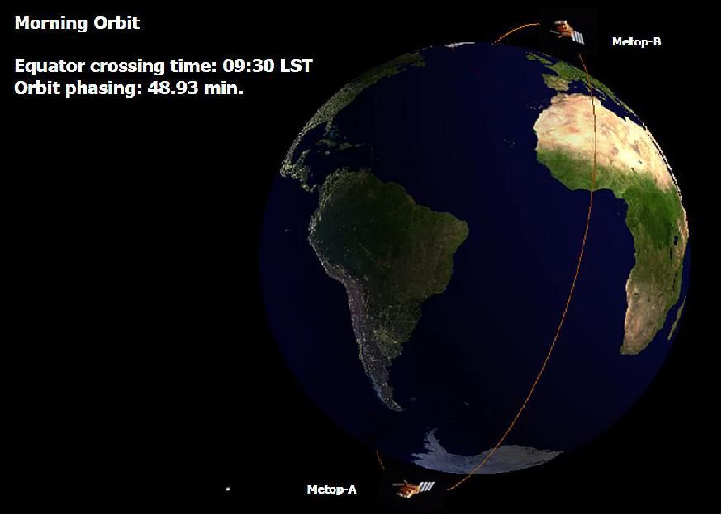

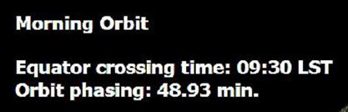
Metop (Polar-Orbit) – Playload:
AVHRR
HIRS
AMSU-A
AVHRR :
  1 km at sub-satellite point
  ≥ 2 observations / day

Slide 11
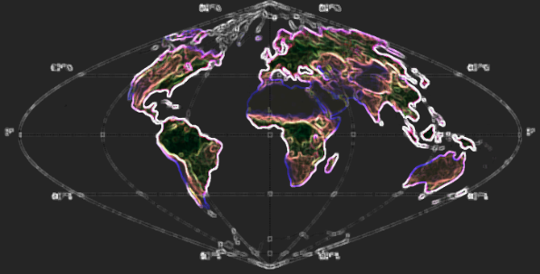
SURFACE RADIATION BUDGET
EPS LST: Land Surface Temperature
EPS AL: Albedo
VEGETTAION STATE
FVC: Fraction Vegetation Cover
fAPAR
LAI
NDVI

Slide 12

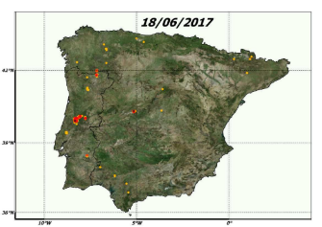

LSA-SAF (MSG Products)
Fire Radiative Power (FRP)
The product records information on the location, timing and fire radiative power (FRP, in MWatt) of landscape fires detected every 15 minutes across the full Meteosat Disk at the native spatial resolution of the SEVIRI sensor.
Integrating FRP over the lifetime of a fire provides an estimate of the total Fire Radiative Energy (FRE) released (proportional to the total amount of biomass burned).
Wildfires in Iberia: Portugal in June 2017.
Several very intense hot-spots (64 casualties).

Slide 13
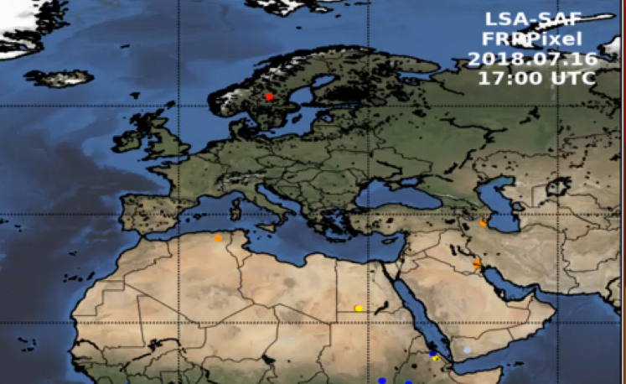
LSA-SAF (MSG Products)
Fire Radiative Power (FRP)
Wildfires in Sweden : 16th July 2018.

Slide 14
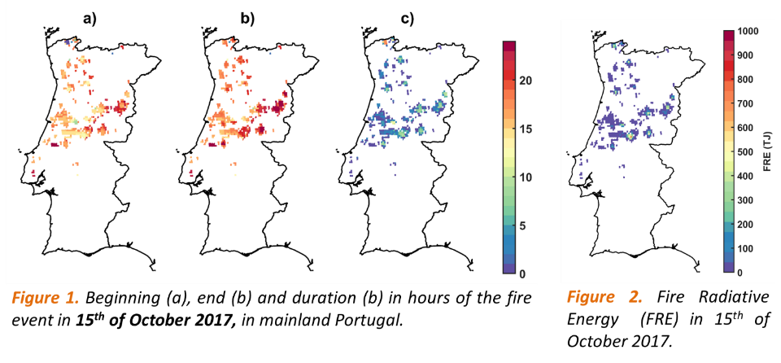
LSA-SAF (MSG Products)
Fire Radiative Power (FRP)

Slide 15
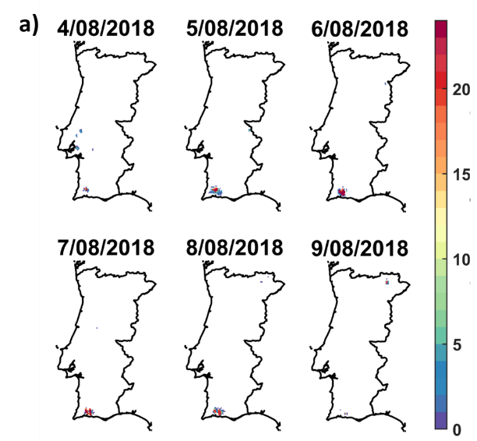
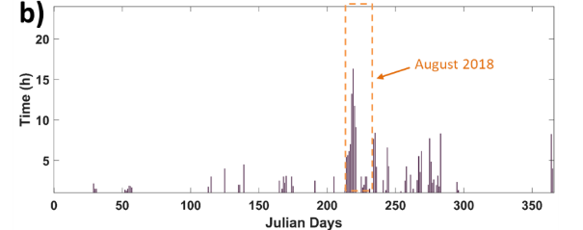
LSA-SAF (MSG Products)
Fire Radiative Power (FRP)

Slide 16
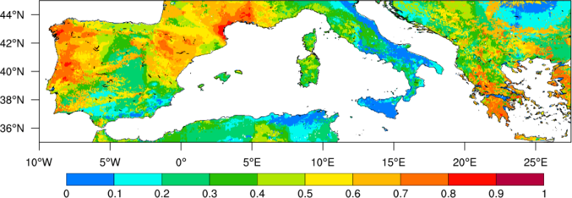
LSA-SAF (MSG Products)
Fire Risk Map (FRM)
Probability of exceedance 2000 GJ/day
Product derived using:
- FWI computed using ECMWF data
- Historical analysis based on FRP (2004-2018)
- Main land cover types

Slide 17

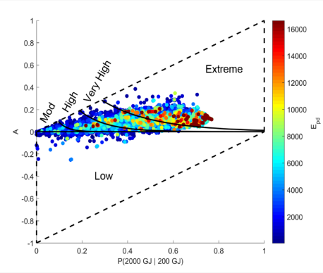
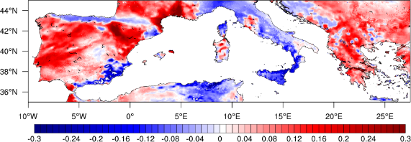
LSA-SAF (MSG Products)
Fire Risk Map (FRM)
Probability of exceedance 2000 GJ/day
Anomalies of Probability

Slide 18
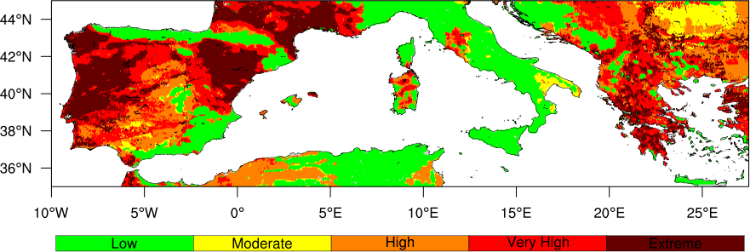
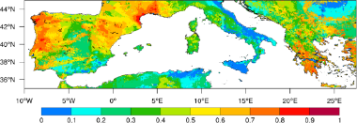

LSA-SAF (MSG Products)
Mediterranean Europe
5 days of forecast risk (soon!)
Fire Risk Map (FRM)
Probability of exceedance 2000 GJ/day
Anomalies of Probability

Slide 19
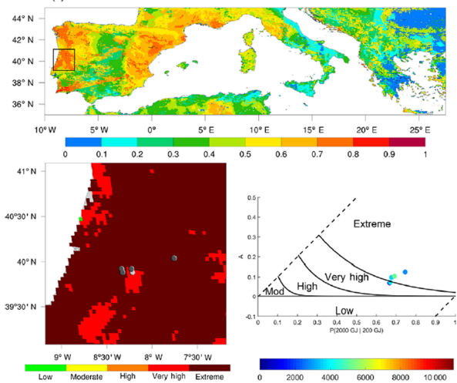
LSA-SAF (MSG Products)
Fire Risk Map (FRM)
Applications: Pedrogão Fire (Portugal)
18th June 2017
High Probability of exceedance and low anomalies of probability

Slide 20
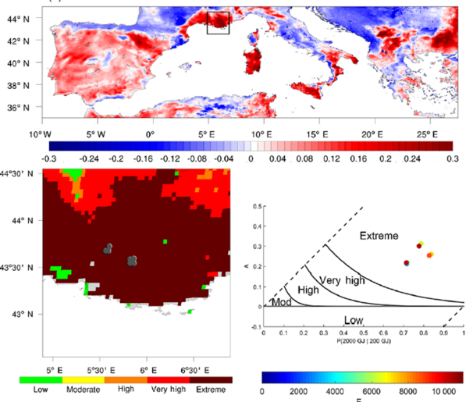
LSA-SAF (MSG Products)
Fire Risk Map (FRM)
Applications: Marselha Fire (France)
25th June 2017
High anomalies of probability and high
probability of exceedance and low

Slide 21
Previous Experience
Greece fires 2017
Gouveia et al., 2017
Number of months with vegetative stress
Number Hot Days
Number Hot Days / Precipitation
NDVI

Slide 22
2018: hot and dry year over central Europa
LST from MSG
Climatology derived between 2004 and 2018 (using median)

Slide 23
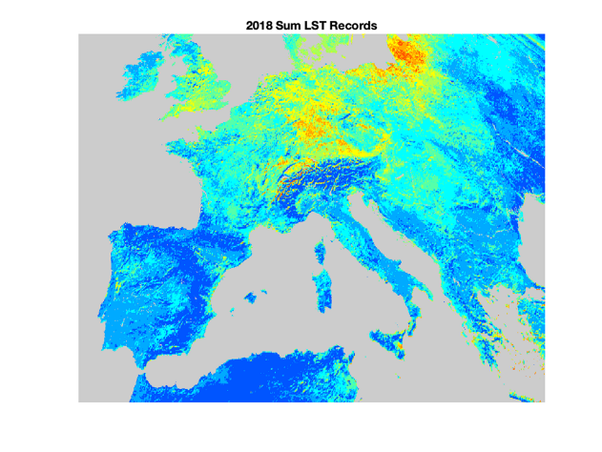
LST - MSG
2018: hot and dry year over central Europa
8
7
6
5
4
3
2
1
Number of months with LST monthly anomalies in 2018 (from January to September) presenting the highest value of LST monthly anomaly since 2004
Climatology derived between 2004 and 2018 (using median)

Slide 24
MSG
FVC Monthly anomalies
2018: hot and dry year over central Europa
Climatology derived between 2004 and 2018 (using median)

Slide 25

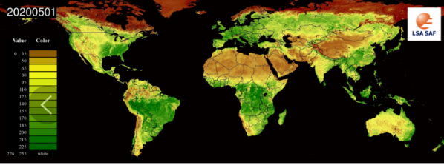
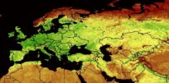
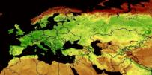
LSA-SAF (EPS Products)
NDVI
10 days
2008 - Present
20200421
20200501

Slide 26
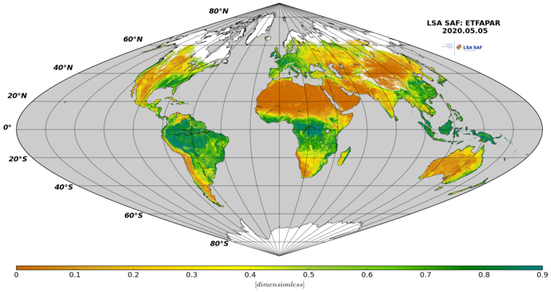
LSA-SAF (EPS Products)
FAPAR
10 days
2007-2020 (will be available begin 2021)
20200421
20200501

Slide 27
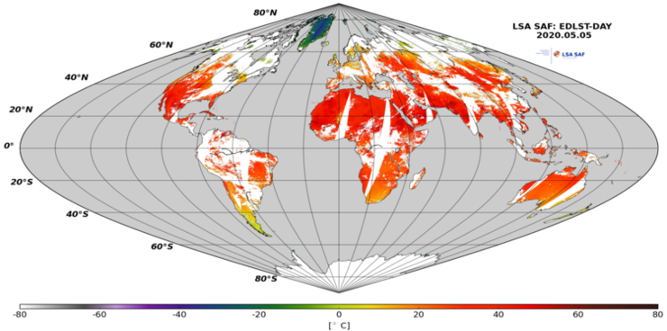
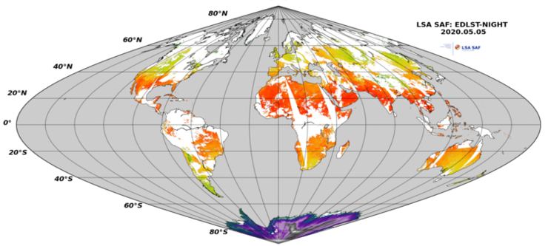
LSA-SAF (EPS Products)
LST
Daily: Day and Night
2007-2020 (will be available begin 2021)
20200421
20200501

Slide 28
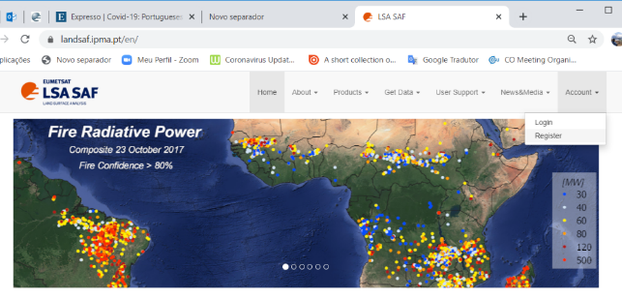
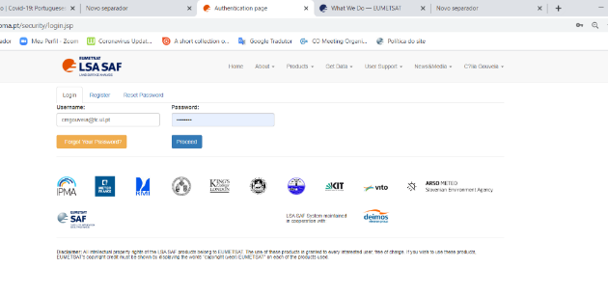
How to access LSA-SAF data
- Users must be registered and need to be logged in before an actual order can be set
- Login with provided credentials
20200421
20200501

Slide 29
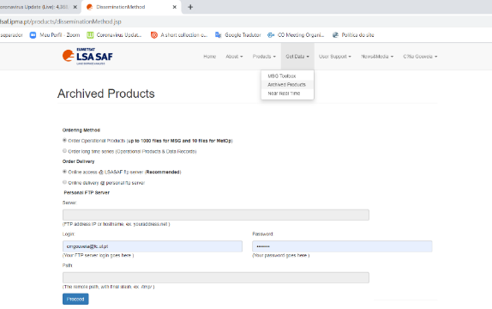
How to access LSA-SAF data
Get Data → Archived Products → Proceed
20200421
20200501

Slide 30
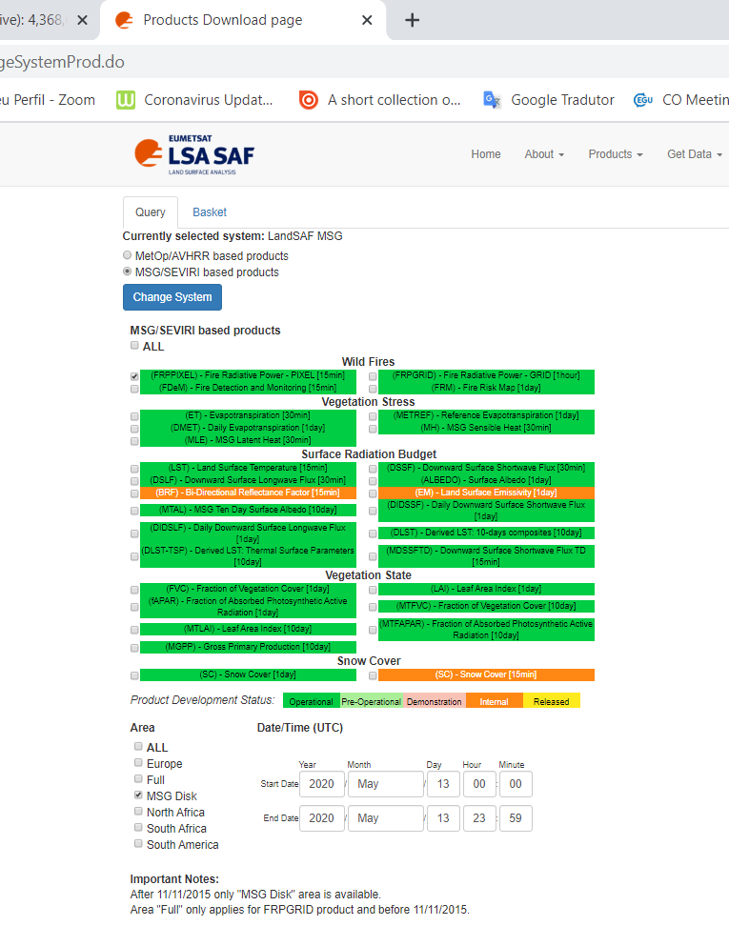
How to access LSA-SAF data
MSG/SEVIRI based Products → FRP Pixel→ MSG Disk→ Data time → Proceed
20200421
20200501

Slide 31
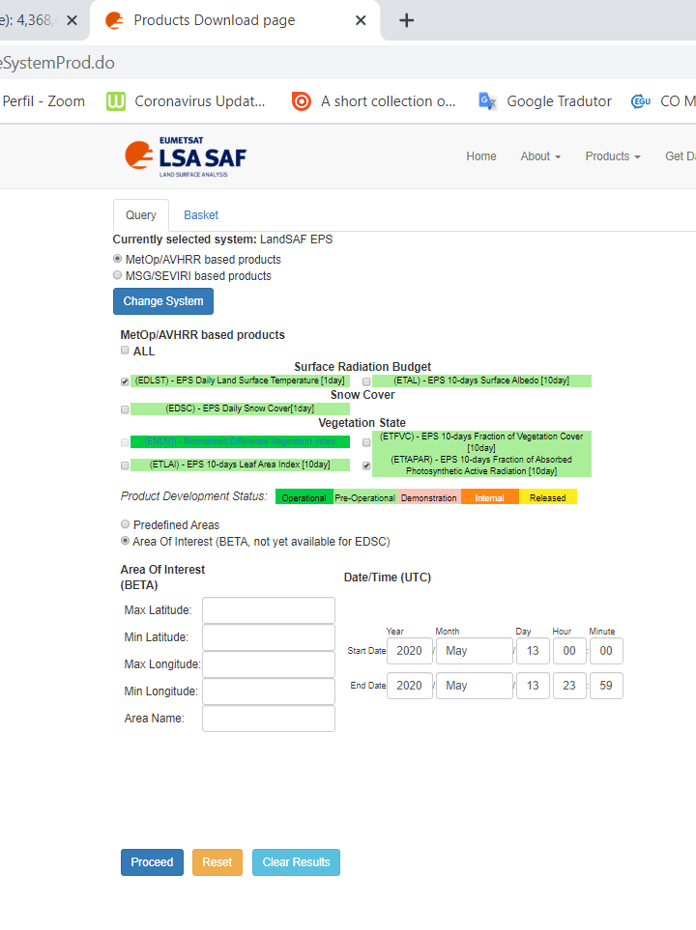
How to access LSA-SAF data
METOP AVHRR based Products → EDLST/ETfAPAR → Area Of Interest → Area Of Interest→ Data time → Proceed
20200421
20200501

Slide 32
Jupiter Notebook
https://ltpy.adamplatform.eu
20200421
20200501

Slide 33
Thank you for your attention!
QUESTIONS?
celia.gouveia@ipma.pt

