Slide 1
Introduction to the product & examples
Fire user workshop – 15.05.2020
Julien Chimot

Slide 2
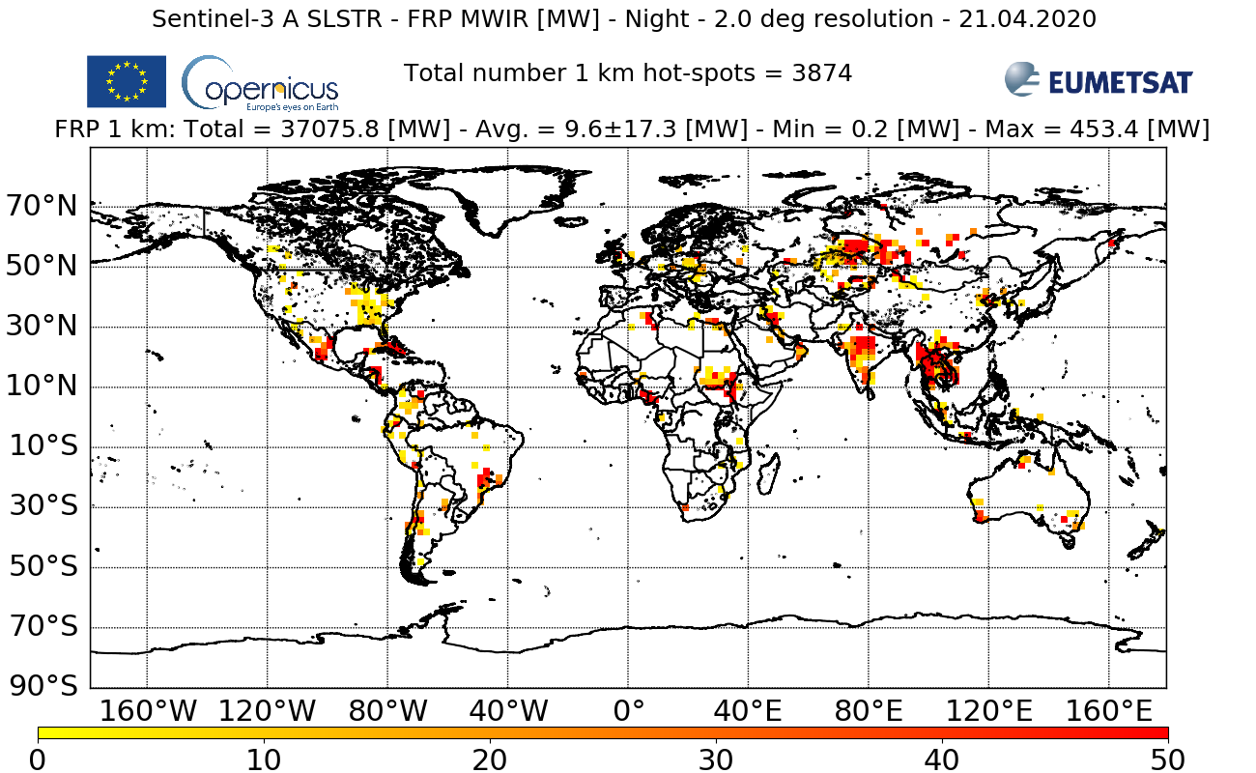
The 1st Copernicus Sentinel-3 NRT FRP after successful deployment
Radiant heating & threat monitoring of fires, industrial gas flares, and volcanoes in Near Real Time (< 3 hours)
http://metis.eumetsat.int/frp

Slide 3
Outline
Satellite hot-spot observations: current situation & needs
Copernicus, Sentinel-3, EUMETSAT for NRT atmosphere applications
The Copernicus Sentinel-3 NRT FRP
Data & visualisation access

Slide 4
Outline
Satellite hot-spot observations: current situation & needs
Copernicus, Sentinel-3, EUMETSAT for NRT atmosphere applications
The Copernicus Sentinel-3 NRT FRP
Data & visualisation access

Slide 5
Air pollution, a silent killer….. take a deep breath
Every human inhales ~14 kg of air per day
Globally in 2012: 3,700,000 premature deaths attributable to ambient air pollution
In EU-28 in 2012: 491,000 premature death
In EU-28 in 2010: 330–940 Billion €
health related external costs
In Netherlands in 2012:13,000 premature death, 135,000 Years of Life Lost
WHO, 2014
EEA, 2015
EC, 2013
EEA, 2015

Slide 6
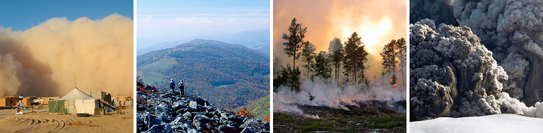

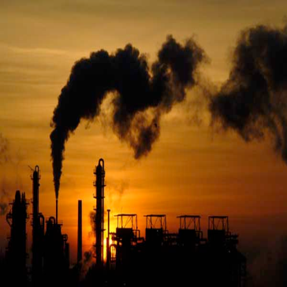
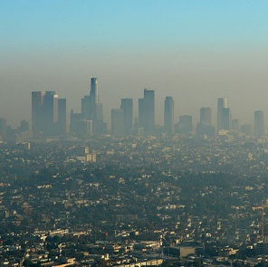
Aerosols
Aerosols, also named particulate matter (PM) = solid / liquid matter suspended in the atmosphere with a wide range of shapes, sizes and chemical compositions:
Size range: from a few nm (superfine) to more than 100 μm (coarse): e.g. PM2.5, PM10
Not to be confused with water clouds!
Aerosol sources are multiple, travel with no borders... and can correlate with gas pollutants
Volatile organic compounds (vegetation)
Smoke (fire & industrial gas flares)
Trace gas precursors (SO₂, NO₂, ...) from anthropogenic activities
Dust
Volcanic ash
Sea salt

Slide 7
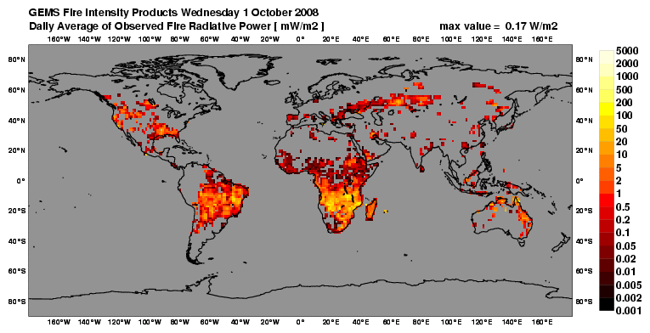
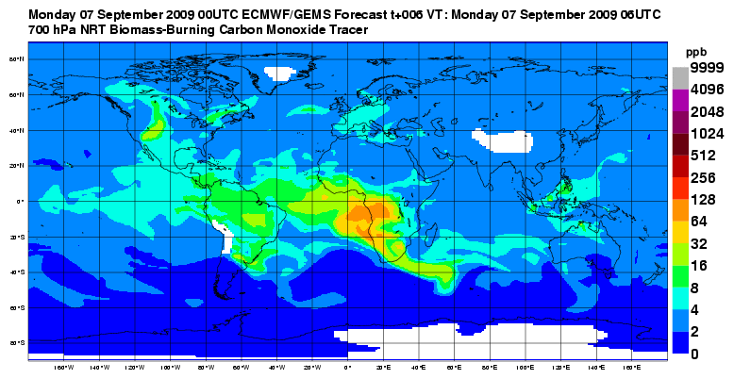

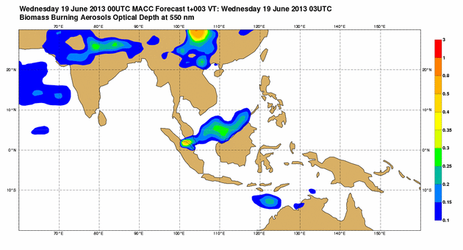

CAMS Global Fire Assimilation System (GFAS) - FRP → Smoke Emissions
Global Active Fire (AF) location / timing plus source strength [FRP] ingested into GFAS
Global NRT Biomass Burning Impacts on Atmosphere (here CO @ 700 hPa)
www.gmes-atmosphere.eu/services/gac/fire/
SE Asia : 4-day AOD Forecast
Regional
Global
Aerosol Optical Depth
Courteousy Martin Wooster, S3VT, May 2019
0.1 0.3 0.5 1 3

Slide 8
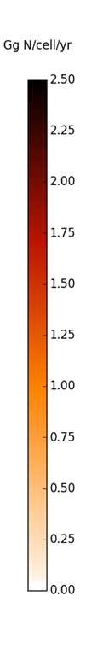

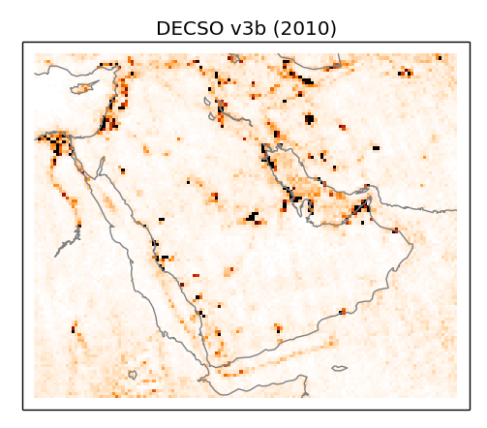
Industrial gas flares – An independent survey needed
Heating flames due to flammable gas disposed at the tip of a stack from Upstream Oil and Gas (UOG) industrial Gas Flaring (GF) released:
between 2003 and 2012 ~304 Tg CO₂ yearly
270 and 210 Gg of BC in 2005 and 2010, respectively.
Regionally, they contribute to half the near-surface BC concentration in the Arctic.
Olivier et al. (2014)
Klimont et al. (2017)
Daily N emission estimates constrained by satellites
Stohl et al. (2013)
DECSO algorithm from KNMI
Bas Mijling , Ronald van der A, KNMI

Slide 9
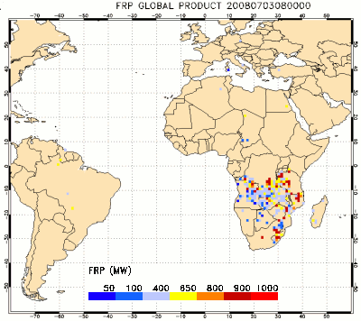

Operational hot-spot satellite missions - Geo
Several Geostationary sensors for FRP:
  e.g. Meteosat Second & Third Generation (Africa & Europe)
  High temporal frequency / sampling => good for fire diurnal cycle
  No global coverage
  High geometry deformation in high latitudes
  Industrial gas flares in North_Sea, Algeria, Persian Gulf, etc…?
  Global inter-calibration?
https://landsaf.ipma.pt/en/products/fire-products/frppixel

Slide 10
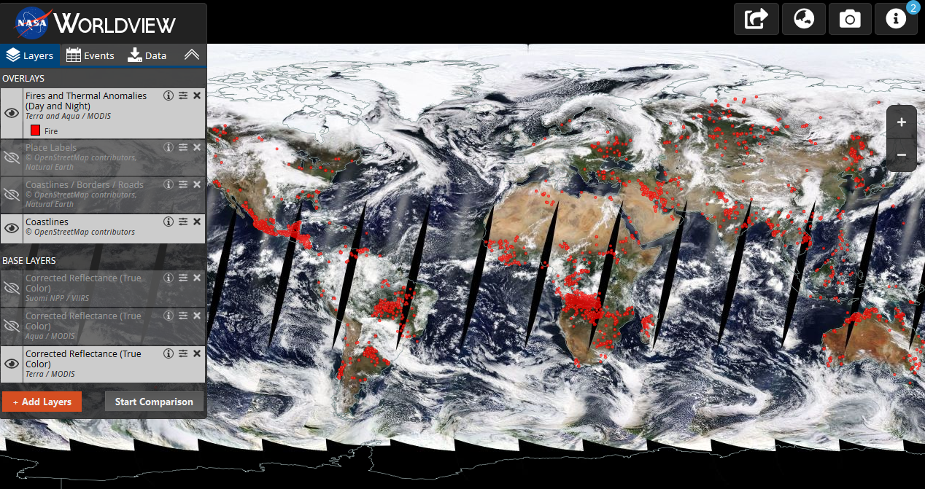
Operational hot-spot satellite missions - LEO
Low Earth Orbit (LEO) Aqua/Terra MODIS => the reference operational NRT FRP product:
  Global, 1 km resolution (nadir)
  Tens thousands of users worldwide
  Limited temporal sampling, but still 4 observations per day (early AM, early PM, early evening, middle night)
But MODIS will not last:
  VIIRS is ensuring the follow-up for the afternoon
  But no global LEO for early morning / evening? => Copernicus Sentinel-3

Slide 11
Outline
Satellite hot-spot observations: current situation & needs
Copernicus, Sentinel-3, EUMETSAT for NRT atmosphere applications
The Copernicus Sentinel-3 NRT FRP
Data & visualisation access

Slide 12
EUMETSAT
The inter-governmental organisation to supply operational weather and climate-related satellite data, images and products – 24 hours a day, 365 days a year, in less than 3 hours from the observing time – to the National Meteorological Services of our Member States in Europe, and other users worldwide.
User-governed operational organization, created in 1986. 30 member states.
Own satellite programs
  Geostationary: Meteosat Second Generation (MSG), & Meteosat Third Generation (MTG)
  LEO: Metop - a series of three polar orbiting meteorological satellites which form the space segment component of the overall EUMETSAT Polar System (EPS). Future EPS-SG coming.
+ Copernicus Sentinels

Slide 13

The European system, funded by the European Commission, for monitoring the Earth using satellites and in situ sensors.
The Earth observation satellites are split into two groups of missions: the Copernicus Sentinels and the Contributing Missions
Data provided to users through a set of six Copernicus services: land, marine, atmosphere, climate change, emergency management and security.
Free, full & open access to environmental data provided to users.

Slide 14
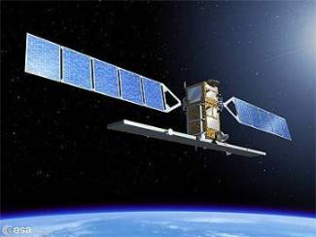
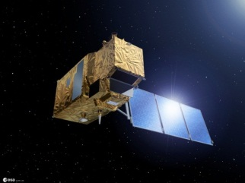
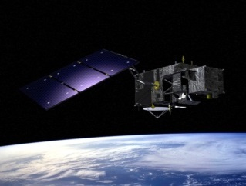

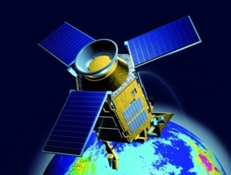
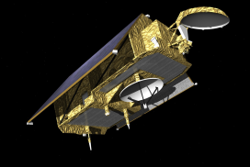
Copernicus Space Component (CSC)
S1: Radar Mission
S4: Geostationary Atmospheric Chemistry Mission
S2: High Resolution Optical Mission
S3: Medium Resolution Imaging and Altimetry Mission
S5P: Low Earth Orbit Atmospheric Chemistry Precursor Mission
S6 (Jason-CS): Altimetry Mission
S5: Low Earth Orbit Atmospheric Chemistry Mission
Evolution considered

Slide 15
Components & responsibilities
Services component: led by EC
In situ component: led by EEA
Space fleet component: developed and deployed by ESA
  Sentinels – satellite mission specifically developed for Copernicus
Operation & scientific quality component: both EUMETSAT & ESA
  ESA operates Sentinel-1, 2, 5 Precursor (5P).
  EUMETSAT (will) operate Sentinel-3, 4, and 5 satellites

Slide 16


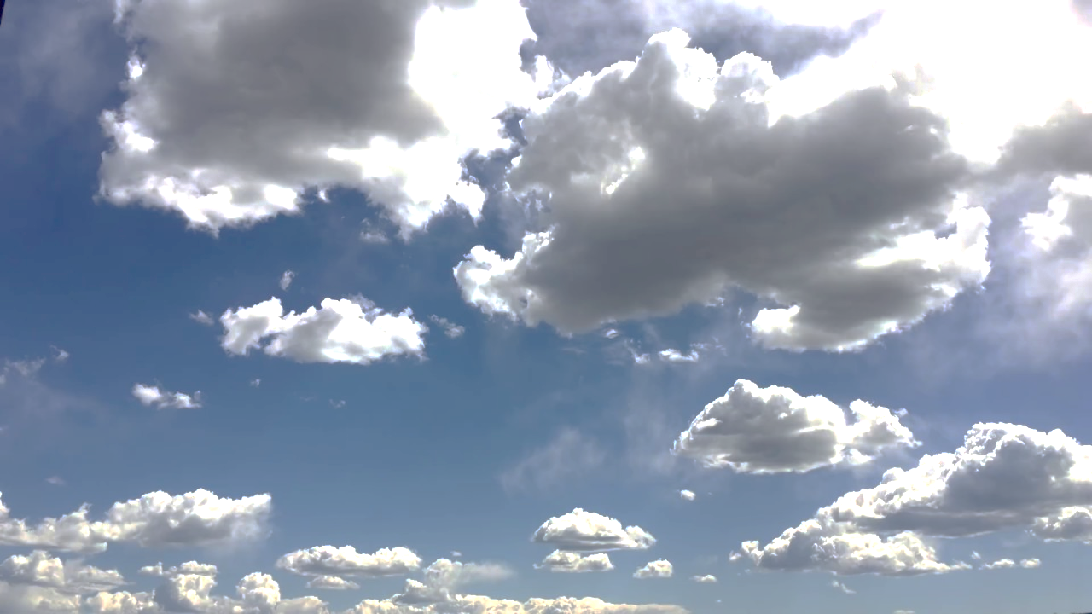
Sentinel-3 Mission Product Responsibilities – Originally Marine / Land
L2 Near Real Time (NRT)
Aerosol
Fires (FRP)
Clouds, AMV, H₂O
L2 Non Time Critical (NTC)

Slide 17




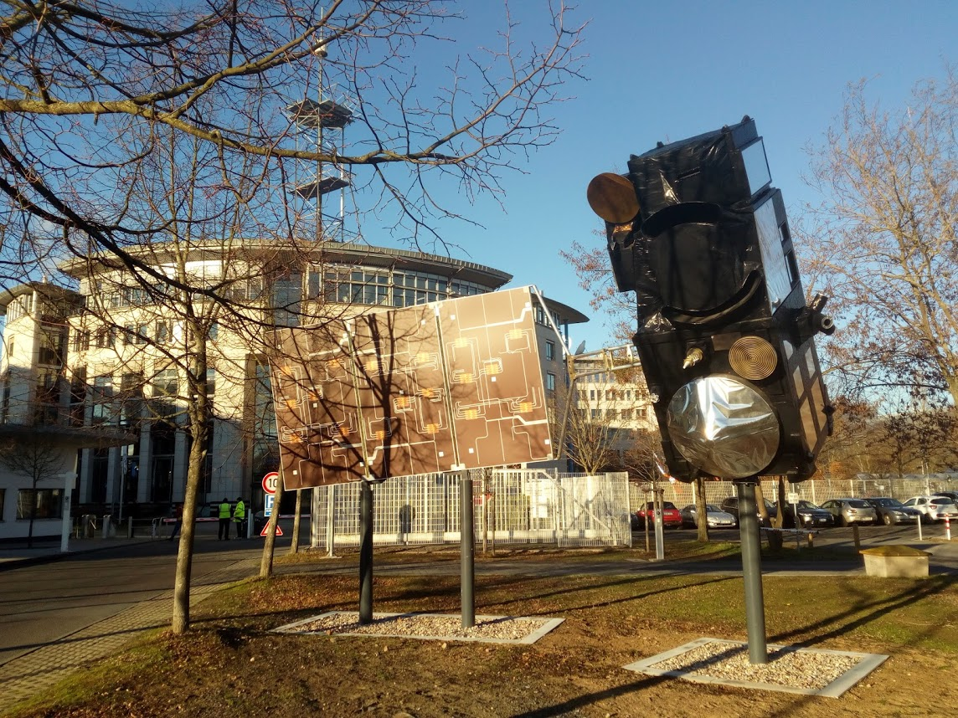
Sentinel-3 – An operational Marine & Land mission - EU Copernicus
=> Moving towards an operational atmospheric mission!
Low Earth Orbit (LEO)
Local Equatorial crossing time 10:00 am
Two active sensors for altimetry – SAR Radar Altimeter (SRAL) & Microwave Radiometer (MWR)
Two optical sensors
  Ocean and Land Color Instrument (OLCI)
  Sea & Land Surface Temperature Radiometer (SLSTR)
Sentinel-3 is an operational constellation
S3 A since 2016.02.16, twin S3 B since 2018.04.25
S3 A & B placed in the same orbital plane with a phase difference of 140°. Final configuration since 2018.11.27
2-3 day global ocean coverage (cloud & glint-free)
OLCI
SLSTR
MWR
SRAL

Slide 18
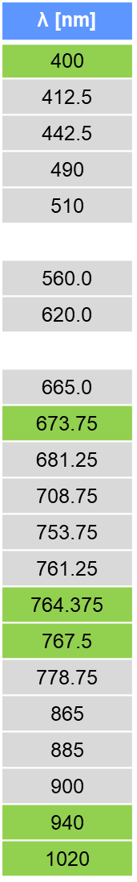
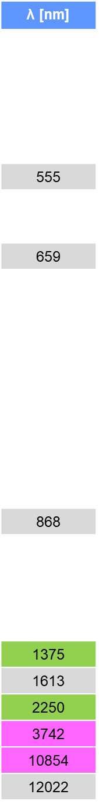
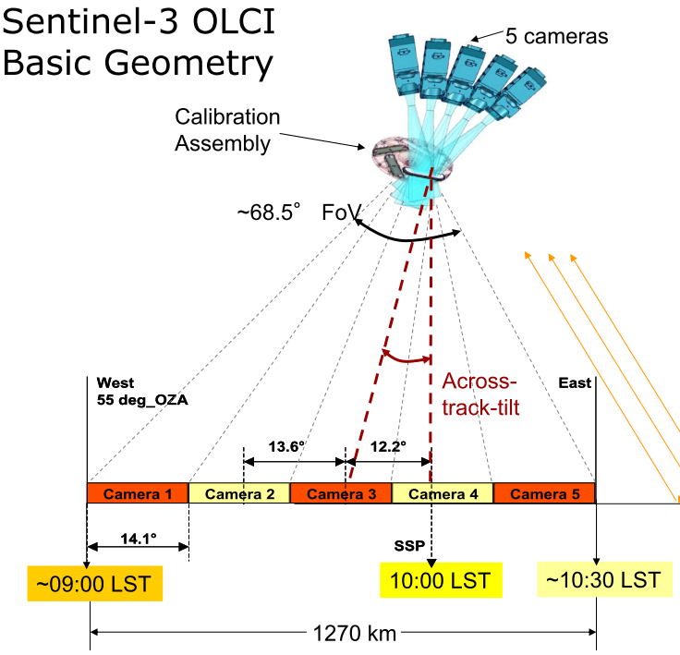
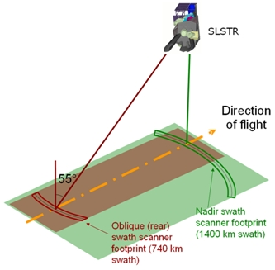

OLCI & SLSTR: ENVISAT legacy with technology improvements
λ [nm]
400
412.5
442.5
490
510
560.0
620.0
665.0
673.75
681.25
708.75
753.75
761.25
764.375
767.5
778.75
865
885
900
940
1020
λ [nm]
555
659
868
1375
1613
2250
3742
10854
12022
2 optical instruments with medium spectral resolution & high spatial resolution
SLSTR – Conical scanning imaging radiometer
Along-track dual view (nadir & oblique backward)
Swaths 1420 km (nadir) & 750 km (oblique)
Pixel size nadir: 500 m (VIS-NIR-SWIR), 1 km (TIR)
OLCI – Push-broom imaging spectrometer
12 degrees westward tilt, to minimize Sun glint
Swath 1250 km
Pixel size nadir: 300 m (fine), 1.2 km (reduced)
VISIBLE
NIR
SWIR
TIR
Additional channels from MERIS / AATSR
2 same channels with different dynamic range

Slide 19
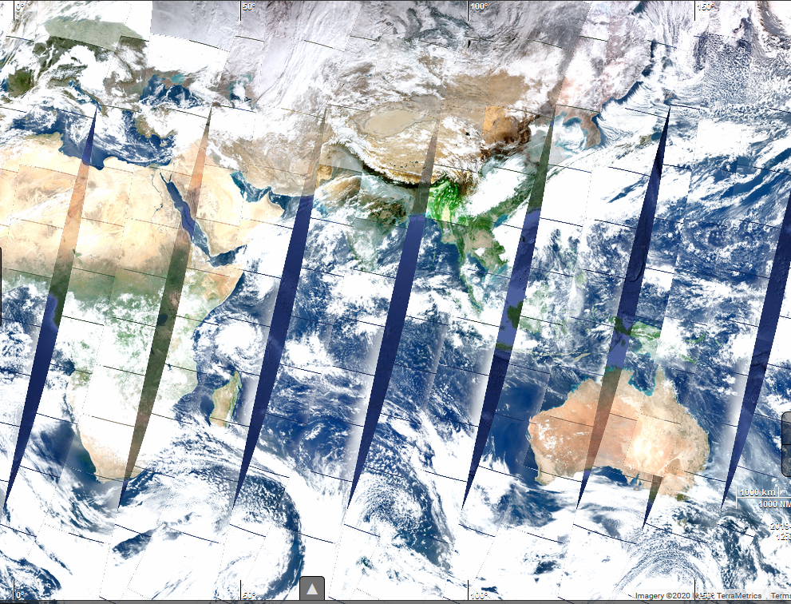
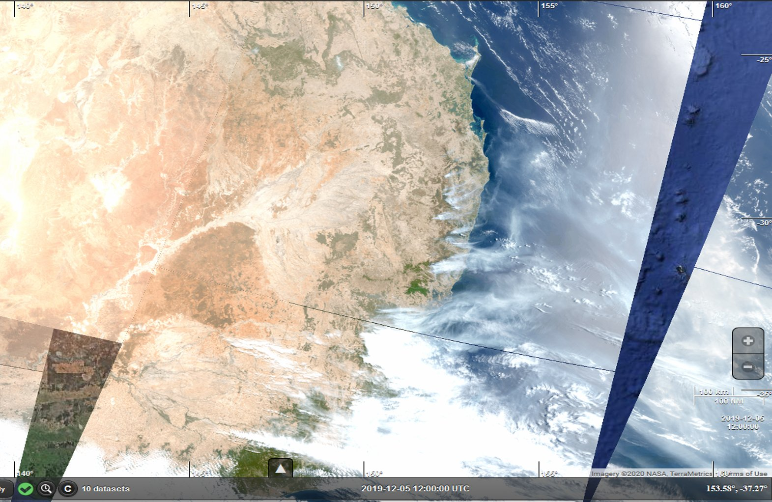
OLCI RGB image – Looking at our Earth
05.12.2019
Australia bush-fires
https://s3view.oceandatalab.com
ESA

Slide 20
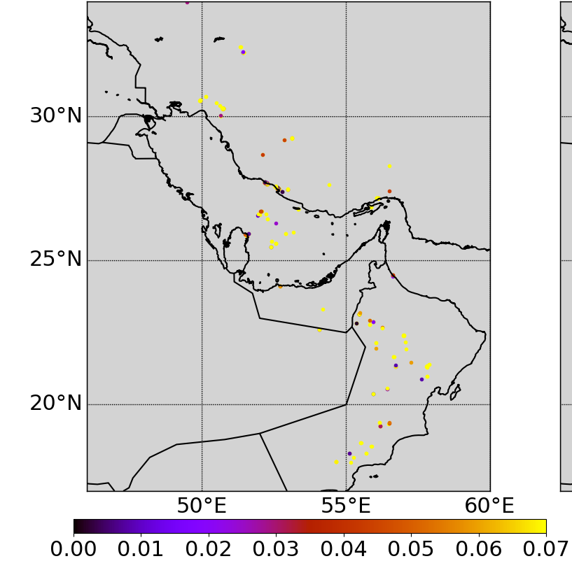
What does Sentinel-3 offer for hot spot monitoring
Fine pixel resolution: 500 m – 1 km => Good for hot-spot!
Early morning / evening observation time
A series of channels sensitive to surface temperature anomalies with variable dynamic range (small & big fires).
SLSTR-A S6 – 0.12 [mW.m-2.sr-2.nm-1]
26.04.2020 – Industrial gas flares in Persian Gulf - night
05.12.2019 – Australia bush fires – night - SLSTR-A
F1 BT [K] S7-S8 [K]

Slide 21
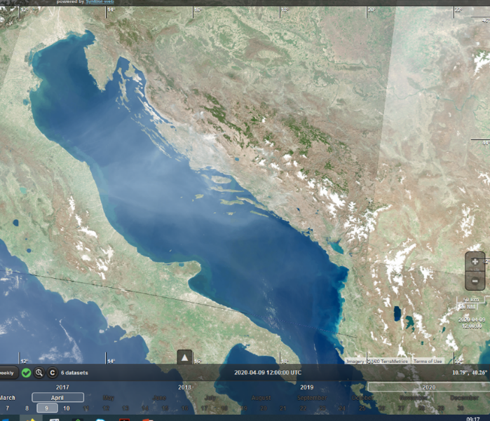
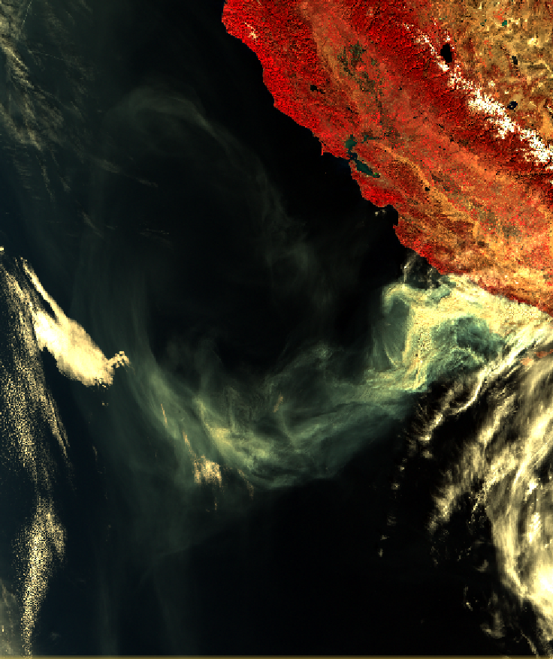
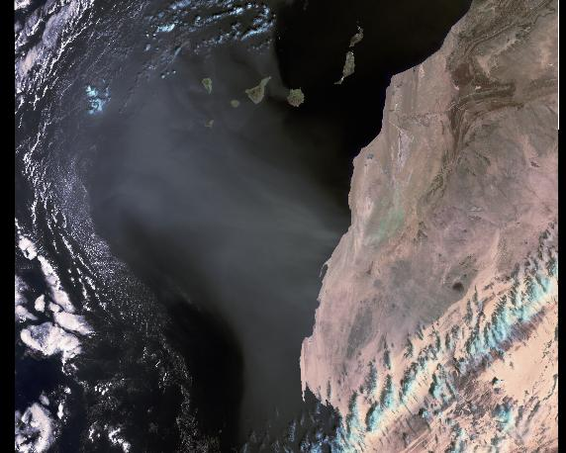
Aerosol from space – In a nutshell
AOD (Aerosol Optical depth) = How much Solar light attenuated by aerosols?
  A proxy of aerosol amount.
Looking at the contrast between aerosol layer & the underlying surface
  Generally, an aerosol layer will enhance the scene brightness.
  Warning: not always true (e.g. a black smoke over bright ice will darker the signal)
  And at the dual-view for aerosol-surface decoupling & aerosol type characterization!
Dust
Smoke
Smoke
Western Sahara – 2019.02.05
S3 A – SLSTR (RGB Composite)
Balkan fires – 2020.04.10
S3 B – OLCI (RGB Composite)
Massive Thomas fire, California, 2017.12.10
S3 A – SLSTR (RGB Composite)

Slide 22
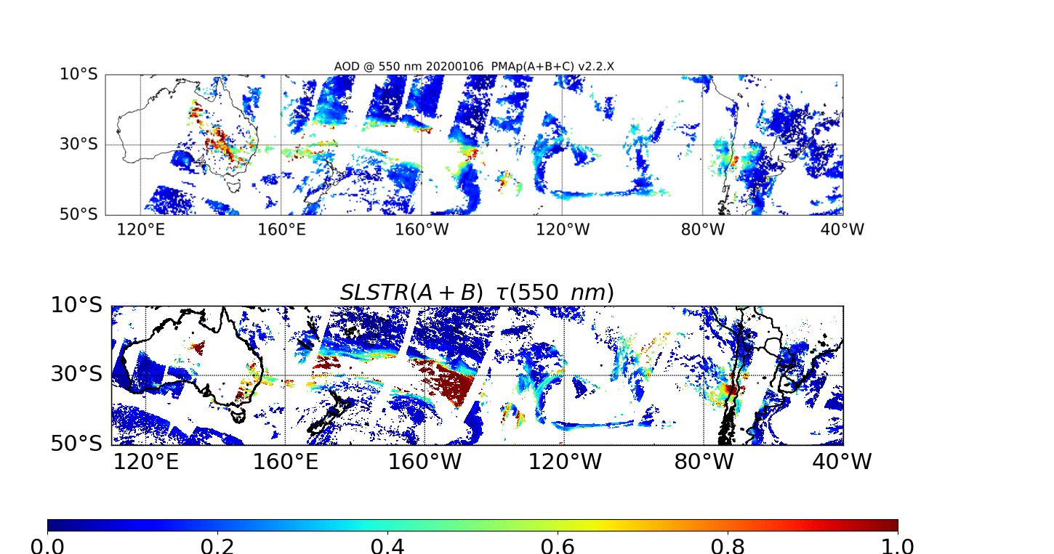
NRT Sentinel-3 AOD – To be deployed soon by EUMETSAT
Smoke from Australia bush-fires

Slide 23
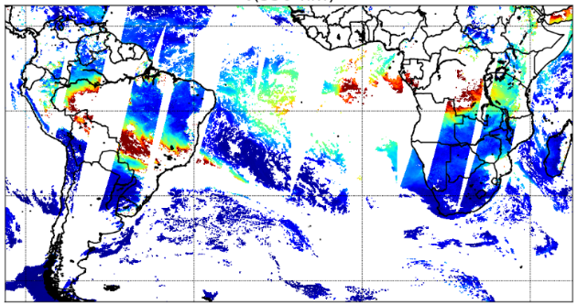
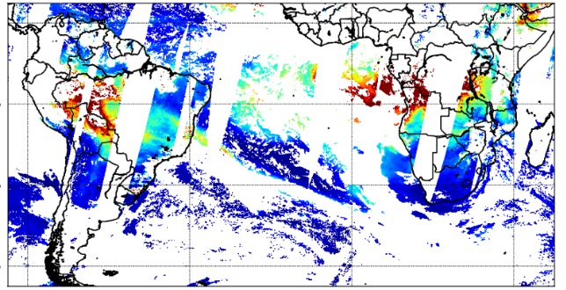
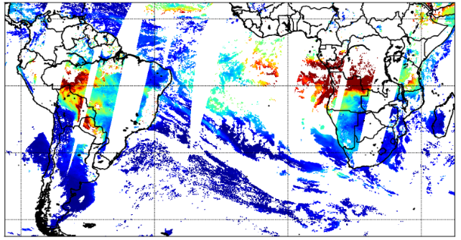
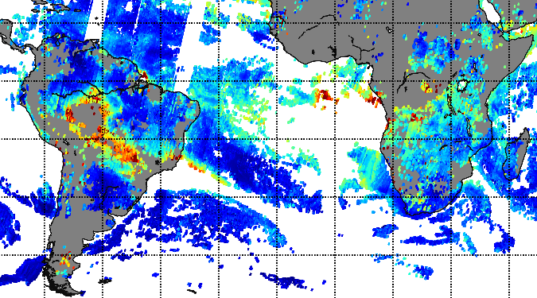
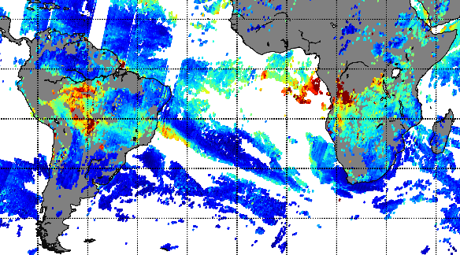
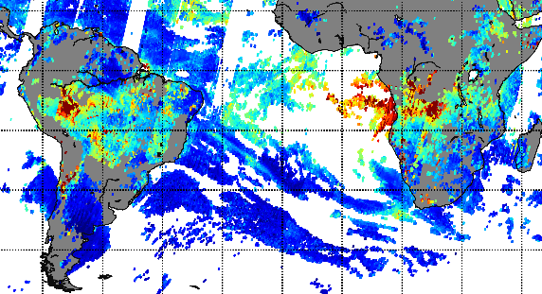
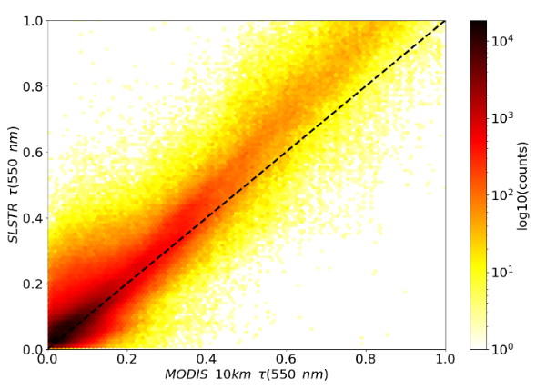
NRT Sentinel-3 AOD – Inter-comparison of 5 satellites
SLTR-A/B
2019.08.20
2019.08.21
2019.08.22
PMAp- Metop-A/B/C
AOD @ 550nm
Ocean & Southern Lands
JJA 2019 - South America – Land only
SLSTR A vs. MODIS Terra

Slide 24
Outline
Satellite hot-spot observations: current situation & needs
Copernicus, Sentinel-3, EUMETSAT for NRT atmosphere applications
The Copernicus Sentinel-3 NRT FRP
Data & visualisation access

Slide 25
Hot-Spot from space – In a nutshell
A hot spot radiates a strong heating signal.
Looking at the temperature contrast between the local hot-spot pixel and the surrounding background
Spectral peak function of Temperature: middle warm – MWIR, Very warm = SWIR
Hot-spot Nx more emissive than the ambient background
  N = 100 => TIR (112 µm)
  N = 1000 => MWIR (3.7 µm)
  N >> 1000 => SWIR (1.5-2.25 µm)
Caseiro et al. (2018)

Slide 26
The Copernicus Sentinel-3 FRP NRT
Hot-Spot detection & FRP quantification (MWIR or SWIR)
    4 key channels: S7 (“cold” 3.7 µm), F1 (“hot” 3.7 µm), S5 (1.6 µm), S6 (2.25 µm)
    Applicable mostly by night for now: challenges due to instrumental S7 saturation.
NRT v2.0 processor
  V1 (starting point): specified by Kings College London (Prof. Dr. Martin Wooster, Dr. Weidong Xu), developed by ACRI-ST, procured by ESA / S3 MPC contract. Development monitored by both ESA & EUMETSAT.
  V2.0, an evolution of v1.0 based on EUMETSAT in-house developments: filtering of spurious / transient events, detection & filtering of South Atlantic Anomaly (SAA), twilight geometry removal.
Key outputs
  FRP MWIR (for MWIR detected hot-spots) [MW]
  FRP SWIR (for SWIR detected hot-spots) [MW]
  SAA flag applicable for FRP SWIR filtering.
  Additional quality flags (recommended for advanced users).
  1 km spatial resolution
Labelled as ‘pre-operational’ - Good quality overall. Further validation on-going
  Regular fine tuning / updates expected in the next months (=> v2.1, etc..).
  V3.0 under specification => full day-time.
  To be assimilated by CAMS/GFAS.

Slide 27

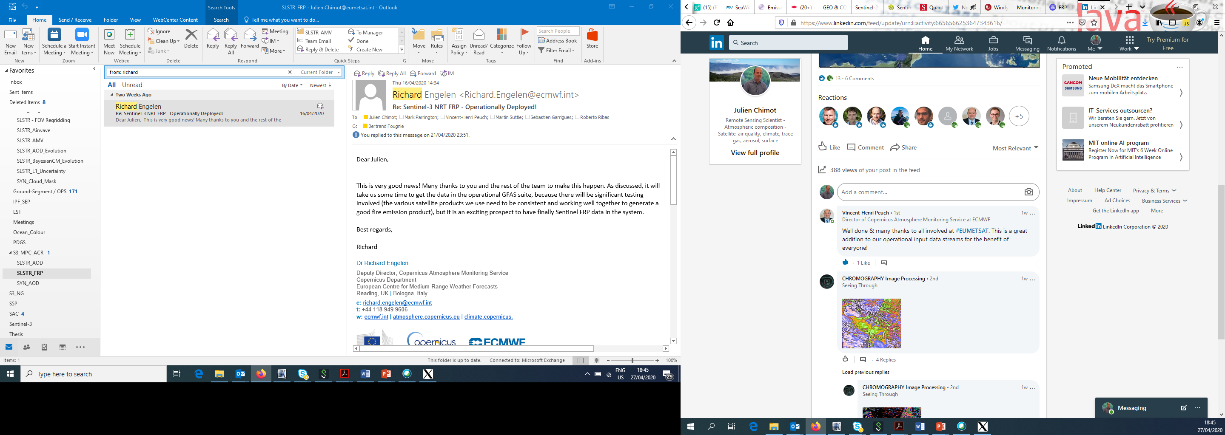
Copernicus Sentinel-3 NRT FRP deployment – during COVID-19…
  Successful deployment & public release on 21.04.2020
  A major milestone thanks to a great team work by EUMETSAT:
    Ready for the “fire season” (in Europe)
    During COVID-19 crisis & major teleworking
    High constraints & strict rotation planning for ensuring maximum health protection for the people on site
    Major collaboration between internal departments ensuring full EUMETSAT autonomy: scientists + system engineers + ground segment operators + managers
Richard Engelen
Deputy Director of the Copernicus Atmosphere Monitoring Service at ECMWF
“This is very good news! Many thanks to you and the rest of the team to make this happen […] it is an exciting prospect to have finally Sentinel FRP data in the system”

Slide 28
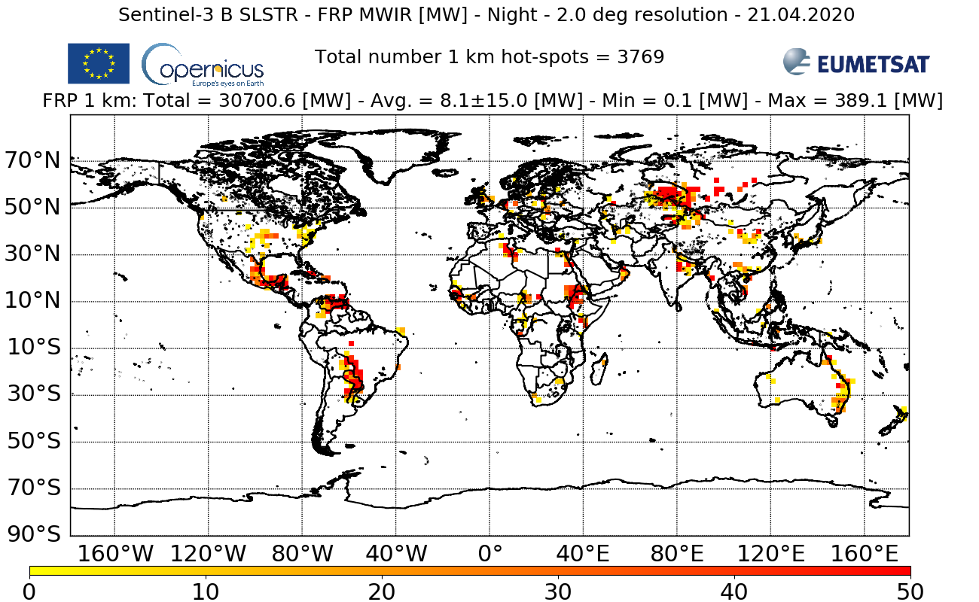
The 1st Copernicus Sentinel-3 NRT FRP map – 21.04.2020

Slide 29
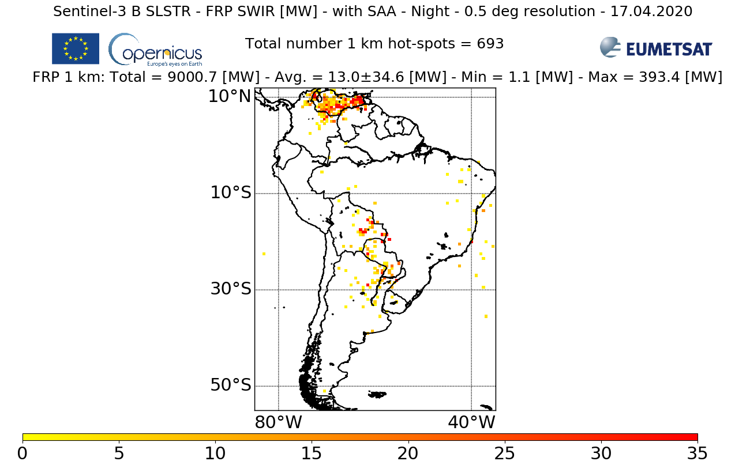
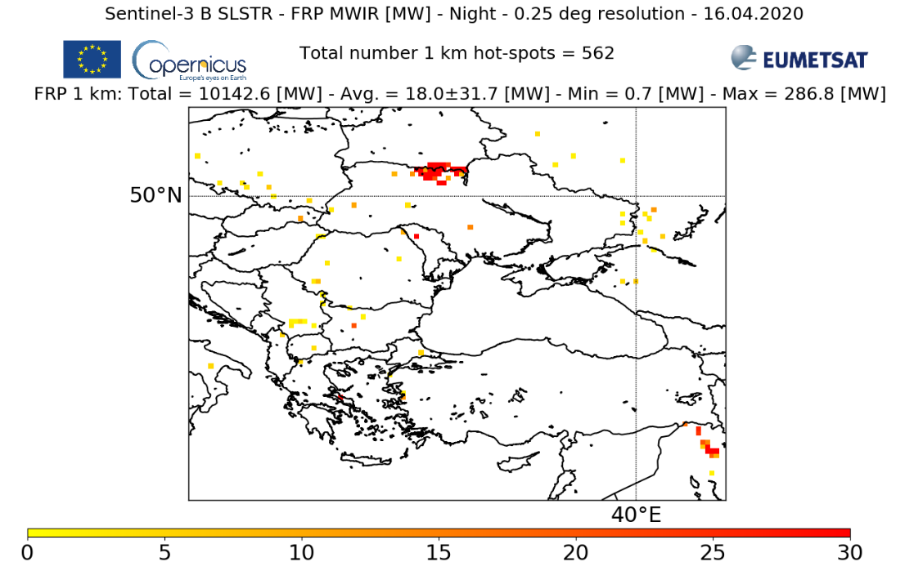
NRT Sentinel-3 FRP v2.0 examples
Venezuela wildfires
Chernobyl forest fire
More on http://metis.eumetsat.int/frp

Slide 30
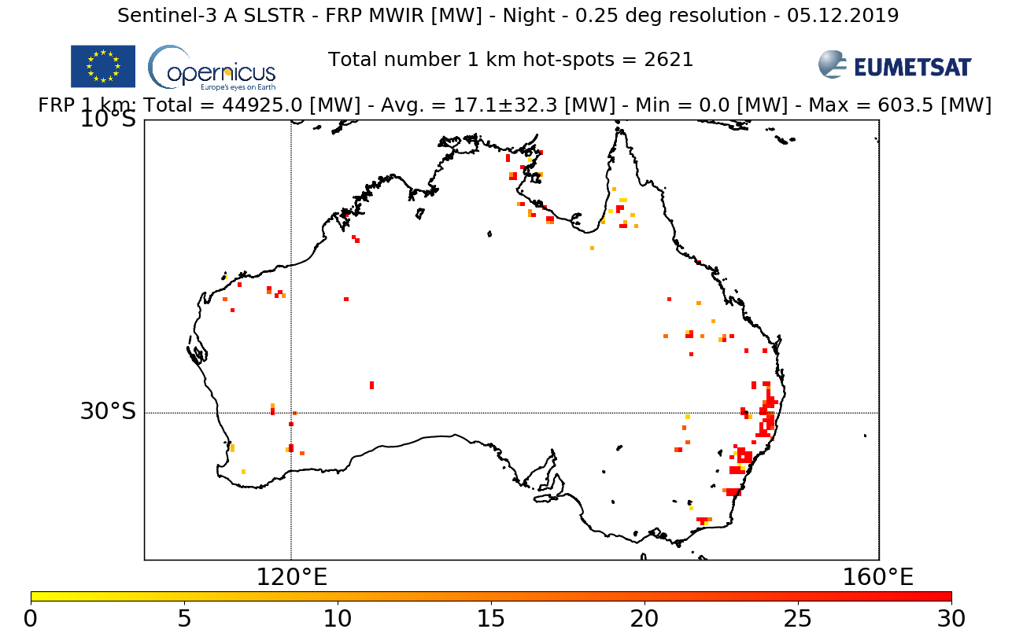
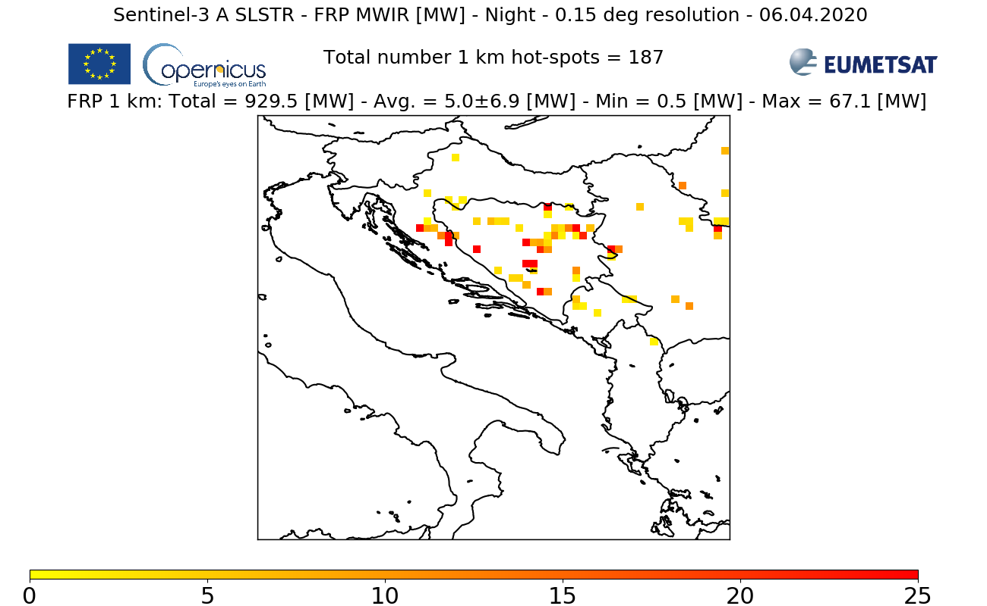
NRT Sentinel-3 FRP v2.0 examples
Australia bushfires
Croatia & Balkans fires Early April
More on http://metis.eumetsat.int/frp

Slide 31
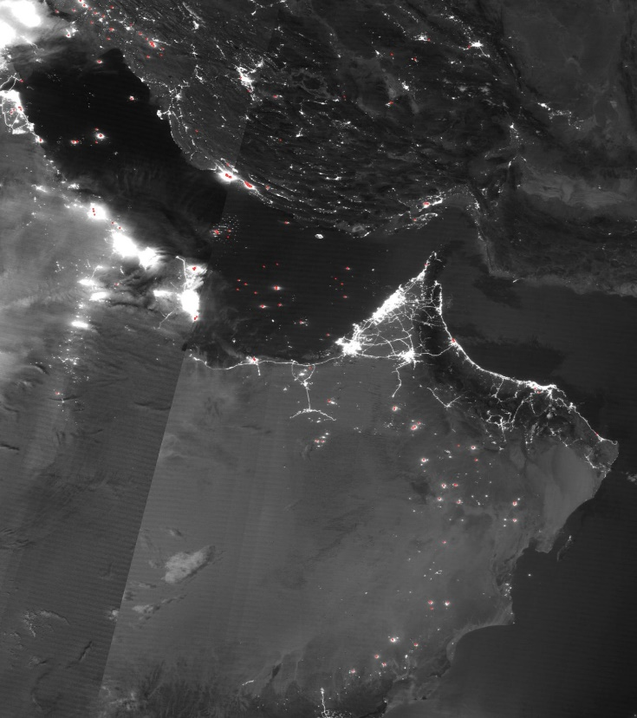
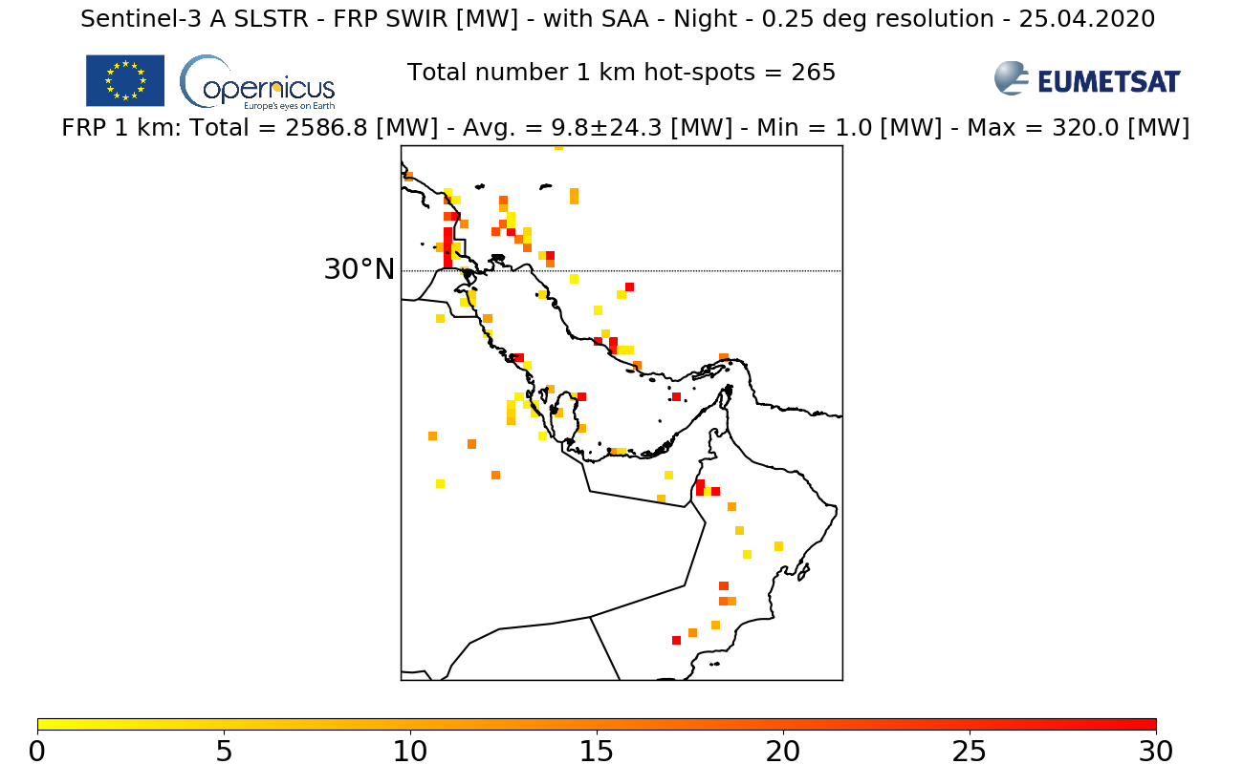
NRT Sentinel-3 FRP v2.0 examples
Persian Gulf industrial gas flares
NASA SUOMI/VIIRS night-time imagery + hot-spot detection
More on http://metis.eumetsat.int/frp

Slide 32
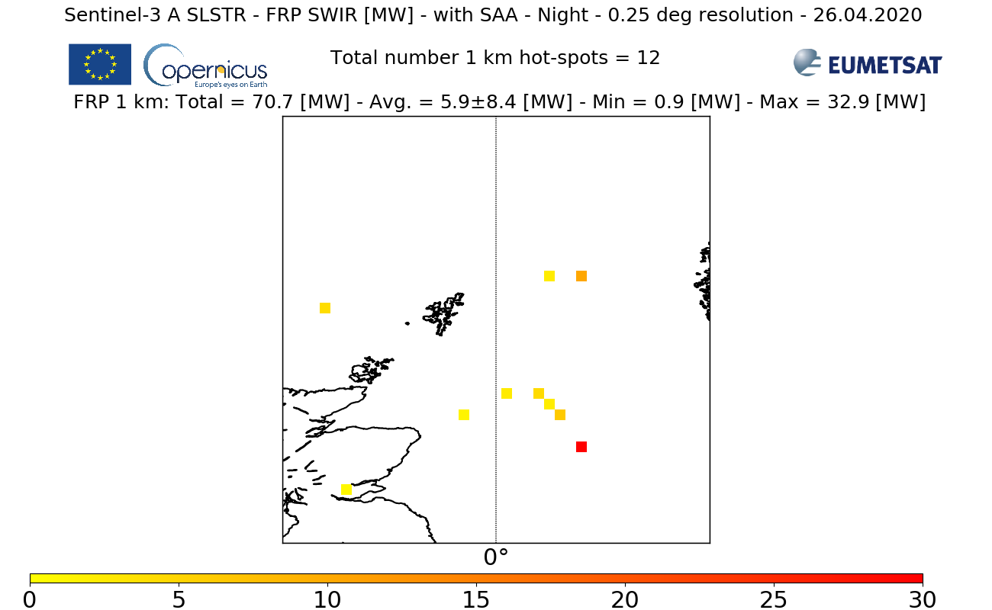
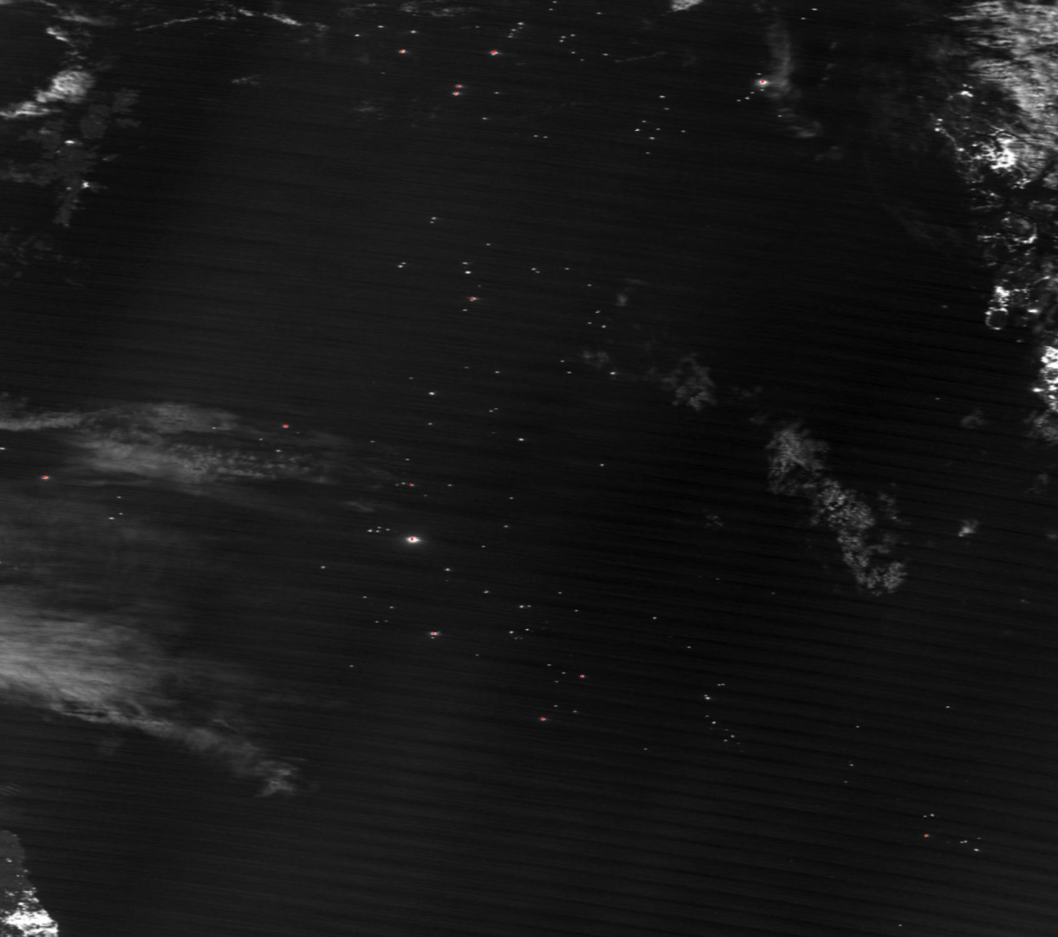
NRT Sentinel-3 FRP v2.0 examples
North Sea industrial gas flares
NASA SUOMI/VIIRS night-time imagery + hot-spot detection
More on http://metis.eumetsat.int/frp

Slide 33
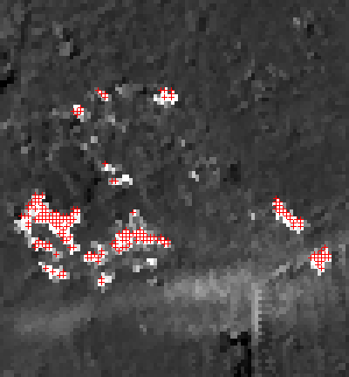
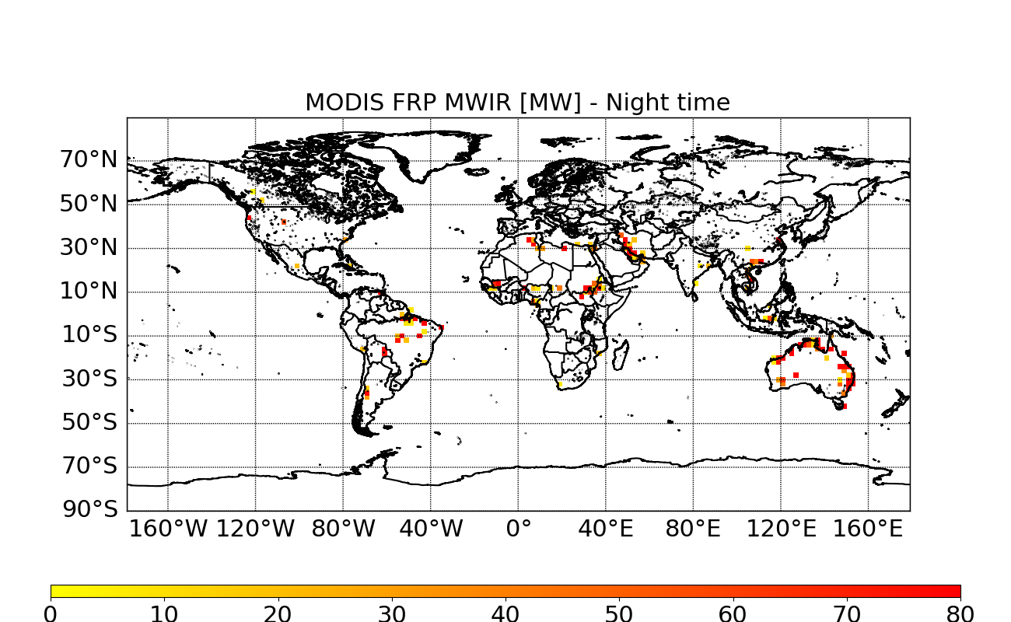
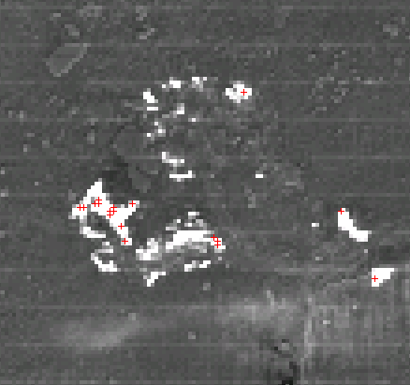
Copernicus NRT Sentinel-3 FRP – More detection of low fire signals than MODIS!
2019.12.05
Night time
2 Deg gridded
FRP MWIR [MW]
SLSTR A
SLSTR-A
SLSTR-A
Fort McMurray Fire, Alberta, 13.05.2016
SLSTR less than conservative than MODIS!
MODIS Terra
MODIS Terra

Slide 34
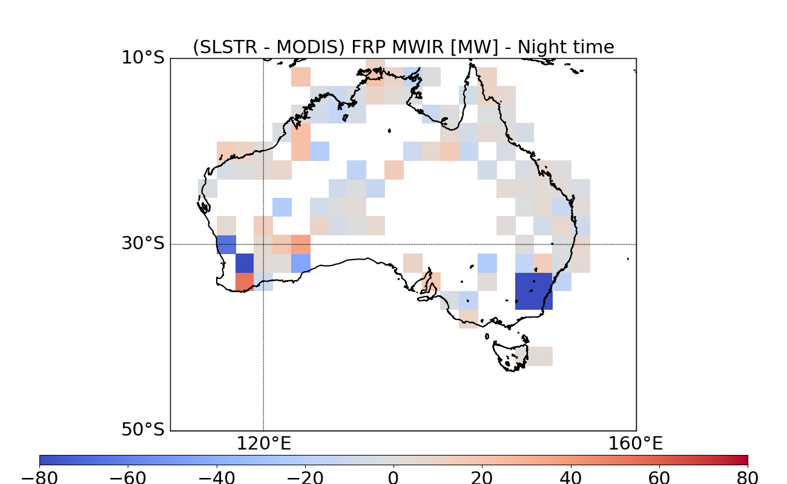
Evaluations – Night Time – 12.2019
Optimized geometry & detectability filtering

Slide 35




South Atlantic Anomaly & spurious signal filtering
Without Flag SWIR SAA
05.12.2019
With Flag SWIR SAA
15 day average – December 2019

Slide 36


NRT Sentinel-3 FRP – Hot-spot detection Validation methodology
An approach and tool developed for SEVIRI FIR & future MTG/FCI
  To be adapted to SLSTR active fire detection. Based on Pytroll framework (Satpy & Pyresample packages)
Reference focus on Central Africa
Get GEO fires full disk
Select LEO swaths
temporally inside GEO repeat cycle
For all
GEO fires
full disks
Extract LEO fires coordinates
and map to SEVIRI grid
Resample LEO swaths to SEVIRI grid
Compare GEO fires (spatially inside swaths)
with extracted LEO fires
Comparisons with MODIS (1 km resolution), VIIRS, EUMETSAT MSG FIR, and Land-SAF FRP detection
Statistics metrics:
  Probability of Detection (POD), Precision (PRE), False Alarm Ratio, F-Score – Harmonic mean of POD & PRE

Slide 37
Outline
Satellite hot-spot observations: current situation & needs
Copernicus, Sentinel-3, EUMETSAT for NRT atmosphere applications
The Copernicus Sentinel-3 NRT FRP
Data & visualisation access

Slide 38




EUMETSAT Sentinel-3 Dissemination Services & Data Access
S3VT annual meetings
Active participation
Sub-group S3VT Atmosphere open!
Co-chaired by Julien Chimot
Simon Pinnock
Subscribe !
User Support
User Registration & Support, Product Discovery Helpdesk, etc
S3 Online Data Access (ODA)
Rolling archive of ~1 m of data supporting ftp access
Copernicus Online Data Access (CODA & CODAREP)
Rolling archive of ~12 m of S3 data supporting http access + GUI + Reprocessed Dataset
https://www.s3vt.org
S3VT “Mini Files”
ftp access only for S3VT members
EUMETSAT Data Centre
Complete historical archive of all EUMETSAT data including S3 marine data
More info from: www.eumetsat.int
Courtesy Vincenzo Santacesaria (EUMETSAT)

Slide 39

METIS - Monitoring & Evaluation of Thematic Information from Space
http://metis.eumetsat.int
A public on-line tool to monitor EUMETSAT operational remotely sensed products

Slide 40

METIS FRP NRT S3
http://metis.eumetsat.int/frp
METIS-FRP NRT S3, the Fire Radiative Power component of Monitoring & Evaluation of Thematic Information from Space (METIS),
Public visualizations + diagnostics the Copernicus Near Real time (NRT) Sentinel-3 FRP.

Slide 41


Slide 42


Slide 43


Slide 44


Slide 45


Slide 46


Slide 47


Slide 48

Access to Sentinel-3 products from EUMETSAT
CODA – Copernicus Online Data Access
https://coda.eumetsat.int/#/home

Slide 49

Access to Sentinel-3 products from EUMETSAT
CODA – Copernicus Online Data Access
https://coda.eumetsat.int/#/home

Slide 50

Copernicus Sentinel-3 NRT FRP Product content
4 Netcdf files
  FRP_in.nc -> Key NRT L2 FRP product
  flags_in.nc -> flags from L1B
  geodetic_in.nc -> Original L1B swath
  geometry_tn.nc -> geometry parameters
  NB: current format under optimization (reduced ancillary files in next upgraded versions)

Slide 51
Copernicus Sentinel-3 NRT FRP Websites
All websites for more information on product, algorithm, data (NRT & reprocessed) access:
  https://www.eumetsat.int/website/home/Data/ScienceActivities/OperationalAlgorithms/CopernicusSentinel3NRTFireRadiativePowerFRP/index.html
  https://www.eumetsat.int/website/home/Satellites/CurrentSatellites/Sentinel3/AtmosphericComposition/index.html
    For all NRT Sentinel-3 Atmosphere products by EUMETSAT
    For all data access infomration
    NB: NRT FRP data reprocessed rom 1st Dec 2019 to onwards + alternative configuration (under validation) available upon request
    Contact EUMETSAT helpdesk: ops@eumetsat.int
  http://metis.eumetsat.int/frp/#
  https://coda.eumetsat.int/#/home

Slide 52

Conclusion
Sentinel-3, an operational Marine, Land and Atmospheric mission!
EUMETSAT is autonomous & entrusted by EC, member states, and Copernicus services for S3 NRT Atmosphere products!
Sentinel-3 NRT: FRP deployed + Aerosols soon (this Summer)
Julien.Chimot@eumetsat.int
@JChimotScience

Slide 53


