Slide 1
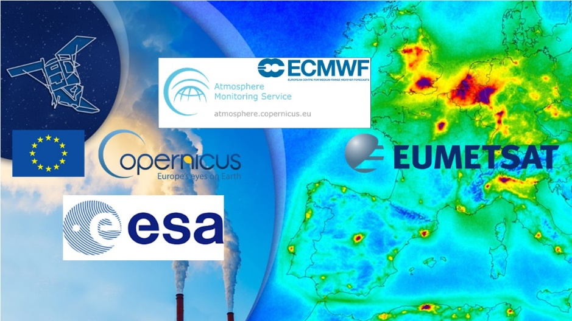
Using Copernicus data for Atmospheric Composition Applications
EGU General Assembly 2020 Short Course | 26 May 2020
Jointly organised by EUMETSAT, CAMS-ECMWF, ESA, with support from Copernicus
Conveners:
Federico Fierli (EUMETSAT)
Christian Retscher (ESA)
Mark Parrington (ECMWF-CAMS)
Julia Wagemann (MEEO / University of Marburg)

Slide 2
Today: Webinar with Atmospheric Composition Experts
Introduction to data by experts from EUMETSAT, ESA, ECMWF-CAMS
Introduction to practical workflows
1
Course Outline
27-29 May
Self-paced data discovery, with support on Sli.do
2
29 May - 10:30 am CET
Interactive zoom session to discuss workflows, questions and feedback
3

Slide 4
Using Copernicus data for Atmospheric Composition Applications
Use of AC SAF GOME-2 data
Federico Fierli (EUMETSAT)

Slide 5
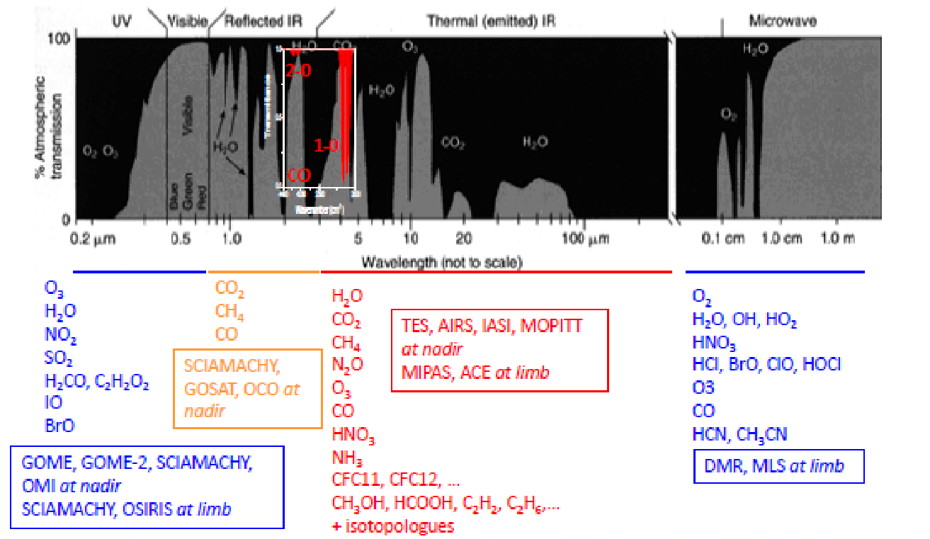
Atmospheric Composition from Satellites
What is measured and why it matters
Example on Air Quality
Notes:
Satellites have instruments who spans different parts of the light spectra, from the UV to the microwaves. Can be sensitive to many species that are key for chem cycles
Describe the book scheme below
Tell that SAT measures integrated column or thick profiles (as said by Mark)

Slide 6
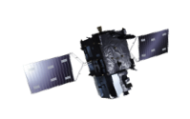
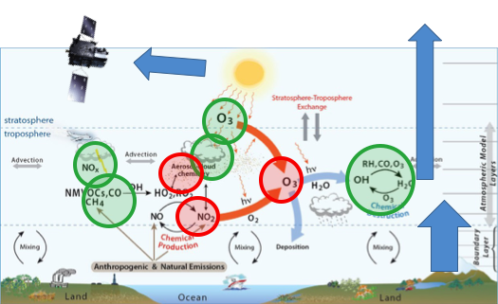
Atmospheric Composition from Satellites
What is measured and why it matters
Example on Air Quality
Notes:
Satellites have instruments who spans different parts of the light spectra, from the UV to the microwaves. Can be sensitive to many species that are key for chem cycles
Describe the book scheme below
Tell that SAT measures integrated column or thick profiles (as said by Mark)

Slide 7
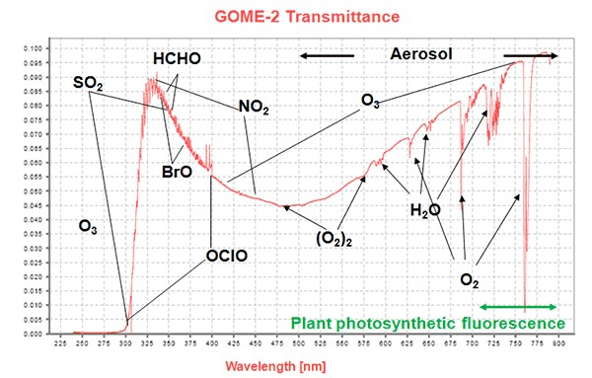
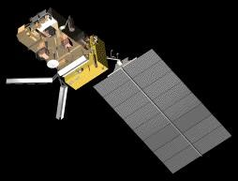
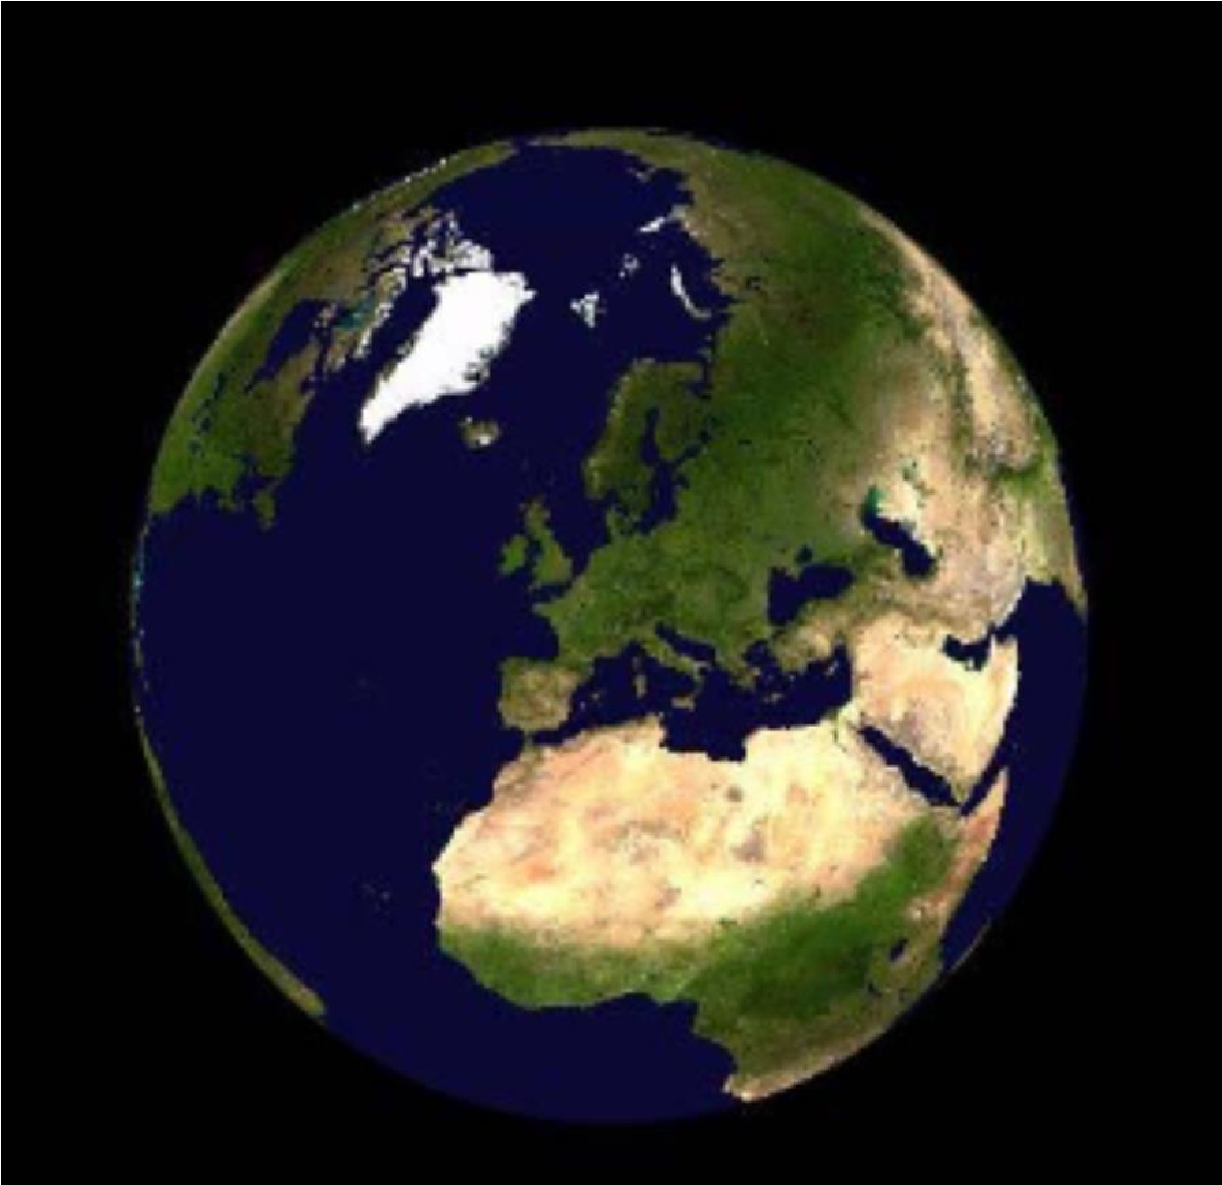
What
can
be
seen
by GOME
-
2
?
CO
-
MOPITT
C. Clerbaux 2015

Slide 8
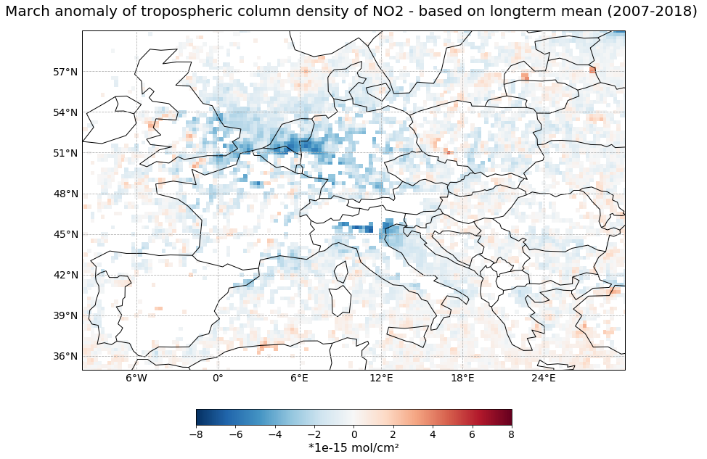
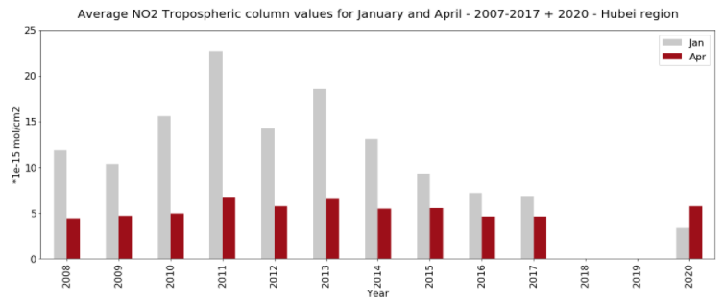
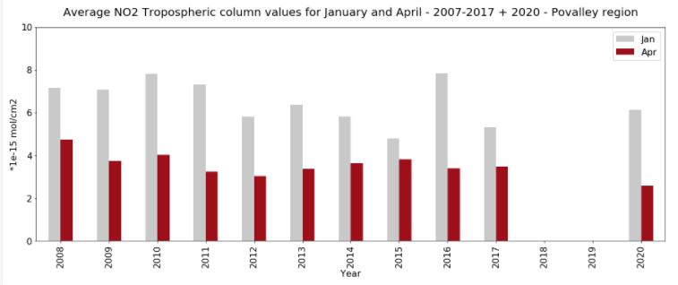
GOME-2 : a 2007-2020 view

Slide 9
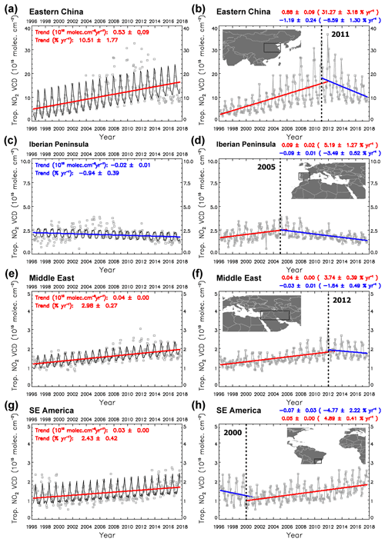
GOME-2 : a 2007-2020 view
Atmos. Chem. Phys., 19, 6269–6294, 2019 https://doi.org/10.5194/acp-19-6269-2019

Slide 10
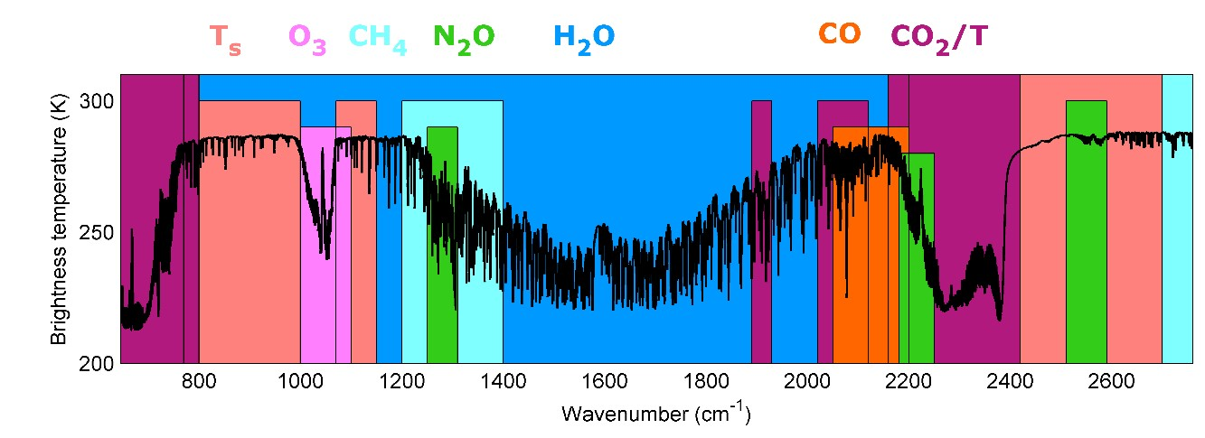
What
can
be
seen
by IASI?
CO
-
MOPITT
C
C.
.
Clerbaux 2015

Slide 11
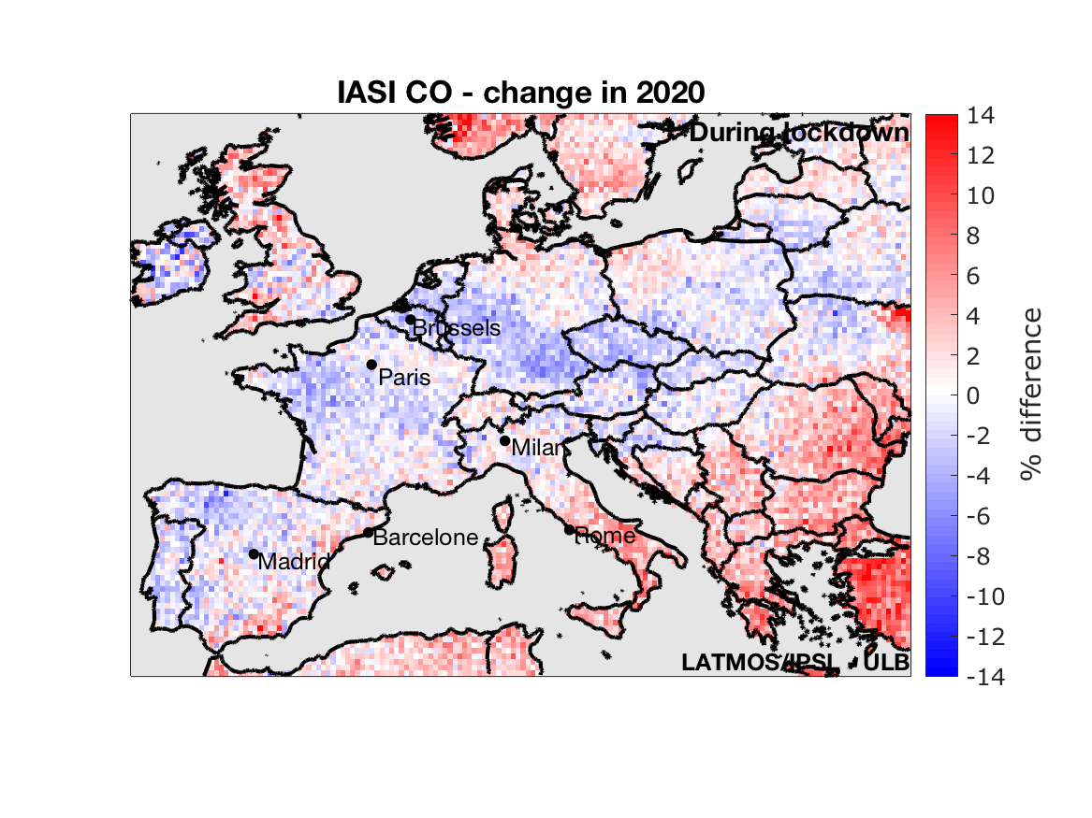
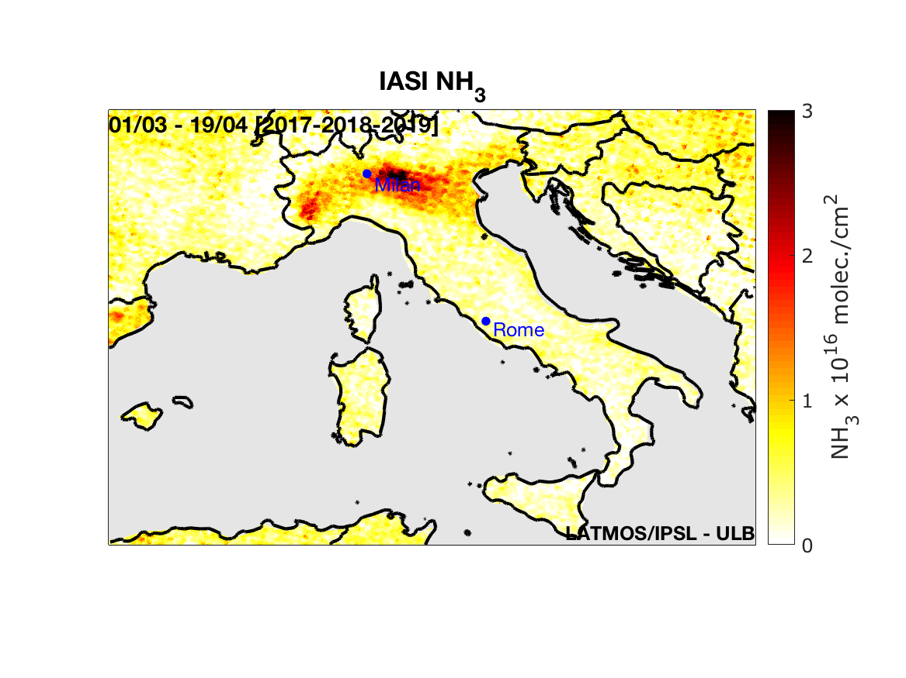
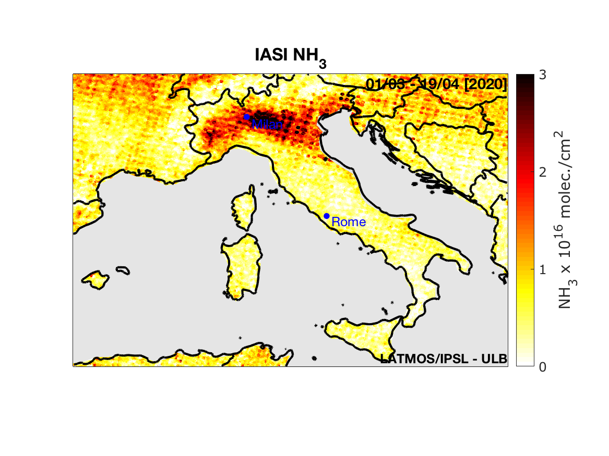
https://iasi-ft.eu/covid-19/italy-air-pollution/

Slide 12
Using Copernicus data for Atmospheric Composition Applications
Use of Sentinel-5p data
Christian Retscher (ESA/ESRIN)

Slide 13
Use of Sentinel-5p data
C. Retscher, ESA/ESRIN

Slide 14
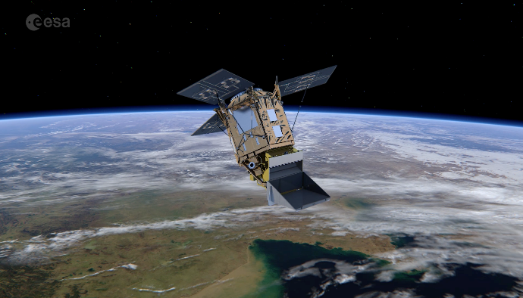
Examples for Usage of Sentinel-5p Data
Air Quality at times of COVID19
Main parameters:
S5p is the first atmospheric Sentinel mission focusing on global observations of the atmospheric composition for air quality and climate monitoring;
Launched on Oct. 13 2017; 7 years design lifetime;
Daily overpass ~13:30 hrs; Swath ~2600 km;
Spatial resolution at nadir ~5.5x3.5 km2 in UVVIS, ~7x7 km2 in SWIR;
Use case: Investigate signatures of the human emission reductions due to COVID19 lockdown measures;
Target datasets: tropospheric columns of NO2 and CO;
Match-up with ground-based data and models.
Related publications:
http://www.esa.int/Applications/Observing_the_Earth/Copernicus/SentinelP/Air_pollution_remains_low_as_Europeans_stay_at_home
https://physicstoday.scitation.org/do/10.1063/PT.6.2.20200501a/full/
https://news.agu.org/press-release/covid-19-lockdowns-significantly-impacting-global-air-quality/
https://news.agu.org/files/2020/05/2020GL087978-Stavrakou.pdf

Slide 15
Examples for Usage of Sentinel-5p Data
NO2 over China
Red laterns: Chinese New Year Holiday
Padlock: lockdown measures
Thin circle: Wuhan
Grey areas: no data
Recovery in NO₂ levels due to progressive easing of lockdown after 25 March
Averaging over several days accounts partly for the effects of natural variability (meteorology)
Copyright: Contains modified Copernicus Sentinel data, processed by BIRA

Slide 16
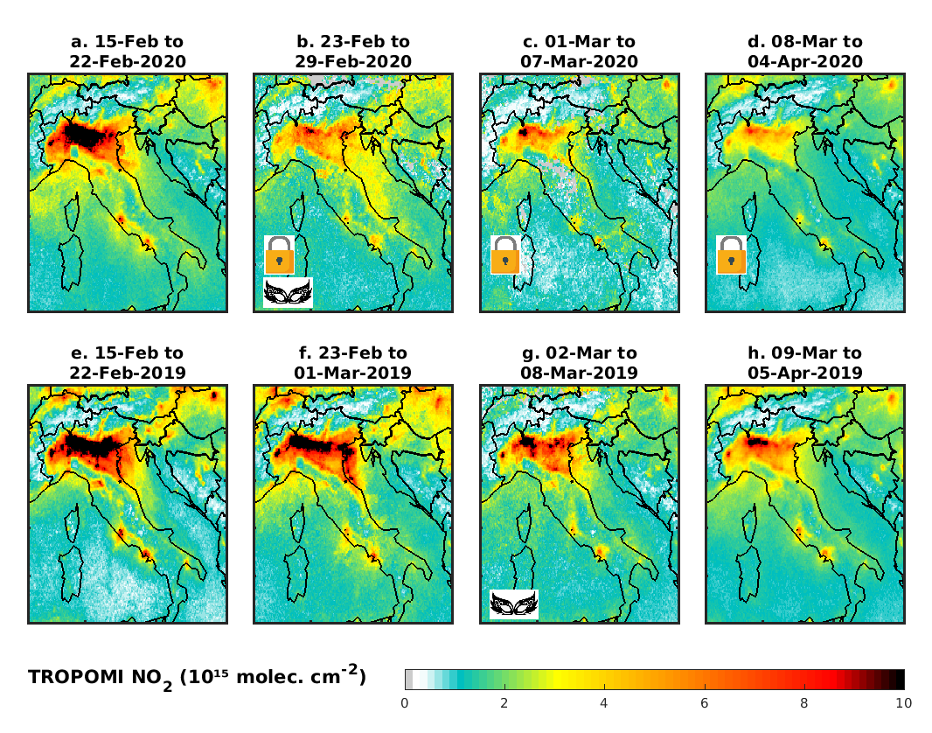
Examples for Usage of Sentinel-5p Data
NO2 over Italy
Much lower levels than the corresponding periods in 2019
The average TROPOMI NO2 column during the lockdown period in 2020 is found to be between 39% and 46% lower than during the same period in 2019 in Milan, Turin and Venice
Copyright: Contains modified Copernicus Sentinel data, processed by BIRA

Slide 17
Examples for Usage of Sentinel-5p Data
NO2 over ES, FR, DE
Exceptional decreses in NO₂ levels during 14 March-3 April with respect to the same period in 2019
Paris : -56%
Madrid: -47%
Lockdowns:
Spain: 14 March
France: 17 March
Germany: 22 March
Copyright: Contains modified Copernicus Sentinel data, processed by BIRA

Slide 18
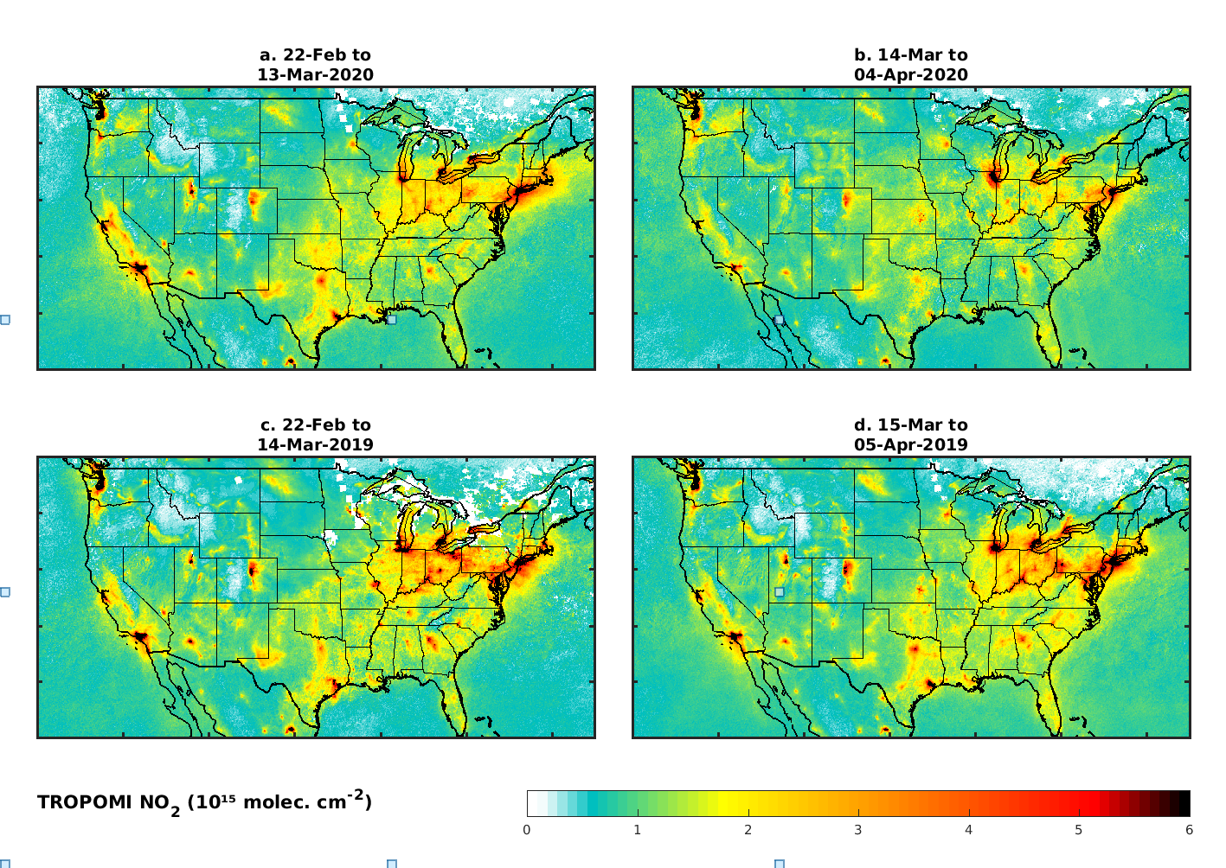
Examples for Usage of Sentinel-5p Data
NO2 over the US
Stay-at-home order
California: 19 March
New York: 22 March
Illinois: 21 March
Copyright: Contains modified Copernicus Sentinel data, processed by BIRA

Slide 19
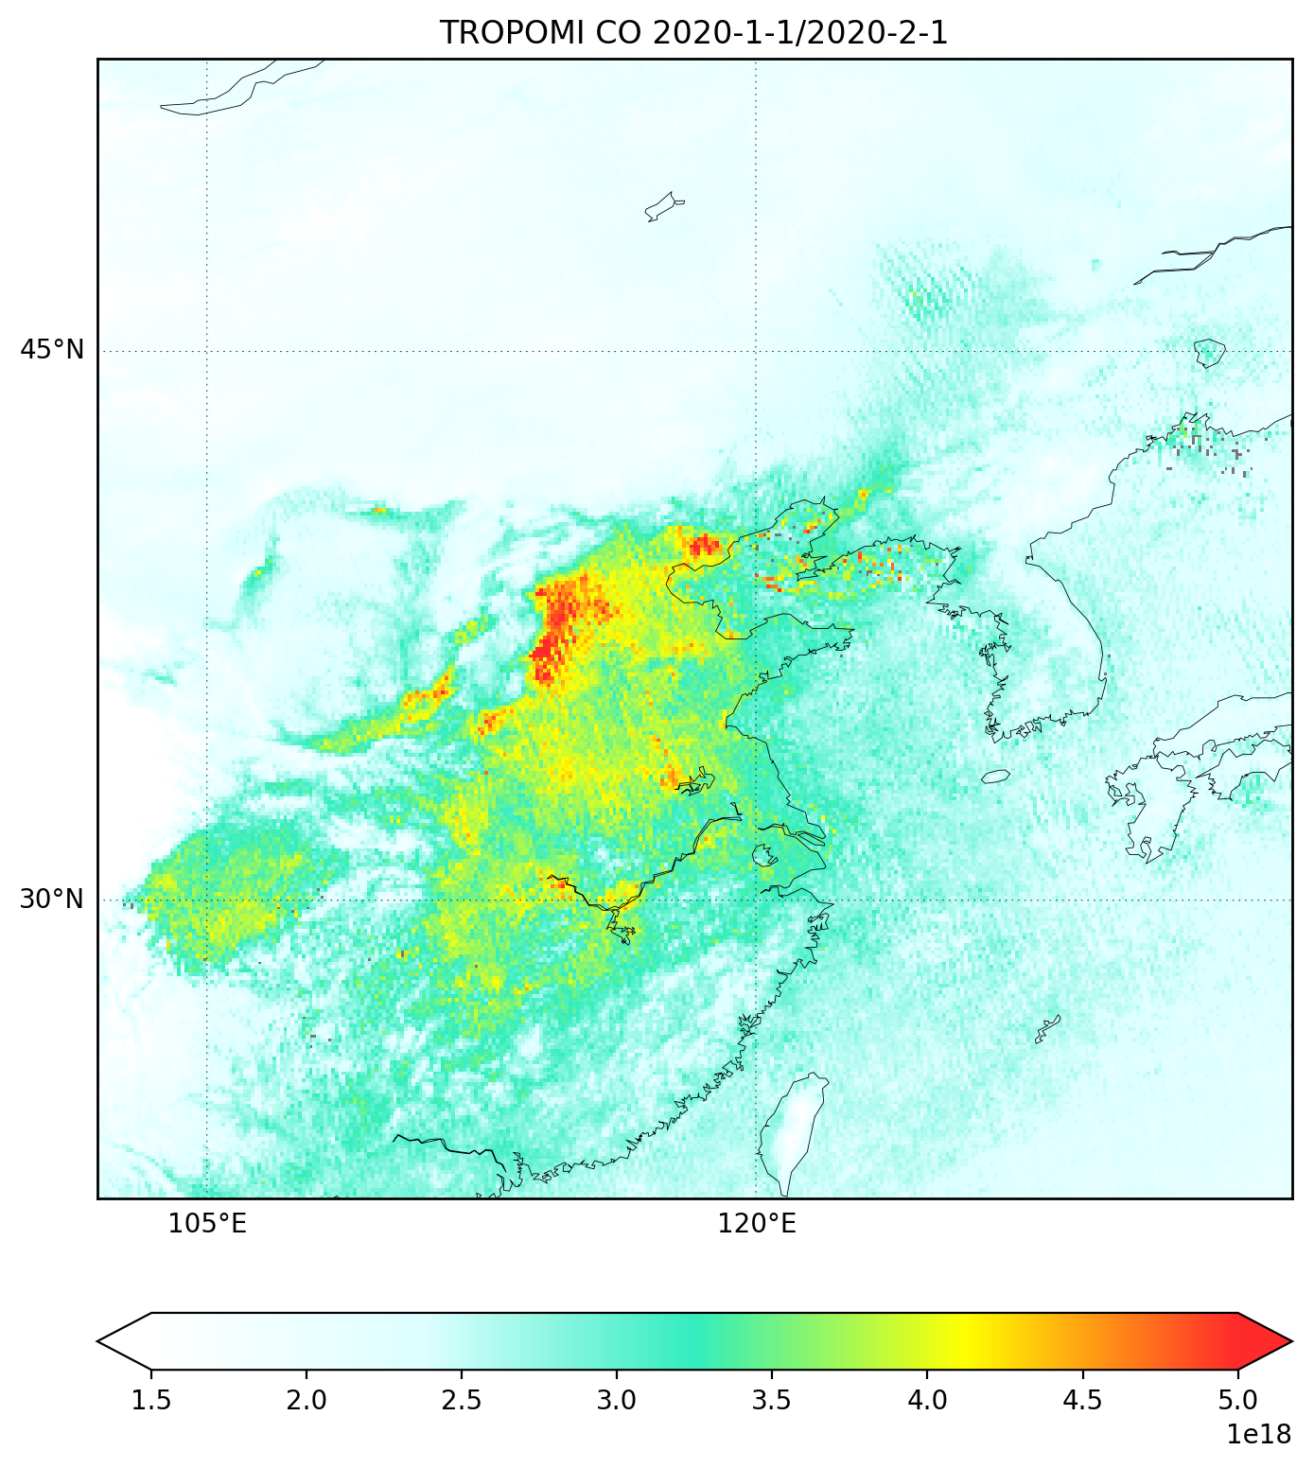
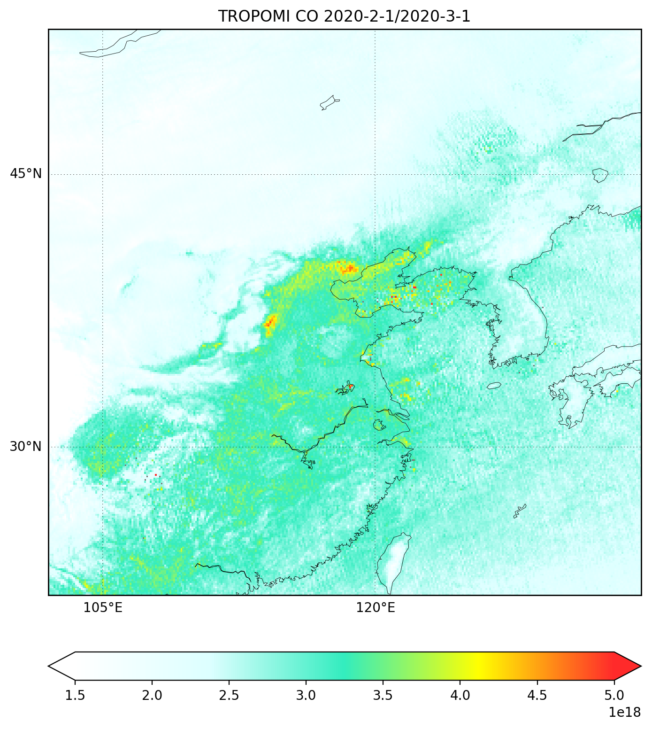
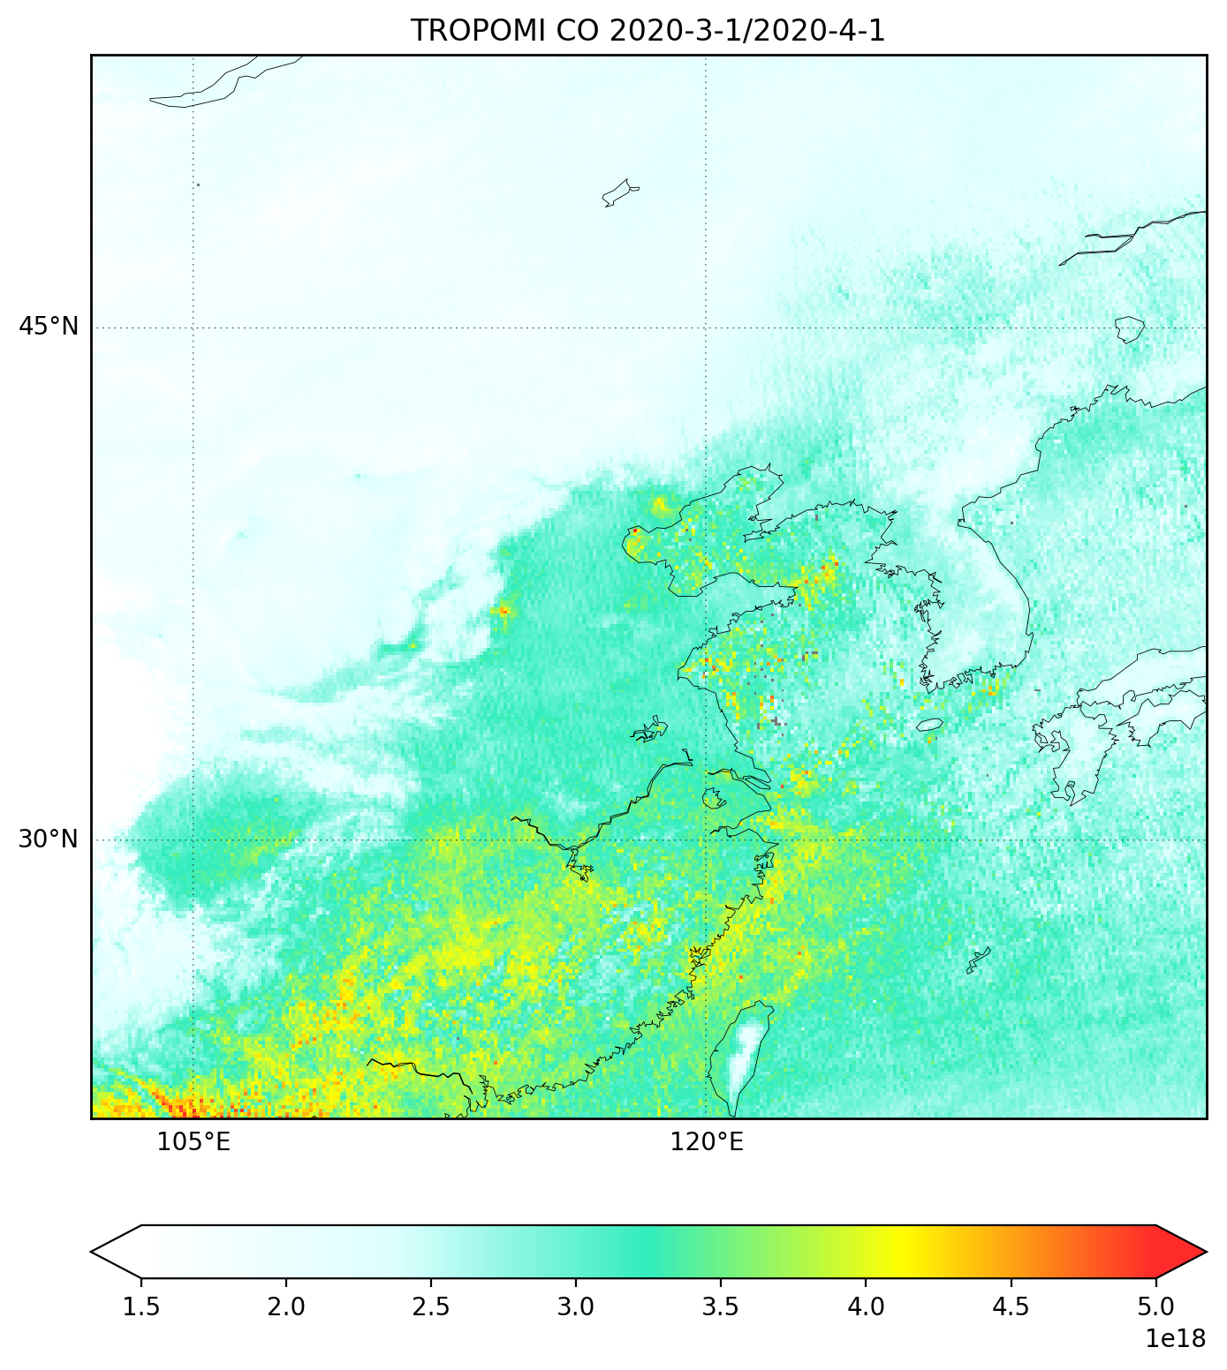
Examples for Usage of Sentinel-5p Data
CO over China
Copyright: Contains modified Copernicus Sentinel data, processed by SRON
19

Slide 20
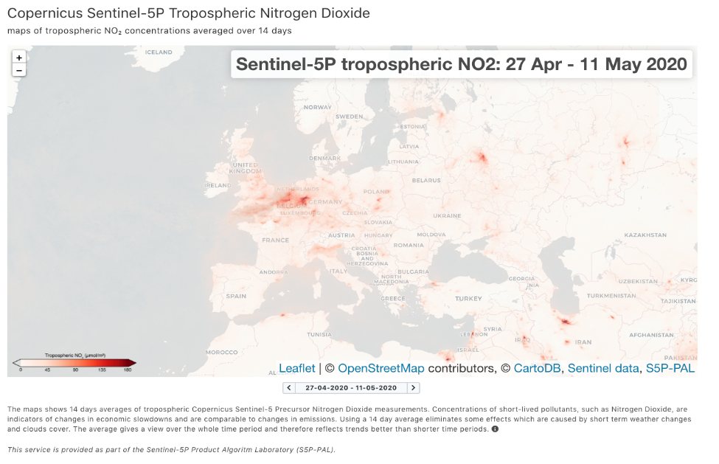
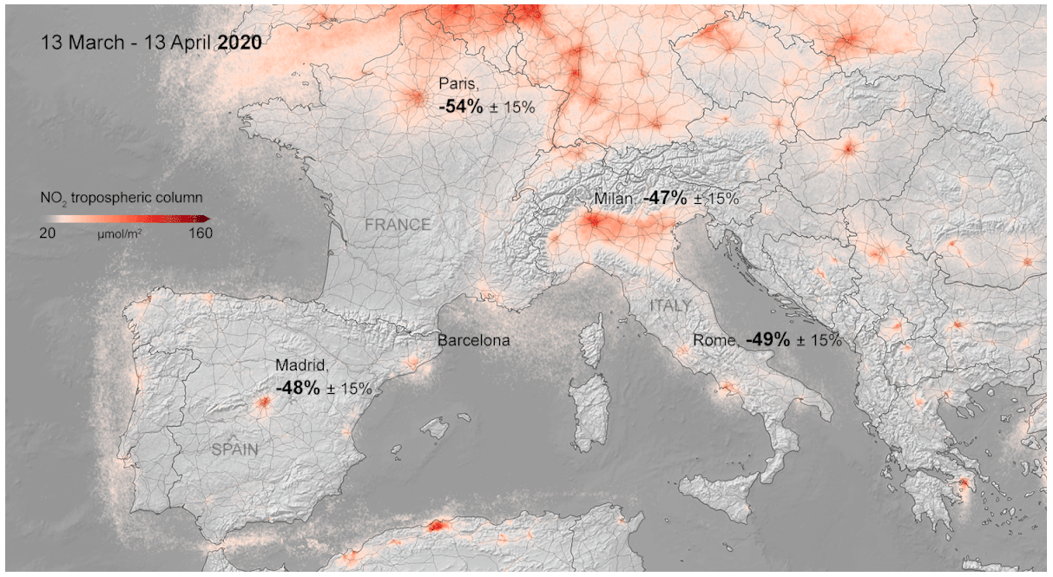
Sentinel-5P PAL NO2 Mapping Service
2-week averages online for public usage
https://maps.s5p-pal.com/
Copyright: Contains modified Copernicus Sentinel data, processed by KNMI and S&T

Slide 21
Using Copernicus data for Atmospheric Composition Applications
Use of data from the Copernicus Atmosphere Monitoring Service (CAMS)
Mark Parrington (ECMWF-CAMS)

Slide 22
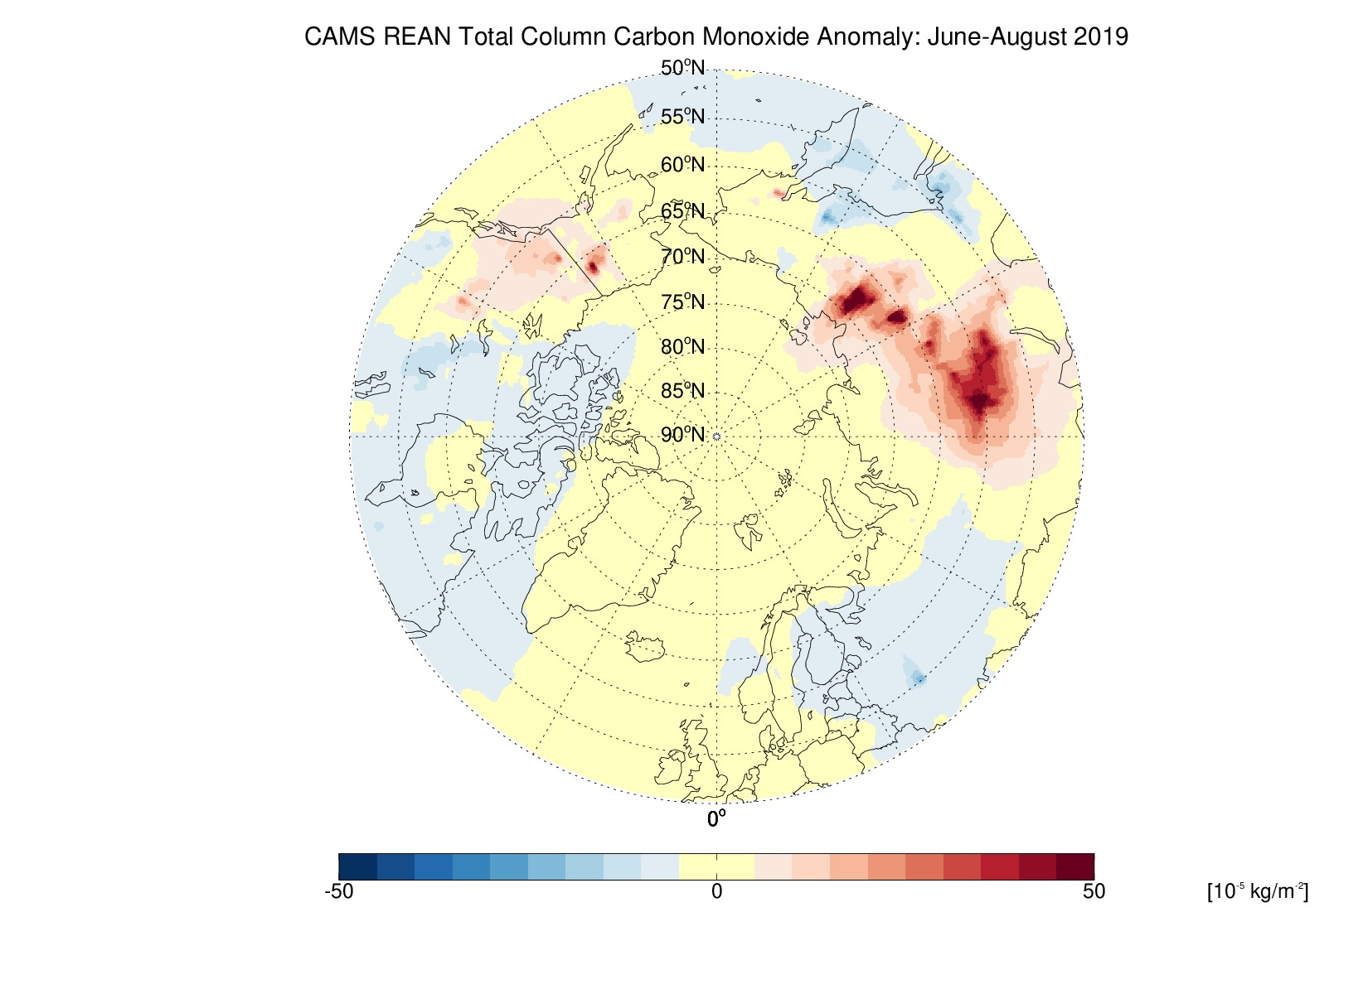
Arctic wildfires 2019: Atmospheric composition anomalies
Estimated wildfire emissions from GFAS provide surface boundary condition for CAMS global/regional forecasts.
CAMS global reanalysis of atmospheric composition for 2003-present provides context for atmospheric impacts of wildfires.
a
b
June-August 2019 anomalies in: (a) organic matter aerosol optical depth at 550nm; and (b) total column carbon monoxide relative to 2003-2018 mean from the CAMS global reanalysis of atmospheric composition.
https://www.ecmwf.int/en/research/climate-reanalysis/cams-reanalysis

Slide 23
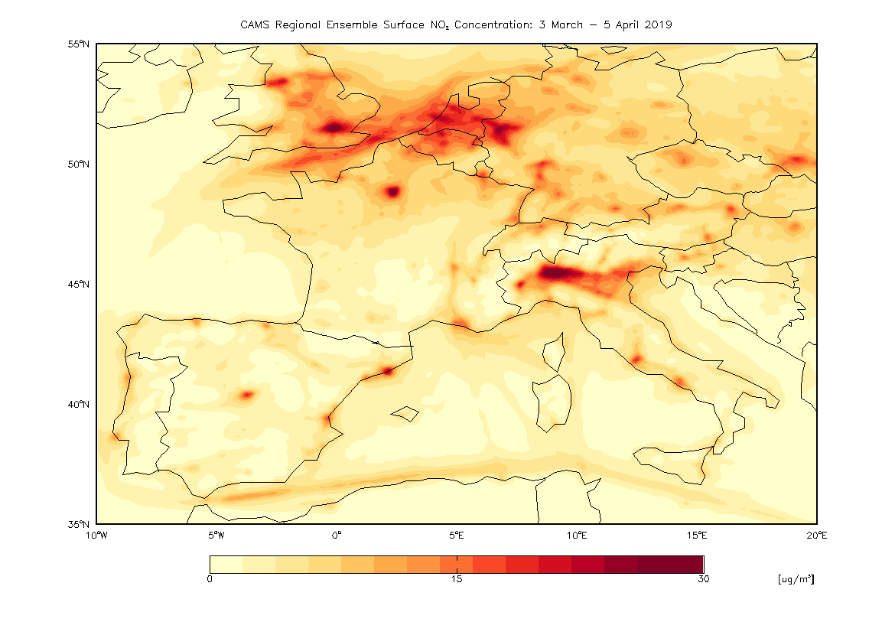
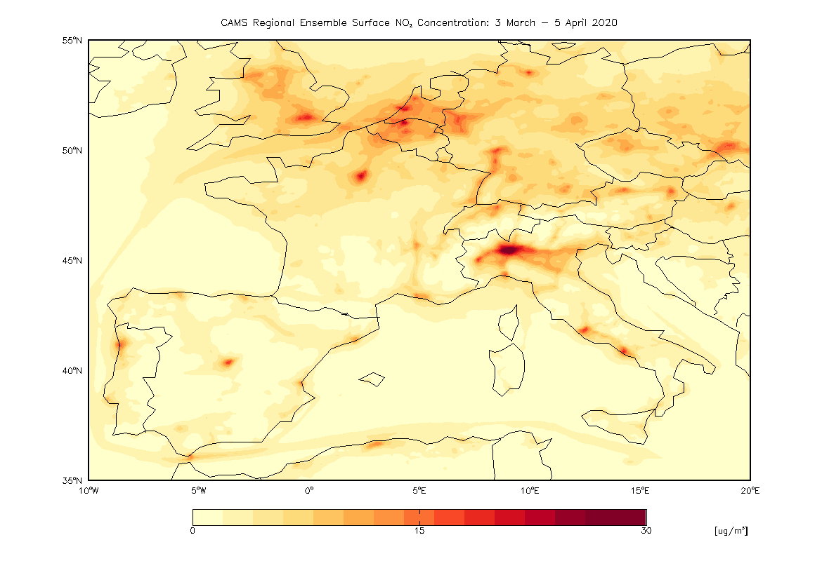
COVID-19 Lockdown: Regional air quality impacts
Reductions in surface air pollution (especially PM_{2.5} and NO₂) related to the COVID-19 lockdown have been shown with satellite observations.
CAMS European regional air quality analyses (and 4-day forecasts) assimilate surface observations into an ensemble of 7 air quality forecast models and further confirm reduced NO₂ in spring 2020 compared to 2019.
14 March to 5 April 2019
14 March to 5 April 2020
[μg/m³]
CAMS regional ensemble mean analyses of surface NO₂ averaged over the period 14 March to 5 April for 2019 (left) and 2020 (right).
https://www.regional.atmosphere.copernicus.eu/

Slide 24
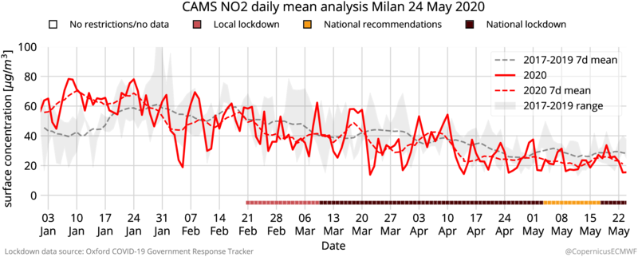
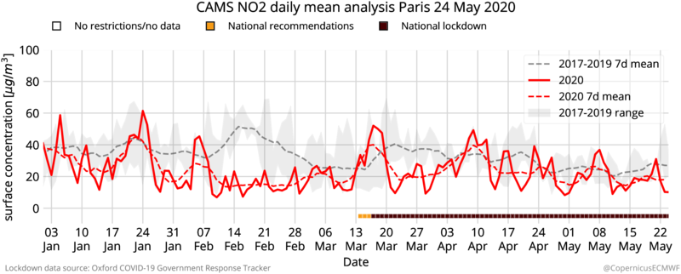
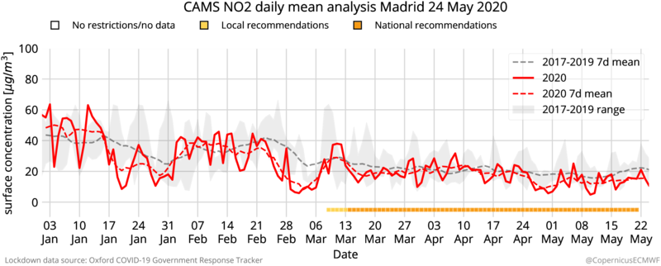
COVID-19 Lockdown: Air quality impacts in cities
CAMS European regional air quality analyses (and 4-day forecasts) assimilate surface observations into an ensemble of 7 air quality forecast models and further confirm reduced NO₂ in spring 2020 compared to 2019.
CAMS provides air quality information in support of the COVID-19 crisis, including time series of key pollutants (PM_{2.5}, PM₁₀, O₃, NO₂) for European cities, providing context to the effect of lockdown measures on air pollution.
Time series of surface NO₂ for Milan, Paris and Madrid between 3 January and 24 May highlight challenges in evaluating changes relative to 2017-2019 mean:
High degree of variability.
Declining levels of short-lived air pollutants from winter into spring (increasing temperatures and insolation).
https://atmosphere.copernicus.eu/european-air-quality-information-support-covid-19-crisis

Slide 25
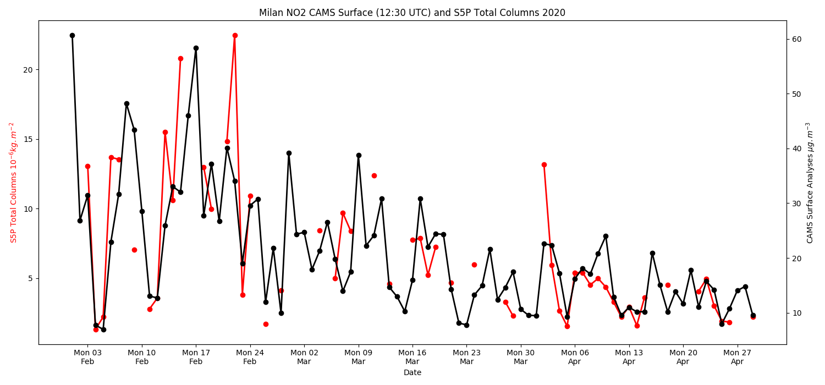
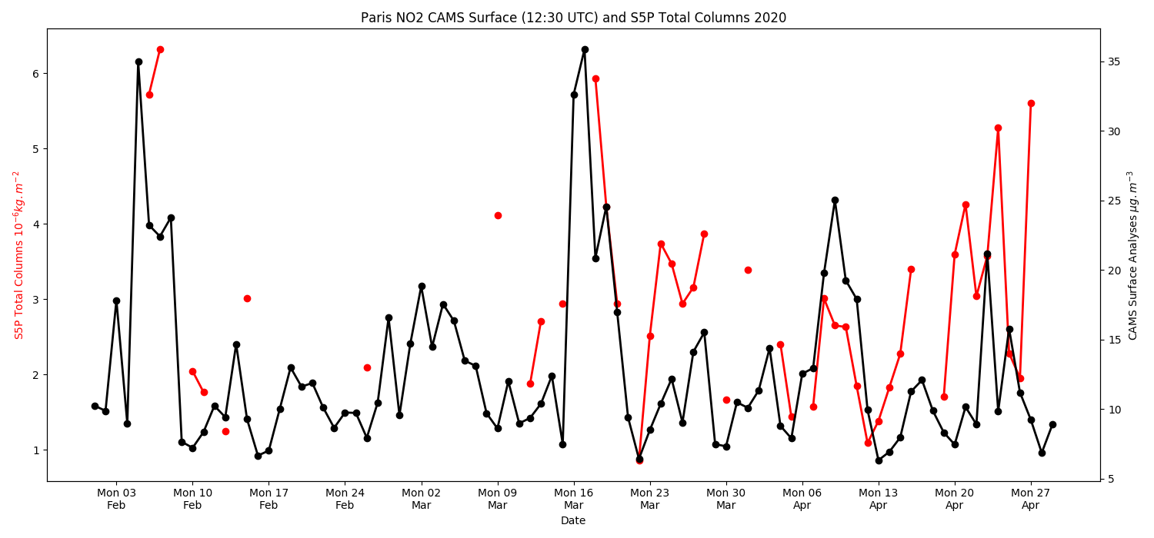
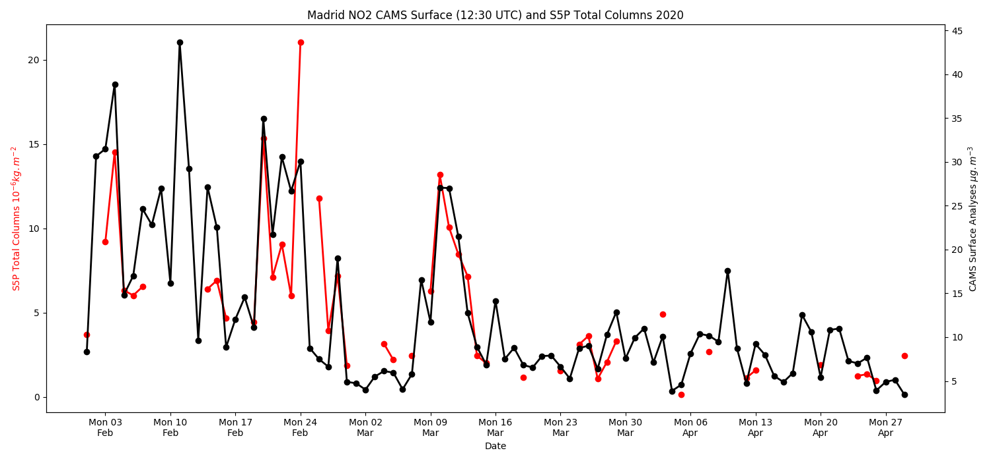
COVID-19 Lockdown: Air quality impacts in cities
CAMS total column NO₂
S5P total column NO₂
Milan
CAMS European regional air quality analyses (and 4-day forecasts) assimilate surface observations into an ensemble of 7 air quality forecast models and further confirm reduced NO₂ in spring 2020 compared to 2019.
CAMS provides air quality information in support of the COVID-19 crisis, including time series of key pollutants (PM_{2.5}, PM₁₀, O₃, NO₂) for European cities, providing context to the effect of lockdown measures on air pollution.
Time series of surface NO₂ for Milan, Paris and Madrid between 3 January and 24 May highlight challenges in evaluating changes relative to 2017-2019 mean:
High degree of variability.
Declining levels of short-lived air pollutants from winter into spring (increasing temperatures and insolation).
Time series of total column NO₂ for European cities shows good agreement in magnitude and trend.
Paris
Madrid
https://atmosphere.copernicus.eu/european-air-quality-information-support-covid-19-crisis

Slide 26
Using Copernicus data for Atmospheric Composition Applications
Practical Workflow Examples
Julia Wagemann (MEEO / University of Marburg)

Slide 27
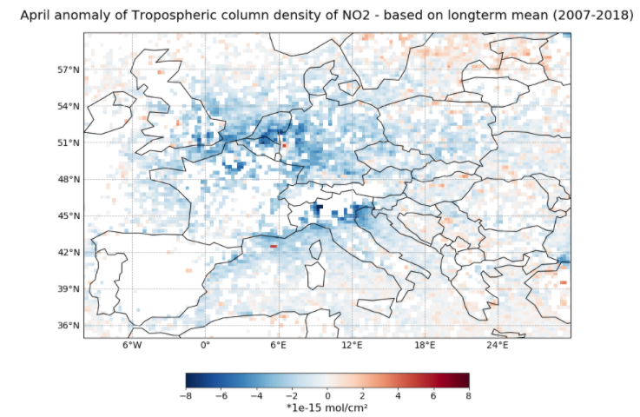
Covid-19 case study - Metop-A / Metop-B GOME- 2
Anomaly map
Time-Series analysis

Slide 28
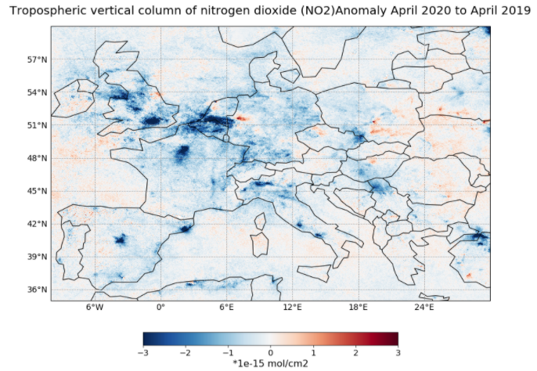
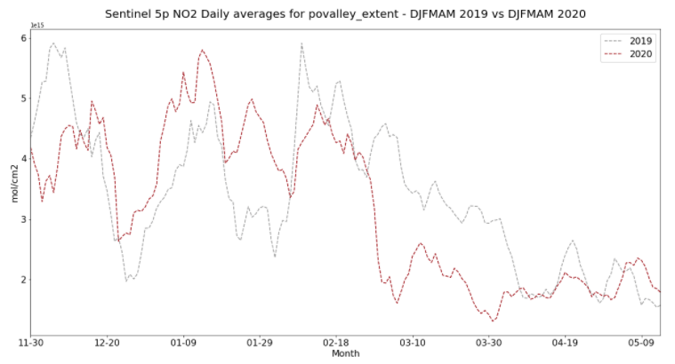
Covid-19 case study - Sentinel-5P TROPOMI
Anomaly map
Time-Series analysis

Slide 29
Using Copernicus Atmospheric Composition Data
1
Create an account: https://wekeo-login.services.meeo.it
Access to the practical course material via Jupyterhub
2
Go to:
https://ltpy.adamplatform.eu

Slide 31
