Slide 1
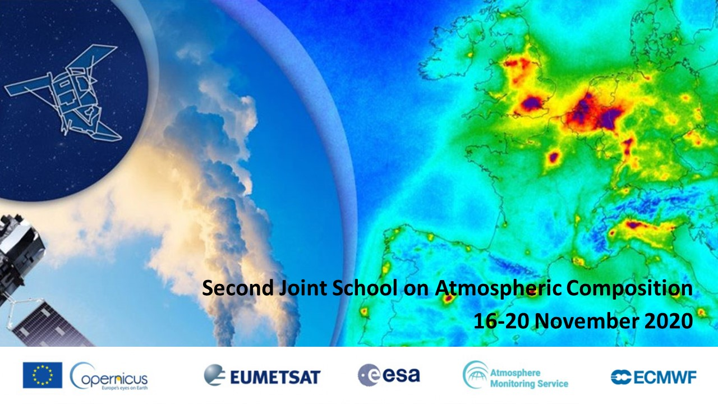
UV-Vis remote sensing instruments - Retrieval and satellite validation
M. Van Roozendael (BIRA-IASB)

Slide 2
Content
Passive UV-Vis DOAS instruments
Retrieval methods
Networks
Satellite validation (Sentinel-5p)
Conclusions and perspectives

Slide 3
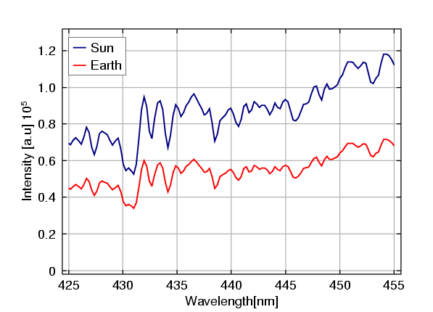
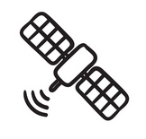
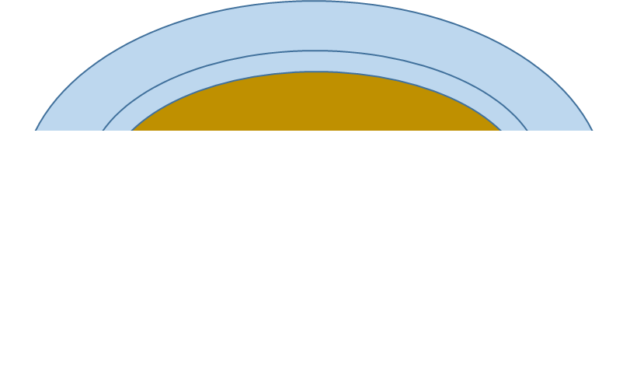

Passive UV-Vis remote-sensing
Space nadir geometry (e.g. Sentinel-5p)
DOAS spectral fitting
Molecular absorption cross-sections
Slant column
AMF calculation
Radiative transfer model
Ancillary informations on atmospheric and surface parameters
Vertical column

Slide 4
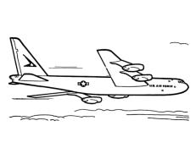
Passive DOAS : the many possible geometries
Det
Direct-sun
Balloon-borne
Airborne multi-axis
Det
Det
Det
Zenith-sky
Multi-axis (MAXDOAS)
Imaging DOAS
Satellite nadir
Satellite occultation
Satellite limb

Slide 5
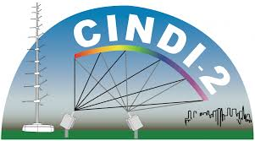
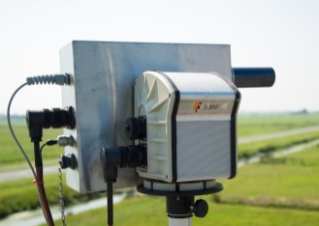
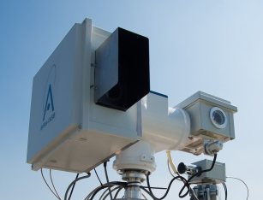
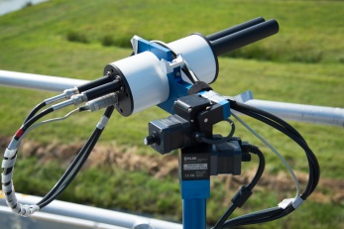
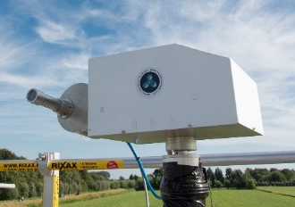
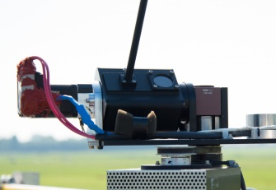
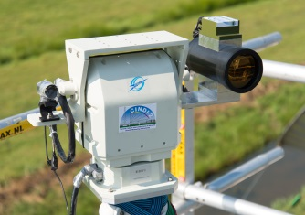
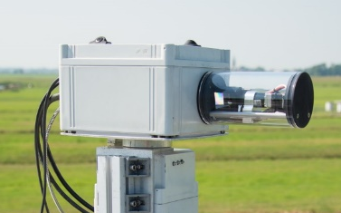
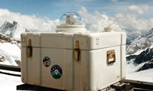
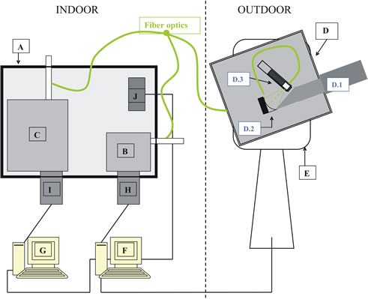
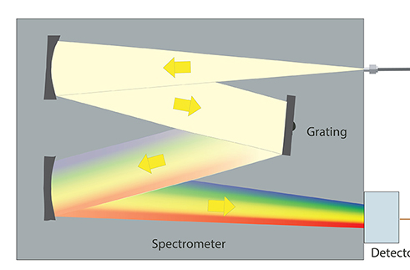
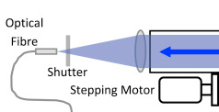
Ground-based DOAS instruments
IUP-B
BIRA
Pandora
Phaeton
CU-Boulder
AIOFM
Airyx Skyspec
SAOZ
Grating spectrometer
Fiber optic
Telescope/lens
Array detector
(CCD)
Entrance optics

Slide 6
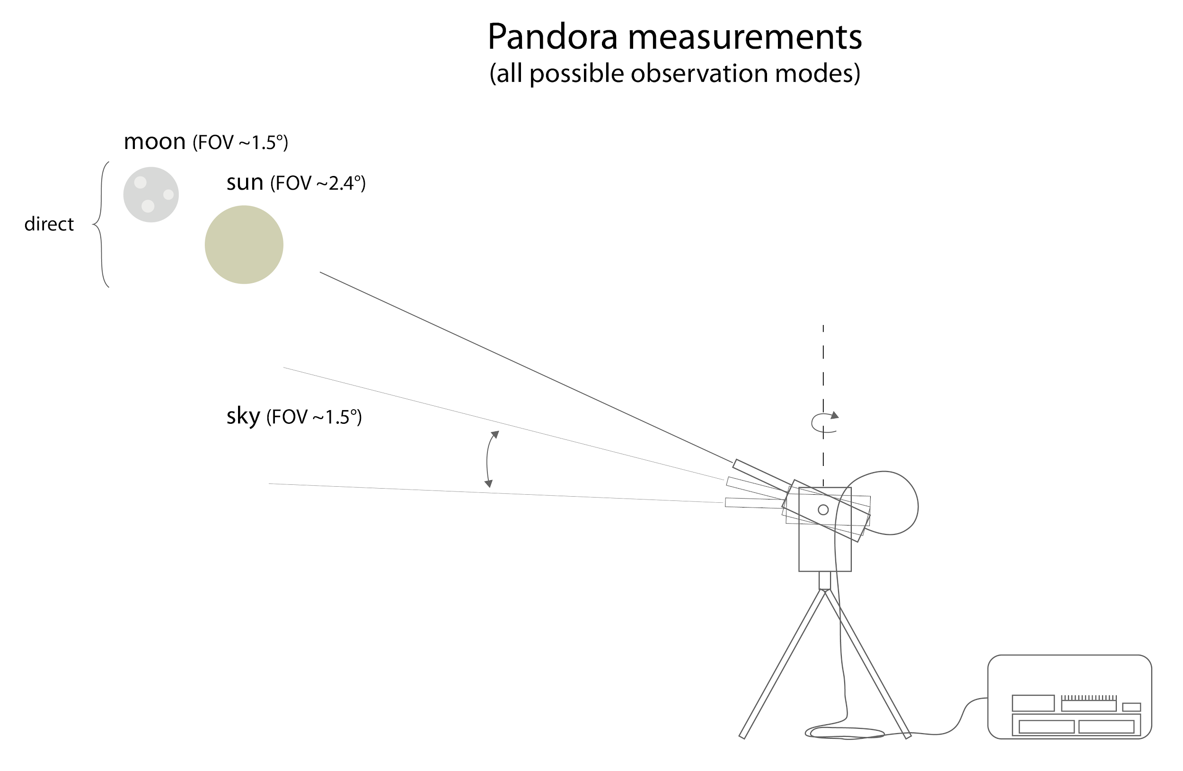

Direct-sun (or direct moon)
Direct sun/moon signal:
= Signal outside atmosphere
after attenuation
(by scattering or absorption)
on the way to the instrument
Light path well defined
→ high accuracy for total column retrieval

Slide 7
Zenith scattered-light DOAS technique
Simple geometry, but the light path is more complex
Used for mobile measurements and to retrieve stratospheric trace gases at twilight
Contains information on the vertical distribution of gases in the stratosphere (due to the progressive rise of the scattering height during twilight)
Det
z
Trace gas layer
SAOZ
Scattering height
Using suitable inversion tools (OE), allows to retrieve vertical profiles in the stratosphere (NO₂, BrO, O₃)

Slide 8
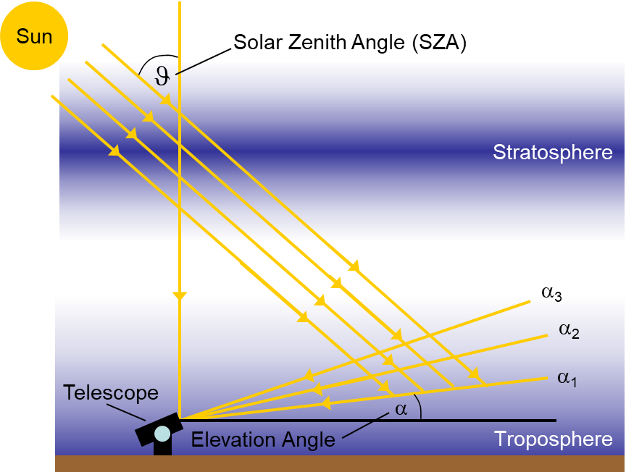
MAX-DOAS (Multi-AXis DOAS)
More complex geometry, but contains more information on the tropospheric composition
Measure sky-spectra at different telescope elevations
The length of the light path in the lower troposphere (close to the surface) is different for each elevation
Can be used to derive the vertical distribution of gases in the troposphere
When subtracting zenith measurements from off-axis ones, the stratospheric absorption can be eliminated

Slide 9
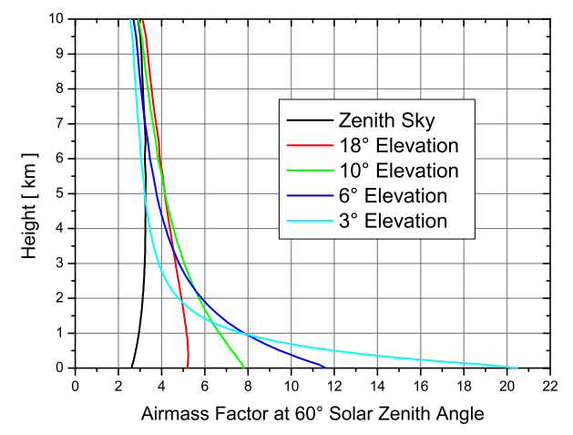
MAX-DOAS (Multi-AXis DOAS)
Retrieval generally complex
For low elevations, the light-path depends strongly on multiple scattering effect due to air and particles
AMF calculations requires accurate multiple-scattering radiative transfer codes (e.g. LIDORT, SCIATRAN) and must account for aerosols
The information content is mostly contained in the lowermost troposphere (boundary-layer)
Best suited to retrieved short-lived tropospheric constituents (NO₂, HCHO, glyoxal, SO₂, HONO, BrO, IO …)
Typical clear-sky box-AMFs at 440 nm
Wittrock (2004)

Slide 10
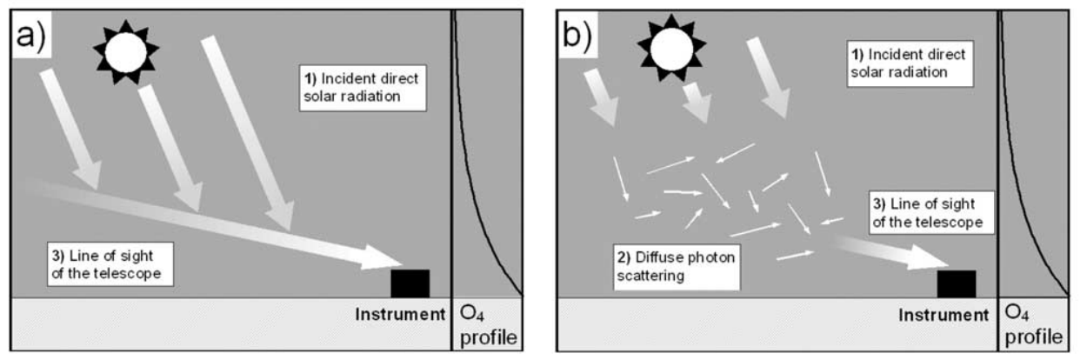
Aerosol retrieval using O₂-O₂ (O₄) measurements
Because of its known concentration in air, O₄ (O₂ collisional complex) can be used to derive information on the light path length in the troposphere (and on aerosol content)
O₄ absorption cross-sections
Clean troposphere (no aerosol)
Polluted troposphere
When present in the atmosphere, aerosols increase multiple-scattering and reduce the horizontal light path (so the O₄ absorption)
Wagner (2004)

Slide 11
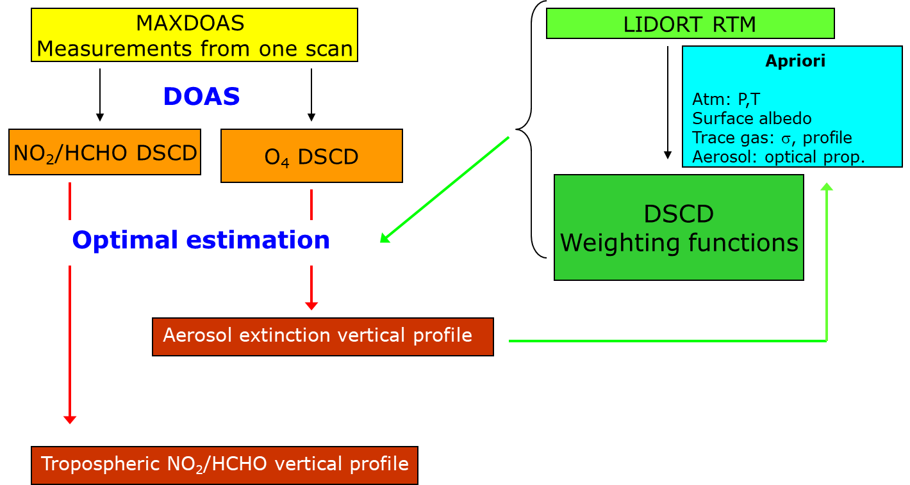
MAX-DOAS retrieval using Optimal Estimation (OE)
Step 1: DOAS retrieval of slant columns (NO₂ and O₄)
Step 2: First optimal estimation (OE) step to retrieve aerosol profile from O₄
Step 3: Second OE step to retrieve the trace gas profile (using the aerosol profile as an input)
Clémer et al., 2010

Slide 12
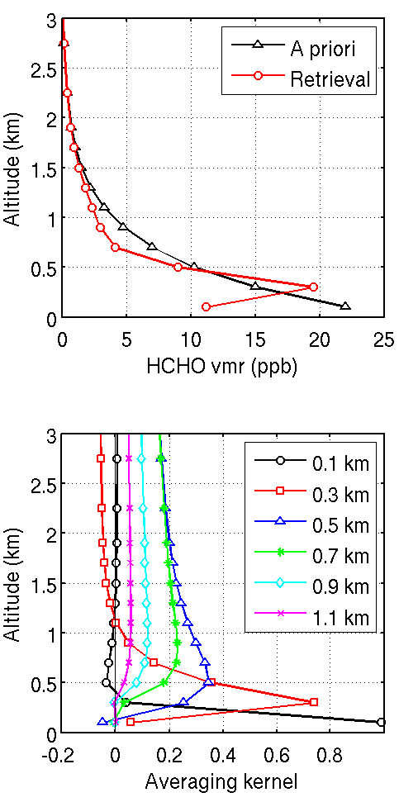
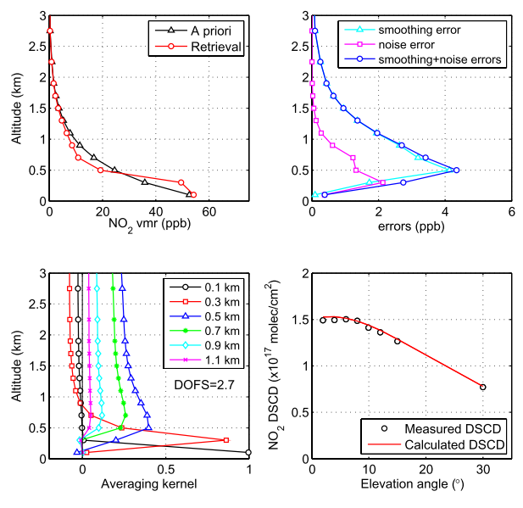
Examples of MAX-DOAS retrievals
HCHO
NO₂
Typical error budget (polluted conditions)
 |  | Smoothing + noise error | Aerosol retrieval error | A-priori error | Absorption cross-sections | Total uncertainty
NO₂ | VCD | 3 | 6 | 10 | 3 | 12
 | Surface conc. | 8 | 25 | 14 | 3 | 30
HCHO | VCD | 10 | 8 | 23 | 5 | 25
 | Surface conc. | 20 | 21 | 11 | 5 | 35

Slide 13


Global networks
NDACC UVVIS-WG
(Network for the Detection of Atmospheric Changes)
https://www.ndaccdemo.org/
SAOZ instrument
DOAS-ZSL and MAX-DOAS instruments (custom-made research systems or commercial)
Spectral range: 300 – 600 nm, 0.4-1.0 nm resolution FWHM
Approx. 30 stations worldwide in operation
Operational products: Total O₃, stratospheric NO₂ column
Scientific products
- Stratospheric BrO and OClO columns
- Tropospheric NO₂, HCHO columns and profiles (DOFs ~ 2)
SAOZ data centrally processed at CNRS/LATMOS
MAX-DOAS central processing under development (FRM4DOAS)
PGN
(Pandonia Global Network)
https://www.pandonia-global-network.org/
Pandora instrument
Direct-sun/moon and sky measurements
Spectral range (S1): 300 – 550 nm, 0.7 nm resolution FWHM
> 50 stations worldwide in operation – fast growing network
Operational products: total O₃ and NO₂ columns
Other products:
- Total SO₂ and HCHO columns
- Tropospheric NO₂ columns and surface concentration
Central calibration of instruments
Central processing using operational Blick software

Slide 14
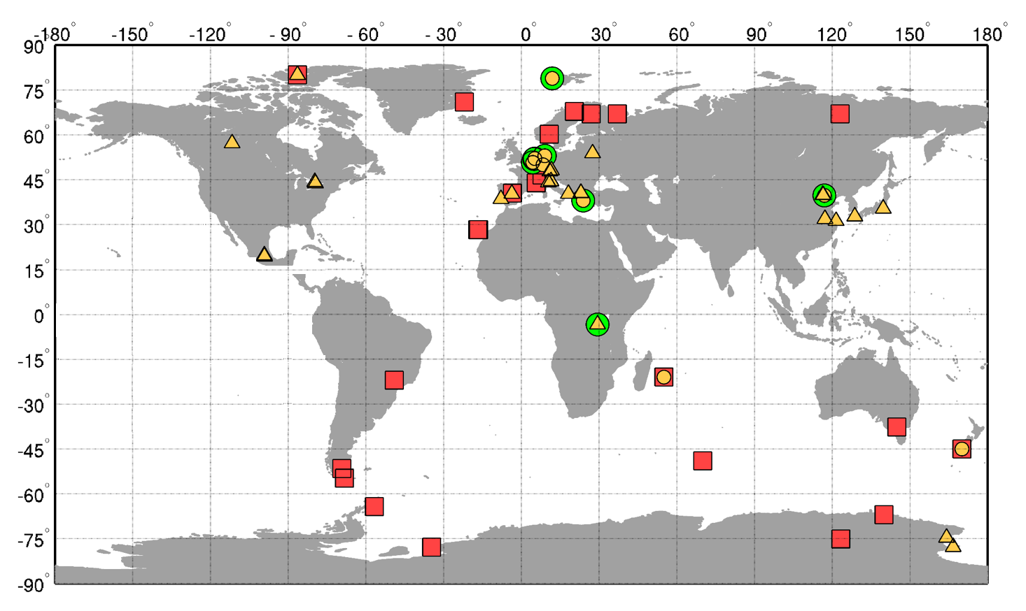
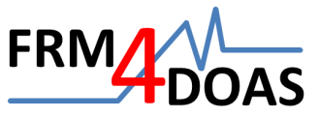
NDACC and associated UV-VIS instruments
SAOZ

Slide 15
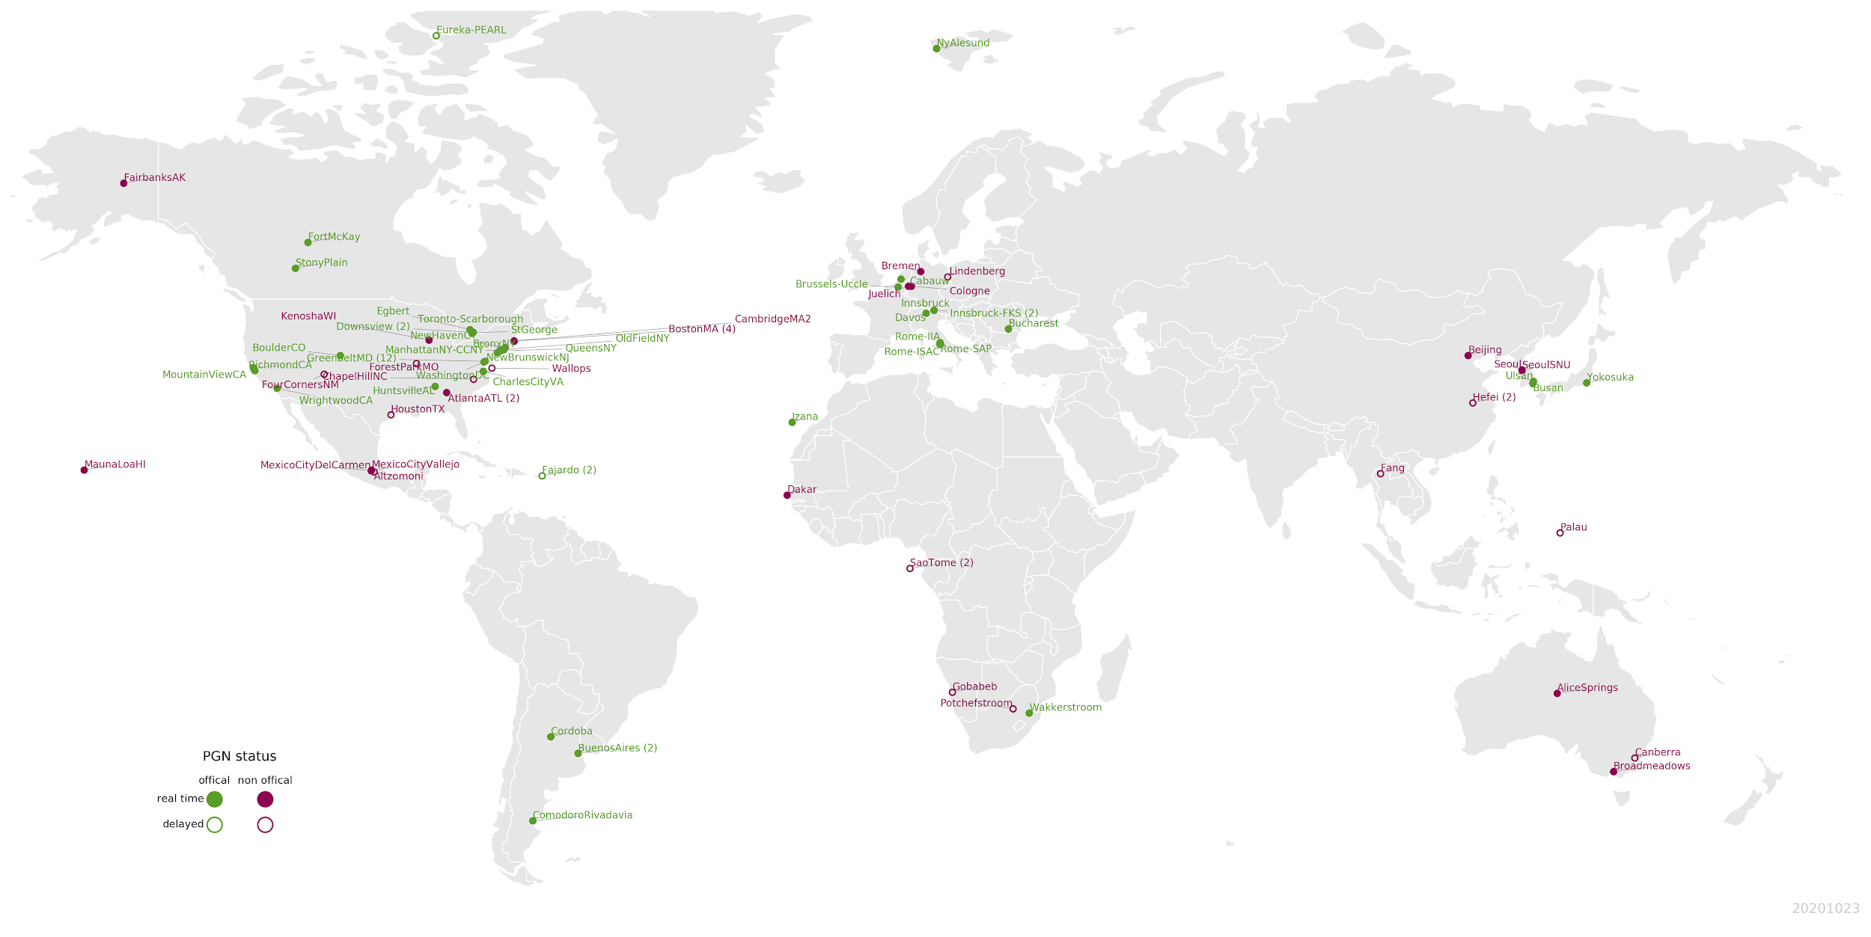
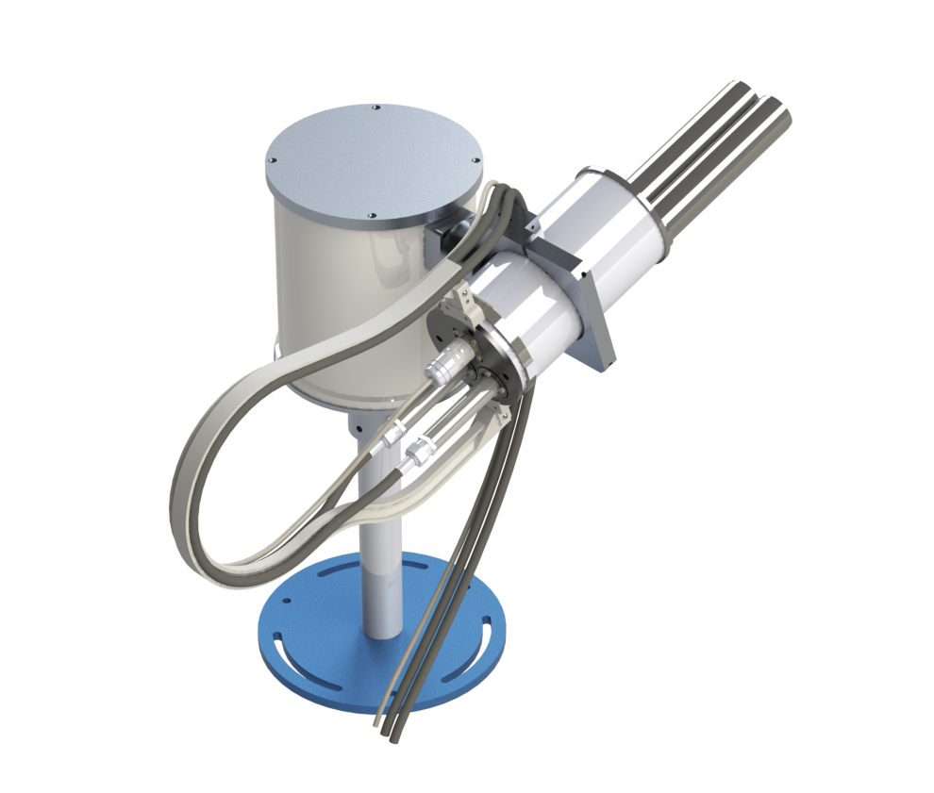
PGN instruments distribution (20 October 2020)
Currently in process of giving certificates to make instruments “official” (from red to green in map)

Slide 16

Other networks and emerging activities
JAMSTEC network over Japan and Asia https://ebcrpa.jamstec.go.jp/maxdoashp/
SKYNET (Chiba University) http://atmos3.cr.chiba-u.jp/skynet/pantnagar/pantnagar.html
BREDOM (Bremen University) http://www.iup.uni-bremen.de/doas/groundbased_data.htm
Various independent research groups
‘Distributed’ European Research Infrastructure with research facilities around the world
22 European countries / > 100 RPO have committed to ACTRIS
NDACC, Pandonia and SAOZ components in CREGARS topical center
Aerosols, Clouds and Trace gases Research Infrastructure
http://actris.net/

Slide 17
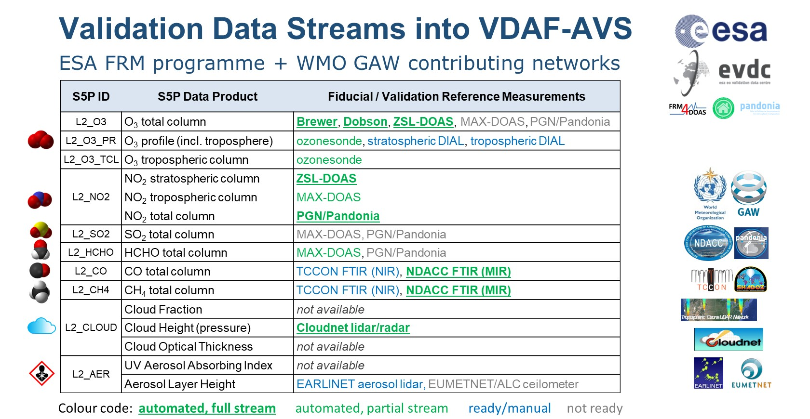
Role of UV-Vis reference networks in Sentinel-5p mission

Slide 18
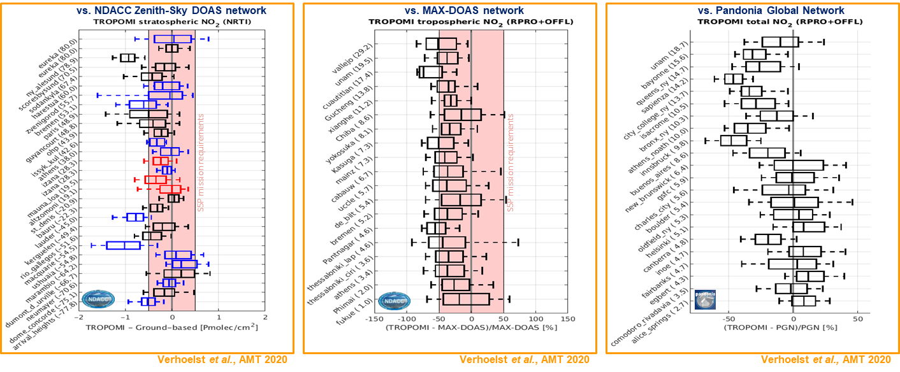
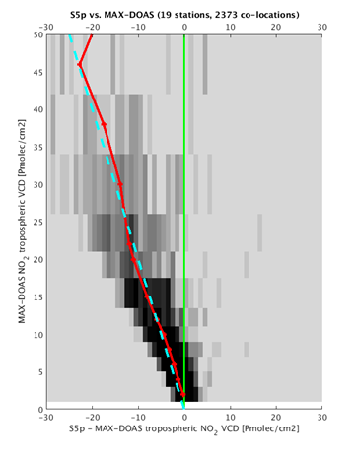
End-to-end validation of S-5p NO₂ product
Harmonised, end-to-end validation of TROPOMI NO2 retrieval: stratospheric, tropospheric and total NO2 vs. ZSL-DOAS, MAX-DOAS and PGN monitoring networks

Slide 19
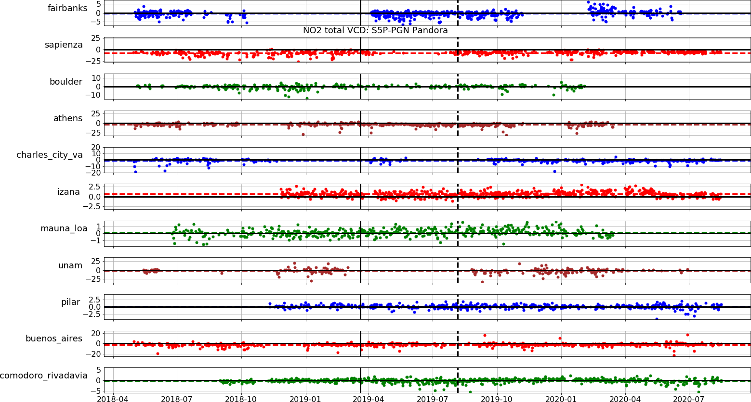
Operational monitoring of S-5p NO₂ stability
Processor version switch (v1.2 -> v1.3)

Slide 20
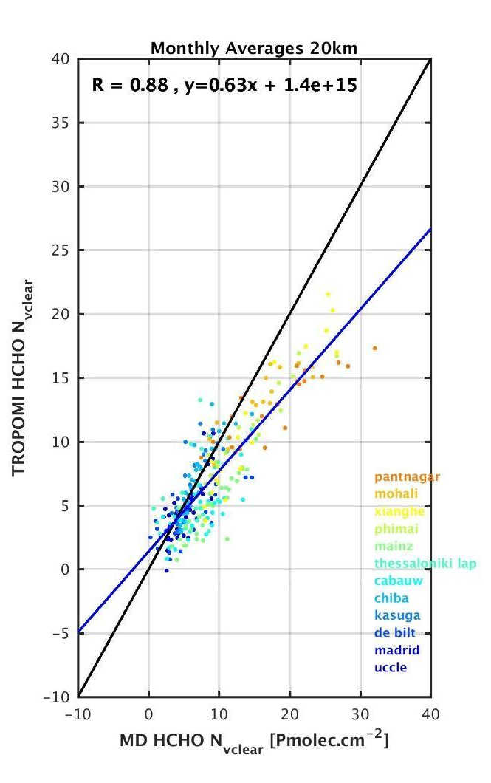
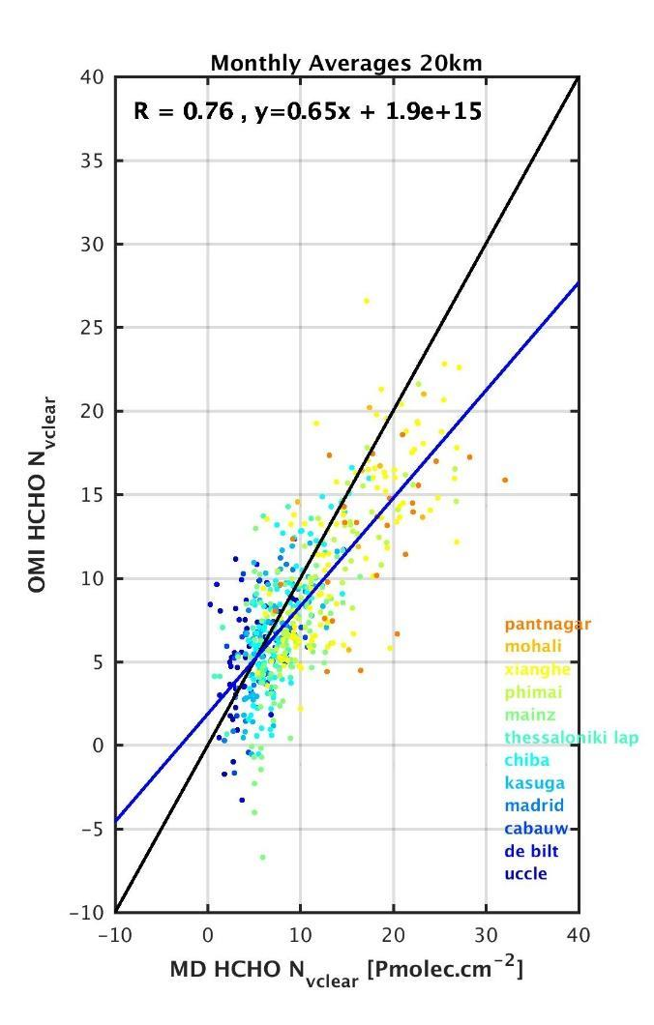
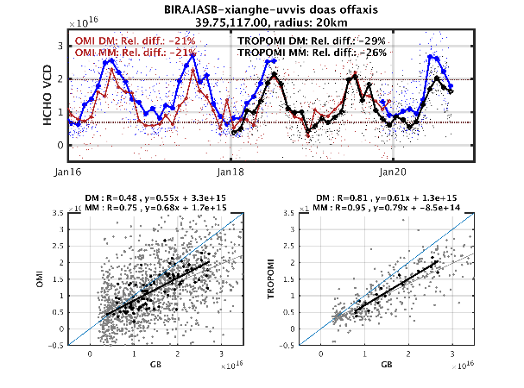
HCHO: scientific validation of S-5p and OMI products
TROPOMI
OMI
Courtesy I. De Smedt, BIRA

Slide 21
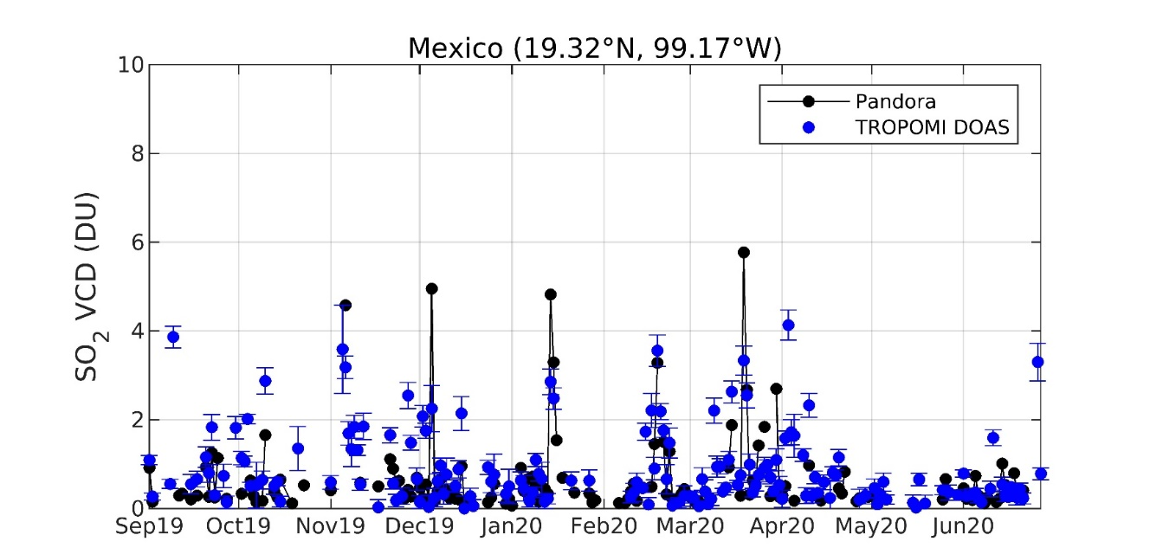
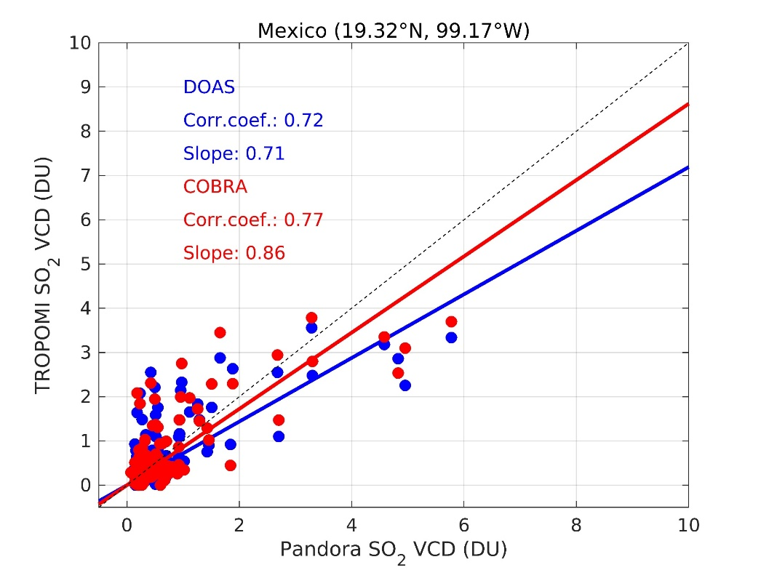
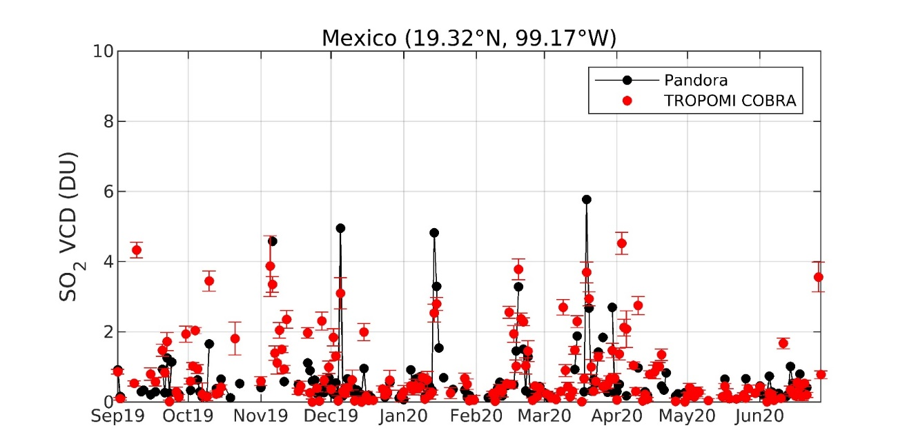
Testing a novel approach to S5p SO₂ retrieval using Pandora*
*non-operational Pandora data
S5p operational
COBRA = Covariance-Based Retrieval Algorithm
-> new approach to S5p SO₂ retrieval, alternative to DOAS
(Nicolas Theys, BIRA)
S5p COBRA

Slide 22
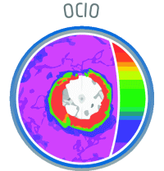
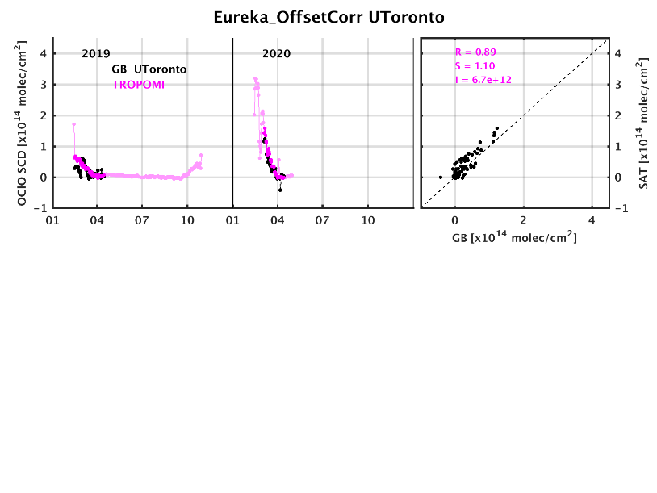
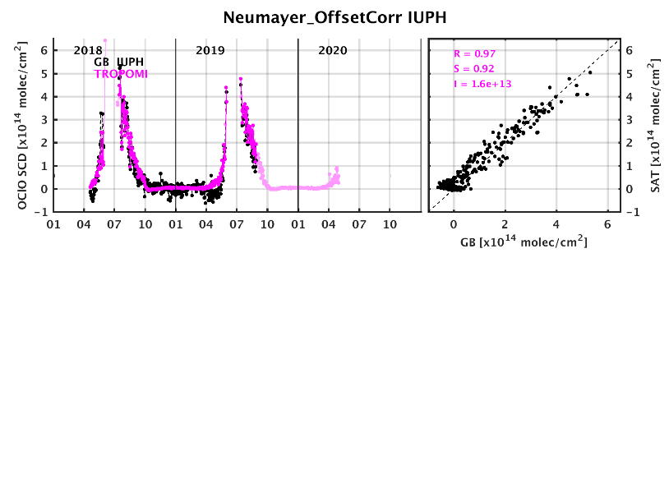
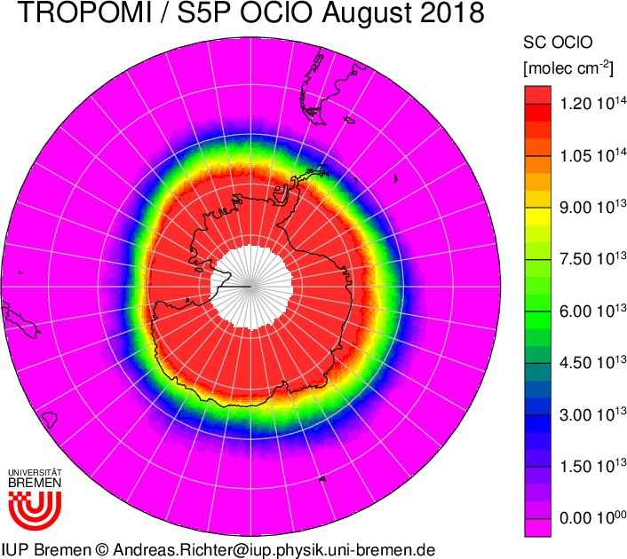
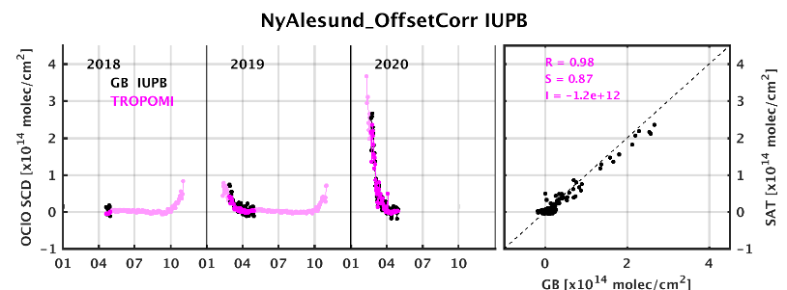
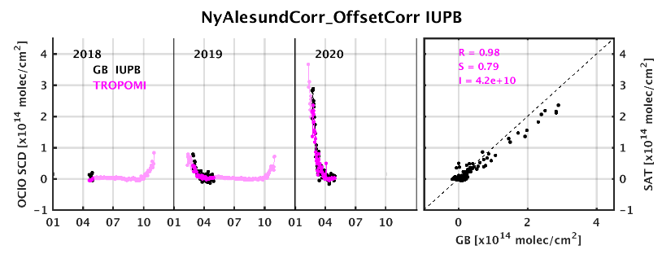
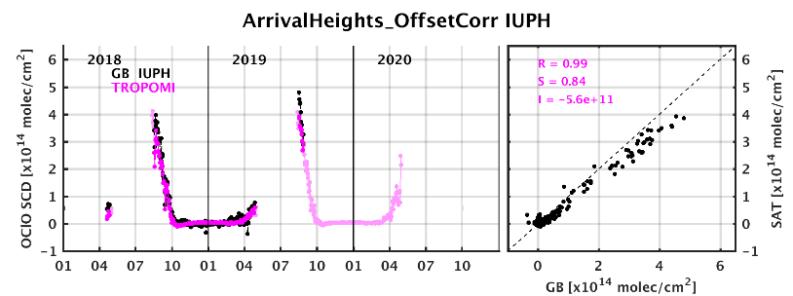
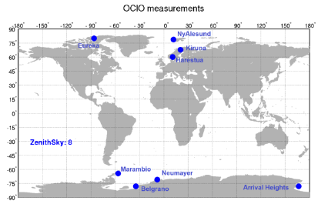
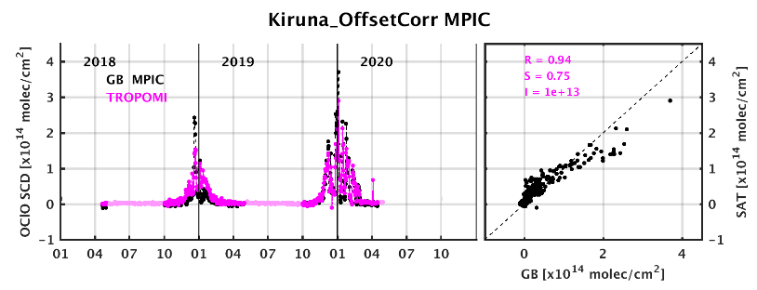
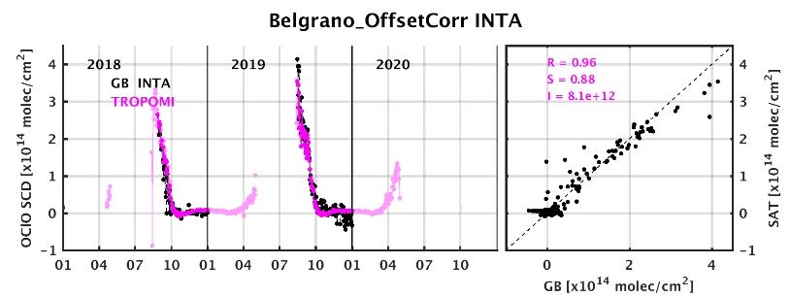

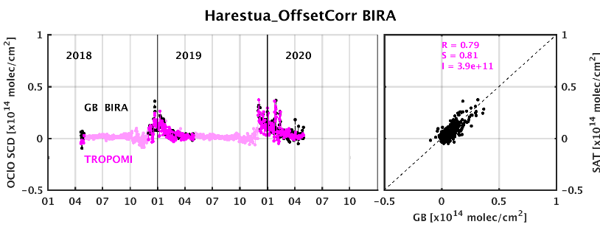
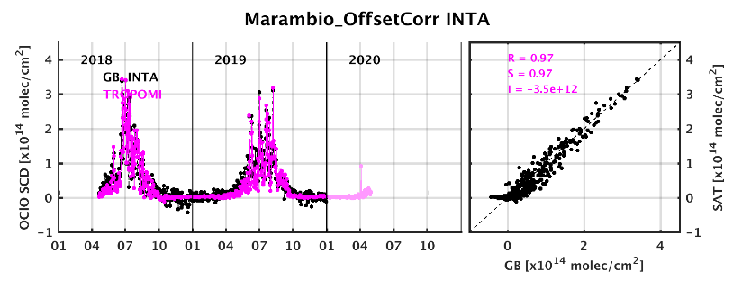
Validation of S5p innovation OClO product
S5p Innovation
Eureka (U. Toronto)
Eureka (U. Toronto)
Neumayer (IUPH)
Ny Alesund (IUPB)
Arrival Height (IUPH)
NDACC
Kiruna (MPIC)
Belgrano (INTA)
Harestua (BIRA-IASB)
Marambio (INTA)
G. Pinardi (BIRA-IASB)
A. Richter (IUPB)

Slide 23








MetOp-A & B GOME-2 glyoxal products
MAM
GOME-2A
GOME-2B
S5p Innovation

Slide 24
Issues and perspectives
Improve treatment of clouds and aerosols (reduce uncertainties)
Improve QA/QC methods
Network data consistency (→ central processing, interoperability)
Better understand spatial representativeness of measurements
New retrieval developments
  Additional species (glyoxal, SO2, HONO, …)
  Improve vertical profile inversion algorithms (O3, NO2, ….)
  Develop advanced methods to retrieve information on small-scale horizontal structures (NO2). Can be obtained making use of multi-angular, multi-wavelength MAX-DOAS measurements and/or deployment of city-scale networks of instruments (tomography)
Optimise global network deployment

Slide 25


Network deployment
S5p NO₂
Some key emission regions are not covered enough by current networks
S5p HCHO

Slide 26

Conclusion
Ground-based UV-VIS remote sensing is developing as an important contribution to Fiducial Reference Measurements (FRMs) for atmospheric composition
Implies activities around:
  Network development (PGN, NDACC, …)
  Calibration facilities and establishment of best practices
  Algorithms and product developments
  Central processing facilities
  Interoperability (common standards and data formats)
Supported by Space Agencies (ESA, NASA, KARI, …)
Integrated in ACTRIS research infrastructure
Key element of the geostationary satellite constellation of observing systems, started with OMPS, Sentinel-5p, EMI and GEMS (first AQ sensor on GEO)

