Slide 1
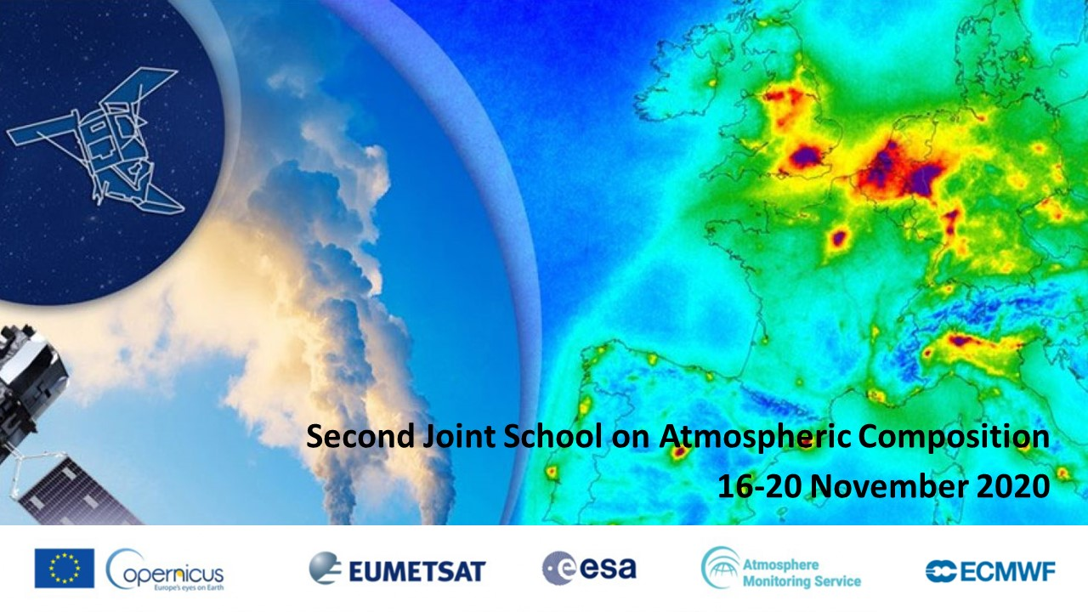
Christian Retscher, ESA

Slide 2
Welcome
Second joint training course on
atmospheric composition
Federico Fierli, EUMETSAT
Mark Parrington, ECMWF/CAMS
Christian Retscher, ESA
Chris Stewart, ECMWF
Rosa Ullucci, EUMETSAT
Julia Wagemann, EUMETSAT
https://atmostraining.info/

Slide 3
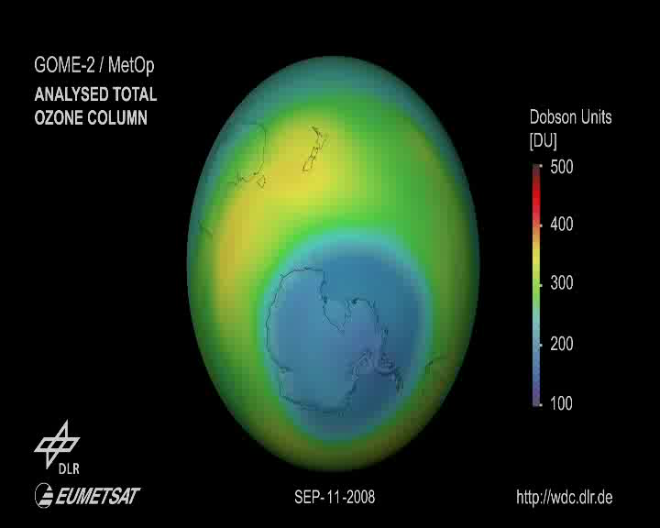
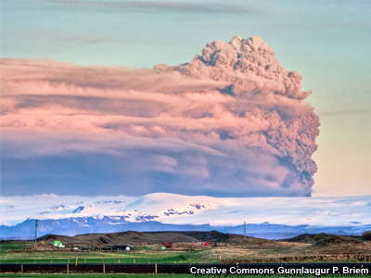
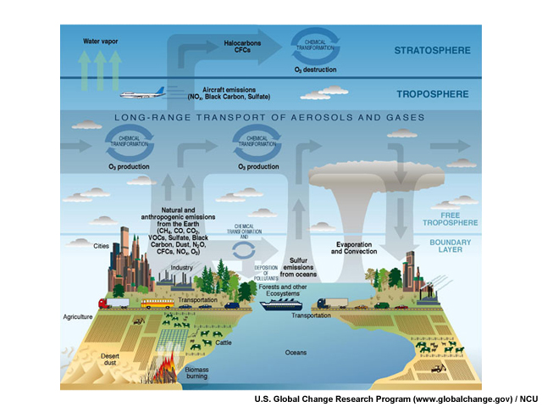
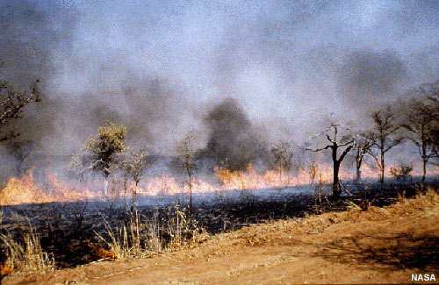
Aerosols and Volcanic Emissions
Stratospheric Ozone & Ozone Depletion Monitoring
Biomass Burning
Air Quality Monitoring & Forecasting

Slide 4

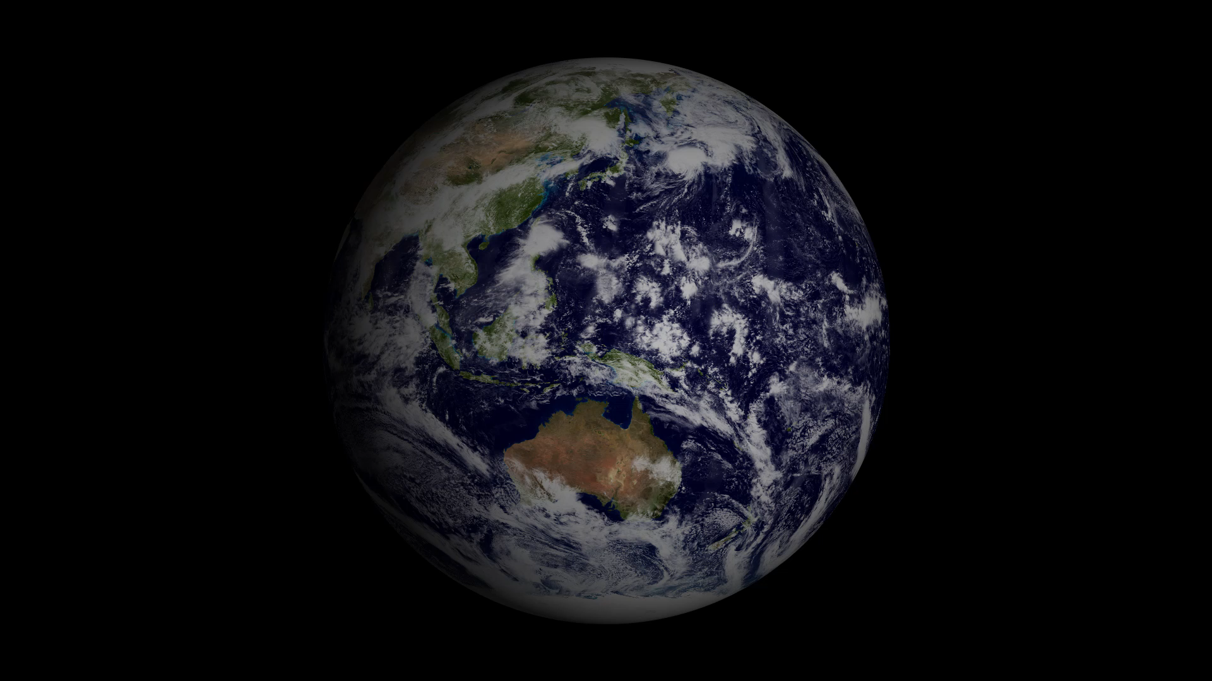





















ESA Earth Observation
“Taking the Pulse of our Planet”
ESA UNCLASSIFIED – For Official Use
European Space Agency
Notes:
One might think that visions of space exploration have little to do with Earth Observation activities
Nothing is less true
The Earth is the spaceship of our species and all life we know
In ESA EOP our mission is to feel the pulse of our planet – spaceship Earth
EO is crucial in understanding the current state of our planet and its future

Slide 5
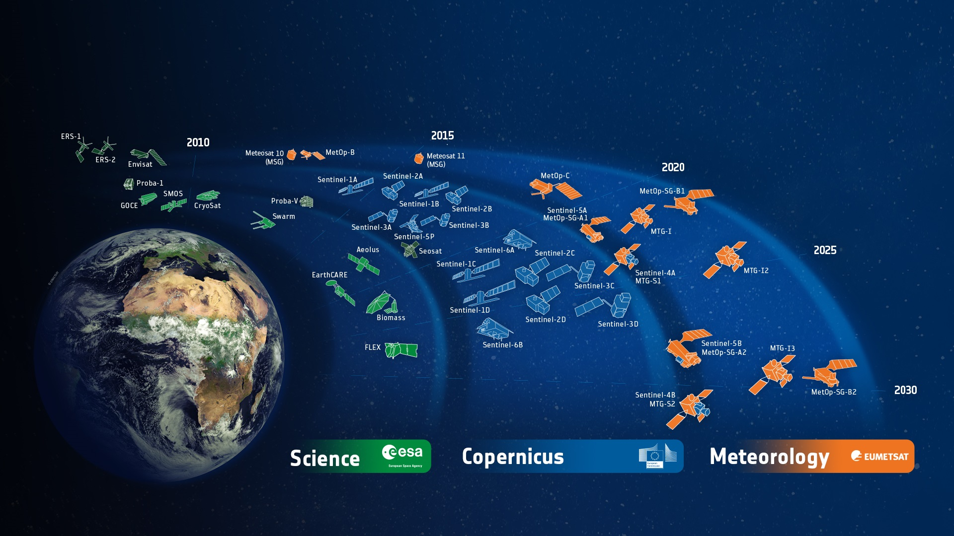
A successful Track-Record
ESA-Developed Earth Observation Missions
ESA UNCLASSIFIED – For Official Use
European Space Agency
Notes:
D/EOP has three main lines of activities: Earth Science, Copernicus and Meteorology
Since the latest launch of Aeolus on 22 Aug. 2017, we have 25 satellites in development and 15 satellites in operation.

Slide 6
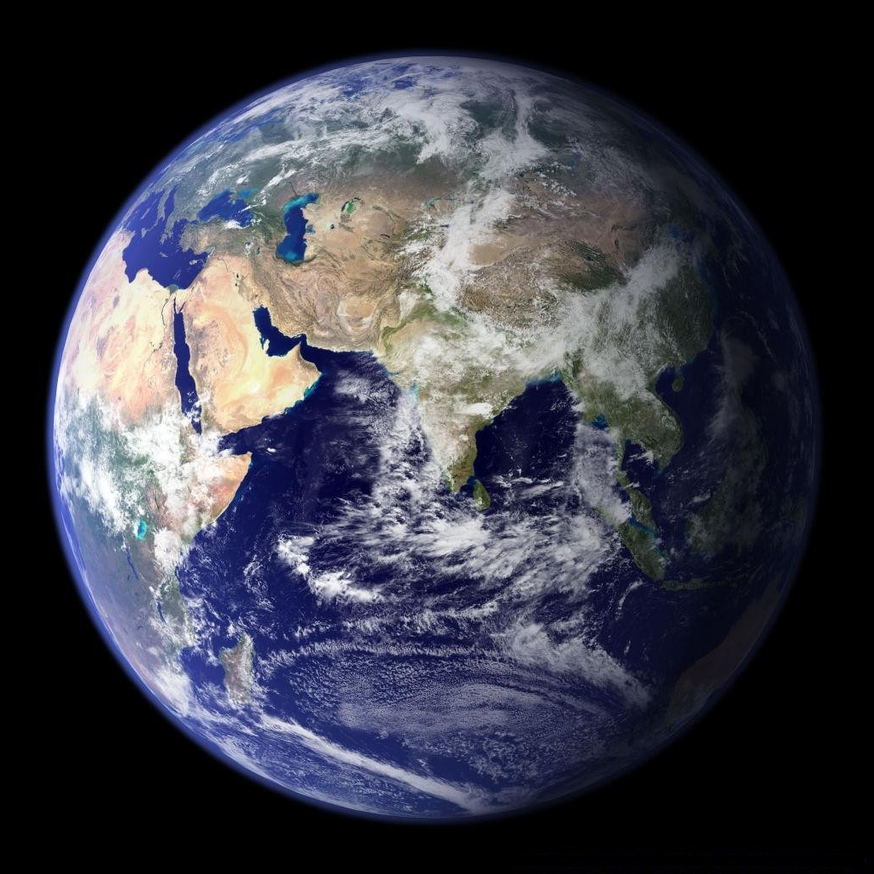
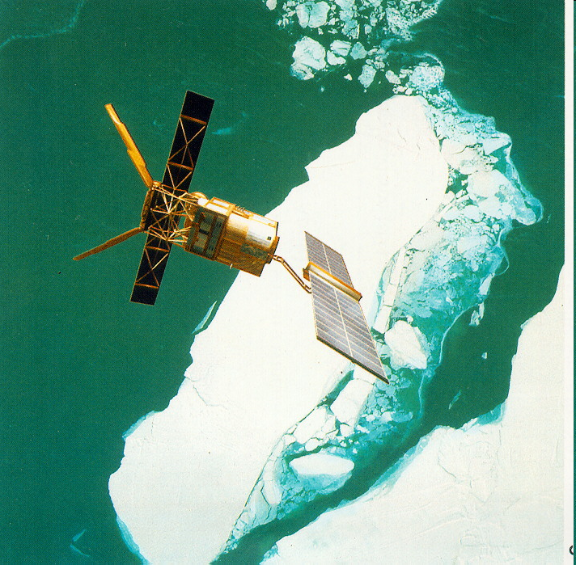
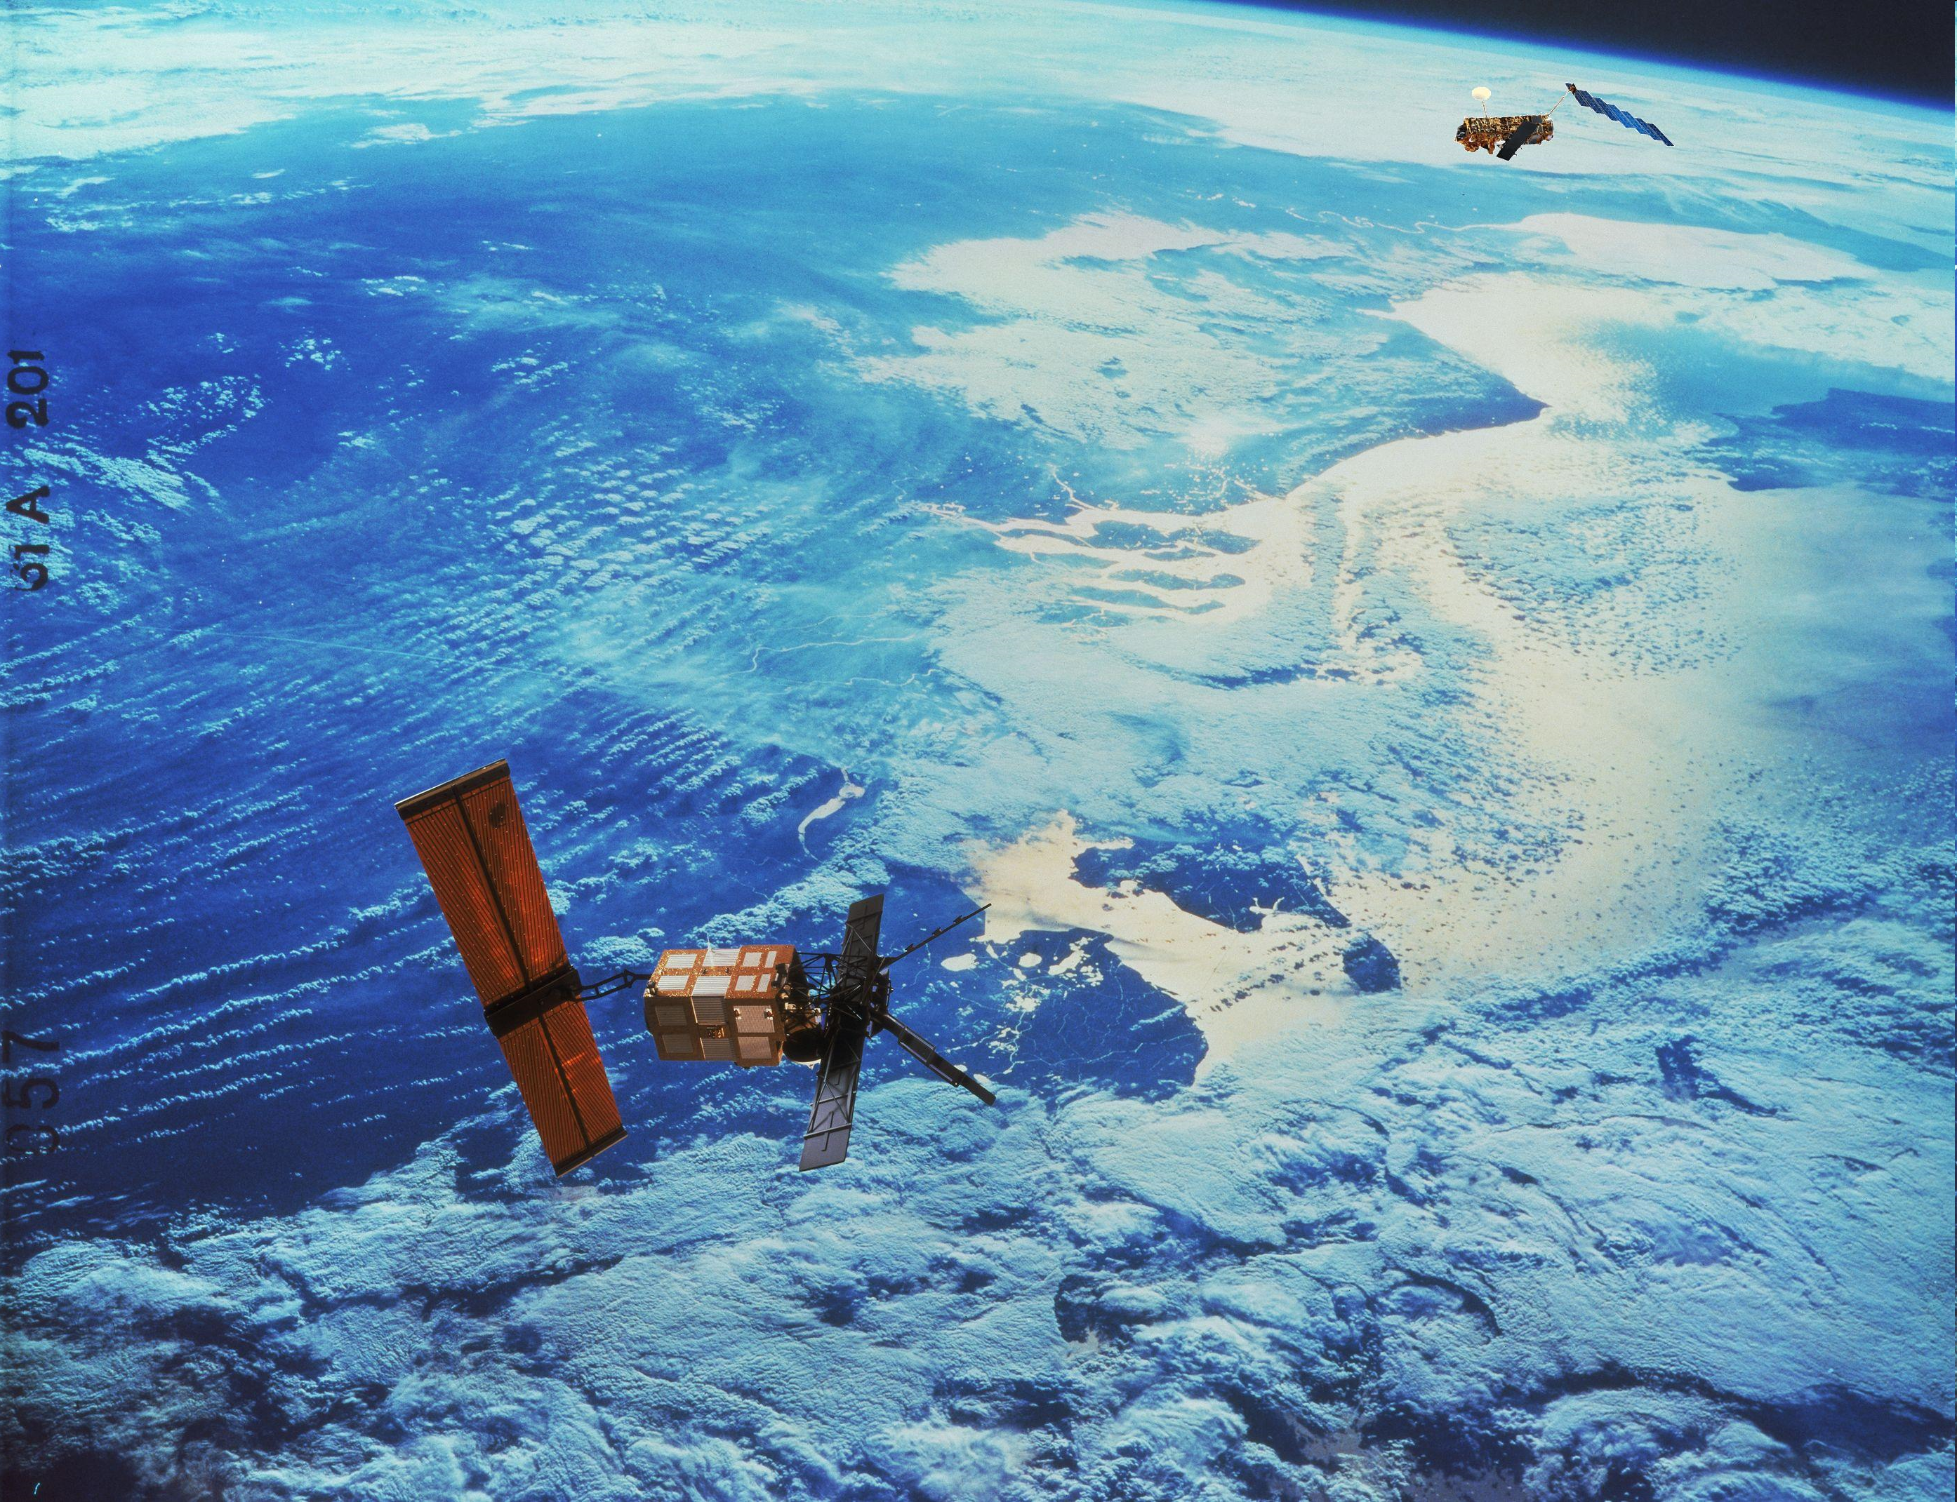
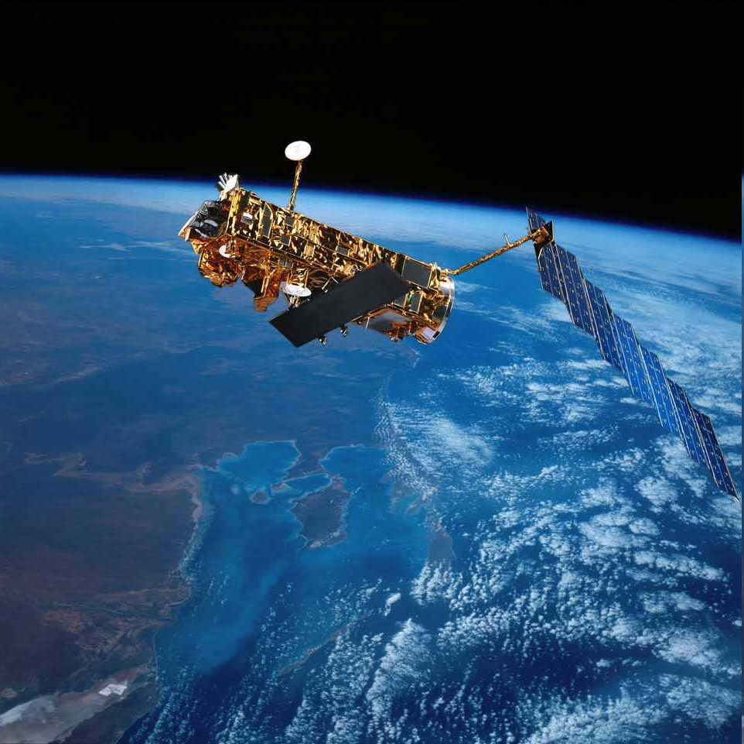
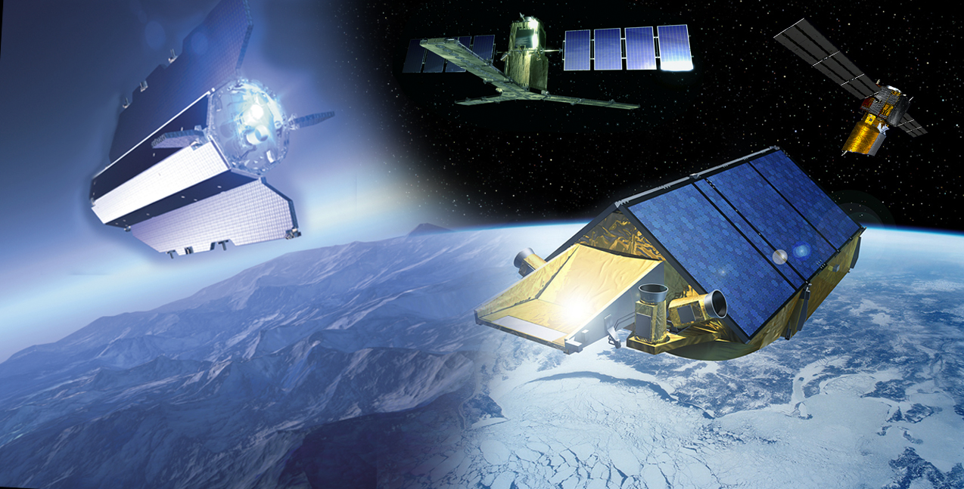
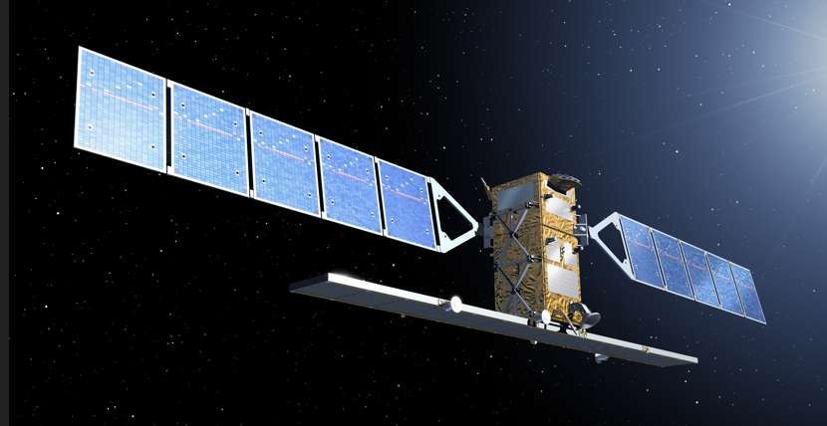
1991 - 2000
1995 - 2011
2002 – 2012
2009+
2014+
ESA EO Missions
15 satellites in operations
25 satellite under development
EO data available since 1991 (ERS-1)
~ 40 ESA Third Party Missions
(e.g. OMI, OSIRIS, ACE)

Slide 7
What is Copernicus ?
Observations
Infrastructure
Services
Notes:
Define the blocks and mention green lights: data are for free

Slide 8
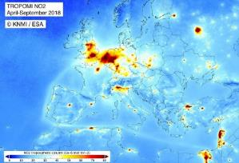
From data to applications
Observations are essential, but require care:
Gaps in space and time
Observed quantities may not be directly relevant
→ Is that what I need ?
Complex and numerous
Copernicus improves usability:
Integrate observations
satellite and non satellite, models
Understand User’s needs
Generate added value products
Provide Guidance
Ensure Quality and usability
Notes:
Describe the complete flow from observations to the service – CAMS in this case – to the development of applications by the users - you

Slide 9
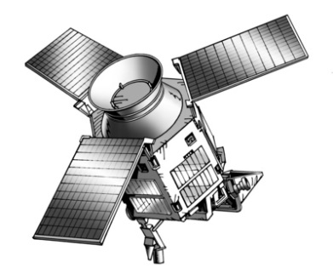
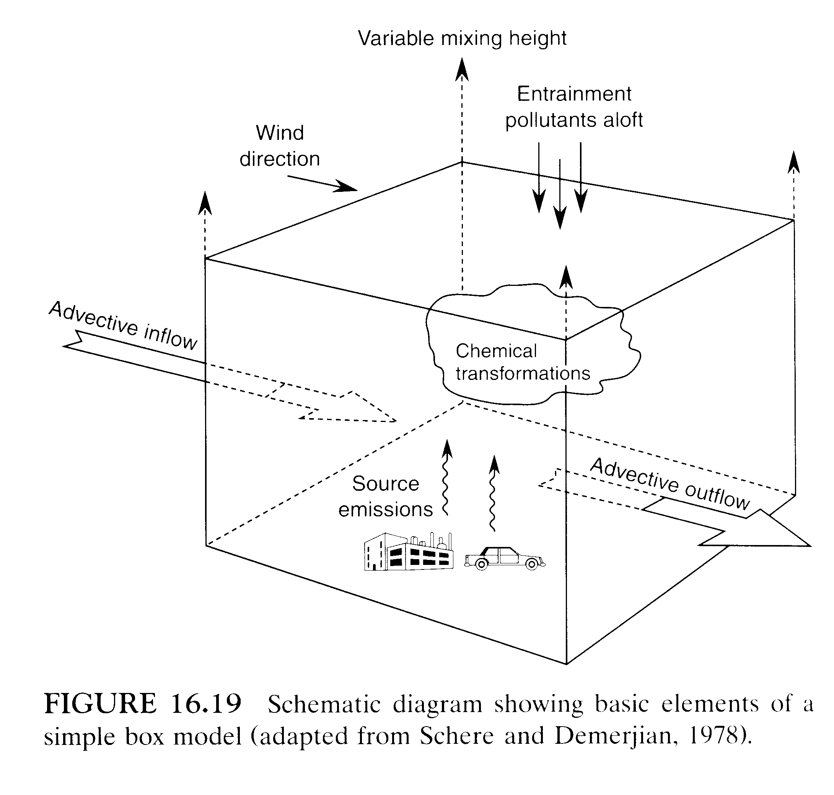
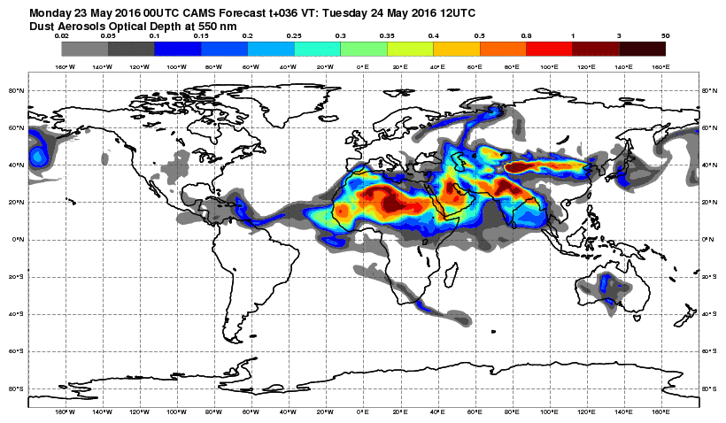
Modelling: the CAMS global system
Observations
The model itself (IFS):
ECMWF 4D-var and meteorology (T511)
Integrated chemistry and aerosol representation
Integrated natural biosphere model
Dynamical emissions
Emissions inventories

Slide 10
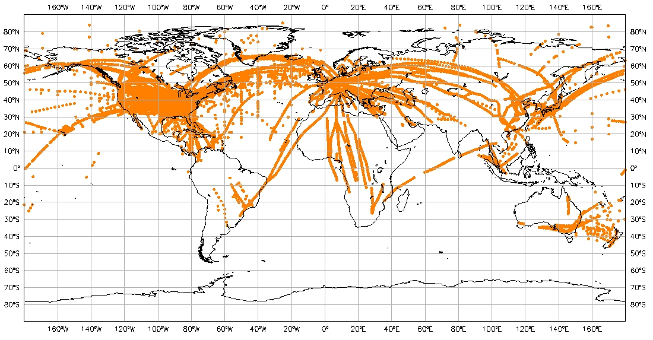
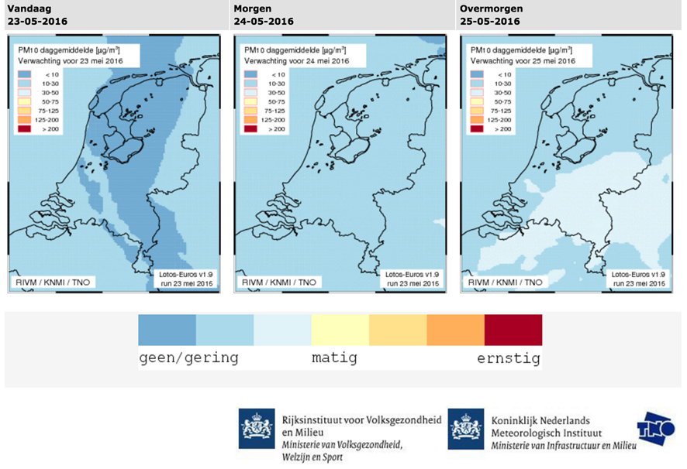
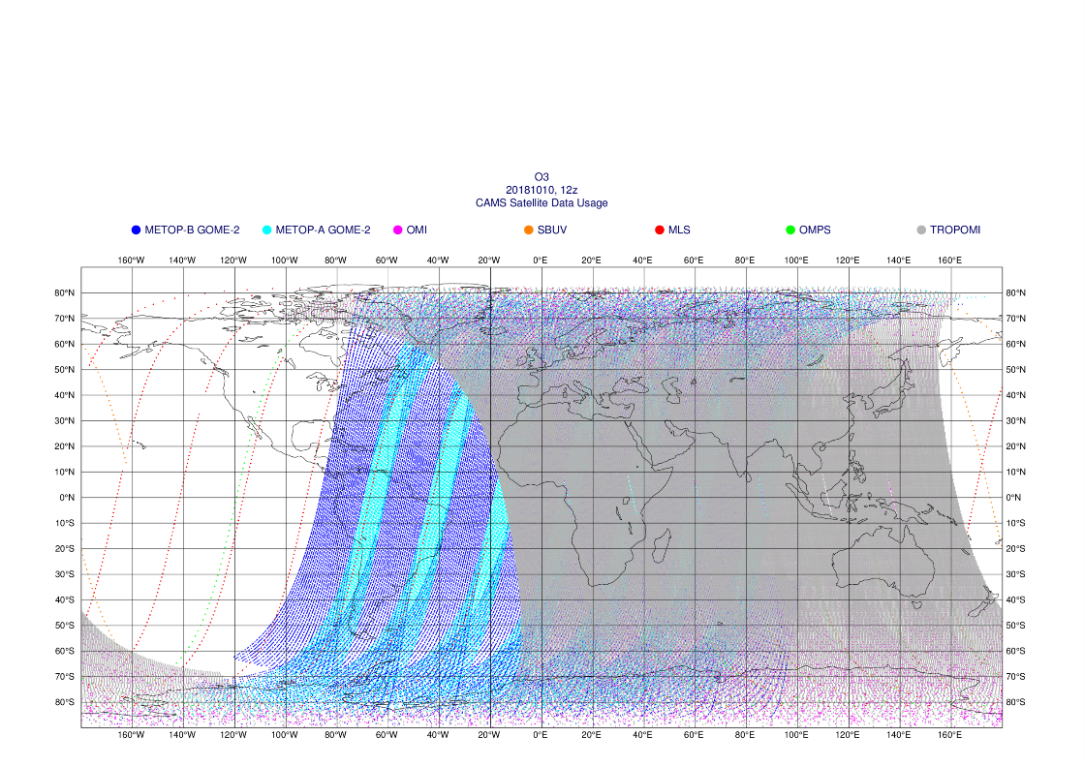
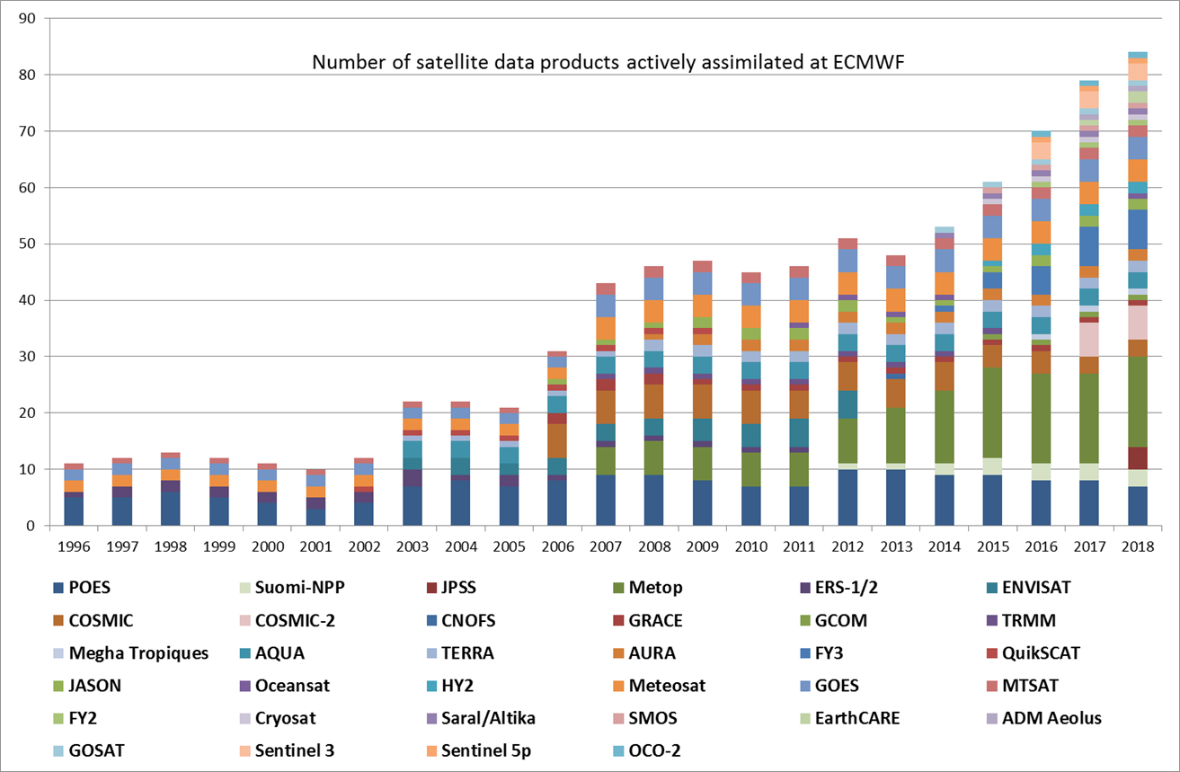
Let CAMS do the heavy weight lifting
…and public/commercial users run the last mile. All Copernicus data are fully open & free of charge.

Slide 11
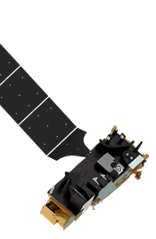
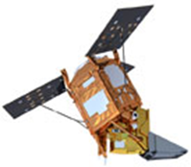
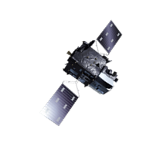
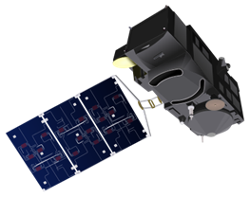
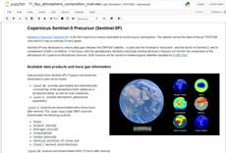
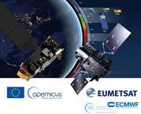


Training / communication / outreach
Develop competences and foster applications
Training in many forms (also on-line)
Explore advanced applications
Engage experts
  Workshop, Consultation
Communicate
  Podcast, MOOCs

Slide 12
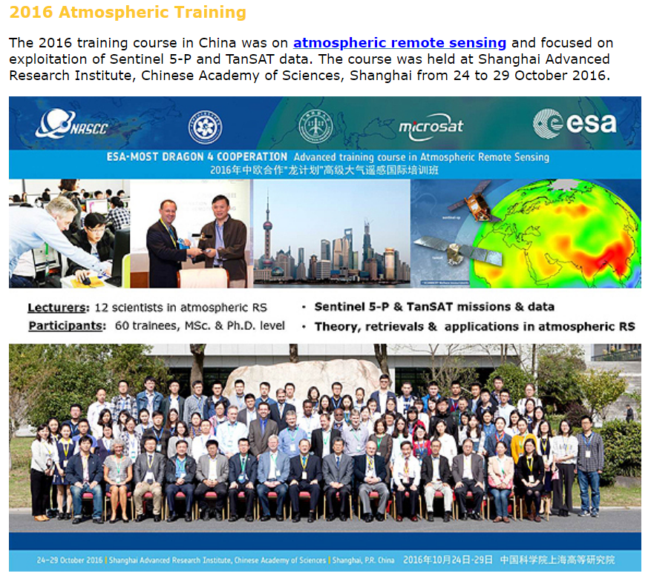
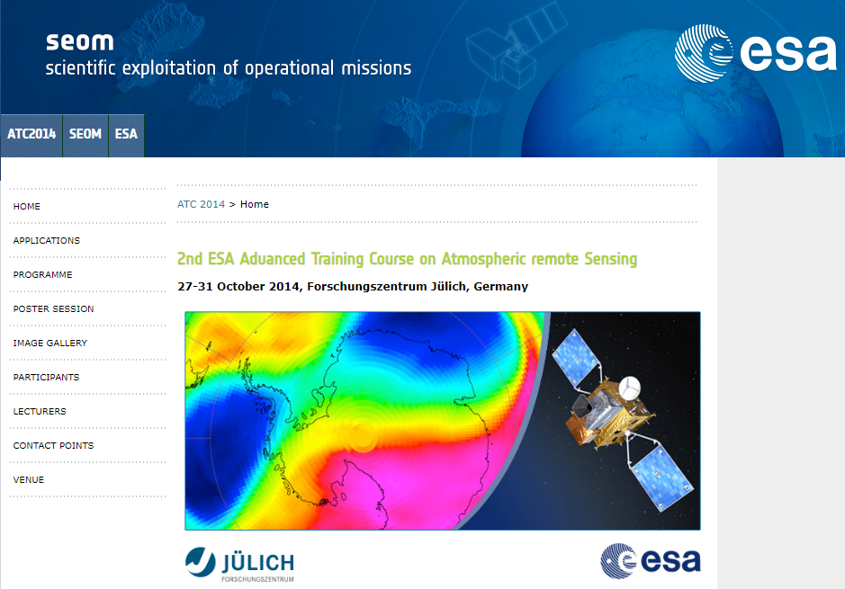
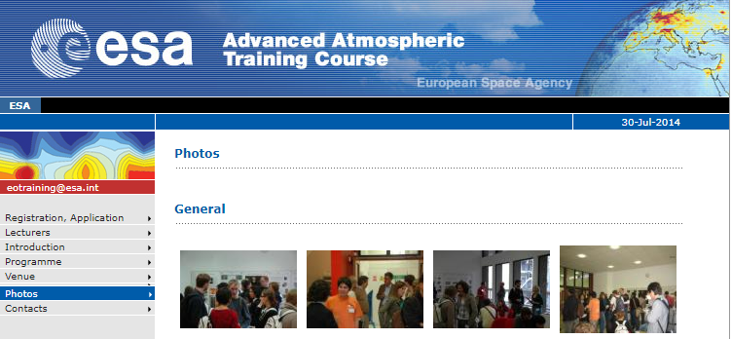
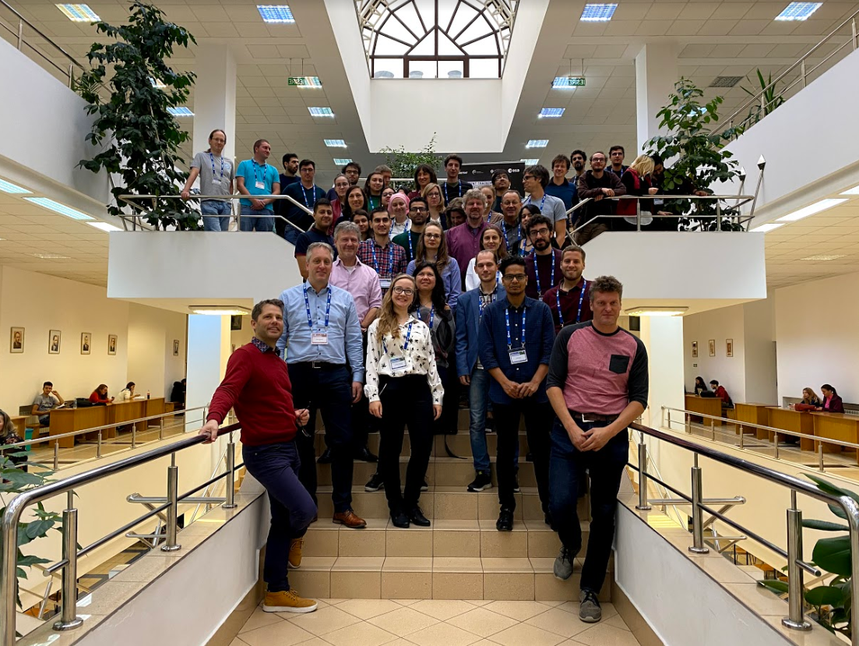
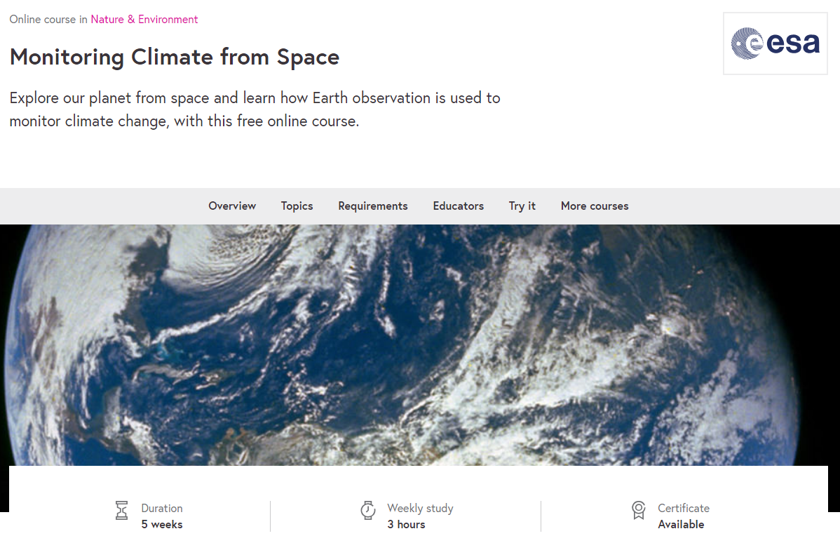
History on related activities
Successful 1st joint
training course

Slide 13
Course schedule
16 – 20 November 2020
Morning session:
10h00 - 12h45 CET
(streamed live on youtube)
Afternoon session:
14h00 - 16h30 CET
Course Format
Webinars with keynote speakers;
Open discussions;
Step-by-step interactive data discovery;
Team projects design and development.

Slide 14
Lecturers and Instructors
J. Barre, ECMWF
A. Cede, LUFTBLICK
C. Clerbaux, LATMOS-CNRS
A. Colette, INERIS
H. Eskes, KNMI
F. Fierli, EUMETSAT
A. Inness, ECMWF
P. Laj, Université-Grenoble-Alpes
L. Mona, CNR-IMAA
R. Munro, EUMETSAT
S. Niemeijer, S&T
M. Parrington, ECMWF
H. Petetin, BSC
V.-H. Peuch, ECMWF
M. Razinger, ECMWF
C. Retscher, ESA
A. Richter, Uni Bremen
A.M. Sundstroem, FMI
M. Van Roozendael, BIRA-IASB
A. Voulgarakis, Imp. College London – Univ. of Crete
J. Wagemann, EUMETSAT / MEEO
C. Zehner, ESA
Thanks to all giving lectures and leading practical sessions!

Slide 15
Specific Goals
Present the state-of-the-art in air quality monitoring and modelling;
Provide an overview of the different observations, tools and applications;
Enhance the capacity on data access and analysis of existing and new satellite data products and monitoring services;
Foster participants driven personal and team projects.
Themes
Air quality observations from satellites and in-situ platforms;
Atmospheric modelling;
Data assimilation;
Comparison and combined use of satellite data;
Software and programming targeted on air quality applications.

Slide 16
Prerequisites, preparation phase,
working towards course output
No specific prerequisites are requested on coding;
Participants were advised to get familiar with data in order to maximise the learning success;
Gradual exposure to themes and coding;
Work in groups;
Shape short projects;
Final project presentation.

Slide 17
Zoom sessions, Sli.do Q/A
… [please fill on the HOWTO]

Slide 18
Outlook
Other related training courses, e.g. EGU2021
ACT2021
…
Useful links/Feedback
…

Slide 19
Enjoy
Christian Retscher, ESA

