Slide 1
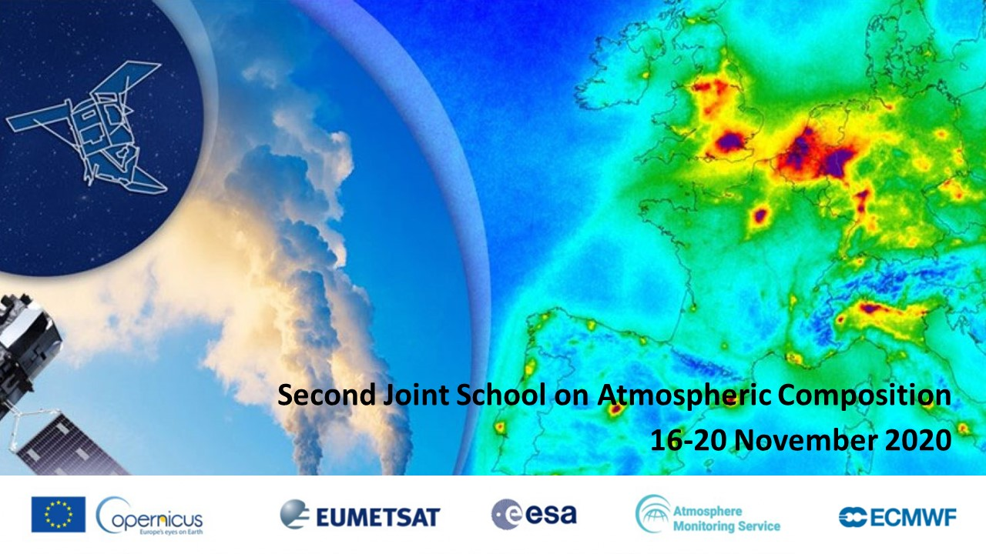
Global atmospheric models (2)
Examples from the CAMS global system

Slide 2
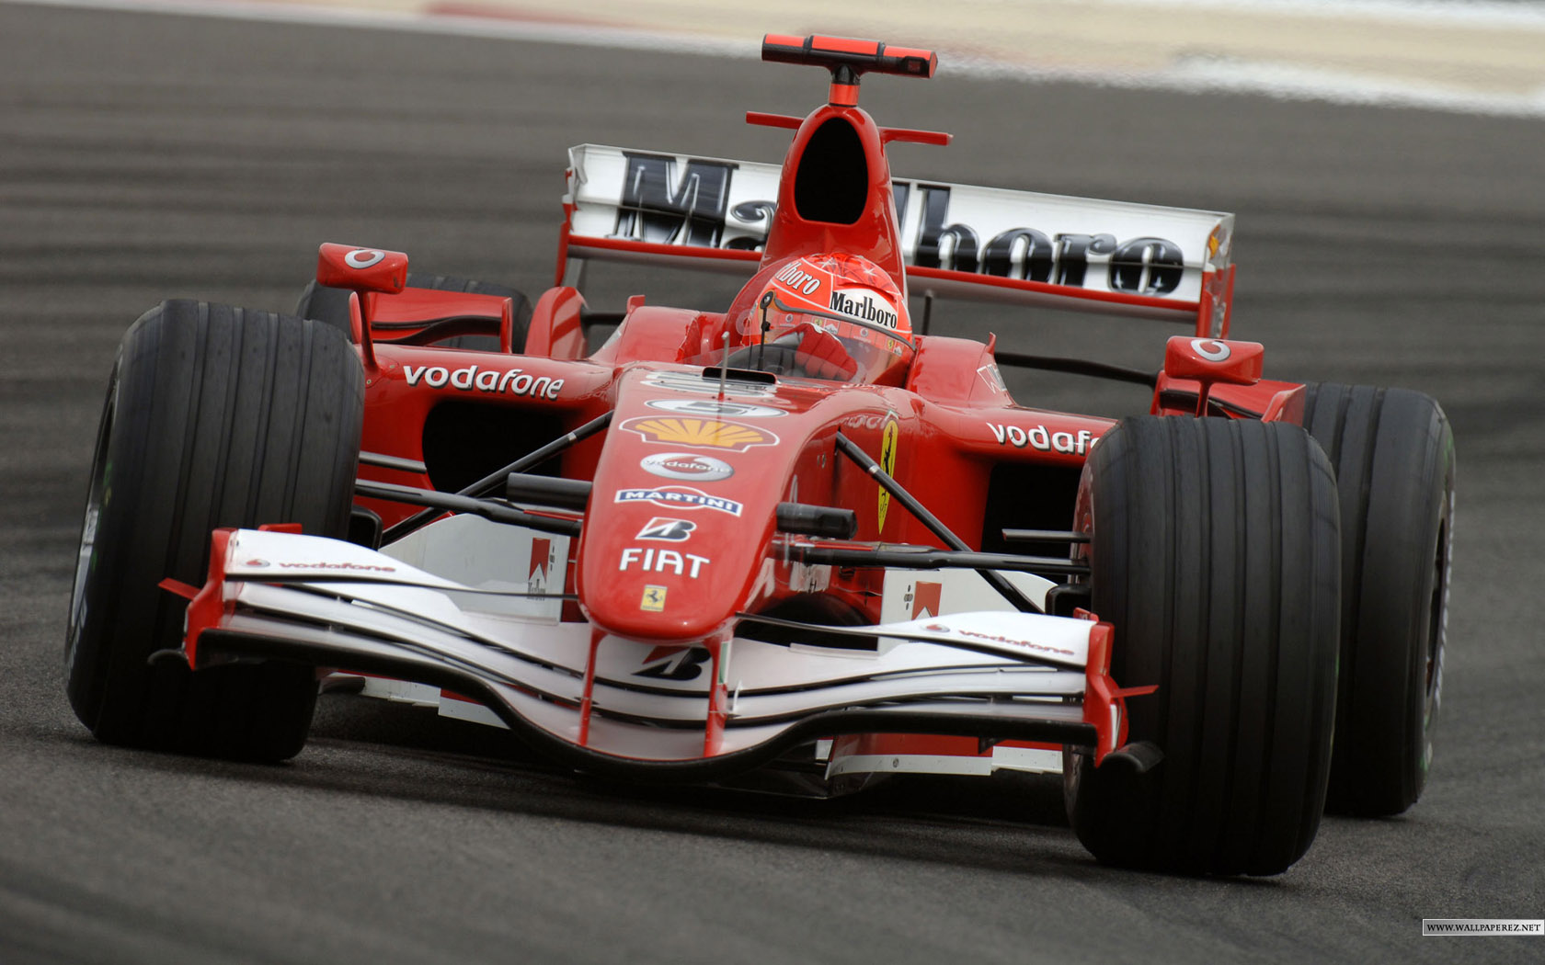
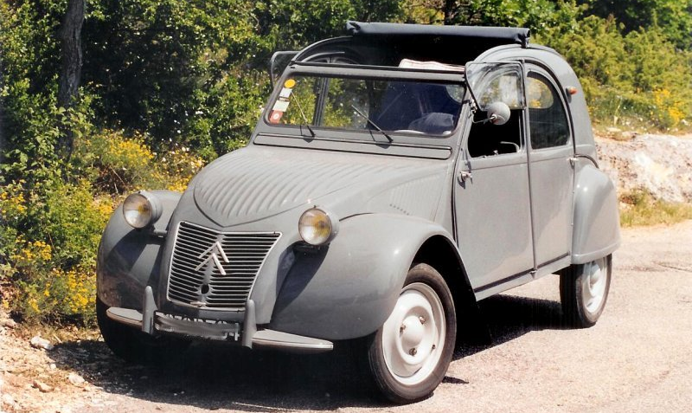
THESE ARE DIFFERENT “MODELS”
Atmospheric models have a common general purpose and share some aspects, but the same concept covers very different realities.
Some model platforms are for general consumption with appropriate documentation and kit to get you on the road once you have your license, others are one-of-a-kind and are developed and maintained for specific high-end objectives.
This drives a wide design choices and explain the variety of several dozens of global and regional models being used in the world today.

Slide 3
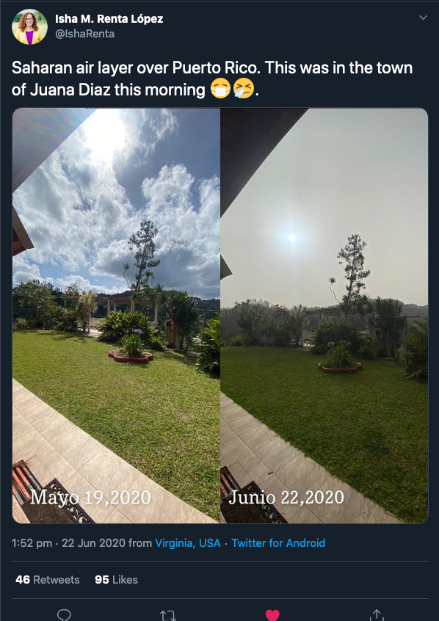
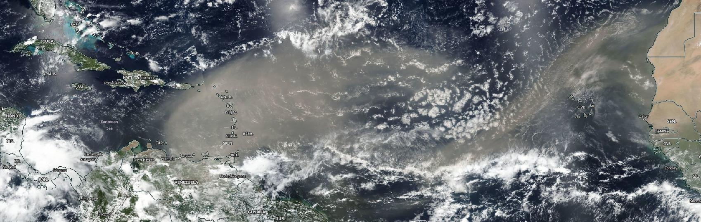
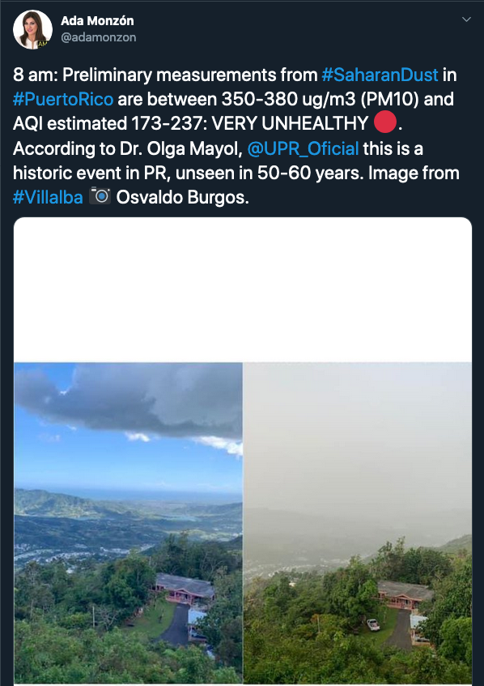
WHY METEOROLOGICAL ASPECTS ARE ESSENTIAL?
Puerto Rico
NASA/NOAA Suomi-NPP VIIRS imagery for 21 June 2020
The “Godzilla” dust plume case (06/2020)

Slide 4
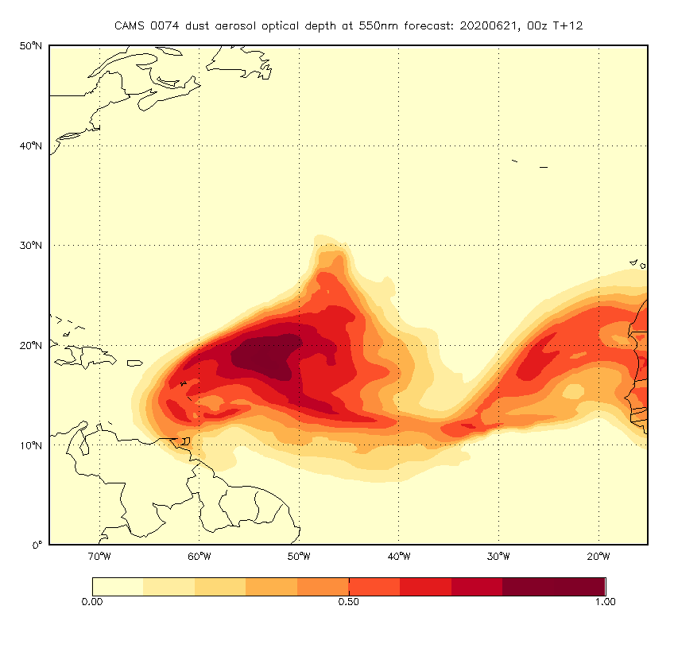
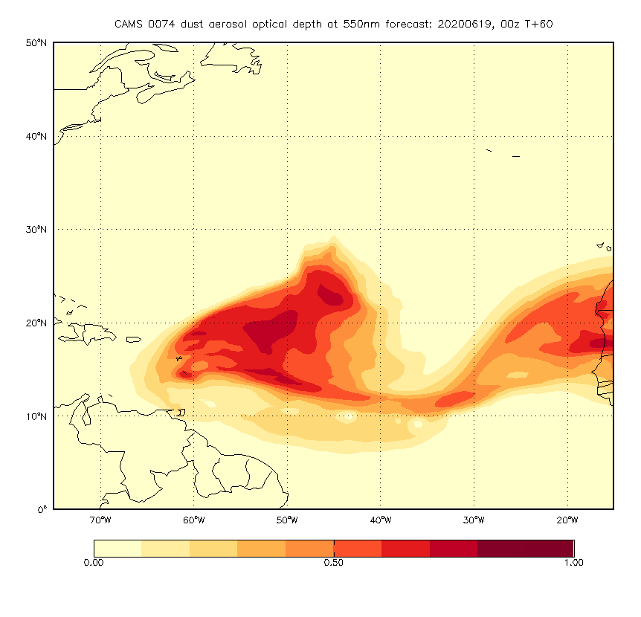
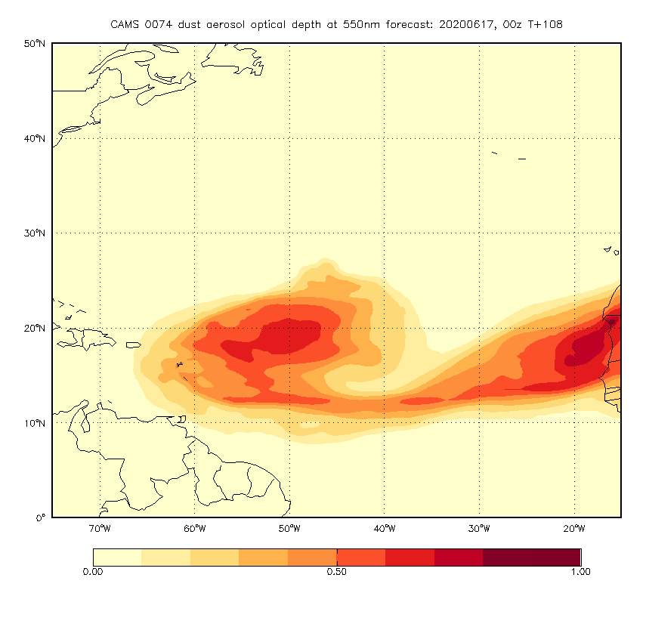
NOT ONLY MONITORING, BUT FORECASTS ARE NEEDED AS WELL
Puerto Rico
ECMWF IFS COMPO (47r1) – CAMS operational configuration
+12h forecast
+60h forecast
+108h forecast

Slide 5
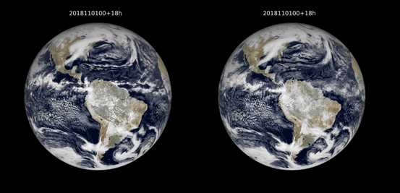
IFS: GLOBAL NUMERICAL WEATHER PREDICTION MODEL AT ITS BEST
5-10 years: 1.4 km, 5km ensembles…
Today: 9 km
ECMWF/IFS - 3-hourly accumulated radiative fluxes at the top of the atmosphere
(Wedi et al, 2020)

Slide 6
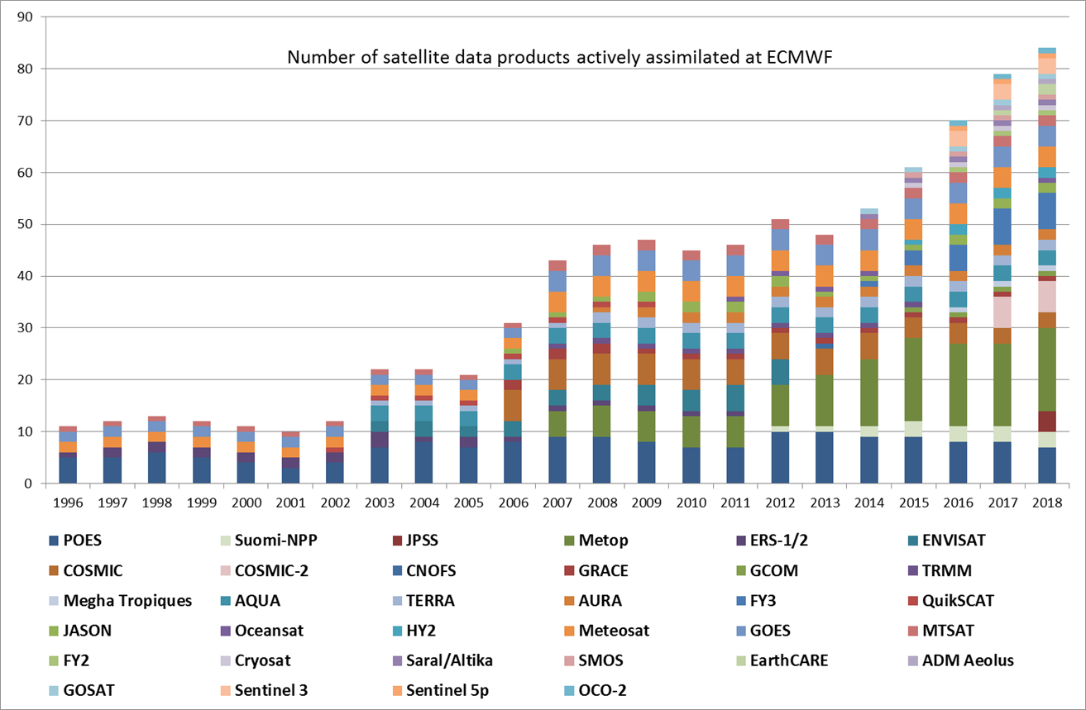
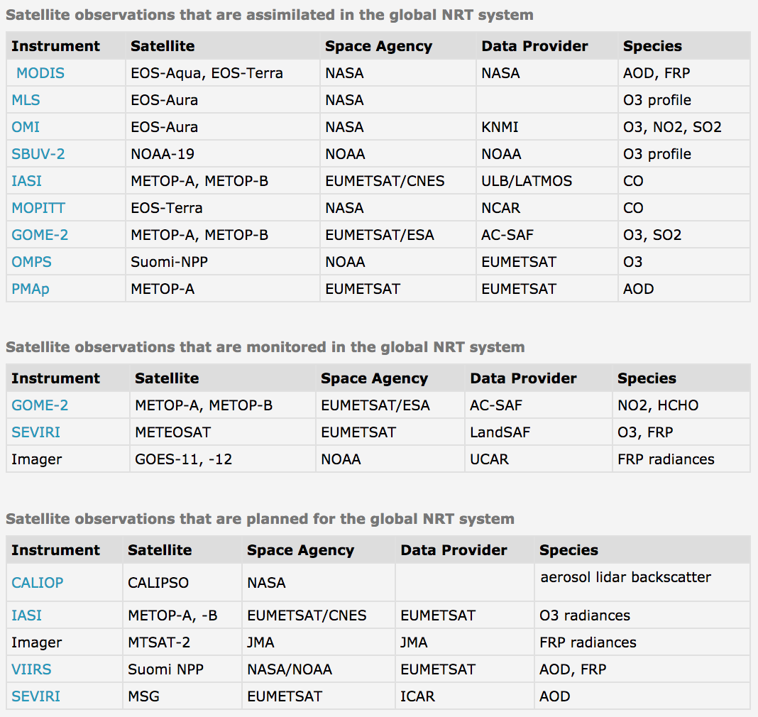
OVER 80 SATELLITE DATA STREAMS USED DAILY FOR CAMS OPERATIONS
https://atmosphere.copernicus.eu/cams-input-data
See presentations on data assimilation (tomorrow)
Notes:
This is a considerable effort: doing it once for Europe, fully operationally avoids duplication and/or degraded solutions

Slide 7
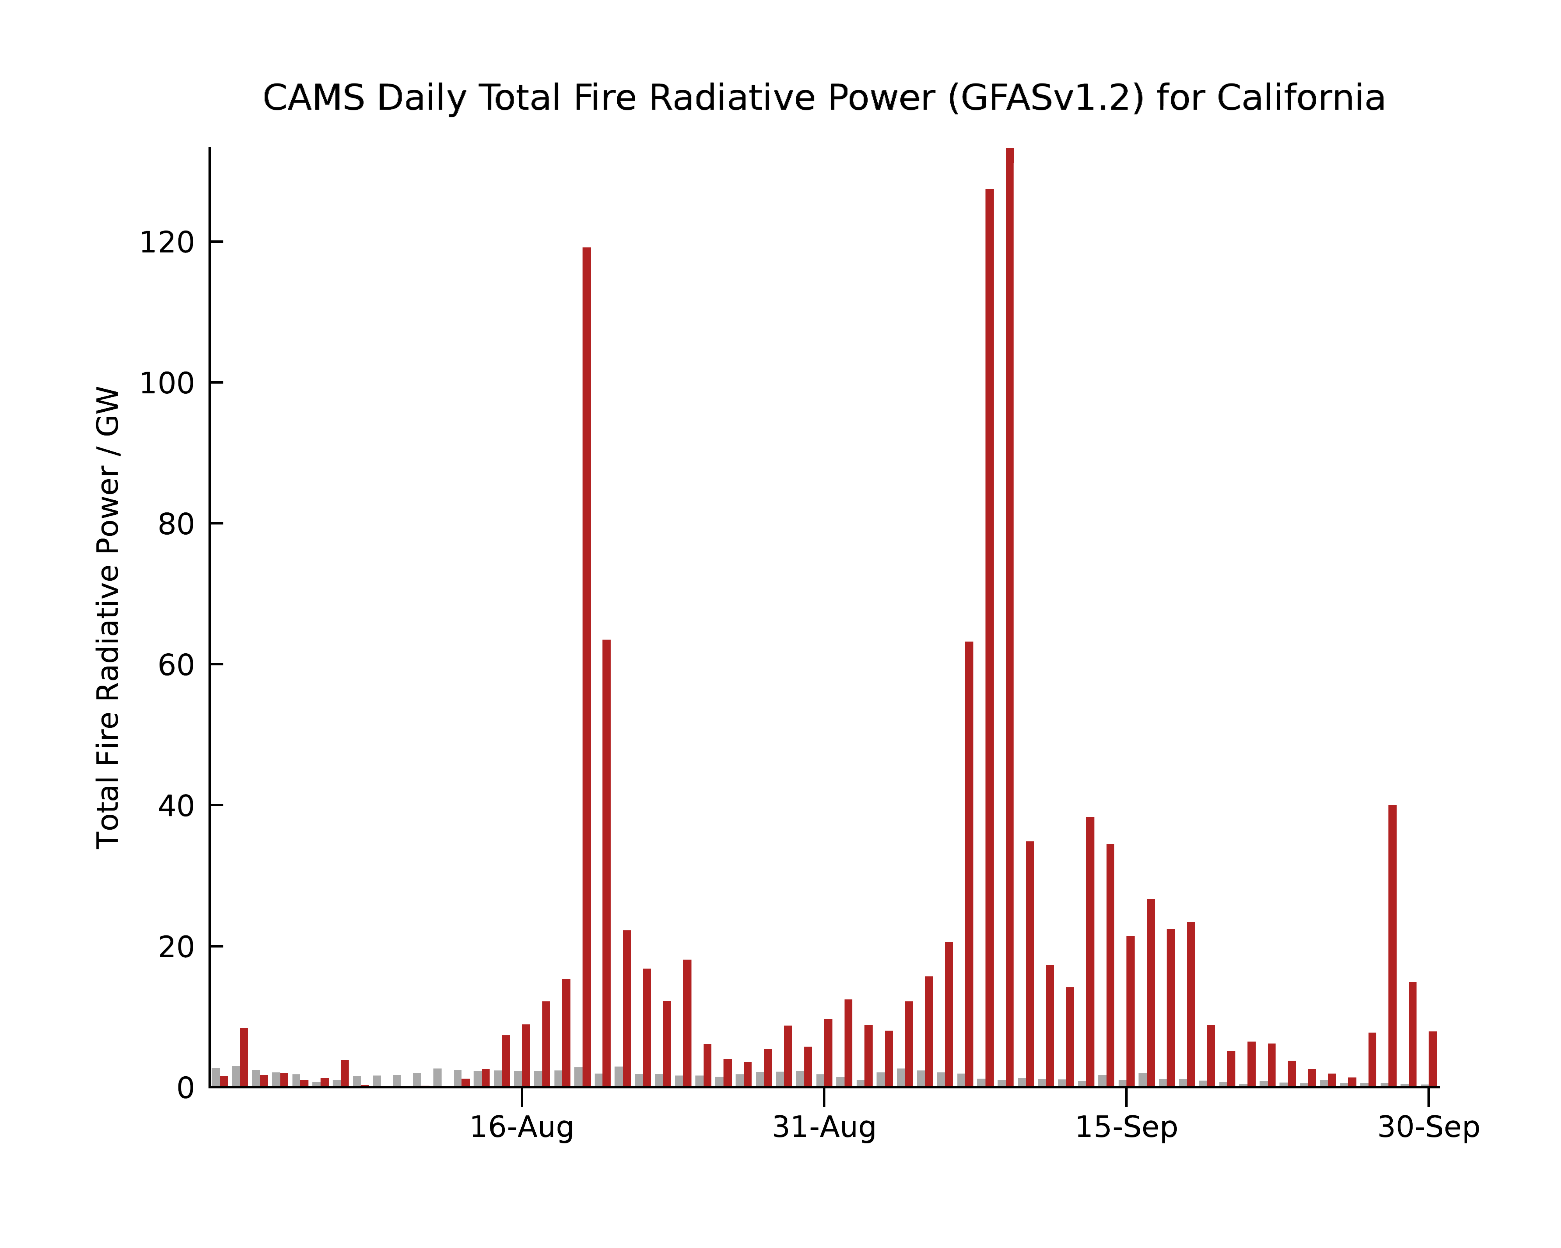
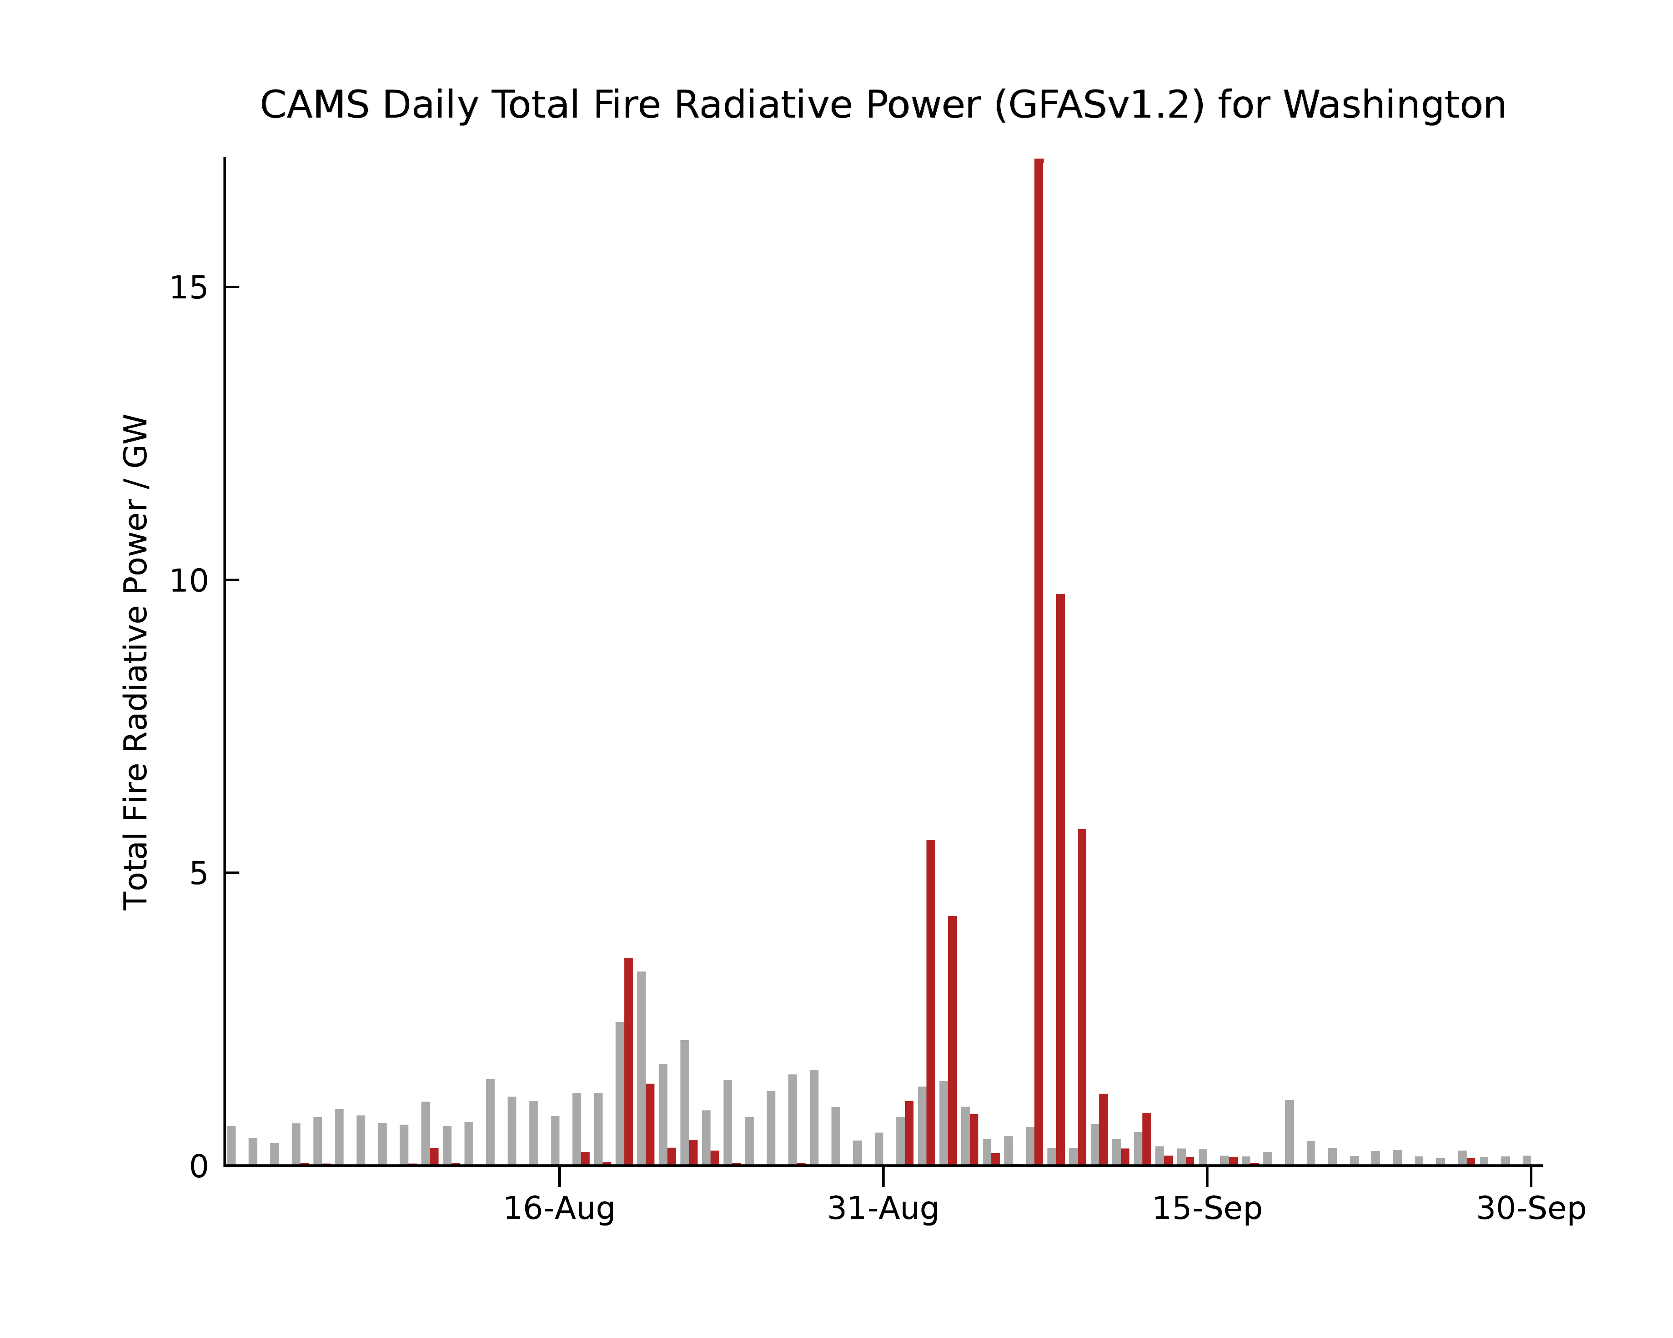
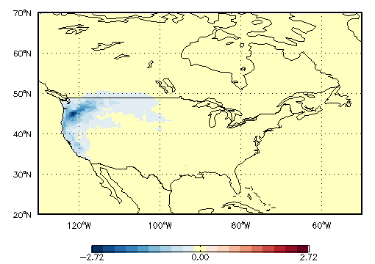
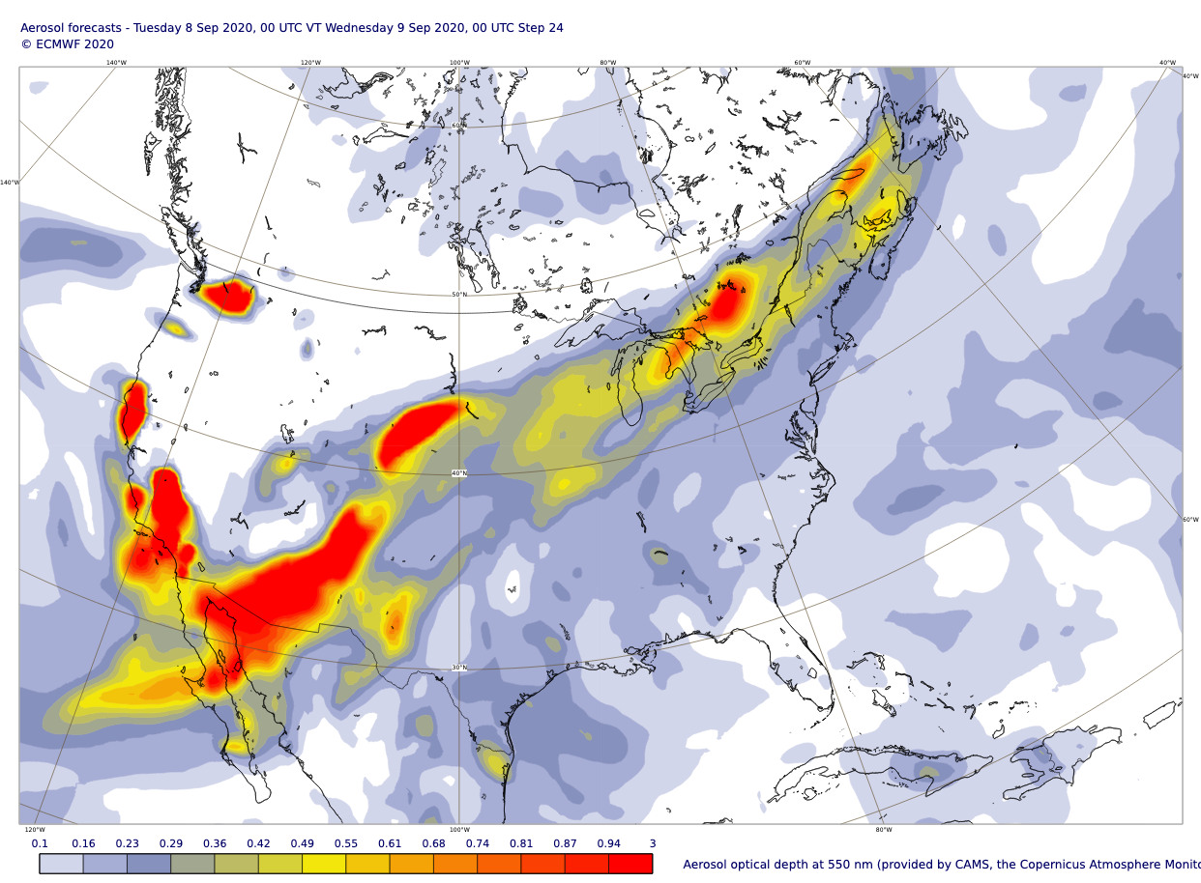

WHY EMBEDDING A COMPOSITION MODEL IN A NWP MODEL?
Temperature difference (K) between a run with fixed (climatological) aerosol and a run with interactive aerosol in average for 1-8 September 2020.

Slide 8
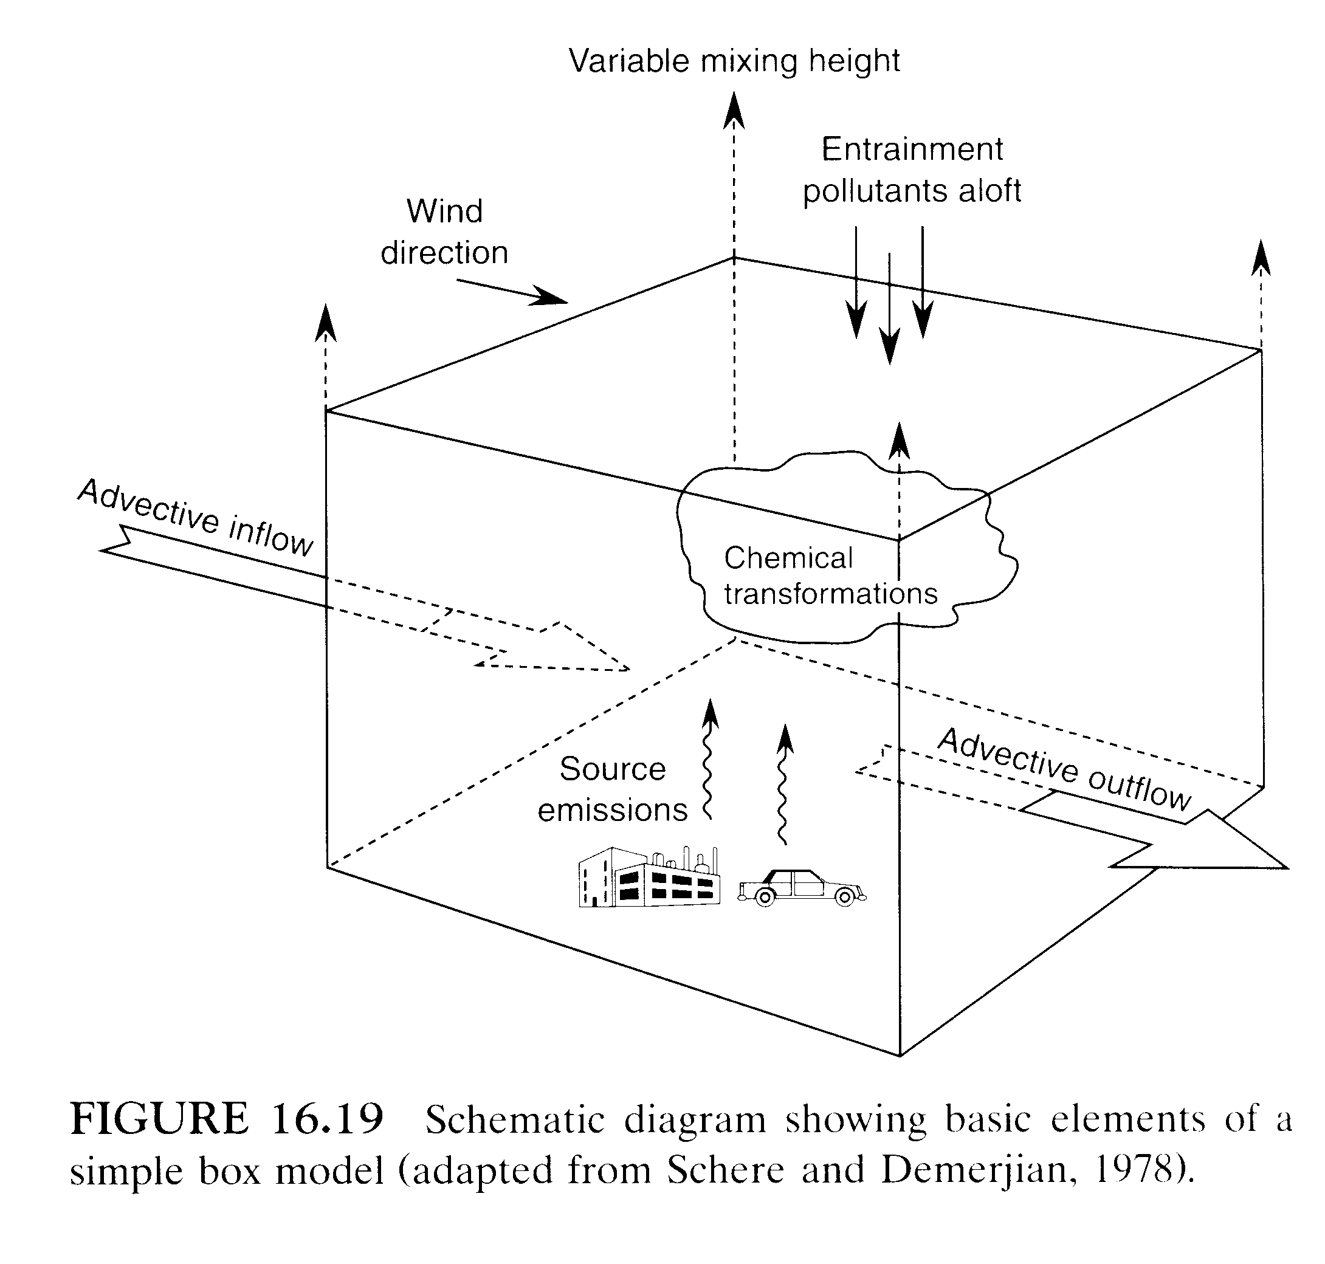
ATMOSPHERIC MODELLING IS ALL ABOUT MAKING CHOICES
Turbulent mixing and convection
Advection
Wet deposition
Sedimentation
Radiation and clouds
Homogeneous and heterogeneous chemistry, including photochemistry
Biogenic and anthropogenic emissions
Aerosol processes
Dry deposition

Slide 9
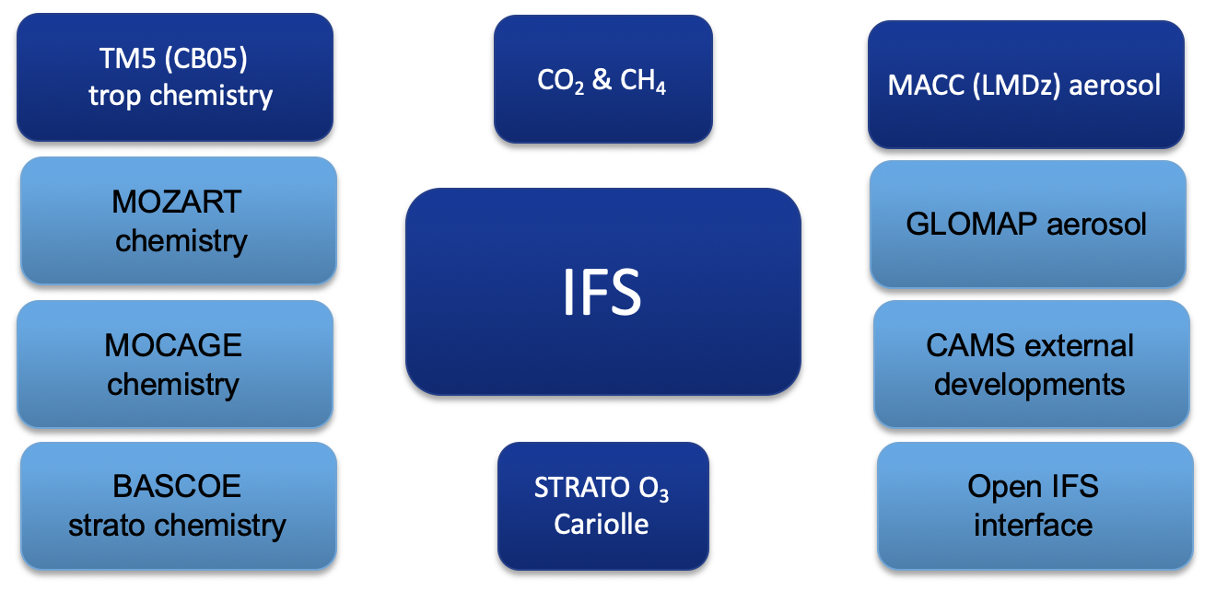
ECMWF IFS COMPOSITION CONFIGURATIONS
Current operational version
Based on IFS Cy47r1
Horizontal: T511 (~40km)
Vertical: L137
V. Huijnen et al., Quantifying uncertainties due to chemistry modelling – evaluation of tropospheric composition simulations in the CAMS model (cycle 43R1), GMD, https://doi.org/10.5194/gmd-12-1725-2019.
S. Rémy et al., Description and evaluation of the tropospheric aerosol scheme in the Integrated Forecasting System (IFS-AER, cycle 45R1) of ECMWF, GMD, https://doi.org/10.5194/gmd-12-4627-2019.
A. Agusti-Panareda et al., Modelling CO₂ weather – why horizontal resolution matters?, ACP, https://doi.org/10.5194/acp-2019-177, 2019.
A. Inness et al., The CAMS reanalysis of atmospheric composition, ACP, https://doi.org/10.5194/acp-19-3515-2019, 2019.

Slide 10
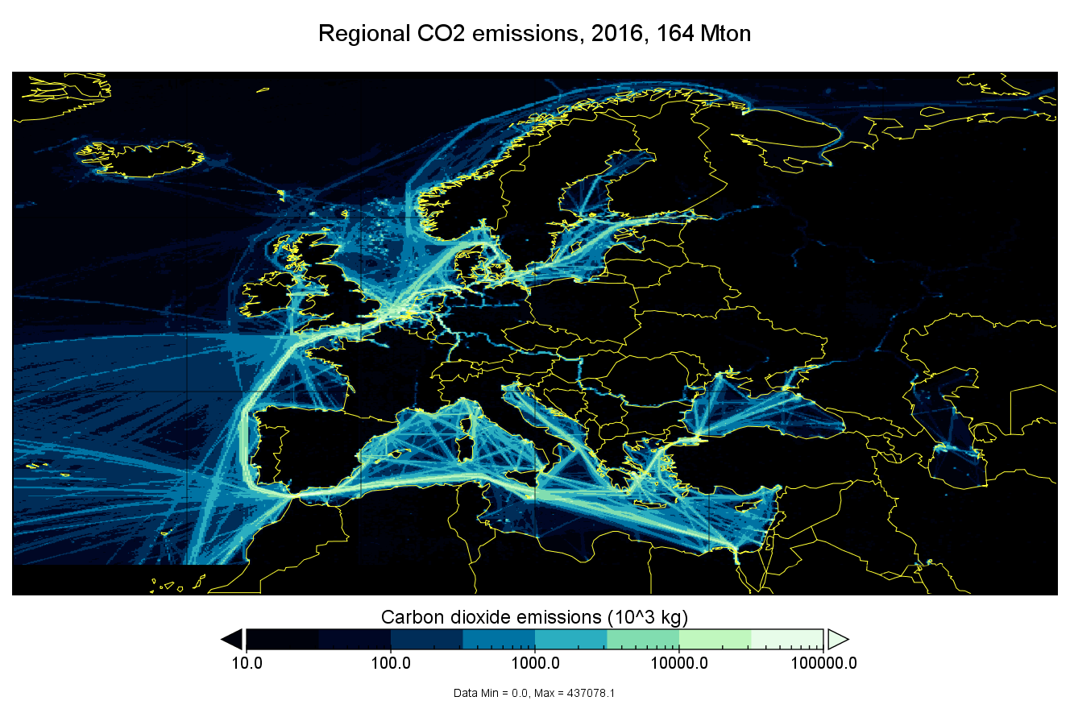
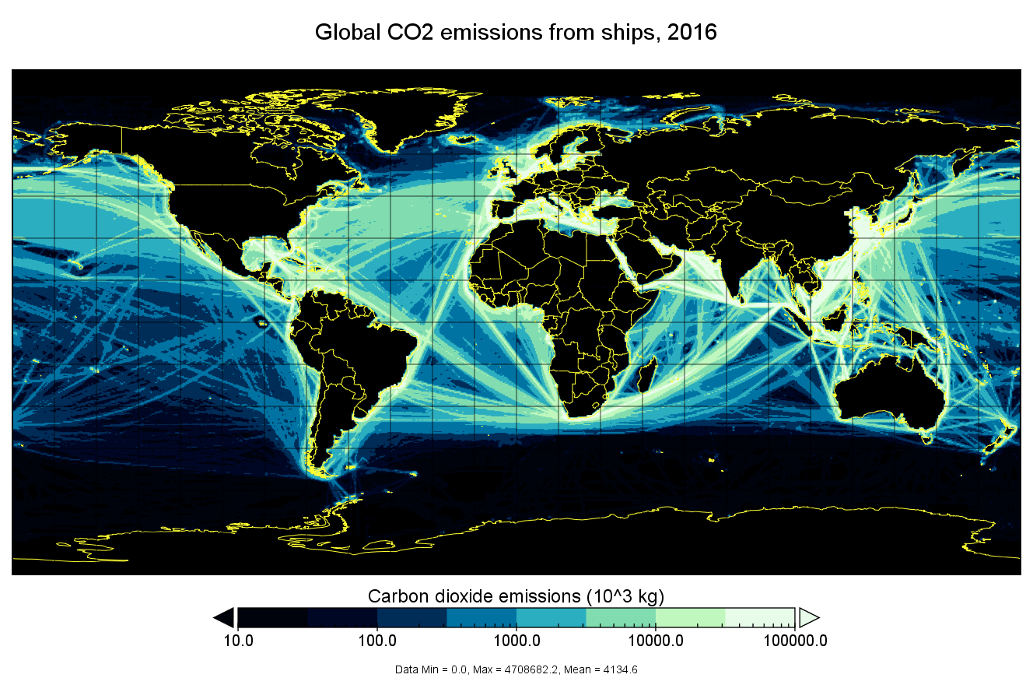
CAMS EMISSIONS INVENTORIES (BOTTOM UP)
Emissions are both an input to CAMS global and regional systems and a popular product. New datasets have been produced covering 2003 to 2020 (extrapolation). Example: CO₂ emissions from shipping activities (provider: FMI, Finland).
(Granier et al., doi 10.24380/d0bn-kx16)

Slide 11
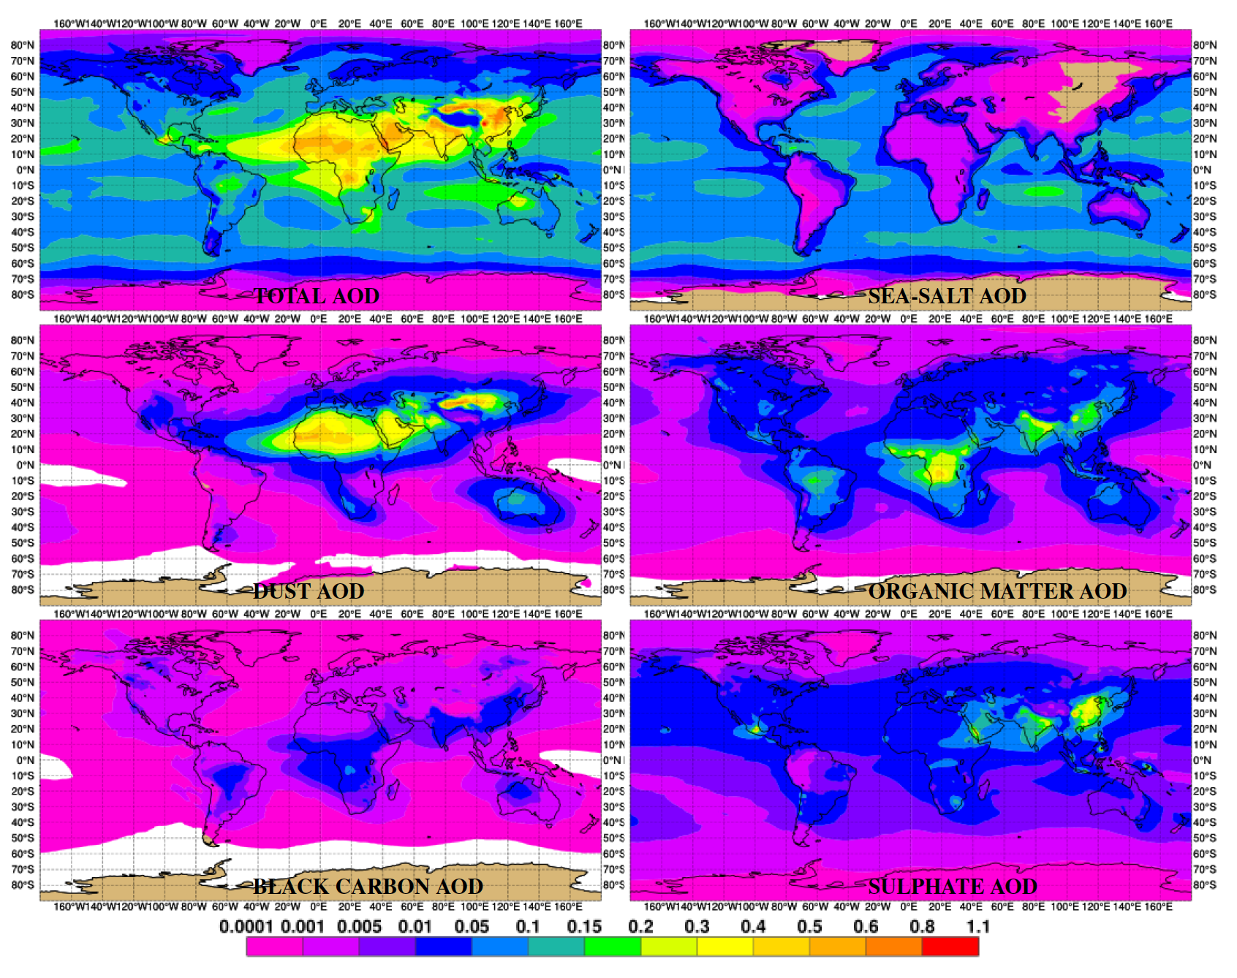
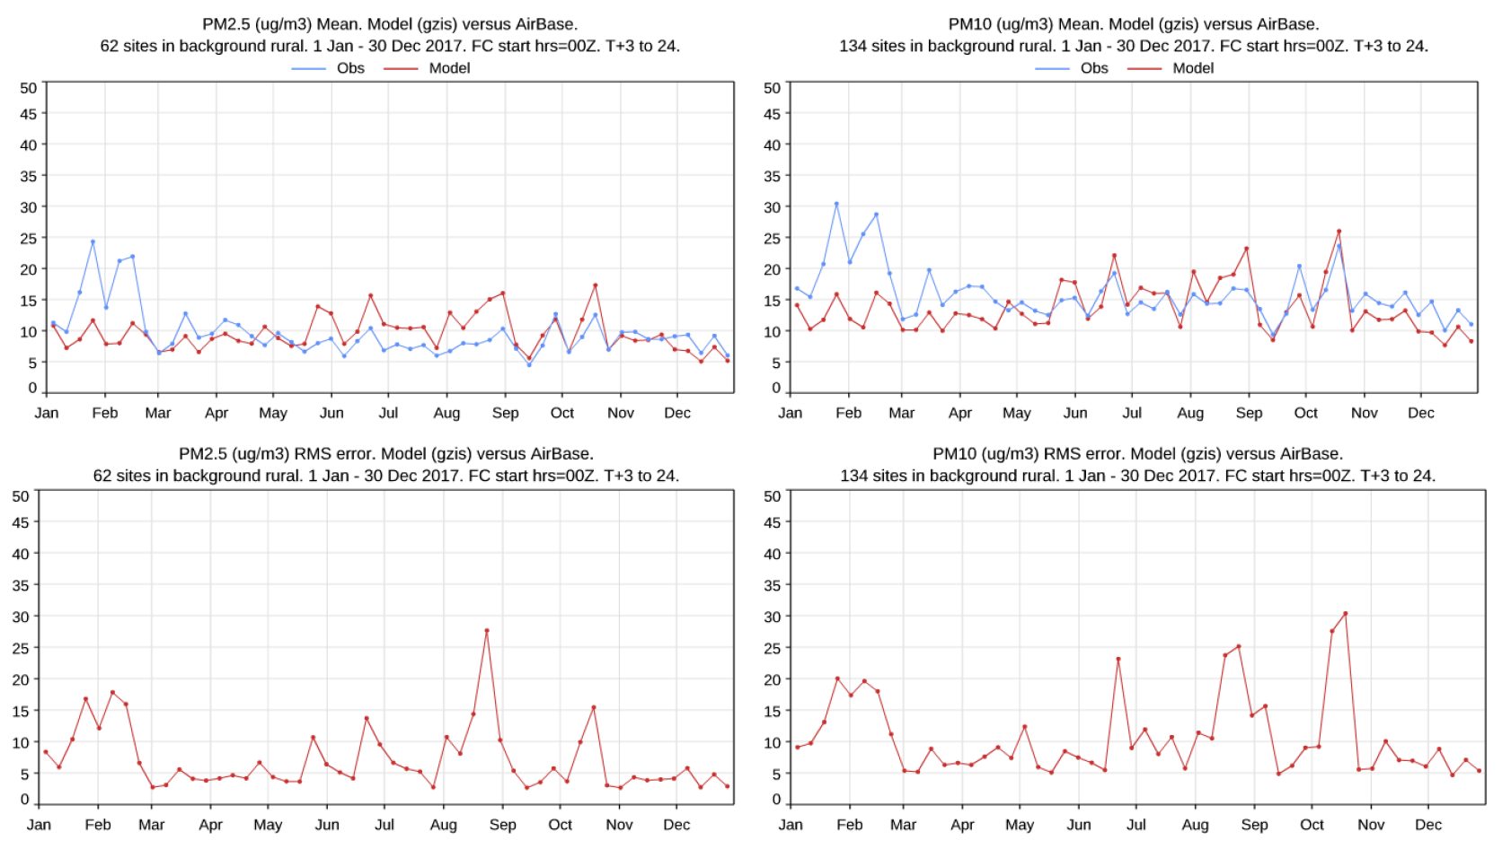
A SNAPSHOT OF AEROSOL (AND ITS COMPLEXITY) IN IFS
Natural and Anthropogenic emissions sources
Several types of particles (composition, size, number, shape/mixing…), 15-30 tracers to the absolu
Very challenging to get everything right at the same time (and observations are sometimes missing to help assessing what is wrong).
2017
(Rémy et al, GMDD, 2019)

Slide 12
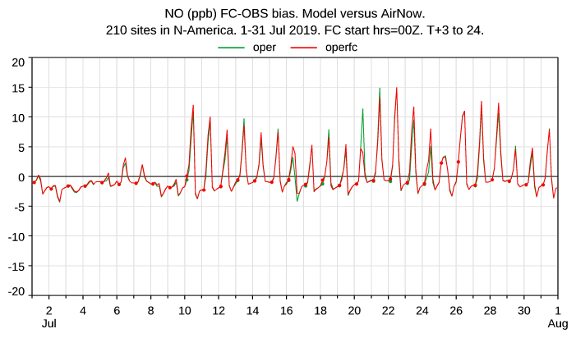
SOLVING AN ISSUE: NIGHT TIME BIASES
For a long time CAMS/IFS primary pollutants simulation suffered from high bias at the surface during night
Several potential reasons:
  No diurnal cycle of emissions
  No injection height for anthropogenic emissions from elevated sources (stacks)
  Nocturnal Planetary Boundary Layer too low / mixing too weak
  20 m lowest level extent is small
  no diagnostic for 2 m observation height
  …

Slide 13
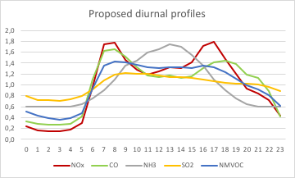
ADDING DIURNAL PROFILES OF EMISSIONS
Synthesized from
CAMS emissions work over Europe.
Depends on main emissions source for each pollutant (NOx: 40-50% traffic; NH3: 90% agriculture…)
Applied using local time.

Slide 14
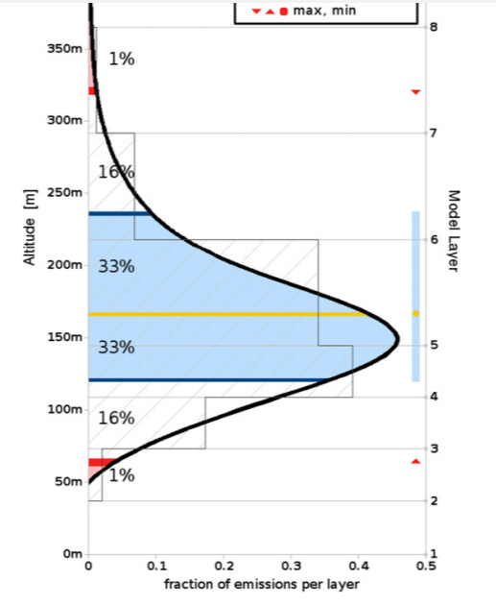
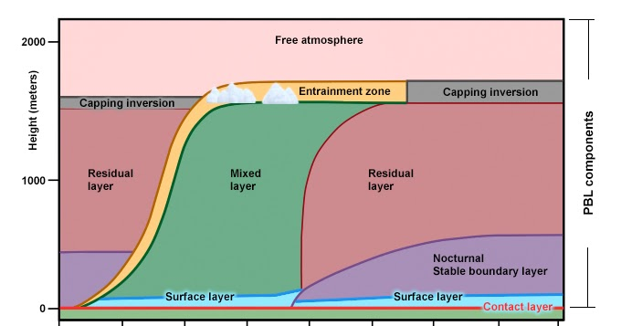
INJECTION HEIGHT ASSUMPTION
Uniform (in delta p) distribution of x fraction , 1-x injected as surface flux as part of vertical diffusion scheme
SO₂: x = 100% ; CO: x = 80%
NO: x = 5%, 60% if NO emission > 1.10⁻¹¹ kg.m⁻².s⁻¹ in grid box (NO point source marker)
Sea: 30-100m ; Land: 100-500m

Slide 15
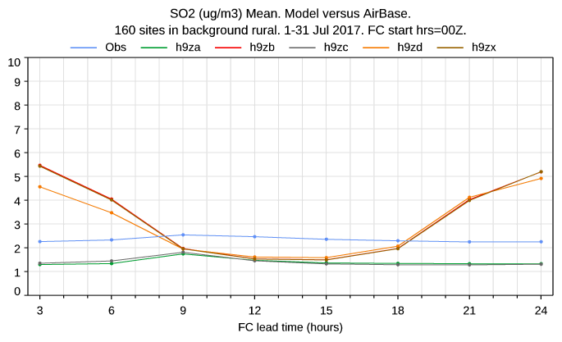
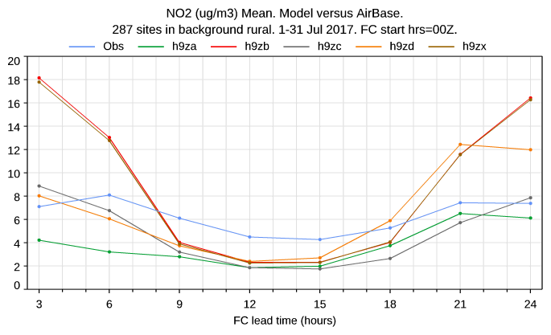
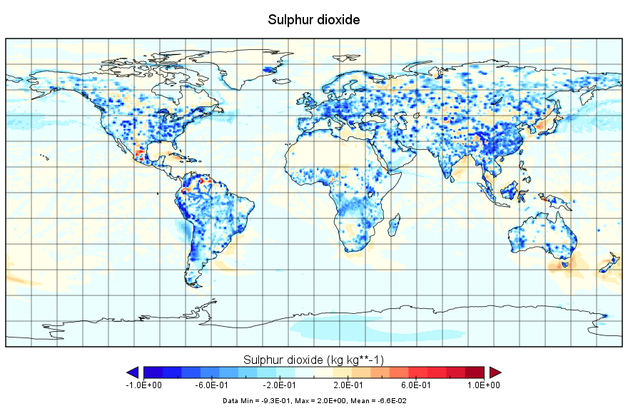
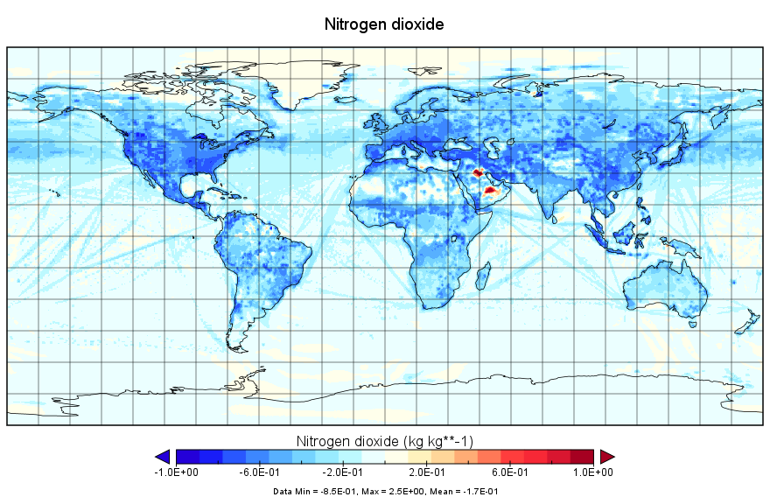
SO₂ & NO₂ NIGHT TIME BIAS IMPROVED
no INJ and no DiuC
yes INJ and yes DiuC
observations
Strong improvement in SO₂ and NO₂ night time values. Reduction in surface values for the pollutants (too much, but much less diurnal variations vs observations).
Included in the operational upgrade (06/10/2020) of the CAMS system.

Slide 16
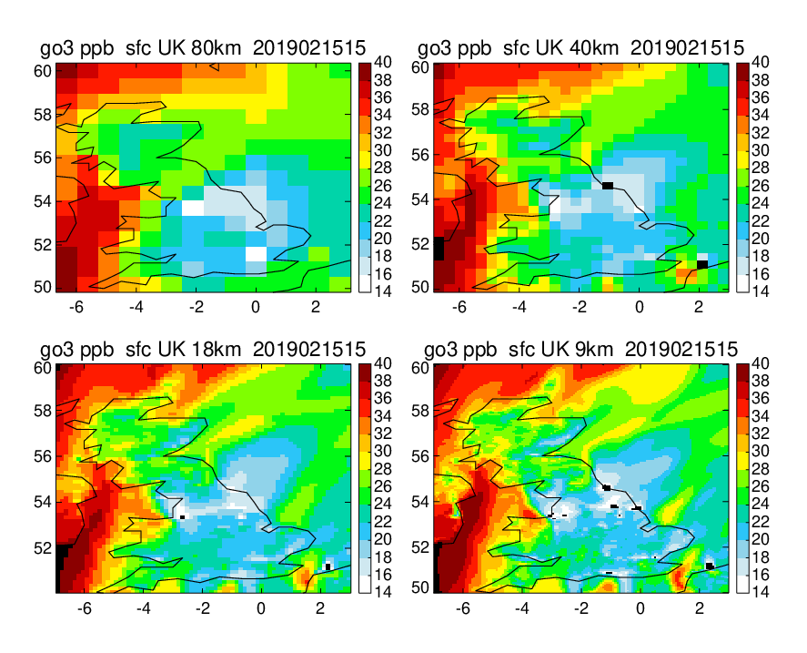
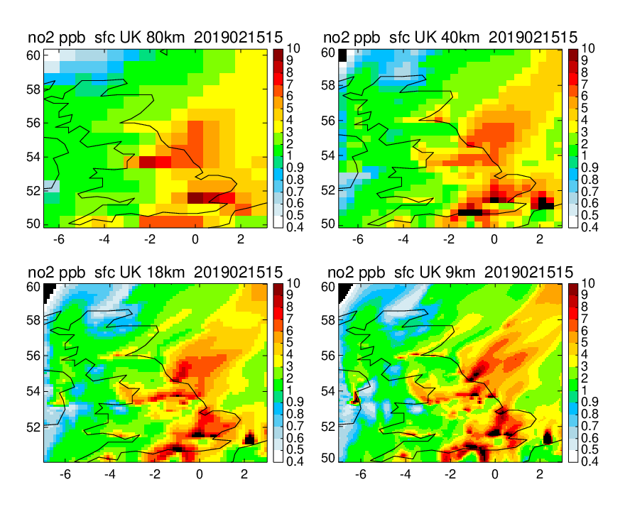
ZOOM: UK
SPATIAL RESOLUTION MATTERS
All simulations are global
Ozone
NO₂
Zoom only (model is global). Higher spatial resolution allows to make use of high-res information of emission data.

Slide 17
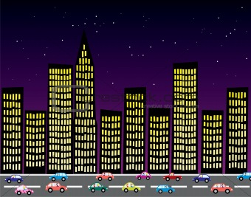
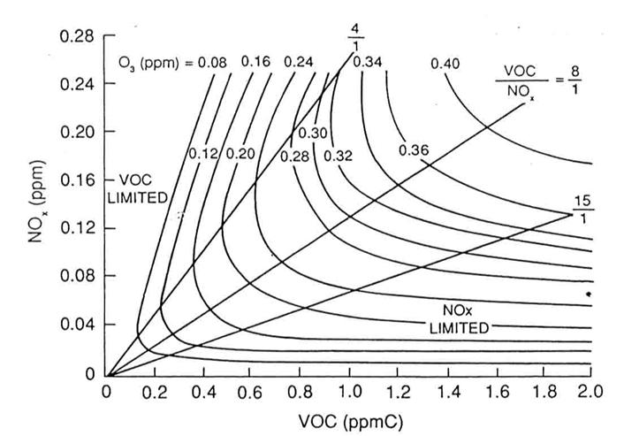

THERE IS WORSE: SOME PHENOMENA ARE NON-LINEAR…
“Empirical Kinetic Model Approach” (EKMA) or “ozone isopleth” diagram (Dodge, 1977; was used to establish regulatory policy for the US EPA).

Slide 18
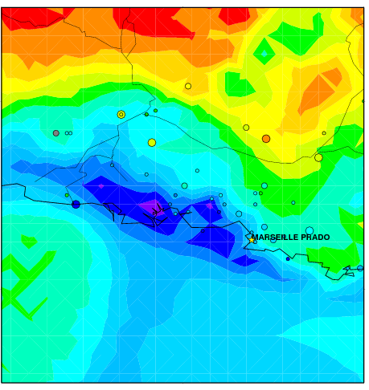
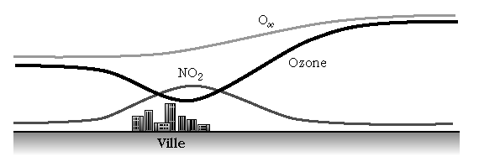
THE (APPARENT) OZONE PARADOX
Let’s travel from city center to peri-urban and rural areas…
MOCAGE (Météo-France)
Area of Marseille, mid-afternoon July 2001
Anthropogenic emissions of NOx are not cleaning the atmosphere!
City

Slide 19
THE « GOOD FORECASTS FOR WRONG REASONS » CASE
Models can be good on some parameters from wrong reasons, as there can be some compensation of errors. For instance, let alone chemistry, too much mixing in the PBL can compensate too high emissions or insufficient dry deposition!
Need for many different observations in order to be sure for instance that ozone is correct for the right reason.
If NOx is low (and correct), almost any amount of VOC will give correct ozone.
Several couples (NOx,VOC) provide the same ozone!

Slide 20
BACK TO THE HORIZONTAL RESOLUTION ISSUE…
Ozone
~120 ppb
Ozone
~120 ppb
Ozone
~180/2 = 90 ppb
Sub-grid distribution of sources can lead to significantly different dillution levels for the same quantity of precursor pollutants…
…and very different production rate of ozone, thus different biases, requiring some degree of “tuning”.
Ozone ~300/4 =75 ppb

Slide 21
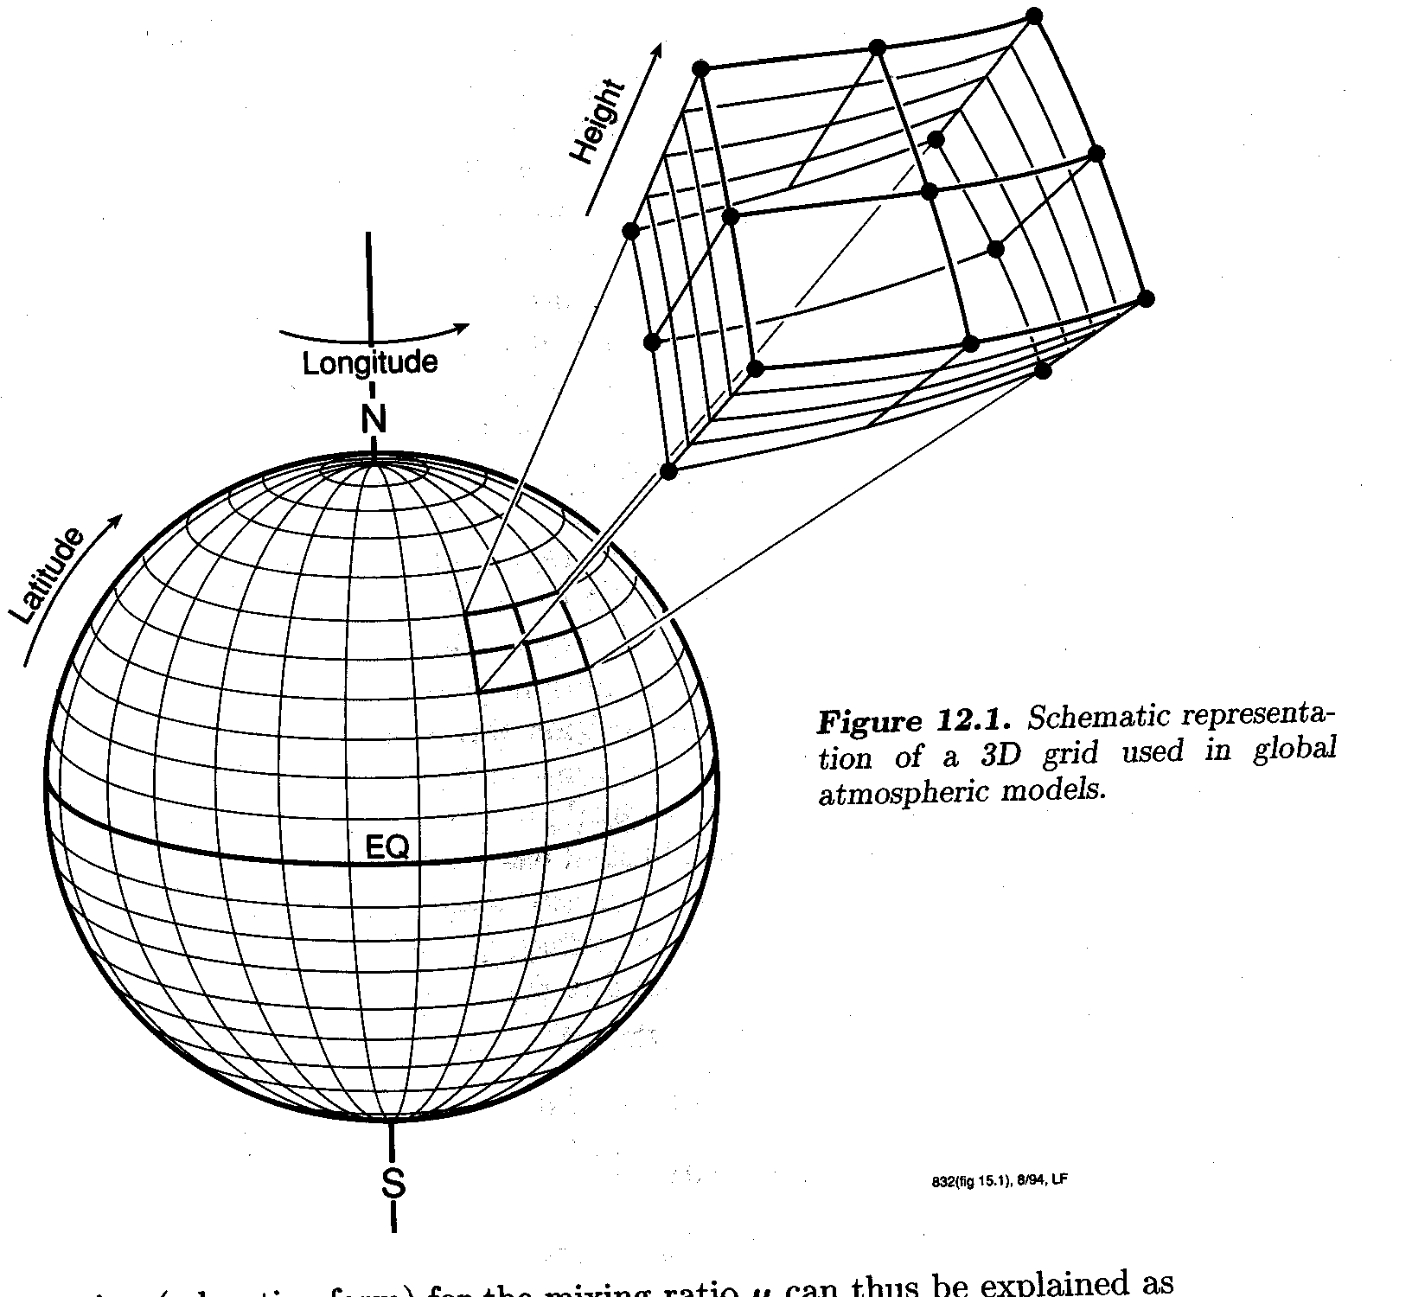
COMPUTING COSTS: THE CASE OF ADVECTIVE TRANSPORT
Eulerian models use assemblages of boxes exchanging mass to resolve spatial structure
Courant-Friedrichs-Lewi condition (space/time discretization constraints)
Rapid growth of computational cost with the number of tracers
…
Lagrangian models use assemblages of traveling puffs not exchanging mass, and sum over all puff trajectories to resolve spatial structure
Very well appropriate for certain application (e.g. accidental releases, specific plumes…)
How to account for mixing?
How to “map” the entire space?
…
n_{i}(x,t_{o}+Dt)
n_{i}(x,t_{o})

Slide 22
SEMI-LAGRANGIAN SCHEMES: A BIT OF BOTH…
Type of approach used by IFS (3D)
No CFL
Spatial interpolation factors are the same for all the tracers (limited growth in cost with the number of tracer)
…
But…
Mass conservation (solutions: mass fixers, conservative formulations…)
Numerical diffusion
…
Q(t)
Q(x₃⁰, t)
Q(x₃,t+Δt)
u
x₁
x₂
x₃
x₄
x₁⁰
x₂⁰
x₃⁰
x₄⁰
Q(x₃,t+Δt) = Q(x₃⁰,t)

Slide 23
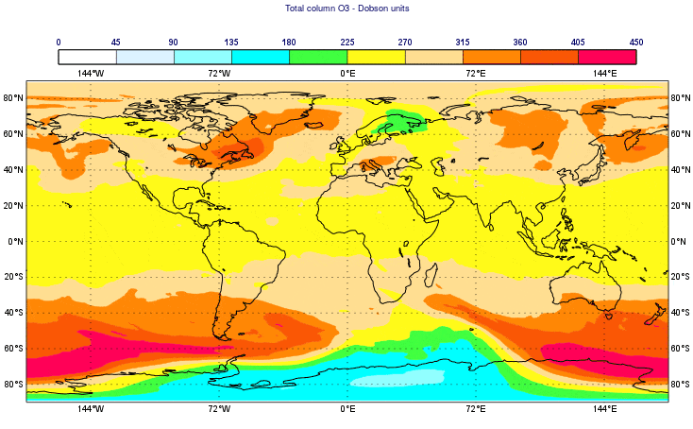
EXPLORING MULTIGRID OPTIONS
Demonstrator of ozone transport at 32km grid forced by winds on a 18km grid model in IFS. In principle, capacity to run NWP and air quality operations simultaneously without compromising too much on aerosol size/number/components.
t ^{n}
t ^{n+1}
High resolution model time stepping
Pressure
Temperature
Wind
Tracer
REMAP
REMAP
Tracer
t ^{n}
t ^{n+1}
Advection in coarse mesh
Future: advection, chemistry and linked physical processes on coarse mesh

Slide 24
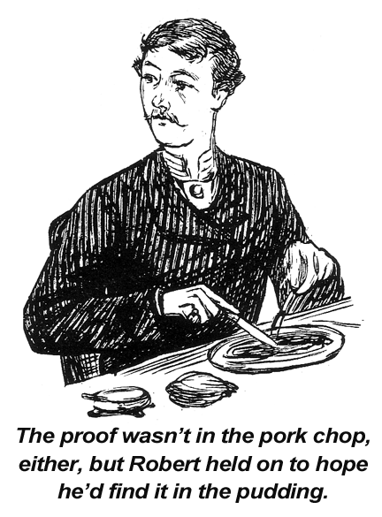
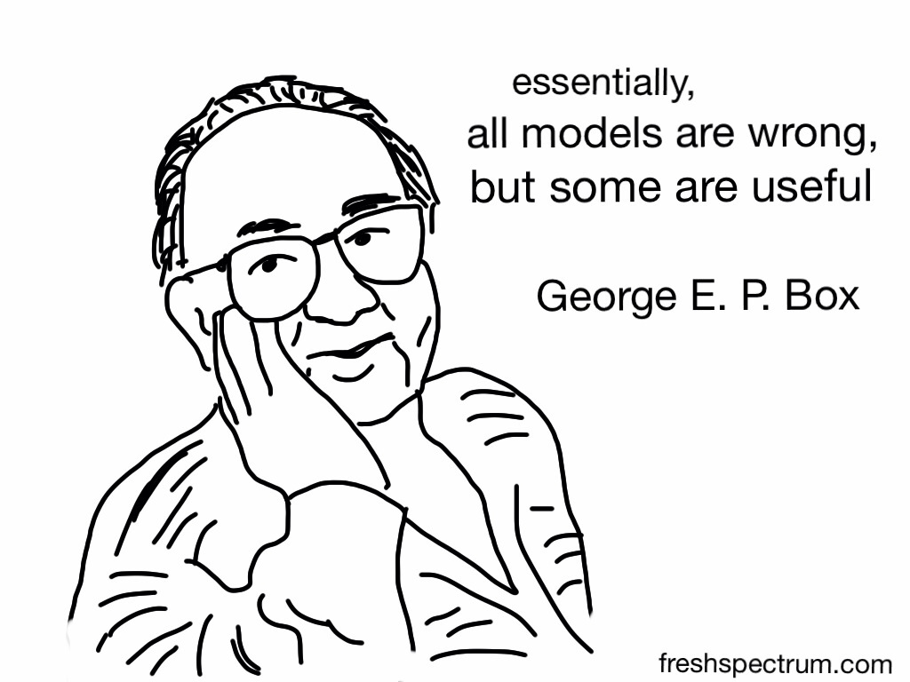

Slide 25
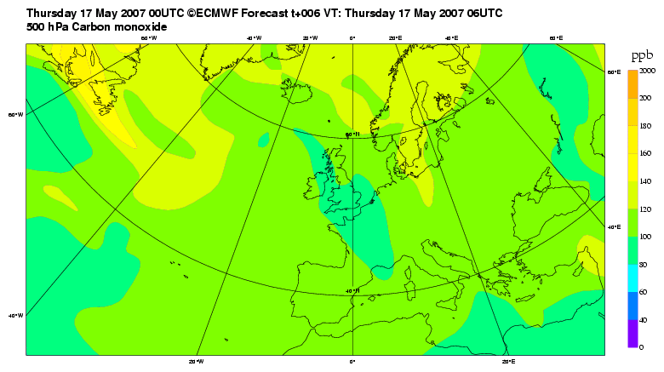
ROUTINE FORECASTS SINCE MAY 2007, OPERATIONAL SINCE 2015MODEL?
Over 13 years of continuous daily global atmospheric composition forecasts at ECMWF

Slide 26
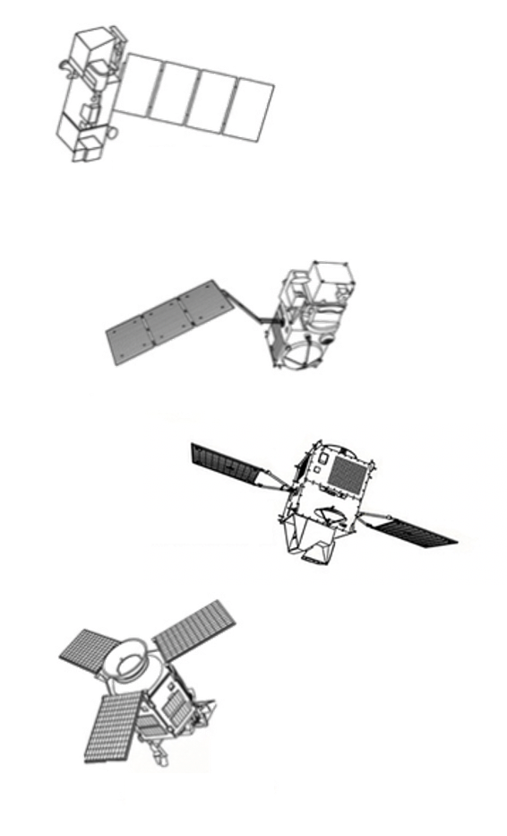
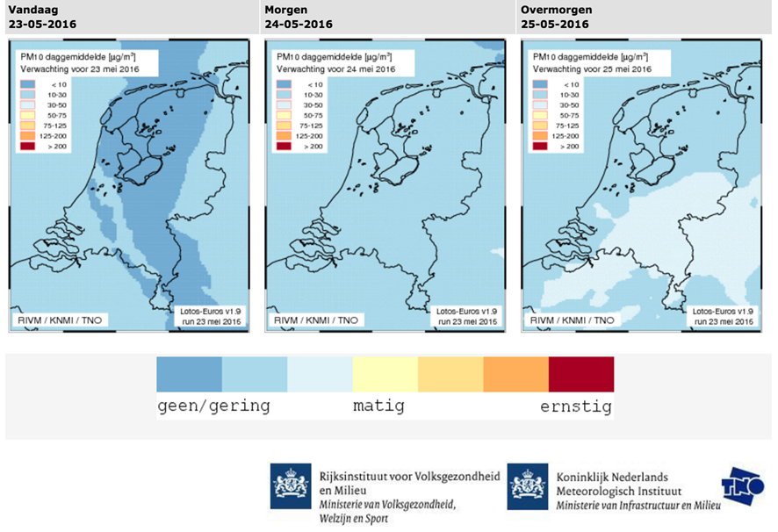
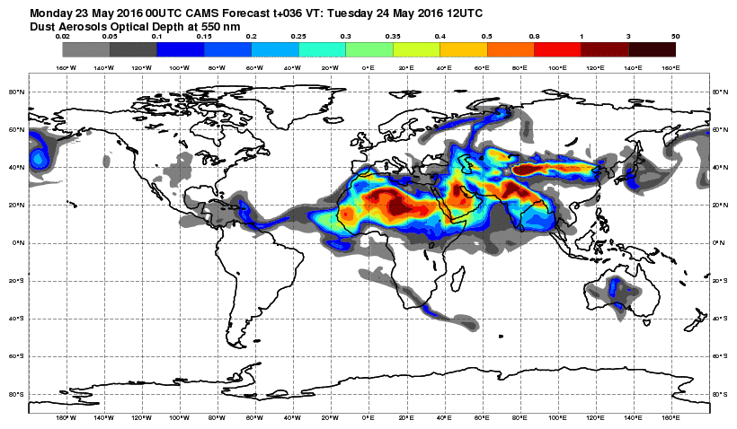
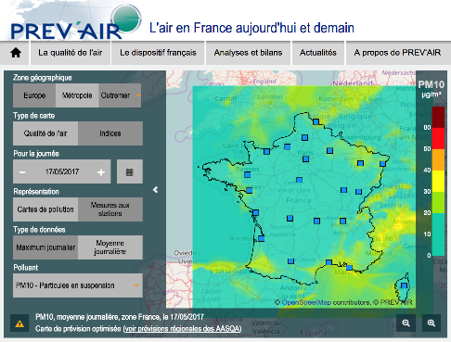
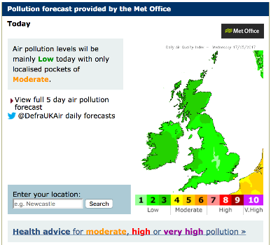
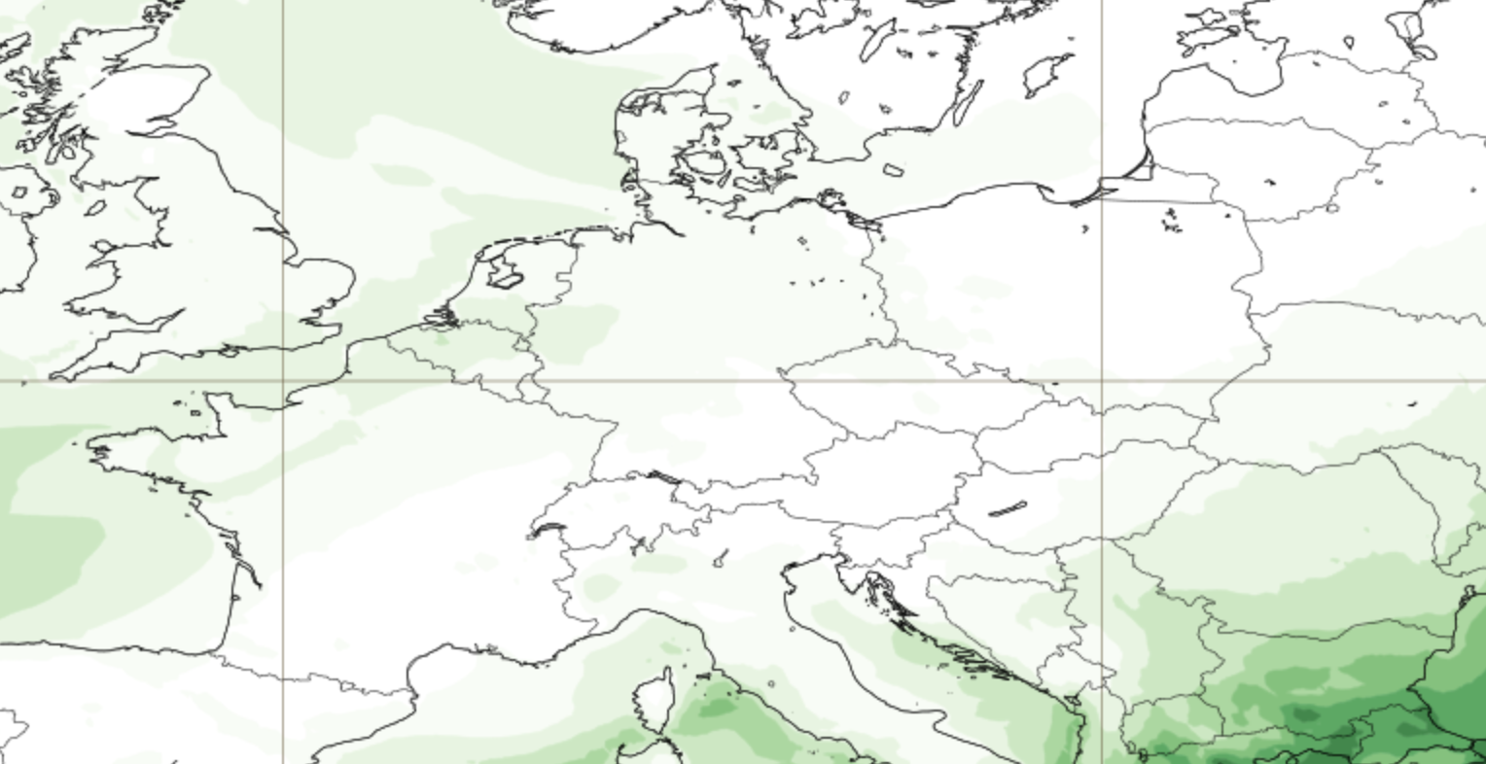
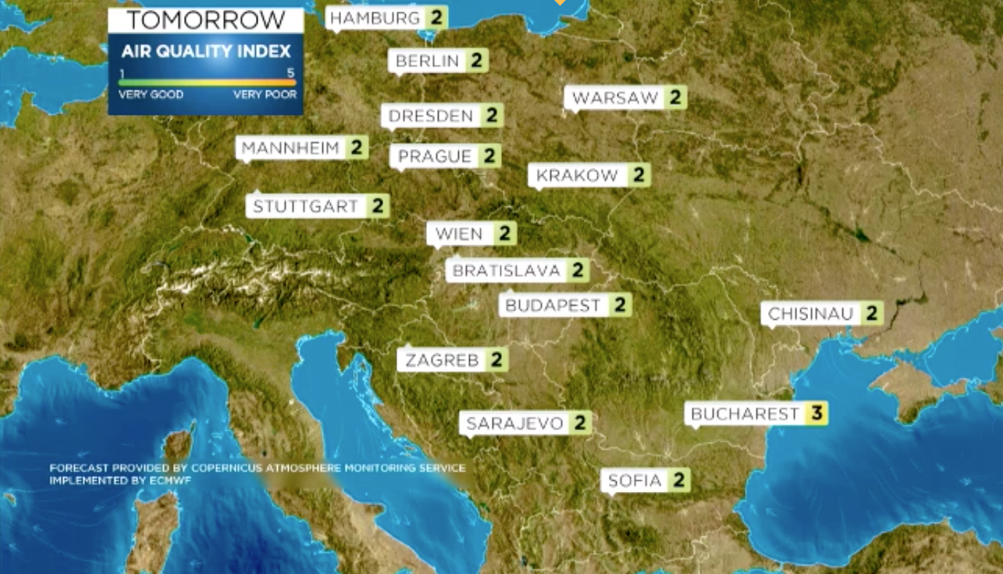
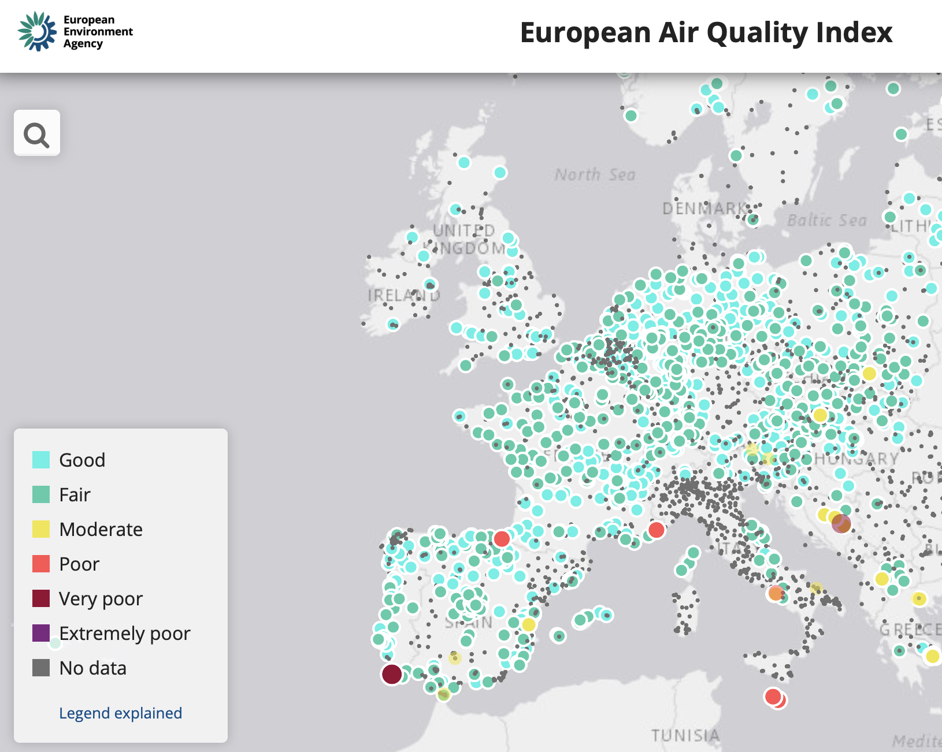
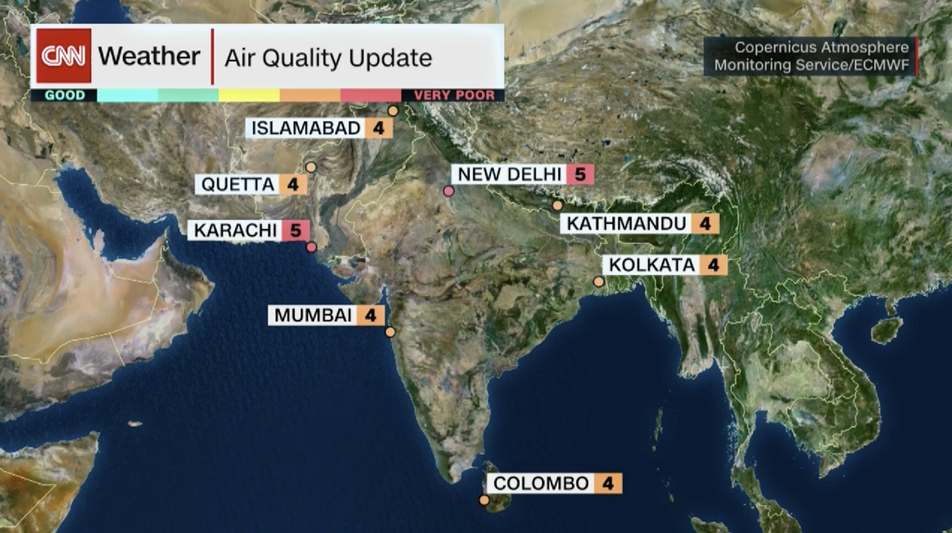

CAMS INFORMATION FLOW
CAMS users
40km Globe
(twice daily, d+5)
CAMS main operational data assimilation and modelling systems
Earth Observation from satellite (>75 instruments) and in-situ (regulatory and research)
10km Europe
(daily, d+4)

Slide 27
Thank you for your attention!

