Slide 1
Data Assimilation for Atmospheric Composition: Applications and Challenges Part 2
/ Antje Inness & Jérôme Barré (ECMWF)

Slide 2
Outline
Data assimilation approaches: variational and ensemble
The operational emissions inversions needs and challenges
Co-emission
Chemistry-meteorology data assimilation coupling

Slide 3
Data assimilation approaches
Different data assimilation approaches exist to solve the same problem:
$$x_{a}=x_{b}+K(y−H(x_{b}))$$
K is called the gain matrix and handles the transformation of the information from the observation space to the forecast model space: concentrations, surface fluxes or even parameters.
Because of the dimension of the problem with atmospheric composition this cannot be solved straightforwardly.
Two approaches are mainly used: variational or ensemble

Slide 4
Variational data assimilation
Data assimilation for atmospheric composition is in principle no different from NWP data assimilation
$$J\left(x\right)={\left(x−x_{b}\right)}^{T}B^{−1}\left(x−x_{b}\right)+\sum_{i=0}^{n}{{\left(y_{i}−H_{i}M_{i}\left[x_{i}\right]\right)}^{T}R_{i}^{−1}(y_{i}−H_{i}M_{i}\left[x_{i}\right])}$$
Outer loops
Full non-linear model
Full chemistry
Full resolution
High resolution non-linear forecast
12hourly
Non linear trajectory
Departures: d=y=H(x)
Inner loops
Tangent linear and adjoint NWP model linearized around outer-loop trajectory
Reduced resolution
Simplified chemistry
2 or 3 Outer Loops
(Increasing resolution)
Inner Loop
Tangent Linear model
Adjoint model
Iterative minimization
High resolution non-linear forecast

Slide 5
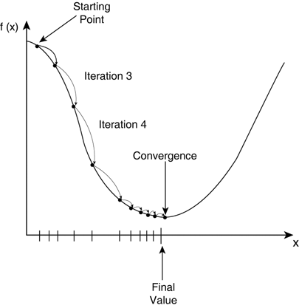
Variational data assimilation
$$J\left(x\right)={\left(x−x_{b}\right)}^{T}B^{−1}\left(x−x_{b}\right)+\sum_{i=0}^{n}{{\left(y_{i}−H_{i}M_{i}\left[x_{i}\right]\right)}^{T}R_{i}^{−1}(y_{i}−H_{i}M_{i}\left[x_{i}\right])}$$
We calculate the gradient of the cost function and find its minimum such as
$∇_{δx_{0}}J=B^{−1} (x$₀$−xb)+\sum_{i=0}^{n}{M^{′T}}H_{i}^{T}R_{i}^{−1}\left(H_{i}{M′}_{i}[x_{i}]−y_{i}\right)$
$H_{i}=$ observation operator
$M^{′}=$ tangent linear forward model
All this gives a sensitivity from y to x
$H_{i}^{T }$= adjoint of observation operator
${M′}_{ }^{T }$= adjoint of the tangent linear model
Notes:
Jerome: You can skip that one if you need to save some time as I will go back to the equations in my Var vs Ens slides. I will then talk about the TL and AD. However you could focus more on H and maybe showing that accounting for the AVK is better if not, mandatory.

Slide 6
Ensemble data assimilation
The modeled state of the atmosphere can be seen as a probability density function (PDF). This can be achieved by running in parallel an ensemble of perturbed model realizations.
High resolution non-linear forecast
High resolution non-linear forecast
High resolution non-linear forecast
Departures: d=y=H(x)
Sequential Data Assimilation
Departures: d=y=H(x)
No need for Tangent linear and adjoint
Full model information can be drawn from the ensemble information
Self update on B at each cycle
Costly: large number of ensembles
Prone to sampling error
Departures: d=y=H(x)
Observations
$$x_{a}=x_{b}+BH^{T}{\left(H{BH}^{T}+R\right)}^{−1} (y−H(x_{b}))$$
High resolution non-linear forecast
High resolution non-linear forecast
High resolution non-linear forecast

Slide 7
Ensemble data assimilation
$$x_{a}=x_{b}+BH^{T}{\left(H{BH}^{T}+R\right)}^{−1} (y−H(x_{b}))$$
The Kalman Gain is
$$K=BH^{T}{\left(H{BH}^{T}+R\right)}^{−1}$$
Which sequentially and locally is usually simplified to the linear approximation
$$K= \frac{σ_{b}^{2}}{σ_{b}^{2}{+σ}_{o}^{2}} \frac{σ_{xy}}{σ_{y}^{2}}$$
Obs space
Model space
Relative weights of R and B

Slide 8
Emission inversions estimates
Emissions are one of the major uncertainties in composition modeling (can not be measured directly)
The compilation of emissions inventories is a labour-intensive task based on a wide variety of socio-economic and land use data, past emissions are used into the forecasts
Some emissions can be “modeled” based on wind (dust and sea salt aerosol) or temperature (biogenic emissions)
Some emissions can be observed indirectly from satellites instruments (Fire radiative power, burnt area, volcanic plumes)
“Inverse” methods can be used to correct emission estimates using observations and models

Slide 9
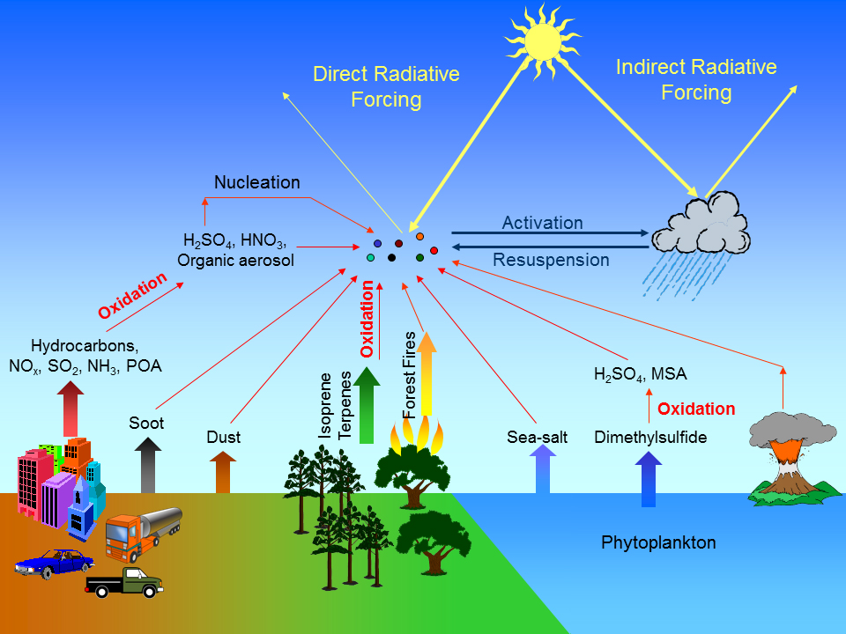
Modelling improvement is crucial for DA
Better modelling of fluxes and emissions and how they are inputted into models are very important
Sea salt and dust are dependent on wind and precipitations
Biogenic (plants) fluxes
Wildfires
Modelling human emissions…

Slide 10
Inverse models (emission estimations)
Use data assimilation to constrain not only the concentrations but also emission and surface fluxes
Larger scales
Satellite
Observation
Transport
Finer scales
Emissions/Fluxes
Adjoint Model
Kalman Gain
Notes:
Les processus de grande echelle mais aussi de fine echelle sont a prendre en compte dans les procedures d’inversions
Les inversions doivent don prendre en compte d’une manière ou d’une autre les erreurs dues aux simplification des modeles, (car ils en auront toujours)

Slide 11
Inverse models (emission estimations)
Use data assimilation to constrain not only the concentrations but also emission and surface fluxes
Larger scales
Satellite
Observation
Transport
Finer scales
Emissions/Fluxes
Adjoint Model
Kalman Gain
Short assimilation window problem
Notes:
Les processus de grande echelle mais aussi de fine echelle sont a prendre en compte dans les procedures d’inversions
Les inversions doivent don prendre en compte d’une manière ou d’une autre les erreurs dues aux simplification des modeles, (car ils en auront toujours)

Slide 12
Inverse models (emission estimations)
Use data assimilation to constrain not only the concentrations but also emission and surface fluxes
Larger scales
Satellite
Observation
Satellite
Observation
Satellite
Observation
Satellite
Observation
Transport
Finer scales
Emissions/Fluxes
Adjoint Model
Adjoint Model
Adjoint Model
Kalman Gain
Kalman Gain
Kalman Gain
Short assimilation window problem: Increasing revisit and resolution will help but not only…
Operational data assimilation needs to be advanced
Notes:
Les processus de grande echelle mais aussi de fine echelle sont a prendre en compte dans les procedures d’inversions
Les inversions doivent don prendre en compte d’une manière ou d’une autre les erreurs dues aux simplification des modeles, (car ils en auront toujours)

Slide 13
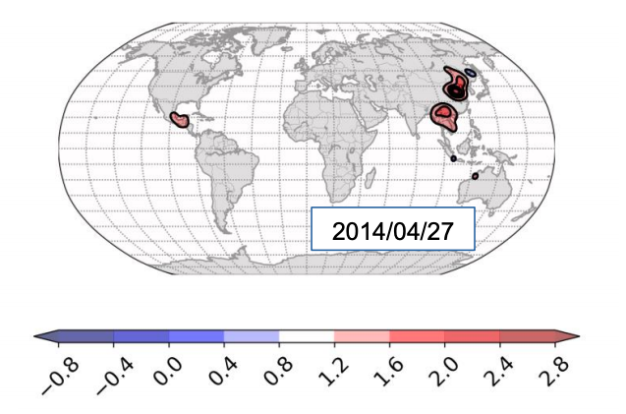
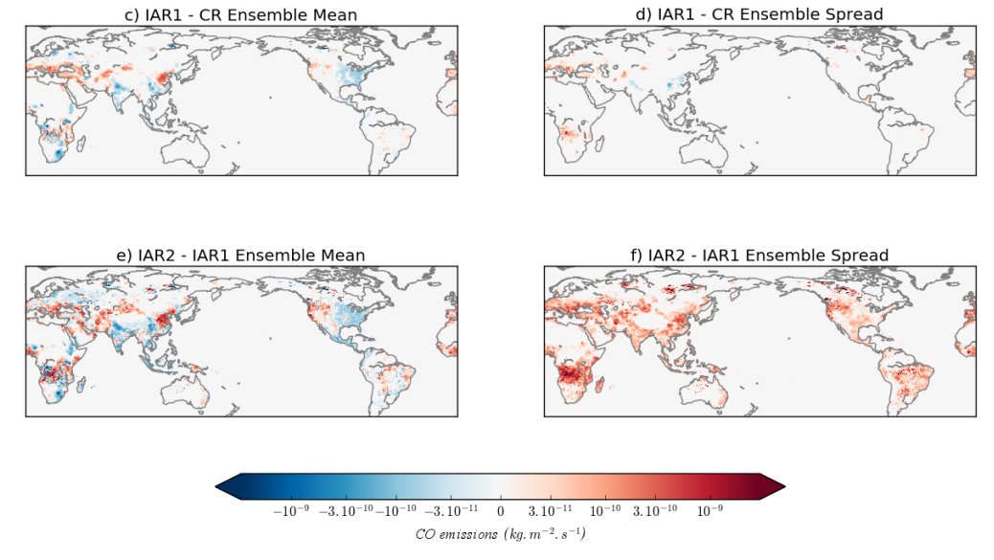
Operational emissions estimations using IFS: foundations
4D Var information:
DETERMINISTIC
Ensemble Information:
STATISTICAL
Not operational yet
Compare and combine the two (hybrid) in order to design a synergistic system

Slide 14
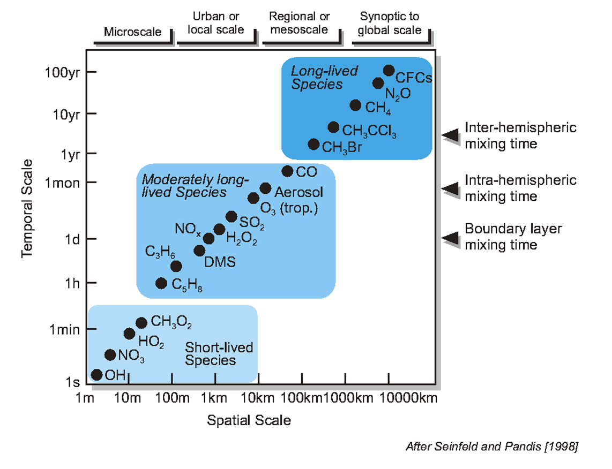
The emission problem across the scales
Sat Obs
Emissions
NO₂
CO₂
CO
Sat. Obs.
CO₂

Slide 15
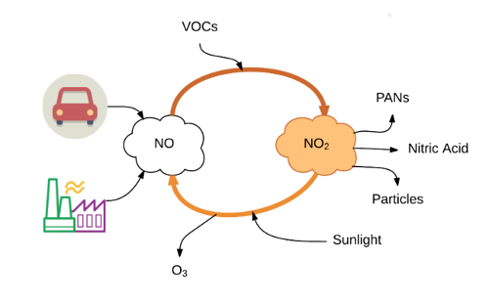
NO₂: problems with fast chemistry
NO₂ is short lived: few hours to half a day
NO₂ chemistry is non-linear and very reactive
NO₂ levels are strongly dependent on emissions but also other factors: weather variability and presence of other pollutants (VOCs)
Credit: AQICN

Slide 16
Short lived memory of NO2 assimilation
OMI NO2 analysis increment [%]
Differences between
Analysis and CTRL
12h fc from ASSIM and CTRL
JF 2008
JF 2008
JJA 2008
JJA 2008
[10¹⁵ molec/cm²]
Large positive increments from OMI NO₂ assimilation
Large differences between analyses of ASSIM and CTRL
Impact is lost during subsequent 12h forecast
It might be more beneficial to adjust emissions (instead of IC)

Slide 17
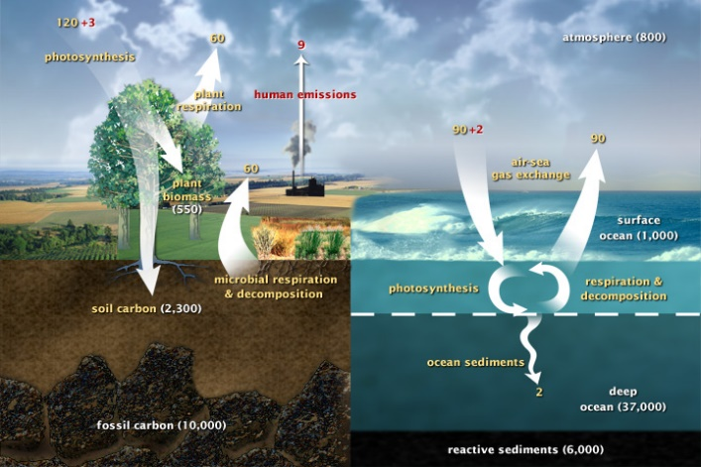
CO2 assimilation and surface fluxes
An example of all the surface fluxes that need to be accounted for with CO₂
Vegetation
Ocean
Fires
Soil (microbial)
Human emissions
Notes:
Jerome: Maybe leave this to me or just use it quickly and refer to it if you need it in further slides and refer to the second part.

Slide 18
Example of atmospheric composition forecasts: The Australian Fires

Slide 19
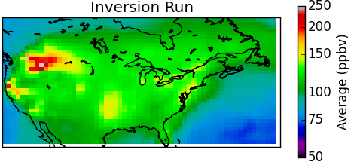
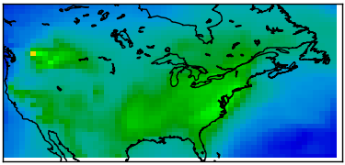
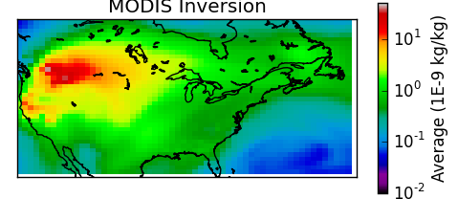
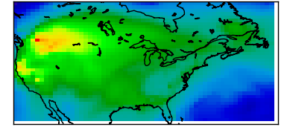
Co-emission example: 2015 US fires
Updated CO and OC+BC emissions estimates
Average CO changes across N.America: Surface-200hPa average
CO inversion
With MOPITT CO
Average OC+BC changes across N.America: Surface-200hPa average
Fire PM inversion
With MODIS AOD
Barré, 2016

Slide 20
Co-emission example: US fires
Updated CO and OC+BC emissions estimates
Factor 3.3 increase
Using MOPITT CO to estimate fire PMs emissions
Factor 3.75 increase
Factor 3.3 increase
Assuming full correlation is probably not sufficient needs refinements for accuracy
Barré, 2016

Slide 21
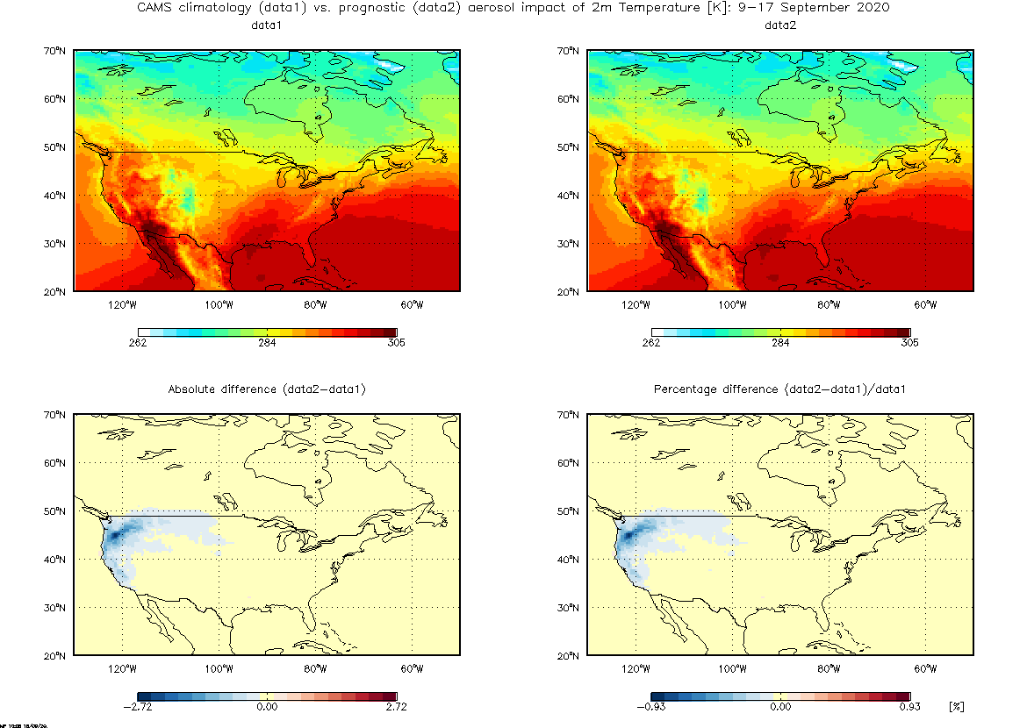
Aerosol Impacts on temperature 2020 US fires
Courtesy M. Parrington

Slide 22
Coupling between tracer and wind field in 4D-Var: illustration using 1D advection model
Model equations
u = u(x,t) = wind
q = q(x,t) = tracer
= diffusion coef.
= perturbations
= adjoint variables
Tangent linear equations:
Adjoint equations:

Slide 23
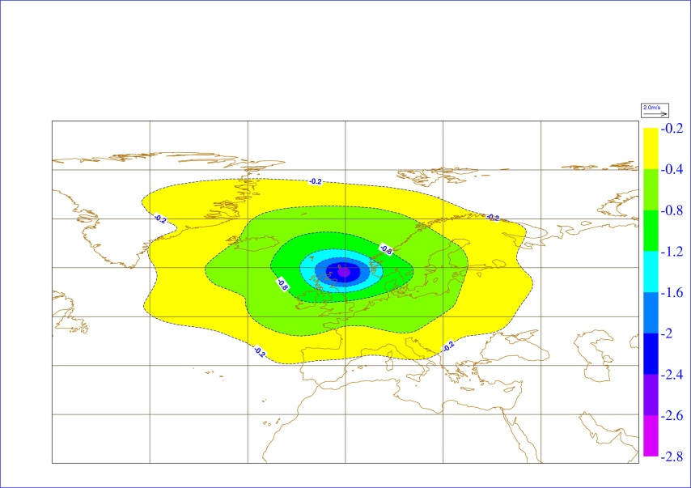
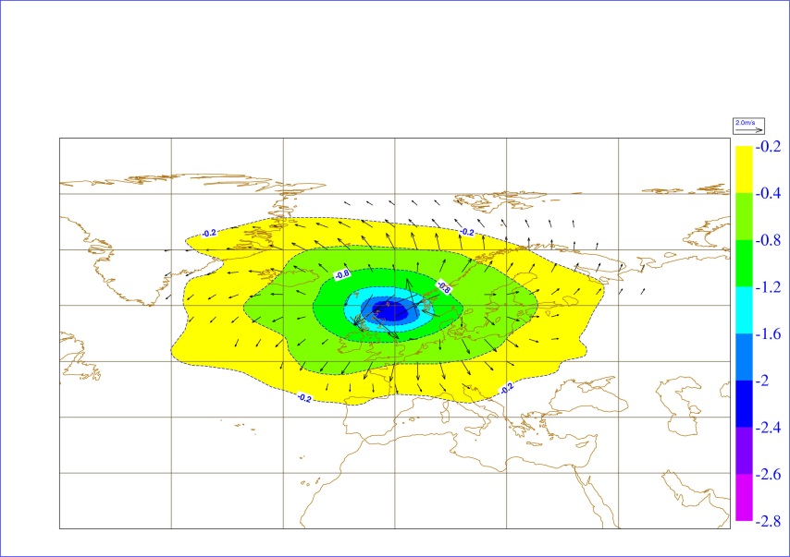
Single observation experiments - Ozone and wind increments
Level 20,
≈ 30 hPa
3D-Var
4D-Var 9z
Observation at T0: 4D-Var = 3D-Var
Observation at T3: wind increments
Observation at T6: wind increments
4D-Var 12z
4D-Var 15z
6h assimilation window

Slide 24
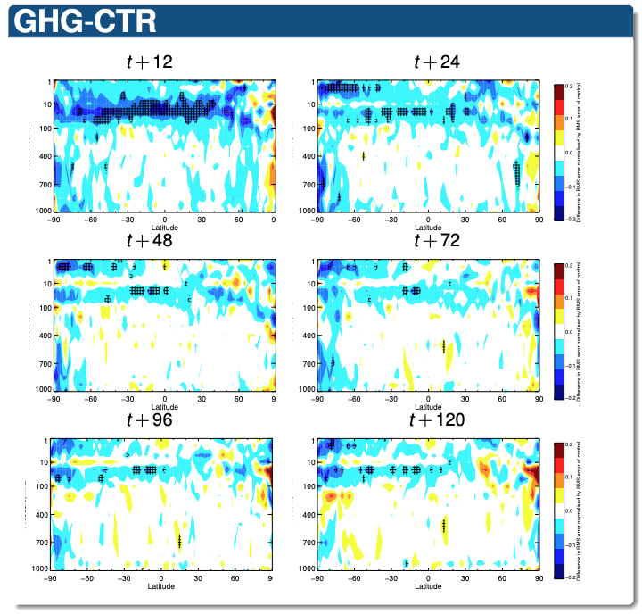
Using the ensemble information
Test using CO2 and CH4 satellite information to constrain NWP: winds, rel hum., temperature
Here, using the ensemble information to correct relative humidity from CO2 and CH4 departures.
Impacts on the stratosphere where the NWP observation coverage is weak
Worse
Better
Worse
Better
Worse
Better
Massart, 2017

Slide 25
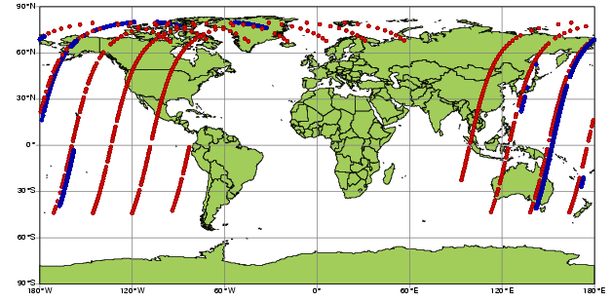
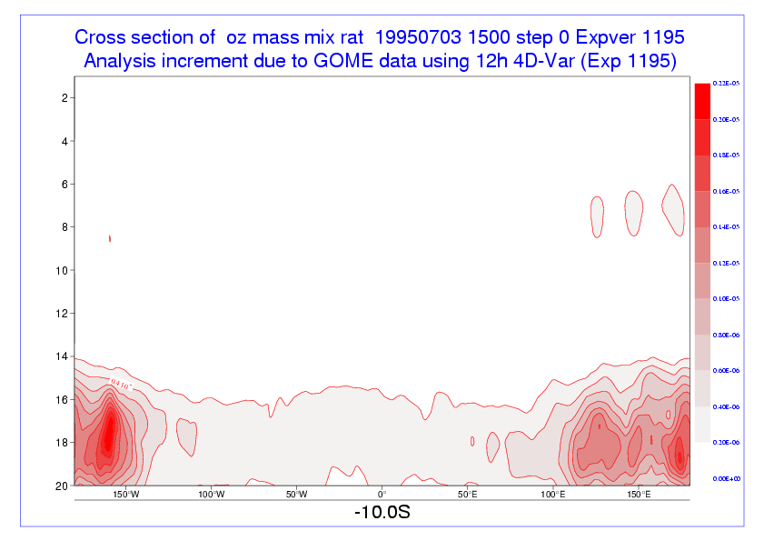
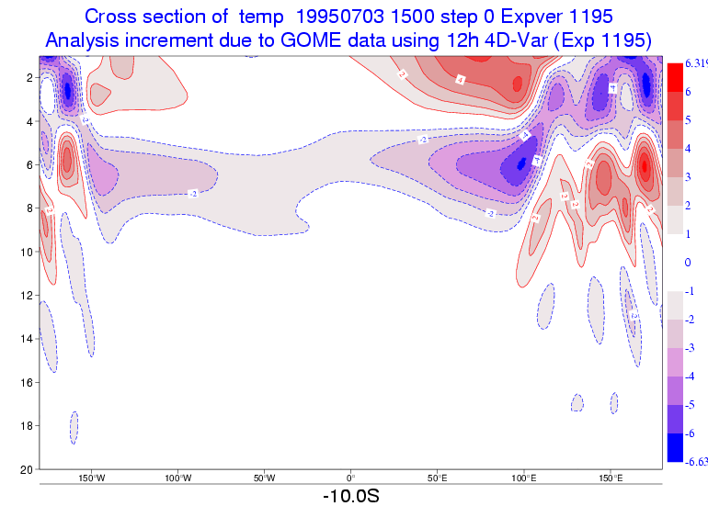
Negative impacts of AC for NWP: Example from ERA-Interim
The stratosphere is not well constrained by observations:
Ozone profile data generate large temperature increments
4D-Var adjusts the flow where it is least constrained, to improve the fit to observations
=> IFS O3 analysis is completely uncoupled now
GOME 15-layer profiles (~15,000 per day)
SBUV 6-layer profiles ( ~1,000 per day)
Ozone increments at 10S
Associated Temp increments
1 hPa
Large systematic O3 increments
20 hPa
D. Dee

Slide 26
Summary
Different data assimilation approaches exist to solve the same problem combine satellite observations with models to provide best estimates and forecasts
One current operational challenge in atmospheric composition is the estimation of surface fluxes and emissions using data assimilation. The operational systems need to evolve and this will be helped by the new generation of satellites
Atmospheric composition is ranging over multiple order of magnitudes in scales: this poses a challenge but also a great opportunity
Atmospheric composition data assimilation could be an added value for numerical weather prediction but to the risk of degradation if not done properly

