Slide 1
An overview of the current in-situ observing system
Paolo Laj
Chair GAW SAG Aerosol/ AOPC panel member
ACTRIS Science chair
Univ-Grenoble-Alpes / Univ. Helsinki

Slide 2
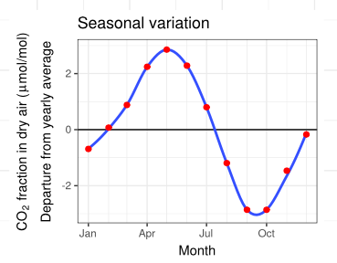
Charles David Keeling 1928 - 2015
Professor Scripps Institution of Oceanography
1957 : Received 2-year funding grant to buy and install CO2 monitors at Mauna Loa
1958 : Reveals the seasonal
variations of CO2 concentrations
1960 : National Science foundation
stops funding. He decides to continue
1963 : Keeling results are used to evidence the CO2 increase and the risks for the climate
2010
2
2

Slide 3
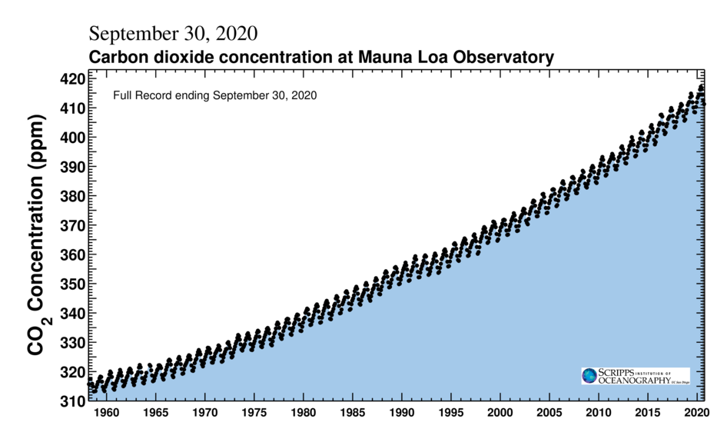
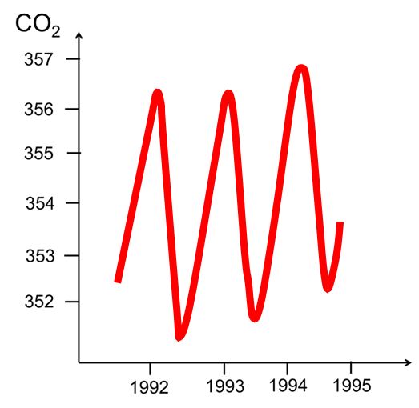
The Keeling Curve 1958 - 2020

Slide 4
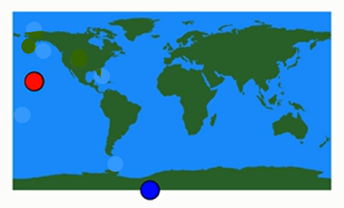
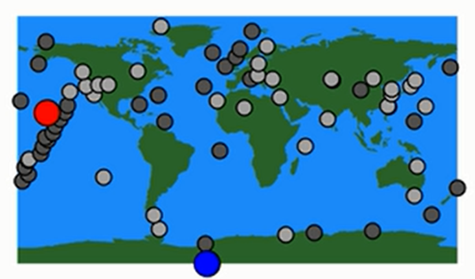
The Keeling Curve 1958 - 2020
Long time series (60 years)
High precision measurements
High density
1960
1980
2000

Slide 5
Climate is not only CO2
“the largest uncertainty to estimates and interpretations of the Earth’s changing energy budget”
Essential Climate Variables (ECVs) defined for a Global Climate Observing System
5
2

Slide 6
Essential Climate Variables (ECVs)
An ECV is variable or a group of linked variables that critically contributes to the characterization of Earth’ s climate.
Criteria for ECVs
Relevance : critical thus limited in numbers
Feasibility: technically, on global scale
Cost effectiveness:
Defined by GCOS (AOPC)
Must be the basis for an operational Climate Observing System

Slide 7
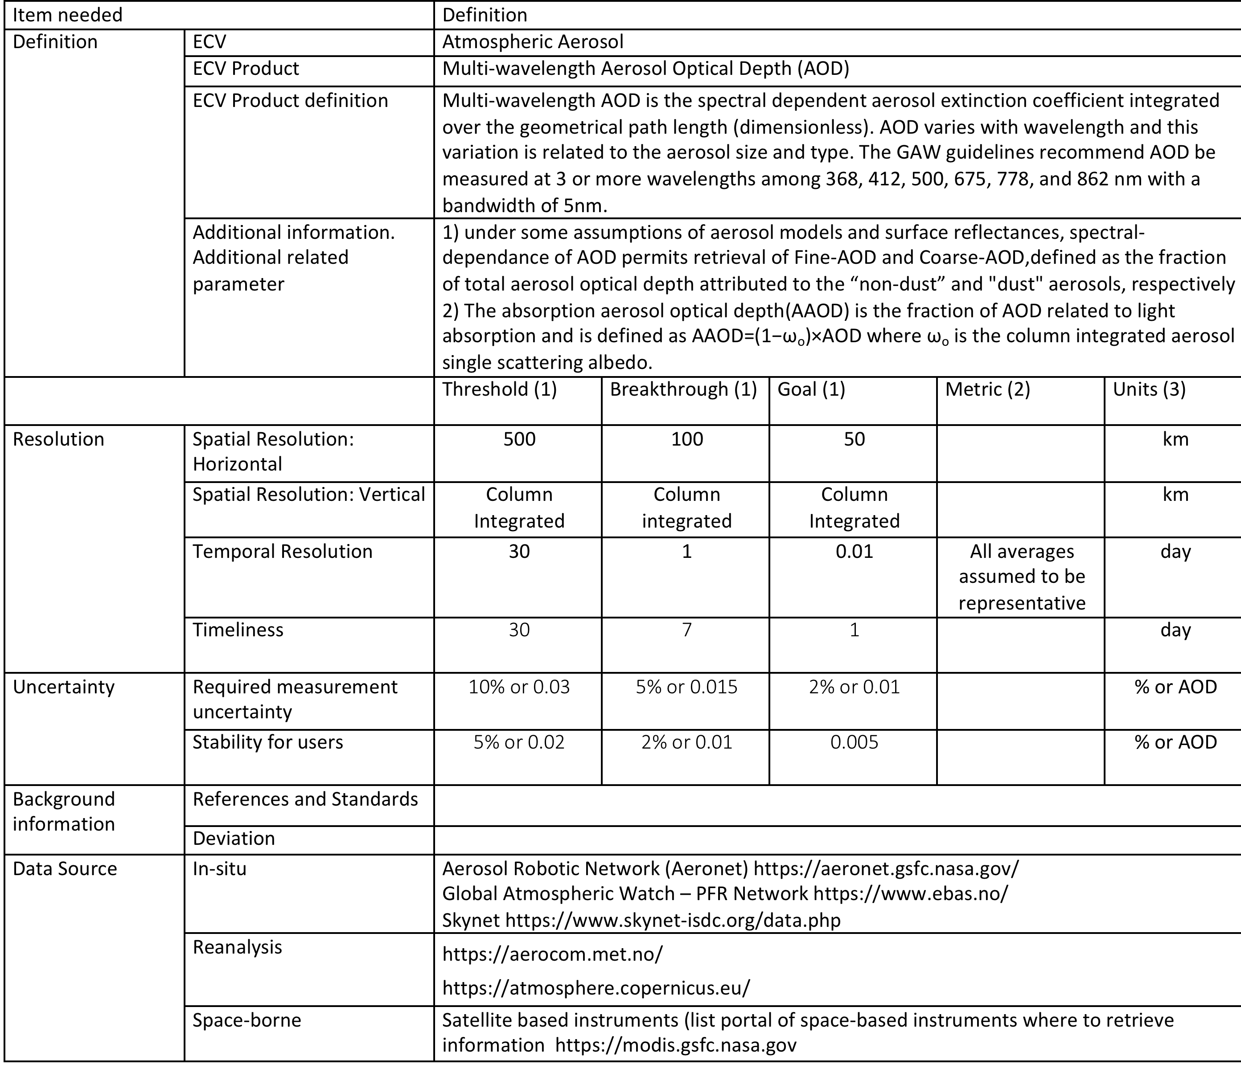
Requirements for ECVs
2

Slide 8
Aerosol ECV products
CURRENT GCOS (2015-2020) | PROPOSED GCOS (2021-2025) | Main Procedures
Optical Depth | Optical Depth | Photometers
Extinction profile | Extinction Profile | Lidars
Layer Height | Abandonned | Lidars, Others
Single Scattering Albedo | Single Scattering Albedo | Retrieved
 | Number Size Distribution | Spectrometers, counters, retrived
 | Chemical composition | Analysis, spectrometers
 | Cloud Condensation Nuclei Concentration | Counters, retrieved
Implementating and operating an Aerosol Observing System for GCOS application is far from trivial
8
2

Slide 9
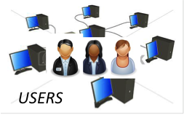
The in-situ Observing System
Data Provision
Central Labs
Data Curation and Access
In-situ means not-space-borne
Multi-players for data provisions central labs, AND, data curation and access
Most widely recognized governance is WMO-GAW, supported by Regional Organizations
NOAA, NASA in the US
Research Infrastructures (ICOS, ACTRIS, IAGOS) in EU
CAS in China
Policy based IMPROVE (US), EMEP (EU)
9
2

Slide 10
The In-situ Observing System - GHG
Data compiled by the World Data Center for Greenhouse Gases (WDCGHG)
Access to data through WDCGHG is delayed
Mainly accessible through NOAA-Global Monitoring Laboratory (US) and ICOS (EU)
10
2

Slide 11
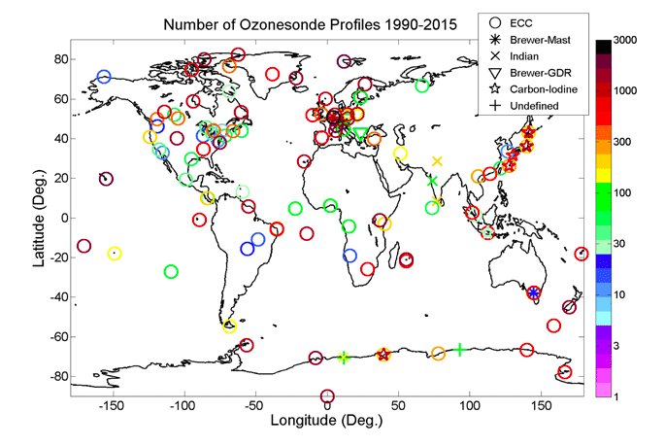
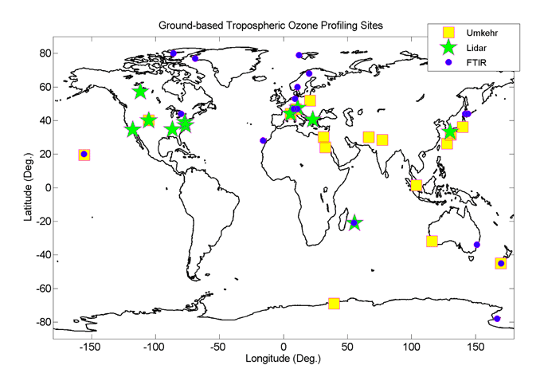
The In-situ Observing System - Ozone
Ozone data are compiled by the Tropospheric Ozone Assessment Report TOAR
Many different organizations are constributing to TOAR
Surface Ozone is reported widely all over the World
Data accessible through TOAR publications (Elementa Special Issue)
Now TOAR II https://igacproject.org/activities/TOAR/TOAR-II
11
2

Slide 12
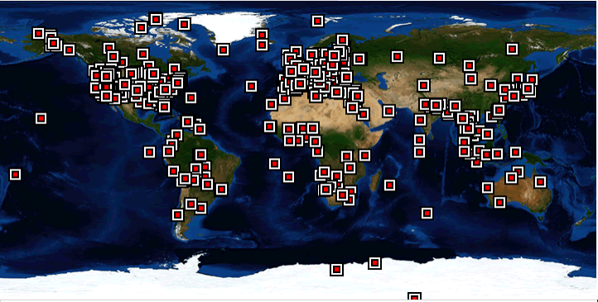
The In-situ Observing System - AOD
Aeronet (NASA) is the most operational and widely used aerosol network
Provides AOD and retrieves other aerosol ECVs
Data access through : https://aeronet.gsfc.nasa.gov/
Completed by Skynet and and PFR (but more limited)
12
2

Slide 13
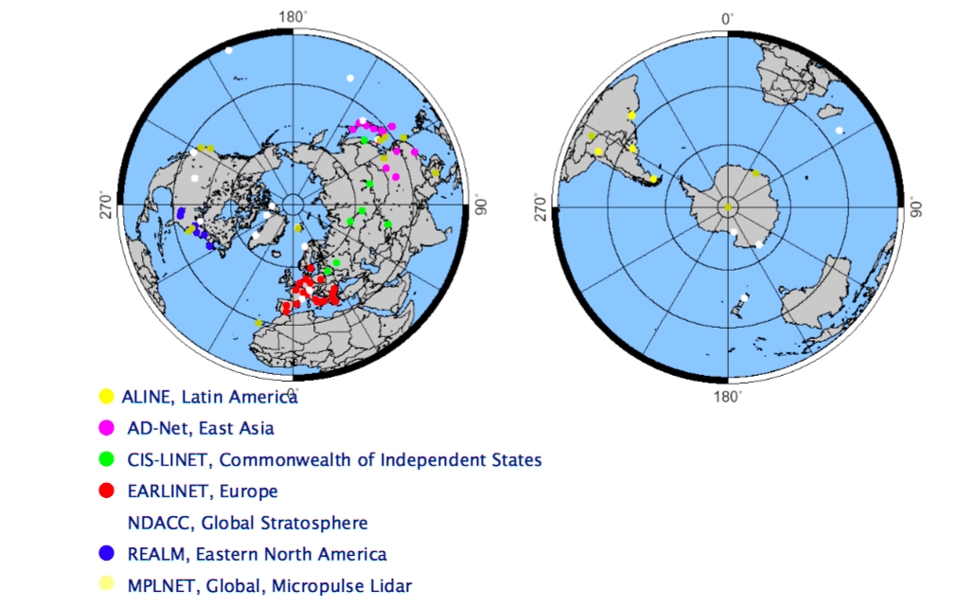
The In-situ Observing System - Extinction
Besides EARLINET (ACTRIS), MPLNET (NASA) and NDACC, data not easily accessible
13
2

Slide 14
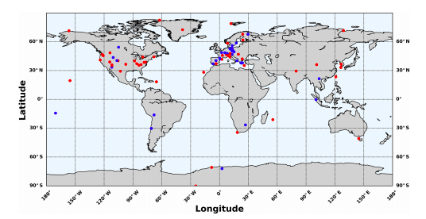
The In-situ Observing System – Aerosol Near-Surface
Data access through the World Data Center for Aerosol (and provided mostly by NOAA-FAN (US) and ACTRIS in-situ (EU)
Data access through : http://ebas.nilu.no/
Each single site Provides several ECVs (SSA, PNSD, CCN, Composition) but rarely all
14
2

Slide 15
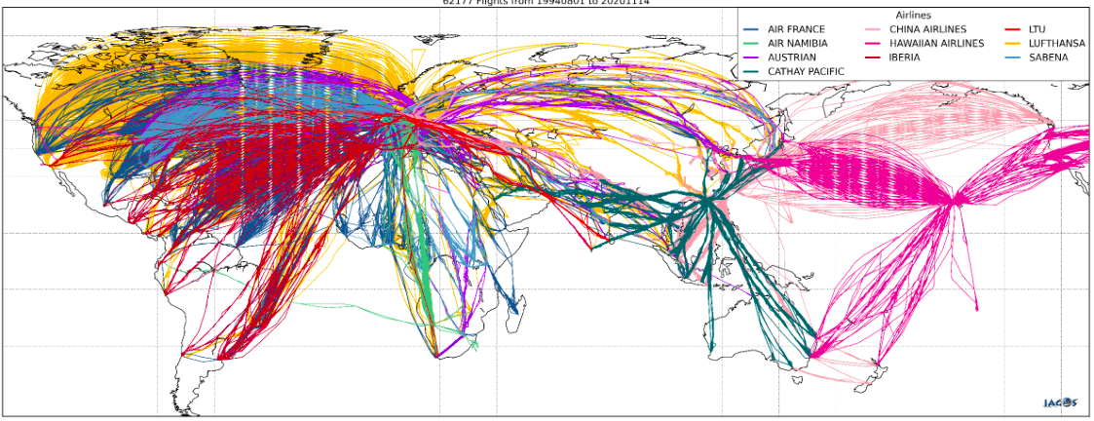
The In-situ Observing System - Airborne
ECVs provided by IAGOS (In-Service Aircraft for a Global Observing System), onboard commercial aircrafts
Data access through : https://www.iagos.org/iagos-data/
Each payload provides reactive gases, ghg and aerosol ECVs
15
2

Slide 16
The In-situ Observing System – Conclusions
The in-situ system is still a complex World for the users with many access points but it is improving through the establishment of interoperable systems
Still a substantial fraction of stations not reporting, in particular when a governing structure is missing
There has been considerable improvments in the quality and time coverage of data although the lack of measurements in many regions of the World is still very problematic
16
2

