Slide 1
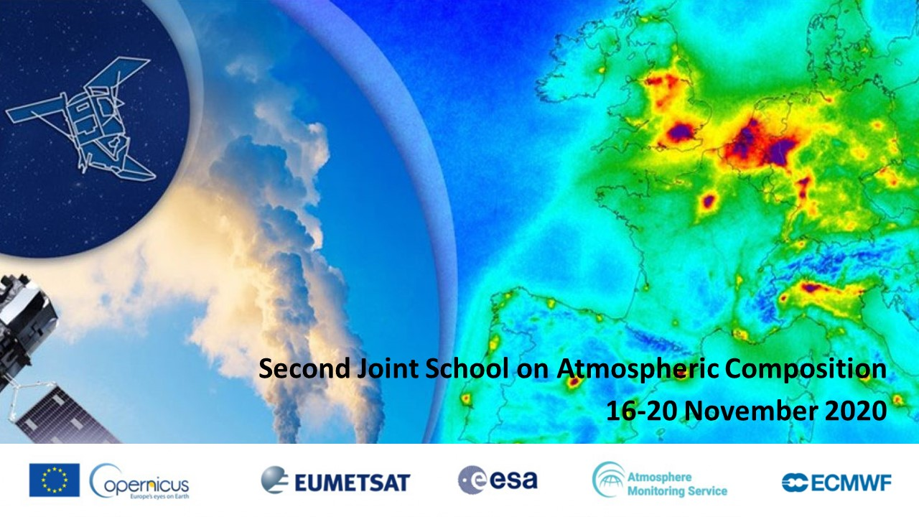
Atmospheric Composition Observations from EUMETSAT Satellites
Rosemary Munro and EUMETSAT colleagues

Slide 2

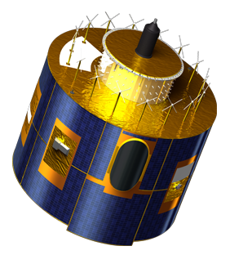
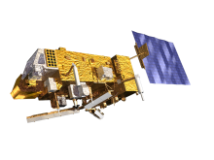
The need for two types of meteorological satellites
Polar orbit
Global coverage
Critical for forecasts up to 10 days
Long range transport
Links geostationary platforms
Geostationary orbit
High temporal sampling
Vital for forecasts up to a few hours
Regional air quality applications

Slide 3
EUMETSAT & Copernicus Sensors for
Trace Gas Observation
Main types of sensors providing measurements for trace gas retrieval:
Geostationary UVNS spectrometers:
→ MTG/UVN (Copernicus Sentinel-4)
Geostationary hyperspectral IR spectrometers:
→ MTG/IRS
Polar-orbiting UVNS spectrometers:
→ EPS/GOME-2, EPS-SG/UVNS (Copernicus Sentinel-5),
→ Copernicus CO₂ Monitoring mission
(high priority candidate mission, not yet approved)
Polar-orbiting hyperspectral IR spectrometers:
→EPS/IASI, EPS-SG/IASI-NG

Slide 4
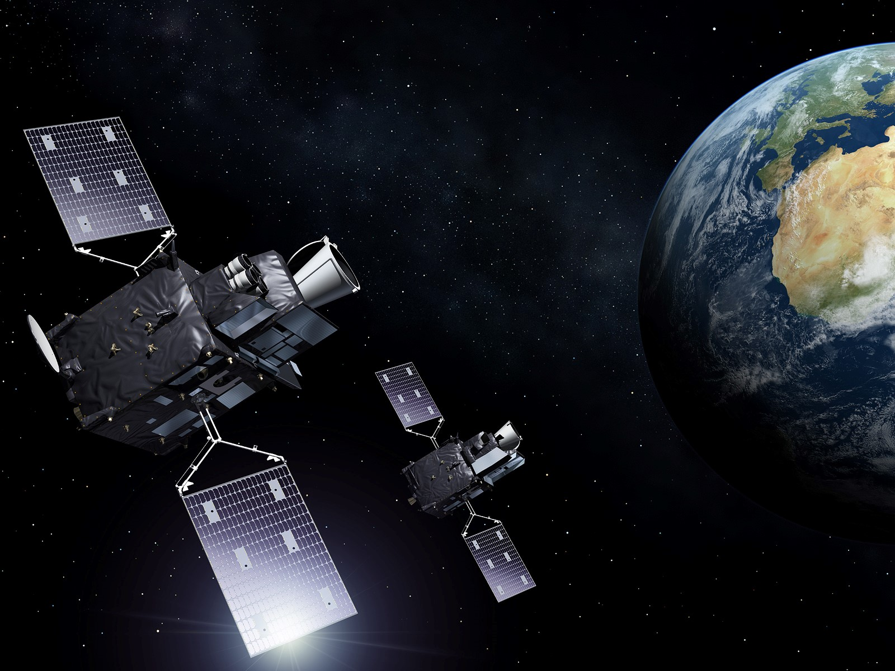
Meteosat Third Generation (MTG): Mission overview
Imagery missions (MTG-I):
  Full disk imagery every 10 minutes in
  16 spectral bands with the Flexible Combined Imager (FCI). Fast imaging of European weather every 2.5 minutes
    Day/night Lightning Imager (LI)
Sounding mission (MTG-S):
    3D mapping of water vapour, temperature with Hyperspectral Infrared Sounder (IRS) + trace gases
    Air quality monitoring and atmospheric chemistry with the Copernicus Sentinel-4 / Ultraviolet Visible & Near-infrared
Start of operations in 2023 and 2024
Operational exploitation: 2023–2042

Slide 5

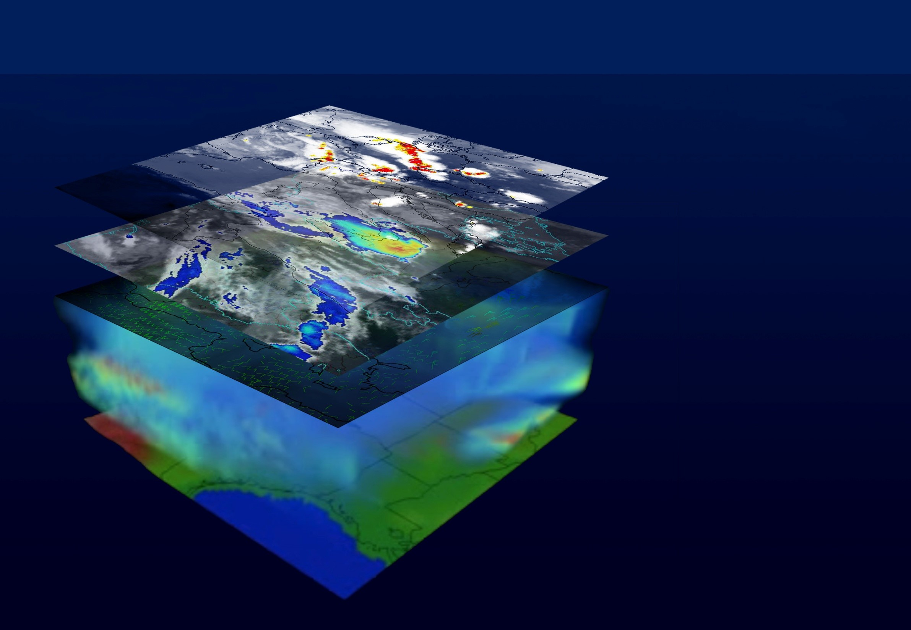
4D Weather Cube with MTG-I and MTG-S
Lightning
Convection
Winds
Atmosphere

Slide 6
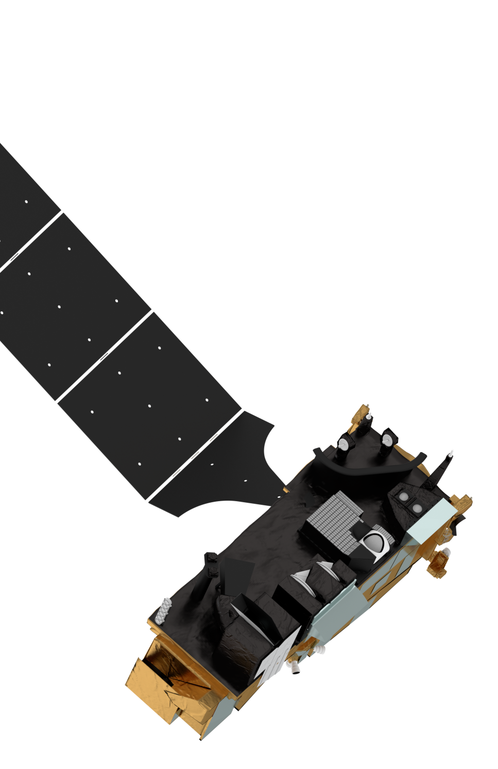
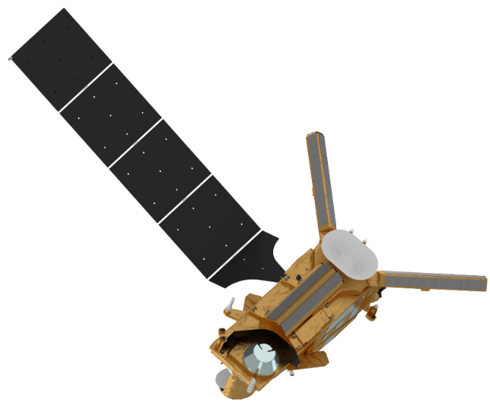

Future Mission EPS-SG: EUMETSAT Polar System - SG
Metop-SG B
SCA
Scatterometer
MWI
Microwave Imager
Radio Occultation
RO
3MI
Multi-viewing,
-channel,
-polarisation Imager
ICI
sub-mm wave Ice Cloud Imager
MWS
Microwave Sounder
Two-satellite configuration Metop-SG-A and –B
on the same orbit, separated by 90°
Metop-like orbit:
→ Sun synchronous
→ low earth orbit at 835 km mean altitude
→ 09:30 local time of the descending node
  Nominal launches:
    2023 Metop-SG A1 2024 Metop-SG B1
    2030 Metop-SG A2 2031 Metop-SG B2
    2037 Metop-SG A3 2038 Metop-SG B3
Sentinel-5
UV-VIS-NIR-SWIR Sounder
METimage
Visible-Infrared Imager
Metop-SG A
IASI-NG
Infrared Atmospheric Sounding Interferometer
– New Generation

Slide 7
GEO_AQ_Constellation_Geophysical_Validation_Needs_1.1_2Oct2019.pdf, ceos.org

Slide 8
Cal/Val & End User Products for Trace Gas Missions
Product (Cal/Val & Trace Gas) | Metop GOME-2 | MTG-S S4/UVN | EPS-SG S5/UVNS | Coper. CO₂ M | Metop IASI | Metop-SG IASI-NG | MTG-S IRS
Radiance | √ | √ | √ | √ | √ | √ | √
Irradiance | √ | √ | √ | √
O₃ total column | √ | √ | √ |  | √ | √ | √
O₃ profile (incl. troposphere) | √ |  | √ |  | √ | √ | √
O₃ tropospheric column | √ | √
NO₂ total column | √ | √ | √ | √
NO₂ tropospheric column | √ | √ | √ | √
SO₂ | √ | √ | √ |  | √ | √ | √
SO₂ Layer Height |  |  | √ |  | √ | √
HCHO | √ | √ | √
CHOCHO | √ | √ | √
BrO | √ |  | √
OClO |  |  | √
HNO₃ |  |  |  |  | √ | √
NH₃ |  |  |  |  | √ | √ | √
CO |  |  | √ |  | √ | √ | √
CH₄ |  |  | √ | √ | √ | √
SIF | √ |  | √ | √
CO₂ |  |  |  | √ | √ | √ | √
H₂O | √ | √ | √
UV Products | √ | √ | √
Surface Reflectance | √ | √ | √
Cells coloured:
blue indicate products to be produced at EUMETSAT, green indicate products to be produced by the AC SAF, orange indicate products not yet committed but possible.
Grey indicate “Not Applicable”

Slide 9
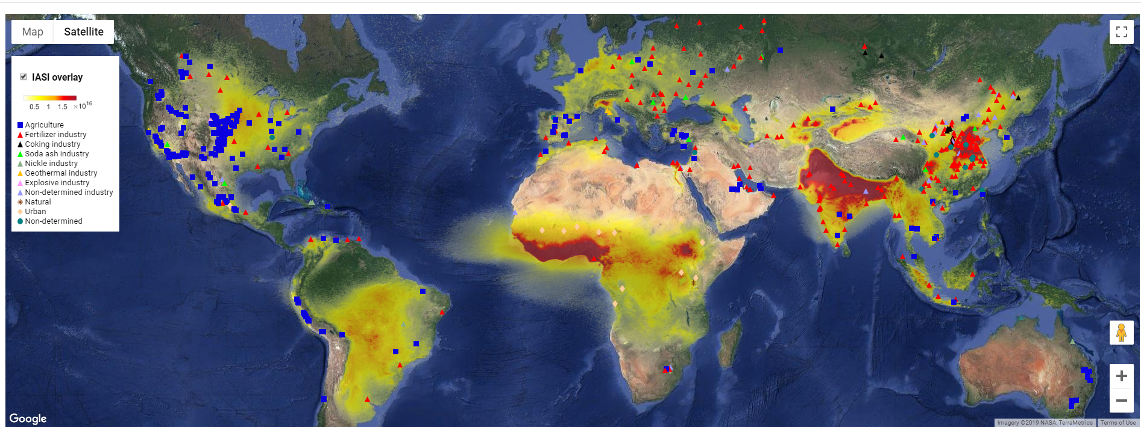
IASI Ammonia (NH₃) https://www2.ulb.ac.be/cpm/NH3-IASI.html
IASI
IASI-NG
Courtesy: ULB/LATMOS

Slide 10

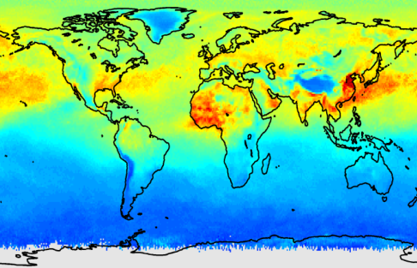
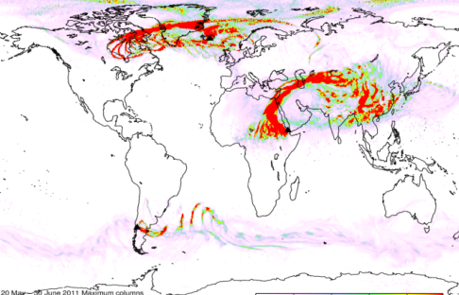
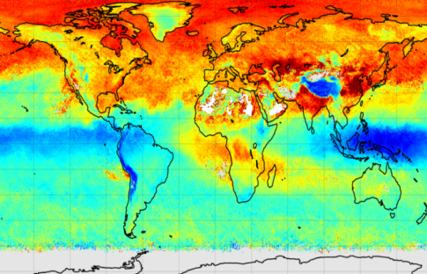
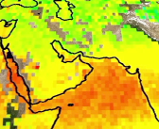

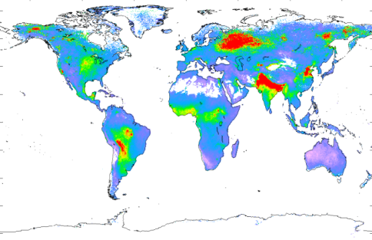
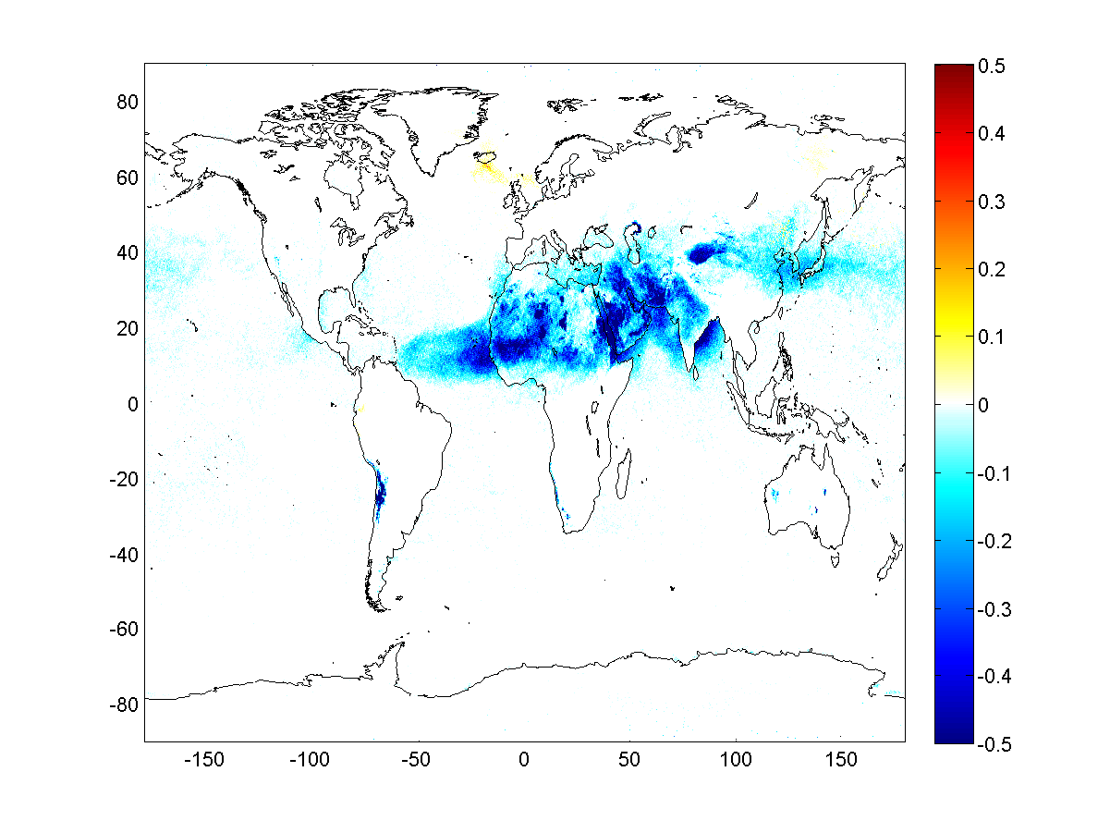
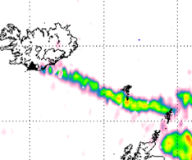


IASI products - operational distribution
Eumetsat (2016 – 2020)
Not AC SAF
CO
SO₂ + alt
O₃
LMD/CH₄
HNO₃
NH₃
Dust
Ash

Slide 11
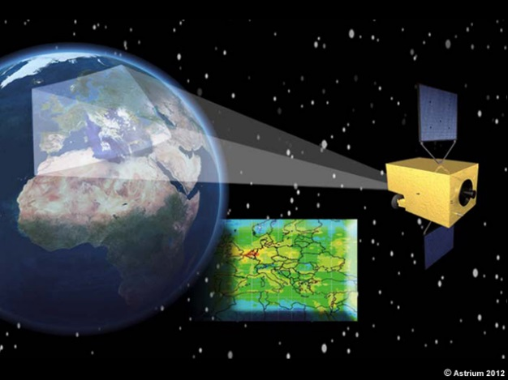
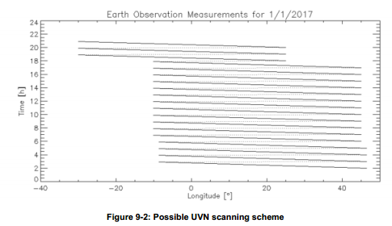
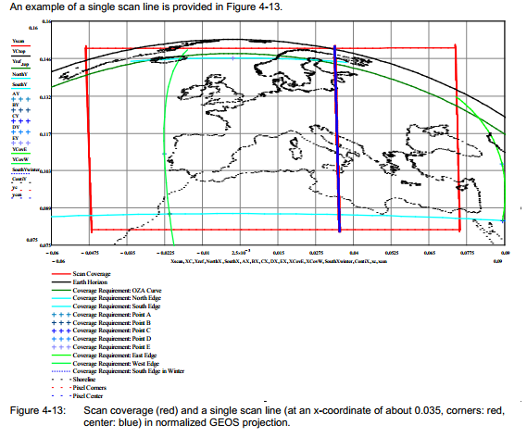
MTG-S Sentinel-4/UVN: UV-NIR Spectrometer
Sentinel-4 has heritage from the GOME/SCIAMACHY/GOME-2/OMI
series of instruments
Primary focus is the monitoring of air
quality in the European domain with
high spatial and temporal resolution
The spatial resolution will be ~ 8 x 8 km with hourly temporal resolution
Sentinel-4 level 1 and 2
products will be produced
operationally by EUMETSAT
Products: O₃, NO₂, SO₂, HCHO, (CHOCHO), UV, AAI, AOD, ALH, FCI support, CLD, HSC, SUR

Slide 12
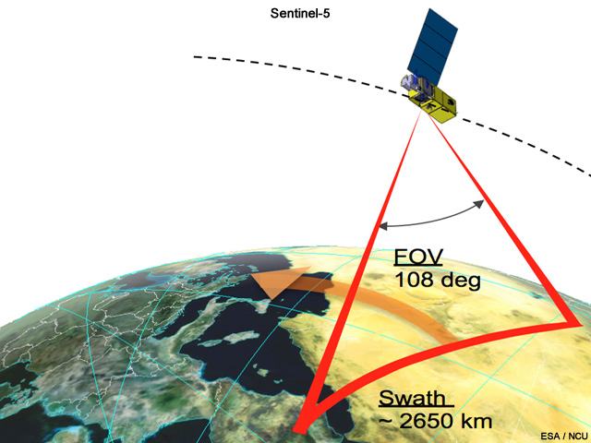
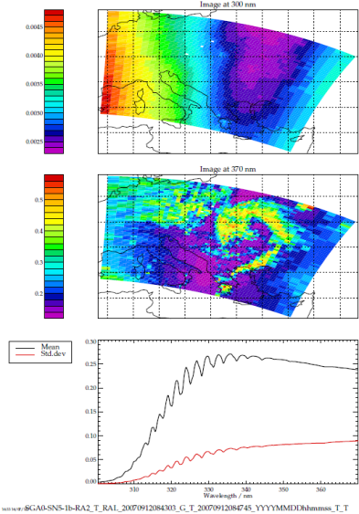
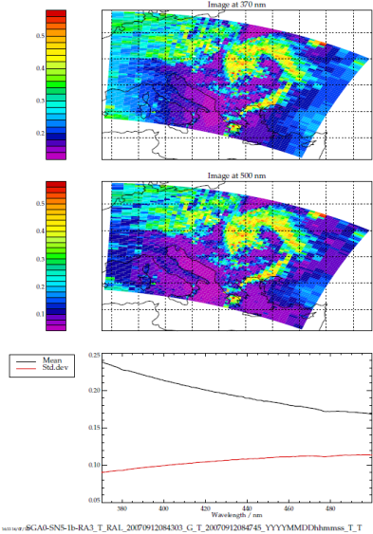
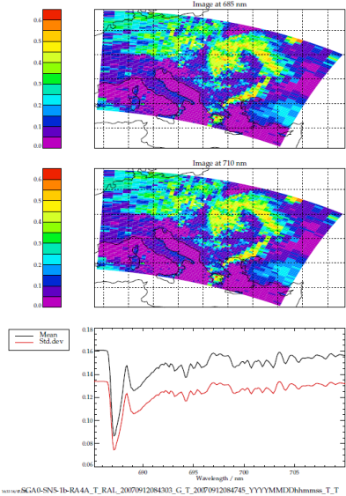
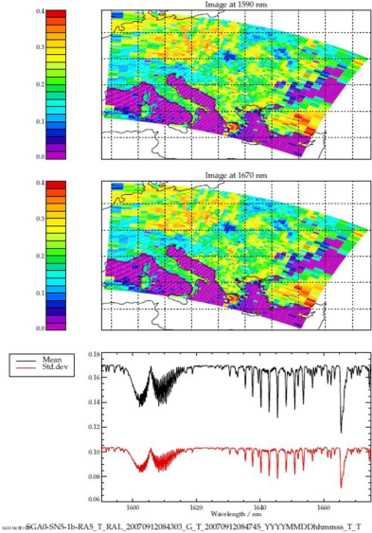
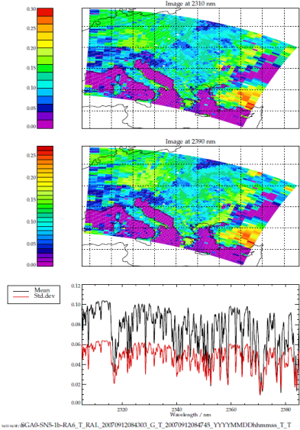
EPS-SG Sentinel-5/UVNS: UV-NIR-SWIR Spectrometer
Sentinel-5 will build on the heritage from the GOME/SCIAMACHY/GOME-2/OMI series of instruments and will provide continuity with these instruments
The spatial resolution will be significantly improved compared to previous missions
(~ 7 x 7 km at SSP), which is important to support development of air quality applications
Sentinel-5 level 1 and 2 products will be produced operationally by EUMETSAT
Products: O₃, NO₂, SO₂, HCHO, CH₄,
CO, CHOCHO, UV, AAI, AOD, ALH,
CLD, HSC, SUR

Slide 13
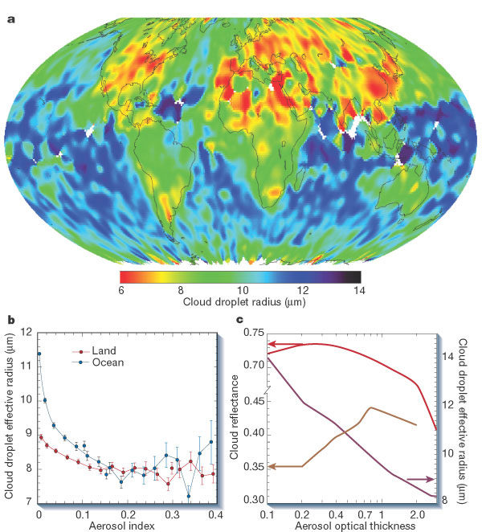
Multi-viewing multi-channel multi-polarisation Imaging
Objectives of a new mission
Aerosol – optical thickness, particle size,
type, height, absorption
Volcanic Ash
Cloud phase, height, optical depth
Surface albedo
Implementation
  ESA development
Key performances
12 channels: 0.41 – 2.13 µm
3 polarisations: 0°, 60°, -60°
14 views
radiometric bias: 3%
SNR: 200
spatial sampling: 4 km
push-broom scan (2200 km swath)
Kaufman et al. (2002)
Breakthrough:
Enhanced spatial sampling (4 km)
  Improves separation of cloudy areas
12 spectral channels (9 polarised), extending into the UV and SWIR
  Better aerosol characterisation
Higher angular resolution (14 views)
  Better phase function characterisation

Slide 14
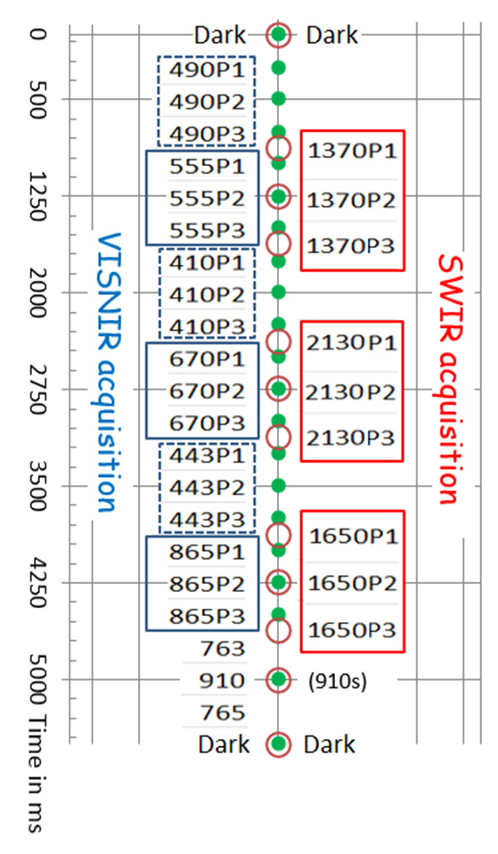
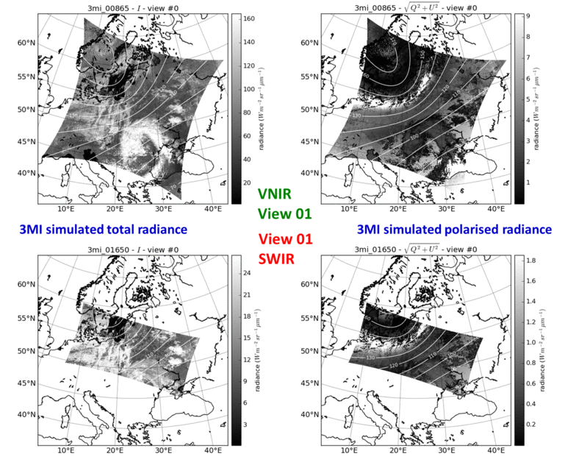
3MI: Instrument Concept
2D Push-broom radiometer (2200 km swath, 4 km pixel at nadir) with: - Multi-view: 1 ground target is seen 14 times
    VISNIR : 1 view every 22s, ~9° between 2 successive views
    SWIR : 1 view every 11s, ~4.5° between 2 successive views
    - Multi-channel (12 channels from 410 to 2130 nm)
    - Multi-polarisation (9 channels with -60°, 0°, +60° polarisers)
3MI channels
410-P ± 10 nm
443-P ± 10 nm
490-P ± 10 nm
555-P ± 10 nm
670-P ± 10 nm
763 ± 5 nm
765 ± 20 nm
865-P ± 20 nm
910 ± 10 nm
VNIR
Optical Head
CCD VNIR
Detector
(509x509 pixels)
c
c
c
c
c
c
c
c
c
c
c
c
c
c
c
c
c
c
c
c
Filter wheel
1370-P ± 20 nm
1650-P ± 20 nm
2130-P ± 20 nm
CMOS SWIR
Detector
(255x499 pixels)
SWIR
Optical Head

Slide 15
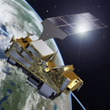
Towards an EPS-SG Hyper-Instrument
3MI/S5/IASI-NG/VII - MAP
Combining co-locations of VII/Sentinel5/IASI-NG observations with co-registered multi-viewing observations (3MI) on 3MI multi-viewing fixed grid.
Sentinel-5
UV-Vis-SWIR hyper spectral sounder
IASI-NG
IR hyper spectral sounder
Co-location and co-registration
EPS-SG
hyper-instrument
METimage
Very high spatial resolution,
multi channel imager
0.29 – 15μm
0.5 – 7 km²
~ 19000 channels
3MI
Multi-viewing,
Multi-polarisation,
Multi-channel imager
EPS-SG Platform
Initial product: Multi-sensor Aerosol product (MAP)

Slide 16
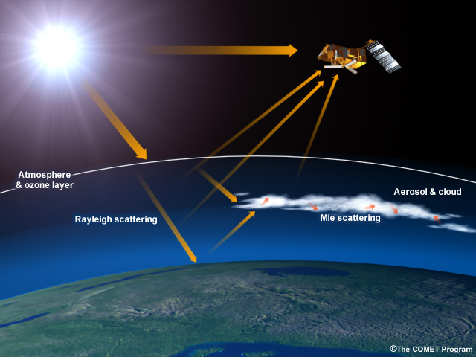
Atmospheric composition measurement Techniques
UV/Visible/NIR/SWIR (UVNS) Solar Backscatter
I₀ Spectral
Solar
Irradiance
I Spectral
Radiance
Measurement
Concept

Slide 17
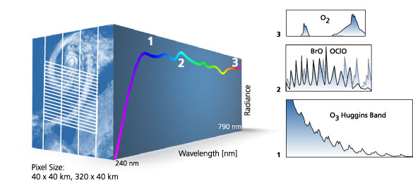
The GOME-2 instrument on Metop
Measuring atmospheric composition from space
Spectra collected from 240‑790 nm
80 km × 40 km (main channels) 80 km × 10 km (PMD)
Courtesy: WDC – DLR

Slide 18
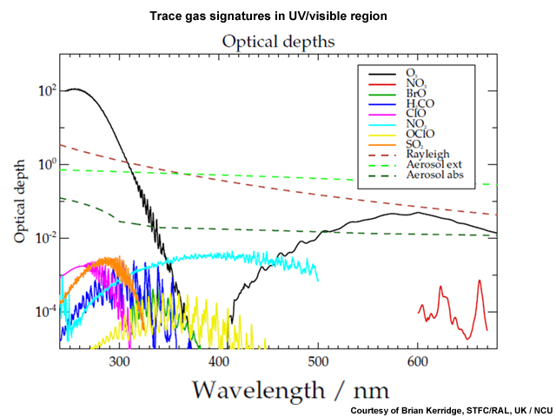
Atmospheric Composition Measurement Techniques:
UV/Visible Solar Backscatter
Many trace gases are measured in the UV/Visible spectral range.

Slide 19
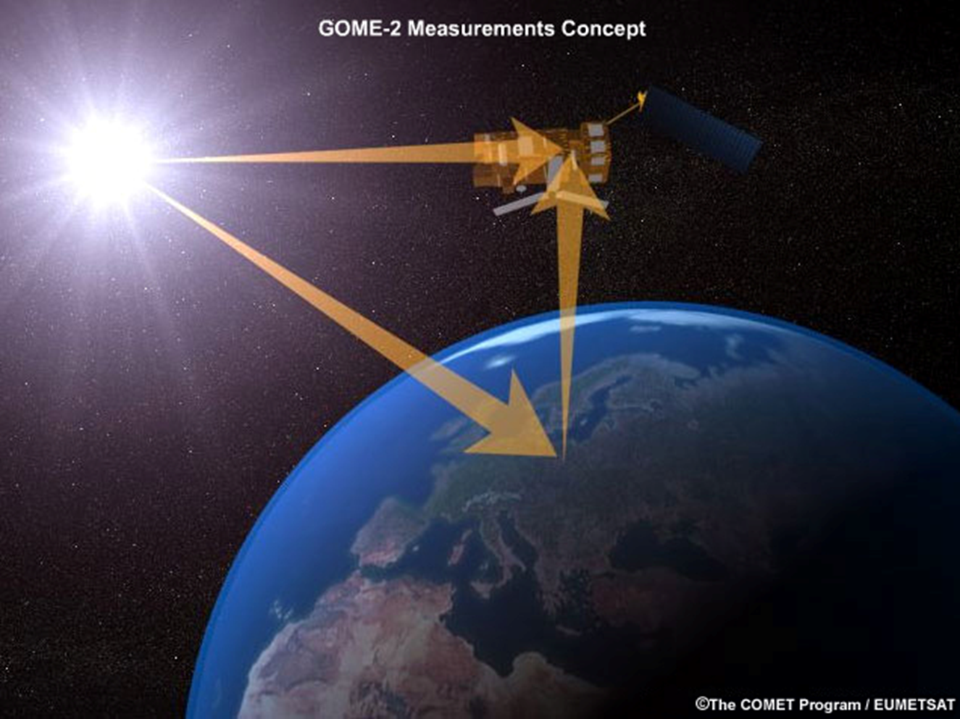
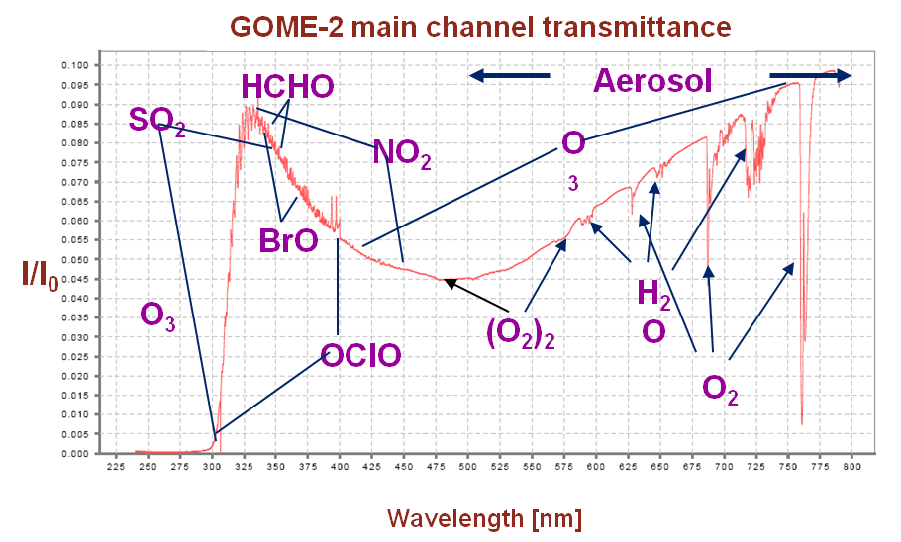
I₀ Spectral
Solar
Irradiance
I Spectral
Radiance

Slide 20
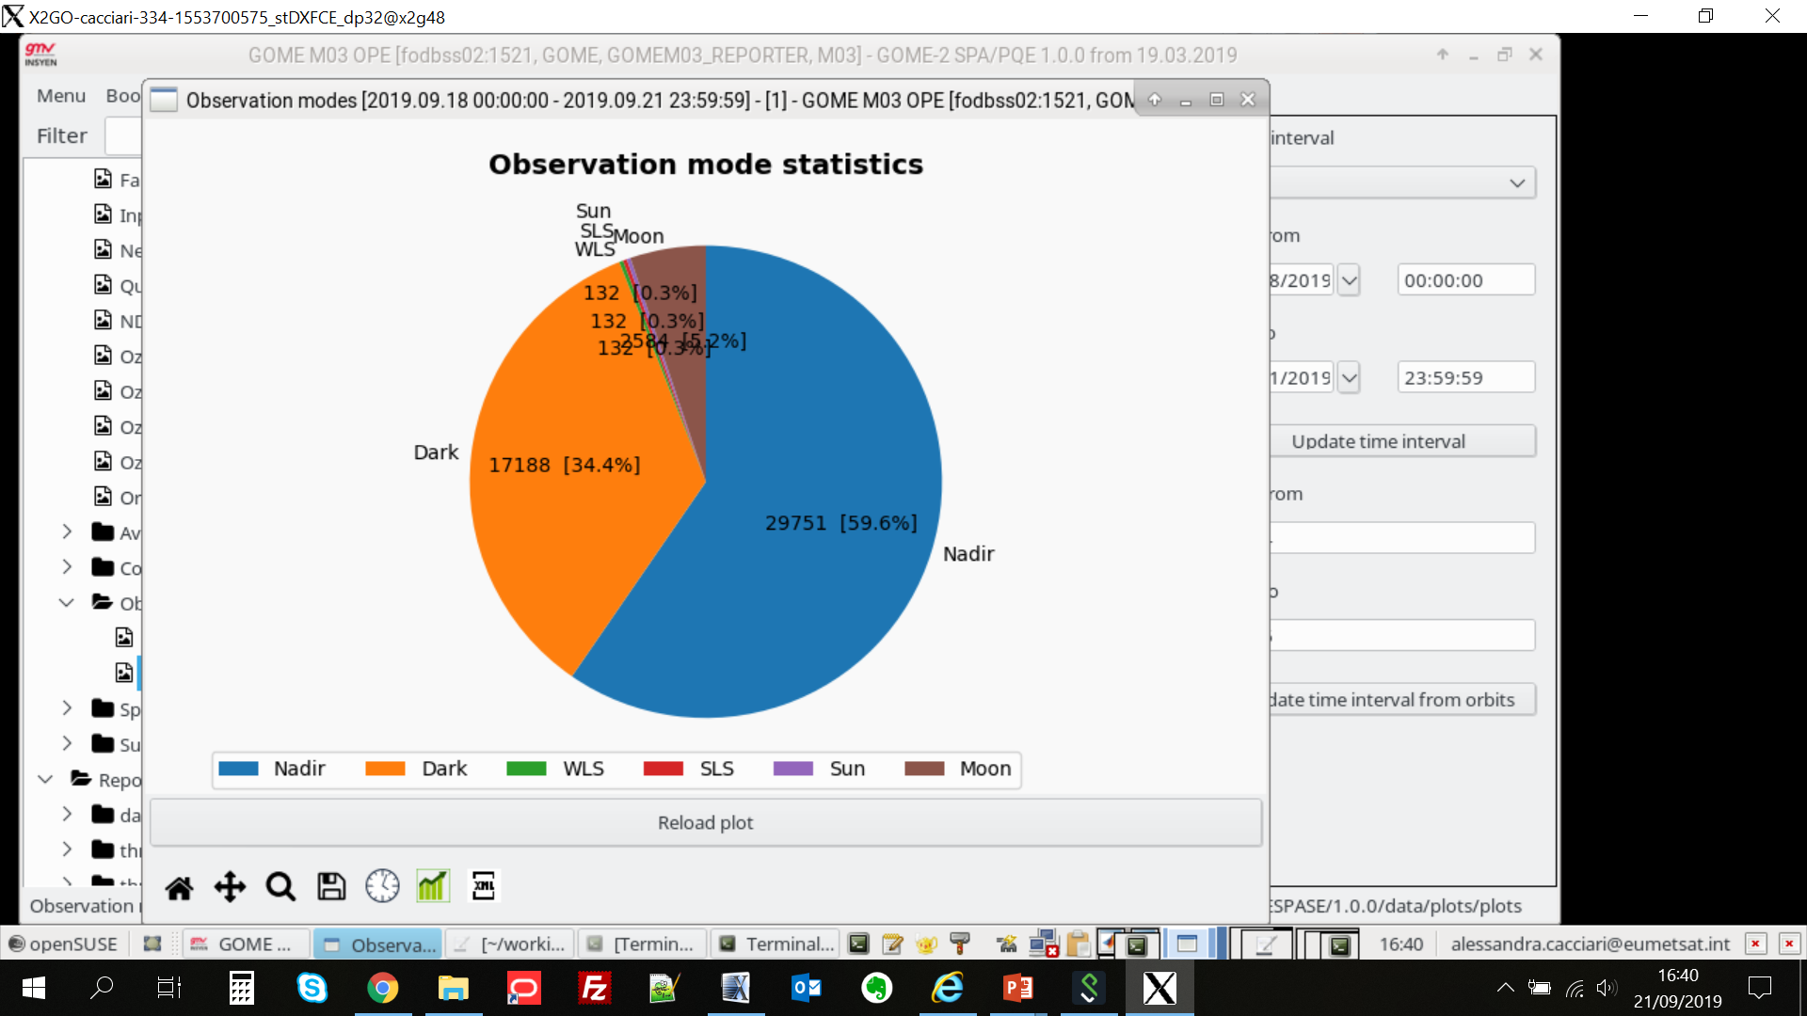
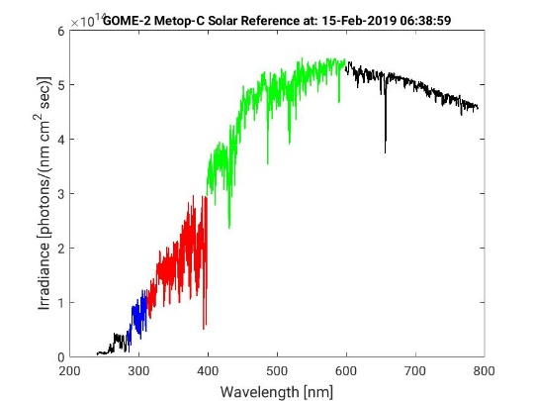
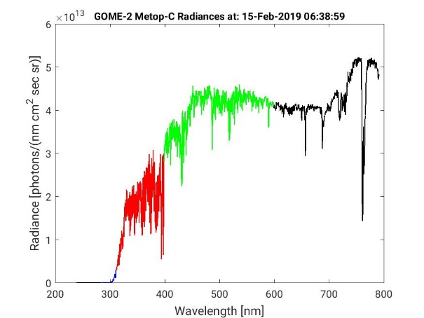
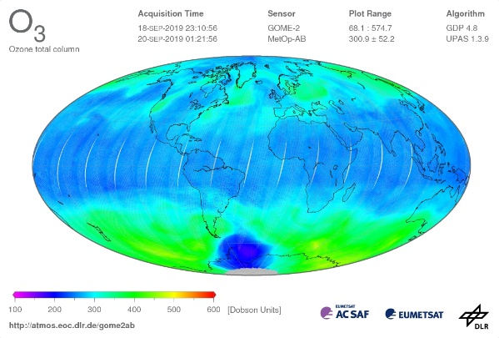
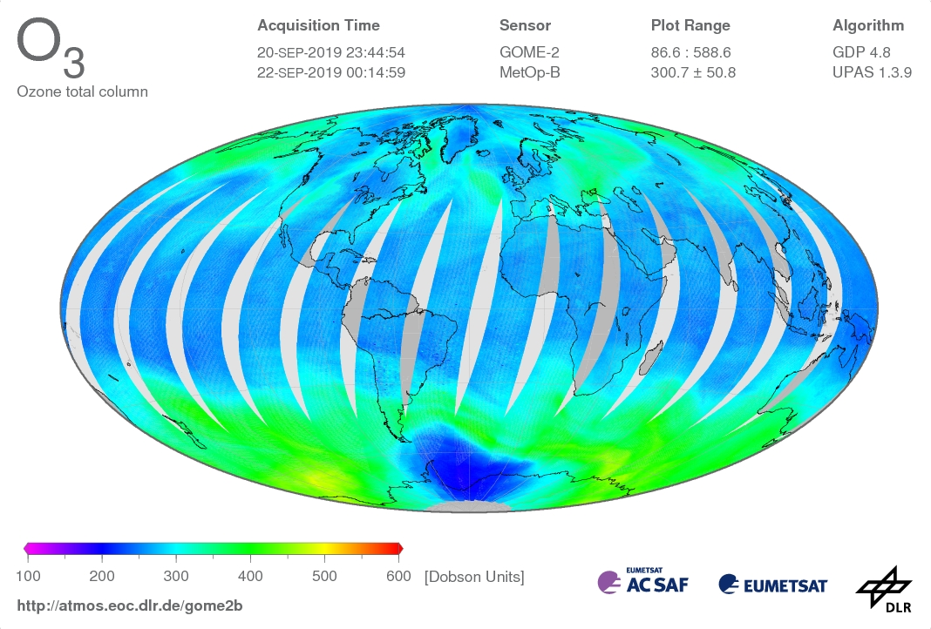
Data Processing Levels
Data Level | Description
Lev0 | Reconstructed, raw instrument data and payload data at full resolution [BU]
Lev1A | Reconstructed, unprocessed instrument data at full resolution, time-referenced, and annotated with ancillary information, including in-flight calibration coefficients and georeferencing parameters computed and appended but not applied to Level 0 data
Lev1B | Level 1A data processed geolocated and calibrated radiance Earthshine data Solar Spectrum measurements [Wm²sr⁻¹um⁻¹, Wm²um⁻¹]
Lev2 | Retrieved geophysical variables at the same resolution and location as Level 1 source data
Lev3 | Variables mapped on uniform space-time grid scales, usually with some completeness and consistency.

Slide 21
Data Processing Steps: CALIBRATION
 | Processing
Lev0 TO Lev1B | Signals calibration and correction producing measurements independent from the instrument INPUT instrument signal + Calib Coeff [BU] On-Ground In-flight - scene-dependent corrections polarisation straylight - instrument-dependent corrections for GOME e.g. dark signal, PPG, etalon, … spectral calibration (ISRF) radiometric calibration geo-referencing OUTPUT radiance, irradiance [Wm²sr⁻¹um⁻¹, Wm²um⁻¹] Spectral radiance in the UV-VIS-NIR Solar spectra in the UV-VIS-NIR

Slide 22
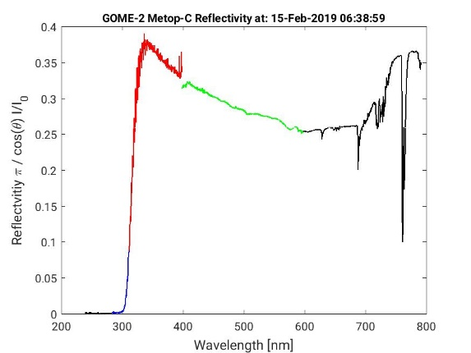
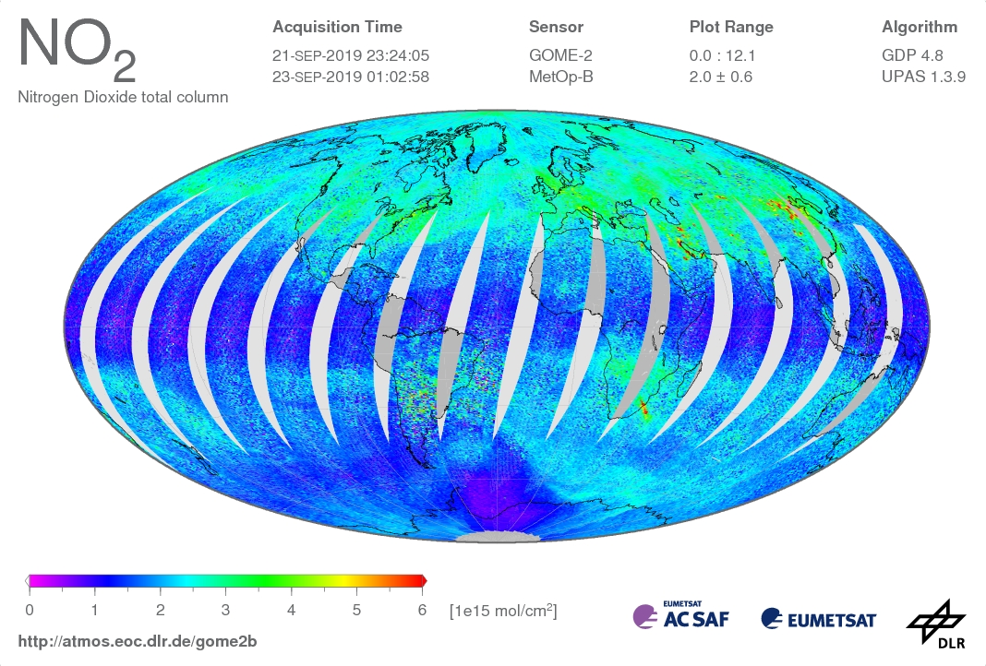
Data Processing Steps:
RETRIEVAL
 | Processing
Lev1B TO Lev2 | Retrieval Techniques INPUT radiance, irradiance + auxDB [Wm²sr⁻¹um⁻¹, Wm²um⁻¹] RETRIEVAL Full physics retrieval (OE) Fast retrieval (DOAS, AAI) OUTPUT O₃ [DU], NO₂ [molec cm⁻²], HCHO, BrO, SO₂

Slide 23
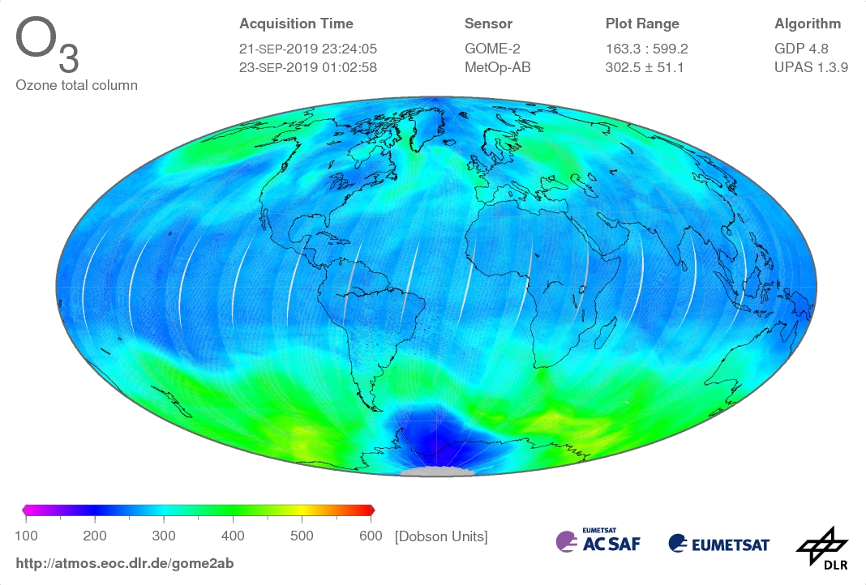
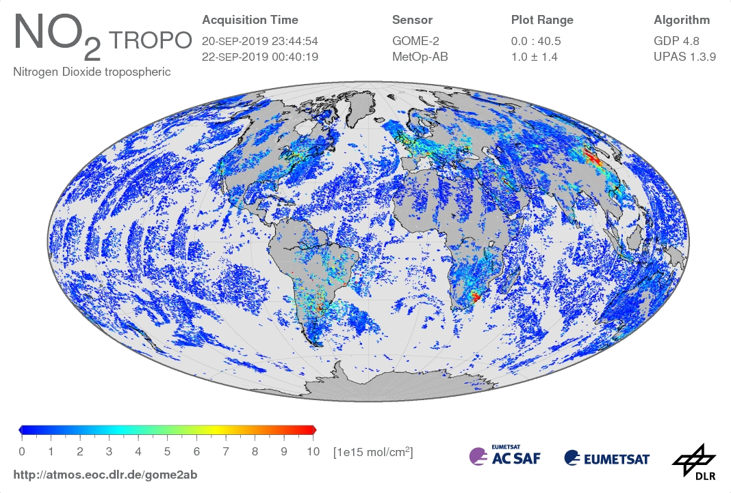
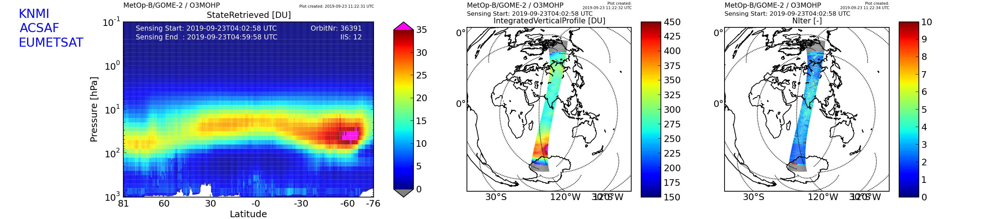
GOME-2 L2 Products

Slide 24
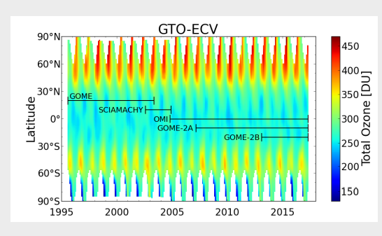
GOME-2 L2 products
Total Ozone
The same retrieval algorithm is applied to measurements of from GOME/ERS-2, SCIAMACHY/ENIVSAT, OMI/AURA and
GOME-2/Metop-A and Metop-B
monthly latitudinal mean of the merged data set for the time period between 1995 and 2017
the merged data set is regularly extended
Covering a period of more than 22 years the time series can be used to determine trends,
or look for correlations with other datasets
Heue, K. 2018. ‘Two Decades of Homogenized Satellite Ozone Measurements for Climate Services’. In: Deutsche Klima Tagung.

Slide 25
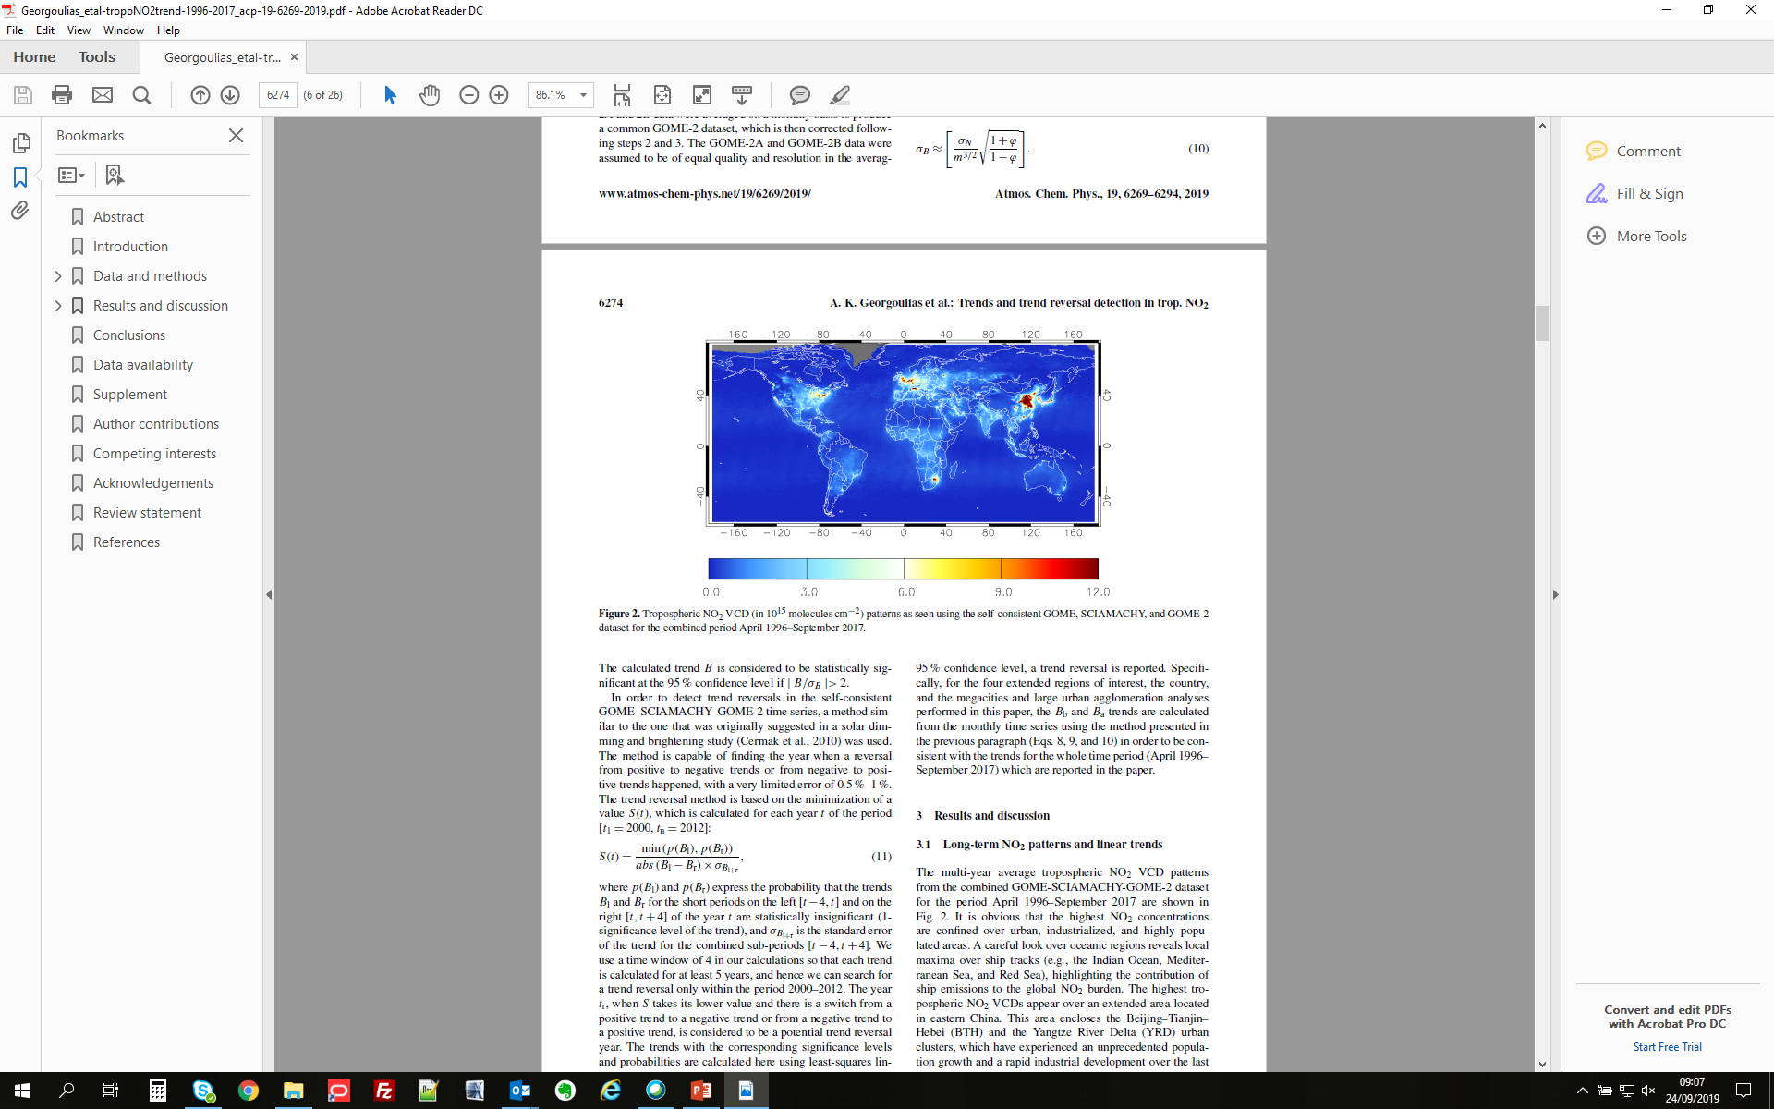
GOME-2 L2 products and applications
Tropospheric NO₂
ACP

Slide 26
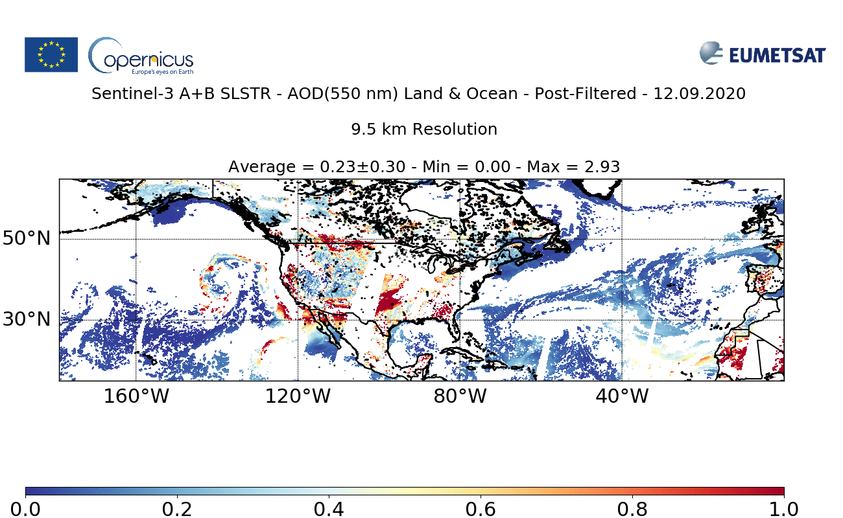
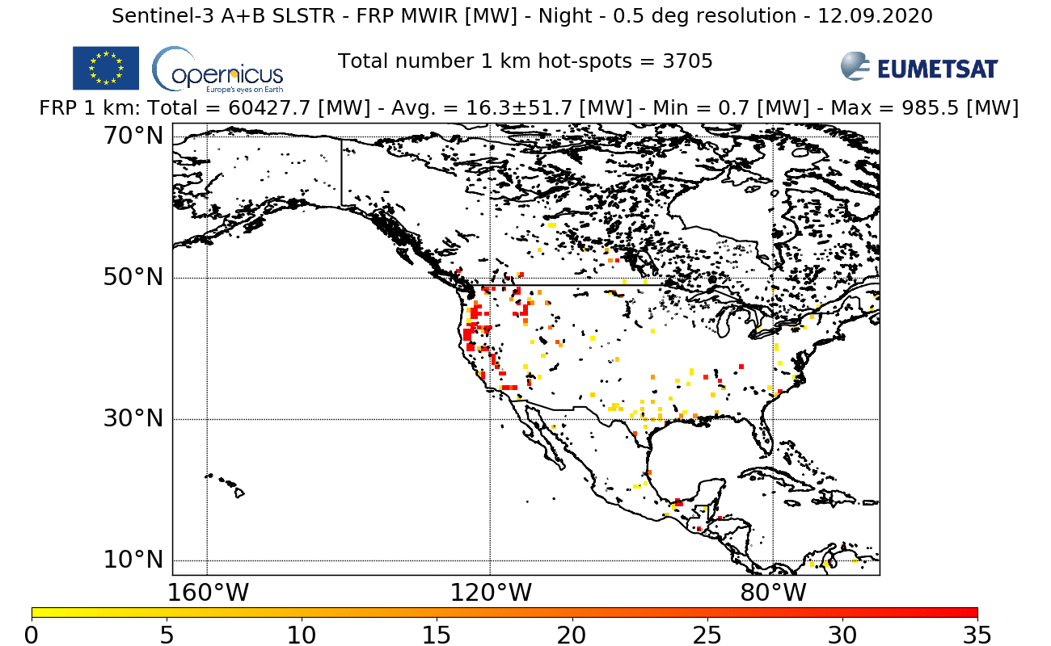
Copernicus Sentinel-3 Aerosol & FRP
California fires 2020: 12-20 September
From Copernicus Sentinel-3 A+B NRT Atmospheric L2 products deployed by EUMETSAT
NRT FRP Processor v2.0, Baseline Collection 1
NRT AOD Processor v2.0, Baseline Collection 1
NRT FRP
NRT AOD

Slide 27
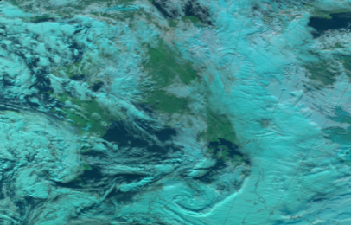

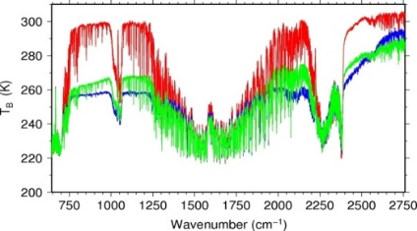
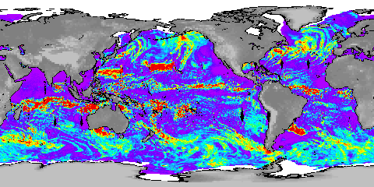




Synergy of Observation Missions
Observation missions are
highly complementary
Co-registration of measurements will allow to optimise the information extraction
Synergy to be considered in payload distribution of a dual satellite configuration
Essential co-registrations
IASI-NG – METimage – S5/UVNS
MWI - ICI
Desired co-registrations
IASI-NG – MWS
METimage – 3MI
IASI-NG – S5/UVNS – 3MI
MWI – SCA – METimage

Slide 28
EUMETSAT operational products
NRT and offline data sources
EUMETSAT data is available in near-real time
via EUMETCast in EPS native (and netcdf4).
See our Product-Navigator under
www.eumetsat.int > Data
Full orbit offline data. Available from the EUMETSAT archive
http://archive.eumetsat.int
Documentation (user guides etc.):
www.eumetsat.int > Data > Technical documentation

Slide 29
Thank you

