Slide 1
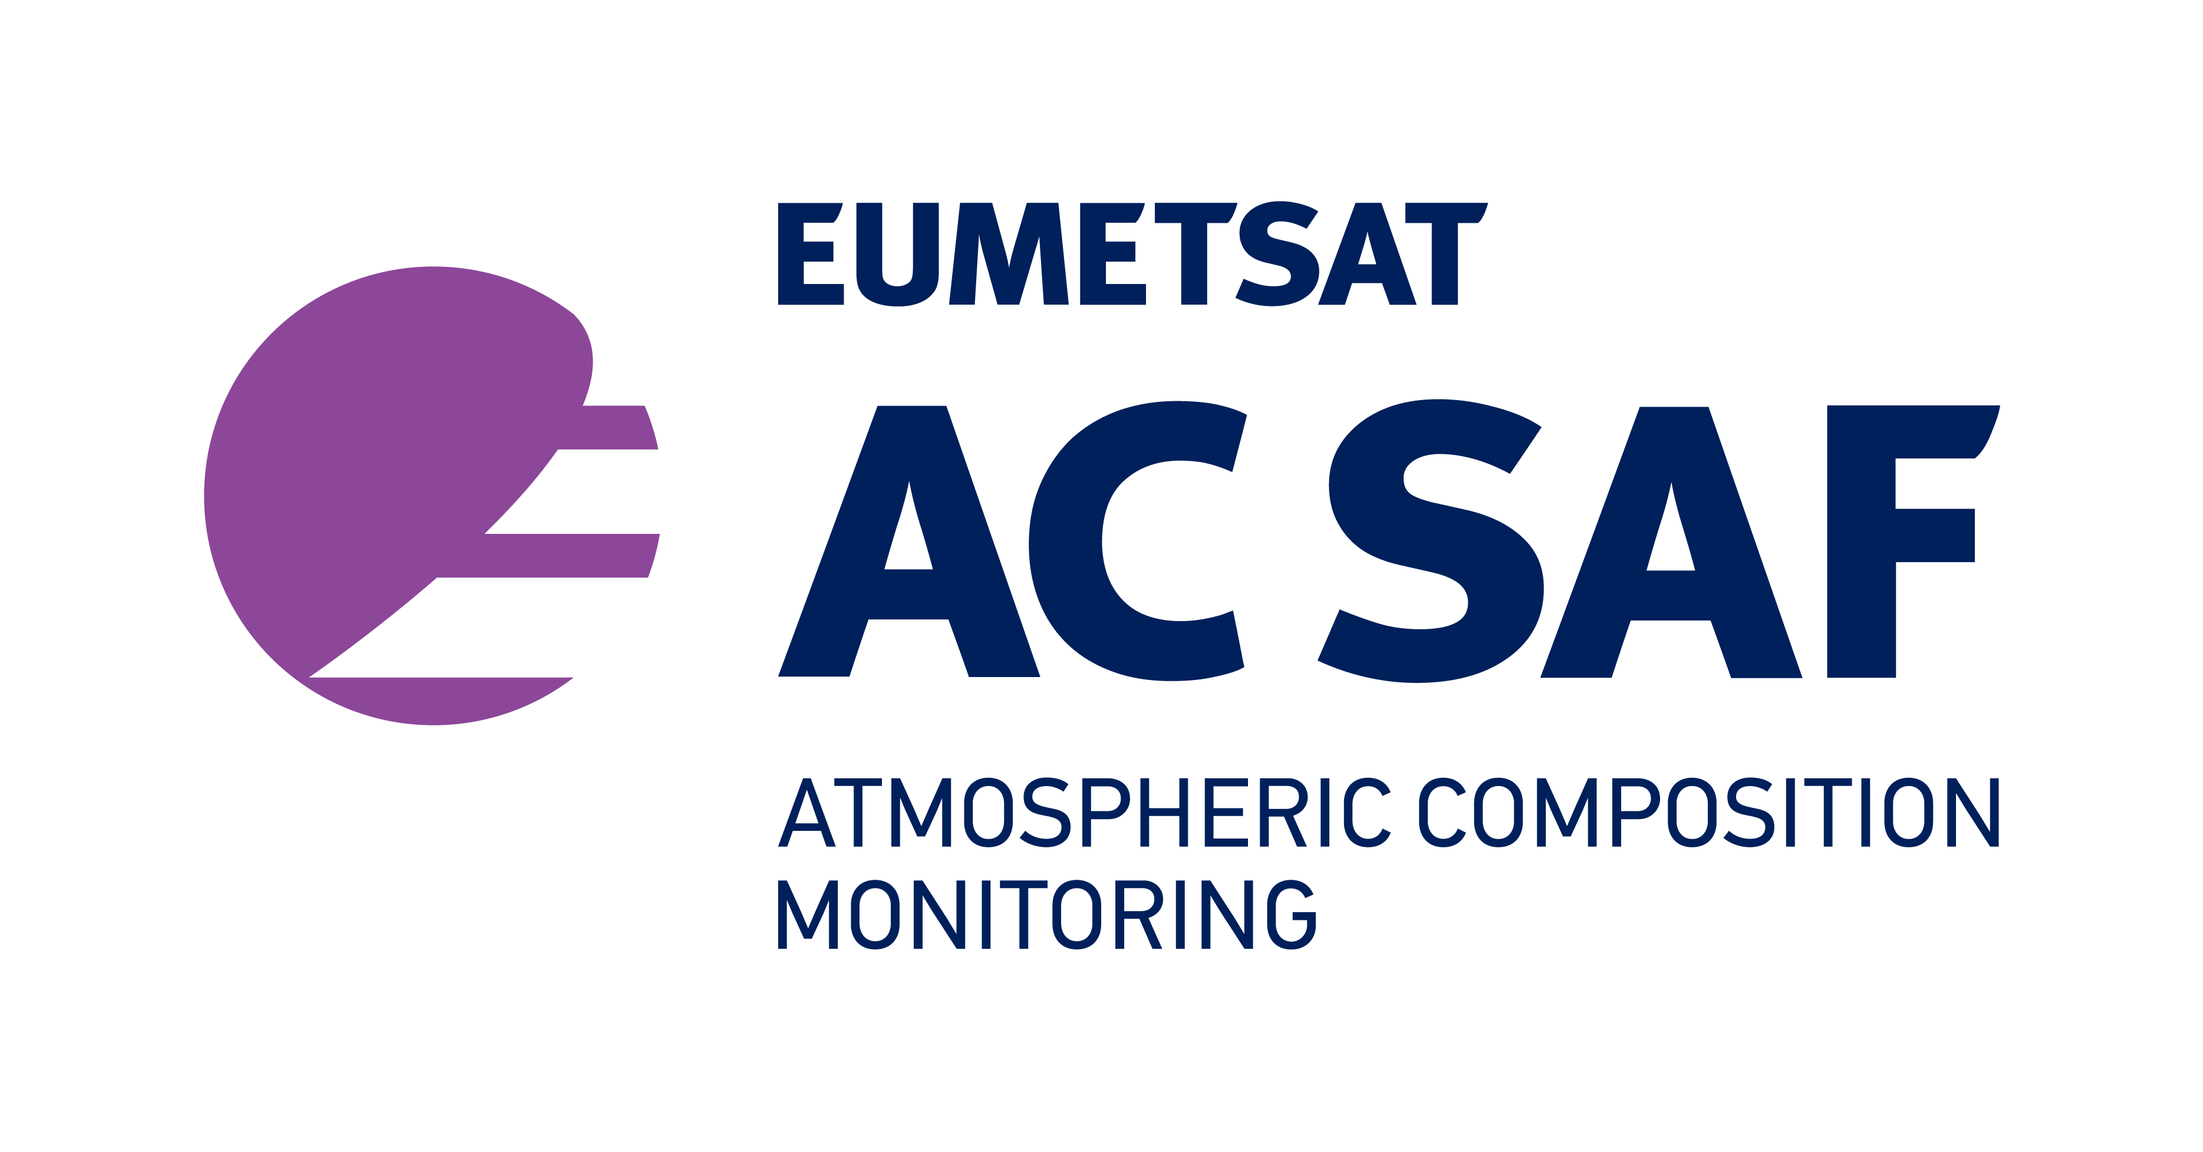
Satellite Applications on Aerosols:
From Local Sources to Long Range Transport
Anu-Maija Sundström, Finnish Meteorological Institute & EUMETSAT Atmospheric Composition Monitoring SAF (AC SAF)

Slide 2
Contents of the Lecture
Introduction
Satellite Observations of Aerosols
AOD
Absorbing Aerosol Index
Absorbing Aerosol Height
Example case: US Fires in September 2020

Slide 3
AEROSOLS
Solid or liquid particles suspended in the Earth’s atmosphere.
Sizes vary from nanometers (1 nm =10⁻⁹ m) to hundreds of micrometers (1 μm = 10⁻⁶ m).
Either emitted directly into the atmosphere (primary aerosols) or formed via gas to particle conversion (secondary aerosols).
Sources are both anthropogenic and natural.
Residence time in the atmosphere typically from few days to weeks.
Animation created by Antti Lipponen, FMI, based on NASA Global Modeling and Assimilation Office (GMAO) GEOS FP analysis.

Slide 4
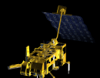
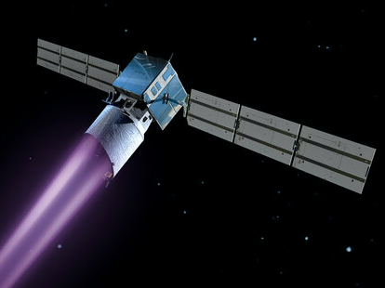
Optical Remote Sensing Measurements of Aerosols
Key aerosol properties:
Aerosol loading ->optical thickness (”how much?”)
Aerosol size distribution, size vs. radiation wavelength
Aerosol chemical composition (type)
Complex refractive index; single scattering albedo
Limited number of general aerosol type categories that have distinctly different optical properties
Satellites
Passive
Spectroradiometers
Optical depth, absorbing aerosol Index
Various other parameters e.g. layer height, fine mode fraction etc.
Active
Space-based lidars
Aerosol vertical profiles
Ground-based
Passive
Sunphotometers
Optical depth & various other retrieved parameters
Active
Lidars, Ceilometers
Aerosol vertical profiles

Slide 5
Aerosol Optical Depth (AOD)

Slide 6
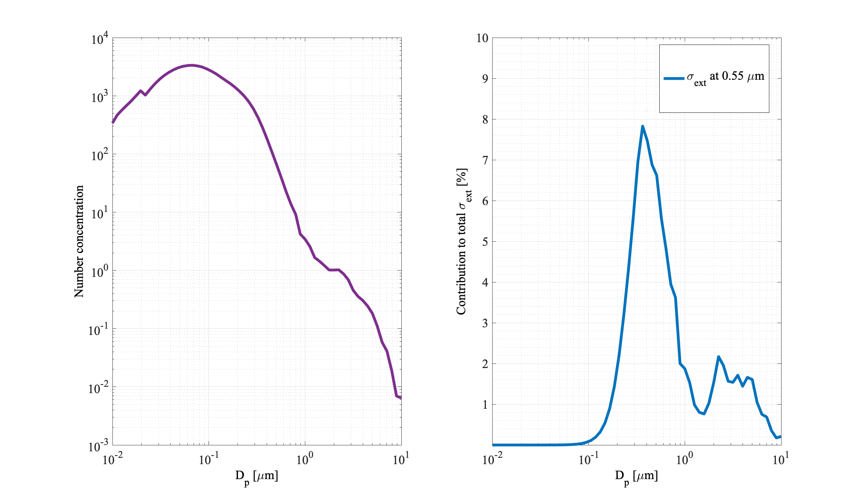
Aerosol optical depth (AOD)
Also known as aerosol optical thickness (AOT)
AOD is related to the amount of (optically active) aerosols in the total atmospheric column.
Retrieved from satellite- and ground-based instruments
Extinction coefficient:
units of inverse length [m⁻¹]
Measured aerosol size distribution
Contribution of each particle size to the total extinction at 550 nm
AOD is defined as the sum of aerosol extinction at all atmospheric levels, from surface up to the top of the atmosphere
[unitless]

Slide 7
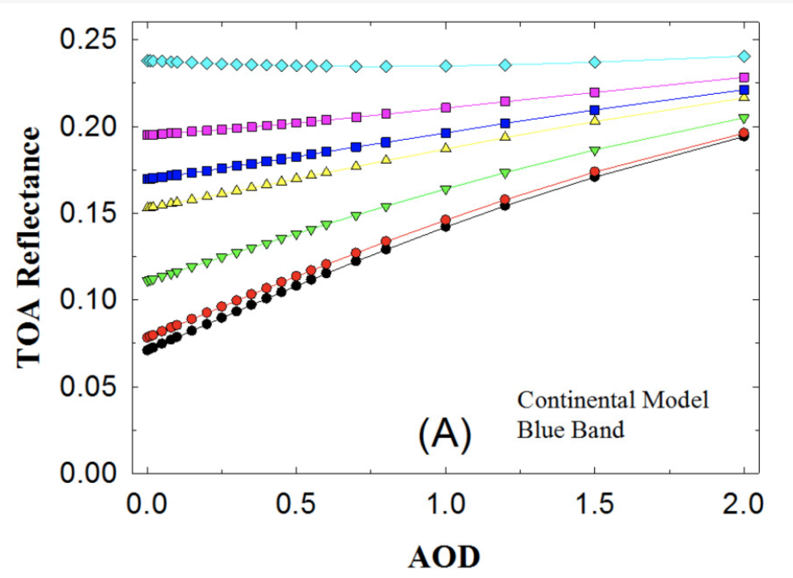
AOD retrievals
From Tian & Sun, 2016
”Bright” Surface
Reflectance at TOA measured by satellite
Atmospheric path reflectance:
aerosols
molecules
Surface contribution
TOA reflectance measured by the satellite
”Dark” Surface
Cloudscreening
No aerosols
Aerosol overlay
Rayleigh correction
Bright surface
Surface correction
Dark surface
Aerosol contribution

Slide 8
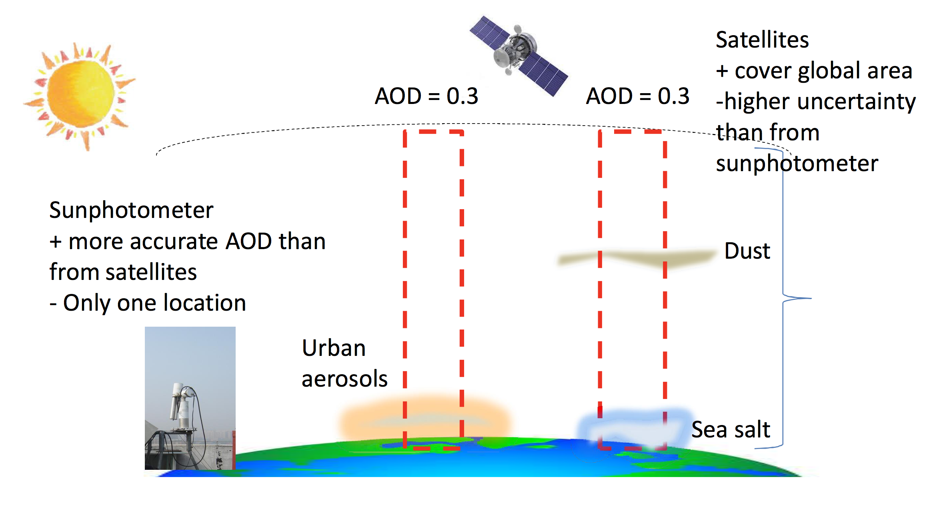
AOD is wavelength dependent
often given at 550 nm.
AOD doesn’t tell about vertical distribution of aerosols.
However, often aerosols are located within the lowest few kilometers.
Satellite AOD is available from several instruments (and wavelengths), e.g.:
OLCI, SLSTR (Sentinel 3), AATSR (Envisat, until 2012)
MODIS (Aqua, Terra), MISR (Terra), SeaWIFS…
Multi-instrument products such as PMAp (combining information from GOME-2, AVHRR, IASI)

Slide 9
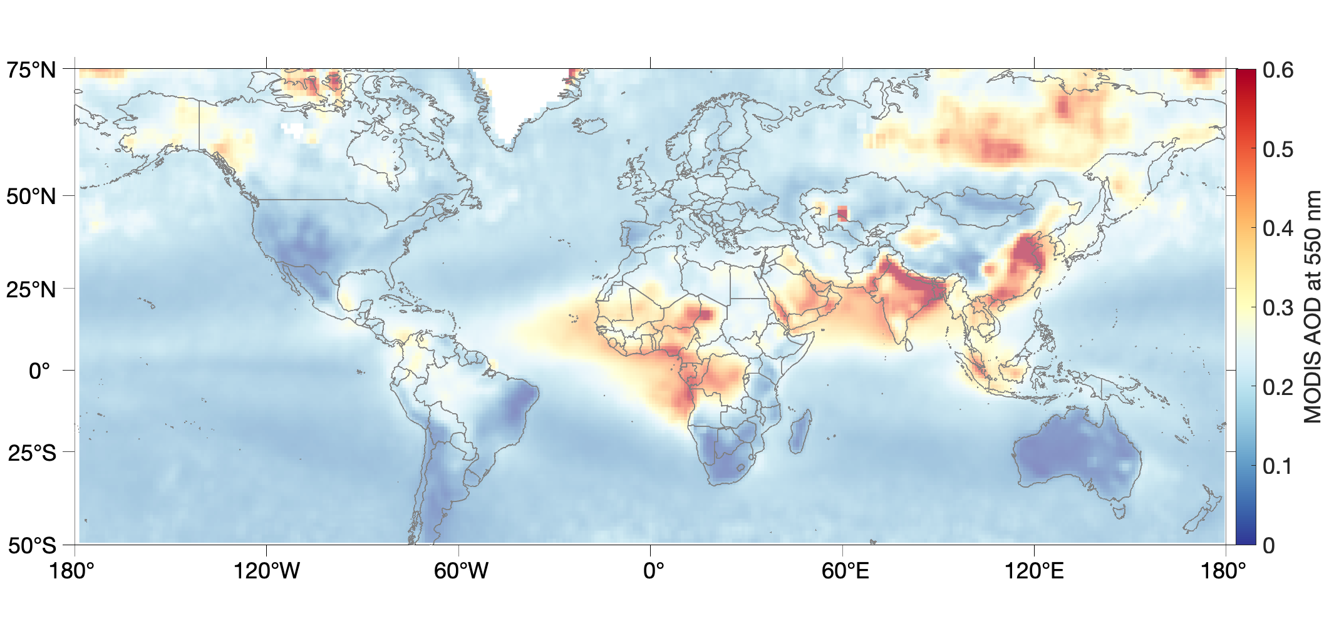
MODIS Terra AOD (at 550 nm) 2019
Biomass burning
Biomass burning
Dust
Anthropogenic pollution
Dust
Biomass burning
Biomass burning
Global mean AOD at 550 nm: about 0.15
Typical range of variation at 550 nm: 0.05…2.0
AOD timeseries of > 20 years are available (e.g. Sogacheva et al. 2020 )

Slide 10
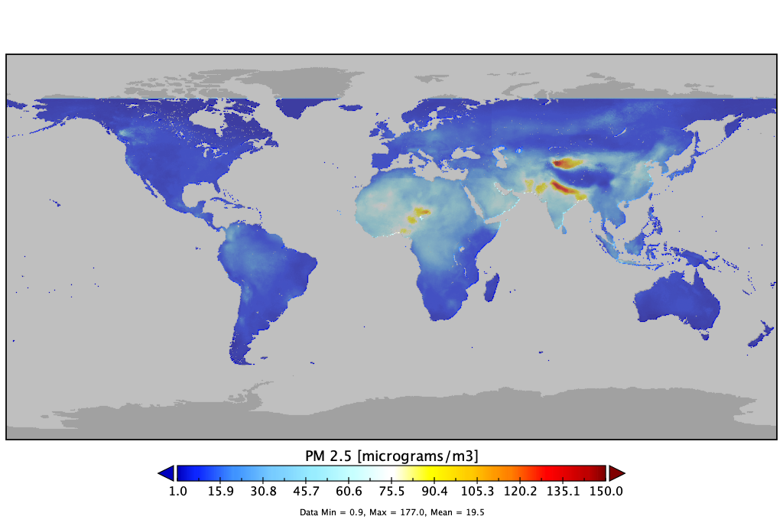
(Satellite) AOD vs. (in situ) Particulate Matter (PM)
Global and national air quality standards considering aerosols are based on the amount of particulate matter (PM, [μg/m³])
PM10: inhalable particles, with diameters 10 μm and smaller
PM2.5: fine inhalable particles, with diameters 2.5 μm and smaller
AOD and PMs are both related to aerosol concentration.
Satellite-based AOD has been used in many applications to estimate e.g. global PM2.5 concentrations (see e.g. Van Donkelaar et al., 2010, 2016)
AOD
total column -> elevated layers possible.
can’t distinguish aerosols exactly by their physical size
At ambient relative humidity
PM
Surface concentration
Measurement of specific sizes, also aerosols that are too small for satellites ”to see”.
Defined from dry particles

Slide 11
Absorbing Aerosol Index (AAI)

Slide 12
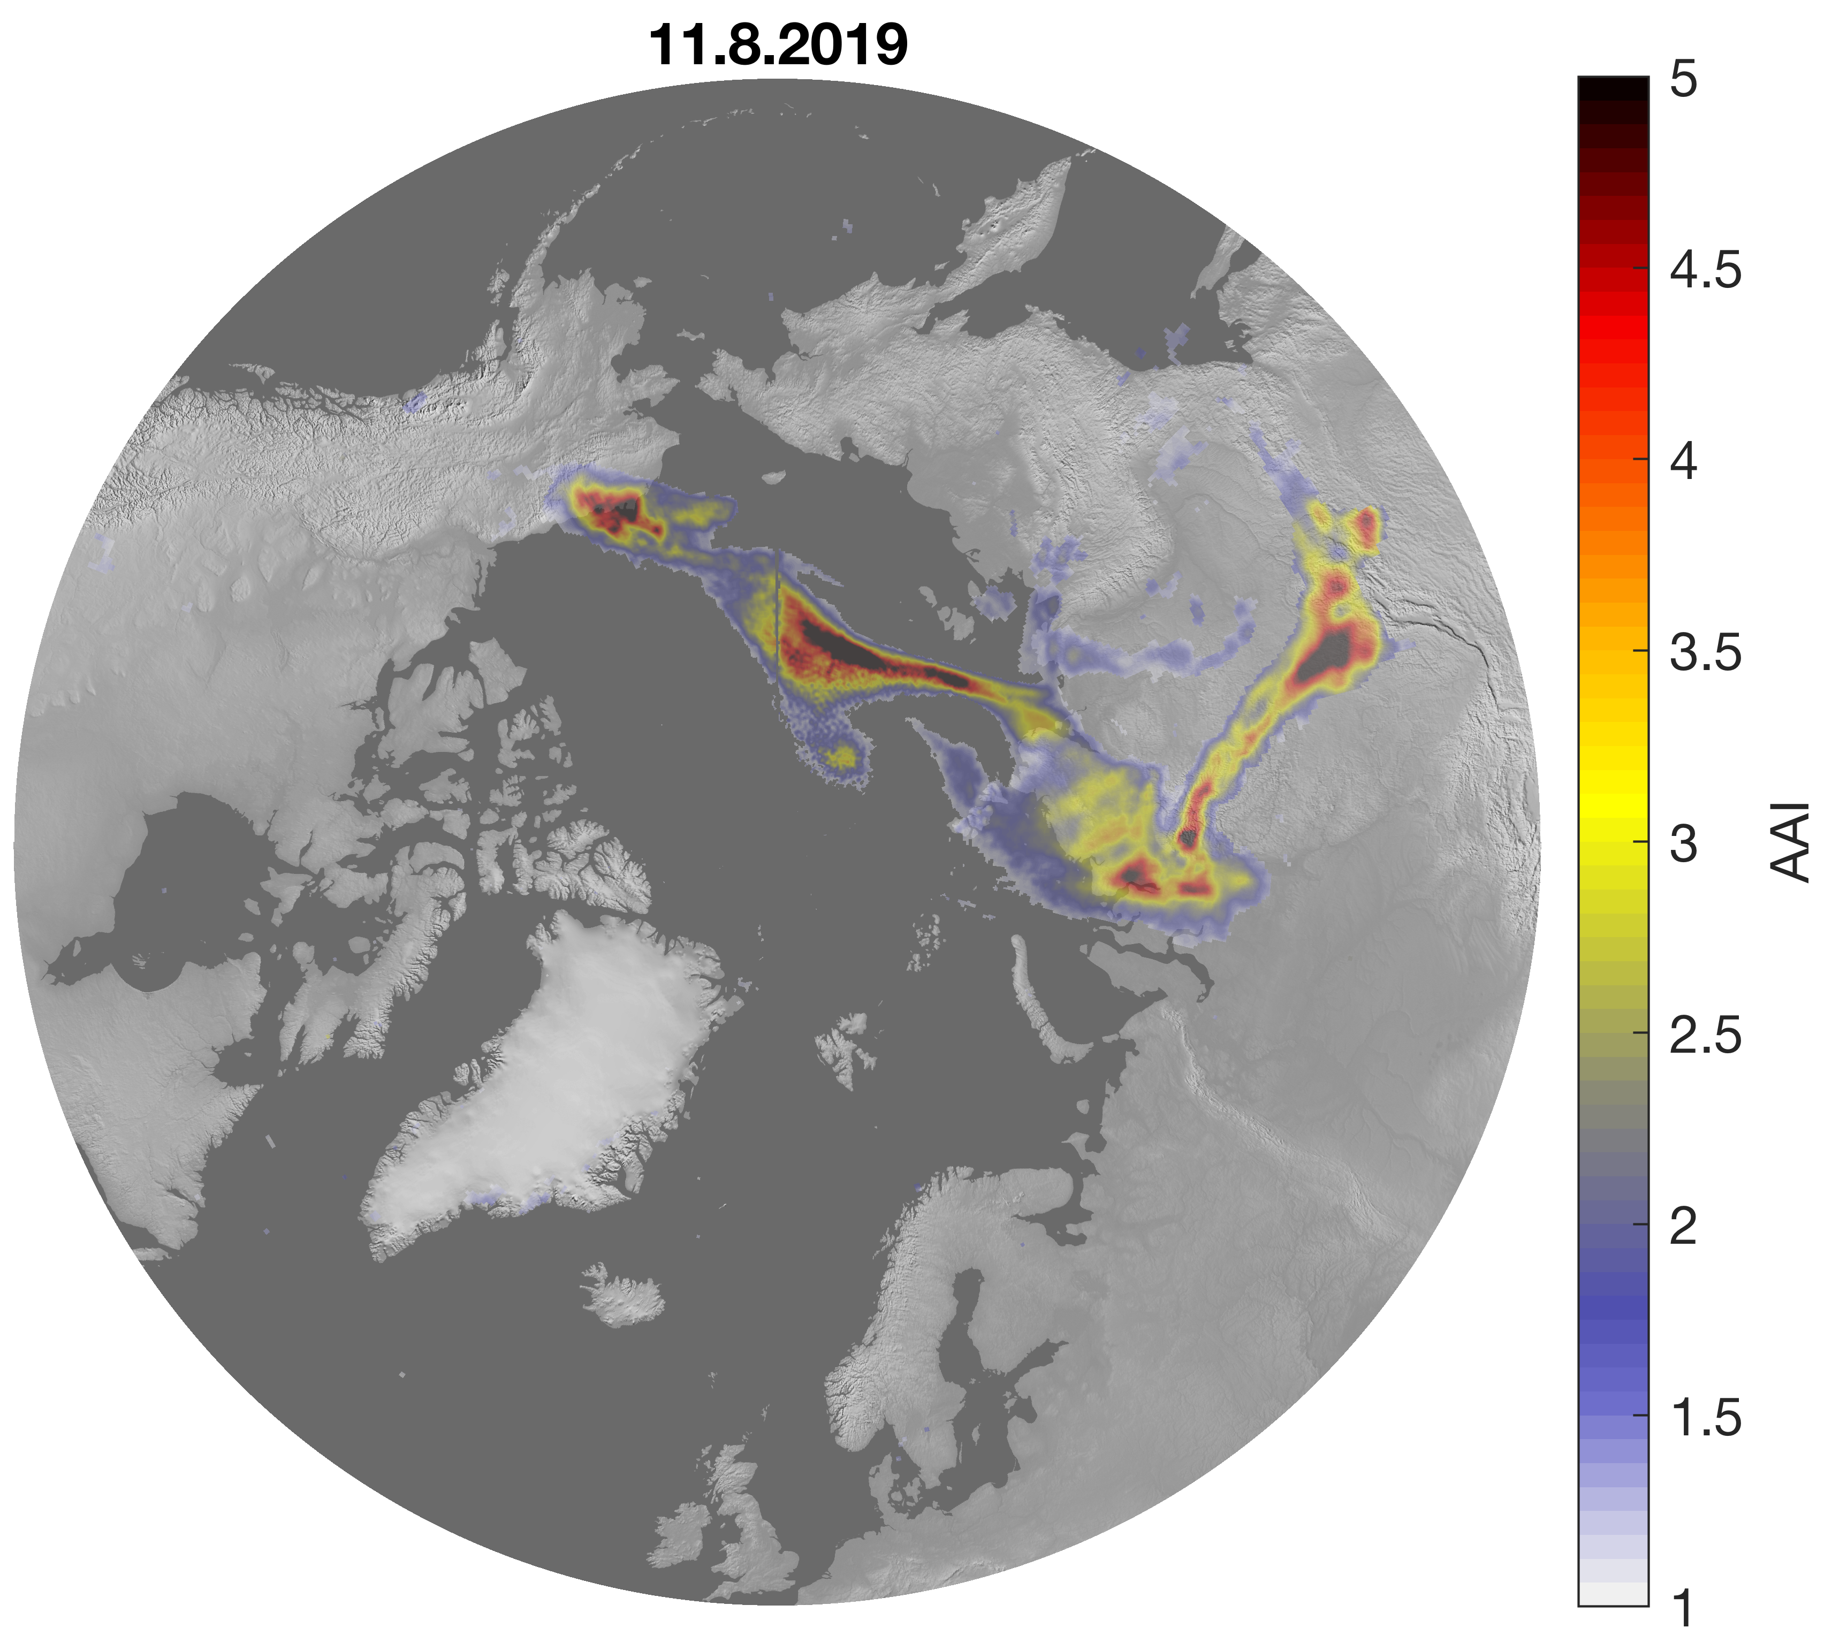
Absorbing Aerosol Index (AAI)
Also known as UV Aerosol Index (UVAI)
Defined using UV-wavelengths (typically 340 – 380 nm; GOME-2, TROPOMI, OMI, OMPS)
Sensitive to absorbing aerosols: smoke, volcanic ash, desert dust
AAI separates the spectral contrast at two UV wavelengths caused by aerosol extinction from that of other effects (e.g. molec. scattering)
Can be obtained also for cloudy scenes, where aerosols are on top of clouds.
AAI is a good tracer for smoke and dust/ash plumes

Slide 13
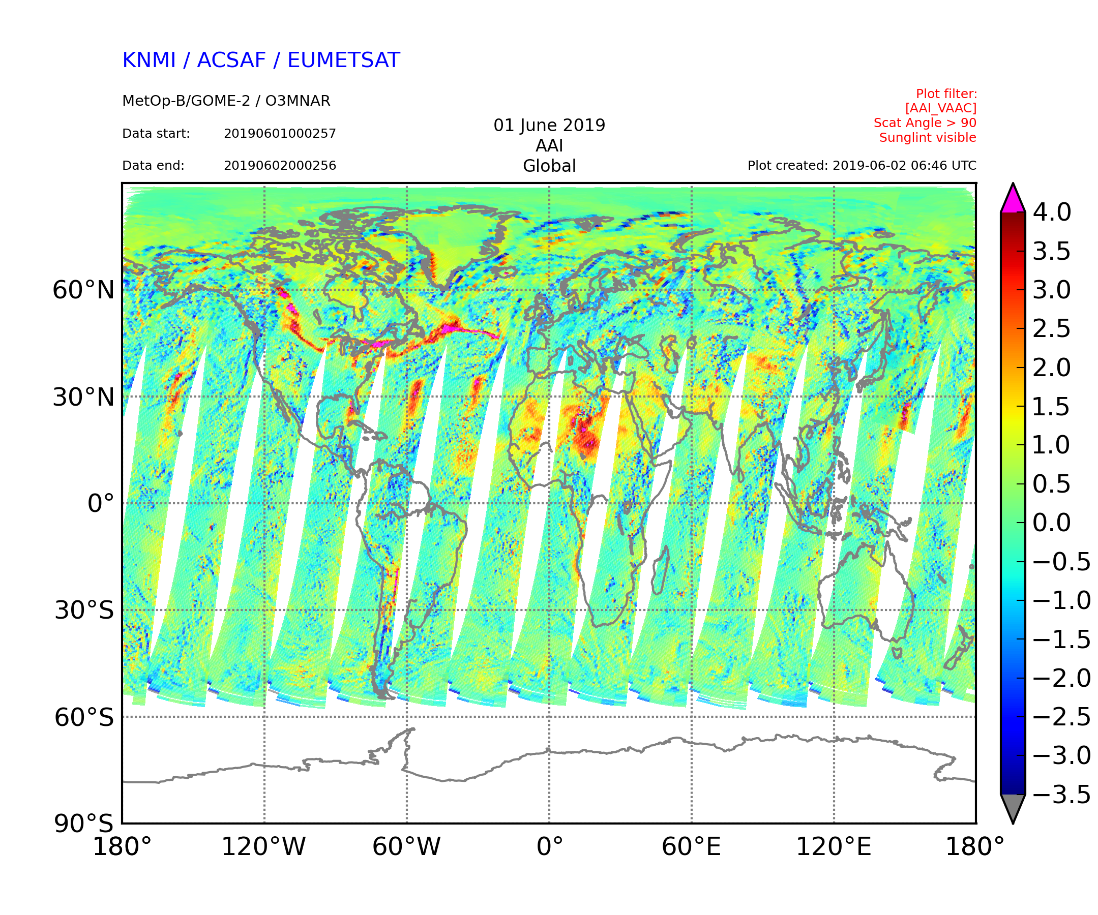
Interpreting AAI (1)
Smoke plume from Canadian forest fires
Positive AAI values indicate presence of absorbing aerosols
For clouds (or scattering aerosols) AAI is close to zero or negative
Also sunglint over ocean causes positive values but that is often filtered out from the data.
For plumes typically AAI > 1.0
Background typically slightly positive
Desert dust
AAI is available from several instruments:
GOME-2 (A,B,C)
TROPOMI
OMI, OMPS
Multi-instrument AAI (> 40 year time series! )
Sun glint

Slide 14
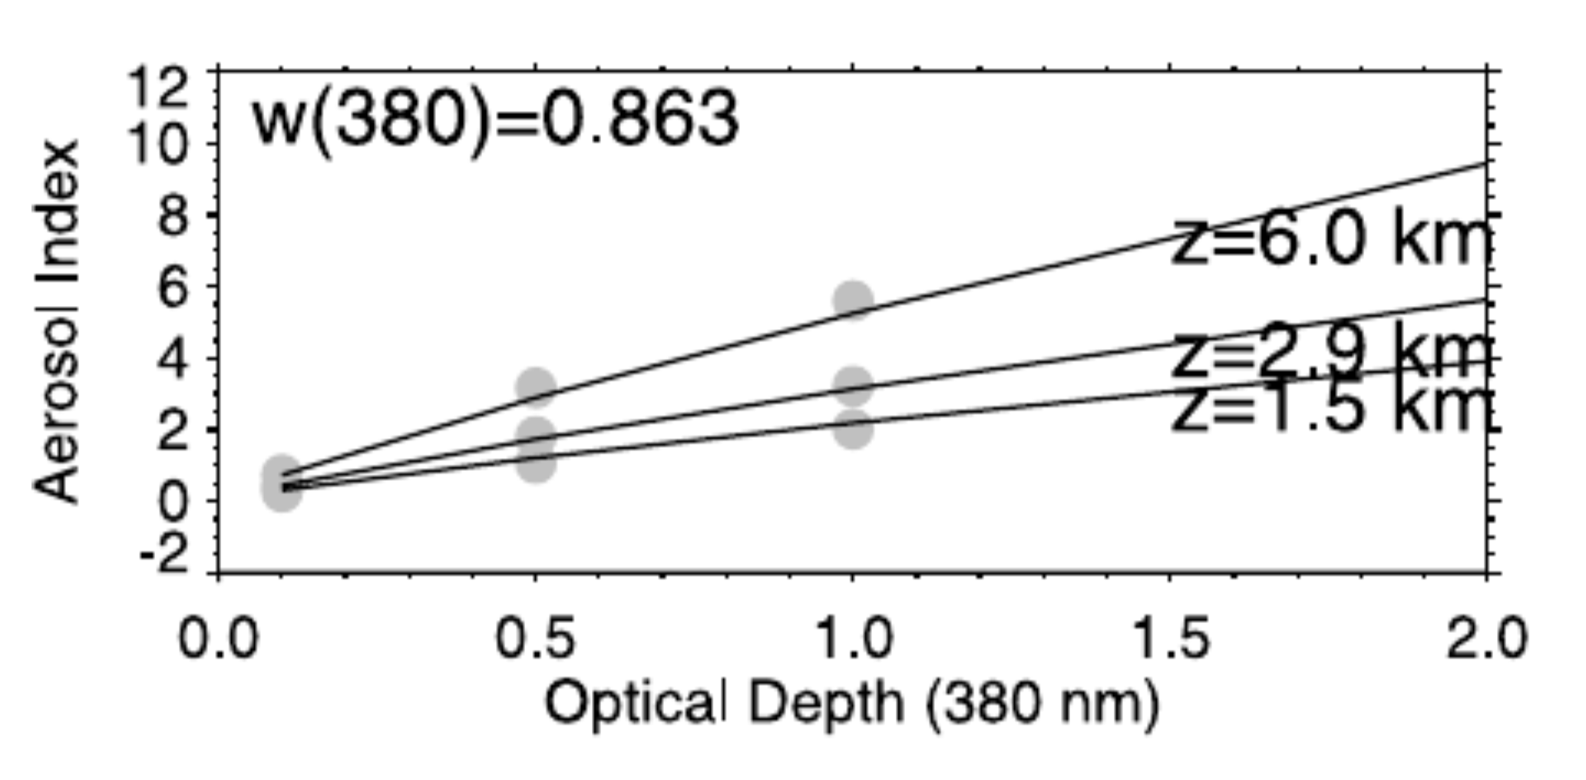
Interpreting AAI (2)
AAI values depend on various factors
Comparing cases is not straightforward!
Not a ”direct” measure of aerosol loading
With AAI you typically see an elevated plume
For assessing air quality at the surface, additional information (model, in situ) is recommended.
(single scatt. albedo)
Abs. aerosols at 6 km height
Abs. aerosols at 2.5km height
Abs. aerosols at 1.5km height
”Increasing aerosol loading”
From: Ginoux & Torres, JGR, 2003

Slide 15
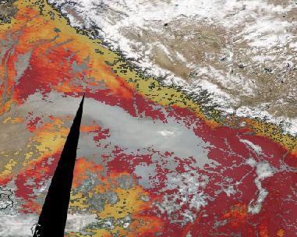
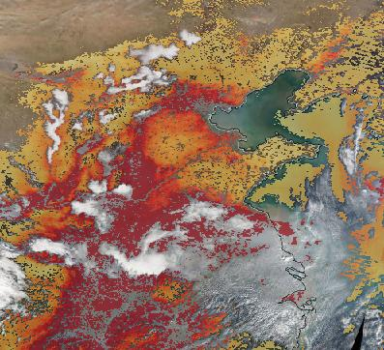
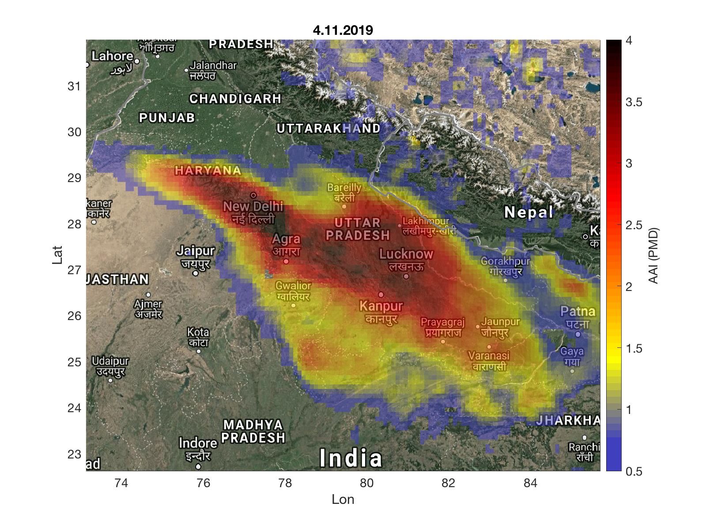
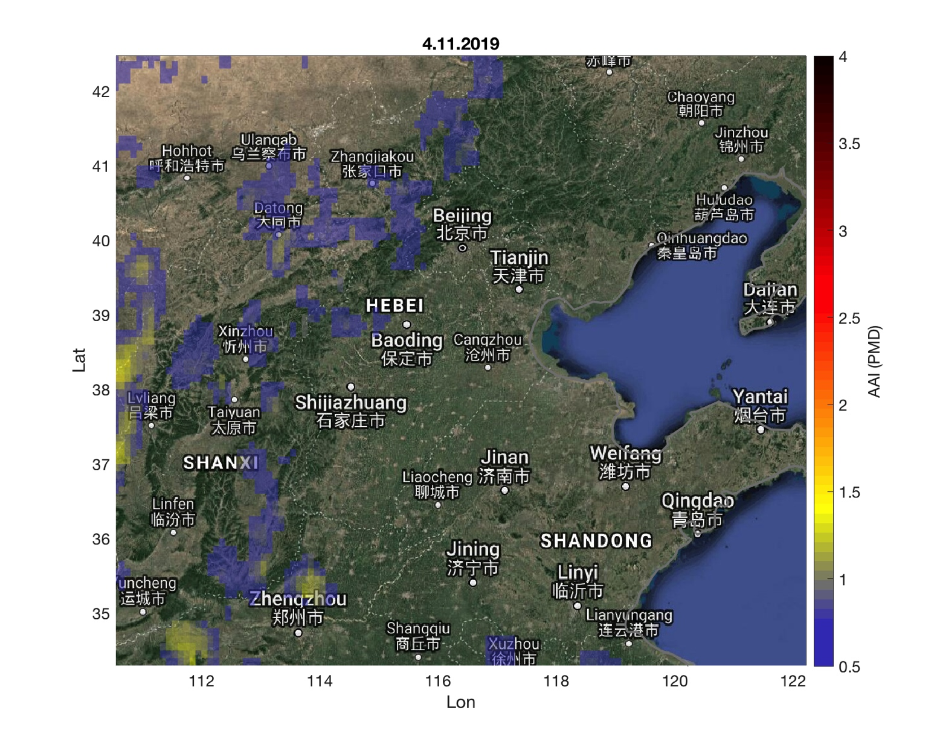
AOD vs. AAI: India and China, 4.11.2019
On 4.11. in India and China AOD (550 nm) was very high (0.5…2.0)
The same day AAI was elevated only in India.
AOD at 550 nm
Why the difference?
Aerosol type!
AOD -> all optically active aerosols, related to aerosol amount.
AAI -> only absorbing aerosols! Depends on the amount but also on many other factors
AAI

Slide 16
Absorbing Aerosol Height (AAH)

Slide 17
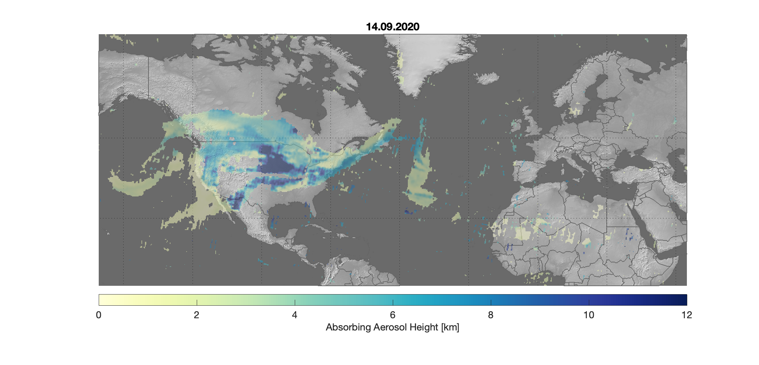
GOME-2 Absobing Aerosol Height
Retrieval is based on Oxygen A-band and information derived from FRESCO cloud algorithm.
AAH is provided from GOME-2 (A,B,C) and can be obtained via AC SAF FMI server.
AAH should be analysed with AAI:
AAI < 2 correspond to scenes with too low amounts of aerosol to result in a reliable AAH -> pixels have fill value.
2 < AAI < 4: aerosol layer is not in all cases thick enough for a reliable retrieval, but AAH estimate is given, should be used with caution.
AAH also available from TROPOMI
Example of GOME-2 (A,B,C) AAH

Slide 18
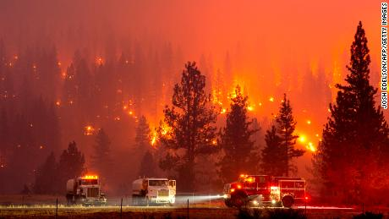
Fires in the US: September 2020
PMAP AOD
GOME-2 (A,B,C) Absorbing Aerosol Index
GOME-2 (A,B,C) Absorbing Aerosol Height

Slide 19
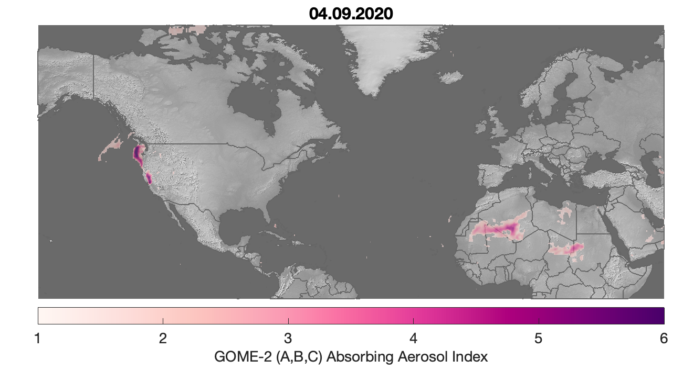
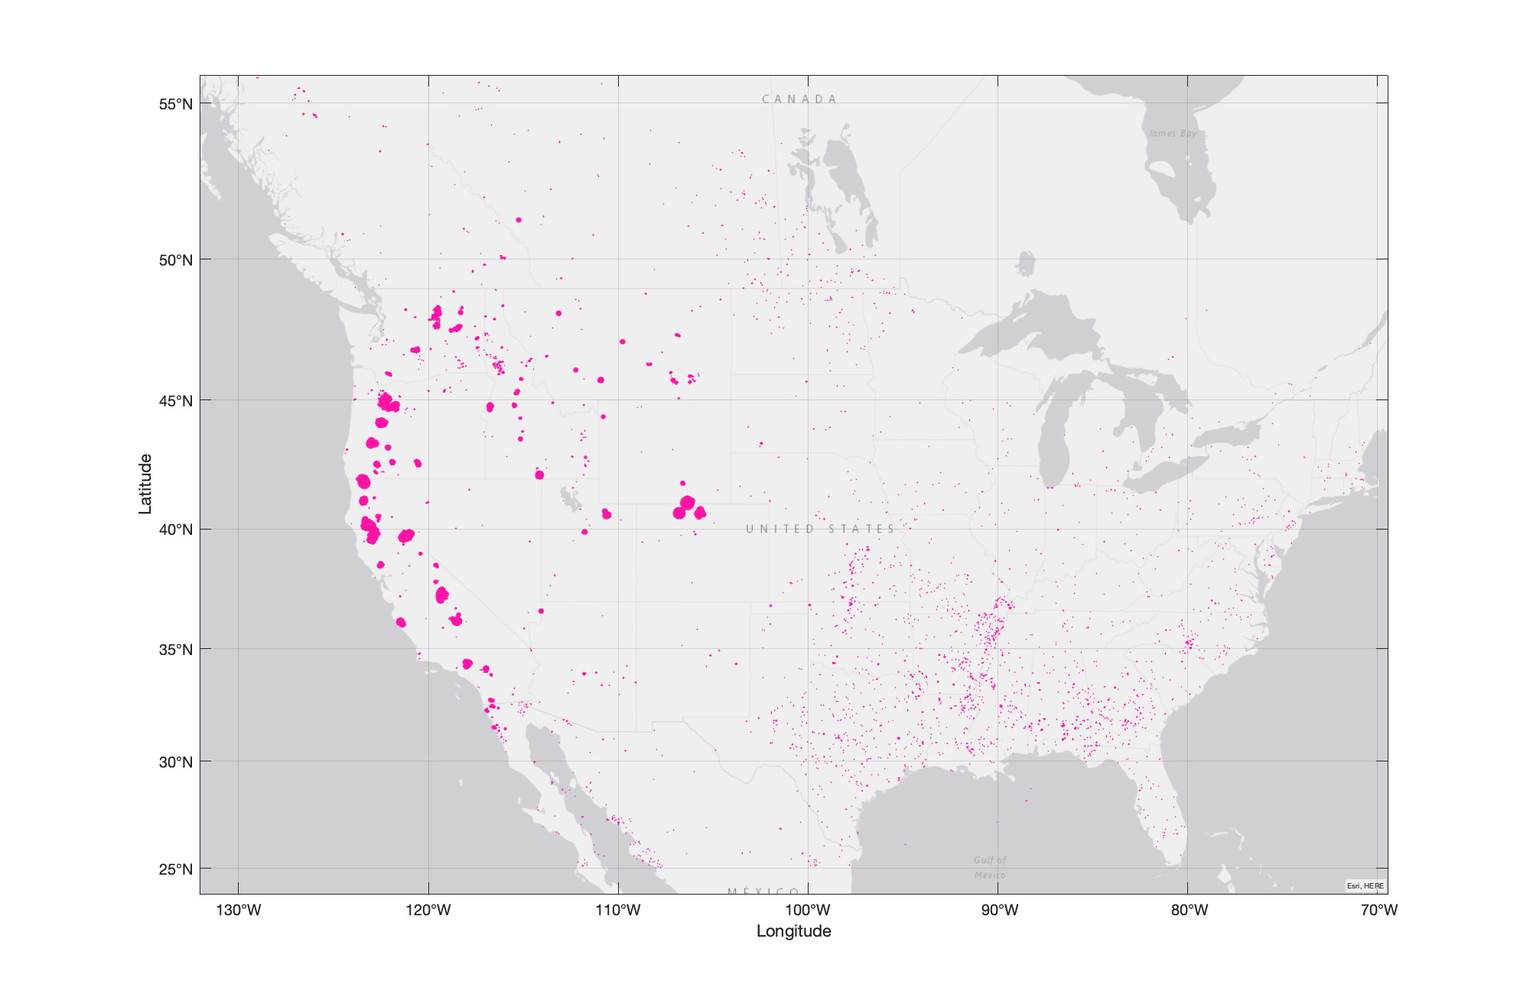
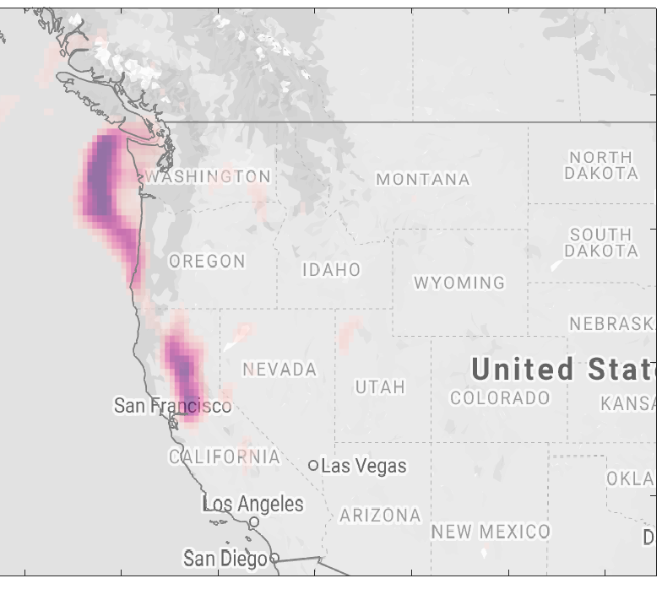
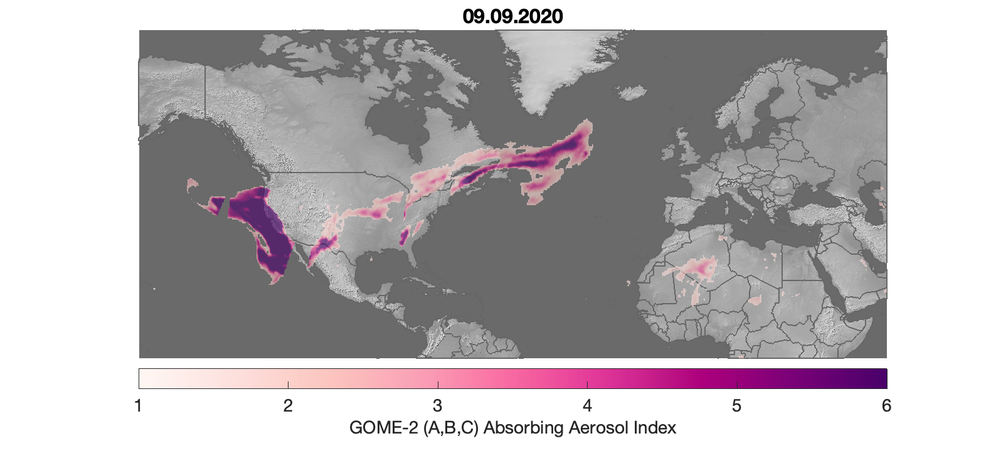
In early September largest fires and smoke were concentrated in the West coast
Detected fires over the US in September 2020
GOME-2 AAI
MODIS Coll. 6 FRP

Slide 20
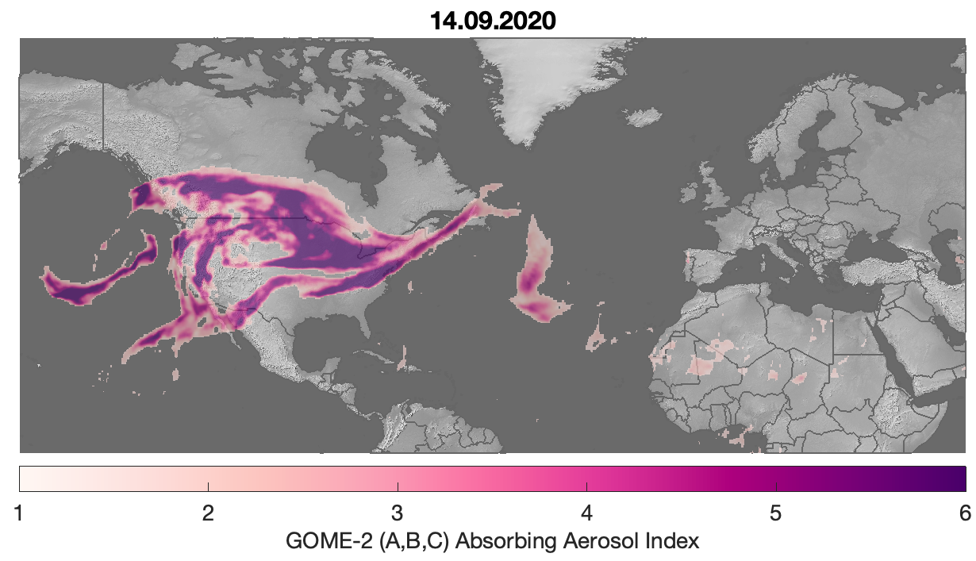
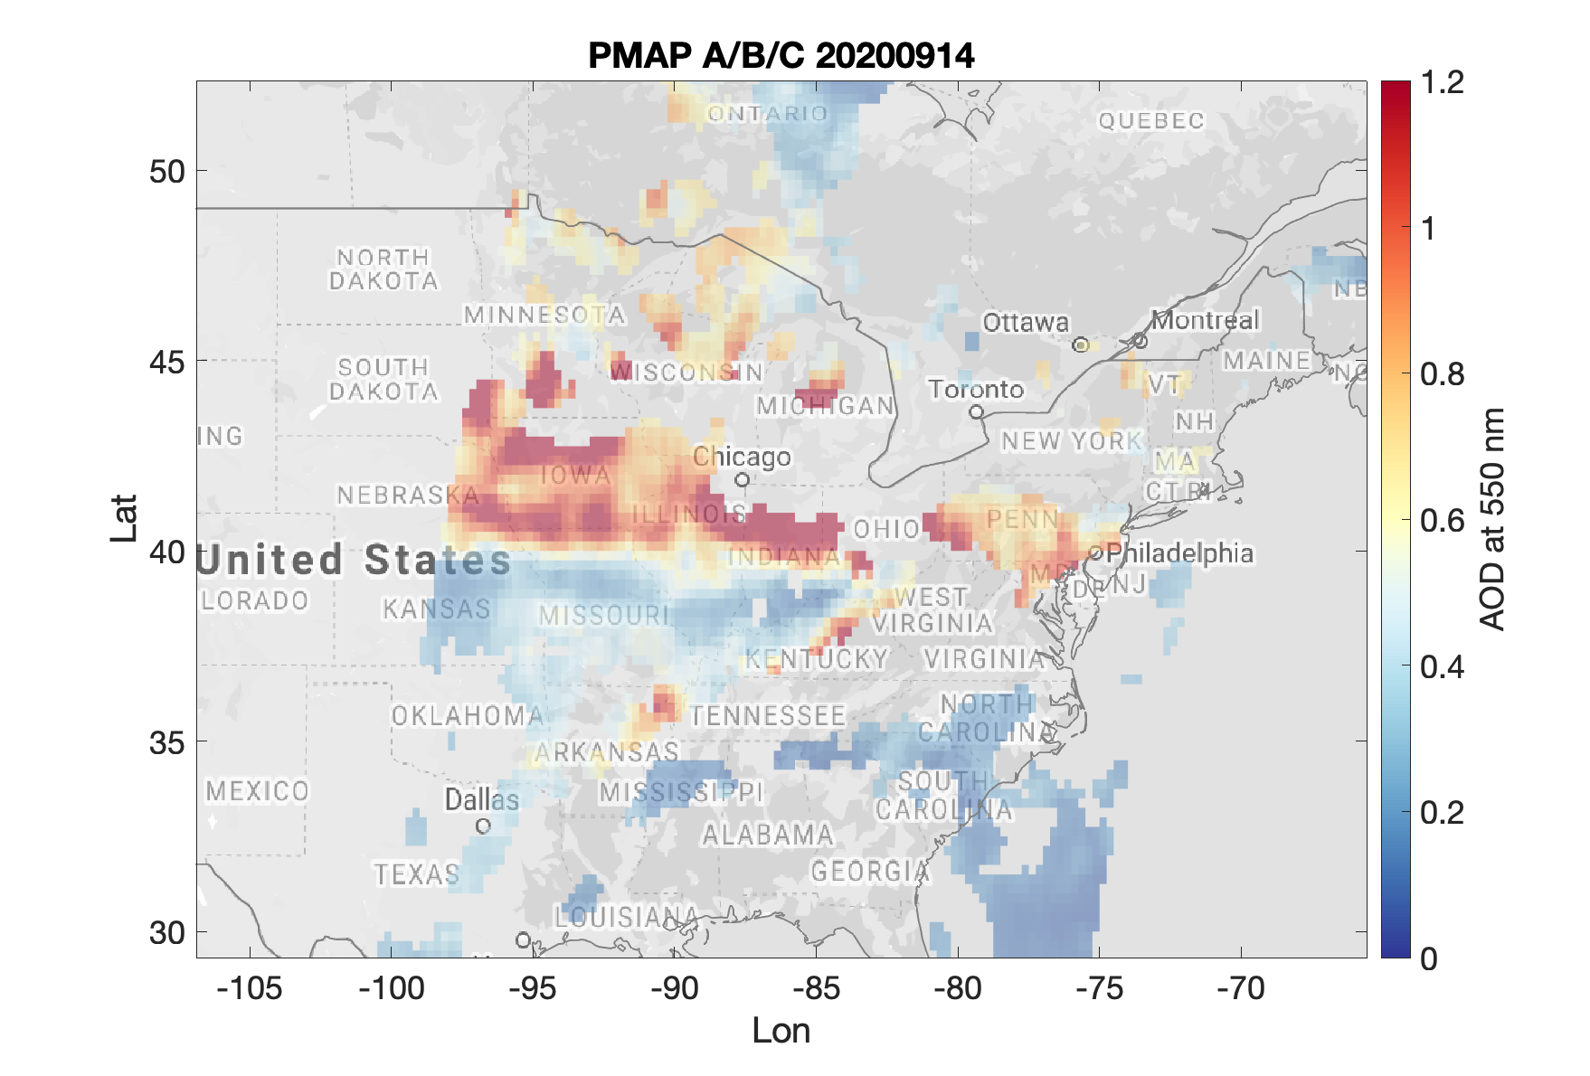
As more fires were ignited, also meteorological conditions changed and significant aerosol transport towards Europe was observed.
GOME-2 AAI
PMAP AOD at 550 nm
GOME-2 AAH

Slide 21
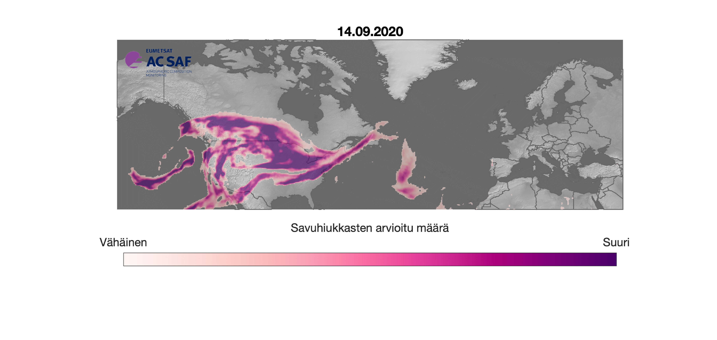

Slide 22
Take Home Messages
Satellites offer an efficient way to monitor aerosols on a global scale.
AOD, AAI and ALH can be used in many applications: from analyzing local aerosol sources to long-range transport.
It is important to remember the interpretation of each parameter.
For air quality assesment, it is recommended to combine information from several sources; e.g. satellite data and models
References:
Tian and Sun: Retrieval of Aerosol Optical Depth over Arid Areas from MODIS Data, Atmosphere, 7(10), 134 2016.
Sogacheva et al.: Merging regional and global aerosol optical depth records from major available satellite products, Atmos.Chem. Phys, 20, 2020
Ginoux & Torres: Empirical TOMS index for dust aerosol: Applications to model validation and source characterization, JGR, 108, 2003.
Van Donkelaar et al.: Global estimates of ambient fine particulate matter concentrations from satellite-based aerosol optical depth: development and application, Environ. Health. Perspec. 118, 2010.
Van Donkelaar et al.: Global Estimates of Fine Particulate Matter using a Combined Geophysical-Statistical Method with Information from Satellites, Models, and Monitors, Environ.Sci. Technolog., 50, 2016.

