Slide 1
Satellite Applications: SO₂, HCHO, CHOCHO, CO, AI
Andreas Richter
Institute of Environmental Physics
University of Bremen

Slide 2
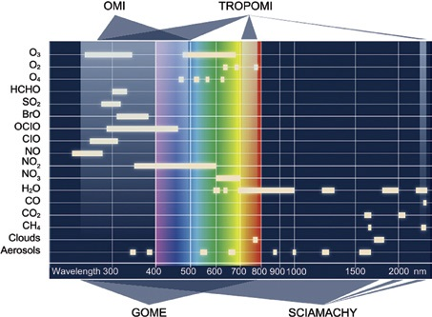
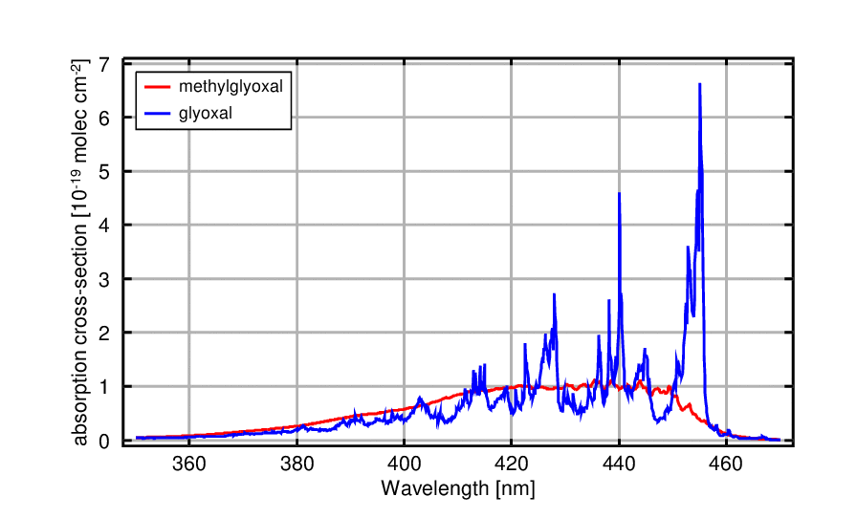
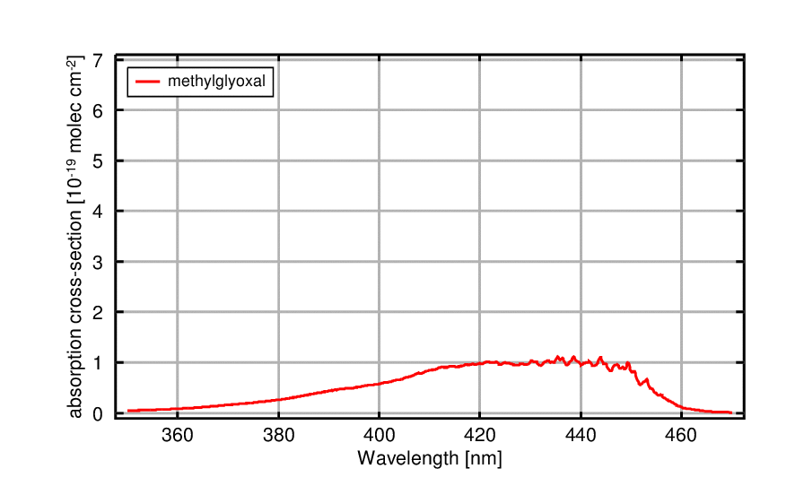
What else can we do with UV/visible/NIR spectra?
NO₂ is great, but is there more in UV/vis/NIR spectra?
Anything can be measured that has
Structured absorption spectra in the wavelength range covered
(2)

Slide 3
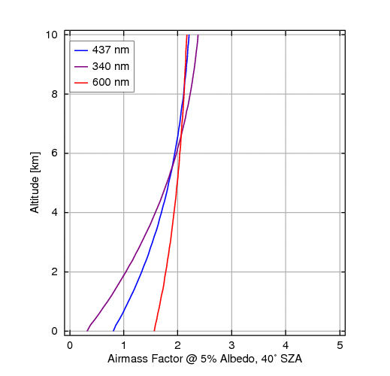
What else can we do with UV/visible/NIR spectra?
NO₂ is great, but is there more in UV/vis/NIR spectra?
Anything can be measured that has
Structured absorption spectra in the wavelength range covered
Creates large enough absorptions to be detectable above the noise
Large absorption cross-section
Large abundance
Higher up in the atmosphere
Effect of Rayleigh scattering

Slide 4
What else can we do with UV/visible/NIR spectra?
NO₂ is great, but is there more in UV/vis/NIR spectra?
Anything can be measured that has
Structured absorption spectra in the wavelength range covered
Creates large enough absorptions to be detectable above the noise
Large absorption cross-section
Large abundance
Higher up in the atmosphere
Not enough signal?
Averaging, averaging, averaging, averaging …
Avoid winter observations if not above snow (low signal)

Slide 5
What else can we do with UV/visible/NIR spectra?
O₃
SO₂
HCHO
CHOCHO
CO
BrO
IO
OClO
H₂O
CH₄

Slide 6
What else can we do with UV/visible/NIR spectra?
O₃
SO₂
HCHO
CHOCHO
CO
BrO
IO
OClO
H₂O
CH₄

Slide 7
Sulphur dioxide (SO₂)
Sources:
Oxidation of biogenic dimethyl sulfide from oceans
Volcanoes (degassing, eruptions)
Smelters
Coal fired power plants
Gas & oil production and refineries
Ships
Relevance:
Formation of sulphuric acid
Acid rain
Aerosols => aviation, air quality, clouds, climate

Slide 8
Sulphur dioxide (SO₂)
Vertical distribution:
Close to surface if from
Ocean
Volcanic degassing
Power plants
Domestic heating
Higher up if from
Volcanic eruptions
Transport events after vertical lifting
Wavelength region:
312 – 335 nm
Hard to detect
Easier to detect
Available from: GOME SCIAMACHY OMI GOME-2 OMPS TROPOMI

Slide 9
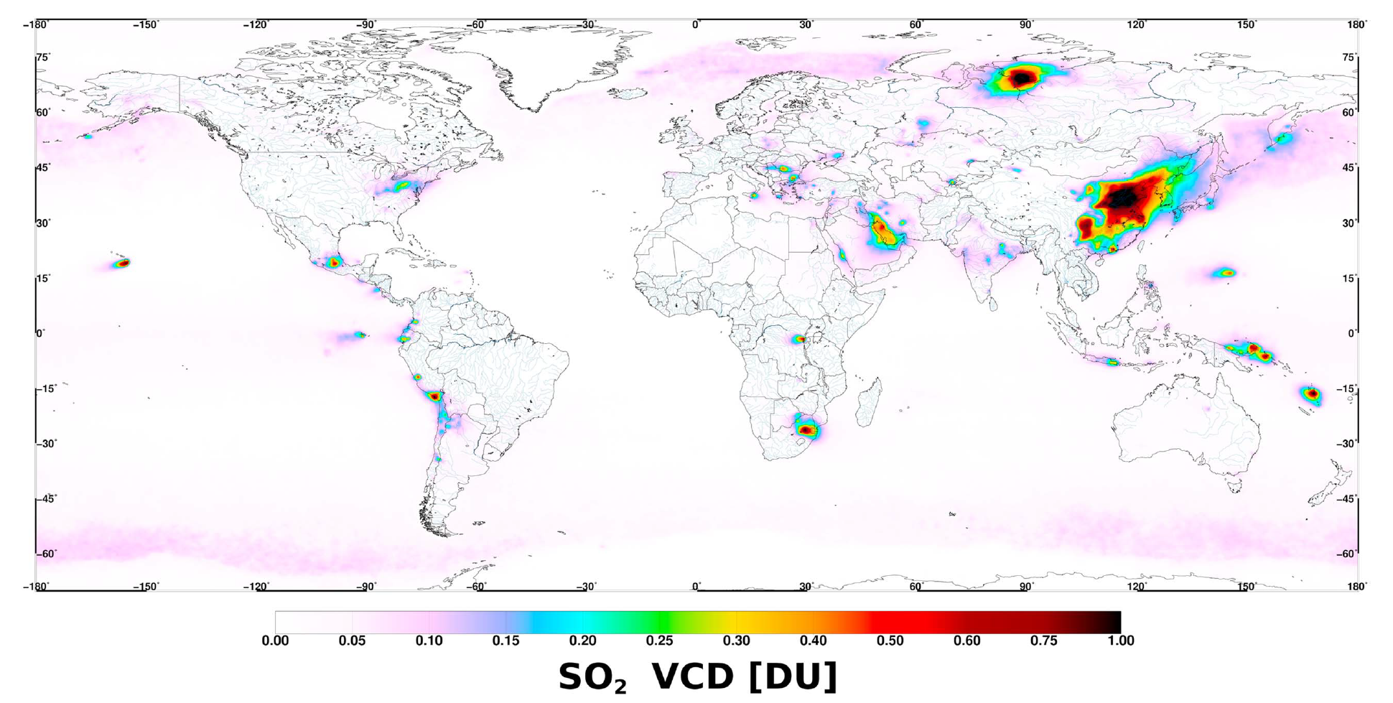
Sulphur dioxide: Example I
Anthropogenic
China
Norilsk
Persian Gulf
India
Eastern Europe
Eastern US
South Africa
Volcanic
Theys, N. et al. : Sulfur dioxide vertical column DOAS retrievals from the Ozone Monitoring Instrument: Global observations and comparison to ground-based and satellite data, J. Geophys. Res. Atmos., doi:10.1002/2014JD022657, 2015.
OMI 2004 - 2009
OMI relative to 2005
Krotkov, N. et al.: Aura OMI observations of regional SO₂ and NO₂ pollution changes from 2005 to 2015, Atmos. Chem. Phys., 16(7), 4605–4629, doi:10.5194/acp-16-4605-2016, 2016.

Slide 10
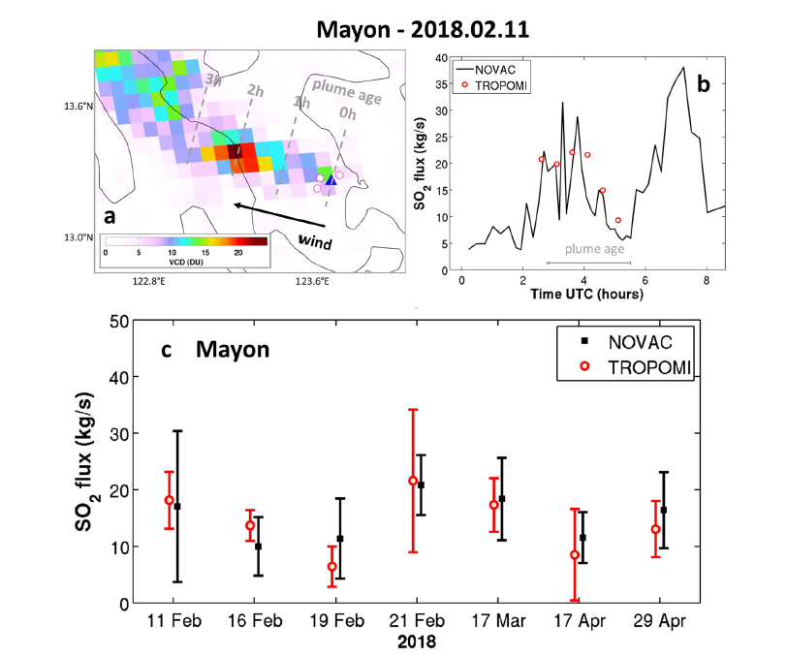
Sulphur dioxide: Example II
TROPOMI
With TROPOMI, volcanic plumes can be resolved in detail
With wind speed, this can be converted to time dependent emissions
Very good agreement with NOVAC on short and long term
Theys, N. et al. : Global monitoring of volcanic SO2 degassing with unprecedented resolution from TROPOMI onboard Sentinel-5 Precursor, Sci. Rep., 9(1), 1–10, doi:10.1038/s41598-019-39279-y, 2019.

Slide 11
Formaldehyde (HCHO)
Sources:
Secondary production from biogenic emissions
Secondary production from biomass burning
Secondary production from anthropogenic emissions
Relevance:
Intermediate in atmospheric oxidation of hydrocarbons
Proxy for emissions of isoprenes / terpenes
Relevant for O₃ production, OH, aerosol formation
Available from: GOME SCIAMACHY OMI GOME-2 OMPS TROPOMI

Slide 12
Formaldehyde (HCHO)
Vertical distribution:
Close to surface if from
Biogenic emissions
Anthropogenic emissions
Higher up if from
Biomass burning
Transport events after vertical lifting
Wavelength region:
328 - 346 nm
Easier to detect than BL SO₂

Slide 13
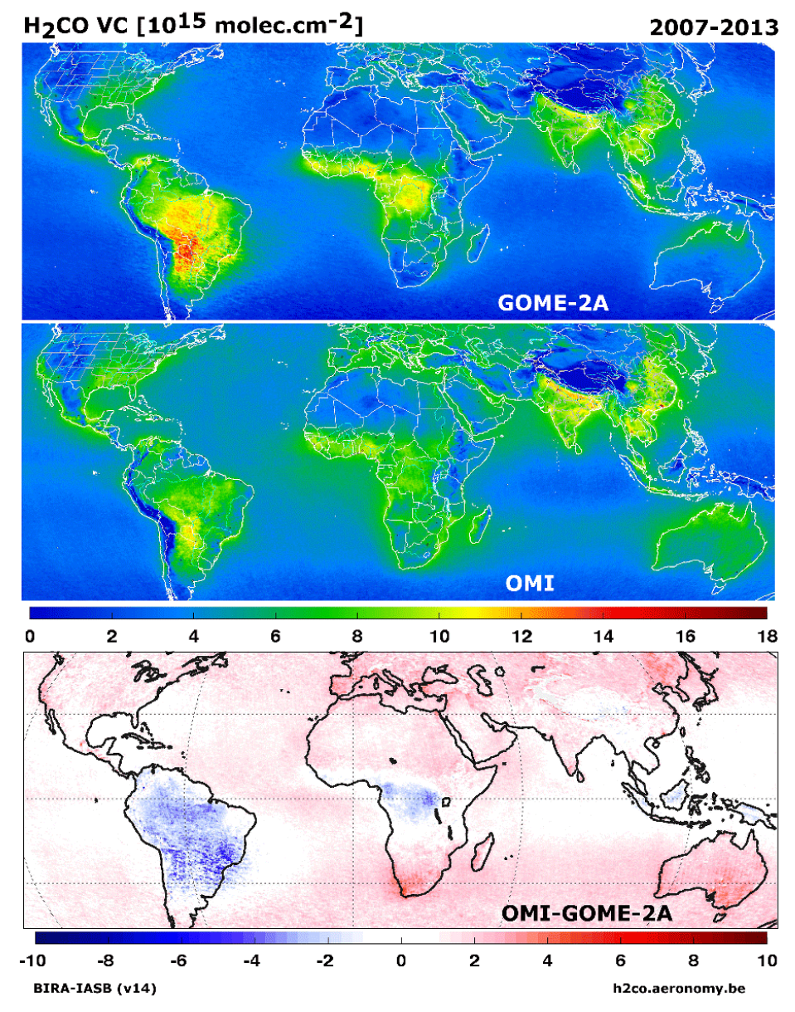
Formaldehyde: Example I
High values in mean fields mainly from biogenic emissions and fires
Good agreement between GOME-2a (morning orbit) and OMI (afternoon orbit)
OMI generally higher than GOME-2a with the exception of measurements over rain forests
Lower OMI columns are also observed for glyoxal, another VOC
Qualitatively consistent with GB data
De Smedt, I.et al.: Diurnal, seasonal and long-term variations of global formaldehyde columns inferred from combined OMI and GOME-2 observations, Atmos. Chem. Phys., 15(21), 12519–12545, doi:10.5194/acp-15-12519-2015, 2015.

Slide 14
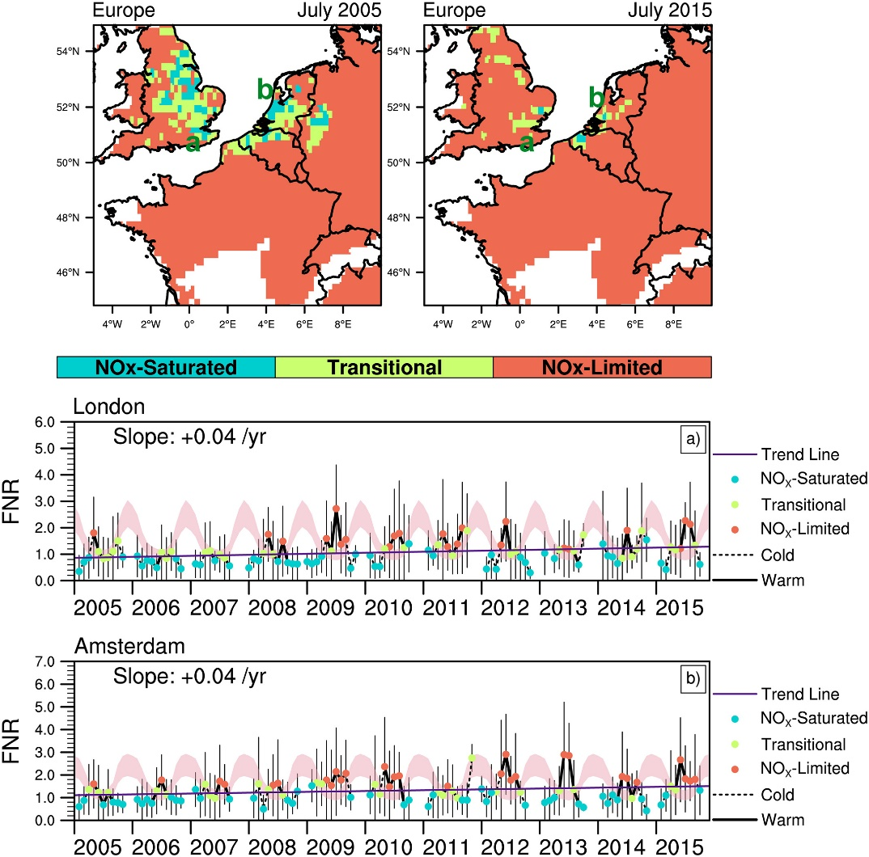
Formaldehyde: Example II
OMI
Ratio of HCHO to NO₂ column can be used to distinguish NOx limited and NOx saturated regimes in tropospheric O₃ production
Vertical profile of NO₂ and HCHO needs to be taken into account for surface O₃ production (model calculations)
Uncertainties in NO₂ and HCHO impact on results in a different way
More regions were longer NOx limited in 2015 than in 2005
Jin, X et al..: Evaluating a space-based indicator of surface ozone-NO x -VOC sensitivity over mid-latitude source regions and application to decadal trends, J. Geophys. Res. Atmos., 1–23, doi:10.1002/2017JD026720, 2017.

Slide 15
Glyoxal (CHOCHO)
Sources:
Secondary production from biogenic emissions
Secondary production from biomass burning
Direct emission from fires
Anthropogenic
Relevance:
Intermediate in atmospheric oxidation of VOCs
Proxy for emissions of isoprenes / terpenes
Secondary particle production
Available from: GOME SCIAMACHY OMI GOME-2 OMPS TROPOMI

Slide 16
Glyoxal (CHOCHO)
Vertical distribution:
Close to surface if from
Biogenic emissions
Anthropogenic emissions
Higher up if from
Biomass burning
Transport events after vertical lifting
Wavelength region:
433 – 465 nm
Easier to detect than HCHO

Slide 17
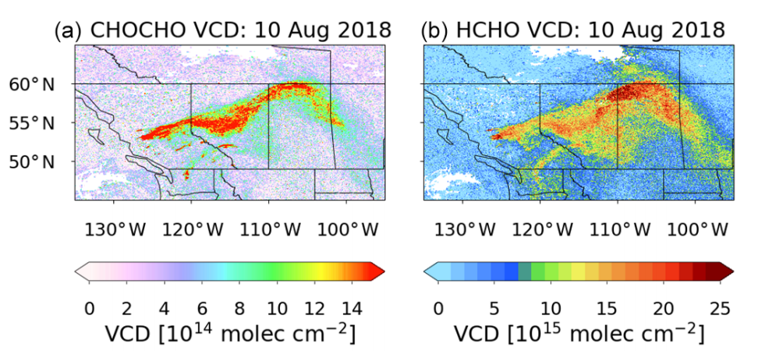
Glyoxal: Example I
TROPOMI
Large fires in Eastern US emitted huge quantities of aerosols and CO
NO₂ has very short lifetime => concentrated at sources
CHOCHO and HCHO have short lifetime but behave as if they had long lifetime
=> continued production
Alvarado, L. M. A.et al.: Unexpected long-range transport of glyoxal and formaldehyde observed from the Copernicus Sentinel-5 Precursor satellite during the 2018 Canadian wildfires, Atmos. Chem. Phys., 20(4), 2057–2072, doi:10.5194/acp-20-2057-2020, 2020.

Slide 18
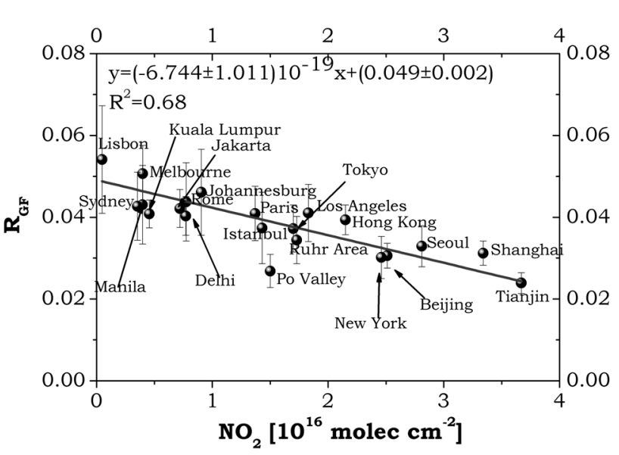
Glyoxal: Example II
GOME-2a
The ratio of glyoxal to formaldehyde can inform about sources of VOCs
There also is a clear dependence of this ratio on NO₂ pollution
Satellite, GB and model data do not yet agree on these ratios
Vrekoussis, M. et al..: GOME-2 observations of oxygenated VOCs: what can we learn from the ratio glyoxal to formaldehyde on a global scale?, Atmos. Chem. Phys., 10, 10145-10160, doi:10.5194/acp-10-10145-2010, 2010

Slide 19
Carbon monoxide (CO)
Sources:
Incomplete combustion (traffic, industry)
Biomass burning
Relevance:
Tracer of pollution transport
Regulated air pollutant
Available from: GOME SCIAMACHY OMI GOME-2 OMPS TROPOMI

Slide 20
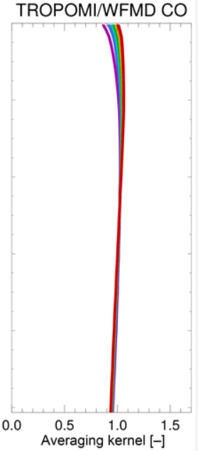
Carbon monoxide (CO)
Vertical distribution:
Close to surface if from
Anthropogenic sources
Higher up if from
Fires
Wavelength region:
2311 – 2338 nm (SWIR)
Little height dependence

Slide 21
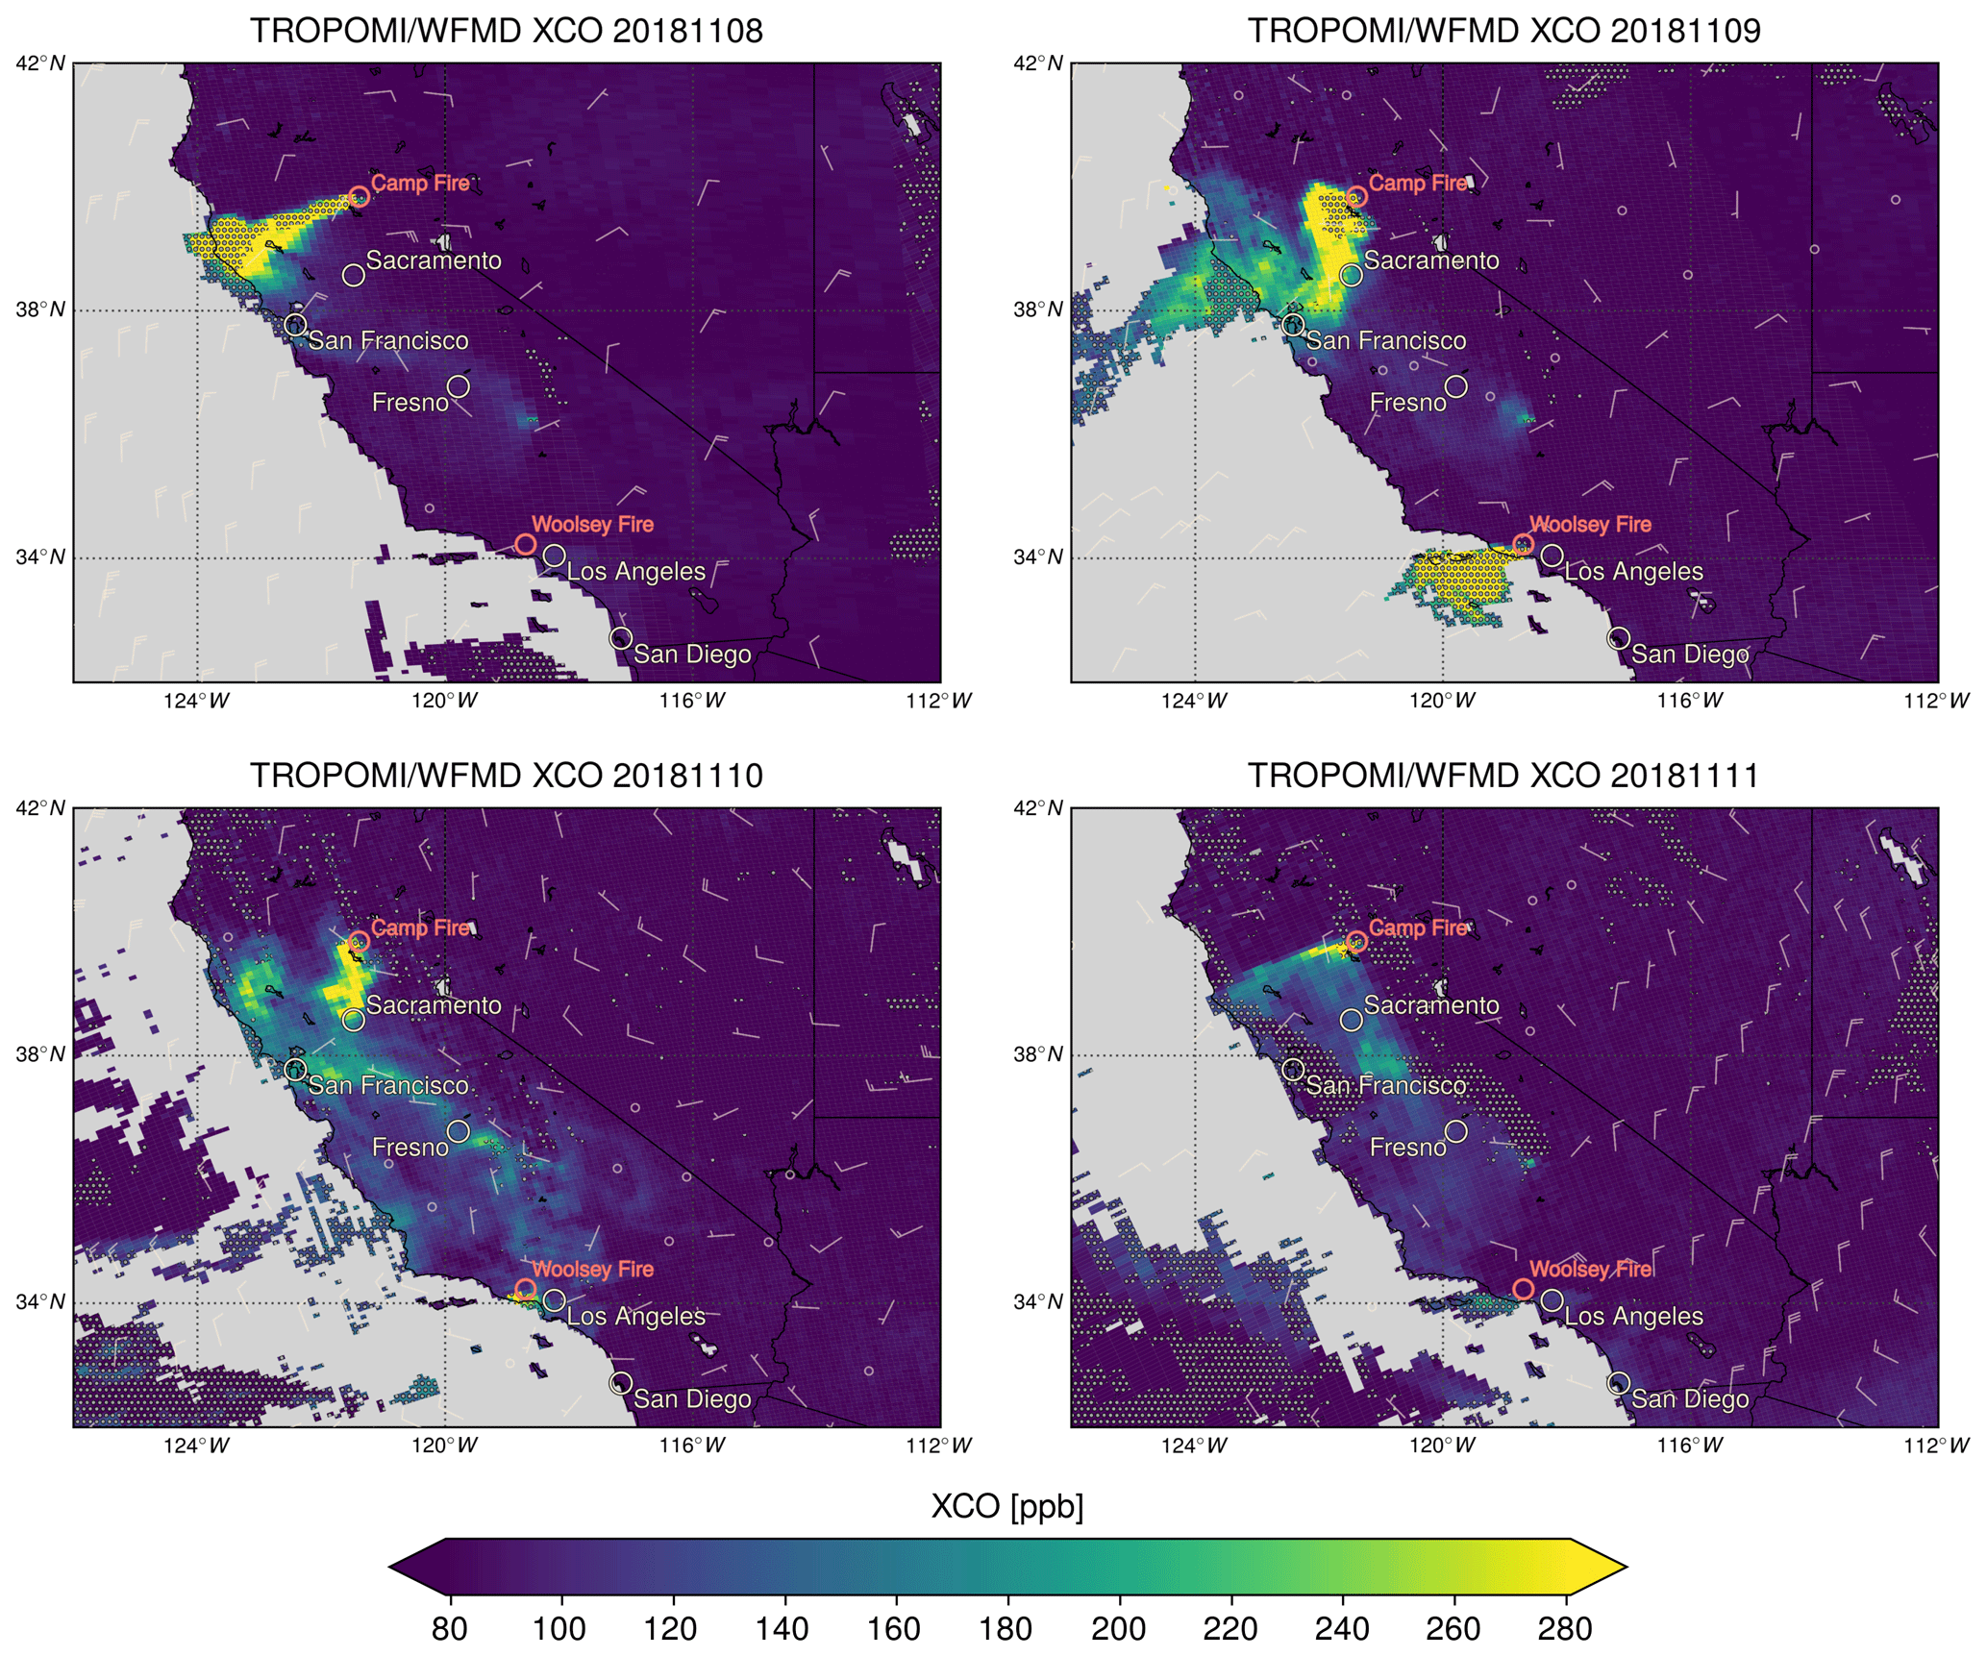
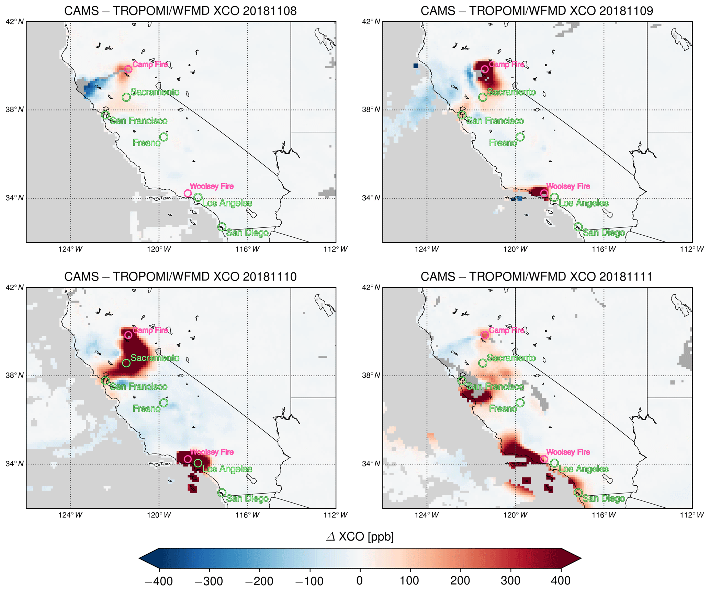
Carbon monoxide: Example
TROPOMI
Clear CO signal from fires in California
Some flagging necessary because of uncertainties from aerosols
Difficult to retrieve over oceans
CAMS model clearly overestimates CO columns and transport is not always correct
Schneising, O.,et al.: Severe Californian wildfires in November 2018 observed from space: the carbon monoxide perspective, Atmos. Chem. Phys., 20, 3317–3332, https://doi.org/10.5194/acp-20-3317-2020, 2020.

Slide 22
Aerosol Index (AI)
Sources:
Sea salt
Desert dust
Soot from biomass burning / fossil fuel burning
Sulphates from coal burning / dimethyl sulfide oxidation
Relevance:
Cloud & rain formation
Climate forcing
Health

Slide 23
Aerosol Index (AI)
Aerosol properties:
Composition, mixing state, humidity
Size distribution
Vertical distribution
Measurements:
Ratios of reflectances outside of known absorption bands
Wavelength region:
335 / 376 nm
Cannot be measured directly
UV optical properties
Available from: GOME SCIAMACHY OMI GOME-2 OMPS TROPOMI

Slide 24
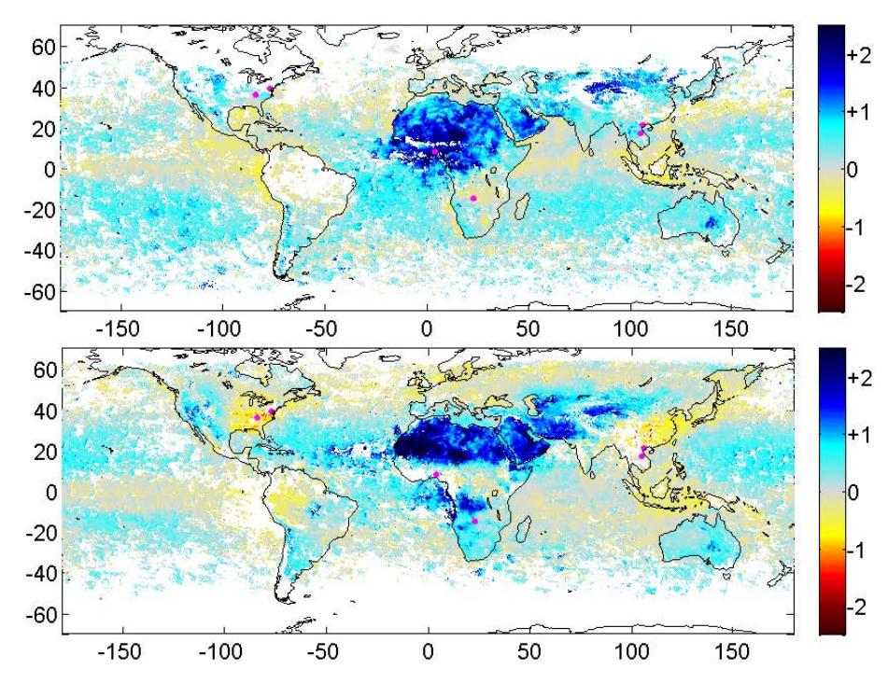
Aerosol Index: Example
SCIAMACHY 2005
Aerosols can absorb or reflect light
Clouds can interfere and need to be filtered out
Absorbing aerosols from desert dust and biomass burning
Scattering aerosols in summer over industrialised regions and Amazon
Jan - Mar
Penning de Vries, M. J. M. et al.: UV Aerosol Indices from SCIAMACHY: introducing the SCattering Index (SCI), Atmos. Chem. Phys., 9, 9555–9567, https://doi.org/10.5194/acp-9-9555-2009, 2009.
Jul - Sep

Slide 25
Summary
NO₂ is the most important tropospheric pollutant that can be retrieved from UV/vis satellite observations
SO₂, HCHO, CHOCHO, CO and AI can also be retrieved and can be used in many applications including
Emission estimates and trends
Analysis of biomass burning plumes
Monitoring of volcanic emissions
Evaluation of atmospheric chemistry models
Often, uncertainties are large and averaging needs to be applied
The combination of small pixels and low noise in TROPOMI data creates many more possible applications

