Slide 1
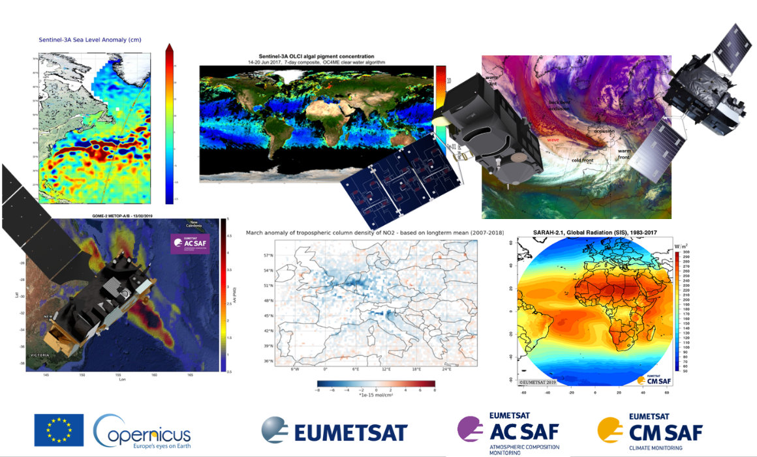
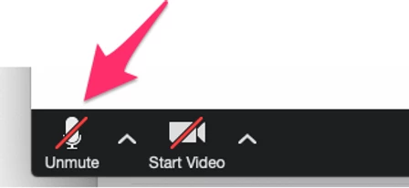
Welcome to the first short online course in the series
The session will begin at 12 UTC - 14 CEST
Please keep your
Audio and Video off !
If you have technical issues, please send a message in the chat box to Support.
For Q&A: go to Slido.com – event code: #SC11

Slide 2
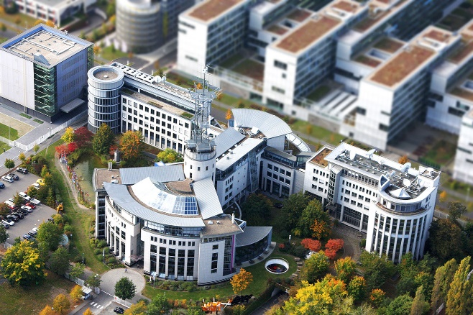
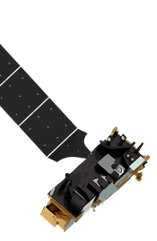
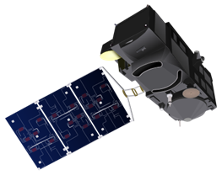
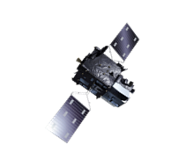


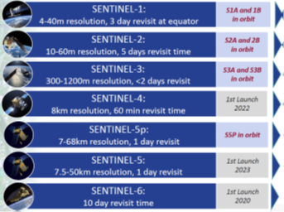
What is EUMETSAT ? Satellite Monitoring of Climate & Weather for Europe …
Make data available at best
Gather (and satisfy) needs
Grant data access
Help and support Users
Training (also on-line)
Explore applications
Communicate - outreach
EUMETSAT programs
METOP (1-3)
Meteosat
Meteosat III Gen
Polar II Gen
Monitor CO2

Slide 3
Ozone hole tour – the exceptional 2020 winter(s)
J. Wagemann – MEEO @EUMETSAT
A. Cacciari - EUMETSAT
F. Fierli - EUMETSAT

Slide 4
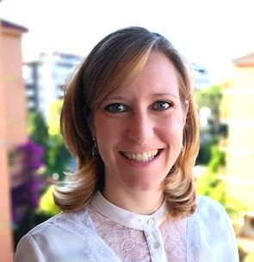

Course Program
(1) Webinar & Data discovery
12:00 - 12:25: Stratospheric Ozone basics
12:25 - 12:50: Observing principles of GOME-2
12:50 - 13:30: Data Discovery and play with ozone hole …
13:30 - 13:45: Q&A and Wrap-Up
(2) Self-paced phase until …
(3) 23 Feb 2021 @14:00 UTC 15 CET Feedback session
→ Discussion Q&A on:
slido.com #EUMSC11
Access the data / handling tools
https://training.eumetsat.int/course/view.php?id=377
Please keep your
Audio and Video off !

Slide 5

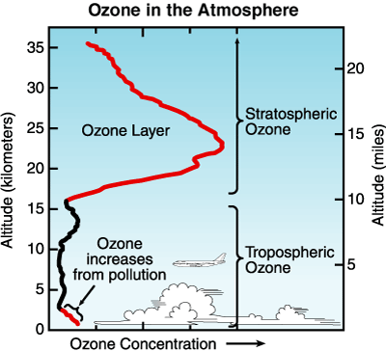
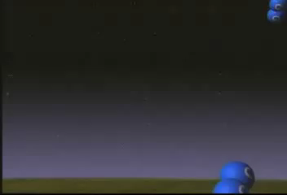
The ozone layer protects us from UV radiation
UV
Visible
Ozone layer
Earth surface
Ozone absorbs UV radiation
while letting visible radiation through
Ozone (O₃) is produced naturally in the stratosphere
from molecular oxygen (O₂)

Slide 6
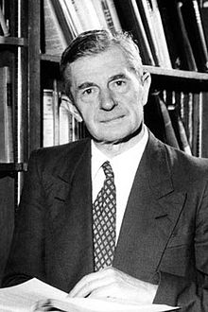
Chapman mechanism for stratospheric ozone (1930)
Sydney Chapman
(1888-1970)

Slide 7
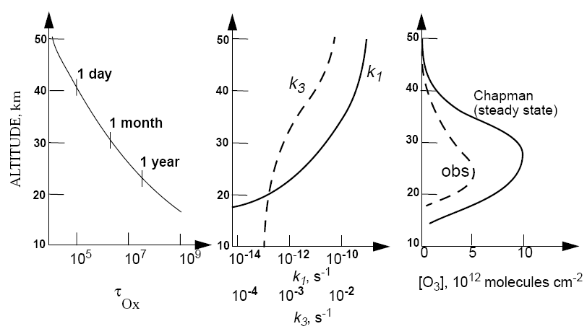
Chapman mechanism vs. observations
log n_{O2}
shape
determined
by k₁n_{O2}
-3
Chapman mechanism reproduces shape, but is too high by factor 2-3 e missing sink!

Slide 8
Ozone loss catalyzed by nitrogen oxide radicals (NO_{x})
Initiation: conversion of air to NO radicals
in combustion engine
NO ≡ nitric oxide
NO₂ ≡ nitrogen dioxide
Propagation: cycling of NO_{x} radicals (NO_{x} ≡ NO + NO₂)
R6 is rate-limiting step
for catalytic ozone loss:
-d[O₃]/dt = 2k₆[NO₂][O]
Termination: oxidation of NO_{x} to HNO₃ (nitric acid)
OH is a very strong oxidant
(we will encounter it often)
Recycling: conversion of HNO₃ back to NO_{x}
HNO₃ is called a ‘reservoir’ for NO_{x}

Slide 9
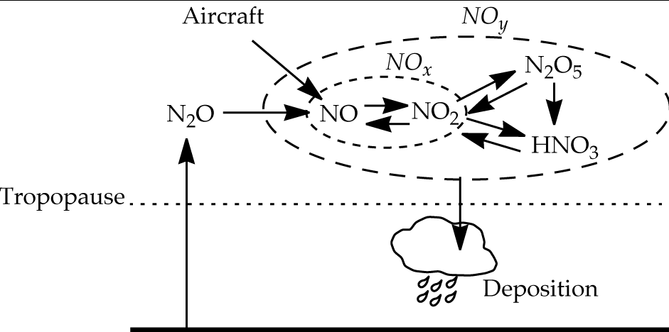
Computing the NO_{x}-catalyzed ozone loss rate
Total nitrogen oxides
Conserved in stratosphere
Loss rate depends on:
NO_{x} emission rate E
[NO_{x}]/[NO_{y}] ratio (< 0.1)
[NO₂]/[NO_{x}] ratio (≈ 1)
Ozone loss rate given by (R6)
Residence time τ of air in stratosphere (≈1 year)
tropopause
Typically [NO_{x}]/[NO_{y}] < 0.1; importance of reservoirs!
Notes:
O + NO₂ ; NO₂ + NO₃ + M -> N₂O₅ … + H₂O -> 2 HNO₃ Removes NOx and O₃

Slide 10
Ozone loss catalyzed by chlorine radicals (ClO_{x})
Initiation: photolysis of CFCs
Propagation: cycling of ClO_{x} radicals (ClO_{x} ≡ Cl + ClO)
R5 is rate-limiting step
for catalytic ozone loss
Termination: conversion of ClO_{x} to HCl and ClNO₃ reservoirs
HCl ≡ hydrogen chloride
ClNO₃ ≡ chlorine nitrate
CH₄ ≡ methane
NO₃ ≡ nitrate radical
Recycling: conversion of HCl and ClNO₃ back to NO_{x}

Slide 11
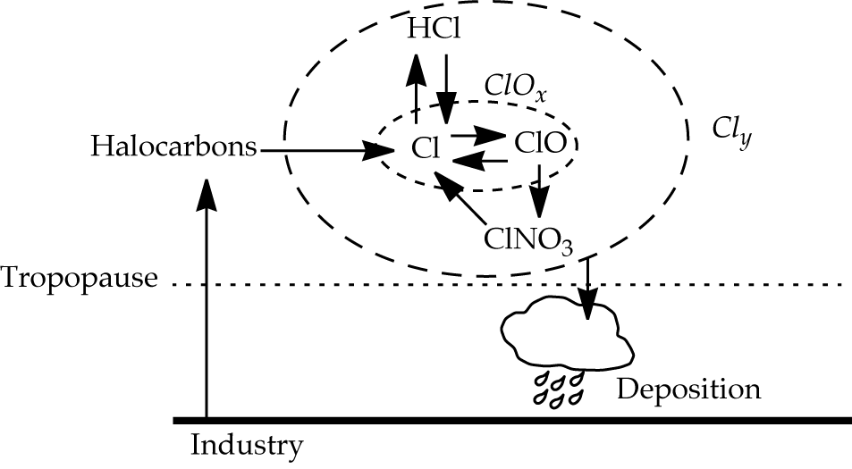
Computing the ClO_{x}–catalyzed ozone loss rate
Follow exactly the same approach as for the NO_{x}-catalyzed ozone loss rate

Slide 12
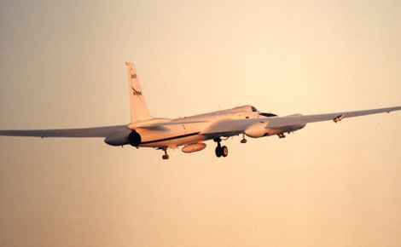
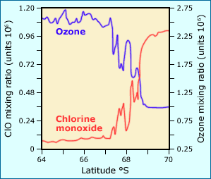
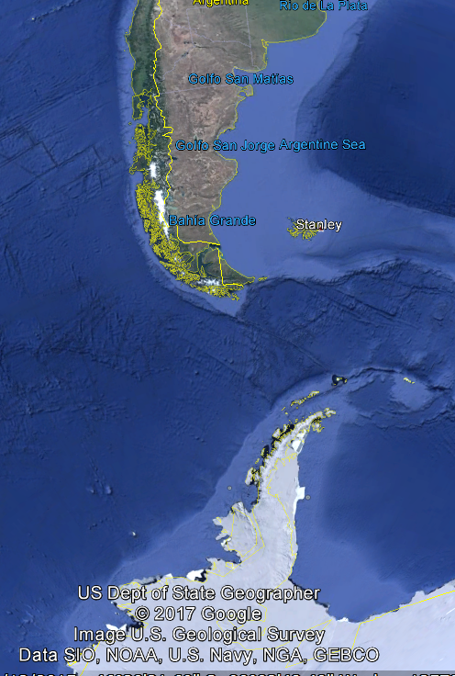
What is the cause of the ozone hole?
Spring 1987 NASA ER-2 mission from Punta Arenas, Chile
Ozone-destroying chlorine produced from CFCs
ozone
hole
boundary

Slide 13
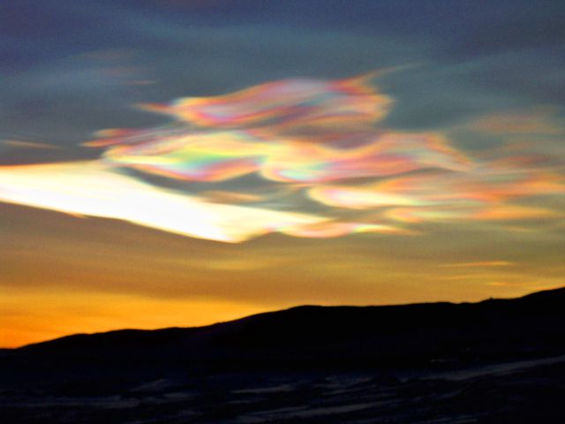
Conversion of Cl reservoirs to ClO in polar stratospheric clouds (PSCs)
HCl and ClNO₃ stick to PSC particles and then react
ClNO₃
HCl
HCl
PSC
particle
ClNO₃
ClNO₃
HCl
HCl
ClNO₃
ClNO₃
ClNO₃
HCl
Polar stratospheric clouds
over McMurdo, Antarctica

Slide 14
Polar stratospheric clouds require very cold conditions, found mainly in Antarctic stratosphere in winter
Observed
PSC formation
Frost point of water
WMO [2014]

Slide 15
Year-to-year variability in Arctic ozone depletion is driven by temperature
Paul Newman, NASA

Slide 16
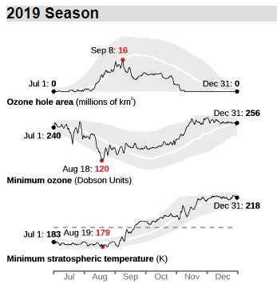
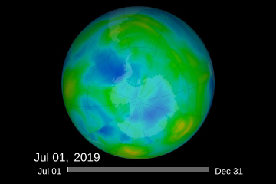
Ozone hole is a seasonal phenomenon it develops in austral spring (September-October) and is gone by December
Isolated concentric region around Antarctic continent is called the polar vortex.
Strong westerly winds, little meridional transport
http://ozonewatch.gsfc.nasa.gov/

Slide 17
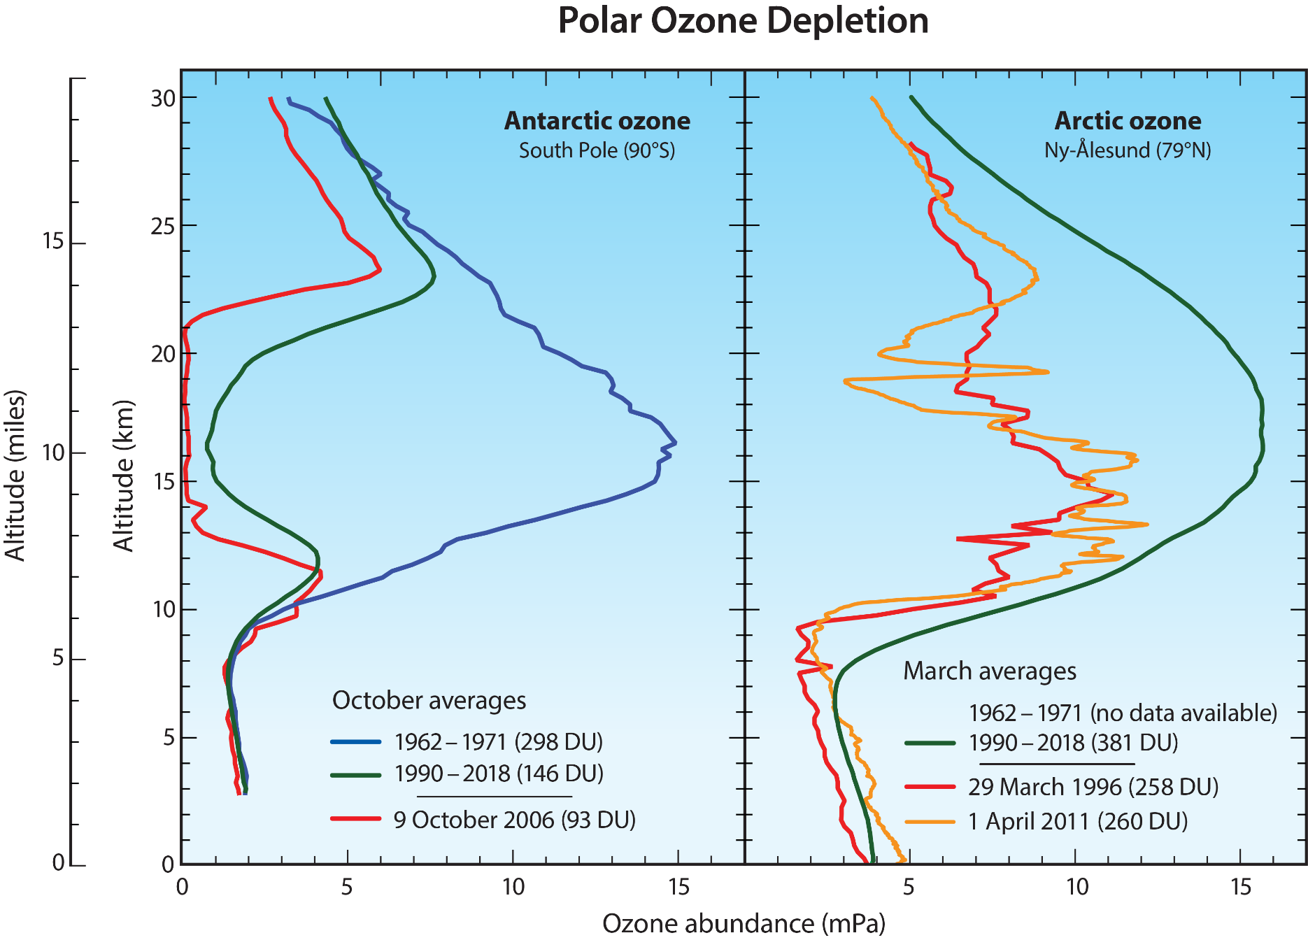
Even in cold winter, ozone depletion in Arctic is much less than in Antarctic
WMO [2018]

Slide 18
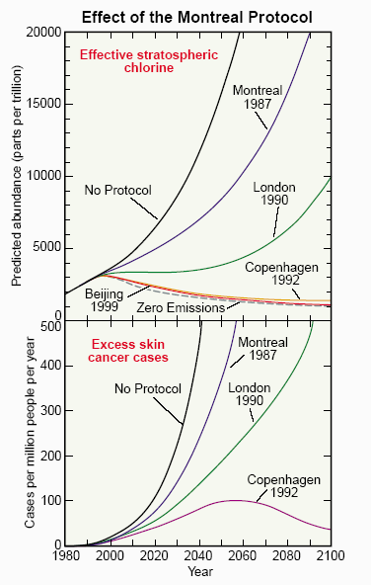
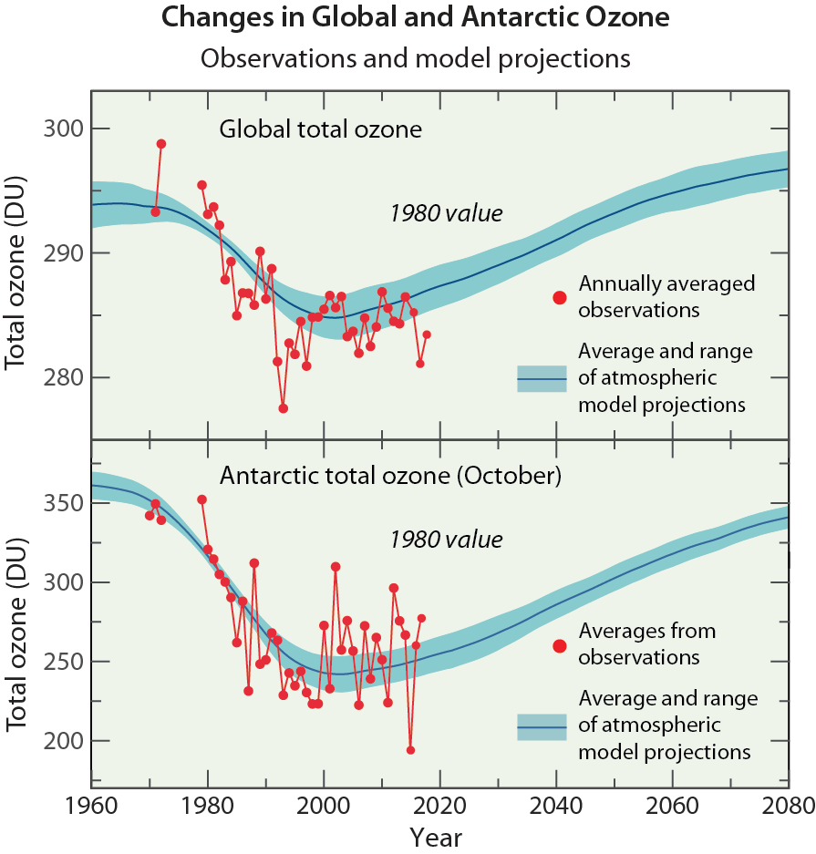
Montreal Protocol as model for successful global environmental action
Montreal Protocol and its amendments have reversed the stratospheric chlorine trend
Ozone recovery may take another decade to confirm
beause of meteorological year-to-year variability
WMO [2014]
Notes:
ozone changes and climate

Slide 19
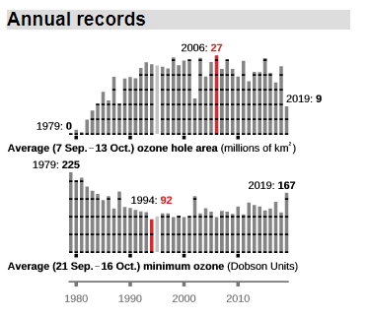
There is tentative evidence that Antarctic ozone recovery has begun
http://ozonewatch.gsfc.nasa.gov/

Slide 20
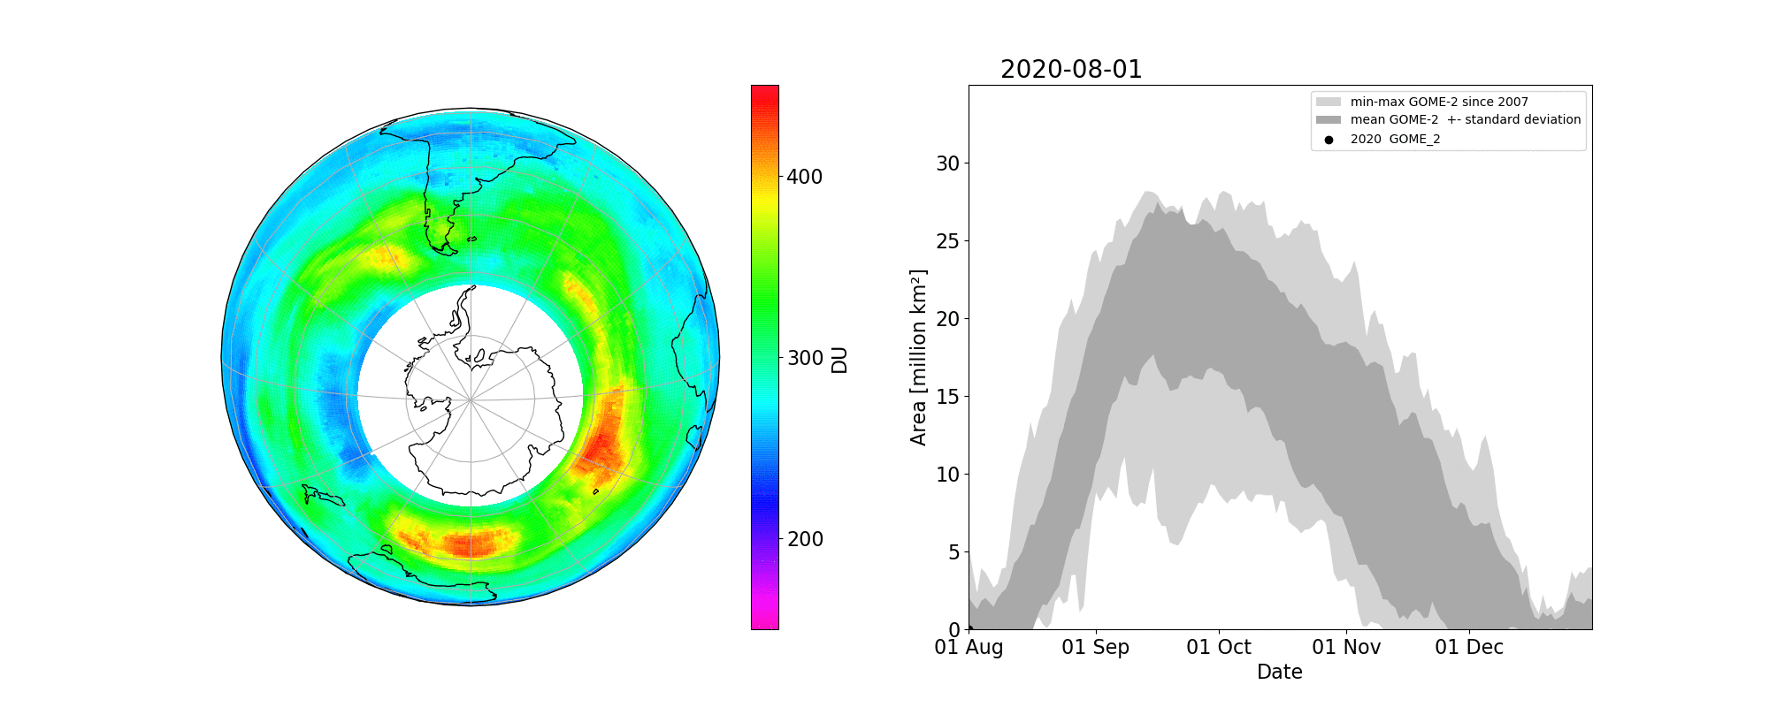

Slide 21
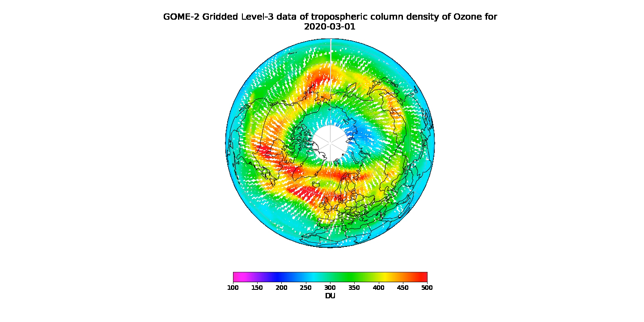
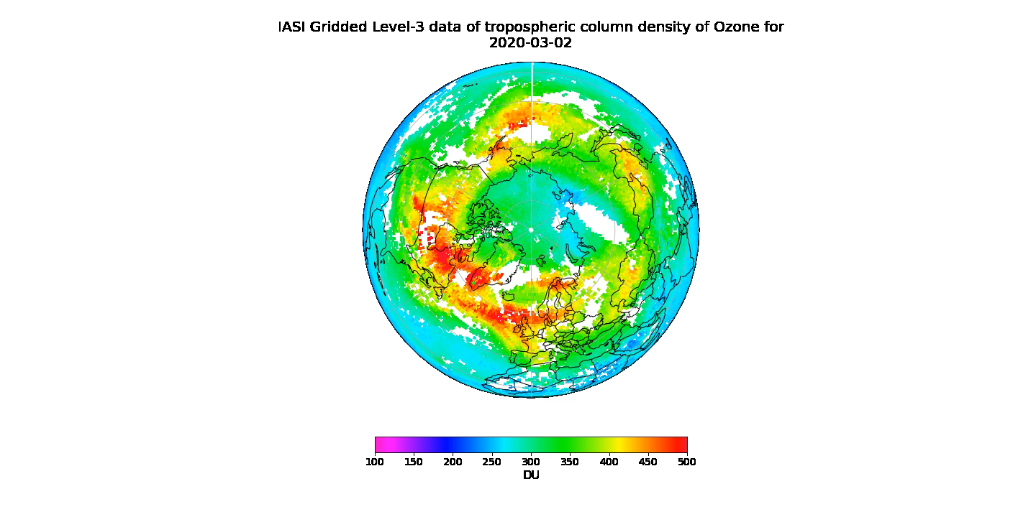
Arctic ozone hole in 2020
Seen by IASI and GOME-2
You will reproduce these video in the practical session …

