Slide 1
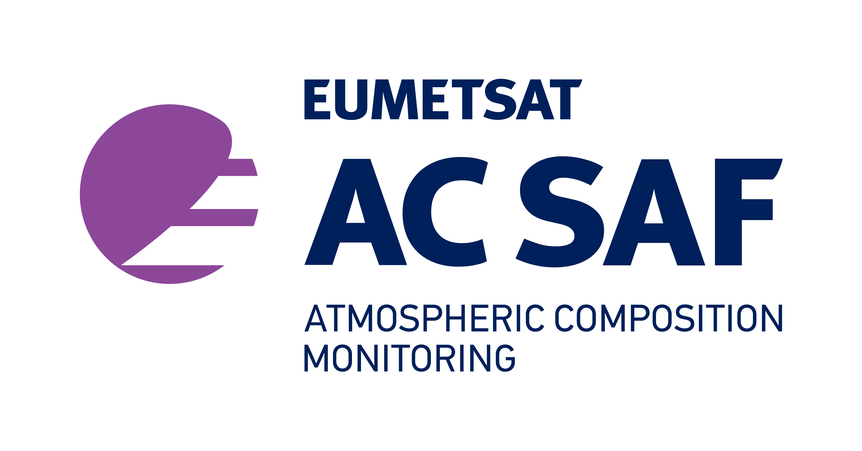
Introduction to AC SAF Atmospheric Observations for Wildfires Monitoring
Anu-Maija Sundström, AC SAF and Space and Earth Observation Centre, Finnish Meteorological Institute
25.5.2021

Slide 2
acsaf.org
EUMETSAT Satellite Application Facility on Atmospheric Composition Monitoring – AC SAF
Develop algorithms and methods to retrieve atmospheric composition data from polar orbiting Metop- A, -B, and –C satellites.
Carry out the validation for the AC SAF products.
Disseminate the data
Training on atmospheric composition and air quality
Leading entity
Co-operating entities
Sub-entities
@Atmospheric_SAF

Slide 3
Current satellite instruments included in AC SAF
EUMETSAT METOP A (2006->), B (2012->) and C (2018->)
Instruments:
GOME-2 (UV-VIS)
IASI (Thermal IR)
IASI
GOME-2
IASI
Noon

Slide 4
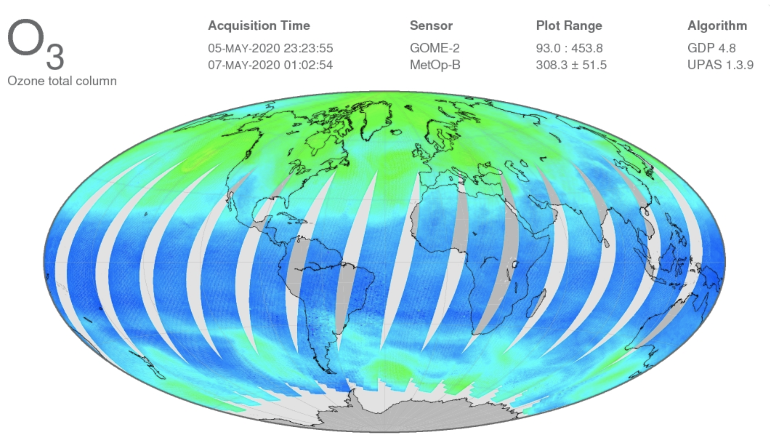
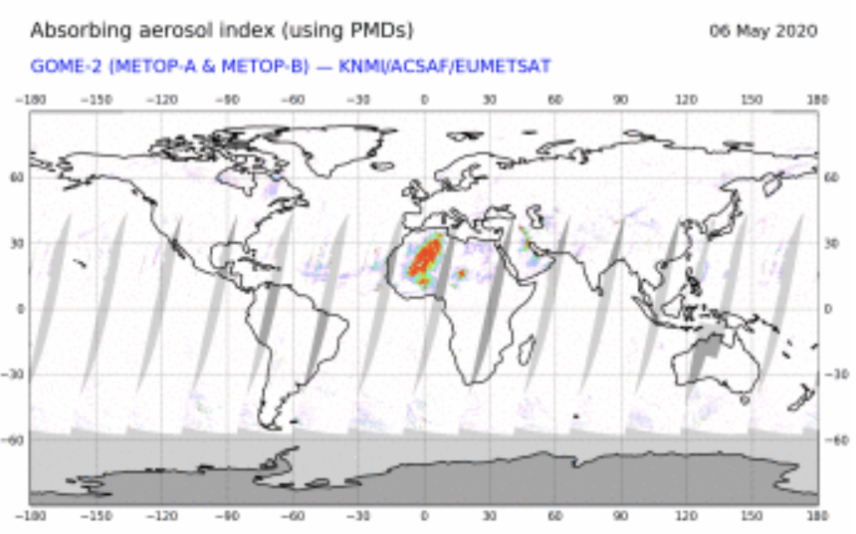
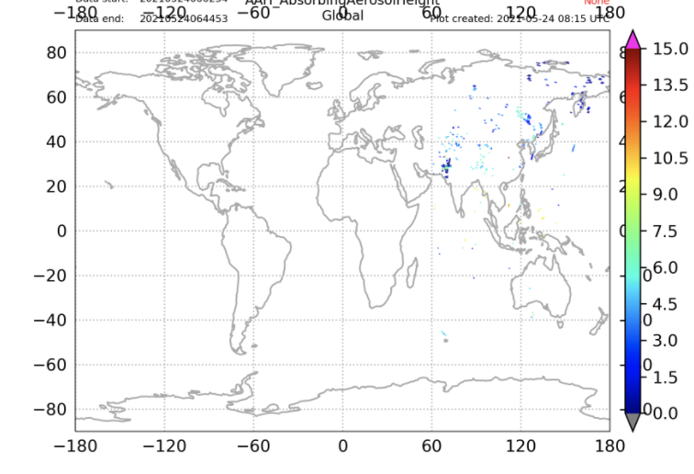
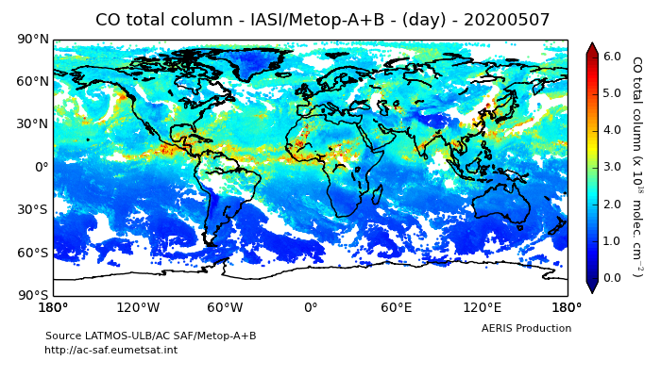
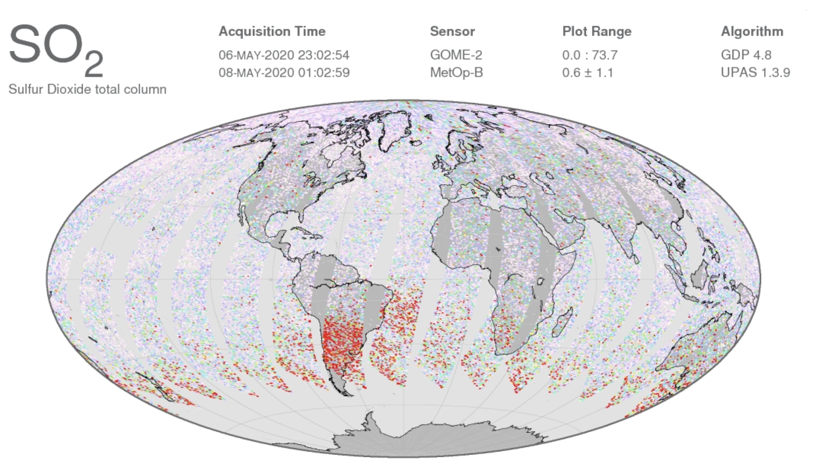
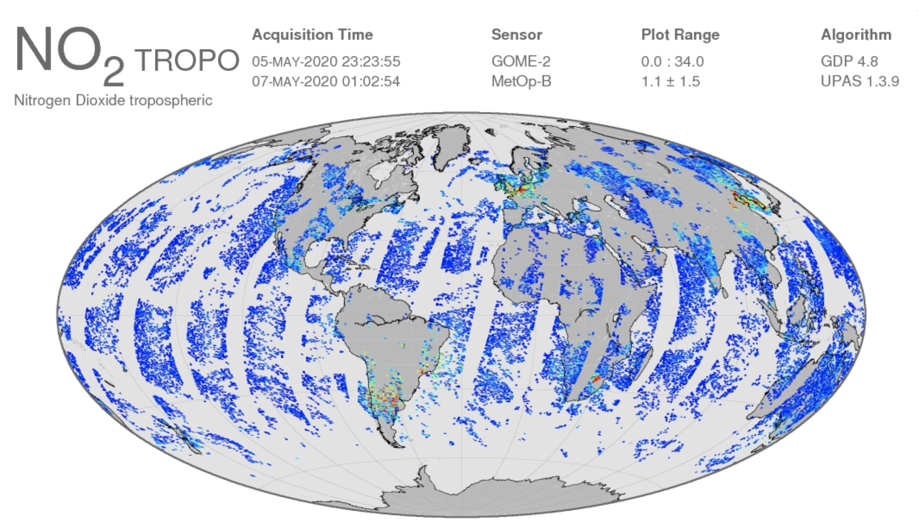
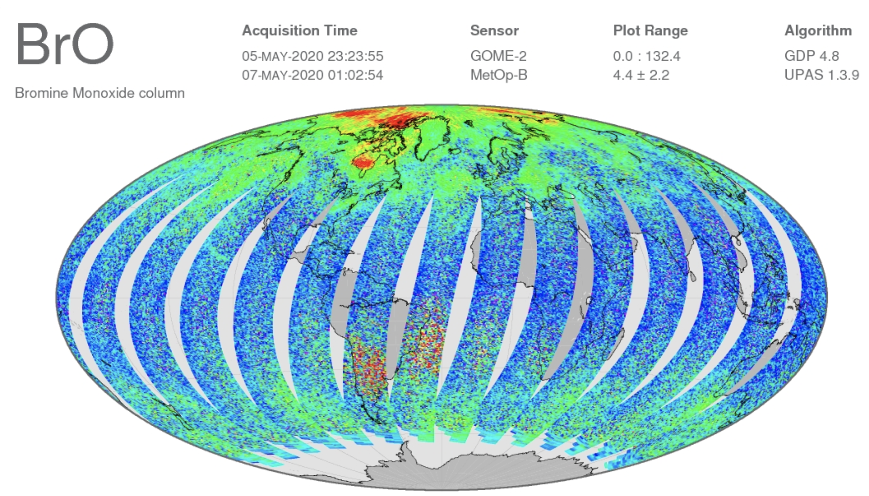
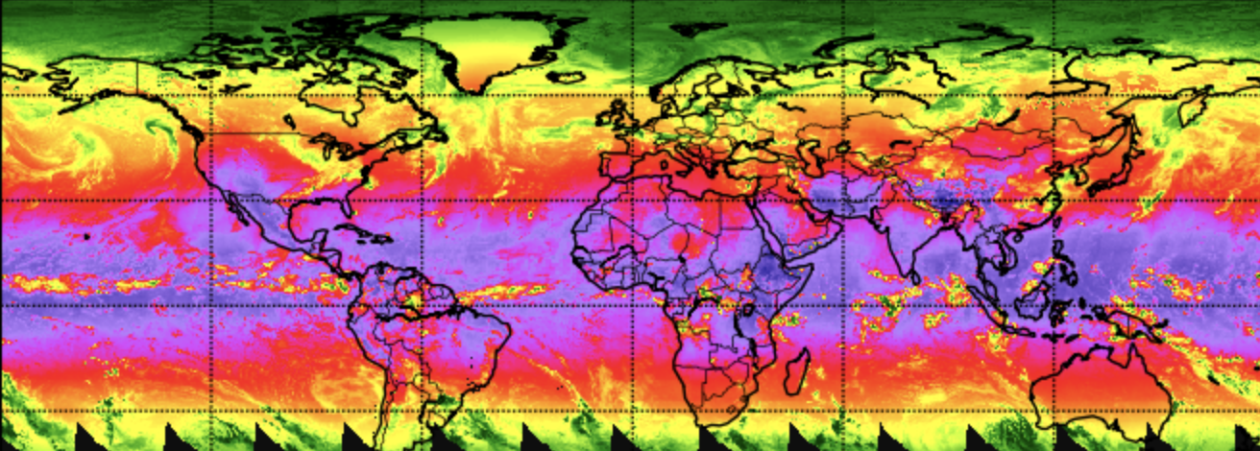
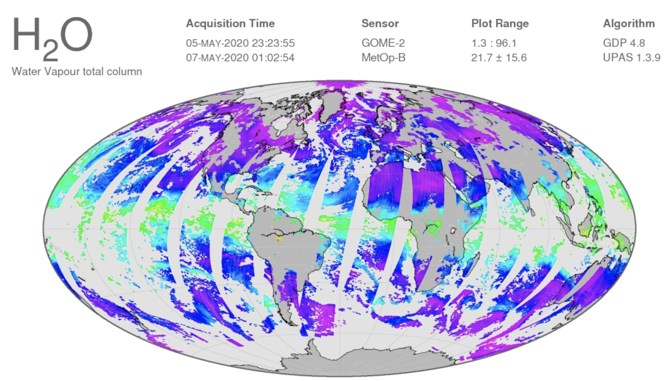
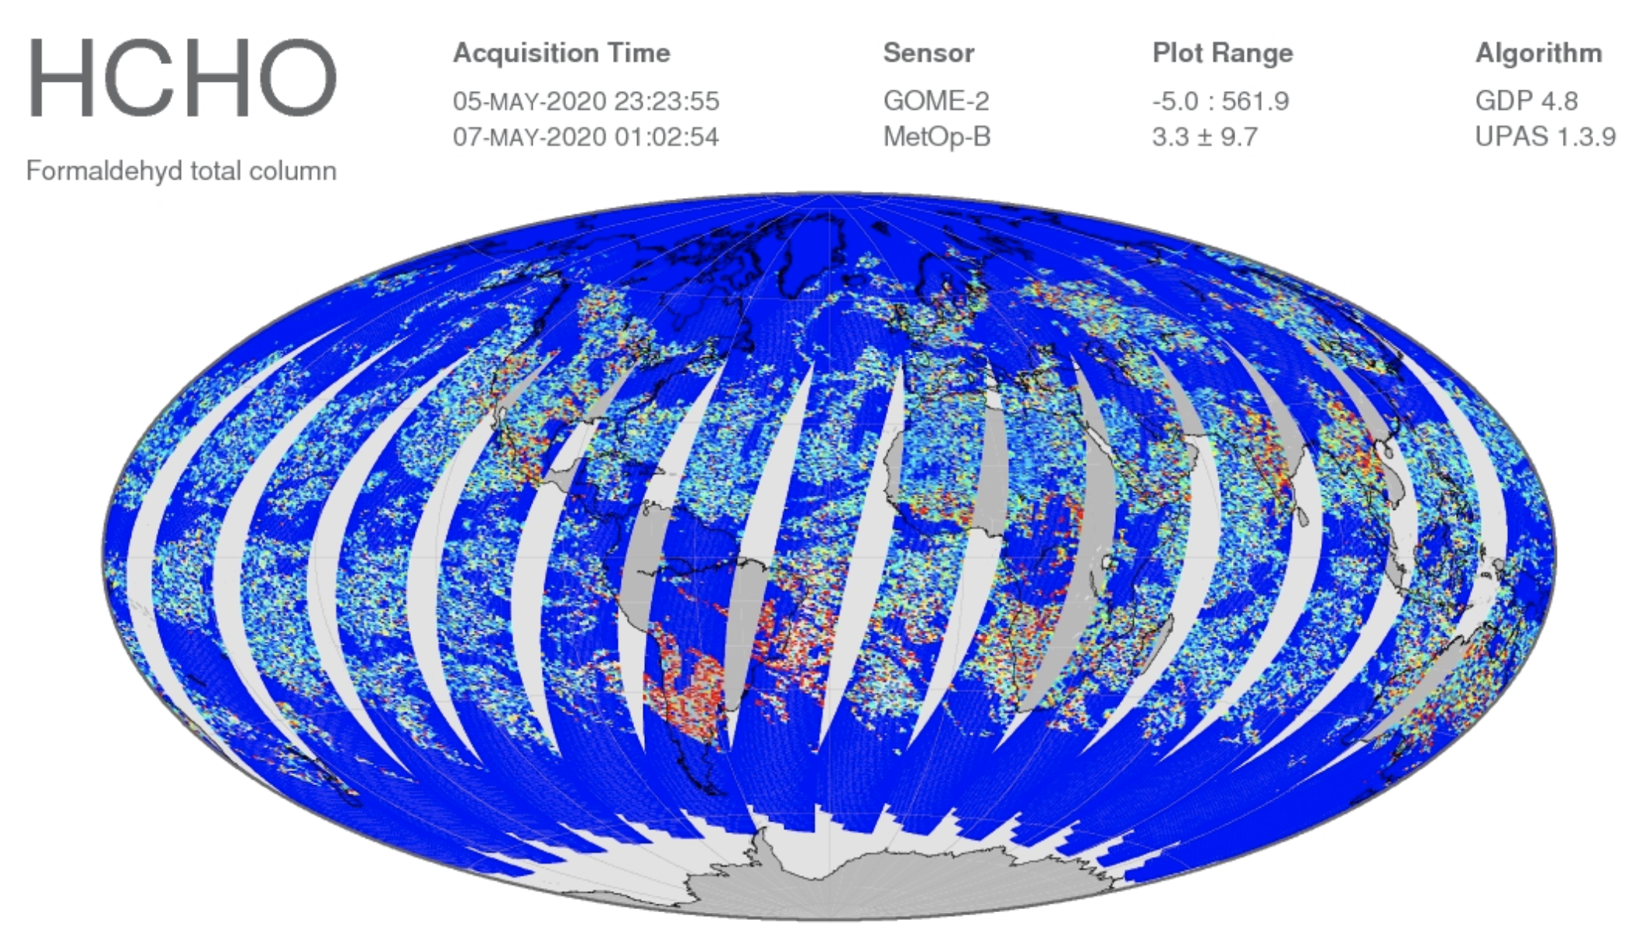
An overview of the AC SAF products
GOME-2
IASI
AAI
AAH
Surface UV

Slide 5
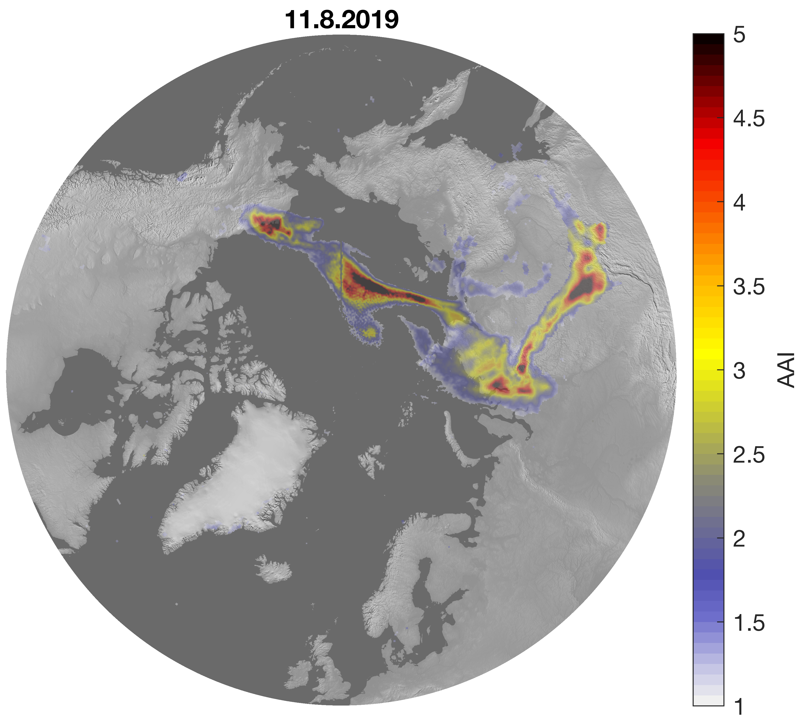
Absorbing Aerosol Index (AAI)
Also known as UV Aerosol Index (UVAI)
Defined using UV-wavelengths (GOME-2, TROPOMI, OMI, OMPS)
Sensitive to absorbing aerosols: smoke, volcanic ash, desert dust
AAI separates the spectral contrast at two UV wavelengths caused by aerosol extinction from that of other effects (e.g. molec. scattering)
Clouds do not completely “prevent” the observation
Example of GOME-2 (A,B) AAI
AAI can be a good tracer for (large scale) smoke plumes

Slide 6
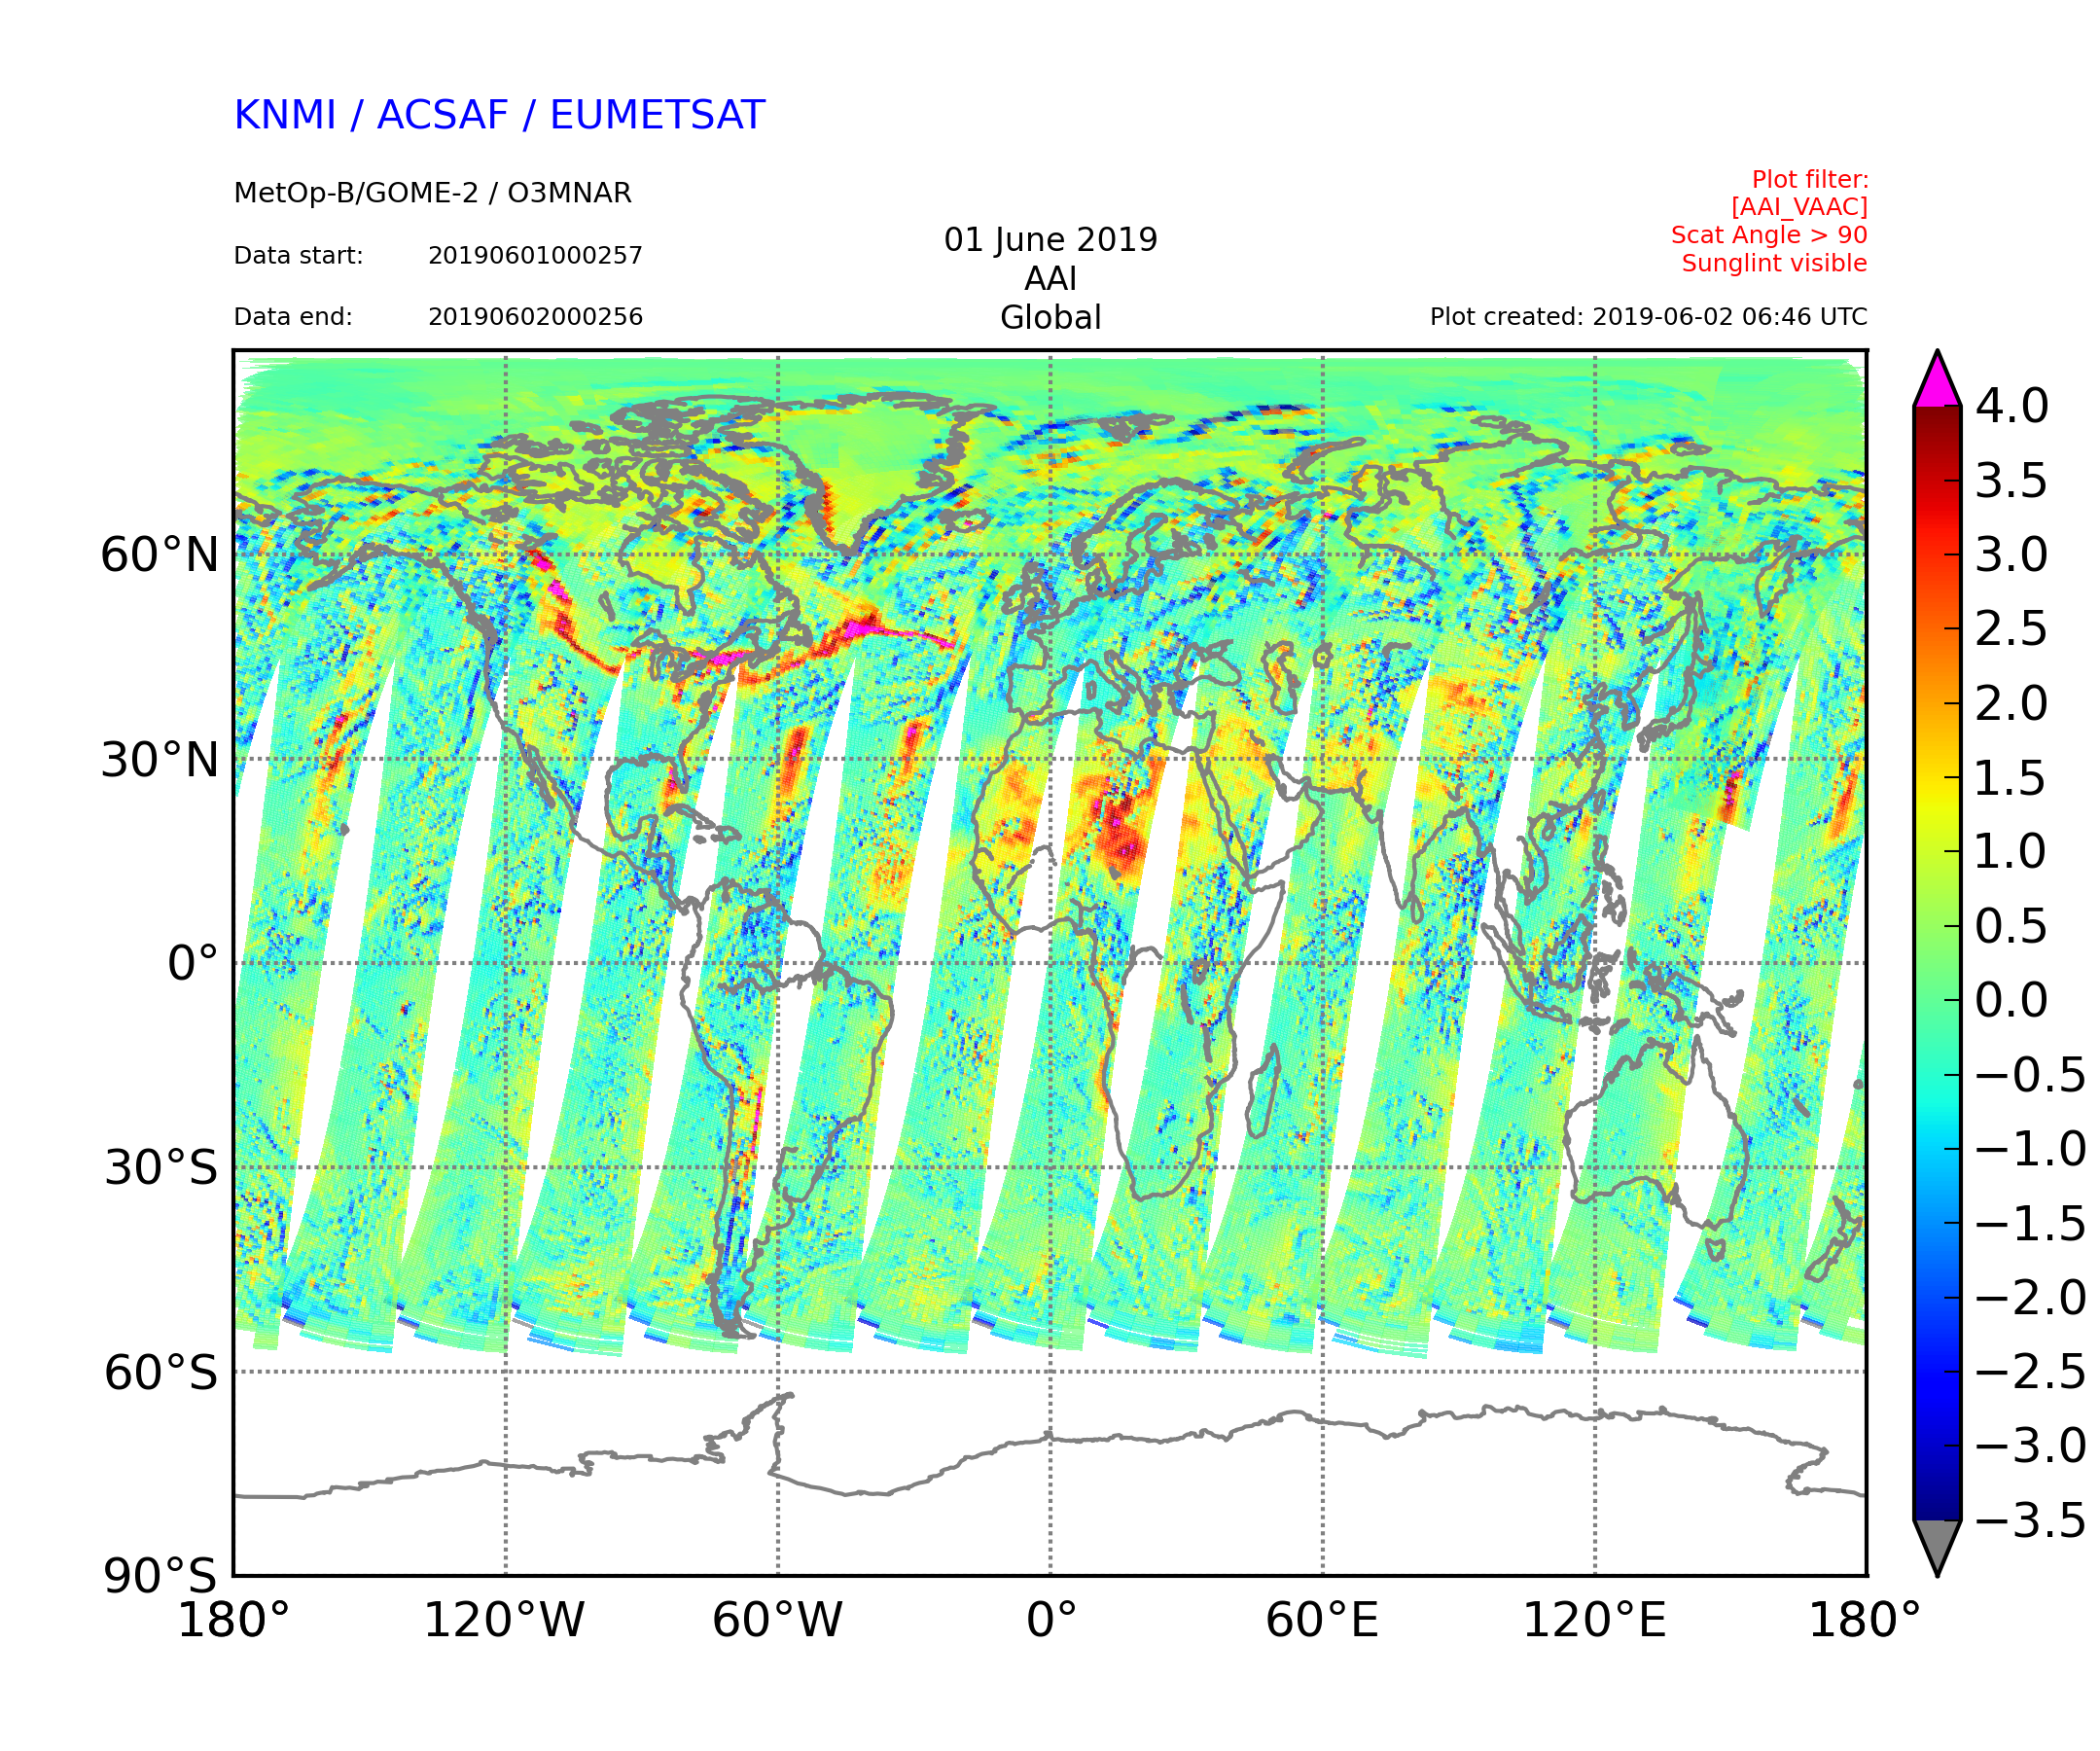
Absorbing Aerosol Index (AAI)
Positive values of AAI indicate presence of absorbing aerosols
For clouds (or scattering aerosols) AAI is close to zero or negative
Positive values can also be other aerosols than smoke!
Sunglint over ocean causes also positive values, but that is often filtered out from the plots/data.
For (smoke) plumes typically AAI > 1.0
Typical background slightly positive
Smoke plume from Canadian forest fires
Desert dust
Sun glint

Slide 7
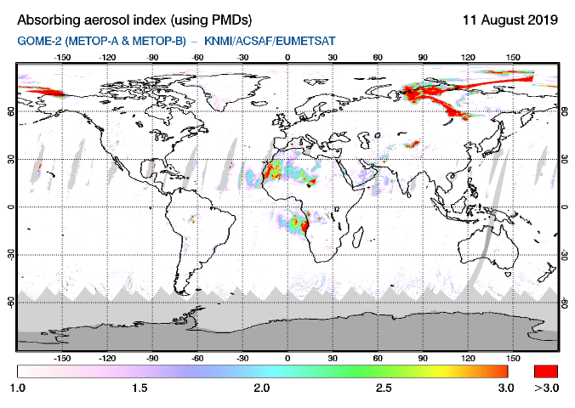
Absorbing Aerosol Index (AAI)
GOME-2 AAI Quicklooks:
SACS: https://sacs.aeronomie.be/nrt/
TEMIS: https://www.temis.nl/airpollution/absaai/
AAI values depend on various factors: amount of aerosols, plume height, and aerosol type.
Comparing different cases is not straightforward!
Not a ”direct” measure of aerosol loading
With AAI you typically see an elevated plume
For assessing air quality at the surface, additional information (model, in situ) is recommended.
Sun glint filtered out
AAI color scale starts from 1

Slide 8
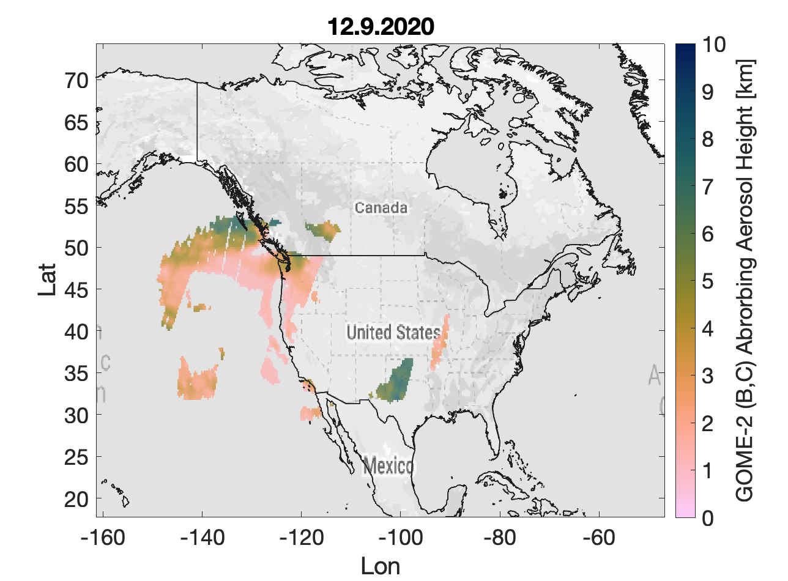
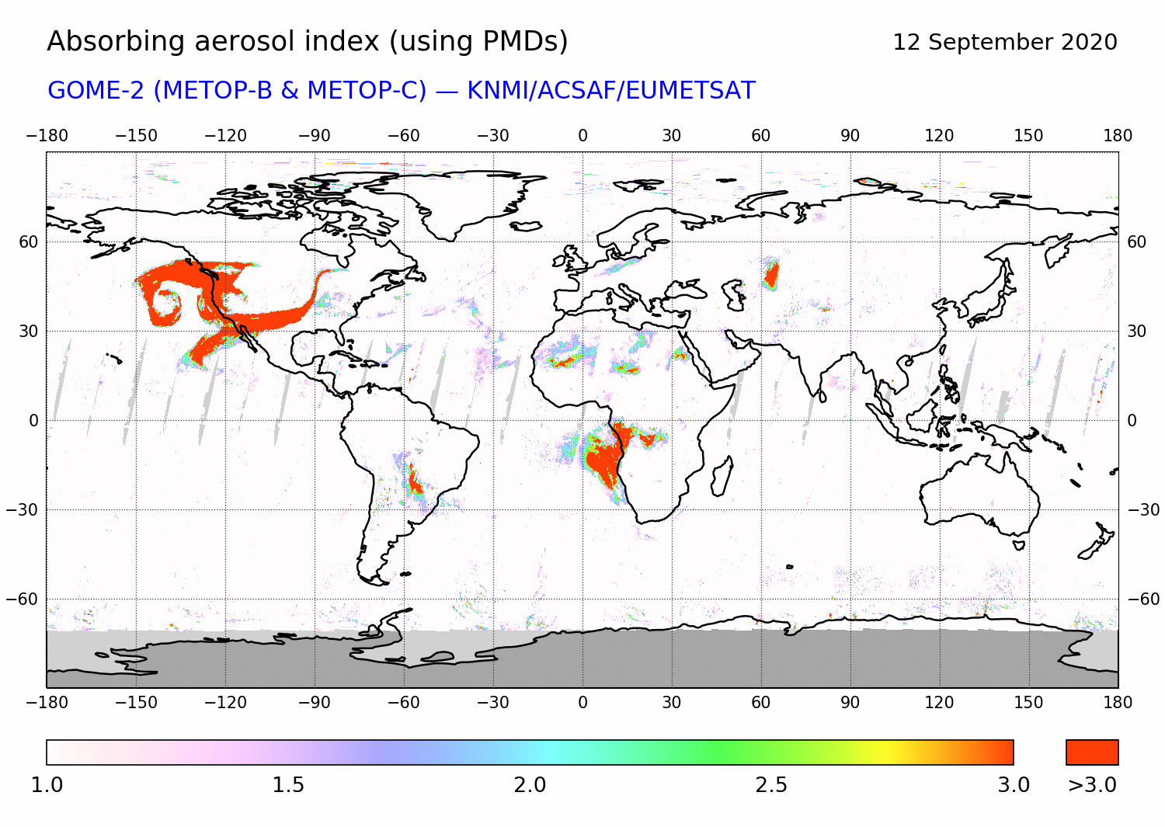
Absorbing Aerosol Height (AAH)
AAH is provided from GOME-2 (A,B,C)
provides information on the height of absorbing aerosol layers
Retrieval is based on Oxygen A-band and information derived from FRESCO cloud algorithm.
Reliable AAH can be obtained only for pixels where AAI is high enough (AAI>4)
AAI < 2 correspond to scenes with too low amounts of aerosol to result in a reliable AAH -> pixels have fill value.
2 < AAI < 4: aerosol layer is not in all cases thick enough for a reliable retrieval, but AAH estimate is given, should be used with caution.

Slide 9
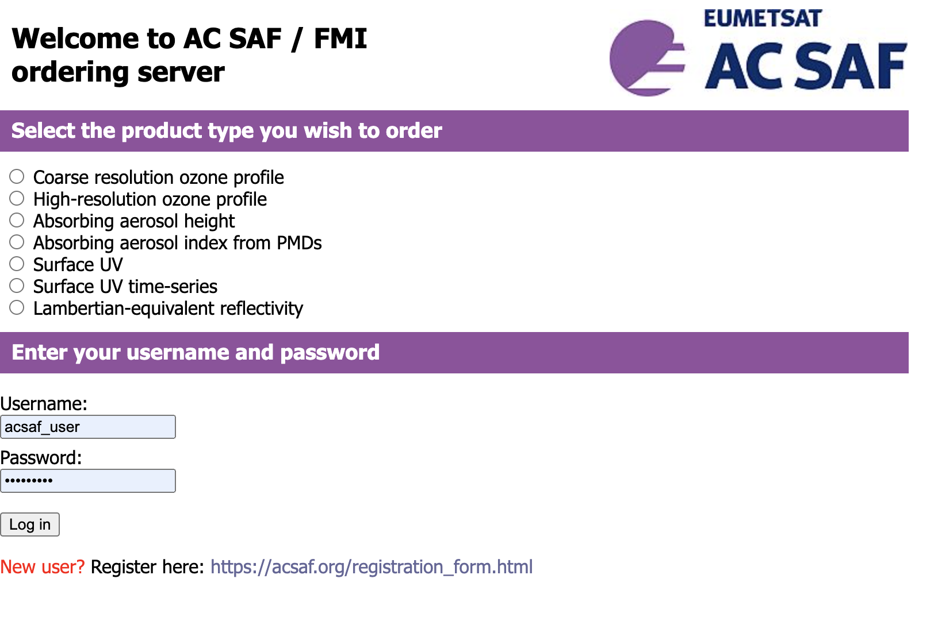
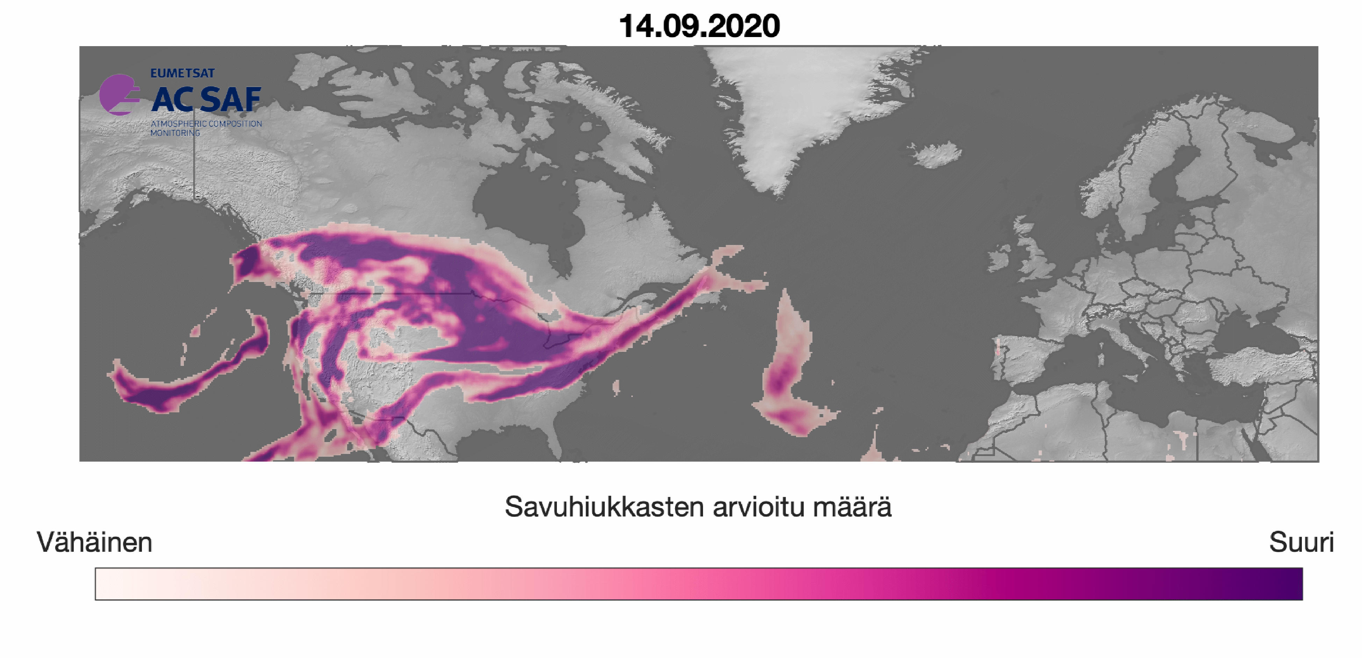
Obtaining the AC SAF aerosol data
GOME-2 AAI and AAH: FMI AC SAF data service
Register: https://acsaf.org/registration_form.html
Download: https://acsaf.org/offline_access.html

Slide 10
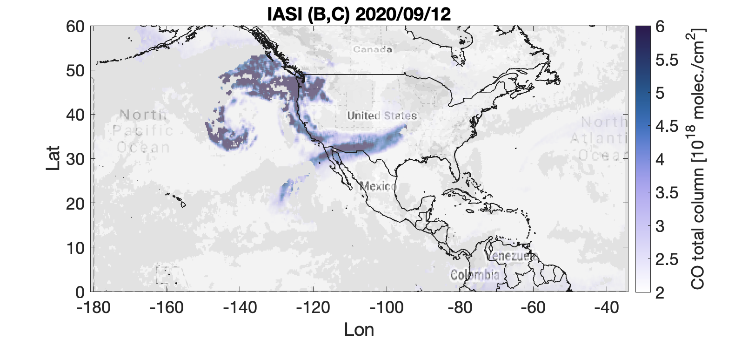
Carbon monoxide (CO)
The IASI instrument observes CO using the Thermal InfraRed (TIR) spectral band
Observations are made twice a day: ”day”, ”night”
IASI is most sensitive to CO at 5-7 km layer
CO is given as ”total column” values
Units are e.g. molec./cm²
Analysis of (daytime) IASI CO can help to identify smoke plumes from GOME-2 AAI.
IASI
IASI
Noon

Slide 11
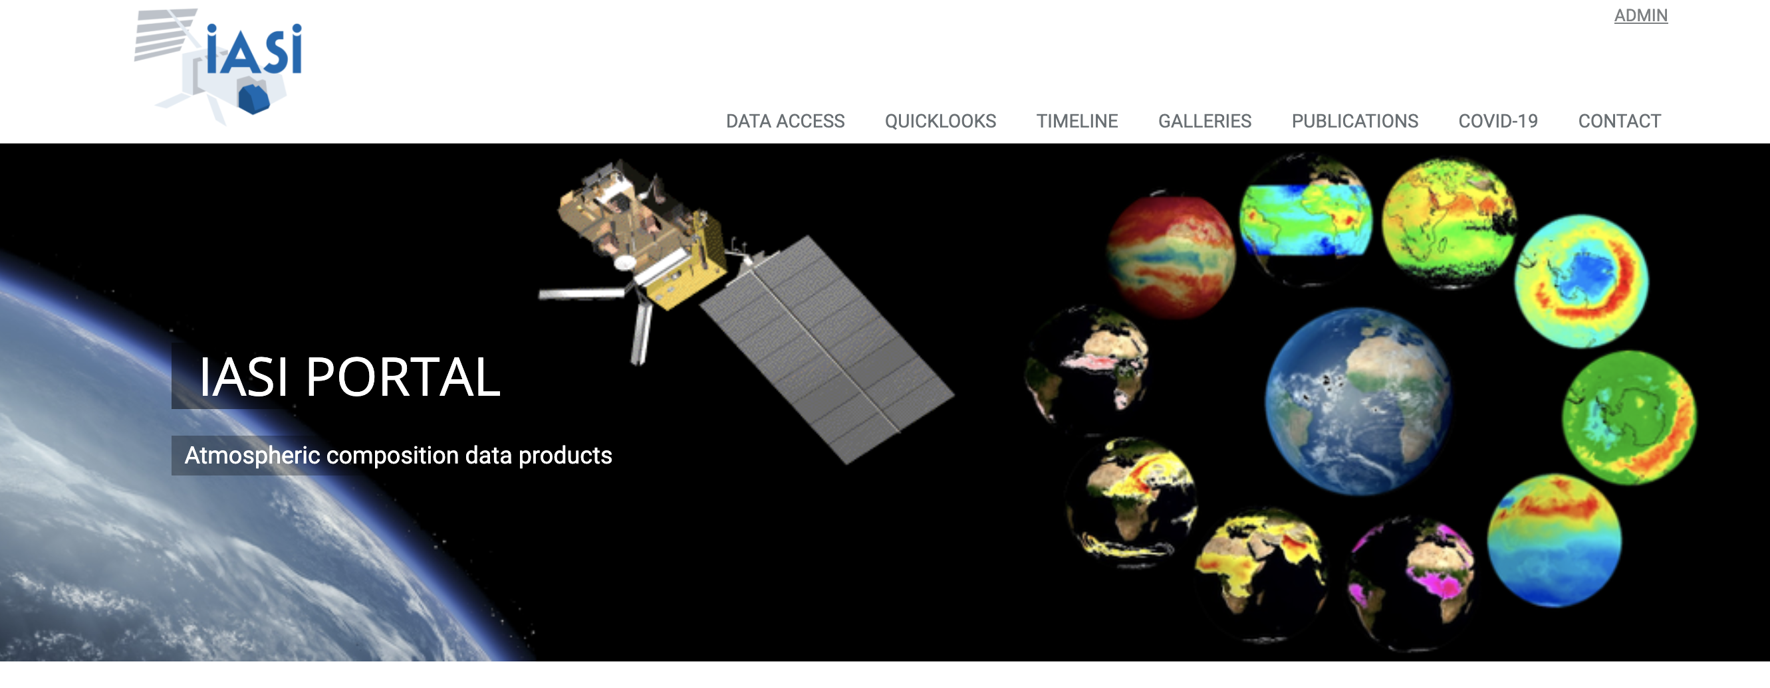
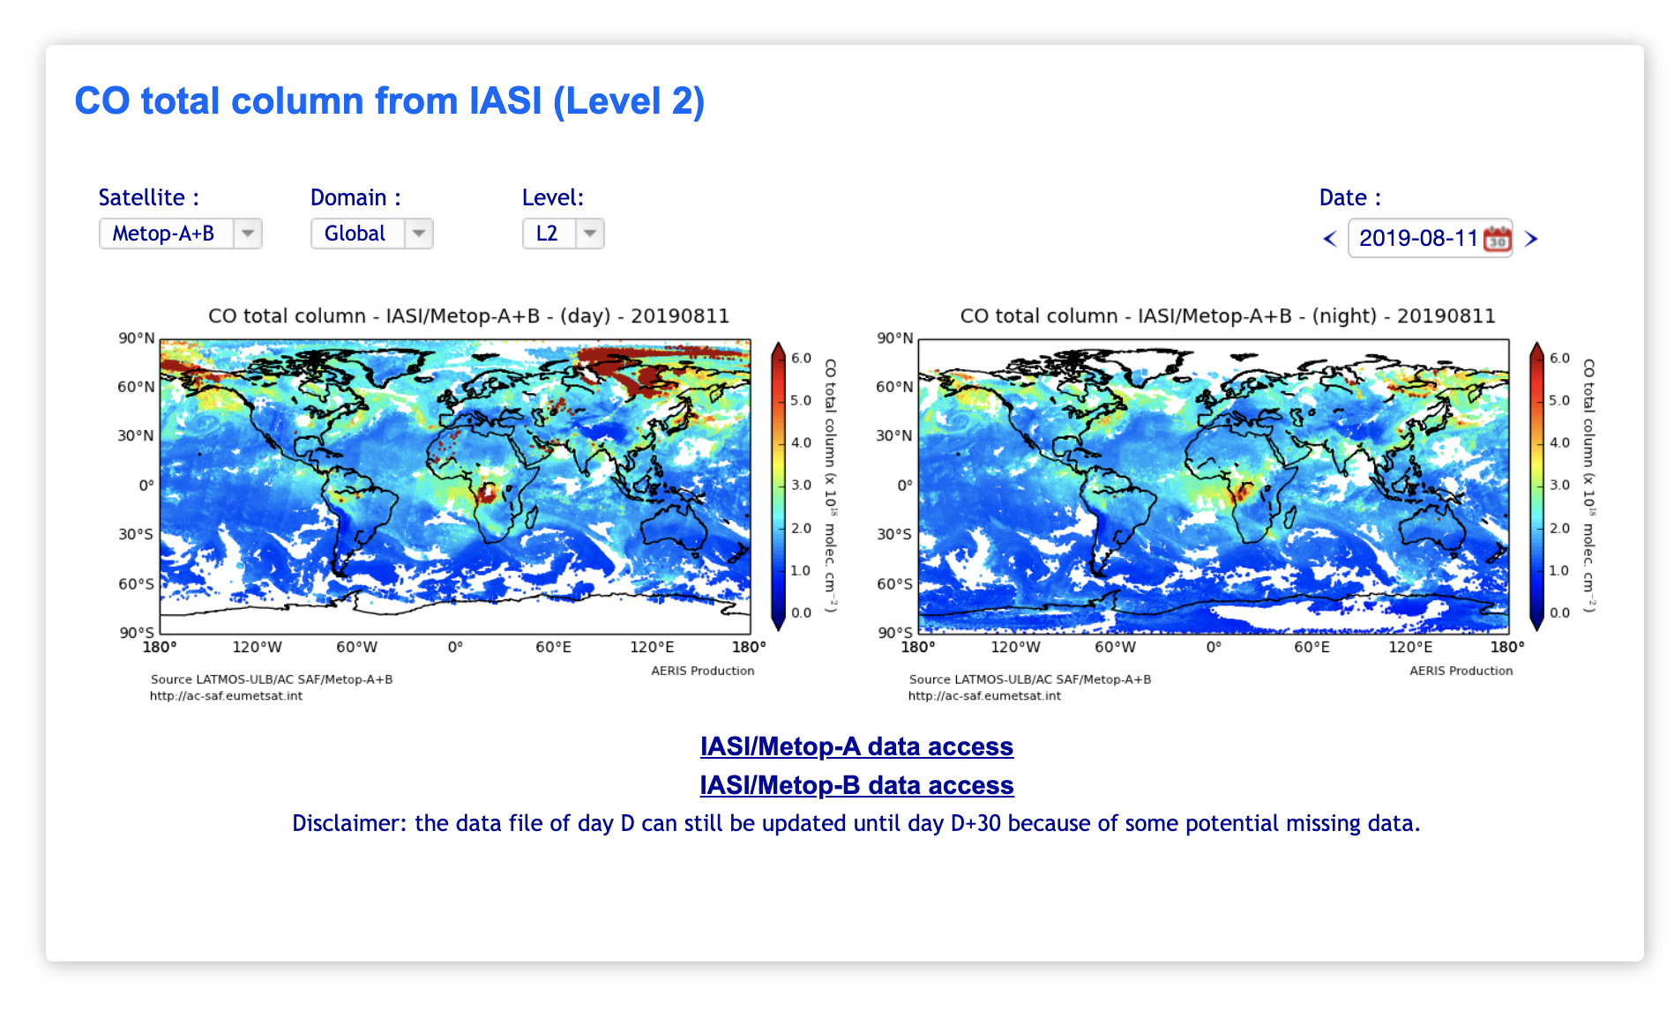
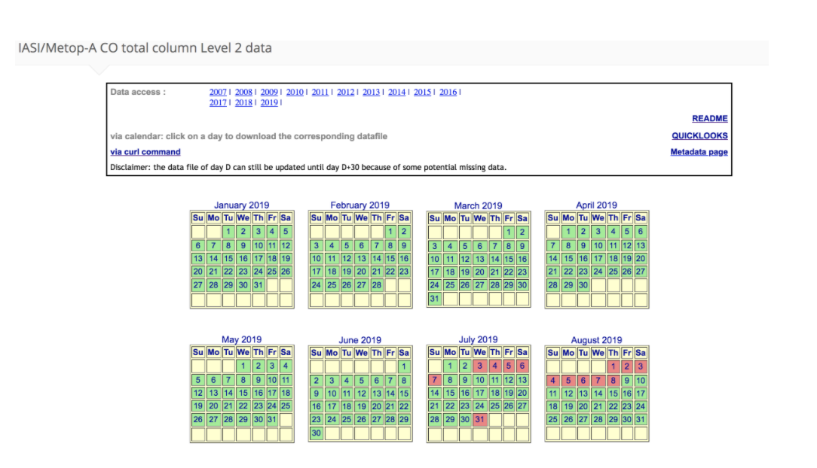
IASI CO quicklook and data access:
https://iasi.aeris-data.fr/

Slide 12
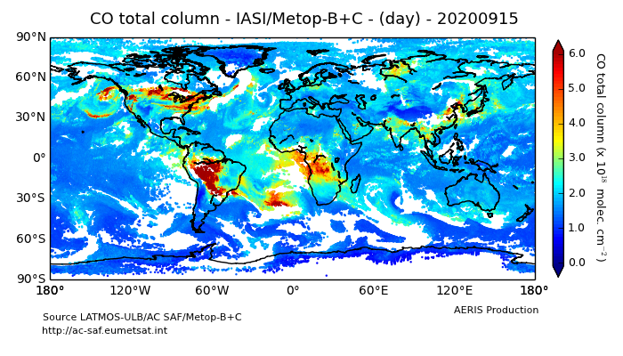
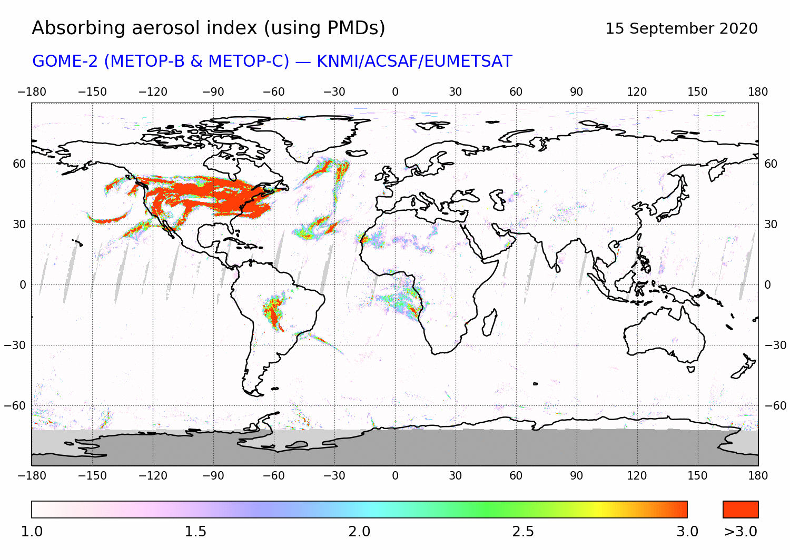
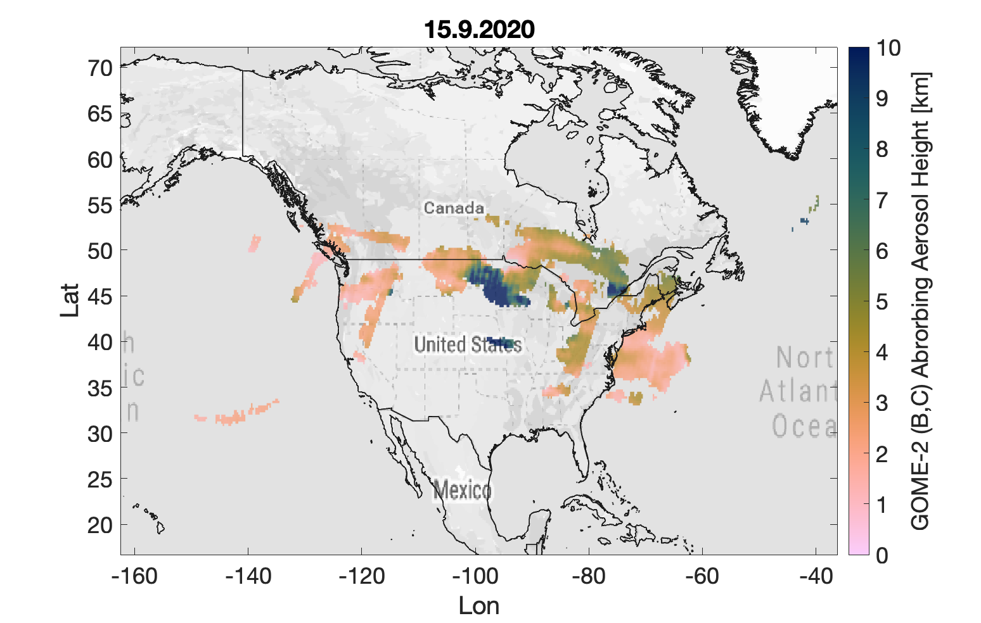
Example: IASI CO and GOME-2 observations for fire plume detection
Fire plume Where both AAI and CO enhancements are observed
Absorbing Aerosol Height

