Slide 1
FORÇA ESPECIAL DE PROTEÇÃO CIVIL
“Per Angusta ad Augusta”
Existing and next generation earth observation based products for wildfires monitoring - data discovery user workshop
Meteorological data applied to fire analysis in Portugal

Slide 2
FORÇA ESPECIAL DE PROTEÇÃO CIVIL
What we do
Needs
What we use
Who we are
Necessary developments
“Per Angusta ad Augusta”
Summary

Slide 3
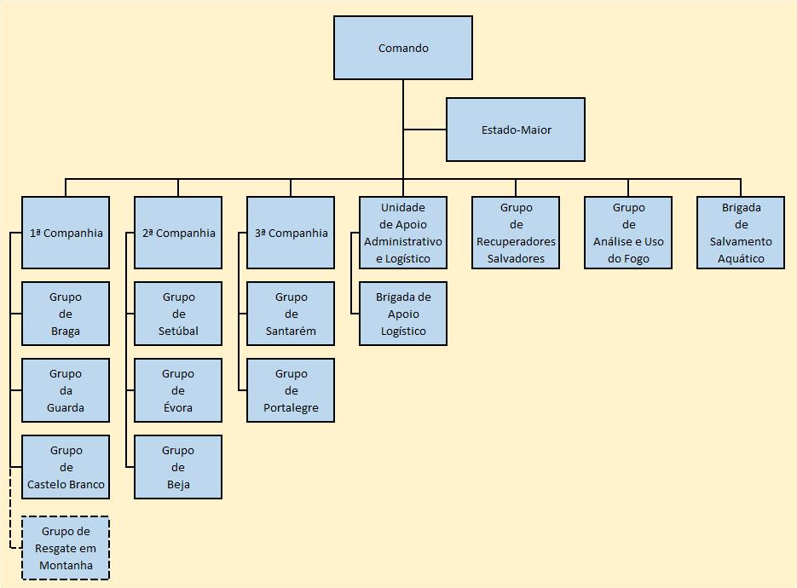
FORÇA ESPECIAL DE PROTEÇÃO CIVIL
“Per Angusta ad Augusta”
Who we are
NAD-AIR Decision Support Nucleus - Analysis of Rural Fires
AVRAC Reconnaissance, Evaluation and Coordination Airplane
EAUF Wildfire Analysis and Use of Fire Team
EAUF
AVRAC
NAD-AIR

Slide 4
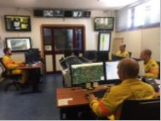
FORÇA ESPECIAL DE PROTEÇÃO CIVIL
“Per Angusta ad Augusta”
Who we are
Develops a strategic analysis every 3 days.
Formulates and sends to Commander of operations the information in case of wildfire, to support the decision.
Collects and treats all the necessary information for fire analysis.
NAD-AIR
Direct articulation with the National Comand the of Civil Protection (CNEPC), AVRAC e EAUF.
Technical support for CNEPC decisions and assisting teams on the ground.
National daily briefing with analysis of the current and expected situation.
Develop GIS tools, for the management and analysis of Wildfires.

Slide 5
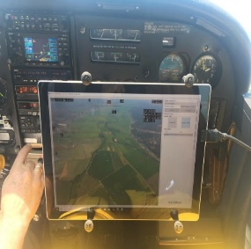
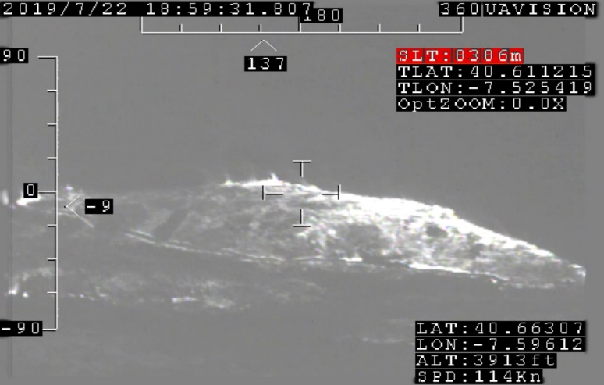
FORÇA ESPECIAL DE PROTEÇÃO CIVIL
“Per Angusta ad Augusta”
Who we are
Direct articulation with NAD-AIR and National Command for Relief Operations (CNEPC).
Monitor of the entire national territory.
AVRAC
Sharing all the information with NAD-AIR.
Collection of images and information in real time of Rural fires.

Slide 6
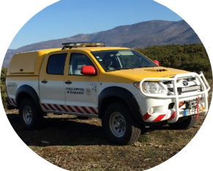
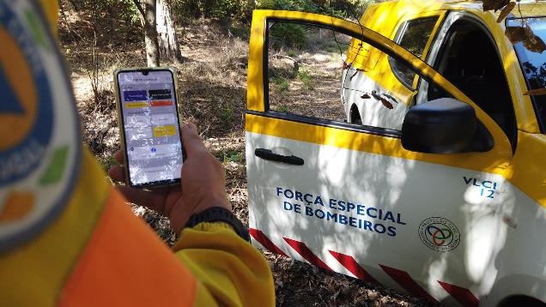
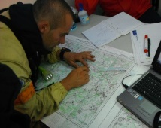
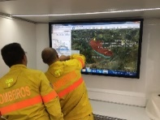
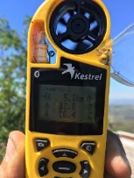
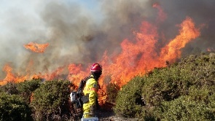
FORÇA ESPECIAL DE PROTEÇÃO CIVIL
“Per Angusta ad Augusta”
Who we are
Update information on the common fire analysis and management platform –
FEB Monitorização.
Direct articulation with NAD-AIR and operational decision makers (national, district and local levels).
EAUF
Fire analysis, presentation of tactical proposals for operational intervention.
Relief Operations Commander supports
Technical operational decisions.
Monitor and evaluate weather conditions and fire evolution.
Evaluate and perform technical fire maneuvers.

Slide 7
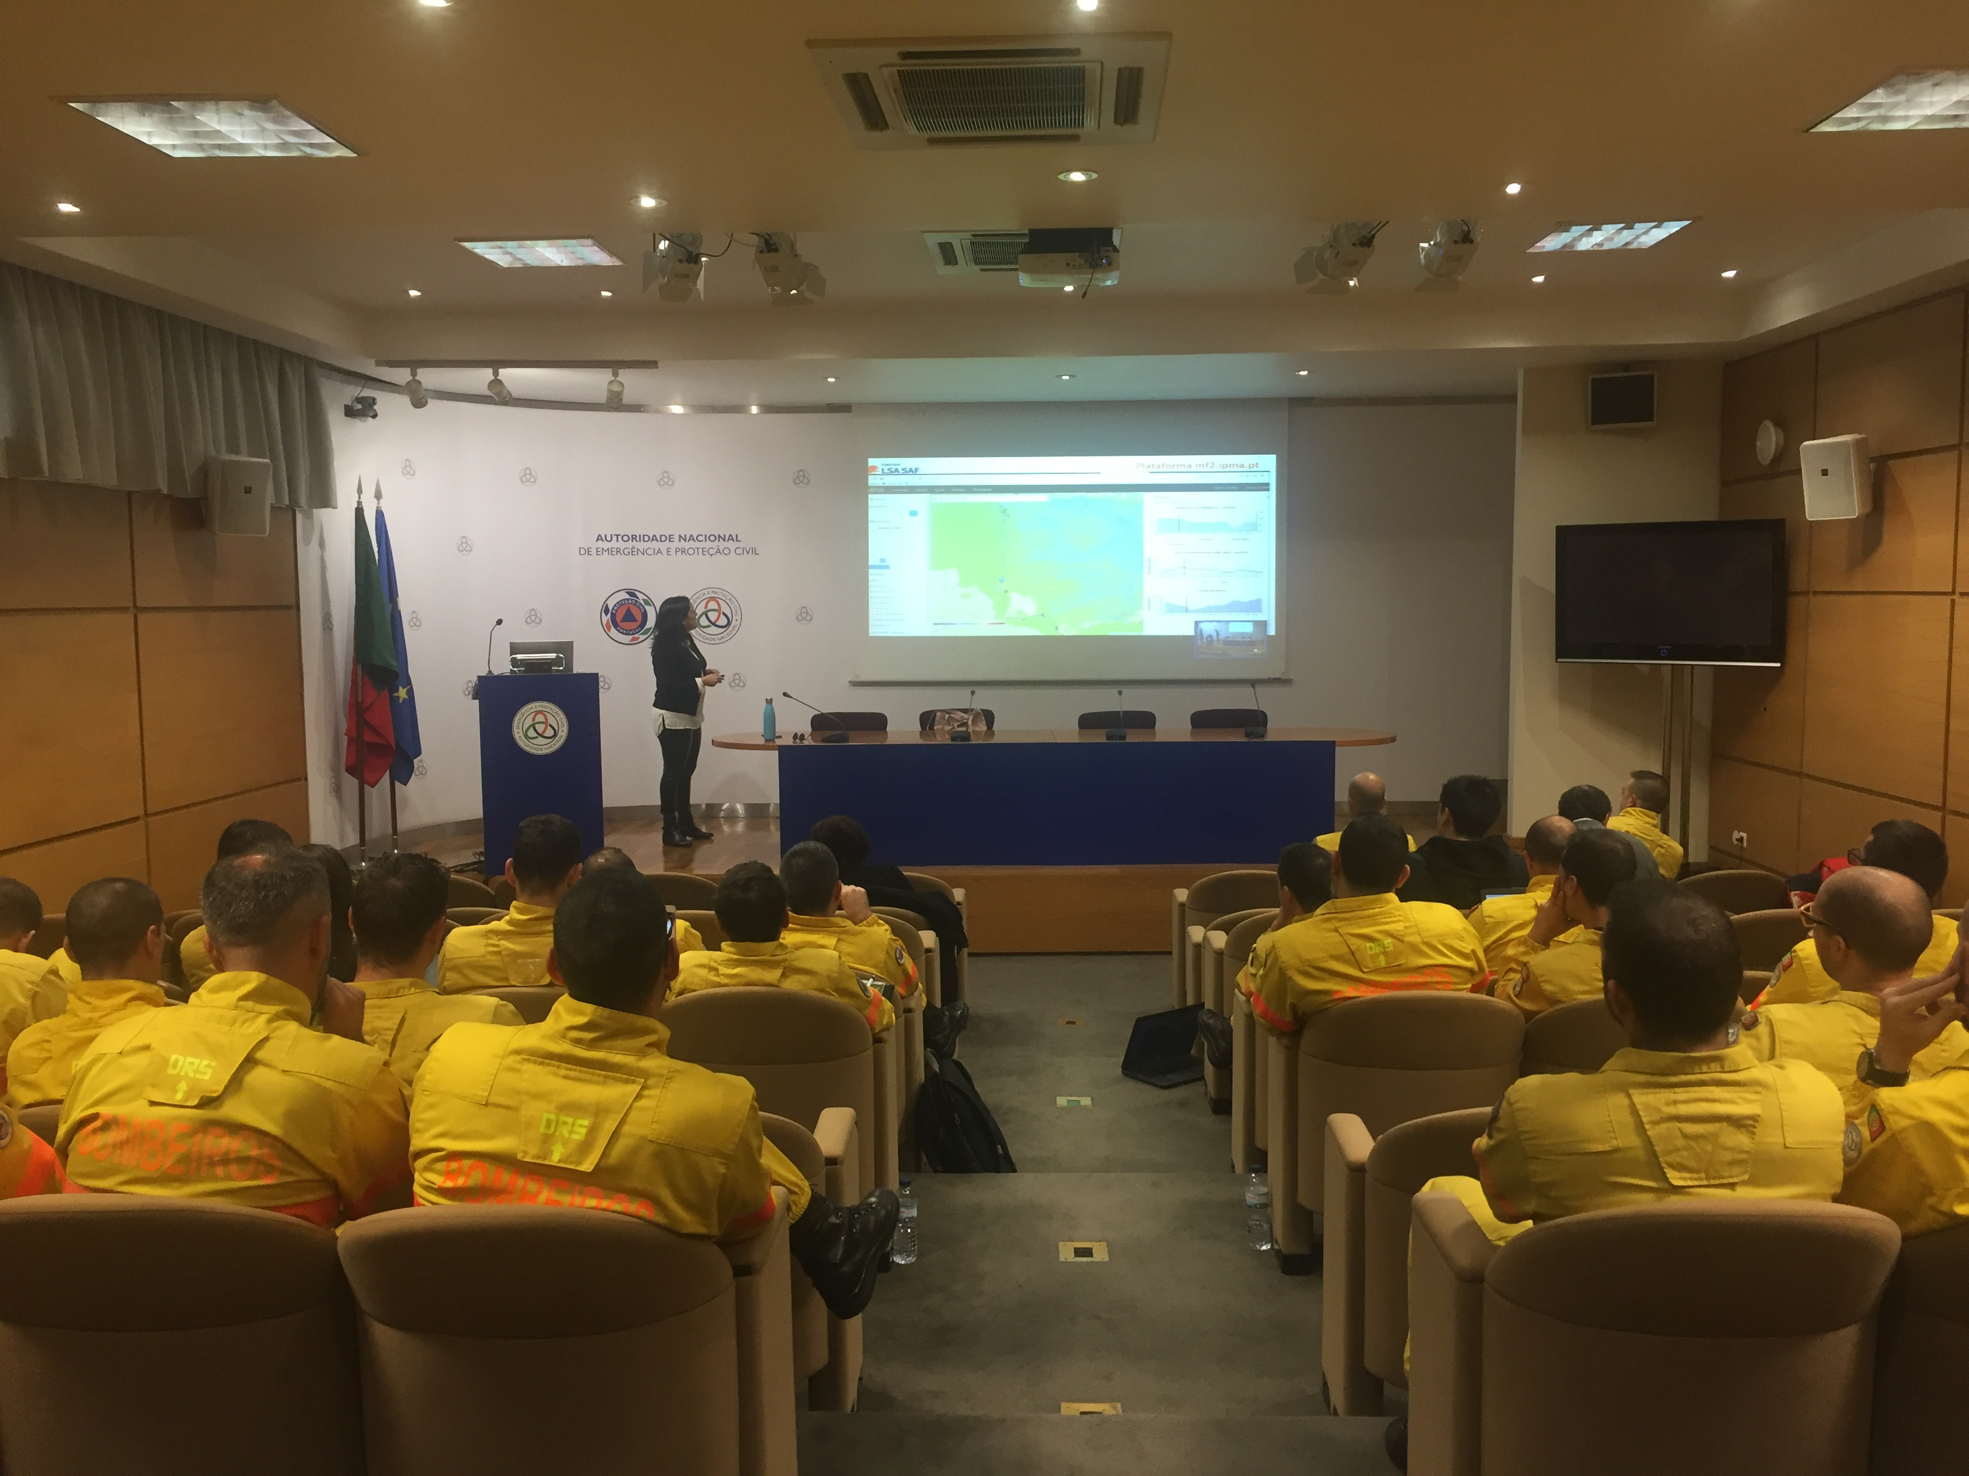
Fire Use and Analysis Group
Training
Reporting
Tools for decision making
Operational Information
Manuals
Video Tutorials
Operating Instructions
Training in prescribed burn
Fire and Suppression analysis training
Use of satellite information
Case studies
Internal Training
Producing Results
External Training
Exchange of experiences
University education
Technical Fire Courses
Meteorological Analysis
Geographic Information Systems
Fire Simulation
University projects
Specialized Units
Controlled Fire
Participation in events
Training actions with other agents

Slide 8
FORÇA ESPECIAL DE PROTEÇÃO CIVIL
“Per Angusta ad Augusta”
What we do
Strategic Operational Analysis
Potential for fire evolution.
Operational Information
WildFfire analysis;
Decision support;
Post-Fire Evaluation
Case studies;
Operational Training
Decision support tools;
Analysis of meteorological indicators, fuel availability, operational statistics.
Strategic and tactical proposals.
Severity analysis;
Fire behavior study.
Simulation of fire behavior;
Fire analysis;
Presentation of case studies;
Collaboration with universities.

Slide 9
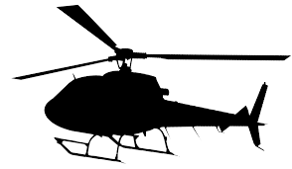
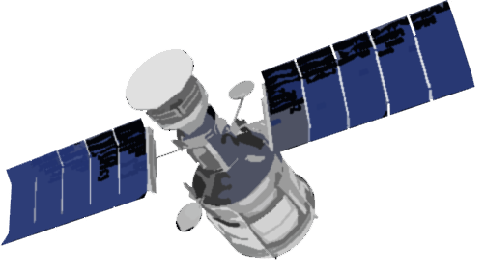
FORÇA ESPECIAL DE PROTEÇÃO CIVIL
“Per Angusta ad Augusta”
What we do
Any Device
Decision Support
Command
Integration and Analysis
Operational
Reconnaissance Aircraft
NAD-AIR
Development
Scripts
Coordination Helicopters
Satellites

Slide 10
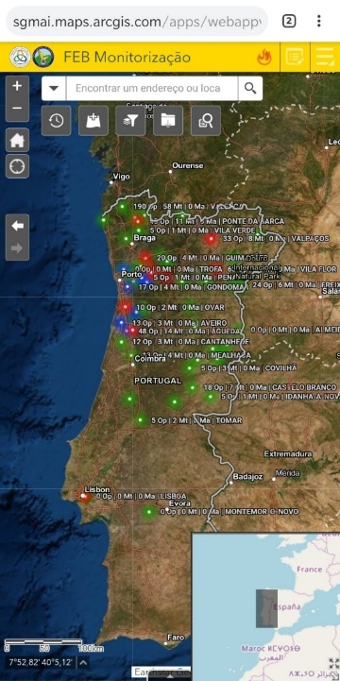
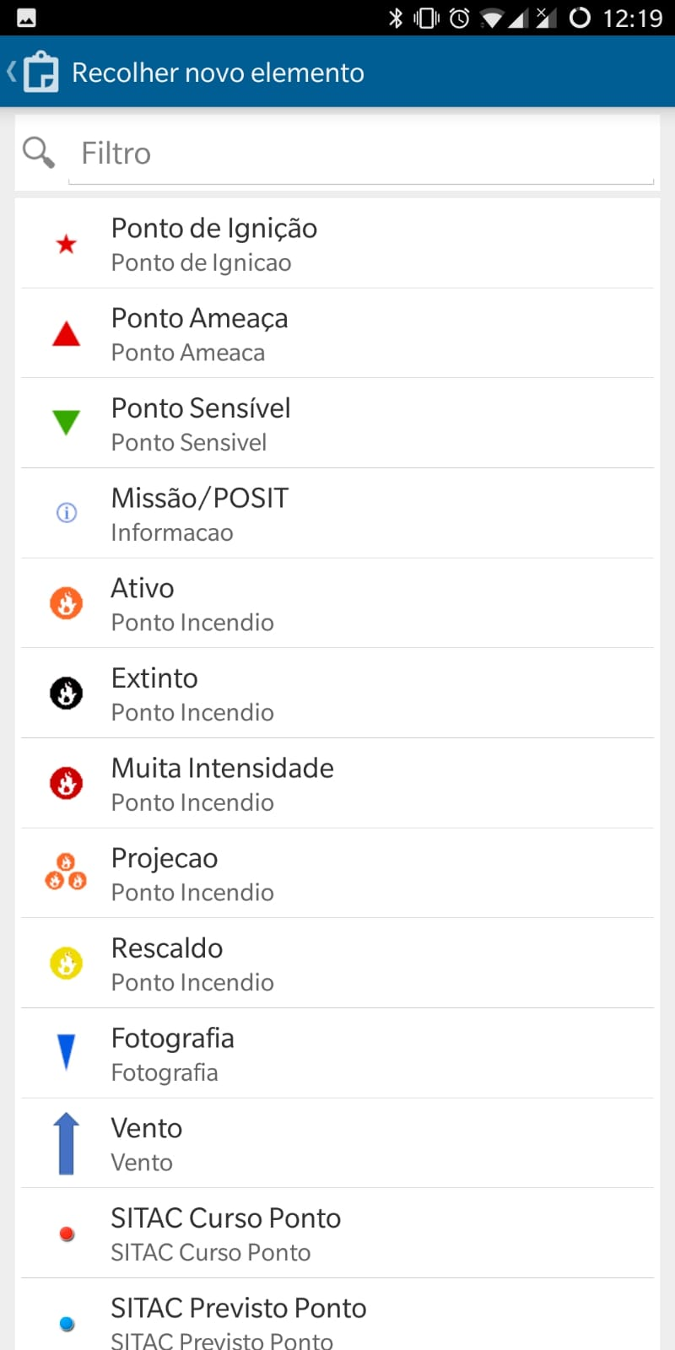
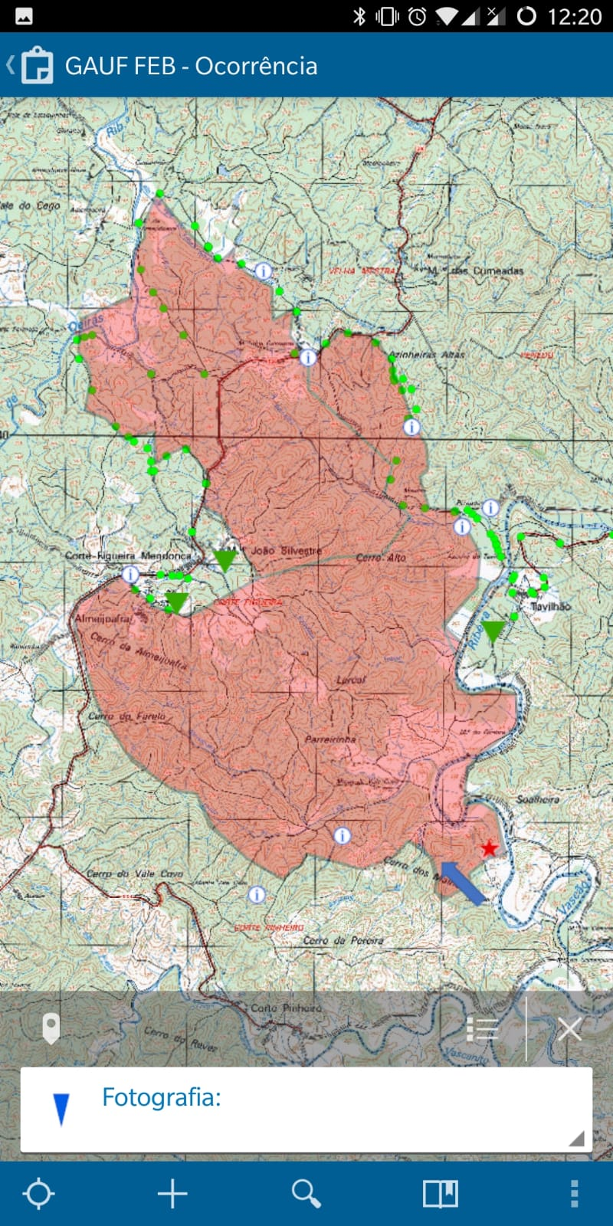
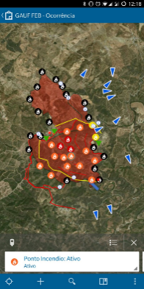
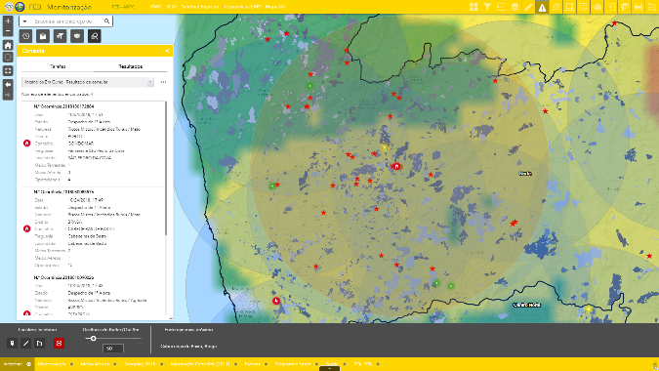
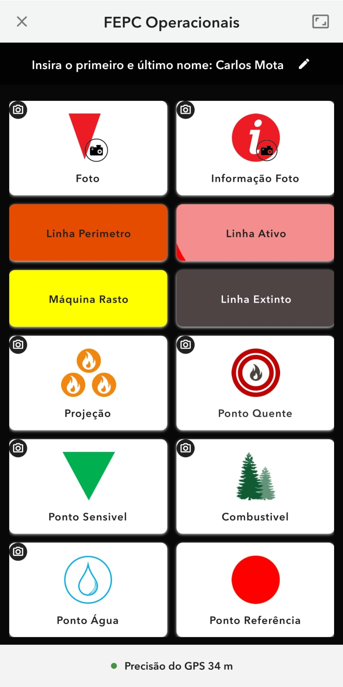
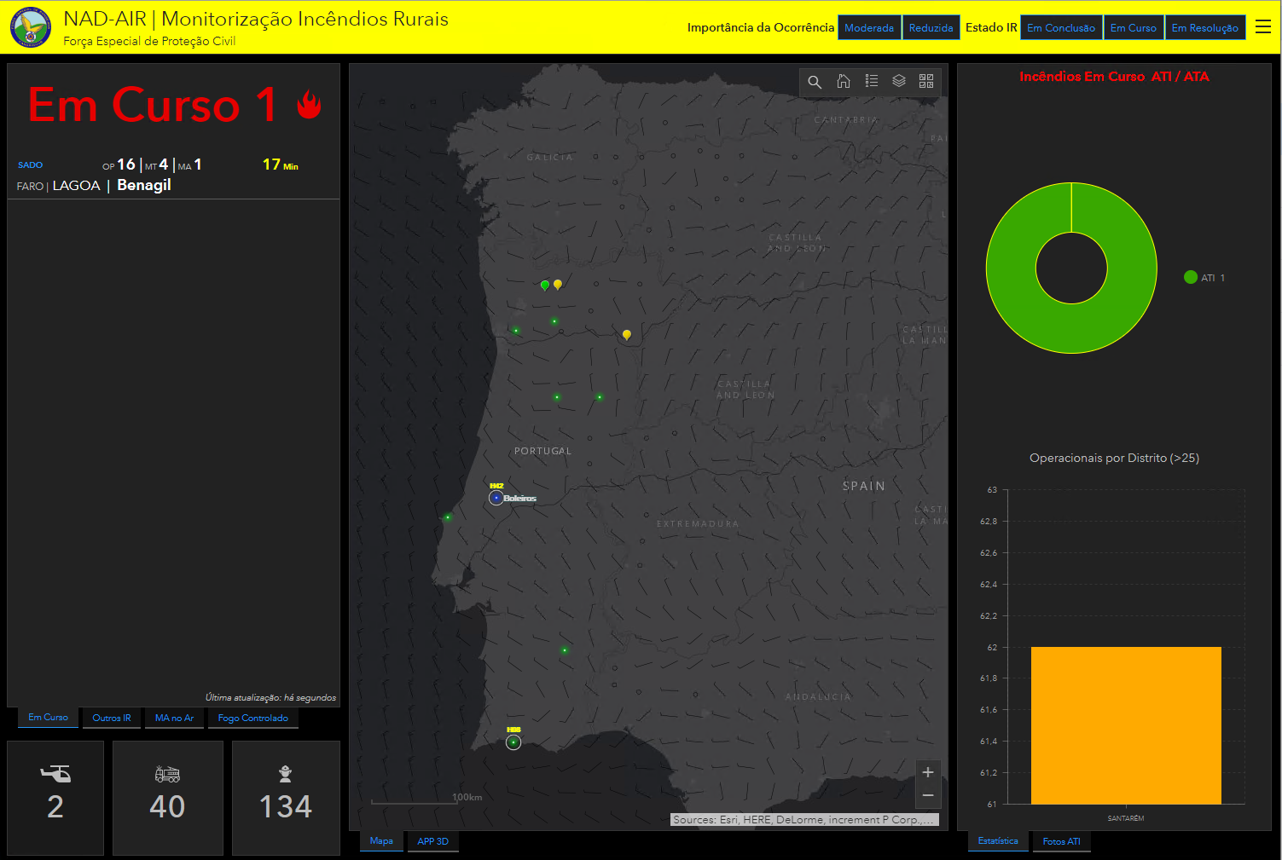
FORÇA ESPECIAL DE PROTEÇÃO CIVIL
“Per Angusta ad Augusta”
What we do
FEB Monitorização
Collection / Visualization
(Offline)
Creation / Editing / Analysis
FEB Monitorização
ArcGIS Online
Information Panel

Slide 11
FORÇA ESPECIAL DE PROTEÇÃO CIVIL
“Per Angusta ad Augusta”
What we do
Flow of information
Operational
Geographic Information
NAD-AIR
Aerial Means
CNEPC
Location Radios SIRESP
Command Post / COS
Notes:
Workflow
Informação Geográfica:
Cartografia de Risco,
Áreas Ardidas
Imagens Satélite recentes

Slide 12
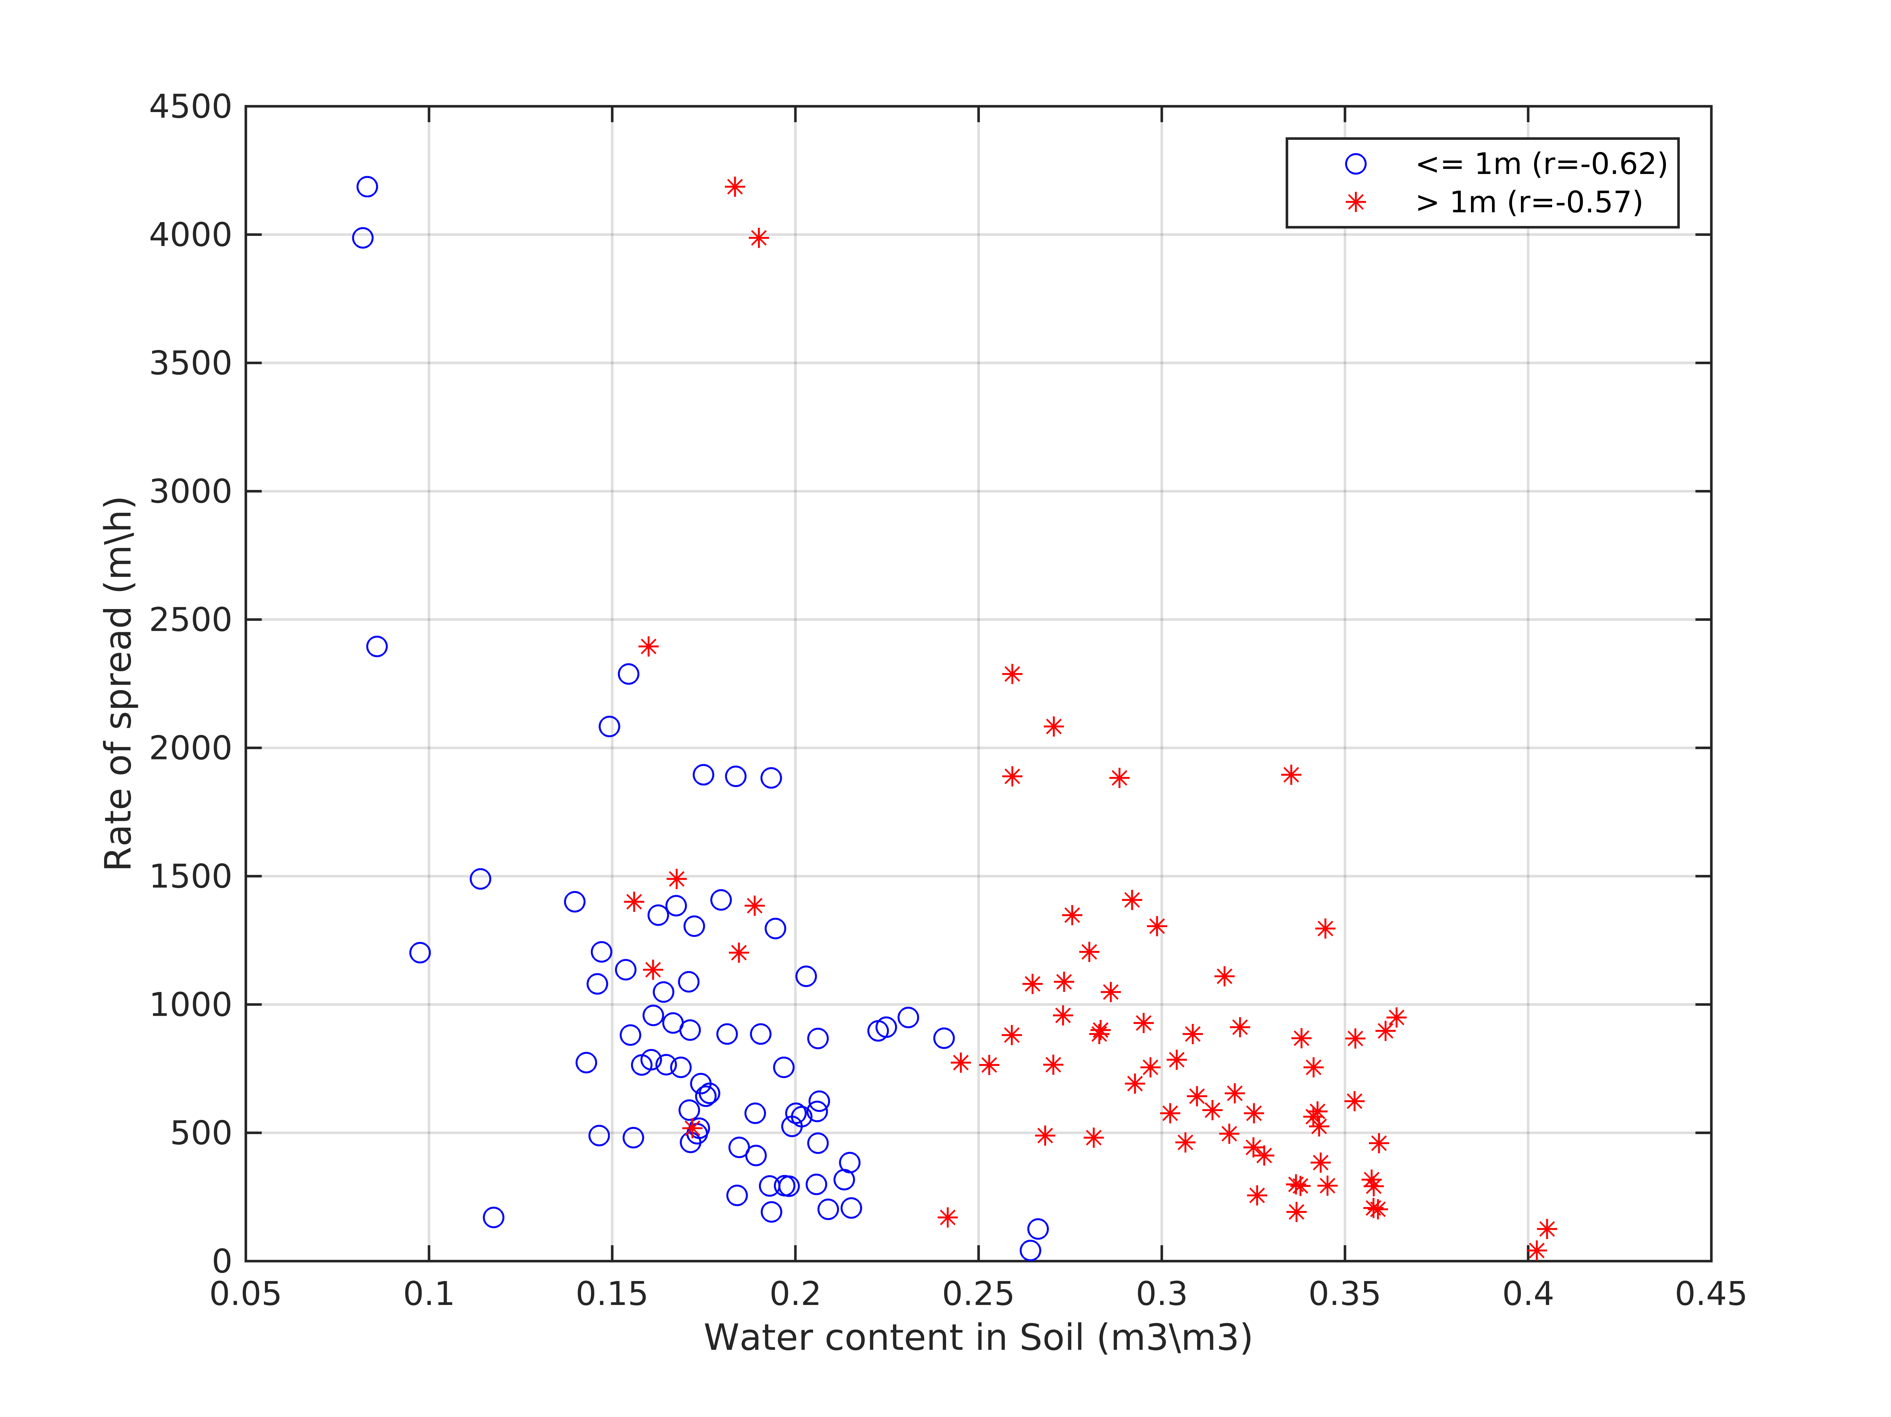
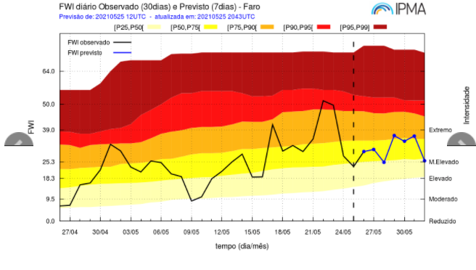
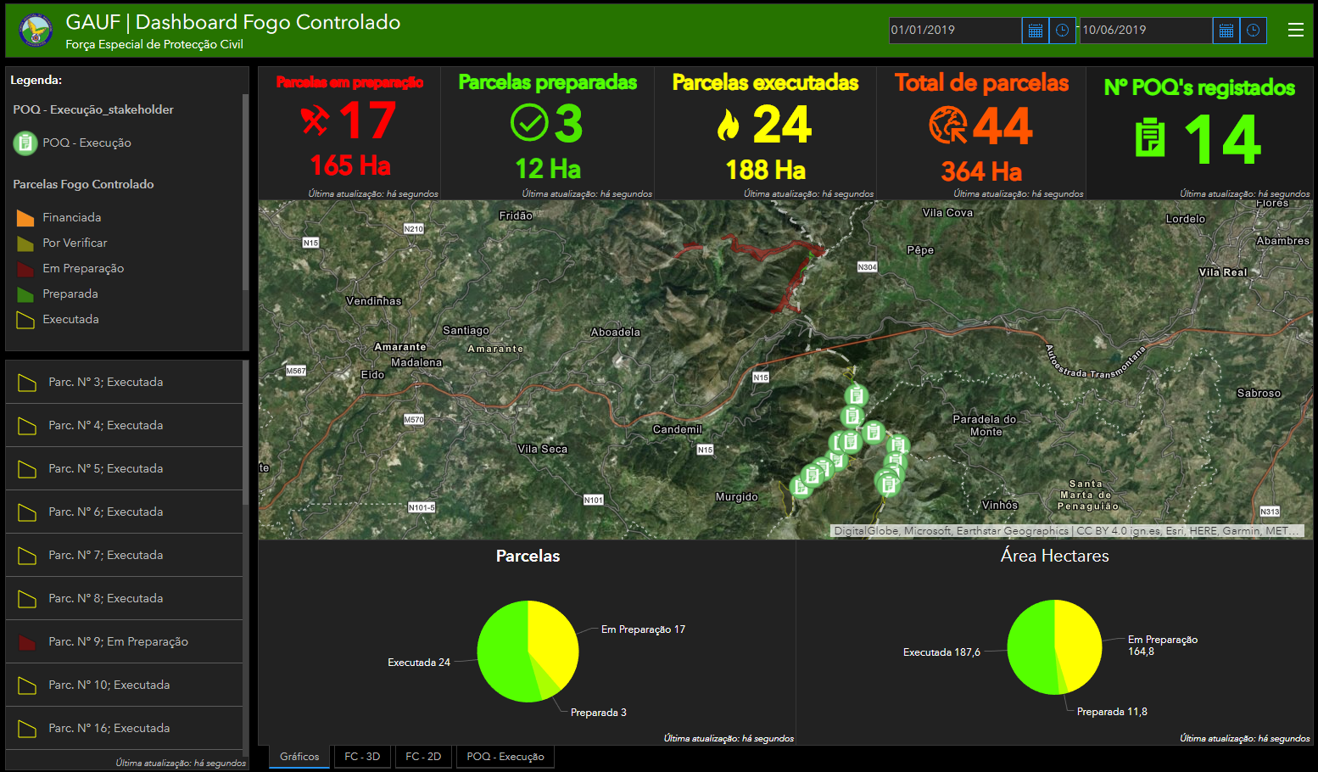
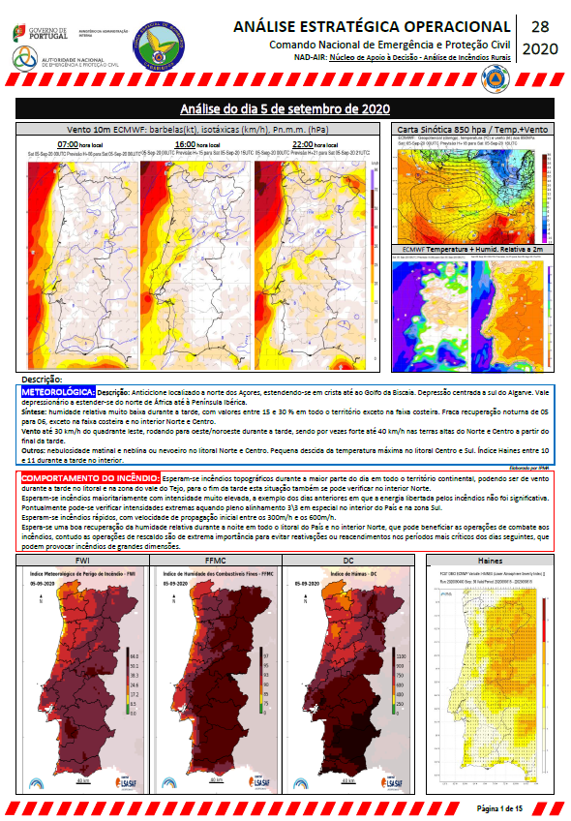
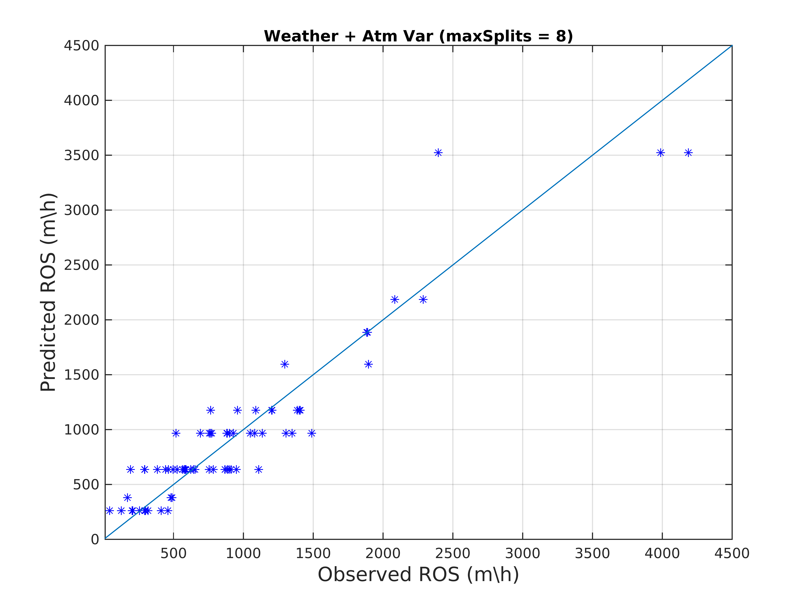
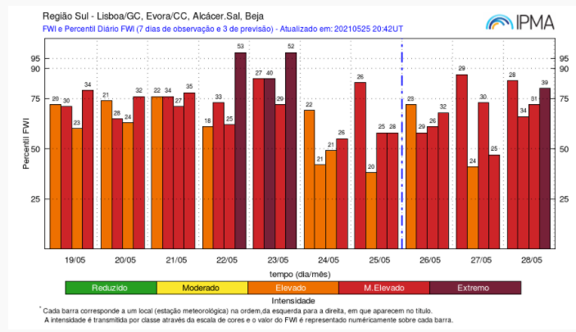
FORÇA ESPECIAL DE PROTEÇÃO CIVIL
“Per Angusta ad Augusta”
Before Wildifire

Slide 13
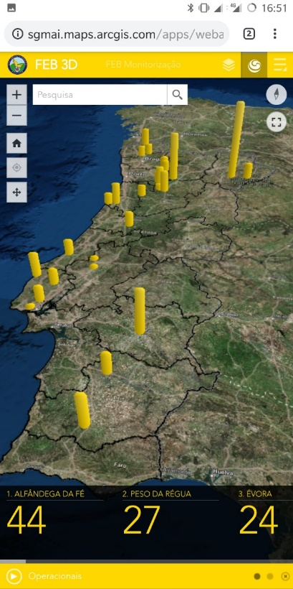
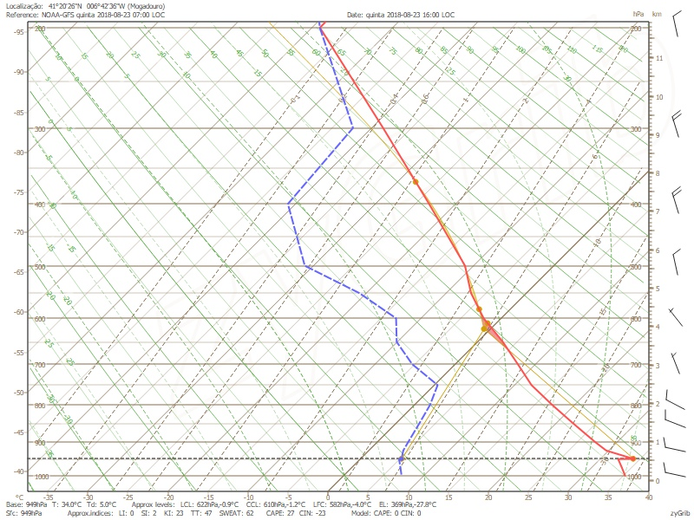
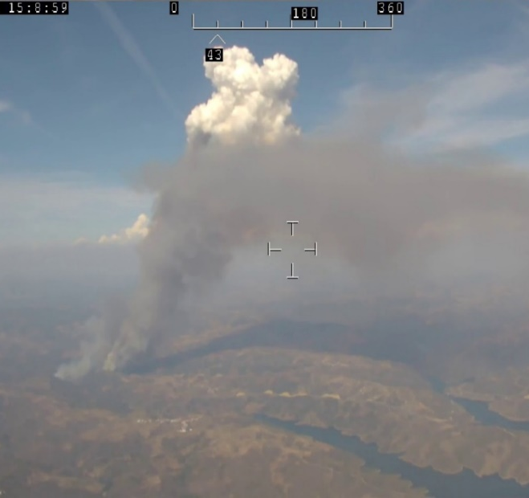
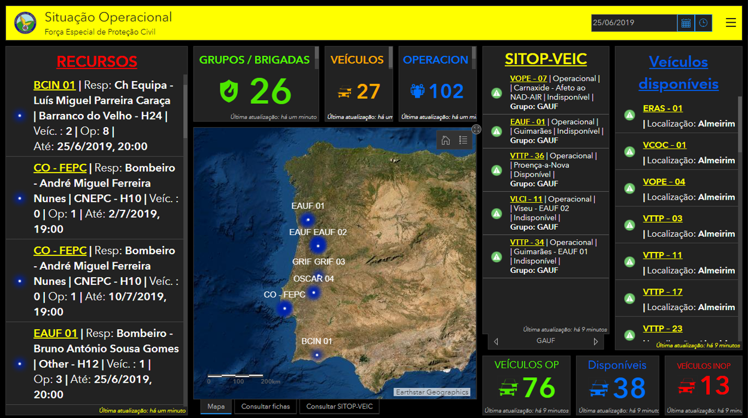
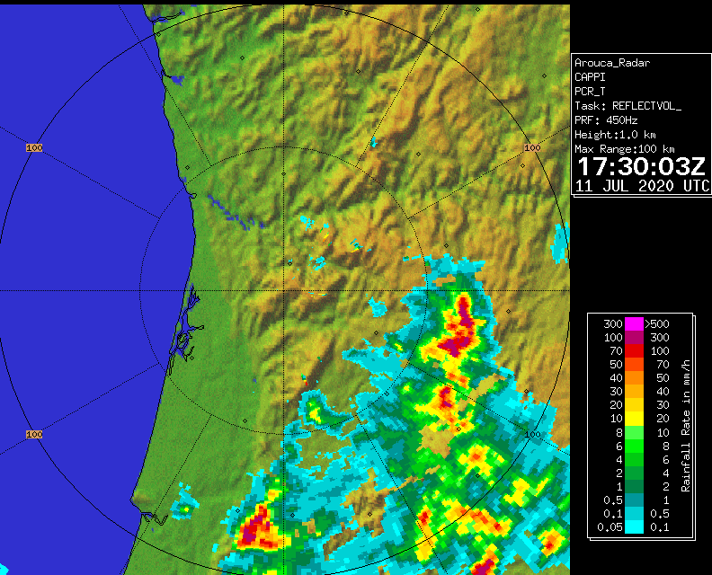
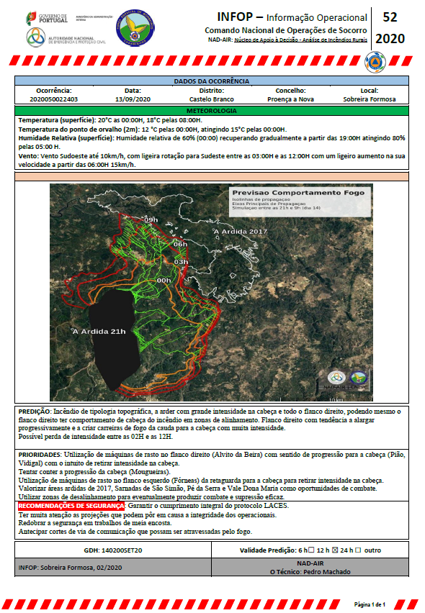
FORÇA ESPECIAL DE PROTEÇÃO CIVIL
“Per Angusta ad Augusta”
During Wildifre

Slide 14
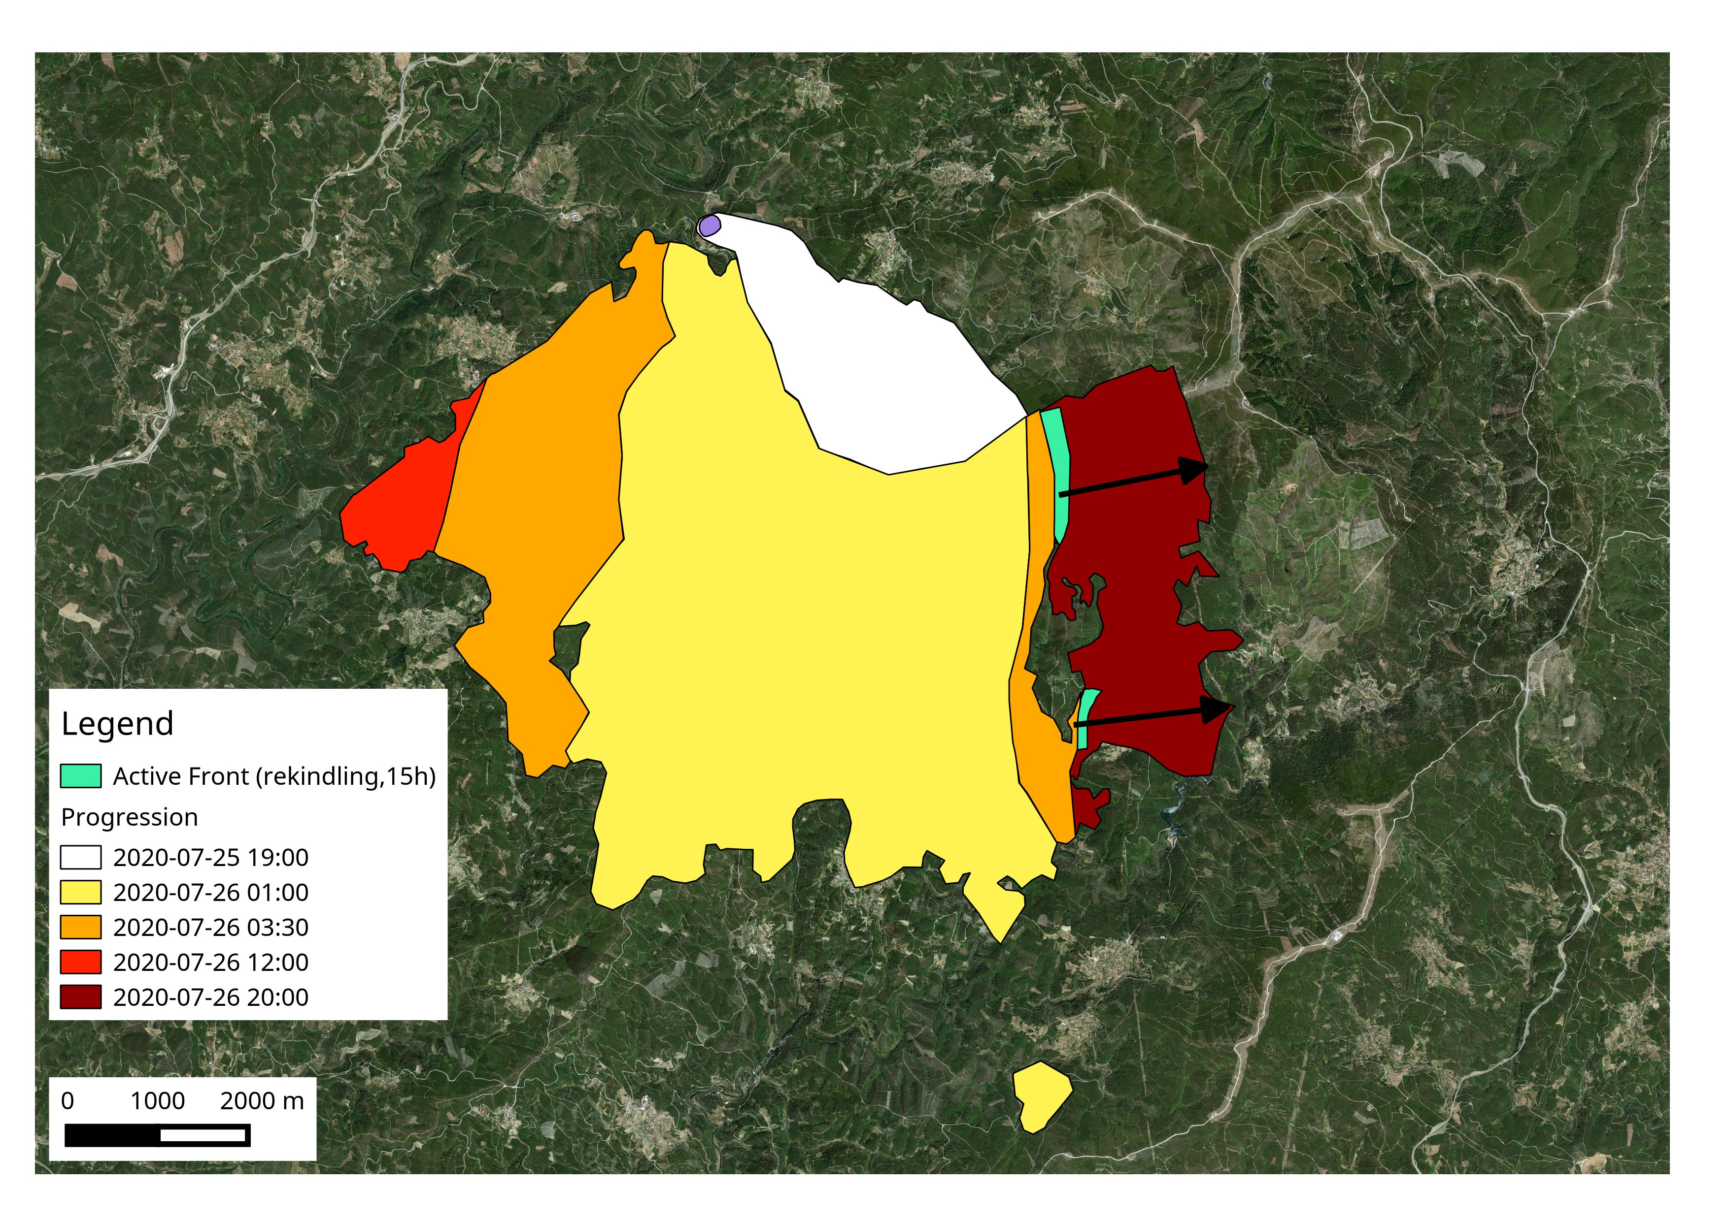
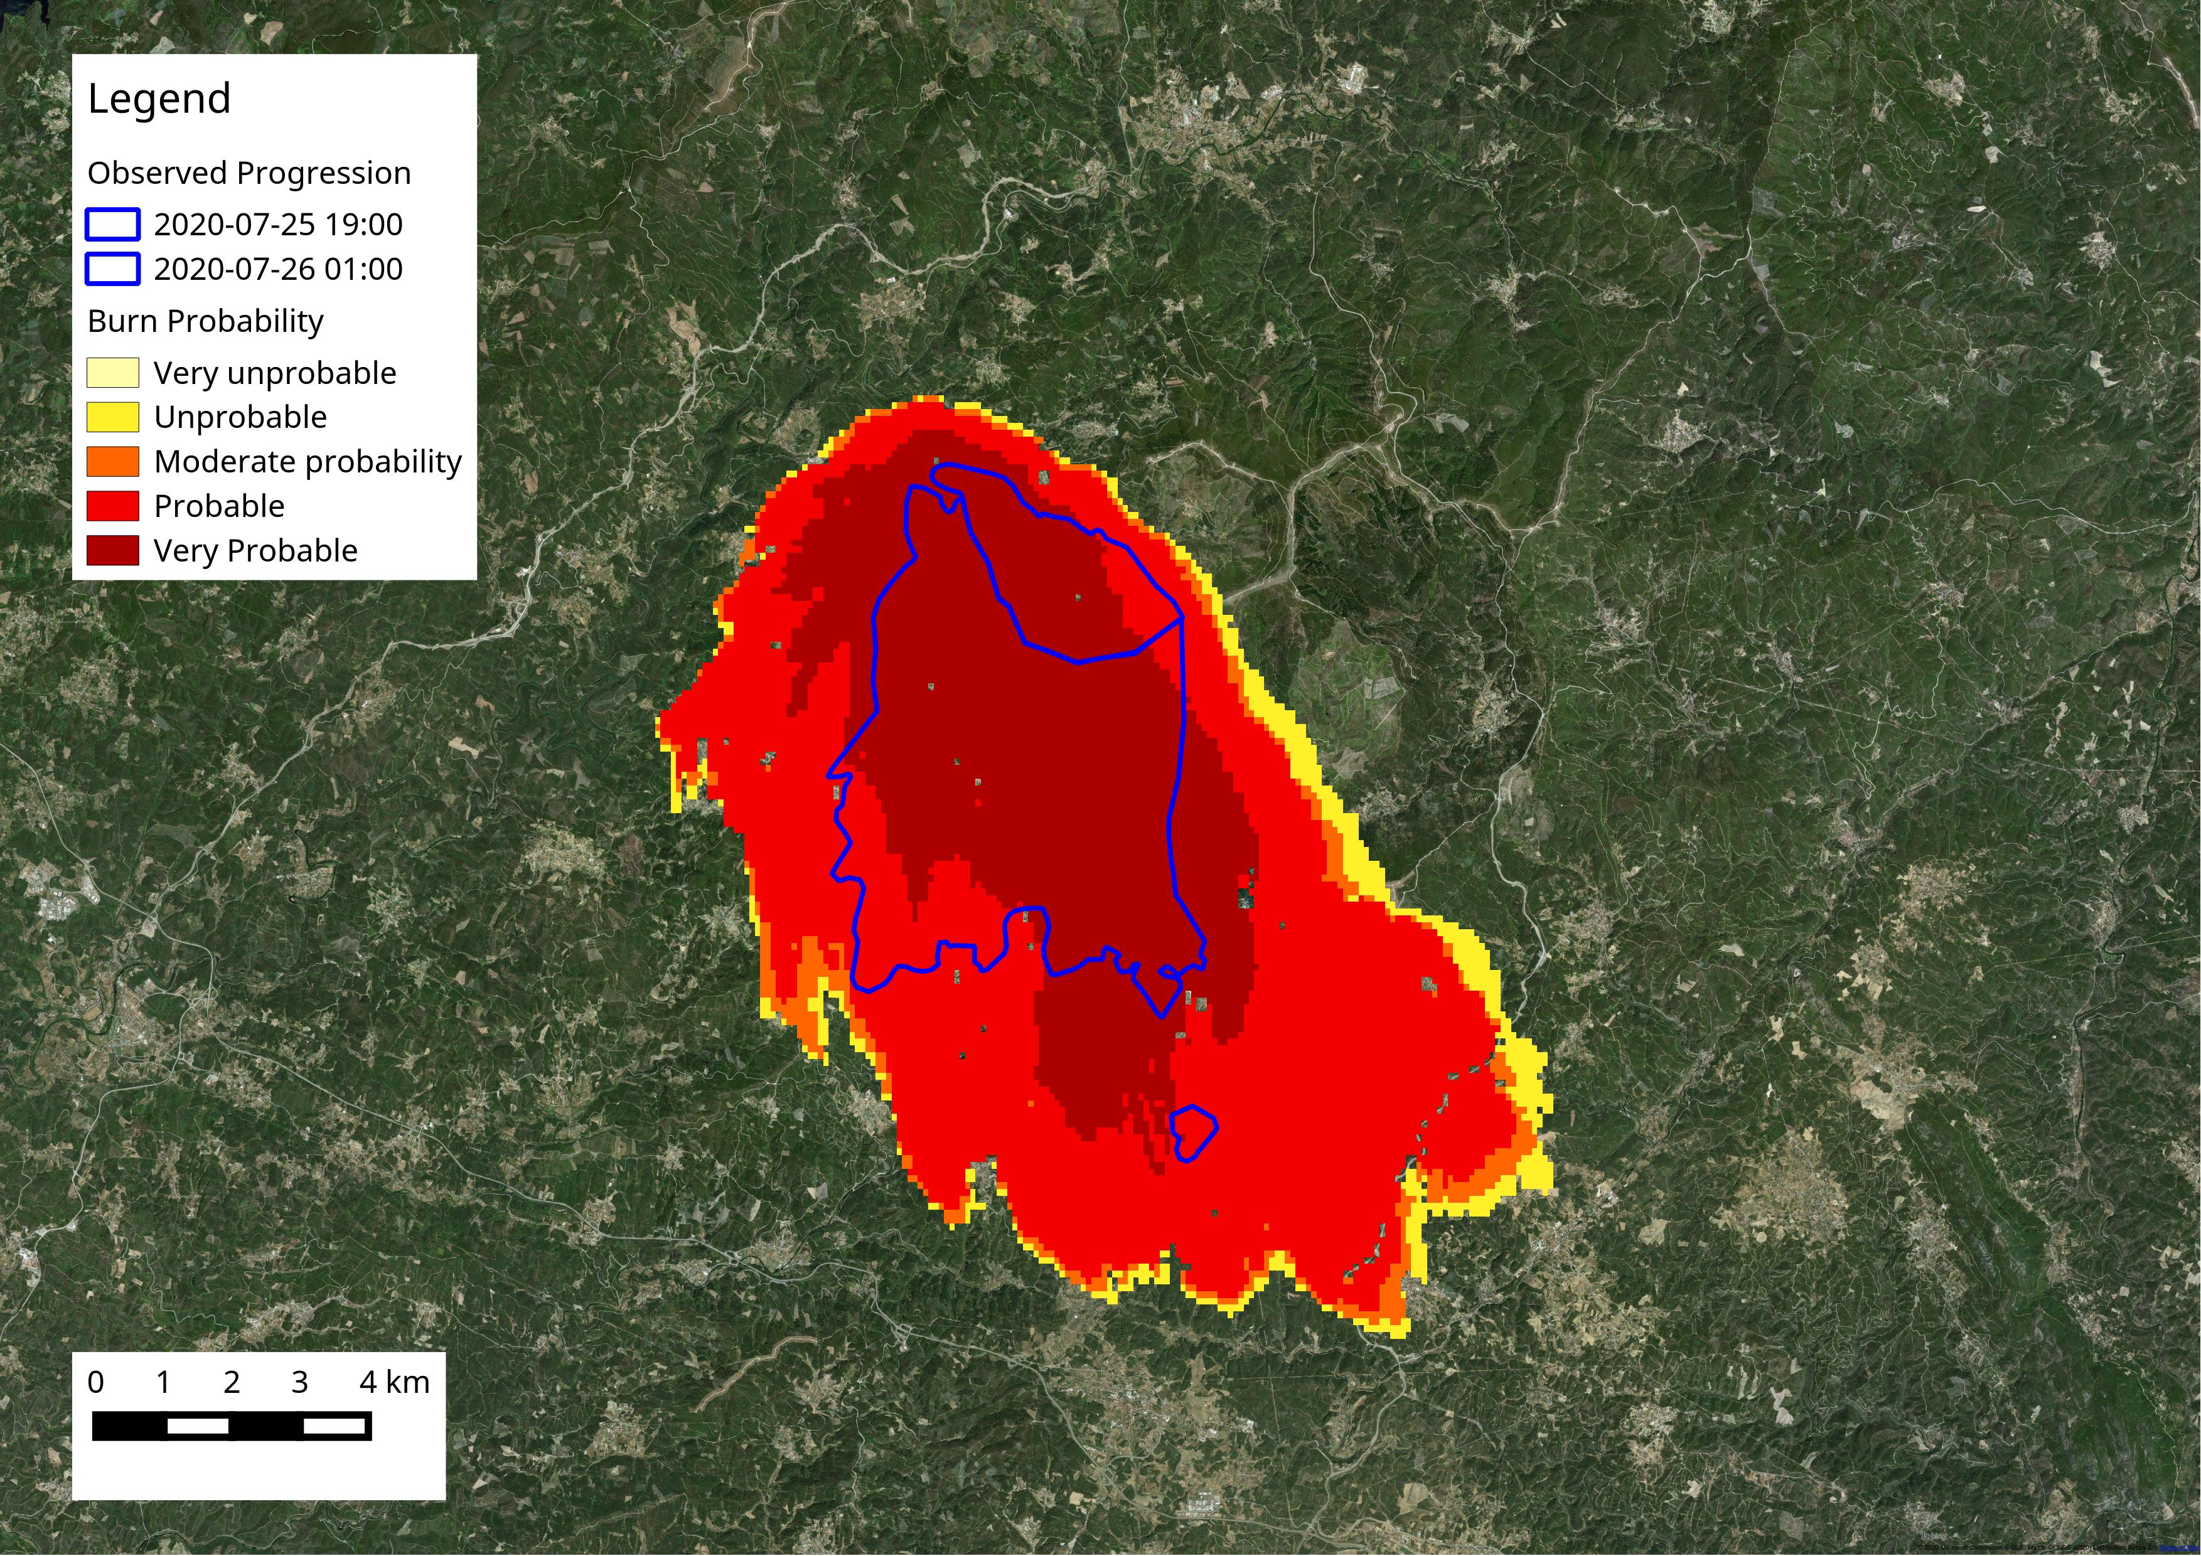
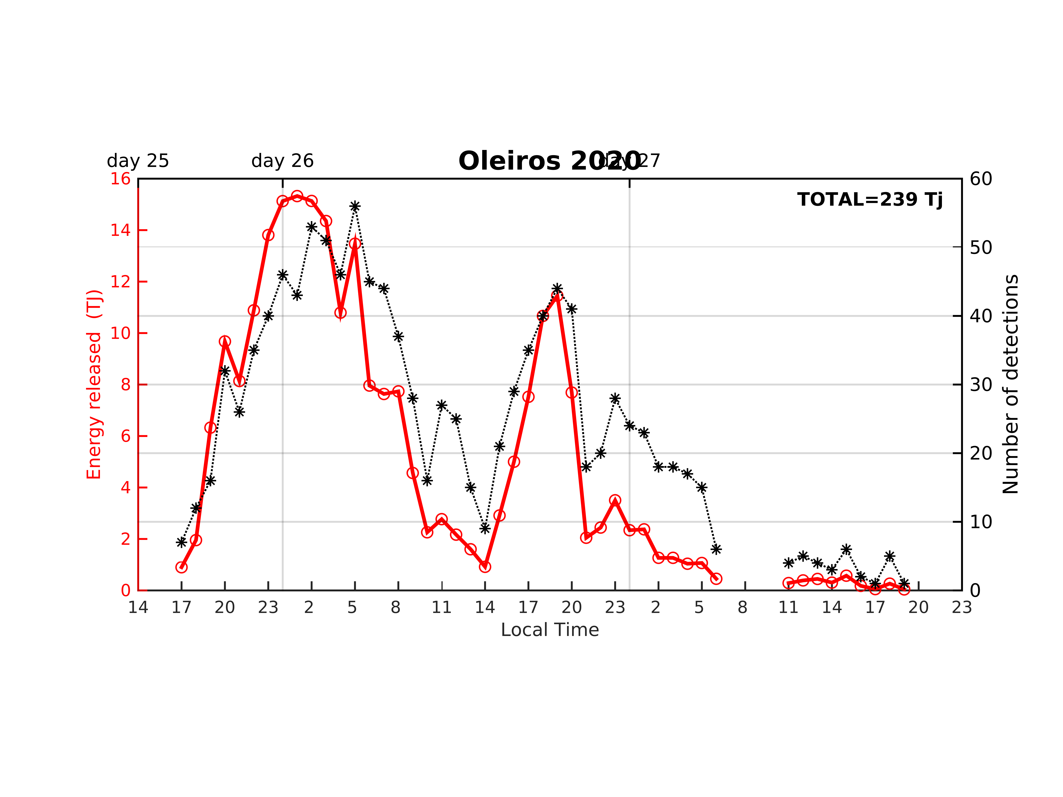
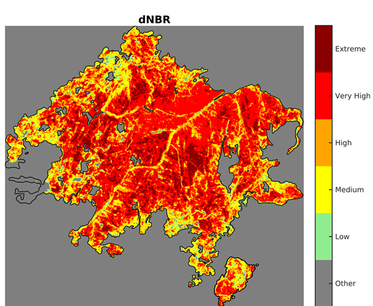
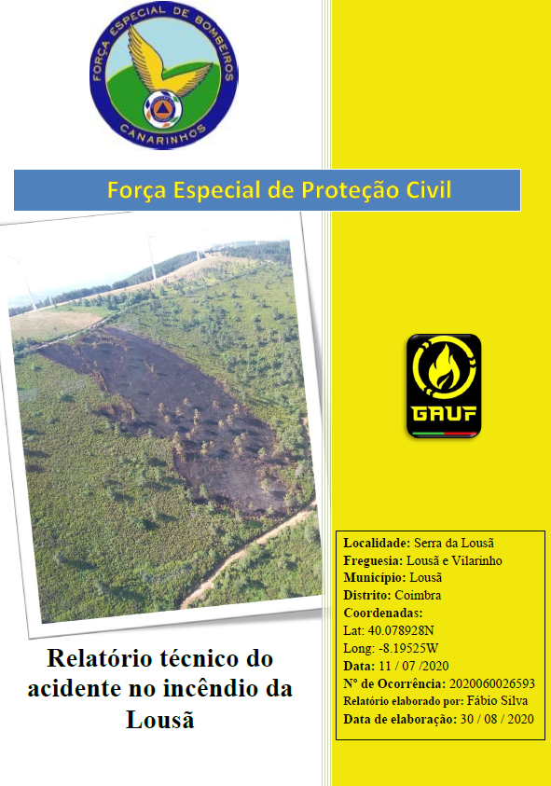
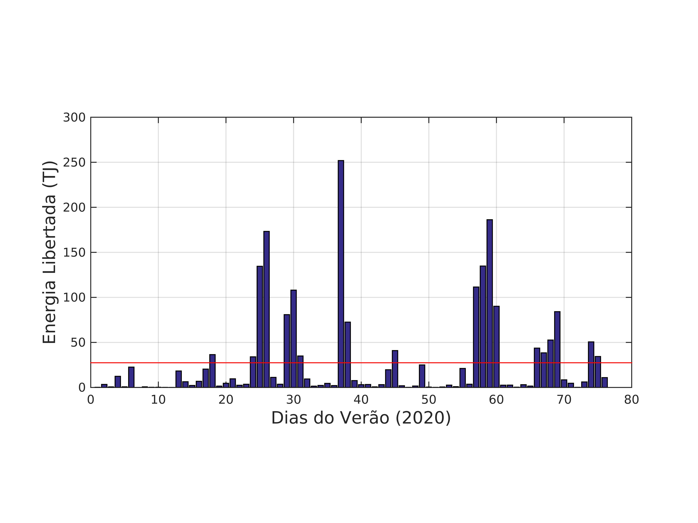
FORÇA ESPECIAL DE PROTEÇÃO CIVIL
“Per Angusta ad Augusta”
After Wildifre
Source: project FIRE MOD SAT II

Slide 15
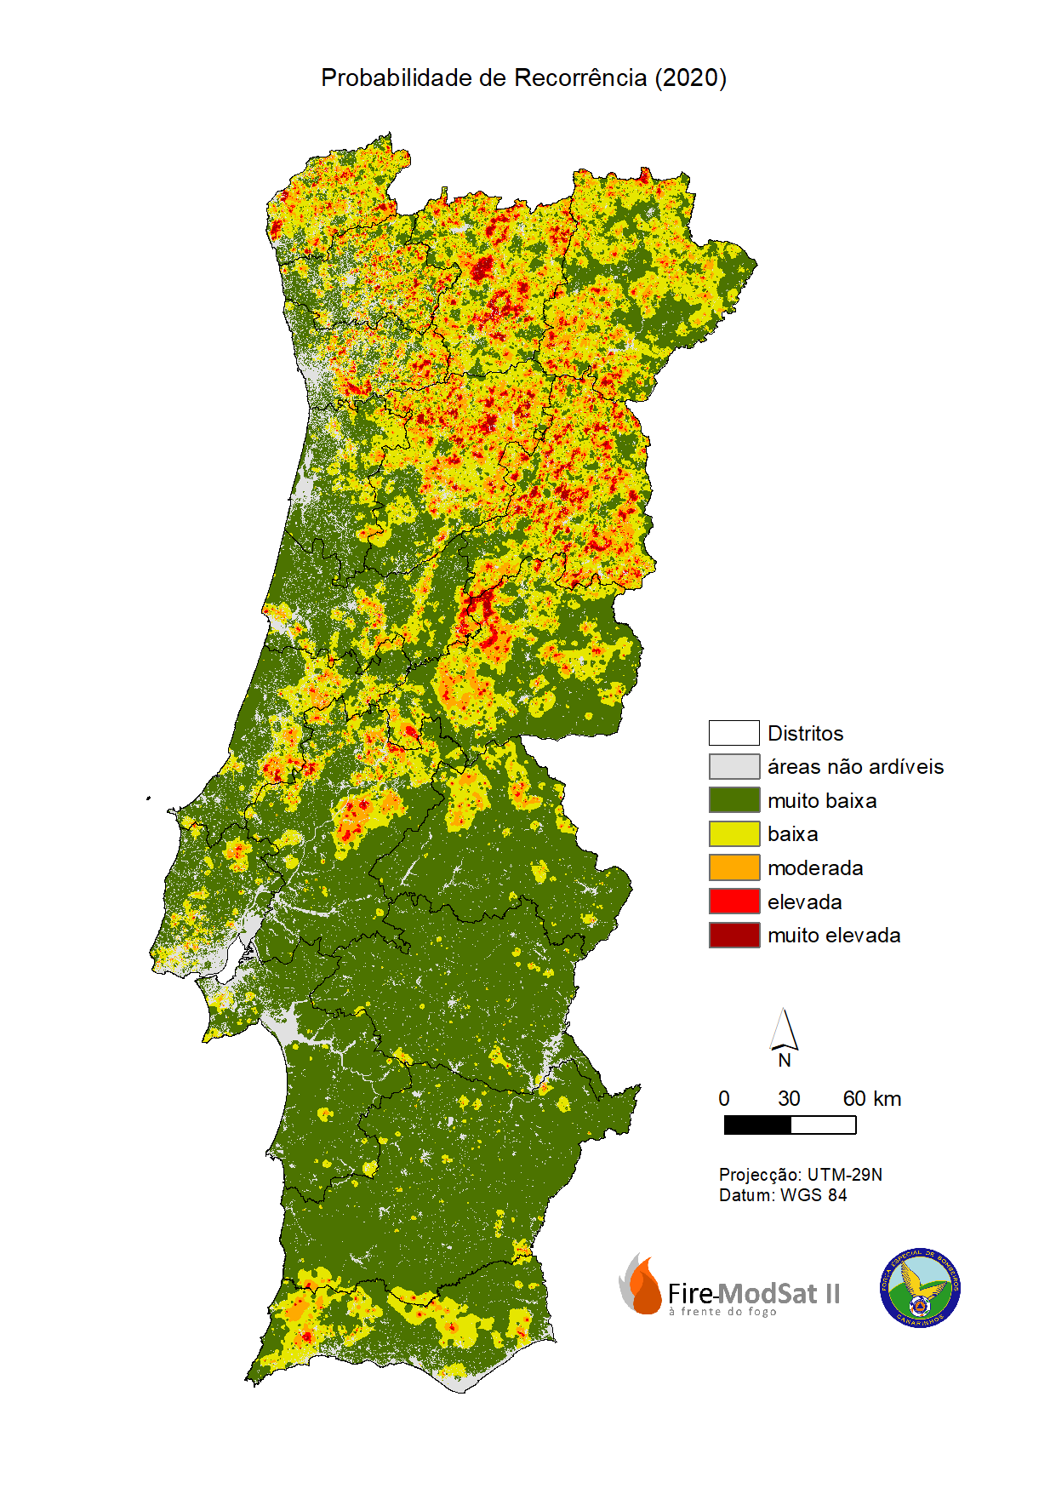
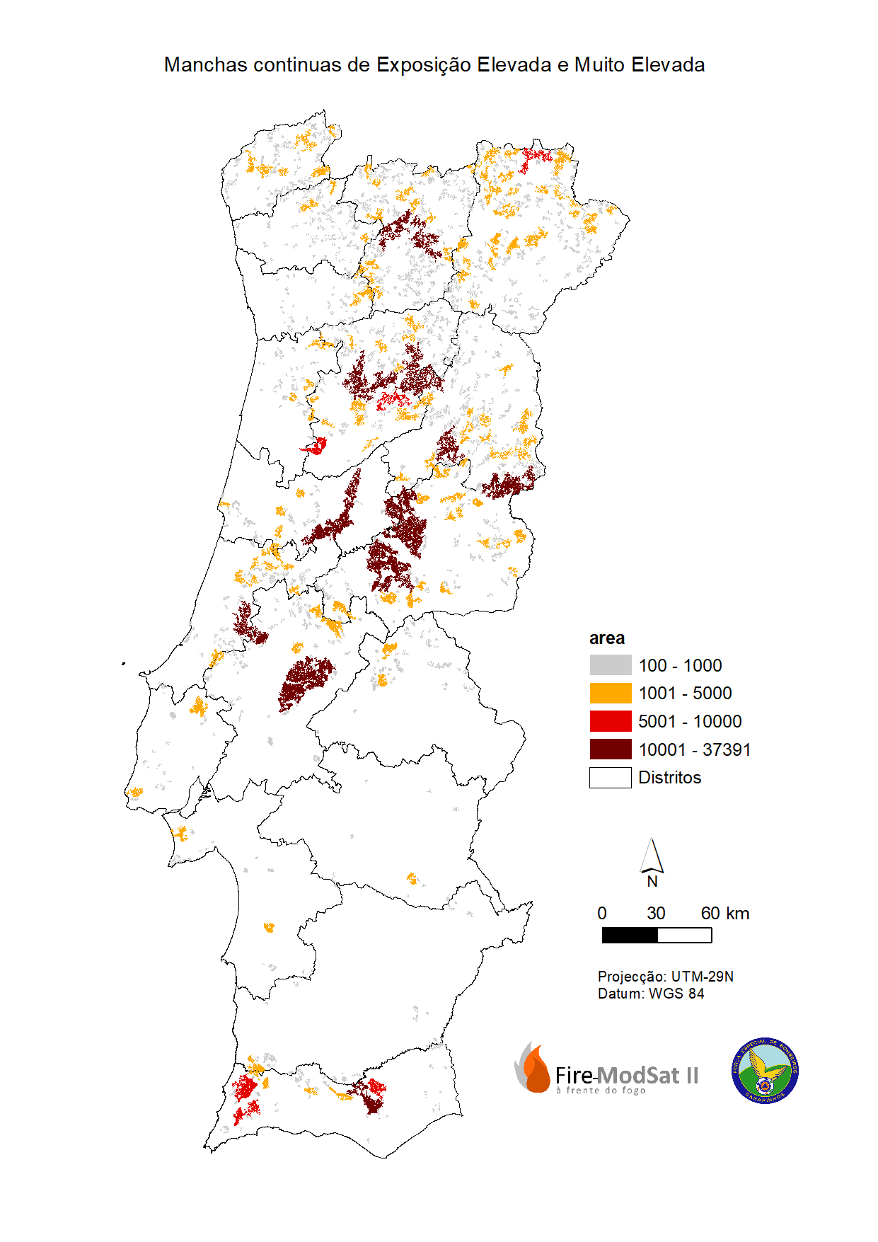
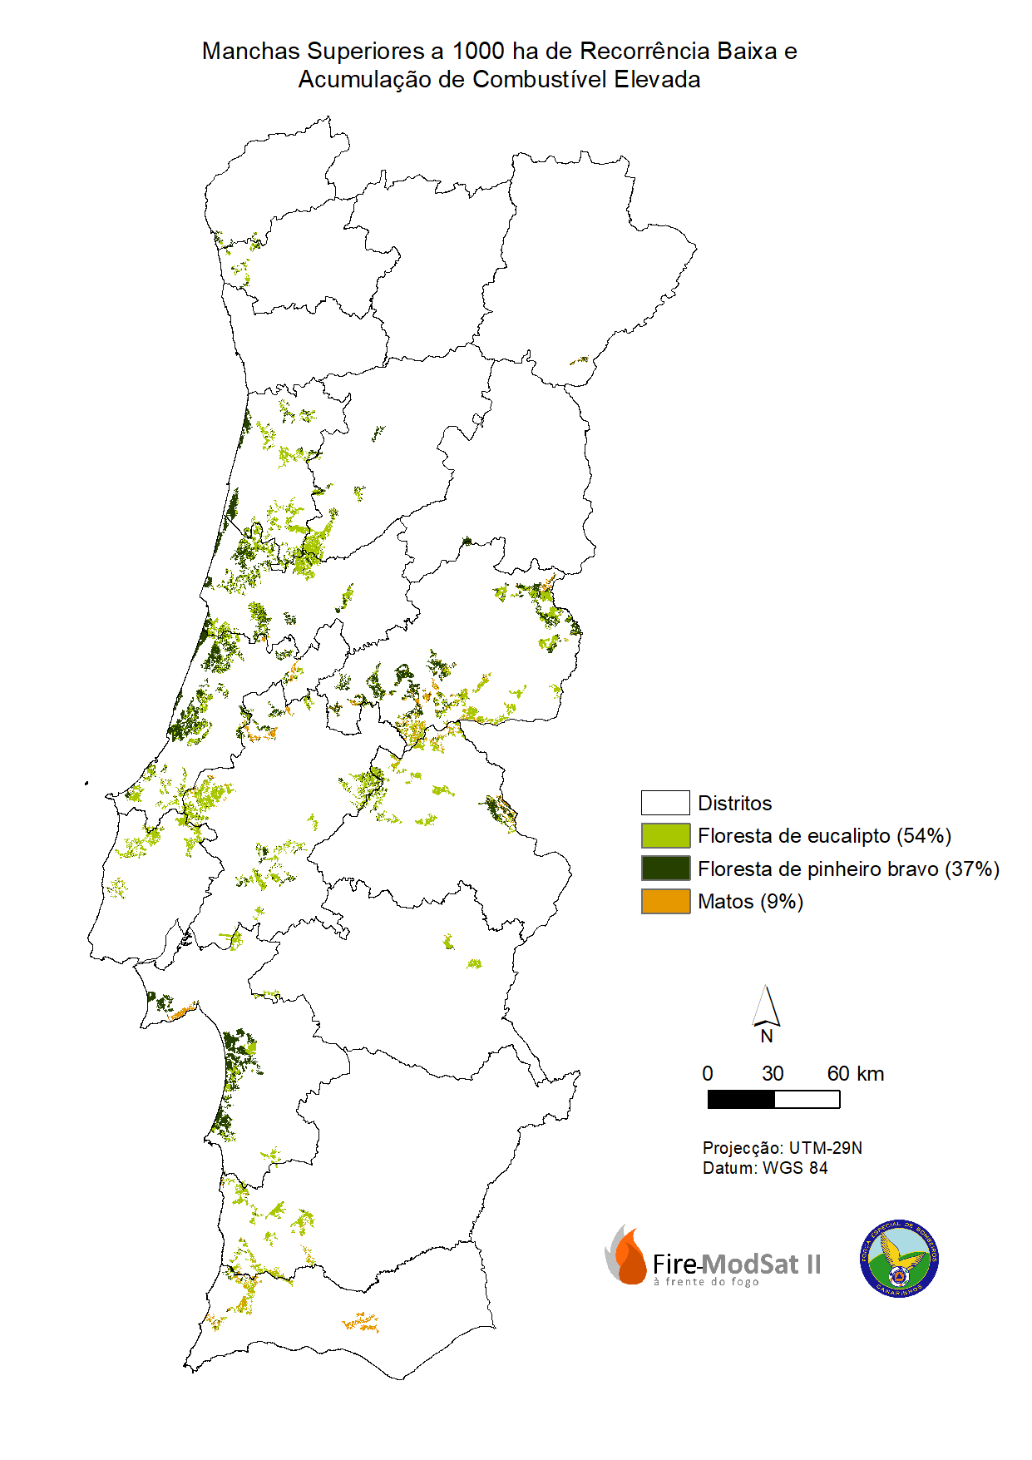
FORÇA ESPECIAL DE PROTEÇÃO CIVIL
“Per Angusta ad Augusta”
What we do
Spacial pattern of fires based on the 45-year history of burnt areas
(1975 - 2019)
Large continuous areas of high biomass with recurrence of large fires.
Eucalyptus and pinus pinaster areas without recurrence of fires for over 20 years
Source: project FIRE MOD SAT II

Slide 16
FORÇA ESPECIAL DE PROTEÇÃO CIVIL
“Per Angusta ad Augusta”
What we do
The Portuguese Large Wildfire Spread Database
~70 wildfires larger than 500ha
410 000 hectares of burnt area
Period: 2015 – 2020
Combination of satellite, spacial and field data
rate-of-spread (kph), growth rate (ha/h), fire radiative energy
wildfire risk assessment (ongoing), fire spread simulation (this project), link fire severity with fire behavior (FRISCO project), etc etc
Diurnal coverage of the different data sources used
Source: project FIRE MOD SAT II (Akli Benali)

Slide 17
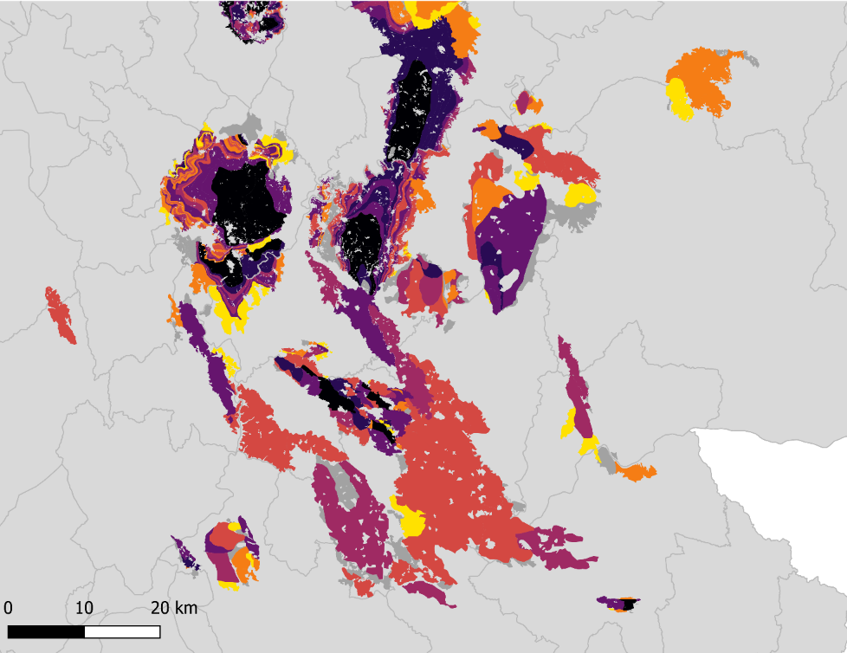
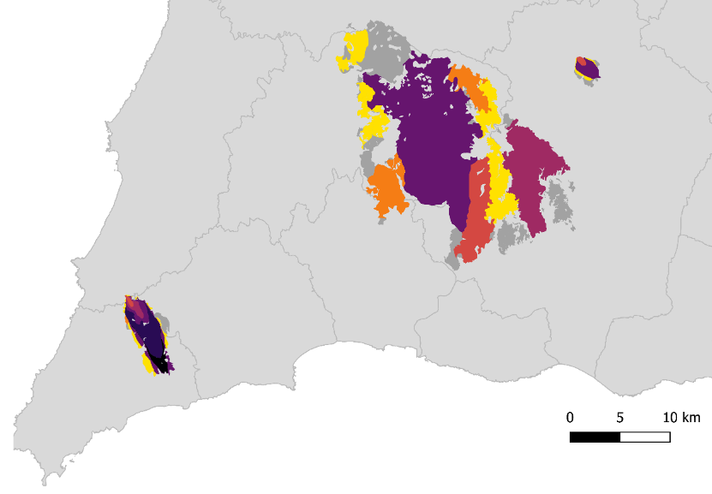
FORÇA ESPECIAL DE PROTEÇÃO CIVIL
“Per Angusta ad Augusta”
What we do
The Portuguese Large Wildfire Spread Database
Estimated
Rate-of-spread (m\h)
Source: project FIRE MOD SAT II (Akli Benali)

Slide 18
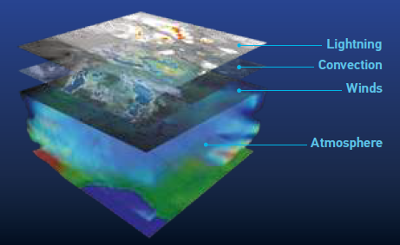
FORÇA ESPECIAL DE PROTEÇÃO CIVIL
“Per Angusta ad Augusta”
Needs
Synoptic letters
Meteograms
Skew-T
Historical data
External data
Weather data
Hotspots
Burnt areas
Severity
Vegetation monitoring
Satellite data
FWI
Percentage of moisture in the soil
Humidity of live fuels
Drought level
Source: https://www-cdn.eumetsat.int/files/2020-04/pdf_mtg_info-pack_v12.pdf
Fuel moisture
monitoring

Slide 19
FORÇA ESPECIAL DE PROTEÇÃO CIVIL
“Per Angusta ad Augusta”
What we use
The platform automatically checks MODIS, VIIRS and MSG data and creates a one layer of Hotspots.
Our tool having the last image of the Burnt Areas, using Sentinel 2, updating every 5 days.
Copernicus data:
Provision of vector and raster data
Very high resolution images.
We incorporated Web service from IPMA, with meteorological data and FWI.
Automation of FRE graphics, showing the energy released, by fire or by defined areas, over a period of time.
Update of polygons Burnt Areas, using EFFIS.
RADAR products to evaluate plume.
Satellite image in the analysis of pyrocumulus and Pyrocumulonimbus.

Slide 20
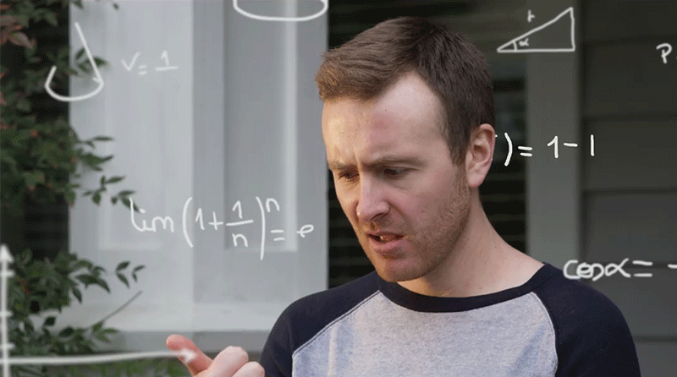
FORÇA ESPECIAL DE PROTEÇÃO CIVIL
“Per Angusta ad Augusta”
Necessary developments
simplifying data access
Data format
User friendly tools
Is a fire analysis nucleus dependent on an IT department?
Areas in need of development
Reduce the complexity of using information (satellite, audiovisual, meteorology, etc.)
Integrate MSG active fire data in an interactive platform (e.g. EFFIS) .
Near-real-time estimation of live fuel moisture content at an European Scale.
Reduce the limitation caused by persistent cloud cover.
Reduce the impact of radiative contamination of active fires (energy released in neighbor pixels)
Develop meteorological indicators associated with convective wildfire behavior.
Improve spatial resolution (Ative Fires Monitoring)
Development of radar and satellite imaging products for pyrocumulonimbus analysis.

Slide 21
FORÇA ESPECIAL DE PROTEÇÃO CIVIL
“Per Angusta ad Augusta”
Fábio Silva
fabio.silva@prociv.pt
Thank you for your attention

