Slide 1
PyroLife ITN
Funded by European Commission Horizon 2020 Marie Curie Innovative Training Networks
Presenting: Prof George Boustras
This project has received funding from the European Union’s Horizon 2020 research and innovation programme MSCA-ITN-2019 - Innovative Training Networks under grant agreement No 860787

Slide 2
Innovative training networks (ITN) and PyroLife
Objective: train a new generation of creative, entrepreneurial and innovative early-stage researchers, able to face current and future challenges and to convert knowledge and ideas into products and services for economic and social benefit.
ITN will raise excellence and structure research and doctoral training in Europe, extending the traditional academic research training setting, incorporating elements of Open Science and equipping researchers with the right combination of research-related and transferable competences. It will provide enhanced career perspectives in both the academic and non-academic sectors through international, interdisciplinary and intersectoral mobility combined with an innovation-oriented mind-set.
https://ec.europa.eu/info/funding-tenders/opportunities/portal/screen/opportunities/topic-details/msca-itn-2018
This project has received funding from the European Union’s Horizon 2020 research and innovation programme MSCA-ITN-2019 - Innovative Training Networks under grant agreement No 860787

Slide 3
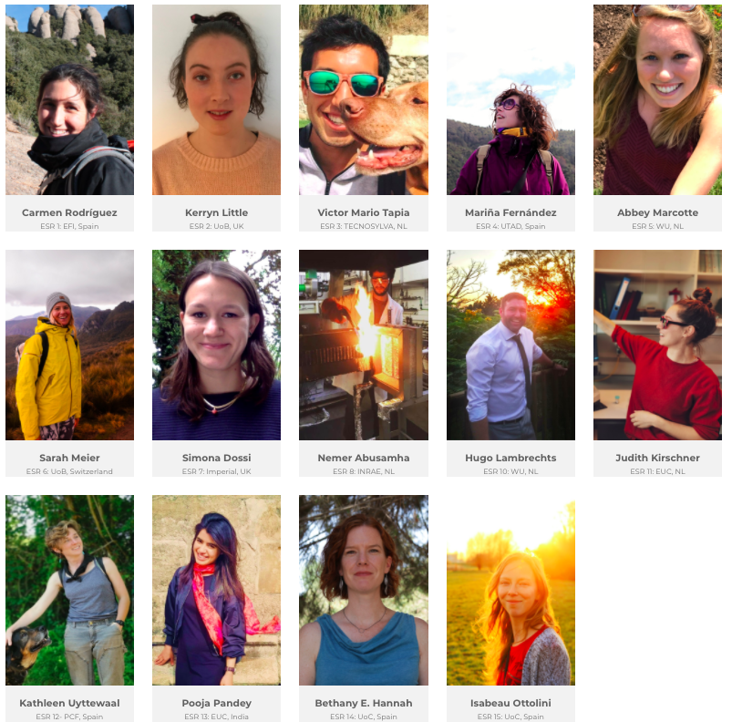
Early Stage Researchers (ESRs)
https://pyrolife.lessonsonfire.eu/
This project has received funding from the European Union’s Horizon 2020 research and innovation programme MSCA-ITN-2019 - Innovative Training Networks under grant agreement No 860787

Slide 4
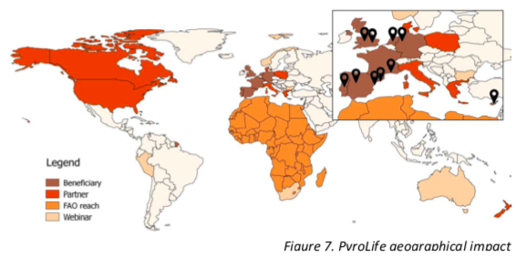
PyroLife ITN Network
In no specific order
Wageningen University
Pau Costa Foundation
European Forest Institute
NFPA
Imperial Lab
Tecnosylva
United Nations Food and Agricultural Organization
Universidade de Trás-os Montes e Alto Douro
University of Alberta
European University Cyprus
Open University of Catalonia
Arup
University of Birmingham
INRAE
Fredriksborg Fire AID
Forestry Commission England
Aguas de Portugal
WildfireTacAd
Instytut Techniki Budowlanej)
New Zealand Forest Research Institute (Scion)
Hellenic Agricultural Organization (Demeter)
This project has received funding from the European Union’s Horizon 2020 research and innovation programme MSCA-ITN-2019 - Innovative Training Networks under grant agreement No 860787

Slide 5
Training in the PyroLife network
PyroLife International Symposium 2020
‘Living with fire’ webinar series 2021 (ongoing, see https://pyrolife.lessonsonfire.eu/)
Understanding fire in the landscape: biophysical aspects, human dimensions
Secondments: two times 4 months, North & South, academia & practice
This project has received funding from the European Union’s Horizon 2020 research and innovation programme MSCA-ITN-2019 - Innovative Training Networks under grant agreement No 860787

Slide 6
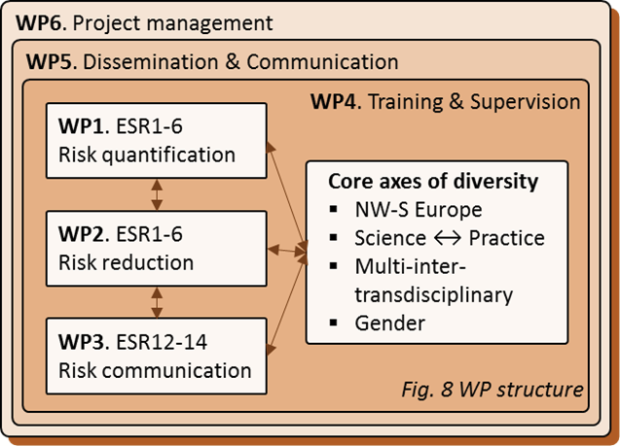
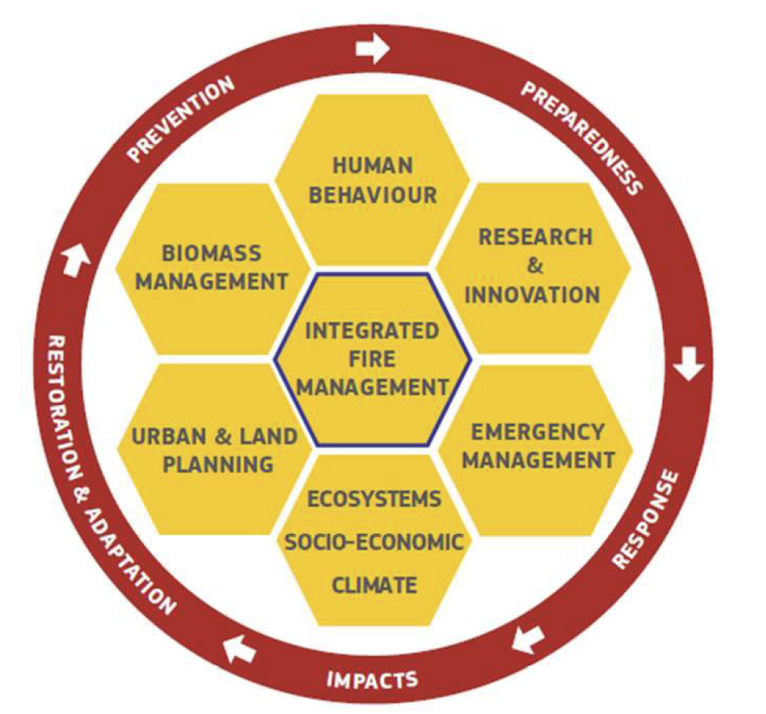
Research focus: Holistic, Integrated Wildfire Management for Europe
Figure: Vallejo Calzada, Victoriano Ramon, et al. "Forest fires. Sparking firesmart policies in the EU." (2018).
This project has received funding from the European Union’s Horizon 2020 research and innovation programme MSCA-ITN-2019 - Innovative Training Networks under grant agreement No 860787

Slide 7
Work packages and individual projects
15 wildfire focused PhD projects
1. Risk quantification
2. Risk Reduction
3. Risk Communication
ESR 1: Wildfire risk perception
Carmen Rodriguez, EFI
ESR 2: Wildfire risk temperate Europe
Kerryn Little, University of Birmingham
ESR 3: Wildfire behaviour temperate Europe
Mario Tapia, Tecnosylva
ESR 4: Megafire drivers and behaviour
Mariña Fernandez, University of
Trás-os-Montes and Alto Douro
ESR 5: Effects on Water quality
Abbey Marcotte, Wageningen University
ESR 6: Economic Impact
Sarah Meier, University of Birmingham)
ESR 7: Home ignition zone (Simona Dossi, Imperial College)
ESR 8: Vegetation flammability (Nemer Abusamha, INRAE)
ESR 9: Landscape resilience
ESR 10: Fire prevention (Hugo Lambrechts, Wageningen University)
ESR 11: Fire resilient governance (Judith Kirschner, European University Cyprus)
ESR 12: Stakeholder involvement through transdisciplinary research (Kathleen Uyttewaal, PCF)
ESR 13: Interagency exchange (Pooja Pandey, European University Cyprus)
ESR 14: Community engagement (Bethany Hannah, Open University of Catalonia)
ESR 15: Risk communication (Isabeau Ottolini, Open University of Catalonia)
This project has received funding from the European Union’s Horizon 2020 research and innovation programme MSCA-ITN-2019 - Innovative Training Networks under grant agreement No 860787

Slide 8
Kerryn Little: Landscape drivers of fuel moisture content variability & their importance for fire danger and fire behavior
Host institution: University of Birmingham (advisor: Dr. Nick Kettridge)
Secondments: Tecnosylva (advisor: Dr. Adrian Cardil), UAlberta (advisor: Dr. Mike Flannigan)
F
What is the range of variability in live/dead Calluna vulgaris across a landscape and is it important?
Considering aspect, slope, soil type and canopy density
What are the key drivers of fuel moisture content variability?
Goal: Incorporate relationships between fuel moisture and landscapes to create functional fire danger ratings and fire behaviour models
k.e.little@bham.ac.uk
Work package 1:
Risk quantification
This project has received funding from the European Union’s Horizon 2020 research and innovation programme MSCA-ITN-2019 - Innovative Training Networks under grant agreement No 860787

Slide 9
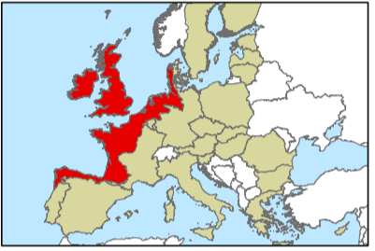
Mario Tapia: Fire behavior in Temperate NW Europe
Host institution: Tecnosylva (advisor: Dr. Adrian Cardil)
Secondments: UTAD (advisor: Dr. Paulo Fernandes), WildfireTac (advisor: Andy Elliot)
F
Is fire behaviour in Northwest Europe meaningfully different than that of Southern Europe?
Goal: To assess the accuracy of fire spread models in temperate ecosystem context and to make improvements necessary for use in research and firefighting
Work package 1:
Risk quantification
This project has received funding from the European Union’s Horizon 2020 research and innovation programme MSCA-ITN-2019 - Innovative Training Networks under grant agreement No 860787

Slide 10
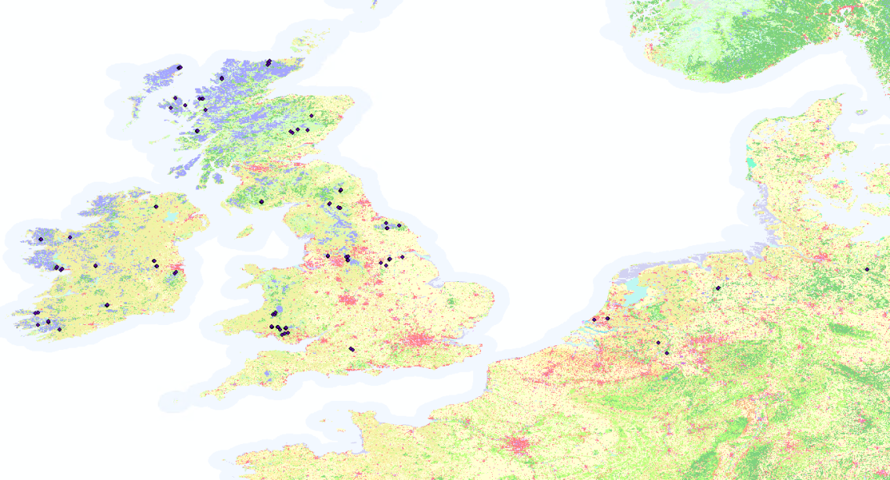
Mario Tapia: Fire behavior in Temperate NW Europe
Ongoing Projects and Challenges
VIIRS Hotspots in NWE
344,000+ hotspots (2012-June 2020)
1,134 hotspot clusters
50 fires
Current Challenges
Lack of data
Collecting data on fire behaviour is proving to be a greater challenge than expected
mtapia@tecnosylva.com
Work package 1:
Risk quantification
This project has received funding from the European Union’s Horizon 2020 research and innovation programme MSCA-ITN-2019 - Innovative Training Networks under grant agreement No 860787

Slide 11
Simona Dossi: Increasing Wildfire Safety of Rural European Homes
Host institution: Imperial College London (advisor: Guillermo Rein)
Aim: To increasing wildfire building resilience by studying common European building vulnerabilities and performance
under wildfire threats
Research:
1. Statistical Analysis of Post-Fire Building Inspection Data 2.Database of wildfire vulnerabilities (materials and features) of EU buildings 3.Computer Modelling (FDS) of Building Feature Performance under wildfire threat 4.Laboratory Experiments of Features & Materials Performances
Outcomes: Scientifically-backed building design recommendations for wildfire-resilient building design for Europe
I am interested in talking to and collaborating with anybody about post-fire building data and relevant rural building materials and geometries information she can analyse to complement her research and stakeholders’ needs.
Contact Simona: sd820@ic.ac.uk
Work package 1:
Risk quantification
This project has received funding from the European Union’s Horizon 2020 research and innovation programme MSCA-ITN-2019 - Innovative Training Networks under grant agreement No 860787

Slide 12
Hugo Lambrechts: How to make wildfire prevention enticing
Host institution: Wageningen University (promotor: Prof. dr. ir. Carolien Kroeze)
Aim: To motivate stakeholders to take to action and put in place fire prevention and fuel management and become
more resilient to wildfire.
Research: 1. Lessons in risk reduction from Dutch flood risk reduction
2. SWOT analysis of wildfire prevention/ fuel management in NW Europe
3. To assess how co-production of climate information service can make fire prevention more attractive for communities living in the wildland urban interface.
4. To assess to what extent Payment for Ecosystem Service incentives can make wildfire prevention enticing to forest and land managers.
Outcomes: Practical guidance on how to motivate citizens, agencies and governments to implement best practices of fire management, prevention and sustainable forest management.
I am interested in talking to land owners/managers, fire managers and collaborating with anybody about fire
management, fuel management and wildfire prevention.
Contact Hugo: hugo.lambrechts@wur.nl
Work package 2:
Risk reduction
This project has received funding from the European Union’s Horizon 2020 research and innovation programme MSCA-ITN-2019 - Innovative Training Networks under grant agreement No 860787

Slide 13
Judith Kirschner: Wildfire Resilient Governance
Host institution: European University Cyprus (advisor: Prof. Boustras)
Secondments: University of Birmingham (advisor: Dr. Clark), FAO (advisor: Dr. Moore)
Aim: Review status quo wildfire governance in Europe
Explore new innovative governance concepts to increase wildfire resilience
Objectives: Use insights from natural resources governance and disaster risk governance
Outcomes: Identify best-practice & innovative governance models
I am interested in talking to - collaborating with - learning from anyone who is engaged in fire governance in NW Europe and beyond
Contact: j.kirschner@research.euc.ac.cy
Work package 2:
Risk reduction
This project has received funding from the European Union’s Horizon 2020 research and innovation programme MSCA-ITN-2019 - Innovative Training Networks under grant agreement No 860787

Slide 14
Pooja Pandey: Interagency exchange
Host institution: European University Cyprus (advisor: Prof. Boustras)
Secondments: FireAID (advisor: Kim Lintrup), Tecnosylva (advisor: Dr Adrian Cardil)
Aim: Analyse and understand the operational ways to promote EIE (European interagency Exchange) in emergency management
Objectives: Analyse the barriers for European collaboration and exchange in emergency management (multi-level approach by public sector governance system)
Outcomes: Strengthen the preparedness approaches through interagency streamlining
Pooja is interested to get in contact with
Stakeholders, fire managers, actually anyone who can share knowledge and experience of the best policies involved in prevention, also throw some light on how the European South can be helpful to North in managing wildfires and what we can learn from North.
P.Pandey@research.euc.ac.cy
Work package 3:
Risk communication
This project has received funding from the European Union’s Horizon 2020 research and innovation programme MSCA-ITN-2019 - Innovative Training Networks under grant agreement No 860787

Slide 15
Thank you for your attention!
https://pyrolife.lessonsonfire.eu/
G.Boustras@euc.ac.cy
Twitter:
@PyroLife_ITN
This project has received funding from the European Union’s Horizon 2020 research and innovation programme MSCA-ITN-2019 - Innovative Training Networks under grant agreement No 860787

