Slide 1
Advantages and limitations in the operational use of Sentinel-2 for fire danger prediction and automatic update of burned area mapping in Italy
Francesco baghino¹, Guido Biondi¹, Edoardo Cremonese², Mirko D’Andrea¹, Elisabetta Fiori¹, Paolo Fiorucci¹, Michel Isabellon¹,Umberto Morra di cella^{1,2}, Luca Pulvirenti¹, Giuseppe Squicciarino¹ , Andrea trucchia¹
¹ CIMA Research Foundation, Italy ² ARPA VDA, Italy
Contacts: paolo.fiorucci@cimafoundation.org

Slide 2
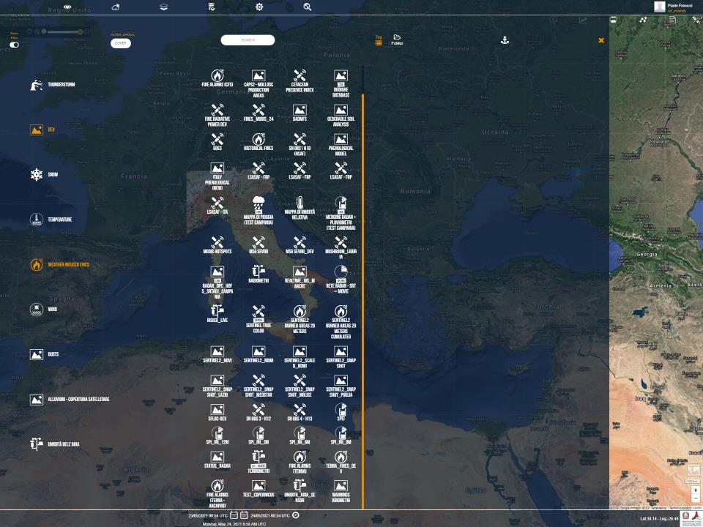
Real time observations
EO data
MSG SEVERI
MODIS HOT SPOT
H-SAF & LSA-SAF
Sentinel2

Slide 3
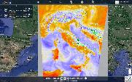
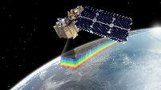
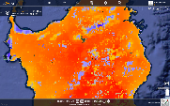
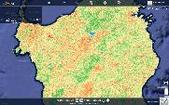
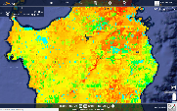
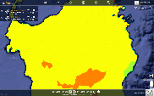
Weather forecasts & observations
SENTINEL2
Early warning
3h Dead Fine Fuel Moisture
5 days NDVI
3h Potential Rate of spread
Burned areas
Daily Fire Danger Index

Slide 4
NRT Mapping of BA and NDWI using S2 data
S2 acquisition plan guarantees a continuous streaming of multispectral data (5-day revisit)
A systematic production of maps of vegetation indices and BA maps at medium-high spatial resolution (20m) can be envisaged
Software AUTOBAM (AUTOmatic Burned Areas Mapper): fully automated processing chain for NRT mapping of BA from multitemporal spectral indices derived from S2 data.
It also produces maps of NDVI & NDWI
AUTOBAM works at national scale (Italy), but the BA mapping can be in principle applied everywhere

Slide 5
AUTOBAM requirements and characteristics
Input data: S2 level 2A products
Fully automated
including S2 data download and delivering of the maps to the end user (Italian DPC)
Working 365 days-a-year
Running once a day at 02:00 AM
Output maps available within 20 h from the S2 acquisition (level 2A products available in 8-10 h)
Resolution of the output maps 20m
BA maps include a quality flag giving indications about the agreement with ancillary active fire products (VIIRS, MODIS, MSG)

Slide 6
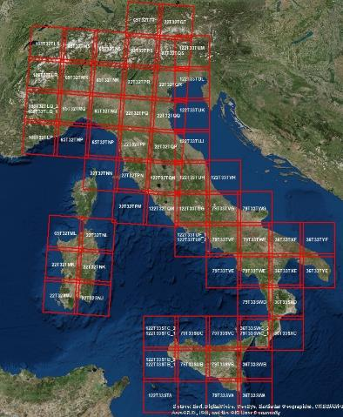
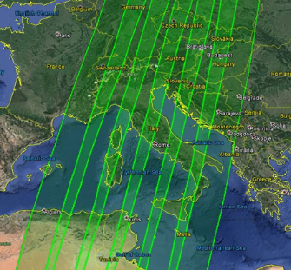
S2 coverage of Italy
Revisit time 5 days (could be longer because of cloud cover)
6 orbits, 70 tiles
Courtesy from ESA

Slide 7
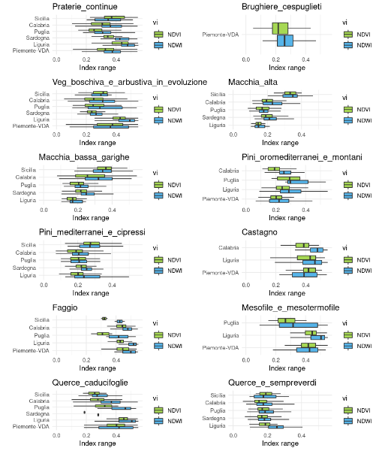
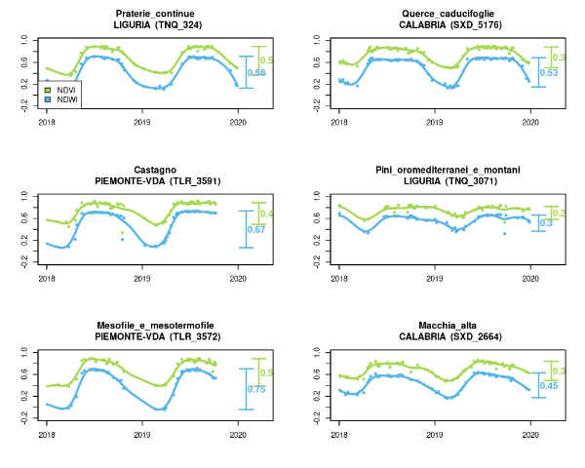
VI analysis

Slide 8
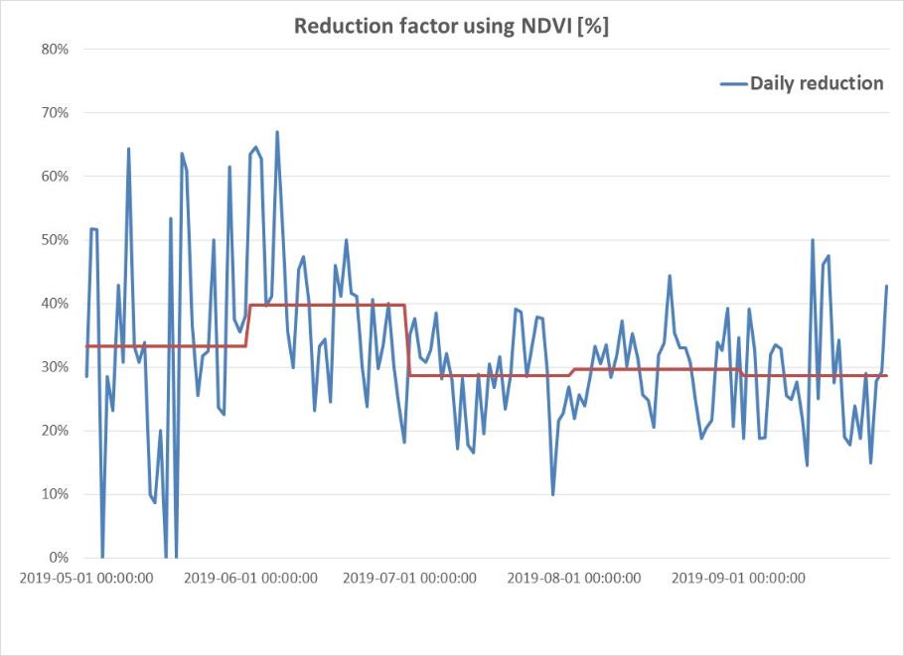
Results

Slide 9
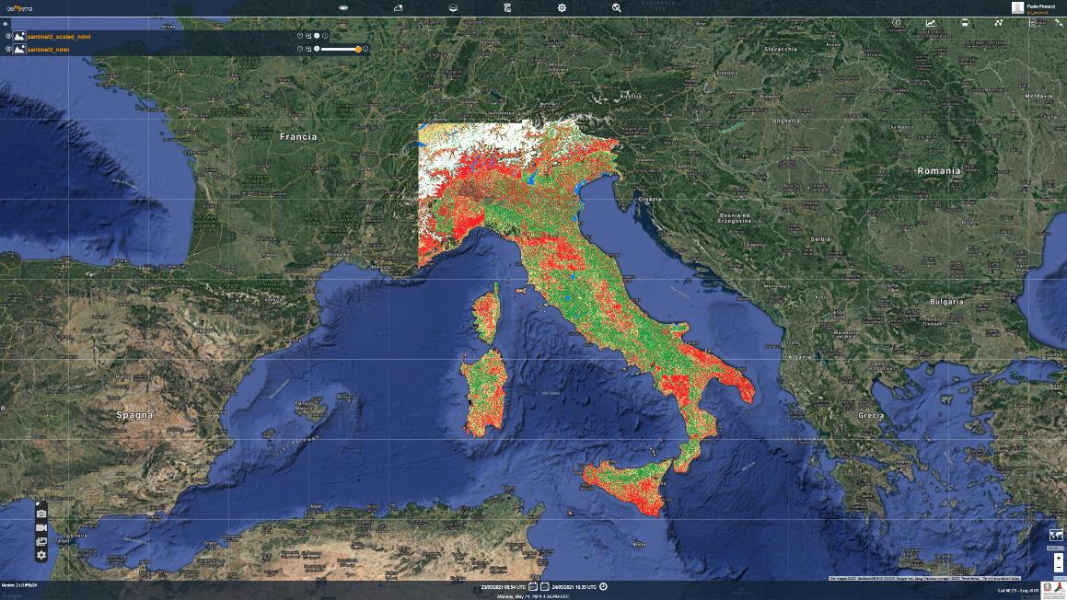
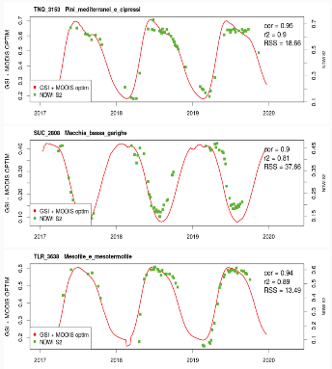
Limitation:
Revisit time
Solution:
Gap filling of Sentinel 2 data using a phelogical model

Slide 10
Fully automated mapping
Adavantages:
Does not need any activation (timeliness of the maps).
Allows for potentially mapping all the BA larger than the minimum mapping unit (1 ha) (reduced omission error)
Allows for building a dataset of BA (statistics about the impact of forest fires during the fire season)
Limitations:
Cloud masking is very critical for a tool which processes all the available S2 images of Italy (data with cloud cover > 40% are discarded)
Undetected clouds → commission error
Cloud masking relies on the scene classification included in the S2 L2A products (sometimes affected by errors)
In general supervision by a skilled user increases mapping accuracy (especially for low severity fires)

Slide 11
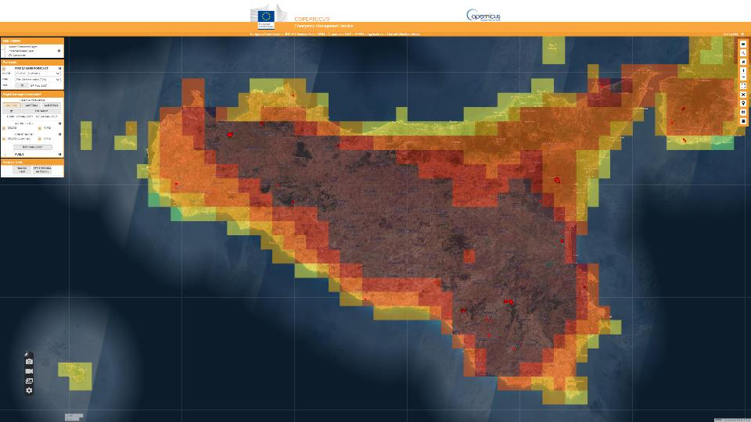

Slide 12
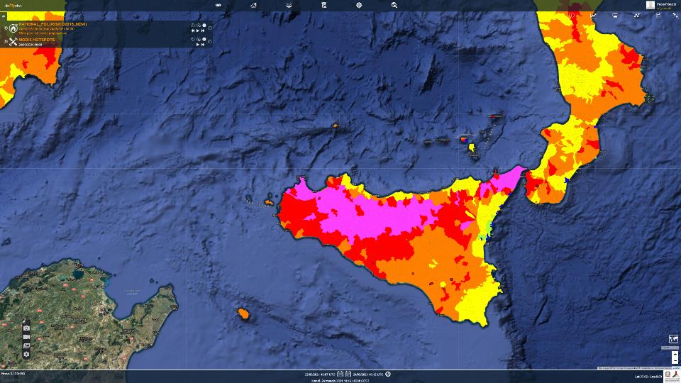

Slide 13
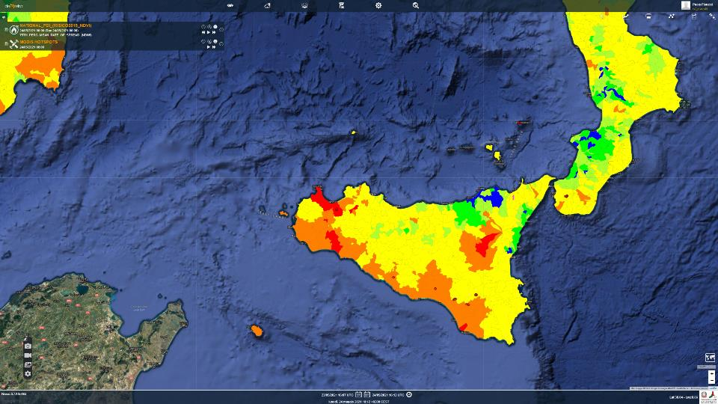

Slide 14
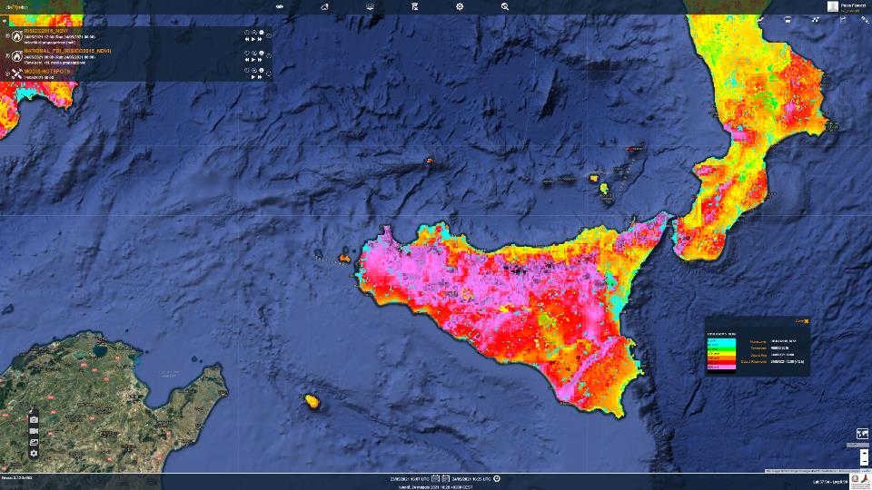

Slide 15
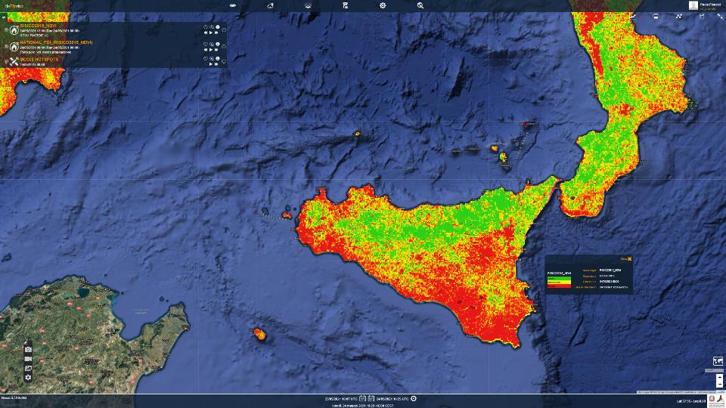

Slide 16
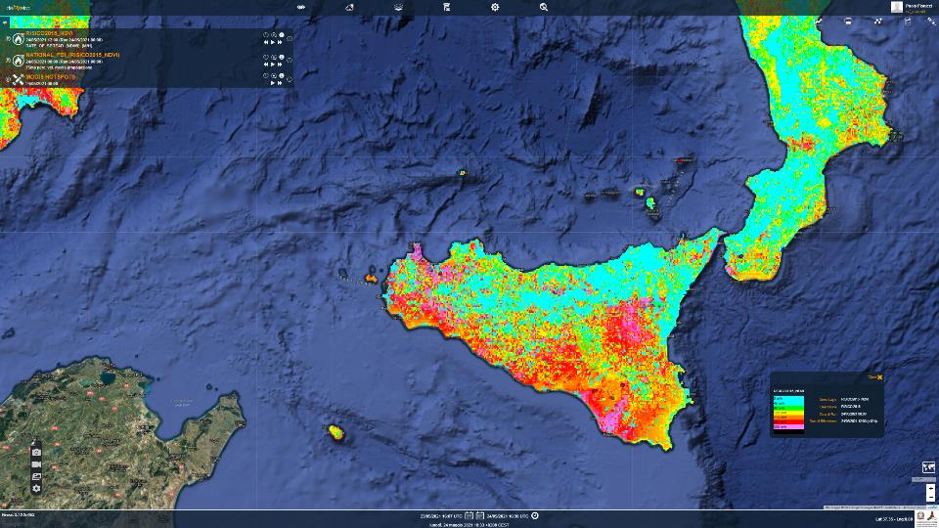

Slide 17
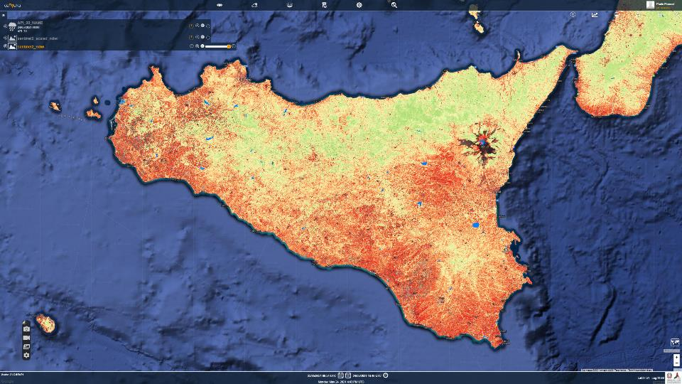

Slide 18
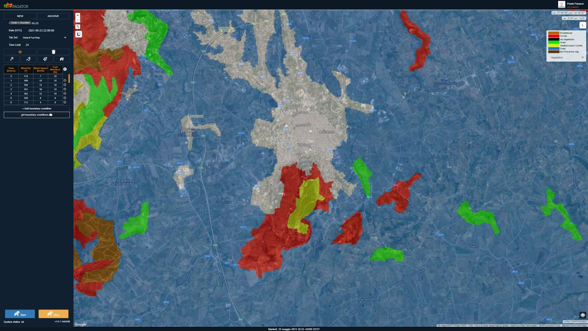
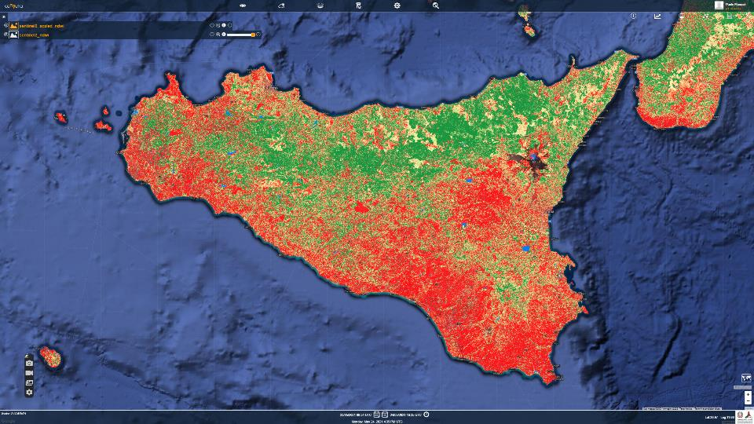

Slide 19
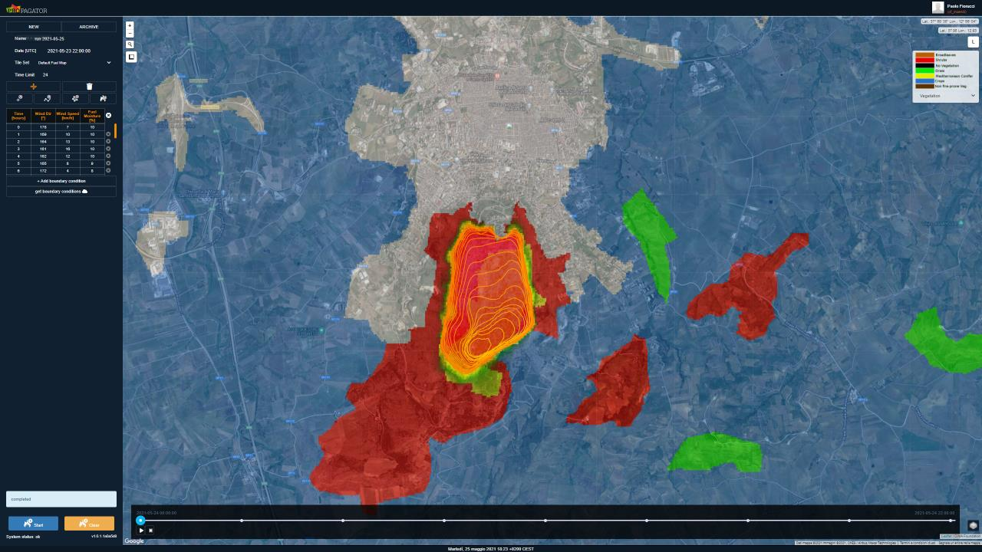

Slide 20
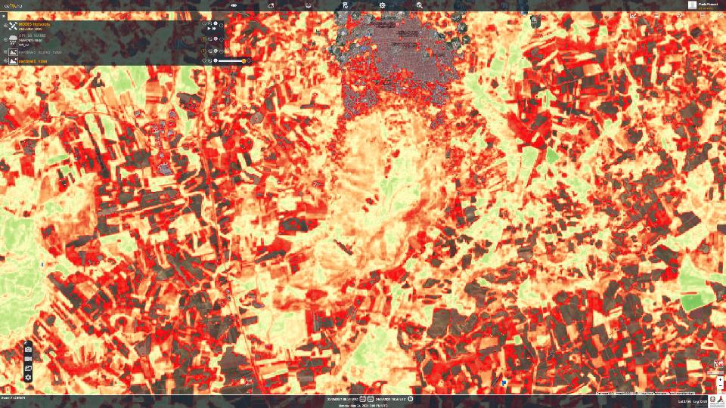
On-demand Wildfire Nowcast and Forecast
to predict the spread and the potential impacts of an active fire, based on EO data, supporting decisions during emergencies

Slide 21
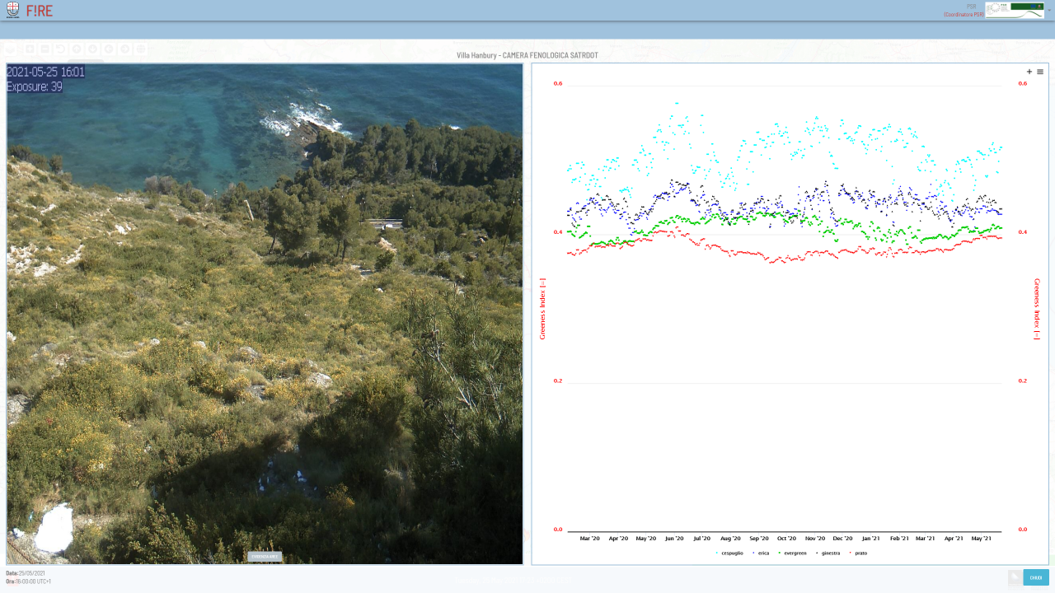
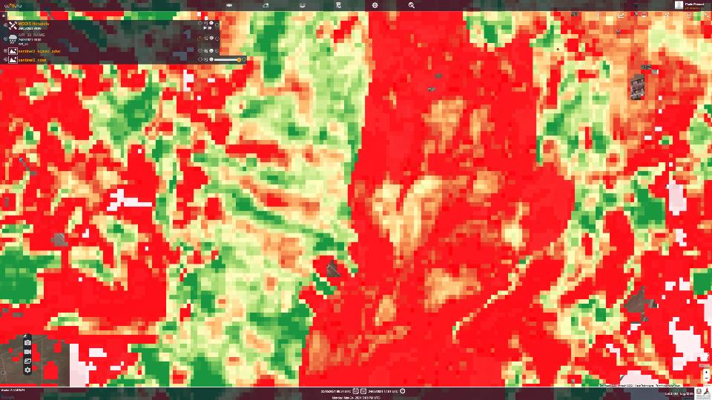

Slide 22
Thanks for your attention

