Slide 1
Observing wildfires from space:
Copernicus and EUMETSAT programs
Federico Fierli with key contributions from Stephan Bojinski, Julien Chimot, Sauli Joro, Andrea Meraner … and many other

Slide 2
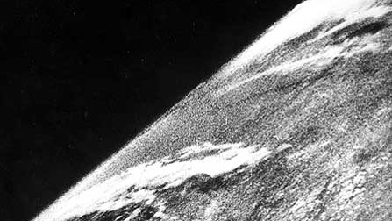
The origin of images …. 1946
View of Earth from a camera on V-2 #13, launched
October 24, 1946

Slide 3
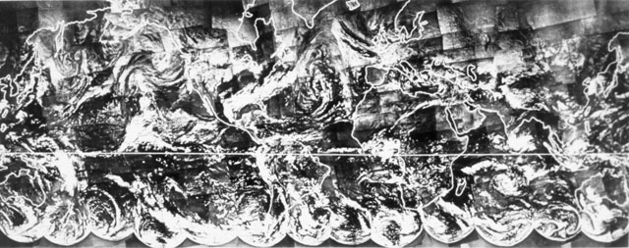
1965: The first Polar Satellites
First complete view of the world’s weather (TIROS-9) Jan 1965
and first satellite in a sun-synchronous orbit !
1950
1970
1990
2010
2030
TIROS-1
TIROS-N
NOAA 1-11
NOAA 12-19
COSMIC
NPP
NPOESS
Jason
OSVW
OCO
Wind Lidar
TIROS-9
NIMBUS
DMSP
Notes:
1965: TIROS-9, first complete view of the world’s weather and first satellite in a Sun-synchronous orbit
1966: Application Technology Satellite-1, first cloud/severe weather tracking observations from stationary platform
1967: ATS-3, first full-disk image of the Earth
1969: Nimbus-3, first global vertical temperature profiles of the atmosphere
1970: Nimbus-4, first global ozone profiles
1972: Earth Resources Technology Satellite (later named LandSat) multispectral map of the surface of the Earth
1973: NASA’s Skylab, first active microwave sensor (Edge of storms, through clouds)
May 17, 1974: Synchronous Meteorological Satellite (SMS-1), 1st generation of geostationary meteorological satellites
First data transfer of from surface platforms to be relayed via satellite to central receiving, providing 24/7service
October 15, 1975: GOES satellites were launched
1975: Nimbus-6 provides first Limb Scanner and Global Earth Radiation Budget Measurement
1976: Defense Meteorological Satellite Program
1977: Meteosat: 1st microwave sounder with all-weather sounding capability
1978: 2 new microwave techniques were introduced
Seasat, provided global measurements of winds at the ocean surface, sea surface topography, surface and internal waves and bathymetry in shallow regions
Nimbus 7 provided a the 1st global ocean color measurements and 1st daily mapping of ozone concentration
October 13, 1978: 3rd generation of polar metsats
Image 1: first complete view of the world’s weather and first satellite (TIROS-9)
Image 2: First image from Geostationary platform Colorized courtesy of UofW.
Image 3: TRMMS image showing rainfall intensity

Slide 4
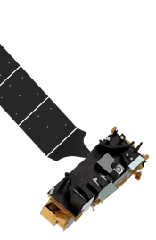
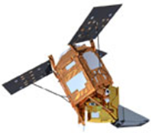
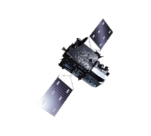
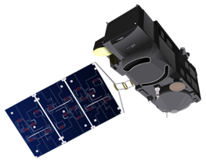
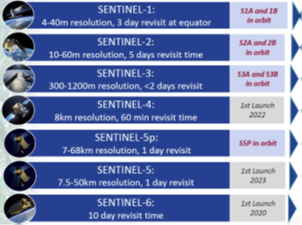
EUMETSAT current and future missions EUMETSAT does (and will do) on fire detection
The inter-governmental organisation to supply operational weather and climate-related satellite data, images and products Unique set of existing and upcoming data 30 Member states
EUMETSAT programs
METOP (1-3)
Meteosat
Meteosat III Gen
Polar II Gen
Monitor CO2
User Oriented:
Make data available at best
Gather (and satisfy) needs
Grant data access
Help and support Users
Training (also on-line)
Explore applications
Communicate - outreach

Slide 5
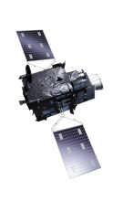
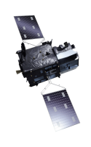
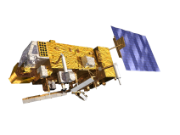
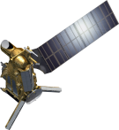
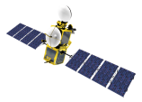
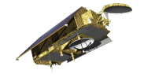
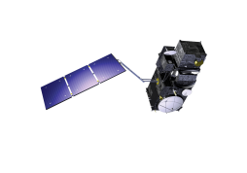
EUMETSAT Mission Planning
YEAR...
03
04
05
06
07
08
09
10
11
12
13
14
15
16
17
18
19
20
21
22
23
24
25
26
27
28
29
30
31
32
33
34
35
36
37
38
39
40
METEOSAT SECOND GENERATION
METEOSAT-8
METEOSAT-9
METEOSAT-10
METEOSAT-11
METEOSAT THIRD GENERATION
MTG-I-1 : IMAGERY
MTG-S-1: SOUNDING
Mandatory Programmes
MTG-I-2: IMAGERY
MTG-I-3: IMAGERY
EUMETSAT POLAR SYSTEM (EPS)
MTG-S-2: SOUNDING
METOP-A
MTG-I-4: IMAGERY
METOP-B
METOP-C
EUMETSAT POLAR SYSTEM SECOND GENERATION (EPS-SG)
METOP-SG A: SOUNDING AND IMAGERY
METOP-SG B: MICROWAVE IMAGERY
JASON (HIGH PRECISION OCEAN ALTIMETRY)
Optional
Programmes
JASON-2
JASON-3
SENTINEL-6 (JASON-CS)
COPERNICUS
Third Party
Programmes
SENTINEL-3 A/B/C/D
SENTINEL-4 ON MTG-S
YEAR...
03
04
05
06
07
08
09
10
11
12
13
14
15
16
17
18
19
20
21
SENTINEL-5 ON METOP-SG A
22
23
24
25
26
27
28
29
30
31
32
33
34
35
36
37
38
39
40

Slide 6
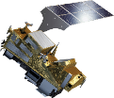
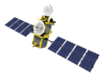
Copernicus Sentinels operated by EUMETSAT
YEAR...
07
08
09
10
11
12
13
14
15
16
17
18
19
20
21
22
23
24
25
26
27
28
29
30
31
32
33
34
35
36
37
38
39
40
METEOSAT THIRD GENERATION
Monitoring atmospheric composition
MTG-S-1: SOUNDING
MTG-S-2: SOUNDING
SENTINEL-4 on MTG-S
EUMETSAT POLAR SYSTEM SECOND GENERATION (EPS-SG)
METOP-SG A: SOUNDING AND IMAGERY
SENTINEL-5 on METOP-SG A
JASON (HIGH PRECISION OCEAN ALTIMETRY)
JASON-2
Monitoring the ocean
JASON-3
SENTINEL-6 (JASON-CS)
COPERNICUS
SENTINEL-3 A/B/C/D
YEAR...
07
08
09
10
11
12
13
14
15
16
17
18
19
20
21
22
23
24
25
26
27
28
29
30
31
32
33
34
35
36
37
38
39
40

Slide 7
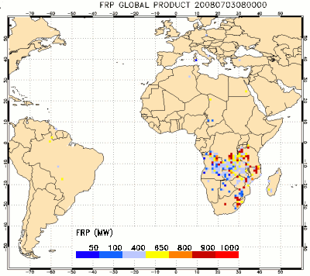
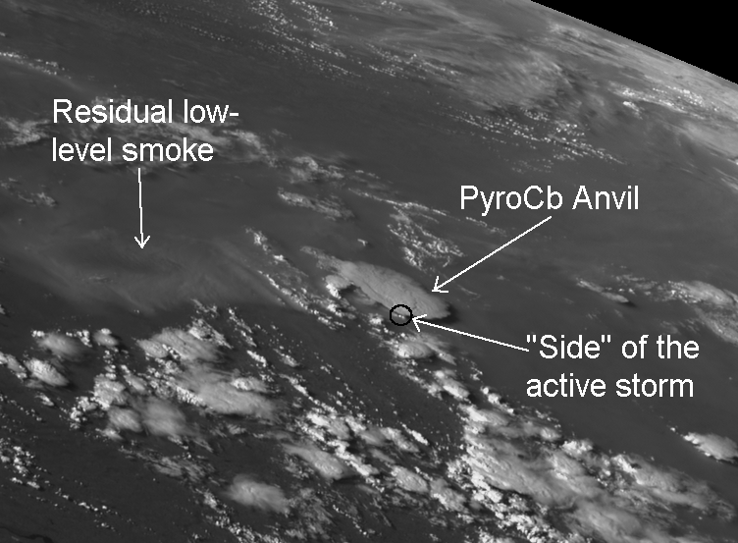
Observe from Geostationary orbit
Meteosat Second & Third Generation (Africa & Europe)
High temporal frequency / sampling => good for fire diurnal cycle
No global coverage
High geometry deformation in high latitudes
https://landsaf.ipma.pt/en/products/fire-products/frppixel

Slide 8
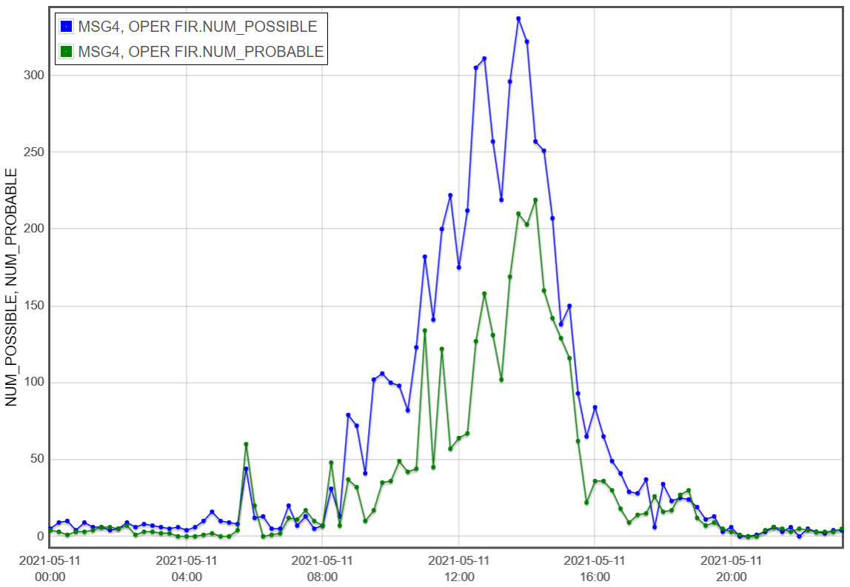
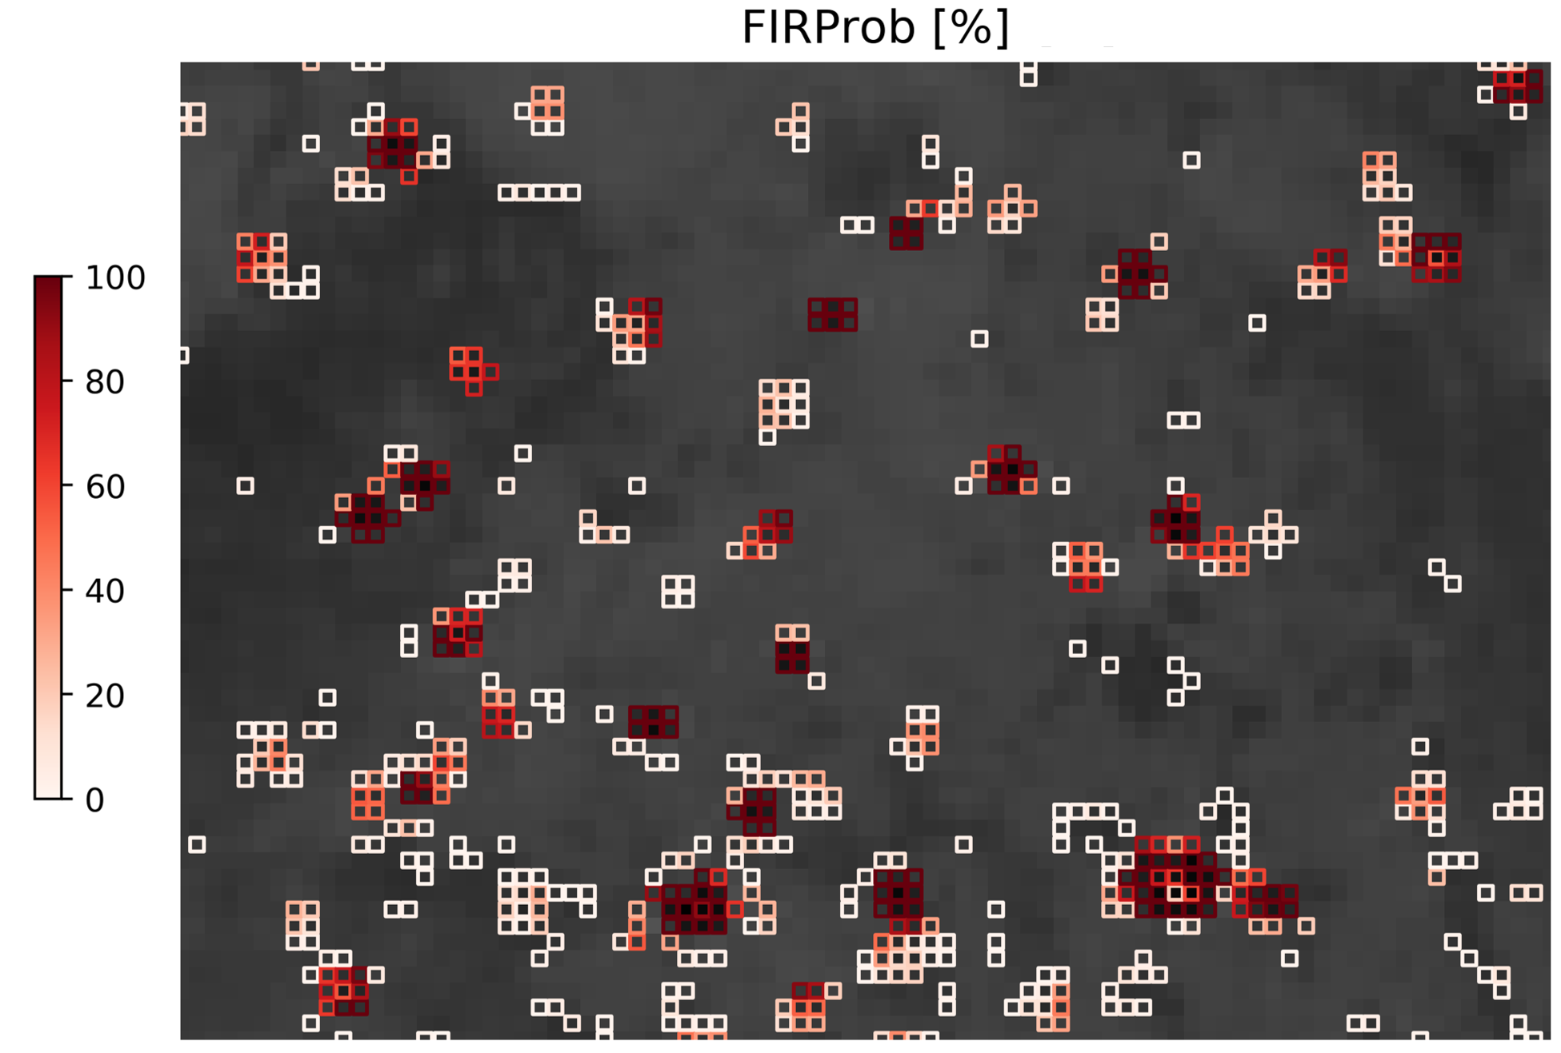
EUMETSAT’s Active Fire Monitoring Product (FIR)
Operationally produced from Meteosat data and disseminated every 15 min for the full-disk and every 5 min over Europe (Rapid Scan Service)
Based on Bayesian-type tests on 3.9µm and 10.8µm channels
Two-level active fire classification (possible/probable) and a fire probability map (since August 2019)

Slide 9
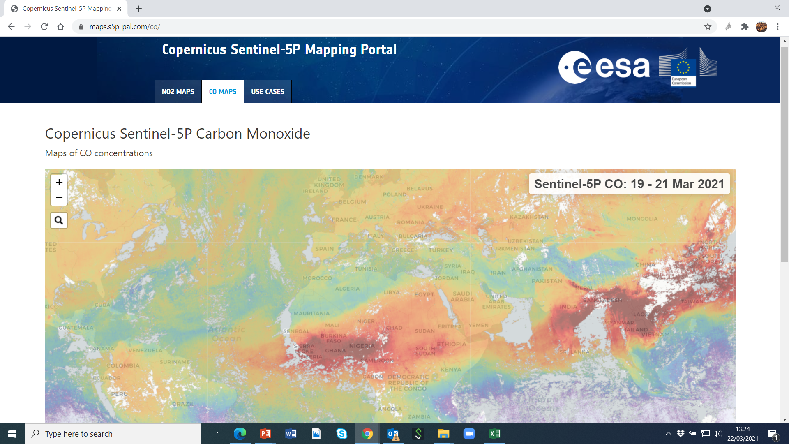
Observe from Polar orbit …
Global, 1 km resolution (nadir)
Tens thousands of users worldwide
Limited temporal sampling
Accumulate data

Slide 10
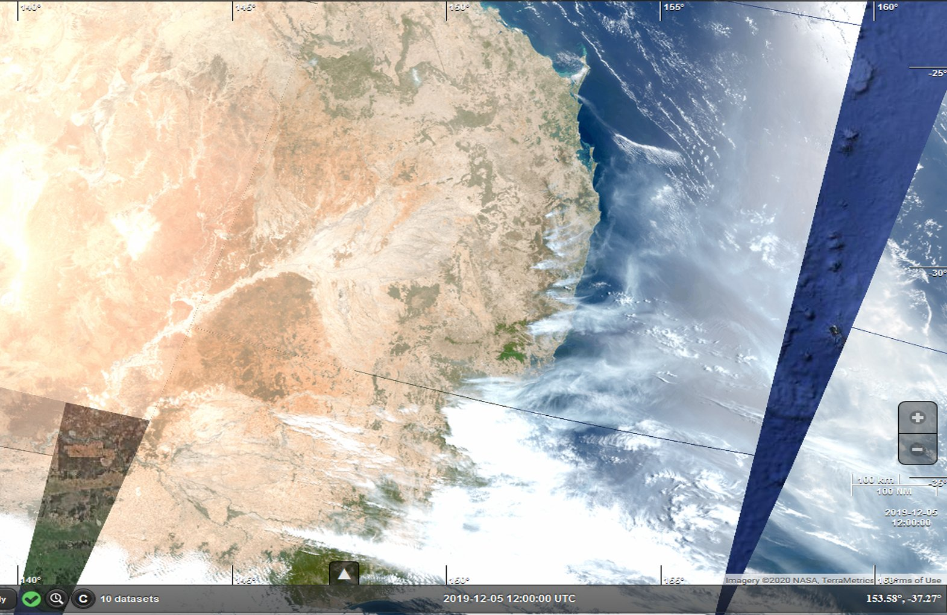
Observe Smoke: Sentinel3
https://s3view.oceandatalab.com
ESA

Slide 11
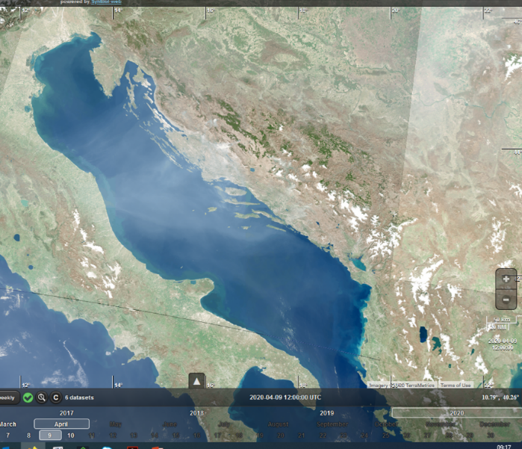
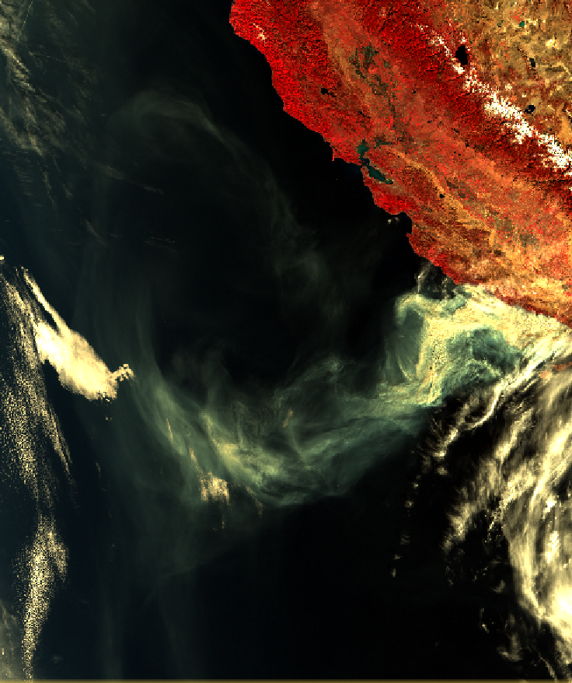
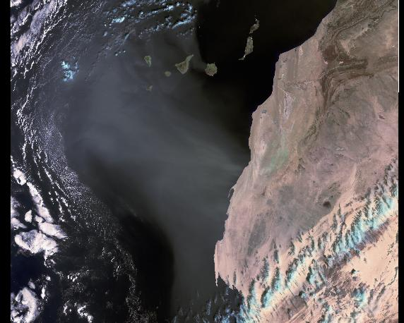
Observe smoke : In a nutshell
AOD (Aerosol Optical depth) = How much Solar light attenuated by aerosols?
A proxy of the aerosol amount in air
Looking at the contrast between aerosol layer & the underlying surface
Dust
Smoke
Smoke
Western Sahara – 2019.02.05
S3 A – SLSTR (RGB Composite)
Balkan fires – 2020.04.10
S3 B – OLCI (RGB Composite)
Massive Thomas fire, California, 2017.12.10
S3 A – SLSTR (RGB Composite)

Slide 12
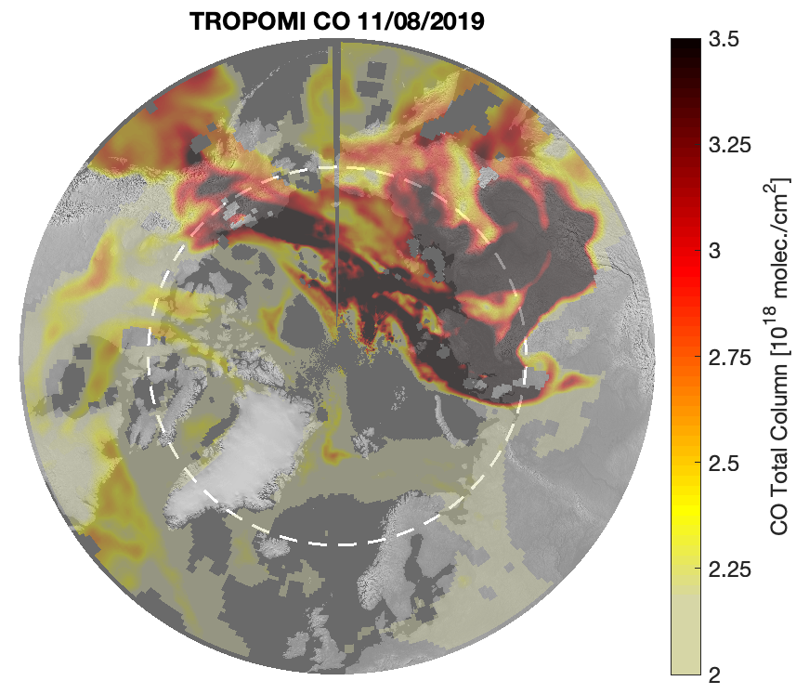
TROPOMI observes CO from the from sunlight reflected by the Earth atmosphere (clear- and cloudy sky) in the 2.3 μm spectral range of the shortwave infrared (SWIR)
TROPOMI has also sensitivity to boundary layer (in clear sky situations)
For cloudy scenes partial column is obtained.
Units and interpretation is the same as for IASI
IASI
IASI
TROPOMI
Noon

Slide 13
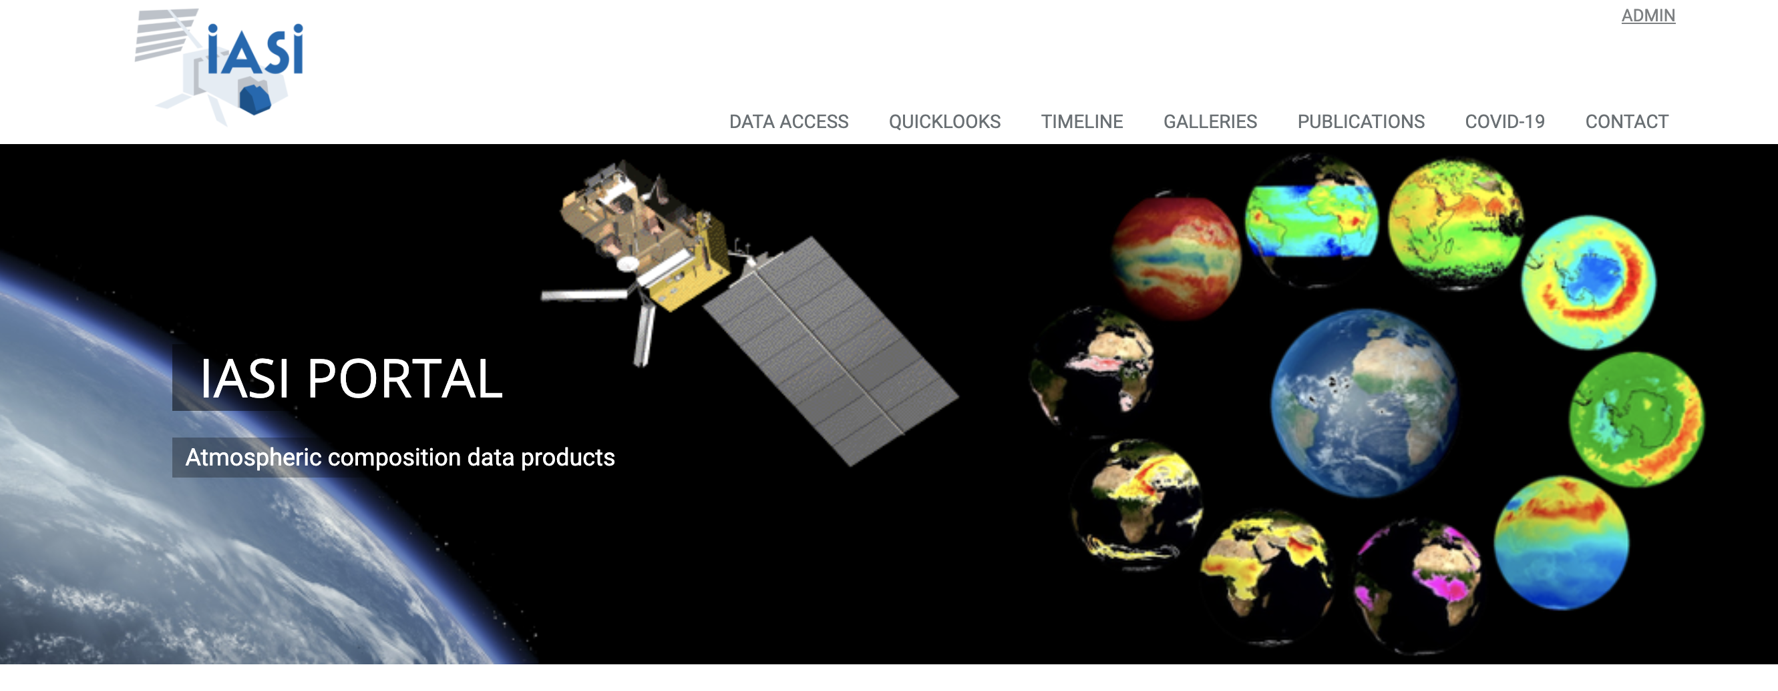
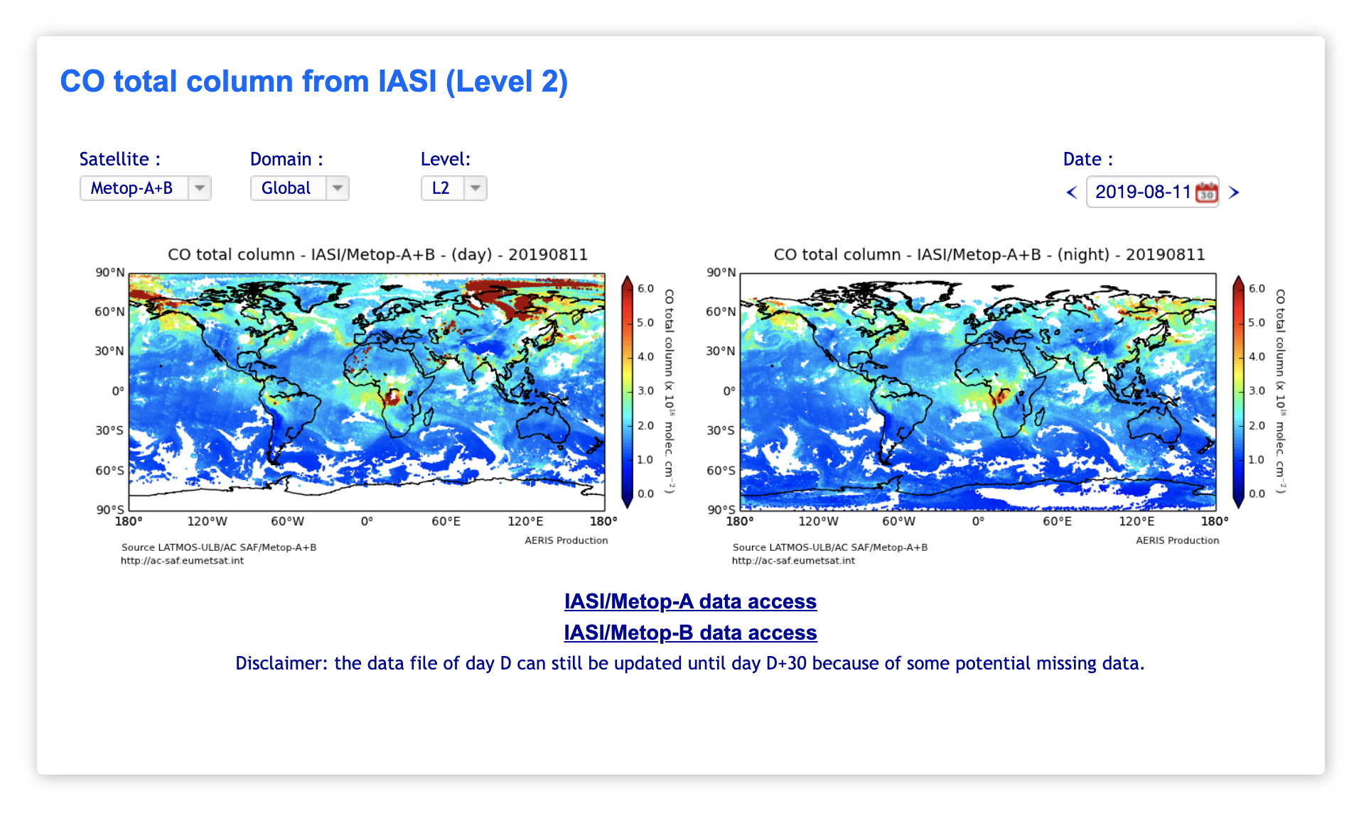
IASI CO quicklook:
https://iasi.aeris-data.fr/

Slide 14
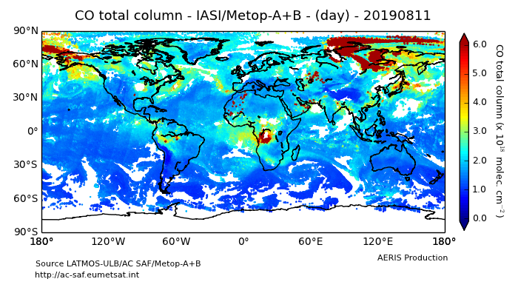
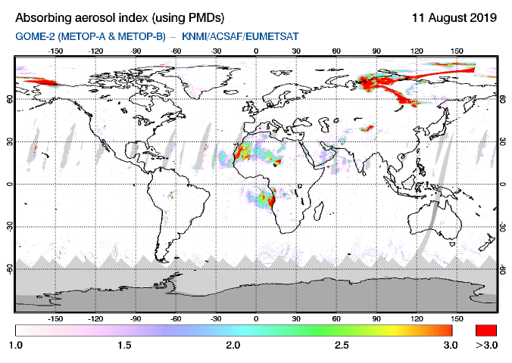
Compounds and particles combined to track fires
Fire plume Where both Aerosol and CO are large

Slide 15
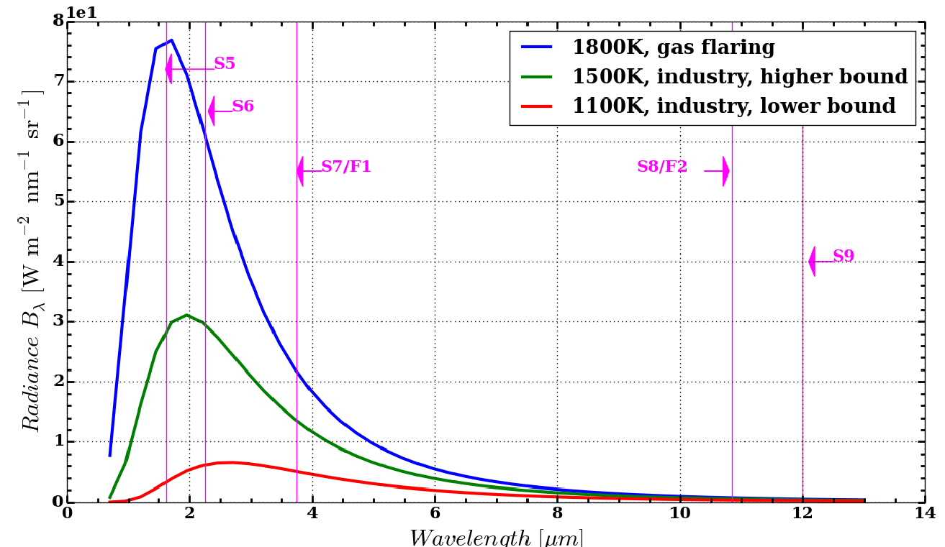
Fire Hot-Spot from space – In a nutshell
A hot spot radiates a strong heating signal.
Looking at the temperature contrast between the local hot-spot pixel and the surrounding background
Hot-spot more emissive than the ambient background
N = 100 => TIR (112 µm)
N = 1000 => MWIR (3.7 µm)
N >> 1000 => SWIR (1.5-2.25 µm)
Caseiro et al. (2018)

Slide 16
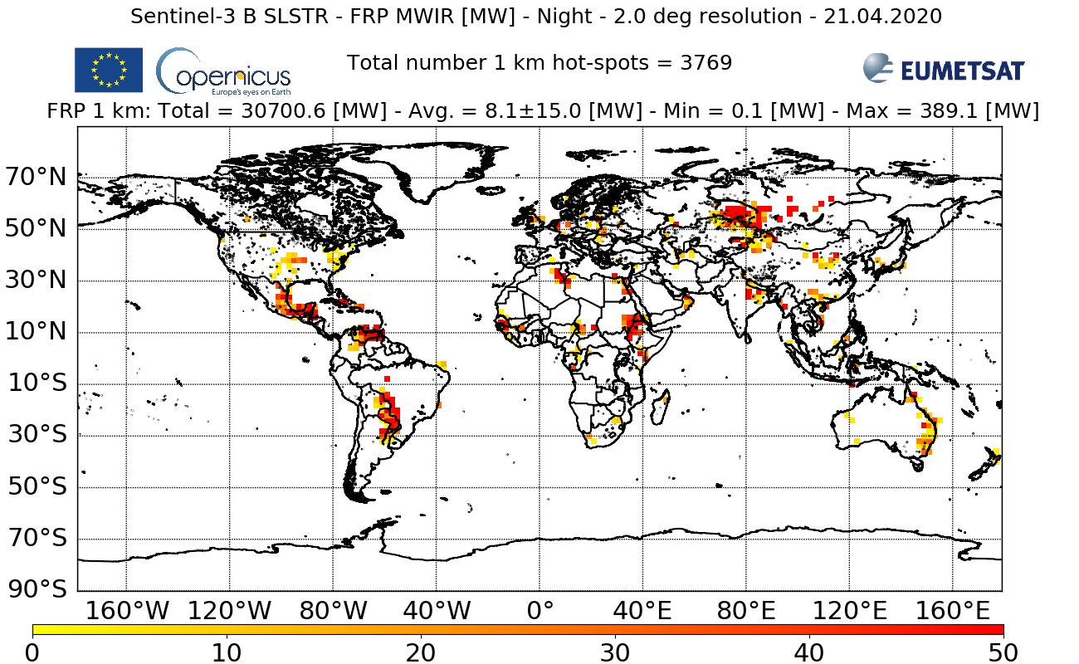
Copernicus Sentinel-3 NRT FRP map – 21.04.2020

Slide 17
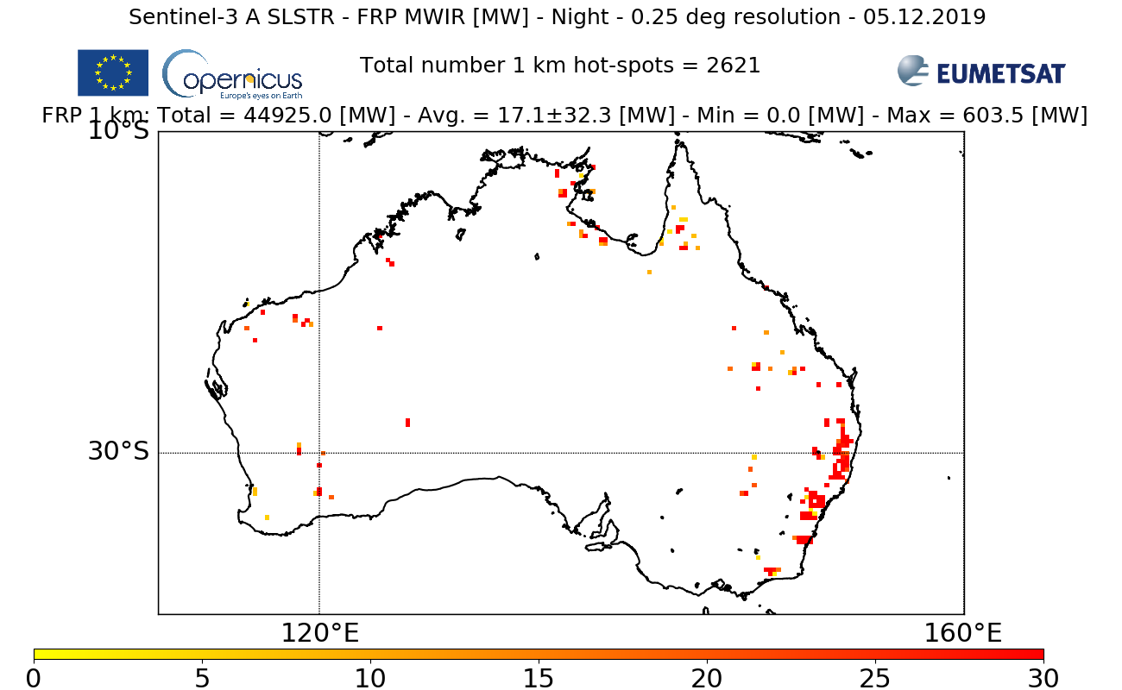
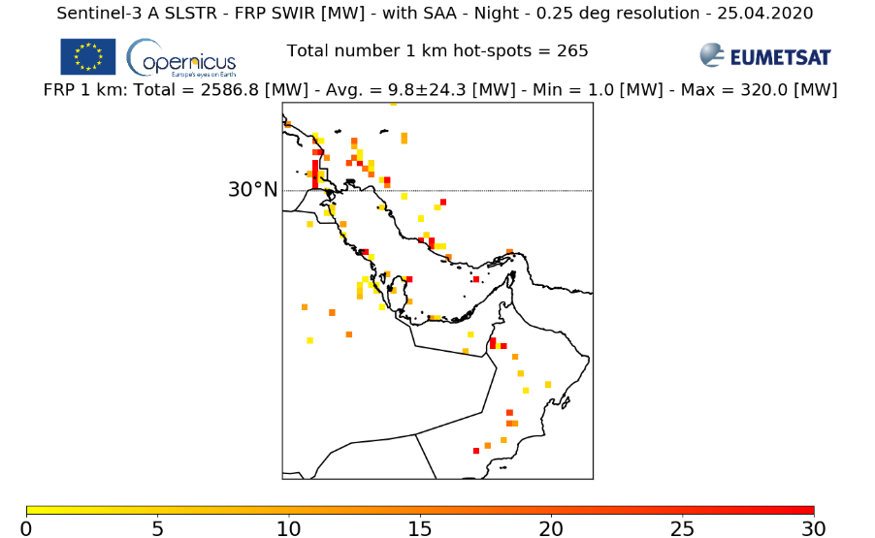
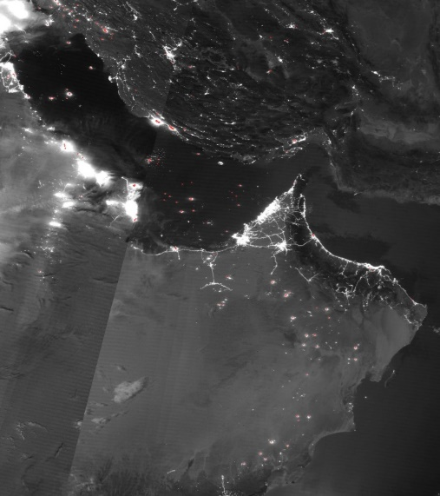
Copernicus Sentinel-3 examples
Persian Gulf industrial gas flares
http://metis.eumetsat.int/frp
NASA SUOMI/VIIRS night-time imagery + hot-spot detection

Slide 18
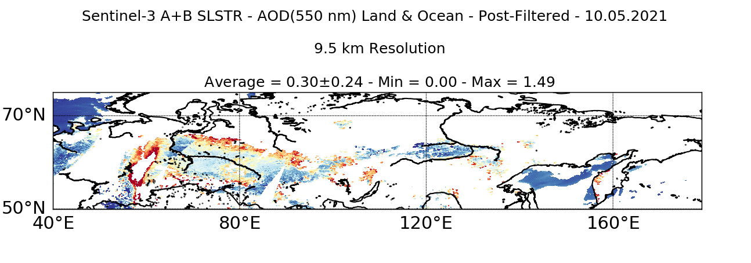
Copernicus Sentinel-3 NRT
Fires: New Processing baseline 1.2 – OPE since 06.05.2021
Aerosols: New Processing baseline 1.1 scheduled for Fall (operational tests internal at EUMETSAT).
FRP [MW]
60
30
0
AOD(550 nm)

Slide 19
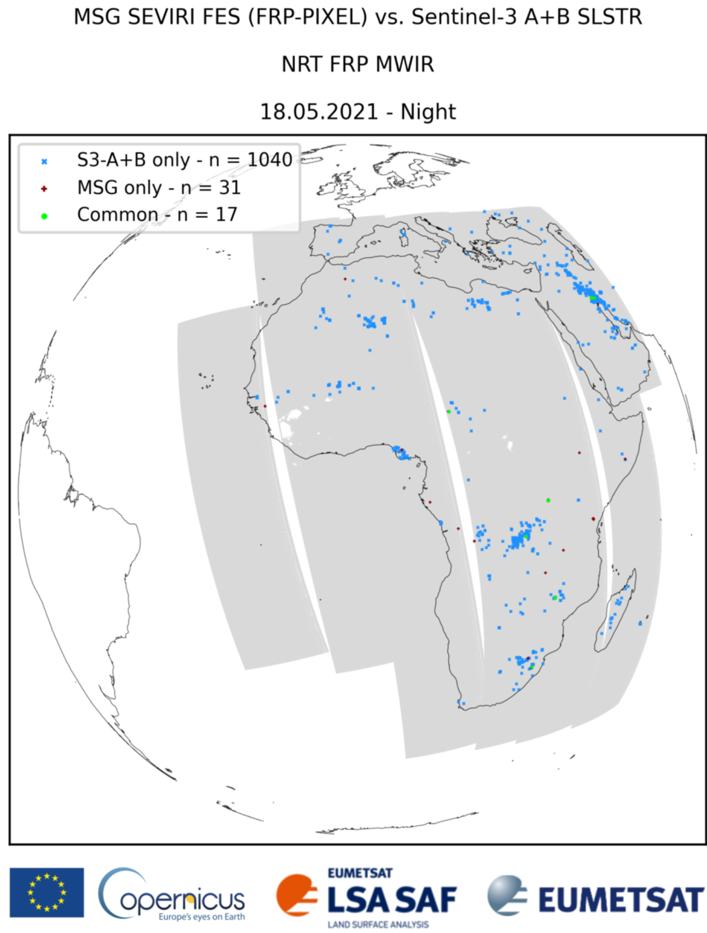
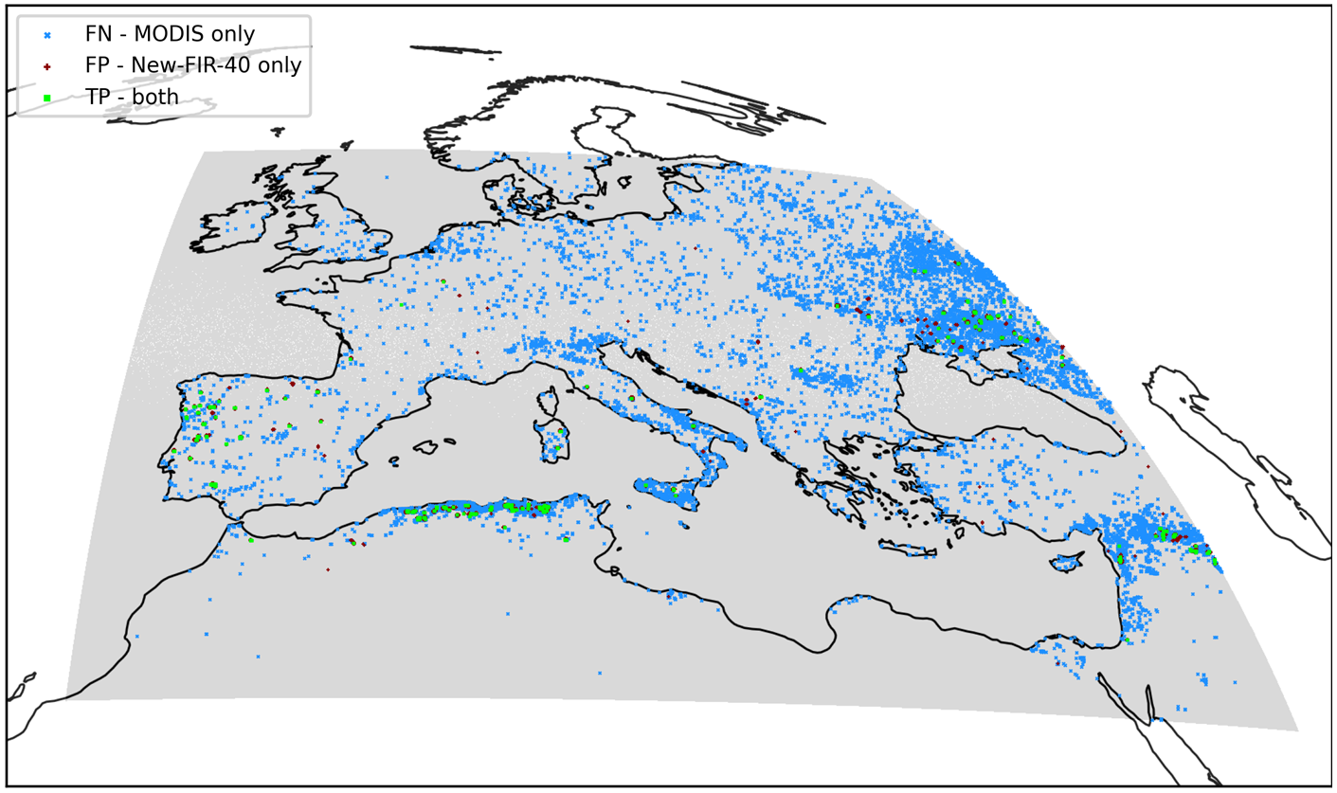
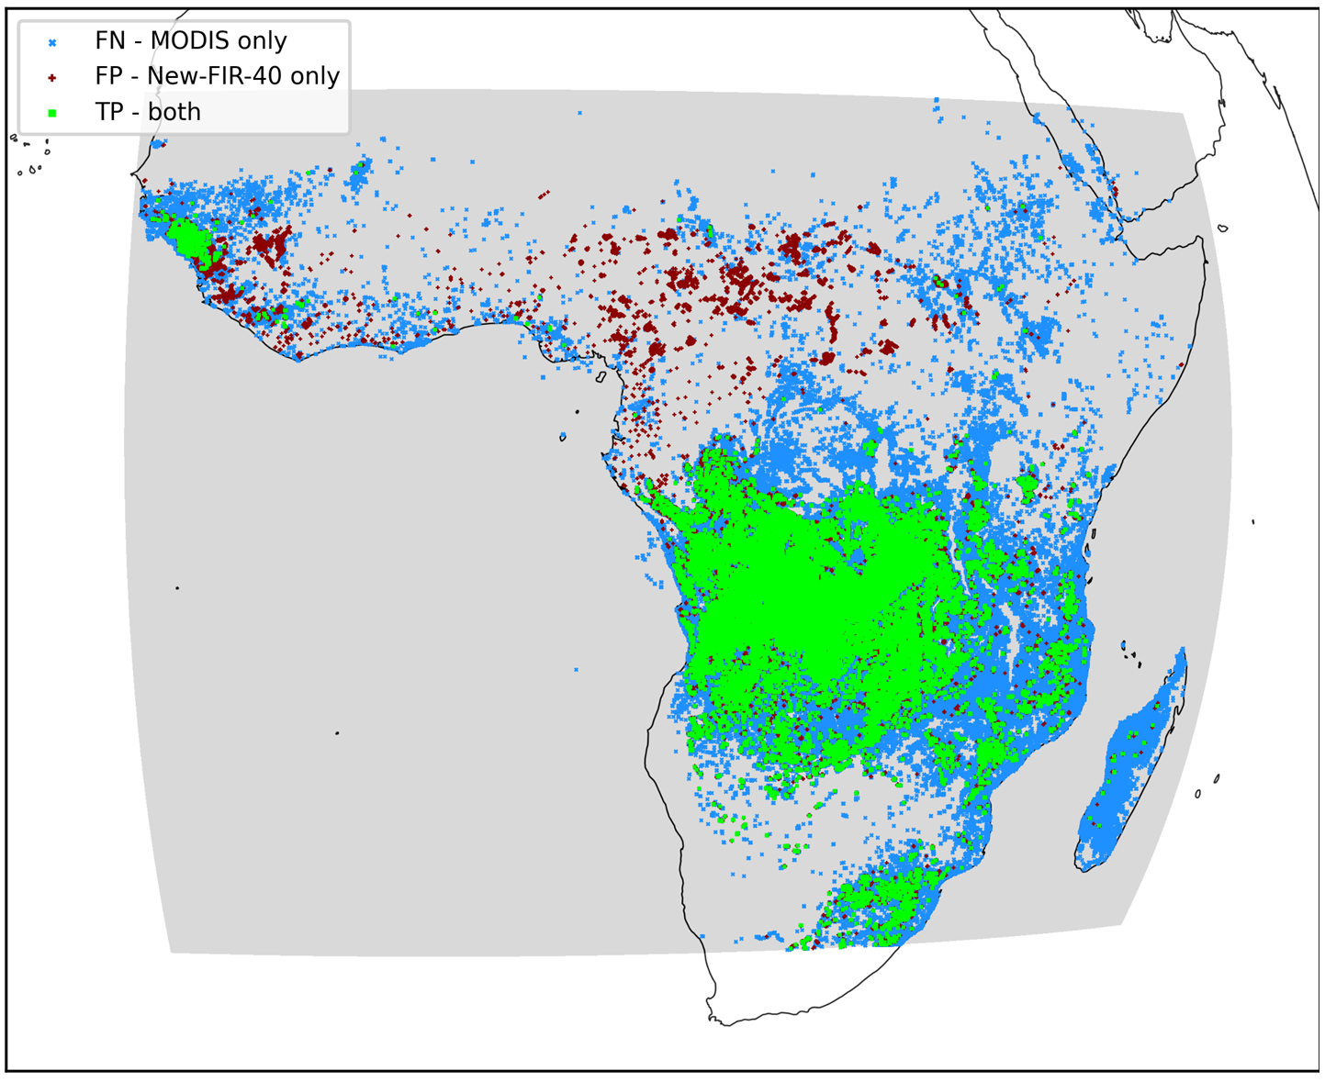
EUMETSAT’s Cal/Val Activities for Fire Products
Cal/Val framework was developed by EUMETSAT for inter-comparison of GEO/LEO fire products
Flexible for usage with different GEO/LEO comparison sources, also on a long-term basis
Used for
Validation campaigns of SEVIRI FIR product against MODIS/VIIRS
Validation of Copernicus Sentinel-3/SLSTR NRT FRP product
Validation and performance evaluation of upcoming MTG-FCI FIR product

Slide 20
Inter-comparison of 5 satellites
January 2020 - Australian Bush fires
PMAp- Metop-A/B/C
SLTR-A/B
AOD @ 550nm

Slide 21
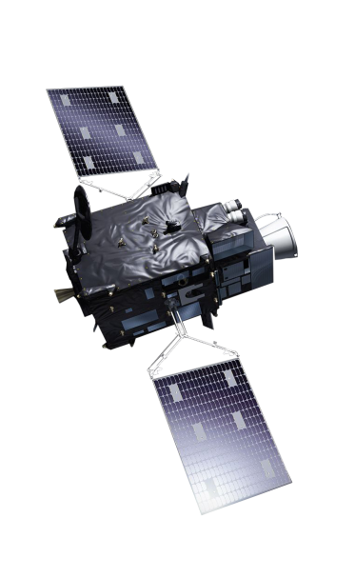
A step in the future satellite (third) generation
Imagery mission implemented by two MTG-I satellites
Full disc imagery every 10 minutes in 16 bands
Fast imagery of Europe every 2.5 minutes
New Lightning Imager (LI)
Start of operations in 2023
Operational exploitation: 2023-2042
Notes:
Imagers – Full disc + lightning

Slide 22
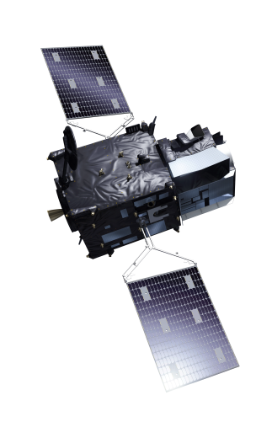
Meteosat Third Generation: Sounding mission (MTG-S)
Hyperspectral infrared sounding mission
3D weather cube: temperature, water vapour, O3, every 30 minutes over Europe
Air quality monitoring and atmospheric chemistry in synergy with Copernicus Sentinel-4 instrument
Start of operations in 2024
Operational exploitation: 2024-2043
Notes:
Sounding infrared hyperspectral

Slide 23
Meteosat Third Generation (MTG): Full operational configuration
Continuity
Innovation
MTG-I
Rapid Scan Service
MTG-S
Sounding Service
MTG-I
Full Scan Service
Notes:
Constellation

Slide 24
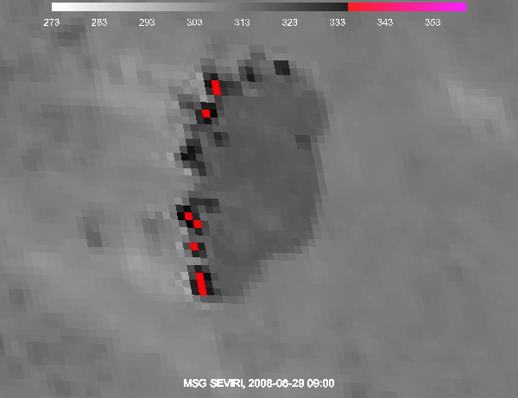
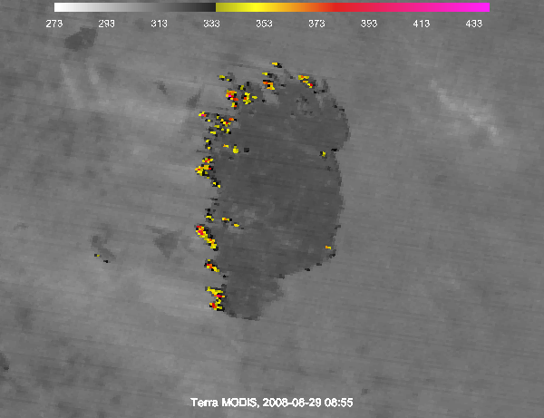
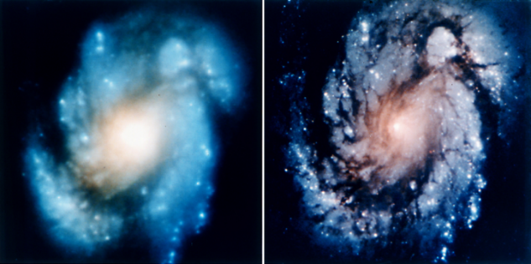
New prospects for fire detection and monitoring
Current
Future
Meteosat (left panel) compared to
future MTG imagery simulated by proxy data (right panel)
Notes:
Right-hand panel: MODIS 3.9 µm channel at 1 km sampling distance simulating FCI imagery, and showing more detailed fire locations and a range of fire brightness temperatures (yellow-orange-red colours); left-hand panel: MSG SEVIRI 3.9 µm channel at 3 km sampling distance, with brightness temperature saturating at 344 K (red pixels); Botswana, 29 August 2008.

Slide 25
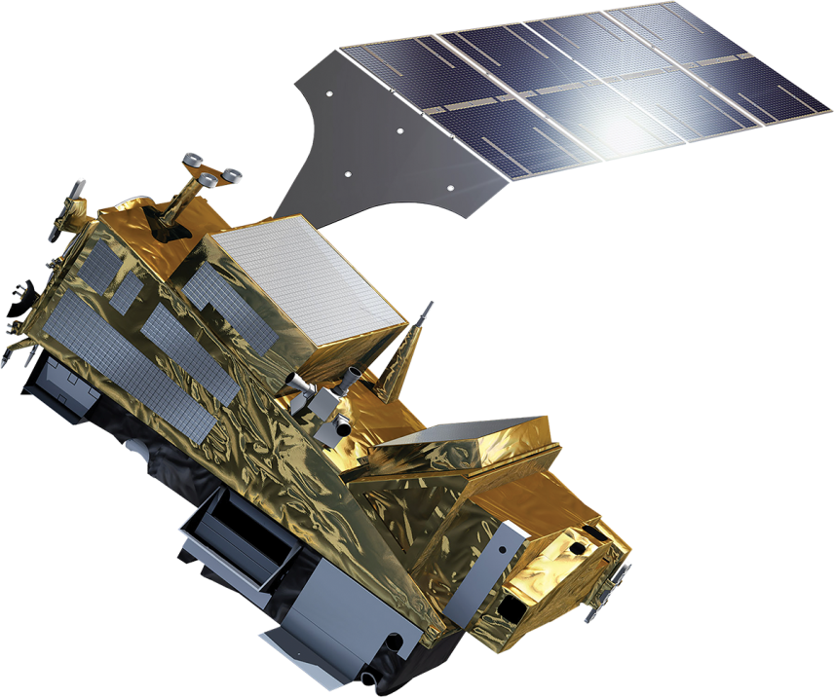
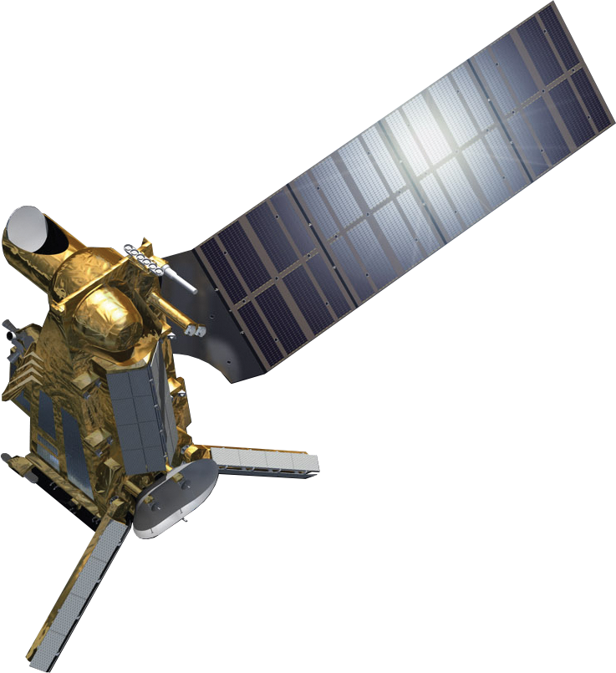
Time for an upgrade in polar orbit too…
Metop
Metop Second Generation
Two types satellite work as pair: imager/sounder & microwave imager

Slide 26
Metop-SG A: sounding and imagery mission
IASI-NG Infrared Atmospheric Sounding
MWS Microwave Sounding
METImage Visible-Infrared Imaging
RO Radio Occultation
3MI Multi-viewing, -channel, -polarisation Imaging – aerosols NEW
Copernicus Sentinel-5 UN/VIS/NIR/SWIR Sounding – air quality
Metop-SG A suite of infrared, microwave & imaging instruments for sounding temperature, moisture and trace gases in the atmosphere.
4
5
2
4
1
6
3
Notes:
Satellite
Planned Launch date
Start of Routine Operations
Details
Metop-SG A1 Q4 2022 Q2 2023 823–848 km, METimage, IASI-NG, MWS, Sentinel-5, 3MI, RO
Metop-SG B1 Q4 2023 Q2 2024 823–848 km, SCA, MWI, ICI, RO, ADCS-4
Metop-SG A2 Q4 2029 823–848 km, METimage, IASI-NG, MWS, Sentinel-5, 3MI, RO
Metop-SG B2 Q4 2030 823–848 km, SCA, MWI, ICI, RO, ADCS-4
Metop-SG A3 Q4 2036 823–848 km, METimage, IASI-NG, MWS, Sentinel-5, 3MI, RO
Metop-SG B3 Q4 2037 817 km, SCA, MWI, ICI, RO, ADCS-4
(Status: May 2019)

Slide 27
Metop-SG B - microwave imagery mission
SCA Scatterometer
RO Radio Occultation
MWI Microwave Imaging for Precipitation NEW
ICI Ice Cloud Imager NEW
ARGOS-4 Advanced Data Collection System
Metop-SG B - radar observations of ocean-surface wind and soil moisture & all-weather microwave imagery of precipitation and ice clouds
3
2
5
4
1
1
2
1

Slide 28
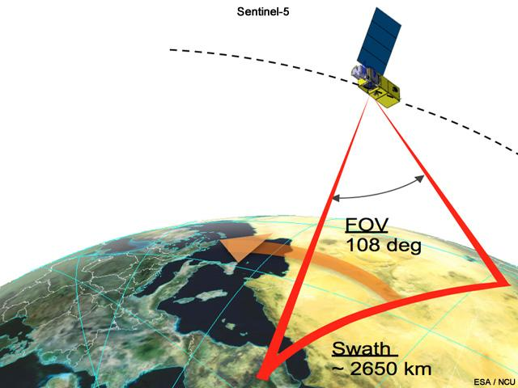
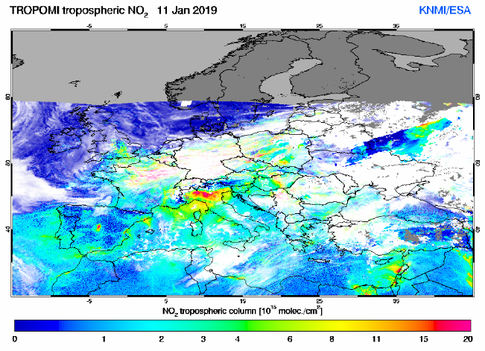
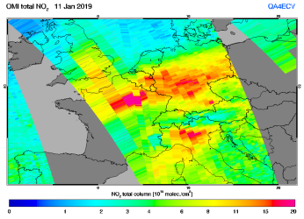
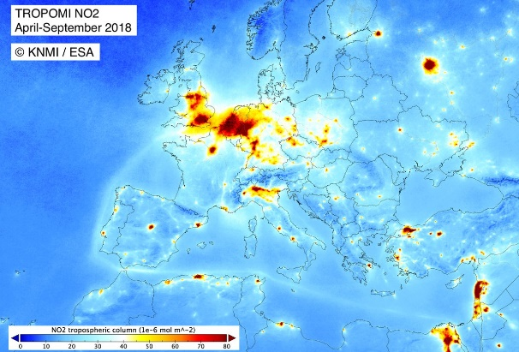
Metop EPS-SG – Sentinel 5
Operational : 2023-2035
Radio Occultation
RO
3MI
Multi-viewing,
-channel,
-polarisation Imager
MWS Microwave Sounder
Sentinel-5 UV-VIS-NIR-SWIR Sounder
Synergy with the instruments on the EUMETSAT Polar Satellites
METimage Visible-Infrared Imager
IASI-NG Infrared Atmospheric Sounding Interferometer – New Generation
Notes:
Clearly mention the

Slide 29
EUMETSAT for Users
Preparation projects for EUMETSAT programmes
Science support
User information and communication
Test data and format support
Data access support
Develop competences and foster applications
Training in many forms (also on-line)
Explore advanced applications
Engage experts - Workshop, Consultation
Communicate - Podcast, MOOCs

Slide 30
Specific programs: User Preparation for Meteosat Third Generation
All Member States and ECMWF share information and experience within the MTG User Preparation Project (MTGUP), facilitated by the EUMETSAT Secretariat.
Objective: To support Member States in:
Achieving a smooth transition to MTG for all services comparable to MSG
Exploiting the innovation potential in MTG data for improved or new applications
The project has 5 Core Themes:
Science support
User information and communication
Test data and format support
User training
Data access support
Project duration: 2017-2026
Synergy with EPS-SG User Preparation, User Engagement for Atmospheric Composition Applications, SAF Preparation for MTG
MTG and EPS-SG User Days 2019
First MTG Applications Training Workshop 2019

Slide 31
How to reach us …
Twitter: @eumetsat
Training calendar & activities
http://training.eumetsat.int
mailto: copernicus.training@eumetsat.int
Copernicus MOOCs
www.atmospheremooc.org
www.oceansfromspace.org
Science stories: https://scienceblog.eumetsat.int/
The EUMETSAT Satellite application facilities
www.acsaf.org
www.lsasaf.org
We want to hear from you!

