Slide 1
Introduction to ERDDAP
NOAA CoastWatch Satellite Course
Last Updated: 9/9/2020
Notes:
Welcome to Introduction to ERDDAP, part of of an online course on oceanographic satellite data products, produced by NOAA’s CoastWatch Program. My name is Cara Wilson, and I’m the node manager of the West Coast Node of NOAA’s CoastWatch Program.

Slide 2
ERDDAP¹ – designed to make data access easier
ERDDAP provides a simple, consistent way to:
Subset datasets temporally and spatially
Download data in > 30 formats
Access data within analysis tools (R, Matlab, python…) using urls which completely define the data request
Machine-to-machine data exchange
Data Aggregation
Data Distribution
ERDDAP provides a simple, consistent way to:
Subset datasets temporally and spatially
Download data in > 30 formats
Data requests defined within URLs, allowing:
Access data within analysis tools (R, Matlab, python)
Machine-to-machine data exchange
Local Storage
Internal Servers
Automated Scripts
Database
Web-Based
Applications
RAID
ERDDAP
Download
By Hand
Remote Servers
NSIDC
NCEI
Software
Applications
Over 85 ERDDAPs exist in 14 countries
Over a dozen different ERDDAPs in NOAA
ERDDAP is one of the recommended data servers in NOAA's Data Access Procedural Directive
Search for data across multiple ERDDAPs at erddap.com
JPL PO.DAAC
NESDIS STAR
¹ERDDAP was developed at SWFSC/ERD by Bob Simons
Notes:
ERDDAP is designed to make data access easier. There are a lot of different data sources out there, which gives rise to a plethora of different file formats and different methods for accessing and downloading data. Each institution that distributes data tends to favor a specific service and procedure, so if you need data from several sources, it can be a real headache to familiarize yourself will all of them, and then to figure out how to convert the data into a format you can use. ERDDAP works as a middleman, pulling data from a variety of different sources, and then distributing data in a wide variety of formats, as both data and graphs.
You now don’t have to learn how to use new protocols and formats, all you have to do is go to an ERDDAP webpage, select data you are interested in, and download it in your preferred format. ERDDAP is a RESTful service, which means that the entire data request is defined by a URL, which allows you to interact with ERDDAP from within your preferred software without having to go to the website. This is especially useful if you need to routinely download data and don’t want to make many different requests manually.

Slide 3
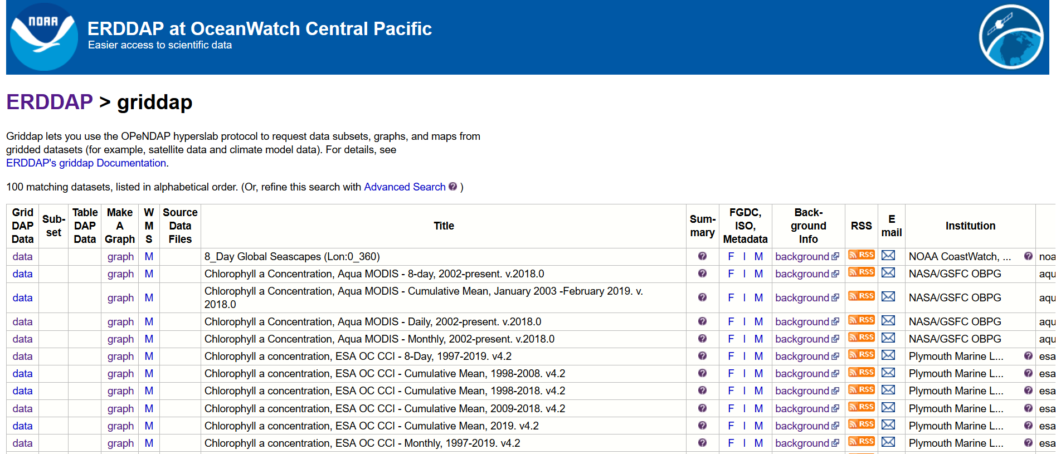
The web interface for the ERDDAP data catalog
Notes:
Here is what a typical ERDDAP webpage looks like. Basically just a list of dataset names, with options to make a graph or to download data, by clicking on the data or graph links to the left of the dataset name. One can also see all the metadata associated with a dataset by clicking on the M to the right of the dataset title. We realize that this interface is not very exciting, and doesn’t exactly draw new users in. However once people understand the capabilities of ERDDAP they generally get pretty hooked on it.

Slide 4
ERDDAP data requests are defined within a URL
Deconstruct the following data request
https://oceanwatch.pifsc.noaa.gov/erddap/griddap/noaa_snpp_chla_monthly.png? chlor_a[(2018-06-02T12:00:00Z)][(23):(18)][(200):(208)]
Base ERDDAP URL: https://oceanwatch.pifsc.noaa.gov/erddap/griddap/ → change to access another ERDDAP
Dataset ID: noaa_snpp_chla_monthly → change to noaa_snpp_chla_weekly for weekly data.
File type: .png → Create a png file of the image
Changing .png to .graph → Access form to modify the graph
Changing .png to .csv → Download a CSV file to your computer
Changing .png to .html → Access form to download the data
Variable name: chlor_a → Change the variable name for dataset containing more than on variable
Time: [(2018-06-02T12:00:00Z)] → Change to [(last)] to access the most recent data
Latitude range: [(23):(18)] → Specify the latitude bounds
Longitude range: [(200):(208)] → Specify the longitude bounds
Notes:
4
The power of ERDDAP lies in its URL. Each data request is entirely described by the request URL, and is easy to customize to change or automate the request. There are several parts to the URL. First is the base URL, shown here in blue text, which is basically the address for the specific ERDDAP server you are downloading data from. Next, here in purple text, is the dataset ID of the selected dataset. The file type is shown in red, and allows you to visualize or download the data in many different formats. In green is the name of the variable within that dataset that you are interested in. Finally you can customize the time period and the geographical region for which you want data, shown here as the brown and aqua text. Being able to subset is useful if you only want to analyze data for a small region without downloading the global data. If the date is changed to the word last, entered in parenthesis, then the most recent data or image will be returned, which is a useful feature for displaying current satellite images on a webpage.
So putting it all together, what will the URL shown here produce? Given that the variable name is chl, we can assume it will get us chlorophyll data, the file type is a png, so it will create an image, and from the latitude and longitude ranges selected it should be for an area around Hawaii. You can copy the url into a browser to see, but I’ll show it to you on the next slide.

Slide 5
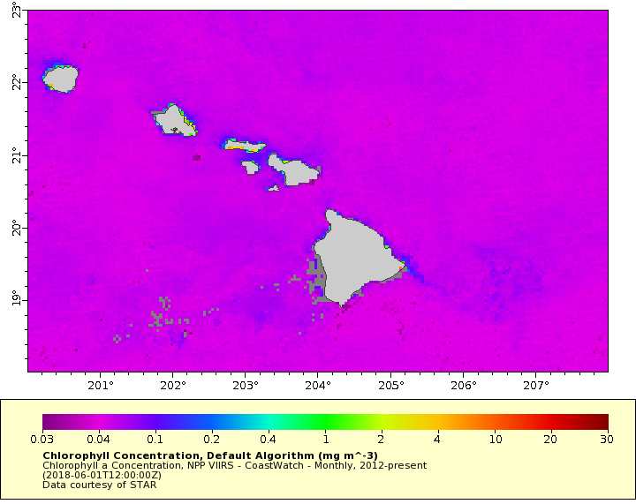
Image produced by the URL
Notes:
5
Well as I surmised, that is a map of chl around Hawaii. But wow, that’s pretty garish looking! There is a little hint of a phytoplankton bloom east of the Big Island. However, it would be easier to see by modifying the graph, which is also possible with ERDDAP. So next we will look at a few examples of how to do that.

Slide 6
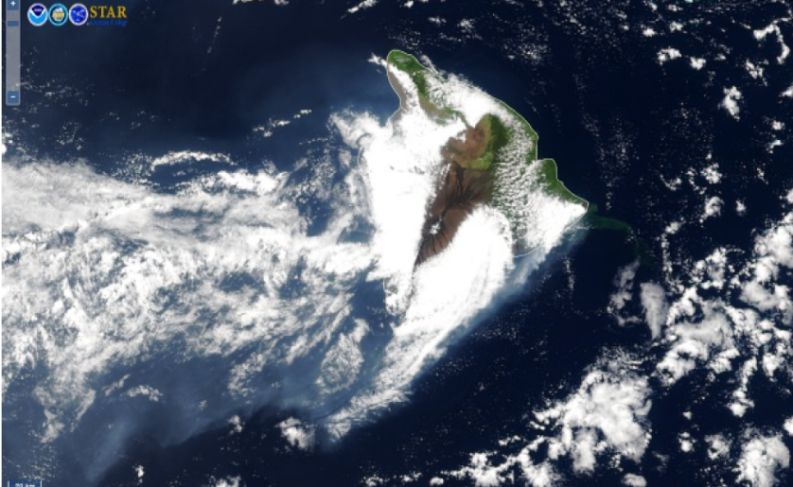
Visualization examples using ERDDAP
Kilauea algae bloom
Hurricane Katrina
1998 El Niño
Notes:
6
We will look at some examples of the visualization capabilities of the ERDDAP webpage using three events – that bloom I just mentioned off of Hawaii, Hurricane Katrina and the 1998 El Nino.
First we are going to take a closer look at that phytoplankton bloom in 2018, which was slightly evident in that image shown on the previous slide.

Slide 7
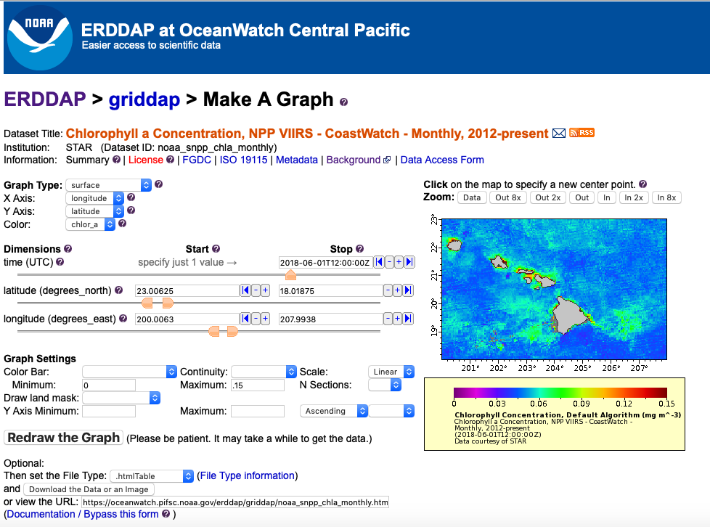
Example #1 - Visualize the Kilauea algae bloom
https://oceanwatch.pifsc.noaa.gov/erddap/griddap/noaa_snpp_chla_monthly.graph?chlor_a[(2018-06-01T12:00:00Z)][(23.00625):(18.01875)][(200.0063):(207.9938)]&.draw=surface&.vars=longitude%7Clatitude%7Cchlor_a&.colorBar=%7C%7CLinear%7C0%7C.15%7C&.bgColor=0xffffffff
Notes:
Changing the “.png” in the URL shown earlier to “.graph” brings up a page where parameters of the graph can be modified. I’ve changed the scale from logarithmic, which is the default for chlorophyll data, to linear, and reduced the color bar maximum from 30 to 0.15 and now that feature is much more obvious. By copying the URL in your browser, you can now share this page, and all the parameters you have set will be preserved. I’ve copied the url here at the bottom of the page which shows additional information has now been added about the graphing parameters.

Slide 8
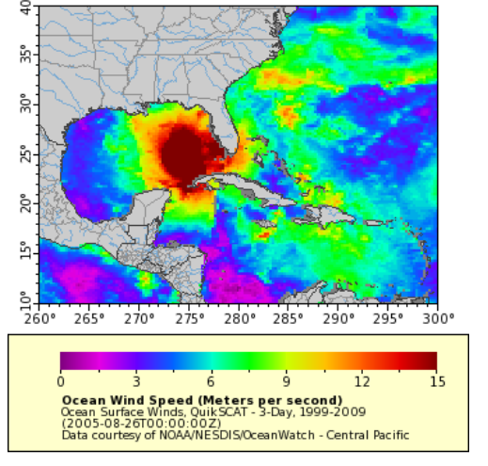
Example #2 - Visualize wind speeds produced by Hurricane Katrina
https://oceanwatch.pifsc.noaa.gov/erddap/griddap/OceanWatch_qscat_wind_3day.graph?spd[(2005-08-26T00:00:00Z)][(10):(40)][(260):(300)]
Notes:
Next, let’s take a look at Hurricane Katrina using QuikSCAT ocean winds data.
Using the URL from this slide, you can plot the wind speed on Aug. 26, 2005, and observe the strength of the winds on that day.

Slide 9
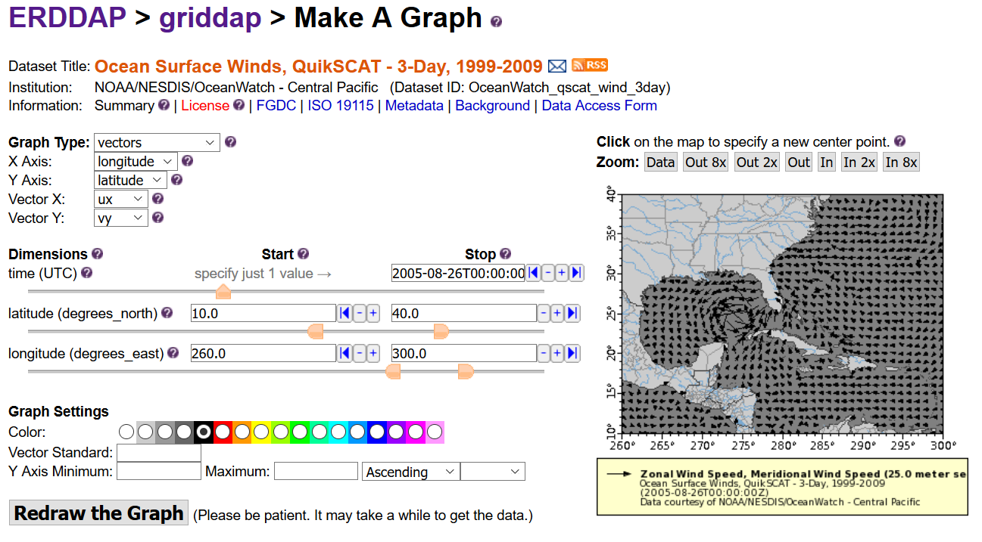
Visualize wind speed and direction produced by Hurricane Katrina
Notes:
You can also visualize the wind direction by changing the Graph Type and selecting vectors instead of surface. Then setting the variables for vector x and y to be the ux and uy variables, which are the zonal and meridional wind speeds.

Slide 10
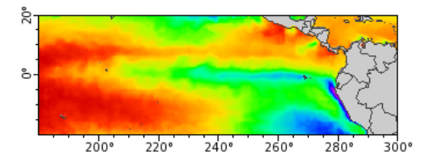
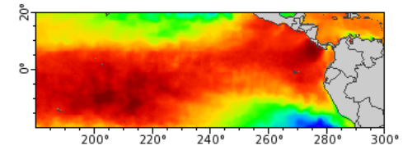
Example #3: Visualize the 1998 El Niño
January 1997
https://oceanwatch.pifsc.noaa.gov/erddap/griddap/CRW_sst_v1_0_monthly.graph?analysed_sst%5B(1997-01-07T12:00:00Z)%5D%5B(-19.975):(20.025)%5D%5B(180.025):(300.025)%5D&.draw=surface&.vars=longitude%7Clatitude%7Canalysed_sst&.colorBar=%7C%7C%7C18%7C30%7C
January 1998
https://oceanwatch.pifsc.noaa.gov/erddap/griddap/CRW_sst_v1_0_monthly.graph?analysed_sst%5B(1998-01-07T12:00:00Z)%5D%5B(-19.975):(20.025)%5D%5B(180.025):(300.025)%5D&.draw=surface&.vars=longitude%7Clatitude%7Canalysed_sst&.colorBar=%7C%7C%7C18%7C30%7C
Notes:
Here we are visualizing the 1998 El Niño using the monthly CoralTemp SST dataset to look at water temperature in the equatorial Pacific region in January 1997 and January 1998.
Notice the drastic difference in the temperature pattern.

Slide 11
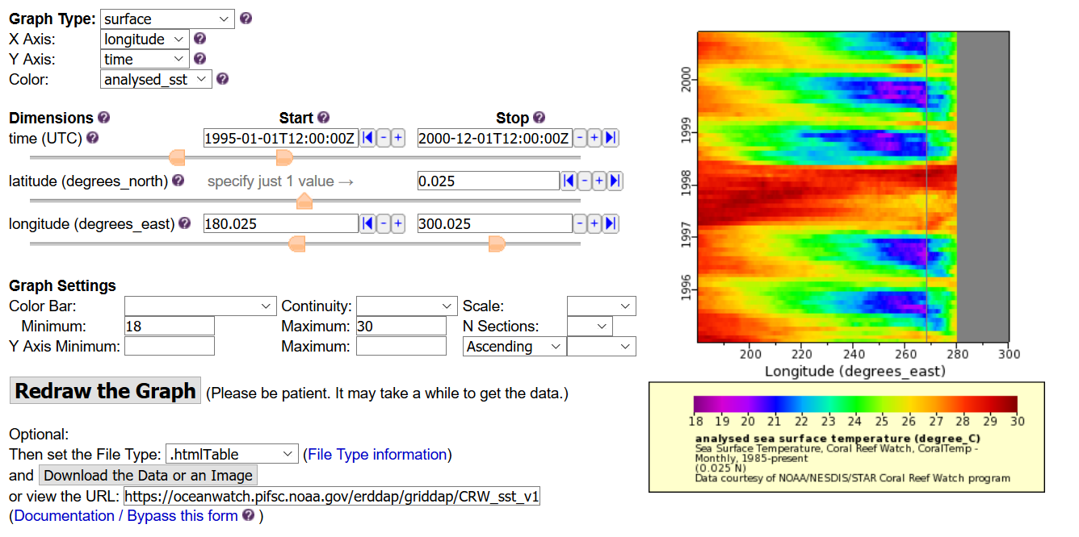
Create a Hovmöller 2-dimensional timeseries plot of the1998 El Niño
https://oceanwatch.pifsc.noaa.gov/erddap/griddap/CRW_sst_v1_0_monthly.graph?analysed_sst[(1995-01-01T12:00:00Z):(2000-12-01T12:00:00Z)][(0)][(180.025):(300.025)]&.draw=surface&.vars=longitude%7Ctime%7Canalysed_sst&.colorBar=%7C%7C%7C18%7C30%7C&.bgColor=0xffffffff
Notes:
A common way to compare years across regions is to use Hovmöller plots, where one axis is time, and the other is either latitude or longitude. In this case, we set latitude at 0º, and set longitude to a range of values across the Pacific, the same as in the previous graphs. The Y-axis is time, from Jan. 1995 to December 2000. You can clearly see that 1997-1998 was an exceptional year with much higher temperatures than usual due to El Niño.

Slide 12
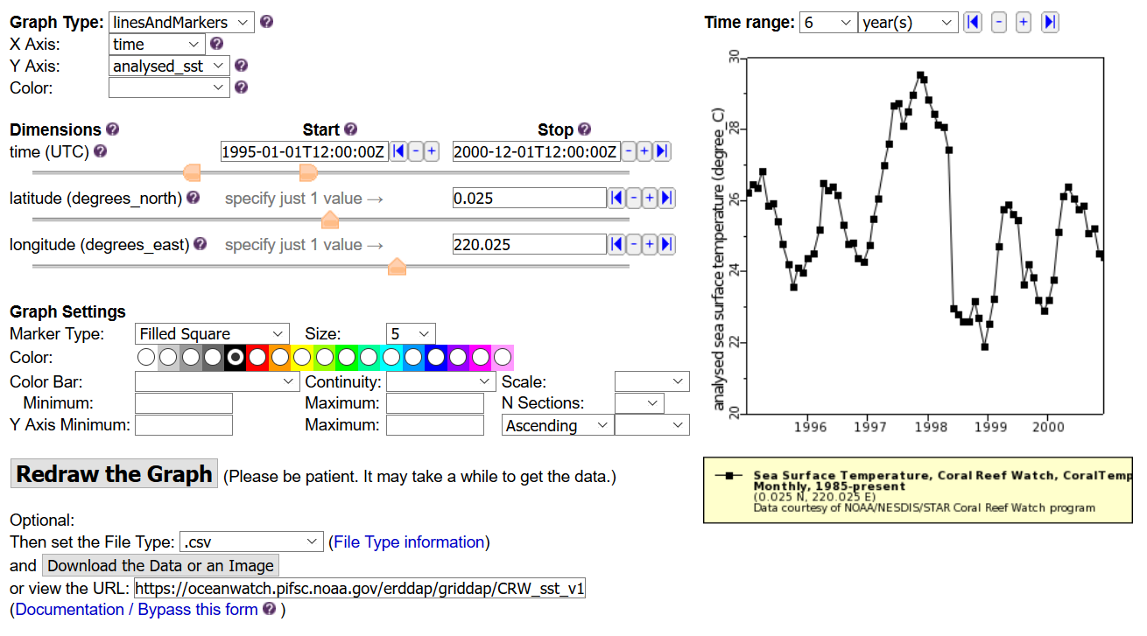
Create a 1-dimensional timeseries of the 1998 El Niño
https://oceanwatch.pifsc.noaa.gov/erddap/griddap/CRW_sst_v1_0_monthly.graph?analysed_sst[(1995-01-01T12:00:00Z):(2000-12-01T12:00:00Z)][(0.025)][(220)]&.draw=linesAndMarkers&.vars=time|analysed_sst
Notes:
You can also visualize the same phenomenon using time-series by changing the graph type to “linesAndMarkers”. You can then look at SST over a time period for a specific location. In this example we set the latitude to 0º and the longitude to 220ºE and are looking at SST at that location from January 1995 to December 2000. You can again observe that SST was much higher than normal in the winter 1997-1998.
You can also download the time-series data by setting the file type to .csv and clicking on the Download button.

Slide 13
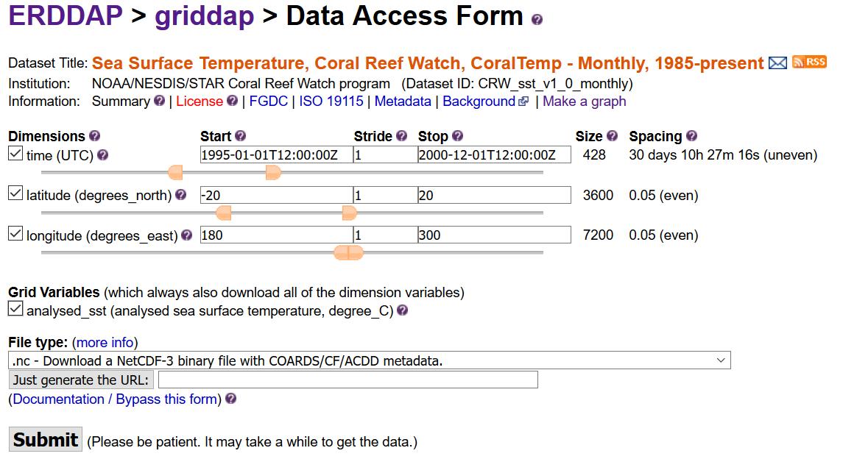
Download the data as a netCDF file
https://oceanwatch.pifsc.noaa.gov/erddap/griddap/CRW_sst_v1_0_monthly.html
Notes:
By changing the extension of the URL to html, or clicking the Data Access Form link under the Dataset Title, you can easily download data for a range of dates, latitudes, longitudes, in your preferred format, here set to NetCDF. This will download the file on your computer, and you can then work with it using your preferred software.

Slide 14
ERDDAP and R tutorials
Available at: https://coastwatch.gitbook.io/satellite-course/tutorials
ERDDAP tutorial: how to graph and download data from ERDDAP https://coastwatch.gitbook.io/satellite-course/tutorials/erddap-tutorial
R/Python tutorials:
Grab data on ERDDAP directly from R and make plots
Learn about the rerddap package
Extract data within a shapefile using ERDDAP and the rerddapXtracto package
Extract data along an animal track
https://coastwatch.gitbook.io/satellite-course/tutorials/r-tutorial
https://coastwatch.gitbook.io/satellite-course/tutorials/python-tutorial
Notes:
14
This was a very brief overview of the capabilities of ERDDAP and its interface. This tutorial is available on the CoastWatch gitbook page, as well as other tutorials that will show you how to work with ERDDAP data directly from within R or Python.

Slide 15
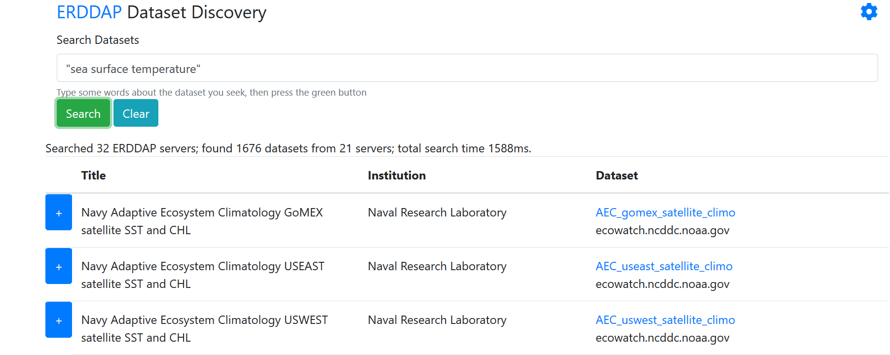
Search multiple ERDDAP servers for datasets
You can use this search engine if you don’t know which ERDDAP server hosts the data you want
http://erddap.com/
Notes:
15
Many institutions across the world have now installed ERDDAP and use it to distribute their data. If you are unsure of where the data you want is available from, there is even a search engine, erddap.com, that allows you to browse a number of available ERDDAP servers to locate your specific dataset of interest.

Slide 16
NOAA CoastWatch Satellite Course - Narrated Presentations
Satellite 101 – Part 1
Satellite 101 – Part 2
Fundamentals of Ocean Color
Fundamentals of Sea-Surface Temperature
Fundamentals of Altimetry, Wind and Salinity
Introduction to ERDDAP
What Dataset to Choose?
Bringing Satellite Data into ARCGIS
Notes:
This concludes the Introduction to ERDDAP. This is one of several presentations put together as part of the CoastWatch Ocean Satellite Course.

