Slide 1
Using Satellite Data in GIS
NOAA Coastwatch Satellite Course
Versioning:
2020, Soracco
2019, Soracco
coastwatch.info@noaa.gov
Notes:
Hello, welcome to the NOAA CoastWatch training on Using Satellite Data in GIS.

Slide 2
This Training
Component of the NOAA CoastWatch Satellite Training Course
Comprised of 3 modules: Data, Tools, Exercise(s)
Uses ESRI ArcMap v 10.7, but techniques work with QGIS and other GIS software
Updated from CoastWatch Satellite GIS training originally given in 2000 for avenue-based ArcView 3.1
Notes:
This training is one part of several tutorials within the NOAA CoastWatch Satellite Training Course. The GIS tutorials consist of 3 modules and although the screenshots and examples use ArcGIS, the principles apply to any GIS software.

Slide 3
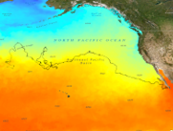
Using Satellite Data in GIS: An Exercise
Michael Soracco
NOAA Affiliate for NOAA CoastWatch
College Park, MD
https://coastwatch.noaa.gov
coastwatch.info@noaa.gov
Versioning:
2020, Soracco, ArcMap 10.7
Notes:
Ok, let's get started. In this module, we will satellite data into the GIS and extract data using a point feature layer.

Slide 4
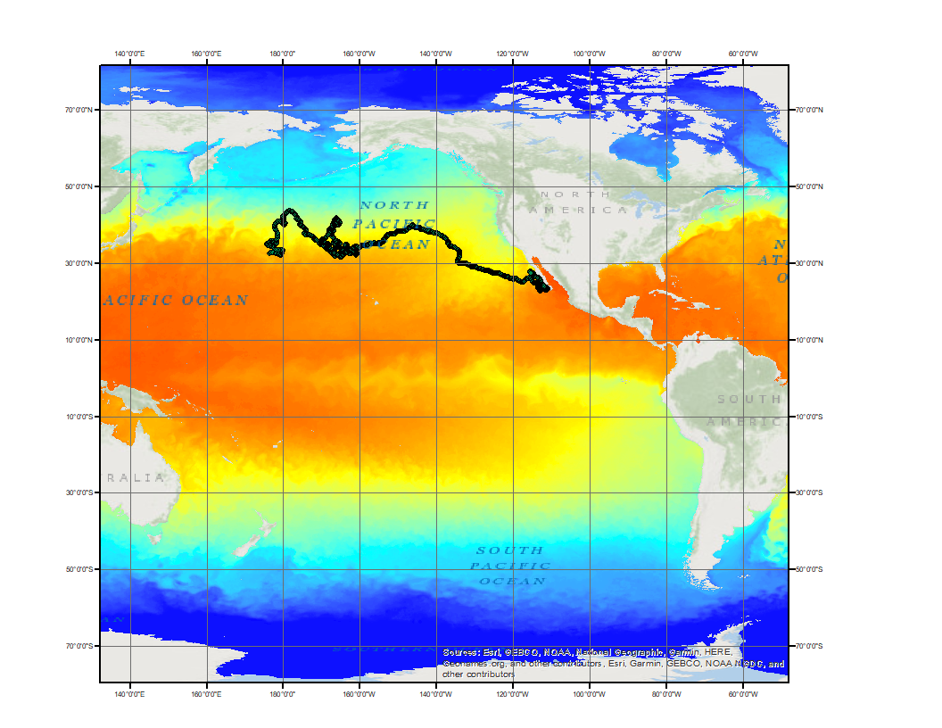
Exercise Background
Patterned after Python Exercise: “Extract data along turtle track” --https://coastwatch.gitbook.io/satellite-course/tutorials/python-tutorial/4.-extract-data-along-a-turtle-track
Uses import of NetCDF, CSV
Builds upon “ArcGIS Tutorial” and TurtleWatch Zone -- https://coastwatch.gitbook.io/satellite-course/tutorials/arcgis-tutorial
Identifies 0 to 360 and
-180 to 180 longitude issues
Multi-year turtle track atop single SST image
Notes:
Some background on this exercise. It's patterned after the "Extract data along turtle track" Python exercise in the CoastWatch Central Pacific training course. It will both import of CSV and NetCDF data, build upon the ArcGIS TurtleWatch example, and identify some issues one may encounter when working with data in GIS -- such as using longitudes 0-360 as compared to -180 to 180.

Slide 5
ArcGIS: Extract data along a turtle track
Scenario: A juvenile loggerhead sea turtle (ARGOS ID 25317) provided positional data over a period of three years (1232 days).
Research Question: For 2016, does this sea turtles’ behavior correspond to oceanographic surface parameters such as sea surface temperature? What range of temperatures are experienced? Does the turtle spend time within the TurtleWatch Area (17.5° to 18.5°C)?
Known information:
  Date range: May 2005 – 2008 (1232 days)
  Distance travelled: 19,491 km
  Tracking Duty Cycle:
    6 hours on , 48 hours off
Notes:
We're given a scenario of a loggerhead sea turtle that was released in the open ocean and tracked for 1,232 days. Our question is does this turtle's behaviour correspond to oceanographic surface parameters such as sea surface temperature? What is the range of temperature experienced? And out of curiosity, does the turtle spend any time within the TurtleWatch Zone (17.5-18.5 degrees C).

Slide 6
Strategy
There are often several pathways to achieve the same results using GIS.
Turtle track and Ocean parameters
0 to 360°
Convert longitude?
Format
-180° to 180°
Format,
Projection
Define Problem
Obtain Data
Prepare Data
Load Data
Spatial Analysis
Output
Import method
Color bar
Data selection
Feature/raster
Graphing
Map
Data
Time Slider
Enable time
Sampling
Extraction
Add XY Data/Feature Class
OpenDAP, ERDDAP, THREDDS, EDC
GIS
Notes:
As with many problems, there may be more than one technical solution. Our solution method will require some spatial analysis using X,Y,T point locations and satellite data. A strategy to work on answering the questions involves looking at the input dataset (turtle locations) and metadata, identifying a suitable satellite ocean remote sensing product to provide SST, and a plan for performing the analyses. Note, in the diagram not all of the steps are within the GIS.

Slide 7
Strategy
Perform matchup of turtle locations with parameters
  Import Turtle CSV:
    https://oceanwatch.pifsc.noaa.gov/files/25317_05.dat
  Convert to Feature Layer / Shapefile
Obtain SST satellite data for geographic coverage and period of study
Outputs:
Overview map – example day of parameter and turtle tracks
Map output showing turtle locations and parameter values
Graph of parameter value for each turtle location vs Time
Export Movie showing Turtle, Parameter, TurtleWatch Zone
Notes:
Some data preparation may be necessary external to the application. Our answers to these questions will be in the form of the following outputs: Overview map – example day of parameter and turtle tracks, Map output showing turtle locations and parameter values, Graph of parameter value for each turtle location vs Time, and a movie showing the turtle's daily locations, SST map, and the TurtleWatch Zone

Slide 8
Output 1: Overview Map
Allows a quick look at the data types and extents we’ll be working with
For the Overview Map, only the turtle track CSV file is required.
Displaying a parameter (i.e. SST) is optional, but the map should be labeled that the SST data is from a single day.
Use 0->360 data for this Overview Map
As a general rule-of-thumb, load raster data first as ArcMap will use the coordinate system of the raster data
Notes:
The Overview map is just that, a quick way to assess the suitability of the data and if there are issues that will need to be addressed before, during, or after bringing the data into the GIS. Technically, only the turtle track is required to display the extent, but since this is about getting satellite data into the GIS, we'll go ahead and use one of the methods from this training series. Because we're working in the Pacific, let's use satellite data with 0 to 360 longitude, as that is more 'ocean' friendly over the antimeridian.

Slide 9
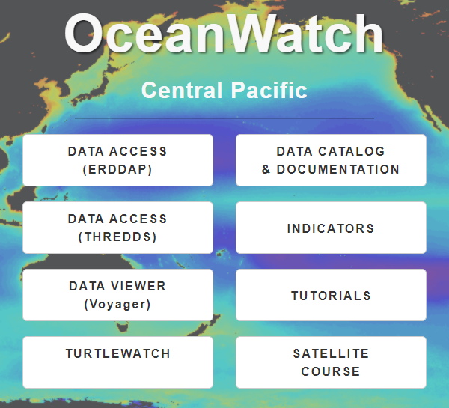
Output 1: Overview Map
Obtain SST data from https://oceanwatch.pifsc.noaa.gov/
  in 0-360
  a SINGLE date between the start/end of the turtle track – i.e. October 10, 2006
  ERDDAP Link to the dataset
Hint: Enter “sst blended daily” in the ERDDAP search box; Click ‘data’ for Sea Surface Temperature, NOAA geopolar blended - Daily, 2002-Present (2017 Reanalysis)
A sample dataset is included as ‘goes-poes-1d-ghrsst-RAN_SingleDayGlobal.nc’ in the Data Package at the end of this slide deck.
Notes:
Fortunately, SST data mapped 0 to 360 are available on the OceanWatch Central Pacific website. Visit the ERDDAP at the website and find Daily SST or click the Link in the Powerpoint slide.

Slide 10
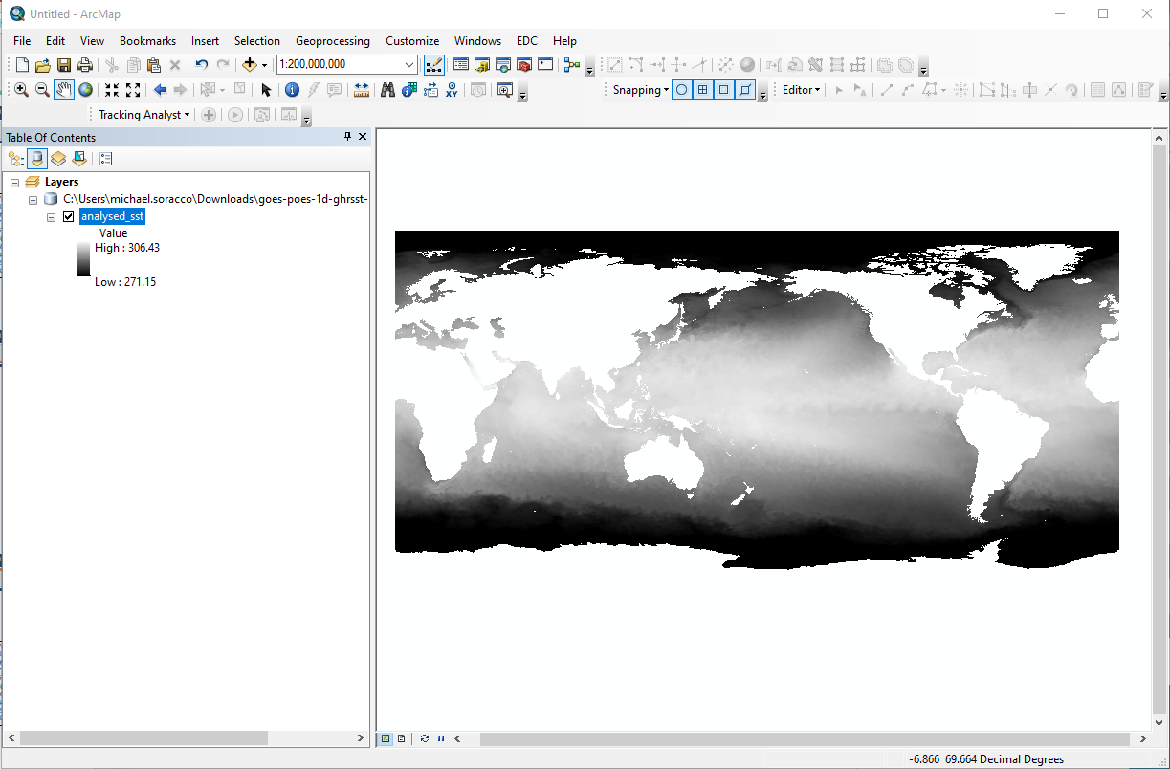
Output 1: Overview Map
Open ArcMap to Blank Map
Drag-and-Drop the NetCDF file onto the View
SST data is 0-360
Notes:
Now that we have satellite SST for a given day, let's retrieve the turtle track data. Although the file has a .dat extension, we find it's just a text file with comma-delimited fields. Save or change the name to reflect a file with csv extension.

Slide 11
Output 1: Overview Map
Obtain Turtle Track
  Data Link
  Save As: 25317_05.dat.csv
"mean_lon","mean_lat","year","month","day" 176.619432886108,32.6787283689241,2005,5,4 176.783786497336,32.755450905856,2005,5,5 177.086094792196,32.8703371644739,2005,5,6 177.523857440759,32.8593957701299,2005,5,7 178.058144591188,32.6740108044364,2005,5,8 178.477225321586,32.4596669014395,2005,5,9 178.739279086398,32.3402034409515,2005,5,10 178.959668448728,32.2630123770382,2005,5,11 179.19299156409,32.1452863228285,2005,5,12
This dataset is included as ‘25317_05.dat.csv’ in the Data Package at the end of this slide deck.
Notes:
We have our two datasets. Open ArcMap and select a blank map. Load the raster first by dragging the file onto the map. It should display in its entirety with the Pacific Ocean centered in the map.

Slide 12
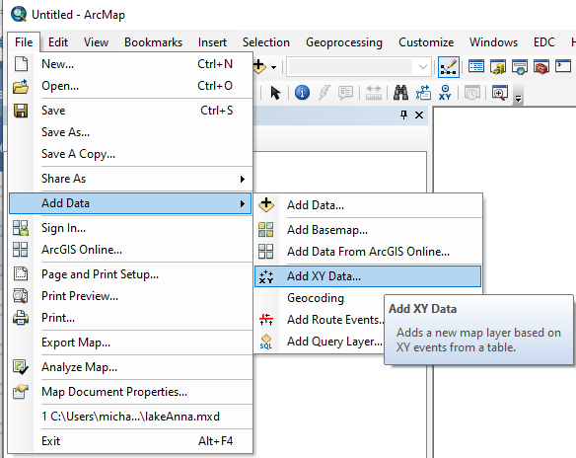
Output 1: Overview Map
Add XY Data to import Turtle Track using one of these methods
  Add Data icon, locate CSV, click Add, then right-mouse Display X-Y
  File->Add Data->Add X-Y Data, locate CSV
  Catalog->locate CSV,right-mouse->Create Feature Class->From X-Y Table
Set the X and Y Fields
  X: mean_lon
  Y: mean_lat
Notes:
For the turtle data, there are multiple ways to bring in CSV files. Use one of these methods and set the X and Y to mean_lon and mean_lat.

Slide 13
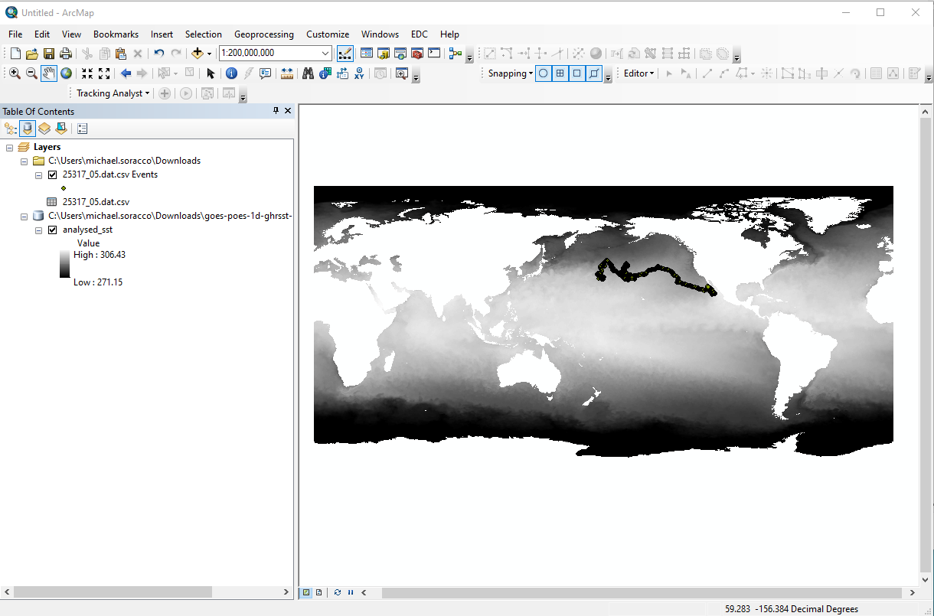
Output 1: Overview Map
Layers:
  Turtle Points
  Sea Surface Temperature (K)
Notes:
Both datasets should now be visible and we're ready to tailor the map as our first output for this exercise.

Slide 14
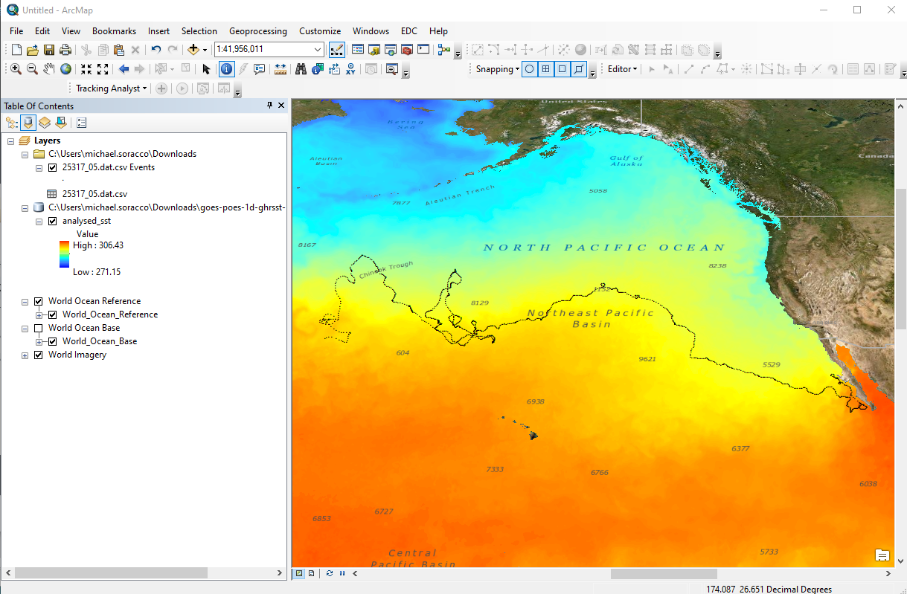
Output 1: Overview Map
Tailor the Map
Options:
  Title
  Color symbology to SST
  Turtle track icon/color
  Basemap / Labels
  Map properties (Legend, scale, North arrow, graticules)
Notes:
Tailoring can include using ArcGIS Basemaps or Reference layers, color symbology, and more. Work with the Data View or Layout View to create your final Overview Map.

Slide 15
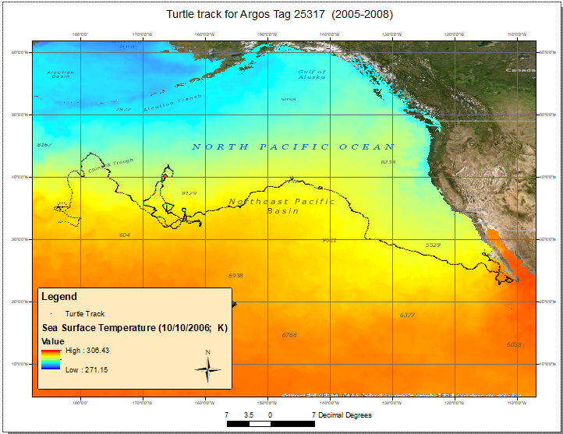
Output 1: Overview Map
Label the Layout View
Save the map as an image file
We now have an overview of the 3+ year Turtle track
Significant time in 160W-170W, 30-40N
Notes:
Once you have the map to your liking, save the map as an image file. In looking at the map most of the turtle's movement is West to East. Nearly 80% of the track is within 30-40 degrees N, and there is an area where the turtle spent a significant amount of time denoted by the red box. This is the feature we'll investigate further.

Slide 16
Overview Map -- Observations
Both data layers are displayed across the Dateline
Loading X-Y Data created a table for display (not queryable/selectable depending on the method used)
Drag-and-drop worked well for the single NetCDF image and subsequent data matched the coordinate system of the raster layer.
Given the extent of the track spatially and temporally, that could result in a lot of data…
Notes:
Some additional observations include data are displayed from 0 to 360. Dragging-and-dropping the NetCDF sea surface temperature data onto the map worked well. The SST data are in Kelvin, so if we desire another unit we would need to perform a conversion. And given the extent of data spanning 1200 plus days, that could be a lot of raster data if we were to work with the full extent of the track data.

Slide 17
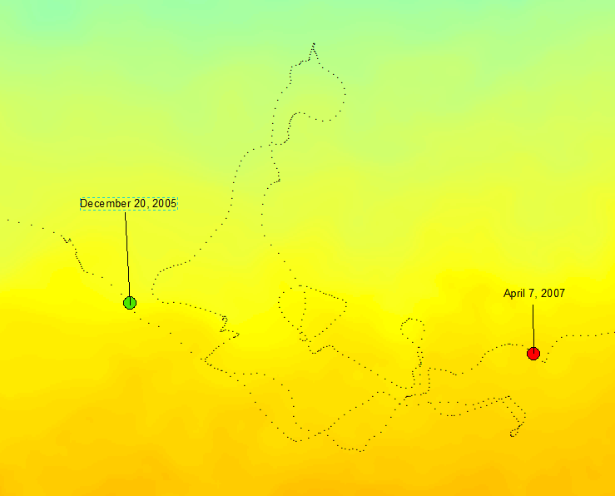
Strategy Adjustments
Reduce study area to:
  Feature of interest
  ~15 months or (37% of total track time)
  December 20, 2005 to April 7, 2007
  Geographic area
    Lat: 31-42 deg N
    Long360: 189 to 200 deg
    Long180: -171 to -160 deg
Work in -180 to 180
Notes:
Adjusting our strategy to focus on the feature of interest, we can re-define the geographic and temporal extents. Also, since the area-of-interest does not cross the antimeridian, we can work in Geographic (180W to 180E).

Slide 18
Data Preparation -- Turtle Data
Turtle CSV: https://oceanwatch.pifsc.noaa.gov/files/25317_05.dat
No metadata
One X-Y pair per day
Satellite tracking so we’ll assume WGS84 Ellipsoid / Datum
Notes:
When looking at the turtle track data-- we can open the file in a text editor or spreadsheet -- we find there is no metadata, each row or record has one X-Y pair per day, and the date is spread across three columns. We were told the data was from Argos, so we'll assume WGS84 for our coordinate system.

Slide 19

Data Preparation – Turtle Data (cont.)
Headers: "mean_lon","mean_lat","year","month","day"
    Save As .csv; load into a spreadsheet or use ‘more’ in Linux to see file contents
Other observations about the CSV
  Temporal Range: May 4, 2005 – September 18, 2008
  Spatial Range:
    Latitude: 22.70 to 43.86;
    Longitude: 175.86 to 249.28 (175.86E to 110.72W)
  Longitudes 0 to 360 degrees. [Most GIS can handle 0-360 but not with all tools]
  Separate fields for Year, Month, Day. No times.
Day, 0hr
mean_lon | mean_lat | year | month | day
176.6194329 | 32.67873 | 2005 | 5 | 4
176.7837865 | 32.75545 | 2005 | 5 | 5
177.0860948 | 32.87034 | 2005 | 5 | 6
177.5238574 | 32.8594 | 2005 | 5 | 7
mean_lon | mean_lat | year | month | day
247.0782107 | 22.70993 | 2008 | 6 | 9
247.0520168 | 22.74948 | 2008 | 6 | 8
247.1459359 | 22.75972 | 2008 | 6 | 10
247.0483884 | 22.83755 | 2008 | 6 | 7
247.2265195 | 22.85263 | 2008 | 6 | 11
Day, 24hr
Mean Location
Notes:
The headers designate mean_lon and mean_lat, so these positions are a daily aggregate. Longitude is expressed in 0 to 360 degrees. So we need to make a couple of adjustments since we plan to work in Geographic in addition to dealing with the year,month,day columns.

Slide 20
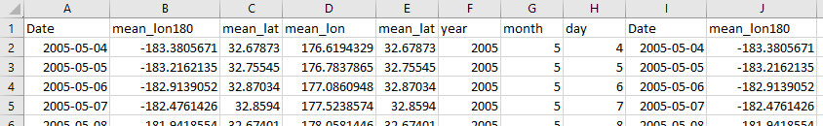
Data Preparation: Input data modification
Modify the dat/CSV file. Combine the Year, Month, Day to a single field. For this exercise using ArcMap, the following conventions are preferred:
  A coverage or shapefile identifies dates in a date field with this format: yyyy-mm-dd.
  A geodatabase formats the date as datetime yyyy-mm-dd hh:mm:ss AM or PM
Use a spreadsheet and create a Date column with ‘=DATE(C2,D2,E2)’ to convert into a date and re-format to custom ‘yyyy-mm-dd’
Use a spreadsheet and create a mean_lon180 column with ‘=A1-360’
Reorder columns: Date, mean_lon180, mean_lat, etc. Save as CSV
Action: Use a spreadsheet and modify the CSV file:
Add mean_lon180
Add Date
This dataset is available in the data package as ‘25317_05_dat_DATE_LON180.csv’ at the end of this slide deck.
Notes:
Modify the CSV file in a spreadsheet per the suggestions in the slide. One thing not listed is paring the date range to our area of interest. We could do that here, but we can address that within the GIS.

Slide 21
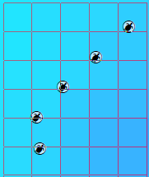
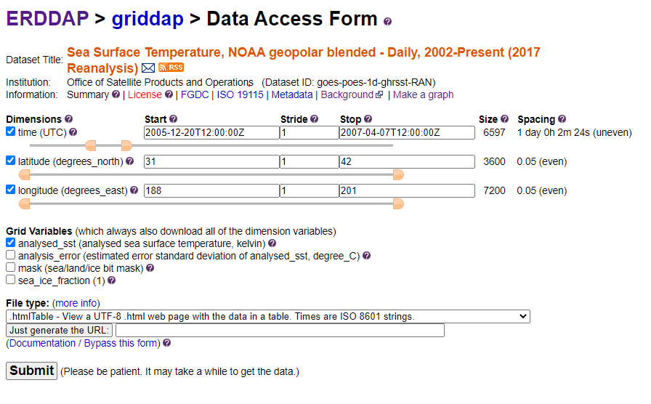
Obtain Satellite Data
Data Choice: The daily blended 5km SST appears to be a good match for determining the SST to pair with the turtle points. [The pixel inspector was used to overlay the SST pixel boundaries.]
SST
  Require data values (compared to scaled values)
  Source of turtle data is mean lat/long, can a turtle travel more than 1km or 5km in a day?
  Temporal period is daily, multiyear
  NOAA Blended SST a good candidate
Use either EDC, ERDDAP, THREDDS, OpenDAP to obtain a NetCDF dataset with daily time ‘slices’.
Note if using 0 to 360 or -180 to 180; Choose to match other data
The following slides show multiple ways to obtain data for:
  Date Range: 2005-12-20 to 2007-4-7
  Latitude: 31-42 N
  Longitude: 171 to 160 W (-171 to -160)
Notes:
Looking more in depth at the requirements for the SST data, it turns out the daily blended SST is a good match. This reanalysis is from 2002-2016, available in both 0 to 360 and 180 to 180, is a daily, quality dataset, and the 5km is a good resolution for pairing with the turtle's movement. Let's review some of the tools to obtain a single NetCDF dataset with the prescribed XY and time dimensions.

Slide 22
Obtain Satellite Data
ERDDAP GridDAP (data):
  0-360: goes-poes-1d-ghrsst-RAN_360_turtle2005-2007.nc
    https://oceanwatch.pifsc.noaa.gov/erddap/griddap/goes-poes-1d-ghrsst-RAN.nc?analysed_sst[(2005-12-20T12:00:00Z):1:(2007-04-07T12:00:00Z)][(31):1:(42)][(188):1:(201)]
  -180 to 180: noaacwBLENDEDsstDaily_180_turtle2005-2007.nc
    https://coastwatch.noaa.gov/erddap/griddap/noaacwBLENDEDsstDaily.nc?analysed_sst[(2005-12-20T12:00:00Z):1:(2007-04-07T12:00:00Z)][(31):1:(42)][(-171):1:(-160)]
The datasets used in this exercise can be obtained for offline use. See the ‘Data used in this Exercise’ slide at the end of this slide deck.
Notes:
Of the given methods, ERDDAP is probably the most reliable. Also, a future release of ERDDAP will accommodate both 180 to 180 and 0 to 360 retrievals 'on-the-fly'. For this exercise I used the CoastWatch Central ERDDAP to obtain the 180 to 180 dataset. The output NetCDF from this call is available on the 'Data used in this Exercise' slide at the end of this slide deck.

Slide 23
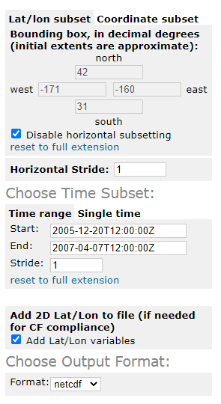
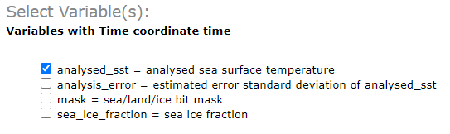
Obtain Satellite Data -- THREDDS
THREDDS (Aggregated View)
  NCSubsetService
  Generates URL in addition to fetching data
  https://coastwatch.noaa.gov/thredds/ncss/BlendedSST5kmNightAggGHRSSTSTARLoM?var=analysed_sst&north=42&west=-171&east=-160&south=31&disableProjSubset=on&horizStride=1&time_start=2005-12-20T12%3A00%3A00Z&time_end=2007-04-07T12%3A00%3A00Z&timeStride=1&accept=netcdf
Notes:
THREDDS can also provide the dataset and in some cases, an ERDDAP may act as middleware to THREDDS data.

Slide 24
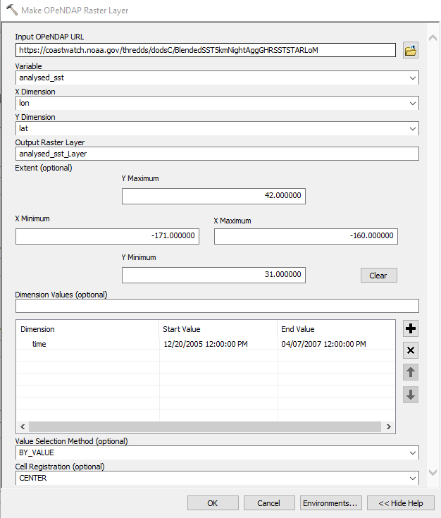
Obtain Satellite Data -- OPeNDAP
OPeNDAP (Aggregated View)
  Service on THREDDS and ERDDAP
  Use ArcGIS tool Make OPeNDAP to Raster Layer
  Enter URL without extension, click another box (do not hit enter)
  The ArcMap GUI builds upon the following URL:
    https://coastwatch.noaa.gov/thredds/dodsC/BlendedSST5kmNightAggGHRSSTSTARLoM
Verify the results!
  https://coastwatch.noaa.gov/thredds/dodsC/BlendedSST5kmNightAggGHRSSTSTARLoM.html
Notes:
There is also OPeNDAP, which ArcMap can talk to directly.

Slide 25
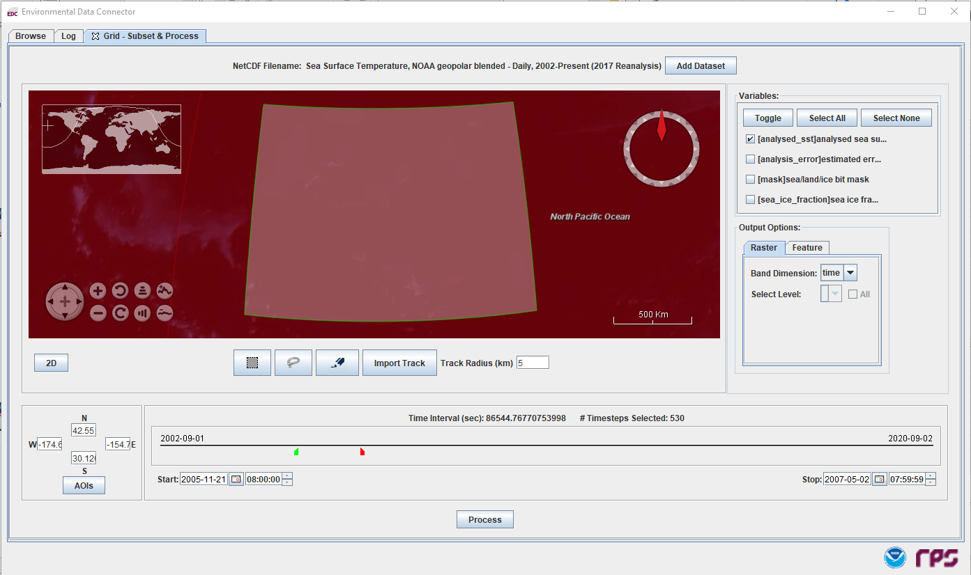
Obtain Satellite Data
EDC
Graphical interface to define extent, time, variables
Automatically loads into GIS
Notes:
And finally, the Environmental Data Connector. This tool is version dependent, but is undergoing updates to improve its compatibility.

Slide 26
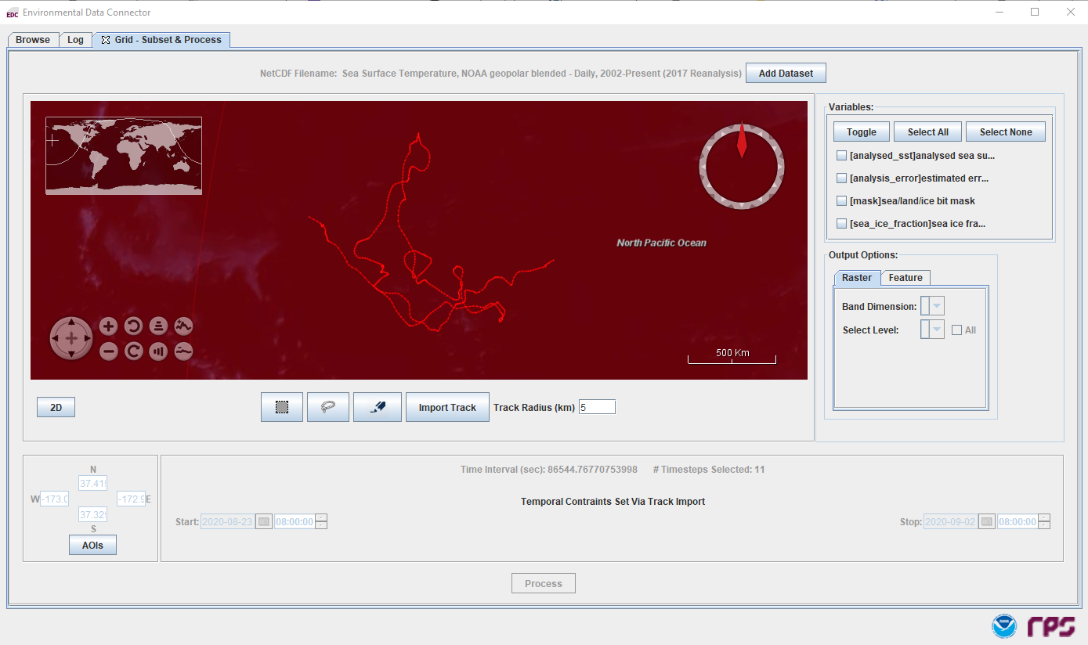
Obtain Satellite Data
EDC
Can also load the track and only pull the raster values for each point/time as either Raster or Feature data
Notes:
In addition to pulling Raster data, the EDC can work similar to the Xtractomatic by building a feature layer of the point-to-raster matchups.

Slide 27
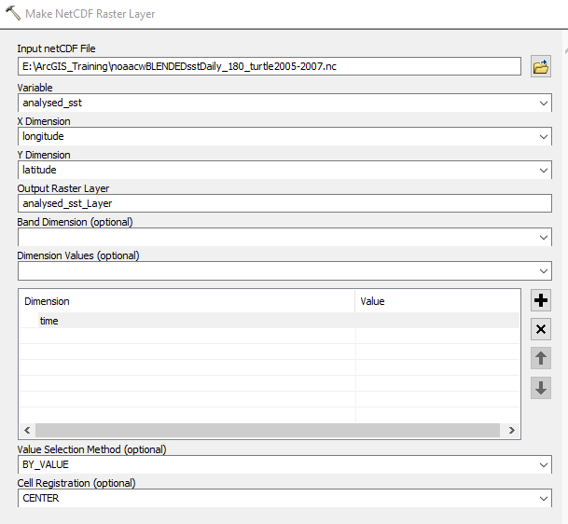
Loading Satellite Data
Open ArcMap to Blank Map
Open ArcToolBox
Use Multidimension Tools:
  Make NetCDF Raster Layer
Set the Input netCDF file
  noaacwBLENDEDsstDaily_180_turtle2005-2007.nc
Confirm Variable, X, and Y Dimensions
Add time as a Dimension Value
Notes:
With the appropriate NetCDF in hand, we can now load it into ArcMap. Us the Multidimension Tool Make Raster Layer from NetCDF and ingest the data.

Slide 28
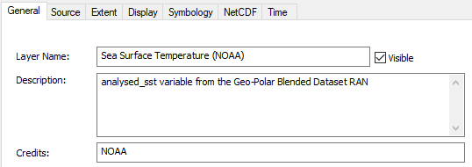

Loading Satellite Data -- Layer Properties – General / Extent
Rename:
  Layer:
    Sea Surface Temperature (NOAA)
  Description
  Credit
Confirm Extent
Notes:
Once added to the View, go ahead and open Layer Properties by double-clicking or right-mouse clicking on the Layer. Modify the Layer Name under the General tab and verify the geographic extents.

Slide 29
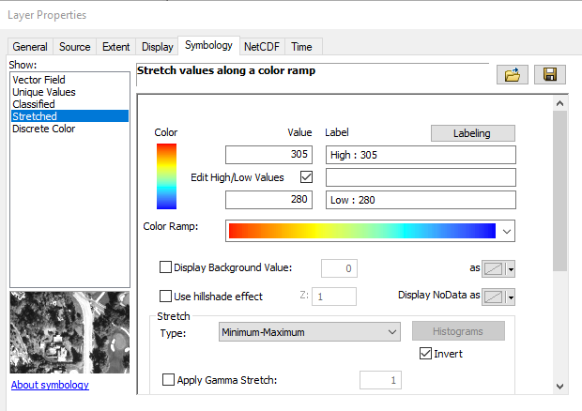
Loading Satellite Data -- Layer Properties -- Symbology
Reset the Stretch type to Minimum-Maximum
Reset the High/Low Values to 280-305
Select a color ramp of choice
Notes:
Under the Symbology tab, reset the stretch type, high-low values, and choose a color ramp of choice.

Slide 30
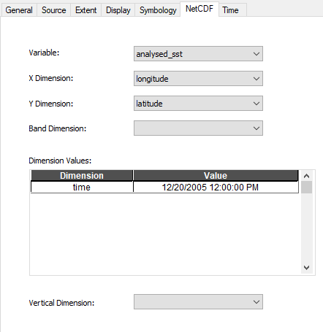
Loading Satellite Data -- Layer Properties -- NetCDF
Verify the NetCDF settings
Notes:
Under the NetCDF tab, just verify the correct dimensions are assigned and that a time dimension is present.

Slide 31
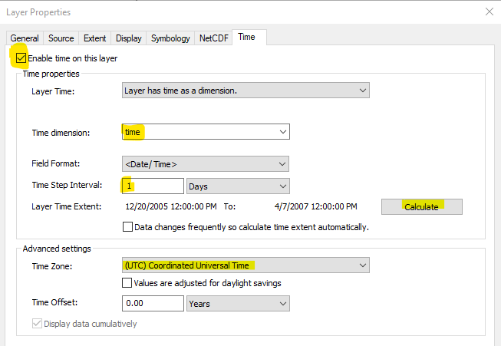
Loading Satellite Data -- Layer Properties -- Time
Enable Time on the Layer
Set the Time Dimension to ‘time’
Set the Step Interval to ‘1’
  You may need to revisit this as ArcMap will rest the value when Calculating range
Set the Time Zone to UTC
Click ‘Apply’ and verify values
Click ‘OK’
Notes:
Finally, in the Time tab, enable time and populate the fields as appropriate. When the calculate button is pressed, the time range should reflect the desired 2005 to 2007 date range and show 12PM for the time. Note, sometimes, the time step interval will change from the desired value. If this occurs, just enter 1 and click apply.

Slide 32
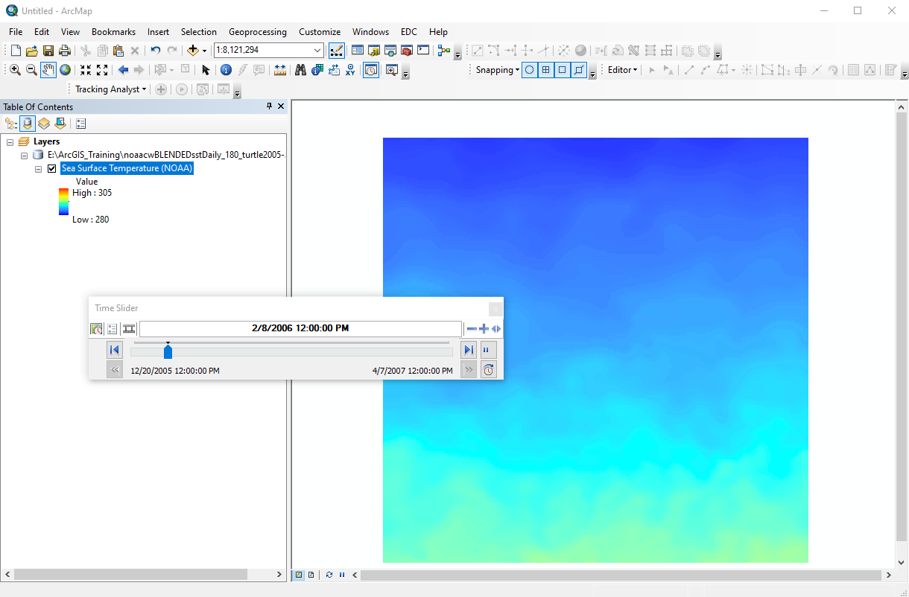
Display Satellite Data
Enable Time Slider
Click the ‘Play’ Arrow
  The images should change as the dates advance
  The color scale range should remain the same for each time step
Notes:
The layer is now ready for display. Open the Time Slider, and click the play button. As the slider increments, the SST image should change. Since we have a fixed color scale, each color represents a fixed value across all of the time slices.

Slide 33
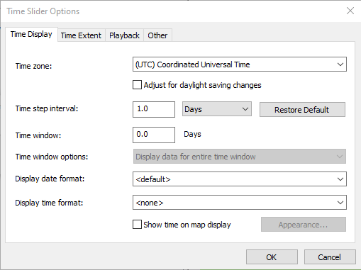
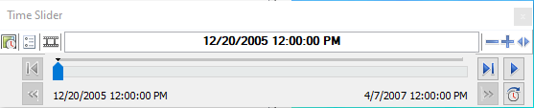
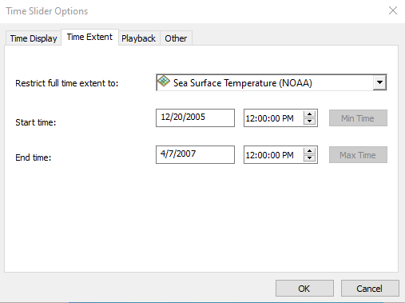
Time Slider
Controls time for all layers in map (Enable/Disable) and Tools
If layers do not display, check:
  Time Zone: UTC
  Step Interval: 1
Exports movie
Notes:
The Time Slider controls time aspects of the map. When enabled, it controls the display of time-enabled datasets. Any data with a temporal dimension should have time enabled in its Layer Properties and then automatically registered in the Time Slider. If data do not display when you think it should, it is often a lack of time (clock time) that causes a misalignment of the data. Recall our satellite data had a time of 12PM and our turtle tracks lacked a time entry.

Slide 34
Loading Data: CSV file
Use the CSV file:
  25317_05_dat_DATE_LON180.csv
Choose a method to import the CSV file
[The following slides will walk through the File-> Add Data method]
  Add Data icon, locate CSV, click Add, then right-mouse Display X-Y
  File->Add Data->Add X-Y Data, locate CSV
  Catalog->locate CSV,right-mouse->Create Feature Class->From X-Y Table
Export as Shapefile [Feature Class will do this automatically]
Notes:
Loading the turtle track can be done in several ways. I'll walk through the Add X-Y Data under the File menu.

Slide 35
Loading Data: CSV file Add XY Data
Select File->Add Data->Add XY Data
Notes:
Under the File menu, select Add XY Data.

Slide 36
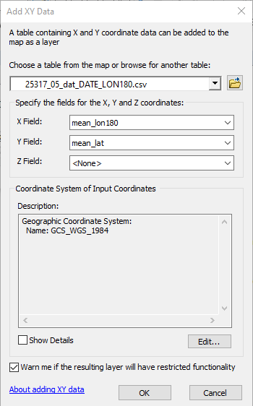
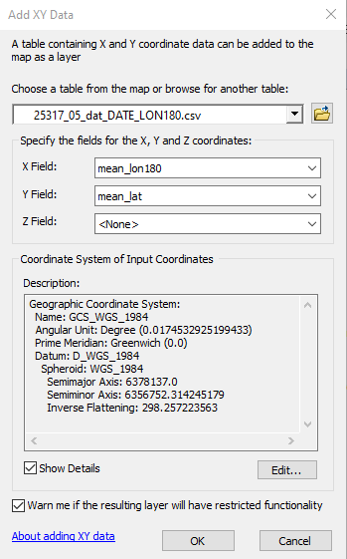
Loading Data: CSV file Add XY Data
Set the table to your CSV file
Set the X,Y Fields
  X: mean_lon180
  Y: mean_lat
Verify or Set the Coordinate System [Global Coordinate System -> WGS1984]
Click OK
Notes:
Open the CSV file and ensure the X and Y fields are mapped to the correct columns: mean_lon180 and mean_lat. Your GIS may automatically assign WGS84. If it doesn't, add it now. Click OK.

Slide 37
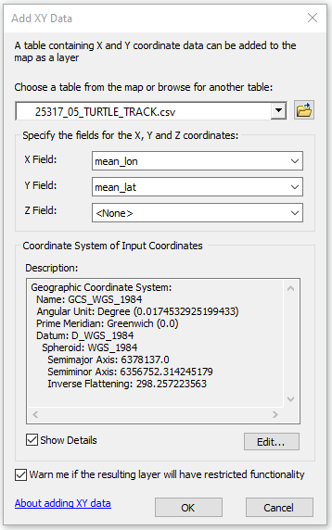
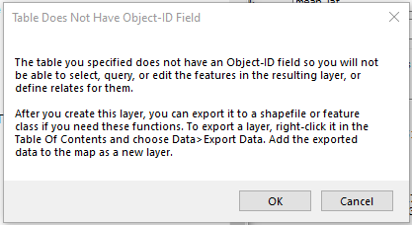
Loading Data: CSV file Add XY Data
An Object-ID warning may appear
Click OK
If the warning appeared, Export the data and re-add the layer to Map
Notes:
A unique record ID is required to allow queries on the data. If you receive this warning, you will need to export the data to a shapefile and add the layer to the map View.

Slide 38
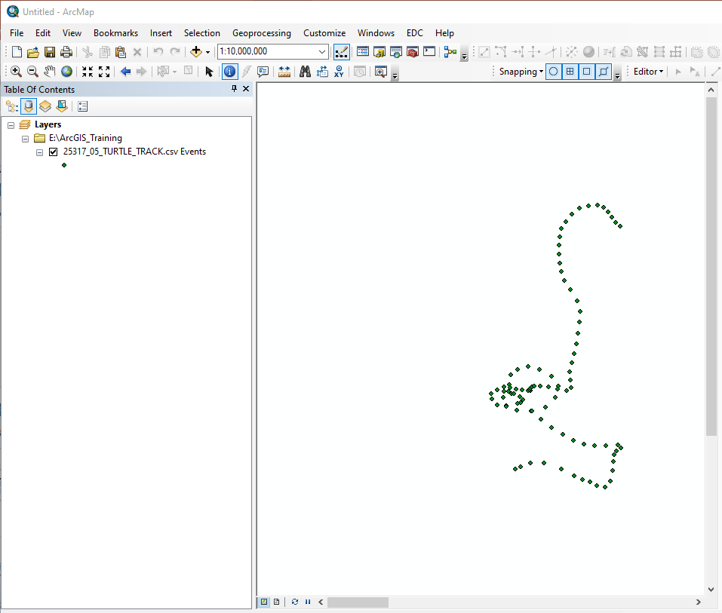
Loading Data: CSV file Add XY Data
By default, the View will show -180 to 180, splitting the data at the ‘dateline’
When we adjusted the longitudes (subtracting 360), the East longitudes become ‘westernized’ as values less than -180. Depending on how the data are loaded and assigned projection, they can display across the dateline.
180E
Notes:
When data that spans the antimeridian is added, by default it will be split showing Eastern Longitudes on the right side of the map and western Longitudes on the left. In general, check the other side of the map if you believe data appear missing.

Slide 39
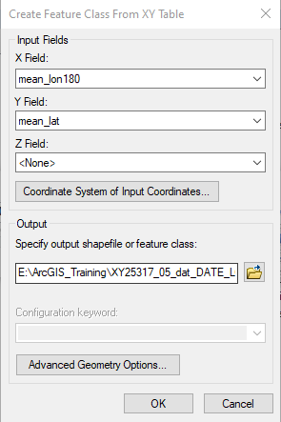
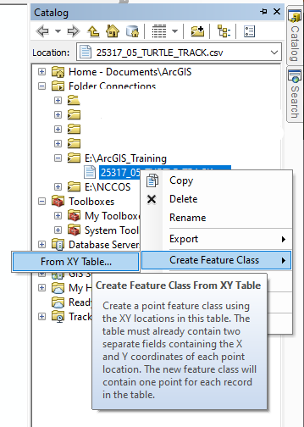
Loading Data: CSV file Create Feature Class
Open the Catalog
Navigate to the CSV file and right-click
Select Create Feature Class
Set the Input Fields, Coordinate System, and Output shapefile location
A notification may suggest adding an ObjectID
Notes:
Another method of bringing in the CSV data is adding a Feature Class. This is similar to the prior method except that it goes directly to generating a shapefile as the output. Confirm or set the X,Y fields, coordinate system, and output shapefile name/location. Note the name as you will need to use Add Data or the Catalog to load this new file.

Slide 40
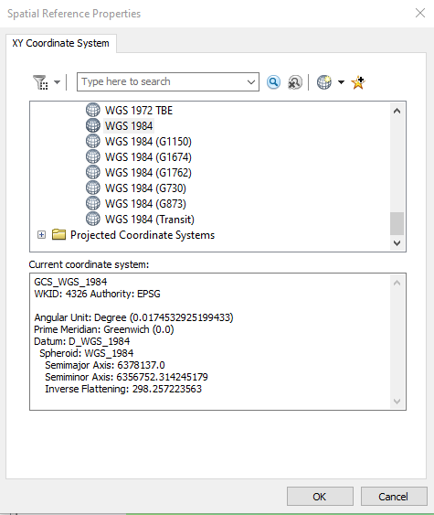
Loading Data: CSV file Create Feature Class
Set/Confirm the Coordinate system
Select Global Coordinate System
Select WGS1984
Notes:
When setting the coordinate system, make sure you choose WGS84 if the coordinate system is not already set.

Slide 41
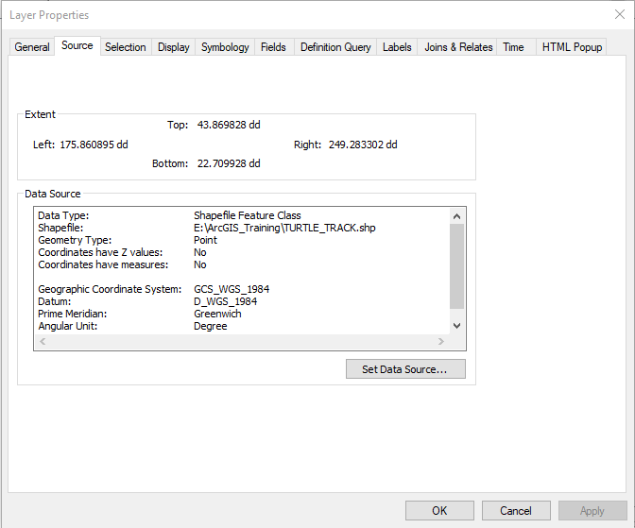
Loading Data: CSV file
Add the shapefile to the map view [if needed]
Verify the Coordinate System under the Source tab
Notes:
Add your newly created shapefile to the map view and check the Coordinate System under the Source tab. We are now ready reduce the file to just the dates needed.

Slide 42
Feature Layer Workflow
Turtle Track is loaded containing all records
Select only dates between 12/20/2005 and 4/07/2007
  Select by attribute, Export, Display XY Data, Enable Time
Perform spatial-temporal sampling with the new Track and SST layer
Select events from the results to reduce the results to the track points and corresponding SST by date
  Select by attribute, Export, Display XY Data, Enable Time
Remove unnecessary layers and obtain Outputs 2,3, and 4
Notes:
Now that we have both datasets available to us in the GIS, we can start working towards answering our questions and generating output. We will have to do a few actions on the Feature data to get only the relevant dates and then use the data to sample the time-enabled raster layer. We will look at how the data are sampled and create a query to retrieve the point-raster matchups needed for the final analysis.

Slide 43
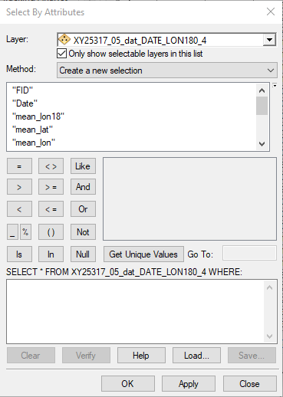
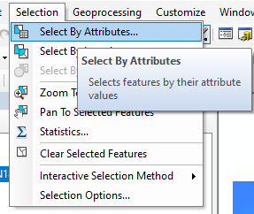
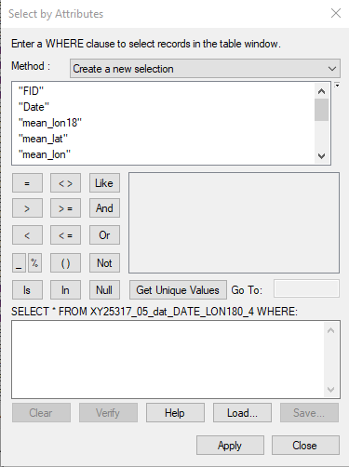
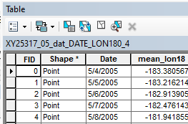
Select Date Range from the Feature Layer
Open ‘Select by Attributes’ using one of the following:
  the menu Selection->Select By Attributes
  opening the Attribute table (right-mouse -> Open Attribute Table) and click the Select By Attributes icon
Notes:
Activate Select by Attributes with one of these two methods

Slide 44
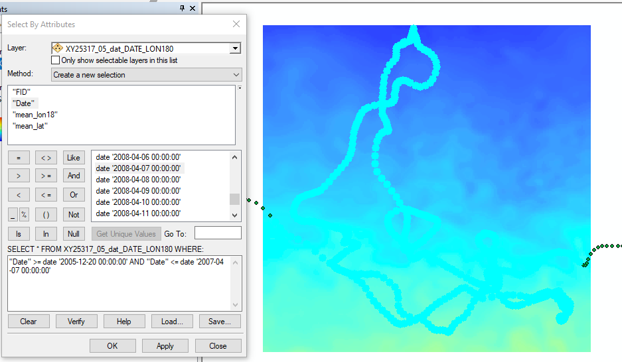
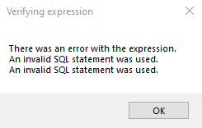
Select Date Range from the Feature Layer
Use Date in the SELECT statement to find records from 12/20/2005 to 4/7/2007
Other selection methods could achieve the similar results
Click Verify and then OK
Version 10.7: "Date" >= date '2005-12-20 00:00:00' AND "Date" <= date '2007-04-07 00:00:00'
Version 10.6: "Date" >= '2005-12-20' AND "Date" <= '2007-04-07'
Notes:
This panel will allow us to build a query to select the records of interest. Build the WHERE clause of the query by clicking Date and setting the range of dates we wish to include. "Date" >= '2005-12-20' AND "Date" <= '2007-04-07' I like to use Get unique values as this will place the value as the software understands it into the statement. In other words, the syntax may be version dependent. If clicking Verify results in an error, check your statement against the two listed at the bottom of the slide. Click OK to submit the query.

Slide 45
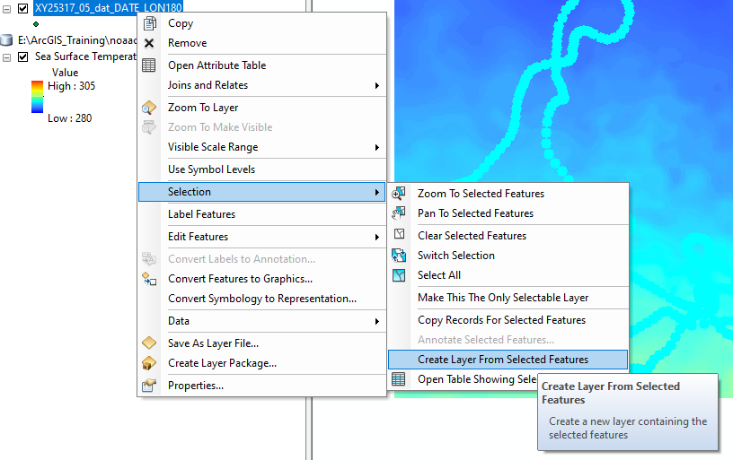
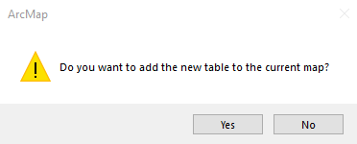
Save the Selection as a Layer
If you used the Selection Menu….
Right-mouse click on the feature layer
Follow the Selection menu to ‘Create Layer From Selected Features’
When prompted, accept ‘Add this layer to map’
Notes:
After the query runs, the records matching the data range criteria will show as selected. We need to save these data into the dataset that will become our submission to the Sample program. Use this method or the following slide's method to create a new layer depending on how you selected the records.

Slide 46
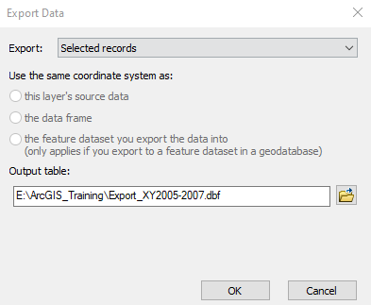
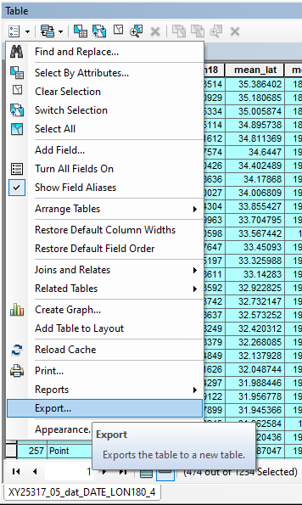
Save the Selection as a Layer
If you used the Attribute Table….
Click on Selected Attributes Icon
Verify correct date range
Select Export from Table Options menu
Export Selected records and Add to Map
Notes:
In either case, add the new layer to the map.

Slide 47
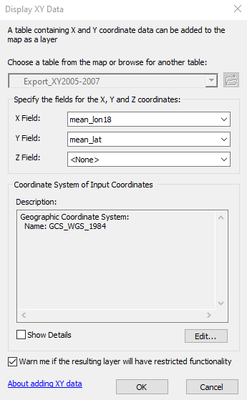
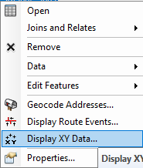
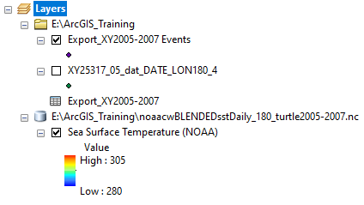
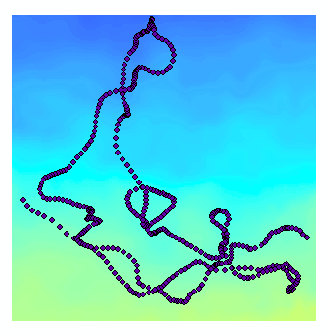
Display the Selected Records: Display XY Data…
Right-mouse on the table and select ‘Display XY Data…’
Make only the SST and Selected (exported) XY data visible
Notes:
Once the data table has been added as a map layer, make it visible by displaying the XY Data

Slide 48
Enable Time on the Selection Layer
The original CSV data only has a date value
ArcMap is sensitive to time and will assume no time entry for a given date is 00:00:00 AM. This will sometimes cause display issues when using the Time Slider.
We will set the daily turtle mean locations to the same as the daily SST observations by putting 12 Hours in as a Time Offset. This effectively sets the time to 12:00:00 PM as shown next…
Notes:
We now need to enable time on the layer, but our original CSV data only had a date. By default, time will be assumed to be 0 or midnight. Because we're using daily mean positions, we can modify the time to noon or 12PM to match our satellite retrievals.

Slide 49
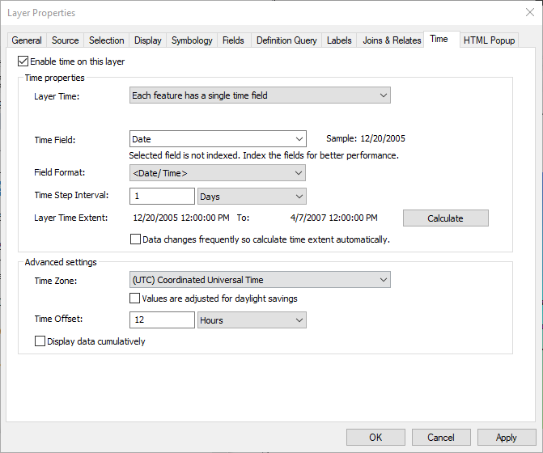
Enable Time on the Selection Layer
Open Layer Properties
Check the ‘Enable time on this layer’ box
Set Time Step Interval to 1 Days
Set Advanced Settings:
  Time Zone to UTC
  Time Offset: 12 Hours
Click Apply and then Calculate
Reset Time Step Interval to ‘1’ and ‘Days’
Click OK
Pressing Calculate often resets the Time Step Interval. Reset to 1 Day and click Apply
Setting the Time Offset will change the timestamp in the ‘Layer Time Extent’
Notes:
Open the Layer Properties and enable time. Confirm or make the entries noted and ensure the time step interval is 1 Day.

Slide 50


Time on the Selection Layer
Feature and Raster data for 12/20/2005
When time is enabled on the Feature Layer and Raster Layer, the display of data will be in sync.
The Time Slider controls the ‘active’ date within the GIS
Only a single date/time is visible at a time unless a larger ‘window’ is set using the Time Window.
Time can be enabled/disabled with the clock icon:
Notes:
We now have a feature and raster layer that can be displayed by time. The Time Slider controls the temporal aspect of the GIS data. Only a single increment is displayed at a time. To view all of the data, use the Enable/Disable Time icon on the slider to toggle the display extent of the datasets.

Slide 51
Extracting data from the Raster Layer by using the Feature Layer
ArcGIS:
  https://desktop.arcgis.com/en/arcmap/10.3/tools/spatial-analyst-toolbox/an-overview-of-the-extraction-tools.htm
  ArcToolbox->Spatial Analyst Tools->Extraction ‣ Sample
QGIS:
  https://docs.qgis.org/3.10/en/docs/user_manual/processing_algs/qgis/rasteranalysis.html#sample-raster-values
  Processing->Toolbox-> Raster analysis ‣ Sample raster values algorithm
December 20, 2005
Feature Layer
December 20, 2005
April 7, 2007
474 days
Raster Layer
April 7, 2007
Notes:
We can now extract data from the raster layer. ArcMap Spatial Analyst contains several tools. The one most appropriate for our needs is the Sample Tool. In the diagram on the right, we see the feature layer with each point having a unique time. Underneath is the raster layer -- a stack of XY SST grids where each slice is for a given time. The Sample tool can take the feature data and drill through the stack of SST grids.

Slide 52
Extracting data using the Sample Tool
474 days
By default, the tool will operate for all points on a single ‘slice’ of the Raster cube.
Resulting table is a single layer raster extraction for December 20,2005 for all points (Dec 2005 to April 2007).
December 20, 2005
April 7, 2007
December 20, 2005
474 days
April 7, 2007
# of samples = 474 points * 1 time slice
= 474
Notes:
By default, the tool operates on a single layer. For example, if I have a date active in the TIme Slider, the raster values for the feature layer points will be returned for that single time. Note, ALL of the feature layer points are submitted for sampling the raster data. So if we have 474 points, we will have 474 SST values.

Slide 53
Extracting data using the Sample Tool
474 days
Tool performs multidimensional extraction retrieving values for all slices
Resulting table has raster values for each point for each time slice
December 20, 2005
April 7, 2007
December 20, 2005
474 days
# of samples = 474 points * 474 time slices
= 224,676
April 7, 2007
Notes:
Checking the multidimension box in the tool panel will all sampling of ALL slices in the raster data. In this case, ALL points are submitted and the SST values for each time slice gets associated with ALL of the points. So with 474 points sampling over 474 days, we end up with 224,676

Slide 54
Extracting data using the Sample Tool
474 days
Our result requires selecting the records from the results table to build a layer with the appropriate x,y,t between the point and raster layer
December 20, 2005
April 7, 2007
December 20, 2005
474 days
# of samples = 474 points * 1 SST value per time slice
= 474
April 7, 2007
Notes:
In our results, we need to retrieve a single SST per day for each point. So we need 474 records, but a 1:1 relationship between each point and SST value for a given day.

Slide 55
Using the Selected Feature Layer for Sampling
The selected feature layer contains 474 points.
The SST layer contains 474 raster layers; one for each day.
Most geoprocessing tools will work with time (which in ArcMap is managed by the Time Slider), but not always how we would expect.
The Sample tool will obtain an SST value for each point on each day. [474 points * 474 days = 224676 records]
Notes:
The tool does the sampling, but doesn't match the time of our point layer with the time slice of the SST layer. But it does sample across the dimensions of the SST layer so our data is in there, we will just need to figure a way to discard the extra 224,202 records!

Slide 56


Perform the Sampling
Disable Time on the map
Open the ArcToolBox
Find Spatial Analyst Tools->Extraction->Sample
Double-click to activate Sample tool
Notes:
Knowing in advance how the tool will behave helps us understand how to extract our results. Disable time in the Time Slider and open the sampling tool.

Slide 57

Perform the Sampling
The Extract Multi Values to Points, Extract Values to Points, and Sample tools have been reengineered for better performance (v10.7). The interpolation methods have also been improved for these tools.
Image services of multidimensional data are now supported in the Sample tool.
WARNING: Prior to ArcMap v 10.7, the multidimensional tools extraction toolset had significant performance and interpolation issues.
If you are using v10.6 or earlier, consider using the Sample output DBF file provided in the Data Used in this Exercise slide at the end of this presentation should you not get results in a reasonable amount of time (5 minutes maximum).
https://desktop.arcgis.com/en/arcmap/10.7/get-started/introduction/whats-new-in-arcgis.htm
Notes:
And a general service announcement. The sampling tool in v10.6 that some of you are using is less efficient than the newer releases. You may not get results in a reasonable amount of time. The output or results table form this tool is included in the 'data pack' listed at the end of this slide deck. You can proceed with this exercise by loading the table and proceeding as normal.

Slide 58
Perform the Sampling
Set the input raster and location source fields
Set a name for the output table
Sampling tool has a checkbox to enable using multi-dimensions
By default (multidimensional unchecked), the tool will work on the current date selected in the Time Slider
Notes:
Set your raster layer to the SST dataset and the input or feature points to our point layer or the events from the data selection. Set a name for the output table and ensure the multidimensional box is checked. Click OK

Slide 59


Perform the Sampling
Sampling should run on the 474 records in less than 2 minutes
Right-mouse and open the data table on the turtlesamples table
Note the layout of the table
  Multiple entries per date
  Analysed_sst column added
  Rowid/ObjectID/OID prefixed to the table
  224,676 records total
This dataset is included as ‘turtlesamples.[dbf,cpg]’ in the Data Package at the end of this slide deck.
Notes:
The Sampling has generated a data table with the expected number of records. On inspection, we see the multiple retrievals where the ANALYSED_SST column has been added to each record for each time in the raster data. Let's filter out our data.

Slide 60

Filter the Sampling Results
Select by Attribute
A general equation to grab every nth row:
  MOD(OBJECTID+2n-x, n) = 0
    n is the every nth record
    x is the objectid to start from
Modified to grab every 475th row.
    MOD(OBJECTID+2(n+1)-x, n+1) = 0
    Object ID starts with 0:
      MOD( "OBJECTID"+950,475)=0
    Object ID start with 1:
      MOD( "OBJECTID"+949,475)=0
  Note, OBJECTID may be OID or Row_Id depending on how data were added
n=474
x=0
x=1
x
Notes:
Using Select by Attribute, we can grab the records of interest. In the data table, the second column is the index of each point of our turtle track. This is useful to ensure we are grabbing the correct records. We would expect this to be a sequential count of 0 to 474 in our final set of records. From this table, we need every 475th row. We can select that by using the modulo operation that returns the remainder of a quotient. Enter the MOD statement into the WHERE clause , VERIFY and click Apply to run the query.

Slide 61


Export the Selected Results
Our results have 474 records
The 2nd column shows the sequential order of points in the track
The Time column matches the Date range we expect.
This selection must be exported and then displayed to aid in our final outputs.
Add the new table to the map
[Display XY Data… see slide #46]
Action: Export the selection and add the new table to the map
This dataset is included as ‘turtleresults.[dbf,cpg]’ in the Data Package at the end of this slide deck.
Notes:
The results should be highlighted and similar to the table shown in the slide. Export the data as a new table and add to the map, and display as XY data.

Slide 62

Display the Sampling Results
Display the selected results
Enable Time (Layer Properties)
Set Zone to UTC
Ensure Layer time Extent displays 12:00:00 PM or adjust Time Offset to 12 hours to match satellite data for ‘daily’
Pressing Calculate often resets the Time Step Interval. Reset to 1 Day and click Apply
Notes:
Verify or change the Time information in Time tab in Layer Properties. Enable time on this newest layer and ensure the time shows 12PM as the time in the Layer Time Extent. Click Ok.

Slide 63

Displaying Sampled Results
Rename samples layer to ‘Turtle Track 2005-2007’
Remove Turtle2005-2007 layer and table
Enable time on the Time Slider
Notes:
Rename this layer to Turtle Track 2005-2007. And remove the interim feature data. Re-enable time on the Time Slider.

Slide 64


Displaying Sampled Results
Verify Results by selecting a date and confirming the SST value of the Raster matches that of the Feature Layer using the identify tool
Notes:
  the time slider window or improperly set dates/times can make values appear incorrect
  Setting the Layer Properties ‘Display’ Tab to have the SST (analysed_S) show as the identify results
Notes:
Selection of a date in the time slider now displays a single point and SST grid but the feature layer's attribute table contains the corresponding SST value. We can spot check a couple of points by choosing a date and using the identify tool to see both the Point's SST attribute and the SST in the raster layer. Under display in the feature layer's properties, change the Display value to the SST field. It may be truncated to analysed_s. Use the identify tool with it set to visible layers and when clicking on a point, you can see the values from both datasets. They should match!

Slide 65


Output 2: Map output showing turtle locations and parameter values
Disable Time (on slider)
Open Layer Properties on Turtle layer
Assign color ramp and classification – 25 levels (Quantities to analysed_sst)
Turn off raster visibility
Turn on Basemap
Notes:
We can now finish the output maps. Disable time on the Time Slider and assign a classification to the analysed_sst field in the symbology tab of the Layer Properties. Use the Layout View to finalize your map output and save as an image.

Slide 66

Output 3: Graph of parameter value for each turtle location vs Time
Open the SamplesTurtleTrackTble
Rename the ANALYSED_S column to Temperature(K)
Select ‘Create Graph’
Notes:
Open the attribute table for the Feature Laye. You can rename Analysed_S to Temperature(K) if you wish and select Create Graph.

Slide 67

Output 3: Graph of parameter value for each turtle location vs Time
Select the Graph type: Vertical Line
Set the Y and X axes
  Temperature(K) vs Time
Continue with the Wizard to finalize your chart.
Notes:
Set the X and Y axes and continue with the Graph Wizard to finalize your chart.

Slide 68
Output 3: Graph of parameter value for each turtle location vs Time
Notes:
From our chart, we see the turtle experienced a temperature range of 287.5 to 297.5 K . From here you could use additional geoprocessing tools to calculate the mean temperature or geostatistical outputs that may help us understand this turtle's movement.

Slide 69
Output 4: Export Movie showing Turtle, Parameter, TurtleWatch Zone
https://www.fisheries.noaa.gov/resource/map/turtlewatch
TurtleWatch Zone:
  Most loggerhead turtles stay in water colder than 65.5°F (about 18.5°C). When the 65.5°F temperature contour is drawn on a map of the current sea surface temperature conditions, it delineates the current southern boundary of the loggerhead's preferred habitat. Over 50% of recorded loggerhead interactions occurred in waters between this southern 65.5°F boundary and the 63.5°F temperature contour to the north.
  Converting F to K: 290.65 – 291.65 K (17.5°C – 18.5°C)
We’ll use symbology to highlight the zone
Notes:
Our final output is correlating the TurtleWatch Zone with the turtle track. There are several ways to do this, but a quick method is using a duplicate raster layer and adjusting its symbology.

Slide 70

Output 4: Export Movie showing Turtle, Parameter, TurtleWatch Zone
Copy and Paste SST raster layer
Rename to ‘TurtleWatch Mask’
Open SST raster Layer Properties->Symbology Tab
Notes:
Copy and paste the SST layer. Rename to TurtleWatch Zone Mask and open layer properties to modify the layer's symbology.

Slide 71

Output 4: Export Movie showing Turtle, Parameter, TurtleWatch Zone
Select ‘Classified’
Set Classes to 1
Classify…
Notes:
To only display the 'zone', we'll use a classification of 1 class.

Slide 72



Output 4: Export Movie showing Turtle, Parameter, TurtleWatch Zone
Under Data Exclusion, Exclusion…
Set the TurtleWatch values that will be highlighted
Enable the Legend, choose a color, and Label
Notes:
It will actually be our Exclusion area that we display as we can set all other values to no color. Open the Data Exclusion Properties by pressing the Exclusion button. Set the values (in Kelvin) of the TurtleWatch zone: 290.65 to 291.65. Select the Legend tab, enable the legend and choose a color to represent the zone.

Slide 73
Output 4: Export Movie showing Turtle, Parameter, TurtleWatch Zone
Double-click the box under ‘Symbol’
Select ‘No Color’ and click ‘Apply’ and ‘OK’
This will make all data values transparent.
Only the excluded values in the classification will be displayed
Notes:
Change the color of the data display by double-clicking the box beneath the symbol column. Select No Color, click apply and OK.

Slide 74






Output 4: Export Movie showing Turtle, Parameter, TurtleWatch Zone
View the data using the Time Slider
Notes:
Use the Time Slider to visualize the TurtleWatch Zone. If the zone is not visible, double-check that the raster layer has time enabled and inherited the correct properties from the original SST layer.

Slide 75


Time Slider – Check Settings
If layers do not display, check:
  Time Zone
  Step Interval
  Time Window
When the Feature data were added, the time defaulted to MM/DD/YYYY 00:00 AM, so either the time window must be set to allow display of both the Raster and Points Layers OR a time offset should be applied to the Feature Data [Note, when exporting a selection from a table, the time may be truncated from the date-timestamp]
Notes:
If a display issue persists, check the options of the Time Slider. Make sure the step interval is 1 day and the window is 0. Now is a good time to save the project.

Slide 76


Output 4: Export Movie showing Turtle, Parameter, TurtleWatch Zone
Save your work!
Use the Time Slider to save the movie
Choice of sequential images or AVI [Sequential images and then assembling in Windows Video Editor works well]
Warning! Selecting an incompatible compressor may result in software crash
Notes:
Now that the TurtleWatch Zone is complete, we can export our movie. Of course, additional analysis could be performed using either table queries or geostatistical tools to calculate the amount of time during this period the turtle was in the zone or other statistics. Use the time slider movie icon to either save a sequence of images or a movie of the data.

Slide 77
Other considerations
Time: Consider adding a default time to the Turtle Points. Ensure the time for daily data is common across data. I.e. A daily average may use 12:00 PM UTC.
Units: Kelvin is not usually easily related to when communicating temperature. Use the appropriate units to communicate your results. The Map Algebra->Raster Calculator or Math->Minus tools can be used to convert the Raster data to either degrees Celsius or Farenheit.
Sampling: Often, tools can accept multiple raster layers to sample. If you have a few raster datasets, try loading each time slice as a separate layer. You could also do this with multiple parameters.

Slide 78
Data used in this Exercise
Turtle Tracks
  Original ‘dat’ CSV file: 25317_05.dat.csv
  Modified CSV file: 25317_05_dat_DATE_LON180.csv
Sea Surface Temperature (NOAA Geo-Polar Blended 5km SST Analysis)
  Single Day NetCDF: goes-poes-1d-ghrsst-RAN_SingleDayGlobal.nc
  Subset (31-42 N, 171-160 W, 2005-12-20 to 2007-04-07):
    180to180: noaacwBLENDEDsstDaily_180_turtle2005-2007.nc
    0to360: goes-poes-1d-ghrsst-RAN_360_turtle2005-2007.nc
Sample output data table:
  Full 274,676 records: turtlesamples.[dbf,cpg]
  Results (474 records): turtleresults.[dbf,cpg]
These datasets are included in the following ZIP file: CW_ArcGIS_TurtleTrackData.zip
https://coastwatch.noaa.gov/cw_html/MTS/CW_ArcGIS_TurtleTrackData.zip
Size: 60MB MD5 Checksum: 36d2fddd788b1bae1d841b639c7a4f4e

Slide 79
End of Exercise
https://coastwatch.noaa.gov
coastwatch.info@noaa.gov

Slide 80
NOAA CoastWatch Satellite Course - Narrated Presentations
Satellite 101 – Part 1
Satellite 101 – Part 2
Fundamentals of Ocean Color
Fundamentals of Sea-Surface Temperature
Fundamentals of Altimetry, Wind and Salinity
Introduction to ERDDAP
What Dataset to Choose?
Bringing Satellite Data into ARCGIS

Slide 81
Extra Slides on the EDC Tool

Slide 82


Slide 83
EDC Track Line Format
Track Line Format
A track line file must be a comma-separated text file. Each line in the text file contains a new point along the track line. Each point can have its own time extent. Each line can have the following fields, in this order:
1.Latitude – in decimal degrees
2.Longitude – in decimal degrees
3.Altitude – in meters (can be 0 if not using altitude)
4.Start Time – the beginning of the time range for data to be selected (optional)
5.Stop Time – the end of the time range for data to be selected (optional)
Here is an example of a track line file:
27.8036,-119.8914,0,2013-03-15T14:40Z,2013-13-15T14:40Z
28.7866,-117.9850,0,2012-03-15T14:40Z,2012-13-15T14:40Z
36.3951,-123.6461,0,2011-03-15T14:40Z,2011-13-15T14:40Z
35.2628,-125.9477,0,2010-03-15T14:40Z,2010-13-15T14:40Z
33.2628,-124.3501,0,2009-03-15T14:40Z,2009-13-15T14:40Z
Spreadsheet
  Convert 0-360 to -180 to 180 ( =if(B2>=180,B2-360,B2) )
  Convert Year,Month,Day columns to single date ( =Date(B3,B4,B5) )
  Set Date format to custom ( yyyy-mm-ddT12:00Z ) (=TEXT(A1,"mm/dd/yyyy") =CONCATENATE(F2,$J$2)

Slide 84


Slide 85


Notes:
The way feature output works is the EDC will initiate a request to the ERDDAP service for the X,Y,T and write a NetCDF file. This can take time, and in this case with 1,234 requests about 40 minutes. Each request is unique and results in an individual NetCDF file for each query. The EDC will then

Slide 86

https://oceanwatch.pifsc.noaa.gov/erddap/griddap/goes-poes-1d-ghrsst-RAN.html
Notes:
File

Slide 87


