Slide 1


Drought & Vegetation Monitoring: Energy–Water Cycle
7th SALGEE Virtual Workshop
24 Nov – 26 Nov 2021
SALGEE
Julia Stoyanova
National Institute of Meteorology and Hydrology, Bulgaria

Slide 2
About EUMETSAT SALGEE Project (2011-2021)
SALGEE
SALGEE, The Satellite Applications in Land surface analyses Group for Eastern Europe has been established in 2009 as an user group for gathering experts in the field of satellite meteorology to complement the activities of EUMETSAT Land Surface SAF for progression of using satellite Land Surface Analyses techniques and widespread interdisciplinary knowledge in SE/E Europe and other regions of interest where their application might be beneficial in conjunction with other source of information (CGMS-38, 2010).
The mission of the EUMETSAT SALGEE user group is to increase the benefit accrued from EUMETSAT Satellite Missions (geostationary and low Earth orbit satellites). The focus is on terrestrial processes and land-atmosphere interactions by coupling of energy-water-carbon cycles, and biosphere coupling to weather and climate.
SALGEE Project supports the implementation of EUMETSAT SAF Strategy related to climate monitoring and applications and the use of satellite products for Terrestrial-Essential Climate Variables (T-ECV).
SALGEE biennial thematic workshops are organized aimed at identification of research and operational opportunities in using LSASAF products.

Slide 3
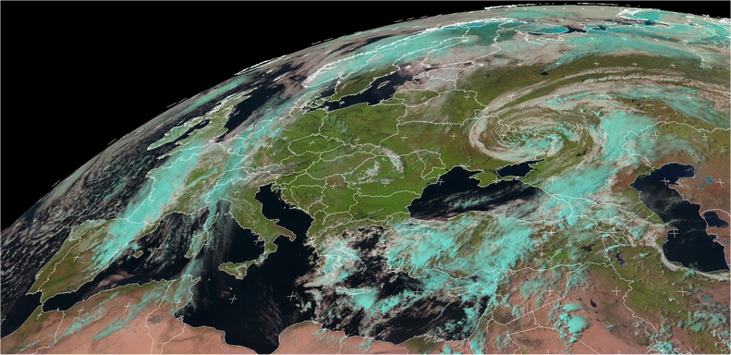
SALGEE thematic workshops
7th SALGEE virtual Workshop, 24-26 Nov 2021
Drought and related environmental response
Fire hazards, risk diagnoses and forecast
Climate – vegetatation net productivity
6th SALGEE
Connection of climate and biosphere, 14-17 Oct 2019
EUMETSAT, Darmsatadt
1st SALGEE
5th SALGEE
4th SALGEE
Drought and Fires
7-10 Sep 2009
Sofia, Bulgaria
Drought and Environmental response
1-3 Sep 2015
Matera, Italy
Heat waves,
Drought Hazard and Fire Monitoring
18-20 September
Yerevan, Armenia
2nd SALGEE
3rd SALGEE
Drought and Fire Emissions
20 - 21 March 2013
Ericeira/Lisbon, Portugal
Drought and Fires
4 - 7 April 2011 Antalya, Turkey
Gathering experts to respond to the contemporary needs to
Facilitate the exchange of knowledge and information between leading scientists and experts at an international level on the use of satellite land surface analysis techniques.
Establish mechanisms and environment where scientists and user community provide feedback to product developers at EUMETSAT, LSA SAF, NOAA/NASA.
Review and discuss progress in technology of using satellite products for land surface applications.
Notes:
3
3

Slide 4
7th SALGEE Workshop
’’Drought & Vegetation Monitoring: Energy–Water Cycle’’
Milestones
Vegetation is the main indicator of climate and plays a functional role in energy balance and the water cycle. Plants reduce the effects of burning fossil fuels by absorbing carbon dioxide.
Land-ecosystems have increasingly been subject to heavy drought. Their role in weather and climate, associated extreme events and their prediction are more and more realized. Thus, quantitatively evaluating drought impacts on ecosystems is an important task of present research.
To assess drought and its impact on ecosystems, it is recommended to consider relevant biogeophysical indexes that can highlight the biological changes of ecosystems in response to the dynamics of drought intensity and their projection in future climate.
Understanding how terrestrial vegetation responds to drought is a great challenge because the physiological and biochemical activities of vegetation, especially its assimilation of CO2, are largely constrained by varying degrees of droughts at various time scales and reveals.

Slide 5
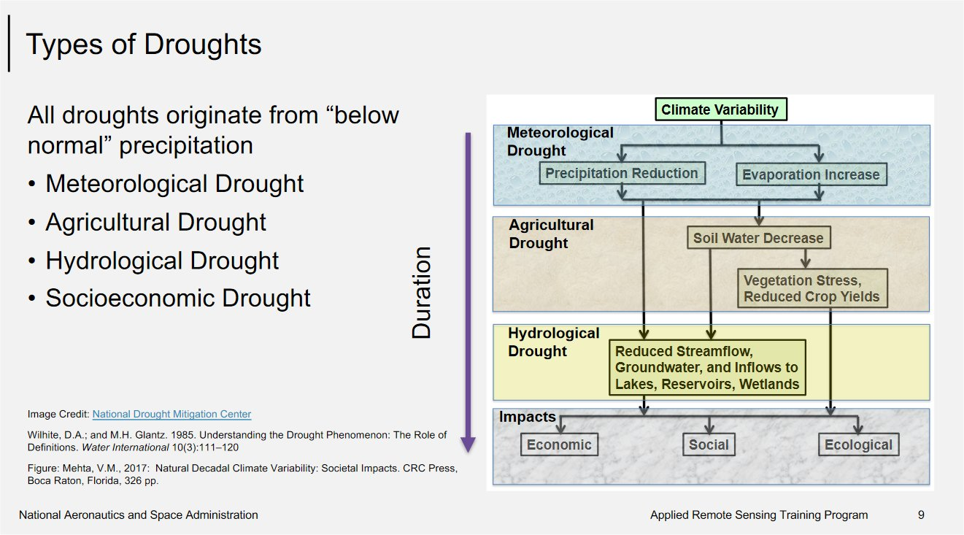
Low SM and high VPD typically cooccur, and it is projected to be more frequent and more extreme in the future, which would strongly limit the capacity of continents to act as a carbon sink.
Spectrum of drought
https://appliedsciences.nasa.gov/sites/default/files/2020-11/Drought_Part1.pdf

Slide 6
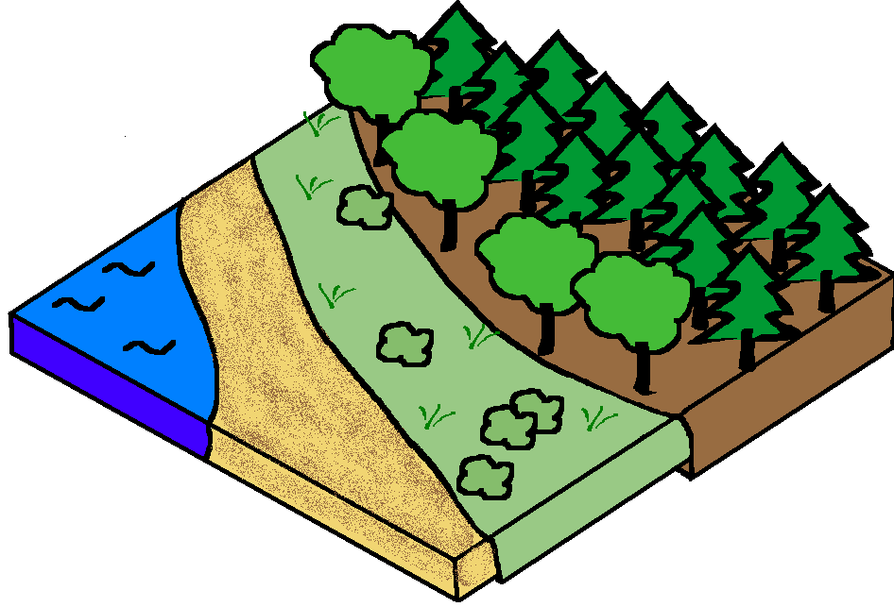
Drought monitoring with Vegetation
Rn
H
During drought plants respond
  Physiologically and
  Structurally to prevent
excessive water loss according to species-specific water use.
АEТ
LE
Р
S
Land–atmosphere (LA) feedbacks have a critical role in driving co-occurring soil drought and atmospheric aridity
Soil
moisture

Slide 7
Drought monitoring with Vegetation
  Vision and knowledge about the phenomenon and related biophysical processes
  Relevant approach (interdisciplinary) and data source
    Satellite biogeophysical products – SAFs (LSASAF, CMSAF, H-SAF)
    Ground measurements
    Model outputs (ECMWF)
  Datasets
    CDRs (EUMETSAT, SAFs, ECMWF, others)
    EUMETSAT D&V Cube

Slide 8

  Vision and knowledge about the drought phenomenon and related biophysical processes Land surface state
The land surface has long been recognized as second in importance only to ocean surface temperatures as a driver of climate.
The land and atmosphere are interlocked by coupled hydrologic and energy cycles that are a major part of the Earth s climate ’ system.
Recent multi-institutional studies with a combination of operational and research models for global weather prediction and climate simulation have demonstrated the potential for land surface states (predominantly soil moisture) to affect the atmosphere in
  key regions (Koster et al., 2004, 2006) and
  importance of knowledge of the land state to improve the skill of forecasts (Koster et al., 2011).
Atmosphere
energy
water
СО2
energy
water
СО2
Land
Ocean

Slide 9
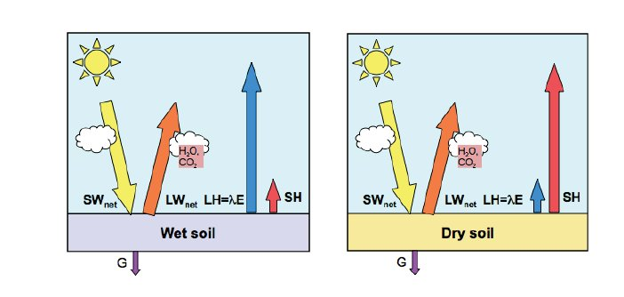
  Vision and knowledge about the drought phenomenon and related biophysical processes
  Land-atmosphere coupling
Land-Atmosphere coupling is based on ecosystems functioning.
  ecosystem functioning is referring to all processes related to biosphere, e.g. distribution, productivity, etc.
LA coupling is resulting in transformation of solar energy into the energetic fluxes of latent heat LE and sensible heat H towards atmosphere, and in the soil heat flux G, as well as chemical compounds.
wet climate regime
dry climate regime
Seneviratne et al. (2011)
As a sort of land surface state, drought is a result of land-atmosphere coupling.
Notes:
9

Slide 10
The role of soil moisture in propagation of terrestrial drought:
Coupling of energy-water cycles at ‘Dry’- ‘Wet’ soil is reflected by the proportion between LE and H.
Terrestrial drought in terms of biogeophysical cycling
meteorological processes that shape the land surface state

Slide 11
Main concepts adopted in drought monitoring with vegetation
Approach
Soil moisture availability concept
LST is a key biogeophysical variable in land surface processes
Evapotranspiration concept
  Potential evapotranspiration, PET
  Actual evapotranspiration, AET
  Combination between them AET/PET

Slide 12
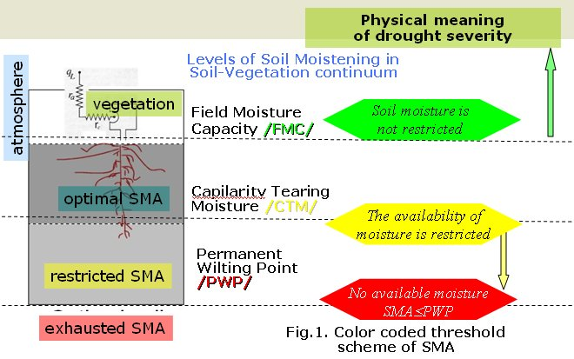
Plant- available soil moisture (SMA) concept
Table 1. Categories of dry/wet classes by the SMAI
Plant SMA concept works in cases of positive correlation between soil moisture and evapotranspiration.
SMA is the capacity of a soil to hold water that is available for plant use.
The terrestrial segment of LA coupling is characterized by the correlation in time between variations in soil moisture and evapotranspiration (e.g., Dirmeyer et al. , 2009).
A positive contemporaneous correlation between the two indicates variations in soil moisture are the controlling factor and variations in evapotranspiration are the response.
  This occurs where there is some degree of soil moisture deficit such that it (and not availability of net radiative energy at the surface) determines evapotranspiration (Koster et al., 2009)
A negative correlation occurs where soil moisture is plentiful but available energy is the limiting factor.

Slide 13
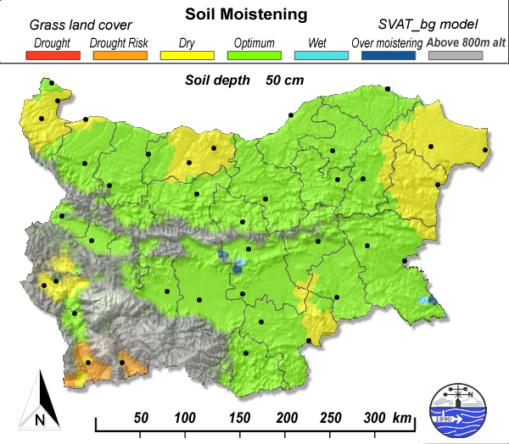
Plant- available soil moisture concept
Table 1. Categories of dry/wet classes by the SMAI
Soil Moisture Availability Index (SMAI) designed as a 6-level threshold scheme to account for moistening conditions. SMA is expressed by digital values ranging from 0 to 5, which are correspondingly color-coded.
Example of color coded map of SMAI over Bulgaria, 0-50 cm soil layer.
Stoyanova & Georgiev, 2013

Slide 14
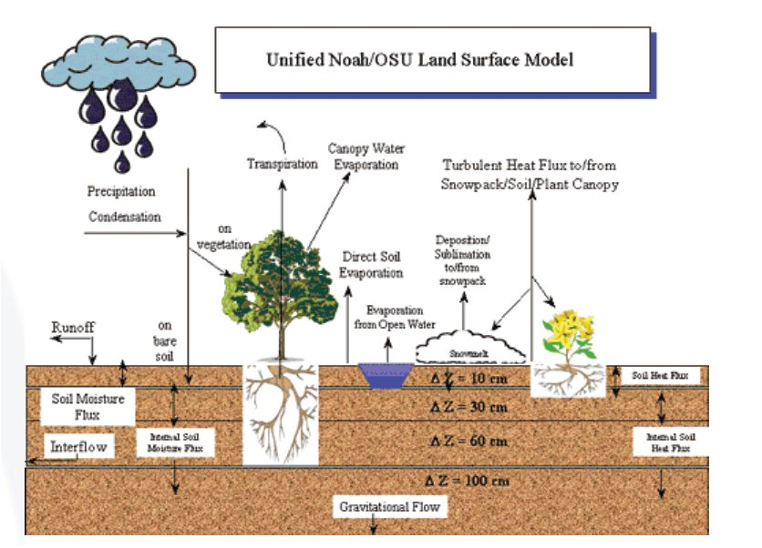
  LST as a key biogeophysical variable in land surface processes
  LST much respond to vegetation occurrence
Land Surface Temperature (LST) is one of the key variables in the physics of land-surface processes on regional/global scales. As a functional parameter in main biogeophysical processes of energy-water-carbon balances it combines the effects of all surface-atmosphere interactions.
Surface skin temperature knowledge on regional and global scales are of importance for Global Circulation Models, for estimation and parametrization of surface fluxes (e.g. Brutsaert et al, 1993), to monitor drought, and estimate soil moisture (e.g. Feldhake et al., 1996), and water budget components (Park et al., 2005), fire risk (e.g. Stoyanova and Georgiev, 2010), and many others.

Slide 15
MSG Satellite LSASAF LST & SVAT products for drought evaluation
Changes in soil moisture affect the albedo and thermal diffusivity of the soil and the Bowen ratio (the ratio of the sensible to latent heat fluxes) in the atmospheric surface boundary layer.
As a result, high skin temperature (LST) are both a cause and the product of dry periods.
Synoptic station Sandanski, Jun-Aug 2012, Bulgaria

Slide 16
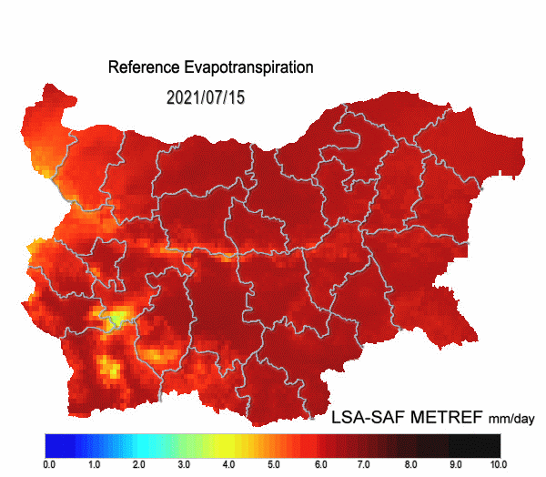
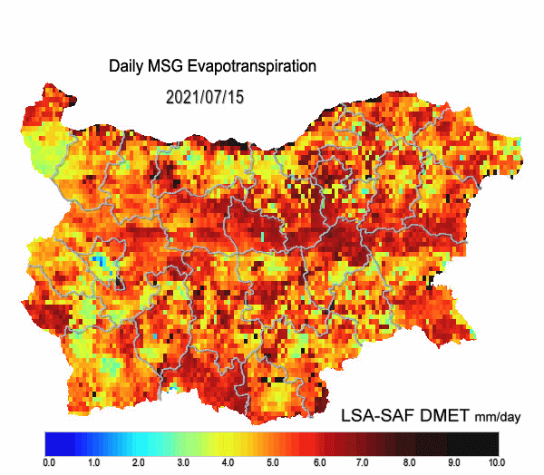
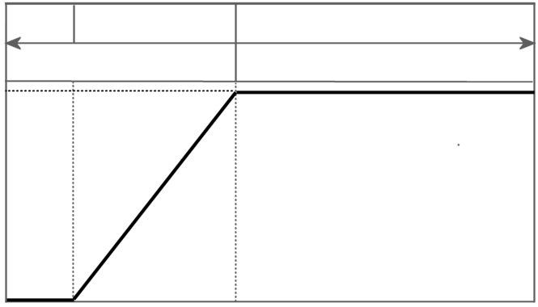
Actual-Potential Evapotranspiration Concept
complementary relationship between actual evaporation and potential evaporation
PET
AET
The complementary and parallel interactions of AET and PET in both sustained and flash droughts
The difference or
Ratios between AET and PET
Coupling between soil moisture and evapotranspiration (Budyko (1956; 1974).
dry
transitional
optimal/wet
soil moisture
restricted
solar energy
restricted
evapotranspiration
fraction
relative soil moisture content

Slide 17
Prototype Data Cube for Drought & Vegetation Monitoring (D&V Cube)
Climate Data Records (CDRs)
    CDRs (EUMETSAT, SAFs, ECMWF, others)
    Satellite observations, Ground measurements, NWP data, LSM data
To facilitate the use of satellite data, EUMETSAT has developed a Prototype Data Cube for Drought & Vegetation Monitoring (D&V Cube), which is a new approach of providing multi-dimensional data from different providers to users. The D&V Cube contains satellite based data records from the LSA-, CM- and H- SAFs; ERA-5 land re-analysis provided by ECMWF as well as interpolated station measurements from the GPCC (Global Precipitation Climatology Project).
Provides new opportunities for collaboration between SAFs for further development of D&V Cube and included CDRs applications.
D&V Cube is a topic of 7th SALGEE workshop regarding such possible joint activities for drought, vegetation and wildfire monitoring.

Slide 18
Objectives of the 7th SALGEE Workshop
Drought & Vegetation Monitoring: Energy – Water Cycle
SALGEE
Using satellite information to characterize droughts on vegetated land surfaces, related processes and consequences, using Climate Data Records (CDRs).
The different aspects of droughts – meteorological, hydrological, agricultural and ecological, inviting representatives from the SAFs to share experiences.
Fire activity in relation to land surface state and biomass burning effects.
Perspectives and improvements of SAF products by using MTG data and development of new EUMETSAT services.
First experiences on using the D&V Cube to access long (Climate) Data Records, analyses and visualization of the results.
  illustrate the usage of the D&V Cube in different applications
  illustrate the applicability of the D&V Cube for regional application.
Workshop discussion and feedback on D&V Cube utlization for potential applications.
Welcome to the ^{7th} SALGEE

