Slide 1
STORM ON 7-8 OCTOBER, 2023
Karīna Rožkova
Jānis Kleperis
LEGMC
07.11.2023

Slide 2
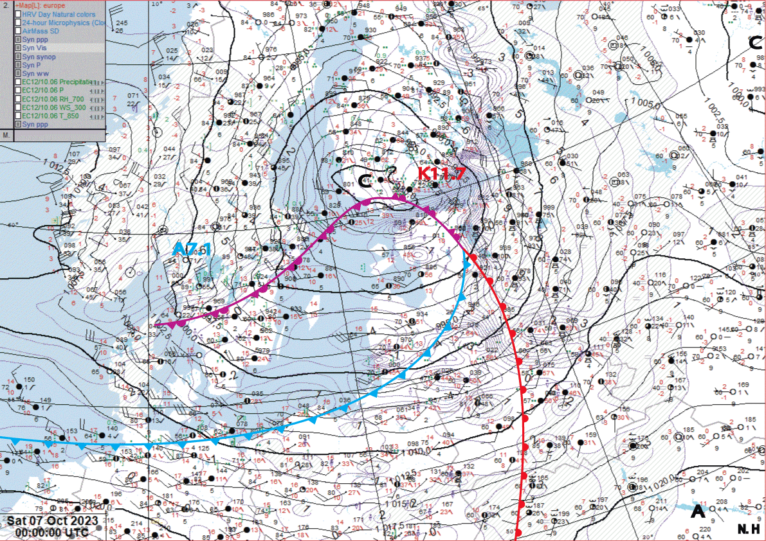
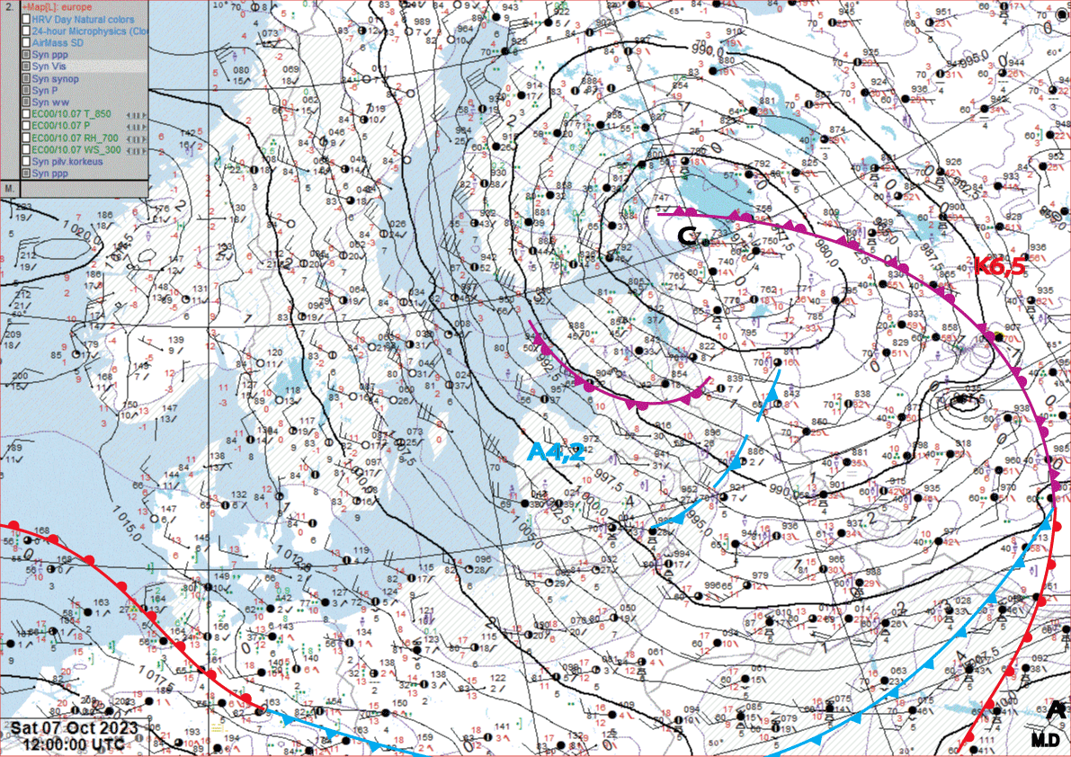
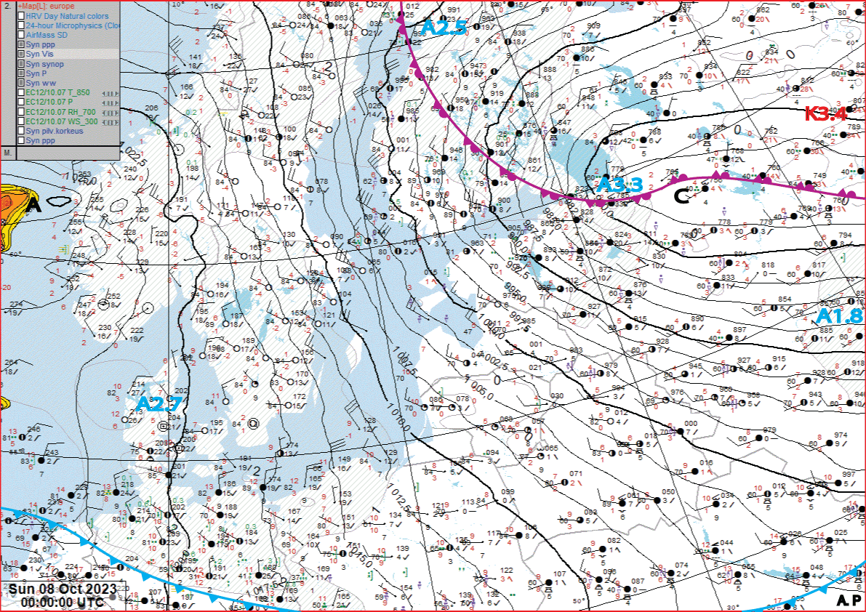
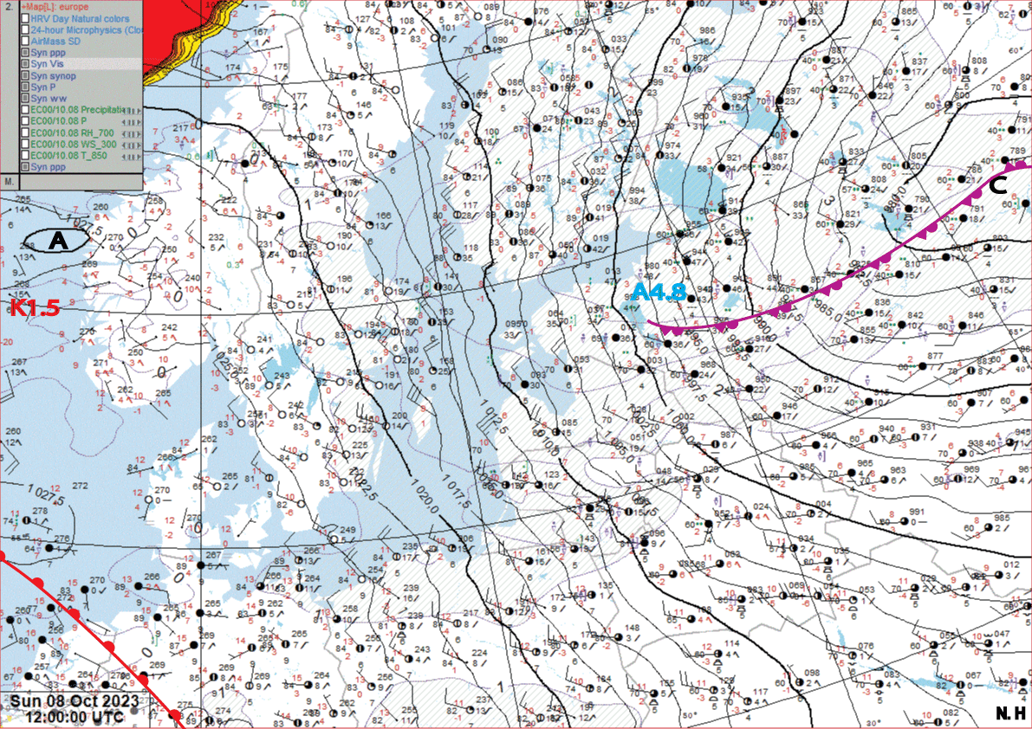
SYNOPTIC SITUATION
Surface
1
2
3
4

Slide 3
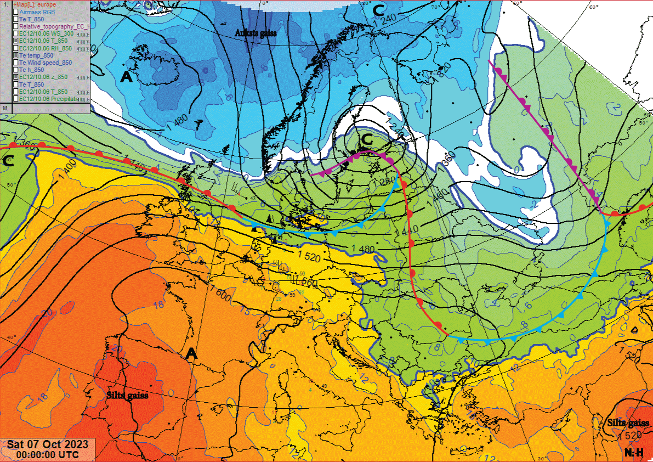
SYNOPTIC SITUATION
850 hPa

Slide 4
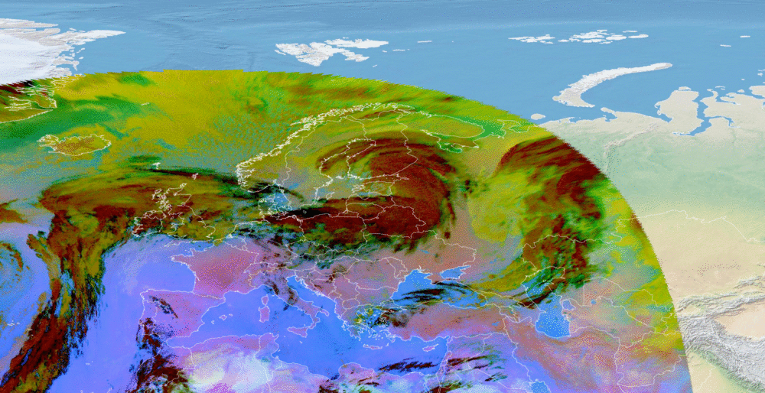
SATELLITE OBSERVATIONS
7th October 00-12 UTC (Dust RGB)

Slide 5
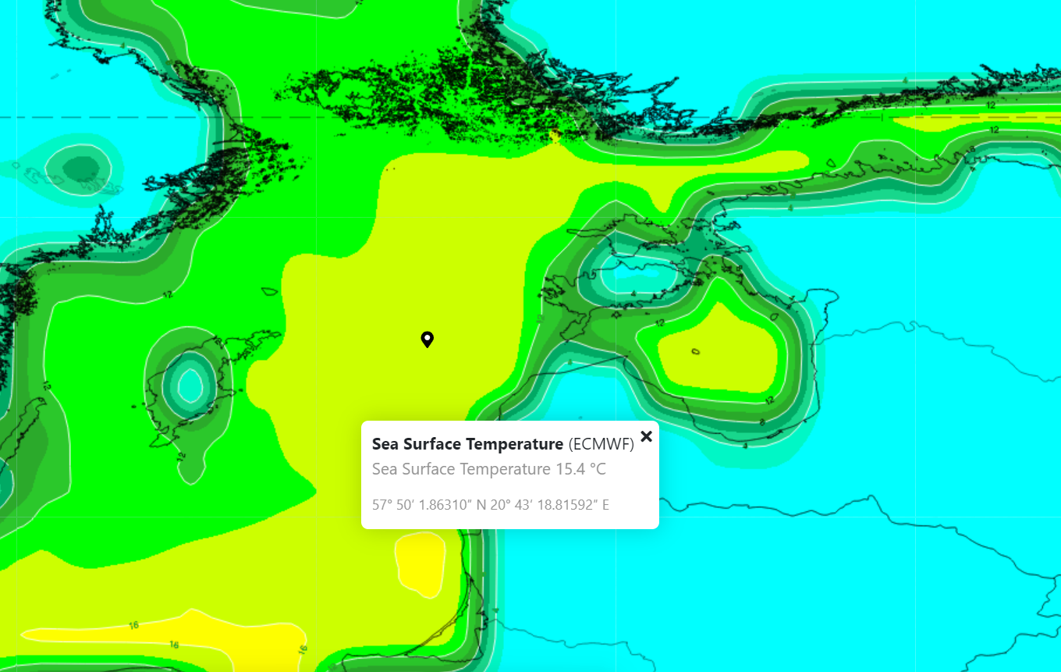
MODEL DATA
8th of October 00 UTC (ECMWF Sea Surface Temperature)

Slide 6
SATELLITE OBSERVATIONS
8th October 08 UTC (Natural Colours)
Notes:
CB mākoņi jūrā un līcī

Slide 7
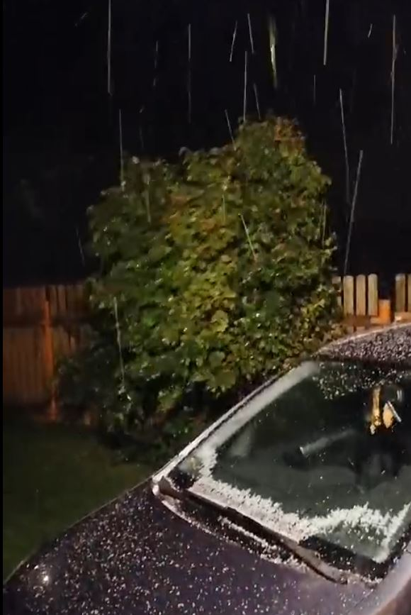
PRECIPITATION
Observed precipitation:
Rain - in all parts of Latvia (not significant);
Sleet, snow - mostly in the eastern parts of Latvia at night and in the morning of October 8;
Thunderstorm, hail - at night on October 8 in Riga.
Hail in Marupe (near Riga) at night to October 8
^{Sleet in Jekabpils, October 8}
^{Hail near Riga, October 8}

Slide 8
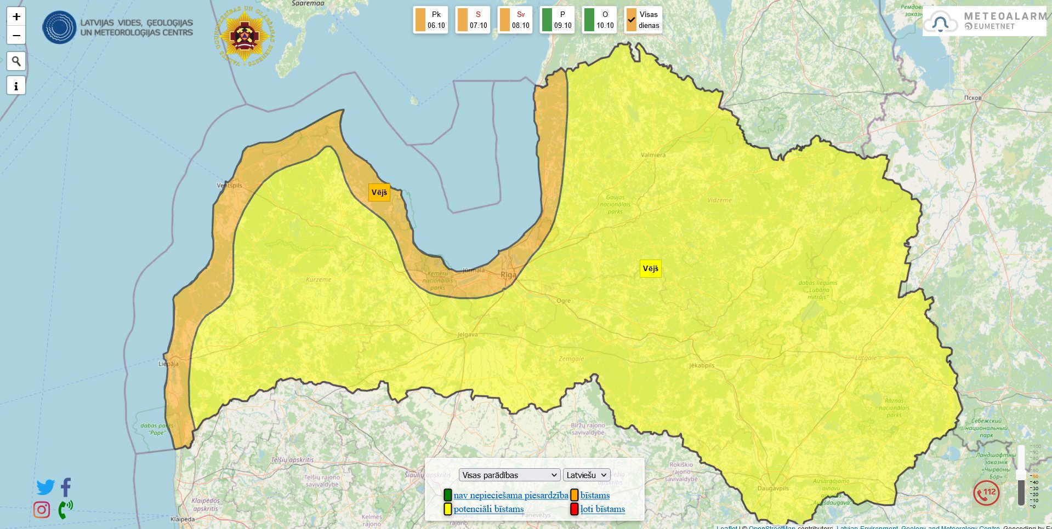
WEATHER WARNINGS
WIND:
for Latvia
for the Central Baltic; the Gulf of Riga; Riga; Liepaja;
Ventspils; the coastal areas
WATER LEVEL:
for Riga
General public weather warnings on October 6

Slide 9
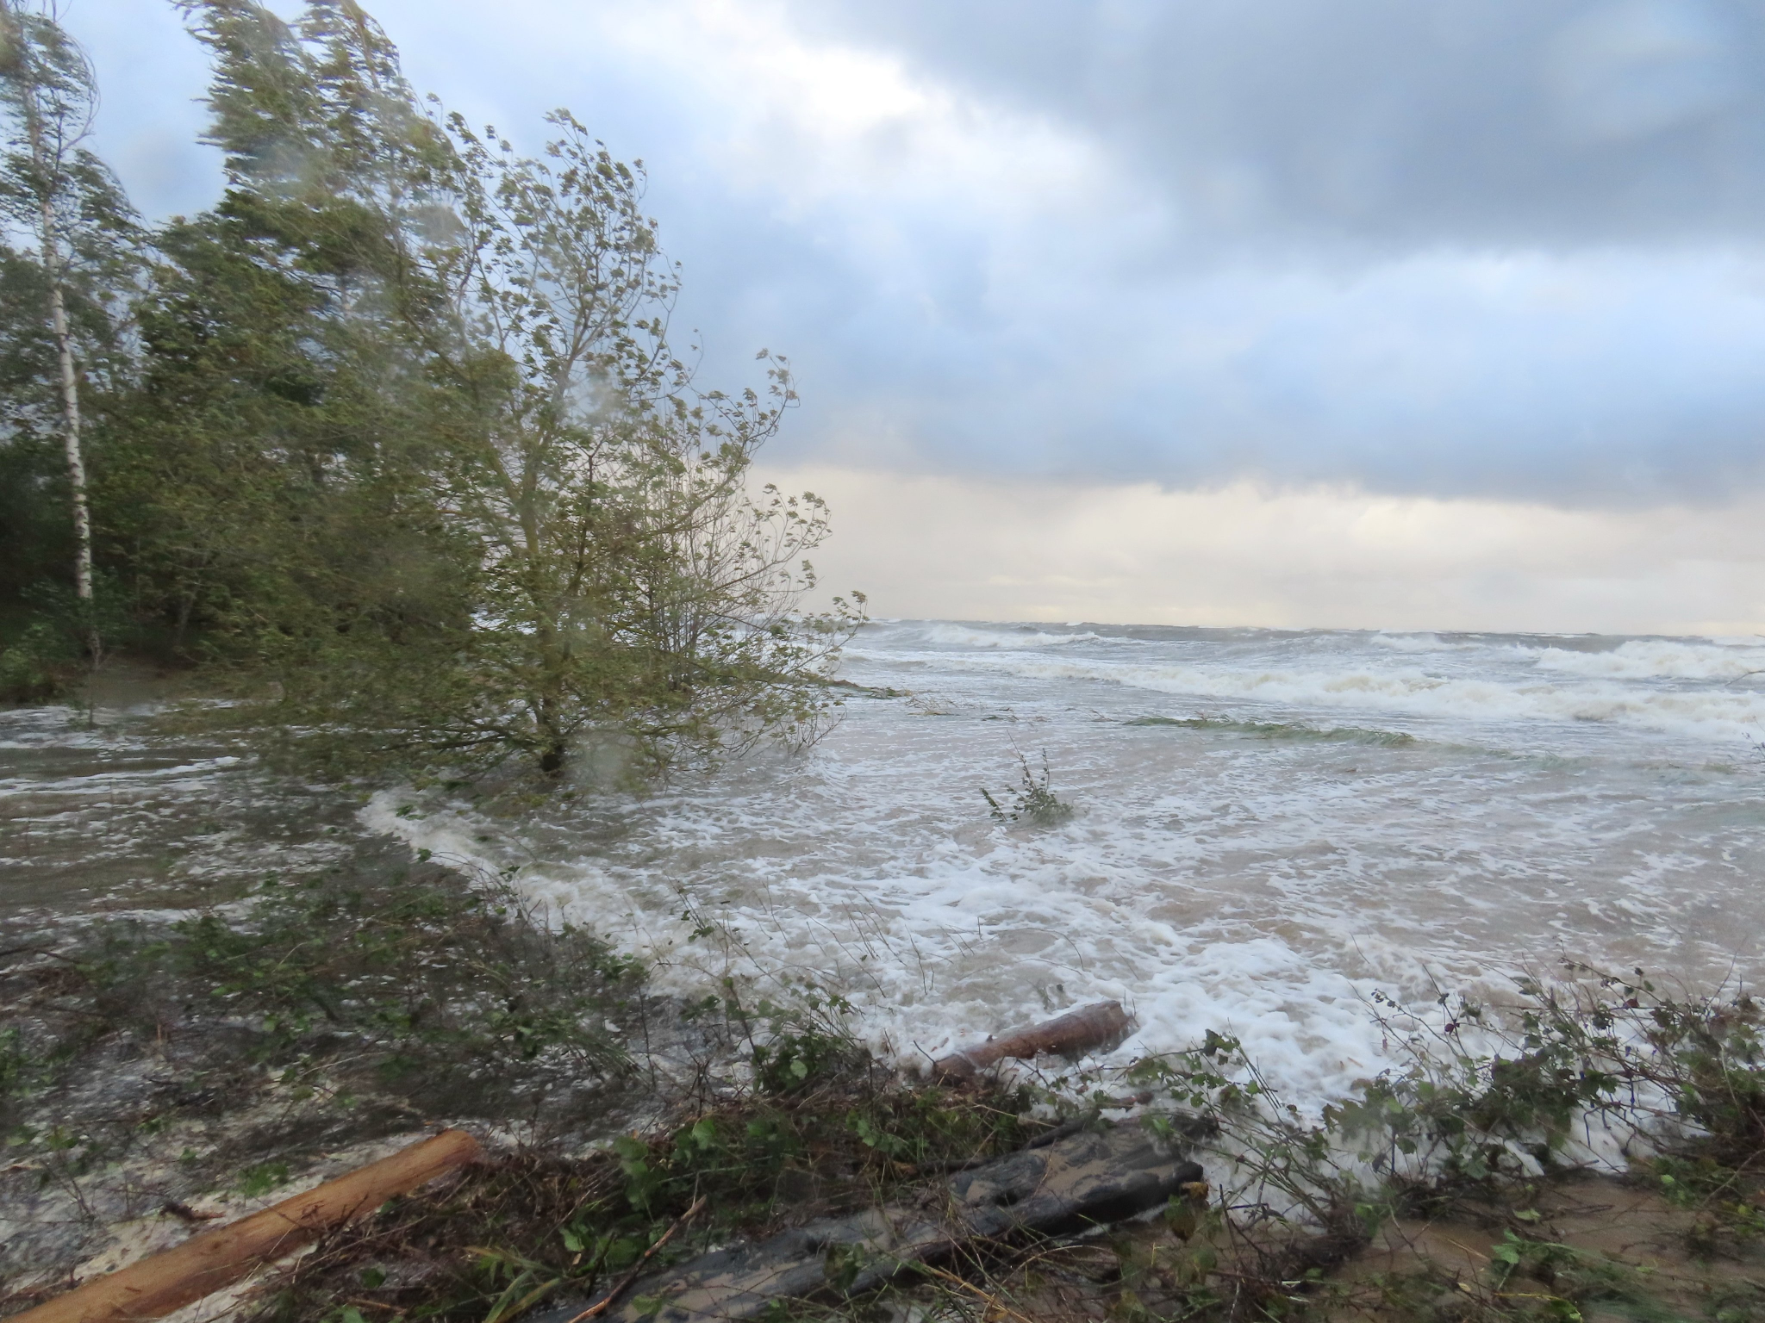
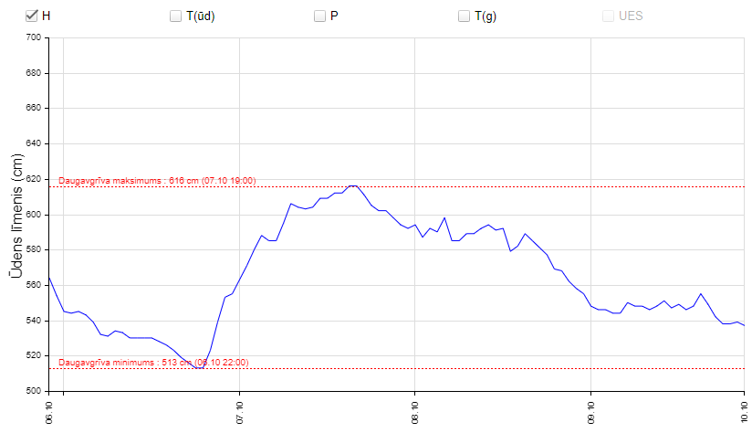
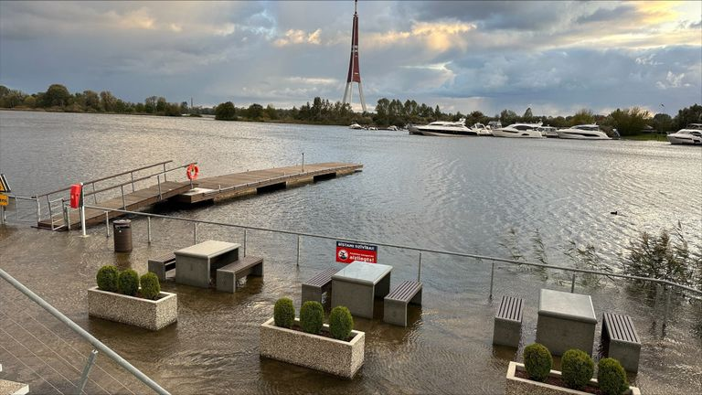
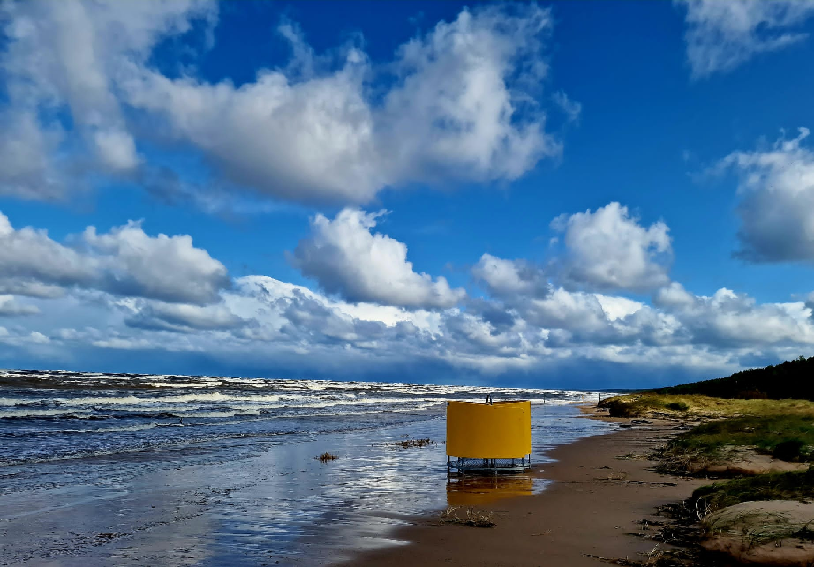
WATER LEVEL
Water level height in Riga (Daugavgriva) (m)
Daugavgriva, October 7
Gulf of Riga, October 8
River in Riga
Notes:
Ventspilī 52h pēc kārtas brāzmas >20 m/s

Slide 10
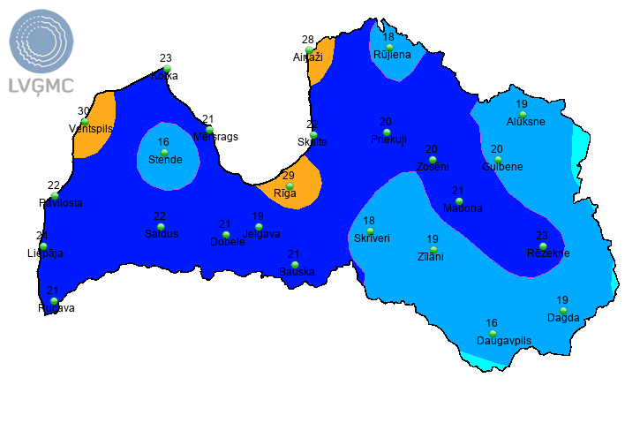
WIND
Highest wind gusts (m/s) registered in the observation stations 7.-8.10.
Notes:
Ventspilī 52h pēc kārtas brāzmas >20 m/s

Slide 11
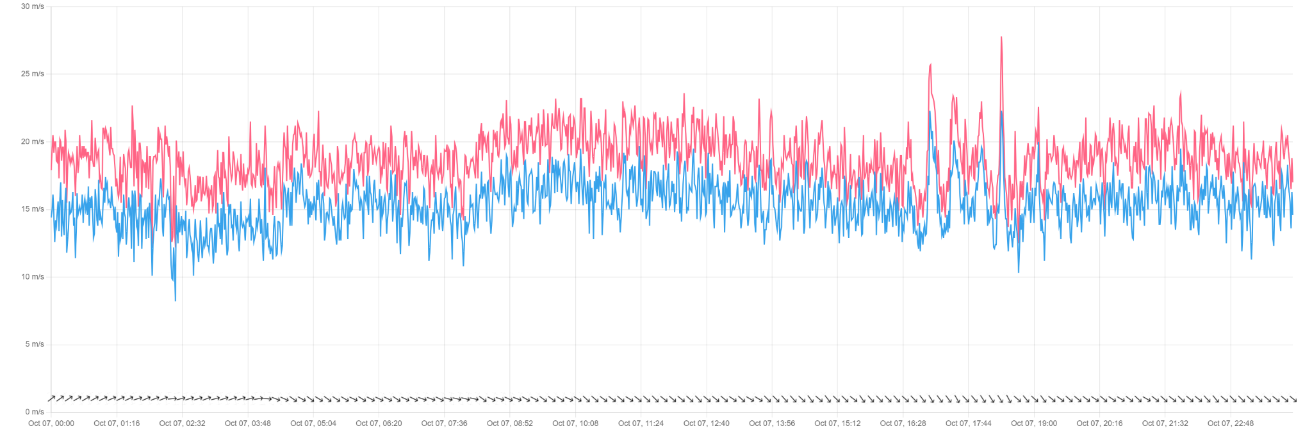
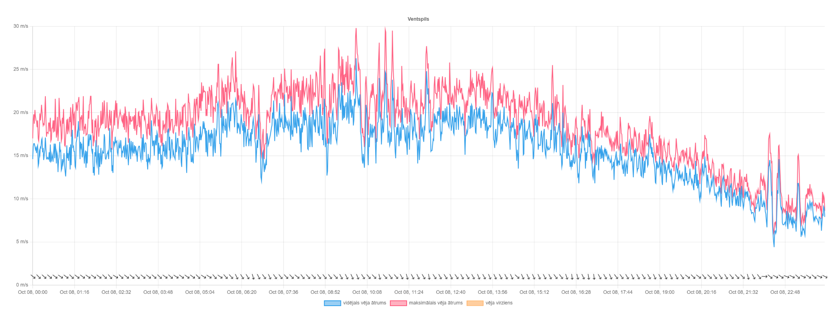
WIND
Wind speed and wind gusts (m/s) in Ventspils from 07.10. 00:00 until 08.10. 23:59

Slide 12
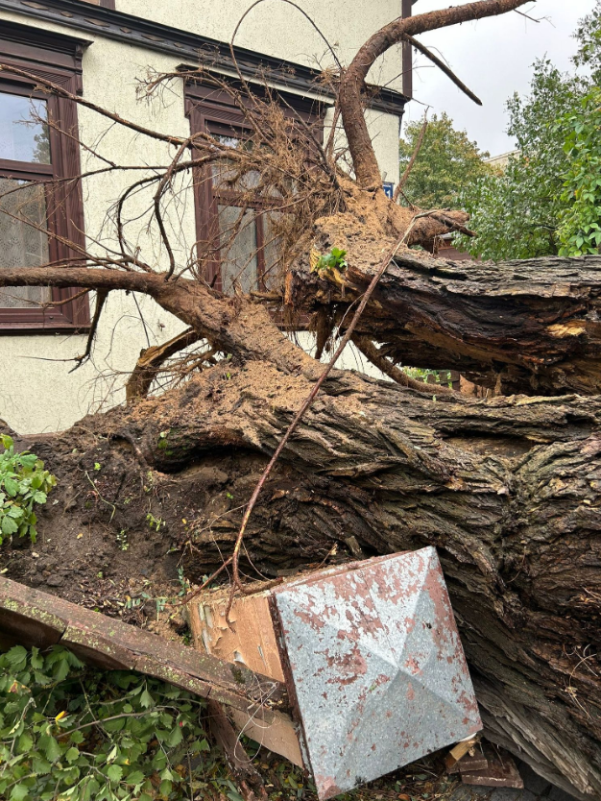
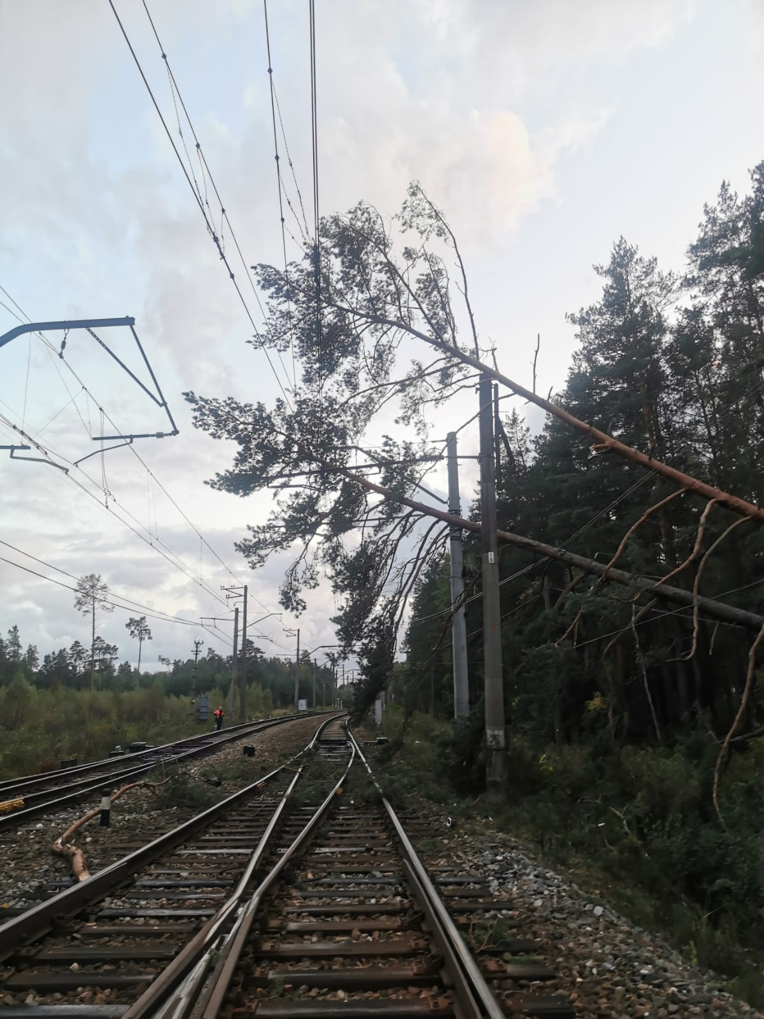
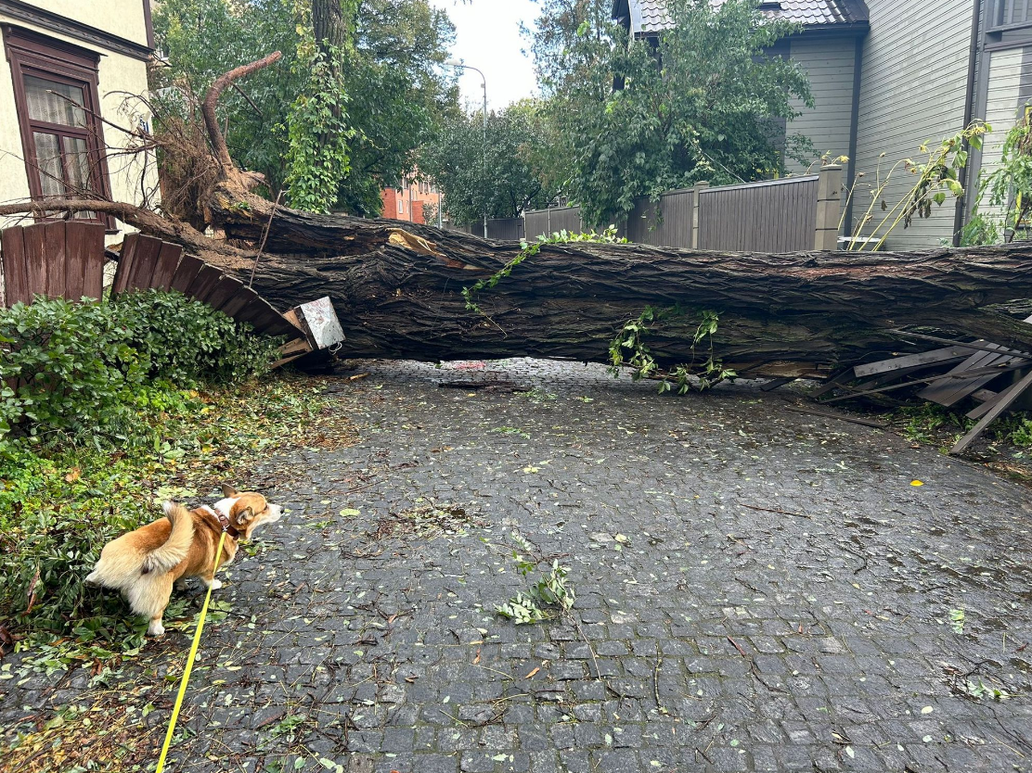
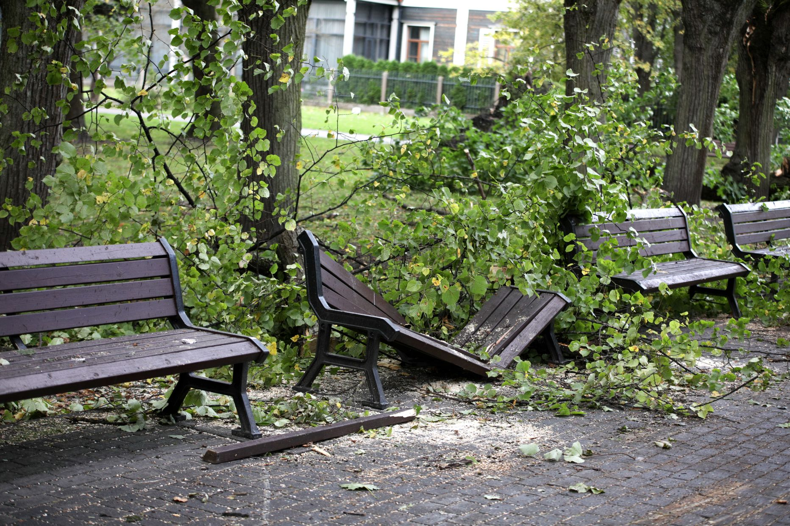
IMPACT
1060 emergency calls, 431 of them only in Riga;
Power supply disturbances in the power grid for at least 44 000 clients;
Disrupted traffic, incl. public transportation - buses and trains.

Slide 13
THANK YOU FOR YOUR ATTENTION!

