Slide 1
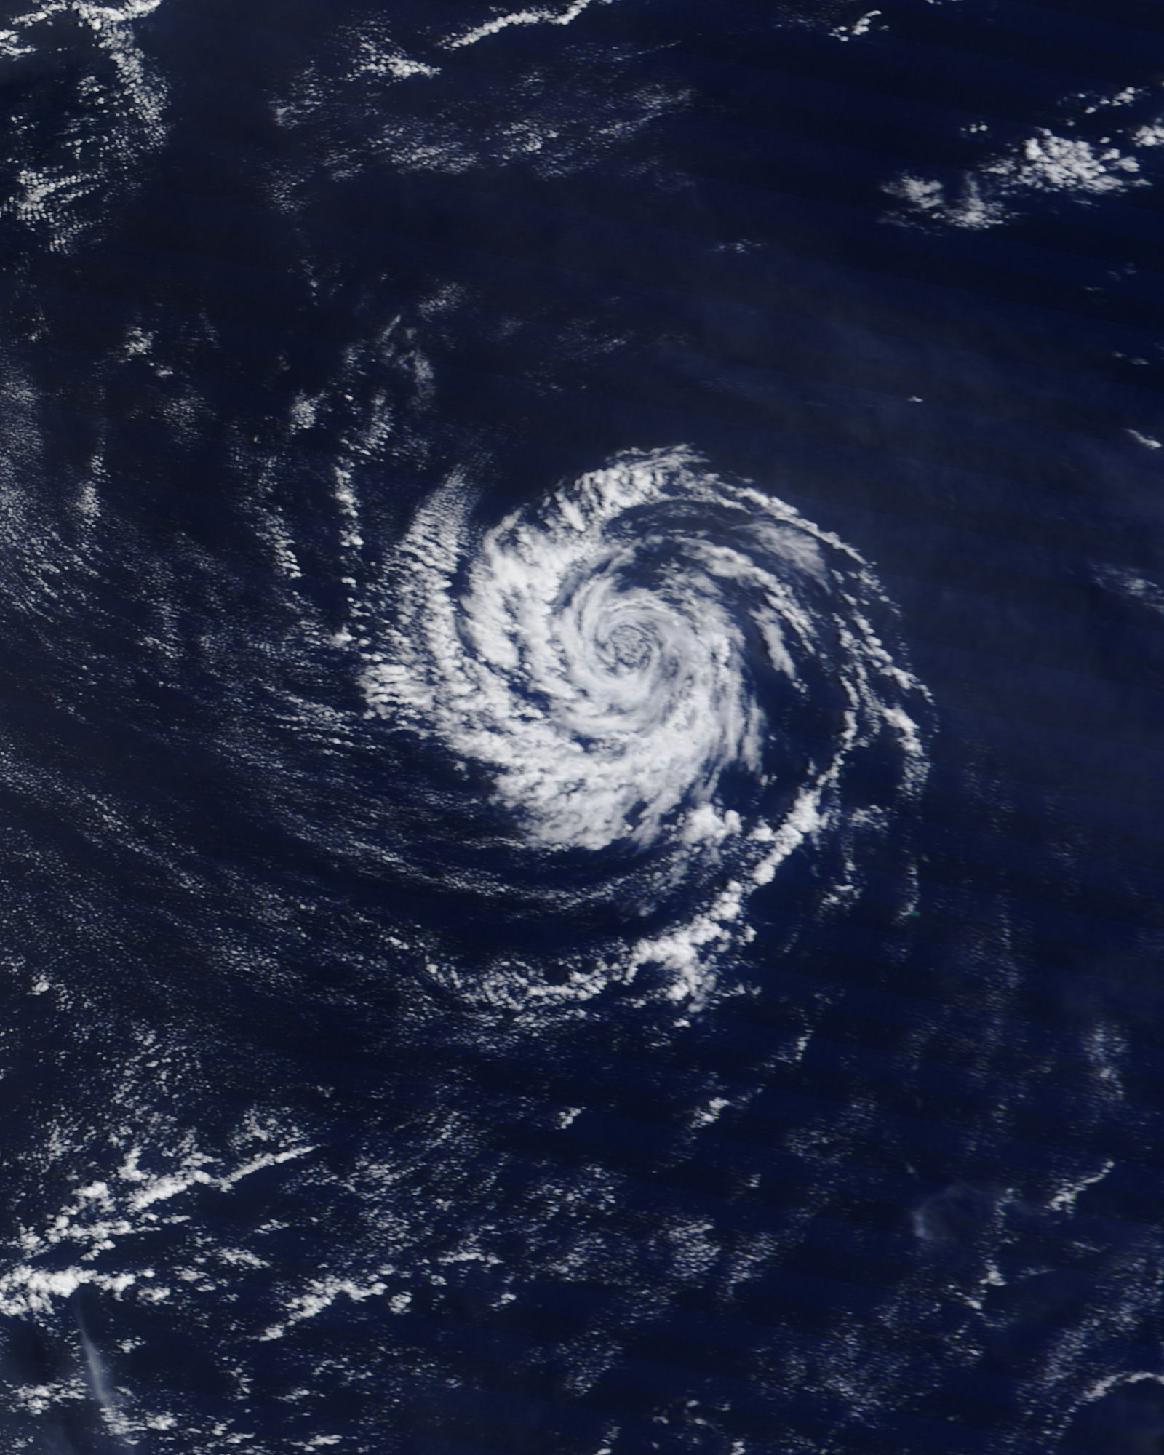
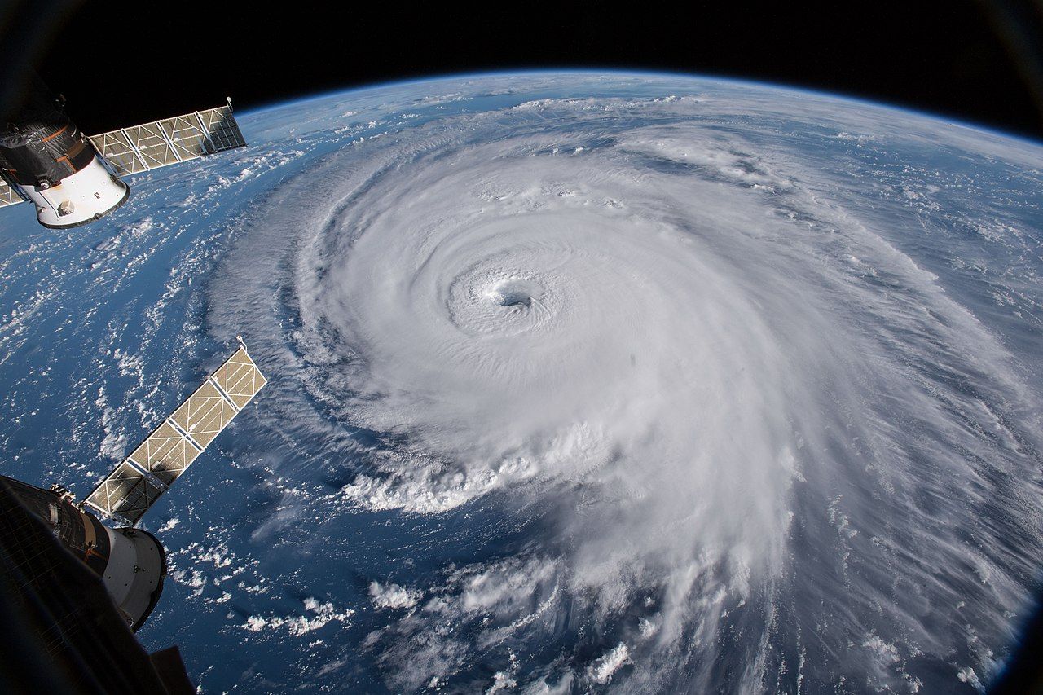
STRONGER THAN EXPECTED 2022.01.14 event in Lithuania
Presenter: Tadas Kantautas, LHMS
Creators: Tadas Kantautas, Giedrė Andruškienė, Saulius Šatas, LHMS

Slide 2
Severe wind warnings issued for 2022.01.14
In the first half of the night south-west, west wind gusts locally, mainly in western regions, 15-20 m/s. In the second half of the night and in daytime west, north-west wind gusts in many places 15-20 m/s, locally 21-24 m/s, on the seashore up to 27 m/s.
–
–

Slide 3
Observations on 2022.01.14
In many places wind gusts 16-27 m/s (Yellow warning treshold 15-27 m/s).
Locally wind gusts 28 m/s (possible more) (Orange warning treshold 28-32 m/s).
In Ventė meteorological station maximum wind gust 35,5 m/s (Red warning treshold ≥33 m/s).
Locally thunderstorm, graupel.

Slide 4
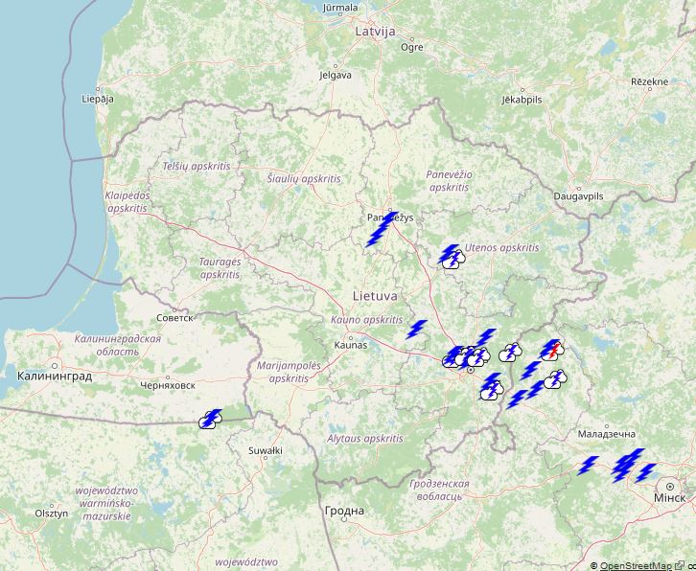
Maximum wind gusts (m/s), Lightnings on 2022.01.14
Ventė 35,5 m/s

Slide 5
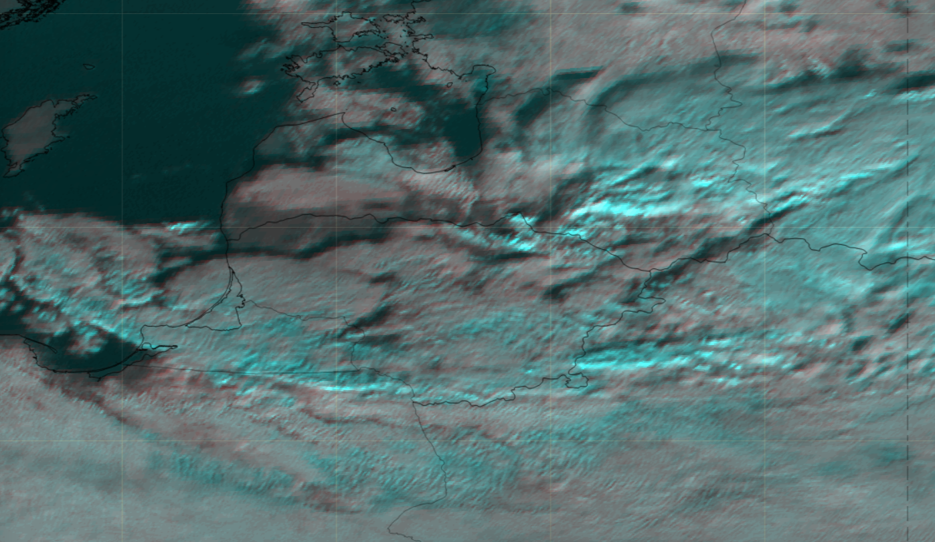
HRV Fog RGB 2022.01.14 09 UTC

Slide 6
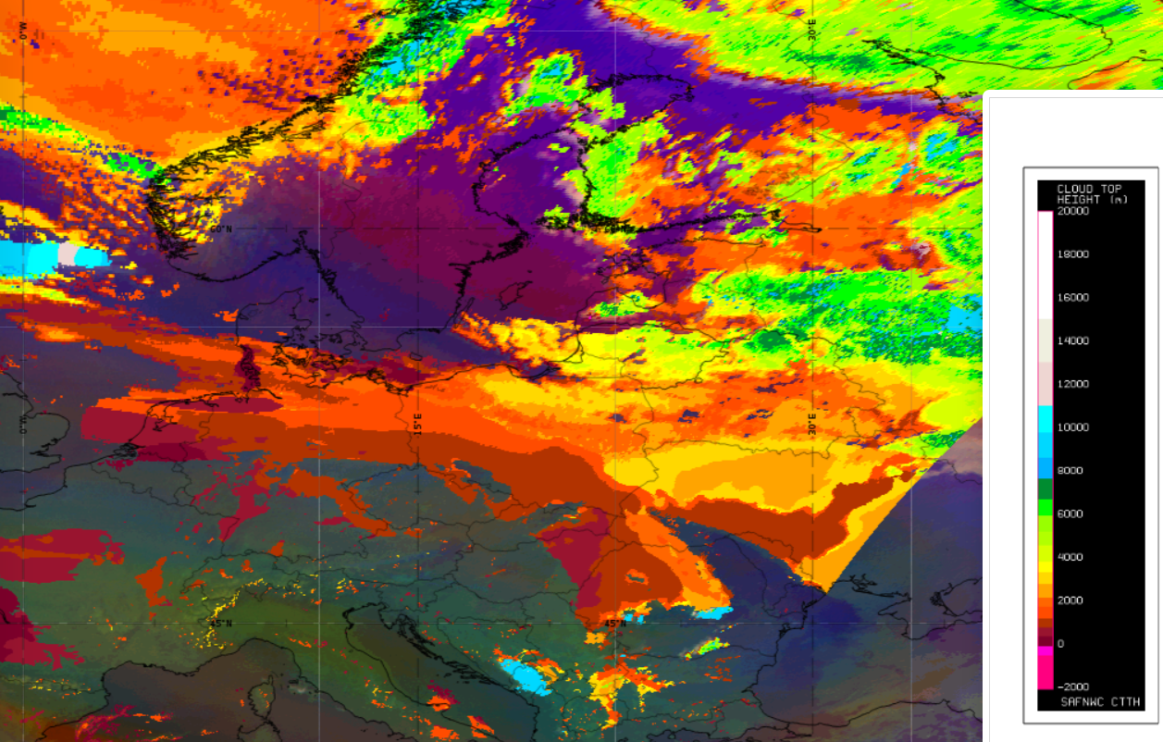
Cloud Top Altitude (m) 2022.01.14 09 UTC

Slide 7
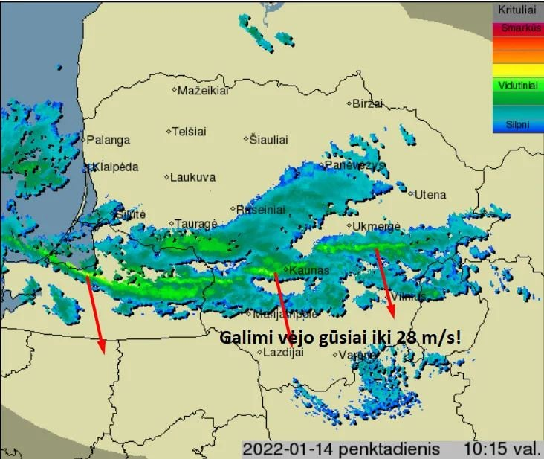
Radar information 2022.01.14 8:15 UTC

Slide 8
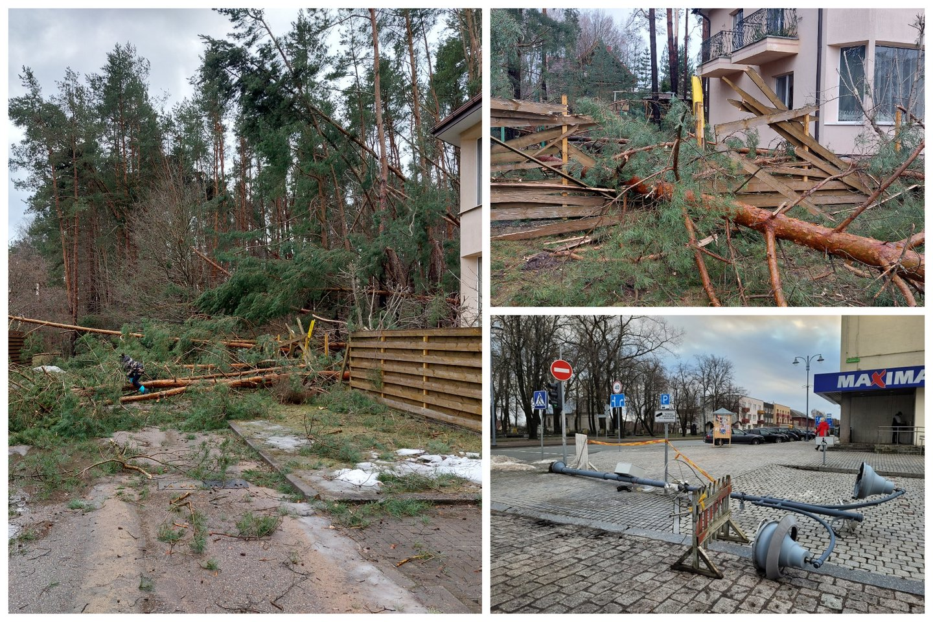
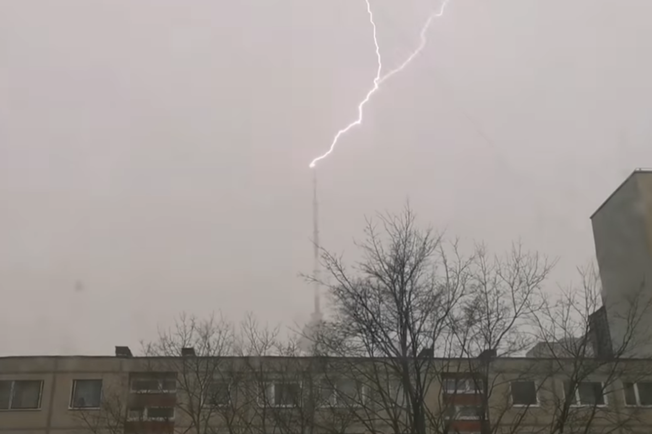
Consequences
Trees downed;
Power outages;
Damage to private and public infrastructure.

Slide 9
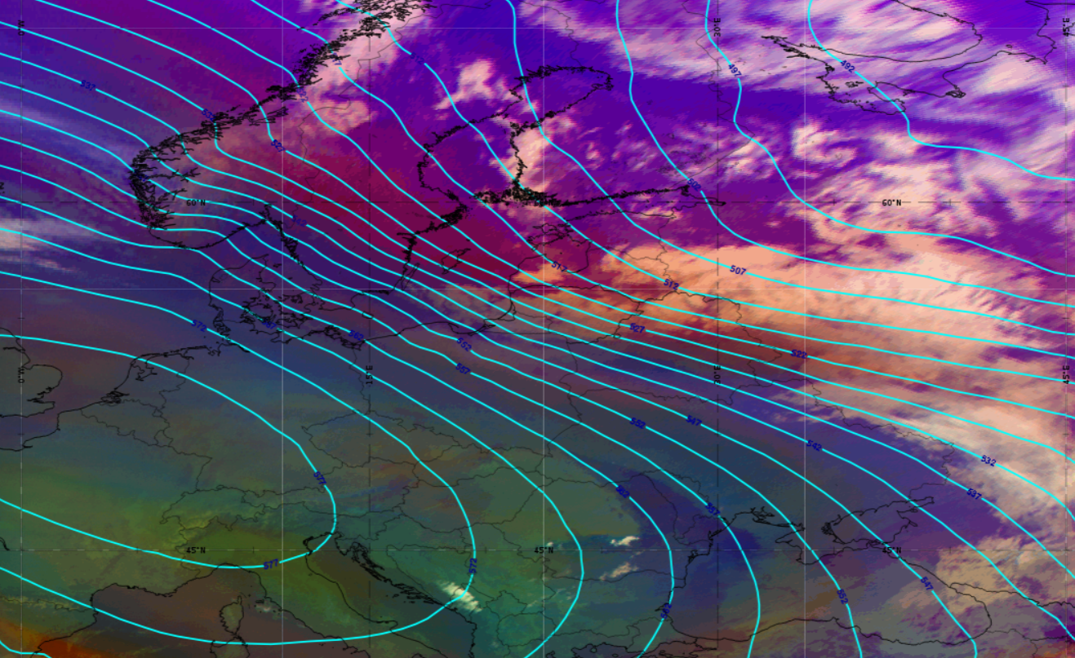
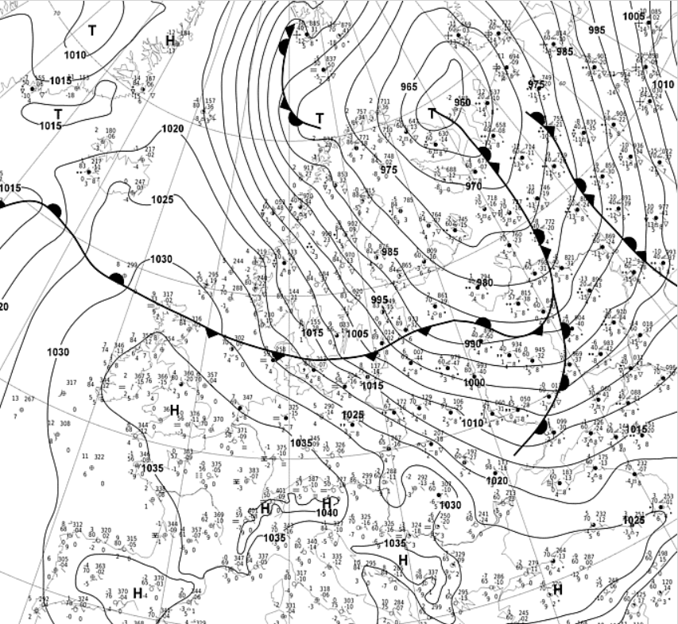
Synoptical conditions and conceptual models analysis Synoptical situation 2022.01.14 06 UTC and Airmass RGB + Geopotential height 500 hPa

Slide 10
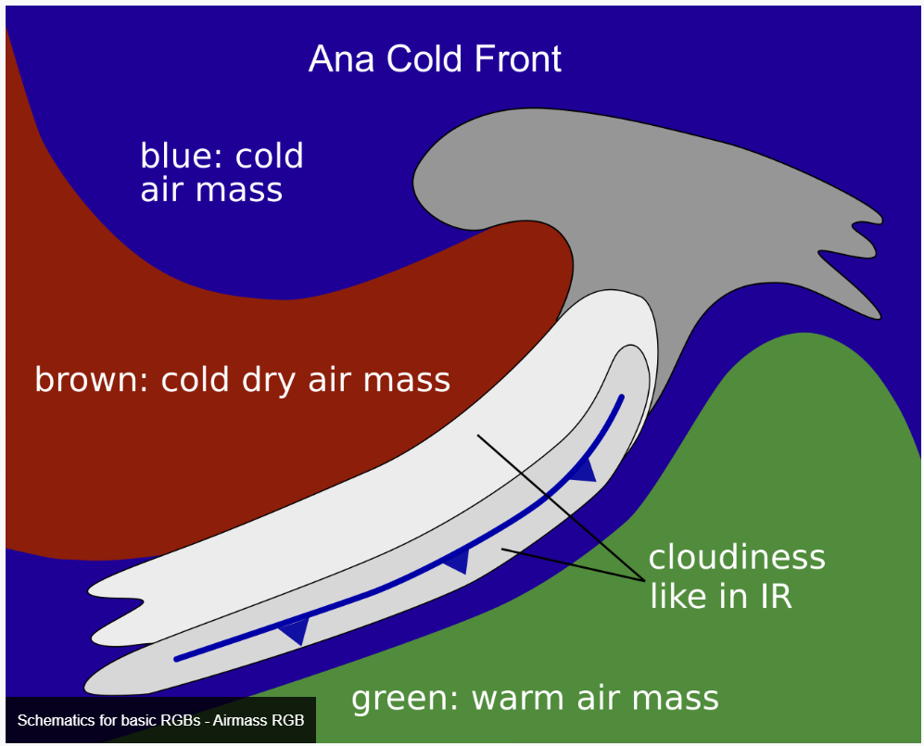
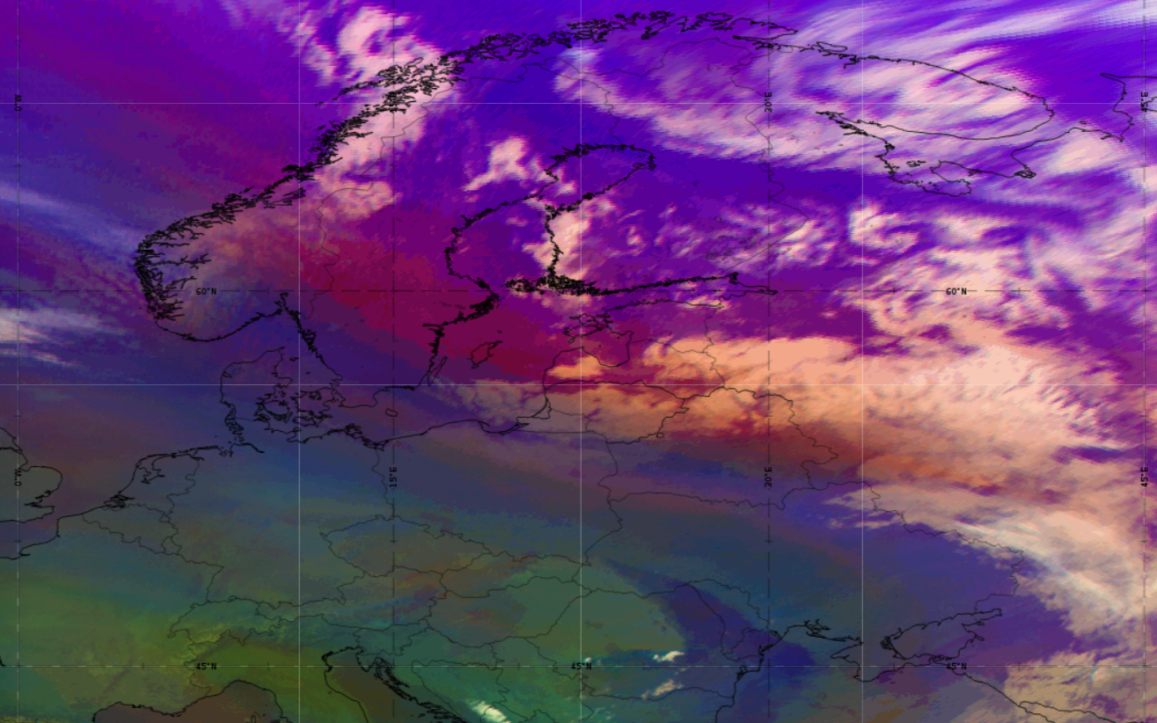
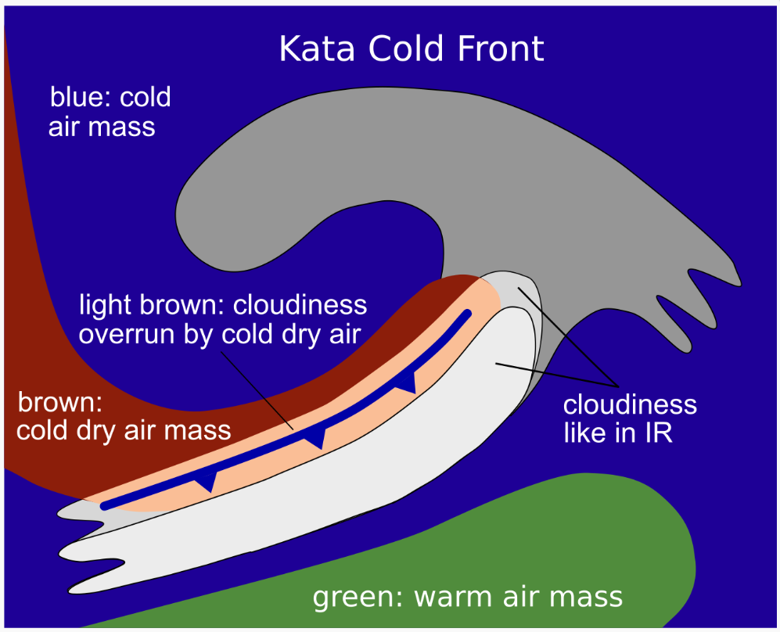
Airmass RGB 2022.01.14 09 UTC + Ana/Kata Cold front clouds color scheme

Slide 11
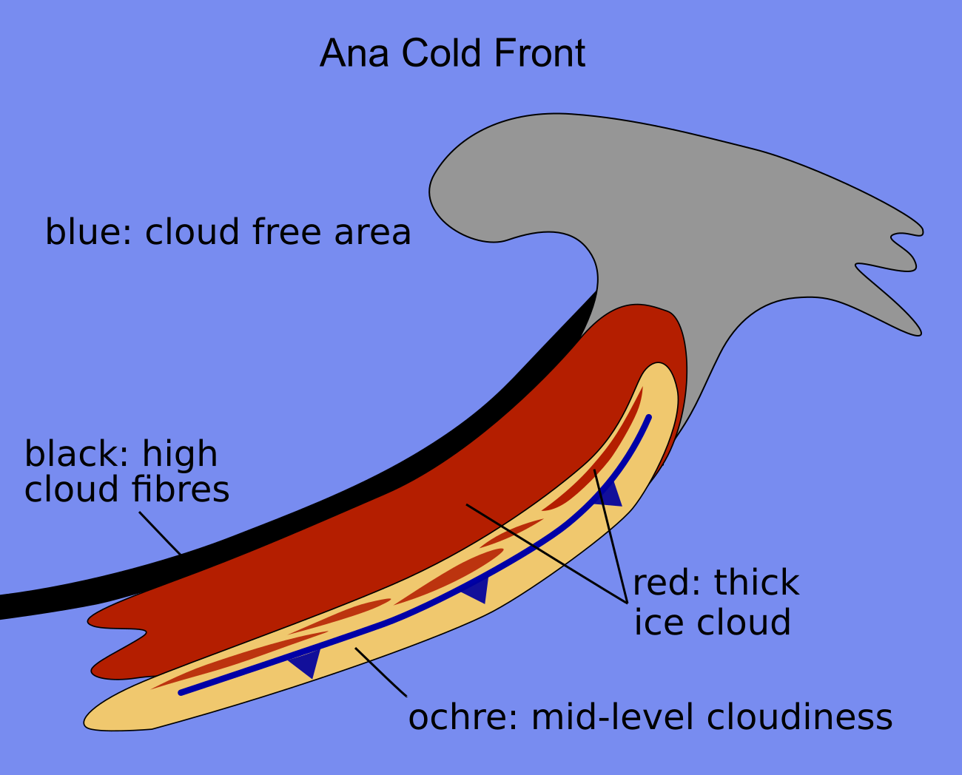
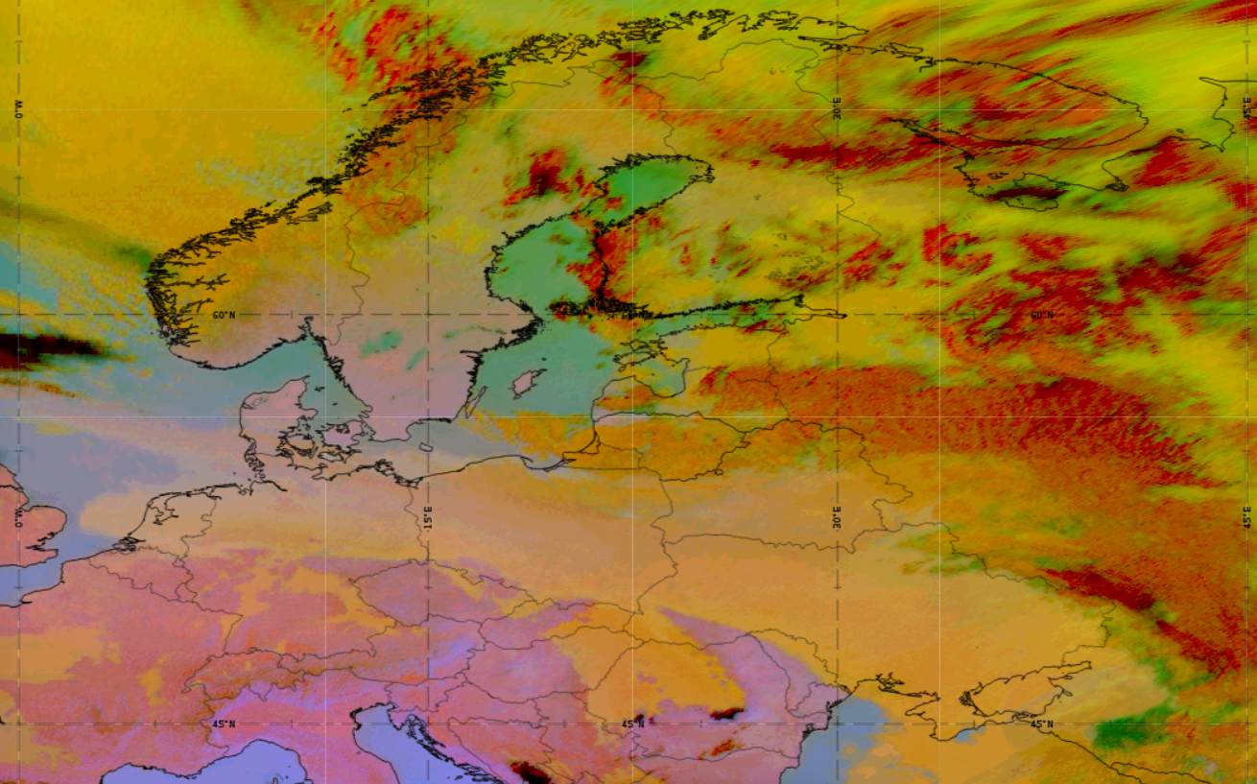
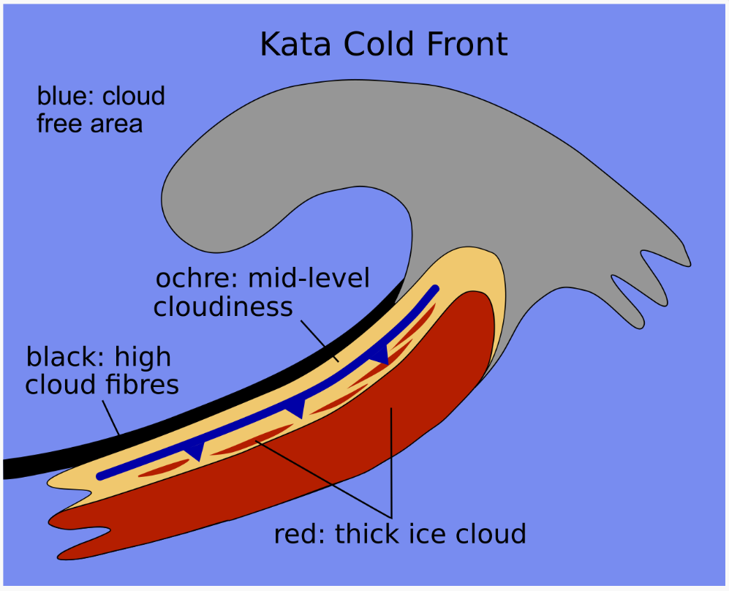
Dust RGB 2022.01.14 09 UTC + Ana/Kata Cold front clouds color scheme

Slide 12
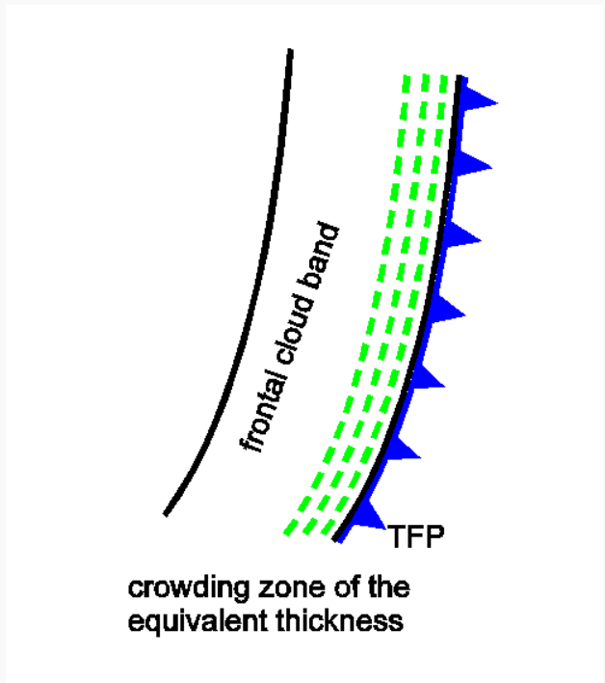
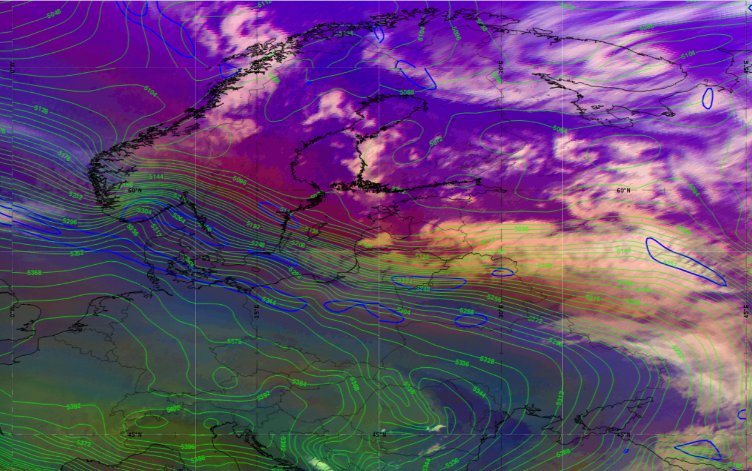
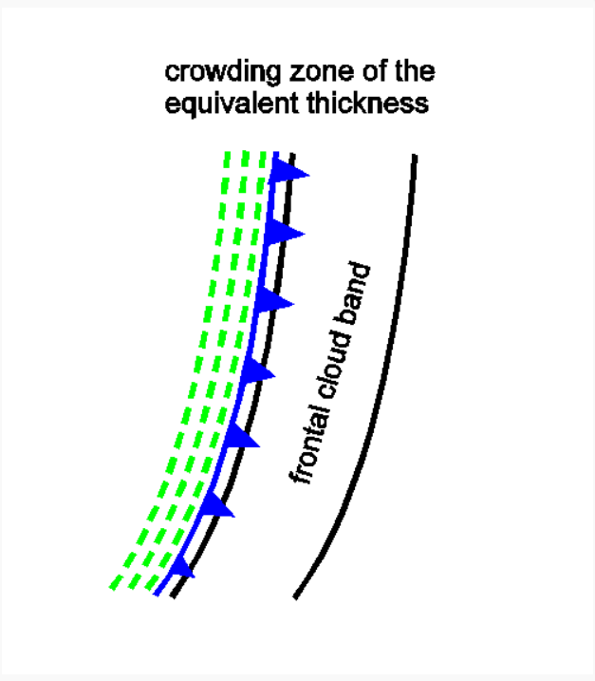
Airmass RGB 2022.01.14 09 UTC + TFP + Thickness 500-1000 hPa
Ana Cold Front
Kata Cold Front

Slide 13
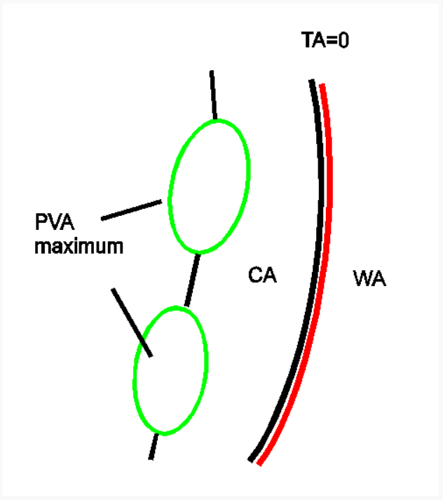
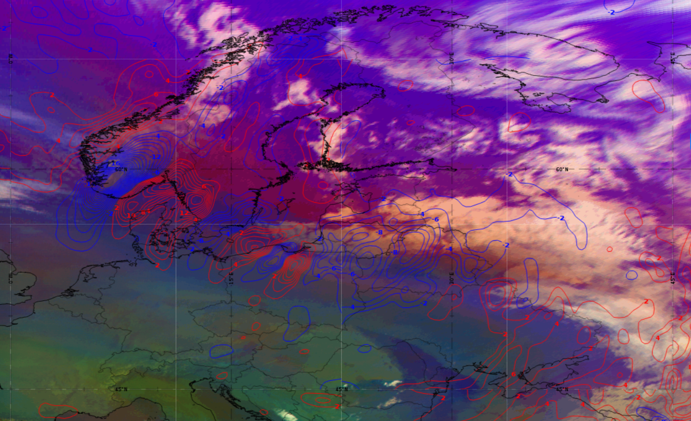
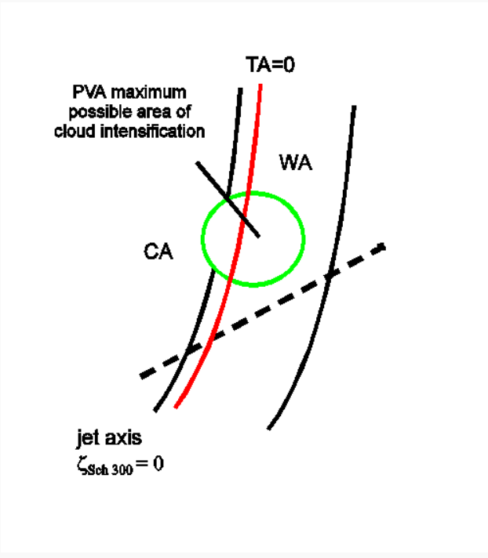
Airmass RGB 2022.01.14 09 UTC + Temperature advection 700 hPa
Ana Cold Front
Kata Cold Front

Slide 14
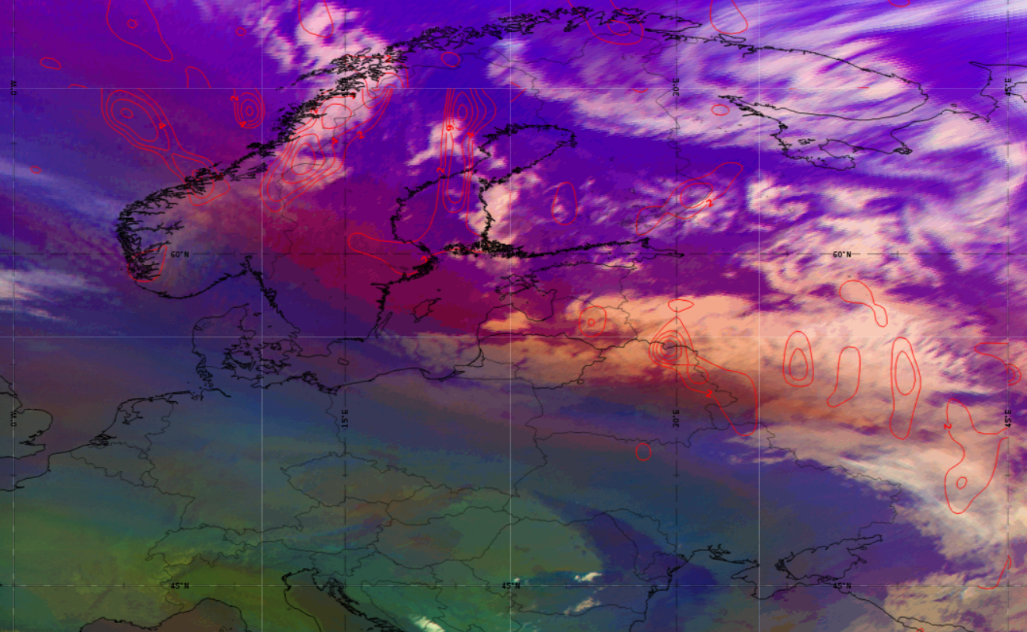
Airmass RGB 2022.01.14 09 UTC + PVA 500 hPa
Ana Cold Front
Kata Cold Front

Slide 15
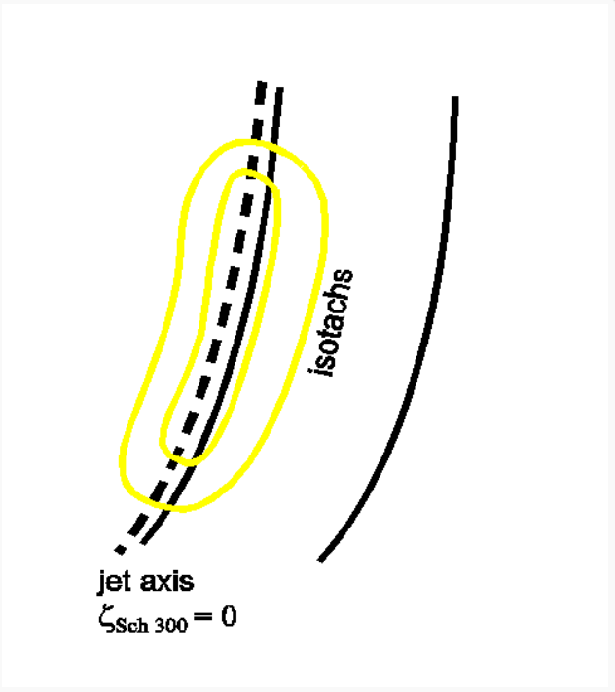
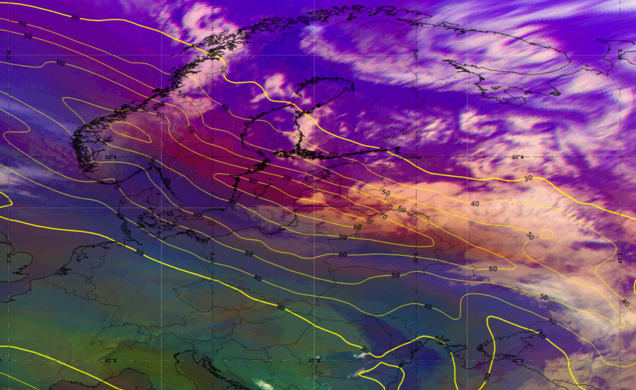
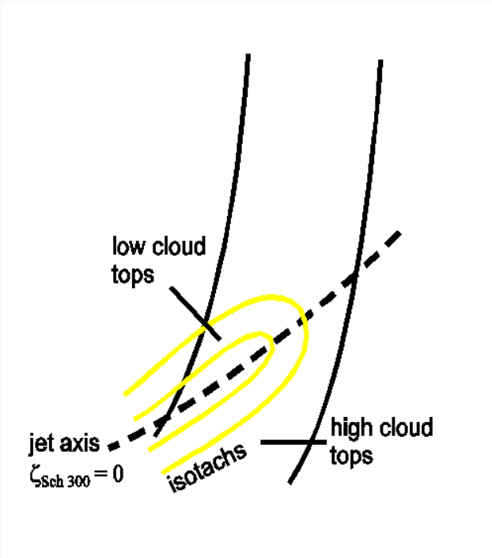
Airmass RGB 2022.01.14 09 UTC + Isotachs 300 hPA
Ana Cold Front
Kata Cold Front

Slide 16
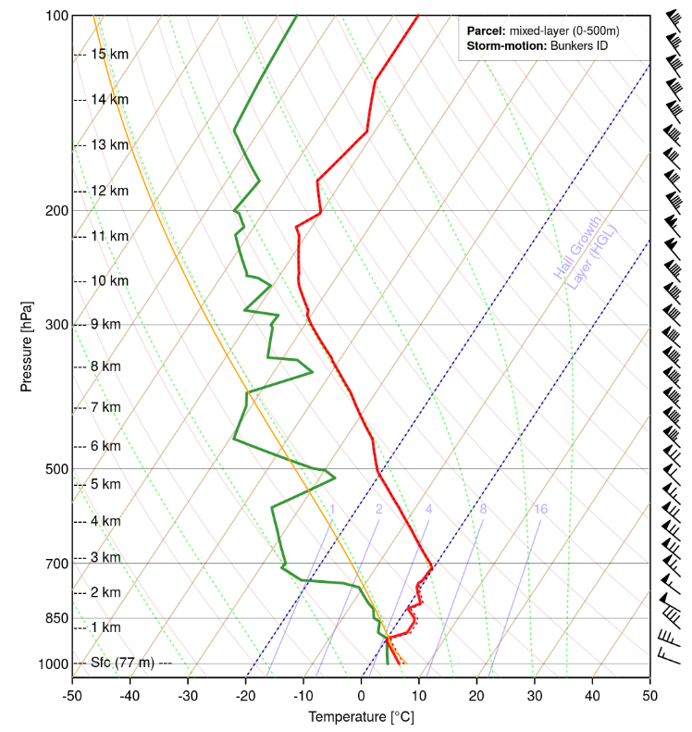
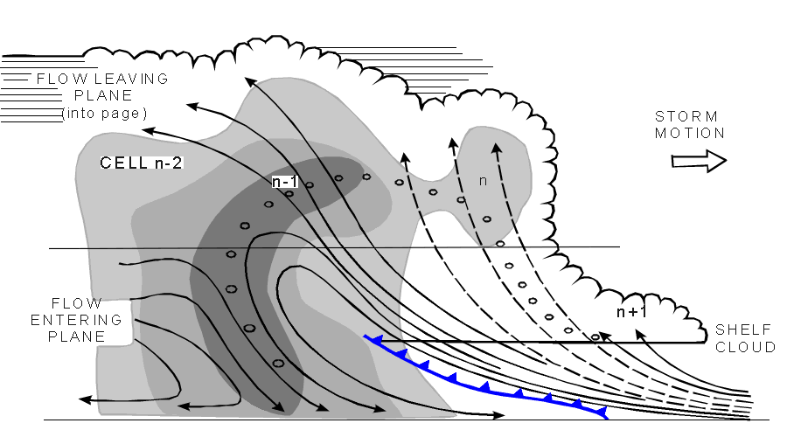
Convection influence for wind gusts (convective)?
Sounding of Kaunas of 2022.01.14 00 UTC

Slide 17
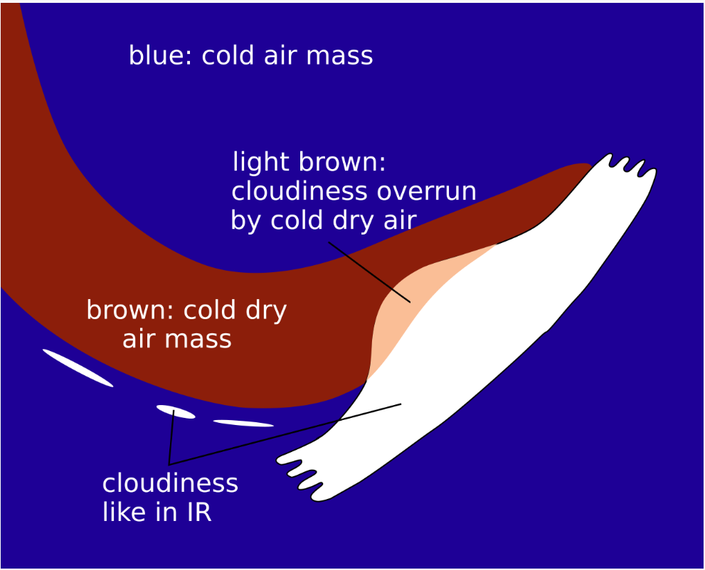
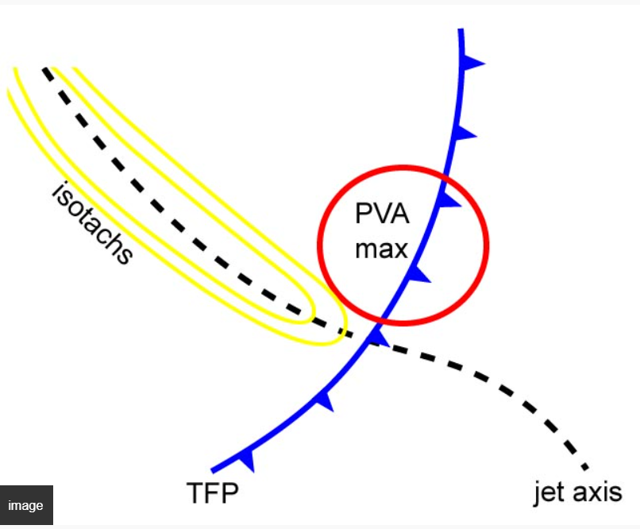
Thank you for your attention
Questions/Discussion
Which cold front type it could be? Ana Cold Front or Kata Cold Front?
Front intensification by Jet crossing influence?

