Slide 1
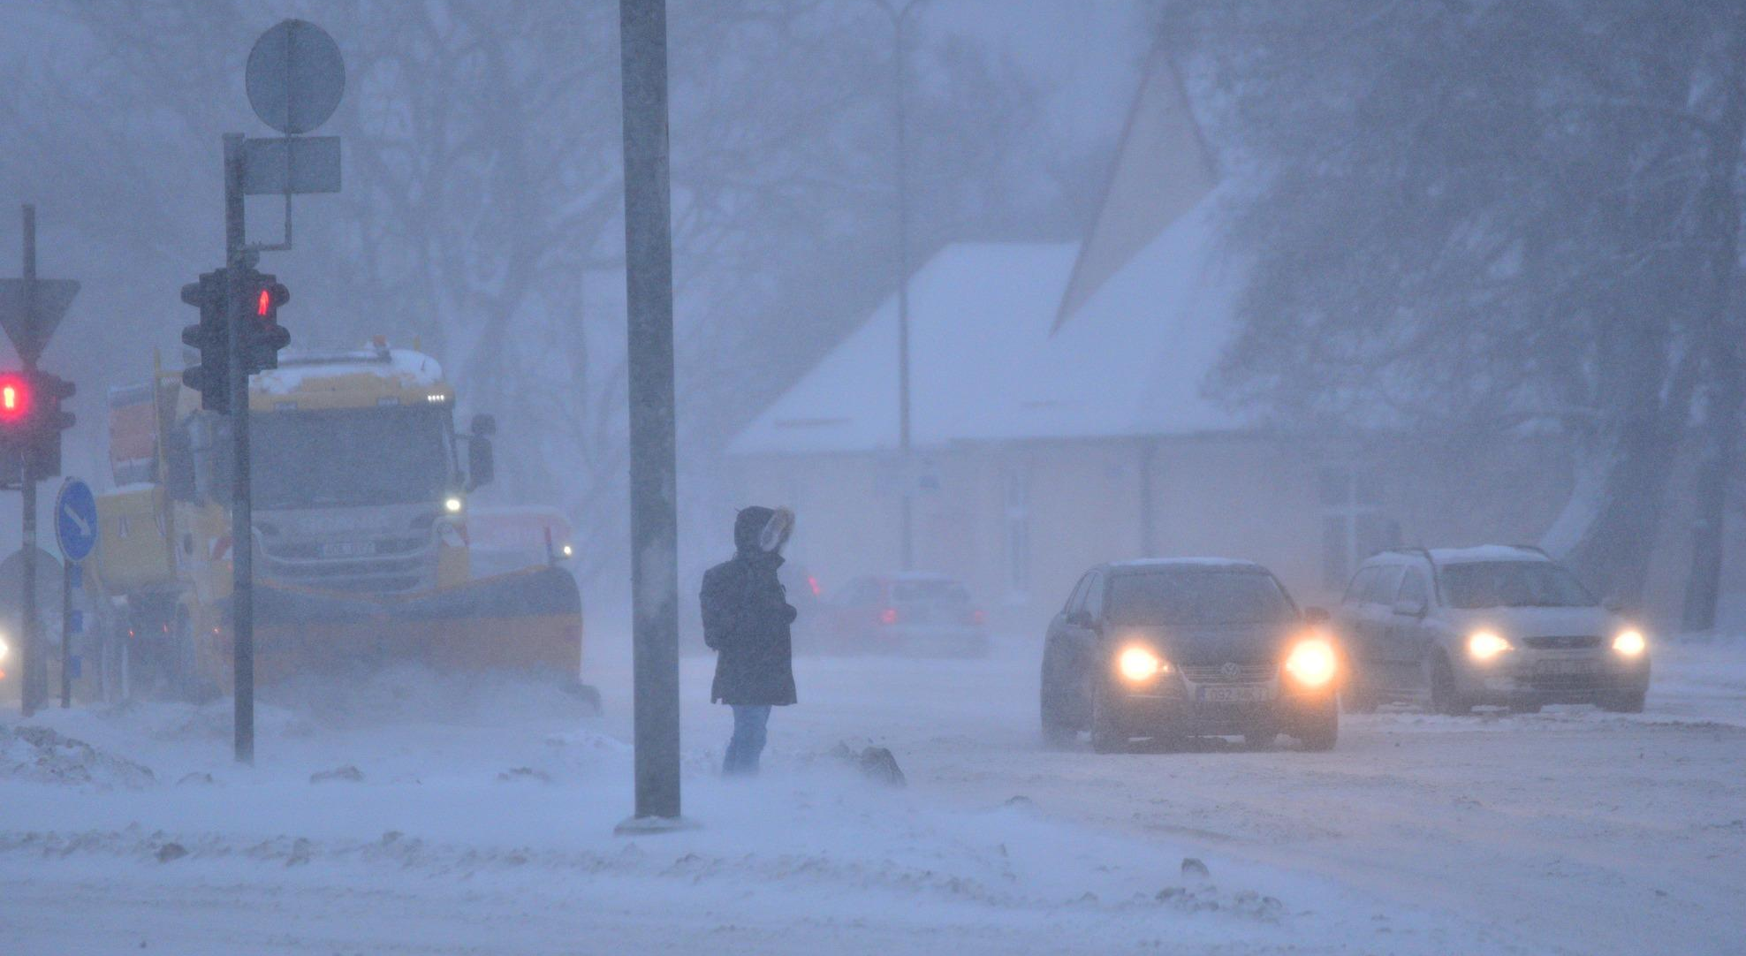
Winter Storm Birgit,
case of Dec 12-13, 2022
Karl Erik Krepp
Kaido Ennok
Katriin Käärik
Estonian Environment Agency
Photo by Kairo Kiitsak

Slide 2
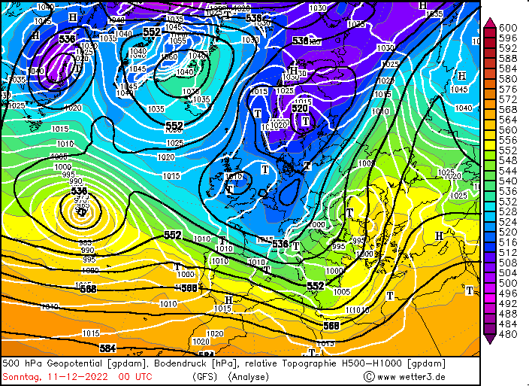
Before the storm:
Cold airmass spreading down to France
Low (over Balkans) with inflow of warm air from Mediterranean
= Large temperature gradient in higher layers

Slide 3
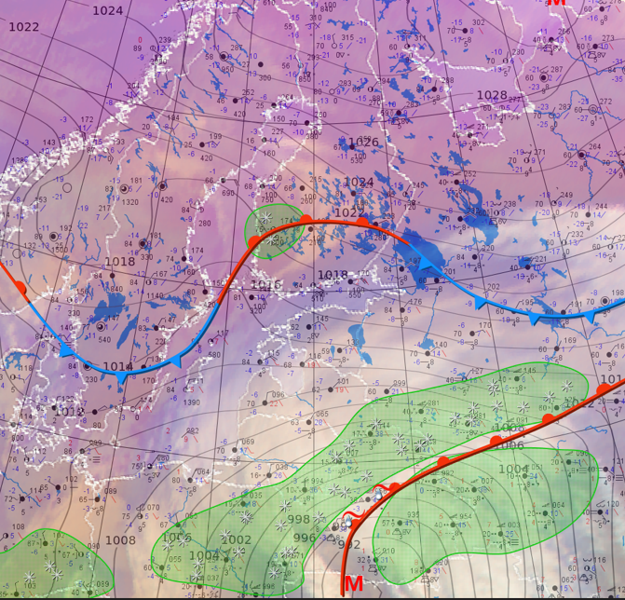
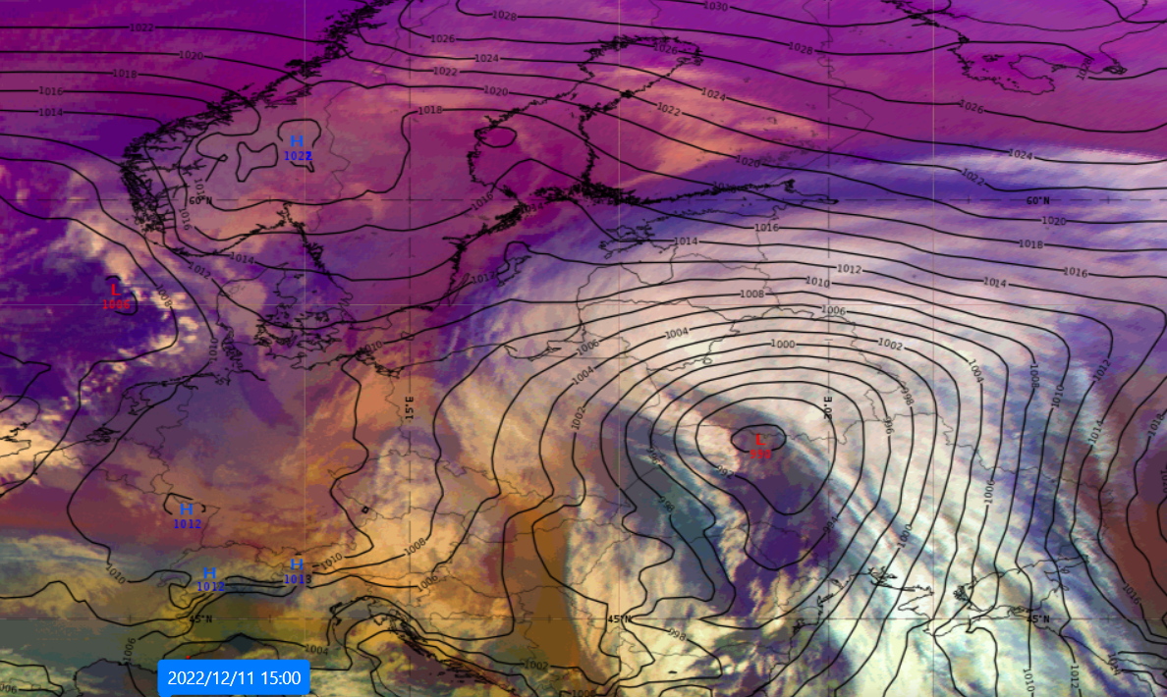
Weather situation before storm
High-level thick clouds were already covering Latvia and Lithuania and some of Estonia
Pressure was dropping quickly in Estonia
Fronts and precipitation 11.12.22 15 UTC
Airmass RGB and mean sea level pressure 11.12.22 15 UTC

Slide 4
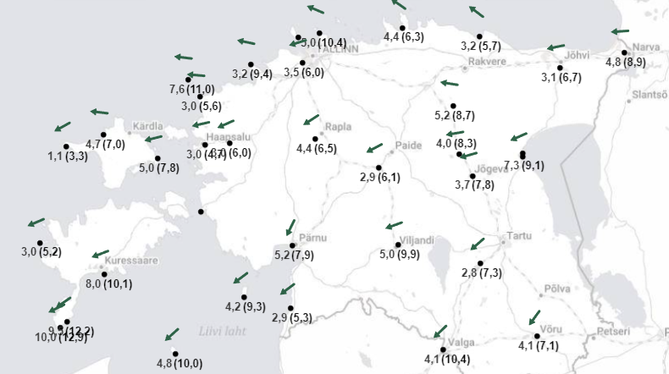
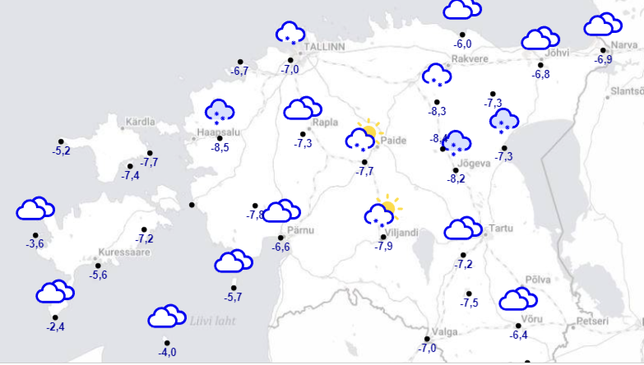
Weather situation before storm
Moderate easterly wind
Cloudy with some clear spells
Locally some snow
Temperatures were between -2..-8°C
Winds over Estonia 11.12.22 15 UTC
Temperatures and weather over Estonia 11.12.22 15 UTC

Slide 5
Overview of the cyclone trajectory

Slide 6
Storm development around Estonia
Source: TIK

Slide 7
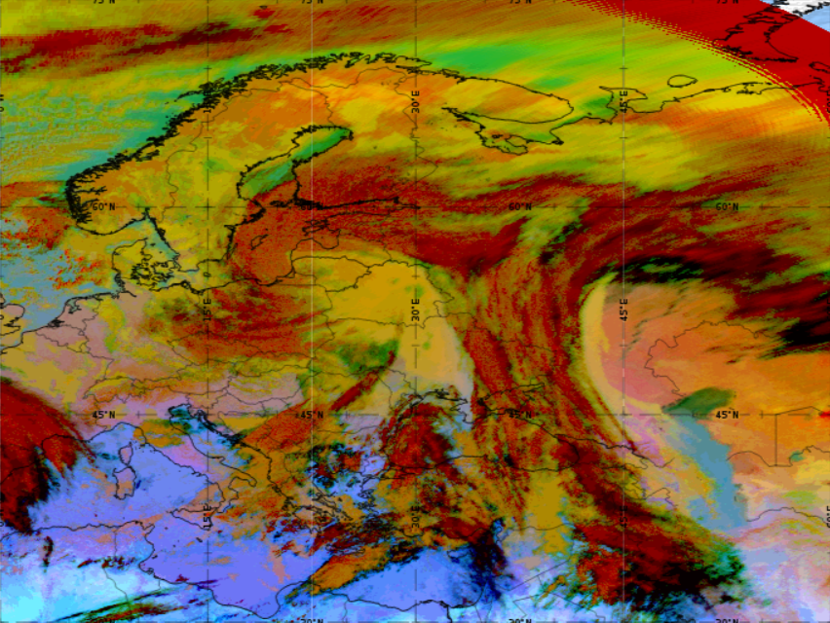
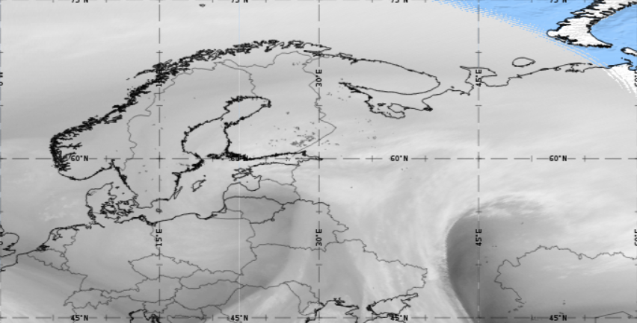
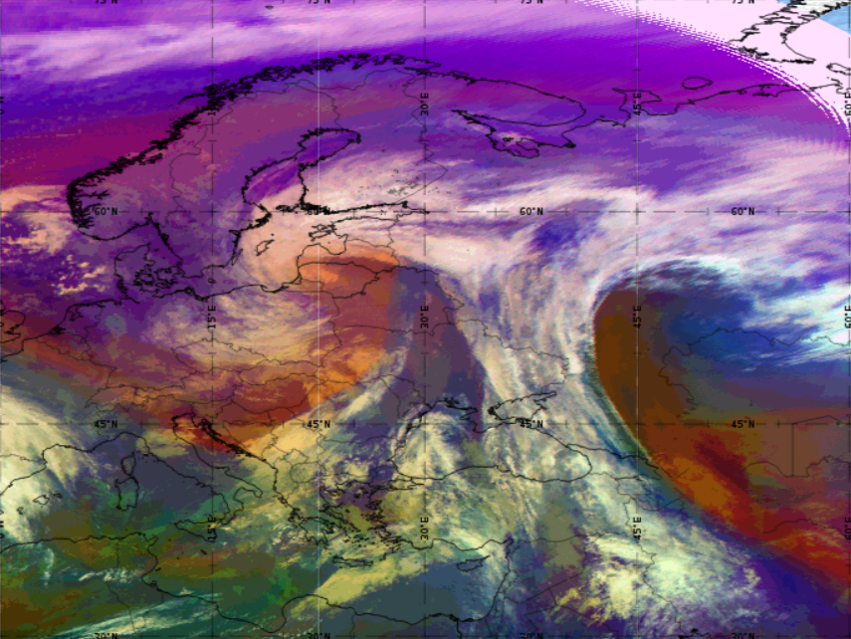
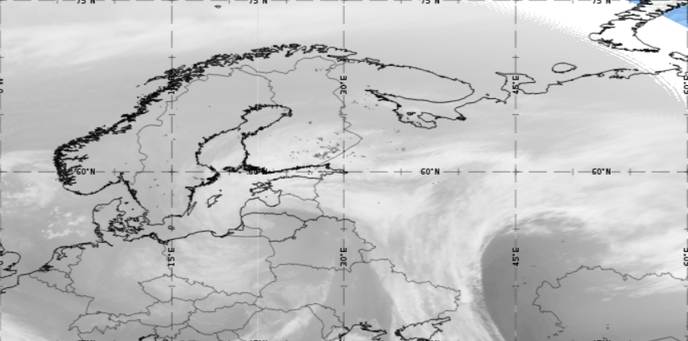
Satellite images
Dec 12, 2022 12 UTC
MSG Dust RGB
MSG WV 6.2 μm
MSG WV 7.3 μm
MSG RGB

Slide 8
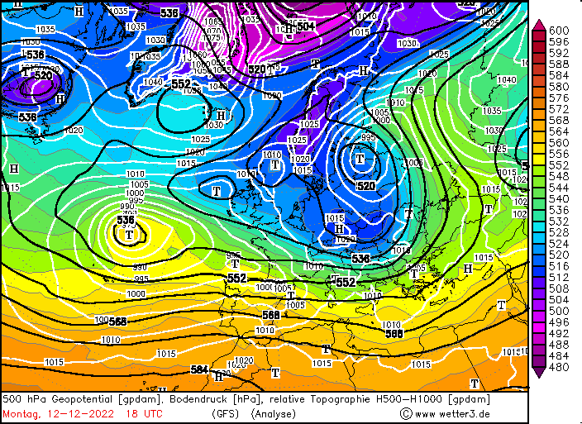
850 hPa layer during the storm:
Cold airmass over the Baltic Sea
Warm sector over Western Russia
Baltics on the boundary/slightly in the colder sector
= surface air temperatures stayed low, winds from NE

Slide 9
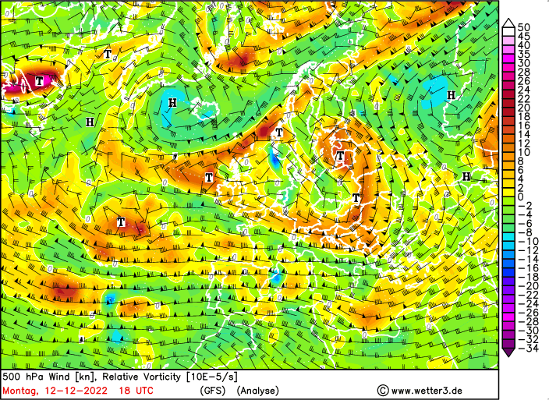
Relative Vorticity values at 500 hPa
Highest values in the storm center and the jet streak

Slide 10
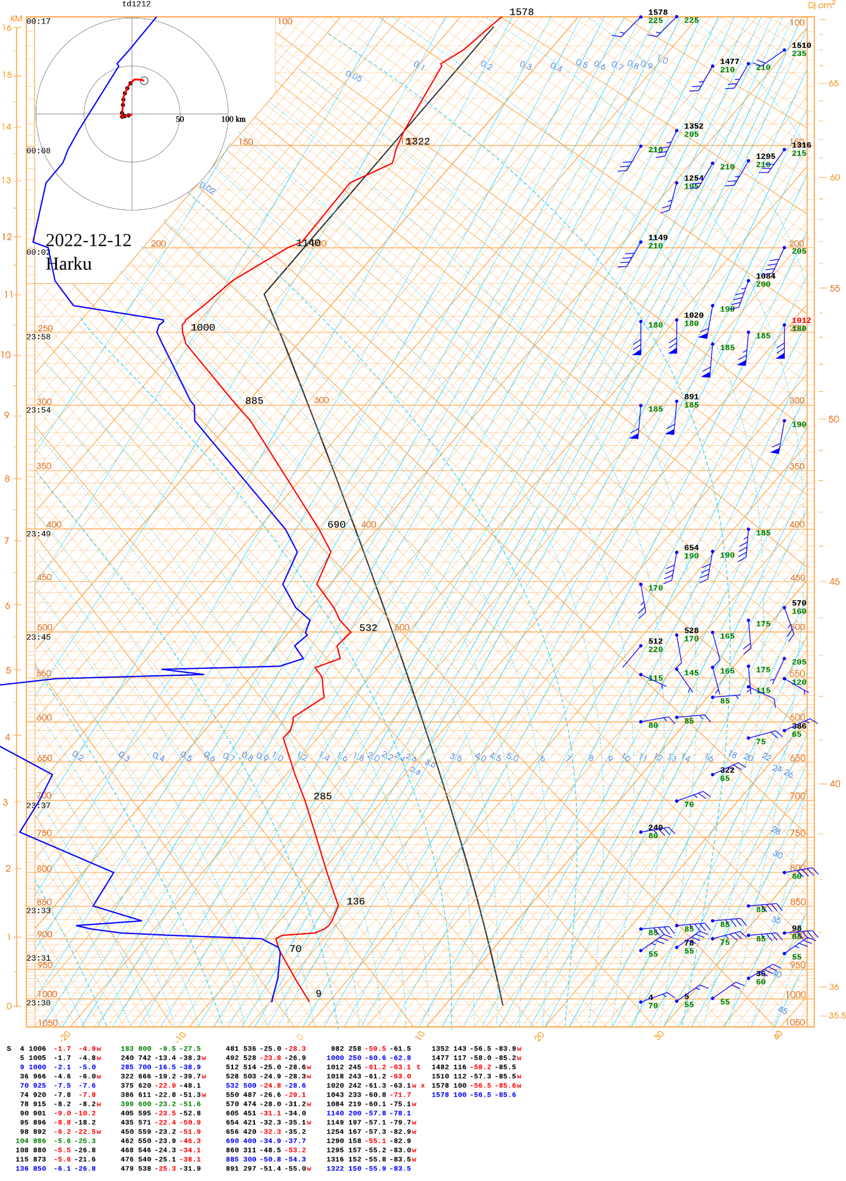
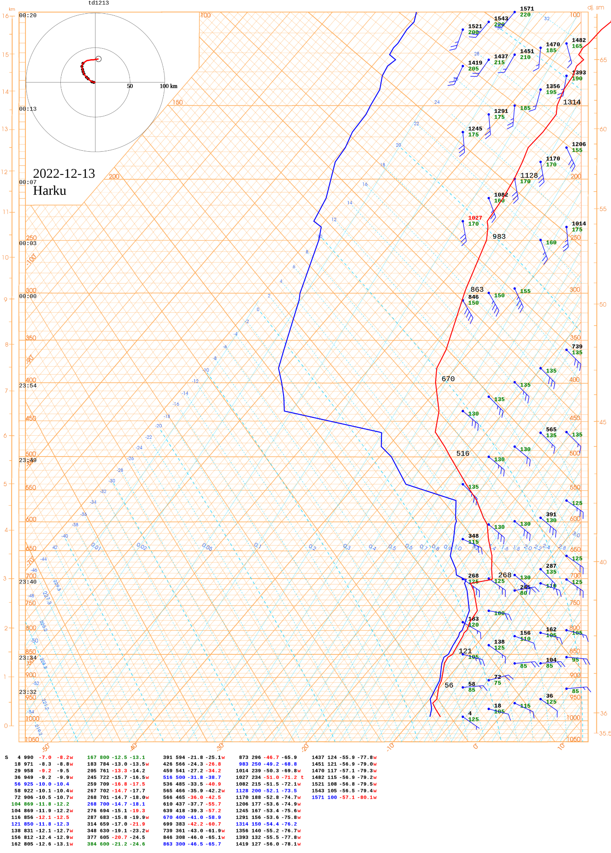
Harku radiosonde data
Dec 12, 2022 at 00 UTC
Dec 13, 2022 at 00 UTC

Slide 11
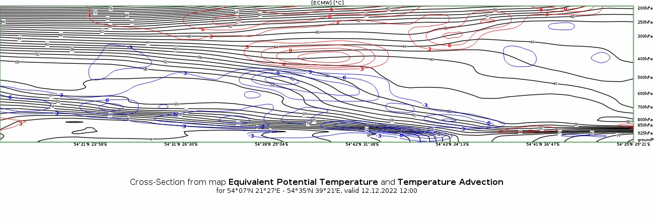
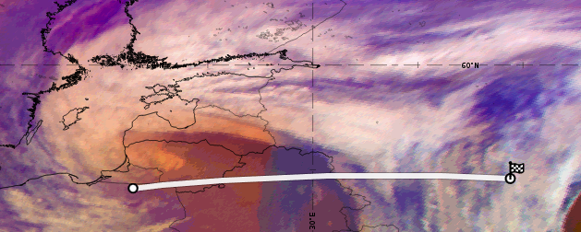

Slide 12
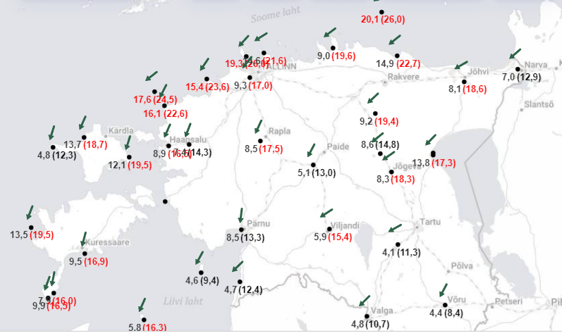
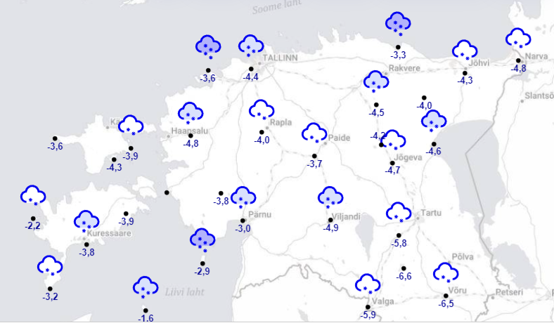
Synoptic conditions over Estonia during storm
Strong winds over Estonia (highest speed 29,2 m/s)
winds were mostly from northeast
weakened on the morning of December 13.
Snow all over Estonia.
the islands received the most snow with record thickness 73 cm in Hiiumaa.
The temperature stayed in the minus side throughout the storm
Winds over Estonia 12.12.22 10 UTC
Temperatures and weather over Estonia 12.12.22 10 UTC

Slide 13
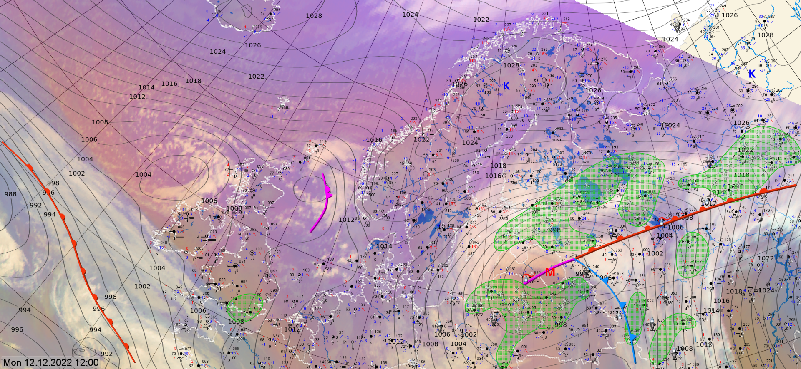
Frontal analysis map 12.12.22 12 UTC

Slide 14
Precipitation accumulation 12.12 - 13.12 radar product
Source: TIK

Slide 15
Low visibility conditions during the storm
Source: TIK

Slide 16
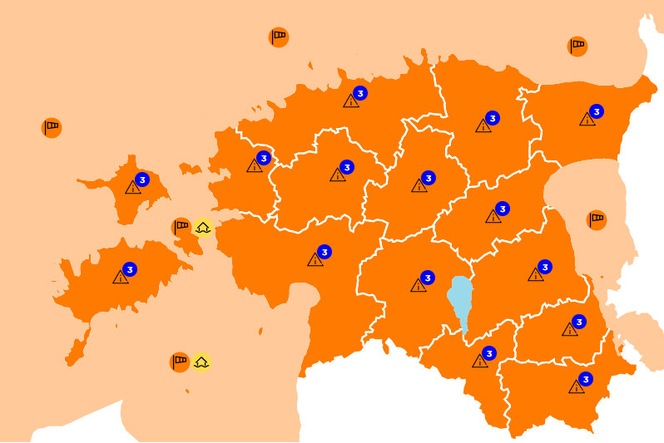
Warnings and prognosis
Official warning given on Dec 11:
Dec 12 at night increasing northeast in gusts 15-21 m/s, in the morning and during the day on islands and on the coast up to 26 m/s. Snow and blizzard spreading across the country starting from Southeastern Estonia, by day intensifying. Visibility is poor. Additional snow 10, locally up to 20 cm. Due to heavy snowfall, strong wind and blizzard, the traffic conditions worsen.
Wind warnings
Lake Peipus: NE 14(20)
Gulf of Finland: E 12(17) -> NE 15-18(26)
Northern Baltic: NE 17(25)
Gulf of Riga: NE 18(25)
Moonsund: NE 16(22)
land area: NE (15-21), islands and coast (26)
Sea level warnings
Pärnu Bay: falling 50-65 cm below average
Moonsund: falling 40-50 cm below average
Warnings map for Dec 12, 2022. Source: Keskkonnaagentuur
Additional warnings for land area:
Heavy snowfall
Blizzard
Mentions of heavy snowfall, blizzard and strong winds appeared in the long term prognosis for Dec 12 night and day more than 3 days prior to the the storm.

Slide 17
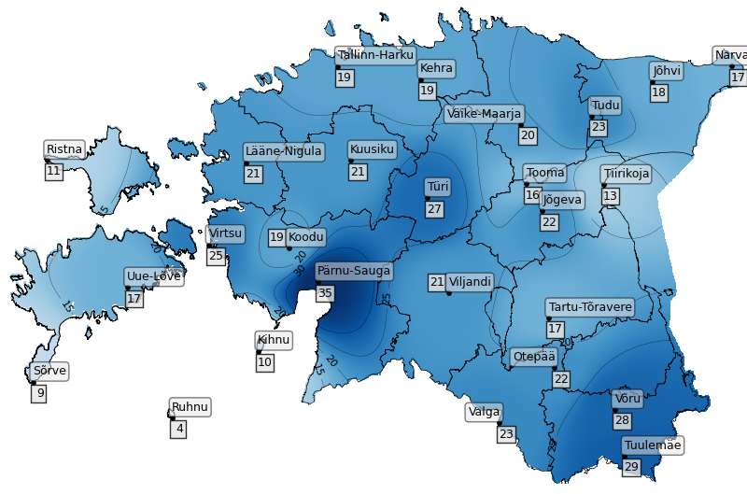
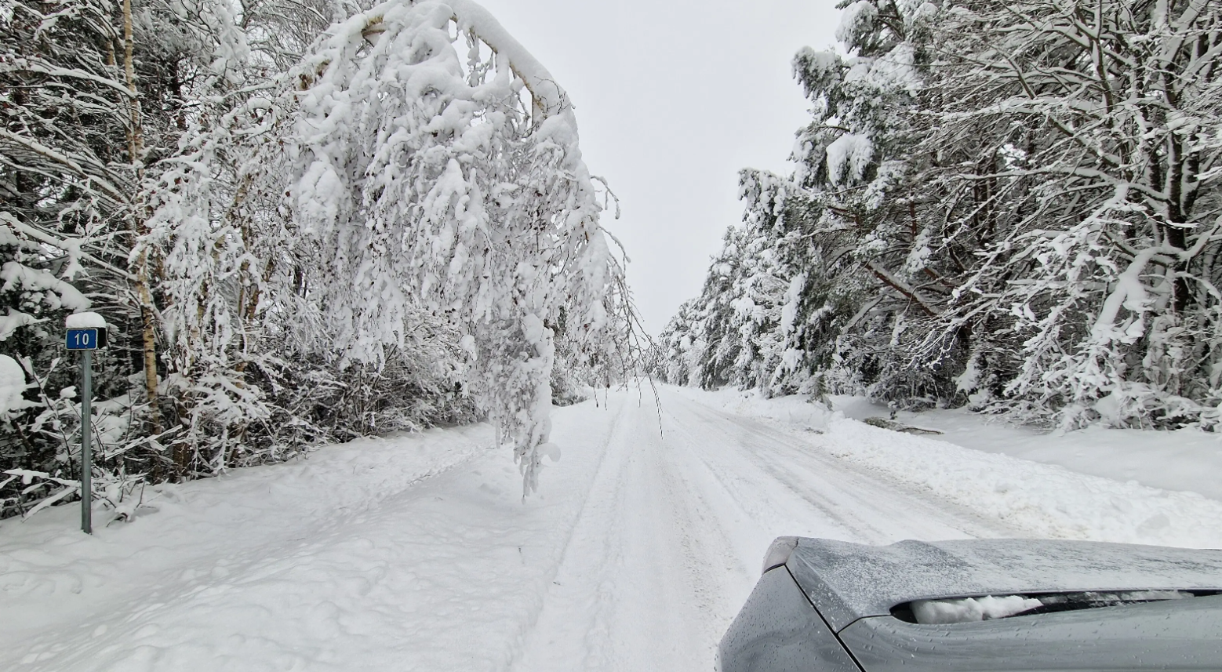
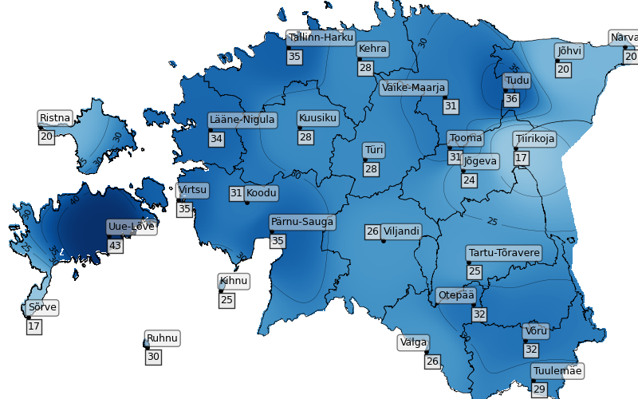
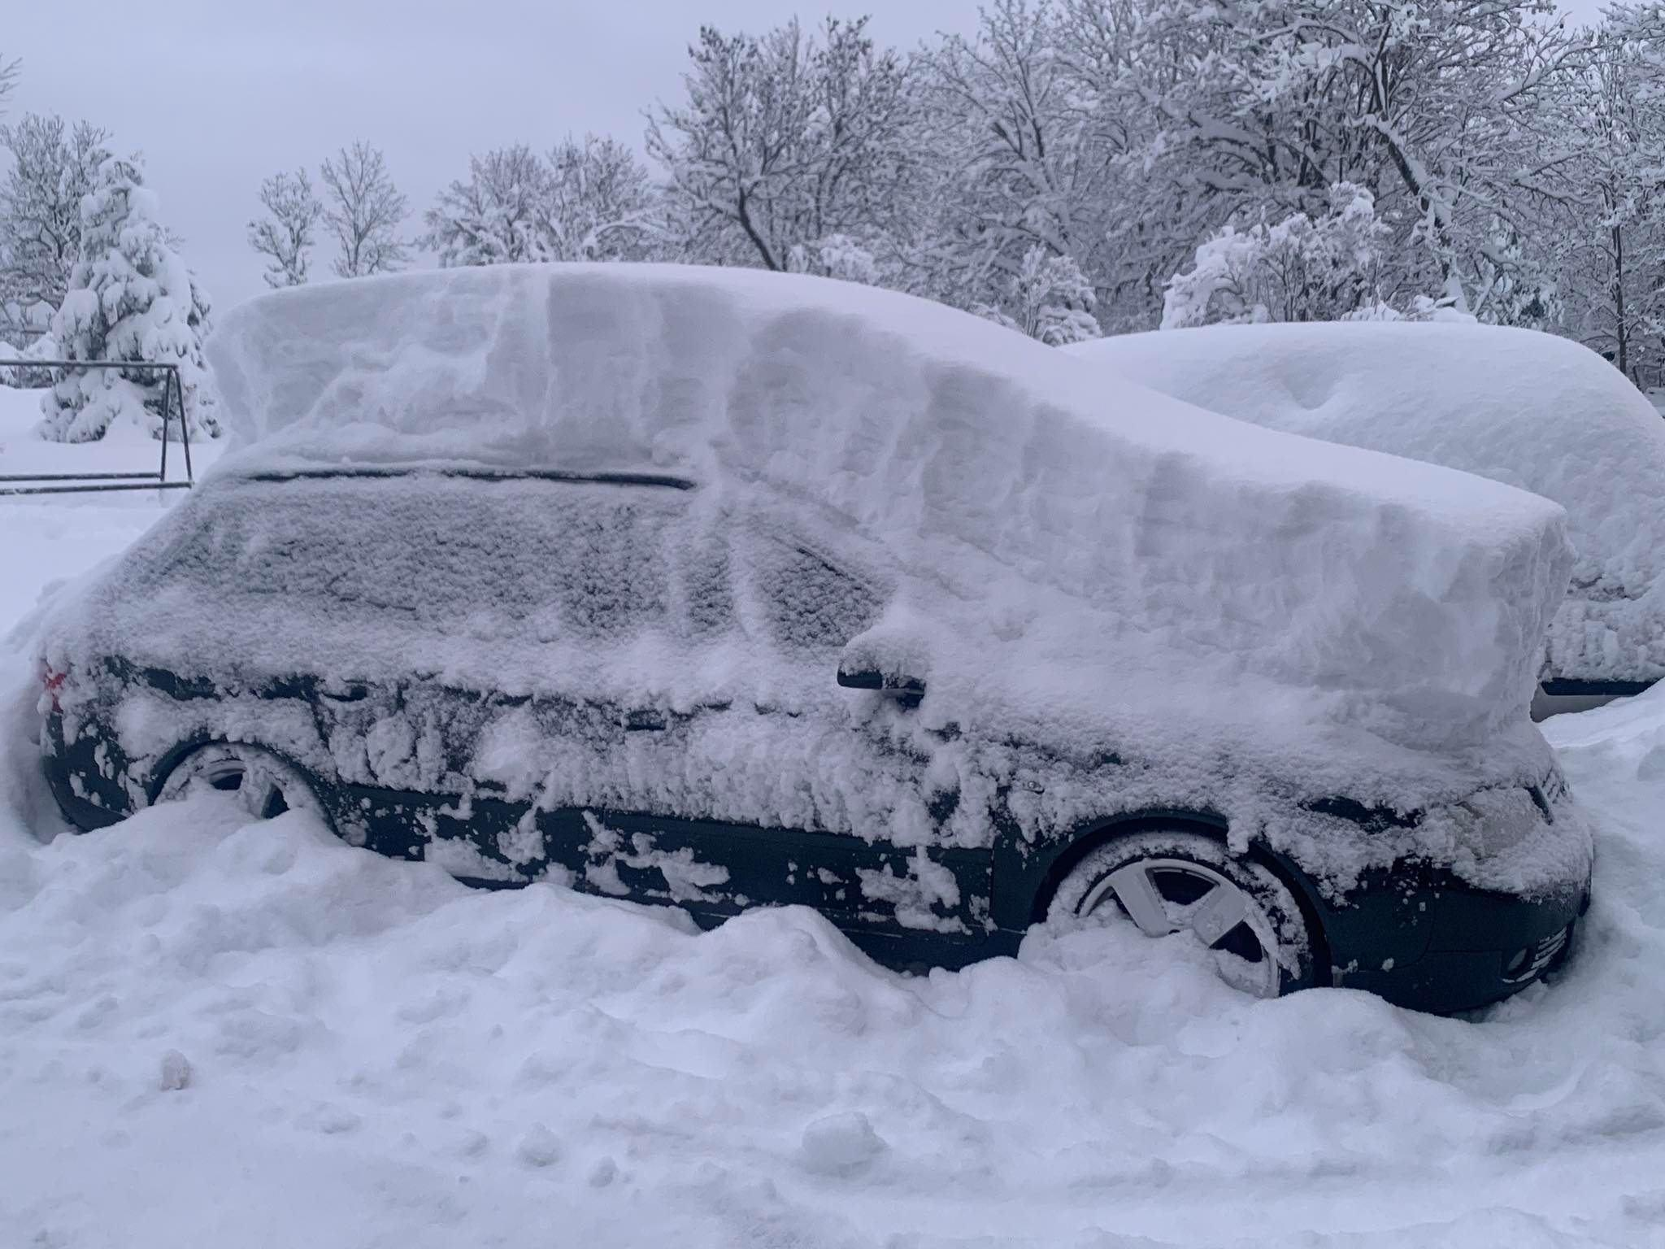
Snow accumulation
Snow coverage across Estonia at 8 a.m. on Dec 11 and 13, 2022.
Source: Keskkonnaagentuur
Snow in Saaremaa on Saturday, December 10, 2022
PRIOR to storm Birgit. Source: Margus Muld/ERR
Situation in Northern Saaremaa on Dec 10, 2022. Source: Silvar Mehik, FB

Slide 18
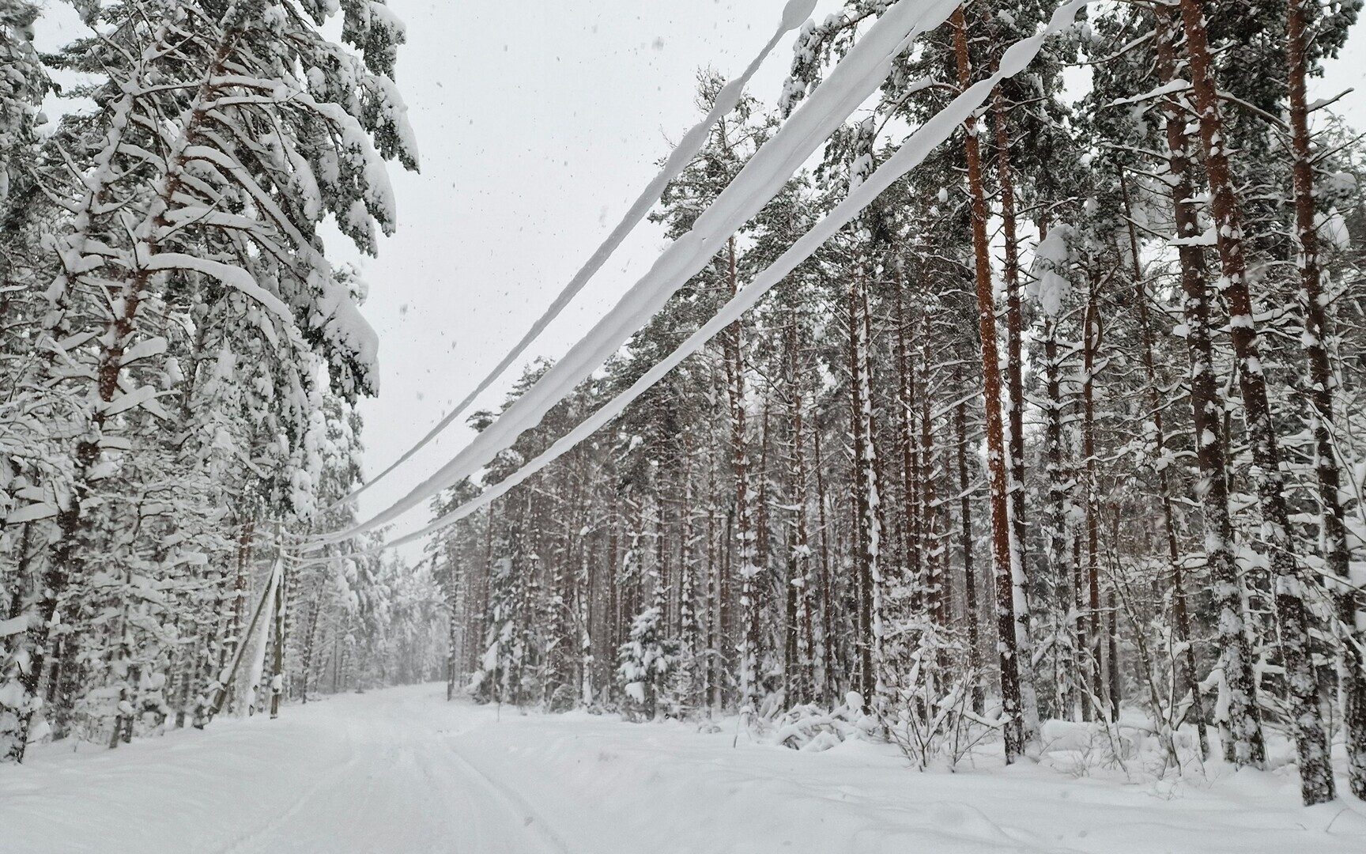
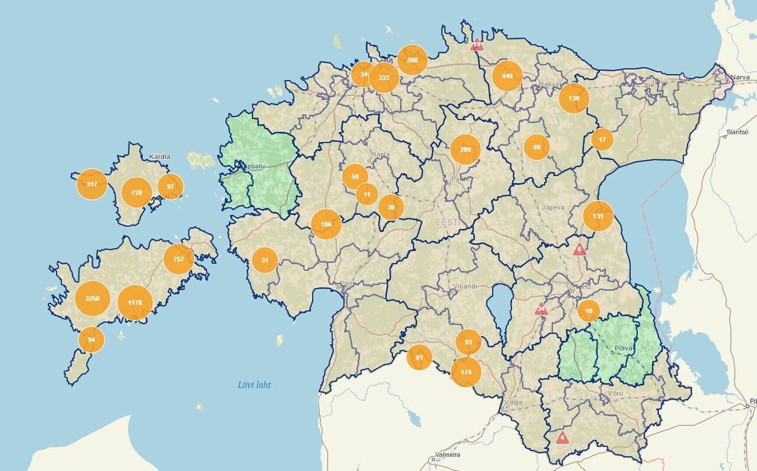
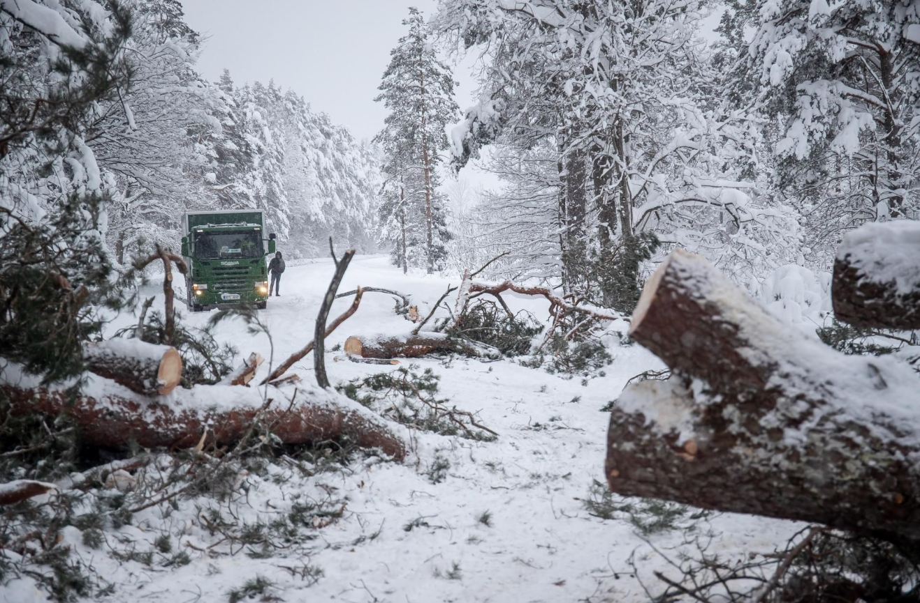
Snow damages
Power lines repair work in Saaremaa. Source: Margus Muld/ERR
Map of power outages on Dec 12 at 15:00 Source: Elektrilevi
Broken tree in Saaremaa. Source: Sander Ilvest, ERR

Slide 19
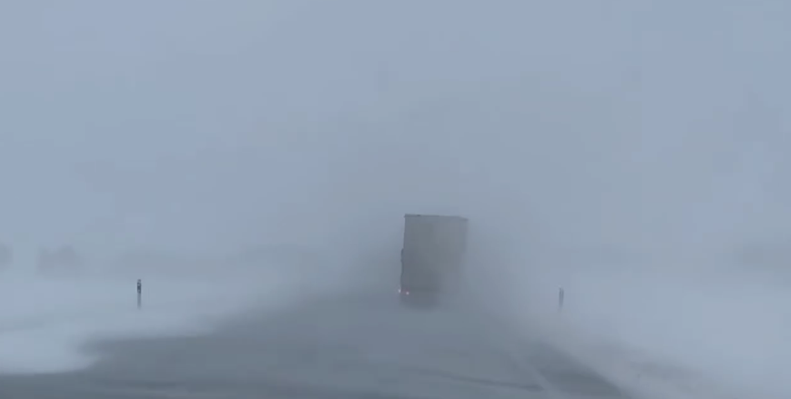
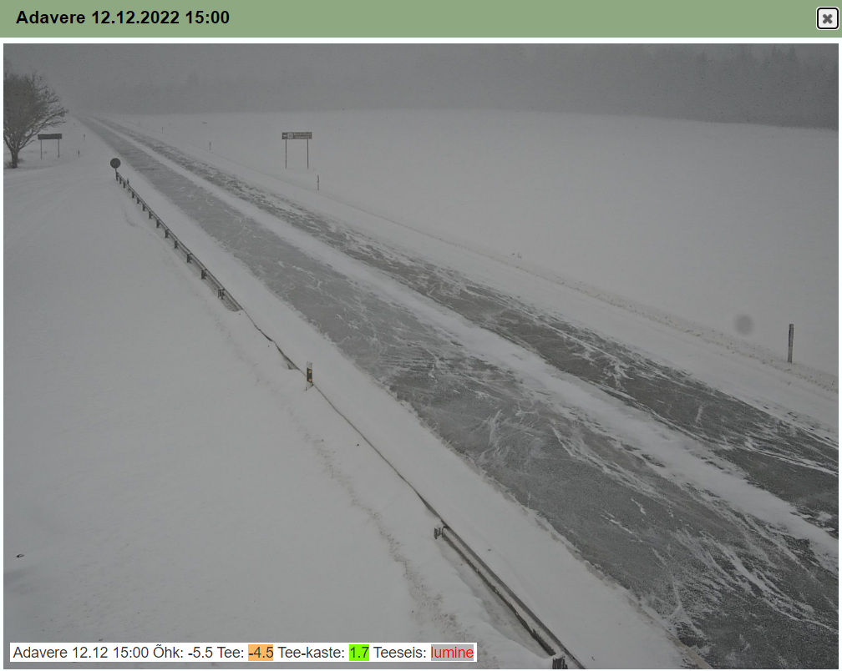
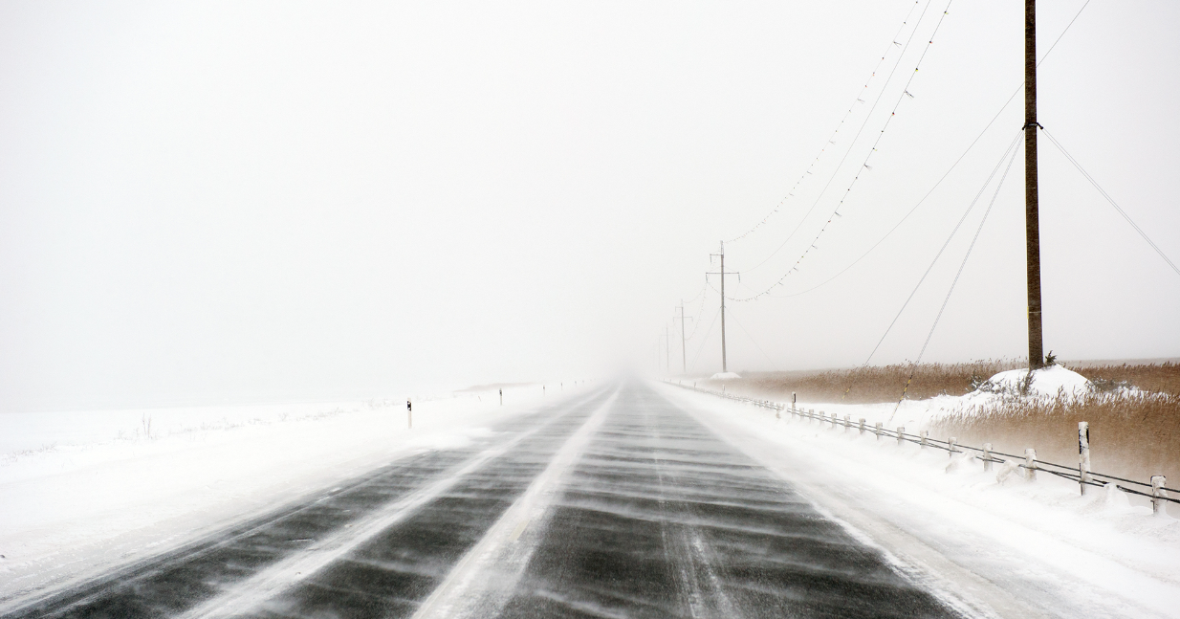
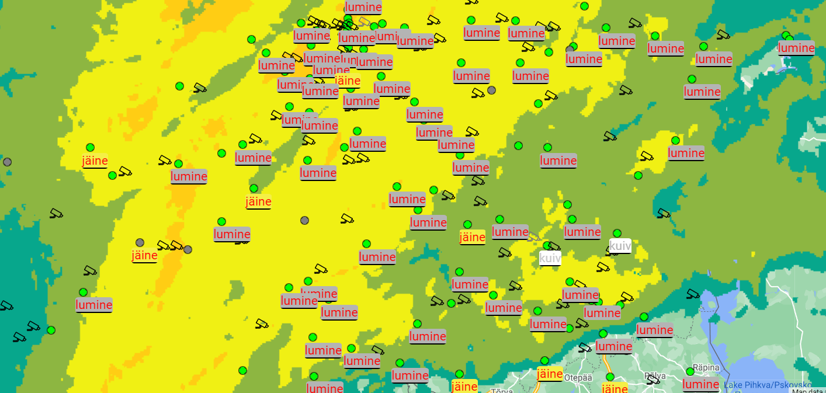
Traffic conditions
Source: screenshot of Heilike Aron’s video, FB
Picture from Adavere road camera at 15:00. Source: TIK
Source: Kalmer Saar, FB
Map of traffic conditions and radar in Estonia at 15:00. Source: TIK

Slide 20
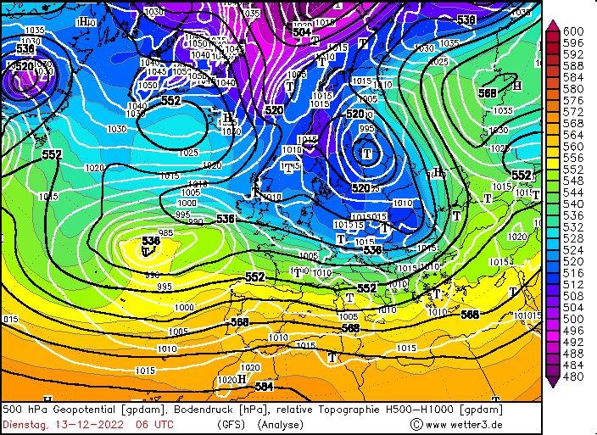
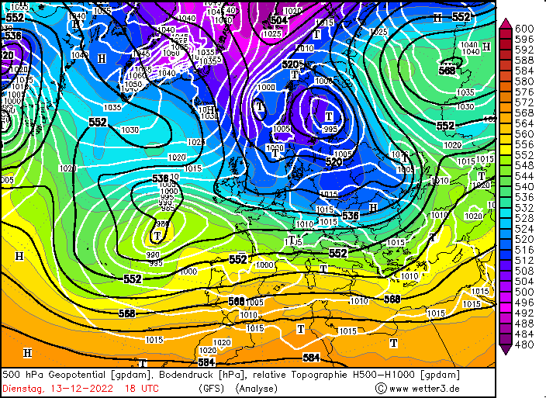
Next day conditions:
Baltics deeper in cold airmass again
Warm sector/inflow in NW Russia
Cyclone moved slowly NW

Slide 21
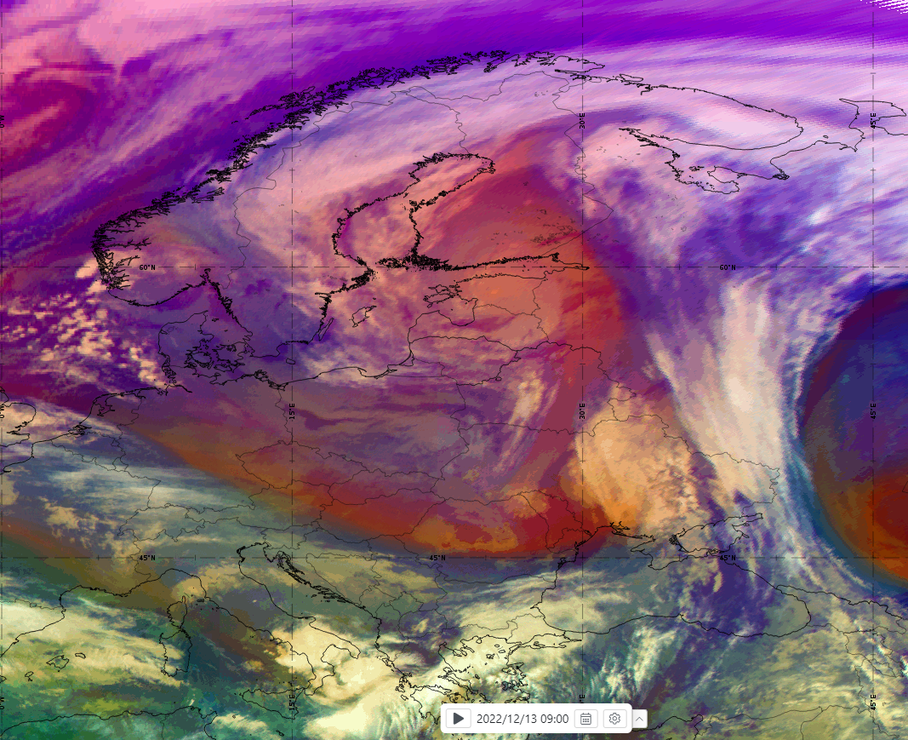
Next morning satellite image:
Airmass RGB 09:00 UTC

Slide 22
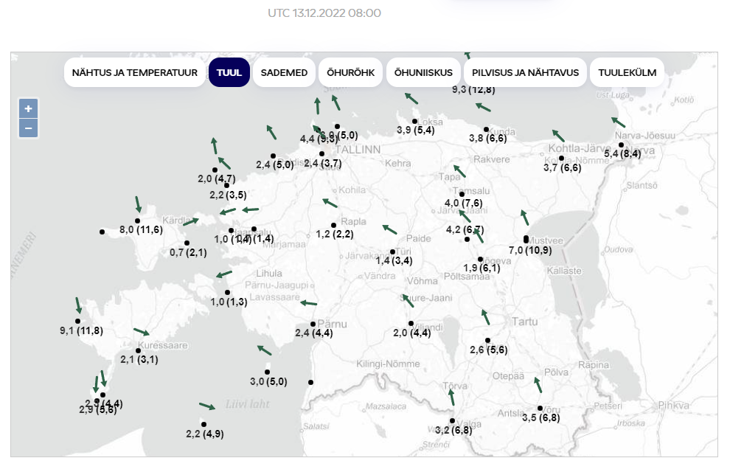
Next morning conditions:
Wind speed over Estonia
13.12 08 UTC

Slide 23
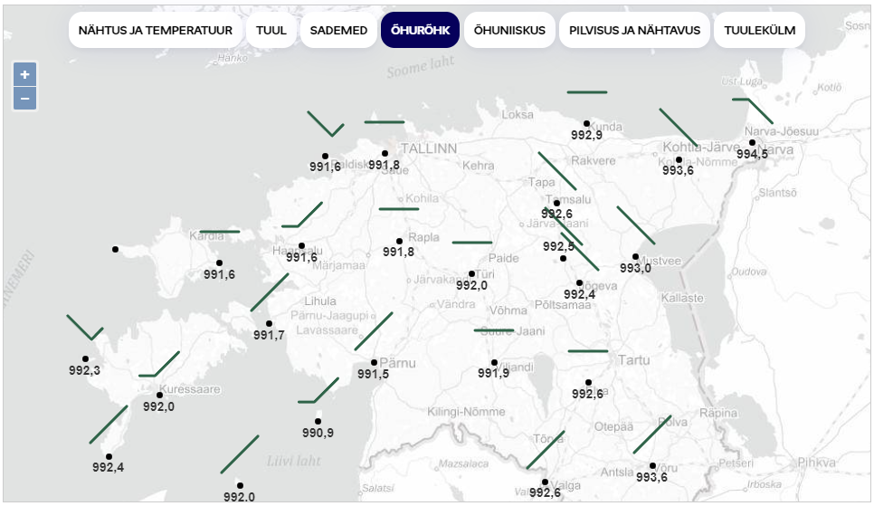
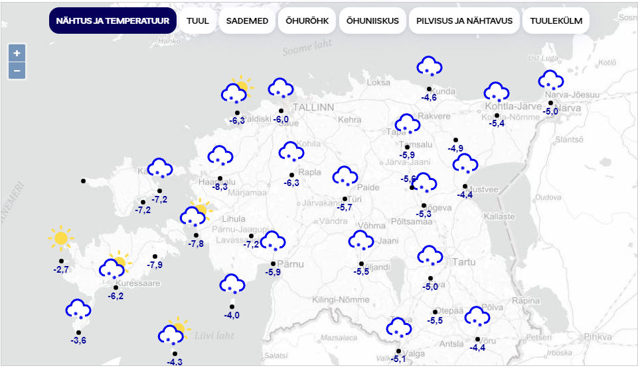
Next morning conditions: SLP; Surface temp.; Significant weather
13.12 08 UTC
Rise in SLP
Light snow
Some scattered cloud cover
Cold temperatures representative of dominant airmass

Slide 24
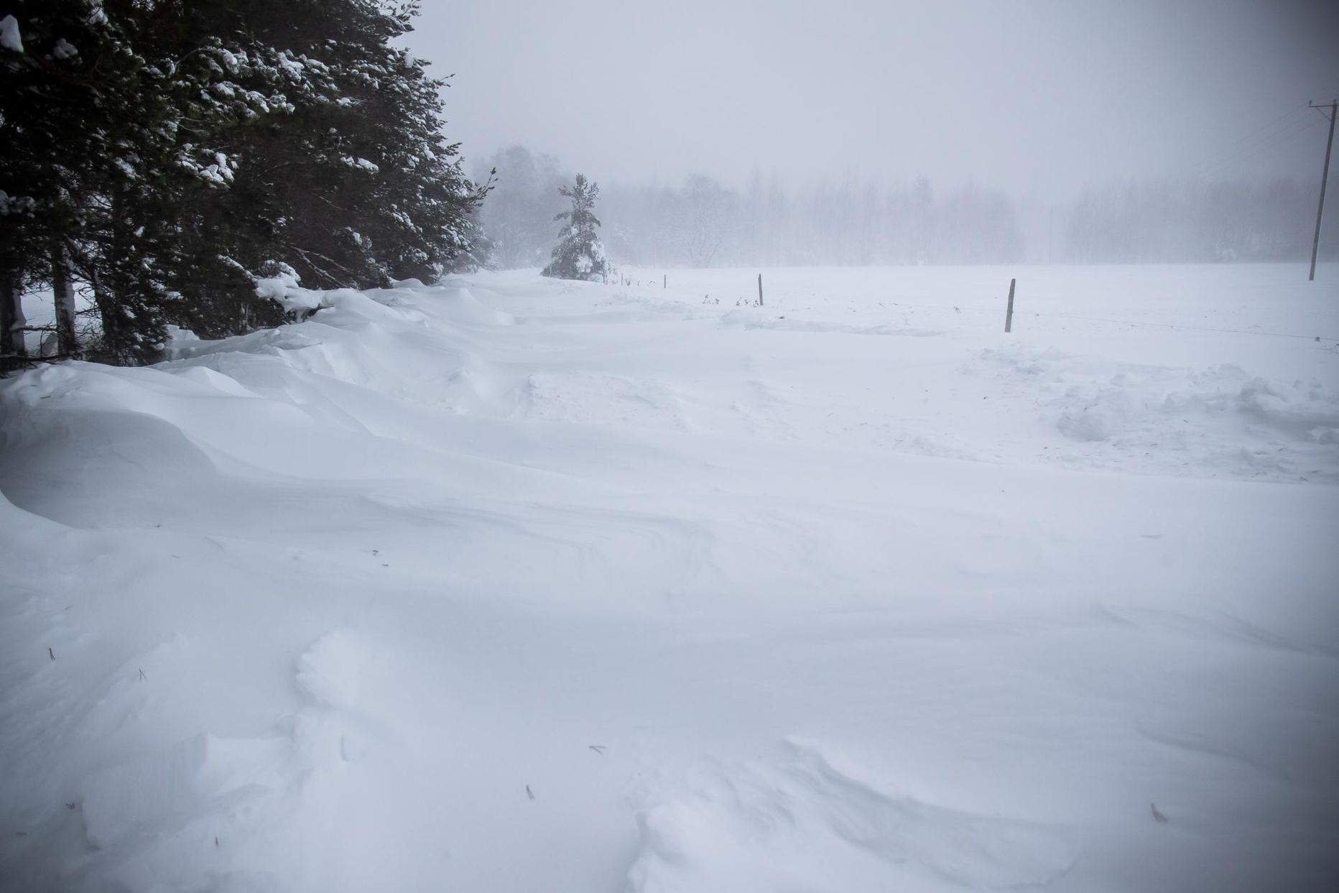
Thank you for you attention!
Photo by Sander Ilvest

