Slide 1
Forecasting impact
Theory and LEGMC experience
Kristiāns Pāps,
Forecaster - methodologist
e-mail kristians.paps@lvgmc.lv
07.11.2023

Slide 2
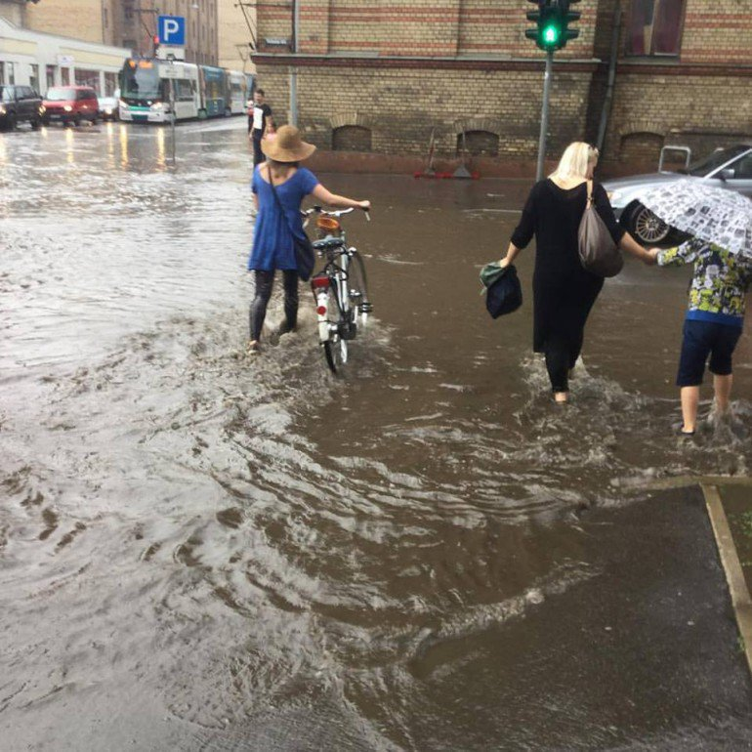
Forecasting impact
Impact assessments turn forecasts and warnings from a description of what the weather will be into a message about what the weather will do.
What the weather will do – weather can have direct and indirect impact. Direct – the phenomenon does the impact itself. Indirect - the phenomenon causes other phenomena or situations that does the impact.

Slide 3
Forecasting impact
Forecast type | Forecast
General forecast / warning | Tommorow in the afternoon south-west wind will increase in gusts to 25-27 m/s.
Impact oriented forecast / warning | Tommorrow in the afternoon south-west wind will increase in gusts to 25-27 m/s. Be prepared for disruption, structural damage and risk of injury from uprooted trees and flying debris. Disruption to power supplies is possible.
Impact forecast / warning | It is expected that due to strong wind gusts on 03.01 from 13:00 till 17:00 in south-west regions of Latvia power outtages covering approximately 30-40% of the grid can be expected.

Slide 4
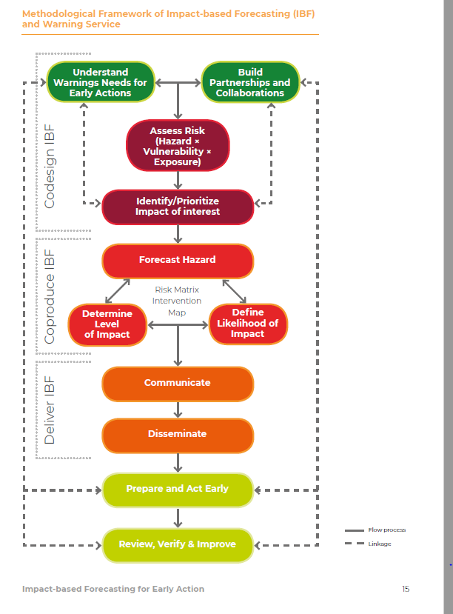
Impact based forecasting system
Some of the main components / actions of impact based forecasting system:
- Understanding of warning needs for early actions
- Building partnerships and collaborations
- Assess Risk
- Risk Matrix
- Identify / prioritize impact of interest
- Communication and dissemination
The inclusion of risk assessments makes impact-based forecasting unique among other forecasts and warnings.
Methodological Framework of Impact-based Forecasting (IBF) and Warning Service

Slide 5
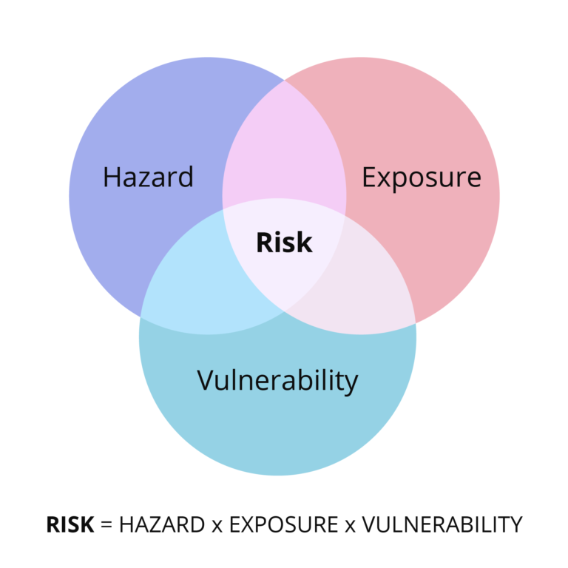
Risk
Risk Assessments
Risk assessments are the keystone of impact-based forecasting and require information on the following dimensions:
▶ Hazard
▶ Exposure
▶ Vulnerability (including coping and adaptive capacity)
Risk and impact assessments are essential steps in developing impact-based forecasts and managing the risk of hazards. Well-designed risk and impact assessments can help decide what potential impacts to investigate by identifying how hazards affect people in different places.

Slide 6
Risk
Hazard refers to the possible, future occurrences of natural or human-induced physical events that may have adverse effects on vulnerable and exposed elements.
Vulnerability refers to the propensity of exposed elements such as humans, their livelihoods, and assets to suffer adverse effects when impacted by hazards. The ability of a population or community to cope and adapt to disasters significantly impacts vulnerability.
Exposure refers to the presence of elements in an area in which hazard events may occur. Hence, if population and economic resources are not located in potentially dangerous settings, no problem of disaster risk exists
(IPCC Definitions)
It is possible to be exposed but not vulnerable (for example by living in a floodplain but having sufficient means to modify building structure and behavior to mitigate potential loss)!
Notes:
At times, hazard has been ascribed the same meaning as risk, but hazard is now widely accepted to be one component of risk and not risk itself. Bīstamība (Hazard) var būt sezonāla (ilgstošs karstums, stiprs sniegs), ikmēneša (aukstums/karstums), iknedēļas (vētra), ikdienas (pērkona negaiss).
Coping capacity is the ability to react to, and reduce the adverse effects of experienced hazards, whereas adaptive capacity is the ability to anticipate and transform structures or organizations to better survive hazards.
Exposure is a necessary, but not sufficient, determinant of risk. It is possible to be exposed but not vulnerable (for example by living in a floodplain but having sufficient means to modify building structure and behavior to mitigate potential loss).

Slide 7
Exposure vs Vulnerability
Exposure
▶ Which populations, infrastructure, natural resources, or assets are exposed?
▶ Where are they? For example, households on the wrong side of protective embankments or in river basins
a long way from high ground are particularly exposed.
Vulnerability
▶ What are the vulnerability indicators that are related to the identified impacts?
▶ How are impacts related to the underlying causes of vulnerability? For example, people with houses made from low-quality materials will be vulnerable to damage. However, more indirect vulnerabilities such as poverty and literacy might play a role an individual’s ability to prepare for and cope with impact
Vulnerability and exposure changes over time, particularly after an extreme weather or climate event. Datasets must be kept up to date to ensure the impact-based forecast or warning using this data is reliable!

Slide 8
Identifying users
Typical Impact-based Forecast Users
▶ Members of the public
▶ Community leaders
▶ Government departments (agriculture, social
welfare, public works etc.)
▶ Local government officials
▶ Disaster Risk Reduction and Civil Protection
▶ Agencies (humanitarian, development, police, military, health providers, local disaster managers)
▶ Local businesses
▶ Transport services
▶ Energy providers and services
▶ Water providers and services
▶ Telecommunication providers and services
A cyclone warning would need different information to be useful to a department of public works compared to a humanitarian organization.
Notes:
For a department of public works, an impact-based forecast service might focus on the probability and magnitude of cyclone hazards that are likely to severely damage certain types of infrastructure across the exposed area. A humanitarian organization focusing on supporting the most populations will likely require information about the percentage of affected livelihoods and the percentage of potential deaths

Slide 9
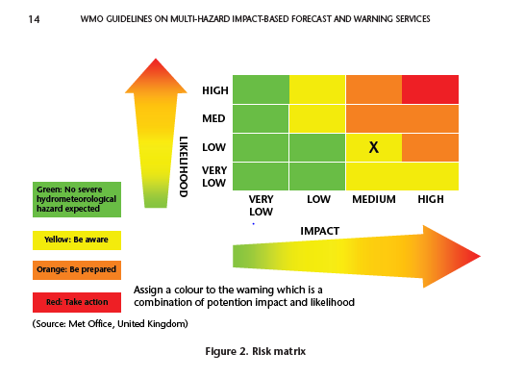
Impact based forecasting
Risk maps are an effective way of combining forecast hazard, vulnerability and exposure data into an easy to interpret visual aid.
A risk matrix plots the level of impact against the likelihood of impacts occurring.
Hazard information along with vulnerability and exposure data is used to assess
the level of impact. Uncertainty in the hazard and uncertainties in vulnerability and
exposure data determine how likely the impacts are to occur.

Slide 10
Identifying impacted areas
Hazard | Cascading hazards | Primary impacts | Secondary impacts
Wind | ▶ High waves | ▶ Danger to life from flying debris ▶ Damage to properties, buildings and other manmade structures ▶ Trees, forests and orchards damaged or uprooted ▶ Destroys some standing crops, especially basic grains ▶ Dangerous travelling conditions ▶ Dangerous sea states ▶ Damage and disruption to transport networks (trees on railway lines and roads, ferry ports inaccessible) | ▶ Loss of services: power, water, communications ▶ Loss of livelihoods ▶ Injuries ▶ Houses inhabitable
Heavy Rain | ▶ Landslide ▶ Excessive erosion ▶ Flooding (flash flood, river flood, waterlogging) ▶ Mudslide ▶ Silt deposit | ▶ Damage of properties, infrastructure ▶ Damage to certain crops and loss of livestock ▶ Death by drowning ▶ Damage to topsoil ▶ Damage of properties, buildings, infrastructure ▶ Damage certain crops, especially tubers ▶ Dangerous travelling conditions | ▶ Houses inhabitable ▶ Loss of services: power, water, communications, health care ▶ Health issues/deaths: waterborne diseases etc ▶ Loss of livelihood ▶ Loss of industrial production ▶ Displacement/Migration: long and short term

Slide 11
Meteorological warnings in Latvia
Wind gusts
Water level in rivers during floods and ice jams
Forest fire
Icing of wet snow
Heat
Cold spell
Thunderstorm
Land and Sea warnings
Frost
Rain
Snow
Rainshowers
Snowstorm
Storm surges– coastal event
Wave height
Visibility
Glazed ice
Icing of the ships

Slide 12
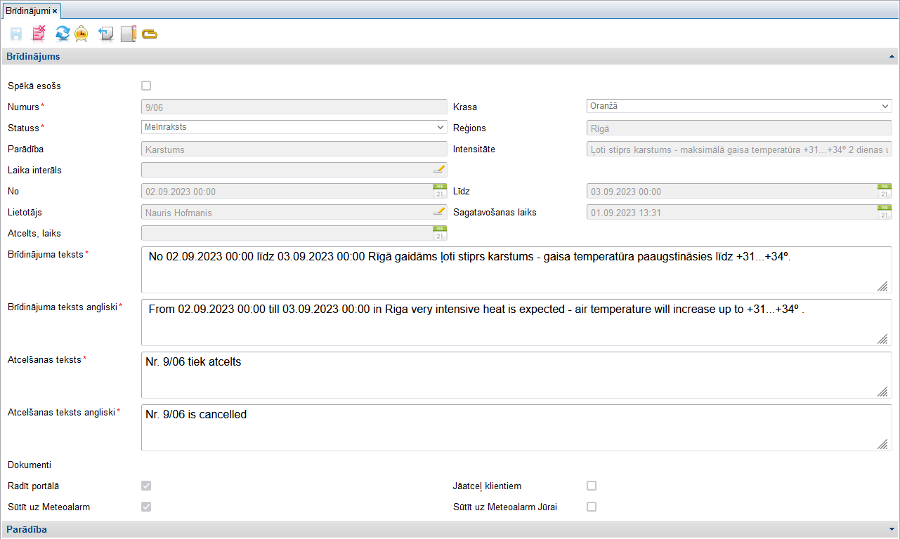
Issuing a warning – step 1
Level
Territory
Phenomena
Intensity
Time from
Time to
Warning text

Slide 13
Issuing a warning – step 2

Slide 14
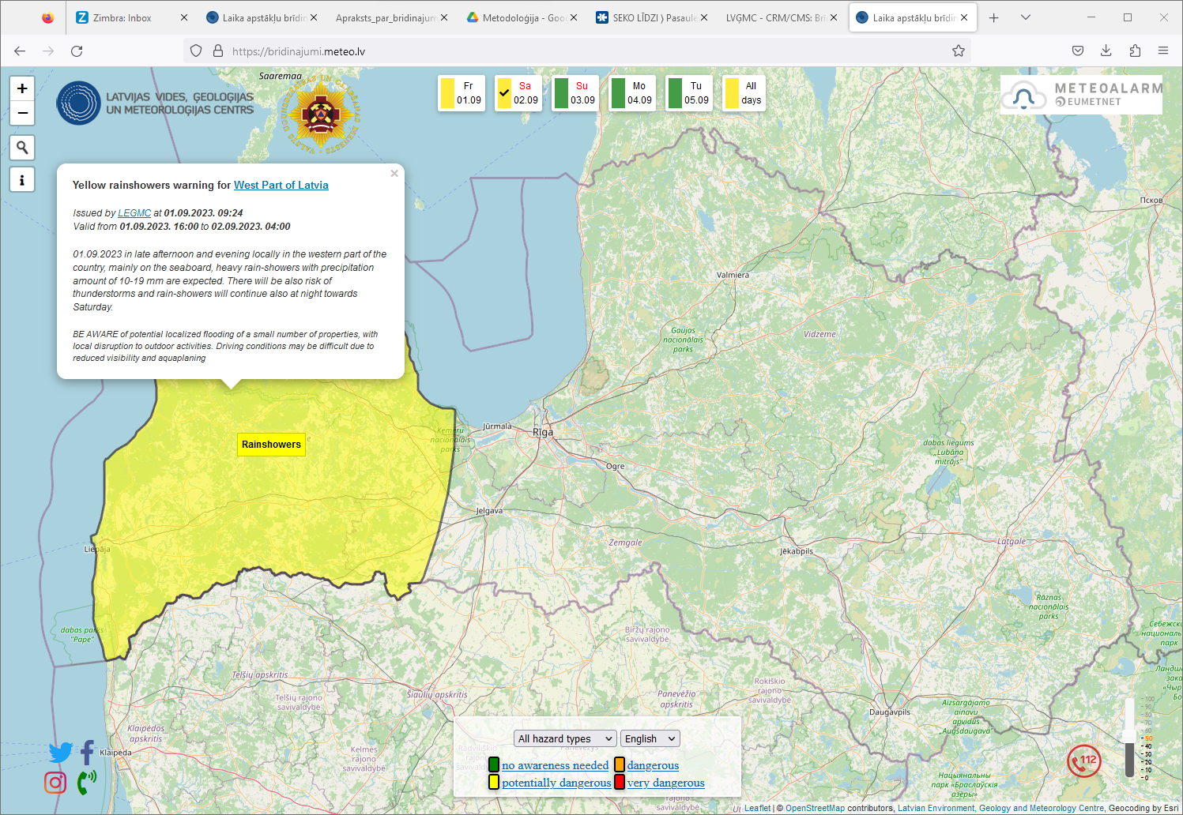
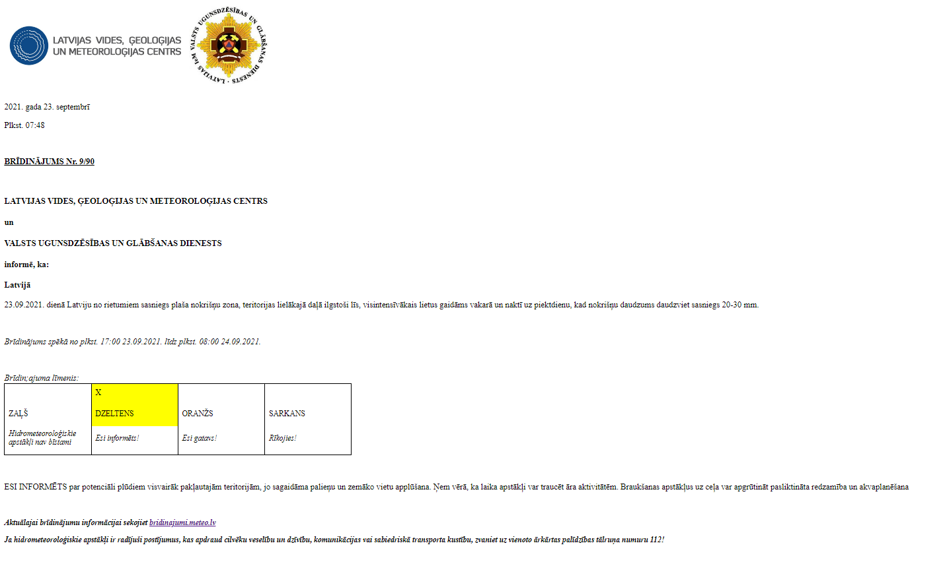
The end result
Information for the public
Information for clients
bridinajumi.meteo.lv

Slide 15
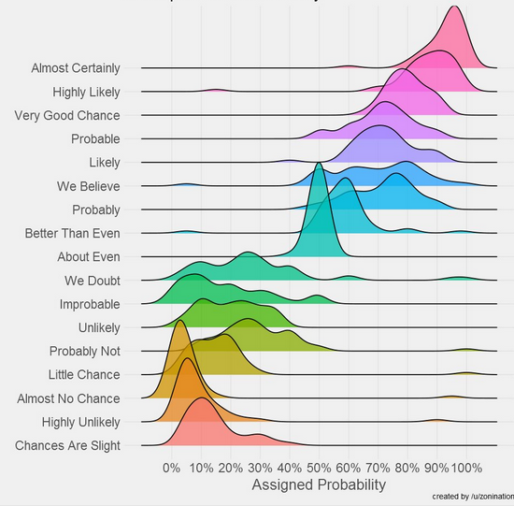
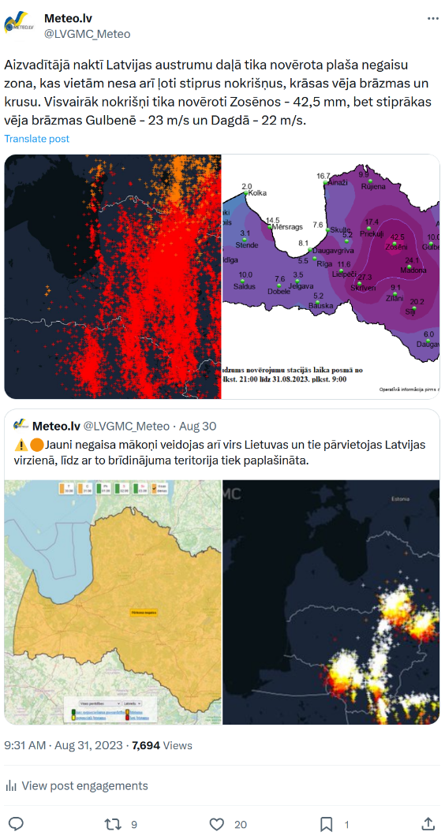
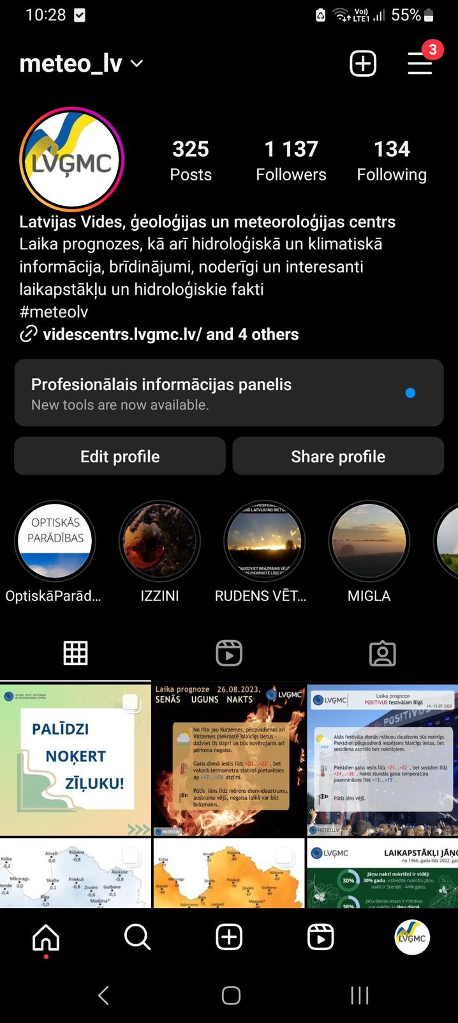
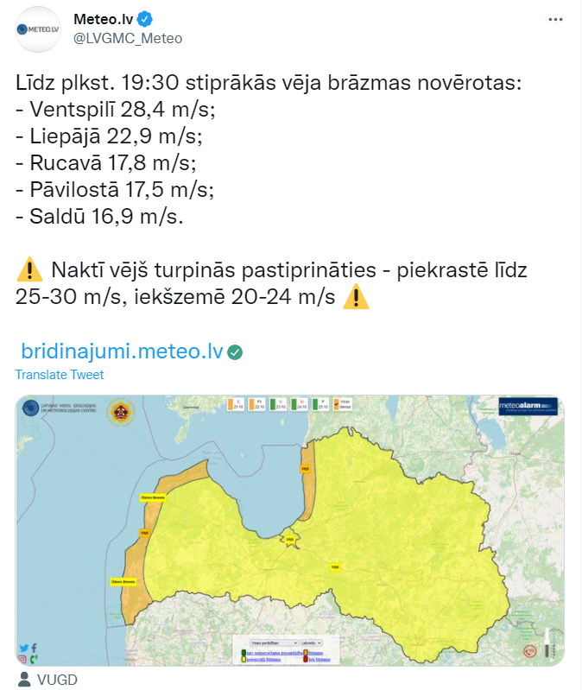
Warning communication
Warnings have very little meaning if they are not communicated in the right way!

Slide 16
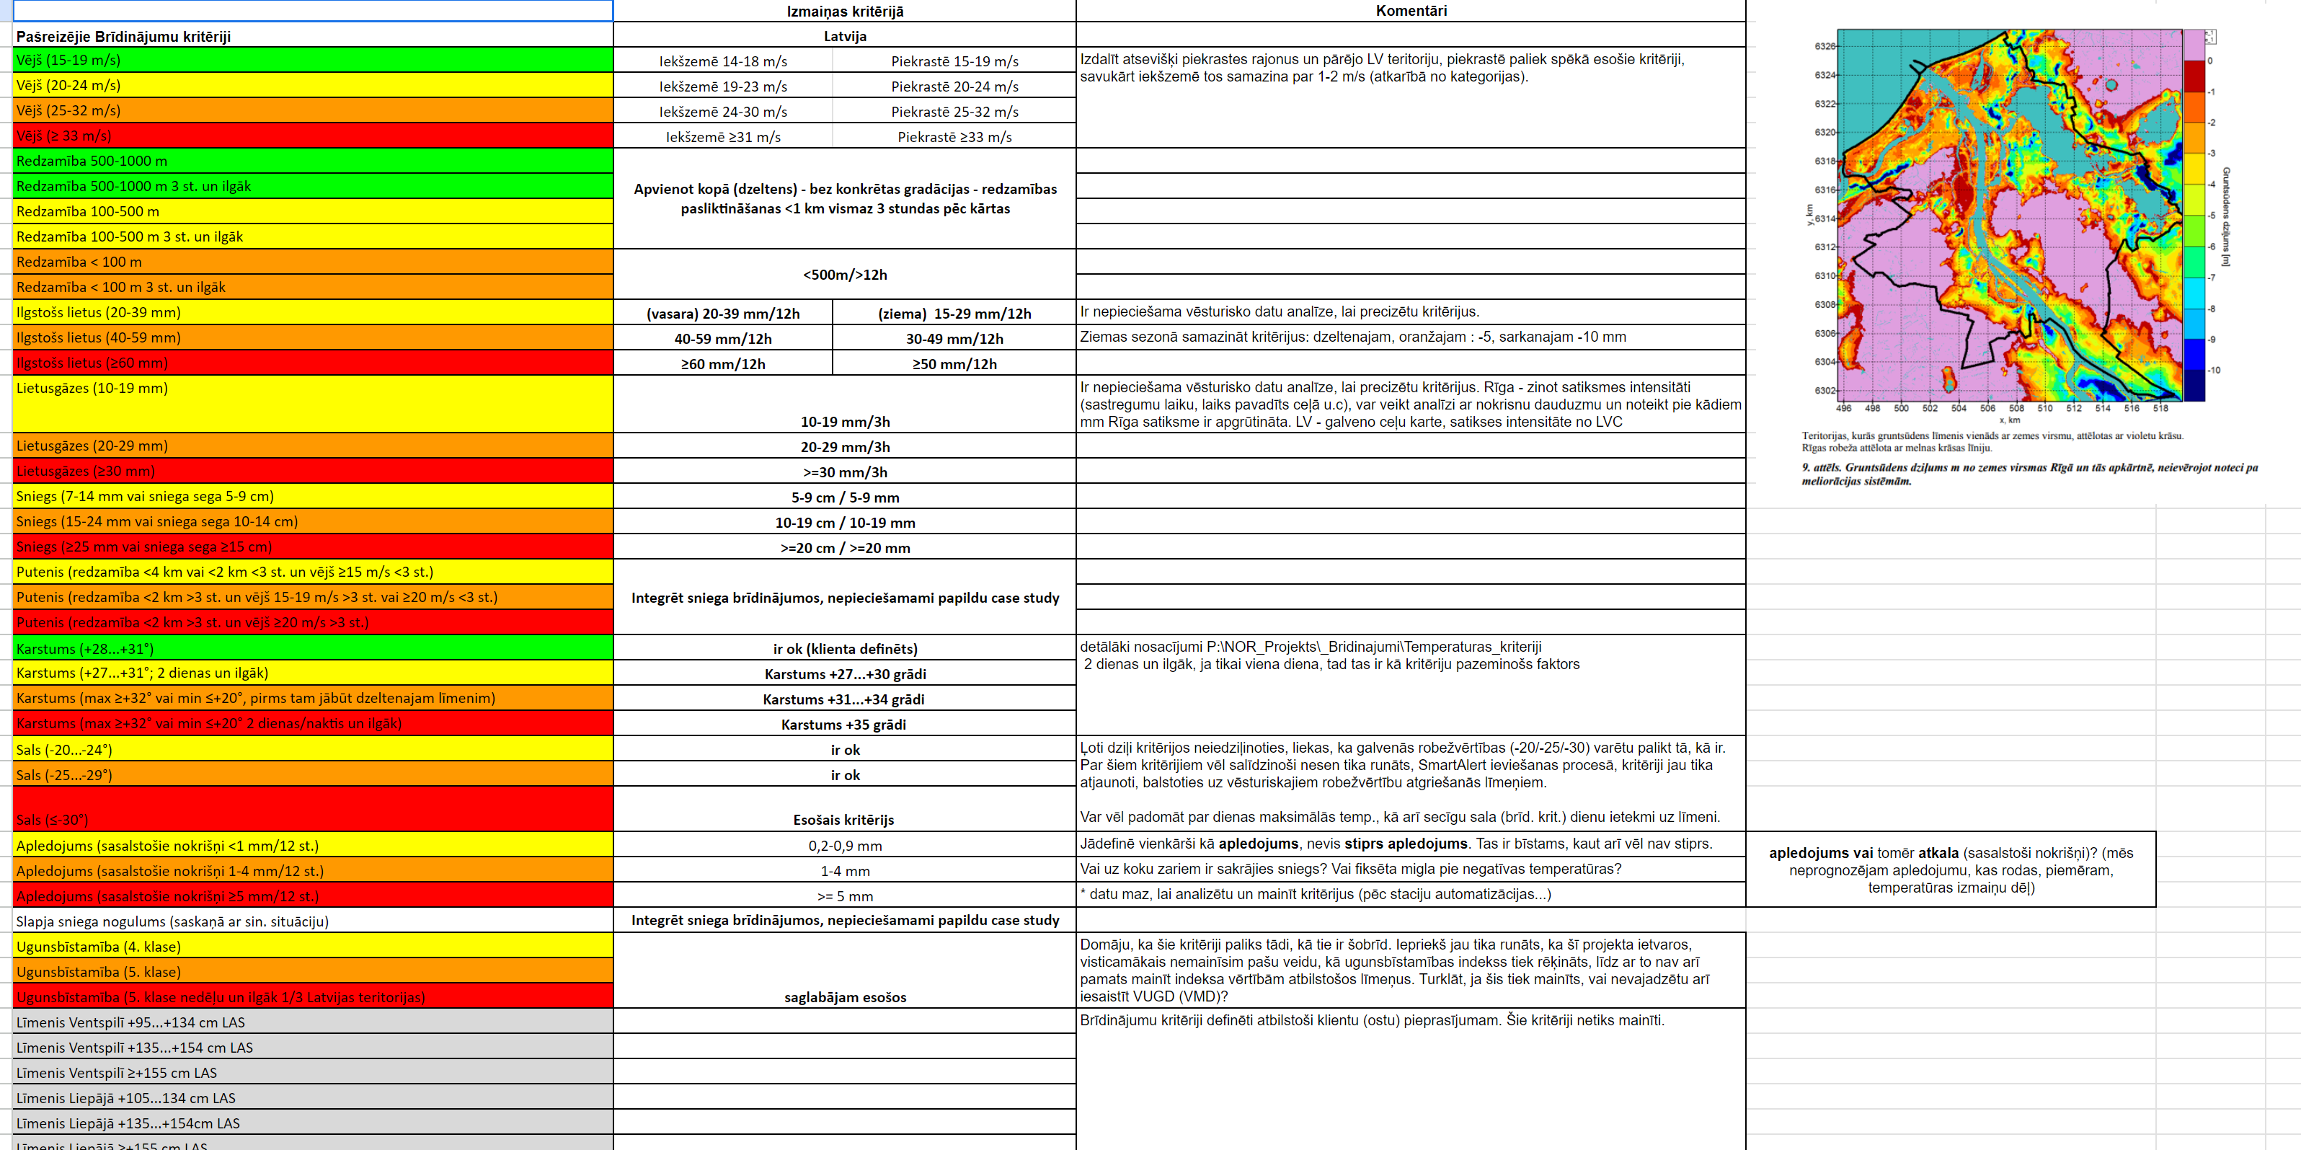
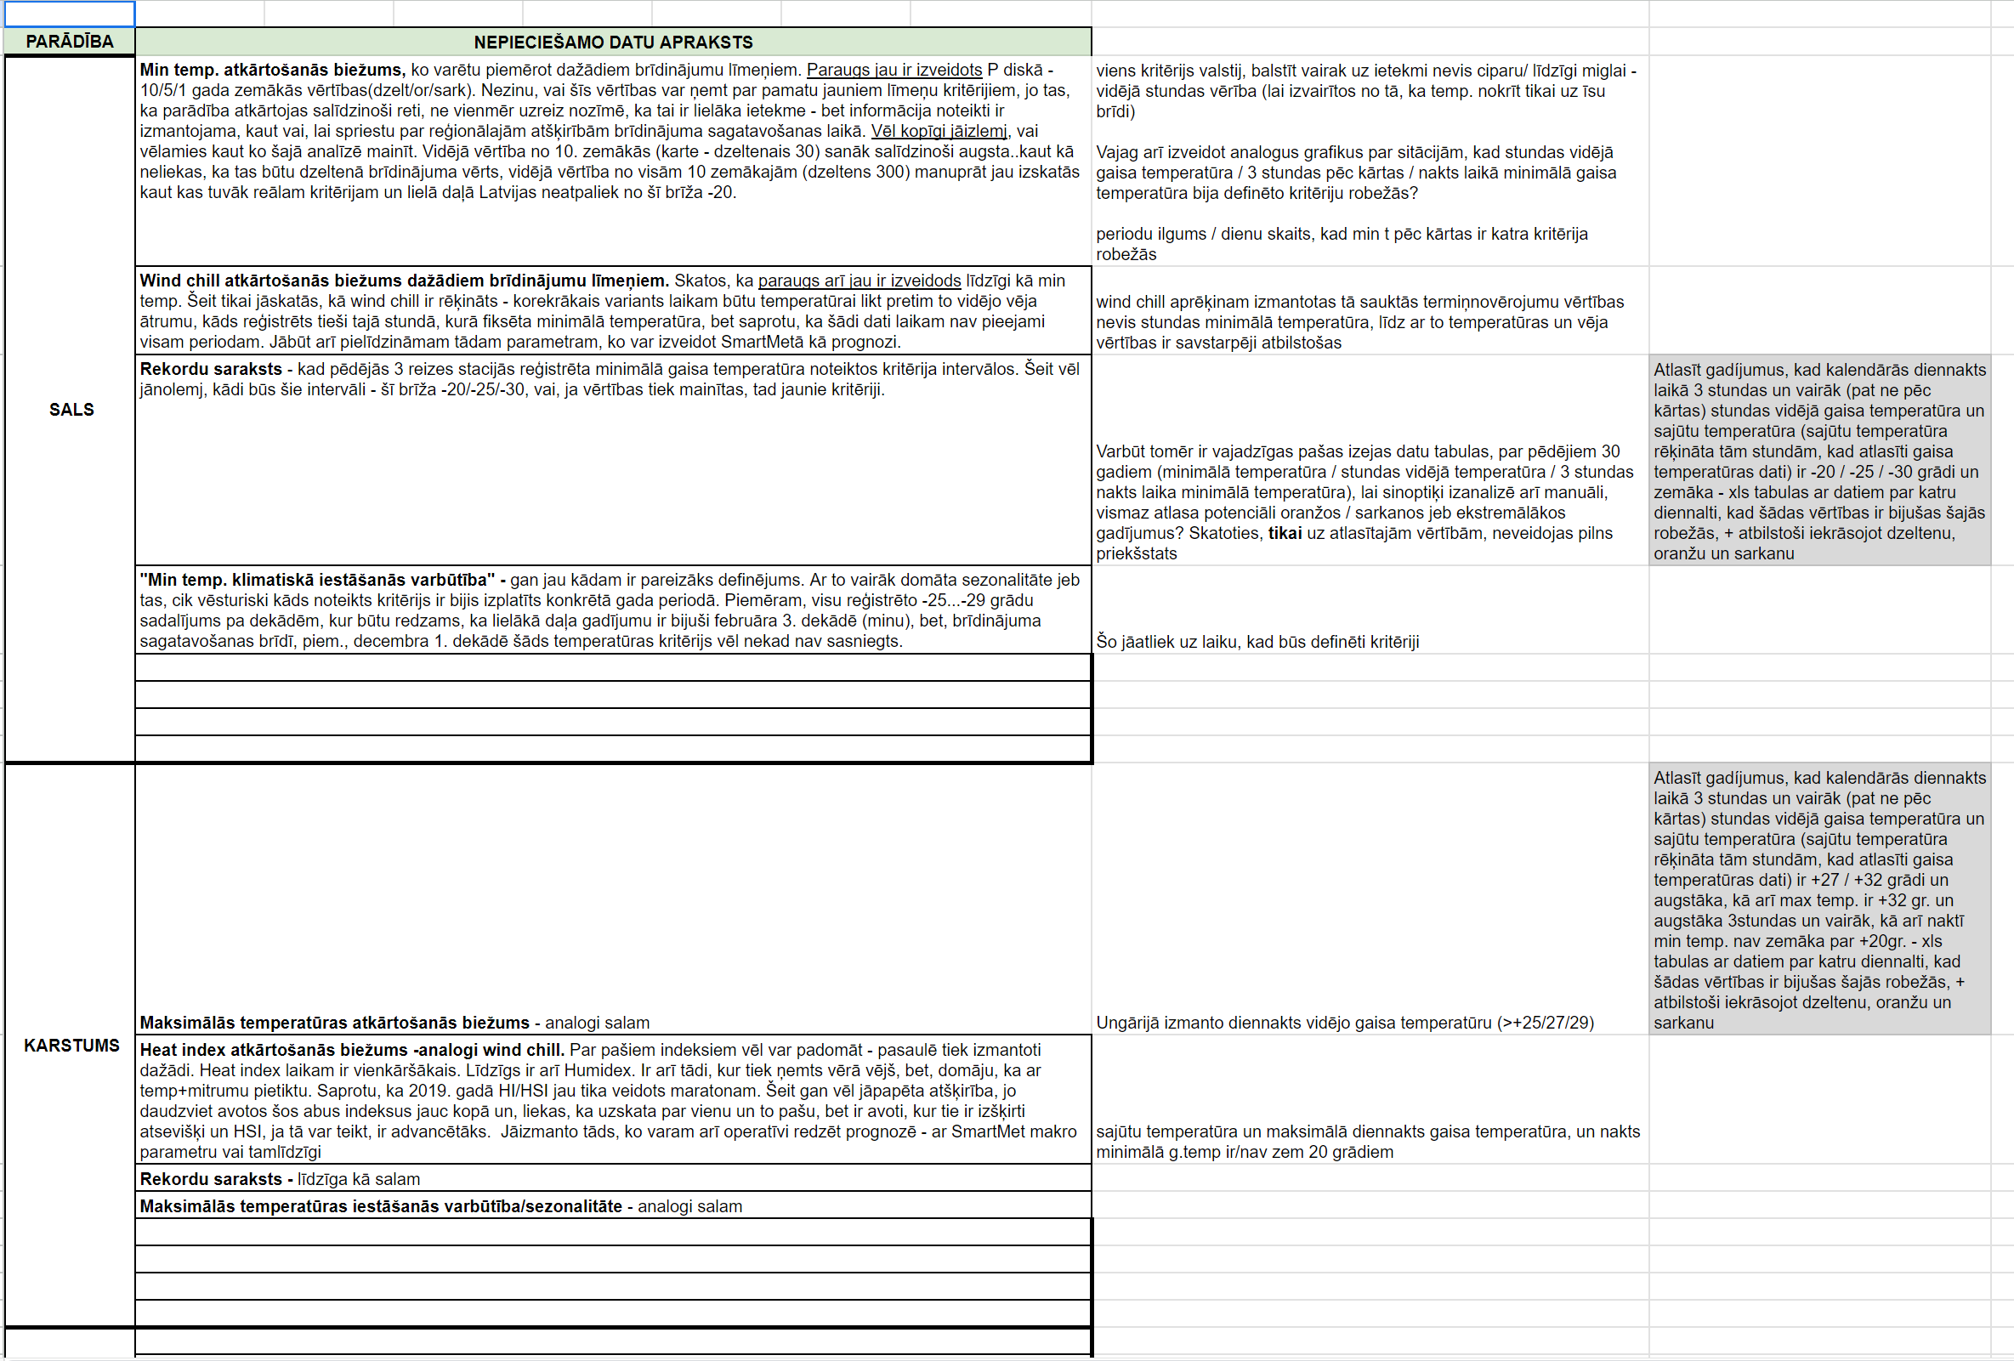
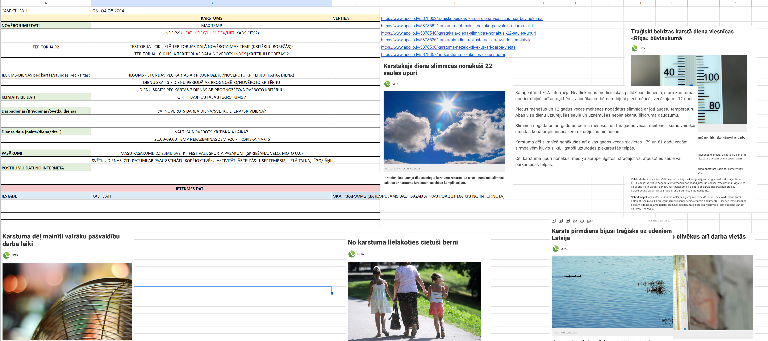
LEGMC experience in impact assessment
In 2021 LEGMC started work in a project to improve our warning system by introducing impact assessment of various weather phenomena into the warnings.
So far the main results are:
- impact data analysis
- updated warning criteria for some phenomena
- new guidelines for forecasters
- development of a new system for issuing warnings in progress
- implementation of warnings for new weather phenomena (frost, grassfires, UV index, drought)
- warning optimization: Blizzard, snow, icing of wet snow → snow

Slide 17
Impact data
State Fire and Rescue Service
Energy sector
State Emergency Medical Service of Latvia
Road Safety Directorate – (not a road maintainer)
Latvian State Forests
etc.
Problems:
- All received data is different in format – database, PDF, xls, csv etc.
- The obtained information differs from each other both in time and space - before starting any analysis, the data had to be organized
Insurance companies and road authorities declined to join project ☹

Slide 18
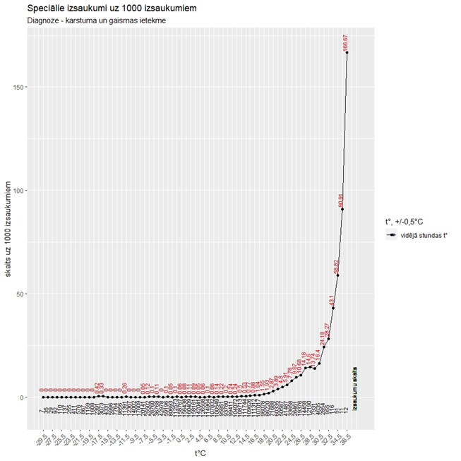
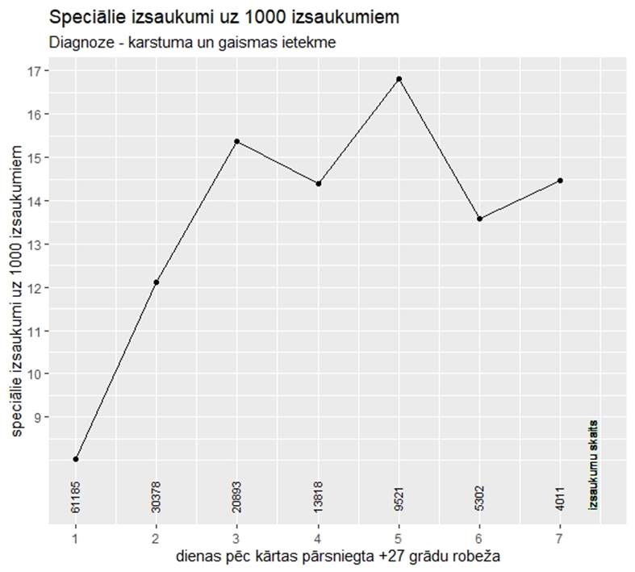
Impact data example - Heat
Exposure to heat and light number of cases per 1000 cases - depending on the average hourly temperature
Sequential days with at least +27 degree heat vs number of cases per 1000 cases

Slide 19
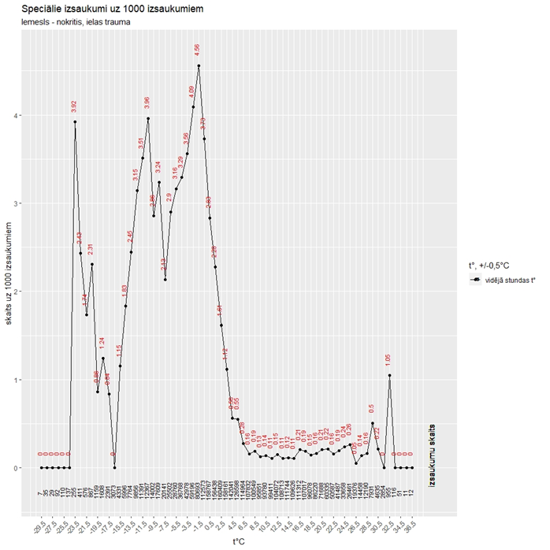
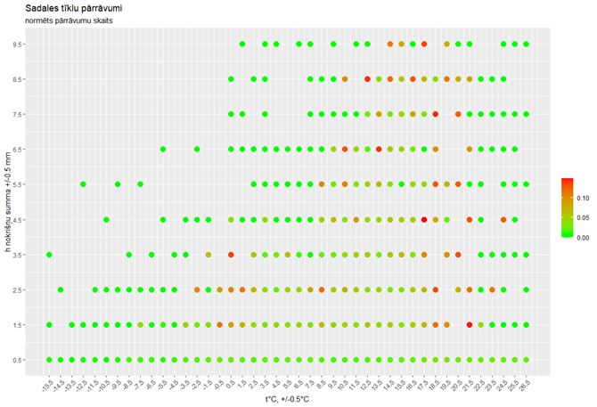
Impact data example - icing
Fall, street injury number of cases per 1000 cases - depending on the average daily temperature
Recorded number of power line breaks - depending on the precipitation amount and temperature

Slide 20
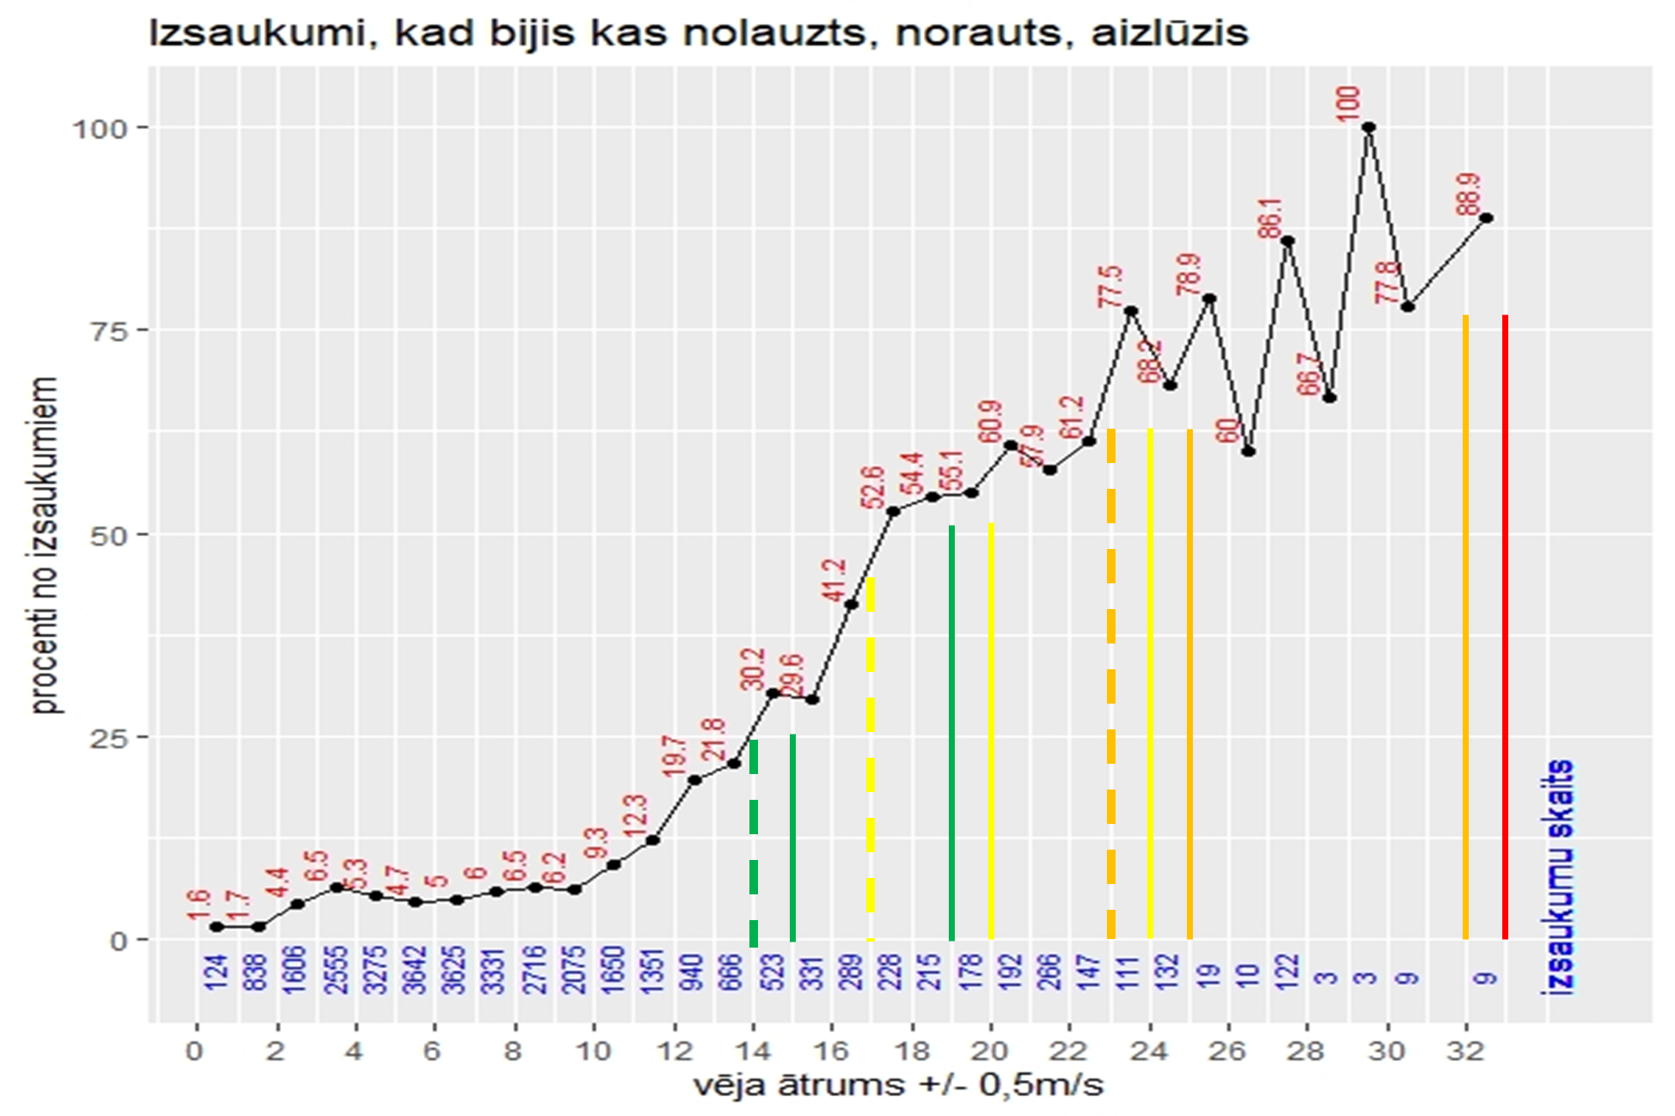
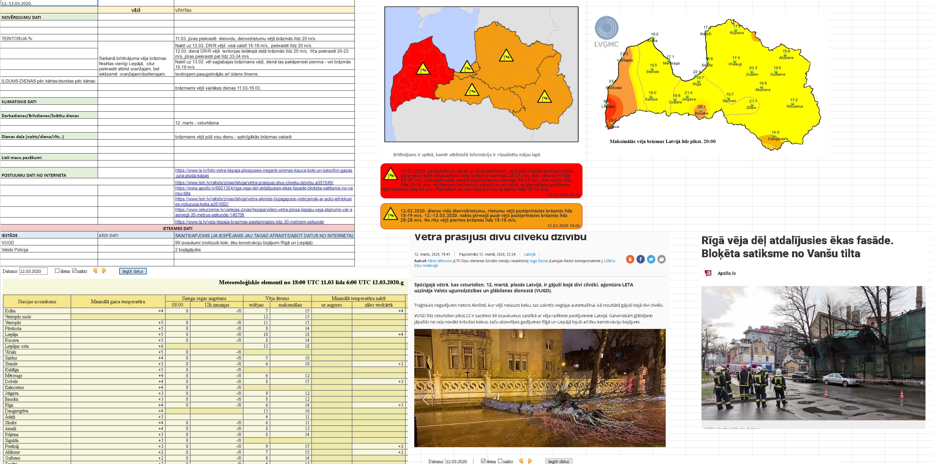
Impact data example - Wind
Case study analysis
Something was broken, torn (State Fire and Rescue Service)
call % - depending on the max wind speed in gusts

Slide 21
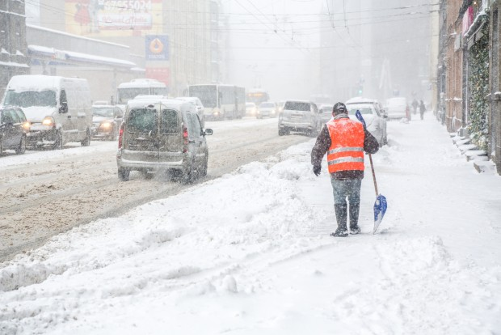
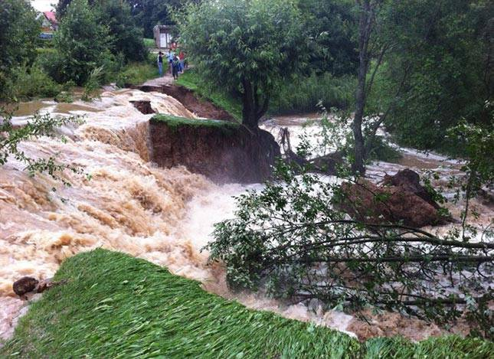
Future developments
- Updated system for issuing and vizualization of warnings
- Establishing cooperation with municipalities, third parties for the impact assessment at a regional and local level.
- Additional impact data and update of the existing dataset

Slide 22
Future developments – a new warning tool

Slide 23
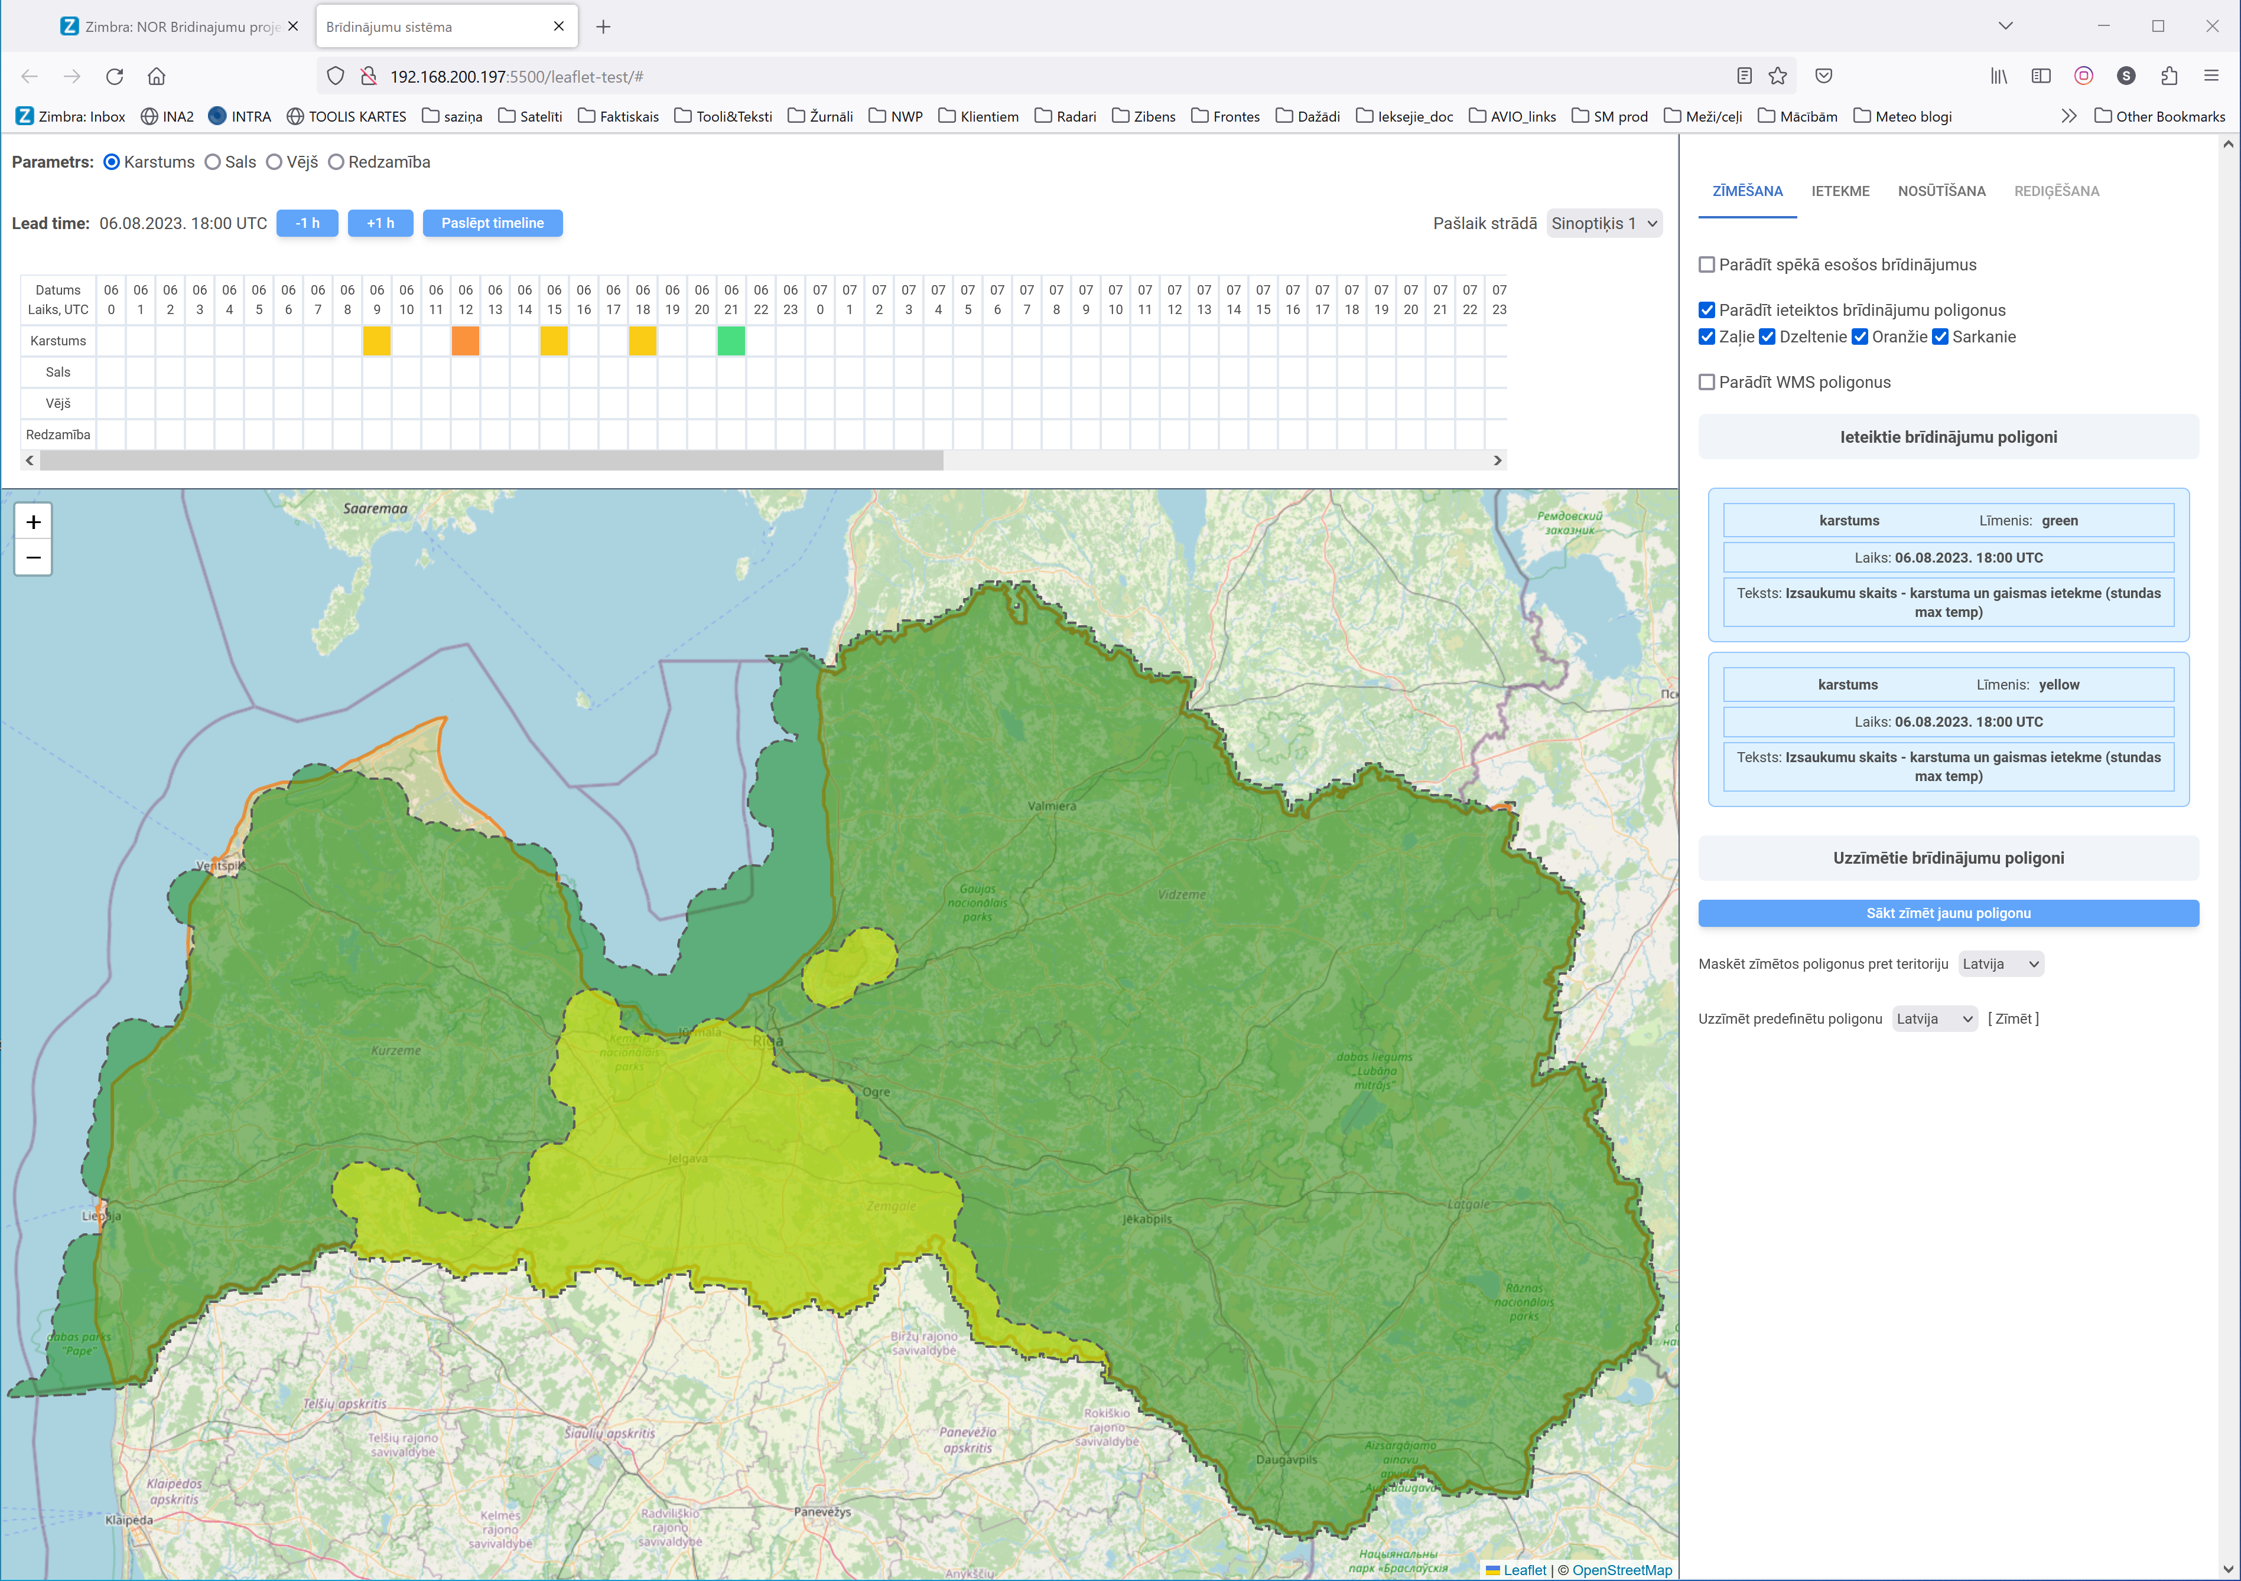
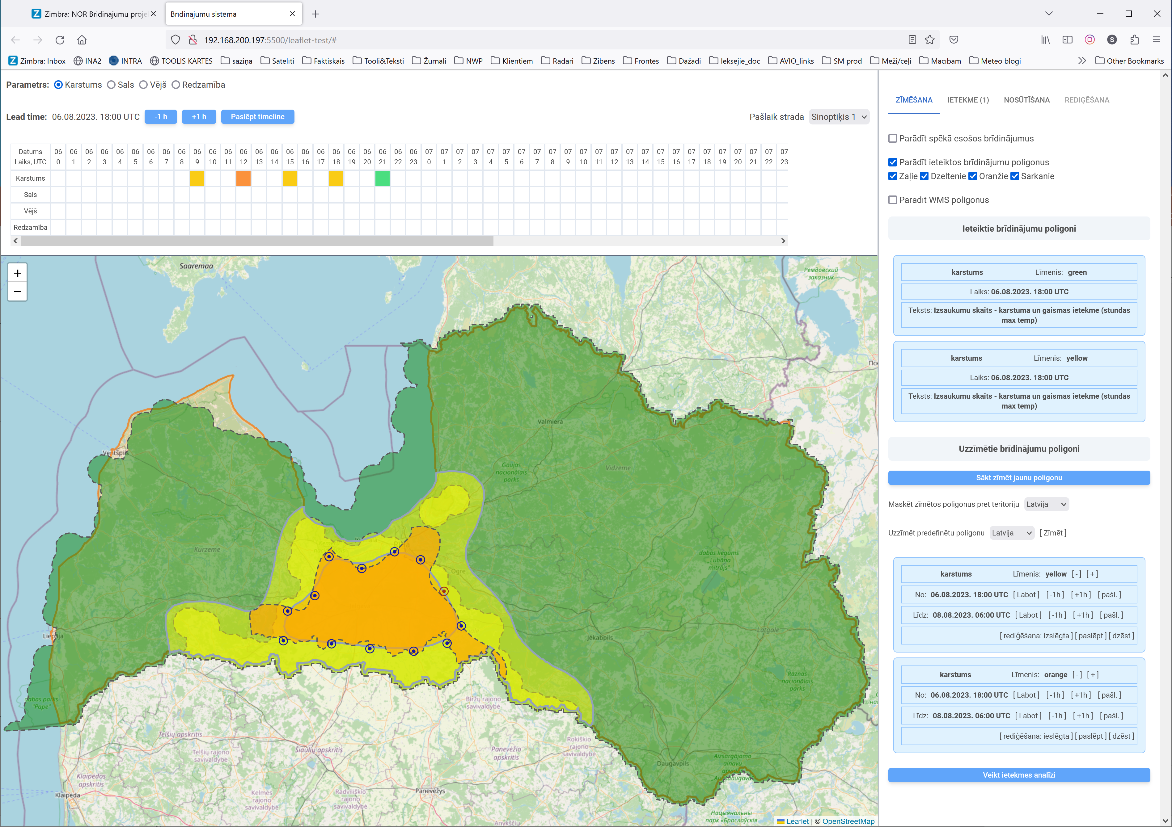
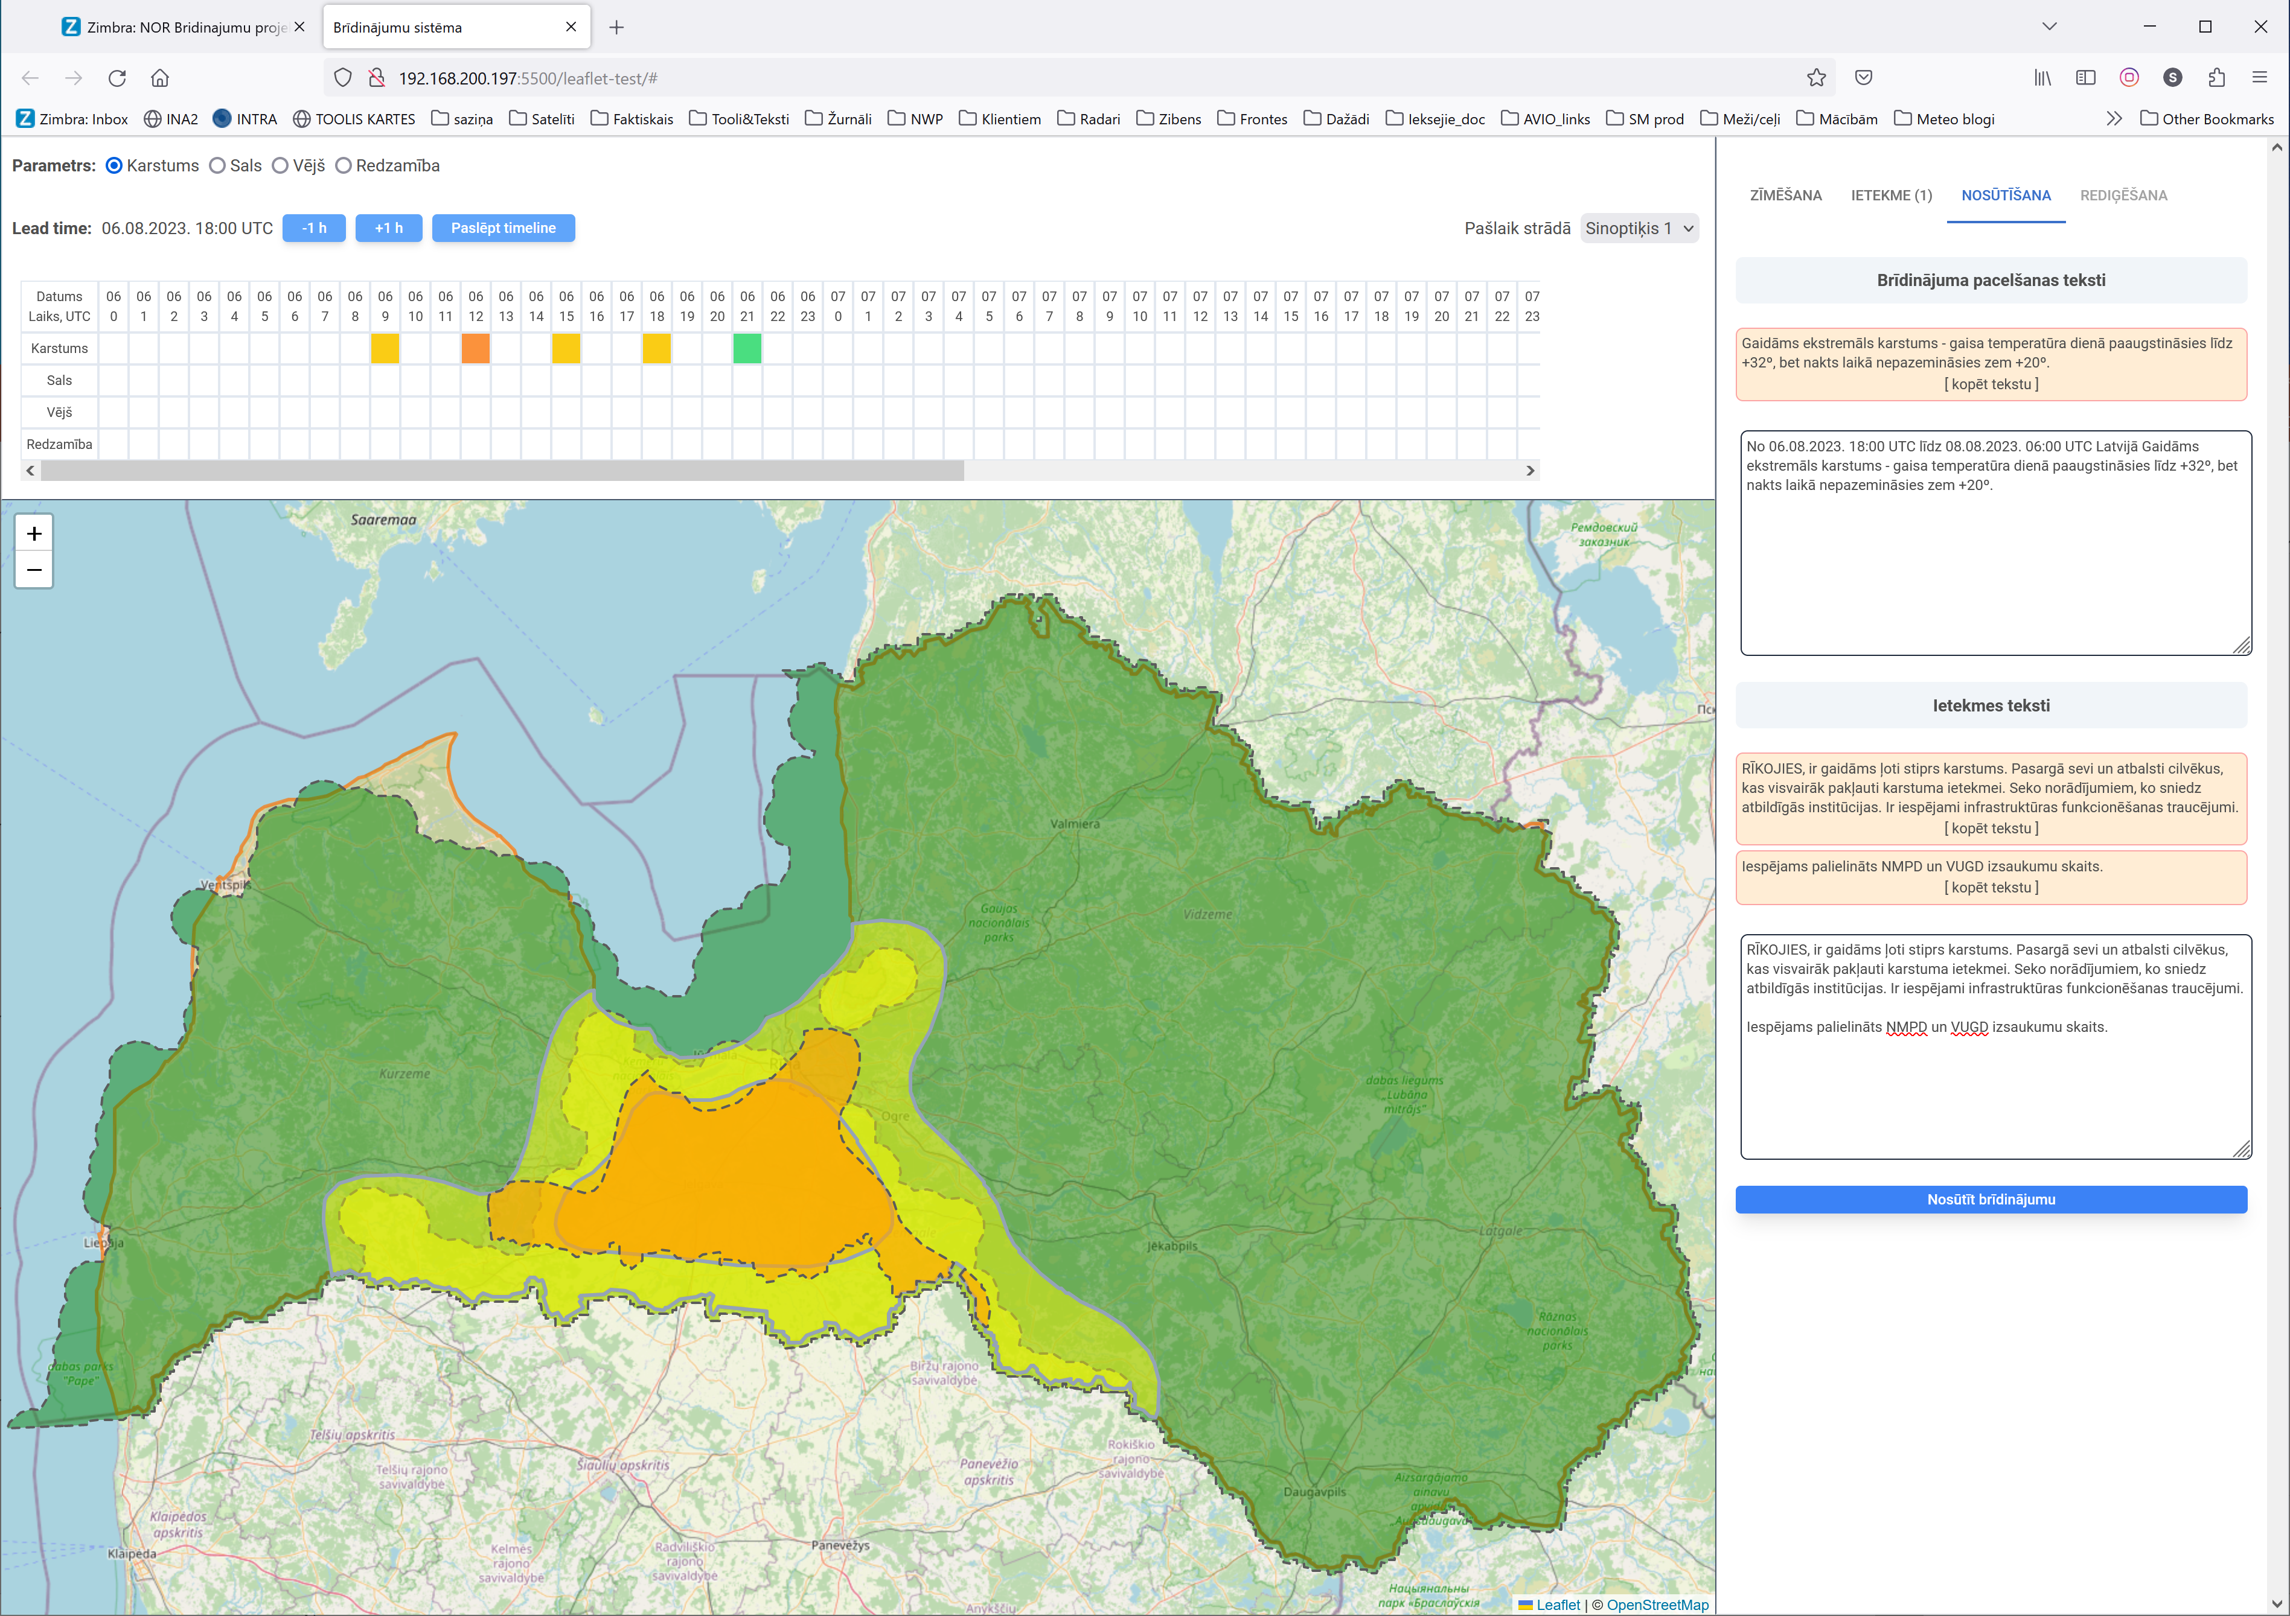
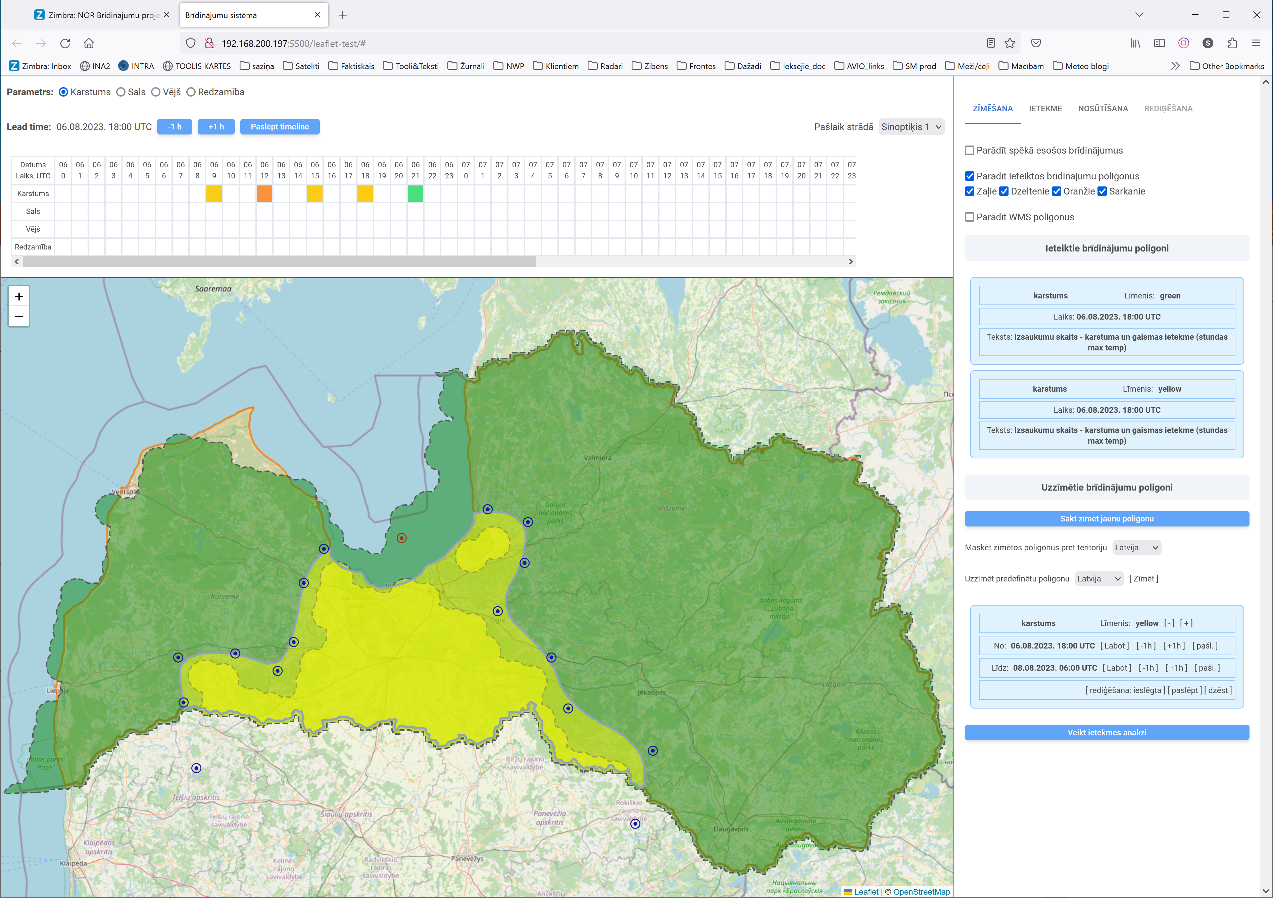
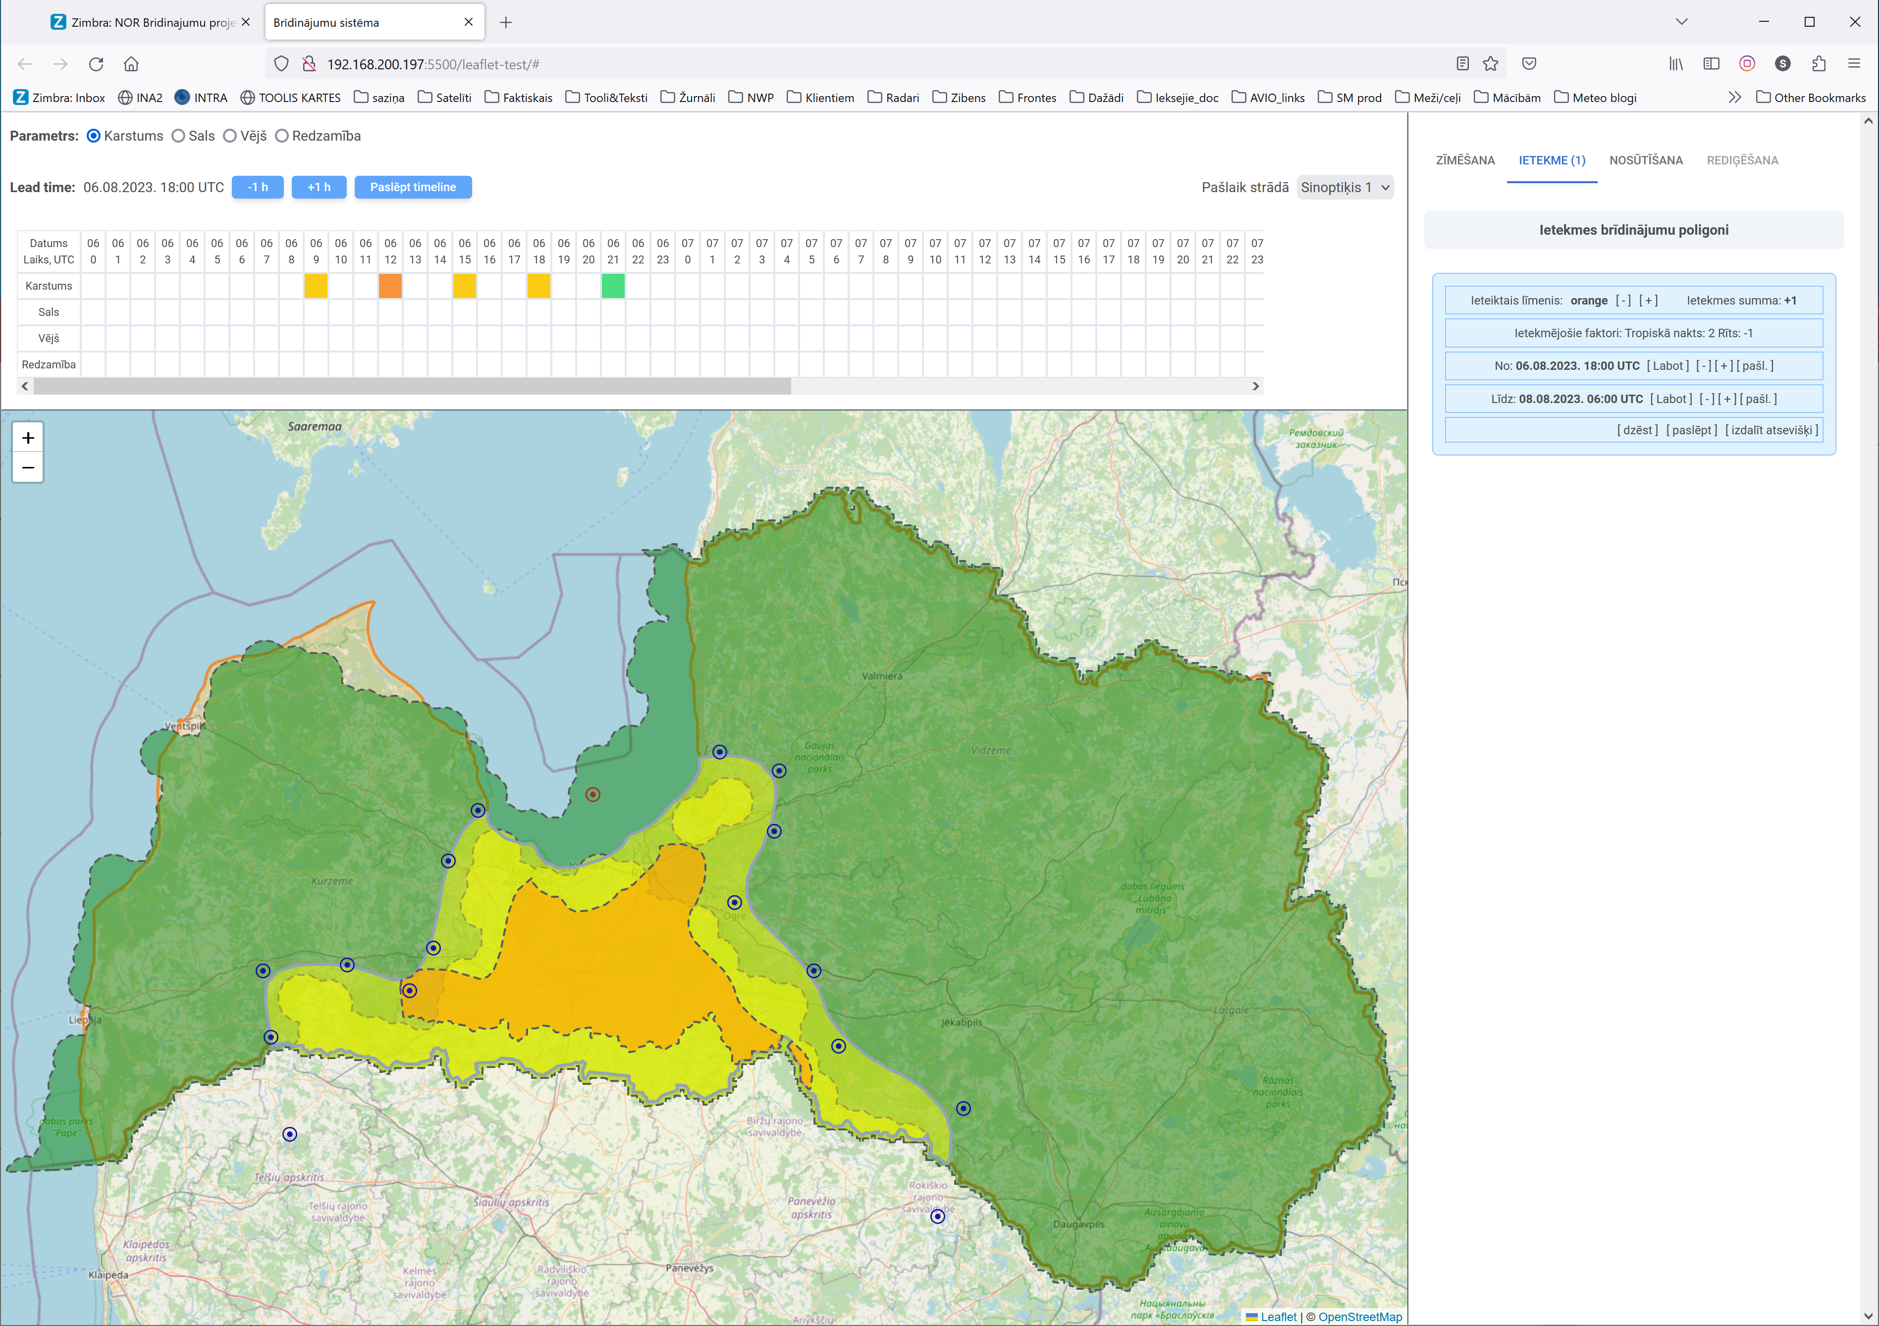
Issuing a warning in the future
Suggested area;
Drawing an area;
Impact assessment;
Drawing impact area;
Suggested texts;
Sending a warning.

Slide 24
Forecasting impact
Thank you!

