Slide 1
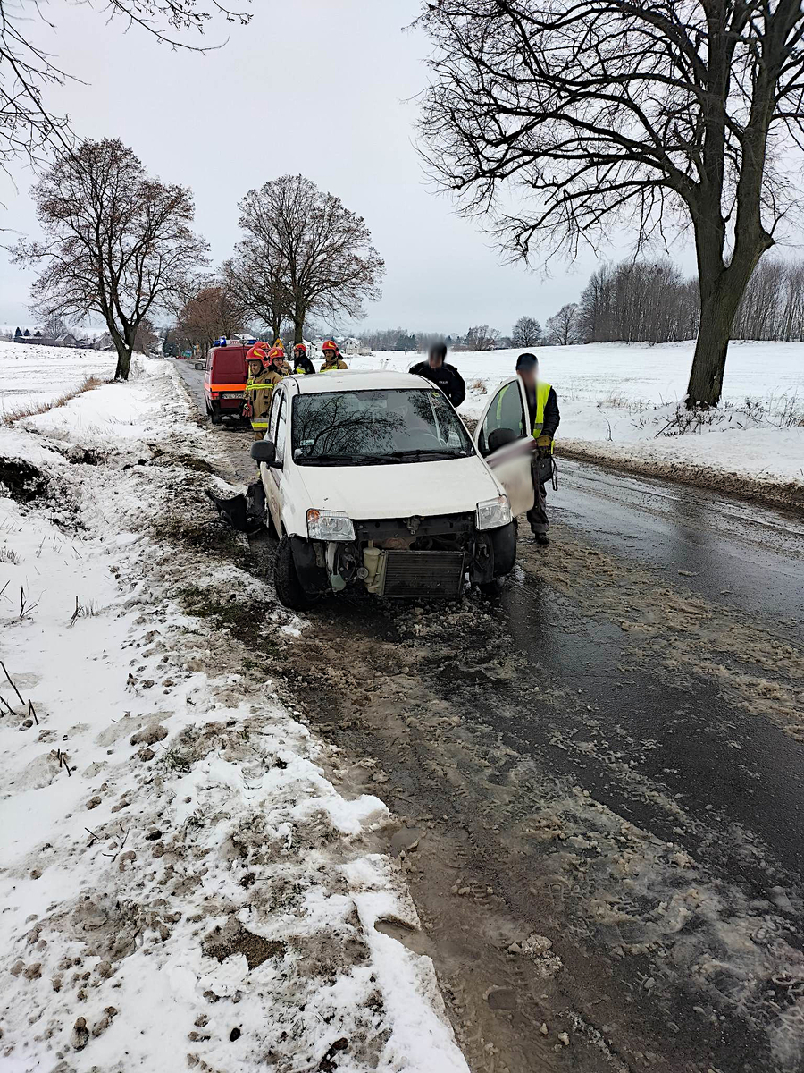
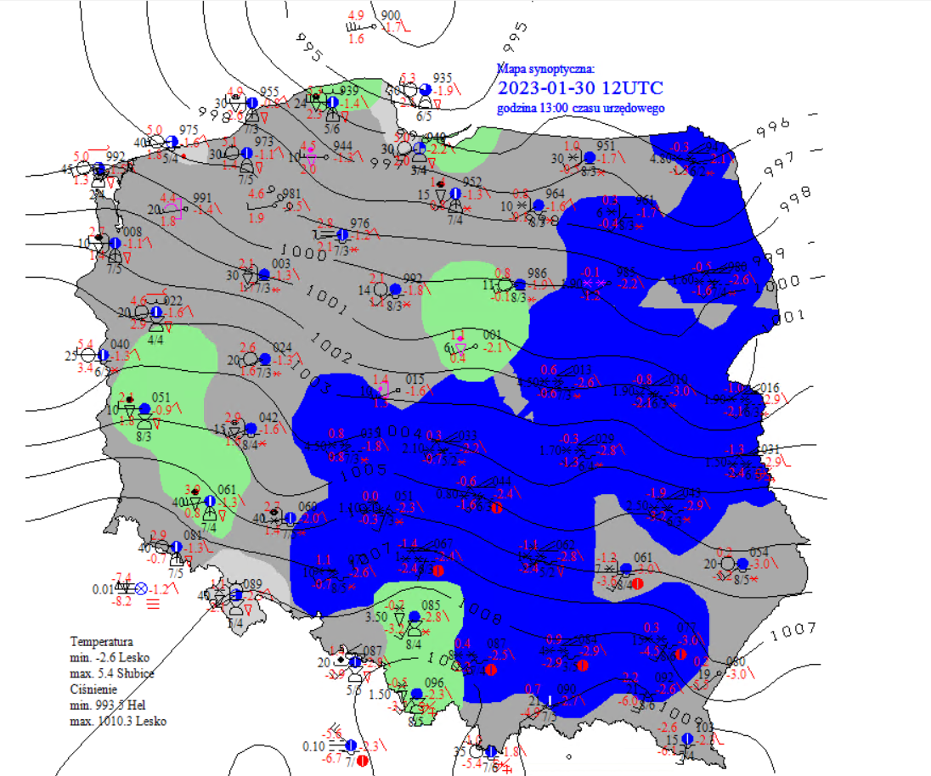
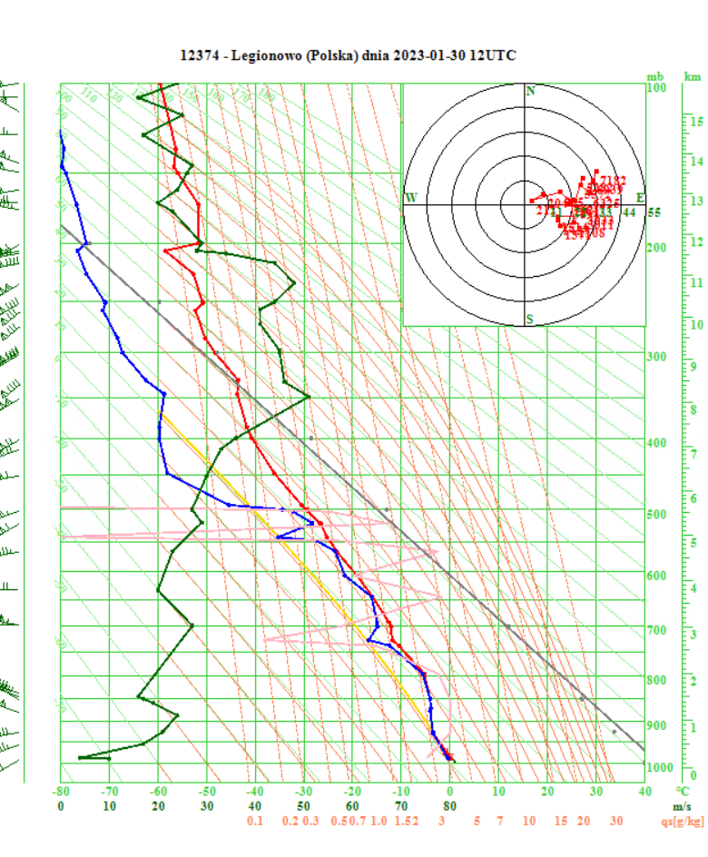
Occlusion Cold Conveyor Belt – 30/01/2023
We can see Occlusion Cold Conveyor Belt in this image.
Weather hazards:
- heavy snowfall ( low visibility – dangerous for aviation and traffic )
- strong wind gusts
Airmass RGB 30.01.2023 12:00 UTC
We can see:
-a multi-layered frontal cloud band associated with the cold front
-a lower cloud spiral which seems to penetrate from below the higher cloud band associated with the cold front
Małgorzata Koper, IMGW (Poland)

