Slide 1
Title : Conceptual Model – cold front
Alla Bilozerova, Ukrainian Hydrometeorological Center

Slide 2
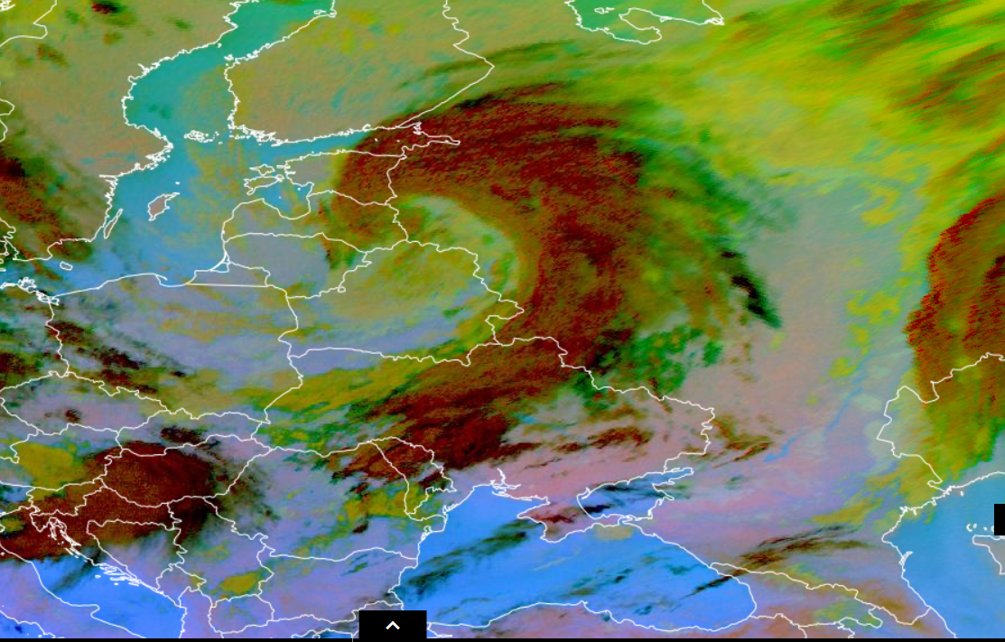
Conceptual Model – cold front in cyclone.
-strong wind
-heavy rain
-low temperature
Airmass RGB and Dust RGB 05/10/2023 21:00 UTC.
On this products we can see a strong cyclone moving from west to east across the Baltic county. His front also moving across Ukrane and change the weather.
Alla Bilozerova, Ukrainian Hydrometeorological Center

Slide 3
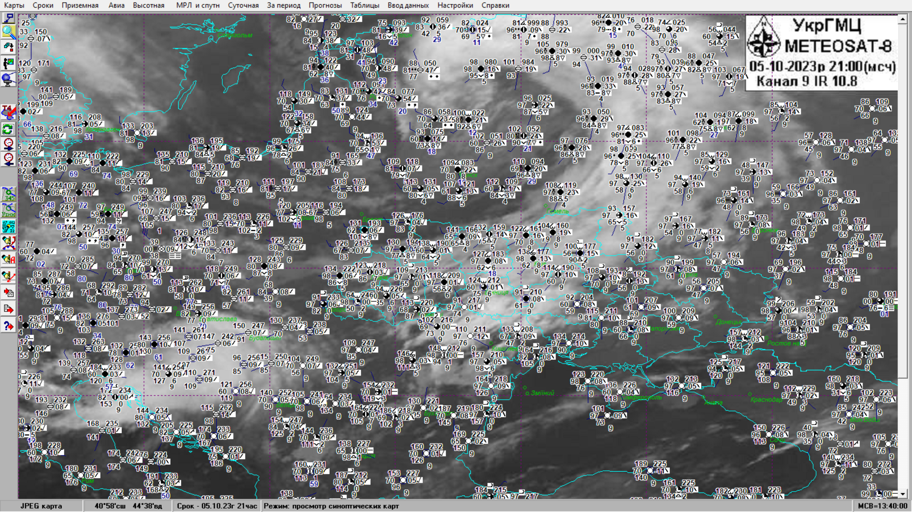

Slide 4
