Slide 1
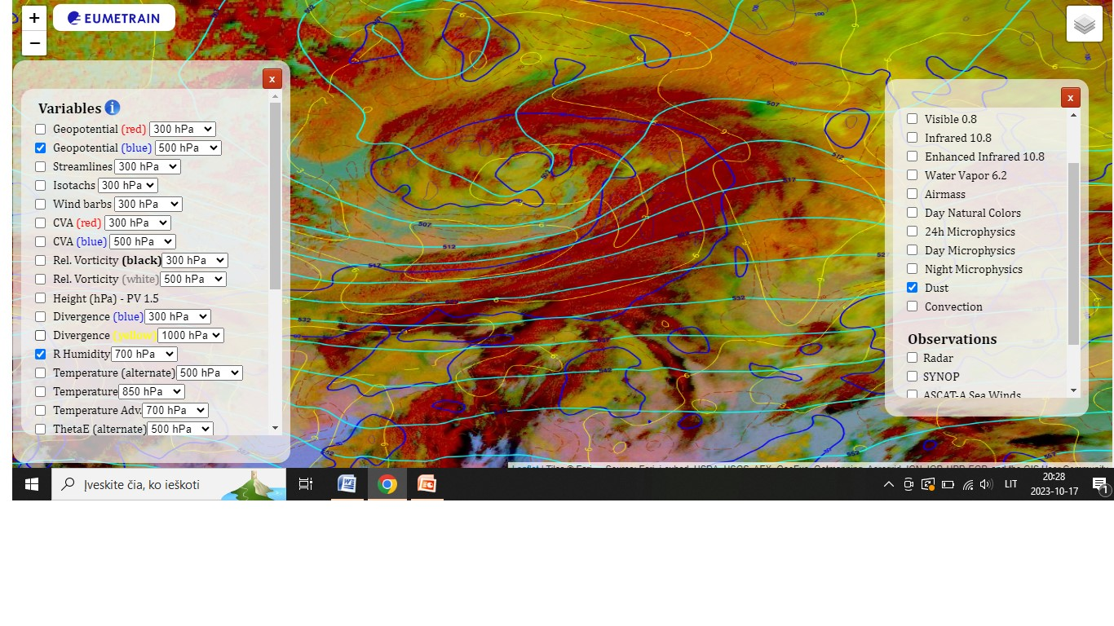
Title : 2023-03-07 – 21:00 UTC
Airmass RGB 2023-03-07 21:00 UTC with thermal front parameter . Southern cyclone cloud system. With strong winds and heavy rain in western part of Lithuania.
Giedrė Andruškienė

