Slide 1
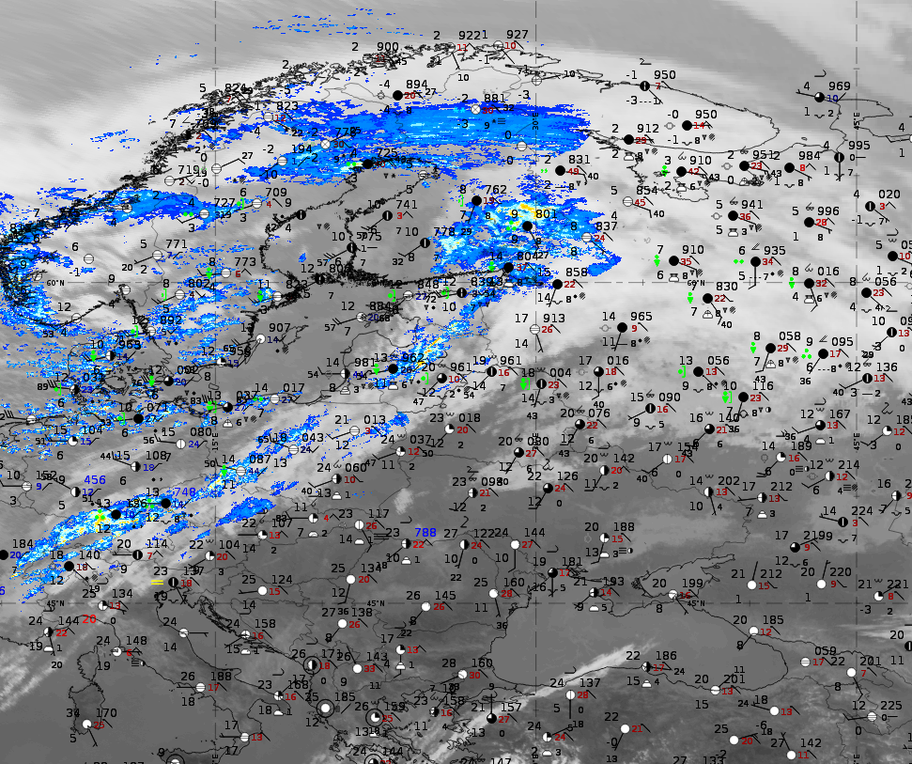
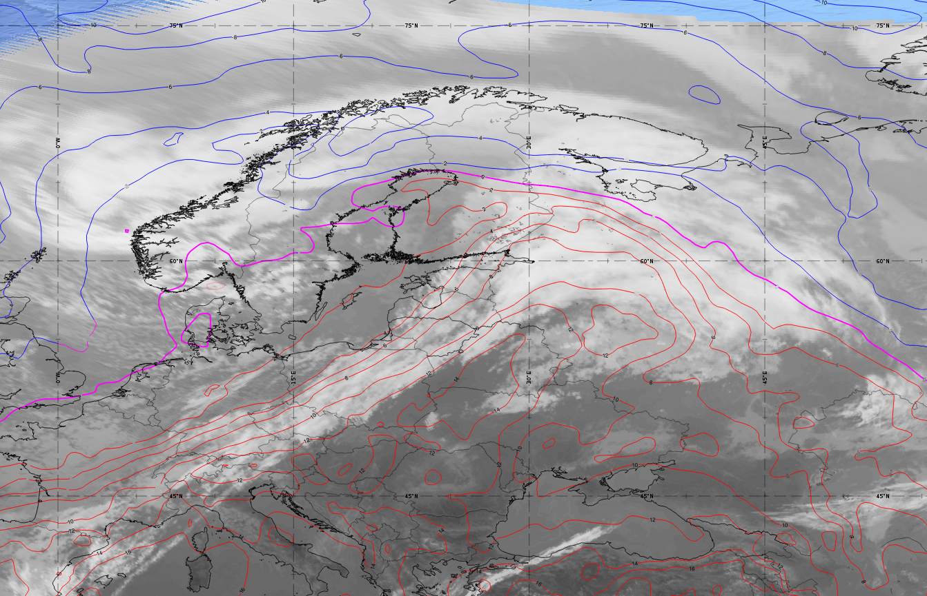
Title : [Ana Cold Front] – [14.10.2023 12:00]
The cold front with a sharp temperature contrast.
Frontal system will bring heavy snowfall across western-southwestern Norway, northern Sweden, and Finland.
Dangerous weather for aviation - high winds, heavy rain and snow, low visibility.
Airmass RGB with geopotential hight 500hPa and thermal front parameter.
Powerful Arctic intrusion of cold air mass from the north.
Ilona Nigale Latvian Air Force weather observer
Notes:
Hello! This is my very first attempt to use satellite imagery, so I tried the best.

