Slide 1
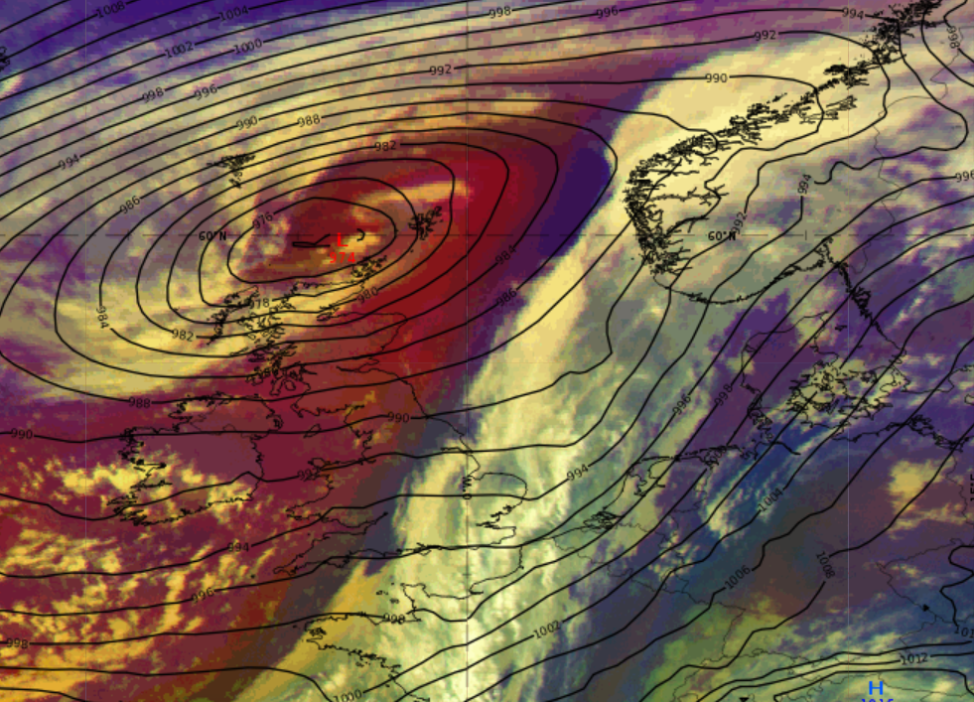
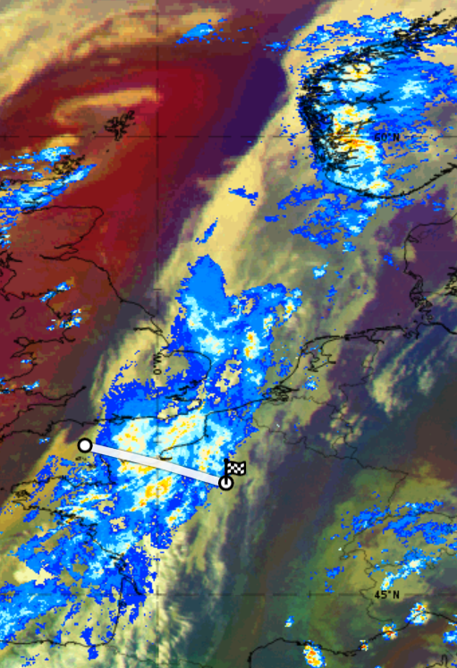
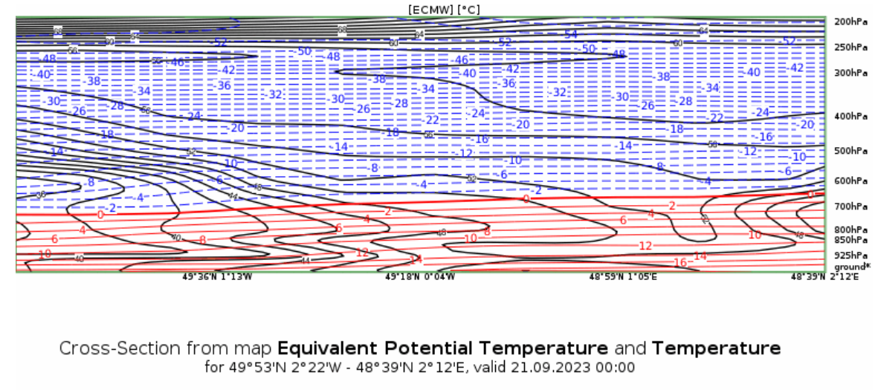
[Cold front ahead of ET cyclone] – [21.09.2023 00UTC]
We can see a cold front ahead of the low.
Behind the frontal cloud system , there is a strip of cold, followed by cold and dry airmass near the center of the low. Ahead of the front the airmass is warmer.
The MSG Dust RGB showcases ochre colors leading the cloud system indicating to an ana cold front.
Heavy rainfall, sudden drop in temperature and thunderstorms are associated with this case.
Intense rainfall was recorded by OPERA radar in multiple places along the frontal system, most intense in Southern Norway and northwestern coast of France. The following day there was there were thunderstorms along the front in easter France and western Germany.
This satellite image is retrieved from ePort. The used products are MSG Airmass RGB and ECMWF mean sea level pressure.
It showcases a low with its through positioned to northeast. Starting from the through an impressive cloud system stretches to southwest and eastwards.
Katriin Käärik, Estonia Environment Agency

