Slide 1
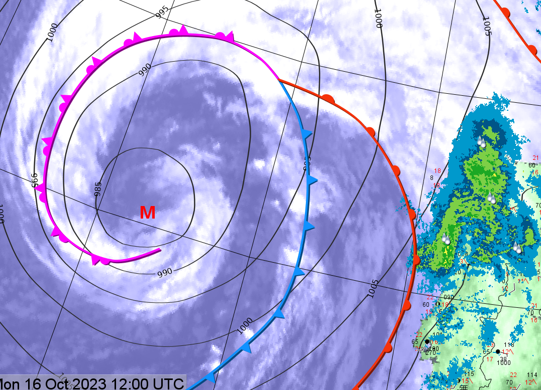
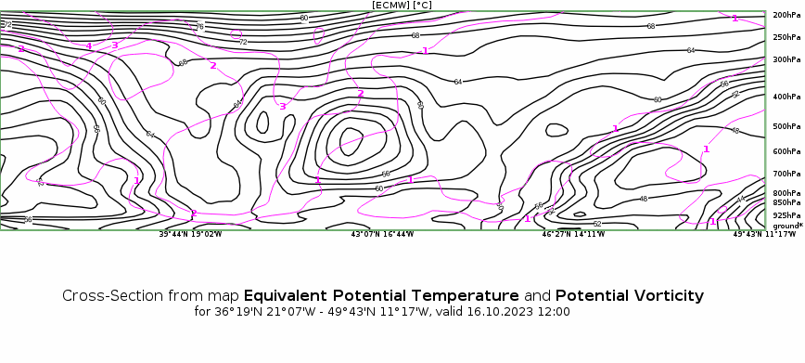
Norwegian type cylogenesis – [17.10.23]
There are two major visible Conceptual Models in this picture – The Norwegian type cyclogenesis (slow initial phase, no separation of warm sector by cold front – excluding SK type cyclone (observed previous stages over the ocean);
Warm Front Shield – thick cloud cover in warm sector, ascending and increasing towards the occluded spiral (strong warm conveyor)
Hazards: Thunderstorms within the occluded area, in the warm sector, visible convection cells in the cold front, Strong winds in the descending jet area (brown/red, at the edge of the spiral on the cyclonic side)
Above – Warm front induced rain over Portugal
On the left – High PV values on the inner spiral of the cyclone (purple)
Product: Airmass RGB, 16.10.23, 12:00 UTC
On the Picture, an ET Cyclone that formed over the Atlantic is moving east towards the Iberian peninsula. On the Airmass RGB product, the cold, dry airmass intrusion is very visible behind the cold front and spiraling into the matured cyclone Center.
Karl Erik Krepp, Estonian Enivronment Agency

