Slide 1
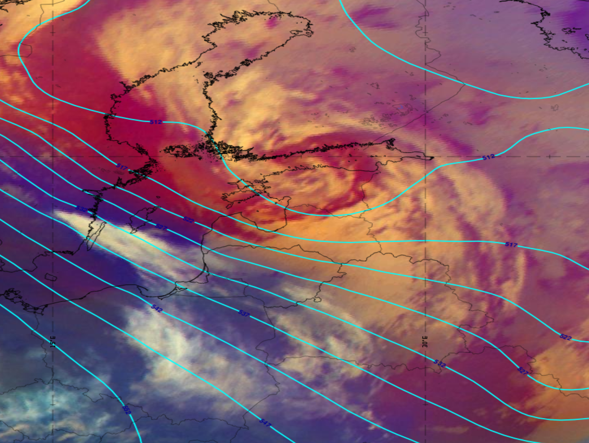
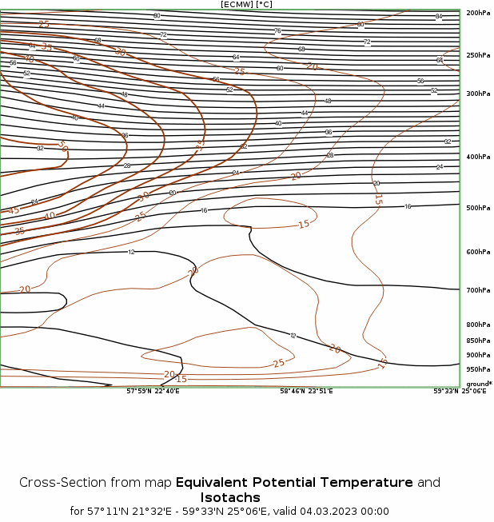
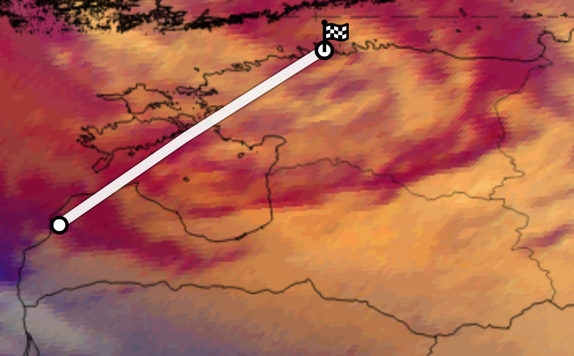
Cyclogenesis Norwegian type over the Baltic countries – March 4, 2023
The satellite image shows the Dissipation stage of the Norwegian type Cyclogenesis Conceptual Model.
The weather observations & consequences in Latvia:
- At night the snow cover in the eastern part grew by 5-7 cm, by day in the whole country by 5-9 cm, locally by 10-13 cm;
- Wind gusts 15-19 m/s, in the central and western parts 20-24 m/s;
- Widespread power outages;
- Accidents on the roads due to snowfall, snow accumulation on the roads and black ice (the air temperature at night and by day was -2...+2°).
Airmass RGB with geopotential 500 hPa (00UTC March 4, 2023)
The bright, white colors depict clouds. The centre of the low is located over the Gulf of Finland, the Occlusion cloud band spiraling several times around it. The dark brown stripe within the cloud spiral represents cold and very dry sinking air.
Karina Rozkova, LEGMC

