Slide 1
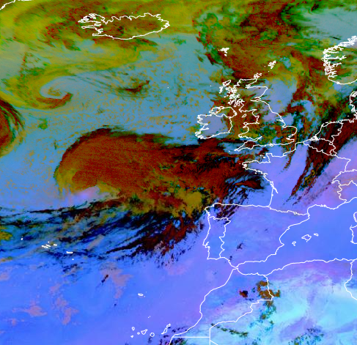
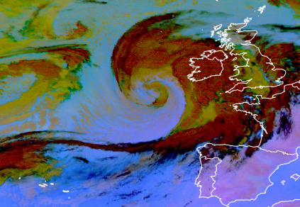
Title : Rapid Cyclogenesis – [27.09.2023 17:15]
We can see Rapid Cyclogenesis CM.
Weather effects asociated with Rapid Cyclogenesis –
intense precipitation,
thunderstorms,
strong wind/ strong wind gusts,
very strong falls/rises in pressure.
(28.09.2023 6:15) hours later a mature stage storm can be observed.
Dust RGB – MSG – 0 degree, 27.09.2023 17:15.
In this Dust RGB we can see a rapidly developing storm in the atlantic ocean. In the Eumetview all stages of storm development can be observed in Dust and Airmass RGB. This picture shows the already advanced stage – could has started to spiral, the centre of the cloud is blue, which means that it is cloud free.
Kristaps Veitners, LEGMC

