Slide 1
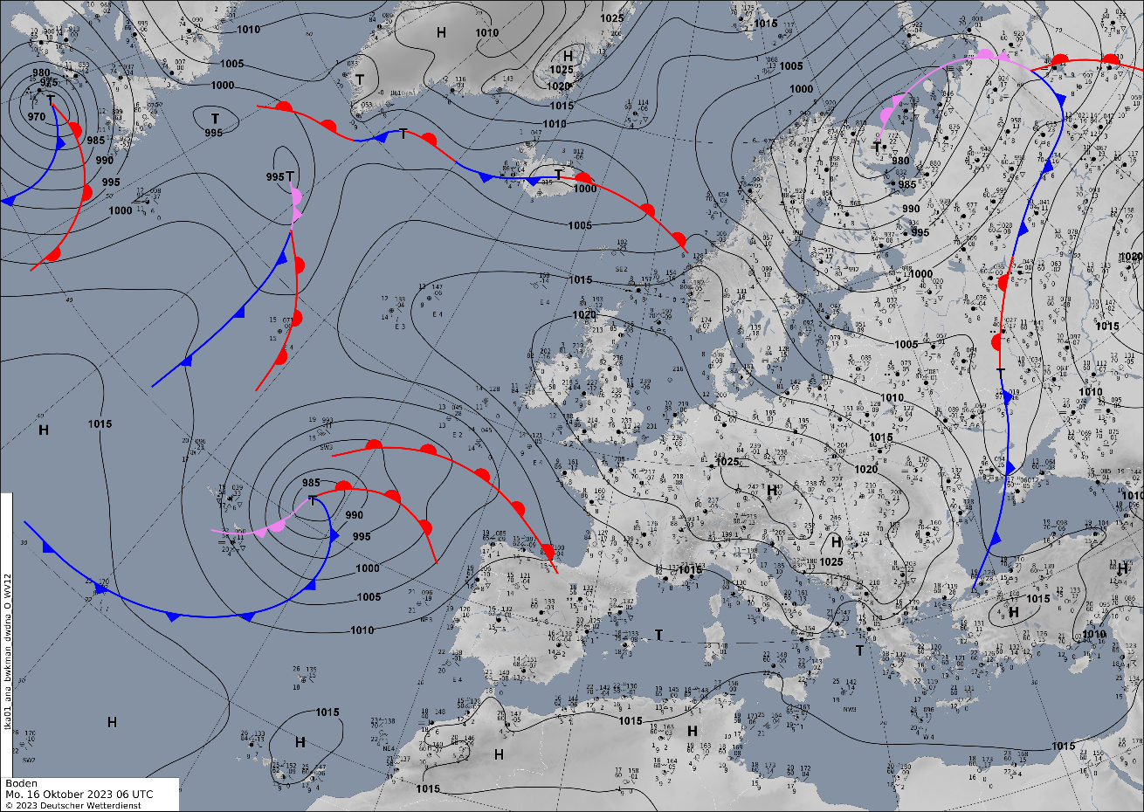
Title : [Norwegian type] – [16 Oct 2023 07:00 UTC]
Conceptual Model – Norwegian type
Weather hazards in this case
- strong wind and wind gust
- heavy rain
- different temperature wich related with frontal system
1
2023 Oct 16 07:00 UTC
Airmass RGB In the Airmass RGB image, the greenish colors in front of the cloud band represent warm air masses; the blue band represents cold air masses. Most often, such images show clouds Cumulonimbus (Cb).
1. Sinoptic map with frontal system on the cyclone
Diana Kryvobok, Ukrainian Hydrometeorological Center

Slide 2
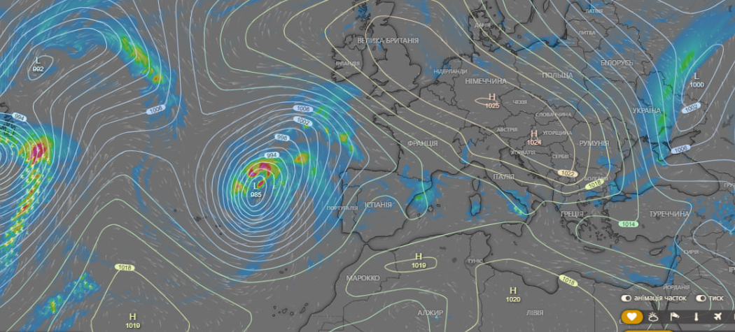
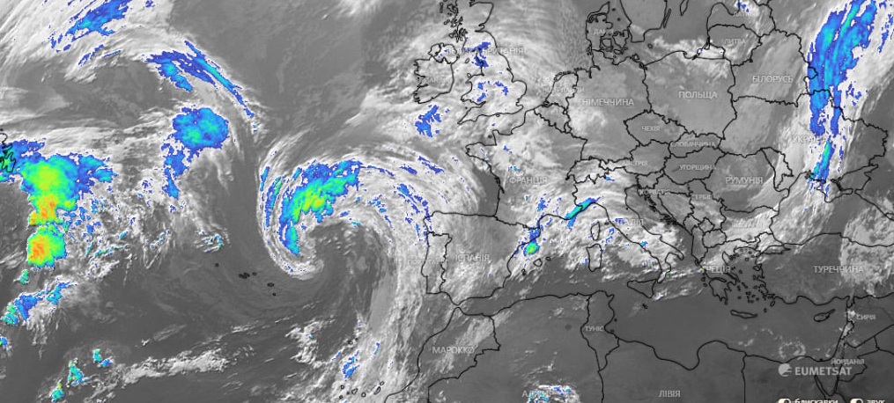
2
3
2023 Oct 16 07:00 UTC
Figure 2 NWP witch shows thunderstorms in a cyclone
3. INFRA+ satellite image
Diana Kryvobok, Ukrainian Hydrometeorological Center

