Slide 1
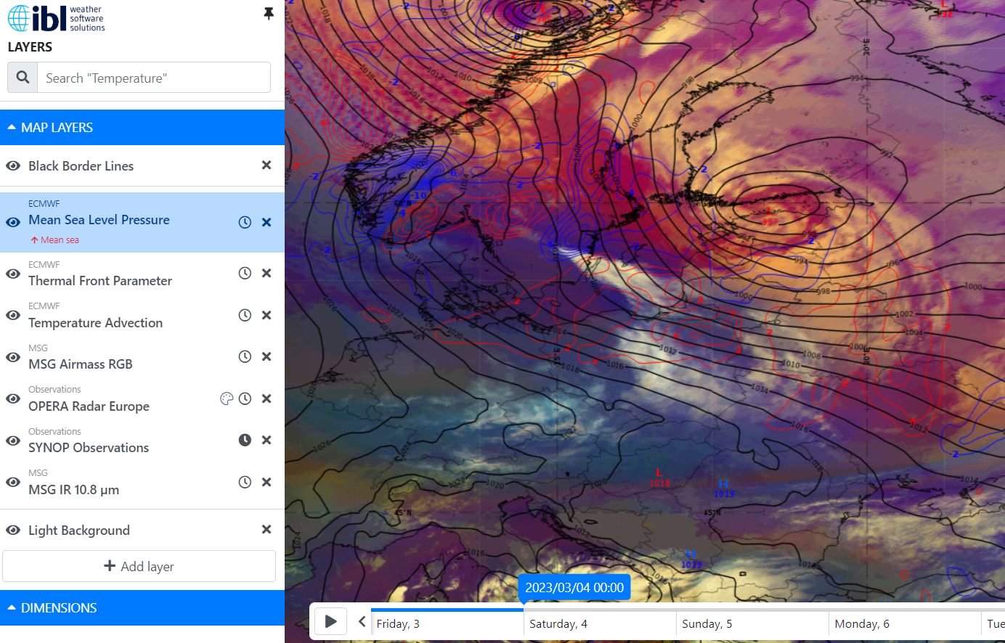
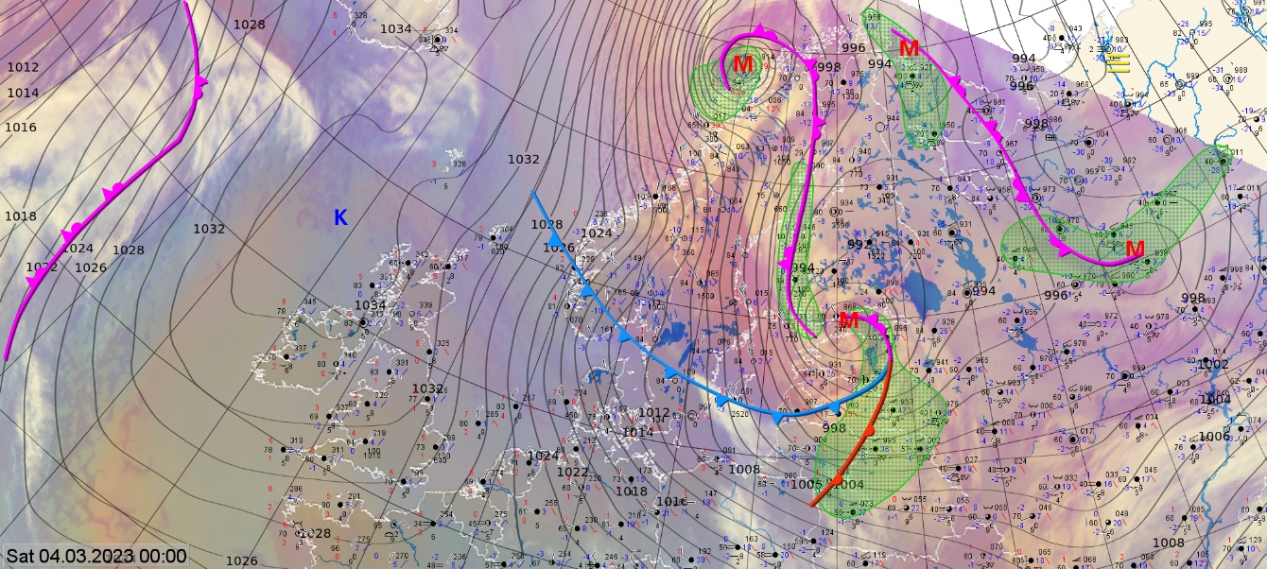
Norwegian cyclone model 04.03.2023 00 UTC
We can see Norwegian cyclon model in this image
Consequences:
slippery roads
poor visibility
power outages
branches breaking under the weight of wet snow
Add here 1-2 additional images (NWP/ Sounding/Vertical Cross Section/Observation/ Photo of the event, etc) describing the case.
Airmass RGB with mean sea level pressure and temperatuure advection. On the right opera radar and SmartMet chart with fronts, synop and satellite image.
ET cyclon cloud system.
Strong winds on Western coast of Estonia. Snow in mainland Estonia and rain on western coast of Estonia. Poor visibility.
Kaido Ennok Estonian Environment Agency

