Slide 1
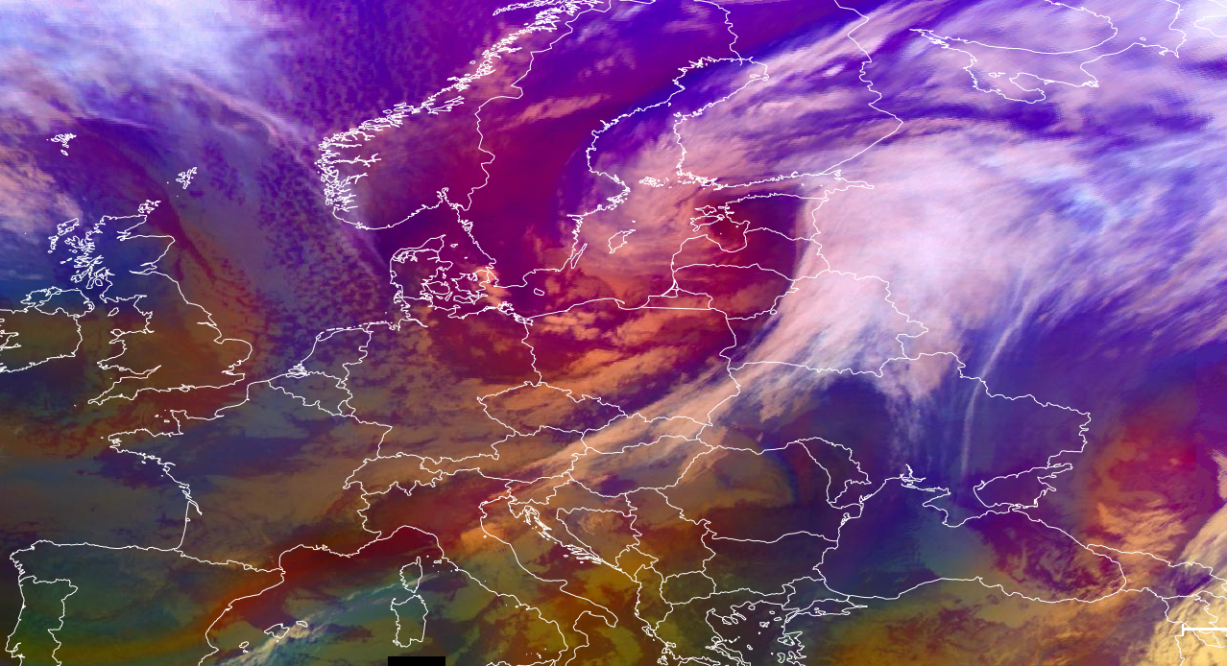
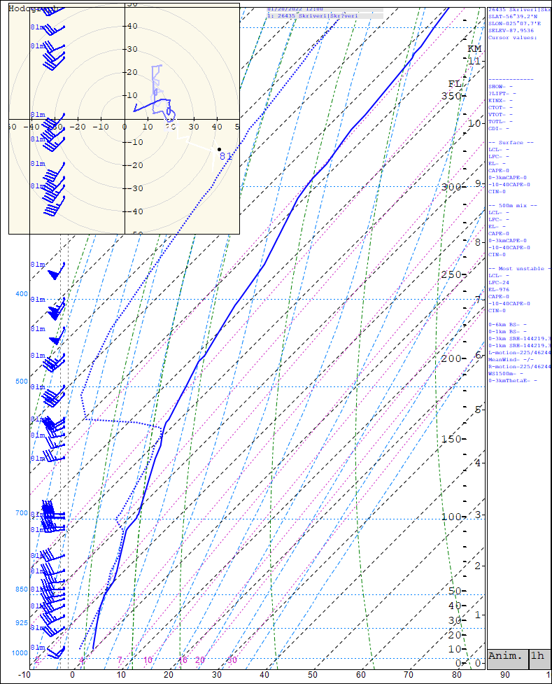
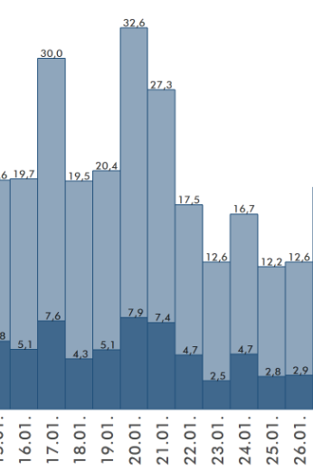
Ana Cold front – 20.01.2022
This image is significant to Ana cold font which was moving over the Poland and Baltics.
It brought strong winds, and snowfall to various regions. The cold front was characterized by a sharp boundary between cold, dense air masses and warmer air masses, leading to significant temperature contrasts.
On this day the wind gusts reached up to 32 m/s that led to
Airmass RGB – 20th of January 2022 09:00 UTC
In this image you can see cyclone in it`s advanced stage
In this image you can clearly see thick inversion layer, which was captured by radiosonde from Meteo station in Skrīveri. This also was a clear indicator of convective clouds forming.
Alise Leitāne, NAF AF meteorological obsever

