Slide 1
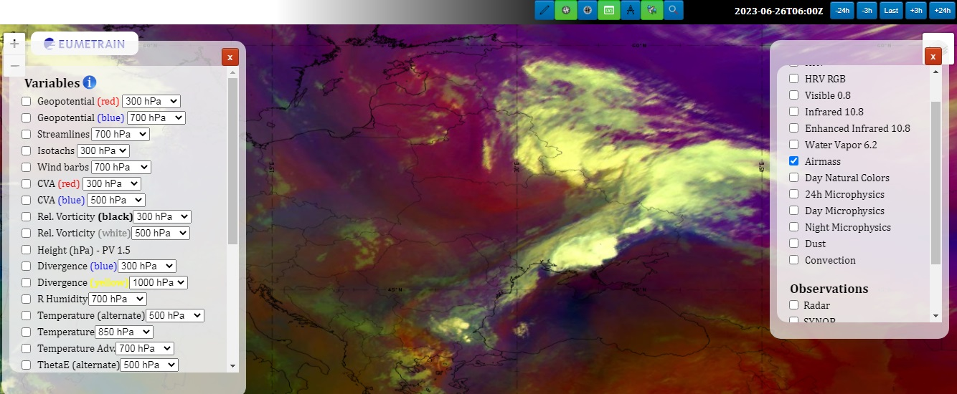
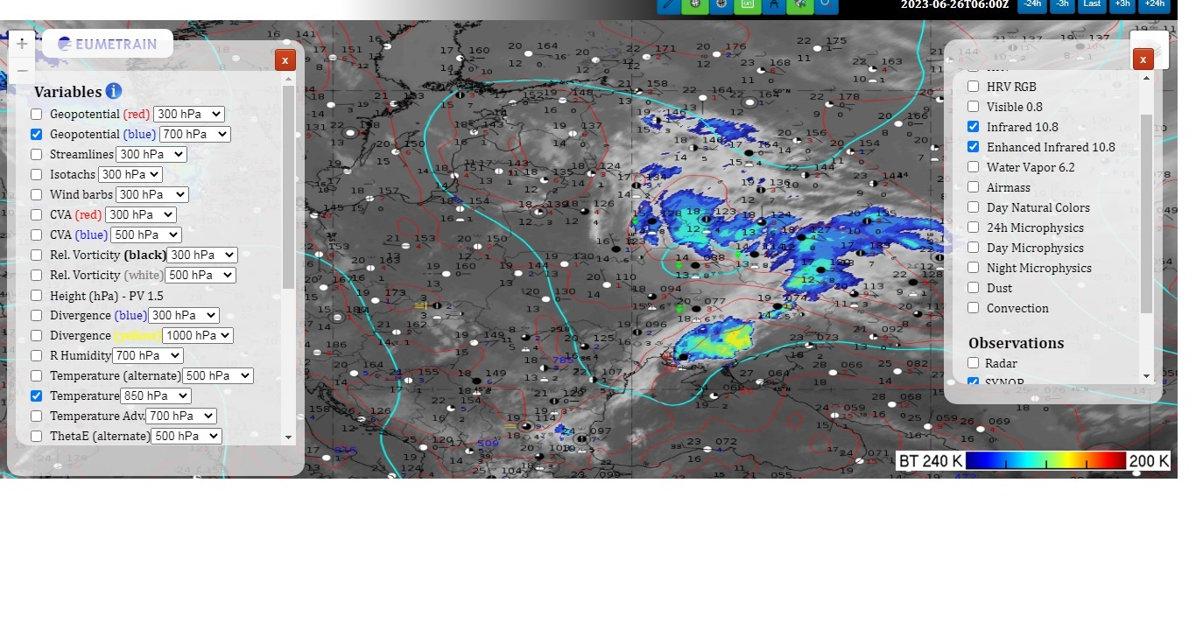
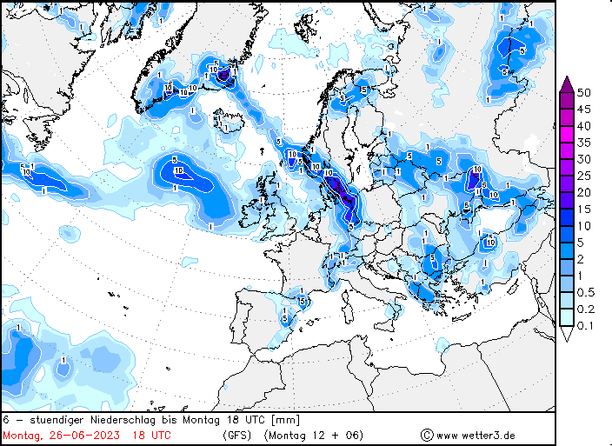
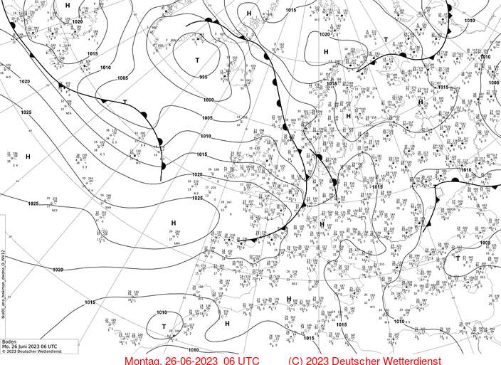
Front Wave – 26.06.2023
Convective phenomena: thunderstorms, hail, heavy showers.
Airmass and infrared imagines. Frontanalyse of DWD.
It was very havy convective phenomenas in south of Ukraine and it moved to east. Forecast of precipitation.
Serhii Mysnyk. Ukraine. UkrHMC

