Slide 1
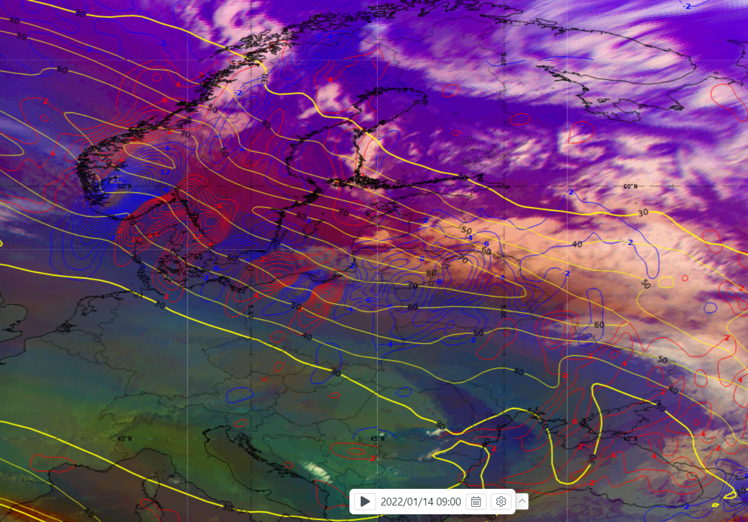
Cold Front (Ana type) Conceptual model – 2022.01.14 09 UTC
This Cold Front moving from north to south through Lithuania and creates fast moving convective squall line.
Consequences of this Cold front (Ana type):
Very strong (25-30 m/s), locally hurricane force winds (up to 35,5 m/s) was measured;
Thunderstorm, graupel was observed;
Trees downed, powerlines outages, significant damage to private and public infrastructure.
We can see Cold Front (Ana type) Conceptual model in these images over Lithuania (images above and on the right).
Airmass RGB, MSLP, Thickness 500-1000 hPa, TFP in image above; Airmass RGB, Isotachs 300 hPa, Temperature advection 700 hPa in image on the right.
There we can see:
dry stratospheric air intrusion (orange color) over and behind the frontal cloud band;
some TFP parameter patches in the front of the frontal cloud band;
crowding zone of equivalent thickness in the frontal cloud band;
strong jet, almost paralel to frontal cloud band orientation;
strong cold air advection in frontal cloud band.
Tadas Kantautas, LHMS, Lithuania

