Slide 1
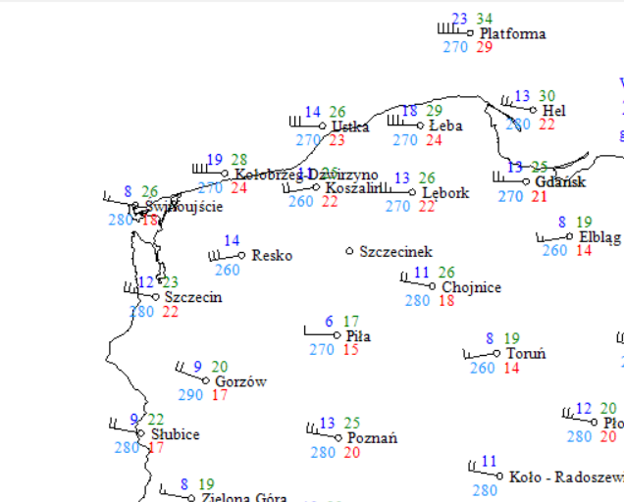
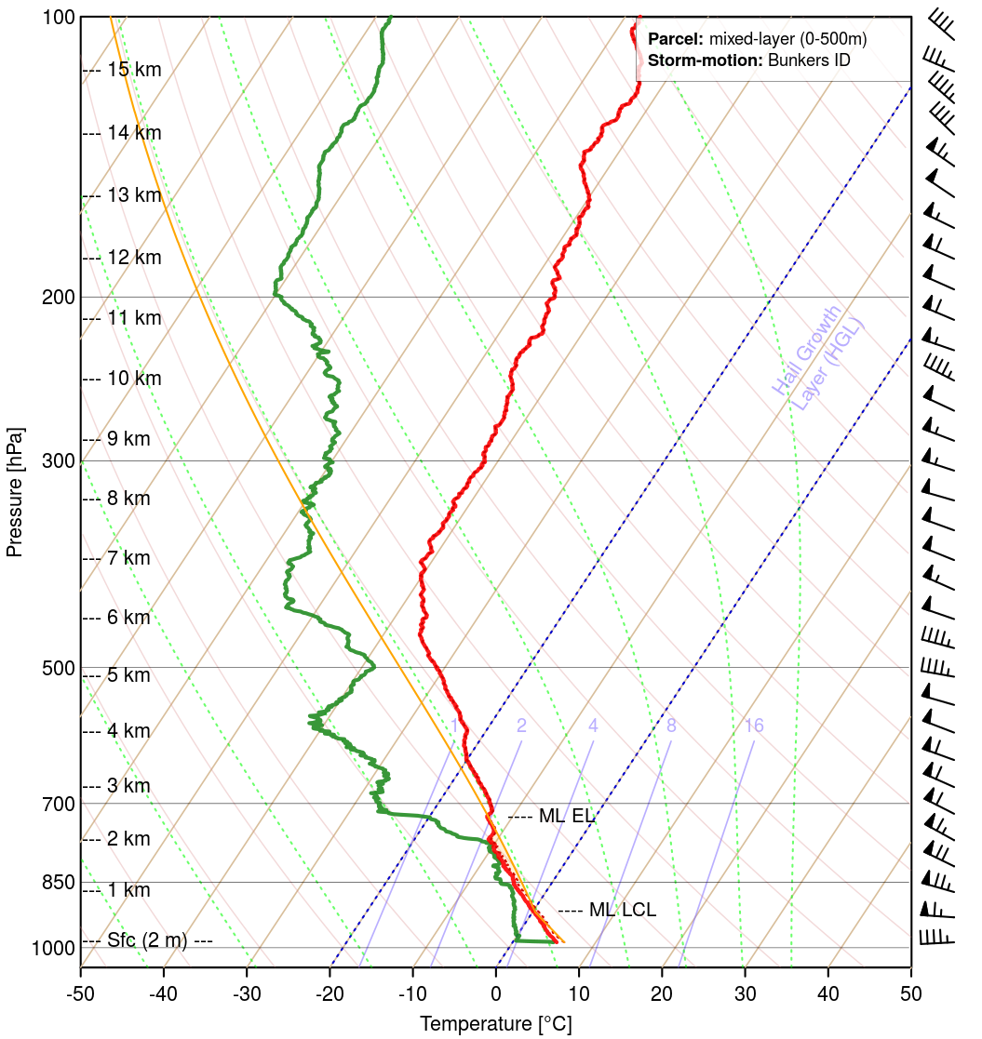
Rapid Cyclogenesis + Cold Front Conceptual Model 30.01.2022
ET Cyclone in mature stage with cold front stretching from Central Baltic to S Europe. Cold front visible as a white curved stripe with a darker edge behind it, which stands for cold and dry air advection. Eye of cyclon located over Central Baltic, visible as an wrapped darked and lighter strips, which are dry stratospheric air and hight clouds.
In this dynamic case strong wind gusts over Poland, Germany and Baltic States are possible as well as high waves oves S Baltic and even flooding in costal regions of Lithuania and Latvia due to strong western winds and sea level rise.
.
Wind gusts (green) in m/s
reaches and exceeds 30m/s even at night
Data from Polish stations IMGW
Satellite VW 6.2 µm + isotachs 300mb 30.01.2022
Intrusion of dry air appears on VW image as well as the strong jet stream on model isotachs- affecting weather over Central and E Europe. Cyclone eye and frontal structure well seen in VW image and also on the other satellite products.
Dry intrusion, low tropopause
Strong wind in whole profile
Air sounding from Łeba (Polish coast station)
Jakub Majchrzak, Institute of Meteorology and Water Management

